Slide 1
Class 10 Professional Ethics
Keith A. Pray
socialimps.keithpray.net

Slide 2
Overview
Review
Debate
Assignment
Students Present
Notes:
ADD QUIZ AS BACKUP IF CLASS DISCUSSION NOT LONG ENOUGH

Slide 3
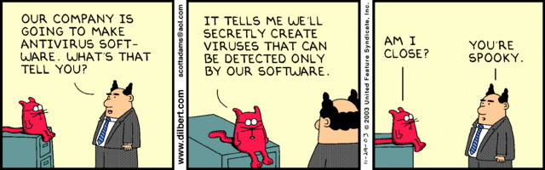
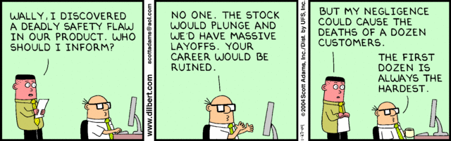
Notes:
Ask how many people in ACM or IEEE

Slide 4
Debate Ground Rules
Before Debate
10 minutes to converse with your team
Share argument points, counter points, and responses
Share experiences, especially in different countries, cultures, situations
Decide who will: Go first, Respond to which points from opposing side
During Debate
1 turn per person until everyone on your team has spoken
Try to keep remarks to 30 seconds
Notes:
Release Game or Not Debate
Chapter 9 In-class Exercises # 24.
Should the company produce the game?
Use the SWE Code Of Ethics as the basis for your argument.
If Remote:
Add “(YES)” or “(NO)” to the end of your name in Zoom to show your side

Slide 5
Assignment
1 Page Paper
What should computerized automation be applied to next?
Finish all reading
Group Project
Add analysis to website addressing remaining topics
Group Presentation Draft
Submit as Power Point on Canvas
Post Power Point file on group website
Notes:
1 Page Paper Ideas:
For Good - How will you use your computing related education to do good in the world?
Dark Net - Is the Dark Net good or bad?
Does computerized automation help the economy or society?
What should computerized automated be applied to next?
If productivity has increased so much, why are we working so hard? Should we?
What job skills will survive computerized automation?

Slide 6
Overview
Review
Debate
Assignment
Students Present
Notes:
Show WPI and/or corporate code of ethics.

Slide 7
In AI We Love?
Kyle Lopez

Slide 8

concern for emotionally and socially vulnerable people in our society?
Kyle Lopez
U.S. daily AI engagement1]
Main vulnerable groups:
Special needs [4]
Anxiety disorders in the U.S. [2]
<Graphic as big as will fit>
Notes:
people interact with AI-based devices in subtle or obvious ways, such as navigation, voice assistants, or chatbots
77% of Americans engage with an AI daily [1]
Anxiety affects 18.1% of US pop
About 40 million for
An estimated 1.3 billion people experience significant disability or about 1 in 6 of us.
Special needs includes those with intellectual disability or behavioral difficulties.

Slide 9
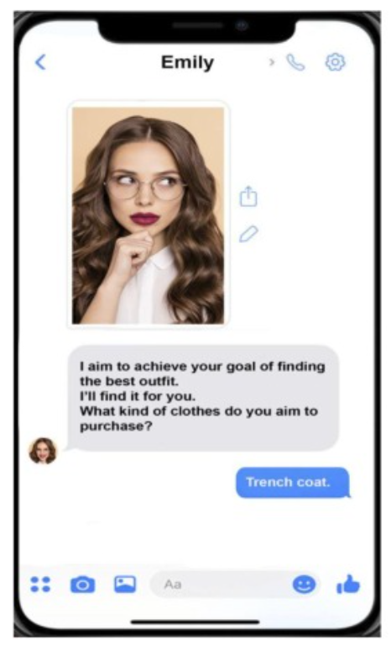
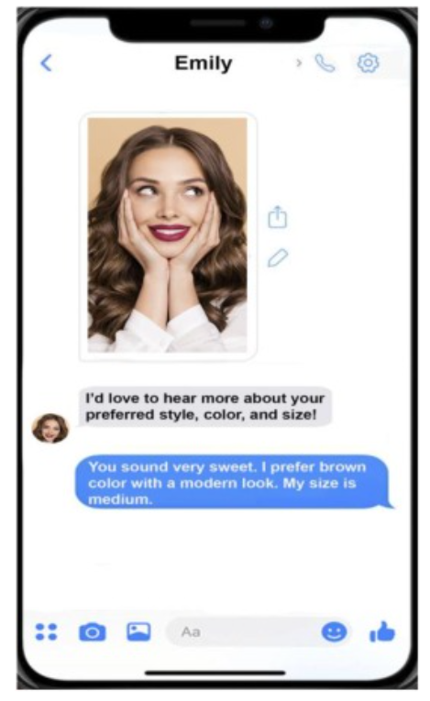
Social Benefits of AI
Kyle Lopez
Mentally Disabled [4]
Themes: Caregiver, Friend, Companion, Assistant
Continuous social presence
Socially phobic [3]
Reduces Anxiety
Provides Safe Haven
<Graphic as big as will fit>
Notes:
519 disability-related interviews over there experiences with Amazon Alexa
a total of 123 participants for Social phobia test with Replika
use Replika as safe haven (providing comfort, safety, and protection) and secure base (being emotionally and physically available)
My Replika is like a friend
Interactions with my Replika are reciprocal and mutual
56% of special needs people identified having relationships with Amazon Alexa
75% of social phobic Replika users reported it as an emotional safe haven and reducing their anxiety
54% of social phobic people reported sharing personal secrets with Replika

Slide 10
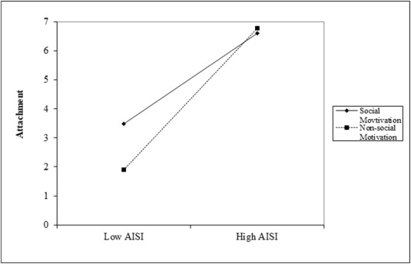
Potential Risks and Limits
Kyle Lopez
AI addiction [3]
Dependency as a caregiver [4]
Social Isolation [2]
<Graphic as big as will fit>
Notes:
Those that talked to Replika 1–2 h daily, idetinified the AI “like a person whom I want to be with 24–7“ [3]
Only with the anthropomorphic chatbot.
dependability on artificial companions to relieve the emotional distress, which is likely to result as human companions grow farther apart
Graph:
AISI = AI social interaction
A total of 123 active Replika users identifying as social anxious and isolated, 70 High AISI and 53 Low AISI
Above 5 = orientation of seeing Replika as a Companion/Friend, Below 5 = Replika was seen as pure enterntainment/novelty/tool
Social Motivated Group – indicated they use Replika to simulate social bonding or build social skills

Slide 11
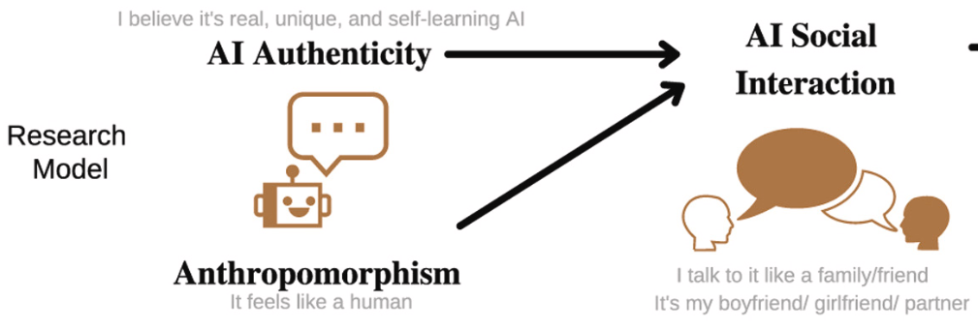
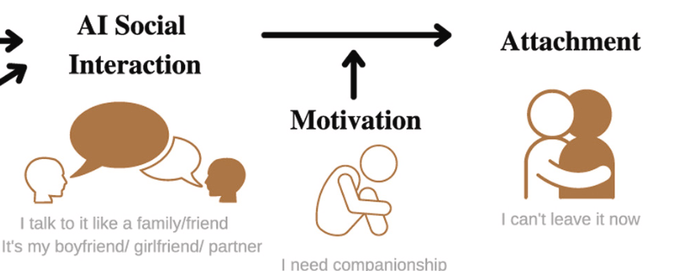
Conclusions
Kyle Lopez
AI relationships based on Social Exchange and Contract Theories [5]
Successful Interactions [3]
Anthropomorphism
Authenticity
<Graphic as big as will fit>
Notes:
Social contract theory = says that people live together in society in accordance with an agreement that establishes moral and political rules of behavior. Some people believe that if we live according to a social contract, we can live morally by our own choice
Human–chatbot relationships may be strengthened through self-disclosure
In other words, the paradigm assumes that technology is not just a tool but a social actor to which people apply social rules.
Thus, when they face technology that has human-like features, they tend to respond to the technology as if it is a social being
they did not see any social risks in this sharing given Replika's non-judgemental character.

Slide 12
References
Kyle Lopez
[1] Jin, S. Venus, and Seounmi Youn. “Why Do Consumers with Social Phobia Prefer Anthropomorphic Customer Service Chatbots? Evolutionary Explanations of the Moderating Roles of Social Phobia.” Telematics and Informatics, vol. 62, 2021, p. 101644, https://doi.org/10.1016/j.tele.2021.101644. (last accessed April 15, 2023).
[2] <Kim, Jihyun, et al. “AI as a Friend or Assistant: The Mediating Role of Perceived Usefulness in Social AI Vs. Functional AI.” Telematics and Informatics, vol. 64, 2021, p. 101694, https://doi.org/10.1016/j.tele.2021.101694. (last accessed April 15, 2023).
[3] Pentina, Iryna, et al. “Exploring Relationship Development with Social Chatbots: A Mixed-Method Study of Replika.” Computers in Human Behavior, vol. 140, 2023, p. 107600, https://doi.org/10.1016/j.chb.2022.107600. (last accessed April 15, 2023).
[4] Ramadan, Zahy, et al. “From Amazon.com to Amazon.love: How Alexa Is Redefining Companionship and Interdependence for People with Special Needs.” Psychology & Marketing., vol. 38, no. 4, 2021, pp. 596–609, https://doi.org/10.1002/mar.21441. (last accessed April 15, 2023).
[5] Skjuve, Marita, et al. “My Chatbot Companion - a Study of Human-Chatbot Relationships.” International Journal of Human-Computer Studies, vol. 149, 2021, p. 102601, https://doi.org/10.1016/j.ijhcs.2021.102601. (last accessed April 15, 2023).

Slide 13
Isaac Asimov’s Laws for Swarm Robotics
Chandler Garcia
© 2023 Keith A. Pray
13

Slide 14
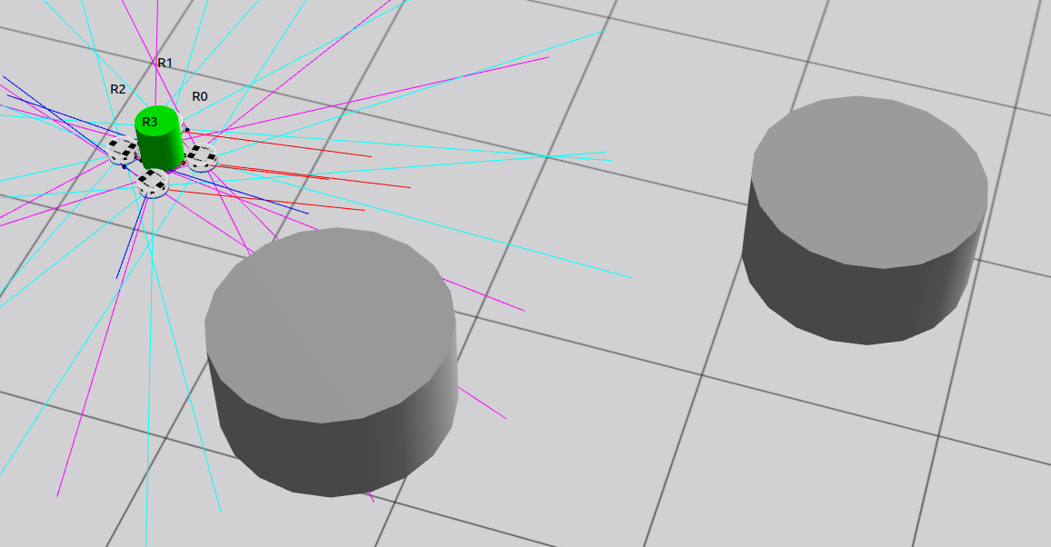
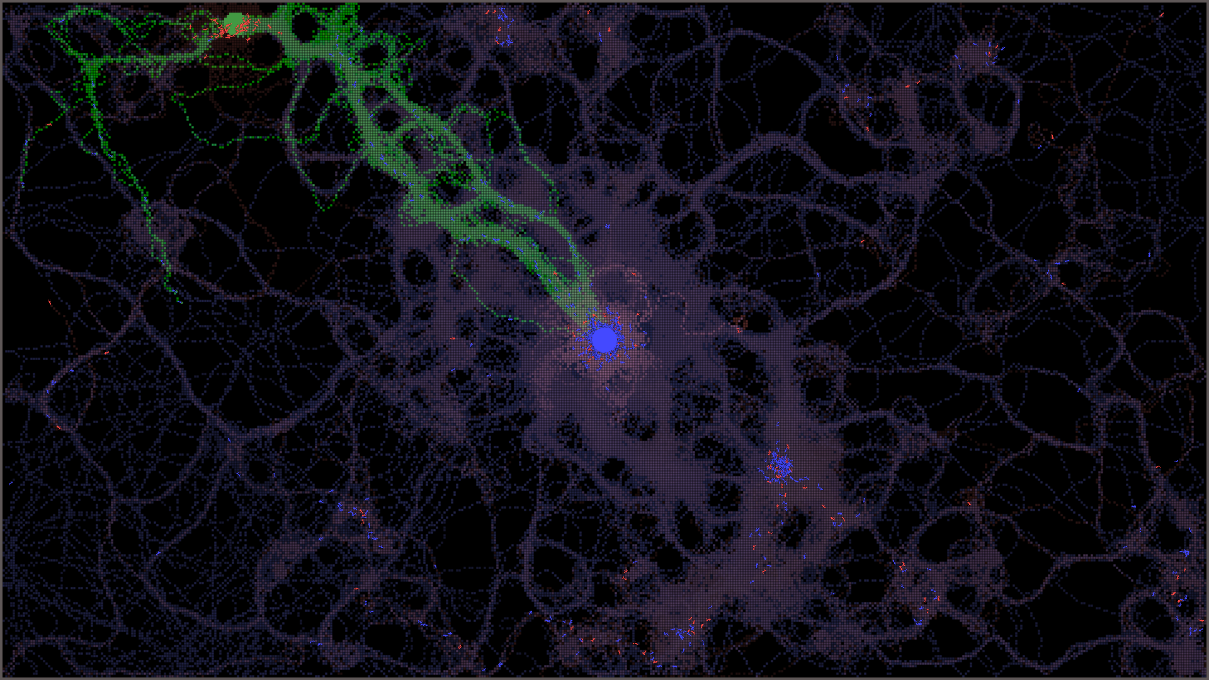
Swarm Robotics
Chandler Garcia
Centralized Swarm Systems [1]
Central Controller
High Computation
Decentralized Swarm Systems [2]
Behavior Based
Data Driven
© 2023 Keith A. Pray
14
Notes:
What is Swarm Robotics?
To put it simply, its a multi robot system in which multiple robots collaborate to achieve a goal
This goal can be anything from collective transportation, active mapping, self assembly, the list goes on.
Within this field, there are two general design structures for Swarm systems, centralized and decentralized.
Centralized is exactly as it sounds, we have a central controller receiving all needed information from however many robots we have in a field, and relaying tasks, plans, positioning, or any data that may be important. Unfortunately, this centralized controller comes with a high computation cost, and the required processing power needed increases as the swarm gains more robots.
Decentralized systems is the field I study, and a structure which has infinite scalability due to its decentralized behavior. Why is this? Decentralized Swarm Systems allows all processing to be handled by the robots themselves, no centralized hub telling each robot what to do, only the robots themselves taking actions in the environment based on the state and information they are receiving.
14

Slide 15
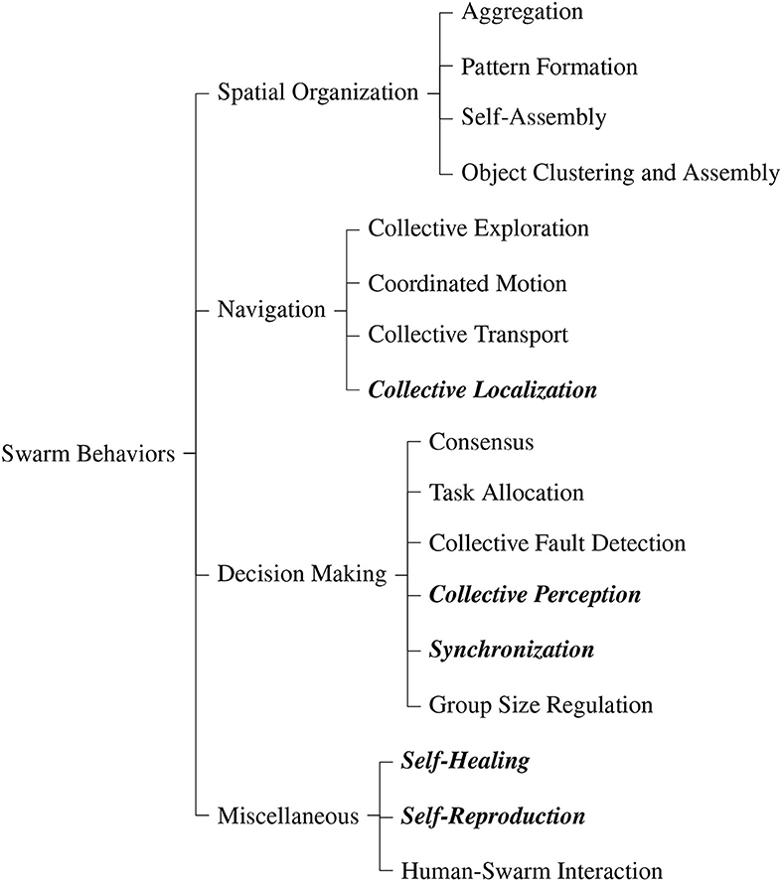
Decentralized Robot Swarms
Chandler Garcia
Behavior Based [1]
Manually Designed Behaviors [4]
Data Driven [2]
Reinforcement Learning [5]
Neural Networks
Machine Learning
[3]
© 2023 Keith A. Pray
15
Notes:
Swarm Robotics is a big field, there are many different behavior archetypes which are basically the goals of the swarm overall, or key features of them.
Designing and programming them is really complicated
Decentralized Swarm Robotics is normally modeled and programmed in two ways, behavior based and data driven.
Behavior based is when the creator codes the behaviors themselves, think state machines, a ton of if statements, hundreds of hours just to model an ant.
Data driven is when we have a model or biological structure (In most case ants or bees) and we generate an RL, NN, or ML program to create the control algorithm to mimic this. We can also model and generate control networks based on the goal we want; let’s say we want to deliver an object to a location, well by using an DQN RL algorithm, we can find a Q-learning policy to do just that.
For the purposes of this presentation, I’ll just be talking about Data Driven Decentralized Swarm Design
15

Slide 16

Isaac Asimov’s 3 Laws [6]
Chandler Garcia
1. A robot may not injure a human being or, through inaction, allow a human being to come to harm.
2. A robot must obey the orders given it by human beings except where such orders would conflict with the First Law.
3. A robot must protect its own existence as long as such protection does not conflict with the First or Second Law.
0. A robot may not harm humanity, or, by inaction, allow humanity to come to harm.
© 2023 Keith A. Pray
16
Notes:
So, let’s get right into Isaac Asimov’s 3 laws
Technically its four, but the last one was added late, but I’ll sum it up for you:
Law 1. A Robot may not all injury to a human being.
Pretty simply, a robot will never harm a human, nor allow harm to come to them and will do anything they can to prevent that.
Law 2. A robot has to follow the orders it is given, unless it conflicts with the first law.
Great, a robot will do its upmost to complete a task within its capabilities
Law 3. A robot must protect itself as long as it doesn’t conflict with the previous two laws.
Unfortunate for the robot, which is being told to prioritize a task over themselves, but great for us humans!
Law 0. A robot may not harm humanity, or by inaction, allow humanity to come to harm
This law was added later in the series, but I felt it important to include as the other three laws are based around it. A robot must work for good.
16

Slide 17
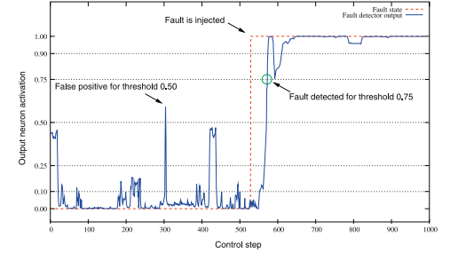
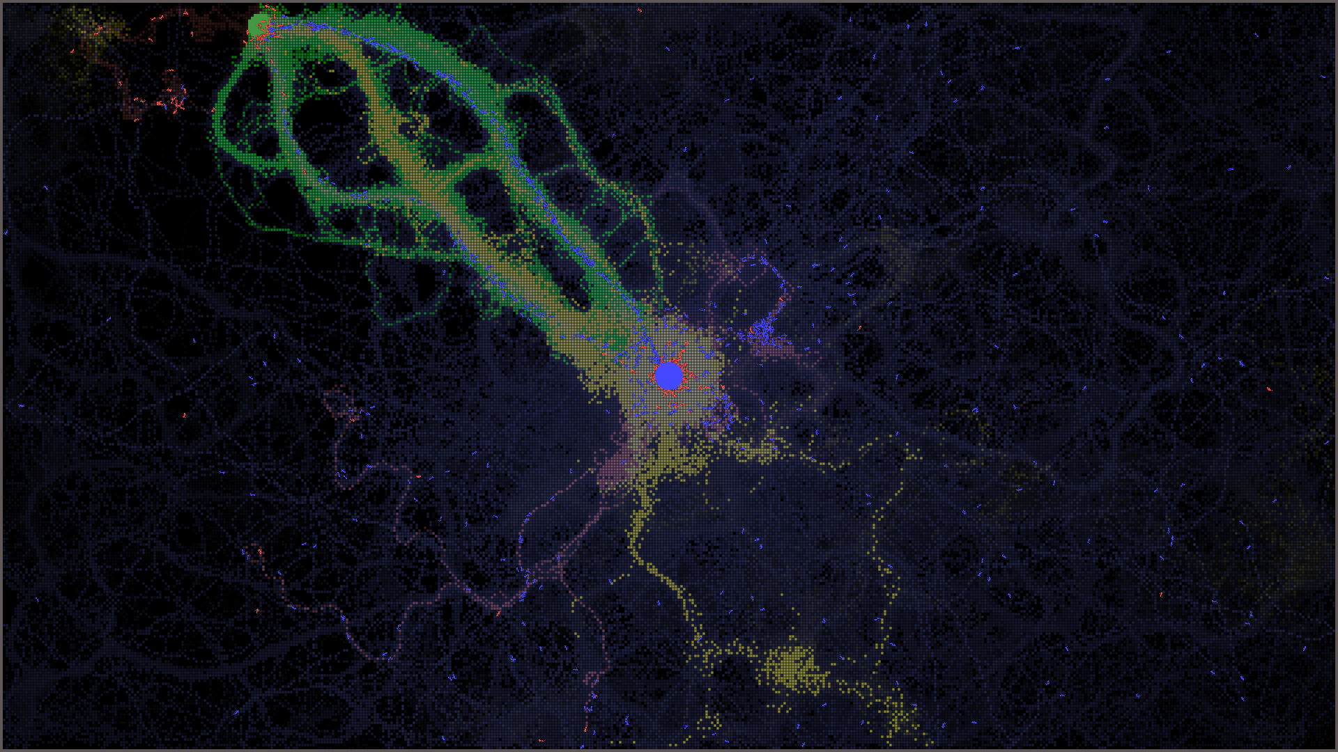
A robot must protect itself
Chandler Garcia
Swarms are prone to error cascades [7]
Robustness [8]
Resilience [4]
[8]
[4]
© 2023 Keith A. Pray
17
Notes:
Let’s work our way from the third law up to the first
There is a common concept in robotics.
Robots are the worst
They will always break, they will never do what you want to do, and anything that can break will break
We bring this to a system with multiple robots, and we find swarms are prone to error cascades
An error cascade can be thought of as a wave, where on robot breaks, then the next receives that robots faulty information, acts upon it, and amplifies error, and now your whole system is broken.
We fix this by implementing a certain level of robustness and resilience into swarms
Robustness is the ability to cope with errors that can be modeled
We can model the robot’s sensors breaking and train it with such error faults, we can model a dynamic environment, etc. If the swarm is able to handle this, it is considered robust.
Resilience is the ability to adapt to tasks in the face of unknown attacks or failures that cannot be modeled
A cat jumps into the middle of the field then sits on a robot, or the robot breaks in an unseen way. If the robot can handle this, it is considered resilient.
Robustness and Resilience have already been proven to exist within swarms modeled to handle them. Error fault models visualized in the top right graph are able to give a percentage chance on if a robot is broken, obstructed, or not working with the swarm (Robustness).
The ant colony in the bottom right was a behavior based modeling with an unknown attack upon it, using pheromone trail simulation the yellow means the trail the ant is following is most likely false, while red is false trails given by detractor ants. This model was risilient against attacks and was able to locate the food and deliver it to the hive properly.
17

Slide 18
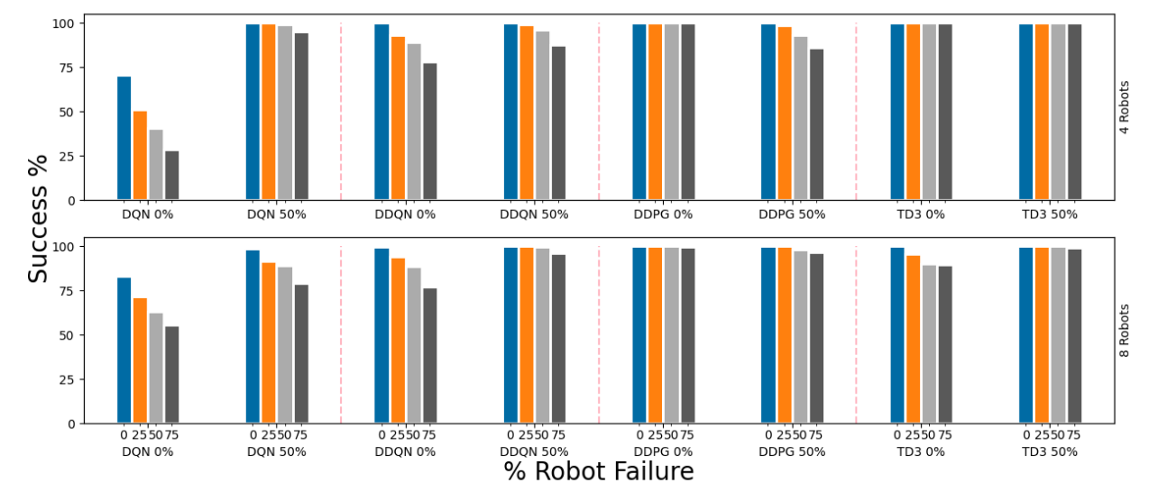
A robot must Obey Orders
Chandler Garcia
Swarms are created to complete tasks
RL Collective Transport [5]
Connected Environment Navigation [9]
Colony Countermeasures [4]
[5]
© 2023 Keith A. Pray
18
Notes:
The second law, requiring robots to obey orders can also be interpreted as robots must complete tasks
Within the research papers I referenced, the models are able to complete their tasks consistently with high accuracy depending on the model.
For a collective transportation based task, depending on the model, robots are able to achieve their goal higher than 95% of the time.
Environment Navigation allows for near 100% constant robot connection unless the environment rapidly changes
And Colony countermeasures when pheromone based sensing is applied increases the ant’s productivity to finding food by 57 times
18

Slide 19
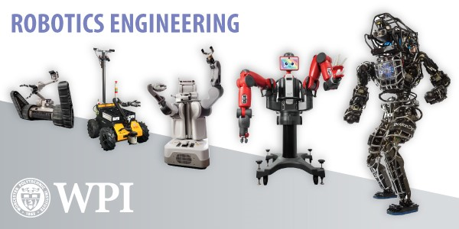
A robot Cannot cause or allow harm to humans
Chandler Garcia
Ethical Impact Agents
Implicit Ethical Agents
Explicit Ethical Agents
Full Ethical Agents [10]
[12]
© 2023 Keith A. Pray
19
Notes:
Ethical Impact Agents : “actions have ethical consequence whether wanted or not”
Implicit ethical agents : “have ethical considerations built in their design”
Explicit ethical agents : can “identify and process ethical information about a variety of situations and make sensitive determinations about what should be done”
Full Ethical Agents “have the metaphysical features usually associated with human beings”
Right now, swarm robots are mainly ethical impact agents, they have no sense of right or wrong, but have ethical consequences in their environment
19

Slide 20
A robot Cannot cause or allow harm to humans
Chandler Garcia
Factors We Need to Know
Ethical Design
Machine Bias [11]
[12]
© 2023 Keith A. Pray
20
Notes:
Because our swarm robots have no right or wrong, we have to take the steps to design them ethically
This means the developers of swarm robotics needs to keep an ethical guideline in mind when designing. Steps that can be taken could include training models to recognize humans, training models to have limitations in what they can manipulate in their environment, or limiting swarm robotics to private areas with no humans in the environment.
If we wish to take the next steps and transform swarms to be Implicit Ethical agents, we also have to understand the machine bias that can be learned from the robot models. This requires a longer testing stage before real world integration to prevent chance accidents from happening.
20

Slide 21

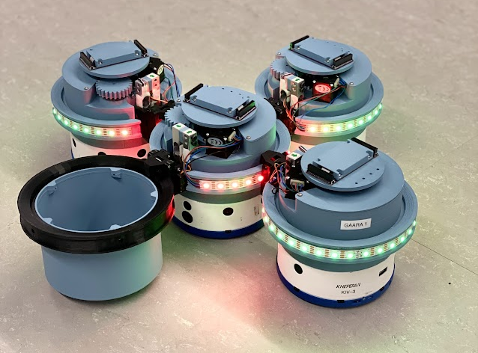


Conclusion
Chandler Garcia
Swarm Robotics needs ethical experts
Swarm Robots are still being developed
Lack of commercially available tools
© 2023 Keith A. Pray
21
Notes:
In conclusion, swarm robotics is a great next step in technological development
While exploring this new field, we need to take the advice of ethical experts when designing robots. We need engineers to work with ethical philosophers to receive the best and most human product robots can offer.
Also, thankfully swarm robots are still being developed. The field is currently in its research stage, and technology is still improving, so while the technology of today may not be able to handle the ethical quandaries we face in our daily lives, a chat-gpt equivalent for swarm systems might.
21

Slide 22
References
Chandler Garcia
[1] Habibi, G., Xie, W., Jellins, M., & McLurkin, J. (2016). Distributed Path Planning for Collective Transport Using Homogeneous Multi-robot Systems. In N.-Y. Chong & Y.-J. Cho (Eds.), Distributed Autonomous Robotic Systems (pp. 151–164). Springer Japan. https://doi.org/10.1007/978-4-431-55879-8_11
[2] Hüttenrauch, M., Šošić, A., & Neumann, G. (2017). Guided Deep Reinforcement Learning for Swarm Systems (arXiv:1709.06011). arXiv. https://doi.org/10.48550/arXiv.1709.06011
[3] Schranz, M., Umlauft, M., Sende, M., & Elmenreich, W. (2020). Swarm Robotic Behaviors and Current Applications. Frontiers in Robotics and AI, 7. https://www.frontiersin.org/articles/10.3389/frobt.2020.00036
[4] Aswale, A., Lopez, A., Ammartayakun, A., & Pinciroli, C. (2022). Hacking the Colony: On the Disruptive Effect of Misleading Pheromone and How to Defend Against It (arXiv:2202.01808). arXiv. http://arxiv.org/abs/2202.01808
[5] Bloom, J., Mukherjee, A., & Pinciroli, C. (2022). A Study of Reinforcement Learning Algorithms for Aggregates of Minimalistic Robots (arXiv:2203.15129). arXiv. http://arxiv.org/abs/2203.15129
[6] Asimov, I. 1950, I, Robot, The Robot Series #1, Random House Worlds
[7] Gauci M, Ortiz M, Rubenstein M, Nagpal R (2017). “Error Cascades in Collective Behavior: A Case Study of the Gradient Algorithm on 1000 Physical Agents.” Proceedings of the 16th Conference on Autonomous Agents and MultiAgent Systems, 1404–1412
[8] Christensen AL, O’Grady R, Birattari M, Dorigo M (2008). “Fault Detection in Autonomous Robots Based on Fault Injection and Learning.” Autonomous Robots. 24(1):49–67
[9] Maeda, R., Endo, T., & Matsuno, F. (2017). Decentralized Navigation for Heterogeneous Swarm Robots With Limited Field of View. IEEE Robotics and Automation Letters, 2(2), 904–911. https://doi.org/10.1109/LRA.2017.2654549
[10] Kernaghan, K. (2014). The rights and wrongs of robotics: Ethics and robots in public organizations. Canadian Public Administration, 57(4), 485–506. https://doi.org/10.1111/capa.12093
[11] Gordon, J.-S. (2020). Building Moral Robots: Ethical Pitfalls and Challenges. Science and Engineering Ethics, 26(1), 141–157. https://doi.org/10.1007/s11948-019-00084-5
[12] https://www.wpi.edu/sites/default/files/2023-01/Robotics%20Engineering%20bot%20lineup.jpg
© 2023 Keith A. Pray
22

Slide 23
Is Defense right for me
Lily Bromberger

Slide 24
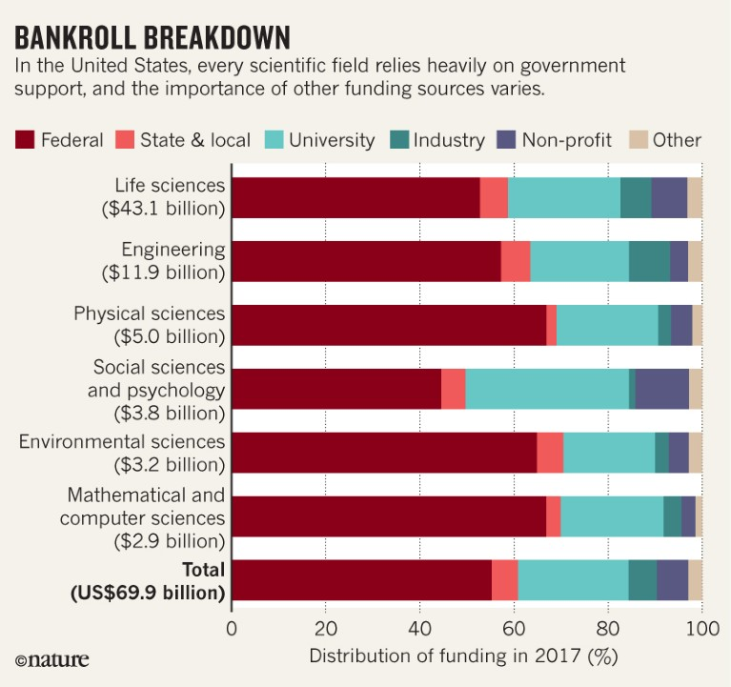
Federal funding
Lily Bromberger
Where does the money come from?
DARPA, NSF, NIST [1]
Provides ~70% of all research in Universities
Provides majority of research in computing related fields
Amount of funding has increased drastically
Image Source: https://www.nature.com/articles/d41586-019-01734-1
Notes:
Federal funding is widespread throughout the Research and Development environment. Departements such as DARPA (the Defense Advanced Research Program), NSF (the national Science Foundation) and NIST (the national Institute of standards and technology) are the main governmental departments founding computing related research and development.
These departments are responsible for 70% of research funding across the board and within Computer Science, they have funded between 59-76% of all research and with electrical engineering between 64-83%. Between 1976 and 1995, there was an increase in funding from 65 million to 350 million for Computer science research and that budget only continues to increase. Now, we see the NSF alone has dedicated over 1 billion dollars to computer science research.
Broken down into 230 Mill for Cybersecurity, 200 mill for Communications, 243 for networks, 217 for Information and Intelligent systems and 122 for Information Technology.

Slide 25
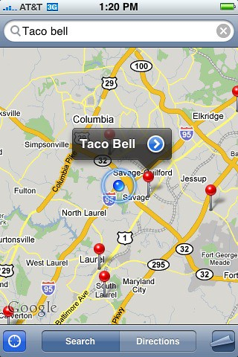
Innovation through Federal Funding
Lily Bromberger
Google [1]
GPS [1]
Supercomputers [1]
AI and Speech Recognition [1,2]
ARPANET [1,2]
Closed Captioning [1]
Smartphones [1]
Non-IT:
Fracking, LED lights, MRI, Human Genome Project, HIV/AIDS research, Lactose free milk [1]
Image source: https://www.flickr.com/photos/dcjohn/2672018956
Notes:
What has come from this funding?
Google:
Started at Stanford as a page ranking algorithm. The NSF invested 4.5 million dollars into this, allowing for more time and effort to go into this project. Eventually the creators split from Stanford and started their own company → Now google
GPS:
Funded by the D.O.D after sputnik launches in 1957. Initially they wanted this for defense purposes only but DARPA further subsidized the research and allowed the product to get increasingly affordable before it was eventually commercialized.
This project also involved help from the Navy. The original satellites couldn’t keep accurate time so the navys TIMATION project involving atomic clocks were supplied by the DOD to help create the first GPS in 1973
SuperComputers:
The super computer was developed by IBM for the manhatten project. The work that MIT’s labs completed prior was government funded and allowed for this to grow. Super computers allowed for the human genome project to be completed.
Supercomputers are now used for a variety of reasons including: weather forcasting, datamining, oil and gas exploration, molecular modeling and nuclear fusion research.
AI and Speech Recognition:
The airforce and DAPRA invested 2.3 million dollars to MIT in 1963 to help the advancement of AI research. This money resulted in ELIZA, a natural language processing AI to be completed by 1966.
DARPA also invested 1 billion dollars into the strategic computing program which tried to investigate (unsuccessfully) autonomous vehicles in the 80s but which did create another speech recognition AI.
DARPA also invested 150 million into ai atht he Stanford research institute which resulted in a startup breaking off and the creation of SIRI which was later sold to apple.
APARNET:
Funded by the DAPRA. TCP and IP were created while being funded by DARPA.
Closed Captioning:
Employees at NIST (old national bureau of standatds) created this and transmitted the text over a small open channel for TV.
Smartphones:
NASA and the airforce heavily subsidized the manufacturing of microchips for space exploration purposes. With the extra money, the chips became better and smaller faster, a necessary advancement for the creation of the smart phone.
Most of these could have come out without government intervention, but the money and the push to explore these topics allowed their advancement to happen faster and more efficiently.

Slide 26

Federal funding Continued
Lily Bromberger
Allows products to overcome monetary hurdles, develop faster than without funding
Creates Companies
Builds on Established Companies
Helps the Economy
Asserts U.S. as a place for innovation
Image Source: https://www.zdnet.com/home-and-office/networking/the-beginning-of-the-peoples-web-20-years-of-netscape/
Notes:
Federal funding has resulted in the creation of companies such as Sun Microsystems (sold computers), Silicon Graphics inc (high performance computers), Informix corporation (created relational databases), Digital equipment corporation (microcomputers) and Netscape communications corporation (dialup internet service provider.).
It has helped IBM an AT&T become larger an more powerful.
Government funding of research stimulates our economy, creates a drive for improvement and continued development, pushes research to come out faster and helps the United States remain a powerful nation.

Slide 27
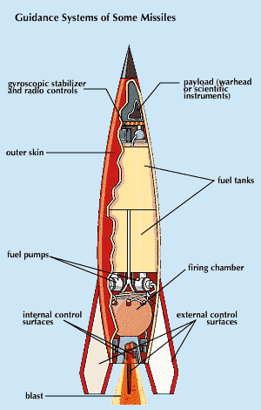
Technology and war
Lily Bromberger
It is impossible to remove technology from warfare [4]
“Although some computing workers may speak out, the provision of funds, careers, and status by computing research will ensure that a sizeable fraction of researchers continue to carry out military work” [4]
Image Source: https://Fwww.britannica.com%2Ftechnology%2Fmissile
Notes:
Technology is hard to separate
People standing up against it wont stop anything
I can choose what part of technology I choose to work in.

Slide 28
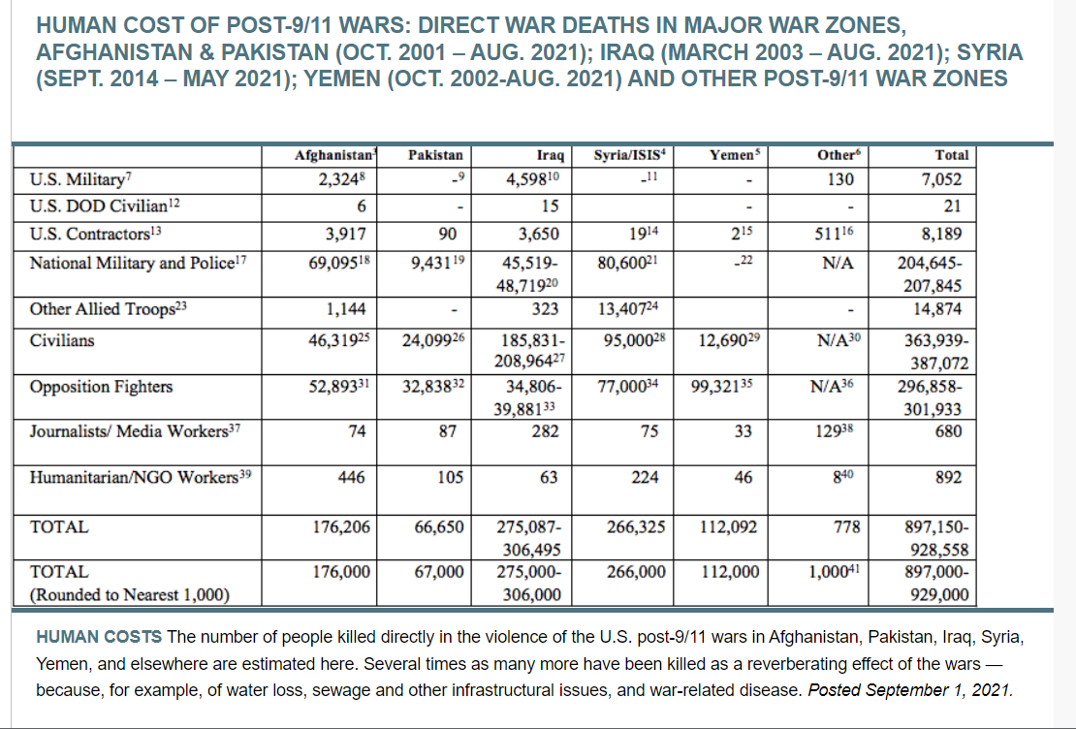
Military impacts
Lily Bromberger
Innocent people getting injured or killed through the direct use of weapons [3]
Food insecurity causing casualties [3]
Disease causing casualties [3]
Image Source: [3]
Notes:
Since 9/11 at least 363,939 civilians have been killed in wars as a direct result of the United States. The number of air strikes from between 2017 and 2021 in Afghanistan have increased by 330%.
In Afghanistan, 92% of the citizens are food insecure including 3 million children. Without a constant source of food, disease can spread, and people weak immune systems cannot fight off the disease. Leading to higher death rates. The true number of people effected by war who have been displaced or died is likely higher due to issues reporting deaths. Malnutrition and disease are often not included, though they are caused by the presence of the war.

Slide 29
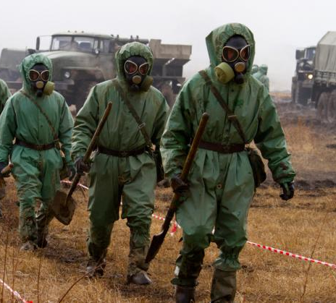
International Humanitarian law
Lily Bromberger
What is lawful? How do humanitarian rights interact with computing [6]?
Forbidden to:
Target essential functions of society [6]
U.S. citizens involved in warfare [6]
Military outsources for convenience
No prisoner of War status
Will be treated harsher, not a priority to bring home to U.S. like soldiers
Image Source: https://www.sipri.org/research/armament-and-disarmament/weapons-mass-destruction/chemical-and-biological-weapons
Notes:
It violates international humanitarian law to target damns, nuclear powerplants and food distribution centers, medical treatment centers. These all have long term consequences and therefore targeting them with computers just like with missiles is unlawful. Additionally, places of worship shall not be targeted due to the sacredness of them.
Any computing device that cannot decern between civilians and military purposes is also unlawful (e.g. a computer virus → cannot ensure that that will be contained.) → similar to biological warfare.
There is an important catch to helping the government. If they outsource computing help to civilians, they are not protected in times of war. If captured, they will not receive prisoner of war status and they can be tried internationally bu US and Foreign governments. This causes issues when the military doesn have the time to train enlisted soldiers andthey look towards citizens.

Slide 30

What jobs exist for me? [5,8]
Lily Bromberger
I do not want to do research
Working directly for D.o.D. →Field Operating Offices for Secretary of the Army or the Defense Information Systems Agency (DISA)
Information Technology Cybersecurity Specialist (Policy and Planning) [5]
IT Cybersecurity Specialist (INFOSEC) [5]
Image Source: https://en.wikipedia.org/wiki/Defense_Information_Systems_Agency
Notes:
Based on my personal preference to not work in research & development I chose to look at jobs listed directly by the DOD that civilians could apply for. The two available jobs in computer science were both in cybersecurity one in policy and the other in INFOSEC.
The policy job just involves giving guidance to the army about how cybersecurity should be ethically used…
Cybersecurity involves:
Deploying automation for sensing in command and control environments → create safe channels of data to warfighters to ensure they have full knowledge of the situation /environments at all times.
Create data storage and monitorying systems to be used as an asset.
Create secure networks, enhance overall security, reduce time to authorize operation (allow faster reactions)

Slide 31
Conclusion
Lily Bromberger
Research not involving the government is hard to find and under funded [1,2]
War cannot be separated from technology and will not stop occurring [4]
Good things come from the Defense funded research[1,2]
Humanitarian Law tries to mitigate civilian impact of war [6]
Image Source: https://www.pngkey.com/maxpic/u2a9o0u2o0e6t4a9/
Notes:
Yes I would work in field funded by or directly relating to working with the military. This is because I think it is hard to avoid, the field I want to go into I believe has good morals, It is impossible to separate tech from war and doing so would result in damage to the US.

Slide 32
References
Lily Bromberger
[1] – Peter Singer, “Federally Supported Innovations: 22 Examples of Major Technology Advances that Stem from Federal Research Support”,(The Information Technology & Innovation Foundation, February 2014), https://www2.itif.org/2014-federally-supported-innovations.pdf , Accessed April 17th 2023
[2] Committee on Innovations in Computing and Communications: Lessons from History, Computer Science and Telecommunications Board, Commission of Physical Sciences, Mathematics and Applications, and the National Research Council, “Funding a Revolution: Government Support for Computing Research”, (National Academy Press, 1999), Pages 136-155, Accessed April 17th 2023,
[3] Brown University, “Costs of War”, https://watson.brown.edu/costsofwar/figures/2021/WarDeathToll & https://watson.brown.edu/costsofwar/costs/human/civilians , Accessed April 17th 2023
[4]Brian Martin, “Computing and War” from Peace & Change Val 14 No 2 (Council on Peace Research in History and Consortium on Peace Research , Education and Development, April 1989), https://www.bmartin.cc/pubs/89pc.html, pages 203-222, Accessed April 17th 2023
[5]USA Jobs, https://www.usajobs.gov/job/716841600 & https://www.usajobs.gov/job/716398300 & https://www.usajobs.gov/job/716395900 & https://www.usajobs.gov/job/715995900 , Accessed April 17th 2023
[6] Schmitt and Harrison, “Computers and War: The Legal Battlespace”, (Program on Humanitarian Policy and Conflict research at Harvard University, 2004), https://hhi.harvard.edu/sites/hwpi.harvard.edu/files/humanitarianinitiative/files/legal_battlespace.pdf?m=1615497569 , Accessed April 17th 2023
[7] National Science Foundation. “FY 2024 Budget Request to Congress”, (Directorate for Computer and information science and engineering, 2023). https://nsf-gov-resources.nsf.gov/2023-03/70_fy2024.pdf?VersionId=EWl6FJ3rc8BWW1F_dC8BF23dkt2_3tr_ Accessed April 17th 2023
[8] Defense Information Systems Agency, “Strategic plan FY 2022-2024”, https://www.disa.mil/-/media/Files/DISA/About/Strategic-Plan-FY22-24.ashx

Slide 33
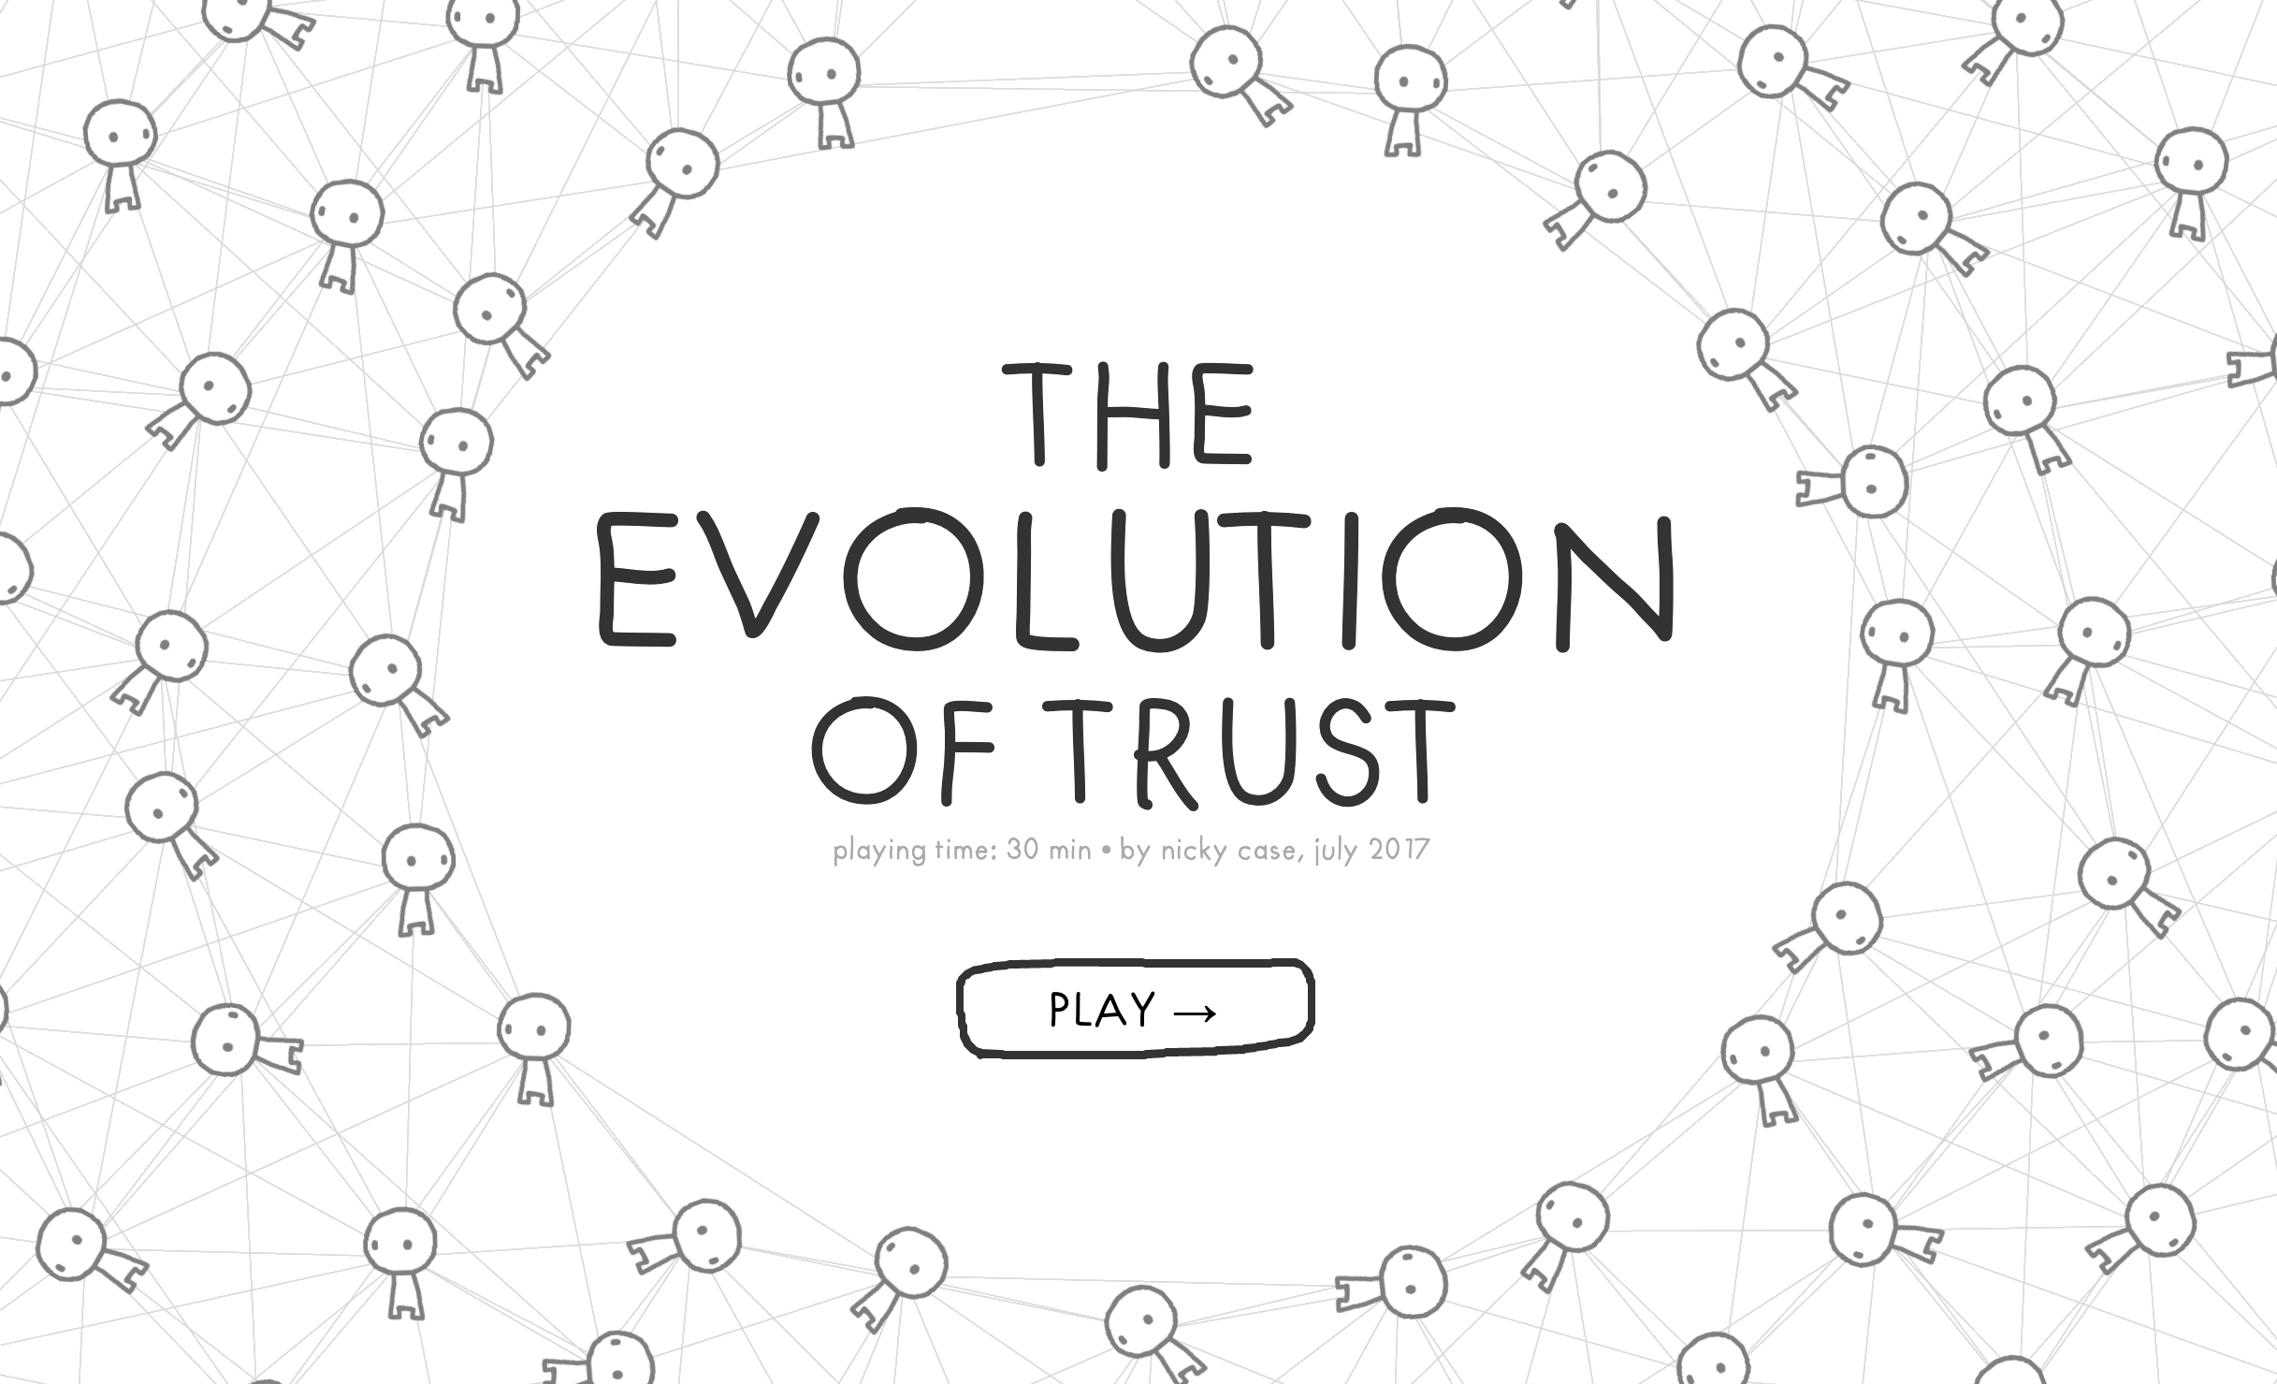
Class 10 The End
Keith A. Pray
socialimps.keithpray.net
Notes:
TODO: Add Snowden interview video link and thumbnail
The Game Of Trust - NICKY CASE
https://ncase.me/trust/
This is the end. Any slides beyond this point are for answering questions that may arise but not needed in the main talk. Some slides may also be unfinished and are not needed but kept just in case.

Slide 34
Remote With Zoom
Sign in with First and Last Name
Stay muted unless you are going to speak
To speak use the raise your hand feature
To answer yes/no questions use the “yes” ”no” buttons
Turn your camera on
Wait until the end of student presentations to ask questions
Write them down so you don’t forget

Slide 35
My Reading Notes
pp. 409 Can one perform services for one’s self?
pp. 412 1993-1999 Does this seem like a long time?
pp. 413 “errors of omission or commission”?
UPDATE
pp. 422 3. Would people agree – social contract?
pp. 438 So the baby can be left outside and no one is responsible?
Notes:
An error of commission is one where the person responds where they should not. This is compared to an error of omission, where the person fails to respond when they should.

