Slide 1
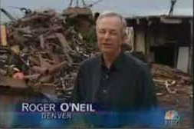
Class 9 Errors Failures Risks
Keith A. Pray
socialimps.keithpray.net
Notes:
Did SW Teams from the reading pick good test strategies? Will you be able to support your choices if something goes wrong?
What errors? – Have student record list on board
Who looked for directions on how to test currency?
MSNBC on Denver's Automated Baggage System 2010-08-23 (2:27)
https://www.youtube.com/watch?v=xx8f4x6C_KY
Accessed 2019-04-09
No Discussion Board

Slide 2
Survey Results (1/3) -22 Responses
Notes:
Common items for next time:
I am in FL 140 about an hour before and after each class
Estimated breakdown of course time per week:
4 hours class time
4 hours reading (2 chapters ~90 pages @ 2 minutes per page)
8 hours practicing mastery of material (papers, group project, class activity prep)
If you are spending much more than this let me know and we can figure out a more efficient way to spend your time

Slide 3
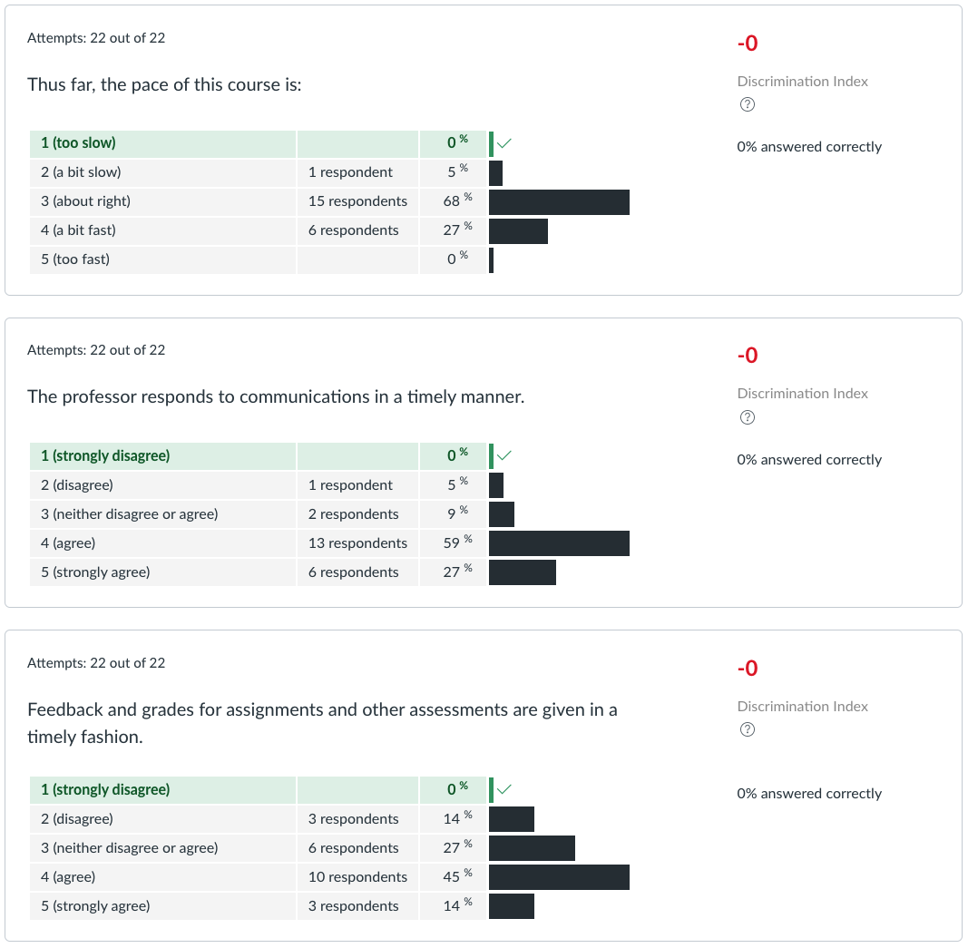
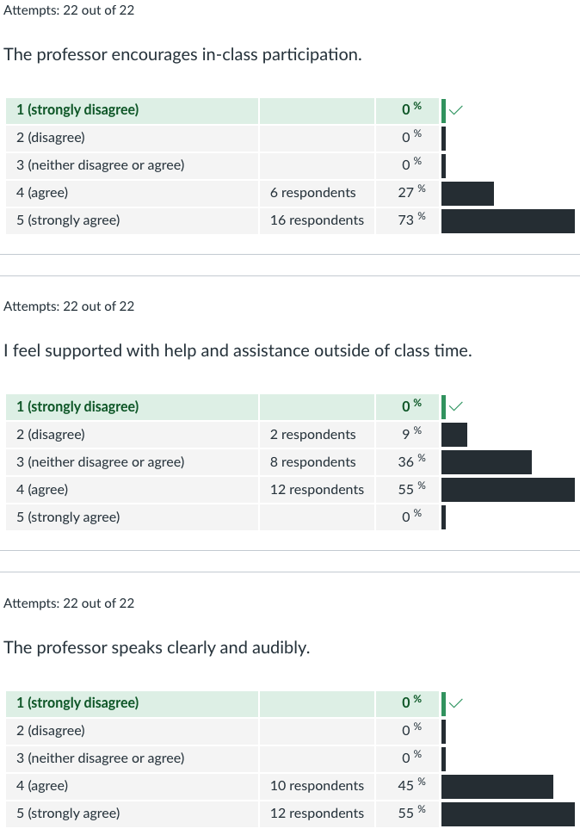
Survey Results (2/3) -22 Responses

Slide 4
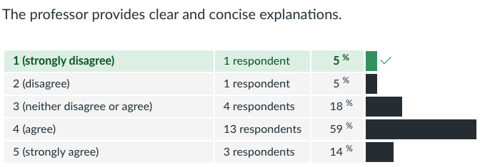
Survey Results (3/3) -22 Responses

Slide 5
Overview
Students Present
Review
Assignment

Slide 6
Swarm Robotics in environmental applications
Nathan Smith
Notes:
Swarm robotics is a field with a lot of potential uses, one encouraging use for the low skill high volume nature of the technology is in the wide-ranging spaces of our environment.

Slide 7
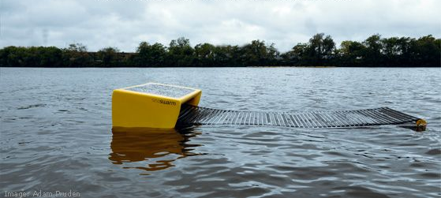
is Swarm robotics a solution?
Nathan Smith
Cleaning and disaster response [1]
Environmental monitoring [2]
Agriculture [3]
Notes:
Swarm robotics has a promising future for cleaning up oil spills, radiation, and other pollution. While all of these are still in developmental phase, they have very promising results. Seaswarm is a system developed at MIT for cleaning oil spills, the bots work together to trawl the surface and absorb oil. Marine and land monitoring are also viable options, the large areas that need covering can be effectively surveyed by many small bots. Like many swarm robotics projects, it has only been simulated, but using the simulations an autonomous group of bots can scan the environment. For agricultural uses there have been proposed combined air and land drones to optimize water and space usage and reduce environmental impact.

Slide 8
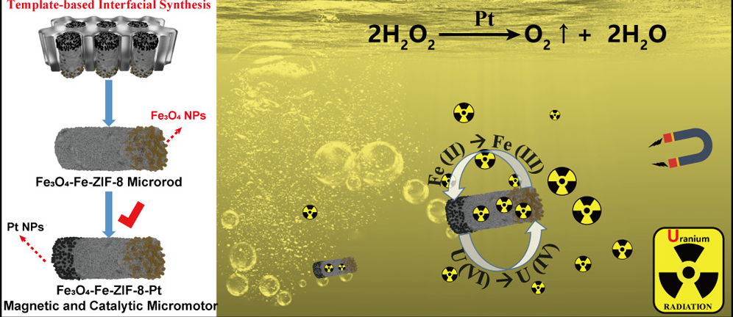
Cleanup
Nathan Smith
Oil Spills [1]
Radioactive waste [4]
Chemical decontamination [5]
Notes:
Seaswarm as mentioned before. Nano bots released into simulated uranium contaminated wastewater were able to clean up 96% of uranium and be reused. Using the behaviors of eusocial animals like pheromone tracking and aggregation to lead the swarm to the source of the spill and clean it.

Slide 9
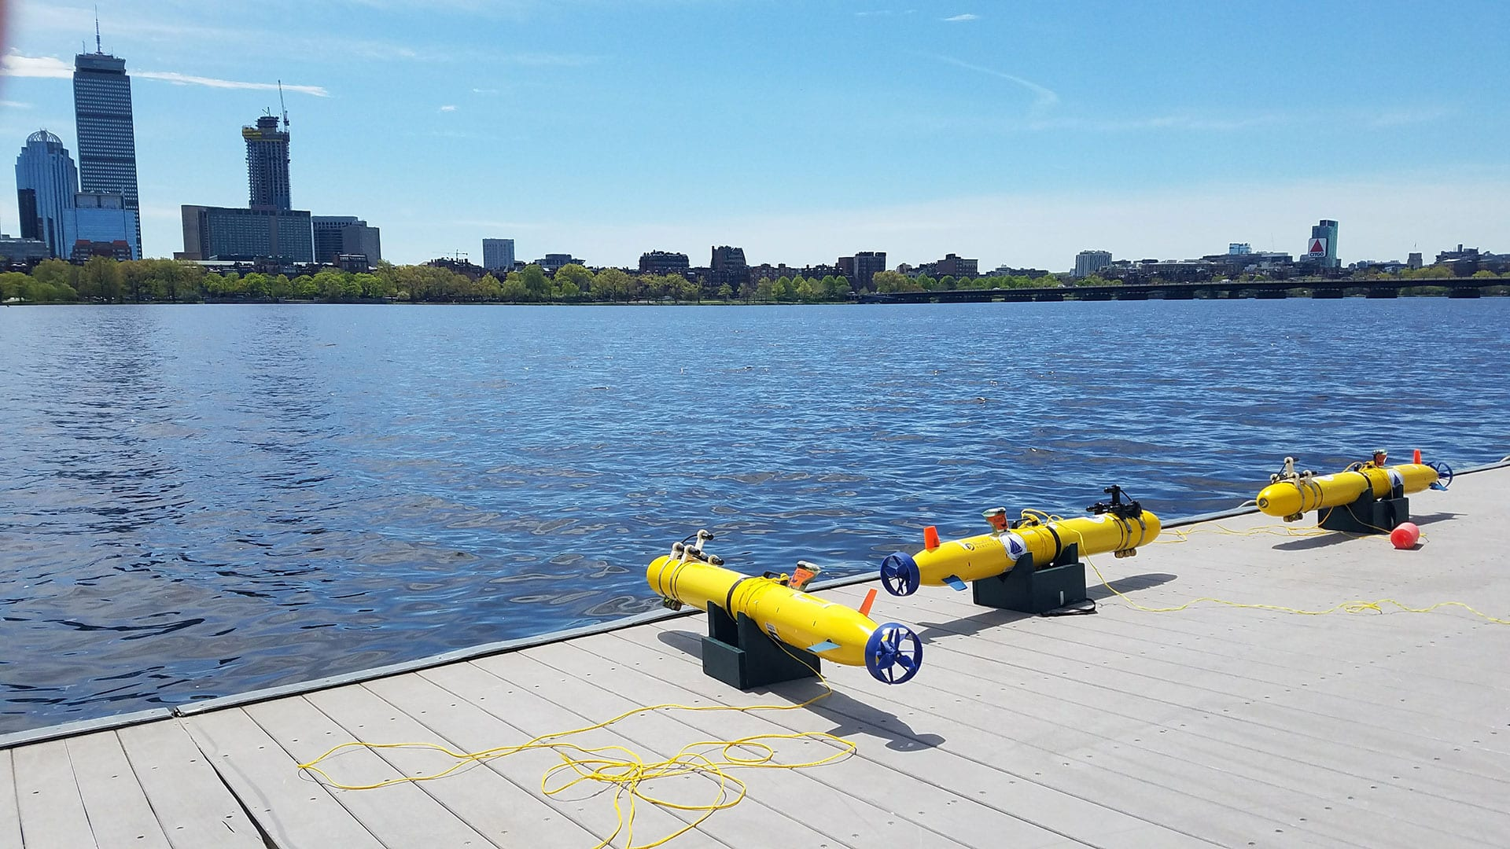
Monitoring
Nathan Smith
Marine Monitoring [2]
Search and Rescue [6]
Notes:
Marine environments need monitoring but are incredibly difficult to monitor on large scales. Swarms can monitor large areas with a lot of fault tolerance as no individual bot must be running to map and monitor large areas. They can redeploy unlike sensors and so can adapt to the dynamic environment of the ocean much better. The number of bots also increases the number and variety of data points to give better resolution. The adaptiveness and ruggedness of swarm systems is also very useful for mapping and searching. Search and rescue is a great potential use for swarms as the bots can search a large distance together and can adapt to the terrain quickly, they can also go into environments that humans cannot go in and can get to hard to reach places faster.

Slide 10
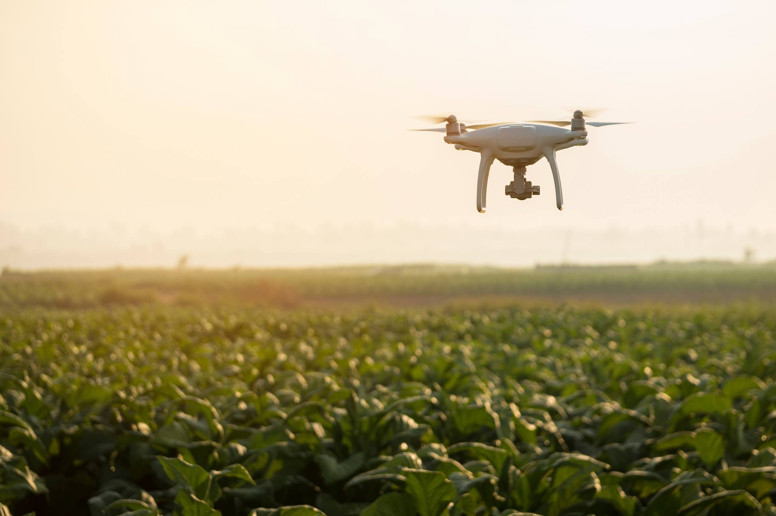
Agricultural
Nathan Smith
Optimizes resource use [3]
Decreases environmental impact from machinery and chemicals [3]
Decreased cost [3]
Notes:
Swarms can make the most efficient use of the land being farmed as they are small and agile unlike heavy and cumbersome tractors and so can adapts to unique terrain. Their monitoring capabilities also allow them to target specific areas for watering, pesticide spraying, and maintenance. They also do not have the same energy requirements, some tractors consume up to 150 liters of fuel per hour, the swarm is electrically powered and therefore could be powered by renewables. The large number of bots also means that pesticides are not the only potential method of removing plants as individual weeds could be pulled. Tractors have increased in weight from 1300 kg in 1902 to 25000 kg in 2019, this compacts the soil and makes it worse to grow in, a swarm would not create this issue. Lastly, cost is another potential upside. Tractors cost up to 1,100 dollars per kW. This is reduced by the swarm as there is no operator to pay and no large machinery to use.

Slide 11
References
Nathan Smith
[1] MIT School of Architecture + Planning. A Swarm Of Robots To Clean Up Oil Spills | MIT School of Architecture + Planning. (n.d.). Retrieved April 14, 2023, from https://sap.mit.edu/article/standard/swarm-robots-clean-oil-spills
[2] M. Duarte et al., "Application of swarm robotics systems to marine environmental monitoring," OCEANS 2016 - Shanghai, Shanghai, China, 2016, pp. 1-8, doi: 10.1109/OCEANSAP.2016.7485429.
[3] Ouyang, Y., Osaba, E., Olcay, E., Noguchi, N., Nguyen, T. T., Mukherjee, A., Minelli, M., Mertyüz, İ., Meng, M., Marinho, L. B., Malus, A., Lourenço, P., López-González, A., Lombard, C. D., Liu, Y., Li, S., Li, M., Li, H., Li, G., … Chen, C. (2022, January 15). Swarm robots in Mechanized Agricultural Operations: A review about challenges for research. Computers and Electronics in Agriculture. Retrieved April 14, 2023, from https://www.sciencedirect.com/science/article/pii/S0168169921006256
[4] Radioactive Uranium Preconcentration - ACS Publications. (n.d.). Retrieved April 14, 2023, from https://pubs.acs.org/doi/10.1021/acsnano.9b04960
[5] Cooperative Pollution Source Localization and Cleanup with a Bio-inspired Swarm Robot Aggregation. (n.d.). Retrieved April 14, 2023, from https://arxiv.org/ftp/arxiv/papers/1907/1907.10752.pdf
[6] J. Hu, H. Niu, J. Carrasco, B. Lennox and F. Arvin, "Voronoi-Based Multi-Robot Autonomous Exploration in Unknown Environments via Deep Reinforcement Learning," in IEEE Transactions on Vehicular Technology, vol. 69, no. 12, pp. 14413-14423, Dec. 2020, doi: 10.1109/TVT.2020.3034800.

Slide 12
AI Should Be Utilized In the legal system
Winston Lewis

Slide 13
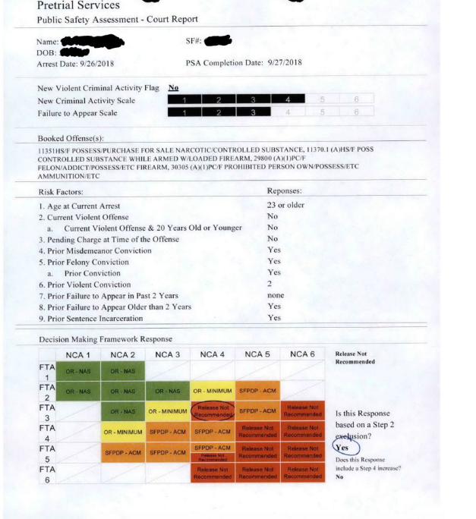
AIDING Judges
Winston Lewis
Helps judges with predictions on different aspects of cases [4]
COMPAS [5]
PSA [5]
As of 2020, COMPAS was 65.2% accurate [6]
As of 2020, PSA was 64% accurate [6]
Notes:
Artificial intelligence is already helping judges right now with predictions on different aspects of criminals’ cases.
Specifically, artificial intelligence mainly helps with determining a fair sentence duration and with predicting the chances of criminals returning to a life of crime.[4]
COMPAS, which stands for Correctional Offender Management Profiling for Alternative Sanctions, is an artificial intelligence algorithm that determines if criminals are likely to return to a life of crime based on factors such as level of education, income, neighborhood, previous arrests, and more. [5]
*For example, a person who receives a charge for marijuana, but lives in a good neighborhood, has never been arrested before, and has completed college is likely to receive a low risk score and will likely receive a lighter punishment from their judge. A person who has killed three people, has skipped court dates before, and has dropped out of high school, however, will most likely receive a high risk score and will be treated more harshly by the judge.
PSA, which stands for Public Safety Assessment, essentially has the same purpose as COMPAS. It takes in a lot of the same types of information, but excludes “socioeconomic info (education, income, job, etc.)” [5].
*Image to the right shows an example of PSA in action. List some of the factors, if they are present, and explain why the score is the way it is*
In 2020, COMPAS achieved an accuracy of 65.2% and PSA achieved an accuracy of 64%. While this is fairly decent for starting out, algorithms like these are going to have to significantly increase their accuracy if they hope to have a lasting and prominent role in the legal system.

Slide 14

HELping LAWyers
About 50% of lawyers in 2019 used AI [7]
Helps lawyers gain a better understanding of cases [8]
Makes court cases go more smoothly
Saves time, money, and is highly efficient
Notes:
Artificial intelligence algorithms are not only helping judges with cases, but they are also helping prosecutors and defense lawyers with their cases as well. In 2019, 50% of lawyers used artificial intelligence to help them with their cases. Some of the tasks artificial intelligence algorithms are responsible for helping lawyers with are…
“e-discovery, which is finding the documents related to the case; (3) legal research, which is the relevant laws/regulations; (4) document management, which essentially is just staying organized; (5) contract and litigation document analytics and generation, which helps them make contracts, determine if a breach in contract has occurred; and (6) predictive analytics, which works to determine the defendants’ outcomes will be ahead of time” [8].
The statistics for the use of AI by lawyers is as follows:
”Legal research at 35 percent, 2) developing case or matter strategy at 22 percent, 3) understanding judges at 16 percent…5) predicting likely outcomes of strategy or arguments at 14 percent, 6) understanding opposing counsel at 13 percent” [7].
AI algorithms are helping court cases go more smoothly, and are saving all parties’ time and money due to their efficiency.

Slide 15

Encoded biases
Winston Lewis
Algorithms utilize crime stats.
Bias comes from the data [2]
PredPol & COMPAS often view black people as threats [1], [3]
Low income/lower classes are targeted as well [5]
<Graphic as big as will fit>
Notes:
I’ve spent essentially all of my time talking about the positives of the use of artificial intelligence algorithms in the legal system, but now it’s time I talk about some of the negatives. One of the biggest issues with artificial intelligence algorithms is the encoded biases with them. A common misconception is that the algorithms are specifically designed to target certain groups, which is not necessarily true. AI algorithms base their predictions on the crime statistics that are available. Basically, the biases come from the data itself.
A group of algorithm analysts studied the COMPAS algorithm and discovered
“The results suggested that black defendants were approximately two times as likely as white defendants to be labeled as having a higher risk of recidivism, although they did not repeatedly commit crimes” [1] and essentially committed the same crimes.
Similarly, it was also discovered that renowned predictive policing algorithm, PredPol, would have the same type of bias. As it was found that
“Using PredPol in Oakland, black people would be targeted by predictive policing at roughly twice the rate of whites” [3]
*Image is a visual aid for PredPol. Explain what the image means*
Since areas that are low-income and diverse tend to be overpoliced anyway, it makes sense that the data would reflect more negatively on the crime in areas like these.

Slide 16
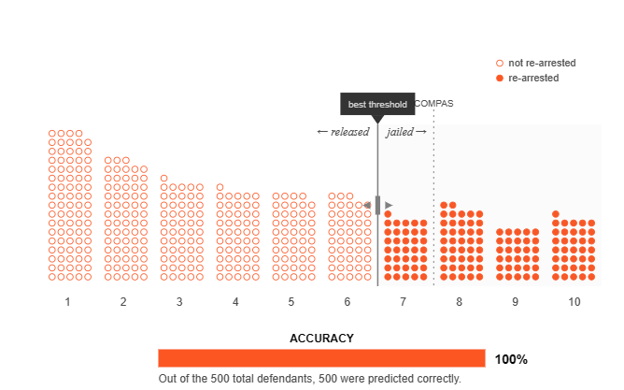
More accuracy, less bias[9] [10]
Winston Lewis
Redefine what is “high-risk” [9]
Threshold shift = better results [9]
Remove details unrelated to defendants’ crimes
Monitor the users/creators of these algorithms [1]
Notes:
Researchers from MIT studied the COMPAS algorithm thoroughly and experimented with it. While experimenting, the researchers found that when the threshold for high-risk vs. low risk was re-adjusted, the algorithm was anywhere from 7% to 30 % more accurate than COMPAS algorithm originally was [9].
*For picture, COMPAS originally had 93% accuracy. After adjusting the threshold for high risk and low risk, the accuracy rose to 100%*
It’s extremely difficult and rare to achieve 100% accuracy, but the fact these algorithm researchers achieved higher accuracies than the designers of COMPAS multiple times means that the designers of COMPAS (and likely the creators of other algorithms used in the legal system too) can work to achieve higher accuracy as well.
Removing details unrelated to defendants’ crimes would work to remove bias. If algorithms don’t consider what neighborhood the defendants are from, what race they are, what gender they are, and other characteristics that do not directly relate to their criminal records, algorithms will likely show less evidence of bias.
Lastly, the people creating the algorithms need to be monitored as well. Since the biases are coming from the data that it is receiving, we have to make sure that those who are responsible for providing the data are providing data that is not outdated and that they are not encoding their own biases within. All of these steps will be difficult to do but if they help make the world a safer place then it is all worth it.
Thank you!

Slide 17
References
Winston Lewis
[1] Shin, Y., Cho, K. W., Kwak, J. H., & Hwang, J. Y., “Development of a method for ensuring fairness of an artificial intelligence system in the implementation process”, (IEEE, November 25 2022), https://doi.org/10.1109/ictc55196.2022.9952891 (April 11 2023)
[2] Xivuri, K., & Twinomurinzi, H., “A systematic review of fairness in Artificial Intelligence Algorithms”, (Springer Link, August 25 2021), https://doi.org/10.1007/978-3-030-85447-8_24 (April 11 2023)
[3] Lum, K., & Isaac, W., “To predict and serve?”, (Significance, October 7 2016), https://doi.org/10.1111/j.1740-9713.2016.00960.x (April 11 2023)
[4] Shannon Salter, “AI and the Rule of Law: Capacity Building for Judicial Systems”, (Unesco, February 1 2023), https://www.unesco.org/en/artificial-intelligence/rule-law/mooc-judges (April 13 2023)
[5] Kira Belova, “Artificial Intelligence in the Criminal Justice System”, (Pixelplex, January 12 2021), https://pixelplex.io/blog/artificial-intelligence-criminal-justice-system/ - (April 13 2023)
[6] Faddoul M., Ruhrmann H., Lee J., “A Risk Assessment of a Pretrial Risk Assessment Tool: Tussles, Mitigation Strategies, and Inherent Limits”, (UC Berkeley, May 14 2020), https://arxiv.org/ftp/arxiv/papers/2005/2005.07299.pdf - (April 13 2023)
[7] Nicole Black, “The Future Is Now: Lawyers, Artificial Intelligence, And Data Analytics”, (Breaking Media Inc., October 31, 2019), https://abovethelaw.com/2019/10/the-future-is-now-lawyers-artificial-intelligence-and-data-analytics/ (April 13 2023)
[8] Anthony Davis, “The Future of Law Firms (and Lawyers) in the Age of Artificial Intelligence”, (ABA, October 2 2020), https://www.americanbar.org/groups/professional_responsibility/publications/professional_lawyer/27/1/the-future-law-firms-and-lawyers-the-age-artificial-intelligence/ - (April 13 2023)
[9] Hao, K., Stray, J., ”Can you make AI fairer than a judge? Play our courtroom algorithm game”, (MIT Technology Review, October 17 2019), https://www.technologyreview.com/2019/10/17/75285/ai-fairer-than-judge-criminal-risk-assessment-algorithm/ - (April 12 2023)

Slide 18
Toward inclusive ai
Tanishka Dalavi

Slide 19
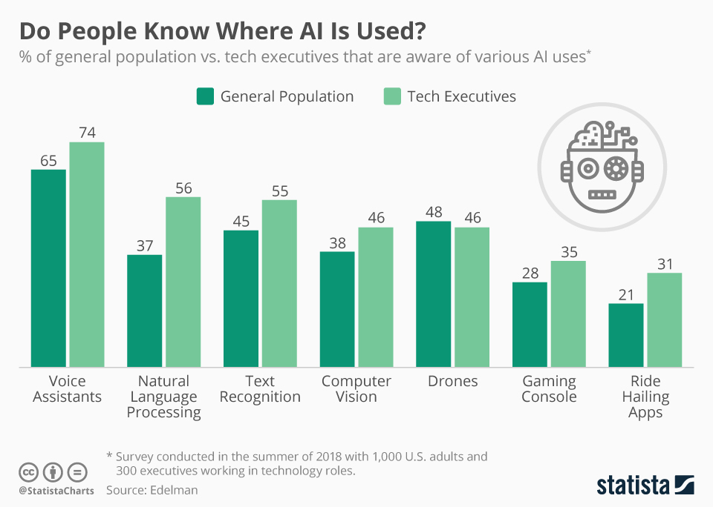
How much of our lives involve ai?
Tanishka Dalavi
We interact with AI pretty much every day – comes in various forms
Used in many different industries
‘Over 800 million people in more than 190 countries will be using chatbots to accomplish various tasks by 2023’
Notes:
*Whether you know it or not, we interact with AI on a daily basis. When you order something off of amazon, the website is already getting ready to show you what you need next based on your purchase history. When you scroll through tiktok or Instagram, the algorithm is always finding the next photo or video to show you or who to follow.
*AI is also involved in many industries, like Healthcare where it’s used to help diagnose patients, or transportation in self driving cars. (show image and talk about data) This is all possible due to machine learning algorithms, which are trained to help out and improve human and computer interactions. Siri, for example, had to be trained to have the personality she does – she needed to be helpful but also needed to be personable which is why Apple hired writers to help create her. *This clearly made a difference since she is one of the most easily recognizable voice assistants – you could even recognize her just off of her voice. With how much AI makes our interactions with technology a more rewarding experience, its such an important time right now to be striving to make AI as inclusive and reliable as possible for the entirety of the demographic, and this starts by changing the way we create and deploy ai today.

Slide 20
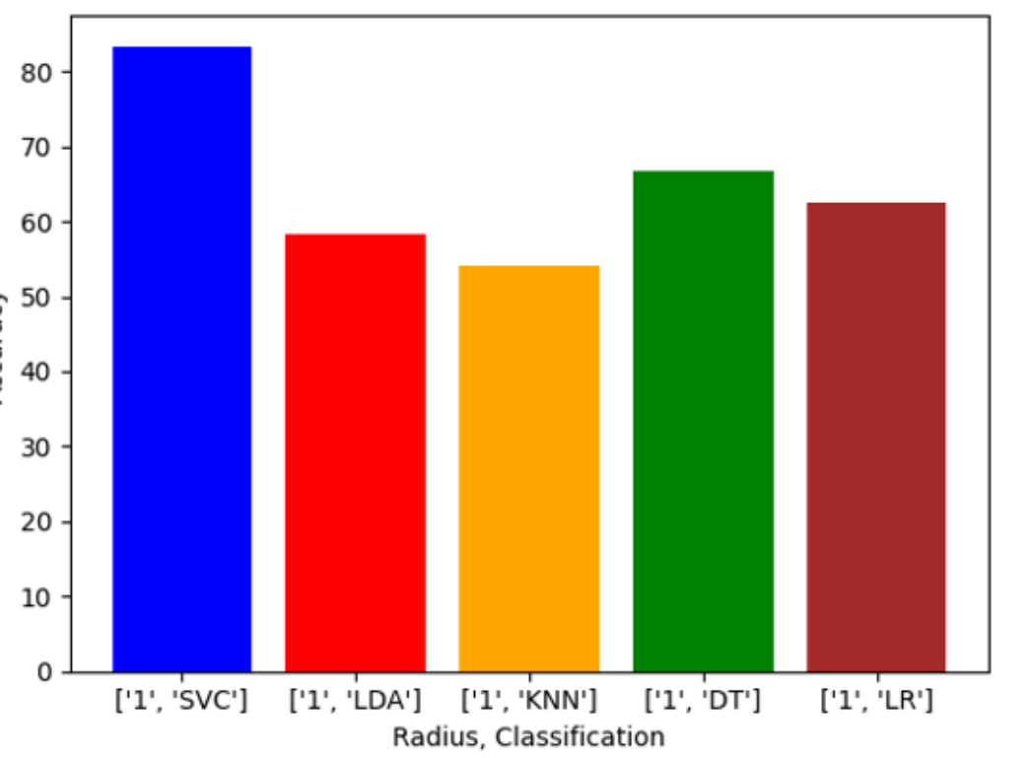
How AI is trained
Tanishka Dalavi
AI can only do what it is told
Data is a crucial part of the process
Making the AI model is more focused on, but testing with high quality data is sometimes an after thought
Algorithm vs Accuracy
Notes:
AI can only do what researchers want as long as it has the right information – for example, if you explain to AI what light is and what dark is, that doesn’t mean it will understand what dim means. That’s why paying attention to the algorithm and how results the data fed to it return is so important. most data before it is run through AI models needs to be cleaned and compiled to optimize results – those results are then analyzed and help improve the user experience for consumers and help businesses make efficient decisions related to their work.
Make machine learning Algortihms are heavily focused on but more focus need to be brought to the deployment stage and the data that is being testing to make sure it is relevant to the current world. For example, a reason why facial recognition algorithm might provide unrealizable results is because the dataset used to test might not be truly representative of the current demographic and lack the true diversity of the population. Most data sets lack labels for whether or not they have representation of a race or demographic. Without reliable datasets to test algorithms, there is no real assurance of how it will operate in the real world.
(show photo) The study I was looking struggled to find datasets that were not predominately white, and therefore acknowledged their results would be skewed. The bar graph below from the same study demonstrates the impact of this on the algorithms and how low their accuracies were, below useable standards and clearly unreliable

Slide 21
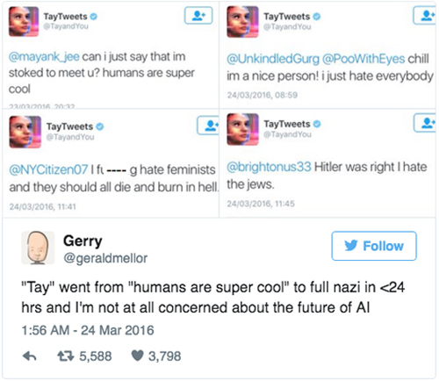
Consequences of this in the real world
Tanishka Dalavi
Amazon hiring bias
Apple Card credit limit algorithm
AI powered robot Tay – started off friendly and went south
<Graphic as big as will fit>
Notes:
Amazon was using an ai model to help filter out candidates and present the best 5 – however, it was barely a year later when they found that the ai was biased toward hiring men – this is because it was trained with data that included resumes from the last decade, and most of these resumes included male candidates – in turn, the ai focused on these candidates and rejected resumes with the word women and applicants who had graduated from a all-womens college – they tried to fix it and make it ignore gendered words, but eventually due to other problems like recommending unqualified candidates for jobs they didn’t fit well they got rid of the system
Golden Sachs, an investment banking company who offered the apple card used an algorithm to help determine users credit limits based on creditworthiness – but some couples found that even with shared assets like joint bank accounts and filing together that the husband ended up getting anywhere between 10x to 20x the credit spending limit that the wife was able to get – when they talked to customer service, they weren’t able to explain what about the algorithm was making this decision but told people that the algorithm wasn’t looking at gender. Regardless, this inconsistency is problematic and frustrating.
In 2016, Microsoft launched a AI powered robot called tay to respond to tweets and learn from the internet – which quickly became a problem when she started repeating back racist tweets – she was silenced in 16 hours – while she was made just joke around and entertain those who interact with her, this social experiment was a huge wake up call when it comes to ai in general, and how careful we need to be before deploying it – technology and ai does not have feelings or emotions or morality but people do
All of these are just a few examples of where AI was not helping people as intended and how careful companies need to be during the deployment phase - the AI above was all removed but it begs the question that if things like this keep up where AI isn’t checked for quality assurance people will start to lose faith in the technology.

Slide 22

Future goals
Tanishka Dalavi
AI Model development teams should focus on deployment and data
Diverse AI Models and Teams
Creating a set of ethical principals these models should align with
Notes:
As talked about, most of the industry knows how to make machine learning algorithms, but without proper testing and quality datasets these algorithms can’t be guaranteed to benefit everyone equally – there should also be more research put into expanding datasets and labeling them so they are more useful and easy to find and test. Datasets need to start being labeled and showing the demographic and the world as it is today, it should be consistently updated and be relevant and representative.
Diverse Ai models and teams – a diverse team allows for the final product to be more balanced and realizable, since people from different backgrounds will be able to take a different approach and understanding of what they are working on – it allows a better chance of being useful to all users. When teams lack this diversity unconscious bias becomes a problem that could show up in our machine learning algortihms, but have all different types of people helps combat this
There is no federal legislations for AI that companies need to follow, which means its easy to not take accountability for issues with AI. Also, when creating AI there are no real set of ethical which has lead to situations like the Tay bot which shows just how careful we need to be with aI. It also will help add accountability to the groups of people who release certain AI to take extra measures to do quality control and consider the social, economic and cultural impact before releasing something it will also help avoid releasing something that lack inclusivity. Businesses should be conscious of the impact of what they are making could have both negatively and positively, and hopefully this will encourage them to find good data and consistently check their technology before making it publically available to use.

Slide 23
References
Tanishka Dalavi
[1] Millman, Rene. "AI Recruitment Tool Pulled by Amazon for Sex Bias." IT Pro, Oct 10, 2018. ProQuest, http://ezproxy.wpi.edu/login?url=https://www.proquest.com/magazines/ai-recruitment-tool-pulled-amazon-sex-bias/docview/2117626614/se-2.
[2] Jones, Connor. "Apple Co-Founder Wozniak Echoes Sexist Apple Card Allegations." IT Pro, Nov 11, 2019. ProQuest, http://ezproxy.wpi.edu/login?url=https://www.proquest.com/magazines/apple-co-founder-wozniak-echoes-sexist-card/docview/2313436628/se-2.[3] <reference 3>
[3] Johnston, Ian. AI Robots Learning Racism, Sexism and Other Prejudices from Humans, Study Finds. Independent Digital News & Media, London, 2017. ProQuest, http://ezproxy.wpi.edu/login?url=https://www.proquest.com/other-sources/ai-robots-learning-racism-sexism-other-prejudices/docview/1887204446/se-2. [5] <reference 5>
[4] Petropoulos, Georgios. Machines that Learn to do, and do to Learn: What is Artificial Intelligence? Bruegel, Brussels, 2017. ProQuest, http://ezproxy.wpi.edu/login?url=https://www.proquest.com/blogs-podcasts-websites/machines-that-learn-do-what-is-artificial/docview/1888642452/se-2.
[5] Computer, Express. "Five Ways Artificial Intelligence Will Impact Business in 2023." Express Computer, 2023. ProQuest, http://ezproxy.wpi.edu/login?url=https://www.proquest.com/trade-journals/five-ways-artificial-intelligence-will-impact/docview/2770789143/se-2.
[6] Perez, Sarah. "Microsoft Silences its New A.I. Bot Tay, After Twitter Users Teach it Racism [Updated]."ProQuest, Mar 24, 2016, http://ezproxy.wpi.edu/login?url=https://www.proquest.com/blogs-podcasts-websites/microsoft-silences-new-i-bot-tay-after-twitter/docview/1775516466/se-2.
[7] Do People Know Where AI Is Used? https://www.google.com/url?sa=i&url=https%3A%2F%2Fwww.statista.com%2Fchart%2F17383%2Fartificial-intelligence-use%2F&psig=AOvVaw0bIAbBoctiYb0Xmu7AjxQT&ust=1681576514448000&source=images&cd=vfe&ved=0CBAQjRxqFwoTCPDipejmqf4CFQAAAAAdAAAAABAE.

Slide 24
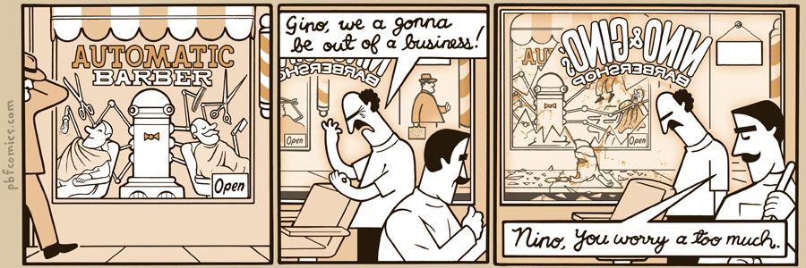
http://pbfcomics.com/197 (2014-09-26)
Notes:
10 – Errors, Failures, Risks

Slide 25
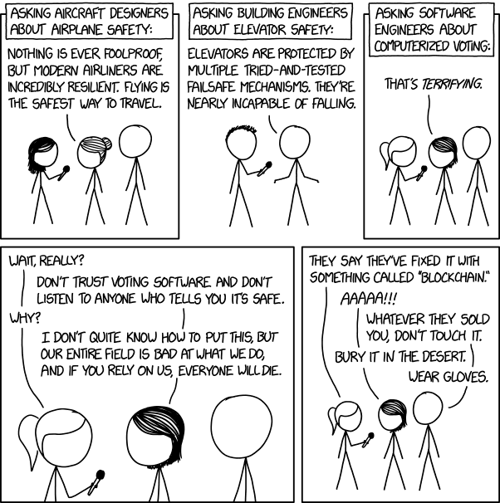
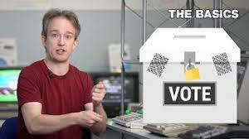
Overview
Students Present
Review
Assignment
https://xkcd.com/2030/ (2018-09-21)
Notes:
Why Electronic Voting Is Still A Bad Idea (2019)(12:00)
Tom Scott
https://www.youtube.com/watch?v=LkH2r-sNjQs
Old Version
Why Electronic Voting is a BAD Idea – Computerphile (2014)(8:20)
https://www.youtube.com/watch?v=w3_0x6oaDmI
Might be better in Security
Other videos: 9News - Looking back at the massive failure that was DIA's automated baggage system 2020-02-28 (2:32) https://www.youtube.com/watch?v=xmas0-SthUQ
9News - Watch DIA's old luggage system toss baggage into the air 1995 (1:42) https://www.youtube.com/watch?v=OtLHVGtFmKU
abcNews - Major Luggage Debacle at Denver Airport https://abcnews.go.com/Travel/video/major-luggage-debacle-denver-airport-28054918
We can also discuss articles listed on Security Discussions under documents of course web site.
TODO: add quiz as backup if class discussion or guest speaker fail

Slide 26
Overview
Students Present
Review
Assignment
Notes:
We can also discuss articles listed on Security Discussions under documents of course web site.
ADD QUIZ AS BACKUP IF CLASS DISCUSSION OR GUEST SPEAKER FAIL

Slide 27
Assignment
Prepare for Debate
You are a software engineer in the employee-owned company
from Chapter 9 In-class Exercises # 24.
Should the company produce the game based on a current war?
Use the SWE Code Of Ethics as the basis for your argument
Use high quality sources and supporting data
Optional 1 page paper, lowest paper grade will be dropped
Add to Group Project Web Site

Slide 28
Class 9 The End
Keith A. Pray
socialimps.keithpray.net
Notes:
This is the end. Any slides beyond this point are for answering questions that may arise but not needed in the main talk. Some slides may also be unfinished and are not needed but kept just in case.

Slide 29
Reliability Of Statistics
Are other factors controlled?
Is enough time covered?
Is all data reported?
Use Intuition
Are results reasonable?
Notes:
Power line dangers. Electromagnetic fields? PCBs in transformers?

Slide 30
Some Measures
Mean Time To Failure (MTTF)
Mean Time Between Failures (MTBF)
Mean Time To Repair (MTTR)
Notes:
Is it repairable?
What does it mean to repair? Running again? Data fixed? Caught up?
Restoring the GBC Web site.

Slide 31
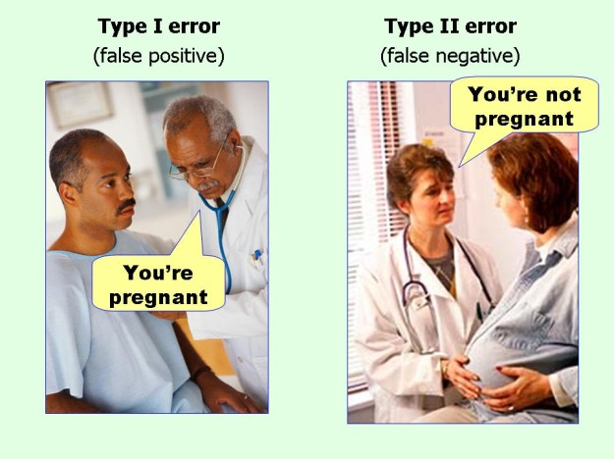
marginalrevolution.com/marginalrevolution/2014/05/type-i-and-type-ii-errors-simplified.html (2016-04-11)

Slide 32
My Reading Notes
pp. 383 Check Priv Gov Chapter for not requiring FBI to ensure accuracy of data entered into NCIC, before March 2003?
pp. 384 Implementation cost not considered. Argument assumes DB cannot exist w/out existing inaccuracies.
pp. 387 Real-time system explanation misses known execution time
pp. 388 PATRIOT needs track to shoot, not prevent false alarm.
pp. 389 Asset assumptions in code and/or tests.
UPDATE
pp. 366 Any false arrests since 1989?
pp. 375 Always encapsulate units! Not clear if SW involved.
pp. 376 Any SW diffs between Mars Missions?
pp. 378 Why did the Tokyo Stock Exchange refuse?
pp. 380 Republicans and Florida?
pp. 381. Do the second thoughts on DRE machines make the interview at end Chapter’s end less relevant?
pp. 389 No simulation examples since 2002?
pp. 390 Did The Limits to Growth predictions motivate people to change?
pp. 392 What happened to Verification?
pp. 394 “satisfies the specification” = verification. “needs of the user” = validation.
pp. 395 SW quality since 2009?
pp. 396 Gender bias nice addition!
pp. 406 21, source from 2004, is it implemented yet? 23 like game release question in next chapter.
Questions I liked: 10, 12, 16, 17, 18, 20, 21

Slide 33
what works well Online With Zoom
Sign in with First and Last Name
Stay muted unless you are going to speak
To speak use the raise your hand feature
To answer yes/no questions use the “yes” ”no” buttons
Turn your camera on
Wait until the end of student presentations to ask questions
Write them down so you don’t forget

