Slide 1
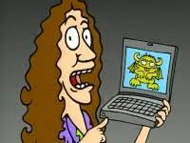
Class 8 Crime
Keith A. Pray
socialimps.keithpray.net
Notes:
“Weird” Al Yankovic – Virus Alert (3:43)
https://www.youtube.com/watch?v=zvfD5rnkTws
Take 5 minutes to fill out survey on Canvas → Quizzes → SGA’s Midterm Course Feedback Questionnaire

Slide 2
Papers – Nice Improvement!
Read assignment
many profiles missing
space used to describe search findings instead of providing argument
Use template, saves time
Use sources that back claims with data
Use backing data
If available provide URLs for sources too
http://socialimps.keithpray.net/assignments/paper-guidelines/
Notes:
0s not included.
Save for next time:
Make decisive conclusions
may, could, etc. = trivial
Absolute statements are difficult to prove
Avoid: all, always, any, every, everyone, never, none… unless you can show it
Be sure to put quotes around entire quote
Hyperbole is the best thing ever!
but not in these papers
Print 2 sided and save a tree
Use template, saves time (and -1 point)
Use and cite supporting data from at least 5 high quality sources
Argument should directly support conclusion
Response should directly address counter point
Arguments should have at least 3 statements
Review fallacies in Appendix B and Class 2 Slides
Avoid Strawman Fallacy
Counter Point and Rebuttal should relate to each other and conclusion
Use supporting data in counter point and rebuttal
Clear, strong conclusion, easy to find
Quantify
Terms like: less, more, a lot, huge, great, big, tiny, growing, etc.
Make clear what claim evidence is supporting, explain how it’s relevant
Avoid fallacies, e.g. begging the question
Try reading paper out loud to yourself to catch typos, grammatical errors, contradictions

Slide 3
Grades To Date
30 Max Possible

Slide 4
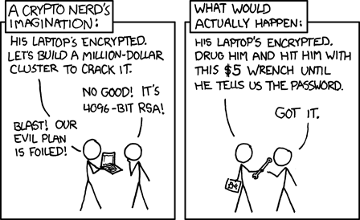
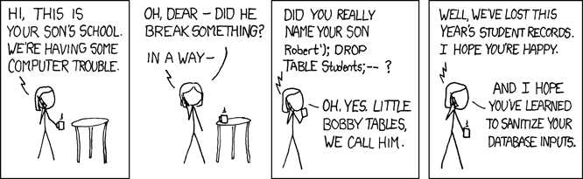
Overview
Review
Assignment
Students Present
https://xkcd.com/538/ (2010-11-14)
https://xkcd.com/327/ (2007-10-10)
Notes:
Are there any questions on the assigned reading?
Use the backup slides to explain Buffer Overflow or TCP attack methods from the text.
XKCD Links last accessed 2020-09-25

Slide 5
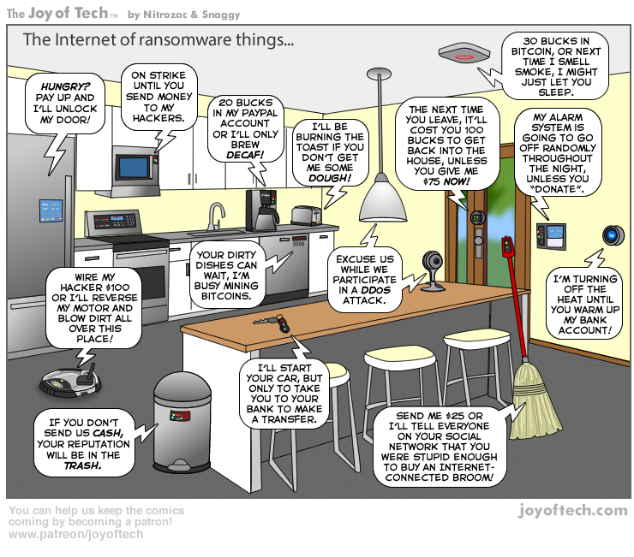
https://cointelegraph.com/storage/uploads/view/5e8f6e0d3a029807dfe181dc3d160cf0.png
Notes:
Find publish date
Note which really exist
Extra credit

Slide 6
Group Quiz
A denial-of-service attack shuts down a bunch of retailer, stock brokerage, large corporate entertainment, and information web sites.
Guilty parties:
Terrorist who aimed to cause billions of damage to U.S. economy
Protestor opposing corporate manipulation of consumers
A minor just having fun with tools found on the web
Show off hacker in search of bragging rights
Choose one ethical theory to use:
Kantian, Rule Utilitarian, Act Utilitarian, Social Contract Theory, Virtue Ethics
State what penalties are appropriate for each
Explain your answers using your ethical theory
Name the laws/acts under which these parties could be prosecuted
Notes:
Works well as small group exercise.
Note: short answer format expected.
Note: 2. only one argument needed, should include logic for all parties
Note: 3. same law(s) should be applicable to all parties

Slide 7
Assignment Code Testing 1 Page Paper 1/2
Research testing, decide on test strategy, test the given code
There are major and minor defects to find
Once testing is done write paper with conclusion: Testing strategy was adequate
Things that might be useful in your argument:
Rationale for testing strategy used (use data, high quality sources)
Explanations of defects found (use data, high quality sources)
How to fix them (use data, high quality sources)
Consequences of leaving defects in production code (use data, high quality sources)
Weakness in testing strategy as counter point (use data, high quality source)
Working example: http://socialimps.keithpray.net/assignments/Test_Sales_Fun
Notes:
If guest presenter coming next class remind students to prepare questions for him.
Remember to work on groups projects.
Each group should have material on their sites for the topics we’ve covered so far.
OLD Prompt:
Design tests for the code on the following slide.
Contains at least one major defect and several minor ones.
Write a paper (1 page not counting any source code) including :
Did you choose a good test strategy? (This is your conclusion.)
The inputs and expected outputs
What defects you found
How you would fix the defects (you may include fixed source)
Why would that fix the problems?
What could happen if the defects are not found before the code is put into production?

Slide 8
Assignment Code Testing 2/2
import java.text.NumberFormat;
public class SalesFun {
public static double calculateSalesTotal ( double amount, double discountRate, double taxRate ) {
double discount = amount * discountRate;
double total = amount - discount;
double tax = total * taxRate;
double taxedTotal = tax + total;
NumberFormat numberFormat = NumberFormat.getCurrencyInstance();
System.out.println ( "Subtotal : " + numberFormat.format ( amount ) );
System.out.println ( "Discount : " + numberFormat.format ( discount ) );
System.out.println ( "Total : " + numberFormat.format ( total ) );
System.out.println ( "Tax : " + numberFormat.format ( tax ) );
System.out.println ( "Tax+Total: " + numberFormat.format ( taxedTotal ) );
return taxedTotal;
}
}
} Lines of interest
Notes:
Bold lines are real focus.
Example input:
amount = 100.05;
discountRate = 0.10;
taxRate = 0.05;
OR
0.70, 0.0, 0.05
95.67, 0.20, 0.7

Slide 9
Overview
Review
Assignment
Students Present

Slide 10
Class 8 The End
Keith A. Pray
socialimps.keithpray.net
Notes:
Any slides beyond this point are for answering questions that may arise but not needed in the main talk.
Some slides may also be unfinished and are not needed but kept just in case.

Slide 11
My Reading Notes
pp. 323 Interesting to compare password guidance over the years.
pp. 325 plenty not sent with HTTP
pp. 328 Getting on TV much more difficult than releasing software
pp. 330 Virus could be new
pp. 332 Goals include infect 3 machine per LAN and as many computers as possible? Never make last minute changes before release. Were they related to the defects?
pp. 333 Testing w/out DEBUG often neglected
pp. 335 Do people use the Internet as an experimental laboratory these days? Shutdown right after booting, “benign” doesn’t seem like the right word.
pp. 337 “send reports back to a host computer”?
pp. 338 Firewalls often not running on same machine as malware, routers?
pp. 339 Have 2003 fears of cyber terrorist attacks been realized?
pp. 347 How is online voting a moral issue?
End of Chapter questions: 14. 25. 29.
Update
Notes:
- If time ask class about online voting in light of COVID-19 challenges.

Slide 12
Buffer Overrun
Run time stack
Local Variables
Return Address
Parameters
Variable Attack
buffer
Target Variable
Stack Attack
buffer
Return Address
code
Return Address
Notes:
Retired slide. Most students have this in depth from new class now.
When a function call is made, local variables, return address, parameters stored on run time stack. Local variables occupy lower memory addresses.
Variable attack – change variable value. Program expects user to input character and allocates a buffer for them. Attacker supplies too many characters and ends up over writing a variable.
Run example of this if there’s interest – next slide
Stack Attack – goal is to change value of return address so execution control goes to code which the attacker has provided in the input buffer.
Prevention – add checks against array bounds being exceeded. modify operating system to not execute instructions stored on run time stack.

Slide 13
Run Example Code
Notes:
Retired demonstration. Most students have this in depth from new class now.
Also, compilers getting more difficult to disable protections, need older HW/OS/compiler for demo to work.
> imps
> assembly
> 123456789qwerty1

Slide 14
Buffer Overrun Code
#include <stdio.h>
#include <string.h>
int main ( void ) {
char buff [ 15 ]; int ace = 0;
printf ( "\n Enter best class ever : \n" );
gets ( buff );
if ( strcmp ( buff, "imps" ) ) {
printf ( "\n %s is wrong! You should FAIL! \n ace=%i\n", buff, ace ); }
else { printf ( "Correct! \n") ; ace = 1; }
if ( ace ) { printf ( "You get an A! \n" ); }
return 0; }
} The Naughty Line
Notes:
Retired slide. Most students have this in depth from new class now.

Slide 15
TCP Three-way Handshake
SYN
SYN-ACK
ACK
Notes:
Retired slide. Most students have this in depth from new class now.
SYNchronize
SYNchronize ACKnowledgement (socket reserved awaiting ACK)
ACKnowledgement
TCP socket connection established

Slide 16
SYN Flood Attack
SYN
SYN-ACK
Notes:
Retired slide. Most students have this in depth from new class now.
Attacker spoofs the IP address so the SYN-ACK is sent to a different machine that cannot respond to the SYN-ACK.
This leaves the connection half open on the server machine decreasing the resources (sockets, memory, threads/processes) available to respond to legitimate clients.
The attacker send many such spoofed SYN messages.

Slide 17
Ping Attack
Target
Attacker
ping
ping
Notes:
Retired slide. Most students have this in depth from new class now.
Attacker finds routers that support broadcasting messages to all computers on their local area networks.
The attacker sends a spoofed ping message, which the routers echo to the spoofed address.

Slide 18
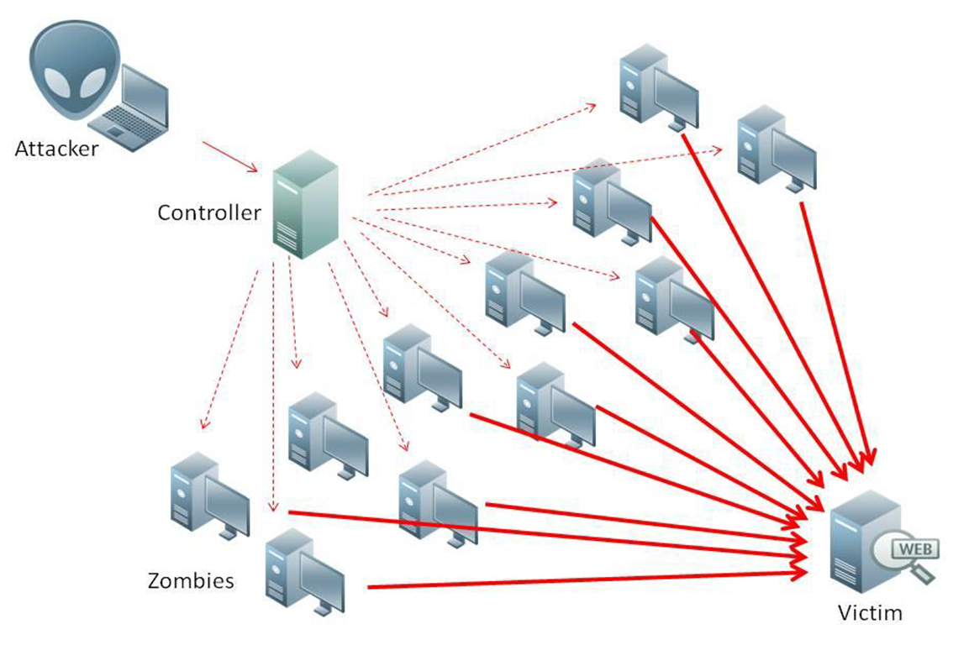
What is Denial of Service (DoS)
Attempts to make target unavailable by flooding with traffic
If victim has to filter attack, it’s too late
Internet Providers have no incentive to help
Businesses get affected, but would not pay provider enough to make worthwhile
This is why Cloudflare, e.g., exists
Many ways to perform this attack
Notes:
Contributed by Brett Ammeson.
https://www.cloudflare.com/ddos/reflection-attack-1.png
https://i.imgur.com/lxYv8cF.png

Slide 19
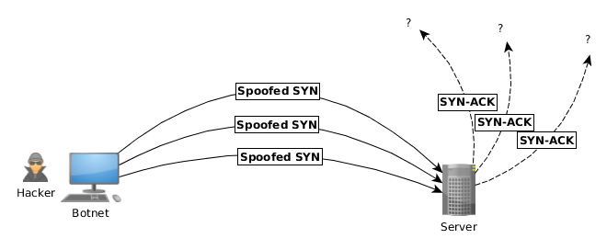
Distributed DoS Vectors
TCP SYN attack
SYN packets are small, low difficulty for attacker
Leaves half-open connections on server
SYN cookies mitigate this
DNS amplification attack
DNS requests are small
Can request all records on server
Crippled by proper configuration
Ingress/egress filtering will reduce effect
Notes:
Contributed by Brett Ammeson.
TCP SYN: https://www.cert.org/historical/advisories/CA-1996-21.cfm
DNS amplification: https://www.cert.org/historical/incident_notes/IN-2000-04.cfm
Ingress/egress: www.giac.org/paper/gsec/705/egress-filtering-keeping-internet-safe-systems/101588

Slide 20
Crime How
Technical and Non-Technical
Break into computer.
Prevent access to computer.
What things make computer related crime easy?
Notes:
Exploit security holes, Break encryption, Spoofing
Social Engineering: Guess passwords, Find out passwords and procedures
Poor passwords, Insecure protocols, Program limitations (buffer overruns), Eavesdropping (Email, Interactive), Insecure files

Slide 21
Crime Bane
Trojan Horse
Virus
Worm
Bot Network
Buffer Overrun
(Distributed) Denial Of Service Attack
How do they work?
How harmful are they?

Slide 22
Crime Why
Why?
Notes:
Money: stolen credit cards, change records, stolen property.
Political, military, economic.
Challenge, Revenge, Mean
Why do at all? Have motivation, think about it, think it will help, think it’s acceptable.
Feel forced. Don’t agree. Don’t care.

Slide 23
Crime Time
What is different now compared to:
10 years ago?
20 years ago?
30 years ago?
40 years ago?
Notes:
More computers. Unsophisticated owners. More complex software. Greater connectivity. Easy access to cracking tools. Incentives. File-sharing
In ’60s and ’70s, access was mostly localized.
Modems. Wardialing.
Some Arpanet and Usenet.

Slide 24
Crime Doers
Hacker or Cracker
Pre-1980 - Golden Age ☺ ?
Eighties
Nineties
Naughts
Criminal Hacking == Cracking?
Notes:
Script kiddies
Phreakers
Security analysts
Packet monkey

Slide 25
Crime Gain
Justifications for Computing Crimes?
What can be done after access is gained?
What resources are available?
How valuable are they?
Notes:
Machines are unused. No harm done. Education. Exposes security holes. Exposes abuses.
Use computer and/or resources. Take data. Destroy data. Alter data. Lock out others. Attack other computers.
Equipment, Processor Time, Disk space, Printer time / paper, Bandwidth

Slide 26
Crime Pay
Computer Fraud and Abuse Act (1986)
Bans :
unauthorized access or use of computers, copying, modifying, or destroying data, disclosing of passwords.
disrupting government and utilities.
Covers government, financial, medical, and interstate systems.
USA Patriot Act (2001)
Raised penalties.
Permits freer surveillance and monitoring to detect illegal activity.
Electronic Communications Privacy Act
Illegal to intercept telephone, email, other data transmissions, access stored email messages without authorization
Assign Cybercrime Treaty (2006), Wire Fraud Act, National Stolen Property Act, Identity Theft and Assumption Deterrence Act
Notes:
Are either of these laws still in effect? Have they been changed?
For additional legislation ask for presenting volunteers to brief recent incidents/cases.
Also ask for volunteers to find out laws from their home country/state.

Slide 27
Crime Stop
Technical
Protect Data
Protect Machine
Protect Access
Non-technical?
Social?
Legal?
Notes:
Encryption, Authentication, Biometrics, Anti-virus, File integrity checking (E.g. Tripwire), Virtual private networks, Point-to-point networking (Twisted-pair Ethernet vs. Coax vs. wireless)
Security through obscurity, physical access required, not on network, behind locked doors.
Remove desire, remove incentives
Legalize, increase penalties, increase chance of getting caught.

Slide 28
what works well Online With Zoom
Sign in with First and Last Name
Stay muted unless you are going to speak
To speak use the raise your hand feature
To answer yes/no questions use the “yes” ”no” buttons
Turn your camera on
Wait until the end of student presentations to ask questions
Write them down so you don’t forget

