Slide 1
Class 6 Information Privacy
Keith A. Pray
socialimps.keithpray.net
Notes:
How is the self search paper going? Offer small group discussion instead of class wide.
Who: found a lot, very little, surprised, not surprised, creepy, share conclusions

Slide 2
Papers
Read assignment
many time lines missing
space used describing history instead of providing argument
many conclusions did not answer prompt
State a strong, clear conclusion
First statement preferred
Quantify
Not terms like: less, more, a lot, huge, great, big, tiny, drastic, quicker, faster, easier, etc.
Avoid absolutes
Terms like: all, none, always, never
Difficult to prove, easy to show false
Cite as specified [1]
When to use quote:
Who said it important to argument
Phrasing is exceptional
Otherwise, your own words are better
Read paper aloud to proof
http://socialimps.keithpray.net/assignments/paper-guidelines/
Notes:
Note ChatGPT Use not permitted.
Any logistic questions?
Save for next time:
Define terms
Quantify
Not terms like: less, more, a lot, huge, great, big, tiny, drastic, etc.
Avoid absolutes
Terms like: all, none, always, never
Difficult to prove, easy to show false
Read paper aloud to proof
Read directions, many time lines missing
Be sure to put quotes around entire quote
State a strong, clear conclusion
First statement preferred
Provide Counter Point and Rebuttal
Counter Point and Rebuttal should directly relate
Print 2 sided and save a tree
Hyperbole is the best thing ever!
but not in these papers
Be wary of counter point strawman fallacy
Text book is not a primary source
Use template, saves time
Beware of fallacies
Avoid blogs, encyclopedias, and text book. These are generally not primary and high quality sources.

Slide 3
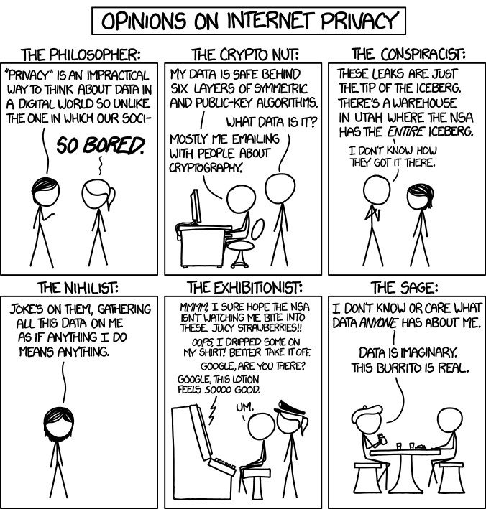

Overview
Review
Assignment
Students Present
http://xkcd.com/1269/
Notes:
1 – Accessed 2014-04-14
Everyone pick the category they identify most with.
Share reasons why.
Jimmy Kimmel Live – What is your password? (2:49)
https://www.youtube.com/watch?v=opRMrEfAIiI
Find out what your DNA says about you and your family.
https://www.23andme.com/
https://motherboard.vice.com/en_us/article/xwkaz3/23andme-sold-access-to-your-dna-library-to-big-pharma-but-you-can-opt-out?utm_source=vicefbus

Slide 4
My Reading Notes
pp. 234 Alexa calling unbeknown scary
pp. 235 How much do you use computer labs now?
pp. 236 Park example, videotape unlikely, Panopticon, businesswoman nice change
pp. 237 “moral capital” Book 1984 relationship == subversive act, ex-spouses just above enemies?
pp. 239 tech price down privacy invasion up?
pp. 240 Hilton consent to pic being in book?
pp. 242 How common are internet connected home surveillance systems?
pp. Do you expect privacy in others’ homes?
pp. 244 Many daycares monitor, any studies yet?
pp. 245 junk mailers not using info well
pp. 246 Anything come of EPIC Facebook Tag Suggestions complaint?
pp. 247 Loyalty programs changed in 20 years?
pp. 248 Clothing body scans common 20 years later?
pp. 249 How common implanted chips now, sources from 2002, 2004, 2007, 2010?
pp. 251 Any OnStar listening in events since? How much do auto black boxes record now?
pp. 252 Does Tivo’s ad skip weaken time shifting fair use? Browsers put cookies on hard drive, not Servers.
pp. 256 Target execs were not savvy before see pp. 308. 2012 source same year Target outed pregnant teen to parents.
pp. 257 500 mil more than US population
pp. 262 How many times has Zuckerberg been quoted saying “I know we can do better”?
pp. 263 Why did Apple not enforce policy of asking permission in the API?
pp. 265 10 hours > 1 page paper
Questions I liked: 30, 39
Notes:
Notes updated: 2023-04-04
OLD not incorporated yet:
pp. 229 means to end?
pp. 245 “…by 2015” did it happen?
pp. 250 why is bills – responsibility assumption flawed?

Slide 5
Assignment
Prepare for class debate:
National ban on facial recognition surveillance for law enforcement?
Do background reading and decide “Yes” or “No”
Come prepared with notes, facts, dates, high quality sources
Optional One Page Paper on the topic, lowest paper grade will be dropped
Notes:
Morgan Lee write up 2021-09-13:
“Facial recognition technology has begun to see widespread adoption in modern law enforcement, with applications in physical & digital security, as well as identifying potential suspects. Critics of the technology argue that passive facial recognition technology violates privacy rights of individuals, while its proponents emphasize its positive uses in preventing and detecting crime. There are currently 12 state-level bills which propose limits or bans on the use of facial recognition technologies by government agencies, with several local bans (including ones in Boston, Brookline, and Cambridge) already in place. Should the United States implement a national ban on the use of facial recognition technology by law enforcement?”
Previous Debates:
Should law require you to use an official ID for Internet access?
Is a National ID System a good thing?

Slide 6
Overview
Review
Assignment
Students Present

Slide 7
IT Never forgets
Najum Soofi

Slide 8
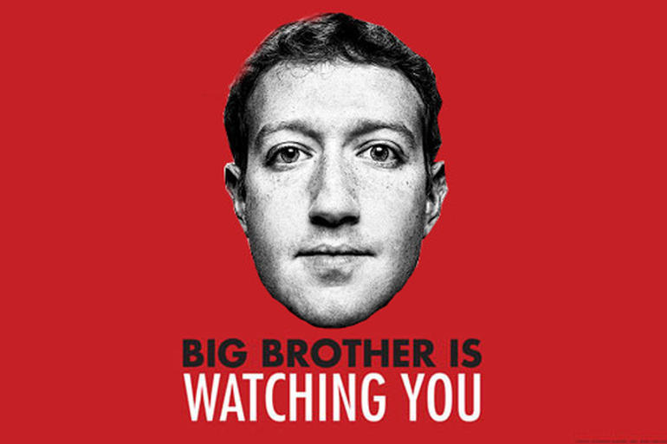
Awareness is key
Najum Soofi
Everything we do is being tracked
Be careful what you share online
Be aware of the tactics companies use to acquire data
Be mindful of control you give to companies ; “read the fine print”
Nothing is ever really “deleted”
Notes:
- Although there isn’t much we can do about being tracked 24/7, there’s tactics we can use to lessen the amount of leaked by companies
- Social media posts, comments on such posts, search queries, etc can all be traced back to you
Companies often disguise malicious intent through sincerity for privacy concerns
Example: will place privacy policies at the bottom of the web page so you have to scroll down through all their material/adverts to distract you (i.e. scrolling through a bunch of food)
Will say things like: “Your privacy is very important to us, allow us to save your browsing data” ; almost sincere sounding
If you take a second to read the whole disclosure you can often see the malicious intent companies hold (i.e. to sell your data, etc)
- Most sensitive information that is “deleted” is usually stored in a backend server unavailable to the user

Slide 9
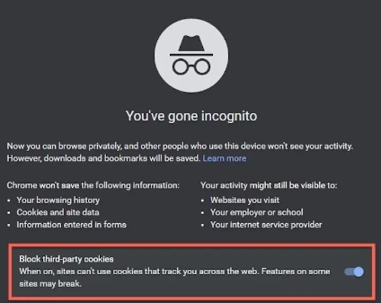
Permissions
Najum Soofi
“Choice” to opt in or opt out
Many loopholes companies exploit
Incognito mode not really incognito?
One approval is all they need
Evercookies, cookie syncing
Notes:
- Although you can opt in or opt out there’s still methods companies can use to track data
-When you go incognito the company can still track your screen resolution, where your curser moves , the size of your browser, etc and other individualized data to put in an algorithm to identify you (incognito only affects cookies stored on local device)
- Your internet provider can still access where you’ve been online
-Once you give a third party company permission to use your microphone, camera, etc. they can track whenever and wherever you are on your device
Evercookies : abuses different browser storage mechanisms to restore deleted cookies ; cookies stored on multiple databases
Cookie syncing: back-end server to server transmission of cookie information between different sites, invis to user

Slide 10
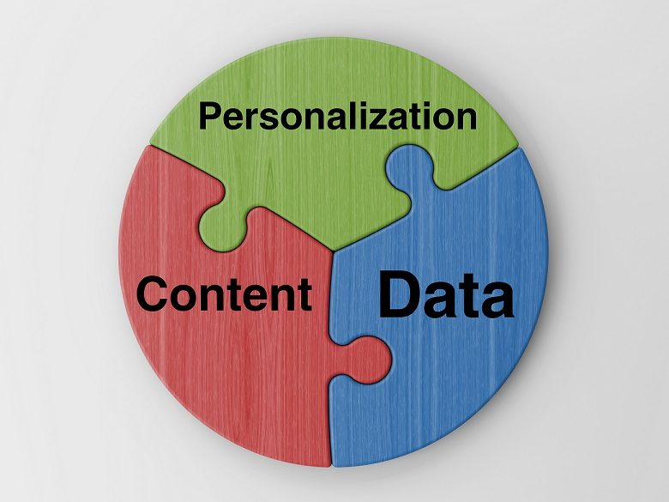
Personally
Najum Soofi
Algorithms keep data persistent and individualized
A first party can leak information to third parties ; intentionally and unintentionally
Monopoly on data
There are benefits to the user
Location tracking
Notes:
Algorithms send and receive data from any servers/companies that’s willing to sell its users and can predict what the user likes to see; storing data on backend servers communicating with one another
In addition, mic can listen and provide ads for something you haven’t even looked up
Provided permissions previously (phone actually is listening)
Unintentional: if a company puts userid (or other identifying info in url or page title)
Intentional: Selling data or trading information access with other companies
Meta: Facebook <-> Instagram <-> Messenger <-> WhatsApp
Communications between the apps
Despite all the negative discourse, personalized settings can be convenient and help a user in their endeavors
Databases can keep tabs on frequent locations you’ve been in and provide ads/suggestions to stores in the area (can be convenient but a violation of privacy?)

Slide 11
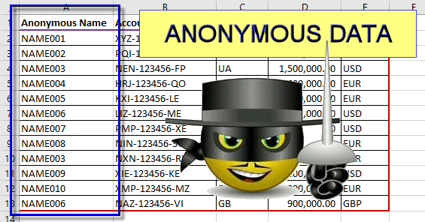
Anonymity doesn’t mean much
Najum Soofi
According to MIT Tech Review:
You can be identified through anonymous data 81% of the time given zip code, gender, and DoB
Cross-referencing data and companies selling/sharing data
Companies will say data being released is anonymous to seem ethical
Notes:
- “Given 15 demographic attributes of someone living in Massachusetts, there’s a 99.98% chance you could find that person in any anonymized database”
Cross referencing technologies and algorithms are so powerful in modern times that anonymous data can almost always be traced back to the individual
For example, your internet provider can sell you out and release information regarding your location and what you access while connected to their services
“Anonymous data” but with a little digging through public records or by selling the data to third parties, identity can easily be revealed

Slide 12
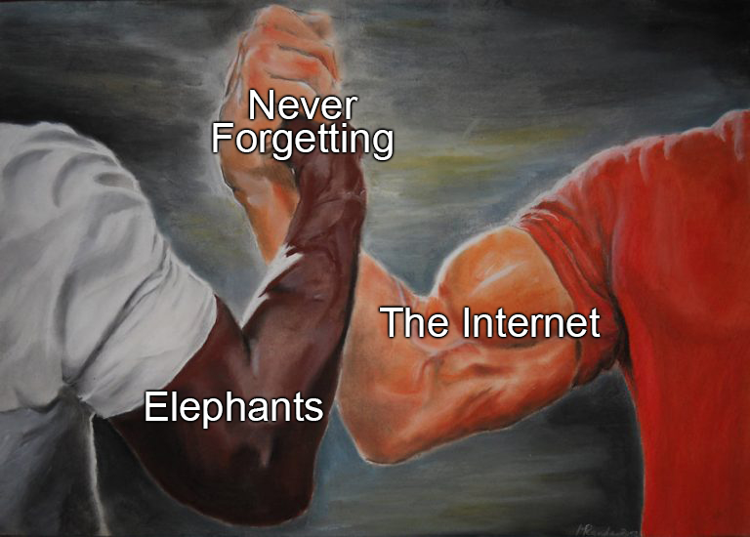
Conclusion
Najum Soofi
You can mitigate how much the internet knows about you
Be selective about how you use the internet
Recognize where data is being stored
Most of us will be fine
Why should we have to be so cautious when the companies operate with malicious intent ?
Notes:
Be selective about the information you provide companies
Be direct about how you use certain apps
Be aware when an application is using permission for something (i.e. mic, camera) in the background without your continued consent
Through general settings or personalization settings you can usually turn off the collection of some data
At the end of the day most people being targeted will be famous people or people holding positions of power but that doesn’t mean you shouldn’t worry because your identity can still be stolen

Slide 13
References
Najum Soofi
[1] Knowledge at Wharton Staff, “Your Data Is Shared and Sold… What’s Being Done About It?” (Knowledge at Wharton, October 28, 2019) https://knowledge.wharton.upenn.edu/article/data-shared-sold-whats-done/ (accessed on 4/4/23)
[2] Laurent Simon and Ross Anderson, “PIN Skimmer: Inferring PINs Through The Camera and Microphone” (ACM, November 8, 2013) https://dl.acm.org/doi/pdf/10.1145/2516760.2516770 (accessed on 4/4/23)
[3] Gunes Acar, Christian Eubank, et al, “The Web Never Forgets: Persistent Tracking Mechanisms in the Wild” (ACM, November 3–7, 2014) https://dl.acm.org/doi/pdf/10.1145/2660267.2660347 (accessed on 4/4/23)
[4] Jonathan R. Mayer and John C. Mitchell, ”Third-Party Web Tracking: Policy and Technology”(Jonathan R. Mayer. Under license to IEEE, 2012) https://ieeexplore.ieee.org/stamp/stamp.jsp?tp=&arnumber=6234427 (accessed on 4/4/23)
[5] Charlotte Jee, “You’re very easy to track down, even when your data has been anonymized” (MIT Technology Review, July 23, 2019) https://www.technologyreview.com/2019/07/23/134090/youre-very-easy-to-track-down-even-when-your-data-has-been-anonymized/ (accessed on 4/4/23)

Slide 14
Beware Wearables
Alessandro Brianti

Slide 15
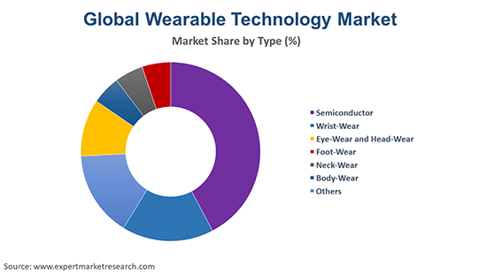
Wearable Technologies are growing
Alessandro Brianti
The market of wearable technologies are growing rapidly
More and more companies are joining the space
Estimate for 2026 is $265.4 Billion [7]
Joining in the Internet of Things
Notes:
The market of wearable technologies is rapidly growing, with smartphone companies like Apple or Google leading it with tight integration to smartphones, as well as FitBit coming in as a third party
The estimate for the wearable technologies market is 265.4 billion dollars, compared to today’s value of 158.2 billion, an increase of over 60% in just a few years.
Wearable technologies come in many different kinds, from watches to glasses and even clothes.
A lot of the profiting companies now are the ones making the processors and chips for these devices, which is an industry that is constantly growing.
Wearable technologies are joining in the internet of things, growing it for more information and to make life easier

Slide 16
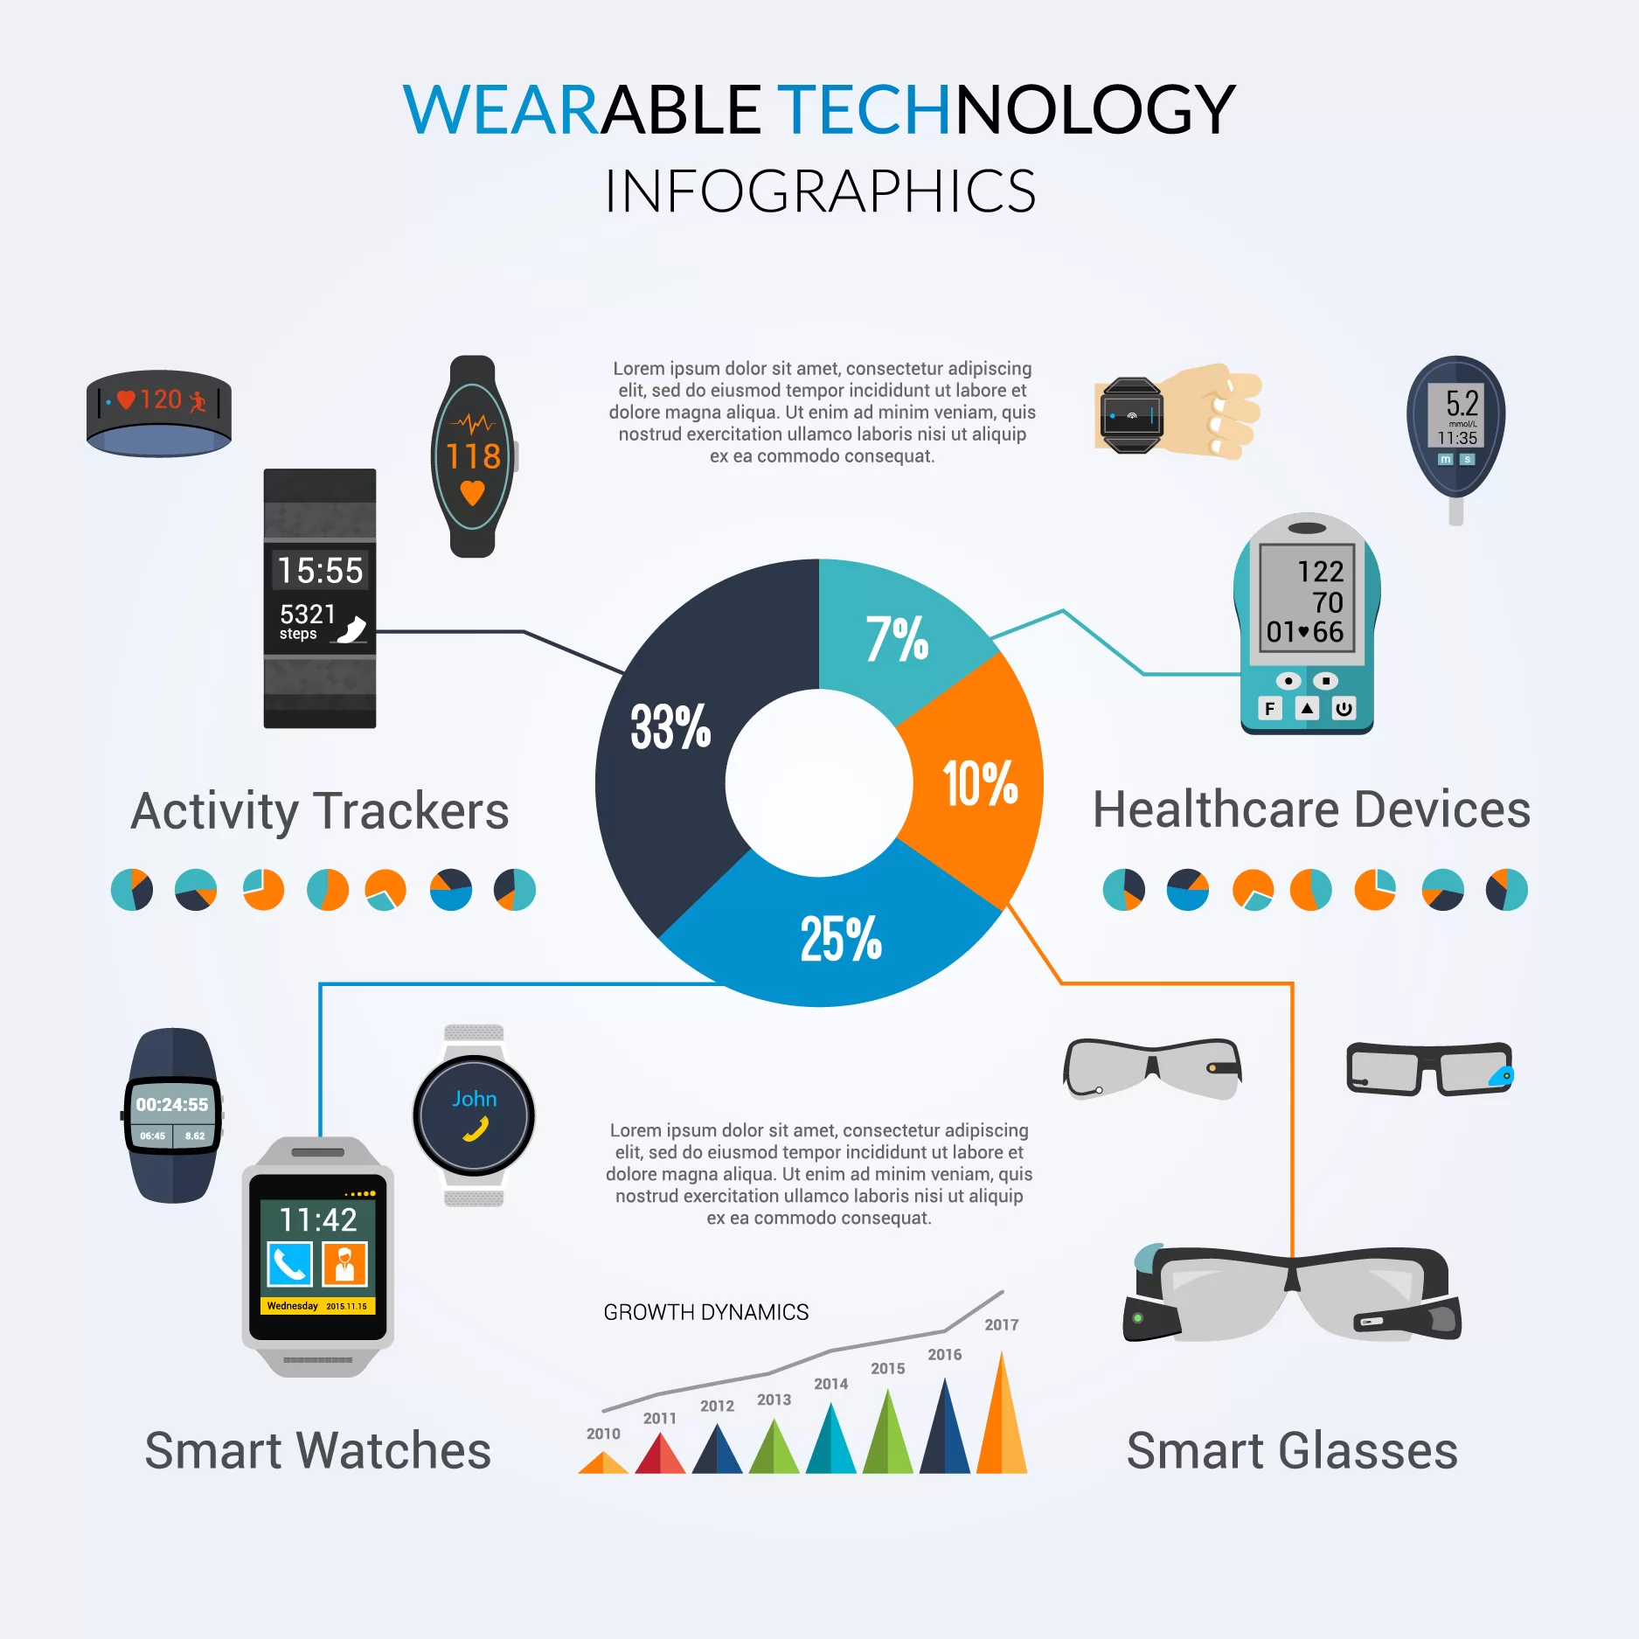
Benefits
Alessandro Brianti
GPS Tracking
Can be used to help people in emergencies, such as being lost
Certain wearable technologies can help with health issues [5]
Track issues
Provide additional information to professionals
Can help with general personal health
Being sure to stay active and tracking activity
Notes:
There are many benefits to wearable technologies, outside of simple notification tracking
It can track your gps location, which is useful in emergency situations, such as someone getting lost and taking a large fall. The watch can then contact emergency services automatically after detecting the fall, sharing your location and any other information they may need
Can also help track health issues, such as irregular heart rates or blood oxygen levels, to ensure that people can stay ahead of their health issues.
Also helps with personal health goals, such as staying active and keeping you on track.

Slide 17
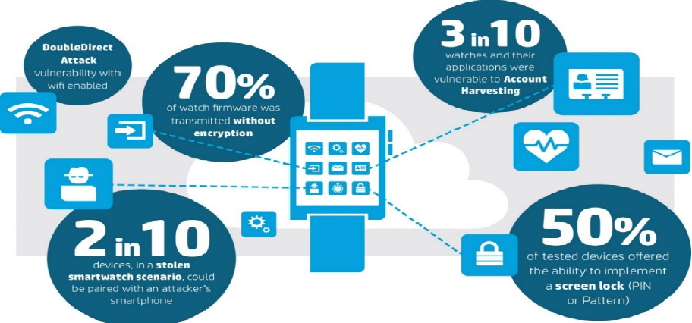
Data privacy
Alessandro Brianti
Can collect a wide variety of personal data [1]
Location history
Health data
Can share this data with third parties
Vulnerable to data breaches [2] [6]
Notes:
Although there are benefits to the data tracking, there always exists an issue when personal information is tracked and stored.
This data can be sold to third parties for personalized advertisements, with other companies that the user doesn’t fully know about being able to see your health and location history
Your information is also vulnerable to data breaches, such as in 2021, when 61M Fitbit, Apple Users Had Data Exposed in Wearable Device Data Breach
In order to properly collect data on personal health, a lot of sensitive information is also tracked and stored about our lives, health and much more. Criminals and hackers can use this personal data to send phishing emails, commit fraud, and obtain even more personal information.

Slide 18
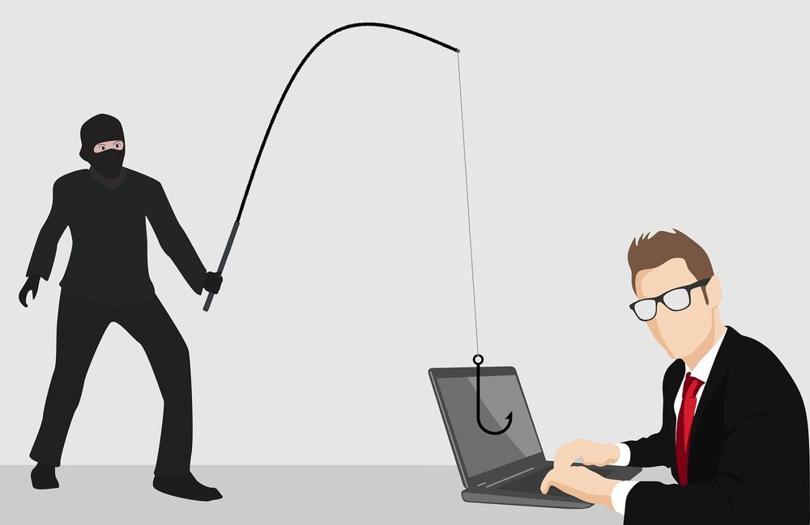
Misuse of information
Alessandro Brianti
Identity Theft
Personal information can be taken, such as birthdays, names, and other sensitive information
Insurance Discrimination [4]
Insurers can deny coverage based on “preexisting” conditions
Stalking
By accessing personal information, someone can get a better idea of habits.
Notes:
Personal information collected by wearable technology could be used by hackers to steal a person's identity and commit fraud. This could include information such as a person's name, birthdate, address, and social security number.
Health data collected by wearable technology could be used by insurance companies to discriminate against individuals. For example, insurers could use this data to deny coverage or increase premiums for individuals with pre-existing conditions or who engage in certain activities deemed "risky."
Wearable technology that tracks location data could potentially be used by stalkers or harassers to track a person's movements and monitor their activities. This could put individuals at risk of physical harm or emotional distress.

Slide 19
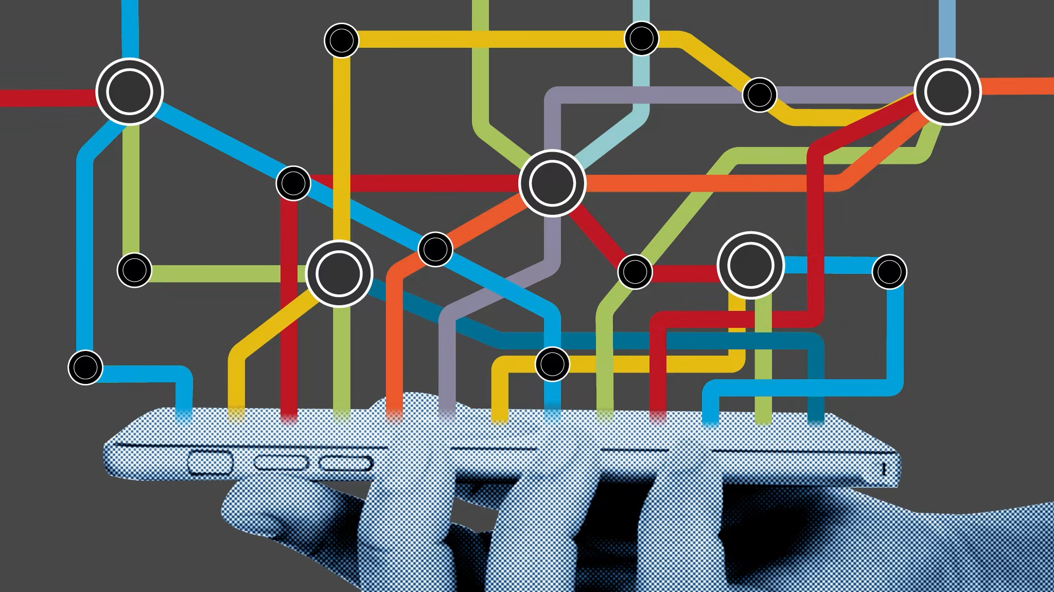
Is it worth it?
Alessandro Brianti
Much of the information can be found elsewhere
Your phone can also track your location and knows information like your name [3]
Certain healthcare companies give a bonus for wearing these devices [4]
Keeping ahead of your health issues is beneficial
Can lead to a larger disparity in healthcare
Notes:
While there are a lot of downsides to this tracking, its important to remember that a lot of the information that is being tracked is already tracked through other devices.
Other devices tracking information: It is important to note that wearable technology is not the only type of device that tracks personal information. Many smartphones, for example, collect location data and usage information.
Additionally, fitness trackers and other health devices have been on the market for several years. If you are concerned about the privacy risks of wearable technology, it may be helpful to evaluate how these risks compare to other devices that you already use.
Insurance bonuses: Some insurance companies offer bonuses or incentives for individuals who use wearable technology. For example, a company might offer lower premiums or rewards points for individuals who meet certain fitness goals. While these bonuses can be appealing, it is important to consider the potential risks of sharing personal data with insurance companies. Additionally, it is important to evaluate whether the rewards offered are truly worth the potential risks.

Slide 20
References
Alessandro Brianti
[1] “Data Privacy When Using Wearable Health and Fitness Devices.” Health Information Exchange, https://mhcc.maryland.gov/mhcc/pages/hit/hit_hie/hit_hie_consumer_hie.aspx.
[2] McKeon, Jill. “61M Fitbit, Apple Users Had Data Exposed in Wearable Device Data Breach.” HealthITSecurity, HealthITSecurity, 17 Sept. 2021, https://healthitsecurity.com/news/61m-fitbit-apple-users-had-data-exposed-in-wearable-device-data-breach.
[3] Nakashima, Ryan. “AP Exclusive: Google Tracks Your Movements, like It or Not.” AP NEWS, Associated Press, 13 Aug. 2018, https://apnews.com/article/technology-science-ap-top-news-business-north-america-828aefab64d4411bac257a07c1af0ecb.
[4] Robeznieks, Andis. “Insurers Want Patients to Use Wearables. That Could Be a Problem.” American Medical Association, 26 Aug. 2019, https://www.ama-assn.org/practice-management/digital/insurers-want-patients-use-wearables-could-be-problem.
[5] Vijayan, Vini. “Review of Wearable Devices and Data Collection Considerations for Connected Health.” Sensors (Basel, Switzerland), U.S. National Library of Medicine, 19 Aug. 2021, https://www.ncbi.nlm.nih.gov/pmc/articles/PMC8402237/.
[6] “The Wearable Future Is Hackable. Here's What You Need to Know.” McAfee Blog, 22 Feb. 2022, https://www.mcafee.com/blogs/privacy-identity-protection/hacking-wearable-devices/.
[7] “Wearable Technology Market Size, Future Outlook and Emerging Trends.” MarketsandMarkets, https://www.marketsandmarkets.com/Market-Reports/wearable-electronics-market-983.html.

Slide 21
Anti-competitive practices of Apple
Skyler Wiernik

Slide 22
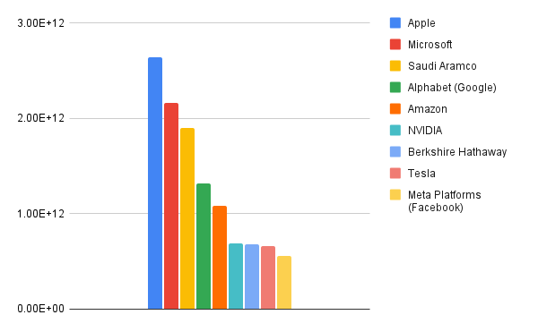
Apple is huge
Skyler Wiernik
Apple is the largest company in the world by a significant margin
At its peak, Apple was worth $3 trillion [2]
Apple is much longer established than most of its competitors
[1]
10 largest companies by market cap
Notes:
Apple is 2x size of google, and over 4x the size of meta
Apple was founded in 1976, 47 years old

Slide 23
Rules set by apple [3]
Skyler Wiernik
All in app purchases must be made through their own payment system
Apple's payment system takes a 30% cut from revenue
All apps must be downloaded from Apple's App Store
The only way content may be accessed outside of an app is through a website
Web browsers (other than Apple's safari, which is preinstalled) must be downloaded from the App Store
All web browsers must be powered by Apple's Webkit
NFT's may not be used to "unlock features" within an app.
Notes:
Webkit is the framework the powers safari. Does not allow for Chromium

Slide 24
Apple vs Spotify
Skyler Wiernik
A brief history [4]
Napster – Late 1990s
iTunes – 2003
Spotify – 2008
Apple Music – 2015
Notes:
Early internet piracy site, first large legitimate streaming platform (apple), launch of Spotify, Apple's response

Slide 25
Apple vs Spotify [5]
Skyler Wiernik
Spotify launches on iOS in 2008
In 2011, Apple decides to require all apps to use their payment system (and pay a 30% fee)
Spotify removes the ability to purchase premium through the app
In 2014, Spotify raises prices by 30%, allowing them to use Apple's payment system
In 2015, Apple Music launches at Spotify's old price
Spotify stops accepting in app payments, and re-lowers price to compete.
Apple threatens to remove Spotify from the App Store for launching promotions similar to their own
Notes:
Customers had to purchase from website, spotify can not mention this in the app
Spotify can't promote through push notifications, Apple can

Slide 26
Apple vs Epic Games [6]
Skyler Wiernik
Epic Games, makers of Fortnite, decided to test Apple's policies by deliberately designing an in app payment method that circumvented App Review, and bypassed Apple's 30% tax
Apple responded by removing Fortnite from the App Store.
Epic filed a lawsuit within 24 hours
Epic made it clear that they had the intent to do more than evade the 30% tax. Epic wanted to create their own App Store for games, similar to the market that they run on PC.
They called Apple a "behemoth seeking to control markets, block competition, and stifle innovation"
Notes:
Lawsuit was planned. Epic was ready with anti-apple ad campaign within 24 hours of removal. EEpic runs a large competitor to Steam. Wants to expand to iOS.

Slide 27
Apple vs Epic Games [6]
Skyler Wiernik
In response to the lawsuit, Apple threatened to completely remove Epic's access to Apple developer tools.
This would cease development of Epic's "Unreal Engine", which is a large framework licensed out too many other companies including Microsoft.
Epic argued that Apple was retaliating against other areas of their business unrelated to the Fortnite claim.
The court ordered Apple not to take action on Epic Game's developer account until the conclusion of the lawsuit
Both Microsoft and Spotify showed support for Epic in the suit
Epic was forced to pay Apple 30% of its revenue ($6 million) for the period of time in which they were evading Apple's payment system.
Apple was forced to update their App Store guidelines to allow developers to include links in apps to pay elsewhere.
Notes:
Apple "won". Judge said "not a monopoly". Still forced to change policy. Microsoft, as a large user of Unreal, sided with Epic, and backed them up in court.

Slide 28
References
Skyler Wiernik
[1] “Companies Ranked by Market Cap.” CompaniesMarketCap.com - Companies Ranked by Market Capitalization, https://companiesmarketcap.com/.
[2] Nicas, Jack. “Apple Becomes First Company to Hit $3 Trillion Market Value.” The New York Times, The New York Times, 3 Jan. 2022, https://www.nytimes.com/2022/01/03/technology/apple-3-trillion-market-value.html.
[3] Apple. “App Store Review Guidelines.” Apple Developer, https://developer.apple.com/app-store/review/guidelines/.
[4] “Online Music Streaming: Past, Present and Future.” Muvi One, 22 Mar. 2017, https://www.muvi.com/blogs/evolution-online-audio-streaming.html.
[5] Spotify. “Timeline.” Time to Play Fair, 28 Feb. 2023, https://www.timetoplayfair.com/timeline/.
[6] Owen , Malcolm. “Epic Games vs Apple Trial, Verdict, and Aftermath - All You Need to Know.” AppleInsider, 14 Nov. 2022, https://appleinsider.com/articles/20/08/23/apple-versus-epic-games-fortnite-app-store-saga----the-story-so-far.

Slide 29
Class 6 The End
Keith A. Pray
socialimps.keithpray.net
Notes:
This is the end. Any slides beyond this point are for answering questions that may arise but not needed in the main talk. Some slides may also be unfinished and are not needed but kept just in case.
If there’s time and we didn’t already look at:
Find out what your DNA says about you and your family.
https://www.23andme.com/
Jimmy Kimmel Live – What is your password? (2:49)
https://www.youtube.com/watch?v=opRMrEfAIiI

Slide 30
what works well Online With Zoom
Sign in with First and Last Name
Stay muted unless you are going to speak
To speak use the raise your hand feature
To answer yes/no questions use the “yes” ”no” buttons
Turn your camera on
Wait until the end of student presentations to ask questions
Write them down so you don’t forget

Slide 31
Logistics
Address email to entire course staff for quickest response
Review Presentation and Paper Guidelines on course site
Notes:
Not needed this time:
Address email to entire course staff for quickest response time
Do not change the format, footers, etc. in the template slides.
Paper writing process: Sources → Notes → Conclusion → Argument → Counter Point → Response
Turn extra credit paper in on myWPI/Canvas and hard copy in class like regular papers
Use Presentation Guidelines on course web site
Use paper and presentation templates
Keep topics inside the course scope: Computing + Society
Presentations are due 24 hours before class
Sign up for Individual Presentation, it’s not too late

