Slide 1
Class 4 Freedom Of Speech
Keith A. Pray
socialimps.keithpray.net
Notes:
If forgot to show the ethical analysis guide, do so now.

Slide 2
Overview
Review
Assignment
Students Present
Notes:
Show syllabus updates if any

Slide 3
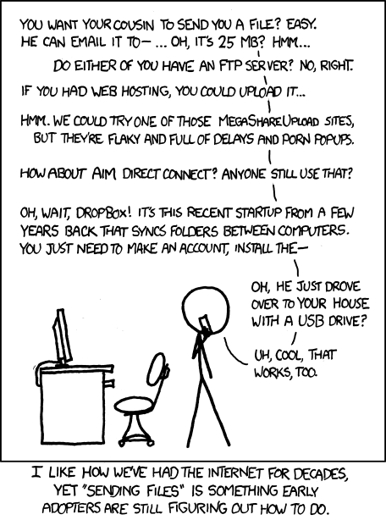
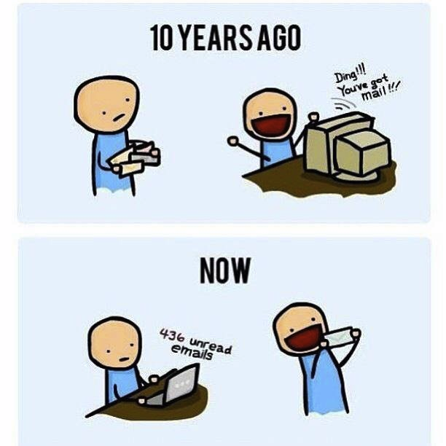
http://poofytoo.com/
25
http://xkcd.com/949/
Notes:
What is more exciting now for you, email or snail mail?

Slide 4
My Reading Notes
pp. 110 First e-games 1972 at Stanford [1]. Has Twitch viewership gone up since the start of the COVID pandemic?
pp. 111 What powers the cell phones and towers? “everyday tasks” not apparent from image.
pp. 113 Ann did not force people to complain.
pp. 114 Does Kantian analysis agree?
pp. 117 9% # transactions or $$? Wikipedia critics source from 2005, is quality still in question?
pp. 118 MOOC source from 2012, now?
pp. 122 Macedonian is nice addition to new edition
pp. 123 “may have” = weak conclusion. Who funded studies?
pp. 124 Easier consolidation of newspapers. Advertisers switching away from newspaper source from 2014.
pp. 126 Search engines link deeper than home page
pp. 127 Any US agencies employing this many people?
pp. 131 Adult bookstores lowering property values source?
pp. 135 “texted… images”
pp. 136 Stating people searching did not consent to material being blocked makes more sense.
pp. 138 sexting examples all from 2009?
pp. 140 College students still as likely? 2013 source
pp. 141 Do mobile plans still charge for text messages?
pp. 146 Hunter Moore convictions seem unrelated to “Anyone Up?” site.
pp. 153 See: http://en.wikipedia.org/wiki/Wikipedia:Citing_Wikipedia
pp. 154 Question 40 same as 46
Questions I liked: 17, 43
Interview nice update
Notes:
[1] Owen Good (19 October 2012). "Today is the 40th Anniversary of the World's First Known Video Gaming Tournament". Kotaku. Retrieved 1 August 2013

Slide 5
Group Quiz
Name two methods some governments use to control access to information.
A large company has a policy prohibiting employees from blogging about company products.
Does it violate the First Amendment? Why?
Name two possible reasons for the policy.
Is it reasonable? Why?
What does “URL” stand for and what is it?
Notes:
Censorship (religious, governmental, private). Adult authentication. Firewalls. Government owned media outlets (TV and radio stations, newspapers), private photocopier ownership illegal
First Amendment prohibits Congress from making laws limiting free speech, not private companies.
Uniform Resource Locator

Slide 6

Overview
Review
Assignment
Students Present
Notes:
But before that:
CPG Grey - This Video Will Make You Angry [Thought Germs] (7:25) – 2015-03-10
https://www.youtube.com/watch?v=rE3j_RHkqJc
Find better examples:
Cedric Gervais - Hashtag (Original Mix) (3:58)
https://www.youtube.com/watch?v=6OmBKd7X7EE
Dave Audé vs Luciana - You Only Talk In #HASHTAG (3:36)
http://www.youtube.com/watch?v=53wIN87lJn0

Slide 7
Assignment
Reading
Individual Presentations
Extra Credit – One page paper
Is WPI’s IT Acceptable Use Policy morally acceptable?
Work on your group project
1.23 Happiness!
1-3 scale with 1 = everyone getting their first pick
See full group project description on course website
Send Web Site URL before next class
Notes:
- Or review group project and individual presentation guidelines right now.
Possible One page paper:
Global intellectual property laws, friends or foes?

Slide 8
Overview
Review
Assignment
Students Present

Slide 9
When should children be plugged in?
Kayla Afonseca

Slide 10
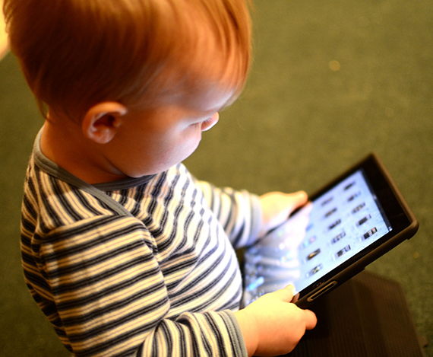
Recommended age?[1]
Kayla Afonseca
Under 18 Months; Video Chatting
18-24 Months; Educational programs with parents
2-5 Years old; Limited 1 hour of educational programs
6 and up; Parents set time limit
<Graphic as big as will fit>
Notes:
There is no recommended starting age rather just what technology should be used for based on age group.
Video chatting makes sense because communication with family is important, and distance should not prevent that
Educational programs like: Ms. Rachel, ABC games
Learning the alphabet, numbers, to read
Parents want more guidance in what technology should be allowed for children ages 6 and up
For 6 and up the content is more important than the time.
Researches are expecting parents to make sure that whatever the kids are on is beneficial and not mind numbing rather than focusing on the time limit.

Slide 11
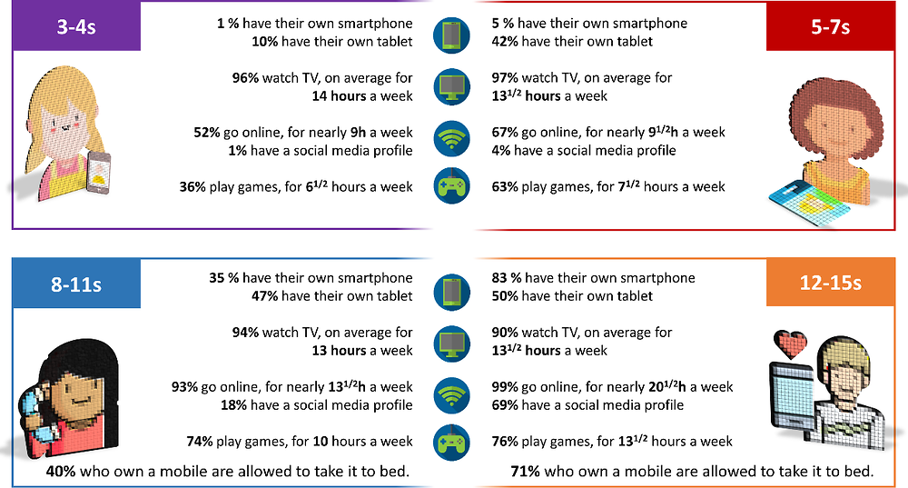
Negative affects of technology[2] & [3]
Kayla Afonseca
Shortened attention span
Lack of social skills
Relationship problems
Bullying
Dangers of the internet
<Graphic as big as will fit>
Notes:
Every site mentions that technology might shorten kids' attention span
Although I have noticed mine becoming shorten, I couldn’t find an actual study on it
No studies on how the attention span is shortened by technology use
They might lack social skills because it takes practice, and they are lacking it from use of technology
No studies just based on excessive use of the internet
They might no longer feel the need for relationships due to their device providing them with all the entertainment they need
same as social skills
They might be bullied on social media or video games
Restrictions on apps rather then limited screen time & bullying can happen in person
It is easier but unpreventable in any case
Strong relationships with the child is better then pure restrictions because if you are aware of the problem, you can help stop it
They might be prayed upon by older people & sites children should not have access too
Also if not monitored there is a lot of things children should not have access to on the internet
These are all might's no website gives concrete evidence for the first 3 and the last two can happen without technology
EXAMPLE “Technology caused a 5% decrease in children's attention spans”

Slide 12

Positive affects of technology[5]
Kayla Afonseca
Enhanced learning opportunities
Improved communication skills
Creativity and self expression
Enhanced problem-solving skills
Exposure to culture and news
Preparedness for the future
<Graphic as big as will fit>
Notes:
Technology is a great resource for a child’s development if it is used to help the child grow.
When technology is used to teach, or to create, or even to play games that challenge the brain it can help children’s development.
Technology can also increase a child’s exposure to news and cultures.
Lastly, it will help the child prepare for future uses with technology, whether that be in the work force or in later education.

Slide 13
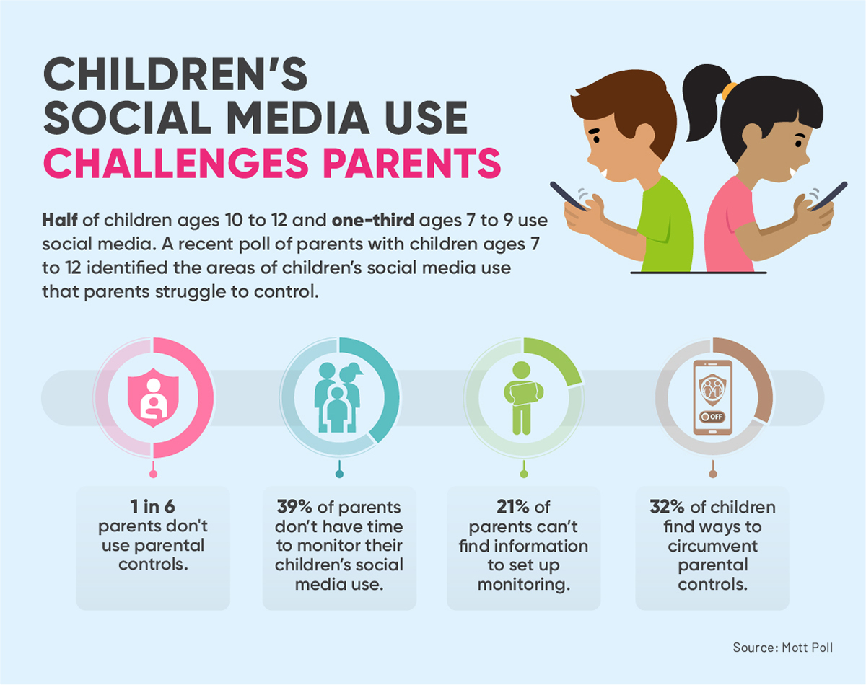
Conclusion[4]
Kayla Afonseca
After 3; opinionated
1hr screen time of educational content
Before 13; monitored usage
Restrict apps and limit time (2hrs)
After 13; usage with knowledge
No restrictions just knowledge(4hrs)
Its not about when its about what!
<Graphic as big as will fit>
Notes:
In conclusion the only wrong time to not allow technology use is before 18 months. Although I feel as if children should not be allowed technology that early. Screen time should be limited for all ages and the content should be regulated as well. The dangers of technology are reliant in its use not how many hours you spend on it. Parents should focus on teaching their kids internet safety and restricting what they use it for before the child is old enough to understand the dangers of the internet. It ultimately depends on the parents but based on research anymore then 4hrs of internet for entertainment purposes is too much.

Slide 14
References
Kayla Afonseca
[1] “Digital Guidelines: Promoting Healthy Technology Use for Children.” American Psychological Association, American Psychological Association, https://www.apa.org/topics/social-media-internet/technology-use-children#:~:text=The%20current%20recommendations%20advise%3A,and%20watch%20with%20their%20children.
[2] Erinfolami, Keyede. “6 Negative Impacts of Technology on Children (and What You Can Do).” MUO, 15 Oct. 2021, https://www.makeuseof.com/negative-impacts-of-technology-on-children/.
[3] The Impact of Technology on Children - Cerritos College. https://www.cerritos.edu/hr/_includes/docs/August_2021_The_Impact_of_Technology_on_Children_ua.pdf.
[4] Johnson, Allie. “Screen Time Recommendations by Age.” All About Vision, All About Vision, 9 Mar. 2022, https://www.allaboutvision.com/conditions/refractive-errors/screen-time-by-age/.
[5] “Sam.” Mrs. Myers' Learning Lab, https://mrsmyersrr.com/news/9-positive-effects-technology-child-development.

Slide 15
Social Media Algorithms: Uncovering Their Harmful Impact on Users
Alexsandra Antoski
Notes:
Hello guys my name is Sandi or Alexsandra whichever one you prefer
Today I’m going to be talking about social media algorithms and why I believe they’re used at the expense of the user
So who here would say they regularly use social media? This includes Youtube, Reddit, Facebook, Tiktok and so on
(respond to hand raises) yeah me too, and I’m not here to tell you what to do. Rather I want to talk about why these algorithms are damaging
Another question who has ever read a privacy agreement for the apps that they’re using?
(response for hands up): that’s good so you probably know where I’m going with this and if you haven’t that’s okay because I’m sure they’re counting on that
(no hands up): that’s okay, I’m sure these companies count on the fact that no one reads any terms of conditions for anything
Now I’m sure most if not all of us understand the objective of these algorithms is to maintain user engagement
With that being said, my first issue with this is in regards to privacy
1:00
(switch slides)

Slide 16
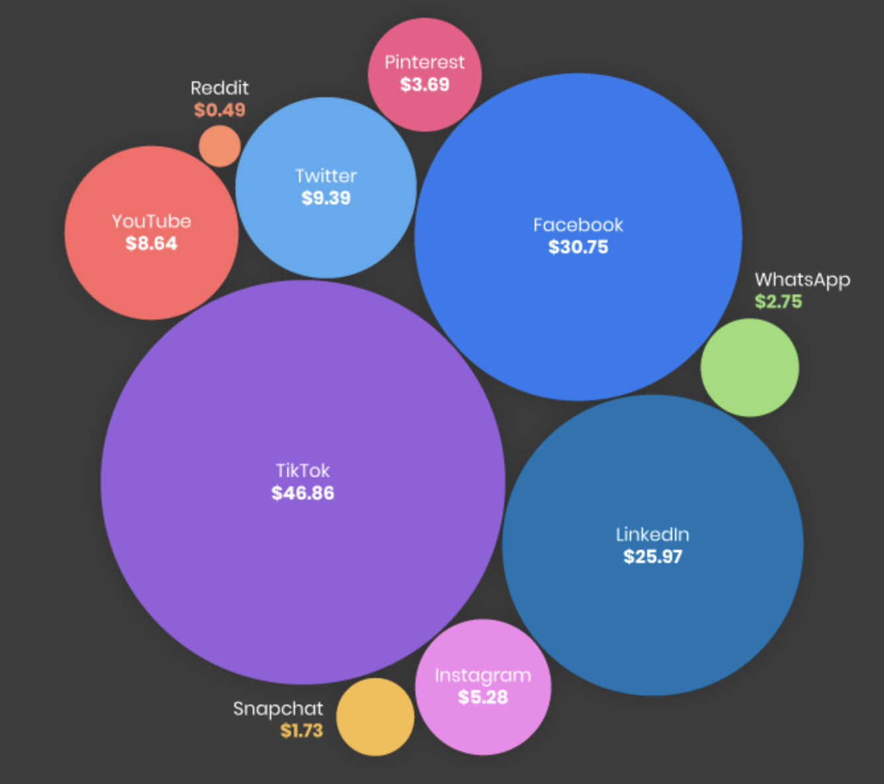
Privacy
Alexasndra Antoski
Information sold to third parties
Facebook was the first social media platform to do this [1]
Monetization of the user
Only way for companies to remain successful
Information is gathered to understand you better
Screen activity, location, type of phone, service provider, etc.
Building a profile of you to keep track of your interests plus activity
[2]
Notes:
1:00
In the chapter we read for today we touched on how all of the information given by our app activity is used to fit you in with similar demographics
In chapter 5 of the book we will talk about privacy and how an individual’s information can be obtained and used so I won’t spend a lot of time talking about that since we all know it’s for money anyways
The book describes privacy as a “zone of inaccessibility” that surrounds a person.
For example when you lock the door to your bedroom, you are creating a zone where no one can access or bother you
Here this sense of privacy is the same, you’re sitting at your desk or in bed or couch and you’re scrolling well no one should be looking over your shoulder and marking everything you do
Yet apps are constantly tracking your activity down to the time spent on one post
I don’t think is a surprise to any one, how else would all the content you see daily be any good?
I’ve read the privacy statements from Facebook, Instagram and TikTok
All of these privacy statements state something similar that your information will (air quotes) “help advertisers and other partners measure the effectiveness and distribution of their ads and services”
At least they’re being transparent.
(points to slide) The image here was created by getting the annual revenue of a platform and dividing that by the number of users
Each user is farmed for information to get an idea of a box you fit into for ads but even better they are getting an understand of how you tick and what you need to get back on the app
If you’re not worried about third parties getting information to show you ads, you should worry about the way they understand how you are
Although we do agree to the terms and conditions of these platforms willingly, that doesn’t mean that they should use this information as an object to sell as well as a tool to get in our heads and understand what will pull us back into our phone
As said by an ex worker of google, “If you are not paying for the product, you are the product.”
3:15
(next slide: filtering)

Slide 17
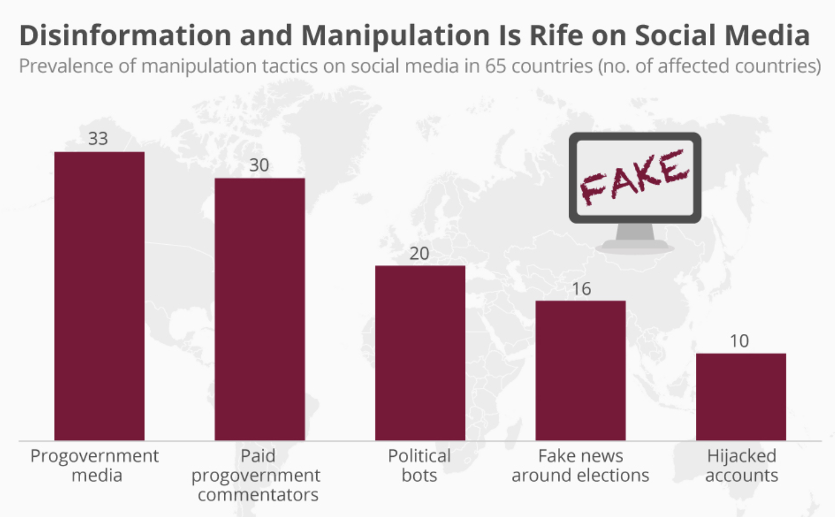
Information Filtering
Alexsandra Antoski
Echo-chambers [3]
Media is fixated to your narrative
Generated by location and engagement
Misinformation
Est. 72% of Americans get their news from the internet/social media [4]
Think of the posts released at the beginning of COVID
Manipulation of Information
Social media can be used to channel false information out
Your reaction is what they rely on
<Graphic as big as will fit>
[5]
Notes:
3:15
Now that they have the information you gave them to get your entertainment, they are able to filter information/posts to fit your taste
This creates two problems, the spread of misinformation and users consumed in their own echo chamber
In short, echo chambers are created from the user’s engagement
Although the algorithm is working correctly by only showing you the content you want to see
It also makes it possible that you are only getting one side of the picture rather than diverse perspectives of that same image
For example this becomes a problem with political issues, left or right leaning users slowly only see their perspective
This creates an experience for the user that “everyone” agrees with them
Now when everyone thinks they’re on the majority side, any touch with the other side can become a situation of “wow I can’t believe you think that” or some form of tension/aggression since supposably “everyone” is on the same page
Considering we spend so much time on our phones, it can be damaging to constantly having your ideals reinforced without hearing another perspective
And I’m with you if you think well I know X is right/wrong so I don’t care if I don’t see the other side, but in a way these apps are creating a division in society by creating these pockets for people to fall into
The other way that this filtering of information is bad is when misinformation comes around
(points to slide) here this graph shows you the number of countries affected by misinformation or manipulation of information from june 2016 to may 2017
Many of us here have come across one post that just didn’t make sense and upon a few minutes or less you figure out that the information is not credible or true
Unfortunately not everyone has that intuition and as of 2019, 45% of the world’s population were active social media users
So now naturally the algorithm is working but it unintentionally creates division amongst people and is now a tool to spread misinformation
5:30

Slide 18
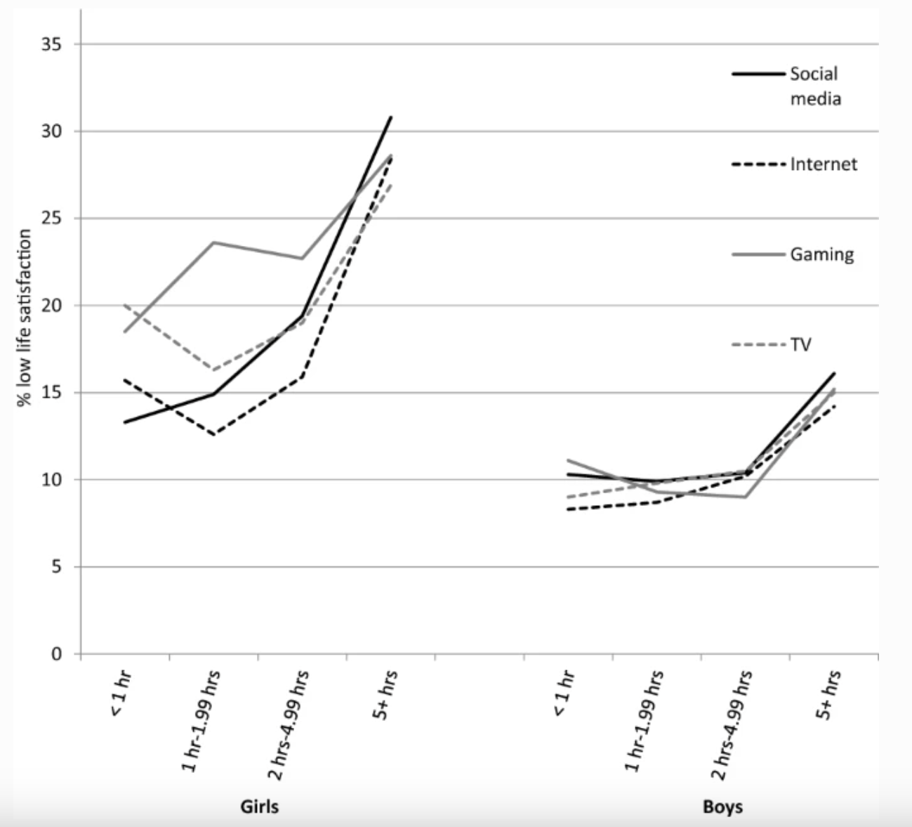
well-being
Alexsandra Antoski
Addiction
Created to keep you engaged
Boosts of serotonin from a notifications
Increase in screen time --> decrease in attentiveness to your needs
Mental State
An increase in social media consumption can lead to [6]:
Low work performance
Less healthy social relationships
Anxiety/Depression
Sleep problems
<Graphic as big as will fit>
[7]
Notes:
(next slide: well-being)
(5:30)
The last thing I’m going to talk about is user well-being
Rather than telling you that more screen time correlates with depression or anxiety, because the studies are there and the chapter we read today touches on that
I want to focus on the point of user engagement, they want you on your phone as much as possible
We read about internet addiction in today’s chapter
The algorithm must be enjoyable, entertaining, captivating, and ultimately addicting
No one is a stranger to addiction in life, we all know someone who must fight it: shopping, partying, gambling, but I bet we don’t question our screen time
This is how we’re connected to others, this is how we get funny videos, this is the first thing I look at in the morning
Because it is not in itself “bad” it can’t be harmful right?
That is the harm in it, they use your information to find all the buttons and levers to adjust to find a way to keep you hooked
Like pushing irrelevant notifications to you to remind you it’s there or feeding into your emotions when your on it giving you something sad then good, good again, informative, something that angers you and so on
It plays on your emotion, that is the only way it can even become addicting.
(point to slide) here is a graph from a study done in the UK consisting of over 11 thousand participants from the ages of 13 to 18
I want to point out although the peak of the girls versus boys is double in height, this would still mean more than 1 in 10 boys have low life satisfaction, their overall differences could be explained from girls being exposed to society’s body standards or boys being told to be “a man about it”
Naturally the more time you put into your phone, the less time you’re putting into your studies, the people around you, or the tasks you should do but simply don’t put first
Your information is used to understand you, your views are the focal point of your feed, and now you are trapped in vulnerable to the addiction you didn’t ask for
There is a good chance that if I haven’t held your attention through my presentation you checked your phone or maybe no one did. Either way thank you for listening are there any questions?
8:00

Slide 19
References
Alexsandra Antoski
[1]: Meta, Facebook Unveils Facebook Ads, (Meta, 11/6/07) https://about.fb.com/news/2007/11/facebook-unveils-facebook-ads/ (3/21/23)
[2] Image slide 1: Daniel Ku, Which Social Media Platforms Make The Most Revenue? (PostBeyond, August 2021) https://www.postbeyond.com/blog/revenue-per-social-media-user/ (3/21/23)
[3]: Terren, L. & Borge, R, Echo Chambers on Social Media: A Systematic Review of the Literature (Array, May 2021) https://doi.org/10.12840/ISSN.2255-4165.028
[4] Nic Newman with Richard Fletcher, Antonis Kalogeropoulos, and Rasmus Kleis Nielsen, Reuters Institute Digital News Report 2019 (Reuters Institute for the Study of Journalism, 2019) https://reutersinstitute.politics.ox.ac.uk/sites/default/files/inline-files/DNR_2019_FINAL.pdf (page 118)
[5] Image slide 2: Felix Richter, Disinformation and Manipulation Is Rife on Social Media, (Statista, November 2017) https://www.statista.com/chart/11831/manipulation-tactics-on-social-media/ (3/21/23)
[6] Yalin Sun, Yan Zhang, A review of theories and models applied in studies of social media addiction and implications for future research (Elsevier Ltd, March 2021) https://doi.org/10.1016/j.addbeh.2020.106699.
[7] Image slide 3: Twenge, J.M., Farley, E. Not all screen time is created equal: associations with mental health vary by activity and gender (Springer Nature Switzerland AG, 2021). https://doi.org/10.1007/s00127-020-01906-9 (3/21/23)
Number of social media users: Savci, M., Tekin, A. & Elhai, J.D. Prediction of problematic social media use (PSU) using machine learning approaches (Springer Nature Switzerland AG, 2022). https://doi.org/10.1007/s12144-020-00794-1
Instagram privacy: Meta, Data Policy (Meta, January 4 2022) https://help.instagram.com/155833707900388 (3/21/23)
Quote from ex Google worker: The Social Dilema (2020)

Slide 20
Saved it on my Phone
Raman Kaushik

Slide 21
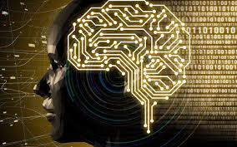
Technology vs Cognitive Process
Raman Kaushik
How does technology affect memory or cognitive skills?
Artificial aspects of tech can have real-world consequences
Excessive internet usage leads to IUDs. [1]
IUDs lead to structural changes in brain regions associated with attentional control.
Notes:
The strong correlations between neural processes implicated in both online and offline social interactions further illustrate how “artificial” aspects of social media platforms (e.g., the quantitative metrics of popularity, such as likes of posted content and explicit friendship requests/acceptance) can have “real-world” social consequences
Thus, by presenting an artificial environment that so closely interacts with regular sociality, online social networks have the potential to interfere with a broad range of cognitive processes involved in social comparisons, self-evaluations, and even mental health
Although there is clearly a broad array of processes through which the internet could impact core cognitive processes
a vast sum of research has shown strong links between excessive usage of the internet and IUDs
For instance, a 2017 review [27] identified structural changes or deficits in brain regions associated with attentional control, reward processing and motivation in those with IUDs compared to healthy controls.

Slide 22
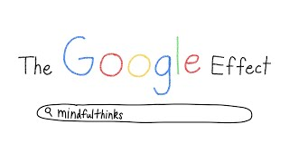
The Google Effect - Dependency
Raman Kaushik
Internet is an external memory system.
What’s more important: where the information is found or the information?
Results show people forget items they think will be available later and remember those which won’t. [2]
Human memory adapts to the changing norms of computing tech.
Notes:
Internet has become an external memory system that is primed by the need to acquire information.
Our research then tested whether, once information has been accessed, our internal encoding is increased for where the information is to be found rather than for the information itself.
In experiment 2, we tested whether people remembered information that they expected to have later access to—as they might with information they could look up online
those who believed that the computer erased what they typed had the best recall, omnibus F(3, 56) = 2.80, P < 0.05 [Erase M = 0.31, SD = 0.04, and Erase Remember M = 0.29, SD = 0.07, paired comparisons of erased conditions not significant (ns)] compared with those who believed the computer would be their memory source
Participants apparently did not make the effort to remember when they thought they could later look up the trivia statements they had read.
Experiment 4 was conducted to see if people would recall where to find information more than the information itself.
The social form of information storage is also reflected in the findings that people forget items they think will be available externally and remember items they think will not be available
These results suggest that processes of human memory are adapting to the advent of new computing and communication technology.

Slide 23
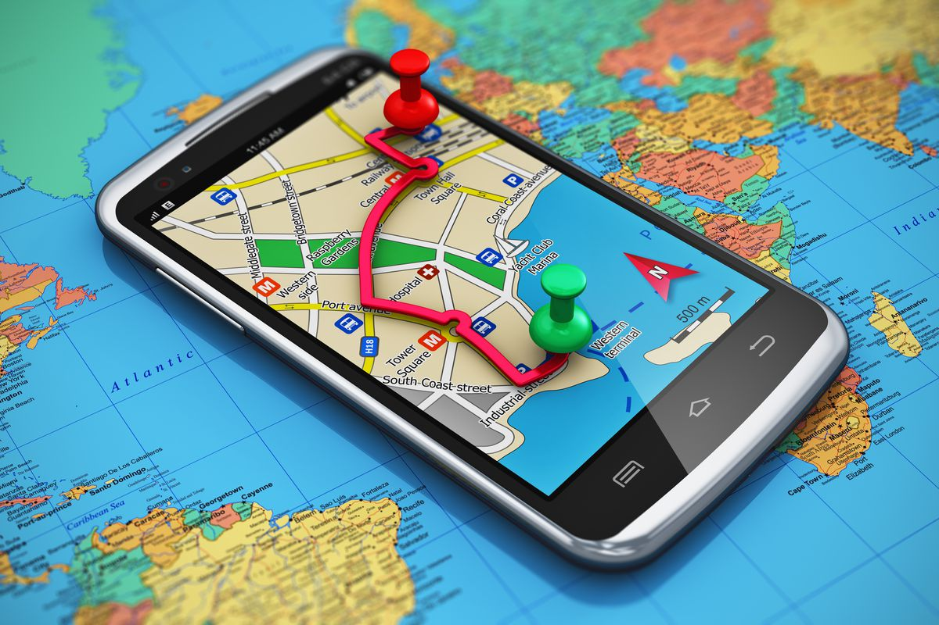
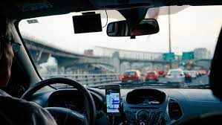
The GPS Experiment - Memory
Raman Kaushik
Spatial Memory: Self-Guided vs GPS
Greater dependency on GPS associates to weaker sense of direction. [3]
Longitudal Study supports the hypothesis
Notes:
Test if people with greater lifetime GPS experience have worse spatial memory when they are required to navigate without GPS.
Results show significant relationship between SBSOD and sense of dependence on GPS and subsequently greater sense of dependence on GPS was associated with lower subjective sense of direction.
People dependent on GPS use less spatial memory strategies i.e, using landmarks as guides than self guided drivers.
Additional study where 13 drivers came back 3 years later showed an increase in GPS dependency and weaker spatial memory skills.

Slide 24
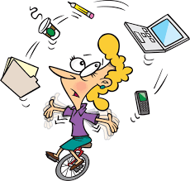
The Age of Interruption
Raman Kaushik
Technology’s help in regularizing multi-tasking.
Multi-Tasking vs Continuous Partial Attention. [4]
CPA is a compulsive diffusion of attention from main task.
Ethicality of CPA?
Notes:
Counter-Argument – Technology has normalized multi-tasking skills making work more efficient.
Rebuttal:
Difference between Continuous partial attention vs Multitasking
Multi-tasking follows a desire to finish tasks more efficiently and with productivity
CPA is the desire to be connected with the Internet
CPA is a compulsive diffusion of attention from main task.
Antiethical to deep thought as attention is scattered and people have no time to reflect and contemplate

Slide 25
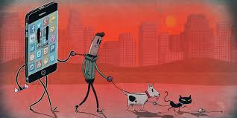
Mitigate The Digital Amnesia
Raman Kaushik
-71% of parents can’t remember children phone numbers and 87% numbers of child’s school. [5]
Mitigate by:
Keep Device out of sight before bed.
Reduce dependency on GPS
Reflect and Contemplate on tasks you did.
Exercise your memory
[6]
Notes:
Kaspersky Lab conducted a survey of 6,000 mobile phone users, it found that 71 per cent of them can’t remember the phone numbers of their children and 87 per cent can’t recollect the phone numbers of their children’s schools.
Ensure that you do not carry your mobile phone to bed at night. Keep any such devices out of your sight before sleeping.
Instead of using GPS everywhere you go, print directions or use strategies such as utilizing landmarks
Reflect and contemplate all the tasks you did.
Exercise your memory

Slide 26
References
Raman Kaushik
[1] Firth, J. A., Torous, J., & Firth, J. (2020, December 17). Exploring the impact of internet use on memory and attention processes. International journal of environmental research and public health. Retrieved March 23, 2023, from https://www.ncbi.nlm.nih.gov/pmc/articles/PMC7766706/
[2] Sparrow, B. (2011, July 11). Google effects on memory: Cognitive consequences of ... - science | AAAS. Google Effects on Memory: Cognitive Consequences of Having Information at Our Fingertips. Retrieved March 23, 2023, from https://www.science.org/doi/10.1126/science.1207745
[3] Dahmani, L., & Bohbot, V. D. (2020, April 14). Habitual use of GPS negatively impacts spatial memory during self-guided navigation. Retrieved March 23, 2023, from https://www.nature.com/articles/s41598-020-62877-0
[4] Rose, E. (2010). Continuous Partial Attention: Reconsidering the Role of Online Learning in the Age of Interruption. Educational Technology, 50(4), 41–46. http://www.jstor.org/stable/44429840
[5] DTE Staff. (2018, September 18). Digital amnesia: Excessive use of mobile phone could lead to memory loss. Down To Earth. Retrieved March 23, 2023, from https://www.downtoearth.org.in/news/health/digital-amnesia-excessive-use-of-mobile-phone-could-lead-to-memory-loss-61660
[6] Loic, L. (2022, January 31). Is technology ruining your memory? how to overcome digital amnesia. MUO. Retrieved March 23, 2023, from https://www.makeuseof.com/technology-ruining-memory-overcome-digital-amnesia/

Slide 27
Class 4 The End
Keith A. Pray
socialimps.keithpray.net
Notes:
Use remaining time for group project questions and/or review group assignment slides.
This is the end. Any slides beyond this point are for answering questions that may arise but not needed in the main talk. Some slides may also be unfinished and are not needed but kept just in case.

Slide 28
what works well REmotely With Zoom
Turn your camera on
Sign in with First and Last Name
Stay muted unless you are going to speak
To speak use the raise your hand feature
To answer yes/no questions use the “yes” ”no” buttons
Wait until the end of student presentations to ask questions
Write them down so you don’t forget

