Slide 1
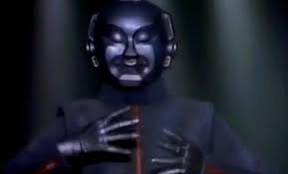
Class 11
Work
Keith A. Pray
socialimps.keithpray.net
Notes:
Styx - Mr. Roboto (1983) (5:34)
https://www.youtube.com/watch?v=uc6f_2nPSX8
Ask about Automation paper:
What did people choose to automate
Share 1 main reason

Slide 2
Remote With Zoom
Sign in with First and Last Name
Stay muted unless you are going to speak
To speak use the raise your hand feature
To answer yes/no questions use the “yes” ”no” buttons
Turn your camera on
Wait until the end of student presentations to ask questions
  Write them down so you don’t forget

Slide 3
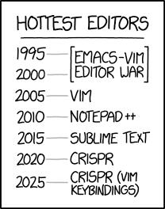
Overview
Review
Assignment
Students Present
https://www.xkcd.com/1823/
Notes:
Full circle.
CRISPR: Clustered Regularly Interspaced Short Palindromic Repeats
Allows permanent modification of genes within organisms.
Published 2017-04-12 according to https://www.explainxkcd.com/wiki/index.php/List_of_all_comics_(1501-2000)
Kickstarter Charter
https://www.kickstarter.com/charter?ref=about_subnav

Slide 4
Overview
Review
Assignment
Students Present
C lustered
R egularly
I nterspaced
S hort
P alindromic
R epeats
Permanent gene modification
https://www.xkcd.com/1823/
Notes:
Full circle.
CRISPR: Clustered Regularly Interspaced Short Palindromic Repeats
Allows permanent modification of genes within organisms.
Published 2017-04-12 according to https://www.explainxkcd.com/wiki/index.php/List_of_all_comics_(1501-2000)
Kickstarter Charter
https://www.kickstarter.com/charter?ref=about_subnav

Slide 5
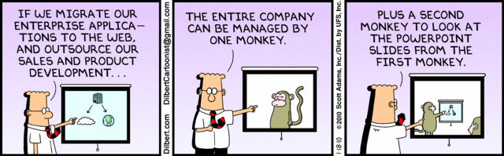
Let’s Look At One way to handle a Decrease In Jobs
Notes:
Poll class:
Expected salary range upon graduation? Min, Max? Put on board.
Assume 40 hour work week.
How many people would work:
32 hours for 0.8 * Max? Put on board.
24 hours for 0.6 * Max? Put on board.
…continue until Min is reached.

Slide 6
Group Quiz
List 2 ways IT can lead to organizational change.
List 4 ways a Video Game Producer may protect its IP and what specific IP each protects.
List a computing technology that can be used to protect an individual’s privacy.
List a computing technology that can be used to intrude upon an individual’s privacy.
Notes:
Could split into groups of 4-5 for this.
Fill time with Work Discussion on Course Web Site

Slide 7
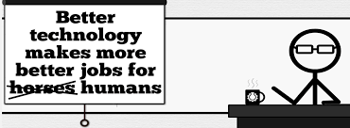

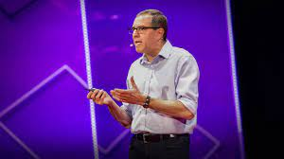
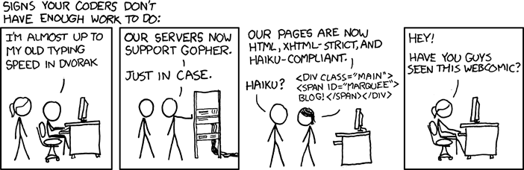
Overview
Review
Assignment
Students Present
http://xkcd.com/554/
Notes:
David Autor
Will automation take away all our jobs? (18:27) (2016)
https://www.ted.com/talks/david_autor_will_automation_take_away_all_our_jobs/transcript?language=en
TEDxXambridge, 2016-12-19
Review Group Assignment Details.
Or first watch video: depends on student presentations, no thunder stealing.
CGP Grey
Humans Need Not Apply (15:00) – 2014-08-13
http://www.youtube.com/watch?v=7Pq-S557XQU
Last access 2016-04-22
These 3D printed homes can be constructed for $4,000 (3:00 – 2018-04-02)
http://www.businessinsider.com/3d-printed-homes-constructed-icon-new-story-tech-charity-4000-dollars-2018-3
https://www.youtube.com/watch?v=SvM7jFZGAec (1:28)
Last access 2018-04-22
Look at:
BBC Intelligent Machines
http://www.bbc.com/news/technology-33978561
BBC Likelihood of robot taking your job
http://www.bbc.com/news/technology-34066941

Slide 8
Assignment Reminders
Finish all reading
Finish Automation Paper
Group Web Sites and Presentations
If your group is not presenting next class prepare 3 questions for each group that is presenting by visiting their web sites.
  See Group Project Details

Slide 9
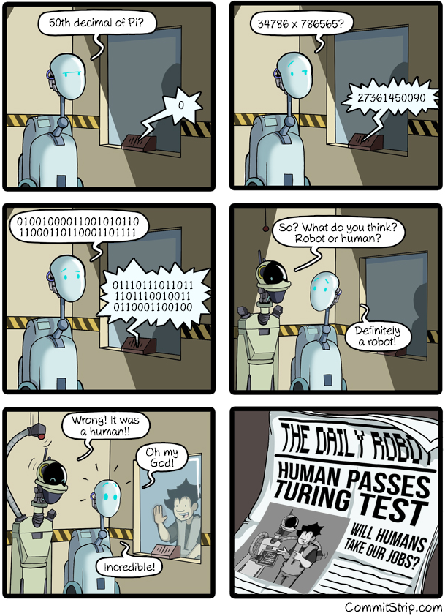
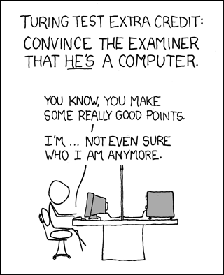
Overview
Review
Assignment
Students Present
https://xkcd.com/329/
Notes:
http://www.commitstrip.com/en/2016/04/14/meanwhile-in-a-parallel-universe-3/ (2016-04-14)
https://xkcd.com/329/ (2007-10-15)

Slide 10
Entertainment Ticket Platforms Shaky Ground
Witt Wang
Notes:
Hello everyone, my name is Witt. Introduce a topic which is a combination of computing technology and economics. It is called ….

Slide 11
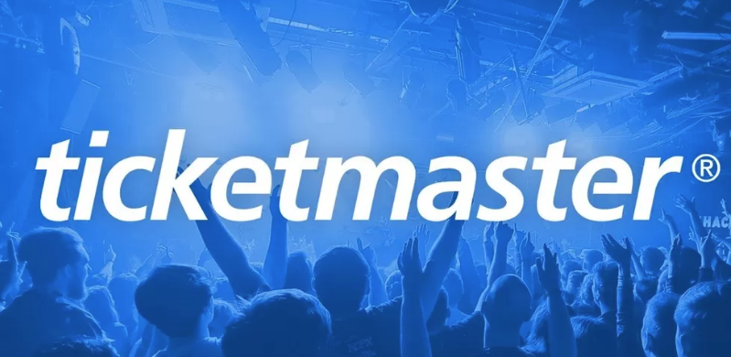

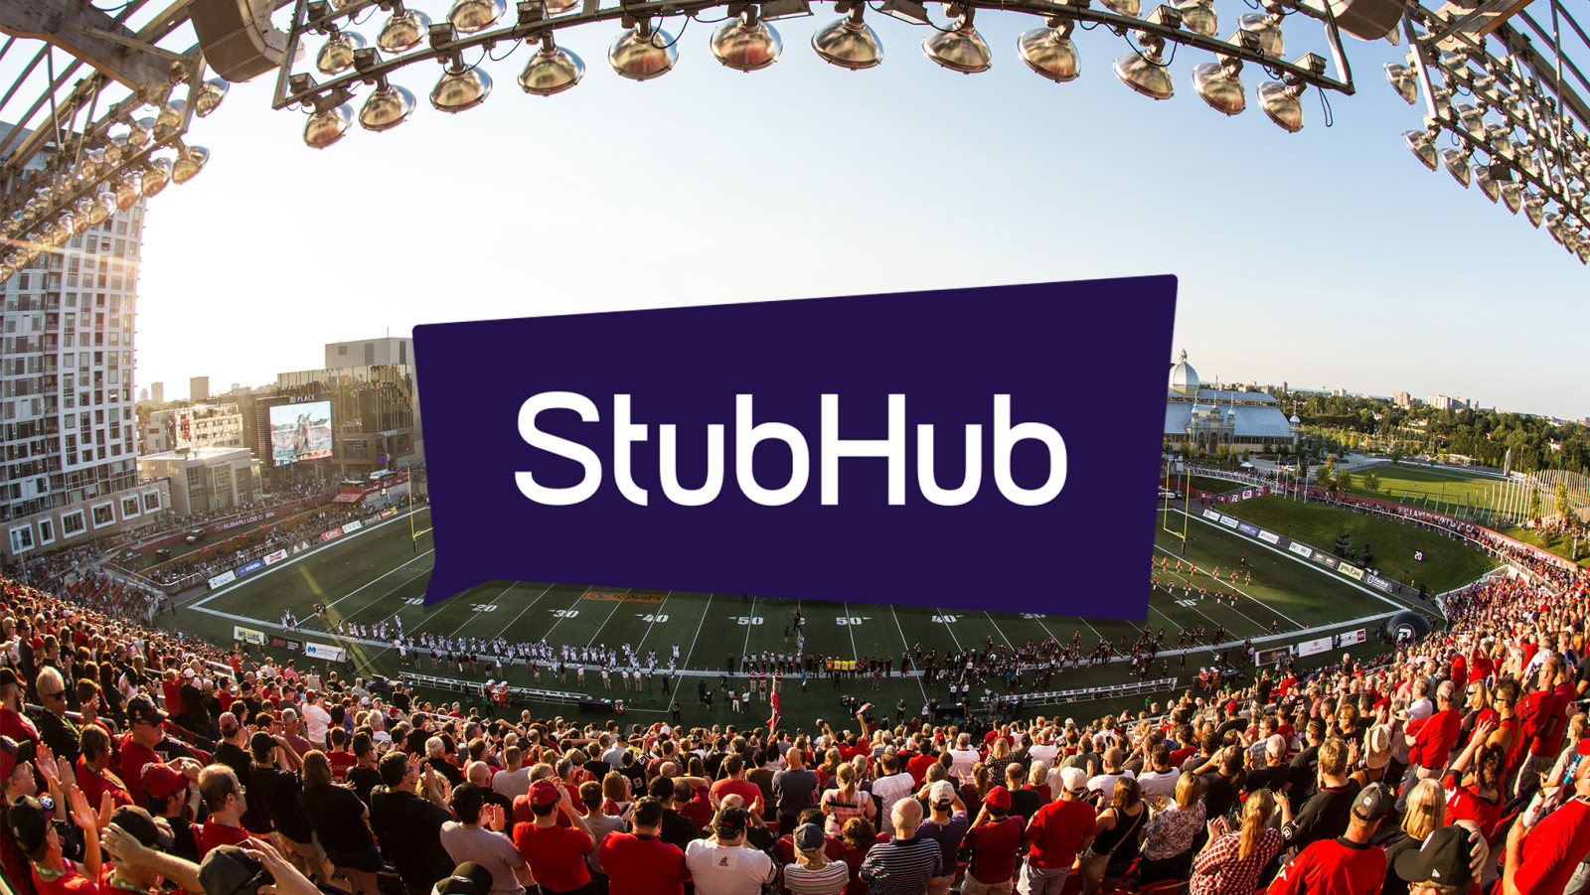

CONCLUSION
Witt Wang
Online entertainment ticket platforms have led to chaos in the entertainment industry market.
Four major online ticket platform in United States[7][8][9][10]
Notes:
Firstly, point out my conclusion that ……. Four major ticket platforms which are prevailing in United States, TM, LN, SG, SH. TM and LN mostly used for first-hand ticket sale, SG and SH used for resale

Slide 12
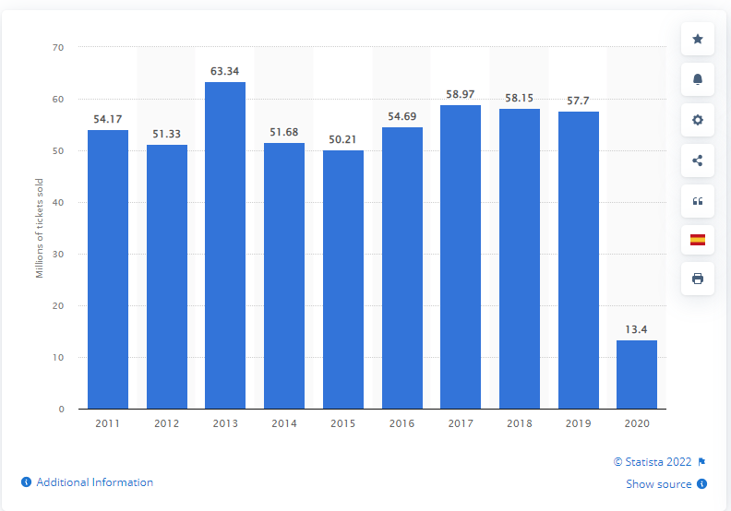
Background
Witt Wang
> 50 million of music tour ticket sold[1]
Estimated $12.44 billion revenue for Sports in 2022[2].
Not fully affected by Covid-19
Bar chart of ticket sold between 2011 and 2020[1]
Notes:
Based on the statistic shown on the graph, more than 50 millions of ticket sold every yr between 2011 and 2019.
The revenue in sport events is projected to reach $12.44 billions. Showing the prospect of huge income of entertainment industry.
Even if the epidemic in 2020, entertainment events still popular. Graph points out 13.4 million of ticket sold in 2020.

Slide 13
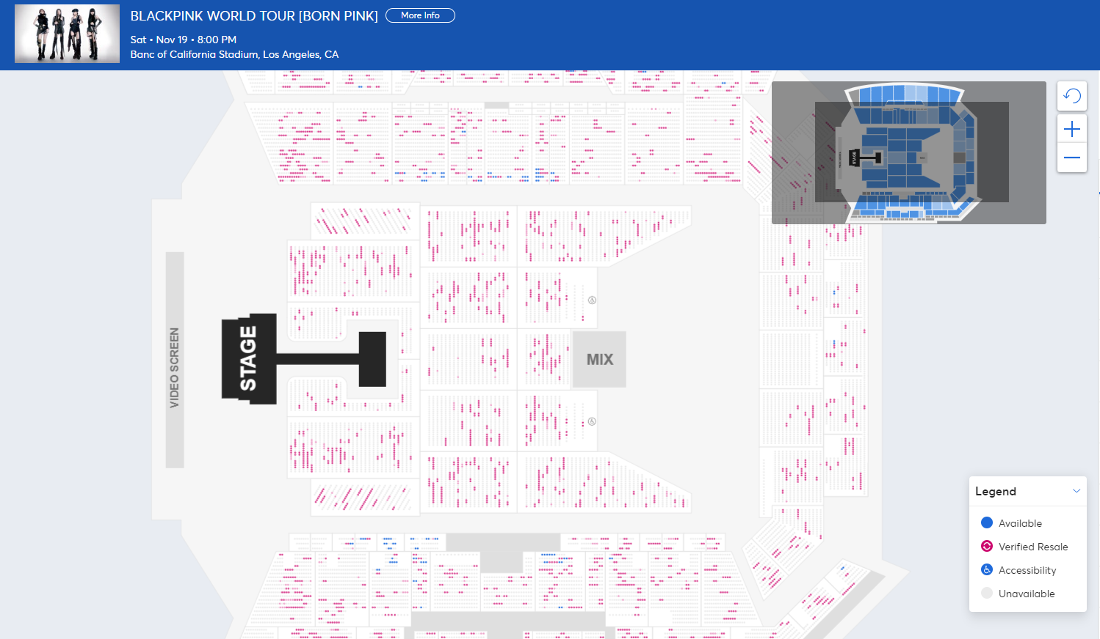
Increase in scalpers
Witt Wang
Use of E-ticket
Serious Resale phenomenon
  Red dots are “verified resale”
  Nearly 55% of the total sale[3]
Event price disruption
  Price becomes higher
  Cannot reflect the popularity of artists correctly
BLACKPINK world tour seat map on Ticketmaster[3]
Notes:
The online ticket platform causes increase in scalpers. To transfer and sell tickets easily, platform uses e-ticket rather than physical tk. Cause the resale phenomenon serious.
Graph on the right is BLACKPINK world tour this year in LA. Red dots are “verified resale”, why I use quote, ironic resale is mainly by scalpers and fans. Nearly 55% of total.
How many people actually buy the ticket for love rather than reselling to gain profit? Lead to chaos in entertainment industry market
Furthermore, disrupt event price, too many scalpers, difficult to get a low price tk, also, cannot reflect the popularity of artists. Fake phenomenon in website, high resale doesn’t mean popular. Scenario on ticket platform is a market oriented illusion. People who buy tickets online like gamble.

Slide 14
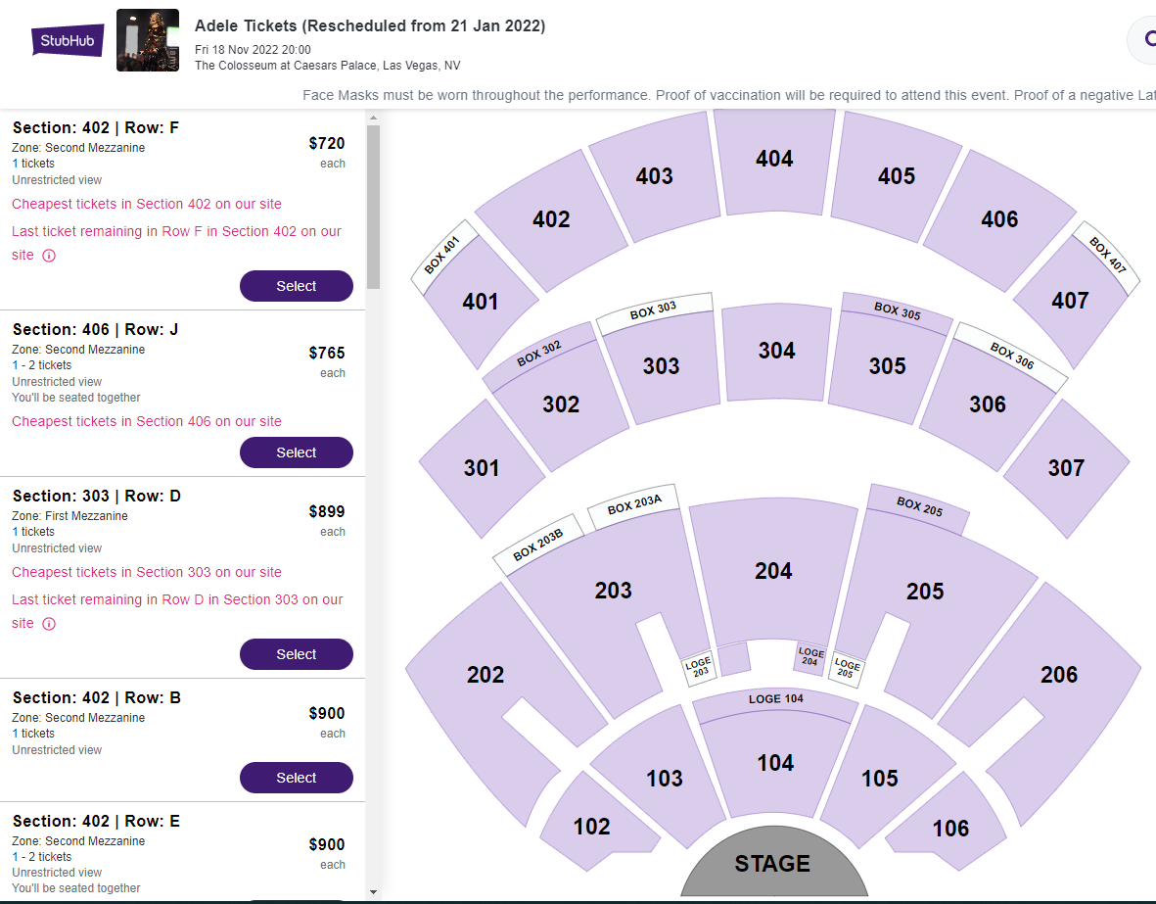
Increase in scalpers
Witt Wang
Affect the profits of consumers and professional ticket sellers
  For sellers
    Increase of ticket volume
    Increase of congener competitors
      76% more ticket sellers in 2017 than in 2016[6]
  For consumers
    Fans become scalpers
    Spend more on tickets
      Official Price(Sec 402): $190
      Actual Price: $720+20%*720
    11% rise in ticket prices(2019-2021), 14% rise in North America [4].
Adele’s Concert Resale tickets seat map on Stubhub[11]
Notes:
Increase in scalpers affect both profits of consumer and seller. Increase in resale ticket influence seller’s plan, congener competitor also increases. Potential unemployment of professional sellers. 76% more ticket sellers in 2017.
For consumers, fans become scalpers to make money, entertainment ticket becomes a tool for hype. Result is people spend more on ticket. Graph on the right is the reselling price about Adele, using fourth floor sec402 as an example, official price 190, actual price is 720 plus 20% service fee, 4 times higher than original price, crazy phenomenon. Based on research, although covid-19, ticket price went up 11% between 2021 and 2019. 11% seems small, but there is a COVID in 2019, number of entertainment event hold decreased.

Slide 15
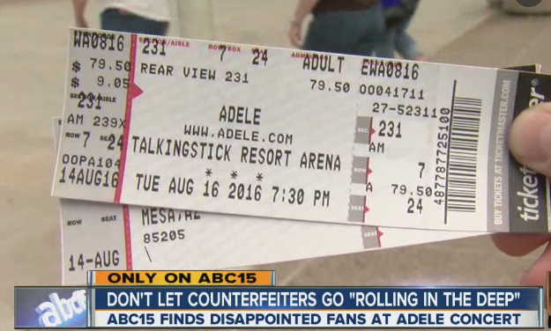
Chaotic platform management
Witt Wang
Doubts about authenticity of tickets
  More than 5 million people receive “fake” tickets every year[5]
Fuzzy qualification of online sellers
  Just upload a simple screenshoot
No comprehensive after-sales service
  Slow response
Fake Adele concert ticket sample on TV[13]
Notes:
Online ticket platform has chaotic platform management. People skeptical about platform, doubt about the authenticity of ticket. Right graph shows the fake ticket, not easy to distinguish by human-eye. More than 5 million people receive fake tk every yr. Platform not responsible for the authenticity of ticket.
Besides, fuzzy qualification of online sellers, I used seatgeek, upload a simple screenshot of ticket, I will be a seller. Platform not consider the existence and reality of ticket. Easy to cause, buyer cannot receive tickets/ fake tickets, so that lose wealth. Also, platform no comprehensive after-sales service. When customer discover transaction in problem, response is very slow, no urgent solution to deal with it. People lose opportunity to go to shows.

Slide 16
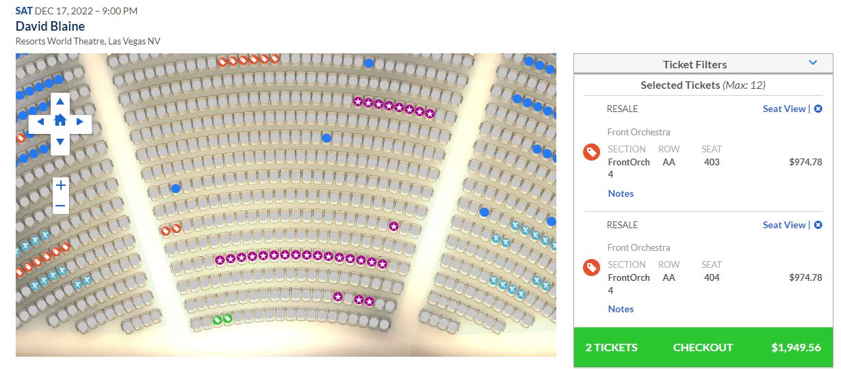
Locking tickets
Witt Wang
Why ticket is so expensive?
  Limited seats?
  Soo many rich people?
Why locking?
  The illusion of scarcity
  Resale for higher price
    Resale price is 4 times of official price
  Encourage membership
    Platform membership
    FansClub membership
    Credit card membership
David Blaine magic show seatmap (At the beginning of public sale)[12]
Notes:
Online ticket platforms lock tickets especially front row, cause an illusion of scarcity. People complain about the extreme high price of front-row tk, why so expensive? Seats too limited? Or So many rich people?
Locking tickets is to create an illusion of scarcity, so that raise the price. On the graph, at the beginning of public sale, few front-row seats are available. The resale price from platform is 4 times higher than original. Huge profits behind attract them to limit tickets in public sale.
Besides, platform want to promote membership mode. The actual meaning of membership is depositing money. For example, consumers deposit 50 dollars for a platform membership can enter the sale queue 1 hr prior.
FansClub membership also popular, it is a common interest between event company and platform. Spend more on fanclub, can buy ticket earlier.
A prevailing mode which emerged in current 3-4 yrs called credit card membership, use certain credit card to check out in order to unlock certain position on seat map. A united profit between bank and ticket platform.

Slide 17
References
Witt Wang
[1] Götting, M.C. “Number of music tour tickets sold worldwide 2011-2020”, Statista, 8 June. 2022, https://www.statista.com/statistics/380115/number-of-music-tour-tickets-sold-worldwide/
[2] “Event tickets- Segment Data Analysis & Forecast”, Statista, Aug. 2022, https://www.statista.com/outlook/dmo/eservices/event-tickets/sport-events/united-states
[3] “BLACKPINK World Tour [Born Pink]”, Ticketmaster, Sept.2022, https://www.ticketmaster.com/blackpink-world-tour-born-pink-los-angeles-california-11-19-2022/event/0A005D21E2E046FD
[4] Pymnts. “Demand, Inflation Drive Up Live Entertainment Ticket Prices”, PYMNTS, 24 Apr. 2022, https://www.pymnts.com/economy/2022/demand-inflation-drive-up-live-entertainment-ticket-prices/
[5] Cyprus, J. “More Than 5 Million Fake Tickets are Sold Every Year. Here’s How to Protect Yourself”, 8 Dec. 2017, https://www.digitalmusicnews.com/2017/12/08/fake-tickets-scam-protect/
[6] Tompkins, T. “An analysis of ticket pricing in the primary and secondary concert marketplace”, 2019 https://www.semanticscholar.org/paper/An-analysis-of-ticket-pricing-in-the-primary-and-Tompkins/250b0dac6661197110fb5eade8be39dd273c7115
[7] “Ticketmaster fined $10m for business 'intrusions”, BBC News, 31 Dec. 2020, https://www.bbc.com/news/entertainment-arts-55496891
[8] “Seatgeek, Your ticket to sports, concerts & more”, Seatgeek, https://seatgeek.com/
[9] “StubHub becomes official ticket partner at TD place”, Ottawa Redblacks, 15 Nov. 2016, https://www.ottawaredblacks.com/2016/11/15/stubhub-becomes-official-ticket-partner-at-td-place/
[10] Injection, M. “Live Nation CEO Expects "Shows At Scale Next Summer“, 10 Nov. 2020, https://metalinjection.net/its-just-business/live-nation-ceo-expects-shows-at-scale-next-summer
[11] ”Adele Tickets(Rescheduled from 21 Jan 2022)”, Stubhub, Feb. 2022, https://www.stubhub.com/adele-las-vegas-tickets-1-21-2022/event/105081779/
[12] “David Blaine in SPADES”, AXS, Feb. 2022, https://www.axs.com/events/434914/david-blaine-tickets?skin=resortsworld
[13] “Unlucky fans get fake tickets to Adele concert in Phoenix”, ABC 15 Arizona, 17 Aug. 2016, https://www.youtube.com/watch?v=g696cE004Eo
Notes:
Any Questions?

Slide 18
Big TECH
Free market Or Oligopoly?
Big Tech is an Oligopoly, and Antirust Measures are Necessary
Presented by Edward Smith
Notes:
Hello all; I’m Edward Smith, and this is my presentation on Big Tech.
Over the next few slides, I hope to convince you that:
Big Tech is an oligopoly
Why antitrust measures are necessary.

Slide 19
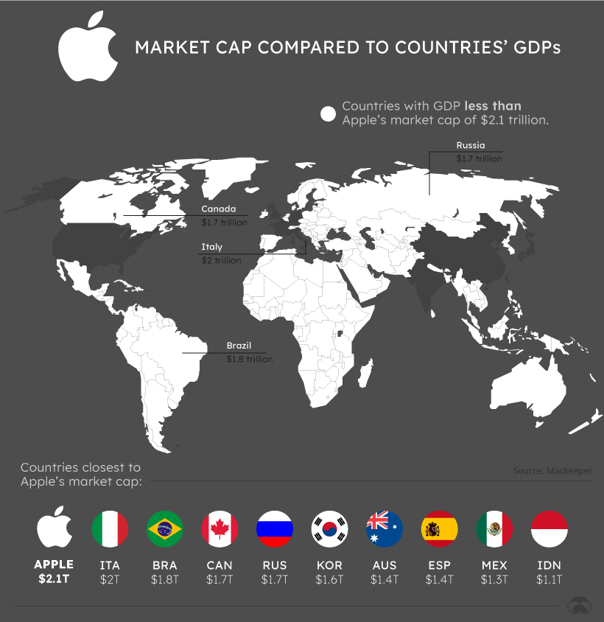
BIG tech’s influence in THE MODERN AGE
Edward Smith
What is “Big Tech”? [1]
  Major dominators of the information industry
    Growing digital ubiquity
    2021: >50% of Internet Traffic [20]
  Innovation & design
Influences
  Influences on world economy
    E.g. Apple v. 96% of countries [18]
  Influences on world politics
    Internet as private political forums
Notes:
Before we examine Big Tech, let's first address what that means
BIG TECH
Blanket term for large corporate entities in technology and software [1]
AND it has growing digital ubiquity
In 2021, Internet Traffic from Big Tech services took up more than 50% of total network traffic [19]
AND are financers of the world's cutting-edge technology [1]
E.G.
Amazon’s Natural Language Processors
Google’s Advanced Query Search
BIG TECH BEARS INFLUENCE
Over world economy
APPLE’s market capitalization valued larger than 96% of world countries’ GDPs [17]
Over geopolitical theater
Even now, Internet has become a private political forum
Images Used: [a]
Sources: [1, 17, 29]

Slide 20
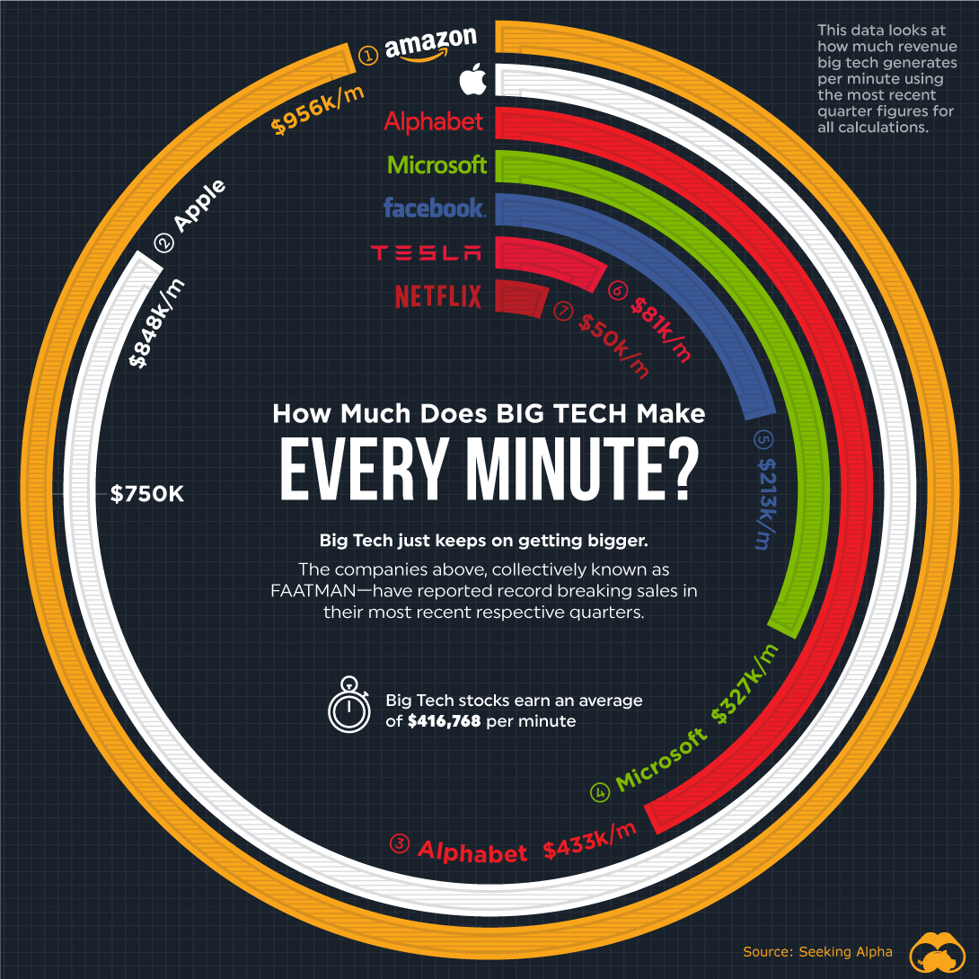
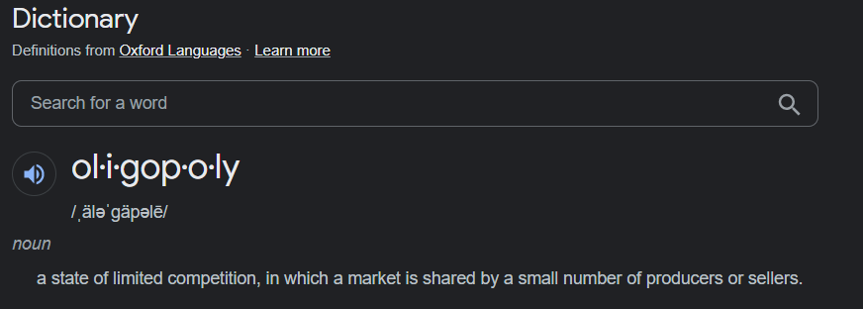
Antitrust measures are necessary
Edward Smith
Big Tech is indeed an oligopoly
  Exhibits anti-competitive behavior
  Acts with relative impunity
Notes:
In short, Big Tech is *indeed* an oligopoly.
But what is an oligopoly you may ask?
An oligopoly is much like a *Mono*poly except the singular elite entity is substituted for a small group
Please regard the image
Note: every minute
Amazon, 44K short of $1million per minute
According to Bureau of Labor Statistics, 2022: average gross salary is roughly below 54K ($53,490 per year )
That’s roughly 8.4 cents/minute
If they worked every minute of every day
8.4 cents vs. 956K, to put the financial capacity in perspective
Since Big Tech has
Exhibited evident anti-competitive behavior
Acts with relative impunity in the face of legal, ethical, and user boundaries
I hold that antitrust measures are necessary
To maintain a free, fair, competitive, and user-focused digital space
Images Used: [b, c]

Slide 21
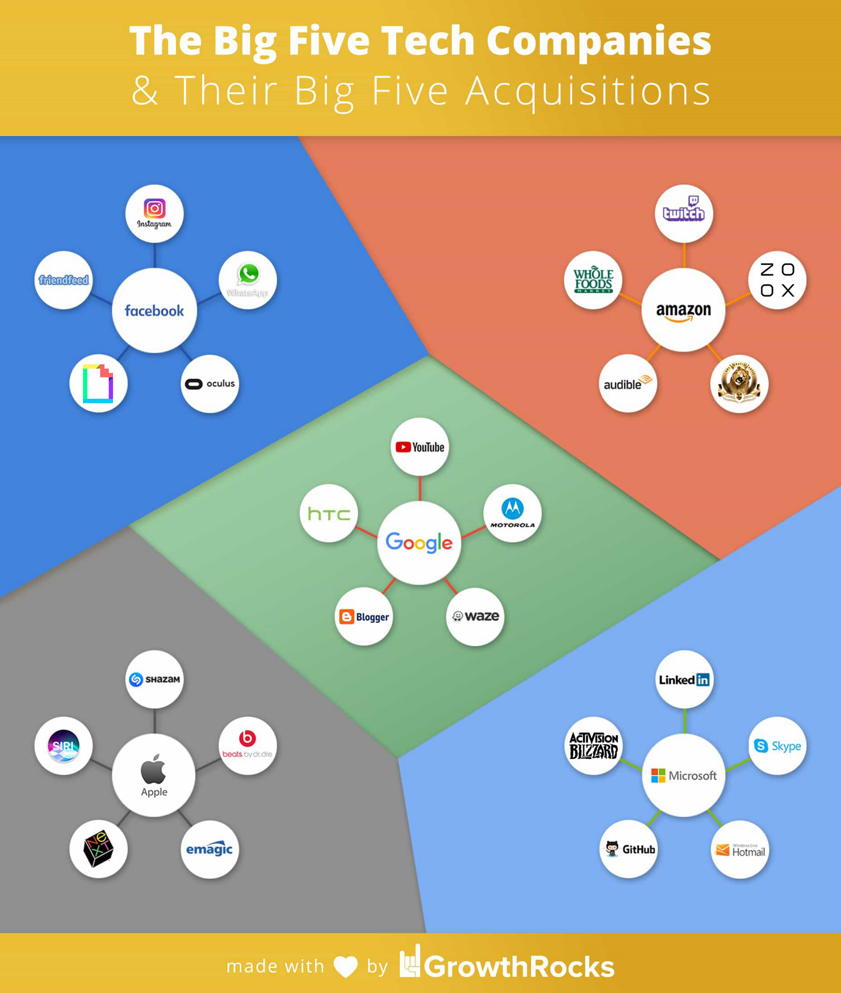
Big tech behaves contrary to fairness
Edward Smith
Fair Trade Law & The USFTC [5, 14]
  Regulator of private corporations
Big Tech and Competition/Neutrality
  Exploitation of market data [6]
  Platforming [12]
Big Tech and User Access
  Influence user access of information [10, 11]
    2021: 38 states sue Google over search manipulations [5]
  Facebook, Twitter, Tik-Tok & Youtube’s targeted news/ads/content [11]
Notes:
FOR A BIT OF BACKGROUND
In the United States, Fair Trade is governed by the Federal Trade Commission or "FTC“
Dealt with large predatory corporations like:
Rockefeller's Standard Oil
J.P. Morgan's U.S. Steel
Vanderbilt's Railroad Monopolies
House Judiciary’s Subcommittee on Antitrust, Commercial, and Administrative Law investigation conducted in 2019
Dubbed “Online Platforms and Market Power”
Compares big tech to the oil barons and railroad tycoons of yesteryear [5, 14]
Big Tech behaves contrary to the fairness standards enforced by the FTC
Issues over seller COMPETITITION
European Trade Commission [1]
Investigated for Big Tech’s usage of seller data to price displace competition
Latest probe in 2021
FOR EXAMPLE
Amazon & Diapers.com [6]
Amazon attempted to purchase Diapers.com, but was refused
Amazon dropped prices, losing $200 million, but bankrupting Diapers.com and forcing them to sell
You may look to the chart
Larger acquisitions in the industry
NEUTRALITY has also raised issues regarding competition [12]
For example, Twitter-alternative Parler exploded
Followed intense partisan censorship on digital platforms
Apple iOS and Google's Android OS delisted Parler from devices
Amazon's AWS cloud hosting terminated Parler [12]
Question of coordinated effort, still in suite
Concerns raised over USER ACCESS to info
Google, Bing, and Yahoo have been fined for search filtering [10, 11]
In 2021, 38 states sued Google over search manipulation [5]
Facebook, Twitter, Tik-Tok, & Youtube’s curated content filters screening unfavorable and contrary content from users [12]
Obscures other POVs from user feeds to create feedback cycles
Images Used: [d]
Sources: [1, 5, 6, 10, 11, 12, 14]

Slide 22
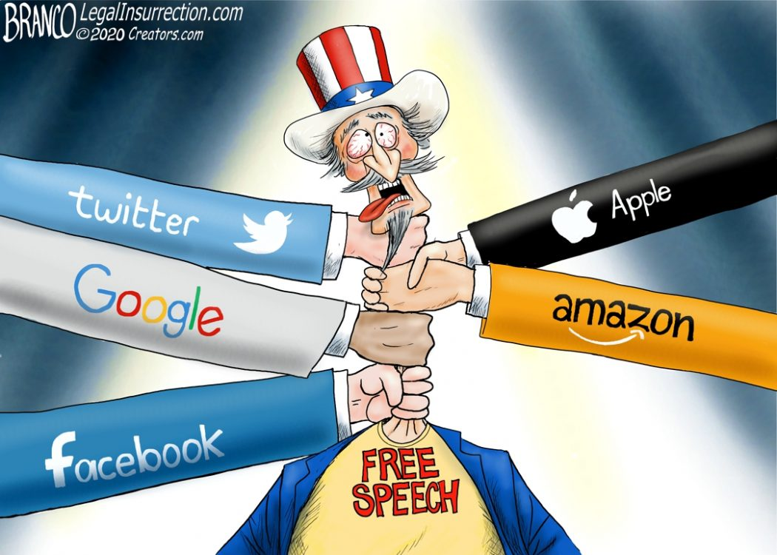
Big tech ACTs with impunity
Edward Smith
Big Tech and IP Law
  Amazon & 3rd Party Sellers
  Multiple occasions of argued product theft [15, 16]
  Legal attrition via PTAB [18]
    2021: Big Tech >80% of petitioners
    2020: 84% of cases dropped
Harvest, usage, and sale of users’ personal data [2]
  Meta (formerly Facebook) Lawsuit [4, 5, 11]
  Apple sale of user geodata [1]
Arbitrary Platform Censorship [3]
  “The Algorithm”
Notes:
Additionally, Big Tech has acted with relative impunity
REGARDING IP DISPUTES
Amazon Marketplace & Amazon Basics particularly guilty, for example:
Case of Peak Design’s Everyday Sling [15]
Peak Design sold high-quality chest sling bags under “Everyday Sling”
Amazon Basic’s “Everyday Sling” sold at half the price with an identical design
When called out, Peak Design was de-platformed for several months
Case of the Pirate Tripods and Amazon [16]
Pirate Tripods made it to #1 seller (@ $3.5+ million)
Amazon Basics tripod w/ identical design & cheaper price
Pirate Tripods de-platformed after expressing grievances
Both taken to PTAB
PTAB (Patent Trial and Appeal Board) [18]
Suites handed down against Big Tech are appealed to PTAB
However
Cases can be appealed endlessly
Becomes a game of financial chicken
Plaintiffs acquiesce due to lack of finance
2021: Big Tech entities made up >80% of PTAB appeals
2020: 84% of appeals lead to dropped cases against Big Tech
REGARDING HARVEST, USAGE, AND SALE OF DATA
FTC sued Meta [5]
Around the sale of user data to 3rd party ad and polling agencies
October 2020: DOJ filed lawsuit against Google [5]
For unlawfully maintaining monopolies over its search services
COVID-19 Pandemic
Apple sold its user’s geodata [1]
For contact tracing programs in cities around the world without user consent
Used by law enforcement in San Francisco, Portland, New York, and others [1]
Arbitrary Censorship [3]
Since Twitter and Facebook’s lack of published standards
& no written or published examples of acceptable/policeable content
Censorship can be dismissed with “The Algorithm” (Twitter, Facebook, Google)
Dodges criticism behind an opaque excuse
These harsh instances of censorship captured in the caricature of Political Cartoonist A. F. Branco
Images Used: [e]
Sources: [1, 2, 3, 4, 5, 12, 15, 16, 18]

Slide 23
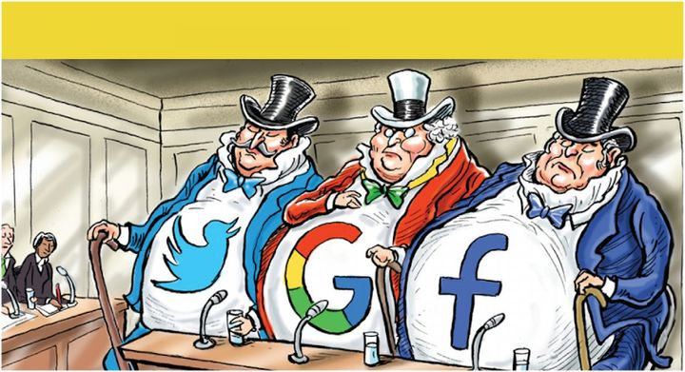
Re-levelling the playing field
Edward Smith
Antitrust Measures are necessary VIA:
Reform & Accountability
  Modernize Anti-Trust legislation for the digital age [4, 5, 6, 9, 17]
    Address platform ubiquity & PTAB
  Establish Executive Liability [3, 7, 13]
  Require company transparency [4, 5]
Law
  Address data privacy concerns
  Amend Section 5 of FTC Act [8, 9]
Notes:
IN CONCLUSION: ANTITRUST MEASURES ARE NECESSARY TO:
RELEVEL THE PLAYING FIELD AND
DECONSTRUCT THE ABUSES OF BIG TECH
_______________________________________________________________
This can be accomplished by way of:
REFORM & ACCOUNTABILITY
We can bring Big Tech to curb beneath the law, à la picture courtesy of Pol. Cartoonist Chad Crowe
We must modernize the current framework of anti-trust legislation to address
The software bases and digital infrastructure dominated by Big Tech
On some platforms, Big Tech dominates more than 90% (like Google’s webservices) [5]
Address PTAB concerns
We must establish executive liability
Reform SECTION 230 of the Communications Decency Act (1996) [13]
Which currently affords liability protection to content platforms
Add concessions:
Strip liability protections from executives, platforms, etc. for censorship & policy violations
Require transparent standards of online conduct criteria
Address algorithms employed in broad-strokes censorship
Must insist on transparency
Require publishing of algorithms for moderation
Require clear policies and examples for acceptable content and policeable content
LAW
The passage of Data Privacy laws, giving the user ultimate ownership over their data
Allowing user freedom and choice with how their data is collected, stored, and handled
Amend Section 5 of FTC Act [8, 9]
Give litigation efforts more bases
Don’t have to produce written agreements on collusions,
Relying on data-driven correlations & market history
ALL OF THESE ARE AIMED AT
RECOVERING A STANDARD OF FAIRNESS
PROMOTING & REGULATING NEUTRALITY
GIVING US THE MEANS TO HOLD BIG TECH ACCOUNTABLE
THANK YOU, ANY QUESTIONS OR CLARIFICATIONS?
Images Used: [f]
Sources: [3, 4, 5, 6, 7, 8, 9, 13, 17]
___________________________________________________________________________
ARGUMENTS, COUNTERS, QUESTIONS
PARLER QUESTIONS
Arguing justifications, it still ignored Due Process Under the Law
Ignores federal and local jurisdiction, approvals, investigative and punitive procedure {Judge, Jury, & Executioner}
5th U.S. Circuit Court of Appeals law prohibiting large social media companies from banning users’ posts based on their political viewpoints will go into effect after a federal appeals court found in favor of the law
https://www.reuters.com/legal/us-appeals-court-rules-against-big-techs-ability-regulate-online-speech-2022-09-16/
All speech ought to be treated equally under law
Will likely be appealed to the SCOTUS
PRIVATE SALE/COLLECTION OF METADATA
Arguing legal authority
Still reeks of privacy violation
Hidden behind written opt-out policies (Facebook, Twitter, Apple Maps)
One might argue this are intentionally obscured
A state of emergency should not suspend laws nor violate individual rights

Slide 24
References
Edward Smith
[1] Chander, Sarah, “How Big Tech Maintains its Dominance” (EDRi, 2021), https://edri.org/our-work/how-big-tech-maintains-its-dominance/ (25 Sept. 2022)
[2] Verdegem, Pieter, “Dismantling AI Capitalism: The Commons as an Alternative to the Power Concentration of Big Tech” (AI and Society, 2022) https://www.proquest.com/docview/2652031571/F3761EC525C5422CPQ/9?accountid=29120 (24 Sept. 2022).
[3] Frederick, Kara, “Combating Big Tech’s Totalitarianism: A Road Map” (Heritage Foundation, 2022), https://www.heritage.org/technology/report/combating-big-techs-totalitarianism-road-map (24 Sept. 2022).
[4] Wörsdörfer, Manuel, “Big Tech and Antitrust: An Ordoliberal Analysis” (Philosophy & Technology, 2022), https://www.proquest.com/docview/2690020068/F3761EC525C5422CPQ/11?accountid=29120 (24 Sept. 2022).
[5] Copenhaver, Sophie, “Big Tech is Why I Have (Anti)Trust Issues” (St. John’s Law Review, 2022), https://www.proquest.com/docview/2706458057/F3761EC525C5422CPQ/16?accountid=29120 (24 Sept. 2022).
[6] Wörsdörfer, Manuel, “What Happened to ‘Big Tech’ and Antitrust? And How to Fix Them!” (Philosophy of Management, 2022), https://www.proquest.com/docview/2713873457/B99ECBCAE74B4EBAPQ/1?accountid=29120 (24 Sept. 2022).
[7] Alford, Roger P.; “The Bipartisan Consensus on Big Tech”, (Emory Law Journal, 2022), https://www.proquest.com/docview/2675250859/B99ECBCAE74B4EBAPQ/8?accountid=29120 (24 Sept. 2022).
[8] Mazumdar, Aneesa, “Algorithmic Collusion: Reviving Section 5 of the FTC Act” (Columbia Law Review, 2022), https://www.proquest.com/docview/2659306122/3A9CB67DD32843F6PQ/7?accountid=29120 (24 Sept. 2022).
[9] McGinnis, John O.; Sun, Linda; “Unifying Antitrust Enforcement for the Digital Age” (Washington and Lee Law Review, 2021), https://www.proquest.com/docview/2545664265/3A9CB67DD32843F6PQ/11?accountid=29120 (24 Sept. 2022).
[10] Freeman, Wilson C.; Sykes, Jay B.; “Antitrust and ‘Big Tech’” (Congressional Research Service, 2021), https://www.everycrsreport.com/files/20190911_R45910_22245eac08d6a4d384893cefac6ce8b396a0c5bf.pdf (25 Sept. 2022).
Notes:
<speaker notes>

Slide 25
References
Edward Smith
[11] Muhammad, Zia, “Study Reveals How Social Media Algorithms Create Echo Chambers” (Digital Information World, 2020), https://www.digitalinformationworld.com/2020/06/study-reveals-how-social-media-algorithms-create-echo-chambers.html (1 Oct. 2022).
[12] Hart, Robert, “Parler Sues Amazon Again in Wake of Deplatforming” (Forbers, 2021), https://www.forbes.com/sites/roberthart/2021/03/03/parler-sues-amazon-again-in-wake-of-deplatforming/?sh=2e360e777251 (1 Oct. 2022).
[13] EFF, “Section 230 of the Communications Decency Act” (Electronic Frontier Foundation, 2022), https://www.eff.org/issues/cda230 (1 Oct. 2022).
[14] US House Committee on Antitrust, Commercial, and Administrative Law, “Online Platforms and Market Power, Part 1: The Free and Diverse Press” (House Committee on the Judiciary, 2019) https://judiciary.house.gov/calendar/eventsingle.aspx?EventID=2260 (1 Oct. 2022).
[15] Campbell, Ian Carlos, “Peak Design Congratulates Amazon for Copying its Signature Sling Bag so Well” (The Verge, 2021), https://www.theverge.com/2021/3/3/22311574/peak-design-video-amazon-copy-everyday-sling-bag (1 Oct. 2022).
[16] Fowler, Kate, “Why Was This Amazon Tripod Company Banned? Owner Alleges Products Were Copied” (HITC, 2021), https://www.hitc.com/en-gb/2020/12/24/amazon-tripod-company-banned/ (1 Oct. 2022).
[17] Wallach, Omri, “The World’s Tech Giants, Compared to the Size of Economies” (Visual Capitalist, 2021), https://www.visualcapitalist.com/the-tech-giants-worth-compared-economies-countries/ (1 Oct. 2022).
[18] “PTAB Trial Statistics FY20 End of Year Outcome Roundup” (USPTO, 2020), https://www.uspto.gov/sites/default/files/documents/ptab_aia_fy2020_roundup.pdf (1 Oct. 2022).
[19] Fitri, Afiq “Big Tech Now Accounts for More Than Half of Global Internet Traffic” (Tech Monitor, 2022), https://techmonitor.ai/technology/networks/big-tech-accounts-for-over-half-of-global-internet-traffic (1 Oct. 2022).
Notes:
<speaker notes>

Slide 26
Image references
Edward Smith
[a] Mackeeper, “The World’s Tech Giants, Compared to the Size of Economies” (Visual Capitalist, 2021) https://www.visualcapitalist.com/the-tech-giants-worth-compared-economies-countries/ (1 Oct. 2022).
[b] Ali, Aran, “How Much Does Big Tech Make Every Minute?” (Visual Capitalist, 2021), https://www.visualcapitalist.com/how-much-does-big-tech-make-every-minute/ (24 Sept. 2022).
[c] Image sampled from Google’s results for the search query of “oligopoly”.
[d] Lekkas, Nicholas, “GAFAM: The Big Five Tech Companies Facts” (FAAMG) (Growth Rocks, 2022), https://growthrocks.com/blog/big-five-tech-companies-acquisitions/ (24 Sept. 2022)
[e] Branco, A.F.; “Hang Em’ High-Tech” (Comically Incorrect, 2021), https://comicallyincorrect.com/a-f-branco-cartoon-hang-em-high-tech/ (24 Sept. 2022)
[f] Crowe, Chad, “Who’s Afraid of the Frightful Five?” (The Hedgehog Review, 2018) https://hedgehogreview.com/issues/the-human-and-the-digital/articles/whos-afraid-of-the-frightful-five (24 Sept 2022)
Notes:
<speaker notes>

Slide 27
Will I have a job?
Jai Patel
Notes:
This is my presentation on the rise of AI/Robotics and its effect on the job market, specifically relating to all of us.

Slide 28
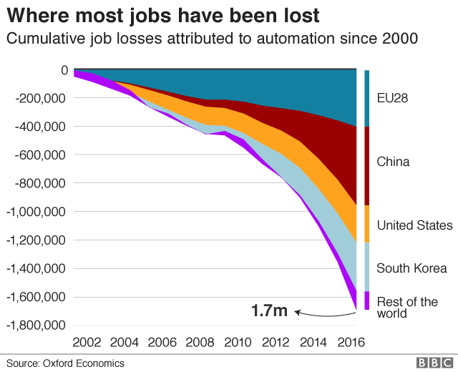
AUTOMATION
Jai Patel
“Making an apparatus/system operate automatically” [1]
Hardware
  Mechanical Devices
Software
  AI, ML, NLP
Hardware + Software -> Robotics
1.7 million jobs lost globally due to automation since 2000 [2]
Notes:
Automation is the fundamental piece of Robotics and AI.
Automation is the process of making an apparatus or system operate automatically.
As you can see in the graph, since 2000, 1.7 million jobs have been lost all over the world due to automation. The downwards exponential curve demonstrates the fast prominence automation has on us today.
Automation can take many forms.
Hardware automation -> Mechanical devices such as pulleys, supply chain tools, etc.
Software automation -> AI makes intelligent decisions, machine learning to train how to make these decisions, natural language processing understands human language to input instructions
With these hardware and software automation strategies, they can be combined into robotics which is taking over the job market.

Slide 29
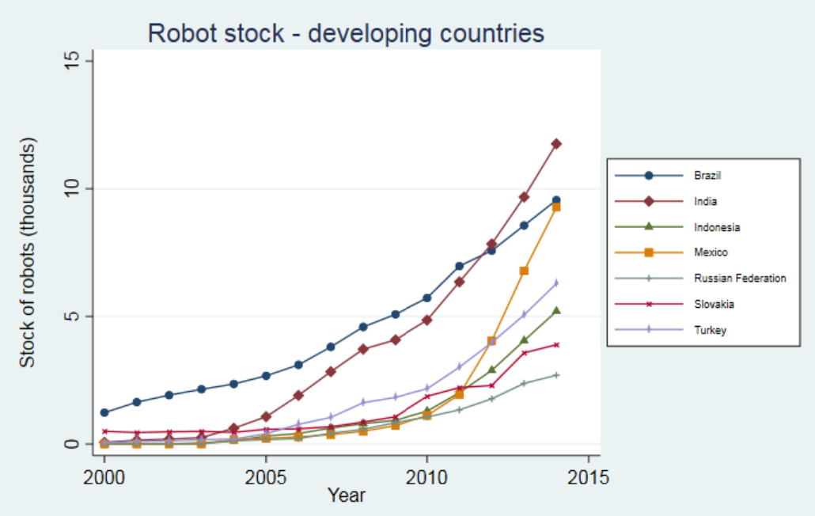
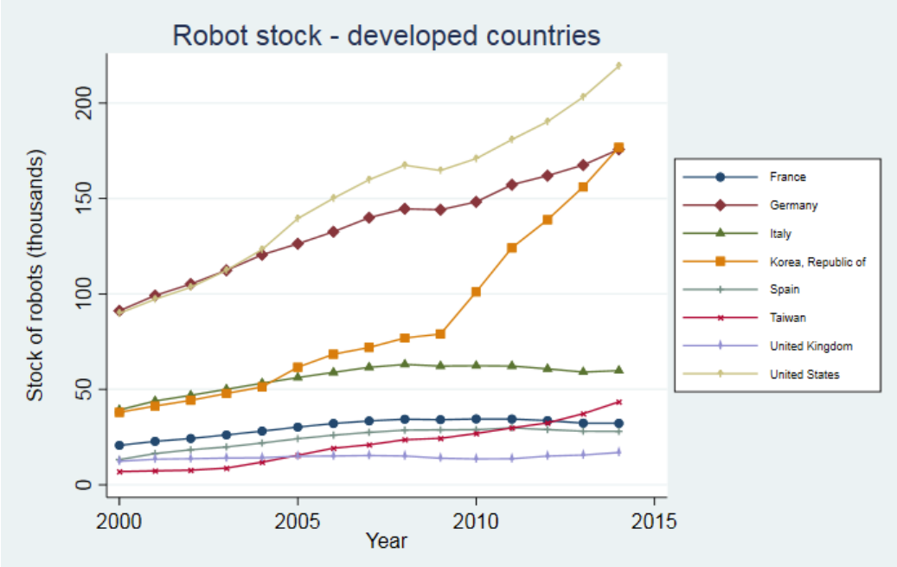
RISE OF ROBOTS
Jai Patel
Examples:
  Pharmacists
  Waiters
  Accountants
  Stock Traders
  Automotive Industry
500% faster than human workers [3]
40% increase in the first quarter of 2022 [5]
Exponential Growth of Robot Stock [4]
Notes:
Robots and AI have been on the rise in the industry, and rightfully so.
Some Robots can perform tasks as much as 500% faster than human workers.
As a result, today, in the first quarter of 2022 the orders of robots increased by 40%.
Some jobs where robots are already being implemented are pharmacists as robotic pill dispensers, waiters, accountants, stock traders which are entirely dependent on AI, and the automotive industry.
In the graph, you can see the rise of robots in both developed and developing countries. Robots in developing countries are growing at an extremely high rate because they are accepting more technology every year. Robots in developed countries including the US are already growing in a steady positive rate, as our advancements become better and stronger.

Slide 30

SHOULD YOU BE WORRIED?
Notes:
Now, many of us in the room are studying Computer Scientist with the hopes of becoming a developer one day. The question I propose to you all is can robots and AI take over the role of a developer by the time we graduate, leaving us jobless?

Slide 31
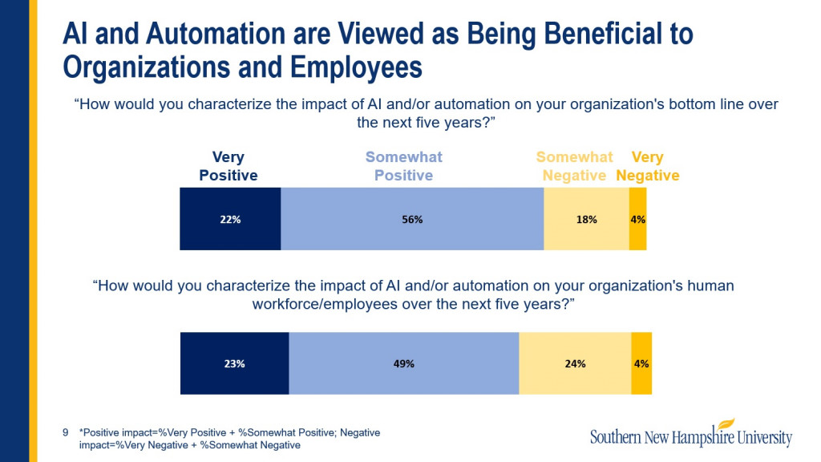
NO, YOUR JOB IS SAFE
Jai Patel
Augment not automate [6]
Better understand options
Be more efficient
Take time [10]
AI/Automation beneficial to organization and employees [11]
Notes:
The answer to that question is NO, our job is safe.
AI/Robotics are meant to augment the efficiency of developers, NOT automate.
The primary role of using and implementing AI/Robots as a developer is to help us better understand our options.
It helps us become more efficient. Instead of having to finish small tedious tasks before finishing our big projects, AI and Robotics can be used to aid in completing small tasks efficiently.
At the same time, AI is capable of writing usable code for very small tasks. It will take a long amount of time for AI to be able to create production-worthy code that can actually be implemented within a large corporation or even sent out to customers.
Automation and AI are viewed positively by executives and employees as shown in the figure. They understand the efficiency they would bring, improving the overall performance of software developers.

Slide 32
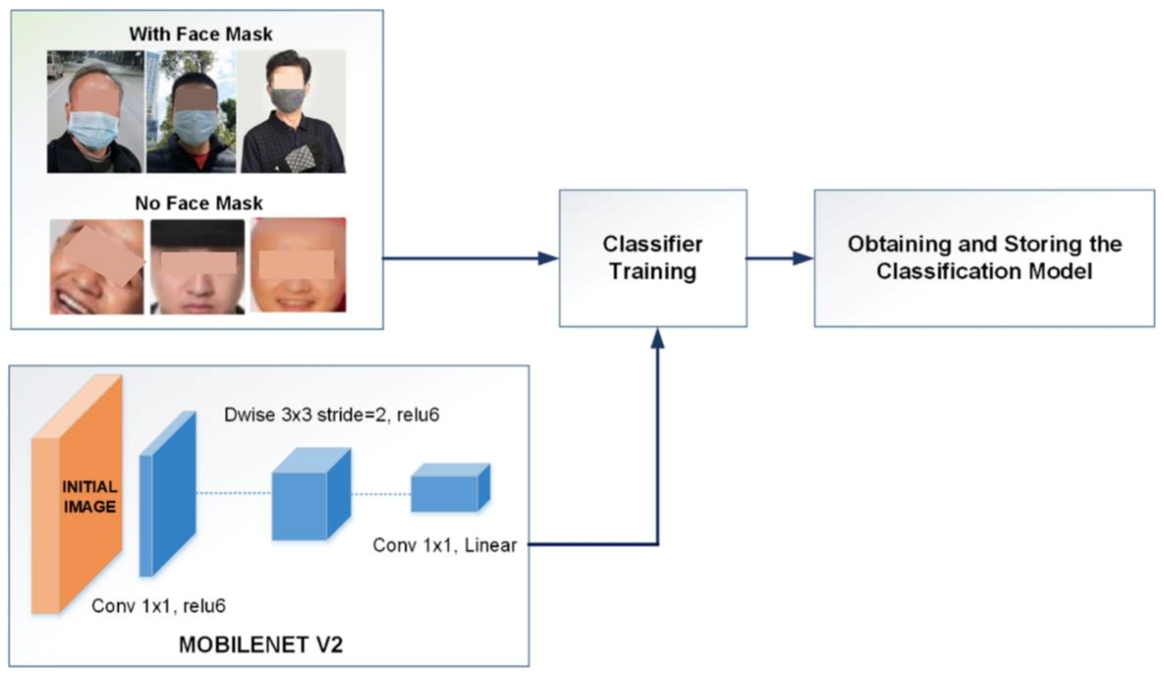
adaptability
Jai Patel
Unsupervised Learning
  Repeating same task
Task/Situation Changes
  AI needs to be retrained
  Example: Covid Pandemic
Facial Recognition Software adjusted
Remodeling ML diagram – Adapting to Changes [9]
Notes:
Another reason why our jobs are safe is adaptability. AI/Robots do not have the ability to adapt well to drastic changes.
Currently, many robots follow unsupervised learning models, where they repeat the same task and learn from past experiences.
If a task or environment changes however, AI and Robots need to be retrained to comply with the new circumstances.
An example of this comes from the COVID pandemic. During the pandemic, AI and Facial Recognition software needed to be adjusted to allow people to unlock their smartphones with masks on.
This is a strong example of why developers are necessary. We can adapt to these types of changes. An AI/Robot wouldn’t be able to make these adaptations without developers writing new software for them. To the right is an example of the machine learning model used by ml engineers to allow phones to be unlocked with masks on.

Slide 33
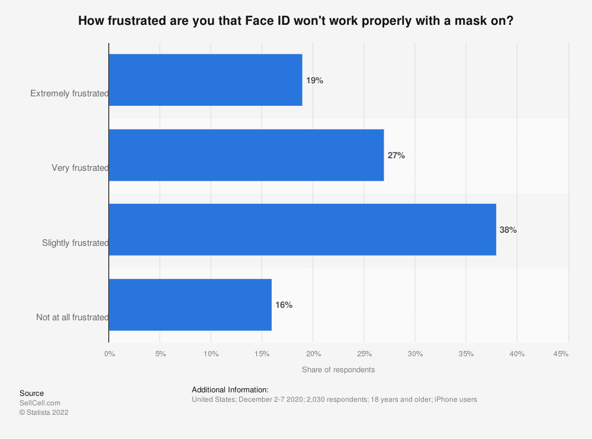
HUMAN EMOTION
Jai Patel
Lack of human emotion
Software developers' goal
  Meet the needs of customers
Understand their products as customers see them [14]
Customers’ Frustration of Face ID not working [7]
Notes:
Going off the last slide, another reason why AI/Robots in the spot of a developer wouldn’t work is due to their lack of human emotion.
A fundamental piece in a software developers’ goal is to meet the needs of customers.
Developing software and products without keeping the needs of a customer or small business in mind would be pointless.
In the same example of the covid pandemic and mask facial recognition, in order to understand the changes that needed to be made, human emotion is required.
In the graph, you can see that in a survey 19% of respondents were extremely frustrated that Face ID wouldn’t work properly with a mask and 27% were very frustrated. Without being able to take in the furiousness of customers and feel compassion towards them, the idea of retraining ML models to fix the software would never have come to the mind of an AI robot.

Slide 34
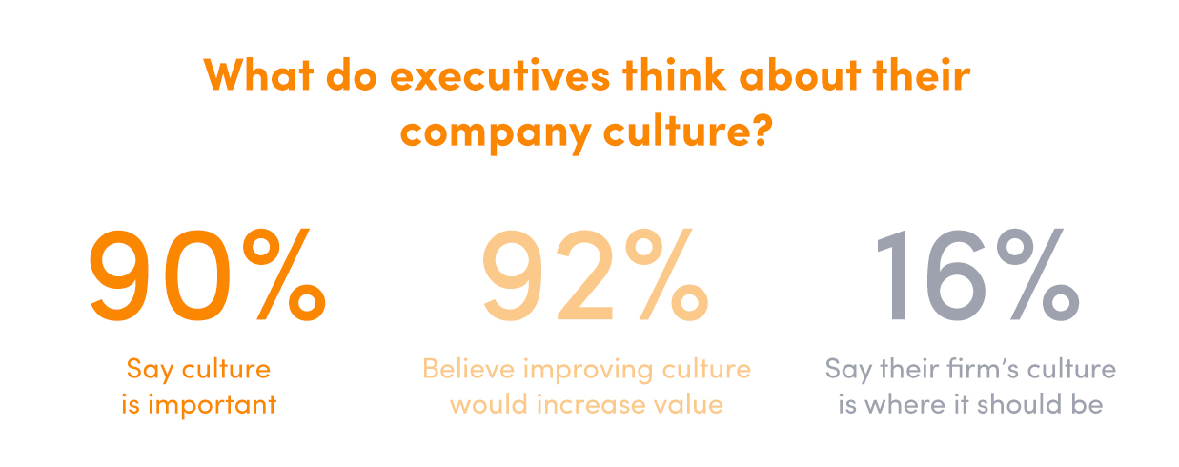
COMPANY CULTURE
Jai Patel
Human interaction and emotion
  Builds company culture
Executives Decision
Company Culture:
  Better chemistry [15]
  Lower turnover [15]
  Company Image
Importance of Company Culture from an Executives View [12]
Notes:
The last reason why AI/Robotics cannot replace software developers is company culture.
Both human interaction and emotion that I touched upon previously is what builds company culture.
Company culture results in better chemistry amongst employees, a lower turnover rate, and strengthens company image.
As you can see in the image, in a survey conducted with executives regarding their company culture, 90% of them say its important and 92% believe it can increase their company value.
When deciding whether to implement robotics, it is ultimately a decision to be made by executives.
With this being said, executives would move away from robotics/AI because of how it diminishes company culture entirely.

Slide 35
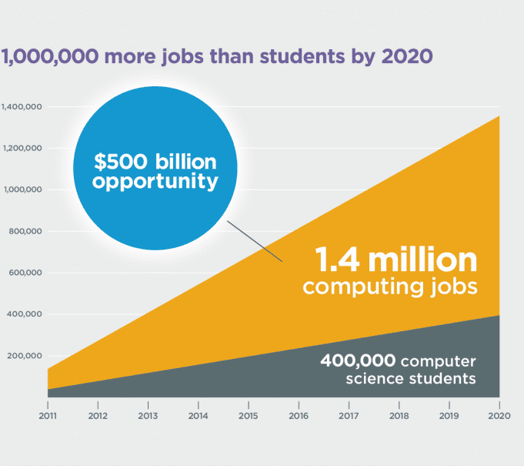
YOUR JOB IS SAFE
Jai Patel
Projected job growth of 21 percent from 2021 to 2031 [8]
Software Developer demand doubled in 2021 [16]
  Remote work capabilities
Tremendous CS Student Job Outlook [13]

Slide 36
References
Jai Patel
[1] Definition of AUTOMATION. (2019). Merriam-Webster.com. https://www.merriam-webster.com/dictionary/automation
[2] Cellan-Jones, R. (2019, June 26). Robots “to replace up to 20 million factory jobs” by 2030. BBC News. https://www.bbc.com/news/business-48760799
[3] Robotic Disruption in US Workforce Leads to New Opportunities and Challenges | RoboticsTomorrow. (n.d.). Roboticstomorrow.com. Retrieved October 2, 2022, from https://www.roboticstomorrow.com/story/2022/04/robotic-disruption-in-us-workforce-leads-to-new-opportunities-and-challenges/18573/
[4] Carbonero, F., Ernst, E., & Weber, E. (2018). Robots worldwide: The impact of automation on employment and trade. https://www.ilo.org/wcmsp5/groups/public/---dgreports/---inst/documents/publication/wcms_648063.pdf
[5] Robot orders increase 40% in first quarter as desperate employers seek relief from labor shortages, report says. (n.d.). Finance.yahoo.com. Retrieved October 2, 2022, from https://finance.yahoo.com/news/robot-orders-increase-40-first-153504436.html
[6] Roberto, V., & Zicari. (2018). http://www.odbms.org/wp-content/uploads/2018/10/Zicari.UCBerkeley.2018.pdf
[7] US: views on masks interfering with Face ID 2020. (n.d.). Statista. Retrieved October 2, 2022, from https://www.statista.com/statistics/1199111/frustrations-with-masks-interfering-with-face-id/
[8] U.S. BUREAU OF LABOR STATISTICS. (2018, April 13). Computer and Information Research Scientists : Occupational Outlook Handbook: : U.S. Bureau of Labor Statistics. Bls.gov. https://www.bls.gov/ooh/computer-and-information-technology/computer-and-information-research-scientists.htm‌

Slide 37
REFERENCES CONT.
Jai Patel
[9] Talahua, J. S., Buele, J., Calvopiña, P., & Varela-Aldás, J. (2021). Facial Recognition System for People with and without Face Mask in Times of the COVID-19 Pandemic. Sustainability, 13(12), 6900. https://doi.org/10.3390/su13126900
[10] Wade, L. (2022, August 7). What Will Coding Look Like In The Future? Sweetish Hill. https://sweetishhill.com/what-will-coding-look-like-in-the-future/
[11] Stevenson, M. (2020, April 8). AI and Automation’s Impact on the Workforce. HR Exchange Network. https://www.hrexchangenetwork.com/hr-tech/articles/ai-and-automations-impact-on-the-workforce
[12] Corporate Culture – Strategically Build the Culture You Want. (n.d.). Find Your Heyday. Retrieved October 2, 2022, from https://findyourheyday.com/service/corporate-culture/
[13] Hour of Code encourages students to develop tech skills. (2015, November 23). SaportaReport. https://saportareport.com/hour-of-code-encourages-students-to-develop-tech-skills/archived-columnists/saba-long/sabalong/
[14] 5 Reasons Developers Should be part of Customer Service - Codemotion. (2020, December 10). Codemotion Magazine. https://www.codemotion.com/magazine/dev-life/developers-customer-service/
[15] Alton, L. (n.d.). Why Corporate Culture Is Becoming Even More Important. Forbes. Retrieved October 2, 2022, from https://www.forbes.com/sites/larryalton/2017/02/17/why-corporate-culture-is-becoming-even-more-important/?sh=20b6644169da
[16] Carey, S. (2022, March 22). Demand for software developers doubled in 2021. InfoWorld. https://www.infoworld.com/article/3654480/demand-for-software-developers-doubled-in-2021.html

Slide 38
Class 11
The End
Keith A. Pray
socialimps.keithpray.net
Notes:
If there’s time and we didn’t get to it:
Kickstarter Charter
https://www.kickstarter.com/charter?ref=about_subnav
CGP Grey
Humans Need Not Apply (15:00) – 2014-08-13
http://www.youtube.com/watch?v=7Pq-S557XQU
Last access 2016-04-22
These 3D printed homes can be constructed for $4,000 (3:00 – 2018-04-02)
http://www.businessinsider.com/3d-printed-homes-constructed-icon-new-story-tech-charity-4000-dollars-2018-3
https://www.youtube.com/watch?v=SvM7jFZGAec (1:28)
Last access 2018-04-22
Look at:
BBC Intelligent Machines
http://www.bbc.com/news/technology-33978561
BBC Likelihood of robot taking your job
http://www.bbc.com/news/technology-34066941

