Slide 1
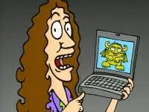
Class 8
Crime
Keith A. Pray
socialimps.keithpray.net
Notes:
“Weird” Al Yankovic – Virus Alert (3:43)
https://www.youtube.com/watch?v=zvfD5rnkTws
Take 5 minutes to fill out survey on Canvas → Quizzes → SGA’s Midterm Course Feedback Questionnaire

Slide 2
what works well Online With Zoom
Sign in with First and Last Name
Stay muted unless you are going to speak
To speak use the raise your hand feature
To answer yes/no questions use the “yes” ”no” buttons
Turn your camera on
Wait until the end of student presentations to ask questions
  Write them down so you don’t forget

Slide 3
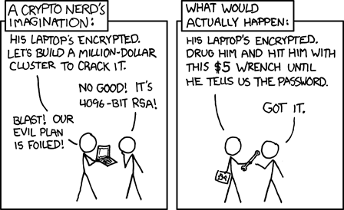
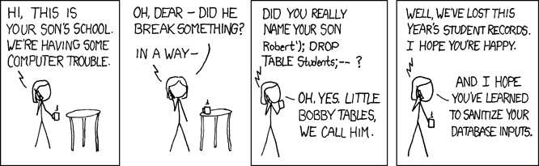
Overview
Review
Assignment
Students Present
https://xkcd.com/538/ (2010-11-14)
https://xkcd.com/327/ (2007-10-10)
Notes:
Are there any questions on the assigned reading?
Use the backup slides to explain any of the attack methods from the text.
XKCD Links last accessed 2020-09-25

Slide 4
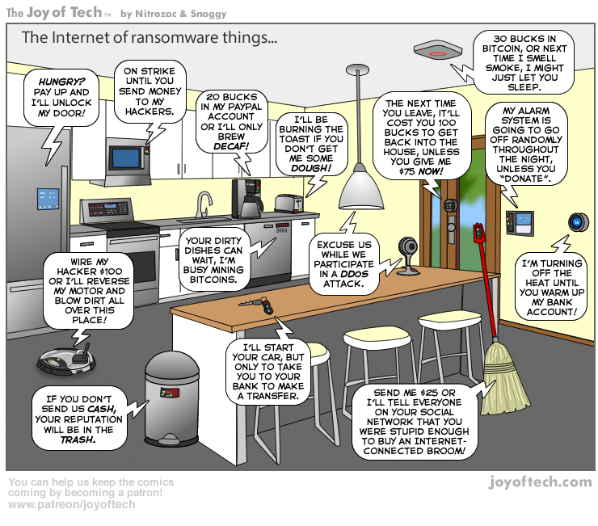
https://cointelegraph.com/storage/uploads/view/5e8f6e0d3a029807dfe181dc3d160cf0.png
Notes:
Find publish date
Note which really exist
Extra credit

Slide 5
My Reading Notes
pp. 323 Interesting to compare password guidance over the years.
pp. 325 plenty not sent with HTTP
pp. 328 Getting on TV much more difficult than releasing software
pp. 330 Virus could be new
pp. 332 Goals include infect 3 machine per LAN and as many computers as possible? Never make last minute changes before release. Were they related to the defects?
pp. 333 Testing w/out DEBUG often neglected
pp. 335 Do people use the Internet as an experimental laboratory these days? Shutdown right after booting, “benign” doesn’t seem like the right word.
pp. 337 “send reports back to a host computer”?
pp. 338 Firewalls often not running on same machine as malware, routers?
pp. 339 Have 2003 fears of cyber terrorist attacks been realized?
pp. 347 How is online voting a moral issue?
End of Chapter questions: 14. 25. 29.
Notes:
- If time ask class about online voting in light of COVID-19 challenges.

Slide 6
Group Quiz
A denial of service attack shuts down a bunch of retailer, stock brokerage, large corporate entertainment and information web sites. Possible guilty parties:
  Terrorist who aimed to cause billions of damage to U.S. economy.
  Protest organization opposing commercialization of the web and corporate manipulation of consumers.
  Script kiddie (a minor) just having fun with tools he found on the web.
  Show off hacker in search of bragging rights.
State what penalties are appropriate for each.
Explain your answer to 1. using a single Ethical Theory for all.
Name the laws/acts under which these parties could be prosecuted.
Notes:
Works well as small group exercise.
Note: short answer format expected.
Note: 2. only one argument needed, should include logic for all parties
Note: 3. same law(s) should be applicable to all parties

Slide 7
Assignment
Code Testing 1 Page Paper 1/2
Research testing, decide on test strategy, test the given code
There are major and minor defects to find
Once testing is done write paper with conclusion: Testing strategy was adequate
Things that might be useful in your argument:
  Rationale for testing strategy used (use data, high quality sources)
  Explanations of defects found (use data, high quality sources)
  How to fix them (use data, high quality sources)
  Consequences of leaving defects in production code (use data, high quality sources)
Weakness in testing strategy as counter point (use data, high quality source)
Working example: http://socialimps.keithpray.net/assignments/Test_Sales_Fun
Notes:
If guest presenter coming next class remind students to prepare questions for him.
Remember to work on groups projects.
Each group should have material on their sites for the topics we’ve covered so far.
OLD Prompt:
Design tests for the code on the following slide.
Contains at least one major defect and several minor ones.
Write a paper (1 page not counting any source code) including :
Did you choose a good test strategy? (This is your conclusion.)
The inputs and expected outputs
What defects you found
How you would fix the defects (you may include fixed source)
Why would that fix the problems?
What could happen if the defects are not found before the code is put into production?

Slide 8
Assignment
Code Testing 2/2
import java.text.NumberFormat;
public class SalesFun {
public static double calculateSalesTotal ( double amount, double discountRate, double taxRate ) {
double discount = amount * discountRate;
double total = amount - discount;
double tax = total * taxRate;
double taxedTotal = tax + total;
NumberFormat numberFormat = NumberFormat.getCurrencyInstance();
System.out.println ( "Subtotal : " + numberFormat.format ( amount ) );
System.out.println ( "Discount : " + numberFormat.format ( discount ) );
System.out.println ( "Total : " + numberFormat.format ( total ) );
System.out.println ( "Tax : " + numberFormat.format ( tax ) );
System.out.println ( "Tax+Total: " + numberFormat.format ( taxedTotal ) );
return taxedTotal;
}
}
} Lines of interest
Notes:
Bold lines are real focus.
Example input:
amount = 100.05;
discountRate = 0.10;
taxRate = 0.05;
OR
0.70, 0.0, 0.05
95.67, 0.20, 0.7

Slide 9
Overview
Review
Assignment
Students Present

Slide 10
Connected we fall
Gus Montana

Slide 11
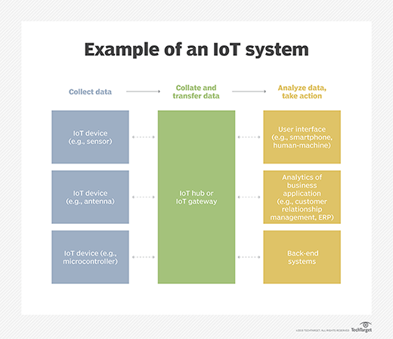
The “internet of things” is everywhere
Gustave Montana
What is a “thing” in the IoT?
  An object with an IP address [1]
  Can transfer data over a network [1]
How does the IoT work?
  “Things” collect data
  Share data by connecting to an IoT gateway [1]
  Data can then be analyzed [1]
Examples
  Smart-home devices
  Car sensors
Notes:
“Everything is connected to the internet”
Probably heard it or said it before
Basically true
What is a thing?
Has an IP
Can transfer data over a network, not necessarily the public internet
Things collect data using processors, sensors, other hardware
IoT device is connected to IoT gateway -> share data to cloud or locally -> data can be analyzed for varying purposes

Slide 12
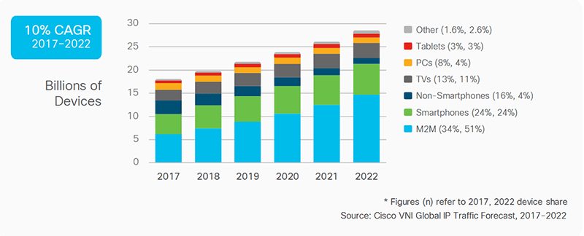
The internet of things is massive
Gustave Montana
18-28 billion connected devices [5]
  35-50% are primarily for machine-machine communication
  Including smartphones and smart TVs, 90% of the internet is IoT
  ~2.5 connected devices per human
IoT will only grow
  Cisco estimates that 61 new devices are connected per second
  In 15 years, IoT could be 1 trillion devices
Notes:
According to leading technology firms (Cisco, ARM, Gartner), 18-28 billion IoT devices
Of that estimate, 35-50% are just devices that only talk to each other (under normal circumstances)
If you include smartphones and smart TVs (roku, google tv, etc.) as IoT, 90% of the internet is IoT devices
On average, there are 2.5 IoT devices per human on Earth
IoT will only get bigger
Cisco, one of firms mentioned earlier in slide, estimates that there are 61 new devices/second being connected to the internet
In the next 5-15 years, estimates from firms (like ones mentioned earlier in slide) range from 41 billion to 1 trillion IoT devices

Slide 13
Malware before and after IoT
Gustave Montana
Before, malware was limited to computers
  Morris worm [6]
  ILOVEYOU [2]
  Mydoom [2]
Now, malware can take advantage of the size of the IoT
  Create botnets using IoT devices
Mirai Botnet
  Botnet released in 2016 [2]
Notes:
Malware was contained to what we might traditionally think of as a “computer,” like the laptop I’m making this slideshow on or the PC that I play video games on.
These are examples of viruses that were devastating and caused damage, but not even close to the scale that viruses do now
This is due to the simple fact that more devices can access the internet now, hence more devices are able to be hacked
The morris worm (read about in book) attacked vulnerabilities created by bugs in parts of operating systems
ILOVEYOU and mydoom spread through email (basic in terms of virus type and could only infect computers which people checked email on)

Slide 14
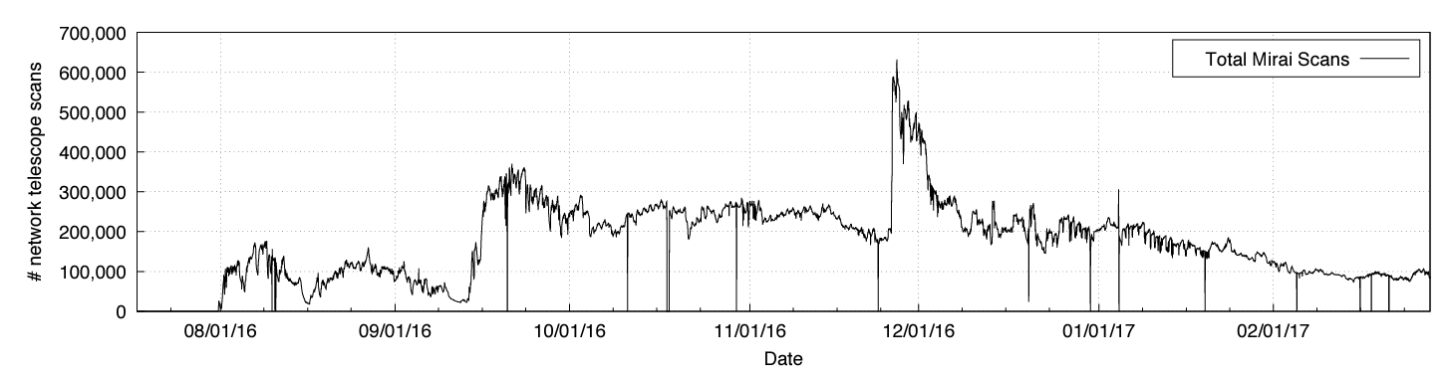
Mirai botnet
Gustave Montana
Created a botnet of IoT devices
  Infected devices scan the internet for IP addresses of other IoT devices [3]
  Logs into vulnerable devices using default login credentials [3]
  Infected devices function almost normally [3]
175,000 website outages in one attack [4]
  DNS provider Dyn [4]
  100 times larger than other botnet attacks [4]
Notes:
Created by a college student named Paras Jha
When a IoT device is new, it comes with a stock pair of credentials which, in a lot of cases, does not get changed
For whatever reason, IT overlooks it at a company, etc.
Infected devices continually scan the internet
Targets those vulnerable devices that use default credentials with a table of ~60 default credentials
If it successfully logs in, it infects the device
Infected devices are almost normal
Slightly slow occasionally
Use more bandwidth
When used, it was 100x larger than anything similar in the past
Used on a DNS (domain name system) provider called Dyn
Caused ~175,000 website outages
Effectively cut off the eastern seaboard of the US from the internet for the better part of a day
Graph is the number of IoT devices infected with Mirai at a time

Slide 15
References
Gustave Montana
[1] Gillis, A. (2022). What is IoT (Internet of Things) and How Does it Work? - Definition from TechTarget.com. IoT Agenda. https://www.techtarget.com/iotagenda/definition/Internet-of-Things-IoT
‌[2] Fruhlinger, J. (2022, June 9). 11 infamous malware attacks: The first and the worst. CSO Online. https://www.csoonline.com/article/3663051/11-infamous-malware-attacks-the-first-and-the-worst.html
[3] Leaked Mirai Malware Boosts IoT Insecurity Threat Level. (n.d.). Security Intelligence. https://securityintelligence.com/news/leaked-mirai-malware-boosts-iot-insecurity-threat-level/
[4] What was the Mirai botnet. (n.d.). Malwarebytes. https://www.malwarebytes.com/what-was-the-mirai-botnet
[5] Braun, A. (2020, January 1). How Big Is the Internet of Things? IoT Tech Trends. https://www.iottechtrends.com/how-big-is-internet-of-things/
[6] Quinn, M. J. (2019). Ethics For The Information Age Pearson Etext. S.L.: Pearson.

Slide 16
WORLDWIDE CYBERCRIME: Are you at risk?
Michael Alicea

Slide 17

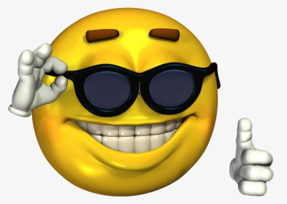
YES
Notes:
Most typically if you are using a device that is connected to the internet, unfortunately YES you are at risk. The biggest vulnerability is you which cyber criminals will try to exploit, with some exceptions which I will touch upon later.

Slide 18
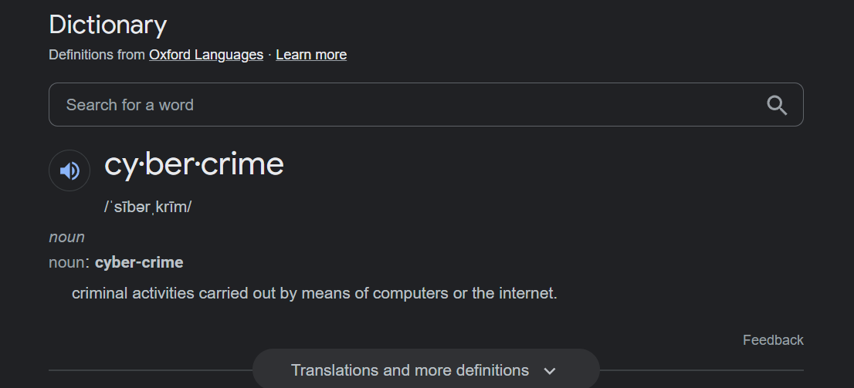
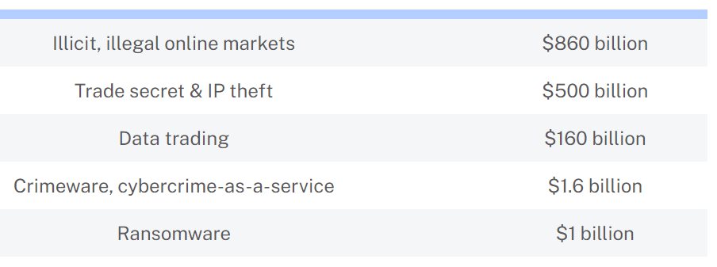
What is Cybercrime?
Michael Alicea
Identity Theft
Ransomware
Spoofing and phishing
Common online scams
Online Viruses, Worms, Trojan files, malicious programs [7]
[8] Table of the damages of cybercrime activity in 2021
Notes:
Cybercrime is any illegal or unethical activity through internet use or using the internet using the computer as a tool. Some examples of this are: (list examples)
The table at the bottom shows the amount of money stolen back in 2019.

Slide 19
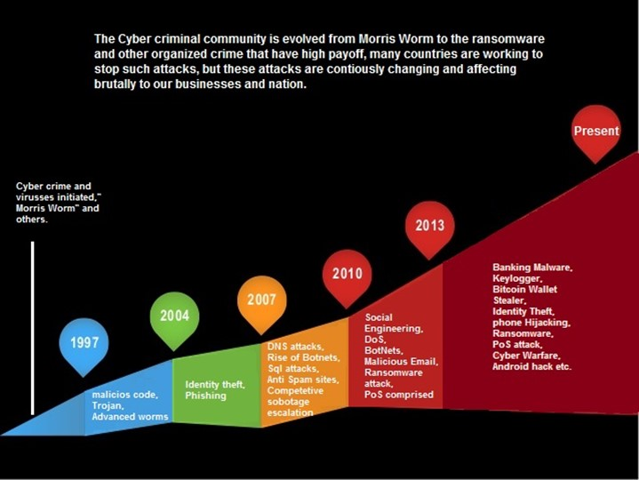
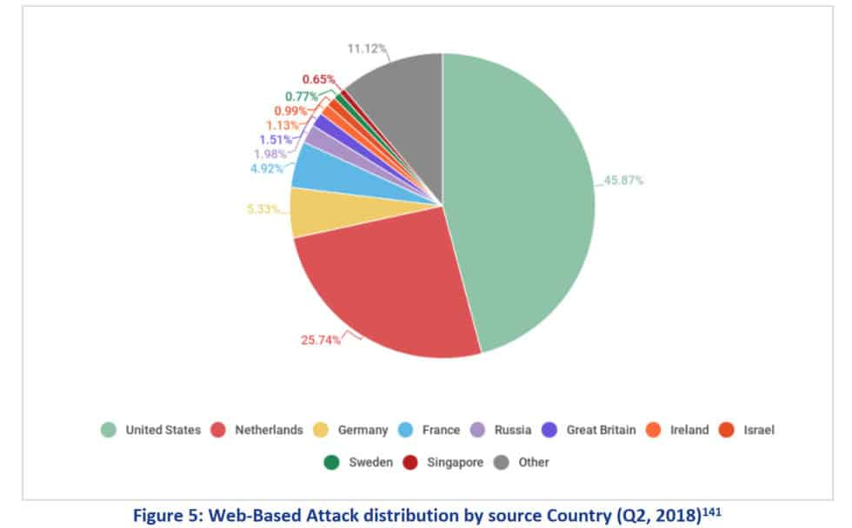
How do cybercriminals operate?
Michael Alicea
Indiscriminate Targeting
  Phishing Scams
  “Casting a wide net” hoping the sheer amount of people will yield enough benefit
Specific Victim Targeting
  High profile/net-worth individuals are more at risk [2]
  Information will be gathered about the victim before making their first move
Figure 5 shows which countries are the primary targets of these attacks
Notes:
Indiscriminate targeting:
In some cases, cybercriminals cast a wide net with "phishing" scams, among others, and hope the sheer quantity of potential victims will yield sufficient economic benefit.
Specific victim targeting
A growing and more concerning trend is the specific targeting of high-net-worth individuals. In many of these cases, criminals spend a great deal of time and effort identifying a worthwhile target and then developing a victim profile based on public and private information—such as property records, credit information obtained via hacking, and posted details on social networks—with the goal of stealing assets from financial accounts.
Although the actual criminal act can take several forms, the basic steps are often similar.

Slide 20
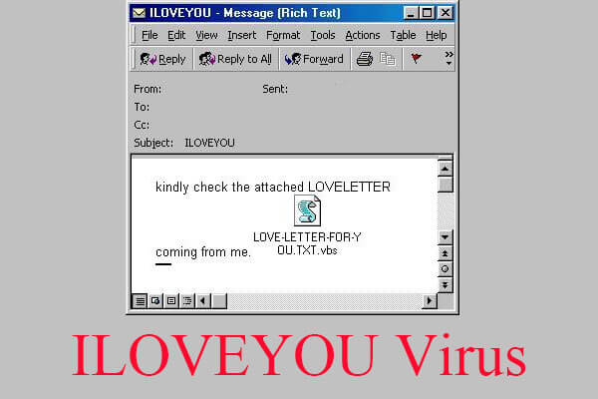
ILOVEYOU Virus – may 4th, 2000
Michael Alicea
The worm used a mailing list of its victims to spread further
  It would send itself using the originators email address to their contact list
It infected over 55 million computers; nearly 10% of the internets connected computers
The worm would render its victim’s files unusable before moving on to the next person
Onel de Guzman created the bug in the Philippines
  He was never charged as there were no laws in place at the time against it
$10-15 Billion USD in damages
Typical email a user would receive that the virus was hidden in
Notes:
ILOVEYOU was one of the first ever large scale viruses on the internet. (Read info on the slides)

Slide 21
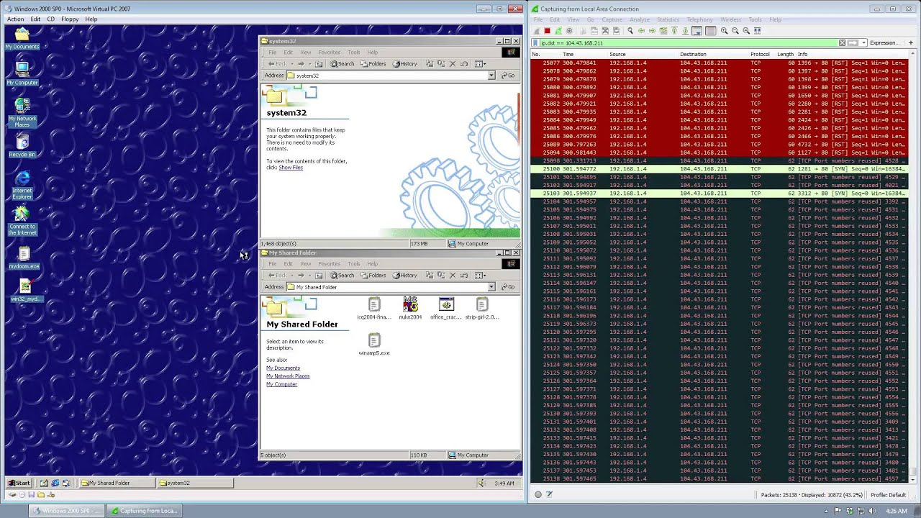
MY.DOOM – January 26th, 2004
Michael Alicea
Used a network of infected computers for targeted DDOS attacks
Originated from Russia
Spread through email from infected computers and created backdoors into its user’s machines [3]
It infected 500,000 computers across the globe (25% of global emails at its time)
1 in 5 emails contained the worm at the peak of its spread
$38.5 Billion USD in damages
What a hacker would see on their computer using the MY.DOOM virus
Notes:
MY.DOOM was a virus that was used its sheer mass of compromised computers to DDOS mainstream companies and servers with the goal of permanently shutting them down. Throughout its lifespan on the internet, there were five variants with, MYDOOM A and MYDOOM B being the most damaging, with A solely focused on SCO websites and B focused on Microsoft and popular antivirus sites at the time.

Slide 22
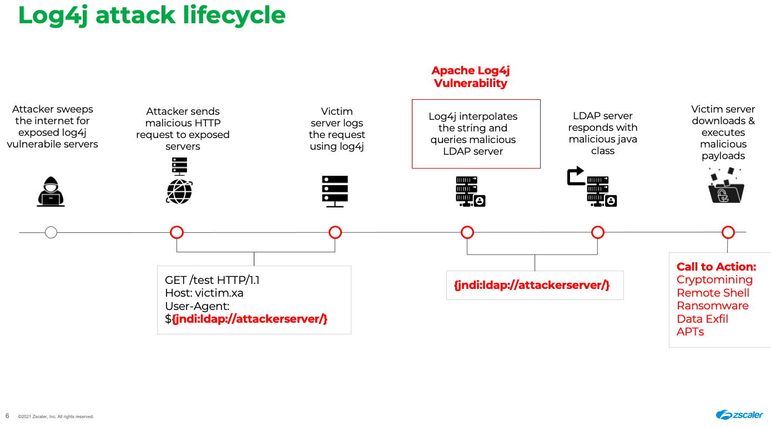
Log4SHELL Exploit – December 2021
Michael Alicea
Enabled a malicious actor to remotely run code on any unsuspecting user in a java environment
The vulnerability affected 93% of enterprise cloud environments
  Steam, Apple, Amazon Web Services, Minecraft: Java Edition
3,700,000 exploit attempts in Dec. 2021 alone on corporate networks
The extent of the damages is still unknown and still occurring today
Notes:
The Log4Shell exploit was an oversight in the core code of how java functioned. An attacker was able to send a request using log4j to make a victims client or server add the information to the log. Due to a vulnerability with log4j servers, attackers were able to remotely send code to their victims forcing their victims to run whatever code or payload was desired. This enabled attackers to install viruses, backdoors or ransomware without needing access to anything. Minecraft was hit the hardest when this exploit was discovered, allowing an attacker to send the payload in the chat and anybody in the same server as the hacker would be compromised.

Slide 23
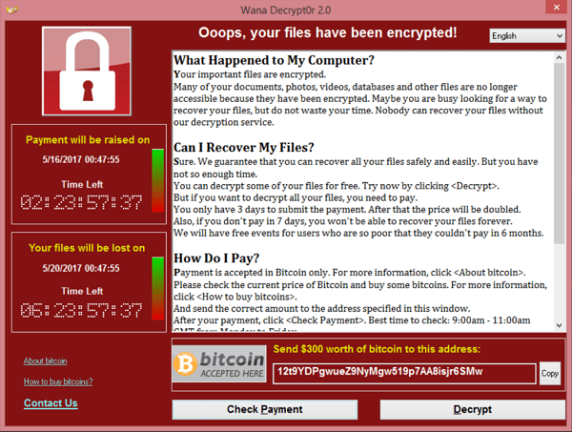
WANNACRY – May 12, 2017
Michael Alicea
A Bitcoin Ransomware crypto worm
Targeted computers running Windows OS [1]
Researchers created the worm as a defense for future attacks
The worm would encrypt all its infected user’s files, delete all its user’s backups and demand payment to decrypt files
Originated in Asia
Infected 200,000 computers across 150 countries
Caused about $4 Billion USD in damages
The typical screen you would see once infected
Notes:
WANNACRY is one of the most recent large scale worms that

Slide 24
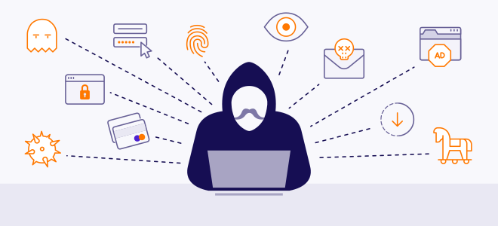
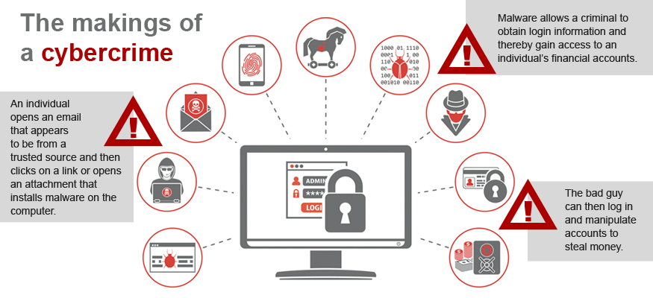
How or can you truly protect yourself
Michael Alicea
Avoiding unsecure or public Wi-Fi terminals [5]
Don’t open shady links, files, or emails
Don’t download and run files with the file extension .exe or .bat
Use 2-Factor Authentication for online financial or sensitive accounts [6]
Keeping your devices updated
Regularly backing up your data
Notes:
Read slide bulletpoints

Slide 25
References
Michael Alicea
[1] Darby, Seyward. “The Mastermind.” The Atavist Magazine, 22 Apr. 2021, https://magazine.atavist.com/the-mastermind/.
[2] Menzheres, Alex. “Top Targets for Cyber Criminals in 2018.” To ETeam.io Website, https://www.eteam.io/blog/targets-for-cyber-criminals-2018.
[3] “Worm:W32/Mydoom.” F, https://www.f-secure.com/v-descs/novarg.shtml.
[4] “300+ Terrifying Cybercrime & Cybersecurity Statistics (2022).” Comparitech, 12 Apr. 2022, https://www.comparitech.com/vpn/cybersecurity-cyber-crime-statistics-facts-trends/.
[5] 21, July, et al. “Evolution in the World of Cyber Crime.” Infosec Resources, 30 July 2021, https://resources.infosecinstitute.com/topic/evolution-in-the-world-of-cyber-crime/.
[6] “Target for Cybercrime.” Fidelity, 12 Oct. 2021, https://www.fidelity.com/viewpoints/wealth-management/target-for-cybercrime.
[7] “Cyber Crime.” FBI, FBI, 3 May 2016, https://www.fbi.gov/investigate/cyber.
[8] “More than 70 Cybercrime Statistics - a $6 Trillion Problem.” Dataprot, https://dataprot.net/statistics/cybercrime-statistics/.

Slide 26
IS Cryptocurrency Money’s Future? The answer is no
Cody Rueda
Notes:
Introduction

Slide 27
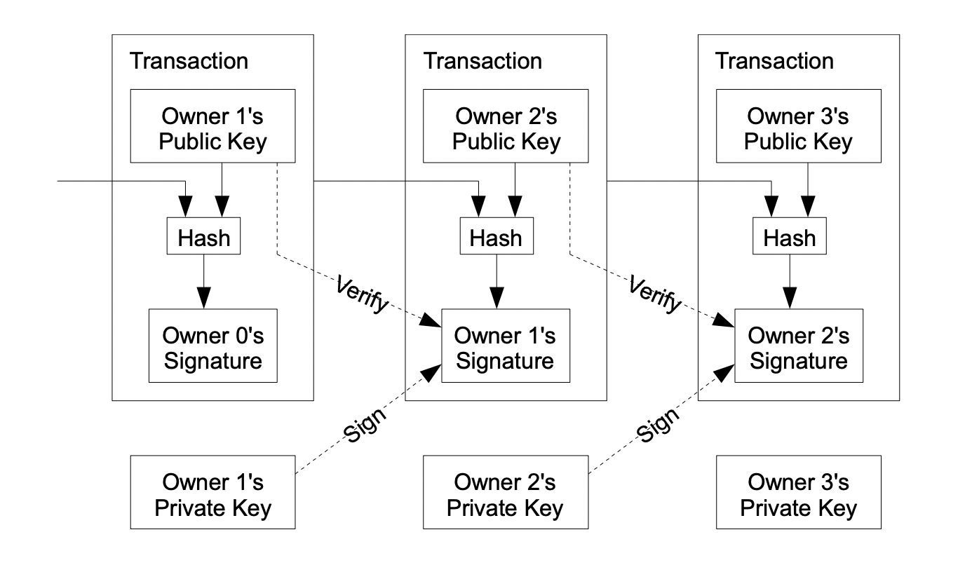
How Cryptocurrency Works
Cody Rueda
Decentralized Control
  Not Reliant On Gov or Banks
Blockchain Technology
Cryptocurrency Mining and Proof of Work VS Proof of Stake
Bitcoin
  41% of total value of crypto was Bitcoin[1]
Other Coins
  Over 19,000 Coins [4]
<Graphic as big as will fit>
[2]
Notes:
Decentralized Control means value cant be regulated by governments or banks
Not one single point of failure so if one node fails the system will be fine
This works because of blockchain technology where there are thousands of different nodes each containing the same information constantly cross checking each other to make sure there are no errors or attacks in the system
New coins are added to the system either by a proof of work or proof of stake method
For a proof of work coin complex cryptography questions are sent out that can only be solved through brute force. The problem that is being solved is the cross checks to make sure the system is running and as a reward for solving the problem a coins are given to the user who solved it. I’ll come back to this but it takes a lot of energy
Proof of stake a single person is chosen to validate a transaction instead of everyone and they receive a reward if they complete it
Bitcoin is the most popular and expensive coin right now valued at about $19,000
There are over 19,000 other coins with more being added all the time including etherium, tether and USD coin
The picture shows how a decentralized system works to verify other transacations

Slide 28
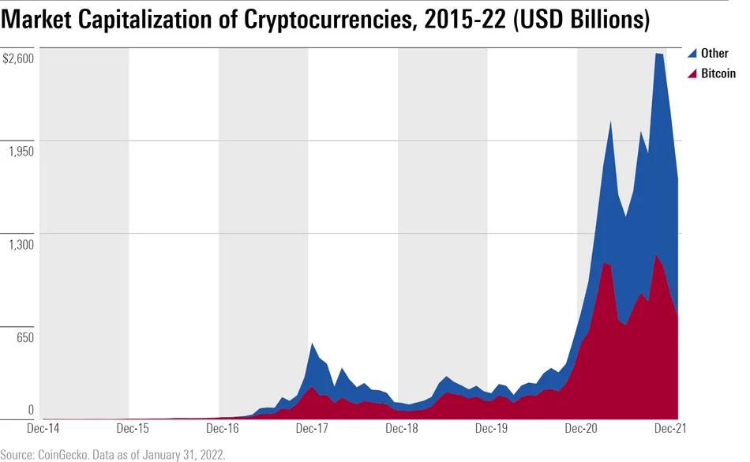
Crypto on the rise?
Cody Rueda
Market Size was USD 800 Million in 2020 – 5.2 Billion by 2028 [2]
46 Million Americans Own Crypto[7]
There are over 30,000 Bitcoin ATMs in The Us
  1,800 four years ago [8]
In the UK 78% of Adults have heard of crypto [7]
  Increase in crypto assets by 20%[7]
[11]
Notes:
Cryptocurrency has gotten increasing popular in the past few years.
The Graph shows how the market capitalization of crypto has increased over the past 8 years and how crypto has shot up.
Market Cap is calculated by the amount of coins times the price of the coin and crypto is very volatile so the estimates can be hard to predict but in 2020 it was 800 Million and predicted to increase to 5.2 Billion by 2028
I came across many different predictions in my research, but all sources pointed to between a 12 and 20 percent compound annual growth rate
Over 16% of the us population owns cryotocurrency I actually own a small amount
The amount of bitcoin atms in the us has also increased allowing the purchase of crypto to become much easier
It is becoming increasingly popular in Europe as a whole, but in the uk most adults have heard of it and the amount of people who have crypto assets has increased by 20 % over the past two years

Slide 29
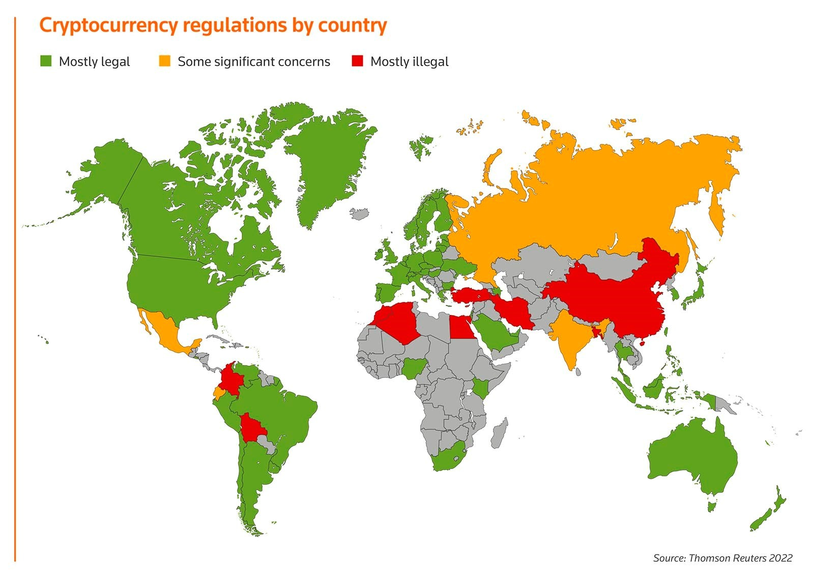
Acceptance and Denial
Cody Rueda
In 2021 El Salvador first country to legalize Bitcoin as legal tender[1]
Japan treats cryptocurrency as property not as currency[1]
In the US it is not legal tender and most regulations vary by state
More than 18 countries have bans or tight regulations including China and India [5]
[7]
Notes:
El Salvador was the first country to allow bitcoin to be used for monetary transactions, but many countries had different approaches
Some other countries such as Japan just treat crypto as property
It’s not legal tender in the US and state to state it varies. I am from new Hampshire and I know crypto wasn’t able to be purchased until recently
There are many influential countries such as India and China that have either outlawed or restricted crypto from being mined or traded

Slide 30
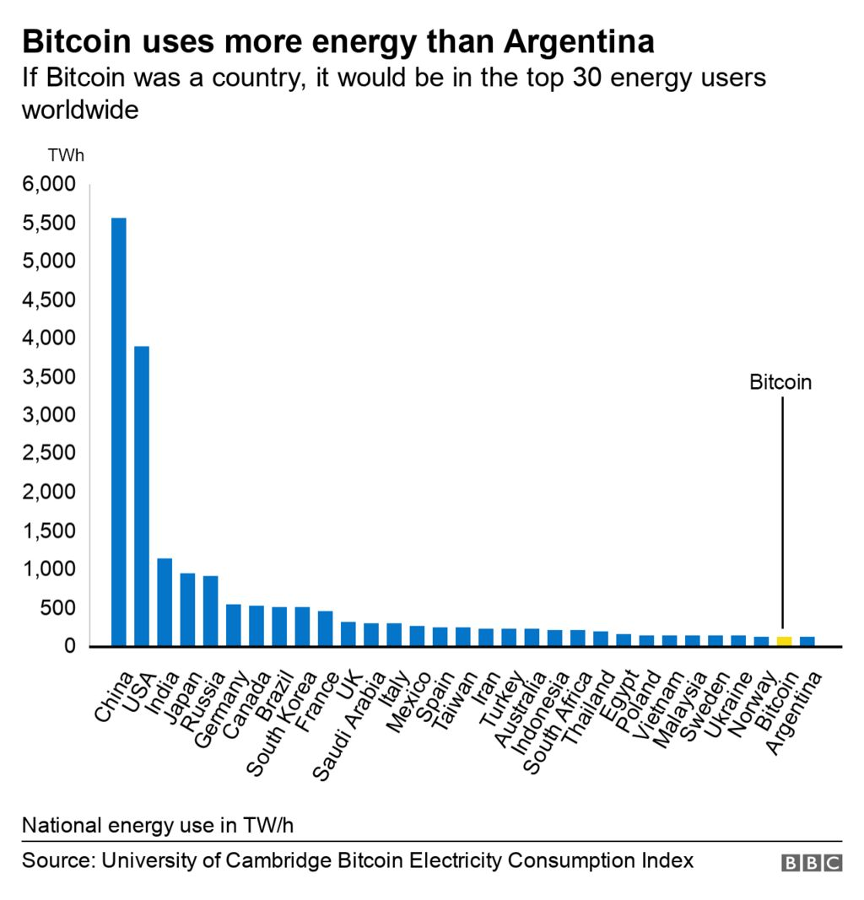
Disadvantages
Cody Rueda
Extreme Volatility
  Bitcoin 52 week high 68,906.84 low 17,614.28 [6]
High Energy Consumption
  Bitcoin alone at 121 TW/H[10]
All Transactions Are Final [2]
Wallet’s Are Not Secure
[10]
Notes:
There are many disadvantages and risks of crypto
The main issue is it’s extreme volatility where prices can skyrocket overnight or tank
In the case of bitcoin …
Proof of work as mentioned before uses a ton of energy and if you look at the graph it is in the top 30 energy consumers in the world
In the case of cryptocurrency all transaction are final and can only be refunded by the person who received the coin. So if on accident a company sent its million dollar order to a wrong address the transaction would be final and unable to reverse
The coins in crypto are secure but the wallet you use to store them Robinhood, Coinbase for ex if the wallet gets hacked or the password lost those coins are forever lost on that account

Slide 31
Conclusion
Cody Rueda
The Merge
  International Electrical Consumption down 0.2% [9]
Stablecoin
Too Unstable
Massive Economical Changes
Notes:
The 2nd most popular cryptocurrency recently switched from proof of work to proof of stake and was estimated to reduce worldwide energy consumption by 0.2%
Less energy demands could make crypto more a more likely candidate to replace fiat money, but most coins still operate on a proof of work method
There is also a type of cryptocurrency called a stable coin which holds its value to something like the USD and remains at a 1:1 trade value but there have still been coins that crashed and went to 0
That is why crypto is too unstable to replace money in the current age. As time goes on its gotten to be less of a gamble, but the risk is still too high
It would also require a massive economical change to scrap fiat money for a digital version. In the end it is not possible within the current day and age, but who knows where the future will go.

Slide 32
References
Cody Rueda
[1]Jake Frakenfield, Cryptocurrency Explained With Pros and Cons for Investment, (Investopedia, May 2022) https://www.investopedia.com/terms/c/cryptocurrency.asp 9/16/22
[2] Somethings you need to know (Bitcoin) https://bitcoin.org/en/you-need-to-know 9/16/22
[3] Cryptocurrency Market to Hit US$5200 Million By 20208 Exclusive Report by Facts and Factors, (Yahoo Finance, 2022) https://finance.yahoo.com/news/cryptocurrency-market-size-hit-us-180900190.html?guccounter=1&guce_referrer=aHR0cHM6Ly93d3cuZ29vZ2xlLmNvbS8&guce_referrer_sig=AQAAAFZPEHb89vOPiqXNWEE9QPGDdjjzNDNx1vKB-STef4MIhpcav2zg8gYv2uUYS0fQrWq0kLuxuYnRaPmEbCWeTKzwmFnpmoj8z9nMfM4ZYHw0FUgY7ypoUqqG_or6FsP6t1HhA-U6LCFvwbYasNmQpS-VBjxUj3YT54FXeHwjY9mM 9/15/2022
[4] Arjun Kharpal, Crypto firms say thousands of digital currencies will collapse , compare market to dot coms days (CNBC 2022)https://www.cnbc.com/2022/06/03/crypto-firms-say-thousands-of-digital-currencies-will-collapse.html 9/17/2022
[5] Chloe Orji, Bitcoin Ban,: These are place where crypto is restricted or illegal, (Euronews 2022) https://www.euronews.com/next/2022/08/25/bitcoin-ban-these-are-the-countries-where-crypto-is-restricted-or-illegal2 9/17/2022

Slide 33
References
Cody Rueda
[6]Bitcoin – USD (Barchart 2022) https://www.barchart.com/crypto/quotes/%5EBTCUSD/performance 9/18/2022
[7] Susannah Hammond and Todd Ehret, Cryptos on The Rise 2022 (Thomson Reuters 2022) https://www.thomsonreuters.com/en/reports/cryptos-on-the-rise-2022.html 9/18/2022
[8] RJ Pierce, Will Crypto Replace Cash? Here’s What You Could Expect(Tech Times 2022) https://www.techtimes.com/articles/273169/20220317/will-crypto-replace-cash-heres-what-expect.htm#:~:text=Financial%20tech%20analyst%20Dan%20Dolev,people%20buy%20and%20trade%20them. 9/17/2022
[9] Daniel Kuhn, Did the Ethereum Merge Drop ‘Worldwide Electricity Consumption’ by 0.2%?(CoinDesk 2022) https://www.coindesk.com/layer2/2022/09/19/did-the-ethereum-merge-drop-worldwide-electricity-consumption-by-02/?utm_medium=referral&utm_source=rss&utm_campaign=headlines#:~:text=Proof%2Dof%2Dstake%2C%20Ethereum's,system%20Ethereum%20used%20to%20run. 9/18/2022
[10]Cristina Criddle, Bitcoin Consumes ‘more electricity than Argentina’ (BBC 2021) https://www.bbc.com/news/technology-56012952 9/18/2022
[11] Madeline Hume, Understanding The trends In Cryptocurrency Market In 7 Charts (Morningstar 2022) https://www.morningstar.com/articles/1087440/understanding-trends-in-the-cryptocurrency-market-in-7-charts 9/17/2022

Slide 34
Class 8
The End
Keith A. Pray
socialimps.keithpray.net
Notes:
Any slides beyond this point are for answering questions that may arise but not needed in the main talk.
Some slides may also be unfinished and are not needed but kept just in case.

Slide 35
Buffer Overrun
Run time stack
Local Variables
Return Address
Parameters
Variable Attack
buffer
Target Variable
Stack Attack
buffer
Return Address
code
Return Address
Notes:
Retired slide. Most students have this in depth from new class now.
When a function call is made, local variables, return address, parameters stored on run time stack. Local variables occupy lower memory addresses.
Variable attack – change variable value. Program expects user to input character and allocates a buffer for them. Attacker supplies too many characters and ends up over writing a variable.
Run example of this if there’s interest – next slide
Stack Attack – goal is to change value of return address so execution control goes to code which the attacker has provided in the input buffer.
Prevention – add checks against array bounds being exceeded. modify operating system to not execute instructions stored on run time stack.

Slide 36
Run Example Code
Notes:
Retired demonstration. Most students have this in depth from new class now.
> imps
> assembly
> 123456789qwerty1

Slide 37
Buffer Overrun Code
#include <stdio.h>
#include <string.h>
int main ( void ) {
char buff [ 15 ]; int ace = 0;
printf ( "\n Enter best class ever : \n" );
gets ( buff );
if ( strcmp ( buff, "imps" ) ) {
printf ( "\n %s is wrong! You should FAIL! \n ace=%i\n", buff, ace ); }
else { printf ( "Correct! \n") ; ace = 1; }
if ( ace ) { printf ( "You get an A! \n" ); }
return 0; }
} The Naughty Line
Notes:
Retired slide. Most students have this in depth from new class now.

Slide 38
TCP Three-way Handshake
SYN
SYN-ACK
ACK
Notes:
Retired slide. Most students have this in depth from new class now.
SYNchronize
SYNchronize ACKnowledgement (socket reserved awaiting ACK)
ACKnowledgement
TCP socket connection established

Slide 39
SYN Flood Attack
SYN
SYN-ACK
Notes:
Retired slide. Most students have this in depth from new class now.
Attacker spoofs the IP address so the SYN-ACK is sent to a different machine that cannot respond to the SYN-ACK.
This leaves the connection half open on the server machine decreasing the resources (sockets, memory, threads/processes) available to respond to legitimate clients.
The attacker send many such spoofed SYN messages.

Slide 40
Ping Attack
Target
Attacker
ping
ping
Notes:
Retired slide. Most students have this in depth from new class now.
Attacker finds routers that support broadcasting messages to all computers on their local area networks.
The attacker sends a spoofed ping message, which the routers echo to the spoofed address.

Slide 41
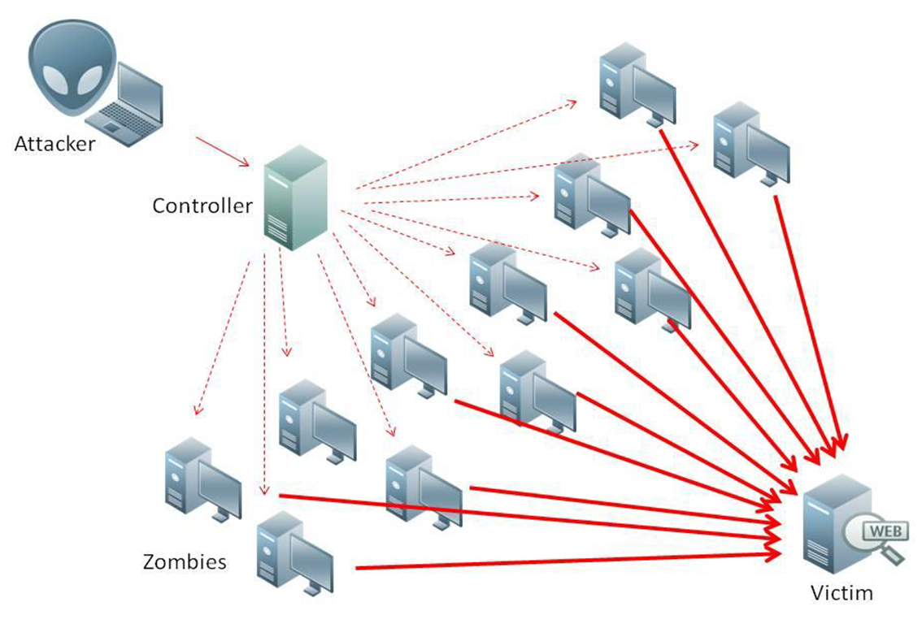
What is Denial of Service (DoS)
Attempts to make target unavailable by flooding with traffic
If victim has to filter attack, it’s too late
Internet Providers have no incentive to help
  Businesses get affected, but would not pay provider enough to make worthwhile
  This is why Cloudflare, e.g., exists
Many ways to perform this attack
Notes:
Contributed by Brett Ammeson.
https://www.cloudflare.com/ddos/reflection-attack-1.png
https://i.imgur.com/lxYv8cF.png

Slide 42
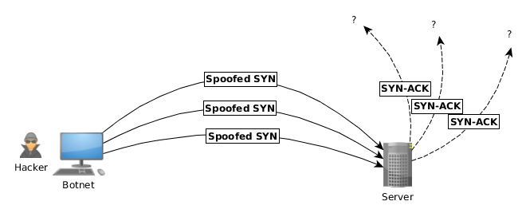
Distributed DoS Vectors
TCP SYN attack
  SYN packets are small, low difficulty for attacker
  Leaves half-open connections on server
  SYN cookies mitigate this
DNS amplification attack
  DNS requests are small
  Can request all records on server
  Crippled by proper configuration
Ingress/egress filtering will reduce effect
Notes:
Contributed by Brett Ammeson.
TCP SYN: https://www.cert.org/historical/advisories/CA-1996-21.cfm
DNS amplification: https://www.cert.org/historical/incident_notes/IN-2000-04.cfm
Ingress/egress: www.giac.org/paper/gsec/705/egress-filtering-keeping-internet-safe-systems/101588

Slide 43
Crime How
Technical and Non-Technical
  Break into computer.
  Prevent access to computer.
What things make computer related crime easy?
Notes:
Exploit security holes, Break encryption, Spoofing
Social Engineering: Guess passwords, Find out passwords and procedures
Poor passwords, Insecure protocols, Program limitations (buffer overruns), Eavesdropping (Email, Interactive), Insecure files

Slide 44
Crime Bane
Trojan Horse
Virus
Worm
Bot Network
Buffer Overrun
(Distributed) Denial Of Service Attack
How do they work?
How harmful are they?

Slide 45
Crime Why
Why?
Notes:
Money: stolen credit cards, change records, stolen property.
Political, military, economic.
Challenge, Revenge, Mean
Why do at all? Have motivation, think about it, think it will help, think it’s acceptable.
Feel forced. Don’t agree. Don’t care.

Slide 46
Crime Time
What is different now compared to:
  10 years ago?
  20 years ago?
  30 years ago?
  40 years ago?
Notes:
More computers. Unsophisticated owners. More complex software. Greater connectivity. Easy access to cracking tools. Incentives. File-sharing
In ’60s and ’70s, access was mostly localized.
Modems. Wardialing.
Some Arpanet and Usenet.

Slide 47
Crime Doers
Hacker or Cracker
  Pre-1980 - Golden Age ☺ ?
  Eighties
  Nineties
  Naughts
Criminal Hacking == Cracking?
Notes:
Script kiddies
Phreakers
Security analysts
Packet monkey

Slide 48
Crime Gain
Justifications for Computing Crimes?
What can be done after access is gained?
  What resources are available?
  How valuable are they?
Notes:
Machines are unused. No harm done. Education. Exposes security holes. Exposes abuses.
Use computer and/or resources. Take data. Destroy data. Alter data. Lock out others. Attack other computers.
Equipment, Processor Time, Disk space, Printer time / paper, Bandwidth

Slide 49
Crime Pay
Computer Fraud and Abuse Act (1986)
  Bans :
    unauthorized access or use of computers, copying, modifying, or destroying data, disclosing of passwords.
    disrupting government and utilities.
  Covers government, financial, medical, and interstate systems.
USA Patriot Act (2001)
  Raised penalties.
  Permits freer surveillance and monitoring to detect illegal activity.
Electronic Communications Privacy Act
  Illegal to intercept telephone, email, other data transmissions, access stored email messages without authorization
Assign Cybercrime Treaty (2006), Wire Fraud Act, National Stolen Property Act, Identity Theft and Assumption Deterrence Act
Notes:
Are either of these laws still in effect? Have they been changed?
For additional legislation ask for presenting volunteers to brief recent incidents/cases.
Also ask for volunteers to find out laws from their home country/state.

Slide 50
Crime Stop
Technical
  Protect Data
  Protect Machine
  Protect Access
Non-technical?
  Social?
  Legal?
Notes:
Encryption, Authentication, Biometrics, Anti-virus, File integrity checking (E.g. Tripwire), Virtual private networks, Point-to-point networking (Twisted-pair Ethernet vs. Coax vs. wireless)
Security through obscurity, physical access required, not on network, behind locked doors.
Remove desire, remove incentives
Legalize, increase penalties, increase chance of getting caught.

