Slide 1
Class 10
Professional Ethics
Keith A. Pray
socialimps.keithpray.net

Slide 2
what works well Online With Zoom
Sign in with First and Last Name
Stay muted unless you are going to speak
To speak use the raise your hand feature
To answer yes/no questions use the “yes” ”no” buttons
Turn your camera on
Wait until the end of student presentations to ask questions
  Write them down so you don’t forget

Slide 3
Overview
Review
Debate
Assignment
Students Present
Notes:
ADD QUIZ AS BACKUP IF CLASS DISCUSSION NOT LONG ENOUGH

Slide 4
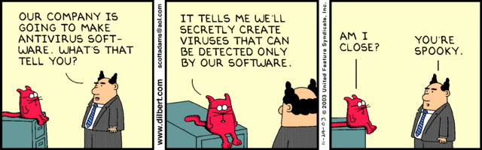
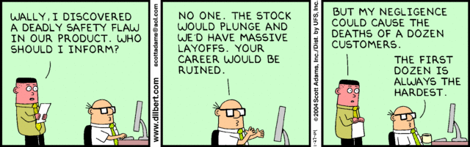
Notes:
Ask how many people in ACM or IEEE

Slide 5
Debate Ground Rules
Before Debate
  Add “(YES)” or “(NO)” to the end of your name in Zoom to show your side
  10 minutes to converse with your team
  Share argument points, counter points, and responses
  Share experiences, especially in different countries, cultures, situations
  Decide who will: Go first, Respond to which points from opposing side
During Debate
  1 turn per person until everyone on your team has spoken
  Try to keep remarks to 30 seconds
  Switch sides at any time if you change your mind
Notes:
Release Game or Not Debate
Chapter 9 In-class Exercises # 24.
Should the company produce the game?
Use the SWE Code Of Ethics as the basis for your argument.

Slide 6
Assignment
1 Page Paper
  What should computerized automation be applied to next?
Finish all reading
Group Project
  Add analysis to website addressing remaining topics
  Group Presentation Draft
    Submit as Power Point on Canvas
    Post Power Point file on group website
Notes:
1 Page Paper Ideas:
For Good - How will you use your computing related education to do good in the world?
Dark Net - Is the Dark Net good or bad?
Does computerized automation help the economy or society?
What should computerized automated be applied to next?
If productivity has increased so much, why are we working so hard? Should we?
What job skills will survive computerized automation?

Slide 7
Overview
Review
Debate
Assignment
Students Present
Notes:
Show WPI and/or corporate code of ethics.

Slide 8
The Ethical use of ai In the security / defense industry
Ethan Reed
© 2022 Keith A. Pray

Slide 9
Artificial intelligence & its current growth
Ethan Reed
AI already surrounds us today
  Used throughout life
  Typing predictions
  Recommended shopping products
  Playlists from similar songs
Rapidly advancing in several fields
Defense industry - guiding robots to full weapons systems [1]
Question- should there be a line for preventing AI’s further implementation into these fields and where?
1. RAF’s Lightweight Affordable Novel Combat Aircraft (LANCA), expected to be one of the most advanced aircrafts in history upon release due to its fully autonomous design [10]
© 2022 Keith A. Pray
Notes:
- Different levels of AI already surround us and are used in several parts of our daily lives
- Examples of this are the greyed-out predictions after the word your typing based off of previous texts you’ve sent
- Products that are recommended to you when you buy something based off of shopping habits
- Playlists for you based on songs you’ve liked or listened to in the past
It is advancing and expanding throughout many fields today, two of which are the security & defense industries
In the defense industry it’s currently used anywhere from guiding basic robots to controlling full autonomous weapons systems
Question to be asked is, knowing that AI will continue its implementation into these fields, where should the line be drawn?
Consequently, knowing that the progress of machine learning is necessary for our growth, we must ensure that guidelines are put into place to prevent this technology from getting out of hand

Slide 10
Types of AI Used Today
Ethan Reed
Narrow AI
  Accomplishment of single task
Artificial General Intelligence (AGI)
  Complex tasks with multiple sensory inputs [2]
  e.x. Tesla self-driving algorithms
Still very far from achieving full AGI, assuming we achieve it all [3]
2. Tesla’s self-driving algorithm recognizing and identifying known objects through self-learning neural networks for autonomous driving
© 2022 Keith A. Pray
Notes:
Brief summary on the types of AI that are used today-
Narrow AI, which is used for the accomplishment of single, often repetitive tasks, which due to their basic yet time consuming nature makes it very easy for machines to often handle these tasks more efficiently than people
Second kind is Artificial General Intelligence (or AGI), which is intelligence that resembles a person’s ability to conduct complex tasks while using multiple sensory inputs
This is still much harder for AI, which is currently not advanced enough to process many real-world things the way people do
Example related to a previous presentation is Tesla’s self driving abilities, which Musk would like to make solely dependent on camera inputs, however cars today do not have the the processing power to achieve this yet without computers that aren’t accessible yet or the help of other sensors that require less neural analyzing to work such as radar or lidar
- This means that we are still very far from achieving full AGI, with some professionals even saying it’s creation isn’t even a definite and it may never actually be created at all

Slide 11
Progression of Lethal Autonomous Weapons Systems
Ethan Reed
Lethal Autonomous Weapons Systems [4]
  Can sense environment
  Identify a target
  Chose to engage
Previously used for defense
  landmines - ground intruders
  Navy’s Phalanx Close - ASMs & aircrafts [5]
Defensive until Kargu-2 fatalities [6]
Creates problems- current offensive tech isn’t advanced enough yet
3. Phalanx Close-In Weapons System (CIWS) with radar-guided M61 Vulcan Gatling gun in navy training exercise
© 2022 Keith A. Pray
Notes:
Now moving onto AI’s connection with the defense industry
Lethal Autonomous Weapons Systems are defined as machines that can sense the environment, identify a target, and determine whether or not to engage, all without human input
Previously, most examples of these systems have been mainly for defense purposes with varying complexities
Anything going from landmines used back in WWII all the way up to our Navy’s Phalanx Close shown on the right, which automatically detects, evaluates, tracks, engages, and performs kill assessments against air-to-surface missiles and high speed aircraft threats that may be targeting our combat ships
- These lethal autonomous weapons systems were at least all thought to be currently defensive, however in March 2020 there was believed to be the first first human death caused by autonomous robots, when a Turkish-built Kargu-2 attack drone engaged and killed human targets in Libya, however some are still unsure if it was operating completely autonomously at the moment
- This scenario shows several very significant problems, the main being that to our knowledge current offensive weapon tech isn’t advanced enough yet to autonomously identify people and determine if the threat is hostile with accuracy

Slide 12
Decision Making in Modern Defense
Ethan Reed
People used to control with AI implemented into coding
  e.x. pilot steers plane, computer controls flaps, rudder, thruster
Col. John Boyd’s decision making model- OODA loop [7]
  Observe
  Orient
  Decide
  Act
Machine’s OODA loops are faster- computer necessities in life-or-death
© 2022 Keith A. Pray
Notes:
- Because this kind of technology doesn’t exist yet, people are still used for physically controlling and operating most machines, with AI used throughout the coding of how they function
- an example being when a pilot steers a plane manually by turning the yoke, and the computer controls the exact actions performed by the wing flaps, rudders, and thruster based on inputs from on-board sensors and outside
data regarding air conditions, along with additionally even using data from past flights to correct errors in these calculations
- I found an article that discussed Air Force pilot Colonel John Boyd’s decision making model on what he calls the OODA loop, or the required process for every action performed flying, these steps being observe, orient, decide, then act
- Our growing issue today that Boyd came to realize as well is that machine’s OODA loops are faster than people’s, and they have been for some time now, meaning that in high stakes situations computers can be the difference between life and death, and it may be necessary to allow the computer to regulate the process or at least recommend a decision to its user to beat the enemy

Slide 13
Ethics of Lethal Aut. Weapons systems
Ethan Reed
Difficulty with “autonomous target recognition” system
  Object recognition- machine learning through neural networks
Problems recognizing military weapons/ vehicles [8]
Question of engagement- how to handle adult holding rifle vs child with toy gun
Do we pursue or risk being outmatched?
© 2022 Keith A. Pray
Notes:
- The ethics of lethal autonomous weapons systems
- The most difficult aspect of the decision chain to automate is the “autonomous target recognition” system
- this is because the object recognition is performed by machine learning, or deep learning through neural networks
- This means that the computer must use machine learning to recognize military weapons and vehicles such as artillery and tanks, which can be done today however still with frequent recurring problems such as false positive identifications
This brings us to the question of whether or not computers should be able to engage targets
for example, how would a sentry drone set up to protect ally soldiers in hostile territory handle an adult holding a rifle vs a child holding a toy gun?
- So, knowing that our enemies are pursuing this technology, do we pursue it as well even with the risk of computers being put in charge of these extremely important decisions, or do we limit ourselves with ethics knowing we may also soon be outmatched by a threat that has no understanding of human life

Slide 14
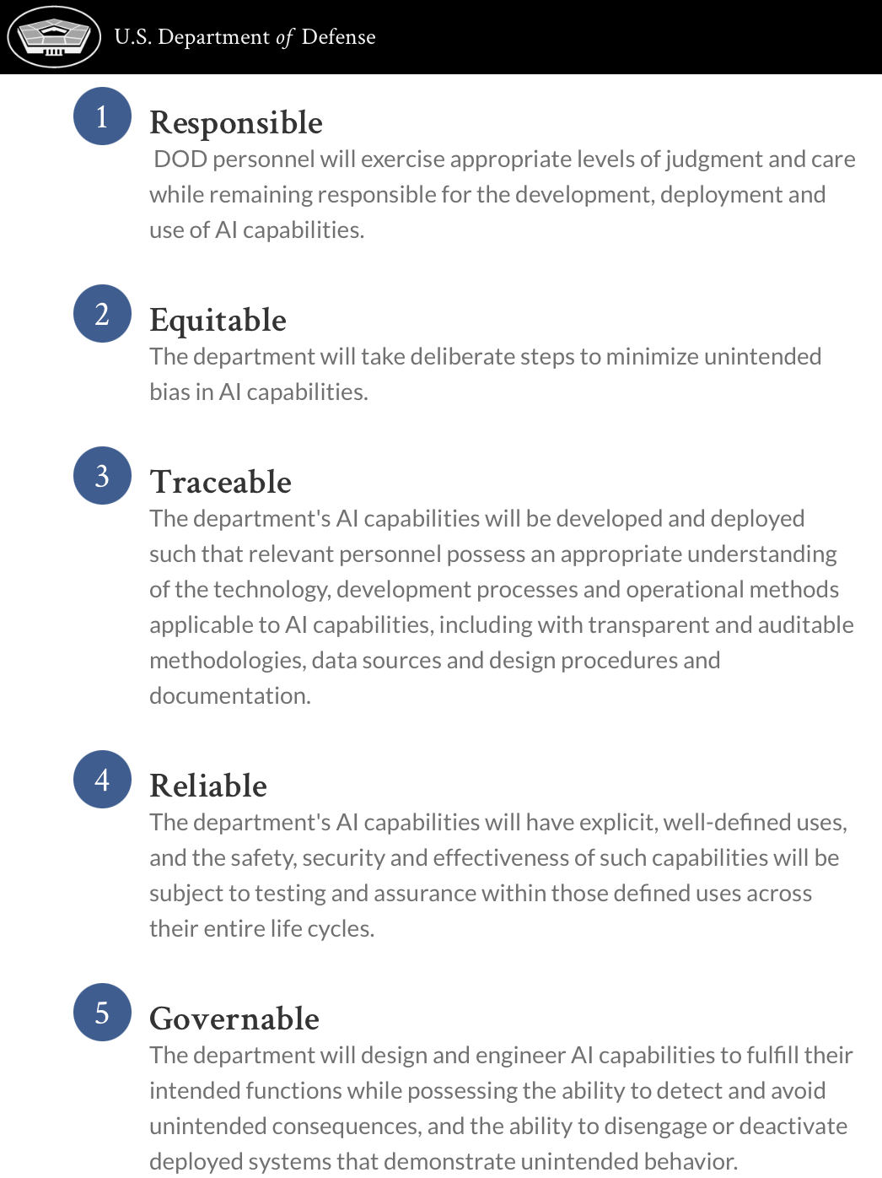
Department of Defense’s Response
Ethan Reed
5 principles of AI ethics for use in the military [9]
US Defense Department will be:
  Responsible
  Equitable
  Traceable
  Reliable
  Governable
Good first step- lacking in detail & open to interpretation
© 2022 Keith A. Pray
Notes:
- In response to moral concerns such as the previous two, the United States Department of Defense has developed 5 principles of AI ethics that are stated to be used as a framework for the design, deployment, and use of AI in the military
The Defense Department has promised it will follow these 5 principles openly stated on their official website:
The DOD and it’s personnel will be responsible and exercise appropriate levels of judgment and care with AI capabilities
They will be equitable and take deliberate steps to minimize unintended bias in AI capabilities
They will be traceable, meaning relevant personnel will have access to the necessary technologies, methods, data, design documents related to projects
The DOD will be reliable, where the technologies will have set uses and safety and security tests that will be required throughout the processes
Finally the y will be governable, and will ensure their technologies only do what’s desired and can be deactivated in the case of misbehavior
This is a very good first step, however this response is nothing more than a statement to keep the public happy, which is clear given how much is lacking in detail and is heavily open to interpretation
It truly does not count as a valid response, and given the severity of the questions related to this, being told the DOD will strictly follow the rules that they make up for themselves and keep very good records that can only be accessed by the people who created them is not very reassuring

Slide 15

Where do we draw the line?
Ethan Reed
Common misconception - humans will always be relevant
How long until it’s necessary? Is their use justified if its to protect lives?
“Is it ever ok to let something that doesn’t know the value of life determine whether or not a person gets to keeps their own?” [1]
4. MQ-1 Predator and MQ-9 Reaper of the 432nd Aircraft Squadron stand idle for next mission at Creech Air Force Base, Nevada
Both are autonomous areal vehicles that use AI for enemy surveillance/ ordinance targeting
© 2022 Keith A. Pray
Notes:
- So, the question we have to ask ourselves is, where do we draw the line?
- It’s easy to think humans will always be in the kill chain of events in these systems because computers should not be allowed to make this decision, but this is changing
- The problem with this belief is how long until removing humans from the equation is necessary, when our enemies currently pursuing this technology finally achieve it and use it against us?
- And, is using lethal autonomous weapons justified by knowing the alternative is losing soldiers to others who are utilizing this technology?
- Finally, the article asks the question Is it ever ok to let something that doesn’t know the value of life determine whether or not a person gets to keeps their own

Slide 16
References
Ethan Reed
[1] The Ethical Use of AI in the Security, Defense Industry, https://www.nationaldefensemagazine.org/articles/2021/12/21/the-ethical-use-of-ai-in-the-security-defense-industry.
[2] Lutkevich, Ben. “What Is Artificial General Intelligence? - Techtarget.” SearchEnterpriseAI, TechTarget, 13 Apr. 2022, https://www.techtarget.com/searchenterpriseai/definition/artificial-general-intelligence-AGI.
[3] Holländer, Branislav. “Why We May Never Develop Strong AI.” Medium, Towards Data Science, 25 Jan. 2021, https://towardsdatascience.com/why-we-may-never-develop-strong-ai-e49c805480f.
[4] Jones, Taylor, et al. “Lethal Autonomous Weapons Systems.” Future of Life Institute, Taylor Jones Https://Futureoflife.org/Wp-Content/Uploads/2015/10/FLI_logo-1.Png, 2 Dec. 2021, https://futureoflife.org/lethal-autonomous-weapons-systems/.
[5] “Mk 15 - Phalanx Close-in Weapon System (CIWS).” MK 15 - Phalanx Close-In Weapon System (CIWS) > United States Navy > Displayy-FactFiles, https://www.navy.mil/Resources/Fact-Files/Display-FactFiles/Article/2167831/mk-15-phalanx-close-in-weapon-system-ciws/.
[6] Nasu, Hitoshi. “The Kargu-2 Autonomous Attack Drone: Legal & Ethical Dimensions.” Lieber Institute West Point, 10 June 2021, https://lieber.westpoint.edu/kargu-2-autonomous-attack-drone-legal-ethical/.
[7] “The Ooda Loop: How Fighter Pilots Make Fast and Accurate Decisions.” Farnam Street, 19 Mar. 2021, https://fs.blog/ooda-loop/.
[8] “The Role of AI in the Defence Sector.” Artificial Intelligence, Big Data Analytics and Insight, 24 Jan. 2022, https://www.analyticsinsight.net/the-role-of-ai-in-the-defence-sector/.
[9] “DOD Adopts 5 Principles of Artificial Intelligence Ethics.” U.S. Department of Defense, https://www.defense.gov/News/News-Stories/Article/Article/2094085/dod-adopts-5-principles-of-artificial-intelligence-ethics/.
[10] Defence, Ministry of. “£30-Million Injection for UK's First Uncrewed Fighter Aircraft.” GOV.UK, GOV.UK, 25 Jan. 2021, https://www.gov.uk/government/news/30m-injection-for-uks-first-uncrewed-fighter-aircraft.
…
© 2022 Keith A. Pray

Slide 17
Image citations (by slide #)
Ethan Reed
[2] https://assets.publishing.service.gov.uk/government/uploads/system/uploads/image_data/file/112983/s960_Mosquito_gov.uk.jpg
[3] https://bernardmarr.com/wp-content/uploads/2021/07/How-Tesla-Is-Using-Artificial-Intelligence-to-Create-The-Autonomous-Cars-Of-The-Future.jpg
[4] https://i.ytimg.com/vi/Zsf38NYzo5Q/maxresdefault.jpg
[5] https://www.google.com/url?sa=i&url=https%3A%2F%2Fobvious.tech%2Fen%2Fooda-vision&psig=AOvVaw1bWVHHRkQGMYtxOoUZCxJl&ust=1649977722029000&source=images&cd=vfe&ved=0CAwQjRxqFwoTCPD31pOUkvcCFQAAAAAdAAAAABAK
[7] https://www.defense.gov/News/News-Stories/Article/Article/2094085/dod-adopts-5-principles-of-artificial-intelligence-ethics/
[8] https://www.belfercenter.org/sites/default/files/styles/featured_image_1280x515_/public/images/publication/feature/24252345085_9cc011f4df_o.jpg?h=a5f17927&itok=EU4ON5dv
…
© 2022 Keith A. Pray

Slide 18
Dehumanizing ubiquity for college students
Juliana Porto

Slide 19
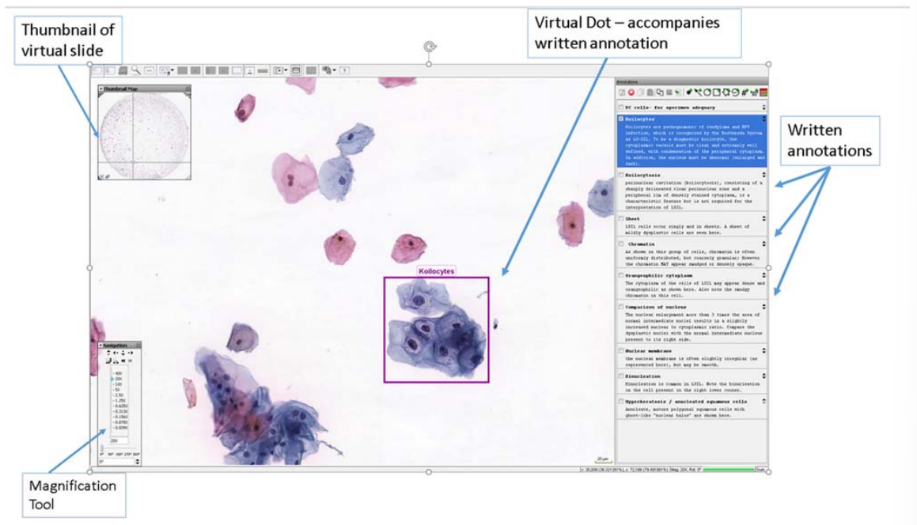
What technology does for us
Juliana Porto
Lectures
  Online
  Recorded
Course Organization
  Canvas
  Online Syllabus
Virtual Scientific Tools [1]
  Example of a Virtual Scientific Tool: mScope for Virtual Microscopy [1]
Notes:
It’s no secret that technology has the ability to make our lives better in and out of the classroom.
For example, class lectures can now be recorded or shared live (as we are doing right now). This allows students to catch up on material they miss due to illness or other unforeseen circumstances. Obviously, this was very helpful when COVID hit and allowed us to stay connected through education even when we were separated by distance.
Courses are also much more organized thanks to systems like Canvas. Students can view the entire class syllabus without having to carry a paper copy with them. Due dates can also easily be adjusted and quickly communicated if needed.
Lastly, virtual scientific tools can be used for easily accessible demonstrations and student practice. Here you can see mScope, an online tool that mimics a microscope.

Slide 20
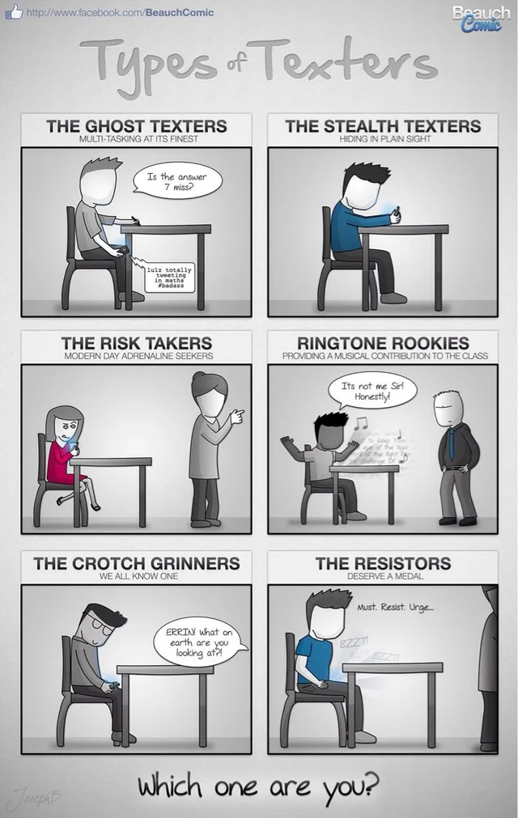
multitasking
Juliana Porto
In-Class Cell Phone Usage Study
  Entire Letter Grade Lower [2]
Survey Done Afterwards
  40% of Students Still Felt that it was Acceptable to Text in Class [2]
Notes:
What’s not as obvious is what technology does to us.
Everyone has a cell phone that they carry with them and lots of students think it’s perfectly reasonable to answer text messages during class. A study done to test the impact of in-class cell phone usage during course lecture on test performance showed that students who responded to messages during lecture performed a whole letter grade worse than those who did not. By trying to multitask, students turn into mindless robots switching their attention back and forth on different topics instead of devoting their attention to whatever is being taught in lecture.
Surprisingly, a survey done after the study showed that 40% (nearly half) of the students still felt that it was acceptable to text in class even after seeing the results. All humans have a basic desire for evolving and improving themselves. Students not caring about something that can better themselves academically goes against basic human nature and is a dehumanizing effect of technology.

Slide 21
Cyberbullying
Juliana Porto
Anonymity
Prevalence
  ~59% in college students [3]
Effects on Victims
  Health (depression, anger, etc.) [4]
  Behavior (substance use & academic performance)
  Personal Relations (loneliness)
Notes:
Technology allows students to have anonymity.
Studies have shown that cyberbullying is prevalent in the lives of about 59% of college students. Cyberbullies dehumanize themselves by hiding behind fake accounts and dehumanize victims by causing them extreme emotional distress. This emotional destress causes negative effects on health, behavior, and personal relationships. A study done by the International Academy for Suicide Research found that victims of cyberbullying are almost twice as likely as non-victims to have attempted suicide.

Slide 22
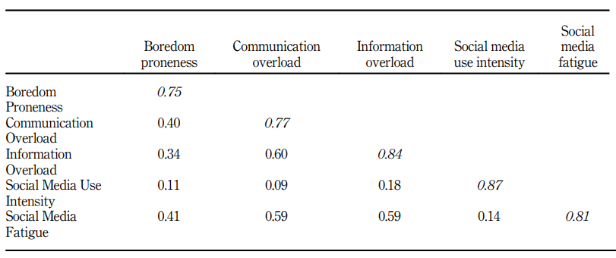
Social media burnout
Juliana Porto
Social Media Fatigue
  Increased Exhaustion because of Information Overload [5]
Correlations
  Communication & Information Overload
  Boredom Proneness
  NOT Social Media Use Intensity
Notes:
Technology also allows students to have constant communication with their peers.
Social Media is a very common form of communication for college students since users can connect with others anytime and anywhere. Because of this constant connection, many students have an impulsive habitual use of social media and smartphones in general. They then become overwhelmed by content and connection demands, and it leaves them exhausted.
Time away from schoolwork is supposed to be used for resting and entertainment, but with Social Media Fatigue, students are using their rest time to tire and stress themselves out even more. Surprisingly, social media fatigue has been found to have very little correlation to social media use intensity, but it does correlate with communication and information overload as well as boredom proneness as seen in the table to the right.
Social Media Fatigue leaves students wandering through classes with extreme exhausting and limits their true academic potential.

Slide 23

Conclusion
Juliana Porto
Is what technology does for us worth what it does to us?
  Multitasking
  Cyberbullying
  Social Media Burnout
Not worth it
  Embrace technology to advance our education
  Be aware of its negative impacts
  Don’t let it take away our humanity or educational potential
Notes:
In conclusion, we must all ask ourselves the final question: is what technology does for us worth what it does to us?
Is answering texts while in class worth possibly dropping a whole letter grade?
Is cyberbullying justified by anonymity?
And is social media worth the constant exhaustion?
My personal answer to all these questions is no. As students we should let technology play a driving force in educational advancement but be constantly be aware of its negative impacts so that we don’t allow it to take away our humanity and limit our educational potential.

Slide 24
References
Juliana Porto
[1] Donnelly, Amber. “CytoTECHnology: The Benefits of Technology in Teaching.” Cancer Cytopathology, Aug. 2018, Wiley Online Library. Accessed 13 Apr. 2022.
[2] May, Kaitlyn, Elder, Anastasia. “Efficient, Helpful, or Distracting? A Literature Review of Media Multitasking in Relation to Academic Performance.” International Journal of Educational Technology, 2018, Open Access. Accessed 13 Apr. 2022.
[3] Camacho et al. “Cyberbullying Impacts on Victims’ Satisfaction with Information and Communication Technologies: The Role of Perceived Cyberbullying Severity.” Universidad de los Andes & McMaster University, 27 July 2016, Elsevier. Accessed 13 Apr. 2022.
[4] Hinduja, Sameer, Patchin, Justin. “Bullying, Cyberbullying, and Suicide.” Archives of Suicide Research, 22 July 2010, Taylor Francis Online. Accessed 13 Apr. 2022.
[5] Whelan et al. “Is Boredom Proneness Related to Social Media Overload and Fatigue? A Stress-Strain-Outcome Approach.” Emerald Insight, 22 Jan. 2020, ProQuest. Accessed 13 Apr. 2022.

Slide 25
AI: where to draw the line?
Neville Ingram

Slide 26
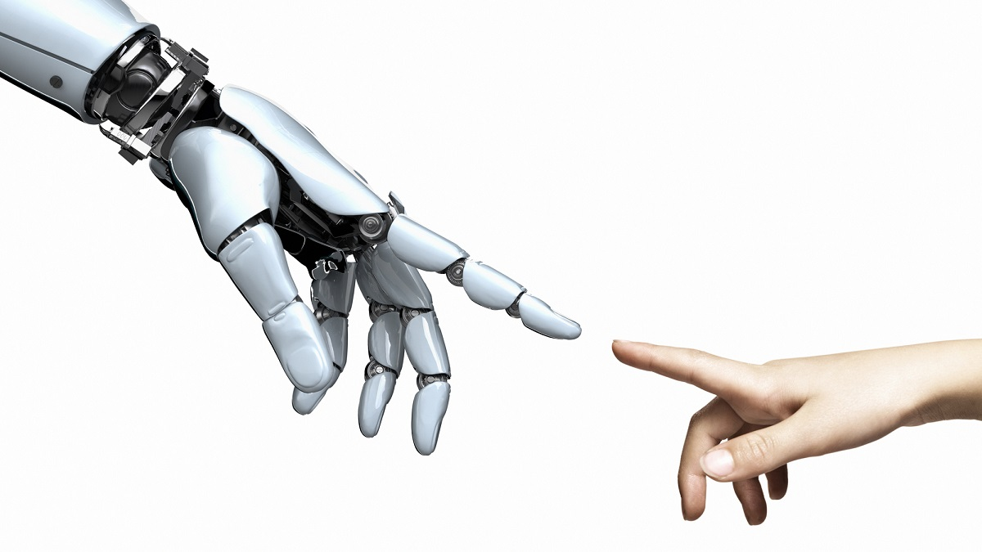
Ethical driven Development
Neville Ingram
Development of AI centered around ethics over progress
Increase in power is an increase in responsibility
Safeguards for AI misuse
https://cosmosmagazine.com/technology/ai/ai-ethics-good-in-the-machine/
Notes:
CONCLUSION
So by drawing the line I mean specifically between progress versus ethics at the dev stage of software so ->
Ethical AI: If the AI is going to be in an environment where an ethical dilemma could occur then the development process needs to be centered around ethics and protecting humans (i.e., a self driving car needs ethics, a simple prediction algorithm does not), this refers to AGI (Will talk about AGI in next slides)
TWO MAIN POINTS:
AI Ability: As the capabilities of AI increases so does the responsibility of developers to take more care in what they create (i.e., creating terminator for the sake of creating terminator is not ok) [SUPPORT ON SLIDE2]
AI Misuse: AI that could potentially be misused by a human needs to have some safeguards in place for it falling into the wrong hands (i.e., a voice mimicking software being used to act as another person) [SUPPORT ON SLIDE 3]
So, I will focus on these two points as reasons why we need to have ethical driven development with the current state of AI

Slide 27
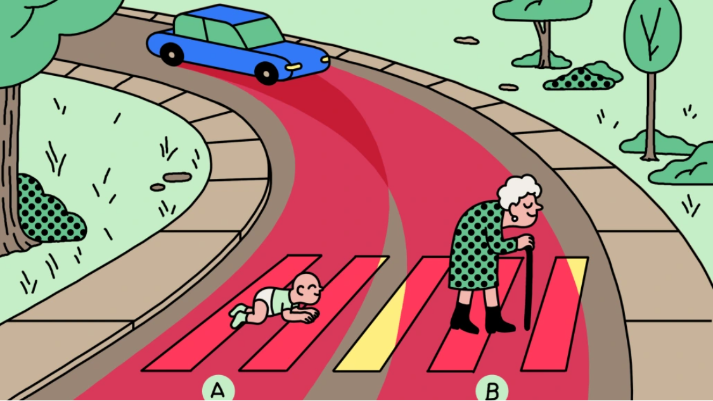
The Importance of ethical driven development
Neville Ingram
AI versus AGI
Trolley problem
AI becoming explicit moral reasoners
https://www.technologyreview.com/2018/10/24/139313/a-global-ethics-study-aims-to-help-ai-solve-the-self-driving-trolley-problem/
Notes:
HIGHLIGHTING AI “ERRORS” THAT POINT TO REQUIREMENT OF ETHICAL DRIVEN DEVELOPMENT
Distinction between AGI and AI: The typical AI that we know is when a piece of software is very good at a specific task, i.e. : the DeepBlue computer that beat Garry Kasparov in Chess cannot play checkers. AGI is when software can/attempts to mimic human intelligence: Could learn to play both checkers and chess and learn optimal strategy -> more dangerous [1] AGI NEEDS ETHICAL DRIVEN DEVELOPMENT -> AI MAY NOT
Trolley Problem: A good example of AI ethics is the trolley problem, which is an ethical dilemma of what to do when choosing between two options that both cause some type of harm, generally the example is a driver choosing between hitting a crossing pedestrian or going into oncoming traffic. As you can see this becomes a clear dilemma, what to do in this case?
Explicit moral reasoners: AI that thinks and makes decisions based on in its environment (self driving cars good example) need to be able to “think” in the moral sense and make proper ethical decisions

Slide 28
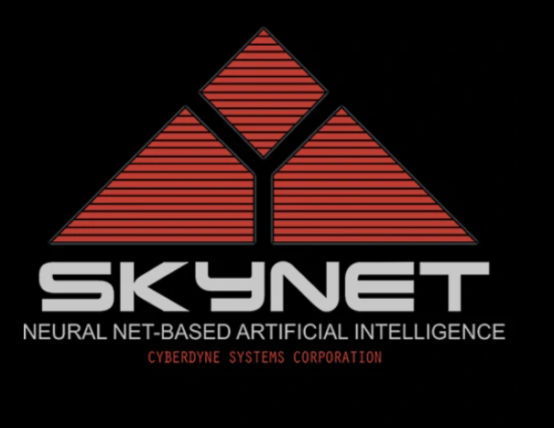
Human misuse in ai
Neville Ingram
AI becoming weaponized
Bypassing software security
Singularity Net
https://terminator.fandom.com/wiki/Skynet
Notes:
HIGHLIGHTING HUMAN “ERRORS” THAT POINT TO REQUIREMENT OF ETHICAL DRIVEN DEVELOPMENT
AI becoming weaponized: With access to AI resources increasing (making it easier to learn about AI), the possibilities of AI increasing, and people caring more about progress over ethics the threat of AI becoming weaponized becomes more prevalent. An example of humans weaponizing AI is in the picture. This is the logo of the company that created Skynet from the movie terminator which was the company that created the neural net used to control all the terminator bots HUMANS MISUING AI LEADING TO WORST CASE OF AI CONTROLLING HUMANS
Bypassing software security: Trend Micro antivirus released a report that discussed how criminals used AI to bypass email spam filters convincing the AI filtering your inbox that their spam emails were not spam HUMANS MISUSING AI
Singularity Net: Singular net is a blockchain company with the goal in mind of creating a blockchain used for the monetization of AI services -> again showing how the access to AI is becoming easier and easier which will lead to an increase of potential criminal activities with AI

Slide 29
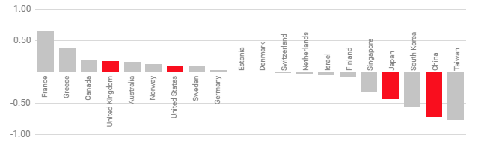
Solution: programming in ethical Codes
Neville Ingram
Goal: Think like a human
Problem: Ethical differences challenge
Two approaches to programming
  Supervised vs Unsupervised
Hope for future
  Current computational limits
  Future computational power
1 indicates more likely to choose to save the young, -1 indicates more likely to save the elderly. [3]
https://www.technologyreview.com/2018/10/24/139313/a-global-ethics-study-aims-to-help-ai-solve-the-self-driving-trolley-problem/
Notes:
SOLUTION: HOW TO PUT IN ETHICAL DRIVEN DEVELOPMENT & CURRENT STATE OF EDD
Goal: Have AI be able to think like a human in ethical scenarios
Ethical differences: MIT moral machine showed that Japan and China were more likely to save the elderly over a young compared to other countries (Trolley problem)
Two approaches: Explicitly program in the ethical theory -> leads to eventual ethical dilemma (). Other approach to program machines to learn inexplicitly from humans. ->NVIDIA driverless car able to learn how to drive after viewing 72hrs of a human driving -> However generally not able to model every situation so would take immense amounts of data to properly train (Supervised versus unsupervised machine learning)
Future: Ideally AGI & AI will be able to make the correct ethical decision like a human's thinking process as the ability for technology to model human behavior improves
Current computational limits: Currently in AI the most model most like human thought is a neural network, which takes inspiration from the human brain. However, these models are complex and are still unable to model the human brain since the amount of computational power needed is far beyond any hardware we have now (“The human brain has phenomenal processing power, far beyond that even of supercomputers today” [5])
Future computational power: The brains power comes from its ability to do an incredible number of “operations” in parallel very quickly whereas a computer simulate parallelism, however there is work on models such as DNN that are being pushed to their limits to possibly attain near human like ability

Slide 30
References
Neville Ingram
[1] Nick Bostrom, Eliezer Yudkowsky, “The Ethics of Artificial Intelligence”,(2011), http://faculty.smcm.edu/acjamieson/s13/artificialintelligence.pdf
[2] Lance Eliot, Tesla Lawsuit Over Autopilot-Engaged Pedestrian Death Could Disrupt Automated Driving Progres, (May 16, 2020, https://www.forbes.com/sites/lanceeliot/2020/05/16/lawsuit-against-tesla-for-autopilot-engaged-pedestrian-death-could-disrupt-full-self-driving-progress/?sh=146d377171f4[3]
[3] Karen Hao, Should a self-driving car kill the baby or the grandma? Depends on where you’re from, (October 24, 2018), https://www.technologyreview.com/2018/10/24/139313/a-global-ethics-study-aims-to-help-ai-solve-the-self-driving-trolley-problem/
[4] Amitai Etzioni, Oren Etzioni, Incorporating Ethics into Artificial Intelligence,(March 7, 2017) https://link.springer.com/article/10.1007/s10892-017-9252-2
[5] Trend Micro Research, Malicious Uses and Abuses of Artificial Intelligence, (December 6, 2021) https://documents.trendmicro.com/assets/white_papers/wp-malicious-uses-and-abuses-of-artificial-intelligence.pdf
[6] Jure Zupan, Neural Networks in Chemistry, (April 1995), https://www.researchgate.net/profile/Jure-Zupan-3/publication/259046271_Neural_Networks_in_Chemistry/links/55112e3d0cf2ba844840ef29/Neural-Networks-in-Chemistry.pdf

Slide 31
Who Consents, Your Neurostimulator or You?
Francis Coghlan

Slide 32
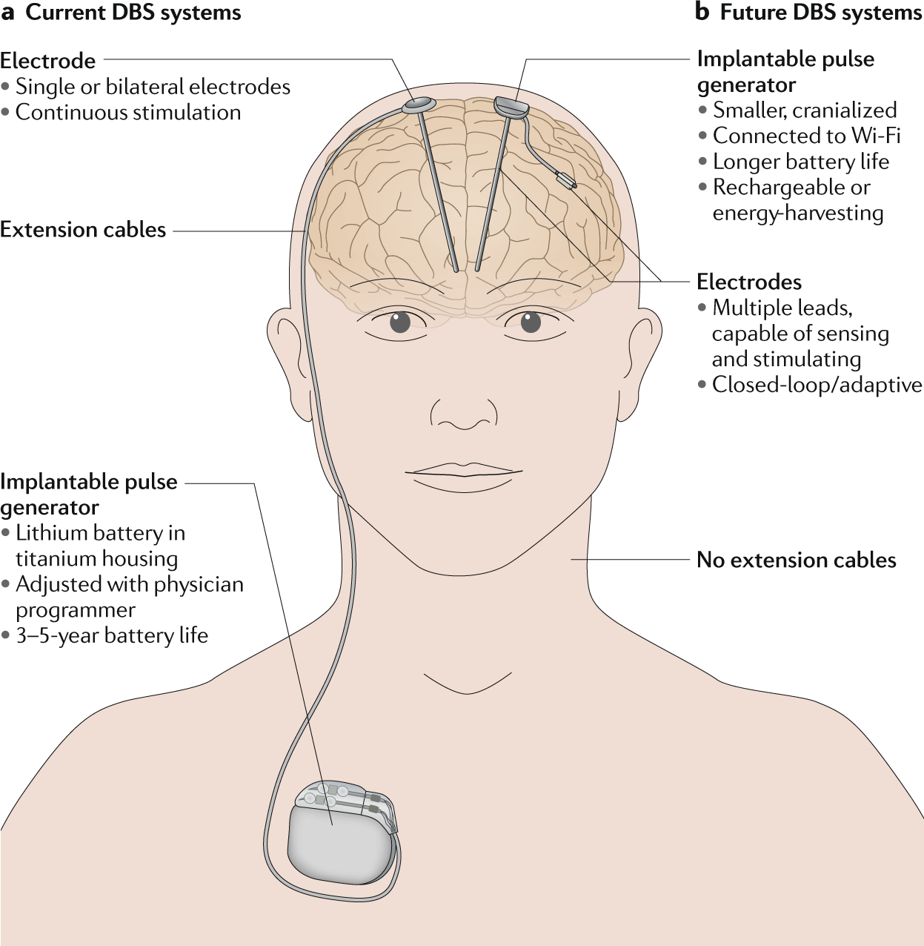
Consent and observation
Francis Coghlan
Neurostimulator implanted individuals must have a group consent with trusted individuals
Those with neurostimulators must be observed by family, friends, or peers for unexplainable behavior or memory changes
If these changes impact the patient’s life in a significant manner, they must be reported to the prescribing doctor
Notes:
Those with neurostimulators must have a system for group consent with trusted individuals, once implanted with a medical neurostimulators.
Those undergoing treatment must be observed by family, friends, or peers for behavior or memory changes. This can include the patient as well, if they’re able.
If these changes impact the patient’s life in a significant manner, they must be reported to the prescribing doctor.

Slide 33
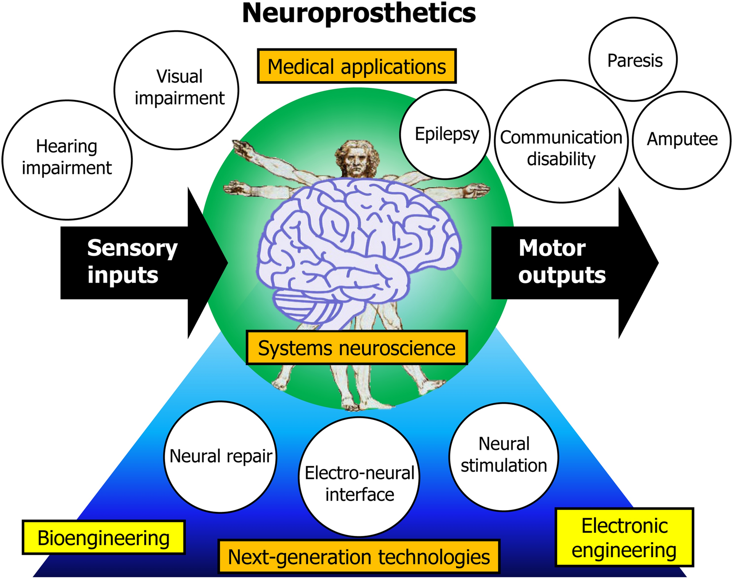
What is a Neurostimulators? What is DBS?
Francis Coghlan
Neuroprosthetics: Devices to regulate impaired portions of nervous system.
DBS = “Deep Brain Stimulation”
BCI = “Brain Computer Interface”
DBS uses an invasive neurostimulator for treatment of disorders.
This Presentation focuses on how DBS affects the brain.
Notes:
A Neuroprosthetic is a device designed to regulate impaired portions of the nervous system.
DBS stands for Deep Brain Stimulation.
BCIs, or brain computer interfaces are designed to create a communication pathway between the brain and a computing device.
DBS utilizes a neurostimulator invasively implanted in the brain to treat various disorders, such as Parkinson’s, epilepsy, and major depressive disorders.
While some BCI’s and neuroprosthetics are designed to only send signals into a user’s nervous system minorly, such as the cochlear implant, or hearing implant, for the purpose of this presentation we will be focusing on how deep brain neurostimulators affect the brain and personality.

Slide 34
Data
Francis Coghlan
Four themes emerged from successful neuroprosthetic treatments:
Control over device function
Authentic self
Relationship effects
Meaningful consent.
Patient 11: “it wasn't so much that it changed who you are, it rather restored who you are,” but he later confessed that this novel restorative empowerment originated an uncontrollable phenomenon from which he dissociated his self and does not recognize himself: “There's nothing that I can do [to stop this] ‘emotional incontinence’ as I call it. … If I had a choice I would say, ‘Look see what you can do … to stop me from doing that.’ Because it does get embarrassing.”
- I Miss Being Me: Phenomenological Effects of Deep Brain Stimulation
Notes:
When the neuroprosthetic is successful in treating a diagnosed disorder, it may in turn create additional side effects, both directly and indirectly. Four themes tended to emerge from successful neuroprosthetic treatments.
Control over device function: differing types of control over DBS device settings and risks and benefits of control, (such as discussing open vs. closed loop DBS)
• Authentic self: The capability of a DBS device to allow expression of authentic self.
• Relationship effects: The impact of a DBS device on relationships with family, medical personnel, and researchers.
• Meaningful consent: effective communication of complex information, the framing of realistic expectations, and attention to cognitive and affective impairments.

Slide 35
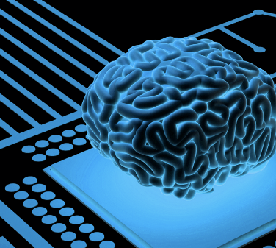
Positives and Negatives
When neurostimulator’s effects results in negative outcomes, then it must be reported.
If the neurostimulator’s changes a patient for the positive unexpectedly, other than the expected result of the treatment, should it be reported?
What is the definition of positive and negative in the patient’s view? The doctor’s? Peers, friends, and family?
Usage may lead to a sense of loss of control, or that the device is influencing their decisions
Notes:
When a neurostimulator’s effects results in negative outcomes, then it must be reported.
But if the neurostimulator’s changes a patient for the positive unexpectedly, other than the expected result of the treatment, should it be reported?
In that case, what is the definition of positive and negative in the patient’s view? The doctor’s? Peers, friends, and family?
The use of a neurostimulator may lead to a sense of loss of control, or that the device is influencing their decisions. In turn, it may become an automatic, inappropriate solution for other mental changes from friends, family, and peers. “Feeling sad? Adjust the DBS device!” while in truth a patient’s sadness may hold a different cause.

Slide 36
Identity, the brain, and change
The Identity is Dynamic.
Dramatic events or experiences can affect the identity.
Neurostimulators can affect the identity but still allows for agency, much like medication for ADHD or Anti-Depressants.
A person must be able to identify their past self, their present self, and what has changed between the two states and what caused the change, to have agency over the identity
When a neurostimulator undermines agency to the point where a patient can no longer contribute to the formation of identity, is when it is a threat to identity.
Notes:
The identity of a person is naturally dynamic. Dramatic events or experiences in life can affect the cognitive-narrative of a person’s relational identity, between the past identity and the present identity.
Neurostimulators can currently affect the identity, and the expression of personality, but still allows for the patient to control their actions, have agency, and associate their past and present identity, such as before the implant-self and after the implant self. For example, medications can affect how a person behaves, such as ADHD medication, or Anti-Depressants, but the individual taking those medications can still associate their past self and identify how they arrived at their present self.
Just a tentative example: I am Francis Coghlan, diagnosed with depression. I am then put on medication for anti-depressants, which increases my mood towards positivity and treats my depression. And yet I still claim that I am Francis Coghlan, because I still remember my past identity, and can recognize what changed between my past identity and my current identity: that I am now taking antidepressants. Thus, I am still Francis Coghlan. Of course, Neurostimulators are a more extreme example.
It is only when a neurostimulator prevents a patient from contributing to the formation of the relational, dynamic identity is when it is a threat to identity. Or in other words, if the neurostimulator prevents a person from comparing their past self with their present self or generates changes towards the negative without the patient’s input, is when it is a threat to identity.

Slide 37
The need for engagement
Neurostimulator-implanted individuals must be interacted with on a friendly basis.
Family, friends, and peers will need to observe and interact with the individual for unexpected changes. But also recognize and be open to the possibility that a patient’s personality change can occurs from other sources.
In addition, therapy is recommended for patients to identify that the neurostimulator are controllable, that they are tools to restore agency, and that unexpected beneficial outcomes are not necessarily negative ones.
Neurostimulators are an experience, much like how trauma, or dramatic events, or even medication, changes the brain.
Note that these are extreme cases: Current and future BCIs tend to not impact the patient’s personality

Slide 38
References
Francis Coghlan
[1] Frederic Gilbert, Eliza Goddard, John Noel M. Viaña, Adrian Carter & Malcolm Horne (2017) I Miss Being Me: Phenomenological Effects of Deep Brain Stimulation, AJOB Neuroscience, 8:2, 96-109, DOI: 10.1080/21507740.2017.1320319
[2] Eran Klein, Sara Goering, Josh Gagne, Conor V. Shea, Rachel Franklin, Samuel Zorowitz, Darin D. Dougherty & Alik S. Widge (2016) Brain-computer interface-based control of closed-loop brain stimulation: attitudes and ethical considerations, Brain-Computer Interfaces, 3:3, 140-148, DOI: 10.1080/2326263X.2016.1207497
[3] Baylis, F. “I Am Who I Am”: On the Perceived Threats to Personal Identity from Deep Brain Stimulation. Neuroethics 6, 513–526 (2013). https://doi.org/10.1007/s12152-011-9137-1
[4] LIPSMAN, N. and GLANNON, W. (2013), BRAIN, MIND AND MACHINE: WHAT ARE THE IMPLICATIONS OF DEEP BRAIN STIMULATION FOR PERCEPTIONS OF PERSONAL IDENTITY, AGENCY AND FREE WILL?. Bioethics, 27: 465-470. https://doi.org/10.1111/j.1467-8519.2012.01978.x
[5] Sara Goering, Eran Klein, Darin D. Dougherty & Alik S. Widge (2017) Staying in the Loop: Relational Agency and Identity in Next-Generation DBS for Psychiatry, AJOB Neuroscience, 8:2, 59-70, DOI: 10.1080/21507740.2017.1320320
Image References
[1] Krauss, J.K., Lipsman, N., Aziz, T. et al. Technology of deep brain stimulation: current status and future directions. Nat Rev Neurol 17, 75–87 (2021). https://doi.org/10.1038/s41582-020-00426-z
[2] Kansaku, K. Neuroprosthetics in systems neuroscience and medicine. Sci Rep 11, 5404 (2021). https://doi.org/10.1038/s41598-021-85134-4
[3] Tayim, F. (n.d.). Linking brain to computer: Science or science fiction? Premier Health. Retrieved April 15, 2022, from https://www.premierhealth.com/your-health/articles/healthnow/linking-brain-to-computer-science-or-science-fiction-

Slide 39
Image References
Francis Coghlan
[1] Krauss, J.K., Lipsman, N., Aziz, T. et al. Technology of deep brain stimulation: current status and future directions. Nat Rev Neurol 17, 75–87 (2021). https://doi.org/10.1038/s41582-020-00426-z
[2] Kansaku, K. Neuroprosthetics in systems neuroscience and medicine. Sci Rep 11, 5404 (2021). https://doi.org/10.1038/s41598-021-85134-4
[3] Tayim, F. (n.d.). Linking brain to computer: Science or science fiction? Premier Health. Retrieved April 15, 2022, from https://www.premierhealth.com/your-health/articles/healthnow/linking-brain-to-computer-science-or-science-fiction-

Slide 40
Class 10
The End
Keith A. Pray
socialimps.keithpray.net
Notes:
The Game Of Trust - NICKY CASE
https://ncase.me/trust/
This is the end. Any slides beyond this point are for answering questions that may arise but not needed in the main talk. Some slides may also be unfinished and are not needed but kept just in case.

Slide 41
My Reading Notes
pp. 409 Can one perform services for one’s self?
pp. 412 1993-1999 Does this seem like a long time?
pp. 413 “errors of omission or commission”?
UPDATE
pp. 422 3. Would people agree – social contract?
pp. 438 So the baby can be left outside and no one is responsible?
Notes:
An error of commission is one where the person responds where they should not. This is compared to an error of omission, where the person fails to respond when they should.

