Slide 1
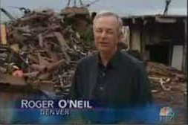
Class 9 Errors Failures Risks
Keith A. Pray
socialimps.keithpray.net
Notes:
What is the point of this assignment? (Did SW Teams from the reading pick good test strategies? Will you be able to support your choices if something goes wrong?)
What errors? – Have student record list on board
Who looked for directions on how to test currency?
MSNBC on Denver's Automated Baggage System 2010-08-23 (2:27)
https://www.youtube.com/watch?v=xx8f4x6C_KY
Accessed 2019-04-09
No Discussion Board

Slide 2
what works well Online With Zoom
Sign in with First and Last Name
Stay muted unless you are going to speak
To speak use the raise your hand feature
To answer yes/no questions use the “yes” ”no” buttons
Turn your camera on
Wait until the end of student presentations to ask questions
Write them down so you don’t forget

Slide 3
Papers
Clear, strong conclusion, easy to find
Make clear what claim evidence is supporting, explain how it’s relevant
Try reading paper out loud to yourself to catch typos, grammatical errors, contradictions
Avoid fallacies, e.g. begging the question
http://socialimps.keithpray.net/assignments/paper-guidelines/
Notes:
0s not included.
Save for next time:
Make decisive conclusions
may, could, etc. = trivial
Absolute statements are difficult to prove
Avoid: all, always, any, every, everyone, never, none… unless you can show it
Be sure to put quotes around entire quote
Hyperbole is the best thing ever!
but not in these papers
Print 2 sided and save a tree
Use template, saves time (and -1 point)
Use and cite supporting data from at least 5 high quality sources
Argument should directly support conclusion
Response should directly address counter point
Arguments should have at least 3 statements
Review fallacies in Appendix B and Class 2 Slides
Avoid Strawman Fallacy
Counter Point and Rebuttal should relate to each other and conclusion
Use supporting data in counter point and rebuttal
Quantify
Terms like: less, more, a lot, huge, great, big, tiny, growing, etc.

Slide 4
Grades To Date
34 Max Possible

Slide 5
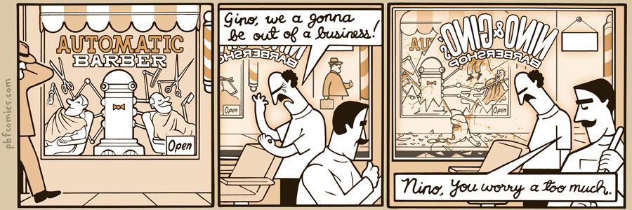
http://pbfcomics.com/197 (2014-09-26)
Notes:
10 – Errors, Failures, Risks

Slide 6
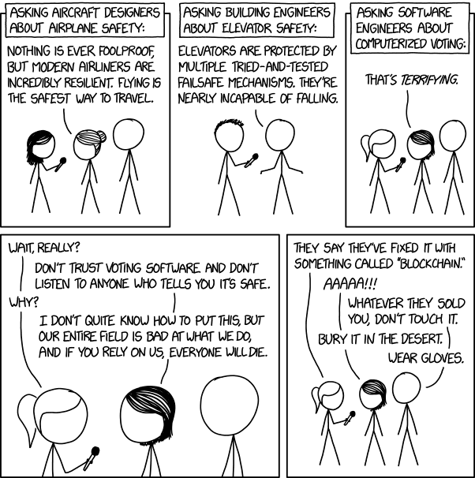

Overview
Review
Assignment
Students Present
https://xkcd.com/2030/ (2018-09-21)
Notes:
Good alternative if guest speaker not coming or late
Why Electronic Voting is a BAD Idea - Computerphile
https://www.youtube.com/watch?v=w3_0x6oaDmI
Might be better in Security
Other videos: 9News - Looking back at the massive failure that was DIA's automated baggage system 2020-02-28 (2:32) https://www.youtube.com/watch?v=xmas0-SthUQ
9News - Watch DIA's old luggage system toss baggage into the air 1995 (1:42) https://www.youtube.com/watch?v=OtLHVGtFmKU
abcNews - Major Luggage Debacle at Denver Airport https://abcnews.go.com/Travel/video/major-luggage-debacle-denver-airport-28054918
We can also discuss articles listed on Security Discussions under documents of course web site.
TODO: add quiz as backup if class discussion or guest speaker fail

Slide 7
My Reading Notes
pp. 366 Any false arrests since 1989?
pp. 368 Argument assumes DB cannot exist without existing inaccuracies.
pp. 373 This is not to keep the PATRIOT system from responding to false alarms.
pp. 375 Always encapsulate units! Not clear if SW involved.
pp. 376 Any SW diffs between Mars Missions?
pp. 378 Why did the Tokyo Stock Exchange refuse?
pp. 380 Republicans and Florida?
pp. 381. Do the second thoughts on DRE machines make the interview at end Chapter’s end less relevant?
pp. 389 No simulation examples since 2002?
pp. 390 Did The Limits to Growth predictions motivate people to change?
pp. 392 What happened to Verification?
pp. 394 “satisfies the specification” = verification. “needs of the user” = validation.
pp. 395 SW quality since 2009?
pp. 396 Gender bias nice addition!
pp. 406 21, source from 2004, is it implemented yet? 23 like game release question in next chapter.
Questions I liked: 10, 12, 16, 17, 18, 20, 21

Slide 8
Overview
Review
Assignment
Students Present
Notes:
We can also discuss articles listed on Security Discussions under documents of course web site.
ADD QUIZ AS BACKUP IF CLASS DISCUSSION OR GUEST SPEAKER FAIL

Slide 9
Assignment
Prepare for Debate
You are a software engineer in the employee owned company
from Chapter 9 In-class Exercises # 24.
Should the company produce the game?
Use the SWE Code Of Ethics as the basis for your argument
Use high quality sources and supporting data
Optional 1 page paper, lowest paper grade will be dropped
Add to Group Project Web Site

Slide 10
Sanctioned AI Human Harm
Yveder Joseph
Notes:
Hello welcome to my presentation on the ethics of killer robots.

Slide 11
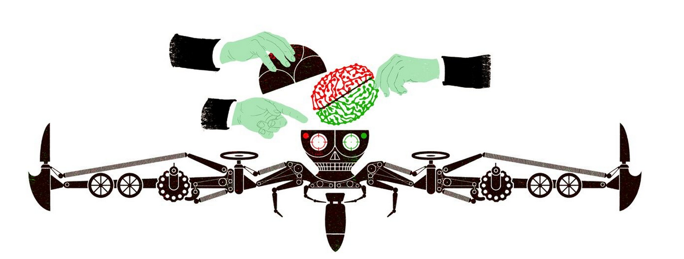
Defining Autonomous Weapons
Yveder Joseph
An autonomous weapon is one that can decide independent from human interference, when and against whom to use lethal force against[1].
Notes:
Before we delve into the ethics of these murderous droids, we need to define what they are exactly.

Slide 12
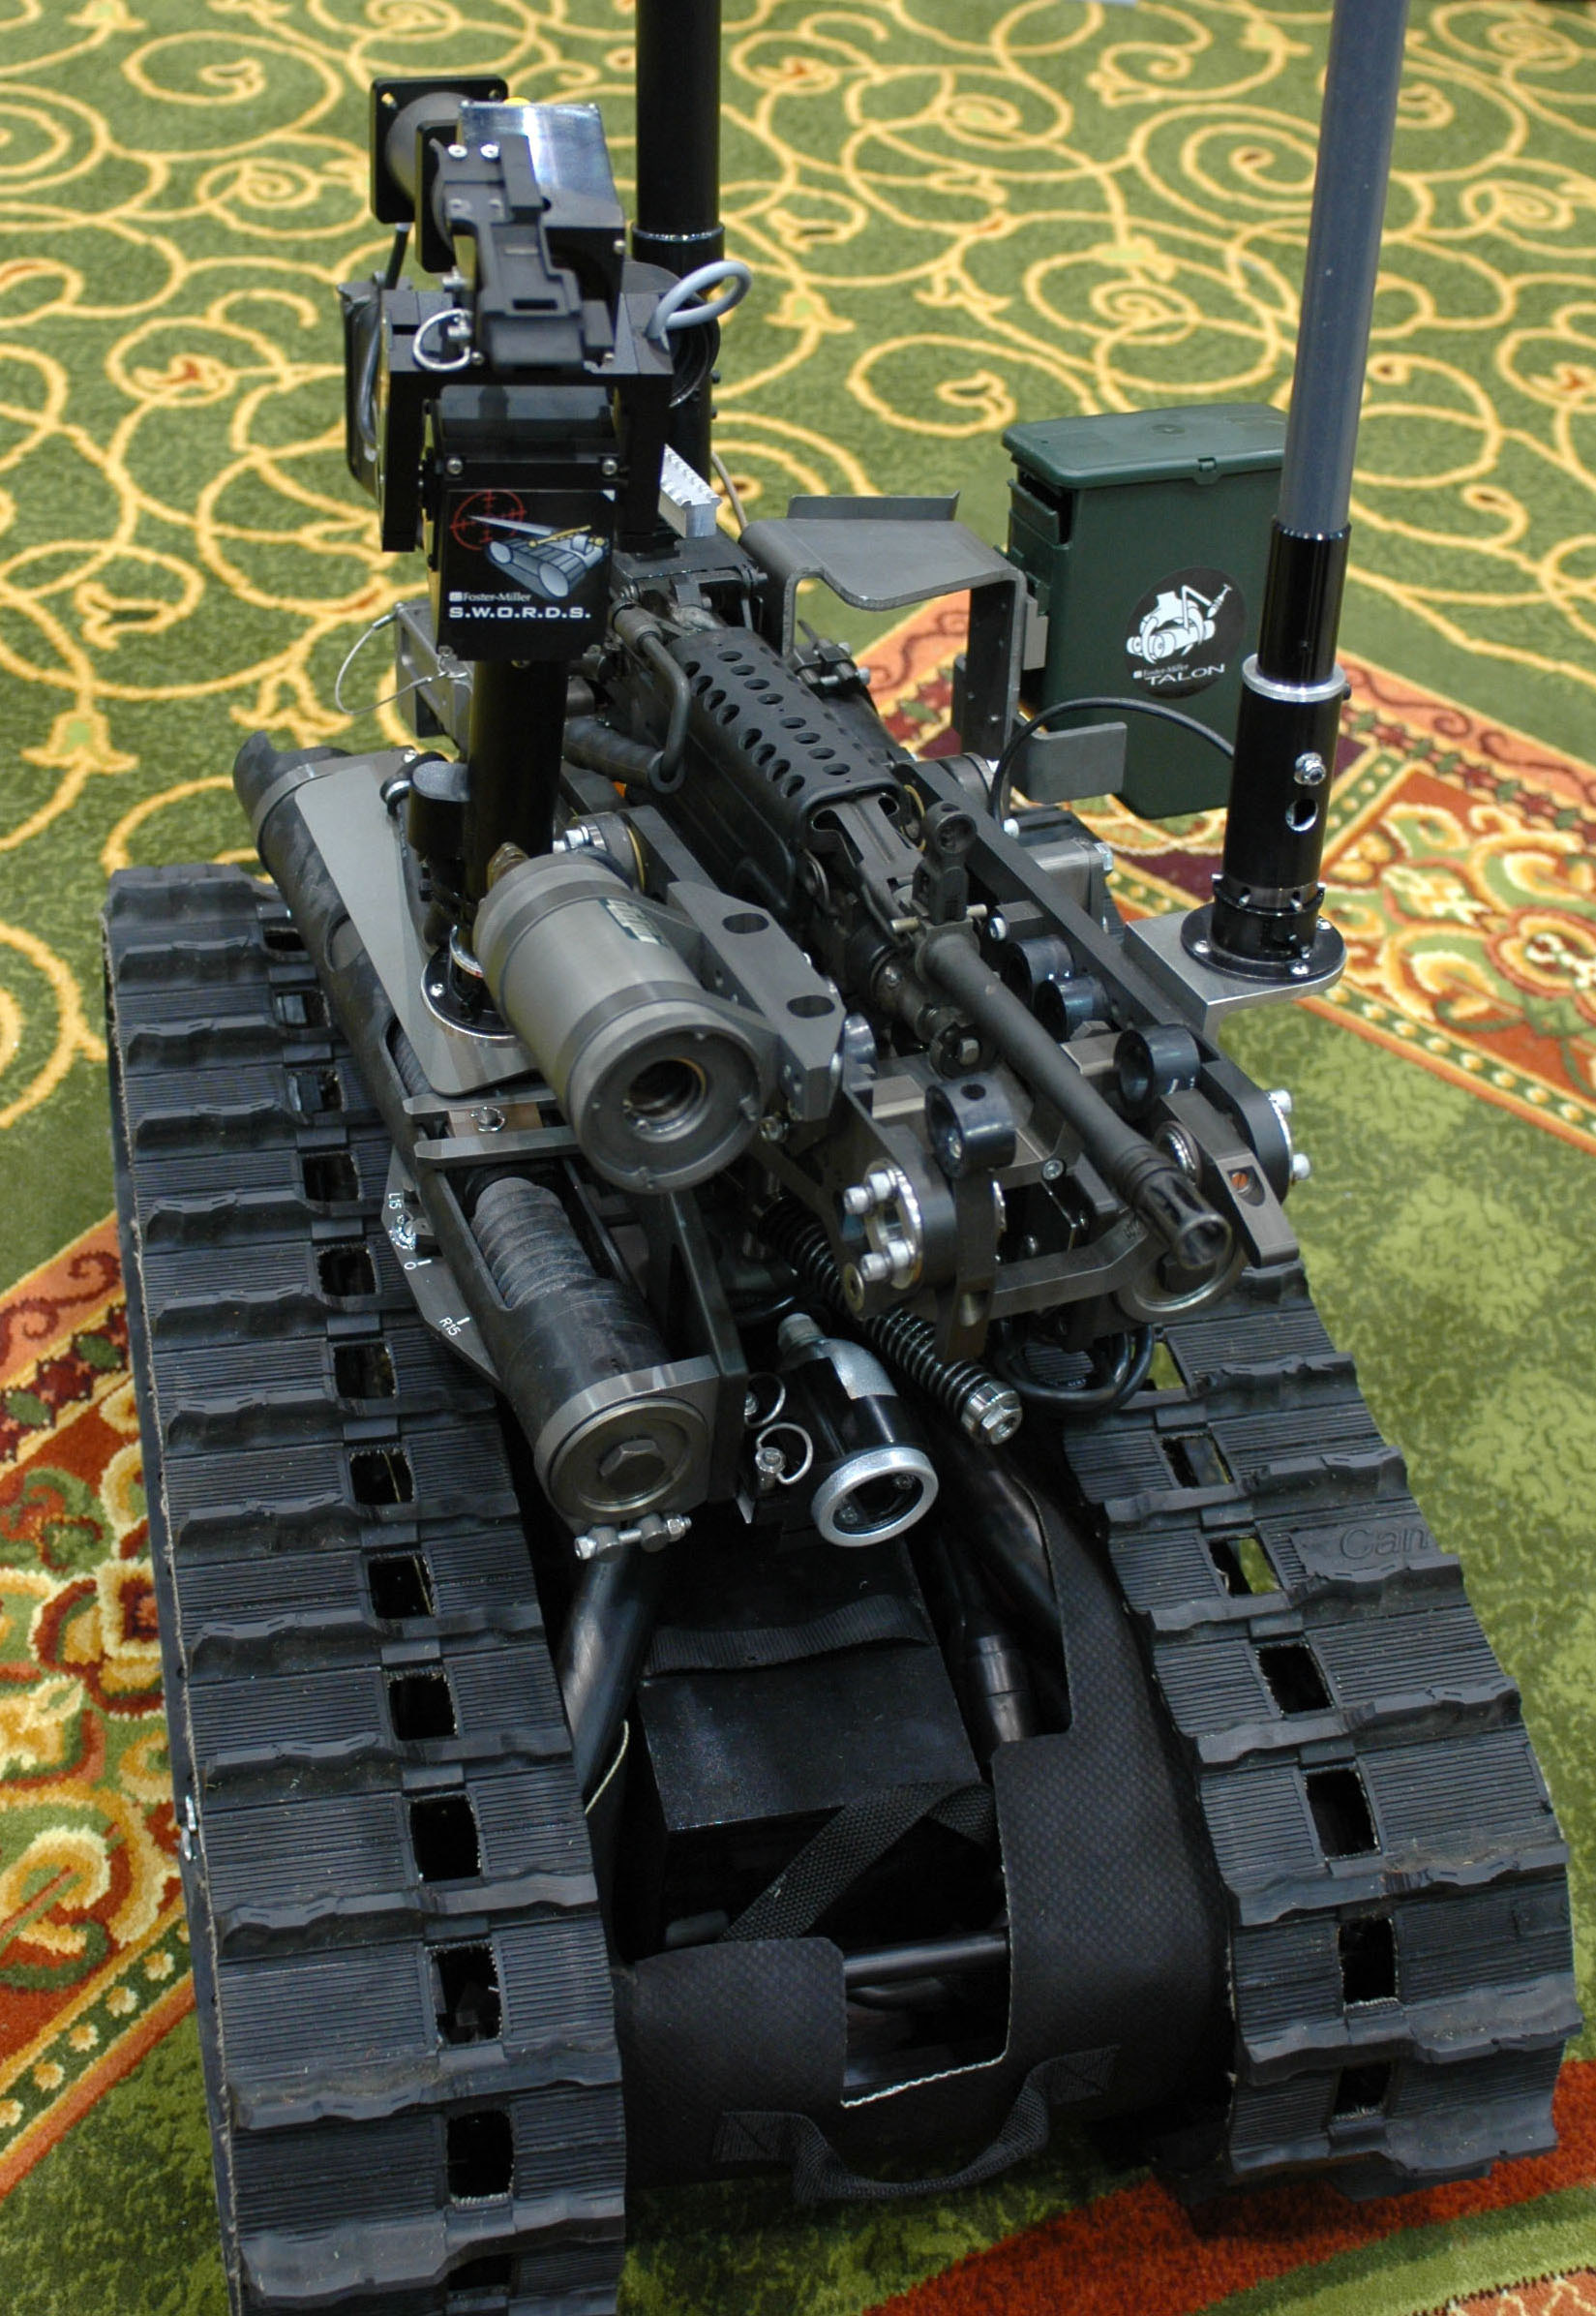
Military Advantage to Autonomous Systems
Yveder Joseph
Autonomous weapon systems are a force multiplier [2]
Autonomous weapon systems can operate in hazardous environments[2]
Autonomous weapon systems provide economic advantages[2]
Notes:
Autonomous weapons offer significant advantages in warfighting, regarding the scope of their operational use and in minimizing the size of the military force needed. By adding more support robots, the army could reduce the size of a brigade from three thousand to four thousand without any loss in effectiveness. Furthermore, by decreasing the number of warfighters lessens the number of causalities. Lastly, the cost of an average soldier in Afghanistan is $850,000 while outfitting the TALON( a small robotic rover) with weapons would only cost $230,000.

Slide 13
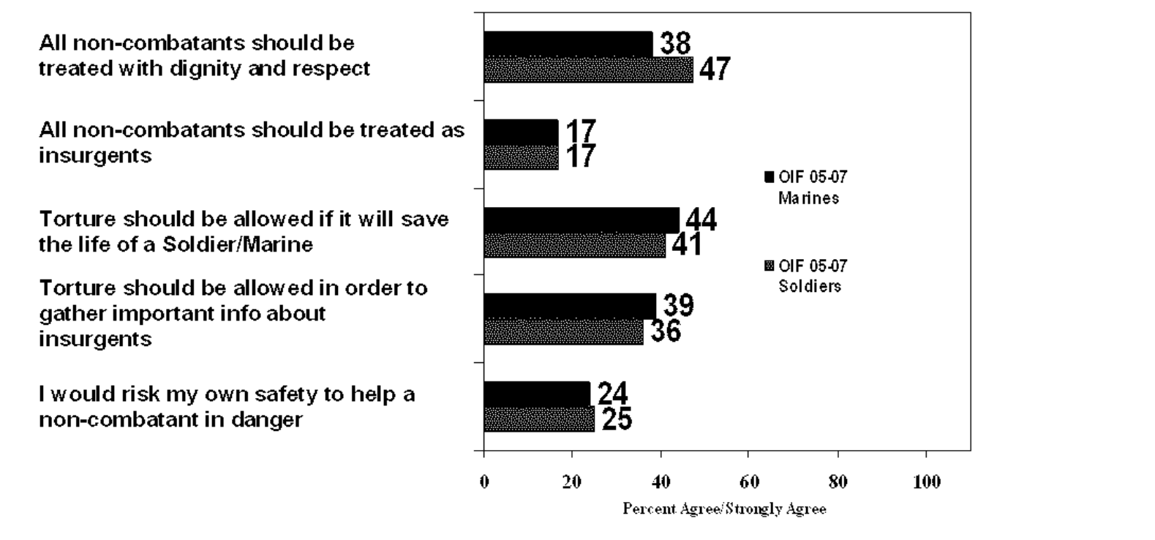
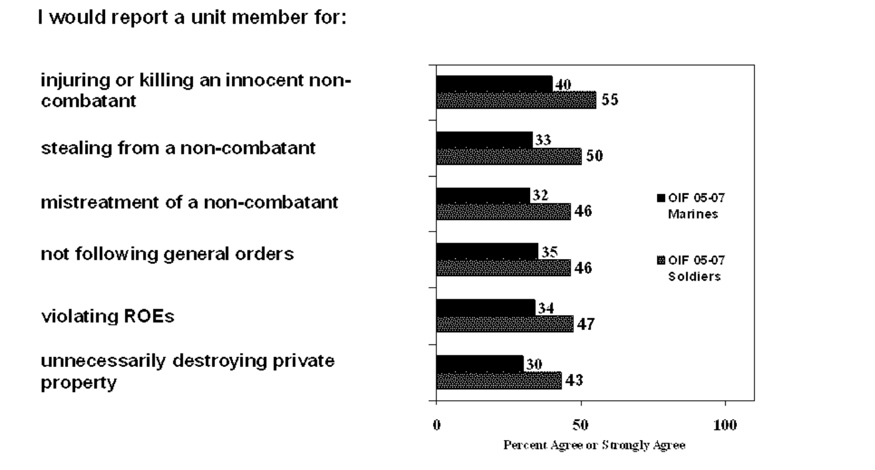
Automatic Ethics
Yveder Joseph
Human soldier set a low bar for ethical behavior in war, autonomous systems simply need to exceed that[4].
Notes:
A study conducted by the Mental Health Advisory Team (MHAT) in 2006, to assess the ethical conduct of US soldiers found that even tough 80% of those surveyed admitted that they received battlefield ethical training less then half strongly-agreed that non-combatants should be treated with respect. Furthermore, 40% strongly agreed that torture is allowable if it is to save the life of a fellow soldier, also 40% of soldiers agree that they would not report their comrades for injuring or killing innocent non-combatants.

Slide 14
The Killer Bug
Yveder Joseph
There will be bugs in the programing of these systems[6]
Autonomous weapon systems, strength is a double edge sword[3]
Notes:
As bugs are errors in the programs logic not malfunctions, so they are nearly undetectable. According to Murphy’s first law a working program is just a program with undetectable bugs. Murphy's laws of programing are a set of laws that are observations of common programmer errors. So, these systems will contain bugs and considering that these systems are meant to be lethal that’s a serious issue. Furthermore, bugs allow for the possibility of being hacked.
Unlike human combatants autonomous weapon systems will follow their programming exactly. But that very fact presents another problem, as what happens when such a system is face with a situation that falls outside of the scope of it’s programing? War is a chaotic and unpredictable environment so it’s nearly impossible to account for every possible situation. A human can choose to disregard orders and protocol when faced with an unknown situation but these systems inherently by their nature cannot.

Slide 15
Emotional Calculus
Yveder Joseph
Autonomous weapons cannot account for the non-legal protections provided to civilians[5]
Notes:
Autonomous weapons as rule-based systems do not exhibit compassion, which can be an important component to protect civilian lives. The non-legal protection provided to civilian's come from the emotional restraints that a human experiences. An autonomous system cannot question the orders that it is given and has its ethical rules defined by whoever is controlling it. As such a system can only be as ethical as its master. Such systems could be used as tools for repressive governments.

Slide 16
Conclusion
Yveder Joseph
Fully autonomous systems should not be used
These systems should be semi-autonomous with a human failsafe
Notes:
Autonomous weapons systems should be used, as their application removes soldier from the dangers of the theater of war. Furthermore, considering that the low moral standards exhibited by human war fighters seem to stem from a desire to protect those from their group. The data from the Mental Health Advisory Team (MHAT) shows this as less then half of the soldiers surveyed where willing to report the wrongdoing of their fellow soldiers and nearly 40% where willing to use torture to help a fellow soldier. 80% of those surveyed admitted to being trained in ethics of the battlefield and yet still admitted to being willing to partake in such unethical behavior. If humans are removed from the danger of war, then then the need to protect their group is no longer present, so they can be used as a failsafe for when the weapon system is faced with a situation beyond its decision-making capabilities. These systems do not have to be perfect but merely exhibit better ethical behavior then human combatants.

Slide 17
References
Yveder Joseph
[1] Caron Jean-François, "Defining semi-autonomous, automated and autonomous weapon systems in order to understand their ethical challenges," Digital War, vol. 1, (1-3), pp. 173-177, 2020. Available: http://ezproxy.wpi.edu/login?url=https://www.proquest.com/scholarly-journals/defining-semi-autonomous-automated-weapon-systems/docview/2532607608/se-2?accountid=29120. DOI: http://dx.doi.org/10.1057/s42984-020-00028-5.
[2] Etzioni, Amitai, and Oren Etzioni. "Pros and cons of autonomous weapons systems." Military Review, May-June (2017).
[3] M. C. Horowitz, “The Ethics & Morality of Robotic Warfare: Assessing the Debate over Autonomous Weapons,” Daedalus, vol. 145, no. 4, pp. 25-36, Fall 2016.
[4] Surgeon General’s Office.Mental Health Advisory Team (MHAT) IV Operation Iraqi Freedom 05–07, Final Report,November 17. Retrieved from: https://ntrl.ntis.gov/NTRL/dashboard/searchResults/titleDetail/PB2010103335.xhtml(2006).
[5] Human Rights Watch, Losing Humanity: The Case against Killer Robots (New York: Human Rights Watch, 2012).
[6] Michał Klincewicz.Autonomous Weapons Systems, the Frame Problem and Computer Security, Journal of Military Ethics, 14:2, 162-176, DOI: 10.1080/15027570.2015.1069013(2015)

Slide 18
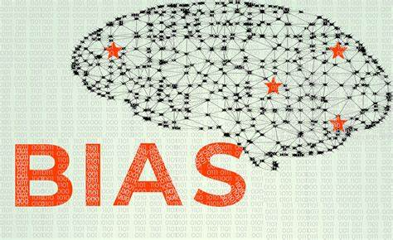
Algorithmic Bias
Hailey Anderson
Notes:
<speaker notes>

Slide 19
The Growing Importance of Algorithms
Hailey Anderson
“Algorithms are harnessing volumes of macro- and micro-data to influence decisions affecting people in a range of tasks, from making movie recommendations to helping banks determine the creditworthiness of individuals.” [1]
Notes:
Algorithms have been a big deal lately…
This quote shows it when stated “Algorithms are harnessing volumes of macro- and micro-data to influence decisions affecting people in a range of tasks, from making movie recommendations to helping banks determine the creditworthiness of individuals.” [1]

Slide 20
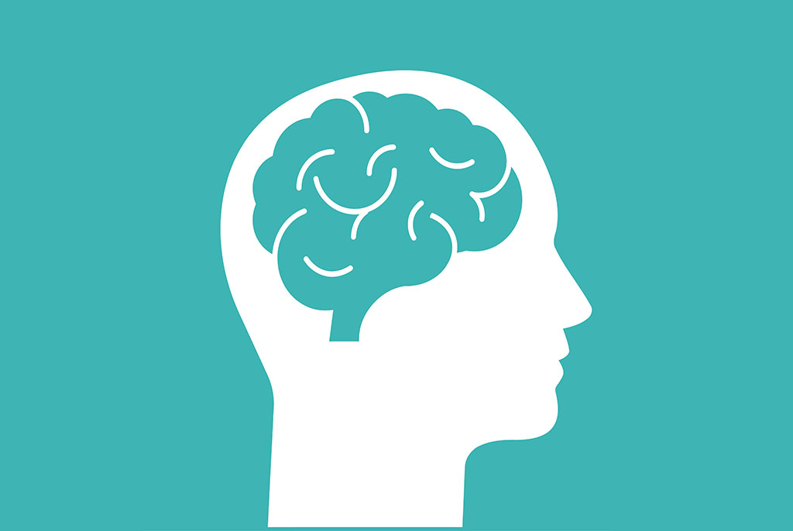
What is implicit bias?
Hailey Anderson
Implicit bias describes how we have attitudes or associate stereotypes with people. [2]
Notes:
Implicit bias describes how we have attitudes or associate stereotypes with people. [2]
In code, these biases can be manifested in how they take care of others.

Slide 21
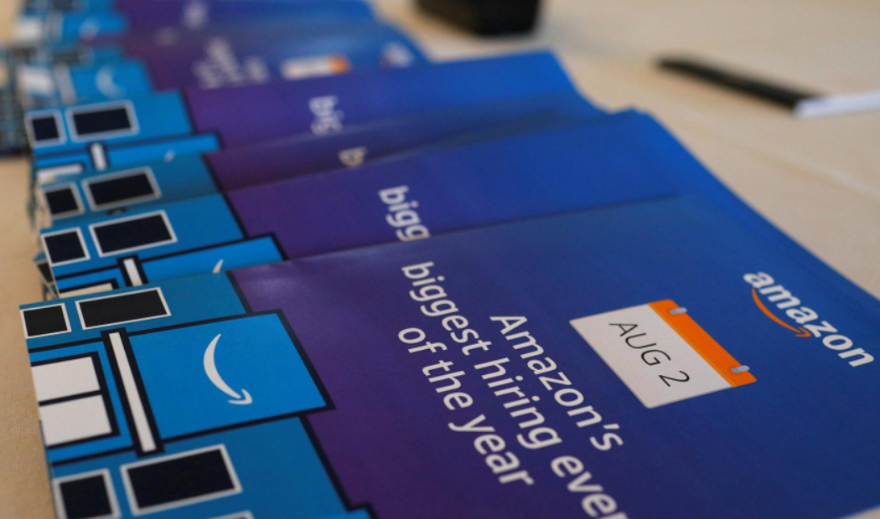
Amazon’s Hiring AI
Hailey Anderson
Amazon’s recruiting engine in 2014. [3]
The algorithm was taught from previous candidates of Amazon.
Notes:
<speaker notes>

Slide 22
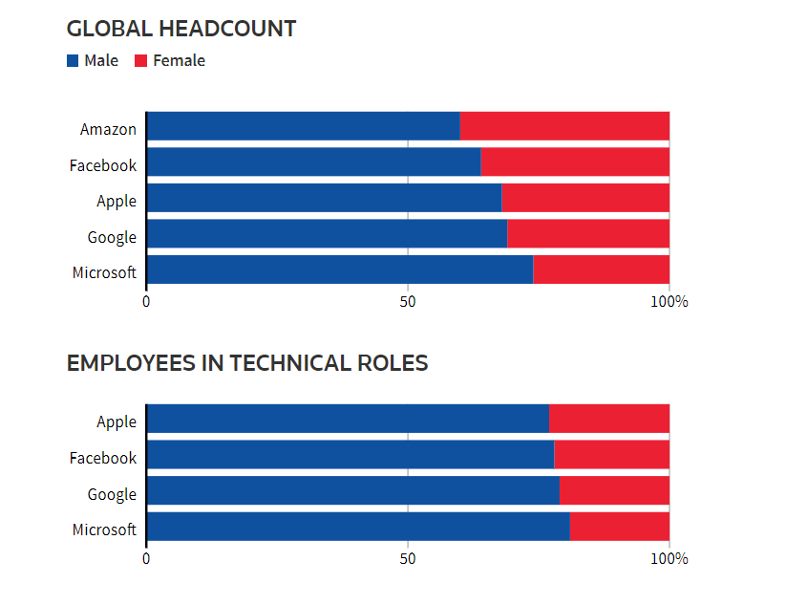
Problems Arose
Hailey Anderson
The Algorithm through data assumed that men were preferable.
It was not tested for bias until a year later.
Notes:
The Algorithm through data assumed that men were preferable.
It was not tested for bias until a year later.

Slide 23
Food For Thought
Hailey Anderson
With no implicit bias checks are we making technology of the future or the past?
Notes:
Algorithms have been a big deal lately…
This quote shows it when stated “Algorithms are harnessing volumes of macro- and micro-data to influence decisions affecting people in a range of tasks, from making movie recommendations to helping banks determine the creditworthiness of individuals.” [1]

Slide 24
References
Hailey Anderson
[1] ​Lee, N. T., Resnick, P., & Barton, G. (2019, October 25). Algorithmic bias detection and mitigation: Best practices and policies to reduce consumer harms. Brookings. Retrieved April 11, 2022, from https://www.brookings.edu/research/algorithmic-bias-detection-and-mitigation-best-practices-and-policies-to-reduce-consumer-harms/.
[2] Implicit bias explained. Perception Institute. (2017, May 17). Retrieved April 11, 2021, from https://perception.org/research/implicit-bias/.
[3] Dastin, Jeffrey (2018, October 10) Amazon Scraps secret AI recruiting tool that showed bias against women. REUTERS. Retrieved April 11, 2022, from https://www.reuters.com/article/us-amazon-com-jobs-automation-insight/amazon-scraps-secret-ai-recruiting-tool-that-showed-bias-against-women-idUSKCN1MK08G

Slide 25
Revisiting Liability
Kseniia Romanova

Slide 26

Benefits of software use
Kseniia Romanova
Provides sophisticated product function
Doesn’t wear out or deteriorate
Can be legally protected
Manufacturing costs are trivial
Economical to modify or enhance
Notes:
In today’s world computers and software programs are embedded in many devices on which we depend.
Common products such as TV sets, radios, and telephones contain hundreds and even thousands of program instructions [1].
The current rate of code growth in many ordinary consumer products, if extended for ten years, will approach 100 times [1].
The increase in software use is understandable since it is an almost ideal product that provides functionality, doesn’t wear out, can be legally protected and is economical to modify and enhance.
A good example of these benefits is the nuclear power industry.
Many of the nation's 113 nuclear power plants still have controls that are 30 or more years old [1].
As the industry replaces them with modem software-controlled devices, they find reliability is much improved [1].
However, as program size grows, so does its complexity, which leads to problems with software quality.

Slide 27

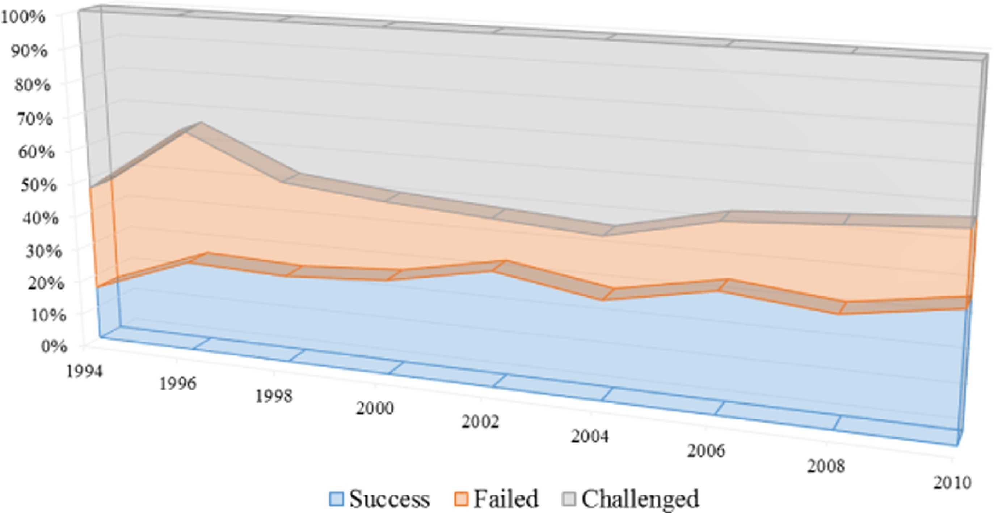

Who is liable for software BUGS?
Kseniia Romanova
Software companies should be held liable, but within reason.
Challenges of software products:
Complex to design
Harder to test
Bugs seem inevitable
Median of 0.6 defects per 1,000 lines of code
Notes:
This raises a question of “Who should be responsible for software errors?”.
The simple answer to this question would be that software companies should be liable for any bugs or defects that their product produces.
However, it should be within reason.
Software products are complex to design and harder to test.
No one has yet built a flawless software product of any size on the first try.
In 1990 a sample of 40 projects from the U.S. and Japan found a median level of about 0.6 defects per thousand lines of code [2].
But despite the improvement even 0.15 defects per thousand lines of code translates into 150 bugs for a million-line software program [2].
Given that many software products today contain tens of millions of lines of code, it is no surprise to see hundreds of bugs in even the best-quality software.
A good example of this would be Microsoft company which was accused of “selling software riddled with security flaws” on October 3, 2003 [2].
On the bright side, based on the Standish Group’s Summary shown on the right, the success rate of software projects increased significantly since 1994 to 2010, while failed rate decreased [2].

Slide 28

Liability should be split
Kseniia Romanova
Software VS Non-Software Factors
August 20, 2008 – airplane crash.
June 10, 1999 – gasoline pipeline explosion.
October 26, 1992 – LAS system crashed.
Liability Split
Notes:
Based on our previous answer, software companies should be held liable for providing a new version or an update for their product to fix the bugs.
However, it becomes more complicated when the software bugs result in injury or even death.
On August 20, 2008, the Spanish airplane crashed momentarily after taking off [3].
The flaps and slats were not deployed as required for takeoff, because the take-off warning system did not work properly [3].
On June 10, 1999, a gasoline pipeline operated by Olympic Pipeline Company exploded in Bellingham [3].
A three-year old investigation pointed out that a series of failures, including a faulty computer system, are to blame for the deaths [3].
On October 26, 1992, London Ambulance Service launched the new Computer-Aided Dispatch system, which crashed after few hours [3].
All these cases have one similarity between them: they all were caused by non-software related factor or human error.
The plane crash was a result of both pilots omitting to check the “flap/slat lever and lights” item in the After Start checklist [3].
The gasoline pipeline exploded because a broken pressure relief valve was not identified during regular maintenances [3].
The London Ambulance Service bad project management was first to be blamed for the loss of 20 lives due to the lack of emergency system [3].
This shows that liability should be split between two groups: software companies and consumers who misuse their product.

Slide 29
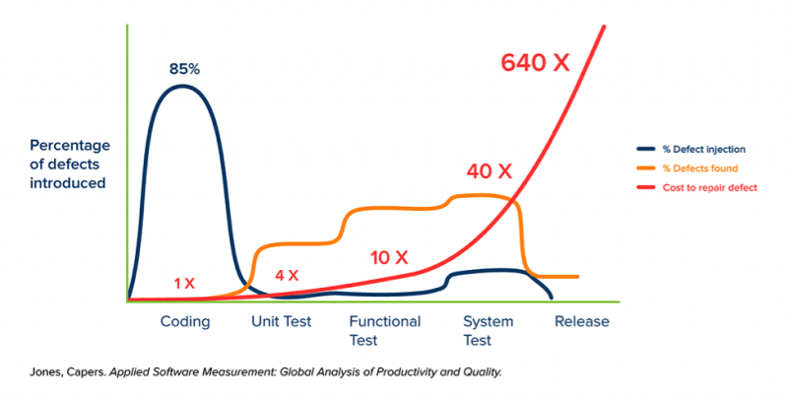
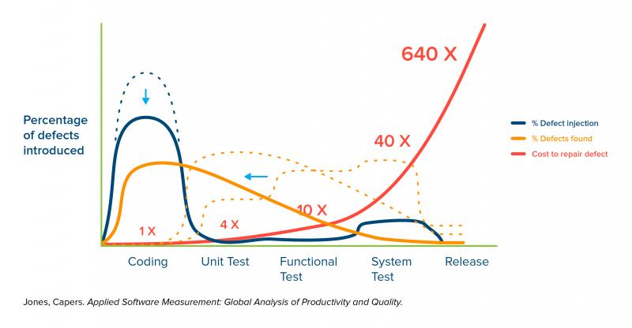
Actions to take to reduce liability of software companies
Kseniia Romanova
85% bugs introduced in coding phase
Shift left
Software Testing Pyramid
Increase Federal Trade Commission fines
Notes:
In order to reduce the amount of software bugs which affect consumers a few actions should be taken.
Figure on the top right shows that while 85% of the bugs are introduced during the coding, they are almost never found at that phase [4].
This can be fixed if the orange curve which represents defects found was shifted to the left.
This would be possible if the software relied on a more mature development practice, such as one based on the software testing pyramid – developers create a set of unit tests that cover the code reasonably well, and functional testers and API testers do as much as they can and minimize reliance on late-cycle testing, so there is just enough manual and UI tests to prove that everything is working [4].
It’s important to remember that the goal is not to find bugs, but to reduce the number of bugs, especially those that make it into the release.
This approach reduces the cost of testing by findings bugs earlier, while also reducing the number of bugs put into the code.
Another action that should be taken is to increase Federal Trade Commission fines, which would force the software companies to produce better quality products [5].

Slide 30
References
Kseniia Romanova
[1] Jody Armour, “Software Product Liability”, (Defense Technical Information Center, 01/08/1993), https://apps.dtic.mil/sti/citations/ADA272570 (04/09/2022).
[2] Michael A. Cusumano, “Who is liable for bugs and security flaws in software?”, (Communications of the ACM, March 2004), https://cacm.acm.org/magazines/2004/3/6549-who-is-liable-for-bugs-and-security-flaws-in-software/fulltext (04/09/2022).
[3] W. Eric Wong, “Be more familiar with your enemies and pave the way forward: A review of the roles bug played in software failures”, (ScienceDirect, 06/23/2017), https://www-sciencedirect-com.ezpv7-web-p-u01.wpi.edu/science/article/pii/S0164121217301334 (04/09/2022).
[4] Arthur Hicken, “The Shift-Left Approach to Software Testing”, (StickyMinds, 12/10/2018), https://www.stickyminds.com/article/shift-left-approach-software-testing (04/09/2022).
[5] Michael D. Scott, “Tort liability for vendors of insecure software: Has the time finally come?”, (Maryland Law Review, 2008), https://digitalcommons.law.umaryland.edu/cgi/viewcontent.cgi?article=3320&context=mlr (04/09/2022).

Slide 31
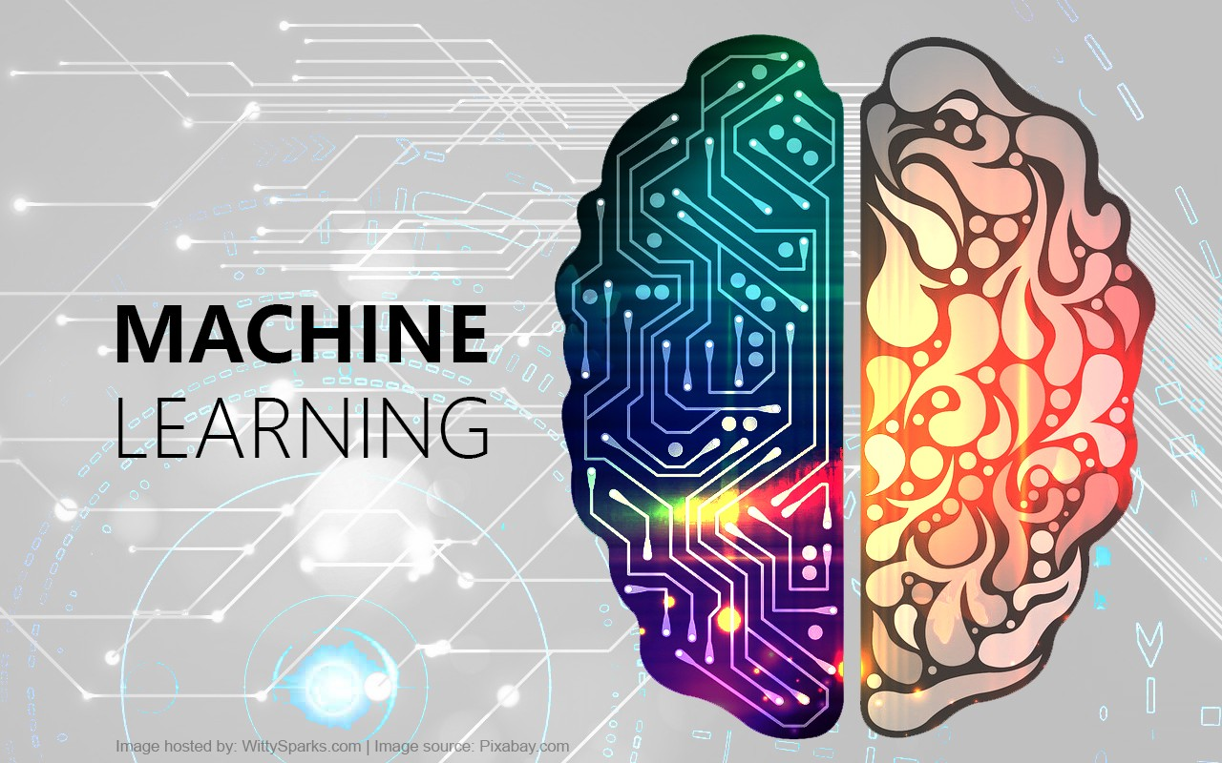
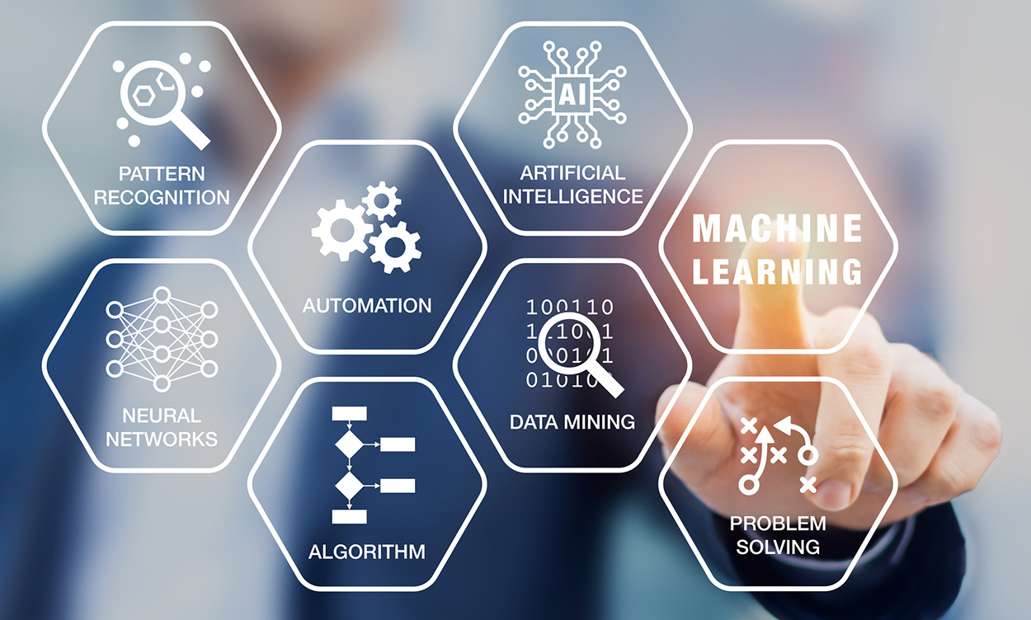
Self Driving Cars and Dangerous Bias: How Society Affects Tech Development
David Datta
Notes:
Introduce topic and self

Slide 32
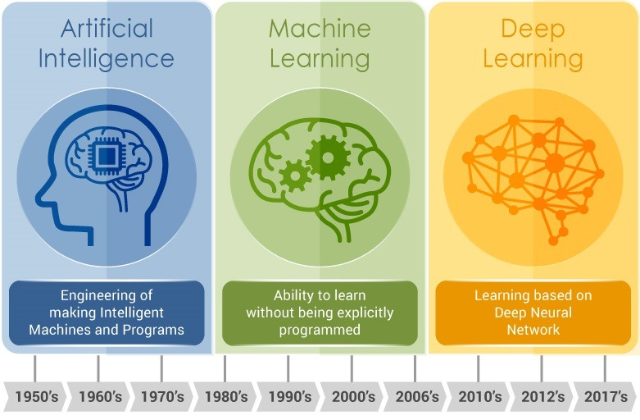
What is Machine Learning?
David Datta
Earliest machine intelligence approaches developed in the 60s, with machine learning emerging near the 80s [1]
Initial approaches were shallow-based, recent approaches are deeper (memorizing vs. pattern recognition)
Now ML integrated across many fields
Notes:
Introduce machine learning, brief overview for those who don’t know ML in depth
“Machine learning refers to the process of creating an algorithm or general program that learns and improves itself as it runs, with little to no explicit human intervention. Earliest machine intelligence was conceptualized and developed in the early 1960s: with technology such as the Perceptron laying the foundation for further explorations into the concept. Machine learning began to bud in the 1980s: beginning with shallow learning approaches that focused more on “memorizing” for prediction rather than trying to figure out underlying patterns and recognizing trends to use for prediction. Slowly, machine learning blossomed into broader and broader applications: with the more recent advent of deep learning increasing the efficacy and usage of machine learning across many aspects of life and daily life.”

Slide 33
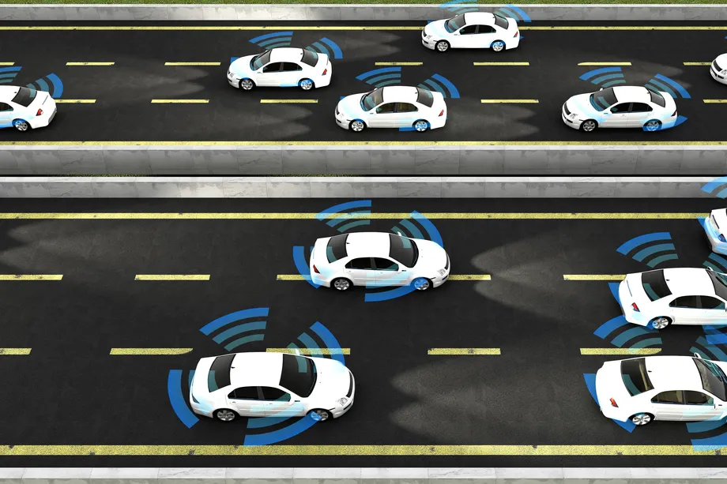
Are Machines Actually Racist?
David Datta
In short: not inherently.
Machines themselves are not built specifically to bias against any minorities
In training algorithms, technology is open to biases that may not be obvious
Leads to the issue of a machine integrating a bias which may go unnoticed
Notes:
Addressing main “shock value” statement. Discuss general problem with ML and start getting into specific parts of ML affected
“With how machine learning has developed, only recently have people begun to identify alarming tendencies within ML technologies. One of the more famous ones (and in fact the premise upon which I based this presentation) was several news articles discussing self-driving cars somehow more likely to ignore people of color and thus run into them. This example, as well as others I will discuss in a moment, have led to a general outcry of “racist” or “sexist” machines and the counter argument of “it’s a machine, how can it be racist/sexist?” While it is true that the machine itself is not necessarily intentionally biased, the way that the machine is built and trained opens it to the possibility of incorporating harmful biases simply as a result of existing societal problems. As a result, these machine learning applications portray such worrying biases for seemingly no reason: when in actuality oversights occurred during the building and training phases of the technology.”

Slide 34
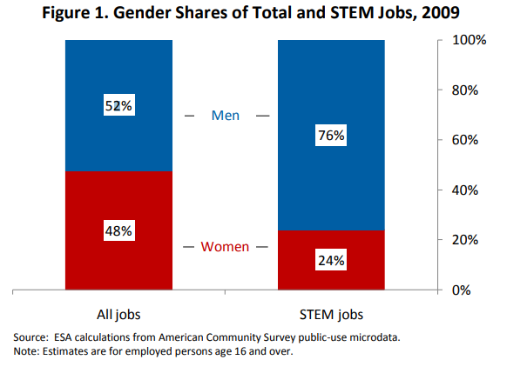
The Sea of Dudes Problem
David Datta
Coined by Margaret Mitchell [2], refers to the general lack of diversity in tech fields (but specifically AI)
“[Margaret Mitchell] estimates she’s worked with around 10 or so women over the past five years, and hundreds of men” [2]
Extends beyond gender gap: racial bias is incredibly prevalent too
See [8]: Gender Shares of Total and STEM Jobs (2009)
Notes:
Discuss lack of diversity in STEM and ML, and how it affects development of ML. Introduce two main areas of focus: training process and training data
“These oversights in the production of technology are characterized as a part of the ‘Sea of Dudes’ problem coined by a former Google researcher, Margaret Mitchell. The premise of the problem is that in the course of Mitchell’s career, ‘she’s worked with around 10 or so women over the past five years and hundreds of men.’ Mitchell uses her personal experience (which has been corroborated by statistics and the personal experiences of other women in STEM) to note the stark disparity of gender inequality within STEM related fields: a divide that is historically even more noticeable in the fields of computer science and AI. As a result, many developments in technology are exposed to a “typical normal:” predominantly white, cis males. This typical normal leads to a general inconsideration of anything outside the “typical normal:” a blindness to minority issues that leads to the accidental inclusion of bias. Two areas of note in ML development are highlighted as problem areas: the actual training processes of ML, and the data the ML is trained on.”

Slide 35
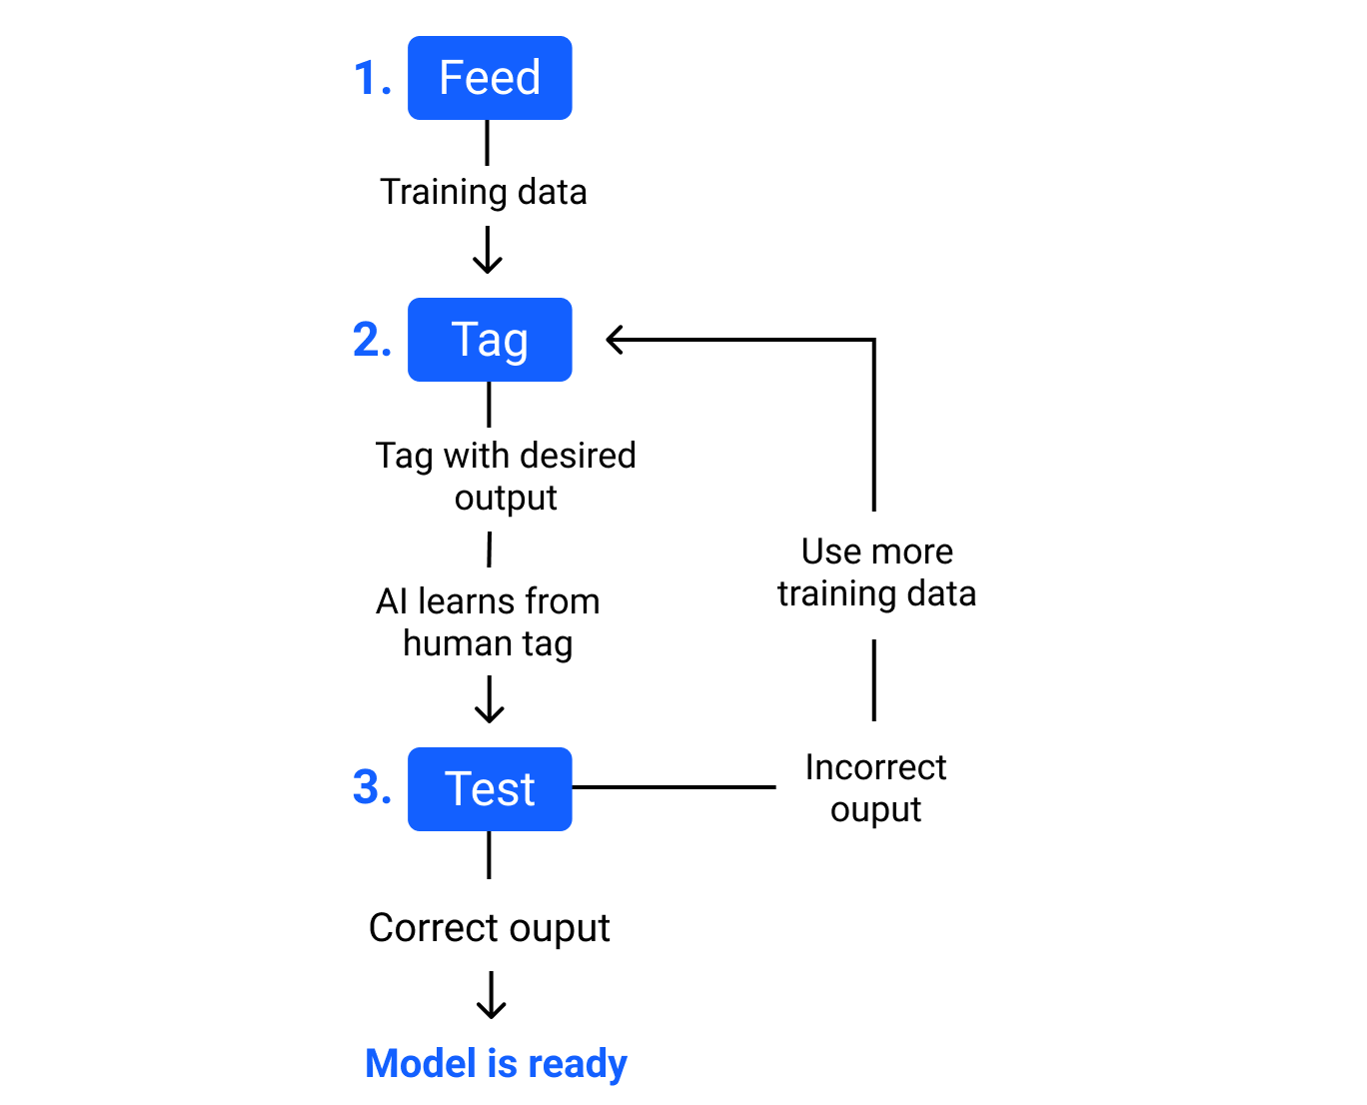
Improper Training
David Datta
As a result of a lack of diversity (or generally flawed approaches), the training process of ML algorithms can lead to bias
Microsoft’s Tay and Zo Chatbots [3]
Google Photos [4]
Self Driving Cars [5]
Notes:
Open discussing how lack of diversity can lead to flawed training. Briefly discuss examples of Microsoft AI chatbots, the Google Photos AI, and the Self Driving cars. Note how neither the researchers nor the machine is overtly racist/sexist, but the way it learned caused it to pick up biases (Zay targeted by extremists).
“With the lack of diversity noted previously in STEM fields, ML technology can be vulnerable to flaws within training methods. The most famous example being one mentioned earlier in the presentation: the tendency of image recognition based programs ignoring people of color. These programs learn from their interactions with data: thus if they are scarcely presented with people of color during their training, their recognition of darker-skinned individuals decreases. A Georgia Tech study found that such programs were 5% less effective on average for darker-skinned individuals even accounting for lighting differences and other variables. Other examples would be chatbots: such as the infamous Tay and Zo chatbots designed a few years ago by Microsoft. The Tay chatbot was up for approximately 24 hours before it had to be taken down due to extremely offensive racial and sexual biases picked up through user interaction. Similarly, the Zo chatbot released a few years later sparked controversy as it quickly began to display islamophobic tendancies after interactions with the userbase. The flaw of these chatbots was that in their continuous learning, they could be targeted or lock onto more sensitive and offensive biases despite those biases not being representative of the user base as a whole. Similarly, in 2015, users noted that the Google Photos AI was consistently grouping photos of black individuals under the category of “Gorilla:” a specific category arguably not at all necessary for organizing photos of everyday life. Coupled with small flaws within the program’s math and code, this egregious miscategorization was born.”

Slide 36
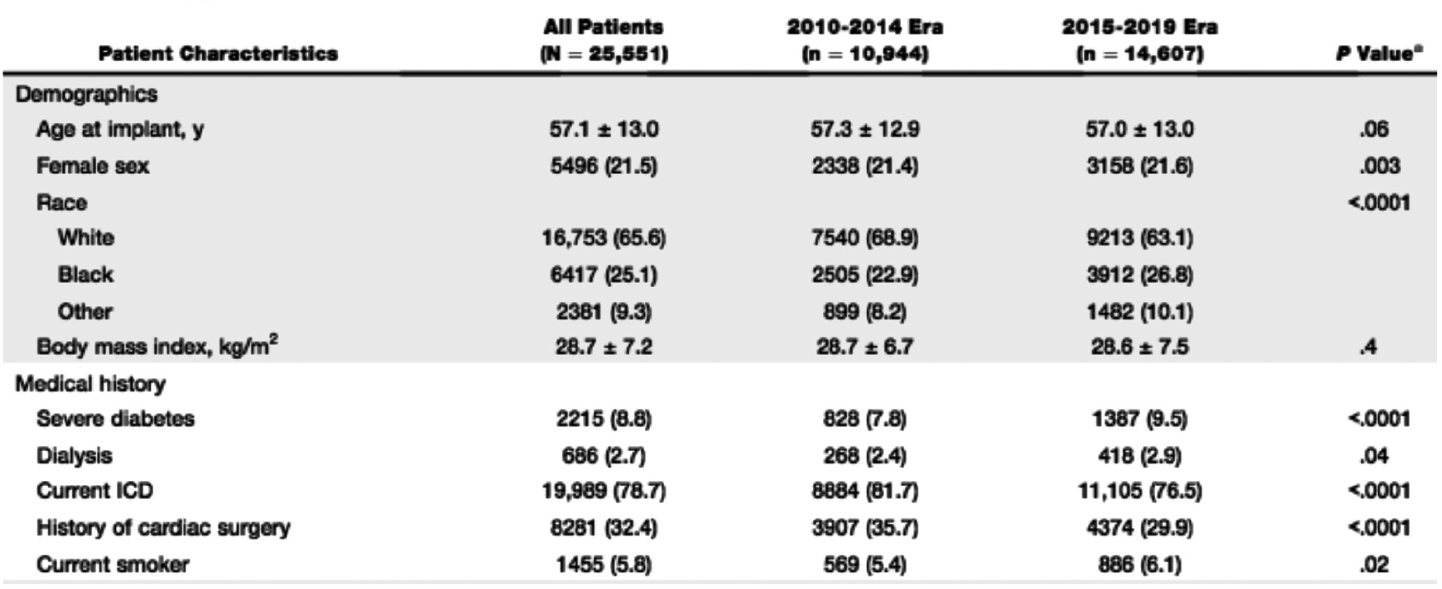
Incomplete Datasets
David Datta
Sometimes the lack of diversity lies within the training data
LVAD Outcome Prediction [6]
Medical Appointment Scheduling [7]
See [6]: Patient statistics for LVAD by characteristic and time period
Notes:
Discuss how diversity within training data also hugely contributes to bias within ML development. Note LVAD example with how first race was not deemed statistically significant, but race plays a role in the certification of LVAD due to societal circumstances (selection bias for having LVAD in the first place). Note also Medical appt scheduling: how racial unaware scheduling weighted against black minorities as a whole while the researcher’s racially aware scheduling produced similar scheduling cost with less biasand more efficiency than racially unaware methodology.
“While a lack of diversity on research teams often leads to oversight on biases, there is also the issue of biases being present within training data. The world is by no means an unbiased place, and thus data taken from the real world often leads to such biases present underneath the data. When one trains a ML technology on such data, the machine thus learns these biases; even though these biases might not necessarily be noticeable at a first glance, continuously training the machine on similar data leads to this bias being reinforced over and over again. For example: one group of researchers who developed a ML algorithm for determining outcomes of LVAD (heart based implants) patients noticed that while their own statistical analysis did not highlight race as significant, this did not take into account the disparity between white and black individuals being certified for an LVAD in the first place. The researchers note that the issue was not necessarily that the data ignored people of color, but rather it reflected existing issues within healthcare related to the representation and treatment of people of color. Similarly, another group of researchers designing a scheduling ML program noted that state-of-the-art scheduling systems often left minority races with longer waiting times due to booking and prioritization. They designed several models around being racially “aware” and “unaware:” demonstrating that the racially aware models performed similarly and even better than the racially unaware models while being more ”fair.”

Slide 37
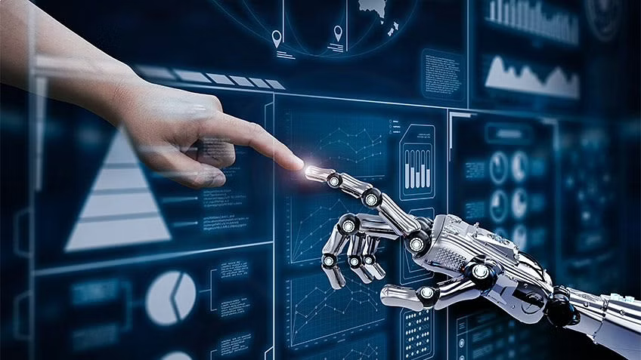
Conclusion
David Datta
While there is still a lot of work to be done, discussing the issue is the first step towards solving it.
Bias in machine learning tends to result from systemic, not intentional bias
Accounting for bias rather than treating data/training as “unbiased” (color-blindness) helps eliminate/mitigate potential bias
Notes:
Restate points, summarize issue. Talk about how the issue is not one of intentional bias, but implicit bias. Also talk about how the solution is not to strive for 100% unbiased data, but rather to simply notice and account for possible bias within data sets or training methods.
“In conclusion, bias in technology is rarely intentional yet still present. While there is still much work to do regarding biases such as sexism and racism, even simply being aware of such biases helps mitigate the damage they can cause. Rather than the traditional “color-blind” approach of ignoring biases such as race or gender, it is more important to recognize how these biases influence trends in society and account for them instead equitably. Ultimately, this issue is a systemic one. In order to prevent it from becoming further ingrained into society, we must make sure to combat it now before it gets out of hand.”

Slide 38
REFERENCES
David Datta
[1] Fradkov, A. (2020). Early History of Machine Learning. IFAC-Papersonline, 53(2), 1385-1390. doi: 10.1016/j.ifacol.2020.12.1888
[2] Clark, J. (2022). Artificial intelligence has a ‘sea of dudes’ problem. Retrieved 12 April 2022, from https://www.bloomberg.com/professional/blog/artificial-intelligence-sea-dudes-problem/
[3] Fuchs, Daniel J.. (2018). "The Dangers of Human-Like Bias in Machine-Learning Algorithms." Missouri S&T’s Peer to Peer 2, (1). https://scholarsmine.mst.edu/peer2peer/vol2/iss1/1
[4] Metz, C. (2022). Who Is Making Sure the A.I. Machines Aren’t Racist? (Published 2021). Retrieved 12 April 2022, from https://www.nytimes.com/2021/03/15/technology/artificial-intelligence-google-bias.html
[5] Wilson, B., Hoffman, J., & Morgenstern, J. (2019). Predictive inequity in object detection. arXiv preprint arXiv:1902.11097.
[6] Kostick-Quenet, K., Cohen, I., Gerke, S., Lo, B., Antaki, J., Movahedi, F., . . . Blumenthal-Barby, J. (2022). Mitigating Racial Bias in Machine Learning. Journal of Law, Medicine & Ethics, 50(1), 92-100. doi:10.1017/jme.2022.13
[7] Michele Samorani , Shannon L. Harris , Linda Goler Blount , Haibing Lu , Michael A. Santoro (2021) Overbooked and Overlooked: Machine Learning and Racial Bias in Medical Appointment Scheduling. Manufacturing & Service Operations Management 0(0). https://doi.org/10.1287/msom.2021.0999
[8] Beede, D. N., Julian, T. A., Langdon, D., McKittrick, G., Khan, B., & Doms, M. E. (2011). Women in STEM: A gender gap to innovation. Economics and Statistics Administration Issue Brief, (04-11).

Slide 39
Class 9 The End
Keith A. Pray
socialimps.keithpray.net
Notes:
This is the end. Any slides beyond this point are for answering questions that may arise but not needed in the main talk. Some slides may also be unfinished and are not needed but kept just in case.

Slide 40
Reliability Of Statistics
Are other factors controlled?
Is enough time covered?
Is all data reported?
Use Intuition
Are results reasonable?
Notes:
Power line dangers. Electromagnetic fields? PCBs in transformers?

Slide 41
Some Measures
Mean Time To Failure (MTTF)
Mean Time Between Failures (MTBF)
Mean Time To Repair (MTTR)
Notes:
Is it repairable?
What does it mean to repair? Running again? Data fixed? Caught up?
Restoring the GBC Web site.

Slide 42
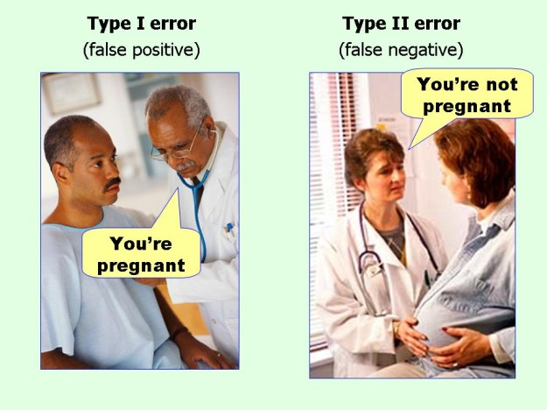
marginalrevolution.com/marginalrevolution/2014/05/type-i-and-type-ii-errors-simplified.html (2016-04-11)

