Slide 1
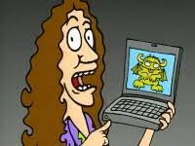
Class 8 Crime
Keith A. Pray
socialimps.keithpray.net
Notes:
“Weird” Al Yankovic – Virus Alert (3:43)
https://www.youtube.com/watch?v=zvfD5rnkTws
Take 5 minutes to fill out survey on Canvas → Quizzes → SGA’s Midterm Course Feedback Questionnaire

Slide 2
what works well Online With Zoom
Sign in with First and Last Name
Stay muted unless you are going to speak
To speak use the raise your hand feature
To answer yes/no questions use the “yes” ”no” buttons
Turn your camera on
Wait until the end of student presentations to ask questions
Write them down so you don’t forget

Slide 3
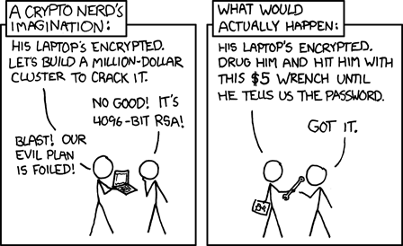
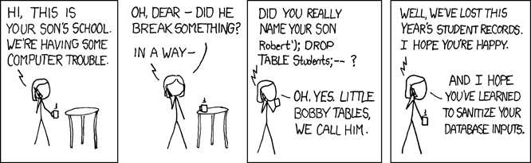
Overview
Review
Assignment
Students Present
https://xkcd.com/538/ (2010-11-14)
https://xkcd.com/327/ (2007-10-10)
Notes:
Are there any questions on the assigned reading?
Use the backup slides to explain any of the attack methods from the text.
XKCD Links last accessed 2020-09-25

Slide 4
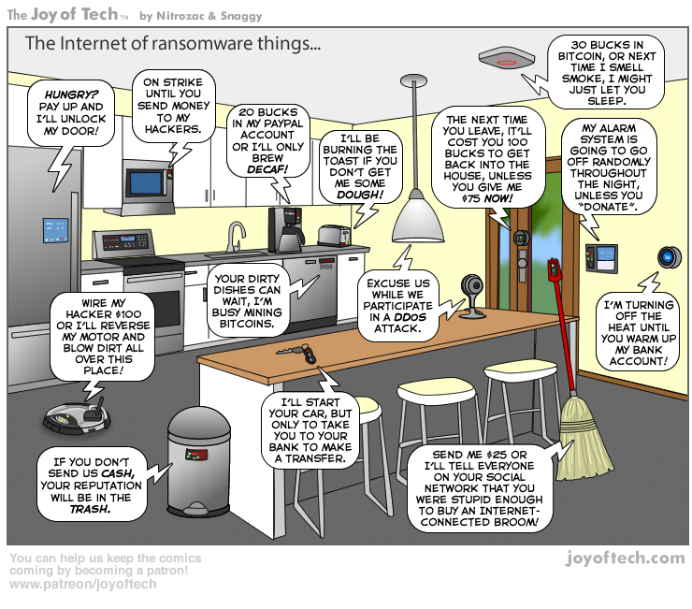
https://cointelegraph.com/storage/uploads/view/5e8f6e0d3a029807dfe181dc3d160cf0.png
Notes:
Find publish date
Note which really exist
Extra credit

Slide 5
My Reading Notes
pp. 323 Interesting to compare password guidance over the years.
pp. 325 plenty not sent with HTTP
pp. 328 Getting on TV much more difficult than releasing software
pp. 330 Virus could be new
pp. 332 Goals include infect 3 machine per LAN and as many computers as possible? Never make last minute changes before release. Were they related to the defects?
pp. 333 Testing w/out DEBUG often neglected
pp. 335 Do people use the Internet as an experimental laboratory these days? Shutdown right after booting, “benign” doesn’t seem like the right word.
pp. 337 “send reports back to a host computer”?
pp. 338 Firewalls often not running on same machine as malware, routers?
pp. 339 Have 2003 fears of cyber terrorist attacks been realized?
pp. 347 How is online voting a moral issue?
End of Chapter questions: 14. 25. 29.
Notes:
- If time ask class about online voting in light of COVID-19 challenges.

Slide 6
Group Quiz
A denial of service attack shuts down a bunch of retailer, stock brokerage, large corporate entertainment and information web sites. Possible guilty parties:
Terrorist who aimed to cause billions of damage to U.S. economy.
Protest organization opposing commercialization of the web and corporate manipulation of consumers.
Script kiddie (a minor) just having fun with tools he found on the web.
Show off hacker in search of bragging rights.
State what penalties are appropriate for each.
Explain your answer to 1. using a single Ethical Theory for all.
Name the laws/acts under which these parties could be prosecuted.
Notes:
Works well as small group exercise.
Note: short answer format expected.
Note: 2. only one argument needed, should include logic for all parties
Note: 3. same law(s) should be applicable to all parties

Slide 7
Assignment Code Testing 1 Page Paper 1/2
Research testing, decide on test strategy, test the given code
There are major and minor defects to find
Once testing is done write paper with conclusion: Testing strategy was adequate
Things that might be useful in your argument:
Rationale for testing strategy used (use data, high quality sources)
Explanations of defects found (use data, high quality sources)
How to fix them (use data, high quality sources)
Consequences of leaving defects in production code (use data, high quality sources)
Weakness in testing strategy as counter point (use data, high quality source)
Working example: http://socialimps.keithpray.net/assignments/Test_Sales_Fun
Notes:
If guest presenter coming next class remind students to prepare questions for him.
Remember to work on groups projects.
Each group should have material on their sites for the topics we’ve covered so far.
OLD Prompt:
Design tests for the code on the following slide.
Contains at least one major defect and several minor ones.
Write a paper (1 page not counting any source code) including :
Did you choose a good test strategy? (This is your conclusion.)
The inputs and expected outputs
What defects you found
How you would fix the defects (you may include fixed source)
Why would that fix the problems?
What could happen if the defects are not found before the code is put into production?

Slide 8
Assignment Code Testing 2/2
import java.text.NumberFormat;
public class SalesFun {
public static double calculateSalesTotal ( double amount, double discountRate, double taxRate ) {
double discount = amount * discountRate;
double total = amount - discount;
double tax = total * taxRate;
double taxedTotal = tax + total;
NumberFormat numberFormat = NumberFormat.getCurrencyInstance();
System.out.println ( "Subtotal : " + numberFormat.format ( amount ) );
System.out.println ( "Discount : " + numberFormat.format ( discount ) );
System.out.println ( "Total : " + numberFormat.format ( total ) );
System.out.println ( "Tax : " + numberFormat.format ( tax ) );
System.out.println ( "Tax+Total: " + numberFormat.format ( taxedTotal ) );
return taxedTotal;
}
}
} Lines of interest
Notes:
Bold lines are real focus.
Example input:
amount = 100.05;
discountRate = 0.10;
taxRate = 0.05;
OR
0.70, 0.0, 0.05
95.67, 0.20, 0.7

Slide 9
Overview
Review
Assignment
Students Present

Slide 10
Ransomware and Government Response
Joe Dobbelaar

Slide 11
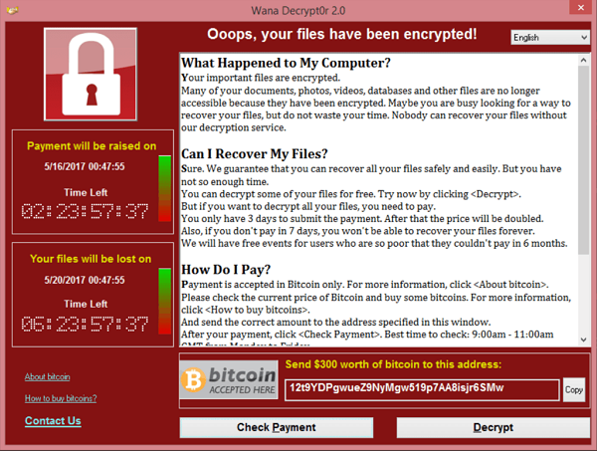
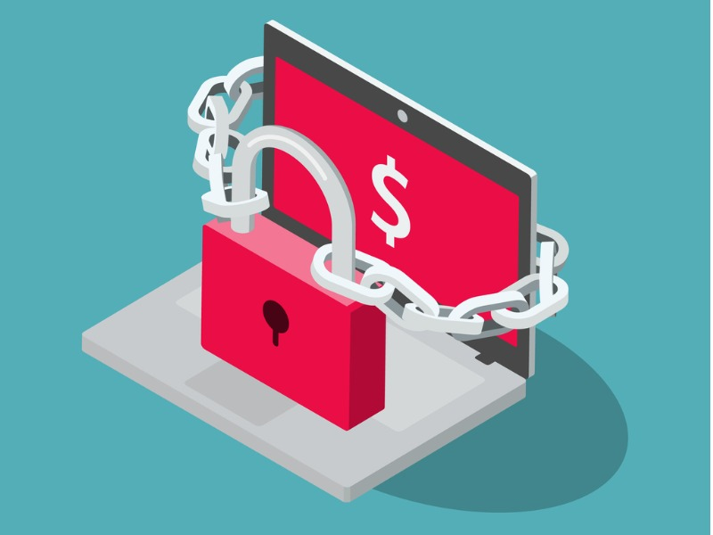
What is ransomware?
Joe Dobbelaar
Encrypts files until a ransom is paid
Attacks businesses and individuals
Many ways to be attacked
Drive-by-download
Trojan horse
Email
USB Drives
Notes:
* The book speaks very little on ransomware
* Most high-profile ransomware attacks are on businesses, but individuals are also at risk
* Many ways to be attacked, really any way that a file can enter your computer

Slide 12
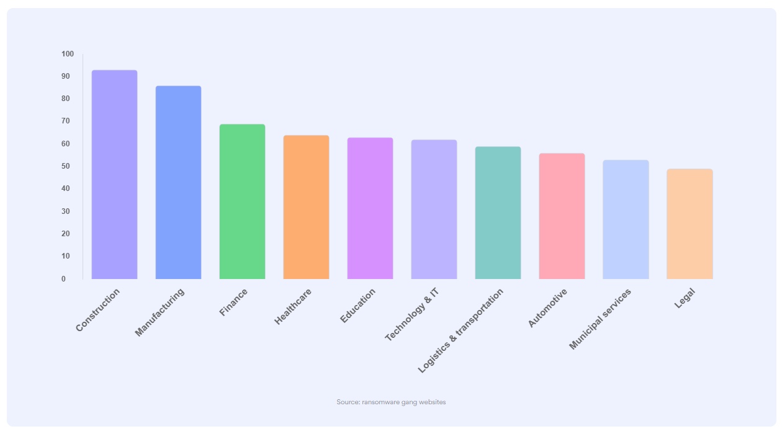
WHO is AFFECTED?
Joe Dobbelaar
Most commonly "essential" businesses
Not just small companies
Average payment is $140,000
Average computer-system downtime is 23 days
Figure 1. Distribution of ransomware
Attacks on different types of businesses [7]
Notes:
* graphic hard to see
* of 1,200 cases made public by hackers in 2020 and 2021, this is the distribution of attacks by type of business
* Construction, manufacturing, finance, healthcare, education, technology & IT, logistics & transportation, automotive, municipal services, legal
* May be surprising that Technology & IT is 6th place, but look what is above it.
* Attacks are on businesses that cannot afford to be inactive for a long time
Who?
* One of the biggest construction companies in France with 1,700 employees and a turnover of $350M
* One of Europe's leading wire and cable manufacturers for customers across the globe in telecom, transport, nuclear power, defense, etc
* Multibillion-dollar real estate investment firms
* French leader in outsourced sterilization of reusable medical devices
* You get the idea

Slide 13

What to do if you are attacked
Joe Dobbelaar
Official FBI Response Plan
Isolate
Backup
Contact law enforcement immediately
Collect partial portions
Change passwords
Clear registry and file system
Consider before paying
No guarantees
May be targeted again
Hidden fees
Encouraging cyber-terrorism
Notes:
Official FBI Plan as follows:
1. Isolate the infected computer immediately – infected systems should be removed from the network to prevent ransomware from attacking network or shared drives
2. Isolate or power-off affected devices that have not yet been completely corrupted – this may afford time to clean and recover data, contain damage, and prevent worsening conditions
3. Immediately secure backup data or systems by taking them offline – ensure backups are free of malware
4. Contact law enforcement immediately – this one is literally underlined in the official FBI contingency plan - "We strongly encourage you to contact a local field office of the DBI or US Secret Service immediately upon discovery to report a ransomware event and request assistance
5. If available, collect and secure partial portions of the ransomed data that might exist
6. If possible, change all online account passwords and network passwords after removing the system from the network – furthermore, change all system passwords once the malware is removed from the system
7. Delete registry values and files to stop the program from loading
What a surprise that law enforcement wants you to contact law enforcement
* No guarantee that an organization will regain access to their data
* Some victims were targted again
* After paying, some victims were asked to pay more
* Paying encourages criminal behavior

Slide 14
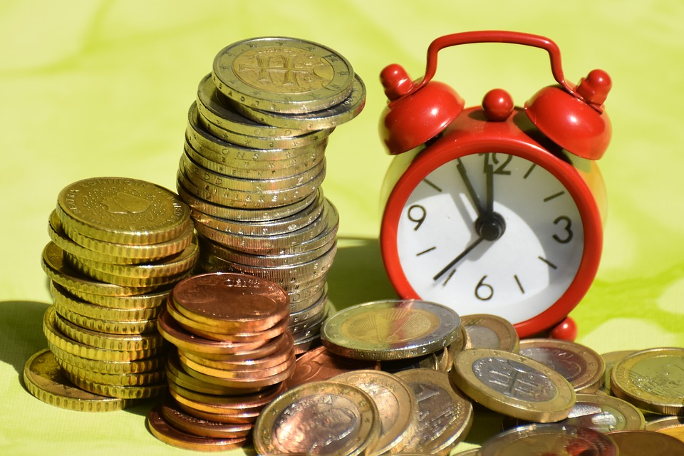
Why you may not want to listen to the FBI
Joe Dobbelaar
Time is money
Cost of remediation
Data Theft
Atlanta, GA
Notes:
Time is money:
* Average downtime is 23 days
* Businesses have to consider whether they will be better off paying the ransom
* Cost of remediation is often 10 times the price of the ransom
Data theft:
* 81% of cases involve data theft
* Data is either leaked or sold
* Depending on the company that is attacked, this could be an even stronger source of blackmail
* Medical companies, for example, need to be careful about not releasing data as to not be fined by regulators. It may by cheaper to pay the ransom than to deal with the legal fees
In 2018, the city of Atlanta refused to pay a ransom of $50,000 and ended up spending over $2M on PR, digital forensics, and consulting.

Slide 15
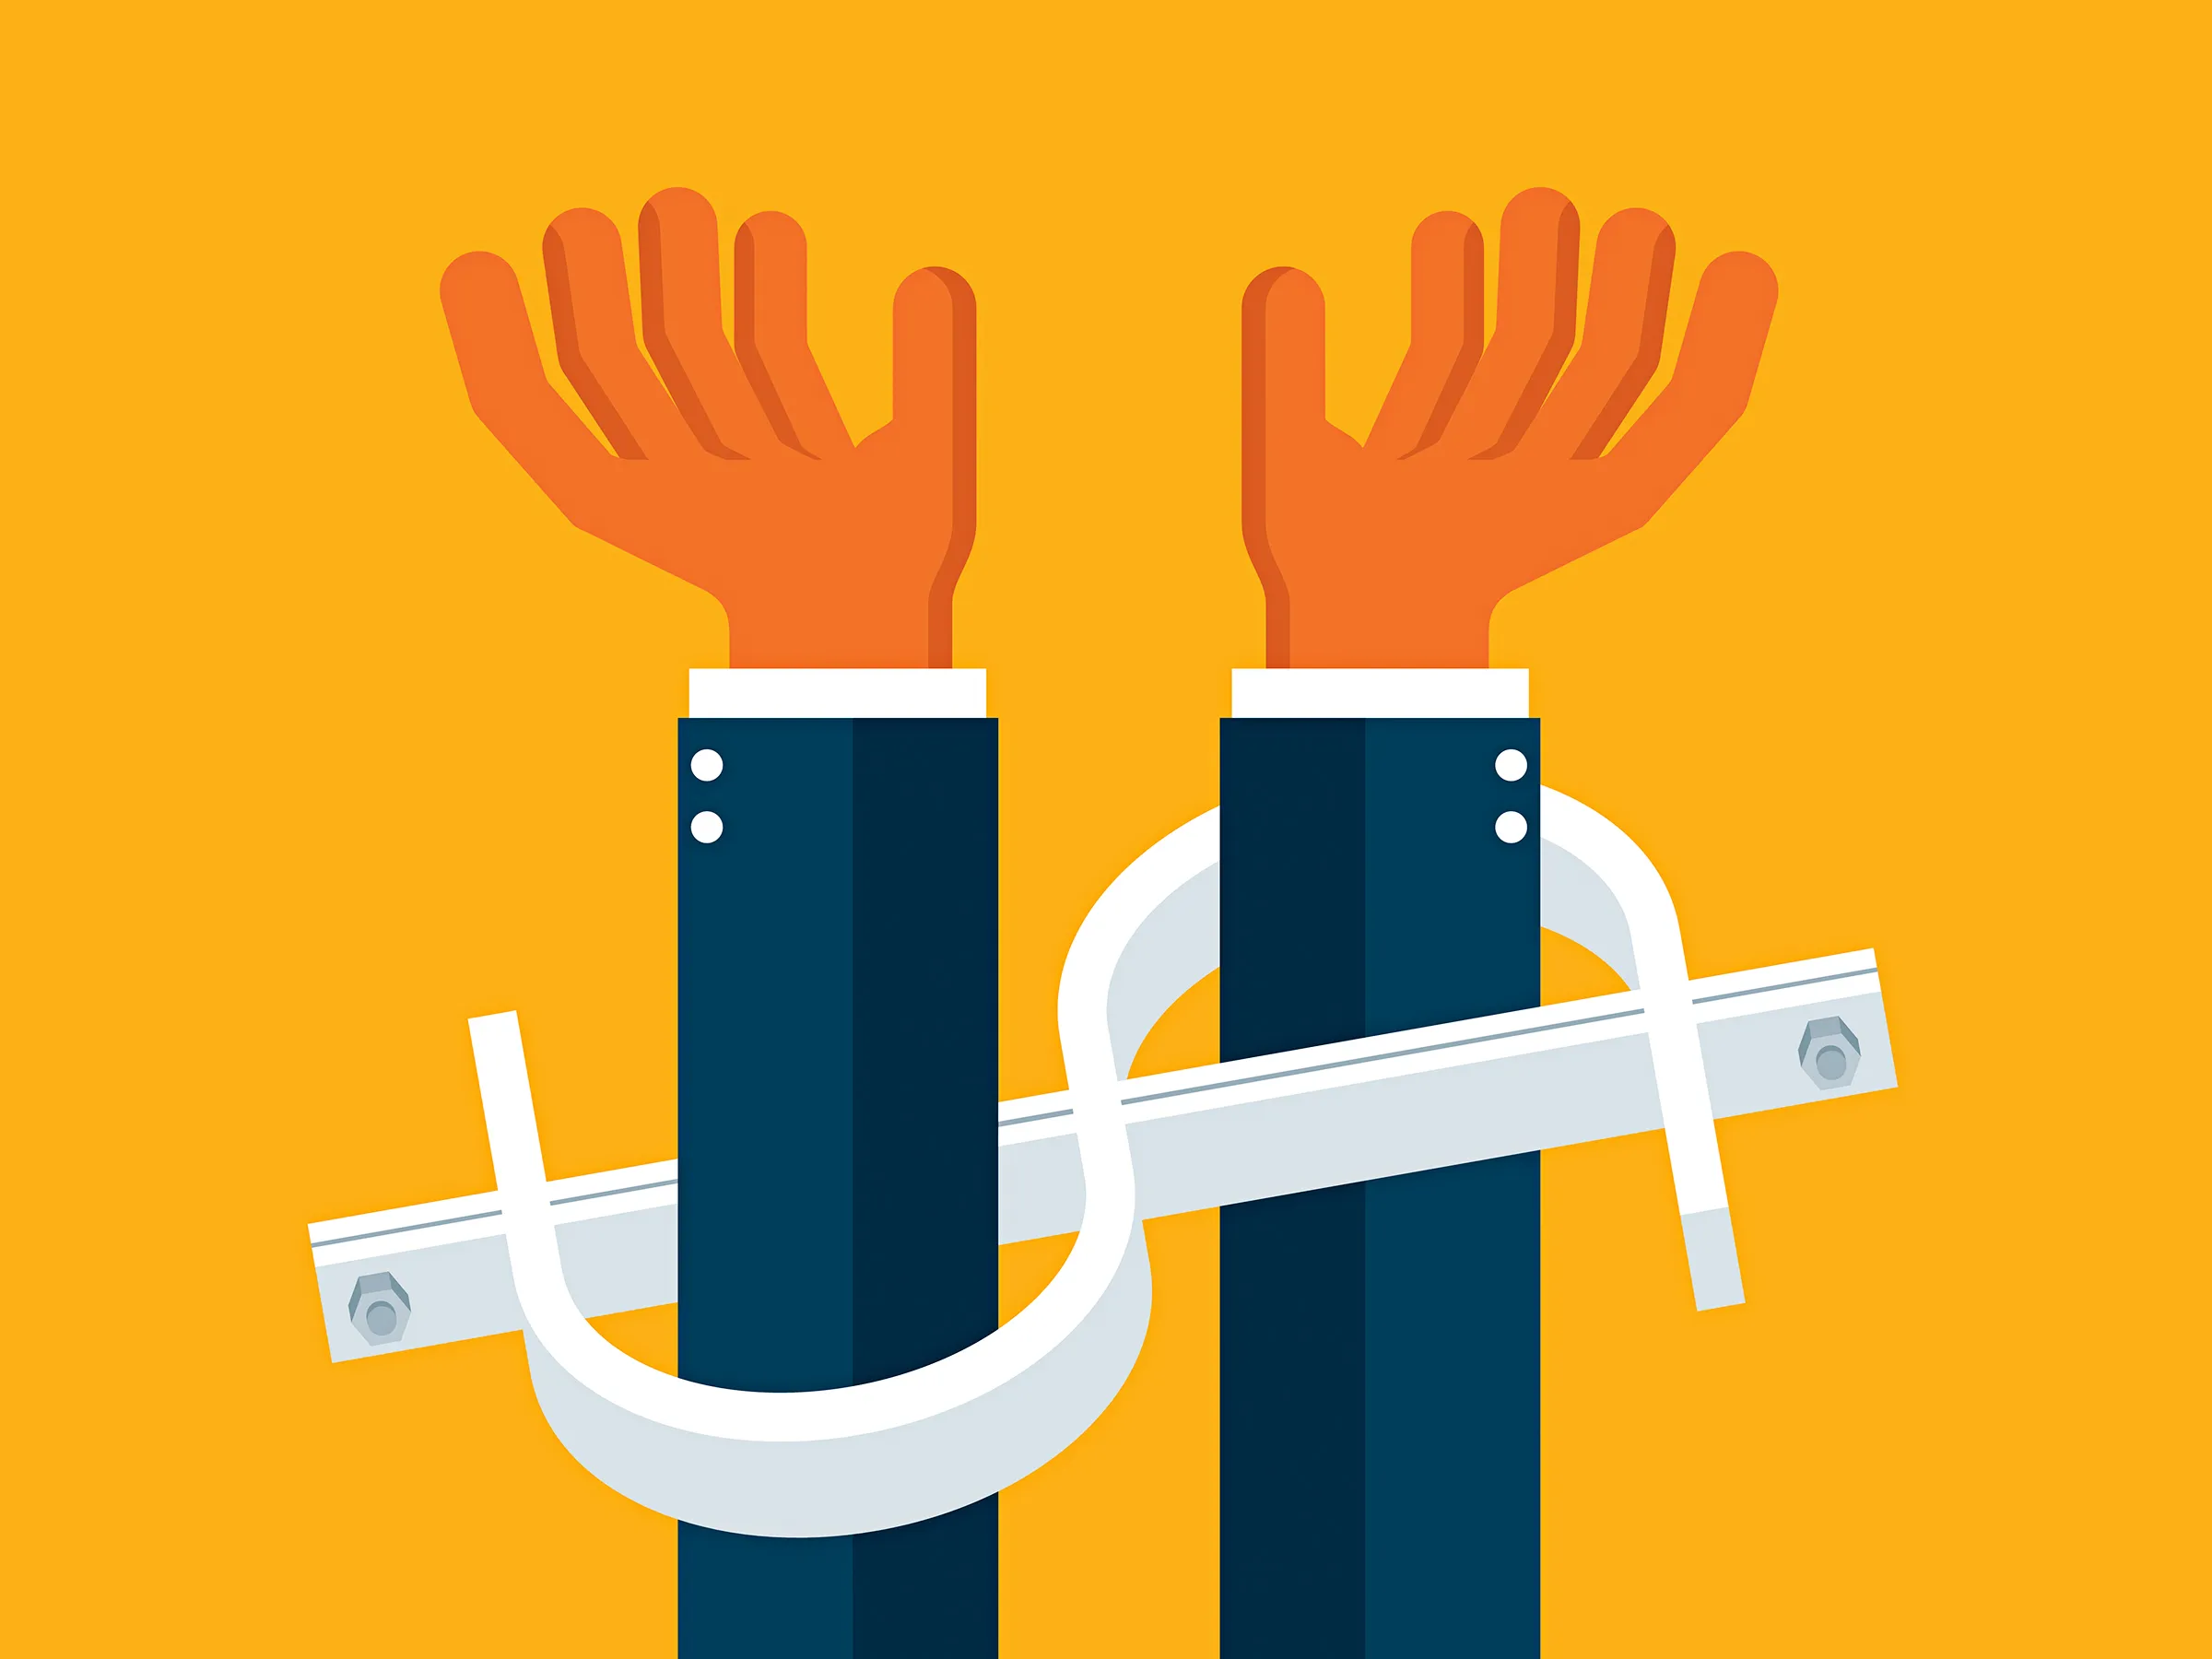
DO not report the incident
Joe Dobbelaar
FBI Wants you to report all incidents immediately
Seems logical at first
Negotiating with terrorists
Data theft
Notes:
* This seems logical at first, but there are serious risks that are often not worth taking
1. It is probably within your best interest to pay the ransom
2. Treasury Department's Office of Foreign Assets Control has laws for ransomware in particular
3. Bans U.S. persons from doing business with certain foreign bad actors and sanctions U.S. persons who do such business
4. There is a list of malevolent countries, organizations, and people.
6. It will probably be impossible to know whether the attacker is on the embargo list because the organizations frequently change their names to throw off law enforcement
7. The agency states it can sanction even if the victim was unaware that the attacker was on the embargo list
Therefore, there is a real chance that paying the ransom and then reporting the crime can get you into legal trouble
Reporting the crime before paying essentially dooms a company to not be able to pay the ransom. The FBI has a tendency to investigate crime.
Since paying the ransom could be illegal, it probably isn't wise to do so while talking to the FBI.
The FBI won't be able to recover your data.
It is also worth considering that bad actors may have planted spyware and can see if someone contacts the government. This would certainly be a trigger to release sensitive data.

Slide 16
References
Joe Dobbelaar
[1] Saltzman, Marc. “Ransomware: What to Do If Hit by an Attack.” USA Today, Gannett Satellite Information Network, 25 July 2021, https://www.usatoday.com/story/tech/columnist/2021/07/24/ransomware-tips-what-do-if-you-get-hit-attack/8076023002/.
[2] “Ransomware.” FBI, FBI, 3 Apr. 2020, https://www.fbi.gov/scams-and-safety/common-scams-and-crimes/ransomware.
[3] Monroe, Rachel. “How to Negotiate with Ransomware Hackers.” The New Yorker, 27 May 2021, https://www.newyorker.com/magazine/2021/06/07/how-to-negotiate-with-ransomware-hackers.
[4] correspondent, JOHN FARMERSpecial. “Leading-Edge Law: Is It Illegal to Pay Ransomware?” Richmond Times-Dispatch, 26 Dec. 2021, https://richmond.com/business/leading-edge-law-is-it-illegal-to-pay-ransomware/article_5e17125a-a177-545b-8fc3-884d67500600.html#:~:text=In%20the%20end%2C%20the%20federal,companies%20will%20continue%20to%20pay.
[5] “Ransomware Prevention and Response for Cisos.” FBI, FBI, 14 July 2016, https://www.fbi.gov/file-repository/ransomware-prevention-and-response-for-cisos.pdf/view.pdf
[6] Quinn, Michael J. Ethics for the Information Age. , 2020. Print.
[7] “What Did 1,200 Ransomware Cases Teach Us.” NordLocker, https://nordlocker.com/recent-ransomware-attacks/.

Slide 17
Class 8 The End
Keith A. Pray
socialimps.keithpray.net
Notes:
Any slides beyond this point are for answering questions that may arise but not needed in the main talk.
Some slides may also be unfinished and are not needed but kept just in case.

Slide 18
Buffer Overrun
Run time stack
Local Variables
Return Address
Parameters
Variable Attack
buffer
Target Variable
Stack Attack
buffer
Return Address
code
Return Address
Notes:
Retired slide. Most students have this in depth from new class now.
When a function call is made, local variables, return address, parameters stored on run time stack. Local variables occupy lower memory addresses.
Variable attack – change variable value. Program expects user to input character and allocates a buffer for them. Attacker supplies too many characters and ends up over writing a variable.
Run example of this if there’s interest – next slide
Stack Attack – goal is to change value of return address so execution control goes to code which the attacker has provided in the input buffer.
Prevention – add checks against array bounds being exceeded. modify operating system to not execute instructions stored on run time stack.

Slide 19
Run Example Code
Notes:
Retired demonstration. Most students have this in depth from new class now.
> imps
> assembly
> 123456789qwerty1

Slide 20
Buffer Overrun Code
#include <stdio.h>
#include <string.h>
int main ( void ) {
char buff [ 15 ]; int ace = 0;
printf ( "\n Enter best class ever : \n" );
gets ( buff );
if ( strcmp ( buff, "imps" ) ) {
printf ( "\n %s is wrong! You should FAIL! \n ace=%i\n", buff, ace ); }
else { printf ( "Correct! \n") ; ace = 1; }
if ( ace ) { printf ( "You get an A! \n" ); }
return 0; }
} The Naughty Line
Notes:
Retired slide. Most students have this in depth from new class now.

Slide 21
TCP Three-way Handshake
SYN
SYN-ACK
ACK
Notes:
Retired slide. Most students have this in depth from new class now.
SYNchronize
SYNchronize ACKnowledgement (socket reserved awaiting ACK)
ACKnowledgement
TCP socket connection established

Slide 22
SYN Flood Attack
SYN
SYN-ACK
Notes:
Retired slide. Most students have this in depth from new class now.
Attacker spoofs the IP address so the SYN-ACK is sent to a different machine that cannot respond to the SYN-ACK.
This leaves the connection half open on the server machine decreasing the resources (sockets, memory, threads/processes) available to respond to legitimate clients.
The attacker send many such spoofed SYN messages.

Slide 23
Ping Attack
Target
Attacker
ping
ping
Notes:
Retired slide. Most students have this in depth from new class now.
Attacker finds routers that support broadcasting messages to all computers on their local area networks.
The attacker sends a spoofed ping message, which the routers echo to the spoofed address.

Slide 24
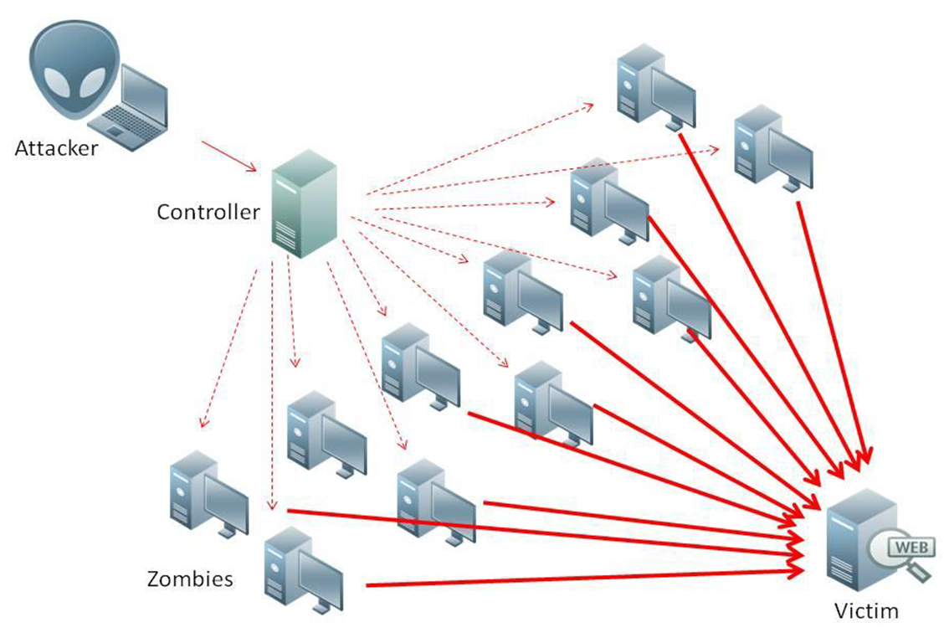
What is Denial of Service (DoS)
Attempts to make target unavailable by flooding with traffic
If victim has to filter attack, it’s too late
Internet Providers have no incentive to help
Businesses get affected, but would not pay provider enough to make worthwhile
This is why Cloudflare, e.g., exists
Many ways to perform this attack
Notes:
Contributed by Brett Ammeson.
https://www.cloudflare.com/ddos/reflection-attack-1.png
https://i.imgur.com/lxYv8cF.png

Slide 25
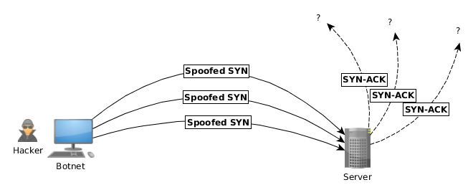
Distributed DoS Vectors
TCP SYN attack
SYN packets are small, low difficulty for attacker
Leaves half-open connections on server
SYN cookies mitigate this
DNS amplification attack
DNS requests are small
Can request all records on server
Crippled by proper configuration
Ingress/egress filtering will reduce effect
Notes:
Contributed by Brett Ammeson.
TCP SYN: https://www.cert.org/historical/advisories/CA-1996-21.cfm
DNS amplification: https://www.cert.org/historical/incident_notes/IN-2000-04.cfm
Ingress/egress: www.giac.org/paper/gsec/705/egress-filtering-keeping-internet-safe-systems/101588

Slide 26
Crime How
Technical and Non-Technical
Break into computer.
Prevent access to computer.
What things make computer related crime easy?
Notes:
Exploit security holes, Break encryption, Spoofing
Social Engineering: Guess passwords, Find out passwords and procedures
Poor passwords, Insecure protocols, Program limitations (buffer overruns), Eavesdropping (Email, Interactive), Insecure files

Slide 27
Crime Bane
Trojan Horse
Virus
Worm
Bot Network
Buffer Overrun
(Distributed) Denial Of Service Attack
How do they work?
How harmful are they?

Slide 28
Crime Why
Why?
Notes:
Money: stolen credit cards, change records, stolen property.
Political, military, economic.
Challenge, Revenge, Mean
Why do at all? Have motivation, think about it, think it will help, think it’s acceptable.
Feel forced. Don’t agree. Don’t care.

Slide 29
Crime Time
What is different now compared to:
10 years ago?
20 years ago?
30 years ago?
40 years ago?
Notes:
More computers. Unsophisticated owners. More complex software. Greater connectivity. Easy access to cracking tools. Incentives. File-sharing
In ’60s and ’70s, access was mostly localized.
Modems. Wardialing.
Some Arpanet and Usenet.

Slide 30
Crime Doers
Hacker or Cracker
Pre-1980 - Golden Age ☺ ?
Eighties
Nineties
Naughts
Criminal Hacking == Cracking?
Notes:
Script kiddies
Phreakers
Security analysts
Packet monkey

Slide 31
Crime Gain
Justifications for Computing Crimes?
What can be done after access is gained?
What resources are available?
How valuable are they?
Notes:
Machines are unused. No harm done. Education. Exposes security holes. Exposes abuses.
Use computer and/or resources. Take data. Destroy data. Alter data. Lock out others. Attack other computers.
Equipment, Processor Time, Disk space, Printer time / paper, Bandwidth

Slide 32
Crime Pay
Computer Fraud and Abuse Act (1986)
Bans :
unauthorized access or use of computers, copying, modifying, or destroying data, disclosing of passwords.
disrupting government and utilities.
Covers government, financial, medical, and interstate systems.
USA Patriot Act (2001)
Raised penalties.
Permits freer surveillance and monitoring to detect illegal activity.
Electronic Communications Privacy Act
Illegal to intercept telephone, email, other data transmissions, access stored email messages without authorization
Assign Cybercrime Treaty (2006), Wire Fraud Act, National Stolen Property Act, Identity Theft and Assumption Deterrence Act
Notes:
Are either of these laws still in effect? Have they been changed?
For additional legislation ask for presenting volunteers to brief recent incidents/cases.
Also ask for volunteers to find out laws from their home country/state.

Slide 33
Crime Stop
Technical
Protect Data
Protect Machine
Protect Access
Non-technical?
Social?
Legal?
Notes:
Encryption, Authentication, Biometrics, Anti-virus, File integrity checking (E.g. Tripwire), Virtual private networks, Point-to-point networking (Twisted-pair Ethernet vs. Coax vs. wireless)
Security through obscurity, physical access required, not on network, behind locked doors.
Remove desire, remove incentives
Legalize, increase penalties, increase chance of getting caught.

