Slide 1
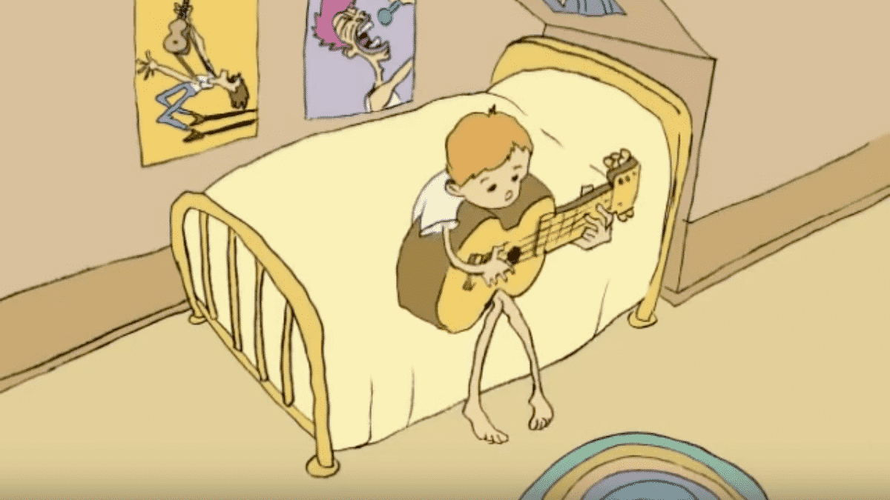
Class 5 Intellectual Property
Keith A. Pray
socialimps.keithpray.net
Notes:
Weird Al Yankovic “Don’t Download This Song” (3:53) 2006-08-21 released exclusively as digital download
https://www.youtube.com/watch?v=zGM8PT1eAvY
Some Analysis Points:
- Slippery Slope Fallacy - CDs were most common way to obtain music - Winner take all society
- Virtue ethics, guilt, shame

Slide 2
what works well Online With Zoom
Sign in with First and Last Name
Stay muted unless you are going to speak
To speak use the raise your hand feature
To answer yes/no questions use the “yes” ”no” buttons
Turn your camera on
Wait until the end of student presentations to ask questions
Write them down so you don’t forget

Slide 3
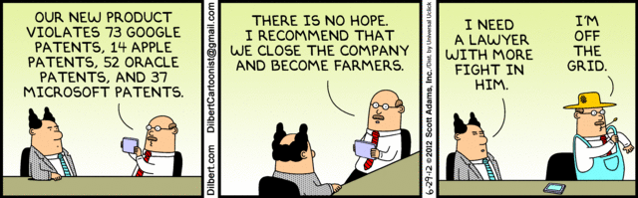
Overview
Review
Assignment
Students Present
Notes:
News: 2021-04-05: SUPREME COURT OF THE UNITED STATES Syllabus GOOGLE LLC v. ORACLE AMERICA, INC. https://www.supremecourt.gov/opinions/20pdf/18-956_d18f.pdf
Accessed 2021-09-09
Comments, observations, questions on IP Chapter?

Slide 4
IP Protection Is Important To Our Economy
2019 Intangible Assets Financial Statement Impact Comparison Report [1]
Notes:
TODO: Move to Critical Thinking
An example of using data to back a statement: From the transition of tangible assets to intangible, ie. intellectual property assets we can see today’s global economy is highly dependent on IP and the laws governing its protection. Note how the 5 largest companies also changed to those who’s main product or business model relies heavily on IP. TODO: Look into Apple’s split between tangible and IP assets since they do have a very successful manufacturing and physical product base.
[1] AON report: 2019 Intangible Assets Financial Statement Impact Comparison Report Sponsored by AonIndependently conducted by Ponemon Institute LLCPublication Date: April 2019 https://www.aon.com/getmedia/60fbb49a-c7a5-4027-ba98-0553b29dc89f/Ponemon-Report-V24.aspx
Last accessed 2021-09-10

Slide 5
My Reading Notes
pp. 172 „not have bothered to invent it.“ or had the time. Any music entering public domain, not just classical. Why does orchestra budget matter? Public domain year 1997/1999 from source published in 1996?
pp. 174 SaaS, Google Search example? “…before he gave them the plot.”? “…cannot erase the memories...” Paycheck (2003)
pp. 176 When was instant photography invented?
pp. 177 $134 billion, copyright leading export 2010, now?
pp. 178 ”not profited” but violated right to distribute and reproduce…
pp. 179 Mickey Mouse – CGP Grey “Copyright: Forever Less One Day”
pp. 180 $150K for VP seems low.
pp. 182 Felicity is also an affected party.
pp. 185 4.4 #2 preferred assuming means published works more likely fair use. See pp. 190
pp. 190 Will Google do the same for music and movies as books?
pp. 191 What about lawsuits over a single hook sample? Revenue != profit. (also pp. 201)
pp. 195 Blocking 100% seems impossible.
pp. 199 Any legitimate BitTorrent use examples since 2005?
pp. 2021 How many subscribe now compared to 2015?
pp. 202 “licensing agreement … hardware”? Confidential source code very outdated.
pp. 203 4.7.3 references?
pp. 204 2021-04-05 Supreme Court find fair use in favor of Google [1]
pp. 207 What did the smartphone patent wars cost consumers?
pp. 208 Pouring can of tomato juice into ocean != hard work/labor
pp. 210 Developers often need to the tool they make and share. Good reputation can lead to more financial remuneration. Producers are currently allowed to share, just not forced. 3rd claim used by opposing argument too.
pp. 212 Perhaps friends should not ask you to break the law?
pp. 213 With Dev/Sec/Ops adoption trending is long release cycles still true? Any successful businesses operate as a support service? Shift to service may be most compelling I list.
pp. 214 Is Perl still most popular? Source? Quality study from 2003, change?
pp. 215 who uses tape?
pp. 216 “human-readable, lawyer-readable…” How strong is Creative Commons chain of reasoning?
pp. 229 Interview has nothing to do with computing
Questions I liked: 20
Notes:
SaaS = Software As A Service
[1] 2021-04-05: SUPREME COURT OF THE UNITED STATES Syllabus GOOGLE LLC v. ORACLE AMERICA, INC. https://www.supremecourt.gov/opinions/20pdf/18-956_d18f.pdf
Accessed 2021-09-09

Slide 6
Group Quiz For each On the left answer a–d on Right
Trademark
Copyright
Patent
Trade Secret
What does it protect?
Qualifications required?
How long does protection last?
Specific example currently protected?
Notes:
Trademark
Used to denote a product or service.
Apply in specific areas of commerce. Only applies in specified area of business
Indefinite term as long as in use and protected against becoming a common noun or verb.
You do not have to register a trademark unless you want to bring litigation before a federal court (there are other benefits too, but what are they?)
Copyright
Expression, not ideas: Fuzzy. E.g. derivative works, characters, merchandising, plots.
Mickey Mouse, Tarzan.
US Default : Original Author, Exception: work for hire, Transferred: yes
Rights: Publication, Performance / exhibition, Adaptation to other media, Excerpting, Attribution, Derivative works
US Term: Lifetime of author plus 70 years., 95 years for companies.
Governed by US law and international treaties (e.g. WIPO).
Fair Use: News reporting, reviews, etc., Scholarly / educational use, Private, non-commercial use, Lending libraries and archives
Fair Use restrictions: Admission charge, Re-transmission
In general, you can: Read, view, play, etc., Copy for personal use., Time-shift, Space-shift
In general, you cannot: Copy for others., Transfer to someone else but keep a copy., Show / perform it publicly.
What about video rentals?
Rationale: Encourage creativity. Encourage dissemination. Balance between private and public good. It’s a social contract.
Patent
A mechanism, process, or composition of matter.
Must be: Novel. Useful. Non-obvious. Described clearly. Must do what it says.
Usual term 20 years.
Utility and plant patents: 20 years.
Design patents last 14 years. (ornamental design of functional item)
Provisional patent gives 1 year, before full patent
Trade Secret
You must take steps.
Enforceable by: Contracts, Laws against industrial espionage.

Slide 7
Group Quiz For each On the left answer a–d on Right
Trademark
Copyright
Patent
Trade Secret
What does it protect?
Qualifications required?
How long does protection last?
Specific example currently protected?
Notes:
Trademark
Used to denote a product or service.
Apply in specific areas of commerce. Only applies in specified area of business
Indefinite term as long as in use and protected against becoming a common noun or verb.
You do not have to register a trademark unless you want to bring litigation before a federal court (there are other benefits too, but what are they?)

Slide 8
Group Quiz For each On the left answer a–d on Right
Trademark
Copyright
Patent
Trade Secret
What does it protect?
Mark denoting product or service
Qualifications required?
Unique in specific area of commerce
How long does protection last?
While in use and protected against common noun or verb usage. Need to register to sue.
Specific example currently protected?
Notes:
Trademark
Used to denote a product or service.
Apply in specific areas of commerce. Only applies in specified area of business
Indefinite term as long as in use and protected against becoming a common noun or verb.
You do not have to register a trademark unless you want to bring litigation before a federal court (there are other benefits too, but what are they?)

Slide 9
Group Quiz For each On the left answer a–d on Right
Trademark
Copyright
Patent
Trade Secret
What does it protect?
Qualifications required?
How long does protection last?
Specific example currently protected?
Notes:
Copyright
Expression, not ideas: Fuzzy. E.g. derivative works, characters, merchandising, plots.
Mickey Mouse, Tarzan.
US Default : Original Author, Exception: work for hire, Transferred: yes
Rights: Publication, Performance / exhibition, Adaptation to other media, Excerpting, Attribution, Derivative works
US Term: Lifetime of author plus 70 years., 95 years for companies.
Governed by US law and international treaties (e.g. WIPO).
Fair Use: News reporting, reviews, etc., Scholarly / educational use, Private, non-commercial use, Lending libraries and archives
Fair Use restrictions: Admission charge, Re-transmission
In general, you can: Read, view, play, etc., Copy for personal use., Time-shift, Space-shift
In general, you cannot: Copy for others., Transfer to someone else but keep a copy., Show / perform it publicly.
What about video rentals?
Rationale: Encourage creativity. Encourage dissemination. Balance between private and public good. It’s a social contract.

Slide 10
Group Quiz For each On the left answer a–d on Right
Trademark
Copyright
Patent
Trade Secret
What does it protect?
Expression, not ideas. Derivative work, publication, performance
Qualifications required?
Original
How long does protection last?
Author lifetime + 70 years, 95 years for companies
Specific example currently protected?
Notes:
Copyright
Expression, not ideas: Fuzzy. E.g. derivative works, characters, merchandising, plots.
Mickey Mouse, Tarzan.
US Default : Original Author, Exception: work for hire, Transferred: yes
Rights: Publication, Performance / exhibition, Adaptation to other media, Excerpting, Attribution, Derivative works
US Term: Lifetime of author plus 70 years., 95 years for companies.
Governed by US law and international treaties (e.g. WIPO).
Fair Use: News reporting, reviews, etc., Scholarly / educational use, Private, non-commercial use, Lending libraries and archives
Fair Use restrictions: Admission charge, Re-transmission
In general, you can: Read, view, play, etc., Copy for personal use., Time-shift, Space-shift
In general, you cannot: Copy for others., Transfer to someone else but keep a copy., Show / perform it publicly.
What about video rentals?
Rationale: Encourage creativity. Encourage dissemination. Balance between private and public good. It’s a social contract.

Slide 11
Group Quiz For each On the left answer a–d on Right
Trademark
Copyright
Patent
Trade Secret
What does it protect?
Qualifications required?
How long does protection last?
Specific example currently protected?
Notes:
Patent
A mechanism, process, or composition of matter.
Must be: Novel. Useful. Non-obvious. Described clearly. Must do what it says.
Usual term 20 years.
Utility and plant patents: 20 years.
Design patents last 14 years. (ornamental design of functional item)
Provisional patent gives 1 year, before full patent

Slide 12
Group Quiz For each On the left answer a–d on Right
Trademark
Copyright
Patent
Trade Secret
What does it protect?
Mechanism, process, composition of matter
Qualifications required?
Novel, useful, non-obvious, described clearly, must function
How long does protection last?
Utility and plant: 20 years
Design: 14 years
Provisional adds 1 year
Specific example currently protected?
Notes:
Patent
A mechanism, process, or composition of matter.
Must be: Novel. Useful. Non-obvious. Described clearly. Must do what it says.
Usual term 20 years.
Utility and plant patents: 20 years.
Design patents last 14 years. (ornamental design of functional item)
Provisional patent gives 1 year, before full patent

Slide 13
Group Quiz For each On the left answer a–d on Right
Trademark
Copyright
Patent
Trade Secret
What does it protect?
Qualifications required?
How long does protection last?
Specific example currently protected?
Notes:
Trade Secret
Anything with business value
You must take steps to keep it secret: Non Disclosure Agreement, protected storage, compartmentalization, etc.
As long as the secret is kept
Enforceable by: Contracts, Laws against industrial espionage.

Slide 14
Group Quiz For each On the left answer a–d on Right
Trademark
Copyright
Patent
Trade Secret
What does it protect?
Anything
Qualifications required?
Must take steps to keep secret, e.g. Non-Disclosure Agreements, contracts
How long does protection last?
As long as kept secret
Specific example currently protected?
Notes:
Trade Secret
Anything with business value
You must take steps to keep it secret: Non Disclosure Agreement, protected storage, compartmentalization, etc.
As long as the secret is kept
Enforceable by: Contracts, Laws against industrial espionage.

Slide 15


Overview
Review
Assignment
Students Present
Notes:
But first take a look at:
CGP Grey
Copyright: Forever Less One Day (6:27)
https://www.youtube.com/watch?v=tk862BbjWx4
Tom Scott
http://tomscott.com
Welcome To Life (2:44)
https://www.youtube.com/watch?v=IFe9wiDfb0E&feature=youtu.be

Slide 16
Assignment - Self Search 1/3
What Really
Is You?
1 Page
Paper
Filter
Inspiration
Search Methods
…
…
…
…
Filter
Profile
Could Be You

Slide 17
Assignment - Self Search 2/3 Discussion Board
Post search techniques
Do not repeat entries.
Use techniques listed to produce a profile that could be you.
Not responsible for techniques posted less than 24 hours before due
Filter first profile so that the information is for you.
Provide as paper appendix
Summary is fine. No details needed unless you for making a point.
Consider:
Exactly how did the data get there?
How can this data be used?
Is this a secondary use?
Did you authorized use of the data? If not and you want to, request its use be discontinued and share the experience.
Be creative, anyone can type a name into Google
Do not pay for search services

Slide 18
Assignment - Self Search 3/3 1 Page Paper
Refer to search results to support your conclusion
Subscribe to the Discussion Board
Example questions conclusion could answer:
What impression would the profile make on a potential employer?
What would your elder family members (or equivalent) think?
Are you comfortable with what you found or did not find?
Do you believe protecting your privacy is important or needed?
5 High quality sources required

Slide 19
Overview
Review
Assignment
Students Present

Slide 20
The YouTube copyright System is being abused TO Limit FAIR USE On the platform
Caleb Scopetski
Notes:
Hello my name is Caleb Scopetski and I will be presenting the topic of the YouTube copyright system and how it can be abused to infringe on fair use.

Slide 21
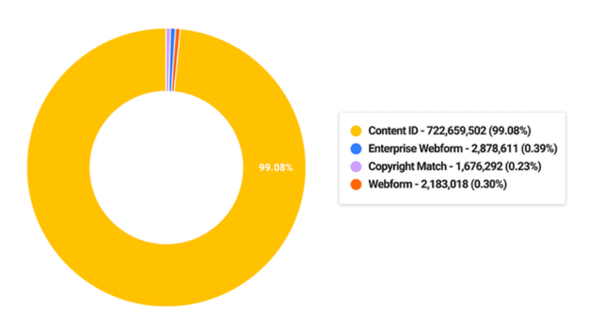
Content ID
Caleb Scopetski
Content ID is YouTube’s copyright identification bot
99% of copyright claims are done through Content ID
Good idea, bad implementation
Fair use
Figure 1. Distribution of types of copyright claims in first half of 2021 [1]
Notes:
- ContentID main source of copyright identification and claims (99% 722 mil)
- Automated system that specific copyright holders (large corporations) use to identify their content in other videos
block, monetize, track
Good idea on paper, allows copyright holders to protect intellectual property
bad implementation, doesn’t take context (fair use) into account
ContentID is just an algorithm, for identifying copyrighted material, no way for it to take context/fair use into account
Transformative content is then copyright claimed
(segway) Creator has to go through copyright claim dispute process
Youtube’s main source of copyright identification and claims is ContentID, 99% of all copyright claims (722 mil) are done through it (as shown in the Figure)[1]. ContentID is an automated system that allows specific copyright owners to identify if their content has been uploaded and manage it. Once a video has been identified to have copyrighted content, the copyright owner is notified and can choose to block the video, monetize the video or just track the video [3]. On paper this sounds great, its a system that allows copyright owners to protect their intellectual property, but ContentID runs into many issues when it comes to fair use.
ContentID is just an algorithm for identifying pieces of copyrighted content, it does not/ cannot consider some of the more opinionated factors of fair use like “the purpose and character of the use” aka is the content transformative. This leads to videos that use copyrighted content transformatively being flagged as containing copyrighted content. This automatically results in the video either being blocked or demonetized (fully or partially) depending on the settings the copyright owner chose [4].
The creator then must go through the copyright dispute process in order to get their video/monetization back.

Slide 22
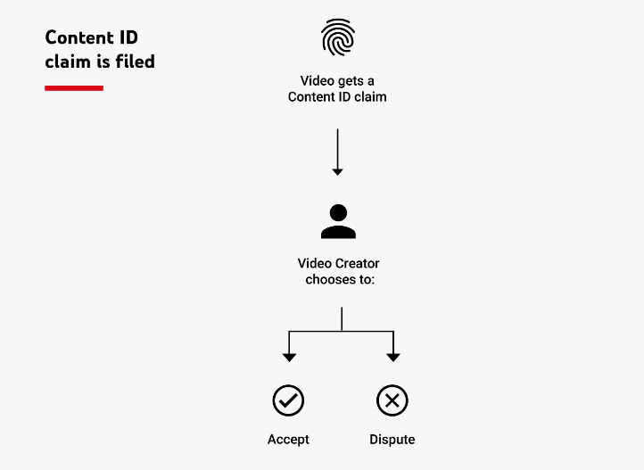
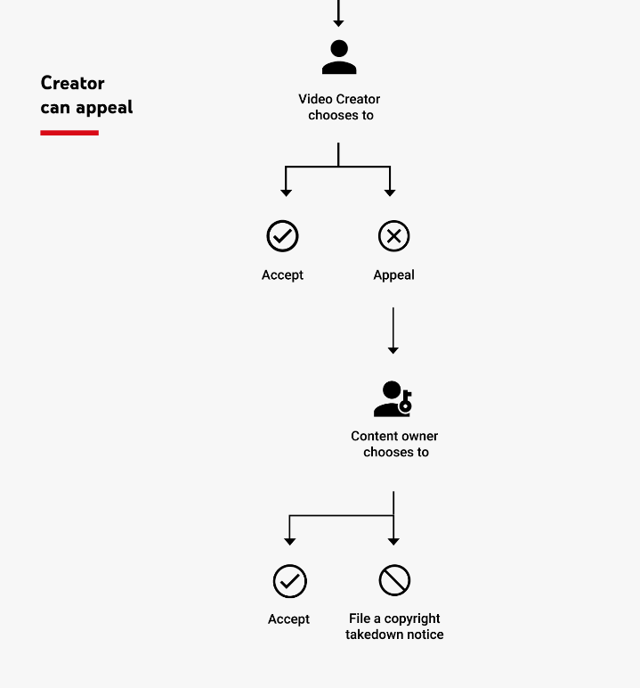
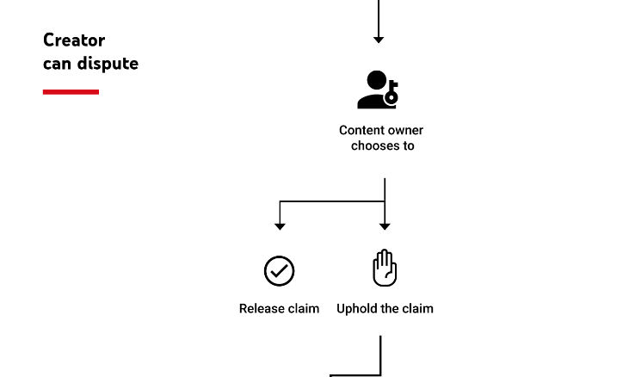
The Dispute: System favors the claimant, not the creator
Caleb Scopetski
Copyright holder has nothing to lose
Creator has a lot to lose
Revenue
Strikes
Lose entire channel
Legal Action
<Graphic as big as will fit>
1
3
2
Notes:
In order to get video back, creator must go through the dispute process
1. claim is filed, creator disputes claim
2. content owner has 30 days to release or uphold the claim
During this period can take monetization or block video (silence video or just take revenue for up to 30 days)
3. creator can appeal the content owner’s claim again
4. content owner has another 30 days to release the claim or file copyright takedown notice
Strike on channel (3 strikes you’re out)
- 5. if creator disputes copyright takedown, usually taken to court
- copyright owner (big corp) usually has a lot more resources for court than creator
No punishment for copyright owners falsely taking down/claiming videos
Creator has a lot to lose
Time, money, channel, legal
When a creator believes that their video falls under fair use, they must dispute the copyright claim in order to get their video back (Step 2 in the figure). When a dispute is filed, the content owner is notified and can either release the claim or uphold the claim. If the content owner does not respond within 30 days, then the claim is released automatically. During this 30-day period, the video is still either blocked or demonetized (partial/full). This allows content owners to silence videos they do not want to be viewed or take partial to full revenue share from videos that they falsely copyright claimed for up to 30 days, with no punishment [4]. On the other hand, if the content owner decides to uphold the claim, they can do so without review from a neutral third party. If there is no punishment for upholding the claim, what motive would the company have to release it?. The creator is then given a final chance to appeal again (Step 3 in the figure), which repeats the previous process however now the stakes are raised for the creator. The content owner now has the options to release the claim on the video or issue a copyright takedown notice which puts a strike on the channel. Youtube channels are deleted after 3 strikes. YouTube does not punish content owners for false copyright takedowns, so if the content owner decides to falsely takedown the video it is up to the creator to reach out to YouTube support or pursue legal action against the content owner who has more resources at their disposal.
There is no punishment for copyright holders pursuing false claims/takedowns, yet the creator can lose a lot by trying to uphold their video that they created in fair use. This allows copyright holders to silence/hide videos that negatively portray their content or criticize the content.
Figure Source [4]

Slide 23
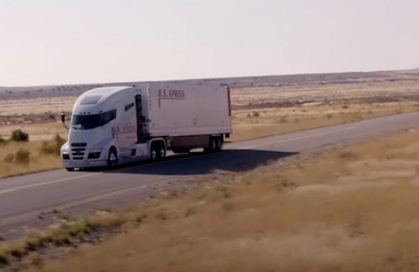
Example: Nikola One Truck
Caleb Scopetski
Video of “fully functioning ” Nikola One prototype aired in 2018
Took down many videos criticizing the promotion
Notes:
-Nikola One truck “fully functioning” actually didn’t work and was rolling down hill
Creators noticed and made videos using a 10-30 second clip from the 10 minute promotional video
Creators provided commentary/criticism of the video claiming that the truck was fully functional
Nikola One used YouTube’s copyright system to identify and block/takedown the videos criticizing Nikola One
One Youtuber was interviewed and said he was “nervous” about disputing claim because he knew that it could result in legal action/fees and he didn’t have the money/time to battle a large corporation
Shows how large corporations can abuse YouTube’s copyright system to silence bad press without consequence
One example of this occurred in 2018, when Nikola announced their Nikola One truck. In their announcement video there was a clip of the “fully functional” truck “driving” when it was actually just rolling down the hill because it wasn’t fully working yet. Many YouTube videos surfaced offering commentary and criticism about the promotional video in fair use, yet Nikola was able to falsely take them down without consequence. One YouTuber was interviewed and stated that he was “too nervous” to challenge the takedown because YouTube says this can result in legal action from the copyright owner. [6]
Copyright owners can use YouTube’s copy strike tool to silence opinions that do not favor them, without consequence.
Figure Source [6]

Slide 24
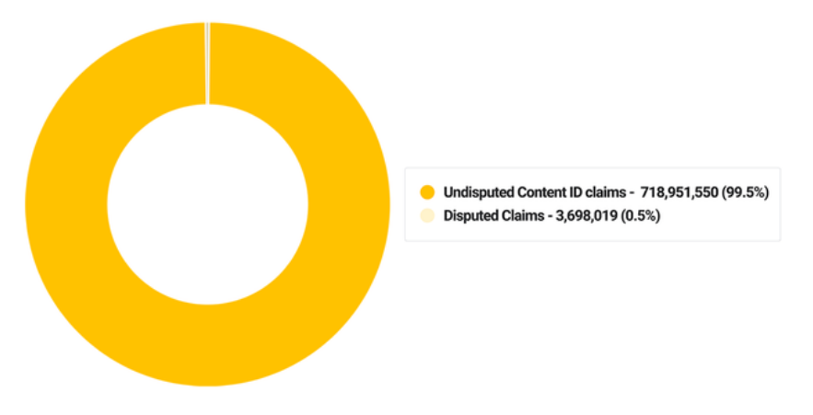
Counter Argument: Not many claims are disputed
Caleb Scopetski
Only 0.5% (3.7 mil) of Content ID claims were disputed
Rebuttal:
500 hours of video uploaded every minute (Not all original creator content)
Risks of dispute outweigh reward
Figure 1. Percentage of Content ID claim disputes in first half of 2021[1]
Notes:
-YouTube used this statistic to prove that false copyrighting was not that big of an issue in their first yearly copyright review
If creators are losing so much revenue to false claims, then how come they don’t dispute them?
A valid counter argument would be that not many Content ID claims are actually disputed. In the first half of 2021, only 0.5% of Content ID claims were disputed [1]. While this point is valid, it is important to consider the factors behind this statistic. On average over 500 hours of video are uploaded to YouTube every minute [1]. While there a lot of great creators out there, the vast majority of the content uploaded to YouTube is low-quality and some is even uploaded by bot accounts. Only 2 million of the over 50 million channels (4%) on YouTube are monetized [5]. These channels are the only channels with an incentive to dispute the claim to get monetization on the video back. The 3.7 million disputed claims seems a lot larger when compared to the 2 million channels that are likely to file the dispute.
As previously mentioned, a large factor that contributes to the lack of disputes is that the risk of disputing a claim often outweighs the reward. When a creator disputes a claim, the claimant is the one who decides if the dispute is valid not a neutral third party. If the claimant finds the dispute to be faulty, they can issue a copyright takedown which takes down the video in question and results in a copyright strike for the creator’s channel. If a channel receives 3 strikes, then it and all its videos are taken down. When served a claim on their videos creators are faced with 2 choices, lose part or all of the revenue on the video due to a false claim. Or dispute the false claim and risk the entire video being taken down and a strike to their channel. [2]
In recent years YouTube has made it easier for creators to remove the copyrighted section from their videos, so most creators choose not to dispute claims and instead remove the portion of the video that triggered the claim instead.

Slide 25
References
Caleb Scopetski
[1] Team, The YouTube. “Access for All, a Balanced Ecosystem, and Powerful Tools.” Blog.youtube, YouTube Official Blog, 6 Dec. 2021, https://blog.youtube/news-and-events/access-all-balanced-ecosystem-and-powerful-tools/.
[2] Google. “Copyright and Rights Management - Youtube Help.” Google, Google, 2022, https://support.google.com/youtube/topic/2676339?hl=en&ref_topic=6151248.
[3] Google. “How Content ID Works - Youtube Help.” Google, Google, 2022, https://support.google.com/youtube/answer/2797370?hl=en#zippy=%2Cwho-can-use-content-id.
[4] Trendacosta, Katharine. “Unfiltered: How Youtube's Content ID Discourages Fair Use and Dictates What We See Online.” Electronic Frontier Foundation, 11 Dec. 2020, https://www.eff.org/wp/unfiltered-how-youtubes-content-id-discourages-fair-use-and-dictates-what-we-see-online#ContentID.
[5] “How Many YouTube Channels Are There?” Tubics, 2020, https://www.tubics.com/blog/number-of-youtube-channels.
[6] Jon Brodkin. “Nikola Issues Copyright Takedowns against Critics Who Use Rolling-Truck Clip.” Ars Technica, 2 Oct. 2020, https://arstechnica.com/tech-policy/2020/10/nikola-tries-to-silence-critics-with-copyright-takedowns-of-youtube-videos/.
…

Slide 26
Class 5 The End
Keith A. Pray
socialimps.keithpray.net
Notes:
This is the end. Any slides beyond this point are for answering questions that may arise but not needed in the main talk. Some slides may also be unfinished and are not needed but kept just in case.

