Slide 1
Class 4 Freedom Of Speech
Keith A. Pray
socialimps.keithpray.net
Notes:
Forgot to show the ethical analysis guide. Do so now.

Slide 2
what works well Online With Zoom
Sign in with First and Last Name
Stay muted unless you are going to speak
To speak use the raise your hand feature
To answer yes/no questions use the “yes” ”no” buttons
Turn your camera on
Wait until the end of student presentations to ask questions
Write them down so you don’t forget

Slide 3
Overview
Review
Assignment
Students Present
Notes:
Show syllabus updates if any

Slide 4
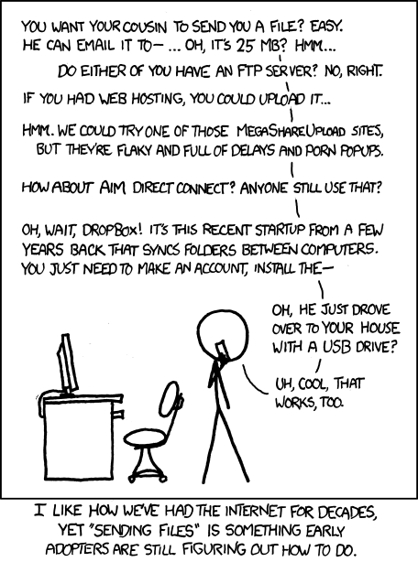
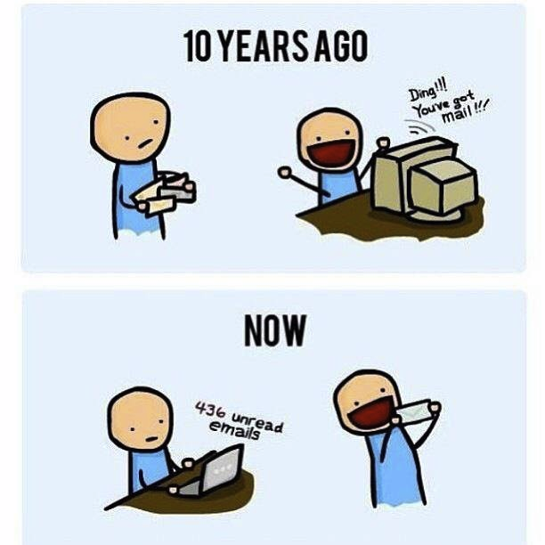
http://poofytoo.com/
25
http://xkcd.com/949/

Slide 5
My Reading Notes
pp. 110 First e-games 1972 at Stanford [1]. Has Twitch viewership gone up since the start of the COVID pandemic?
pp. 111 What powers the cell phones and towers? “everyday tasks” not apparent from image.
pp. 113 Ann did not force people to complain.
pp. 114 Does Kantian analysis agree?
pp. 117 9% # transactions or $$? Wikipedia critics source from 2005, is quality still in question?
pp. 118 MOOC source from 2012, now?
pp. 122 Macedonian is nice addition to new edition
pp. 123 “may have” = weak conclusion. Who funded studies?
pp. 124 Easier consolidation of newspapers. Advertisers switching away from newspaper source from 2014.
pp. 126 Search engines link deeper than home page
pp. 127 Any US agencies employing this many people?
pp. 131 Adult bookstores lowering property values source?
pp. 135 “texted… images”
pp. 136 Stating people searching did not consent to material being blocked makes more sense.
pp. 138 sexting examples all from 2009?
pp. 140 College students still as likely? 2013 source
pp. 141 Do mobile plans still charge for text messages?
pp. 146 Hunter Moore convictions seem unrelated to “Anyone Up?” site.
pp. 153 See: http://en.wikipedia.org/wiki/Wikipedia:Citing_Wikipedia
pp. 154 Question 40 same as 46
Questions I liked: 17, 43
Interview nice update
Notes:
[1] Owen Good (19 October 2012). "Today is the 40th Anniversary of the World's First Known Video Gaming Tournament". Kotaku. Retrieved 1 August 2013

Slide 6
Group Quiz
Name two methods some governments use to control access to information.
A large company has a policy prohibiting employees from blogging about company products.
Does it violate the First Amendment? Why?
Name two possible reasons for the policy.
Is it reasonable? Why?
What does “URL” stand for and what is it?
Notes:
Censorship (religious, governmental, private). Adult authentication. Firewalls. Government owned media outlets (TV and radio stations, newspapers), private photocopier ownership illegal
First Amendment prohibits Congress from making laws limiting free speech, not private companies.
Uniform Resource Locator

Slide 7
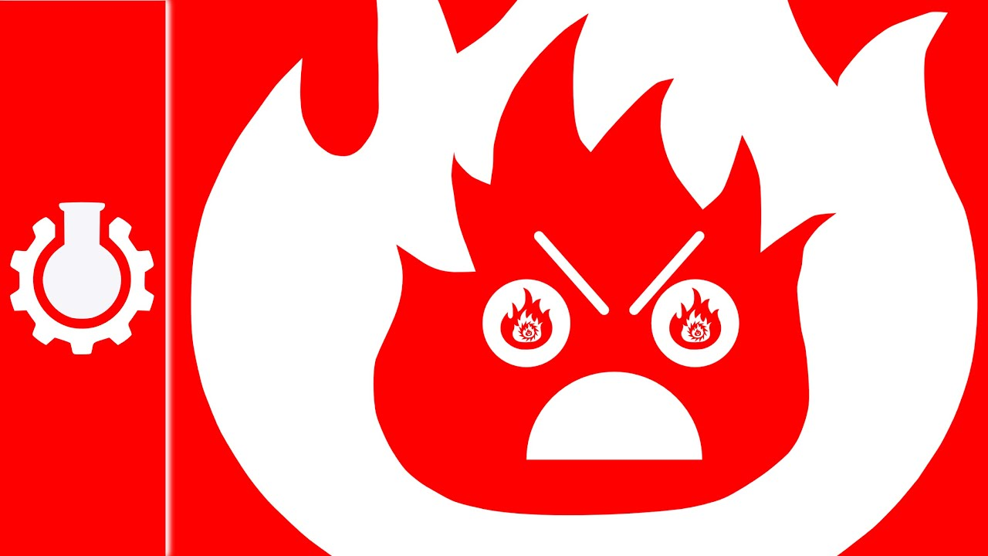
Overview
Review
Assignment
Students Present
Notes:
But before that:
CPG Grey - This Video Will Make You Angry [Thought Germs] (7:25) – 2015-03-10
https://www.youtube.com/watch?v=rE3j_RHkqJc
Find better examples:
Cedric Gervais - Hashtag (Original Mix) (3:58)
https://www.youtube.com/watch?v=6OmBKd7X7EE
Dave Audé vs Luciana - You Only Talk In #HASHTAG (3:36)
http://www.youtube.com/watch?v=53wIN87lJn0

Slide 8
Assignment
Reading
Individual Presentations
Extra Credit – One page paper
Is WPI’s IT Acceptable Use Policy morally acceptable?
Work on your group project
1.43 Happiness!
1-3 scale with 1 = everyone getting their first pick
See full group project description on course website
Send Web Site URL before next class
Notes:
- Or review group project and individual presentation guidelines right now.
Possible One page paper:
Global intellectual property laws, friends or foes?

Slide 9
Overview
Review
Assignment
Students Present

Slide 10
Does Social Media Impede or Improve Communication?
Maia Grant
Notes:
Hello Everyone! My name is Maia Grant and I will be answering the question, "Does Social Media Impede or Improve Communication?"

Slide 11
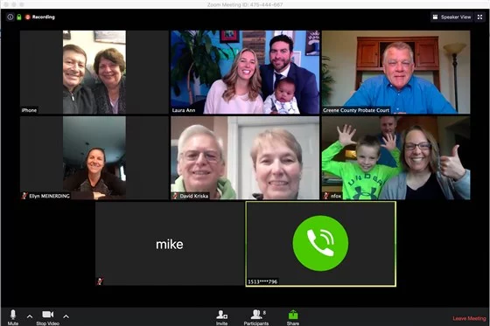
Closing the distance
Maia Grant
Connecting families
Meeting people with similar interests
Sharing advice/tips
Family Zoom Call. Adapted from "Couple Officially Adopts Son Via Zoom Meeting", by POPSUGAR, 2020, retrieved from, https://www.google.com/url?sa=i&url=https%3A%2F%2Fwww.popsugar.com%2Ffamily%2Fcouple-officially-adopts-son-via-zoom-meeting-47380186&psig=AOvVaw0yOGbCwbth6fVjk13f8ZAh&ust=1648232459666000&source=images&cd=vfe&ved=0CAsQjRxqFwoTCIDbusqu3_YCFQAAAAAdAAAAABBR
Notes:
While some people may disagree, I believe social media helps us communicate. Websites and apps such as Instagram, Facebook, Twitter, and many others allow individuals to connect with family members across the globe to share things such as pictures and life updates. During the beginning of the pandemic, my family and I'm sure a lot of your families would participate in Zoom calls to keep in touch with each other. Another point is that you can follow people and pages that you are interested in, and even meet people you probably never would have otherwise. Another example of this is helping others. There are many social media websites that are used as discussion websites. One example of this is Reddit. Users can ask for advice on a wide range of topics as well as share images, stories, and videos.

Slide 12
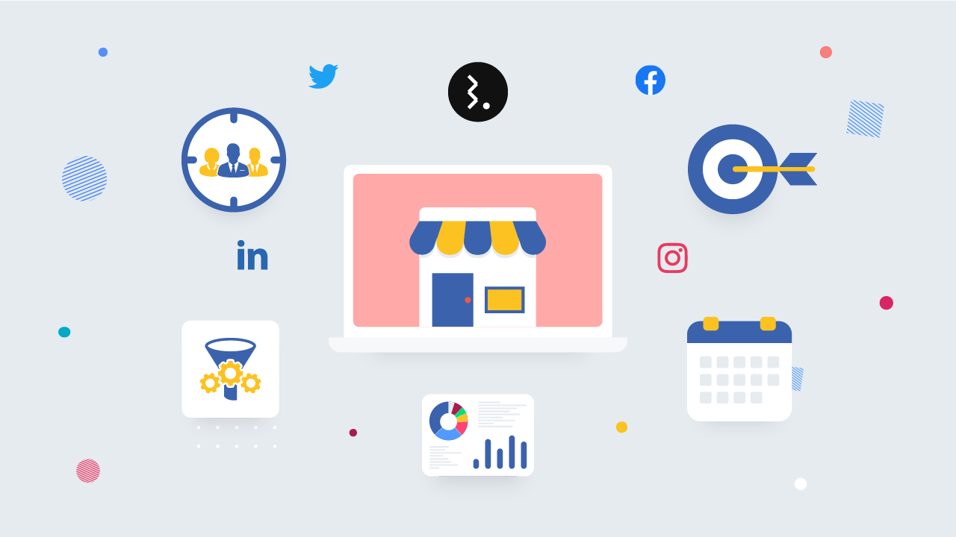
small business outreach
Maia Grant
Ad campaigns
Showcasing a business's "personality"
Social Media and Small Business. Adapted from "How to Use Social Media for Small Business: 10 Effective Tips", by StatusBrew, 2018, retrieved from, https://statusbrew.com/insights/social-media-marketing-tips-for-small-businesses/
Notes:
Another form of communication social media provides is through small businesses. Before the rising use of social media outlets, small businesses relied on word-of-mouth references or even a curious customer driving by. Now, businesses can even operate solely via the internet. Through social media, businesses can now pay for ads online and reach their target audience easier than ever. Employees themselves can create fun ads to share on social media to promote the business and attract customers. Another way social media promotes small business outreach is by giving the business its own "personality". By this, I mean owners and employees can better showcase the company by more than just a website. For example, *talk about TikTok live videos*.

Slide 13
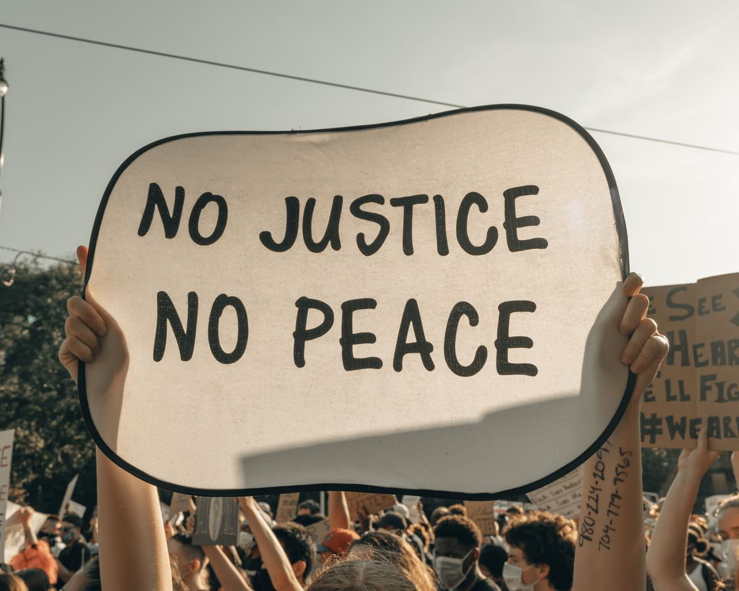
Social Injustice
Maia Grant
Discussions with strangers on political views
Gather groups for protests
Organize clean up groups
Social Injustice. Adapted from "7 Biggest Social Issues That Could Lead to Social Injustice", by Sintelly, 2021, retrieved from, https://sintelly.com/articles/biggest-social-issues-that-could-lead-to-social-injustice
Notes:
Another way of communication social media brings to the world is the discussion of social injustice of any kind. "Cancel culture" is huge in society today and we can hold people accountable, publicly, from our fingertips. Social media can allow debates on political topics, court cases, and many other controversial issues in society through mobile devices or computers. To add to this point, individuals from debates or people "sharing their life's story" could be from a different country, race, economic background, amongst many other factors, without having to travel to do so. People's opinions and voices can be heard like never before. Twitter is a very good example of how we can spread knowledge at a very fast rate, for a large population to see and share. Social media also allows people and organizations to organize protests and gatherings that anyone can attend and can vocally share their concerns. The state of the environment and being environmentally conscious is becoming very prominent in society. Clean-up days can be organized to pick up litter from the streets, woods, and even oceans to leave the planet better than we came into it. We as a society can stay connected like never before.

Slide 14
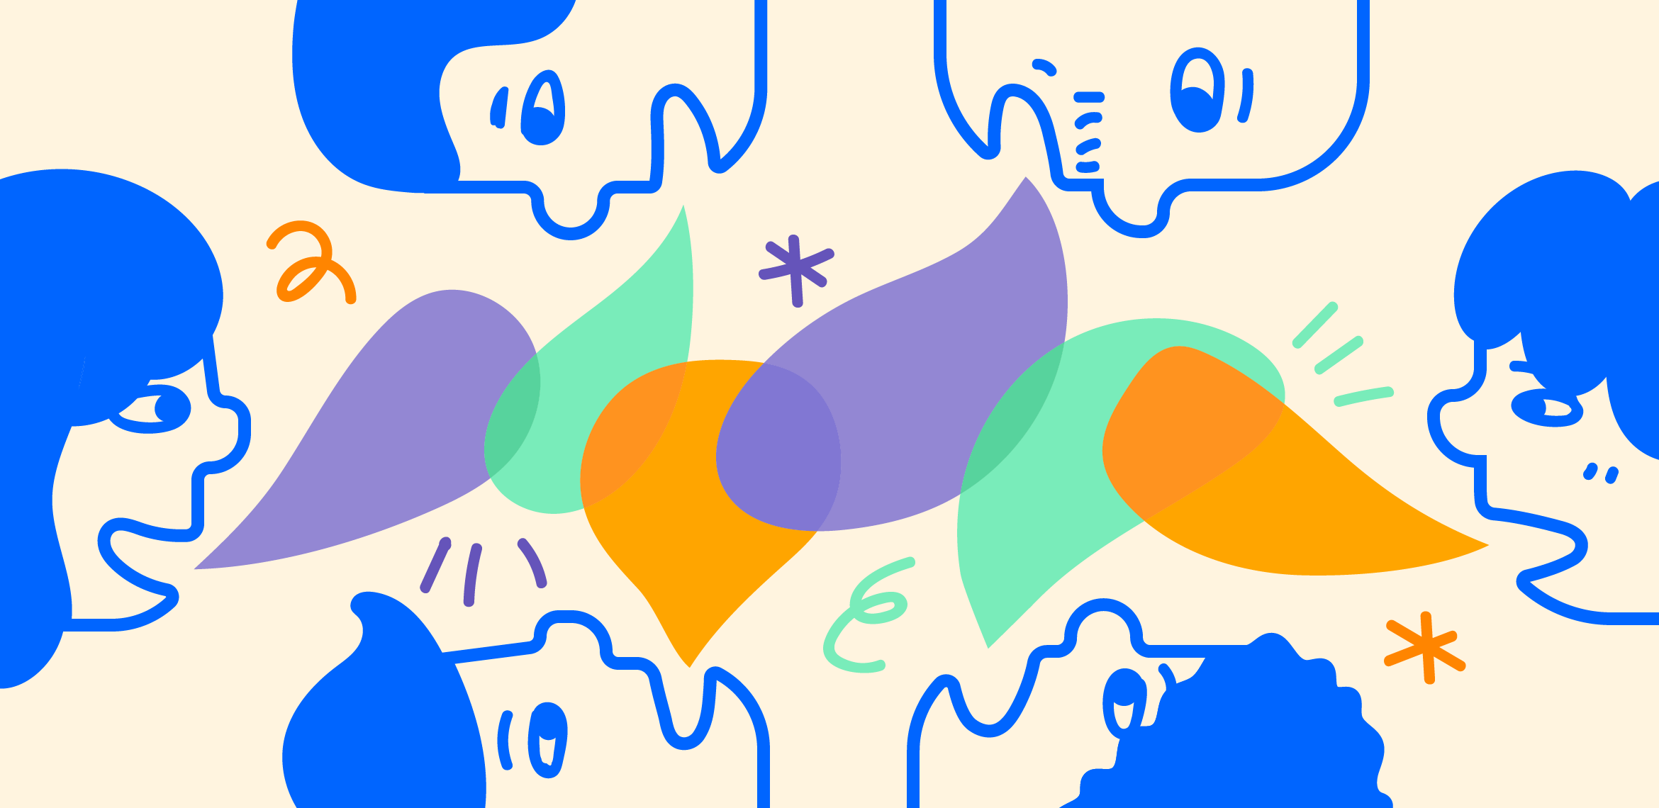
Social media has changed the way we communicate
Maia Grant
Notes:
Yes, social media has effected communication. I think most of us can agree that we hear that "the younger generations 'can't get out from behind a computer screen', or that we "can no longer interact with other people face to face." I disagree with that entirely. Back before the internet, communication was way more limited. I can text my friends and communicate whenever I choose to, face to face, over a text, through pictures, I can send pictures, and we are no longer limited to just a phone call. We have video chatting and the ability to hold classes online. Communication today is undoubtedly different, but I don’t think it has been limited by any means.

Slide 15
References
Maia Grant
[1] Sponcil, M., & Gitimu, P. (2013). Use of social media by college students: Relationship to communication and self-concept. Journal of Technology Research, 4(1), 37-49.
[2] Constantinides, E. (2009, January). Social Media/Web 2.0 as marketing parameter: An introduction. In Proceedings of 8th international congress marketing trends (pp. 15-17).
[3] Taneja, S., & Toombs, L. (2014). PUTTING A FACE ON SMALL BUSINESSES: VISIBILITY, VIABILITY, AND SUSTAINABILITY THE IMPACT OF SOCIAL MEDIA ON SMALL BUSINESS MARKETING. Academy of Marketing Studies Journal, 18(1), 249-260. http://ezproxy.wpi.edu/login?url=https://www.proquest.com/scholarly-journals/putting-face-on-small-businesses-visibility/docview/1645849603/se-2?accountid=29120
[4] Stieglitz, S., & Dang-Xuan, L. (2013). Social media and political communication: a social media analytics framework. Social network analysis and mining, 3(4), 1277-1291.
[5] da Silva, J. A. T. (2020). Stigmatization, discrimination, racism, injustice, and inequalities in the COVID-19 era. International Journal of Health Policy and Management, 9(11), 484.

Slide 16
Social Media platforms should change algorithms to stop promoting Manipulative Incitive Content
Kaley Du
Notes:
Hello, my name is Kaley, and my topic is that social media platforms should change algorithms to stop promoting incitive and manipulative content.

Slide 17
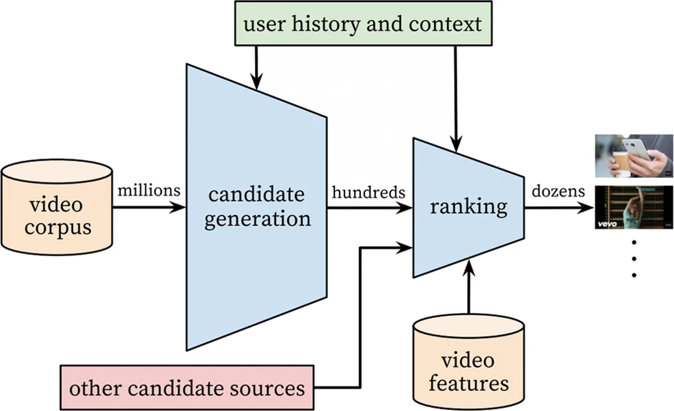
Social media is designed to Incite anger
Kaley Du
Social media is designed to be addicting, according to former Facebook Employees such as Justin Rosenstein who helped create the like button
According Molly Crockett, an associate professor of psychology at Yale, “Amplification of moral outrage is a clear consequence of social media’s business model, which optimizes for user engagement” [1]
Notes:
Social media is designed to be addictive, and even former employees of Facebook, such as Justin Rosenstein, who designed features such as the like button, confirm this [3]. Likes, comments, and shares simulate rewards which cause the brain to release dopamine and cause a person to keep coming back for more[3]. The goal of social media is to feed this addiction and to increase engagement, and what is good for engagement is often shocking or enticing. According Molly Crockett, an associate professor of psychology at Yale, “Amplification of moral outrage is a clear consequence of social media’s business model, which optimizes for user engagement” [1]. What content pops up in our feed matters, and often, divisive content is shown first as it entices more of a reaction that non-controversial content [2]. To further evidence this, a 2018 slideshow from Facebook declared that its algorithms exploit divisiveness and, if left unchecked, would promote more and more divisive content [4]. This content is further amplified by the ‘social’ feature of social media, as reshares can help it spread across the world like wildfire with a far wider scope than it would have had otherwise[2]. Such widespread sharing and increasingly incitive content can lead to real consequences.
Pictured here is a chart of the recommendation process for youtube [2]. As you can see it is personalized by user history and context.

Slide 18
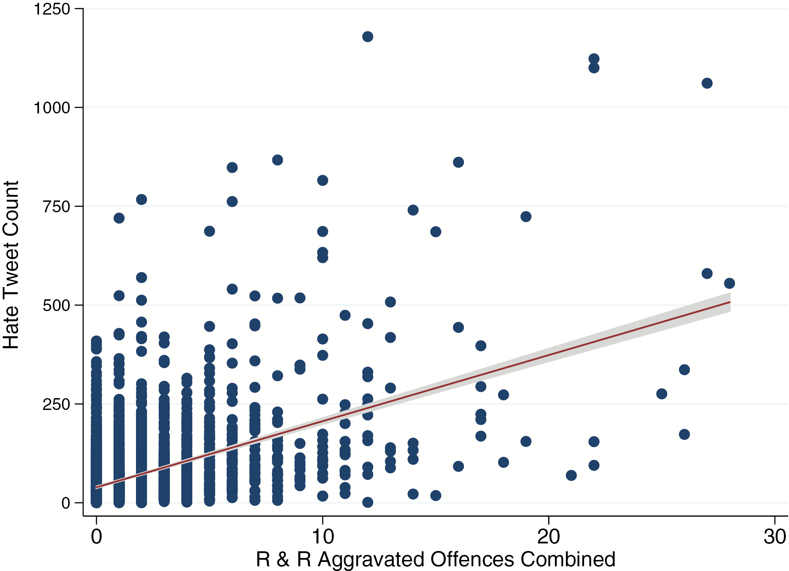
Harmful effects
Kaley Du
Hate Speech
2016 study found 64% of joins to extremist groups were due to Facebook’s recommendation tools
Radicalization
Youtube alt-lite -> alt-right
Political Polarization
Misinformation
Covid-19
<Graphic as big as will fit>
Notes:
One result of the divisiveness of social media content is that it facilitates hate speech and hate groups. A 2016 presentation by Facebook researcher and sociologist, Monica Lee, found that more than one-third of large German political groups on the platform was filled with extremist content [4], and that 64% of the joins to these extremist groups were due to Facebook’s recommendation tools [4].
Hate speech is not where it stops, however. A study from The British Journal of Criminology found that there is a positive correlation from hate tweets and racial and religiously aggravated offences, as depicted on the graph here[6].
Social media algorithms can also help radicalize. A study showed that users on Youtube tend to migrate from relatively mild content to extreme content, and that there is an alt-right pipeline to more extreme views through recommendations: “ a large percentage of users who consume Alt-right content now consumed Alt-lite and I.D.W. content in the past” [5].
Social media has also increased polarization. A study from NYU states that social media plays a role in further dividing political parties in the US [7], and according to a survey, 60% of Americans believe that big tech companies are helping divide people [4]. Contributing to this polarization is widespread misinformation, which also drives engagement, as executives worried, after the 2020 elections, that maintaining a nicer news feed would decrease the amount of time that users would spend on the platform [7].
The incitive nature of social media can bring out the worst side of people, resulting in grave consequences.

Slide 19

Previous efforts
Kaley Du
Many hate speech policies introduced ~2017-2018
Facebook researched promoting of derisive content, announced 2 million in funding for researching polarization
Research efforts were largely abandoned
shift “away from societal good to individual value,”
Notes:
Previously, social media sites have tried to make some changes in order to push back against such derisive content, with social media giants introducing hate speech policies around late 2017 and 2018 [6]. Facebook, during this time, launched research about this topic announcing $2 million in funding for research on polarization[4], and in doing so had to rethink the way that it had always prioritized engagement [4]. However, many of these operations fell apart or were weakened, and later in 2018 Facebook declared that they would shift “away from societal good to individual value,” [4]. Despite all of Facebook’s knowledge about the issue, the research has been mostly shelved.

Slide 20
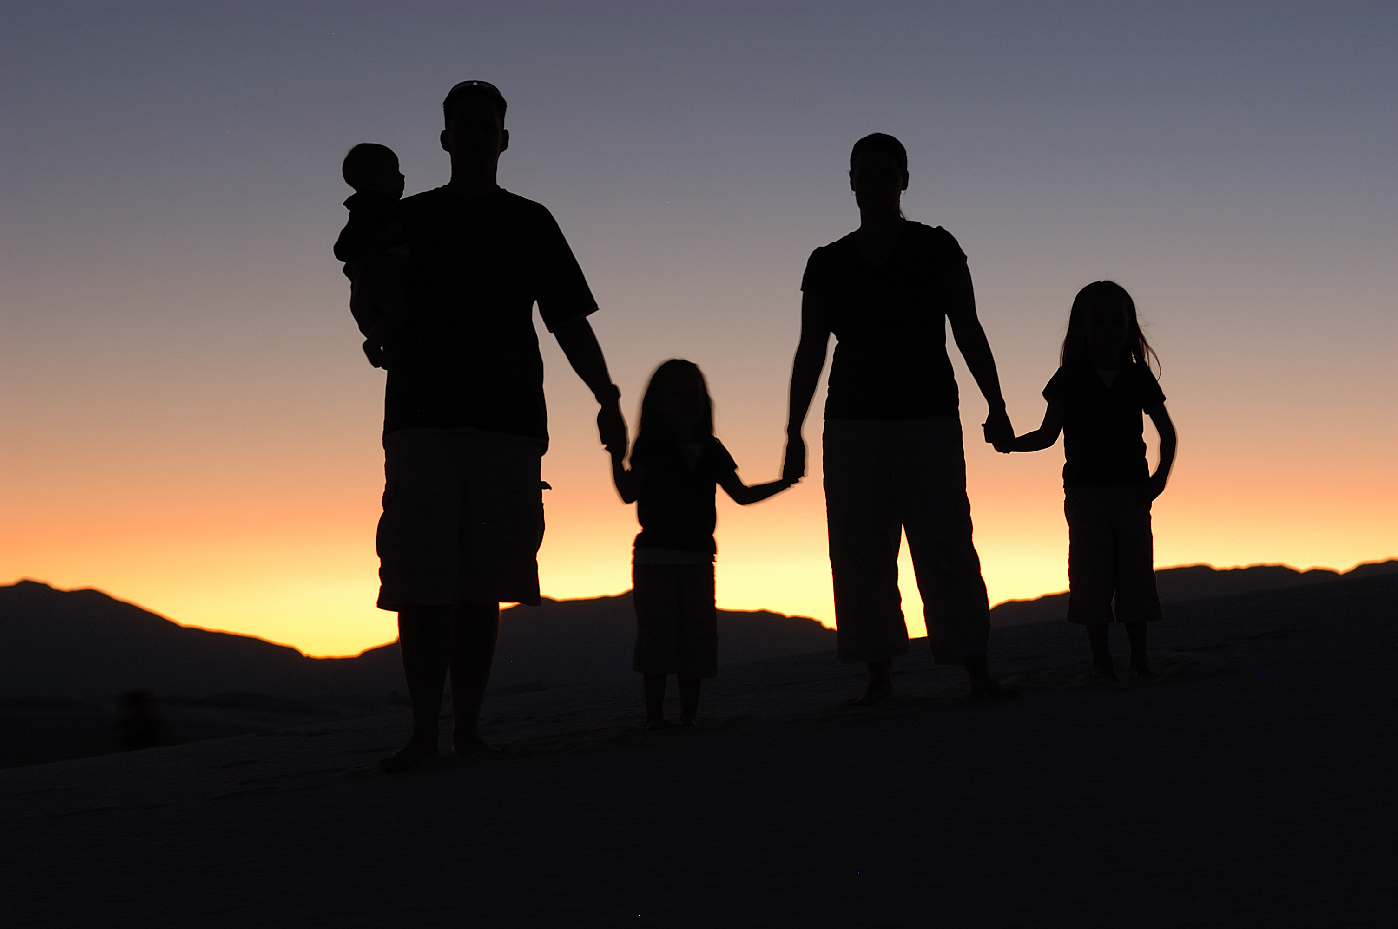
Possible solutions
Kaley Du
Addressing stimulus –More focus on close ties and smaller scope
Addressing responses and widespread outrage - More time to think
Broaden/get rid of recommendations to discourage radical groups
Notes:
So, how should social media change in order to combat these issues? One possible solution is to prioritize the posts of close family and friends, and potentially lower the scope of posts seen [2]. This would decrease the amount of stimulus and may make the content more mundane. Another solution is to add a bit of built-in delay, emulating the slower pace of traditional forums, in order to perhaps encourage the user to think more about the content they post before posting [2]. With regards to Youtube and recommendations, there could be an attempt to broaden the range of recommendations, or not provide recommendations at all [2]. Though there is a lot of work to be done, there are definitely ways to make social media less derisive.

Slide 21
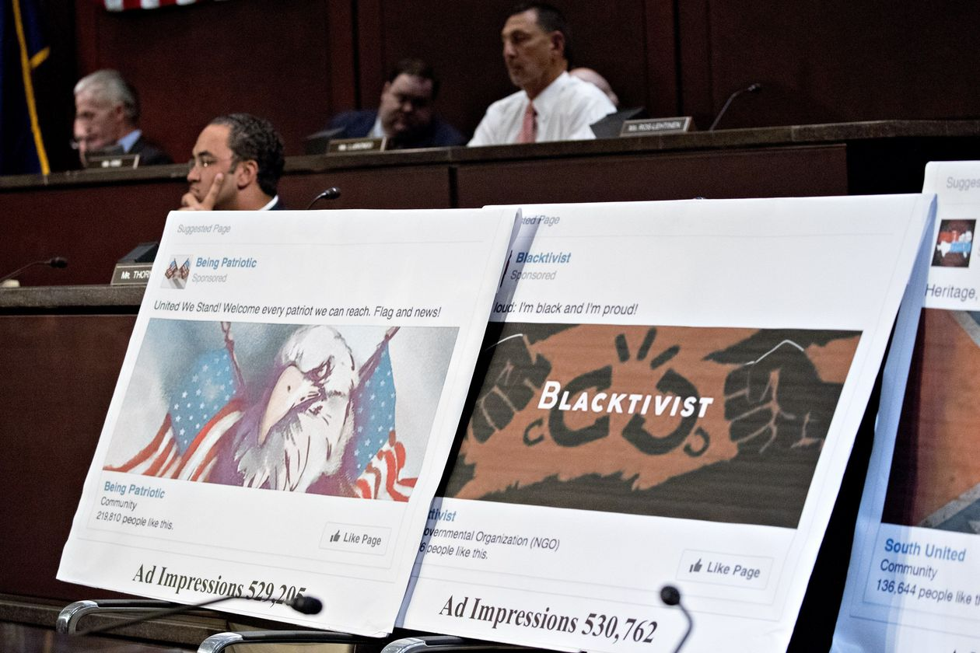
Counterpoints
Kaley Du
Trying to make people more civil is paternalistic
Not collecting data, trying to diversify
Toxicity inevitable based on size, not caused by the platform
Design decisions such as YouTube comment likes can encourage toxic behavior
Bias and freedom of speech
<Graphic as big as will fit>
Notes:
However, there are a few counterpoints to trying to change these algorithms. One point is that trying to make conversations more civil is a bit too controlling, and perhaps pointless [4]. However, one’s feed is already controlled by algorithms that gather a lot of information about users, and a solution would focus more on recommending less incitive content, with no need of gathering more information. Another point is that such problems are inevitable due to the size of these platforms and that it is not the platform that is the problem, but the already-existing toxic people. While it is true that the toxicity comes from toxic people, certain design choices may encourage such toxicity. For example, the fact that Youtube comment’s likes aren’t affected by the amount of dislikes may help promote more controversial comments [2]. Finally, there are concerns about possible infringement of freedom of speech as well as political bias [4]. Measures such as getting rid of misinformation may sometimes result in accidentally taking down false positives, thus restricting freedom of speech [7]. Biases of creators of systems to identify misinformation and radical information may also get in the way, and too much control may result in restriction of certain groups. Although bias is an important concern, it is ultimately worth it to change algorithms as the contributions to polarizations are not helping any of the sides.

Slide 22
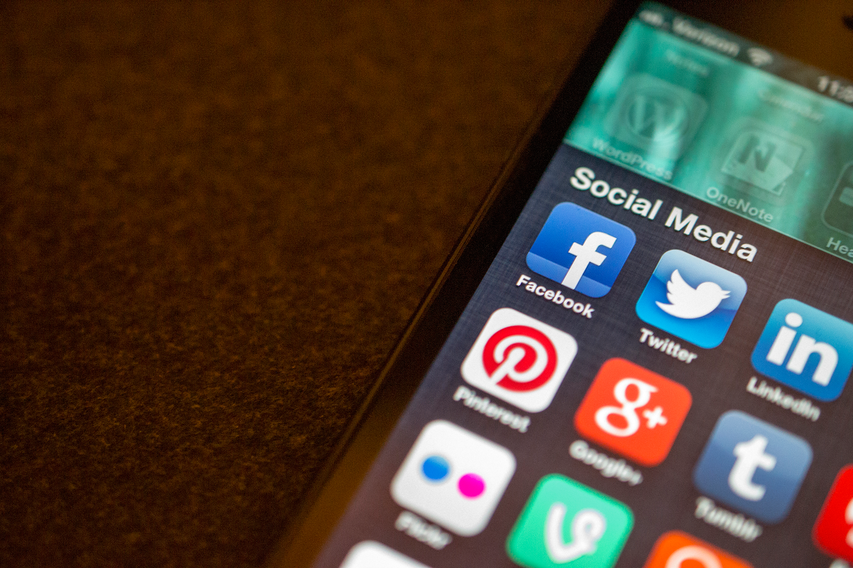
Conclusion
Kaley Du
Social media sites should change the way their algorithms work and invest extra research into preventing inciting content from always reaching the top
Notes:
All in all, social media should change the way their algorithms work and invest extra research into preventing inciting content from always reaching the top. Though some measures may decrease engagement, it is ultimately for the benefit of everyone in order to keep from contributing to hate speech, radicalization and polarization.

Slide 23
References
Kaley Du
[1] Cordis EU Research Results, TRENDING SCIENCE: Social media making us angrier, study reveals, (European Conmission, 26 August 2021), https://cordis.europa.eu/article/id/430608-trending-science-social-media-making-us-angrier-study-reveals (3/24/21)
[2] Luke Munn, Angry by design: toxic communication and technical architectures, (Nature, 30 July 2020) https://www.nature.com/articles/s41599-020-00550-7 (3/24/21)
[3] Paul Lewis, 'Our minds can be hijacked': the tech insiders who fear a smartphone dystopia, (The Guardian, 6 Oct 2017), https://www.theguardian.com/technology/2017/oct/05/smartphone-addiction-silicon-valley-dystopia (3/24/22)
[4] Jeff Horwitz and Deepa Seetharaman, Facebook Executives Shut Down Efforts to Make the Site Less Divisive, (Wall Street Journal, May. 26, 2020), https://www.wsj.com/articles/facebook-knows-it-encourages-division-top-executives-nixed-solutions-11590507499 (3/24/22)
[5] Ribeiro et al., Auditing radicalization pathways on YouTube, (ACM, 27 January 2020), https://dl.acm.org/doi/10.1145/3351095.3372879 (3/24/22)
[6] Matthew L Williams et al., Hate in the Machine: Anti-Black and Anti-Muslim Social Media Posts as Predictors of Offline Racially and Religiously Aggravated Crime, (The British Journal of Criminology, 23 July 2019) https://academic.oup.com/bjc/article/60/1/93/5537169?login=true, (3/24/ 22)
[7] Paul M. Barrett et al., Fueling the Fire: How Social Media Intensifies U.S. Political Polarization— And What Can Be Done About It, (NYU, September 2021), https://bhr.stern.nyu.edu/polarization-report-page (3/25/22)
[8] Lukas I. Alpert, Coronavirus Misinformation Spreads on Facebook, Watchdog Says, (Wall Street Journal, April 20, 2020), https://www.wsj.com/articles/coronavirus-misinformation-spreads-on-facebook-watchdog-says-11587436159?mod=article_inline (3/24/22)

Slide 24
Class 4 The End
Keith A. Pray
socialimps.keithpray.net
Notes:
Use remaining time for group project questions and/or review group assignment slides.
This is the end. Any slides beyond this point are for answering questions that may arise but not needed in the main talk. Some slides may also be unfinished and are not needed but kept just in case.

