Slide 1
Class 7
Privacy and Government
Keith A. Pray
socialimps.keithpray.net
Notes:
After this class we will be half done with the course… very sad I know.
Somebody’s Watching Me (1984) – Rockwell (3:36)
https://www.youtube.com/watch?v=7YvAYIJSSZY
Be the envy of all your classmates if you know the band and/or year:
Rockwell (1984) Michael Jackson sings chorus and Jermaine Jackson on backing vocals.

Slide 2
what works well Online With Zoom
Sign in with First and Last Name
Stay muted unless you are going to speak
To speak use the raise your hand feature
To answer yes/no questions use the “yes” ”no” buttons
Turn your camera on
Wait until the end of student presentations to ask questions
  Write them down so you don’t forget

Slide 3
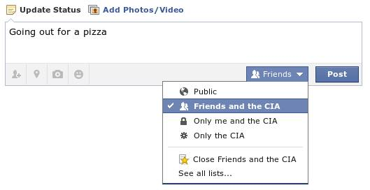
Overview
Review
Assignment
Students Present
Notes:
Review before debate in case anyone unsure of something in reading.
TODO: Image source?

Slide 4
Debate Ground Rules
Before Debate
  Add “(YES)” or “(NO)” to the end of your name in Zoom to show your side
  10 minutes to converse with your team
  Share argument points, counter points, and responses
  Share experiences, especially in different countries, cultures, situations
  Decide who will: Go first, Respond to which points from opposing side
During Debate
  1 turn per person until everyone on your team has spoken
  Try to keep remarks to 30 seconds
  Switch sides at any time if you change your mind
Notes:
“National ban on facial recognition surveillance for law enforcement” Debate
If in class:
Stand up when speaking
30 second limit (elect a timekeeper)
Previous:
Should law require you to use an official ID for Internet access
National ID or Not Debate

Slide 5
Group Quiz
List two problems with using biometrics for identification.
List two advantages of using biometrics for identification.
Describe two tools people can use to protect their privacy on the Web.
For each of the 4 categories of Daniel Solove’s privacy taxonomy give an example not listed in the book.
Notes:
Only if need to fill time.
Information Collection
Information Processing
Information Dissemination
Invasion

Slide 6
Overview
Review
Assignment
Students Present

Slide 7
Assignment – Group Project
Catch up on reading
Analyze Movie for all topics covered to date
Add analysis of computing technology portrayed
See group project slide deck for more
-----
Mid Term Survey on Canvas → Quizzes
Notes:
Movie group project:
List of computing technologies portrayed in movie on website
Categorize computing technologies as existing, future, emerging, impossible or plausible with rationale
Analyze movie for all topics covered to date

Slide 8
Overview
Review
Assignment
Students Present

Slide 9
Be Concerned About AI Surveillance
Austin Rebello

Slide 10
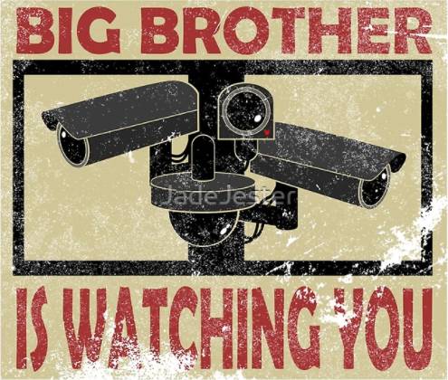
AI SURVEILLANCE TECHNOLOGIES
Austin Rebello
“Smart” Cameras
Surveillance Aircraft
Smartphone Spyware
  Location tracking/analysis
  Message and Phone call record harvesting
  Web traffic monitoring
Notes:
Artificial intelligence encompasses computers that are programmed to perform tasks that humans are capable of or normally do, such as object identification and speech recognition.
“Smart Cameras” are essentially improved CCTV Cameras that include artificial intelligence. These cameras can identify you through facial recognition, and what you are doing, like walking, eating or texting.
Surveillance aircraft, including small drones up to large planes, operate very similarly to Smart Cameras, as they are smart cameras with wings or propellers, but these cameras can follow you anywhere you go.
Smartphone spyware include many methods for collecting information about you through your phone, including your location, text messages and phone call history, and every website you visit. These can all be logged and collected by the government.
With all these methods of tracking people, it feels as though the government is always watching you, hence the phrase, “Big Brother is watching you”, with big brother being the government.

Slide 11
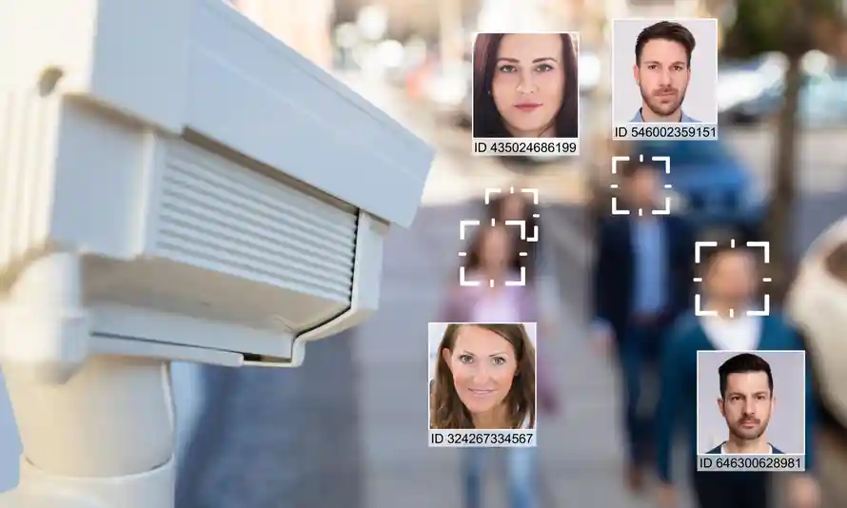
“SMART” CAMERAS
Austin Rebello
Facial Recognition Networks
Track your activity and movements as you move through the system.
NYC alone has over 15,000 smart cameras [3].
Evidence from NYC’s smart cameras were used in 22,000 criminal cases since 2017 [3].
<Graphic as big as will fit>
Notes:
Notes:
Built in large networks to monitor you as you move away from one camera and toward another,
each clip saved into a file designated for you.
Cities across the country employ these cameras, each city building a profile of you.
New York City alone has over 15,000 smart cameras, with that number still expanding, coming into constant use as 22,000 criminal cases had evidence from one or more of these cameras submitted.
As shown in the picture, the cameras can scan your face into its system with an ID, and use that ID to log where you go and what you are doing while in frame.

Slide 12
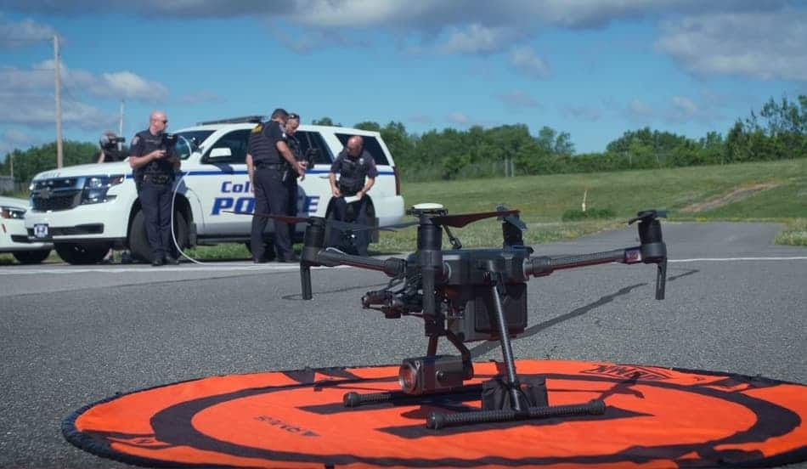
SURVEILLANCE AIRCRAFT
Austin Rebello
Can capture photographs of an entire city at once in great detail [1].
Flies over protests to identify people and track their movements.
In 2018, Baltimore PD used facial recognition software on drones to track and identify rioters for later arrest [1].
The U.S. Govt has spent almost $10 billion on drones in 2019 [5].
<Graphic as big as will fit>
Notes:
Notes:
Drones can follow crowds of people in cities, parks, and even over water, taking pictures and relaying them back to be analyzed, even with large swaths of people to sift through.
Advantages over smart cameras: Follow groups in one continuous shot / into areas not covered by CCTV and Smart Cameras
Example of these being in use was the 2018 Baltimore riots, where drones, like the one pictured here, followed rioters they identified for police to arrest, and ones they cant find they arrested later.
However, that is just the city of Baltimore and their police department, the US Govt spent nearly 10 billion on drones for domestic and foriegn use in 2019 alone,

Slide 13

SMARTPHONE SPYWARE
Austin Rebello
Internet Traffic
  Sites you visit
  Messages sent over social media
Text message and call history
Current Location and History
  Collected by most apps you own
  Commercially sold
  At least 200 known apps on the Google Play Store and Apple Store that the government purchases data from [4].
Notes:
Notes:
Anytime you are connected to an internet connection, everything you do on that connection has to come through a company, whether it be through a web browser or internet service provider itself, therefore, everything you do online is tracked and logged somewhere.
These companies collect information, including your search history, who you have called, even where you have been, and sell it to other corporations, and even directly to the government.
There’s at least 200 apps on the Google Play Store and Apple Store that the government purchases data from, where they run said data through algorithms to find patterns in how people act, and build profiles on known users.
One of the companies that has put dozens of apps on the google play store is CityMaps2Go, which is known to sell its user’s information to the government, in this case, their location data. However, many of their apps have been removed from the store as a result of this, as google has been banning apps that sell users location data to the government, but they continually fail to prevent new ones from popping up.

Slide 14
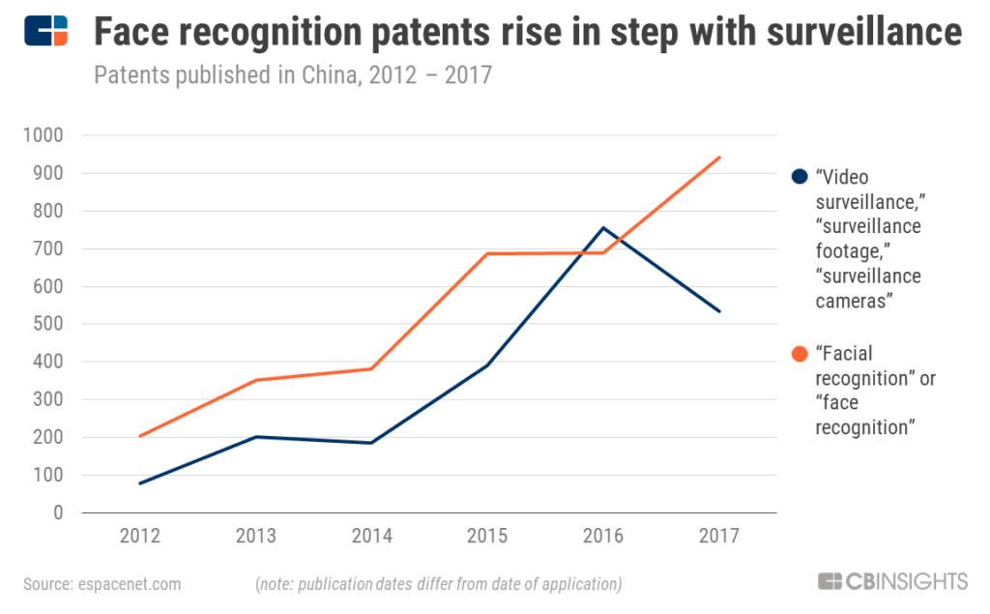
SURVEILLANCE IS EXPANDING
Austin Rebello
40 of top 50 countries in military spending have invested in AI Surveillance [1].
Govt. spending for AI Surveillance tech up 1,900% from 2010-2019 [2].
Smaller towns beginning to adopt this technology.
Notes:
Notes:
AI Technology is expanding, both in spending and in new technologies to monitor people. with 40 of the top 50 military powers in the world investing in AI Surveillance.
The amount of spending is also ramping up among these countries, up a staggering 1900% in the last decade. China alone has seen the number of patents for surveillance technology skyrocket from about 200 to almost 1000 from 2012 and 2017. This spending also encompasses state, city and even small town governments. I noticed that this has spread to local governments as my relatively small town has purchased and used their own police drones according to my towns annual reports from 2018 and 2019.

Slide 15

WHY THIS MATTERS
Austin Rebello
Government can build a profile on you [3]
  Daily routines
  Ideology and views
  Friends and close associates
How it can be used against you
  Measures can be implemented to restrict your lifestyle
  Ex: Viewing WikiLeaks articles could land you in hot water [6].
How can you protect yourself?
  VPNs
  Disabling location sharing with apps
  Hats/Hoods and sunglasses make facial recognition cameras struggle
Notes:
All these technologies are used to track and build information about you.
The government can determine what kind of person you are, what you do on a day to day basis, your opinions of the government and what policies you believe in.
The government can then use this against you. One example is basically anything involving wikileaks. If you are an employee in a public service field or even an aspiring student looking for said field, you can face consequences for visiting the WikiLeaks site. As a current employee, you could face termination, and as a student, you may not be hired for viewing the site’s contents, despite being freely available on the internet.
Shows how the government could, if they wanted to, begin to affect your life by sourcing the lifestyle you live and what you do privately.
To combat this, VPNs are available on whatever platform’s store for both paid and free versions to hide your browsing and posting from being logged. You can also go into most of your apps and disable the ability for them to track your location if you do not need them to. Finally, to combat facial recognition, hats and hoods combined with sunglasses make it much more difficult to figure out who you are.

Slide 16
REFERENCES
Austin Rebello
[1] Steven Feldstein, The Global Expansion of AI Surveillance, (Carnegie, September 2019) https://silviosiefke.com/downloads/WP-Feldstein-AISurveillance_final1.pdf (September 12, 2021)
[2] Grady McGregor, The World’s Largest Surveillance System Is Growing-and so is the backlash, (Fortune, November 3, 2020) https://fortune.com/2020/11/03/china-surveillance-system-backlash-worlds-largest/ (September 12, 2021)
[3] Amnesty International, Surveillance City, (Amnesty International, June 3, 2021) https://www.amnesty.org/en/latest/news/2021/06/scale-new-york-police-facial-recognition-revealed/ (September 12, 2021)
[4] Sara Morrison,App trackers secretly sell your location data to the government. App stores won’t stop them. (Vox, February 23, 2021) vox.com/recode/22278402/x-mode-sdk-google-play-ban-location-data (September 12, 2021)
[5] Dan Gettinger, SUMMARY OF DRONE SPENDING IN THE FY 2019 DEFENSE BUDGET REQUEST, (Center for the Study of the Drone at Bard College, April 2018)
https://dronecenter.bard.edu/files/2018/04/CSD-Drone-Spending-FY19-Web-1.pdf (September 13, 2021)
[6] Eric Lipton, Don’t Look, Don’t Read: Government Warns Its Workers Away From WikiLeaks Documents, (New York Times, December 4, 2010) https://www.nytimes.com/2010/12/05/world/05restrict.html (September 14, 2021)

Slide 17
REFERENCES
Austin Rebello
[4] Sara Morrison,App trackers secretly sell your location data to the government. App stores won’t stop them. (Vox, February 23, 2021) vox.com/recode/22278402/x-mode-sdk-google-play-ban-location-data (September 12, 2021)
[5] Dan Gettinger, SUMMARY OF DRONE SPENDING IN THE FY 2019 DEFENSE
BUDGET REQUEST, (Center for the Study of the Drone at Bard College, April 2018)
https://dronecenter.bard.edu/files/2018/04/CSD-Drone-Spending-FY19-Web-1.pdf (September 13, 2021)
[6] Eric Lipton, Don’t Look, Don’t Read: Government Warns Its Workers Away From WikiLeaks Documents, (New York Times, December 4, 2010) https://www.nytimes.com/2010/12/05/world/05restrict.html (September 14, 2021)

Slide 18
the government SHOULDE use (In moderation) criminal justice algorithms
Emily Baker
CS 3043
17 September 2021
Notes:
My name is Emily Baker and today I am going to defend why the government should use, but in moderation, criminal justice algorithms. In this presentation, I am going to introduce the concept of criminal justice algorithms, present arguments for and against these algorithms, and conclude that there are opportunities to use criminal justice algorithms. NEXT SLIDE

Slide 19
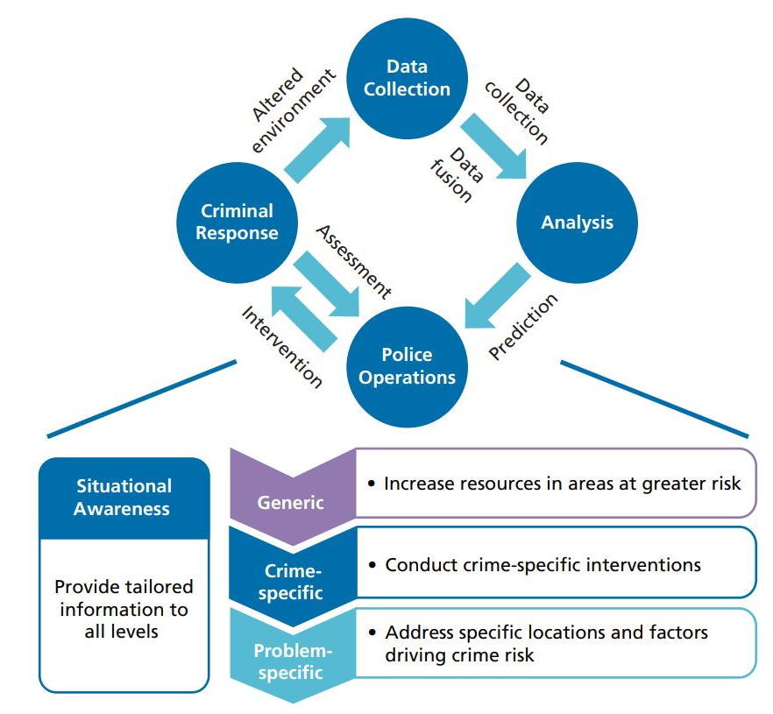
overview
Emily Baker
What are criminal justice algorithms? [6]
  Risk assessment tools
  Implemented as early as 1927
How are these algorithms used? [6, 9]
  Place-based
  Person-based
Figure 1: Feedback loop of interventions and opportunities to implement criminal justice algorithms. [6]
Notes:
Criminal justice algorithms, or predictive policing, belong to a class of algorithms broadly categorized under risk assessment. These algorithms consider legal history of an individual, such as prior criminal history and types of crimes committed, and lifestyle history, such as employment status. Risk assessment for offenders has been implemented since at least 1927. In 1927, University of Chicago sociologist Ernest Burgess proposed 21 factors, including race of the inmate's father, to determine parole success or failure of the parolee of 3,000 Illinois inmates. These predictive factors were put in practice until at least the 1940’s.
Criminal justice algorithms are used to predict a variety of outcomes. Place-based algorithms predict places where crime could occur. Person-based algorithms identify individuals who likely committed a crime, may commit a crime, or were a victim of a crime. They have also been used to predict the likelihood probation violation and pre-trial flight risk. Although these algorithms sound callous since they reduce humans down to a probability, there is evidence that supports that crime is predictable. Anthropologists note that humans are not really random creatures, and criminals operate within a “comfort zone” that is quantifiable.
This image on the right shows a feed back look from data collection to criminal response and different interventions that could happen at different times using a criminal justice algorithm. The flowchart below suggestions preventative measures to reduce crime.
After reading about criminal justice algorithms, I found myself agreeing with their use. I think it is possible to use these algorithms, but there are points within the criminal justice system that may be too sensitive for the algorithms. NEXT SLIDE

Slide 20
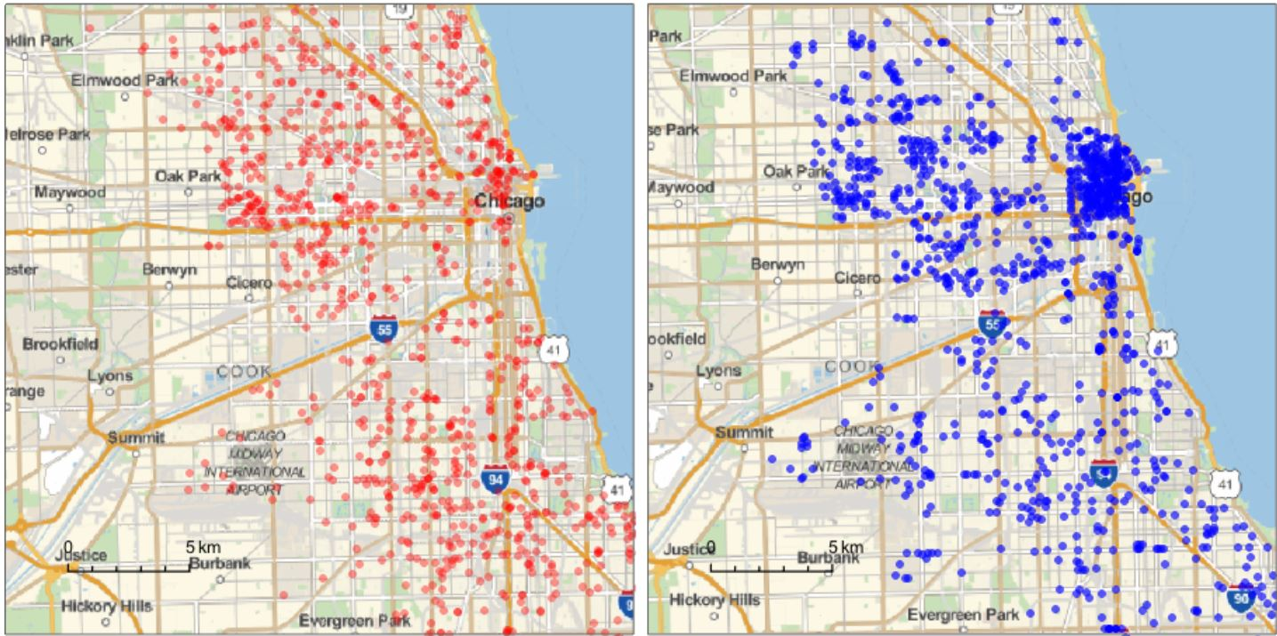
Support for criminal justice algorithms
Emily Baker
Detect Patterns [5]
  Thomas Hargrove: Reporter who hypothesized that an undetected serial killer was active in Chicago
Preventative [9]
  Using historical data to pre-emptively deploy police can reduce some crime
  Richmond, VA police re-routed NYE surveillance routes and reduced random gunfire by 47%
Figure 2: Instances of crime in Chicago (left) and locations of police cameras (right). [3]
Notes:
Support for criminal justice algorithms is drawn for the following broad reasons: detecting patterns that humans may not notice and allowing for preventative interventions.
I recently listed to a podcast called “Algorithm” that featured reported Thomas Hargrove, a reporter who independently made an algorithm to solve murders in the Midwest. He was bothered that 74% of Chicago murders were not being solved and was specifically interested in if there was an undetected serial killer acting in the Chicago area. Hargrove hypothesized that there is not a 1:1 ratio of victims to perpetuators and was also worried about “linkage blindness”, where patterns of crimes are not recognized because detectives can get isolated to one case at a time and do not necessarily talk to each other because of privacy reasons.
He took a break from reporting and developed an algorithm that used FBI crime data for Chicago and grouped homicides by gender, location, and cause of death. One result of this algorithm was leading police to arrest a serial killer who had been active in Gary, Indiana through identifying a series of cold-case strangulations. Another result of this algorithm was bringing attention to Indian’s low rate of solving murders, which was lowest in the US when Hargrove was doing his research.
Criminal justice algorithms can be preventative, but not because they can be used to arrest individuals that a computer believes has a high likelihood of committing a crime. In the early 2000’s, Richmond, VA police used historical data to map what locations had been known for shooting off weapons on New Years Eve. In 2003, they used this data to re-route their New Years surveillance routes and found that random gunfire decreased by 47% from past years. I was most surprised about this use of criminal justice algorithms, primarily because I associated these algorithms with serious inaccuracies. I think the application of algorithms in Richmond VA has the potential to be good. This example of preventative measures is why I support the use of criminal justice algorithms.
The image on the right-hand side shows instances of crime in Chicago as red dots and locations of police cameras as blue dots. An algorithm could be used to plan surveillance routes or identify spots where police could monitor the public from. NEXT SLIDE

Slide 21
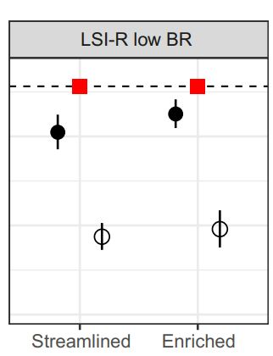
Opposition to criminal justice algorithms
Emily Baker
Oversight [1, 2, 10]
  COMPAS: Proprietary criminal justice algorithm
  State v. Loomis: Wisconsin Supreme Court allowed COMPAS-suggested sentencing recommendations
Bias [1, 4]
  Some factors are linked together
  COMPAS example: For a population 10,000 criminal defendants in Florida, black defendants were 77% more likely to be assigned higher risk scores than white defendants, even when controlling for prior crimes, age, and gender
Lin et al [8]
  Human accuracy (likely) does not exceed algorithm accuracy
  Approximately 30% difference in accuracy for predicting recidivisms between the LSI-R algorithm and humans
Figure 3: Human (White and Black Circle) and Algorithm (Red Square) prediction accuracy. Dotted line is 90% accuracy. [8]
Notes:
It is no surprise that criminal justice algorithms have fraught with controversy and concern. There are evidence-based fears that criminal justice algorithms are not fair since they lack oversight and can be biased.
An example of lack of oversight can be found from the COMPAS Algorithm.
The COMPAS algorithm, Correctional Offender Management Profiling for Alternative Sanctions, is a proprietary algorithm used to predict recidivism rates. It uses publicly available data, data about similar offenders, and an interview with the offender to come to a conclusion about that offender. It is one of the most popular offender scoring algorithms used in the US. But, because it is proprietary, how COMPAS concludes recidivism probabilities is not specifically known. This should not be acceptable in the US, especially for criminal trials, where transparency is extremely important and has the potential to impact a trial outcome. COMPAS was recently the subject of a 2017 court case, State v Loomis. In this trial, Loomis plead guilty to driving a getaway car after a shooting in Wisconsin. The Wisconsin Dept of Corrections used the COMPAS algorithm to sentence Loomis to 6 years in prison and 5 years of supervision. Loomis filed for relief of this sentence as he believed the lack of transparency about COMPAS violated his due process rights, and his sentence was discriminatory since the algorithm considered gender. The State court denied this relief, and the Wisconsin Supreme Court affirmed. Loomis could not provide sufficient evidence that gender was used as a factor, and since the courts had the ability to disagree with COMPAS’s suggestions, his right to an individual sentence was not violated. This court case did not have the outcome I was expecting, but the trial judge did caution COMPAS’s parent company to be prepared to release information about their decision-making process in the future.
Bias is also an issue for criminal justice algorithms. Bias, and by extension, what is and is not fair, is hard to balance. Sometimes, a specific crime is committed by a people group that all have something in common, like age or socio-economic status. But, that linkage can happen because of additional factors, like employment status, family, and the likelihood of a police officer actually arresting two people if they are picked up for the same crime. These factors might be too peripheral and nuanced for an algorithm to consider. The COMPAS algorithm provides an example of bias. ProPublica, an investigative journal, found that COMPAS was not accurate in predicting recidivism rates for every type of crime. For a population of 10,000 criminal defendants in Florida, the violent recidivism analysis also showed that even when controlling for prior crimes, future recidivism, age, and gender, black defendants were 77 percent more likely to be assigned higher risk scores than white defendants.
-------------------------------------EXTRA-----------------------------------------------------------------------
They used data from 10,000 criminal defendants in Florida.
ProPublica found:
- Black defendants were often predicted to be at a higher risk of recidivism than they actually were. They found that black defendants who did not recidivate over a two-year period were nearly twice as likely to be misclassified as higher risk compared to their white counterparts (45 percent vs. 23 percent)
-White defendants were often predicted to be less risky than they were. They found that white defendants who re-offended within the next two years were mistakenly labeled low risk almost twice as often as black re-offenders (48 percent vs. 28 percent)
-----------------------------------------------------------------------------------------------------------------------------------------
When thinking about the accuracy of these algorithms, I researched how accurate humans are compared to criminal justice algorithms. One research article extended someone’s previous research on human vs algorithmic accuracy and found that when presented with “streamlined”, or brief information about a offender;s background, human participants and 2 algorithms, one of which was COMPAS, were similarly accurate about predicting if someone would re-offend (64% human, 68/65 Algorithm). But, when “enriched”, or additional information about a person’s background was presented, the human participants did not perform better than the algorithms (89% vs 60%). This data came from a study of 645 people who gave 32,000 responses. This study shows that criminal justice algorithms should not be completely discounted.
The graph on the right demonstrates this disparity in accuracy. Human prediction accuracy, shown in black and white circles, were lower than the LSI-R algorithm’s prediction accuracy. The black circle shows human accuracy after learning if their previous response was right or not. Presumably, the black circle is higher than the white circle, but not as high as the red square, because the human participants start independently determining which factors lean towards or against recidivisms. BR stands for base rate, which describes a group’s overall probability of re-offending. The graph shows that the algorithm is better at predicting recidivism rates than human participants. NEXT SLIDE
11

Slide 22
Criminal justice algorithms should be used, but there are caveats
Emily Baker
Breadth of Application [6]
  Pre-trial
  Post-Trial
Opportunities for Improvement [6,7]
  Bias
  Transparency
Where, and to what degree, do you think criminal justice algorithms could be used? Should they not be used at all?
Notes:
Criminal justice algorithms are a type of risk assessment instrument . They are best used to aid, and not completely automate, decision making in the courts.
These algorithms are used at different points within the criminal justice system: to determine someone’s need for supervision, likelihood of returning to trial if not held in a jail, sentencing recommendations, and the probability of re-offending. They can also be used to potentially prevent crime by re-routing police surveillance routes. As discussed previously, algorithms are at least on par, or exceed, the accuracy of human predictions of recidivism, so these algorithms should be disregarded on grounds that they are less accurate than their human counterparts.
Like any technological tool, there are opportunities for improvement. Proprietary algorithms like COMPAS should be transparent and need to disclose, at least in the privacy of a court or sealed document, how their algorithm considers and weighs factors. Bias, and factors that act as a proxy for potential bias, need to be quantitively researched and published.
I like the idea of criminal justice algorithms, but their sensitivity should be improved. Algorithms used to make more effective surveillance routes probably do not need to be as sensitive as sentencing algorithms.
Where, and to what degree, do you think criminal justice algorithms could be used? Should they not be used at all? Thank you!

Slide 23
References
Emily Baker
1. Corbett-Davies, Sam et al. “Algorithmic Decision Making and the Cost of Fairness.” Proceedings of the 23rd ACM SIGKDD International Conference on Knowledge Discovery and Data Mining. ACM, 2017. 797–806. Web.
2. Dressel, Julia, and Hany Farid. “The Accuracy, Fairness, and Limits of Predicting Recidivism.” Science advances 4.1 (2018): eaao5580–eaao5580. Web.
3. Finke, J. (2014, December 23). Crime Hotspots in Chicago. Crime hotspots in Chicago. Retrieved September 14, 2021, from https://jfinke.org/crime-hotspots-chicago/ . Last accessed 14 September 2021.
4. Harcourt, Bernard E. “Risk as a Proxy for Race: The Dangers of Risk Assessment.” Federal sentencing reporter 27.4 (2015): 237–243. Web.
5. Kuebrich, Benjamin. “Algorithm.” iHeart Radio. iHeartMedia, 22 June 2021, https://www.iheart.com/podcast/1119-algorithm-83051915/. Last accessed 14 September 2021.
6. Perry, Walt L. Predictive Policing : the Role of Crime Forecasting in Law Enforcement Operations . Santa Monica: RAND Corporation, 2013. Print.
7. Larson, J. A., Mattu, S., & Angwin, J. (2016, May 23). How we analyzed the compas recidivism algorithm. ProPublica. Retrieved September 14, 2021, from https://www.propublica.org/article/how-we-analyzed-the-compas-recidivism-algorithm. Last accessed 14 September 2021.
8. Lin, Zhiyuan Jerry et al. “The Limits of Human Predictions of Recidivism.” Science advances 6.7 (2020): eaaz0652–eaaz0652. Web
9. Meijer, Albert, and Martijn Wessels. “Predictive Policing: Review of Benefits and Drawbacks.” International journal of public administration 42.12 (2019): 1031–1039. Web.
10. Song, J. S. (2017, March 10). State v. Loomis. Harvard Law Review. Retrieved September 14, 2021, from https://harvardlawreview.org/2017/03/state-v-loomis/. Last accessed 14 September 2021.

Slide 24
Our Big brother is too big
Liam Hall

Slide 25
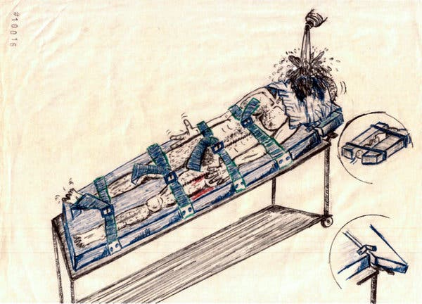
Historical precedence in brief
Liam Hall
After 9/11, the power of the executive branch swelled in a big way [1].
  “Enhanced interrogation techniques” [1]
    Waterboarding
      The man in the figure was waterboarded 83 times. [5]
    Cramped Confinement
      Detainees were subjected to this for “countless hours” [5].
  Military Commissions [1, 2]
  Radically increased surveillance [1]
Abu Zubaydah’s depiction of his experience getting waterboarded. [5]
Notes:
After the Twin Towers fell on September 11, 2001, a flood of executive powers stretched the caliber of the office of the president. .. Years later, it was determined that “enhanced interrogation” denoted torture. Military commissions - which were military courts that were allowed to try non-citizen individuals suspected of terrorism at Guantanamo Bay, Cuba – most poignantly allowed for the suspension of the Writ of Habeas Corpus for these individuals. There was a secret surveillance program codenamed “STELLARWIND”, which allowed for warrantless wiretapping of people thought to be connected with Al-Qaeda. Abu Zubaydah was detained by the CIA, and I’ve featured some drawings that he made while he was in captivity. This one features him being waterboarded.

Slide 26
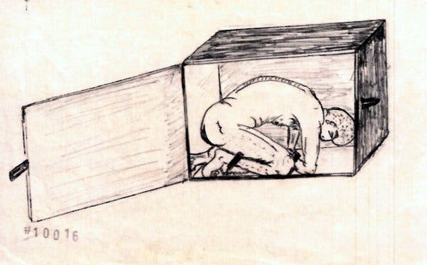
Past as prologue
Liam Hall
Avenues through which the president can expand power:
  Executive orders [4]
  Executive departments
    Department of Justice (Includes FBI)
  Commander in Chief during times of war
  Veto Power of Legislation
A drawing of “cramped confinement” by Abu Zubaydah. [5]
Notes:
Executive orders continue to allow the president to expand his power through the means of his or her executive departments. The president is the Commander in Chief during times of war, and he or she has the power to veto legislation that was passed by congress. The image here features Abu Zubaydah in cramped confinement.

Slide 27
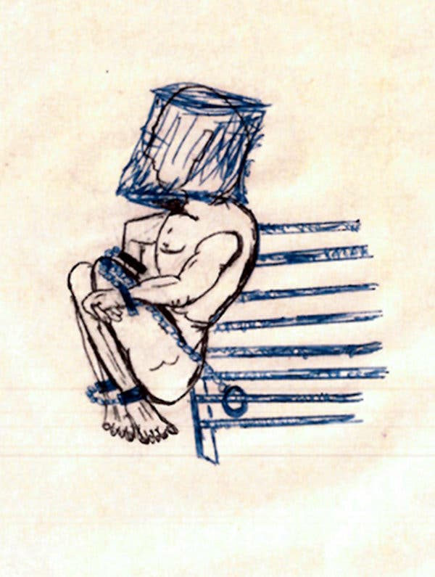
Past as epilogue
Liam Hall
Suggested means for shrinking the powers of the executive branch:
  Favoring non-expansive precedent by former administrations. [3]
  Promoting DOJ independence from the executive branch. [3]
  Limiting executive branch secrecy. [3]
Short shackling, in which Zubaydah had movement constricted by a chain tied to a cell bar. [5]
Notes:
Former presidential administrations have taken less intense courses of action in similar situations, and this set of actions should be considered when discussing precedent for the executive branch. The Department of Justice should not be used as a personal client of the executive branch. Rather, their legal conclusions should be kept separate from the agenda of a particular administration. Congress should pass legislation that limits secret actions by the executive branch and opens the executive branch up to transparency. The image depicts short shackling, another torture method that would be best left behind in the annals of history.

Slide 28

Conclusion
Liam Hall
The technology used by the CIA to find people they ‘suspected’ of ties to Al-Qaeda enabled torture.
Legislation should be created to restrict the use of this type of technology.
Notes:
All of this executive power that can take place in secrecy applies to the expansion of surveillance of people, in some cases citizens, which opens the door for mistreatment and abuse of power. The expansion of the CIA across the world is not necessarily beneficial, and is especially not so if there are no checks against the CIA. With limited checks, the CIA would be able to expand as much as possible, and use whatever cruel and unusual punishments they choose, spreading across the world like some sort of dystopian monster.
Image - https://st2.depositphotos.com/1310390/6095/v/600/depositphotos_60958935-stock-illustration-vector-octopus-illustration.jpg

Slide 29
References
Liam Hall
[1] Madeleine Carlisle, How 9/11 Radically Expanded the Power of the U.S. Government, (Time, 2021), https://time.com/6096903/september-11-legal-history/ (16 September 2021)
[2] Author Not Mentioned, Factsheet: Military Commissions, (Center for Constitutional Rights, 17 October 2007), https://ccrjustice.org/home/get-involved/tools-resources/fact-sheets-and-faqs/factsheet-military-commissions (16 September 2021)
[3] William P. Marshall, ELEVEN REASONS WHY PRESIDENTIAL POWER
INEVITABLY EXPANDS AND WHY IT MATTERS, (Boston University, No Date Mentioned), https://www.bu.edu/law/journals-archive/bulr/documents/marshall.pdf (16 September 2021)
[4] No Author Mentioned, Executive Power, (Cornell Law School, No Date Mentioned), https://www.law.cornell.edu/wex/executive_power (16 September 2021)
[5] Carol Rosenberg, What the C.I.A.’s Torture Program Looked Like to the Tortured, (The New York Times, 12 September 2021), https://www.nytimes.com/2019/12/04/us/politics/cia-torture-drawings.html (16 September 2021)

Slide 30
Class 7
The End
Keith A. Pray
socialimps.keithpray.net
Notes:
This is the end. Any slides beyond this point are for answering questions that may arise but not needed in the main talk. Some slides may also be unfinished and are not needed but kept just in case.

