Slide 1
Class 6 Information Privacy
Keith A. Pray
socialimps.keithpray.net
Notes:
How is the self search paper going? Offer small group discussion instead of class wide.
Who: found a lot, very little, surprised, not surprised, creepy, share conclusions

Slide 2
what works well Online With Zoom
Sign in with First and Last Name
Stay muted unless you are going to speak
To speak use the raise your hand feature
To answer yes/no questions use the “yes” ”no” buttons
Turn your camera on
Wait until the end of student presentations to ask questions
Write them down so you don’t forget

Slide 3
Logistics
Presentations are due 24 hours before class
Address email to entire course staff for quickest response
Review Presentation and Paper Guidelines on course site
Notes:
Not needed this time:
Address email to entire course staff for quickest response time
Do not change the format, footers, etc. in the template slides.
Paper writing process: Sources → Notes → Conclusion → Argument → Counter Point → Response
Turn extra credit paper in on myWPI/Canvas and hard copy in class like regular papers
Use Presentation Guidelines on course web site
Use paper and presentation templates
Keep topics inside the course scope: Computing + Society

Slide 4
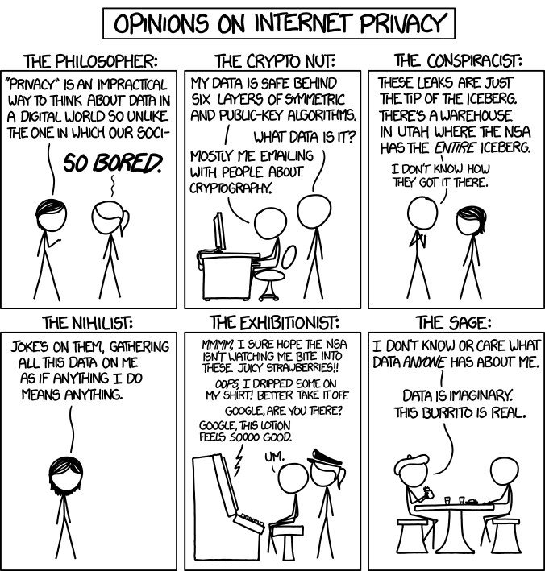
Overview
Review
Assignment
Students Present
http://xkcd.com/1269/
Notes:
1 – Accessed 2014-04-14
Everyone pick the category they identify most with.
Share reasons why.
Jimmy Kimmel Live – What is your password? (2:49)
https://www.youtube.com/watch?v=opRMrEfAIiI
Find out what your DNA says about you and your family.
https://www.23andme.com/
https://motherboard.vice.com/en_us/article/xwkaz3/23andme-sold-access-to-your-dna-library-to-big-pharma-but-you-can-opt-out?utm_source=vicefbus

Slide 5
Assignment
Prepare for class debate:
National ban on facial recognition surveillance for law enforcement?
Once you’ve done the research and have decided “Yes” or “No” assign yourself to the appropriate group on Canvas:
Canvas → People → Facial Recognition Debate: Use the groups to share your research
https://canvas.wpi.edu/courses/23995/groups#tab-6898
Come prepared with notes, facts, dates, high quality sources
Optional One Page Paper on the topic, lowest paper grade will be dropped
Notes:
Morgan Lee write up 2021-09-13:
“Facial recognition technology has begun to see widespread adoption in modern law enforcement, with applications in physical & digital security, as well as identifying potential suspects. Critics of the technology argue that passive facial recognition technology violates privacy rights of individuals, while its proponents emphasize its positive uses in preventing and detecting crime. There are currently 12 state-level bills which propose limits or bans on the use of facial recognition technologies by government agencies, with several local bans (including ones in Boston, Brookline, and Cambridge) already in place. Should the United States implement a national ban on the use of facial recognition technology by law enforcement?”
Previous Debates:
Should law require you to use an official ID for Internet access?
Is a National ID System a good thing?

Slide 6
Overview
Review
Assignment
Students Present

Slide 7
Data breach: we need to be prepared
Cather Zhang

Slide 8
Effects of a data breach
Cather Zhang
On individual – health records, bank credentials, sensitive pictures/videos
On companies – 75.6% of event studies showed that breaches effect financial performance most negatively [1]
On government – confidential information leakage
In U.S. average cost per breach in 2021: $9.05 million [2]
Notes:
Data breach: intentional or unintentional release of secure or confidential information to an untrusted environment
Incident of yahoo, 3 billion accounts – leakage of name, number, dates of birth, security questions and answers, passwords
For Individual: information (as listed in slide) can be used for blackmailing or be used to access bank account
Company: stock value drop, lose customer trust, 75.7% studies shown breaches impact financial most
Government: national security, weapons, spy lists might lead to war
Figure on the right, average total cost of a data breach globally over the years. US has the highest average cost for data breach.

Slide 9
Causes of a data breach
Cather Zhang
“Breaches associated with hacking is decreasing, but with human element is increasing” [3].
Human error [4]:
Weak password
Misuse of company workstations
Lack of computer knowledge
Bad habits
Notes:
How cybercriminals succeed in a data breach:
Step 1: Research: find weakness in security
Step 2: Network/Social Attack:
network – use loophole in infrastructure, system, applications to infiltrate network;
social – trick/bait employee into giving access to company’s network
Step 3: Exfiltration: once getting in, attack network, find and extract confidential company data
Study in 2012 concluded that “Breaches associated … (quote in slide)” -> more social attacks than network attacks
Pie chart: malicious attack cause 3% of breaches, while human error 65%
Human error includes weak password, misuse of company workstations, lack of computer knowledge, or bad behaviors

Slide 10
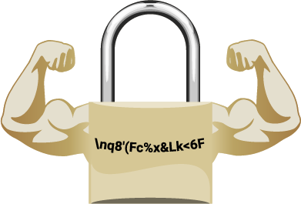
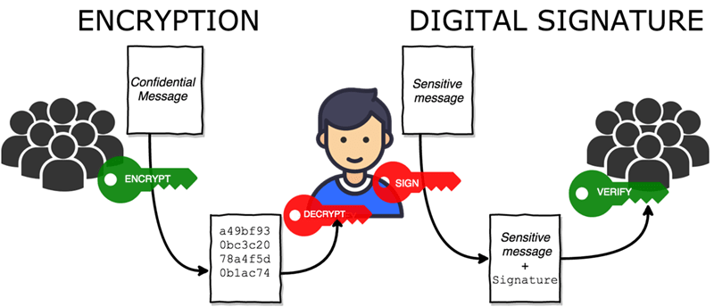
Method 1 – Training / policies
Cather Zhang
In an action study on 16 employees [5]:
9 reported that they are aware of the importance of email encryption
11 showed a better understanding of internet system security
Policy on internet usage and data storage
Restrict access: 1000 -> 10
Notes:
Lack of awareness is a key factor that leads to human errors.
Company can train their employees, reduce human errors, reduce chances for data breaches
Training: the importance of encrypted emails, strong passwords, don’t misuse work emails, don’t click on suspicious links, don’t browse unsafe websites, etc.
Action research: 16 employees of a company that develops application for electronic information processing
9 reported better awareness of encrypted emails
11 reported better understanding of security
Company can develop policies on internet usage to enforce employees and policies on only retaining data for a short period
Developing a restrict access hierarchies can help reduce vulnerabilities
1000 people -> 10 people reduce 99% vulnerabilities

Slide 11
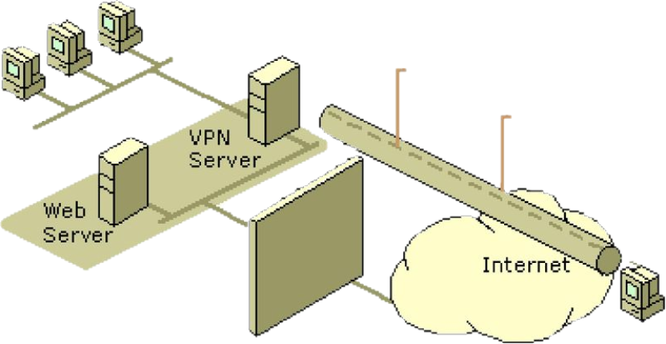
Method 2 – strong security system (Firewall & vpn)
Cather Zhang
Domain Name System (DNS) Firewall
Could prevent 33% of data breach [6]
“Might have prevented $10 billion in data breach loss from the 11,000 incidents in the past five years.” [6]
VPN connection
Tunnel
DMZ
Firewall
VPN Server Behind the Firewall on the Internet
Notes:
Strong security system to reduce the number of potential loopholes in internet security.
Firewall can protect internal network and system from potential threats of a network attack by filtering and screening.
VPN is a virtual encrypted tunnel between user and remote server. All external internet traffic is routed through the tunnel.
A good example is DNS Firewall
Which could prevent 33% data breaches from happening
Might have saved more than $10 billion in data breach loss from the past five years
Cons: Firewall do not protect against internal attack, not secure against software or file with virus
Importance of reducing human errors
Multifactor authentication
Even attacker knows the password, they can not get access
Allow certain password attempts
Eliminate chances for brute force

Slide 12
Method 3 –detection and containment
Cather Zhang
287 days average time to detect, identify, and contain a data breach [2]
Automation and security AI provides biggest cost mitigation
$3.81 million less than organizations without it [2]
Can detect more than 10,000 active phishing sites [8]
Notes:
Period of data breach
Average of 287 days, which is long. Data might have been sold by the time company realizes.
IBM security report: company fully utilize AI spend average $3.81 million less than those without it
Biggest cost mitigation
AI is able to detect phishing sites to help reduce human errors as well
How the information in figure relates to attack
Major data breaches happen through network loopholes
Makes sense AI is used most in network security and data security

Slide 13
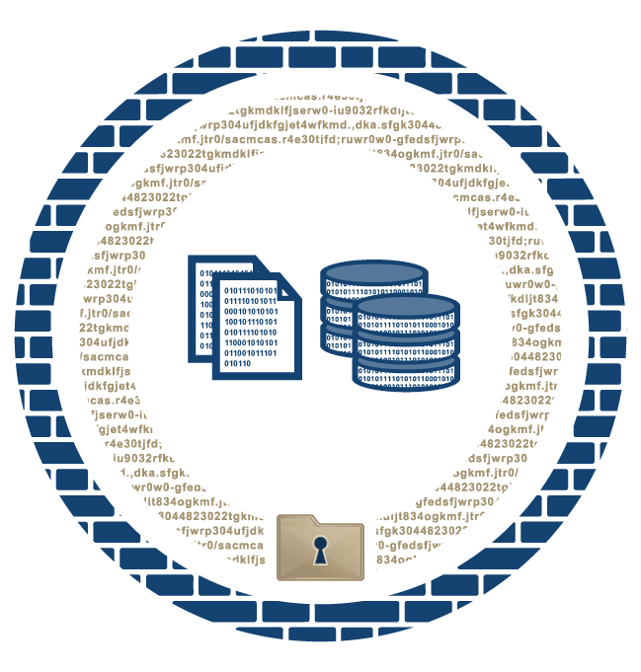
Conclusion
Cather Zhang
Data breaches are preventable:
From source (training employees)
Strong security system
Minimize loss using AI
Notes:
Data breach are scary because it affect millions of people, they cost a lot of money. But there are several approaches to get prepared and to prevent data breaches from happening.
Reduce human errors with training and policies-> prevent from source
Strong security system -> fewer potential loopholes and weaknesses
Detect and contain quickly to minimize loss using automated AI

Slide 14
References
Cather Zhang
[1] Juma'h, A.,H., & Alnsour, Y. “The effect of data breaches on company performance.” International Journal of Accounting and Information Management, Vol. 28, No. 2, pp. 275-301, 2020. http://dx.doi.org.ezpv7-web-p-u01.wpi.edu/10.1108/IJAIM-01-2019-000.6. (9/13/2021)
[2] IBM Security, “Cost of a Data Breach Report 2021.” July 2021. https://www.ibm.com/downloads/cas/OJDVQGRY (PDF). (9/13/2021)
[3] Ramakrishna Ayyagari. “An Exploratory Analysis of Data Breaches from 2005-2011: Trends and Insights.” Journal of Information Privacy and Security, Vol.8, No.2, pp.33-56, 2012. https://doi.org/10.1080/15536548.2012.10845654. (9/13/2021)
[4] Ahmed M., Sharif L., Kabir M., and Al-Maimani M. “Human Errors in Information Security.” International Journal of Advanced Trends in Computer Science and Engineering, Vol.1, No.3, August 2012. http://warse.org/pdfs/ijatcse01132012.pdf. (PDF). (9/13/2021)
[5] Puhakainen P. & Siponen M. “Improving Employee’s Compliance Through Information System Security Training: An Action Research Study.” MIS Quarterly, Vol.34, No.4, pp.757-778, 2020. https://doi.org/10.2307/25750704. (9/13/2021)
[6] “Use of DNS Firewalls Could Reduce 33% of All Cybersecurity Breaches, New Global Cyber Alliance Research Finds: More Than 10 BILLION IN DATA BREACH LOSSES OVER PAST FIVE YEARS FROM THE STUDIED INCIDENTS MIGHT HAVE BEEN PREVENTED, AND $150 TO $200 BILLION IN GLOBAL LOSSES FROM CYBERCRIME.” PR Newswire, New York, 12 June 2019. https://www.proquest.com/docview/2238563699?pq-origsite=primo. (9/13/2021)
[7] “Top artificial intelligence (AI) use cases for cybersecurity in organizations in selected countries as of 2019.” Statista, July 2019. https://www.statista.com/statistics/1028823/ai-security-use-cases-in-organizations/. (9/13/2021)
[8] Mohammed, I.A. “How Artificial Intelligence is Changing Cybersecurity Landscape and Preventing Cyber Attacks: A Systematic Review.” IJCRT, Vol.4, No.2, June 2016. https://www.researchgate.net/profile/Ishaq-Azhar-Mohammed/publication/353888018_How_Artificial_Intelligence_Is_Changing_Cyber_Security_Landscape_and_Preventing_Cyber_Attacks_A_systematic_review/links/6116a19f1e95fe241acd5321/How-Artificial-Intelligence-Is-Changing-Cyber-Security-Landscape-and-Preventing-Cyber-Attacks-A-systematic-review.pdf. (9/13/2021)

Slide 15
Picture link
Cather Zhang
Slide 4: https://www.sysprobs.com/encrypt-email-while-sending-in-ms-outlook
Slide 4: https://support.managed.com/kb/a2245/best-practice-strong-password-policy.aspx
Slide 5: https://slideplayer.it/slide/11952198/
Slide 7: https://scramfs.com/preventing-data-breaches-through-encryption/

Slide 16
Class 6 The End
Keith A. Pray
socialimps.keithpray.net
Notes:
This is the end. Any slides beyond this point are for answering questions that may arise but not needed in the main talk. Some slides may also be unfinished and are not needed but kept just in case.
If there’s time and we didn’t already look at:
Find out what your DNA says about you and your family.
https://www.23andme.com/
Jimmy Kimmel Live – What is your password? (2:49)
https://www.youtube.com/watch?v=opRMrEfAIiI

