Slide 1
Class 4 Freedom Of Speech
Keith A. Pray
socialimps.keithpray.net
Notes:
Were the ethical analysis guide helpful?

Slide 2
what works well Online With Zoom
Sign in with First and Last Name
Stay muted unless you are going to speak
To speak use the raise your hand feature
To answer yes/no questions use the “yes” ”no” buttons
Turn your camera on
Wait until the end of student presentations to ask questions
Write them down so you don’t forget

Slide 3
Overview
Review
Assignment
Students Present
Notes:
Show syllabus updates if any

Slide 4
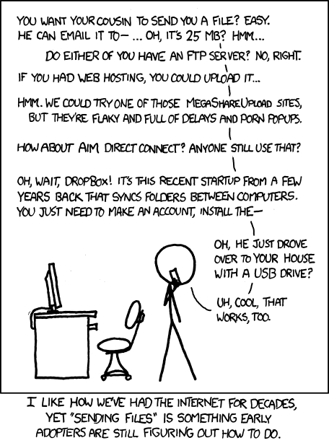
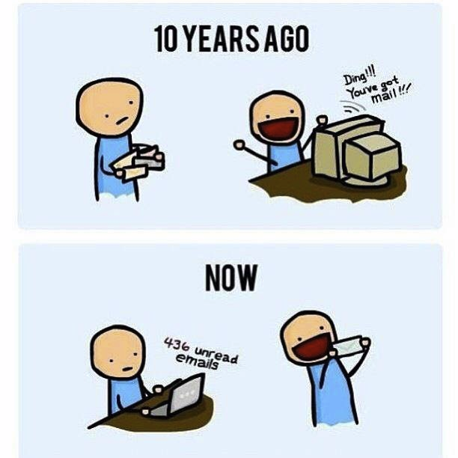
http://poofytoo.com/
25
http://xkcd.com/949/

Slide 5
My Reading Notes
pp. 110 First e-games 1972 at Stanford [1]. Has Twitch viewership gone up since the start of the COVID pandemic?
pp. 111 What powers the cell phones and towers? “everyday tasks” not apparent from image.
pp. 113 Ann did not force people to complain.
pp. 114 Does Kantian analysis agree?
pp. 117 9% # transactions or $$? Wikipedia critics source from 2005, is quality still in question?
pp. 118 MOOC source from 2012, now?
pp. 122 Macedonian is nice addition to new edition
pp. 123 “may have” = weak conclusion. Who funded studies?
pp. 124 Easier consolidation of newspapers. Advertisers switching away from newspaper source from 2014.
pp. 126 Search engines link deeper than home page
pp. 127 Any US agencies employing this many people?
pp. 131 Adult bookstores lowering property values source?
pp. 135 “texted… images”
pp. 136 Stating people searching did not consent to material being blocked makes more sense.
pp. 138 sexting examples all from 2009?
pp. 140 College students still as likely? 2013 source
pp. 141 Do mobile plans still charge for text messages?
pp. 146 Hunter Moore convictions seem unrelated to “Anyone Up?” site.
pp. 153 See: http://en.wikipedia.org/wiki/Wikipedia:Citing_Wikipedia
pp. 154 Question 40 same as 46
Questions I liked: 17, 43
Interview nice update
Notes:
[1] Owen Good (19 October 2012). "Today is the 40th Anniversary of the World's First Known Video Gaming Tournament". Kotaku. Retrieved 1 August 2013

Slide 6
Group Quiz
Name two methods some governments use to control access to information.
A large company has a policy prohibiting employees from blogging about company products.
Does it violate the First Amendment? Why?
Name two possible reasons for the policy.
Is it reasonable? Why?
What does “URL” stand for and what is it?
Notes:
Censorship (religious, governmental, private). Adult authentication. Firewalls. Government owned media outlets (TV and radio stations, newspapers), private photocopier ownership illegal
First Amendment prohibits Congress from making laws limiting free speech, not private companies.
Uniform Resource Locator

Slide 7
Overview
Review
Assignment
Students Present
Notes:
But before that:
CPG Grey - This Video Will Make You Angry [Thought Germs] (7:25)
https://www.youtube.com/watch?v=rE3j_RHkqJc
Find better examples:
Cedric Gervais - Hashtag (Original Mix) (3:58)
https://www.youtube.com/watch?v=6OmBKd7X7EE
Dave Audé vs Luciana - You Only Talk In #HASHTAG (3:36)
http://www.youtube.com/watch?v=53wIN87lJn0

Slide 8
Assignment
Reading
Individual Presentations
Extra Credit – One page paper
Is WPI’s IT Acceptable Use Policy morally acceptable?
Work on your group project
See full group project description on course website
Send Web Site URL before next class
Notes:
- Or review group project and individual presentation guidelines right now.
Possible One page paper:
Global intellectual property laws, friends or foes?

Slide 9
Overview
Review
Assignment
Students Present

Slide 10
Mental Health Impacts of Social Media on Teenagers
Dylan Shanes
Notes:
Hi my name is Dylan Shanes and I did my presentation on how social media has a negative impact on teens’ lives. I’m going to share 4 specific ways in which social media is harming teens.

Slide 11
Mental Health Impacts
Dylan Shanes
Internalizing and externalizing problems
Poor sleep quality
Problematic social media use
PTSD
Notes:
The first is making them internalize and externalize problems more.
It contributes to poor sleep quality.
Teens can develop addictive patterns like problematic social media use.
And teens can even develop clinically diagnosable PTSD from social media incidents.

Slide 12
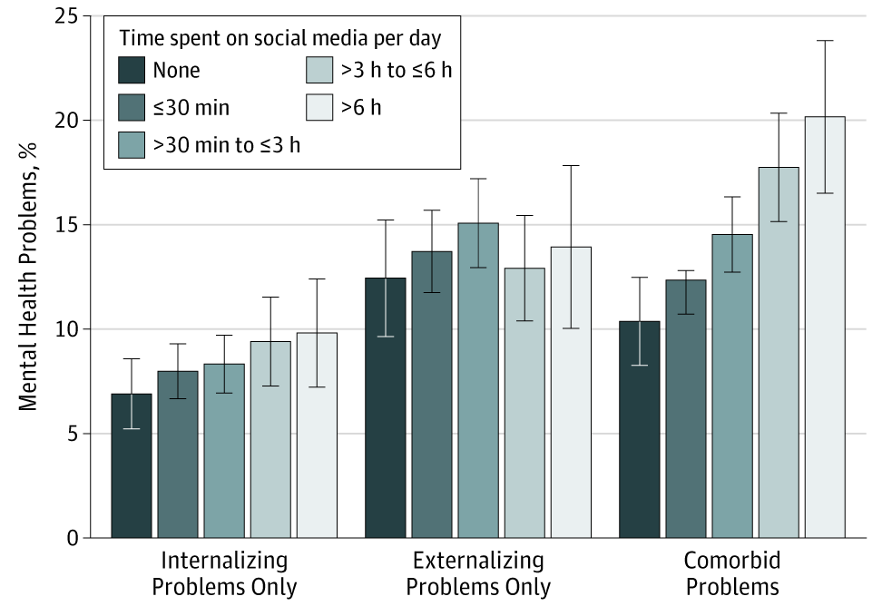
Social Media has a positive Correlation with internalizing and externalizing Problems
Dylan Shanes
It was found in the study that 0.8% - 18.9% of internalizing problems and 0.8% - 15.3% of externalizing problems could be prevented by using social media less. [1]
Social media use led to an increase in internalizing problems alone and comorbid internalizing and externalizing problems. [1]
More time on social media increases the risk of being cyberbullied
Error bars indicate 95% CIs.
Notes:
First we're going to talk about internalizing and externalizing problems.
Internalizing problems are characterized by anxious and depressive symptoms, social withdrawal and somatic complaints
Externalizing problems are defined as aggressive, oppositional, and delinquent behavior such as acting out
As you can see in the chart…
It was found in the study…
“Time spent on social media may increase the risk of experiencing cyberbullying, which has a strong association with depressive symptoms”

Slide 13
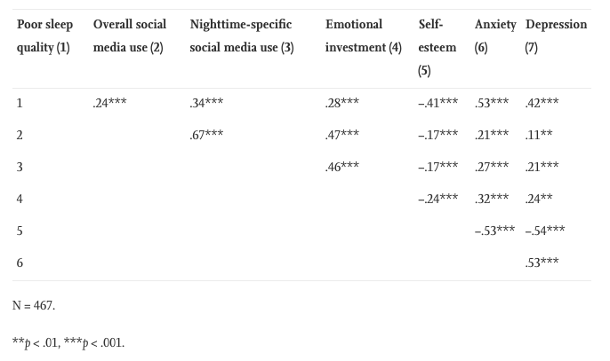
Impact of social media on sleep
Dylan Shanes
“Poor sleep quality is prevalent in adolescents and is known to contribute to depression, anxiety and low self-esteem” [2]
Constant notifications throughout the day
Social media notifications can disturb sleep
86% of surveyed adolescents report sleeping with their phone in their bedroom [2]
Variable Correlation
Notes:
Our next impact is the effect that social media has on sleep.
This study went passed just analyzing amount of time spent on social media, but also looked into what time of day it was used and emotional investment in social media
As you can see in the chart on the right...
Constant notifications contribute to social pressure and a fear of missing out.
The notifications that come in at night harm sleep even more.
86% say… Think about sleeping next to your phone and every time you get any sort of notification, your sleep gets disrupted even if it doesn’t fully wake you up.
“poor sleep is known to contribute to anxiety, depression and low self-esteem during adolescence”

Slide 14
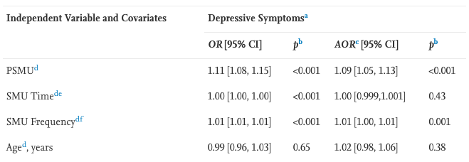
Problematic social media use
Dylan Shanes
PSMU was associated with around a 10% increase in depressive symptoms [3]
Problematic social media users may neglect other important aspects of their lives
Thinking about social media makes people compare themselves to others
Time spent on social media alone doesn’t contribute to depressive symptoms
Frequency of social media use does contribute to depressive symptoms
Bivariable and multivariable associations between problematic social media use (PSMU) and depressive symptoms.
Notes:
Next we have problematic social media use.
Problematic Social Media Use (PSMU) is an addictive pattern of social media use that gets in the way of other aspects of the user’s life like interpersonal relationships and well-being.
PSMU measured on a scale from 0 to 24 based on survey results.
For every 1 unit increase of the PSMU, there is a 10% increase in the risk of developing moderate depressive symptoms
People that spend a lot of time thinking about social media may compare how they think of themselves with the idealized portrayal of how others present themselves online.

Slide 15
Social media causing PTSD in teens
 | α | M | SD
Intrusion | 0.75 | 1.82 | 0.89
Avoidance | 0.76 | 1.86 | 0.91
Arousal | 0.71 | 1.59 | 0.72
Information Breach | 0.70 | 1.24 | 0.30
Cyberbullying | 0.97 | 1.29 | 0.49
Sexual Solicitation | 0.72 | 1.25 | 0.48
Explicit Content | 0.69 | 1.24 | 0.30
Passive Coping | 0.63 | 0.55 | 0.40
Active Coping | 0.73 | 0.30 | 0.33
Communicative Coping | 0.65 | 0.26 | 0.32
Dylan Shanes
PTSD Symptoms
Different types of online risks
Among the different types of risks represented in the study, explicit content was the most common encompassing 62% of online risks [4]
Online risk incidents often lead to clinically diagnosable PTSD
Online Risks
Coping Strategies
Notes:
Our last impact is social media causing PTSD in teens.
The study tracked 4 different types of online risks: Information breaches, cyberbullying, sexual solicitation, and explicit content which is comprised of unwanted or accidental viewing of pornography, extreme violence, or deviant online content
PTSD symptoms were measured using the CRIES-13 which measures 3 types of PTSD symptoms: arousal, intrusion, and avoidance in relation to a traumatic event occurring.
Among the different types of risks represented in the study, explicit content was the most common encompassing 62% of noted risks
The anonymity of the internet gives cyberbullies and sexual predators free reign to do as they please with relatively low risk of reprecussions.
The study found that 36.4 percent of online risk incidents resulted in clinically diagnosable PTSD

Slide 16
Takeaways
Dylan Shanes
Internalizing and externalizing problems
Sleep quality
Problematic social media use
PTSD
Notes:
In conclusion, social media use appears to have a significant negative impact on the mental health of teens as evidenced by internalizing and externalizing problems, decrease in sleep quality, problematic social media use contributing to depressive symptoms, and PTSD as a result of exposure to online risks.

Slide 17
References
Dylan Shanes
Kira E. Riehm, MS¹; Kenneth A. Feder, PhD¹; Kayla N. Tormohlen, MPH¹; Rosa M. Crum, MD^{1,2,3,4}; Andrea S. Young, PhD⁵; Kerry M. Green, PhD⁶; Lauren R. Pacek, PhD7; Lareina N. La Flair, PhD8; Ramin Mojtabai, MD1,4, Associations Between Time Spent Using Social Media and Internalizing and Externalizing Problems Among US Youth (JAMA Psychiatry, 9/11/19) https://jamanetwork.com/journals/jamapsychiatry/fullarticle/2749480 (9/5/21) [1]
Heather Cleland Woods, Holly Scott, #Sleepyteens: Social media use in adolescence is associated with poor sleep quality, anxiety, depression and low self-esteem (University of Glasgow, School of Psychology, 6/10/16) https://www.sciencedirect.com/science/article/pii/S0140197116300343?via%3Dihub (9/5/21) [2]
Ariel Shensa Maab, César G. Escobar-Viera MD, PhD, Jaime E.Sidani PhD, MPH, Nicholas D. Bowman PhD, Michael P. Marshal PhD, Brian A. Primack MD, PhD, Problematic social media use and depressive symptoms among U.S. young adults: A nationally-representative study (4/24/17) https://www.sciencedirect.com/science/article/pii/S027795361730223X (9/5/21) [3]
McHugh, Bridget Christine; Wisniewski, Pamela; Rosson, Mary Beth; Carroll, John M., When social media traumatizes teens, (Emerald Publishing Limited 2018, 2018) https://www.proquest.com/docview/2113587897 (9/5/21) [4]
Monica Anderson and Jingjing Jiang, Teens’ Social Media Habits and Experiences, (PEW RESEARCH CENTER, 11/28/18), https://www.pewresearch.org/internet/2018/11/28/teens-social-media-habits-and-experiences/ (9/5/21) [5] – Not directly used in the presentation, but offers another perspective on teens and social media
Notes:
The last reference talks about teens reporting positive emotions as a result of social media if you want to read about the other side of the argument.

Slide 18
Who censors us?
Kenneth Nguyen

Slide 19
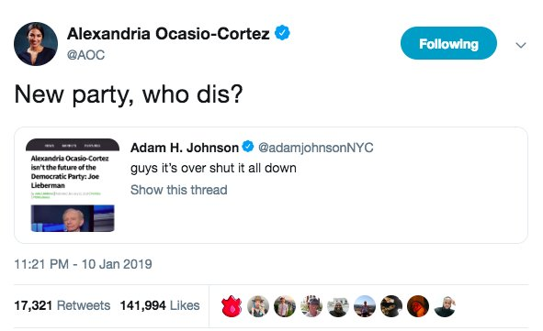
Microblogging
Kenneth Nguyen 1
[2] “small pieces of digital content (e,g text, pictures, videos or weblinks) while their followers view, comment or repost”
Government Microblogging Services
<Graphic as big as will fit>
Notes:
-Define microblogging
-User Gratification Theory regarding social media
-Social media is easy to use and let users control to achieve greater satisfication
-Percieved online-offline integration has a significant and positive effects on content gratification, social gratification and process gratification
-Negative association between perceived internet censorship and continuance intention
-weibo users could become accustomed to self-censoring before posting or searching.”
- AOC as an American example

Slide 20
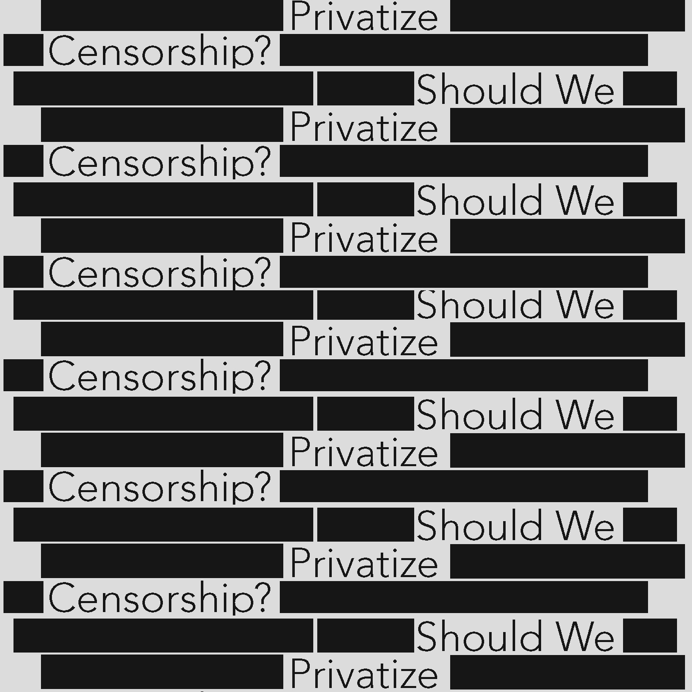
Privatized Censorship
Kenneth Nguyen 2
Hateful Content online
[1] Ex: Twitter removed 2,742 troll accounts linked to Russia’s IRA
Possible Solutions:
Transparency
Filtering incites of violence
Public review of moderation standards
https://issues.org/wp-content/uploads/2019/11/privatize-censorship.jpg
<Graphic as big as will fit>
Notes:
Tech companies seem to be limiting online speech much more than Congress and the courts restrict offline content
Alex Jones calling Sandy Hook a hoax
R Kelly’s song removed from Spotify and Apple due to his sexual abuse charges
2016 presidential election with Russia’s Internet Research Agency

Slide 21

Face to a screen Name
Kenneth Nguyen 3
Anonymity under the First Amendment
[4] First Amendment doesn’t cover defamation
https://i.pcmag.com/imagery/articles/0130rGS36Xo41TqBg4LRUrW-7..1569491877.jpg
<Graphic as big as will fit>
Notes:
Argument against censorship: face to a screen name
“would you say it in person”?
Gossip and cyber bullying
Polar ends: 4Chan full anonymity and Facebook anti-anonymity
“trial courts will ensure that the naming of online John Does will occur only when adequate notice has been given to the defendants and the identity is necessary to further a plaintiff's legitimate claim, and thereby will allow the plaintiff a means of redress while safeguarding a cherished First Amendment right.”
no federal laws against cyber bullying

Slide 22
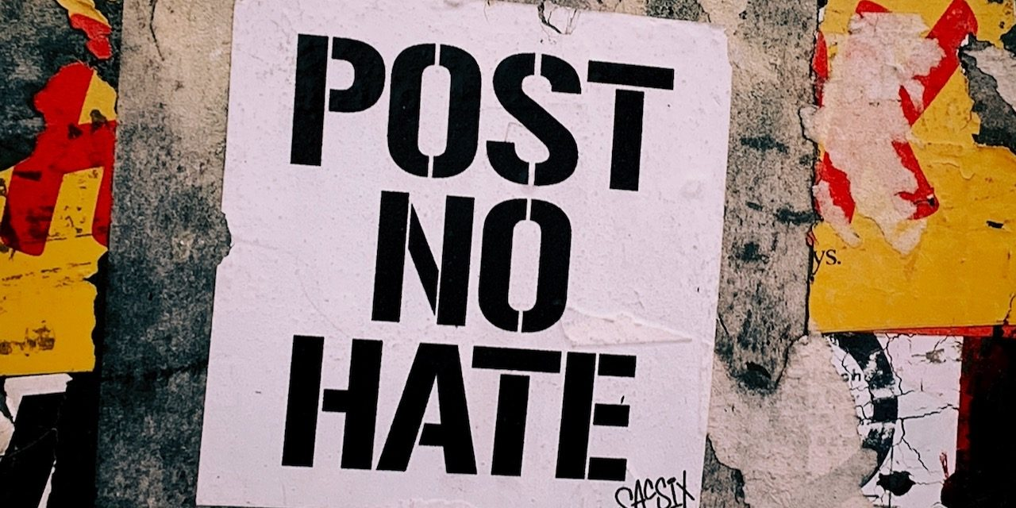
Actions taken by Social Media
Kenneth Nguyen 4
Policy changes: hateful content
[3] 2019 YouTube announced increased efforts to remove “hateful content” such as videos that deny historical events or advocate group discrimination
[3] “Market forces becoming more influential regulators”
Section 230
https://www.connectsafely.org/wp-content/uploads/2019/10/Unsplash-horizontal-1280x640.jpeg
<Graphic as big as will fit>
Notes:
-YouTube policy change covers promotion of Nazi ideology, denying the Holocaust, denying Sandy Hook
Section 230: the legal foundation of the internet
26 words “No provider or user of an interactive computer service shall be treated as the publisher or speaker of any information provided by another information content provider.”
Internet thrived because of section 230
First Amendment trumps section 230

Slide 23
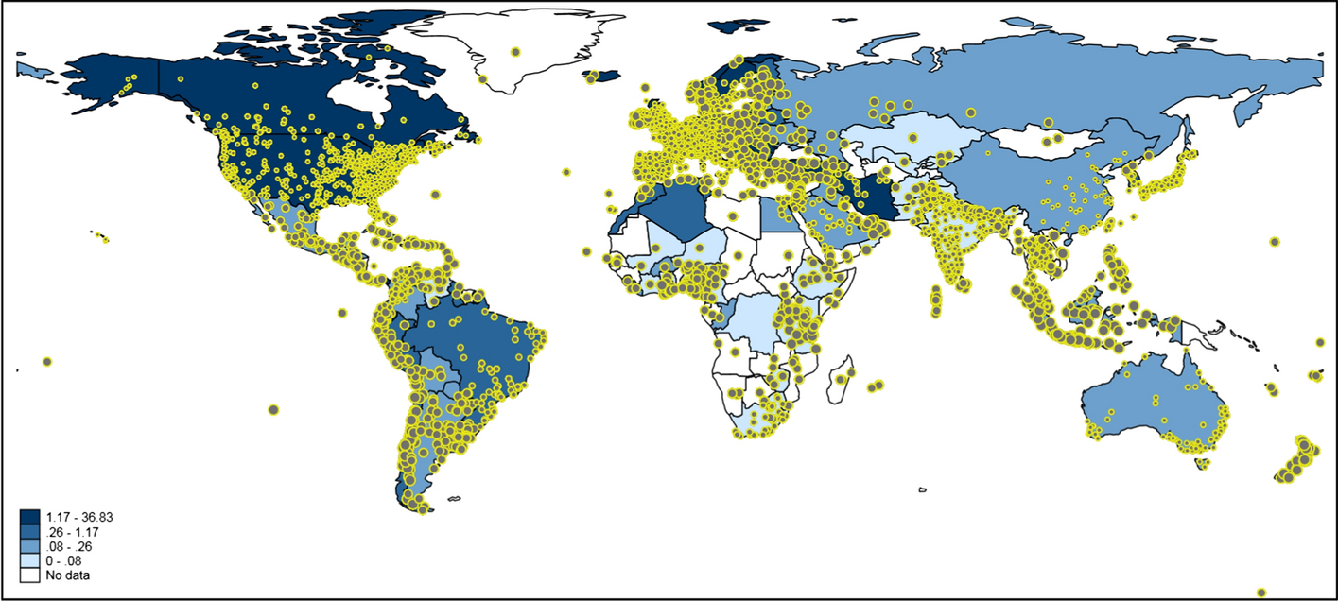
Twitter vs Governments
Kenneth Nguyen 5
Countries ban or threat to ban: China, Nigeria, North Korea
Correlation of COVID Tweets to scientific articles
[5] “censorship of social media may have stifled research dissemination and more importantly avoids swift public scrutiny. “
Image from [5]
Notes:
Restrictions, threaten to ban: South Korea – North Korean Twitter account, England – Riots threat,
Regression models of worldwide data showed a positive correlation between the national deaths per number of population and tweets when holding number of publications constant (coefficient 0.0285, S.E. 0.0003, p < 0.001).
Tweeting on publications dealing with COVID-19/SARS-CoV-2 worldwide. Each tweet is inversely weighted with the number of publications published by authors in the corresponding country: the larger the dots, the smaller the research activity. The countries are colored according to the national deaths per one hundred thousand population. For some countries, e.g. Greenland, no data are available. Countries such as China and Iran block internet access to Twitter or its content (Mortality Analyses 2020)
relationship between this pandemic, research outputs, and Twitter activity, but demonstrates the importance of how social media platforms can be crucial to spread research with rapid scrutiny, which may also impede the degree of misinformation. We urge governments to pause censorship of social media platforms such as Twitter during these unprecedented times to support the scientific community’s battle against COVID-19/SARS-CoV-2.

Slide 24
References
Kenneth Nguyen 6
[1] Etzioni, Amitai. “Should We Privatize Censorship?” Issues in Science and Technology , vol. 36, no. 1, 2019, pp. 19–22.
[2] Li, Yixiao, et al. “Effects of Perceived Online–Offline Integration and Internet Censorship on Mobile Government Microblogging Service Continuance: A Gratification Perspective.” Government Information Quarterly, vol. 35, no. 4, 2018, pp. 588–598.
[3] Matthew P. Hooker, Censorship, Free Speech & Facebook: Applying the First Amendment to Social Media Platforms via the Public Function Exception, 15 WASH. J. L. TECH. & ARTS 36 (2019).
[4] Jennifer O'Brien, Putting a Face to a (Screen) Name: The First Amendment Implications of Compelling ISPs to Reveal the Identities of Anonymous Internet Speakers in Online Defamation Cases, 70 Fordham L. Rev. 2745 (2002).
[5] Patel, V.M., Haunschild, R., Bornmann, L. et al. A call for governments to pause Twitter censorship: using Twitter data as social-spatial sensors of COVID-19/SARS-CoV-2 research diffusion. Scientometrics 126, 3193–3207 (2021). https://doi.org/10.1007/s11192-020-03843-5

Slide 25
Social Sites and Foreign Policy
Brendan Byrne

Slide 26

US Intelligence Community
Brendan Byrne
“The mission of the Intelligence Community is to seek to reduce the uncertainty surrounding foreign activities, capabilities, or leaders’ intentions.”
Foreign actors go through ridiculous lengths in order to keep their identification a secret, but the job of the Intelligence Community is track them down and identify the actor.
Notes:
<speaker notes>

Slide 27
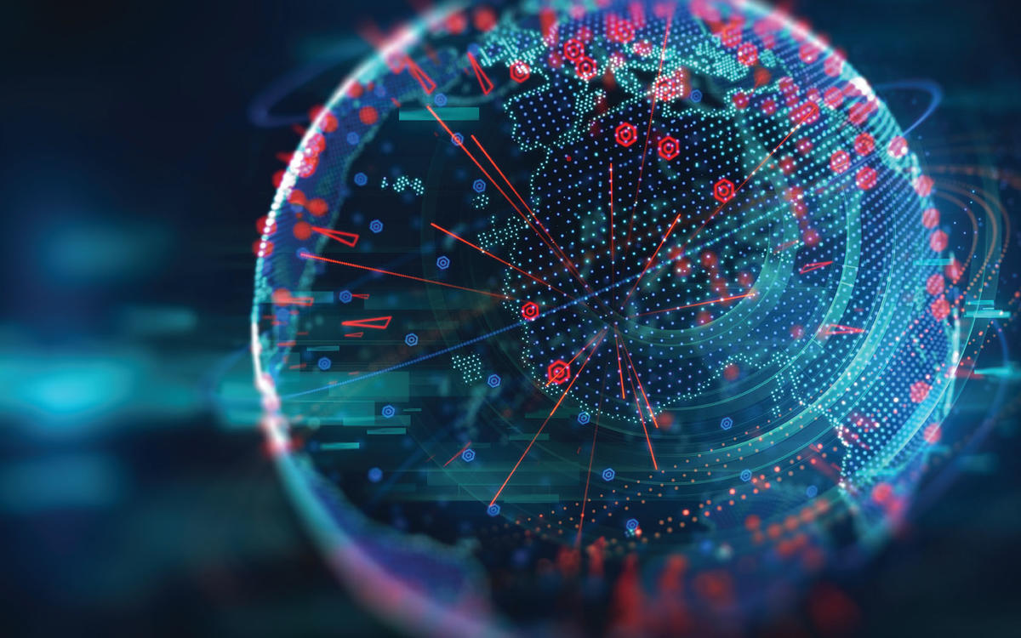
Cyber Incidents
Brendan Byrne
“The nature of cyberspace makes attribution of cyber operations difficult but not impossible”
“Every kind of cyber operation—malicious or not—leaves a trail”
“US Intelligence Community analysts use this information, their constantly growing knowledge base of previous events and known malicious actors, and their knowledge of how these malicious actors work and the tools that they use, to attempt to trace these operations back to their source”
Notes:
<speaker notes>

Slide 28
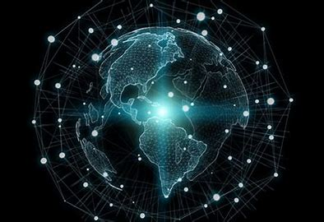
Cyber Incidents(continued)
Brendan Byrne
Because of this trail that gets left behind the US Intelligence Community can track down the actor by their cyber operations they mode on cyberspace.
They keep a record on the found actors and how they did their deed. This allows for the Intelligence Community to learn from their past experiences and then possibly add a new experience making it harder for actors to disappear on them in cyberspace.
Notes:
<speaker notes>

Slide 29

Kremlin
Brendan Byrne
“Some of our judgments about Kremlin preferences and intent are drawn from the behavior of Kremlin loyal political figures, state media, and pro-Kremlin social media actors, all of whom the Kremlin either directly uses to convey messages or who are answerable to the Kremlin”.
Kremlin is a social media actor in Russia that takes command from the Russian government and acts in certain ways politically to portray a message to Russians and international personel
Notes:
<speaker notes>

Slide 30
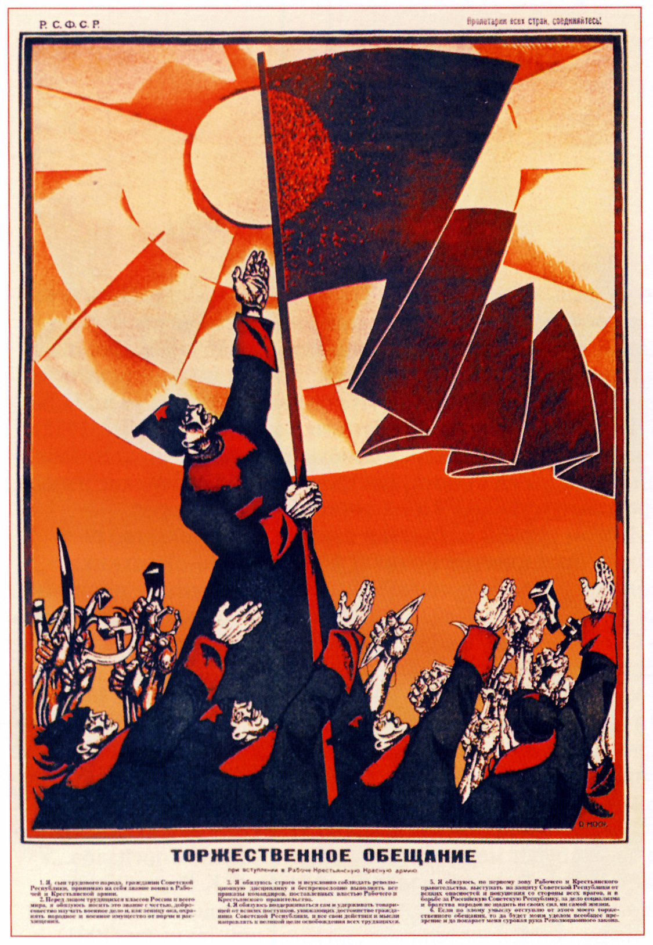
Disinformation
Brendan Byrne
“The Russian leadership invests significant resources in both foreign and domestic propaganda and places a premium on transmitting what it views as consistent, self-reinforcing narratives regarding its desires and redlines, whether on Ukraine, Syria, or relations with the United States”
The Russian government invests in the propaganda that was used in such way in 2016 to try and move the pollical parties in America toward Donald Trumps side. They provided disinformation and propaganda to change a person’s thoughts toward the situation.
Notes:
<speaker notes>

Slide 31
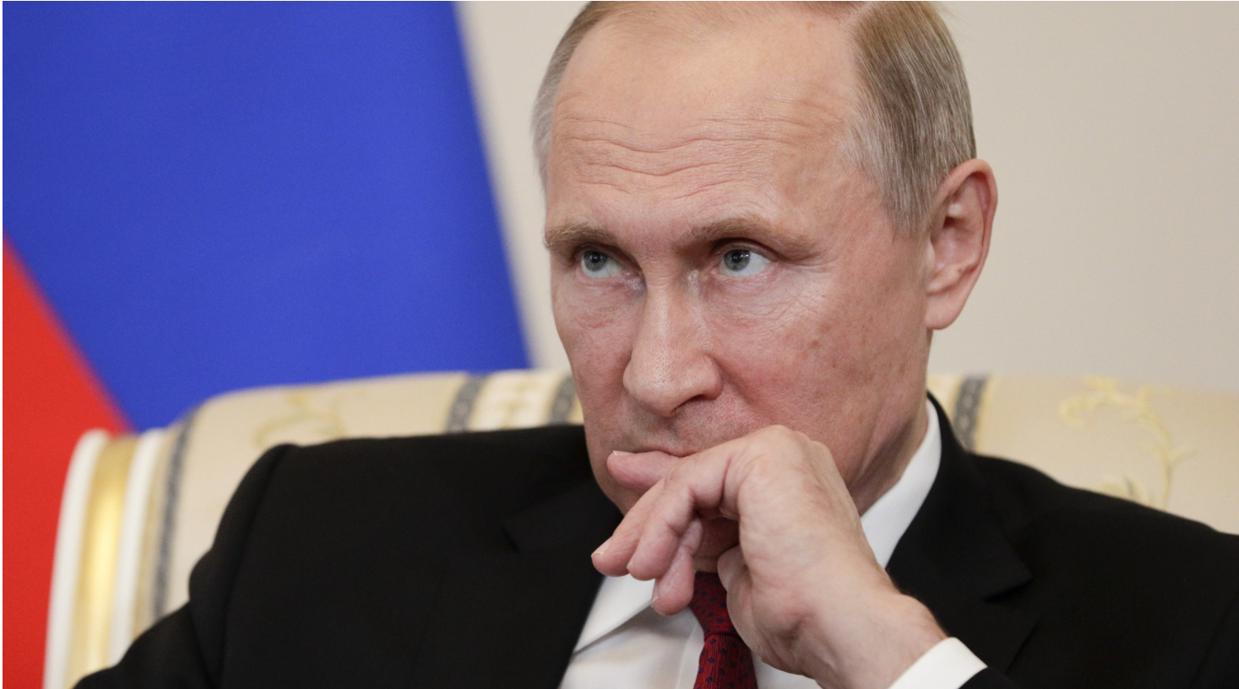
Putin’s response to the accusations
Brendan Byrne
“Putin’s acknowledgment that it was “theoretically possible” that “patriotic” Russians may have engaged in hacking is his first admission that Russians could have played any such role”
Putin neither confirms nor denies that Russians may have acted on the election, and it is implied that Russians may have hacked into American software to portray their “patriotic” view.
Notes:
<speaker notes>

Slide 32
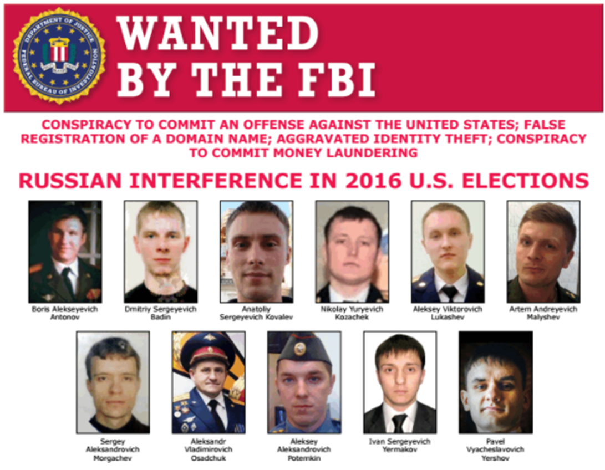
Russian cyber crimes during 2016 Election
Brendan Byrne
“Gaining unauthorized access into the computers of U.S. persons and entities involved in the 2016 U.S. presidential election”
“Stealing documents from computers of US persons”
“Staging releases of the stolen documents to interfere with the 2016 U.S. presidential election”
“Aggravated identity theft”
“False registration of a domain name”
“Conspiracy to commit money laundering”
Notes:
<speaker notes>

Slide 33


Russians with a separate conspiracy
Brendan Byrne
“Aleksandr Vladimirovich Osadchuk and Anatolity Sergeyevich Kovalev, are charged with a separate conspiracy to commit computer crimes, relating to hacking into the computers of U.S. persons and entities responsible for the administration of 2016 U.S. elections”
Therefore, the FBI themselves have traced back who has committed terrible acts upon the people of America and may have influenced the election. These acts show policies toward foreign people and that influence on social sites using a false domain and using it harshly
Notes:
<speaker notes>

Slide 34
References
Brendan Byrne
[1] Assessing Russian Activities and Intentions in Recent US Elections, DNI, (6 January 2017), https://www.dni.gov/files/documents/ICA_2017_01.pdf
[2] “RUSSIAN Interference in 2016 U.s. Elections.” FBI, FBI, (30 Sept. 2018), www.fbi.gov/wanted/cyber/russian-interference-in-2016-u-s-elections
[3] Bambauer, Derek E, “Information Hacking.” Utah Law Digital Commons, (7-2020), https://dc.law.utah.edu/cgi/viewcontent.cgi?article=1268&context=ulr
[4] “Internet Crime Complaint CENTER (IC3): Foreign Actors Likely to Use Online Journals to Spread DISINFORMATION REGARDING 2020 Elections.” Internet Crime Complaint Center (IC3) | Foreign Actors Likely to Use Online Journals to Spread Disinformation Regarding 2020 Elections, IC3,(1 October 2020), https://www.ic3.gov/Media/Y2020/PSA201001
[5] Calamur, Krishnadev, “Putin Says 'Patriotic Hackers' May Have Targeted U.S. ELECTION.” The Atlantic, Atlantic Media Company, (1 June 2017), https://www.theatlantic.com/news/archive/2017/06/putin-russia-us-election/528825/

Slide 35
Class 4 The End
Keith A. Pray
socialimps.keithpray.net
Notes:
Use remaining time for group project questions and/or review group assignment slides.
This is the end. Any slides beyond this point are for answering questions that may arise but not needed in the main talk. Some slides may also be unfinished and are not needed but kept just in case.

