Slide 1
Class 13-14 Last Days
Keith A. Pray
socialimps.keithpray.net

Slide 2
Automation Papers
This Term
Includes Terms:
2018 A 2019 D 2019 A 2020 D 2020 A 2020 B

Slide 3
Papers
Great improvement!
Very Clear Conclusions
Great Quantifying Data
Significant Counter Points
Good Use Of Examples
Notes:
Save for next time:
Clearly state conclusion
First statement preferred
Absolute statements are difficult to prove
Avoid: all, always, any, every, everyone, never, none… unless you can show it
Be sure to put quotes around entire quote
Hyperbole is the best thing ever!
but not in these papers
Print 2 sided and save a tree
Use template, saves time (and -1 point)
Include Counter Point and Response
Include Author, Title, Publish Date, Publisher for references
Read paper aloud to proof

Slide 4
Grades To Date
68 Max Possible

Slide 5
Overview
Reminder: Course and Group Evaluations
Groups Present
Class 14:
See Syllabus
Students Present
Students’ Choice

Slide 6
Preventing a Terminator
Hoang Nguyen
Notes:
I grew up hearing about the terminator, without ever having seen the movie. I don’t know anything about the plot aside from one thing:
A robot is attempting to kill someone. My job today is to see if we can prevent such an incident.
I am Hoang.
And, lets try to prevent a terminator.
NEXT SLIDE!

Slide 7
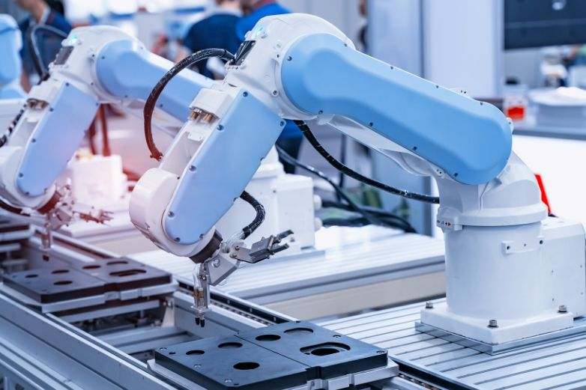
Why have robotic?
Hoang Nguyen
Within automation
Improves efficiency
Reduces errors
Able to increase sales and profits
There are more ways to use robots!
Human Robot Interactions (HRI) are necessary to achieve task tailored for humans
<Graphic as big as will fit>
Notes:
To stop the Schwarzenegger from coming about, why not just stop the creation of robotics altogether?
Well….
If we look at the automation industry,
Robots have been proven to increase the efficacy for manufacturing facilities, and reduce errors.
For example, robots introduced in a California facility were able to ship 30% to 50% of the items within half the time of what it takes for a human worker.
Here is another example
at a phone manufacturing company, robots were able to do the work of 10x the human labor, increase annual production from 8000 to 21,000 phones, and reduce manufacting errors from 25 percent to 5.
Its these factors and more that help make them able to increase sales and profits
Here is a quick example. After introducing Kiki, and swarm-based robotics system, enhanced sales from 71 million dollars in 2004, to 89 billion in 2014.
Outside of automation, we see robots being used in medical care, military machinery, and simple home applications.
We will ultimately have to consider the future or robotics, where there will be the social task we want to automate
It is that idea that leads to the field of Human Robot Interaction Research, or HRI for short.
NEXT :D

Slide 8
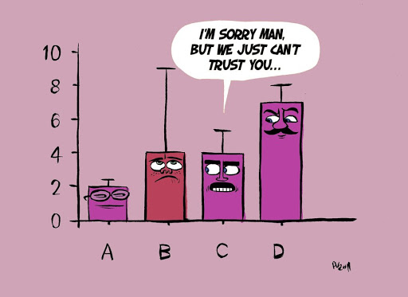
Handling uncertainty
Hoang Nguyen
Uncertainty disrupts a robot's ability to perform normally
Heuristics are used to simplify a situation a robot currently experiences
Examples:
Google Driverless Cars
Agbots: Agricultural Robots
The full scope of all the “disturbances” is hard to define
<Graphic as big as will fit>
Notes:
As good as robots are, they can’t handle uncertainty, randomness.
If robots are introduced to random events and moments, their performance worsen.
To try to handle uncertainty, engineers try to incorporate heuristics, or some set of defining rules and values to help improve a robot’s evaluation of the type of event the robot is experiencing, with something that it understands
This is used in Googles Driverless Cars, which can use sensors to help navigate streets.
Within the agricultural industry, there are agriculture robots, or agbots that can learn how to treat individual plants while harvesting, watering , or planting.
As helpful as heuristics are, they can’t handle all the possible disturbances can appear, and thus, humans can’t completely rely on robots to perform and adjust well.
However, as we devlope robots more, we can try to rely on them more. Lets consider military development of autonamious weapons:
In an international Herald Tribute on November 26, 2008, they quoted Ronald Hakin, professor at Georgia Institude of Techology in which he said the following:
Next Slide

Slide 9
Hoang Nguyen
“My research hypothesis is that intelligent robots can behave more ethically in the battlefield than humans currently can…”
- Ronald Harkin
Notes:
“Quote”
He further goes on to explain that robots who can make decisions autonomously can make the decision to fire at anyone, equally.
It is the mixture of uncertainty, as well as the multitude of ways to interpret the world, that makes self learning robots so hard to control.
Next Slide

Slide 10
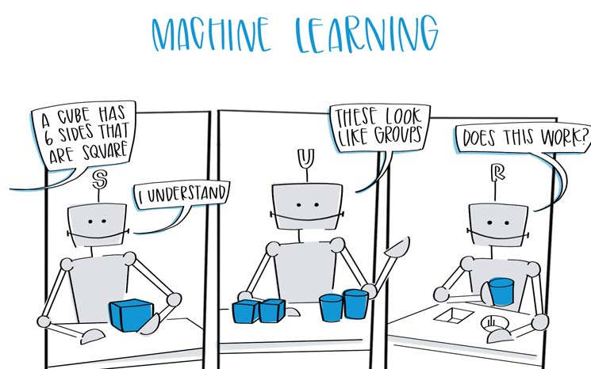
Do we let them Self Learn?
Hoang Nguyen
Self Learning Robots are designed to
Adjust their heuristics to better perform their intended goal
Discover regularities in their environment
There is no certainty how robots will behave within their intended operation environment
<Graphic as big as will fit>
Notes:
Similar to how humans can process the world and make judgments about it:
Self learning robots are designed to self adjust their own heuristics to better perform their intended goal,
And discover the regularities in their environment.
Ideally, the environment is as close to, if not the real environment they were going to be splace in.
Because we allow them to define there hurietsics and learn on their own, there is no way for the manufactures, programmer or the people purchasing the product from having complete certainty that the robot they buy, will work 100 percent of the time.
To give an example of the process that underlie self learning robots, lets consider robotics in a military application.
Reasearchers are developing robotics soilders to go out into the battle field. One decision that robots have to make is allow the enemy to surrender, and be able to recognize the gestures associated with surrender. However, there are small suttle things in the way humans express emotions, and thus, can lead to issues with making that last call.
Robots like these could “accidentally” kill surrendered soilders.
How do we handle situations such as these?
Lets go back full circle.
Next Sldie
Next Slide

Slide 11
Hoang Nguyen
Is there anyway to prevent harmful robots from existing?
Notes:
Is there anyway to prevent harmful robots from existing, while allowing them the ability to make smart decisions?
In trying to answer that question, much like in life, there are always two possibilities:
Robots can be used to assisted and help humanity, and learn the right things needed to do so.
On the other hand, they can learn from their experience to be destructive, harming innocent people.
As a robotics engineer, that is what I fear most.
Thank you.
Is there any question?

Slide 12
References
Hoang Nguyen
[1] Dethe, S. N., Shevatkar, V. S., & Bijwe, R. P. (2011). Google driverless car. International Journal of Scientific Research in Science, Engineering and Technology, 2(2), 133-137.
[2]Gibson, J. (2019). Automating Agriculture: Precision Technologies, Agbots, and the Fourth Industrial Revolution. In Defense of Farmers: The Future of Agriculture in the Shadow of Corporate Power, 135-74.
[3]Jain, D., & Sharma, Y. (2017). Adoption of next generation robotics: A case study on Amazon. Perspect. Case Res. J, 3, 9-23.
[4]Tamburrini, G. (2009). Robot ethics: A view from the philosophy of science. Ethics and robotics, 11-22.
[5]West, D. M. (2018). The future of work: Robots, AI, and automation. Brookings Institution Press.

Slide 13
References Pictures….Who hates Them?
Hoang Nguyen
[6] Holdgraf, C. (2015, May 1). The importance of uncertainty. The Berkeley Science Review. https://berkeleysciencereview.com/2014/04/importance-uncertainty/
[7] Process Solutions, Inc. (2020, July 20). Post author: https://www.processsolutions.com/the-benefits-of-industrial-robotic-automation/
[8] S. (2019, August 28). The 3 Types of Machine Learning. Ceralytics. https://www.ceralytics.com/3-types-of-machine-learning/

Slide 14
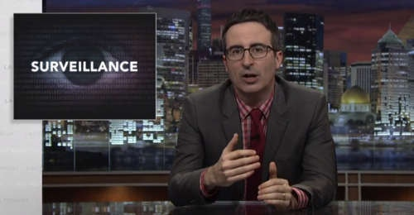

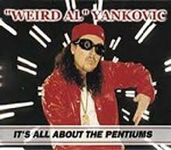


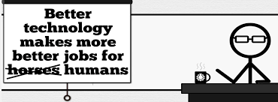


Student Choice – Interesting Videos
Last Week tonight with John Oliver Snowden (33:14)
It’s All About The Pentiums
Weird Al (3:34)
White and Nerdy Weird Al (2:50)
The Game Of Trust - Nicky Case
Why Electronic Voting is a BAD Idea
Computerphile (Tom Scott) (8:20)
Welcome To Life – Tom Scott (2:44)
What "Orwellian" really means - Noah Tavlin (5:31)
Humans Need Not Apply
CGP Grey (15:00)
Notes:
All Last Accessed 2018-10-04
CGP Grey
Humans Need Not Apply (15:00) – 2014-08-13
http://www.youtube.com/watch?v=7Pq-S557XQU
Last access 2016-04-22
Why Electronic Voting is a BAD Idea – Computerphile (Tom Scott) (8:20)
https://www.youtube.com/watch?v=w3_0x6oaDmI
Last Week tonight with John Oliver – Patriot Act, Edward Snowden (33:14)
http://www.upworthy.com/john-oliver-flew-10-hours-to-russia-to-interview-edward-snowden-and-get-him-on-record?c=ufb1
Weird Al – It’s All About The Pentiums (3:34) and look at lyrics
https://www.youtube.com/watch?v=qpMvS1Q1sos
Tie into Ray Kurzweil Singularity
Epic Rap Battles of History: Steve Jobs vs. Bill Gates (If class ok with obscene lyrics) (2:47)
https://www.youtube.com/watch?v=njos57IJf-0
Also Work links on web site http://socialimps.keithpray.net/documents/
-----
Tom Scott
http://tomscott.com
Welcome To Life (2:44)
https://www.youtube.com/watch?v=IFe9wiDfb0E&feature=youtu.be
Passphrases (2:08 need to give context for video)
https://firstlook.org/theintercept/2015/03/26/passphrases-can-memorize-attackers-cant-guess/
If not shown during first class
What "Orwellian" really means - Noah Tavlin (5:31)
http://ed.ted.com/lessons/what-orwellian-really-means-noah-tavlin
Weird Al – White and Nerdy (2:50) and look at lyrics
https://www.youtube.com/watch?v=N9qYF9DZPdw

Slide 15
Student Choice – Interesting Videos (Full)
Last Week tonight with John Oliver Snowden (33:14)
It’s All About The Pentiums
Weird Al (3:34)
White and Nerdy Weird Al (2:50)
The Game Of Trust - Nicky Case
Why Electronic Voting is a BAD Idea
Computerphile (Tom Scott) (8:20)
Welcome To Life – Tom Scott (2:44)
What "Orwellian" really means - Noah Tavlin (5:31)
Humans Need Not Apply
CGP Grey (15:00)
Notes:
All Last Accessed 2018-10-04
CGP Grey
Humans Need Not Apply (15:00) – 2014-08-13
http://www.youtube.com/watch?v=7Pq-S557XQU
Last access 2016-04-22
Why Electronic Voting is a BAD Idea – Computerphile (Tom Scott) (8:20)
https://www.youtube.com/watch?v=w3_0x6oaDmI
Last Week tonight with John Oliver – Patriot Act, Edward Snowden (33:14)
http://www.upworthy.com/john-oliver-flew-10-hours-to-russia-to-interview-edward-snowden-and-get-him-on-record?c=ufb1
Weird Al – It’s All About The Pentiums (3:34) and look at lyrics
https://www.youtube.com/watch?v=qpMvS1Q1sos
Tie into Ray Kurzweil Singularity
Epic Rap Battles of History: Steve Jobs vs. Bill Gates (If class ok with obscene lyrics) (2:47)
https://www.youtube.com/watch?v=njos57IJf-0
Also Work links on web site http://socialimps.keithpray.net/documents/
-----
Tom Scott
http://tomscott.com
Welcome To Life (2:44)
https://www.youtube.com/watch?v=IFe9wiDfb0E&feature=youtu.be
Passphrases (2:08 need to give context for video)
https://firstlook.org/theintercept/2015/03/26/passphrases-can-memorize-attackers-cant-guess/
If not shown during first class
What "Orwellian" really means - Noah Tavlin (5:31)
http://ed.ted.com/lessons/what-orwellian-really-means-noah-tavlin
Weird Al – White and Nerdy (2:50) and look at lyrics
https://www.youtube.com/watch?v=N9qYF9DZPdw

Slide 16

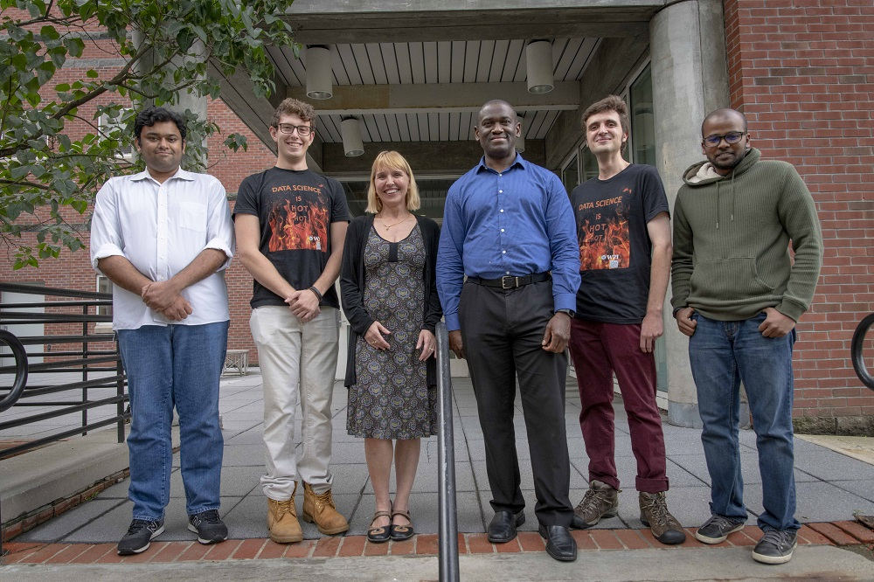

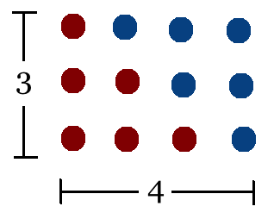
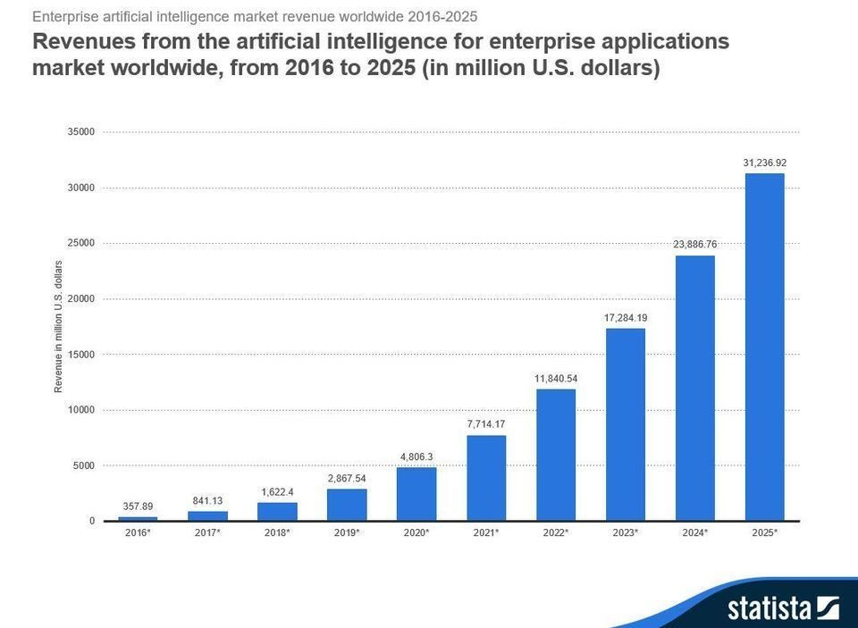
Student Choice – Interesting Articles 1/2
Facebook security breach: Up to 50m accounts attacked - Dave Lee, North America technology reporter, 2018-09-29
WPI Secures $2.8 Million to Develop a Smartphone App to Help Assess the Health of Soldiers, 2018-09-24
Quantified Toilets, 2014, Quantified Toilets LLC
What Did Ada Lovelace's Program Actually Do? - Sinclair Target, 2018-08-18 (First Programming Bug 1843?)
We know ethics should inform AI. But which ethics? - Mauro Guillen, World Economic Forum, 2018-07-26
Notes:
All Last Accessed 2018-10-04
TOOD: Add to first day slides.
Emacs – psychoanalyze-pinhead
doctor (implementation of ELIZA)
yow (quotes from Zippy the Pinhead zippythepinhead.com)

Slide 17
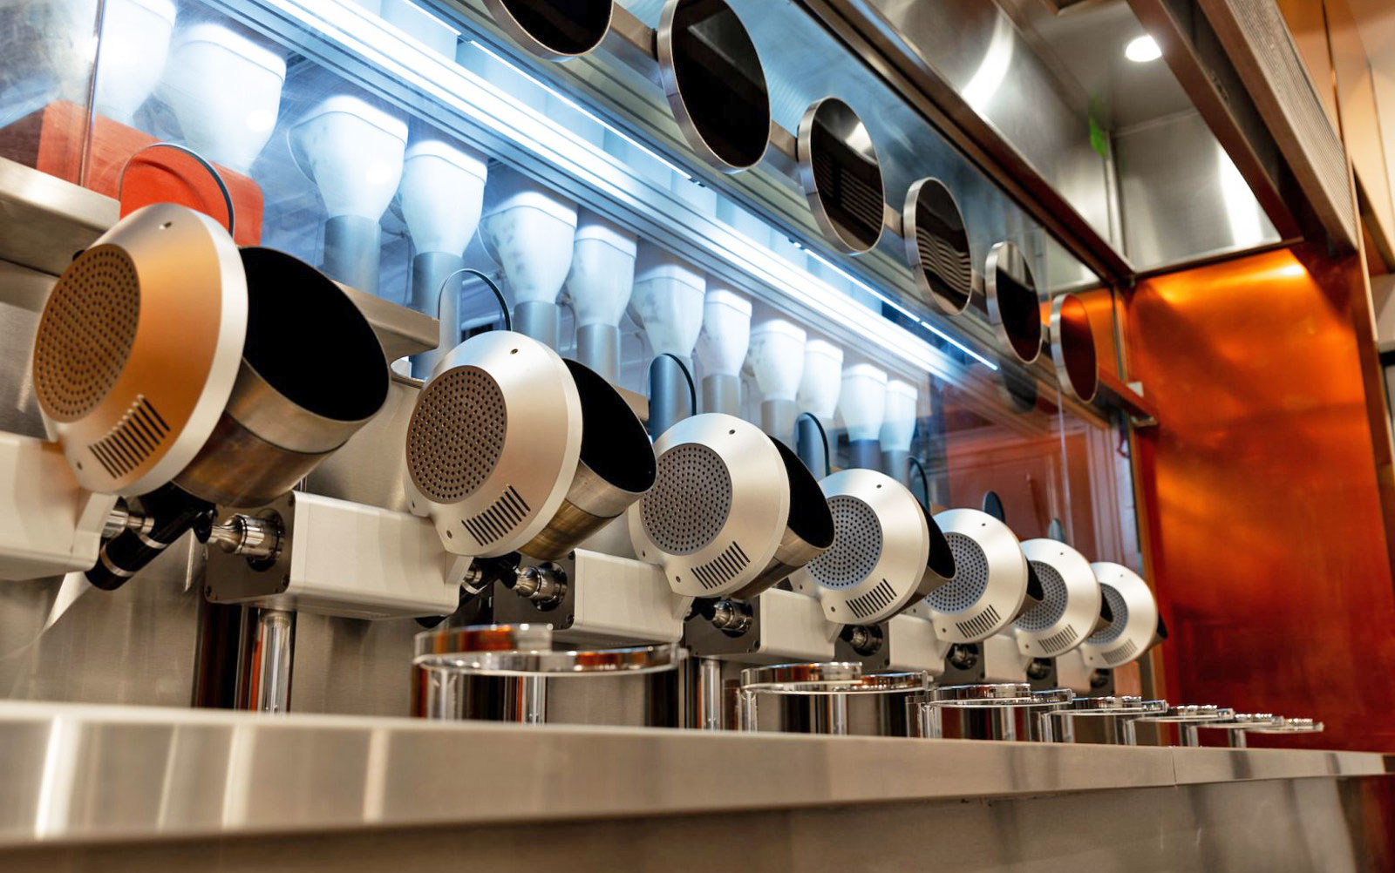
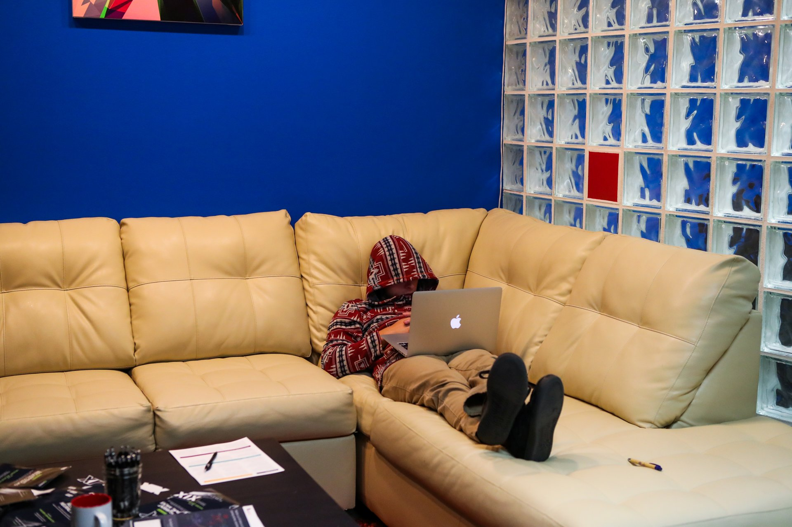
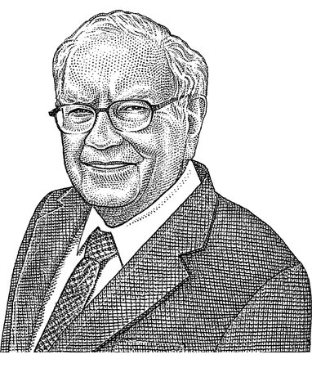
Student Choice – Interesting Articles 2/2
MIT-born Spyce raises $21M to open new robotic restaurants - Lucia Maffei, BostInno, 2018-09-07
The Coders Programming Themselves Out of a Job - Brian Merchant, The Atlantic, 2018-10-02
Berkshire Hathaway’s Stock Price Is Too Much for Computers - Alexander Osipovich, The Wall Street Journal, 2021-05-05 (approaching $429,496.7295 32 bit limit)
Notes:
All Last Accessed 2018-10-04
Spyce image: https://www.engadget.com/2018/05/04/boston-robotic-kitchen-spyce/ , 2018-05-04
Coders Programming Themselves Out of a Job image: Gabrielle Lurie, Reuters (date unknown)

Slide 18
Class 14 The End
Keith A. Pray
socialimps.keithpray.net

