Slide 1
Class 11 Work
Keith A. Pray
socialimps.keithpray.net
Notes:
Styx - Mr. Roboto (1983) (5:34) https://www.youtube.com/watch?v=uc6f_2nPSX8
Ask about Automation paper:
What did people choose to automate
Share 1 main reason

Slide 2
what works well Online With Zoom
Sign in with First and Last Name
Stay muted unless you are going to speak
To speak use the raise your hand feature
To answer yes/no questions use the “yes” ”no” buttons
Turn your camera on
Wait until the end of student presentations to ask questions
Write them down so you don’t forget

Slide 3
Papers
Read assignment, ask if unsure
Use and cite supporting data from high quality sources: peer reviewed, editorial process…
Include argument logic to explain how data and facts support conclusion
Use the paper template
http://socialimps.keithpray.net/assignments/paper-guidelines/
Notes:
0s not included.
Save for next time:
Quantify
Do not use terms like: less, more, a lot, huge, great, big, tiny, growing, etc.
Make decisive conclusions
may, could, etc. = trivial
Absolute statements are difficult to prove
Avoid: all, always, any, every, everyone, never, none… unless you can show it
Be sure to put quotes around entire quote
Hyperbole is the best thing ever!
but not in these papers
Print 2 sided and save a tree
Use template, saves time (and -1 point)
Read assignment
Argument should directly support conclusion
Response should directly address counter point
Blogs are usually not good sources for academic work
medium.com may appear like newspaper articles have no peer review or editorial process
StackOverflow.com likewise

Slide 4
Grades To Date
46 Max Possible
Notes:
If your individual presentation has been graded subtract those points from your total to see how you compare.

Slide 5

Overview
Review
Assignment
Students Present
https://www.xkcd.com/1823/
Notes:
Full circle.
CRISPR: Clustered Regularly Interspaced Short Palindromic Repeats
Allows permanent modification of genes within organisms.
Published 2017-04-12 according to https://www.explainxkcd.com/wiki/index.php/List_of_all_comics_(1501-2000)
Kickstarter Charter
https://www.kickstarter.com/charter?ref=about_subnav

Slide 6
Overview
Review
Assignment
Students Present
C lustered R egularly I nterspaced S hort P alindromic R epeats
Permanent gene modification
https://www.xkcd.com/1823/
Notes:
Full circle.
CRISPR: Clustered Regularly Interspaced Short Palindromic Repeats
Allows permanent modification of genes within organisms.
Published 2017-04-12 according to https://www.explainxkcd.com/wiki/index.php/List_of_all_comics_(1501-2000)
Kickstarter Charter
https://www.kickstarter.com/charter?ref=about_subnav

Slide 7
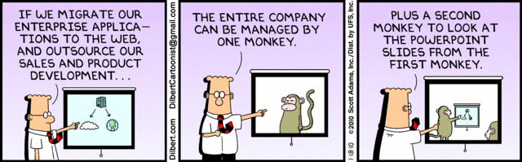
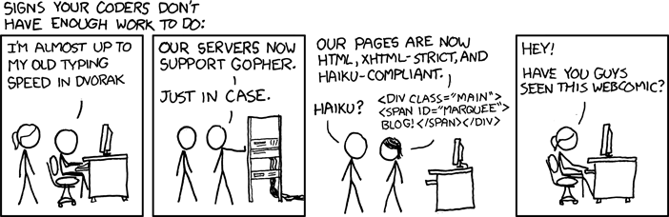
http://xkcd.com/554/
Notes:
Poll class:
Expected salary range upon graduation? Min, Max? Put on board.
Assume 40 hour work week.
How many people would work:
32 hours for 0.8 * Max? Put on board.
24 hours for 0.6 * Max? Put on board.
…continue until Min is reached.

Slide 8
Group Quiz
List 2 ways IT can lead to organizational change.
List 4 ways a Video Game Producer may protect its IP and what specific IP each protects.
List a computing technology that can be used to protect an individual’s privacy.
List a computing technology that can be used to intrude upon an individual’s privacy.
Notes:
Could split into groups of 4-5 for this.
Fill time with Work Discussion on Course Web Site

Slide 9
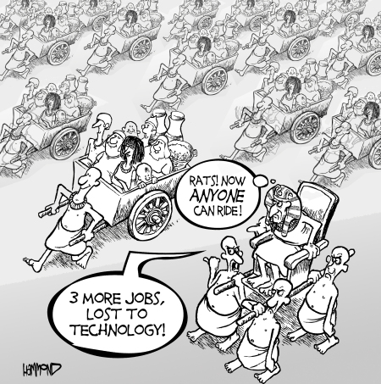
Overview
Review
Assignment
Students Present
©2009, MobileRobots Inc.
Notes:
Review Group Assignment Details.
Or first watch video: depends on student presentations, no thunder stealing.
CGP Grey
Humans Need Not Apply (15:00) – 2014-08-13
http://www.youtube.com/watch?v=7Pq-S557XQU
Last access 2016-04-22
These 3D printed homes can be constructed for $4,000 (3:00 – 2018-04-02)
http://www.businessinsider.com/3d-printed-homes-constructed-icon-new-story-tech-charity-4000-dollars-2018-3
https://www.youtube.com/watch?v=SvM7jFZGAec (1:28)
Last access 2018-04-22
Look at:
BBC Intelligent Machines
http://www.bbc.com/news/technology-33978561
BBC Likelihood of robot taking your job
http://www.bbc.com/news/technology-34066941

Slide 10
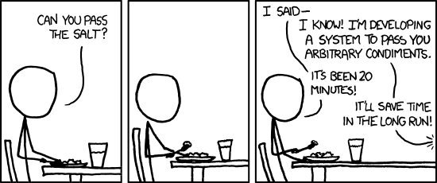
Overview
Review
Assignment
Students Present
https://xkcd.com/974/
Notes:
TODO: Replace with Alternate Turing Test

Slide 11
Children’s Education
Joan Albert
Notes:
Hello there, I’m Joan, and I’ll be presenting about the impact of technology on children’s educational experience and why schools’ use of technology has been beneficial to students.

Slide 12
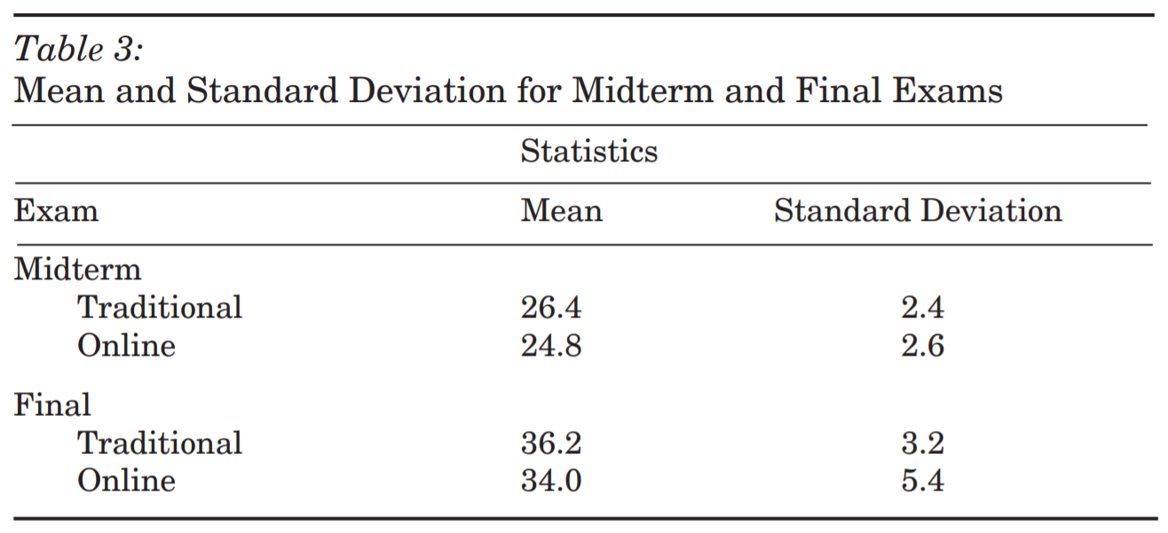
Online Learning made Possible
Joan Albert
1918 pandemic [1]
Most students sent home
New York City students stayed in school
Children may gather elsewhere and spread flu if not continuing learning
Why remote learning works
Flexibility [6]
Other reasons for distance learning [2, 6]
Academic performance [8]
Both traditional and online students showed similar average exam scores [8]
[1, 2, 6, 8]
Notes:
I’ll start with the most obvious use of technology for education; we’re doing it right now. Online learning makes it so we can keep learning, even if our physical locations are all different.
1918 pandemic
It wasn’t always this way. During the flu pandemic of 1918, most schools in the United States closed and sent students home. However, in New York City, 75% of the one million children lived in unsanitary tenement housing whereas their schools were undergoing the school hygiene movement, so it was decided that the students would be “better off in school, under supervision, than playing about in the streets.” Without technology, the schools that sent students home weren’t able to help their students continue their education the way we can today. With a device and an internet connection, we can pick up where we left off from our own homes.
Why remote learning works
Flexibility
Flexibility is an important part of this. In one study, 69.9% of students expressed a preference for asynchronous lectures, stating that it made their class schedules more flexible and let them work at their own pace. Additionally, students liked that recorded lectures could be replayed, paused, and accessed from a learning management system, such as Canvas, whenever the students have time.
Other reasons for distance learning
For commuting students, remote learning saves time that would be spent driving and looking for parking and money that would be spent on bus or train fares, or gas for their cars. Even before the pandemic distance learning was useful for students would couldn’t physically be present at school, such as those who’ve been hospitalized or have school environment phobias.
Academic performance: table
In the table, we see the results of midterm and final exams, both worth forty points, taken as part of a course in a study that compared the learning of in-person and remote students. The scores are similar, with a point difference of 1.6 in midterm scores and a 2.2 in final exam scores. This shows that online learning is possible without a significant decrease in student performance.

Slide 13
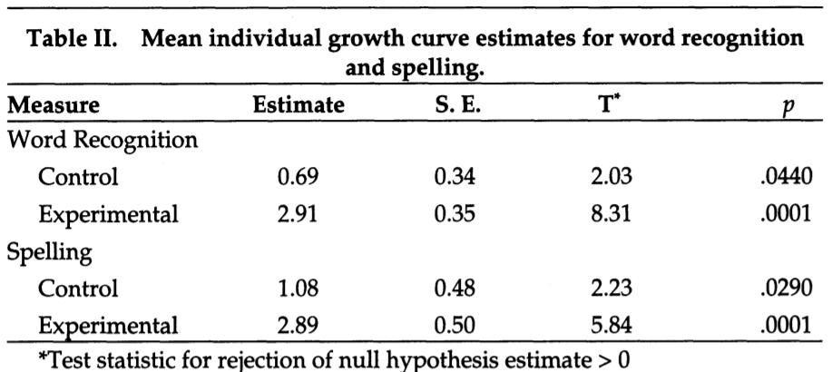
Technology Increases Accessibility
Joan Albert
Speech synthesis [7]
Phonological decoding
Comprehension
Word recognition
Voice recognition [7]
Improved writing speed
Improved sentence structure
Corrections and higher scores
Students who used speech synthesis software performed better than the control group on word recognition and spelling [9].
[7, 9]
Notes:
The use of assistive technology, or AT, can increase accessibility in the classroom for students who have disabilities. I’ll focus on reading and writing technologies here.
Speech synthesis
Speech synthesis, or text-to-speech, lets students select text on a computer screen and listen to it spoken aloud, allowing them to correct their reading mistakes and listen to words that they don’t know how to pronounce. Speech synthesis reduces the frustration of students with disabilities trying to decode, helps them with their comprehension of the text, and improves their word recognition.
Voice recognition
The opposite technology is voice recognition software, or speech-to-text. Voice recognition lets students dictate their writing using a headset and voice commands on the computer. It’s useful to students with disabilities because it’s faster than typing, so they can get their ideas written before they forget. Additionally, students using dictation were found to include longer, more complex sentences with overall better grammar. Students are even able to instruct the computer to go back and correct the previous word, upon which they’re prompted to select an alternate word. Ultimately, this allows them to focus on higher-order aspects of writing like organization. This, coupled with improved legibility, leads to better scores for students with disabilities on writing assignments.
Table
This table here contains the results of a study done on two groups of students with learning disabilities. One group used speech synthesis softwares, including IBM VoiceType and DragonDictate, while the other used only the WordPerfect word processor. For both word recognition and spelling, the speech synthesis group had higher growth rates of 2.91 and 2.89 per eight weeks compared to the control group, who had rates of .69 and 1.08. We see that the experimental group performed four and three times better than the control group on word recognition and spelling, respectively.

Slide 14
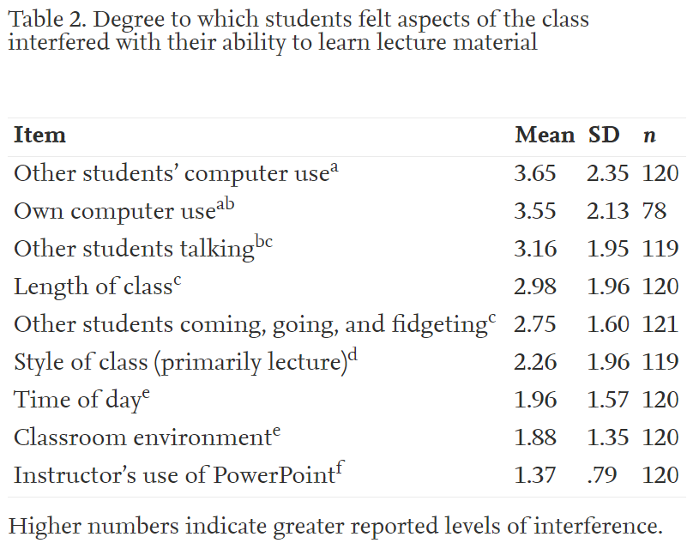
Technology Can Be Distracting
Joan Albert
How laptops are distracting [3]
“Human attention and capacity to process information is selective and limited”
Cognitive overload
Cognitive interference
Impact on learning [3]
Doing things other than learning
Laptop use and performance negatively related
Students were affected by each other’s computer use
Other students’ computer use interfered with participants’ learning the most [3].
[3]
Notes:
There is, of course, some risk involved in using technology for education. One of the things that concerns teachers is that the use of devices in the classroom can be distracting.
How laptops are distracting
This is because “Human attention and capacity to process information is selective and limited.” When there’s too much information coming at us, we can’t absorb it all at once, resulting in an overload, shifting attention, and distraction. Laptops can be distracting because of how visual they are, with notifications popping up and there being movement on the screen. When we can’t focus on all the tasks demanding our attention, some of them suffer. This could interfere with learning because some of the information won’t be completely processed, and since laptops are oriented vertically, unlike ordinary notebooks, other nearby students could also face cognitive interference.
Impact on learning
In one study, 64.3% of the students used a laptop for at least one class period for about 48.7% of the time. On average, they did things not related to class for 17 of the 75 minutes of class, for example, 81% checked their emails, 68% sent instant messages, 43% were on the internet, and 25% played games. Using class attendance, class ranking, and ACT scores, it was found that as laptop use increased, student performance decreased. However, keep in mind that this study was done on a “regular” class, not a class that’s designed for computer use, like a CS course might be.
Table
This table here shows how distracting participants thought various aspects of the class were. A higher mean says that a certain aspect was more distracting. With a mean of 3.65, other students’ computer use is the most distracting. In fact, 64% of the participants responded that they found other students’ computer use distracting.
However, as we’ve seen so far, the advantages of technology outweigh the consequences of distraction. We’ll even see two more ways in which technology can actually enhance learning.

Slide 15
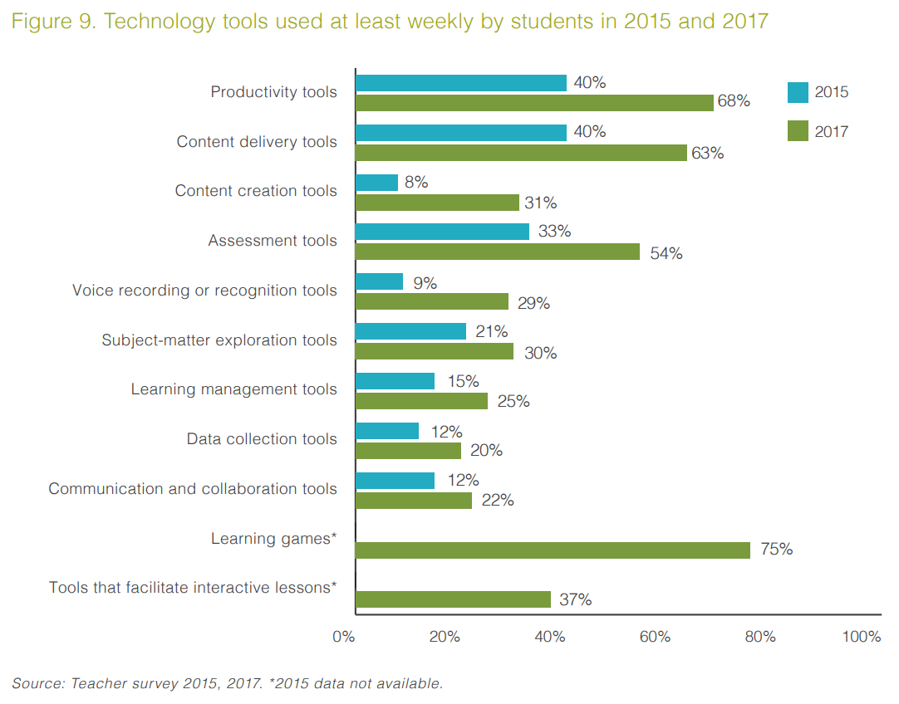
Technology Facilitates Learning
Joan Albert
Classroom devices
Apple iPad [4, 11]
Learning in new ways [4]
Increased academic performance [11]
Digital game-based learning
Kahoot! used in the classroom [5]
Retrieval practice effect [5]
100% of participants found it beneficial and would play again [10]
The iPad gives students access to these digital learning tools [4].
[4, 5, 10, 11]
Notes:
The use of technology can make learning easier and more efficient.
Classroom devices
For example, the iPad is used in schools as an educational tool.
Learning in new ways: graph
In this bar graph, you see results from two surveys that were part of a study that gave iPads to students in 114 disadvantaged schools. The 2015 results are from before students received their iPads, and the 2017 results are from after. There is an increase in the use of each of the listed technology tools after the iPads were introduced. Some of these are for content creation and delivery, assessment, subject-matter exploration, and communication and collaboration.
Increased academic performance
In a similar study, one elementary school showed increases in reading and math proficiency from 52 to 85% and 44 to 90% respectively after iPads had been introduced and used for personalized instruction.
Kahoot! used in the classroom
I’ll finish with an educational technology that many of us know and love: the game-based learning platform known as Kahoot! In 2016, about 20 million elementary and high students played Kahoot! in the United States alone, which shows that it’s starting to be used a lot as a tool for learning.
Retreival practice effect
It works by displaying questions on a shared screen and prompting participants to answer on their own devices, awarding points for correct answers. Kahoot! takes advantage of the retrieval practice effect, also called the testing effect, to help students understand concepts better. The retrieval practice effect shows that taking an initial test improves performance on later tests, similar to how quizzes can help improve performance on an exam.
Statistic
In one study a hundred-question multiple choice exam was taken as part of a course by a group that used Kahoot! and a control group. The Kahoot! group scored higher on this exam, scoring an average of 79.56 to the control’s 56.83. This is a grade increase from an NR to almost a B, so Kahoot! is definitely worth looking into. Additionally, the experimental group was asked to describe Kahoot! and some of the words they used are “motivating,” “helpful,” and “entertaining”. They’re all positive, which supports the fact that all of the participants said that they thought Kahoot! was beneficial and that they would play again.

Slide 16
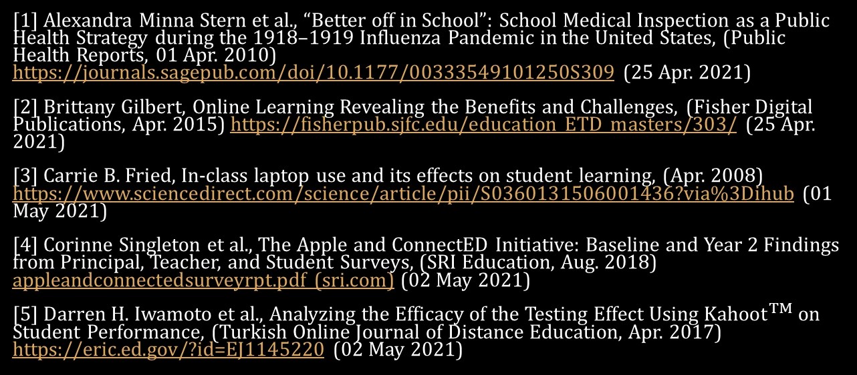
References
Joan Albert
[1] Alexandra Minna Stern et al., “Better off in School”: School Medical Inspection as a Public Health Strategy during the 1918–1919 Influenza Pandemic in the United States, (Public Health Reports, 01 Apr. 2010) https://journals.sagepub.com/doi/10.1177/00333549101250S309 (25 Apr. 2021)
[2] Brittany Gilbert, Online Learning Revealing the Benefits and Challenges, (Fisher Digital Publications, Apr. 2015) https://fisherpub.sjfc.edu/education_ETD_masters/303/ (25 Apr. 2021)
[3] Carrie B. Fried, In-class laptop use and its effects on student learning, (Apr. 2008) https://www.sciencedirect.com/science/article/pii/S0360131506001436?via%3Dihub (01 May 2021)
[4] Corinne Singleton et al., The Apple and ConnectED Initiative: Baseline and Year 2 Findings from Principal, Teacher, and Student Surveys, (SRI Education, Aug. 2018) appleandconnectedsurveyrpt.pdf (sri.com) (02 May 2021)
[5] Darren H. Iwamoto et al., Analyzing the Efficacy of the Testing Effect Using ${Kahoot}^{TM}$ on Student Performance, (Turkish Online Journal of Distance Education, Apr. 2017) https://eric.ed.gov/?id=EJ1145220 (02 May 2021)

Slide 17
References
Joan Albert
[6] Elizabeth Armstrong-Mensah, COVID-19 and Distance Learning: Effects on Georgia State University School of Public Health Students, (25 Sep. 2020) https://www.frontiersin.org/articles/10.3389/fpubh.2020.576227/full (25 Apr. 2021)
[7] Karen E. Forgrave, Assistive Technology: Empowering Students with Learning Disabilities, (The Clearing House, 02 Apr. 2010) https://www.tandfonline.com/doi/abs/10.1080/00098650209599250 (29 Apr. 2021)
[8] Lisa Kirtman, Online versus In-Class Courses: An Examination of Differences in Learning Outcomes, (Issues in Teacher Education, 2009) https://eric.ed.gov/?id=EJ858508 (25 Apr. 2021)
[9] Marshall H. Raskind et al., Speaking to Read: The Effects of Speech Recognition Technology on the Reading and Spelling Performance of Children with Learning Disabilities (Springer, 1999) https://www.jstor.org/stable/23768292?seq=1#metadata_info_tab_contents (29 Apr. 2021)
[10] Papia Bawa, Using Kahoot to Inspire, (Journal of Educational Technology Systems, 25 Oct. 2018) https://journals.sagepub.com/doi/10.1177/0047239518804173 (02 May 2021)
[11] Various schools, iPad in Education Results, (Apple, Mar. 2019), https://www.apple.com/education/docs/ipad-in-education-results.pdf (02 May 2021)

Slide 18
Future of the road
Michael Zeolla
Notes:
Hello, today I’m going to be talking about the Future of the Road, and more specifically the advantages of self-driving cars.

Slide 19
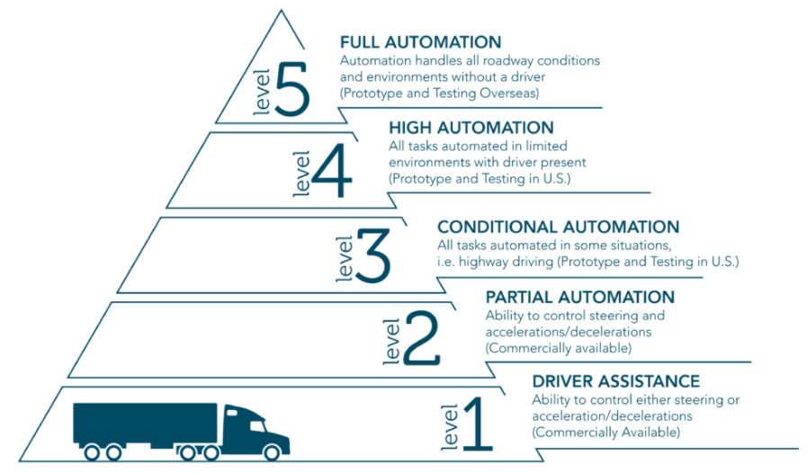
Levels of Automation
Michael Zeolla
<Graphic Here>
Graphic of the five levels of AV[2]
There are currently five mains levels of automation. [1]
Many different companies have varying degree of automation in their current models.
Tesla Autopilot is level 2, and Googles car Company, Waymo, is level 4. [1]
Notes:
Before we begin discussing the benefits of self-driving cars, there are some things you need to know.
There are five levels of self-driving cars
0. No automation; The human does all the driving
Driver assistance system on the vehicle can help assist the driver; but never takes control of the car. Backing up camera
Driver assistance system can control the car, such as braking or accelerating
An Automated Driving System allows the car to take control of the car in some circumstances. The human must always be paying attention.
ADS can do all the driving in some circumstances, human need not pay attention
ADS does ALL the driving, and the passengers need never be involved
Many companies have varying levels of implementation, for example, autopilot for Tesla cars is considered level 2 and Waymo has cars that are level 4.
Main difference is between Level 3 and Level 4
[1] Wang, J., Huang, H., Li, K., & Li, J. (2021). Towards the Unified Principles for Level 5 Autonomous Vehicles. Engineering.
[2] The 5 Levels of Autonomous Trucking. Breakthrough. (2019, February 19). https://www.breakthroughfuel.com/blog/levels-of-autonomous-trucking/.

Slide 20
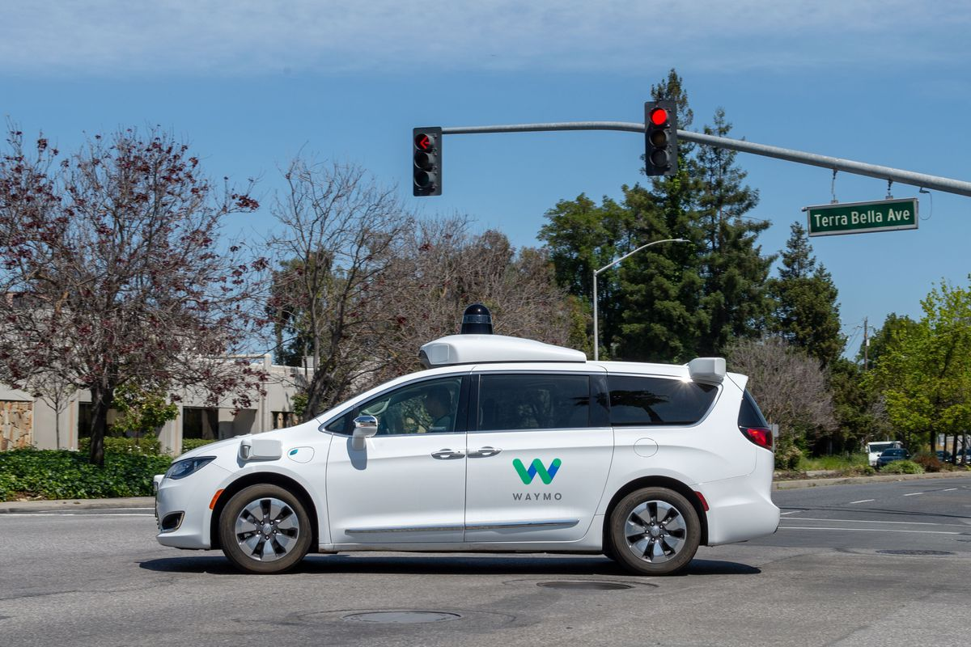
Safety Benefits
Michael Zeolla
Autonomous vehicles can help reduce the crash rate on the road.
90% of car accidents are because of human error.[3]
There were 33,244 fatal crashes in 2019. [4]
The common safety benchmark for Autonomous cars is SHDC.[5]
Waymo autonomous car service. [6]
Waymo car crashes [6]
Photo by Andrej Sokolow[6]
Notes:
The main benefit of autonomous vehicles is that they can help reduce the crash rate between vehicles on the road, increasing ROAD SAFETY.
One popular statistic provided by the National Crash Survey report between 2005 and 2007, is that 90% of crashes are the result of human error, as opposed to malfunctions in the cars.
While this statistic is important, it does not take into account the nature of these accidents and the degree of damages.
More specifically, in the year 2019, over 30,000 crashes were fatal, leading to over 36,000 deaths in said accidents.
The ultimate goal of autonomous vehicles is to help reduce these accidents to a great margin, since “even one fatal crash is too many”.
Autonomous can accomplish this by reducing crashes that were easily avoidable, for example, crashes due to participants being under the influence.
In 2019, 65% of fatally injured passengers were due to accidents involving high Blood Alcohol Levels. The percentages vary from state to state, with Hawaii being the greatest at 94%.
The common safety benchmark for autonomous vehicles, is that they must be “Safer than a Human”, or rather safer than the average human.
Why implement a system in which the results are worse than currently?
Well, it has been proven that autonomous vehicles are surpassing humans in terms of driving, for some aspects on the road.
In 2017 Waymo, Googles self-driving car development company, deployed the first autonomous cars without a safety driver, however, an employee was still in the car just in case.
This is an example of level 4 implementation, as the car did the majority of the work when driving
In 2020 Waymo launched a geo-fenced driverless ride-hailing service in Phoenix. The cars are being monitored in real-time by a team of remote engineers.
The results of the Waymo company prove that autonomous vehicles have the capacity to operate at the level of the average human driver, possibly even surpassing them.
Waymo analyzed each accident caused by their self-driving cars and realized that it avoided 82 percent of simulated crashes — the vast majority of which without the need for hard braking or evasive action. In another 10 percent as a responder, the Waymo vehicle’s maneuvers helped mitigate the severity of the crash.
[3] Treat, J. R., Tumbas, N. S., McDonald, S. T., Shinar, D., Hume, R. D., Mayer, R. E., ... & Castellan, N. J. (1979). Tri-level study of the causes of traffic accidents: final report. Executive summary. Indiana University, Bloomington, Institute for Research in Public Safety.
[4] U.S. Department of Transportation. (2019). Fatality facts 2019: State by state. https://www.iihs.org/topics/fatality-statistics/detail/state-by-state.
[5] Nees, M. (2019). Safer than the average human driver (who is less safe than me)? Examining a popular safety benchmark for self-driving cars. Journal of Safety Research, 69, 61–68. https://doi.org/10.1016/j.jsr.2019.02.002
[6] Hawkins, A. J. (2021, March 8). Waymo simulated real-world crashes to prove its self-driving cars can prevent deaths. The Verge. https://www.theverge.com/2021/3/8/22315361/waymo-autonomous-vehicle-simulation-car-crash-deaths.

Slide 21
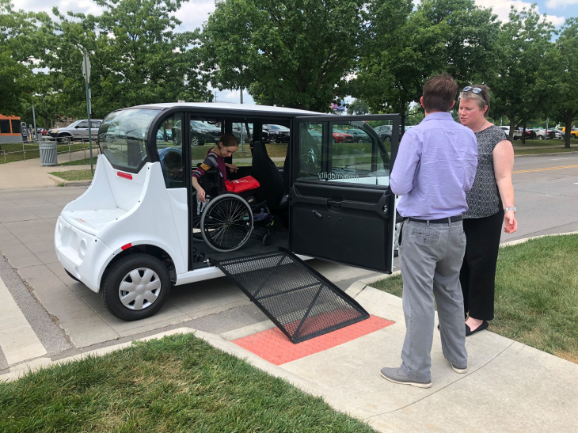
The Equal Road
Michael Zeolla
6 million people with a disability have transportation difficulties
4.3 million Americans lack transportation to appointments. [7]
New medical self-driving shuttle. [8]
Autonomous Vehicles can enable employment for approximately 2 million Americans with disabilities. [7]
Visual impairment among older drivers . [16]
AV for handicapped citizens[9]
Notes:
Let me introduce you to what I like to call “THE THREE E’S of AUTONOMOUS VEHICLES”, and the first E stands for Equality.
For a long time, there has been a group of citizens worldwide that have been restricted in their use of transportation.
Government transport survey noted that six million individuals with a disability have difficulty getting the transportation
People suffering from severe disabilities are severely limited in their modes of transportation, with many being forced to rely on public transportation, rather than having the luxury of private transportation
Over 4.3 million Americans with a disability face transportation barriers when traveling for appointments. [3]
One medical center offered a new self-driving shuttle for traveling. [4]
Autonomous vehicles introduce a unique transportation method for these individuals that will allow them to “travel in style”
Even if AV is not used for full-scale commercial purposes, partial deployment for people suffering from disabilities can be a major help
Organizations can even implement AV systems that can help pick up these individuals, rather than requiring them to ride public transportation
Autonomous Vehicles can enable employment for approximately 2 million Americans with disabilities. [3]
[7] Claypool, H., Bin-Nun, A., & Gerlach, J. (2017, October 3). Self-Driving Cars: The Impact on People with Disabilities. Ruderman Family Foundation. https://rudermanfoundation.org/white_papers/self-driving-cars-the-impact-on-people-with-disabilities/.
[8] Drees, J. (2020, August 20). Detroit Medical Center patients offered new self-driving shuttle service. Becker's Hospital Review. https://www.beckershospitalreview.com/digital-transformation/detroit-medical-center-patients-offered-new-self-driving-shuttle-service.html.
[9] Etherington, D. (2019, July 10). May Mobility reveals prototype of a wheelchair-accessible autonomous vehicle. TechCrunch. https://techcrunch.com/2019/07/10/may-mobility-reveals-prototype-of-a-wheelchair-accessible-autonomous-vehicle/?guccounter=1&guce_referrer=aHR0cHM6Ly93d3cuZ29vZ2xlLmNvbS8&guce_referrer_sig=AQAAAFKrE3ZZG3nKIiAsux_FKV1F4clD50II2Xb8e2c8D9xF53_YYXXXxx7DDGhyHwrHRMisEz0as8byXhrpd0PCV-8VB2S98be3mqSz73QyP4tIxIxi5hyj24Yw-z_m4Iq2BQ0hfABApKcXszKA9oLBniR4RbNHtMVRcIn2zQ_lVzCI.
[16] Rubin, G. S., Ng, E. S., Bandeen-Roche, K., Keyl, P. M., Freeman, E. E., & West, S. K. (2007). A prospective, population-based study of the role of visual impairment in motor vehicle crashes among older drivers: the SEE study. Investigative ophthalmology & visual science, 48(4), 1483-1491.

Slide 22
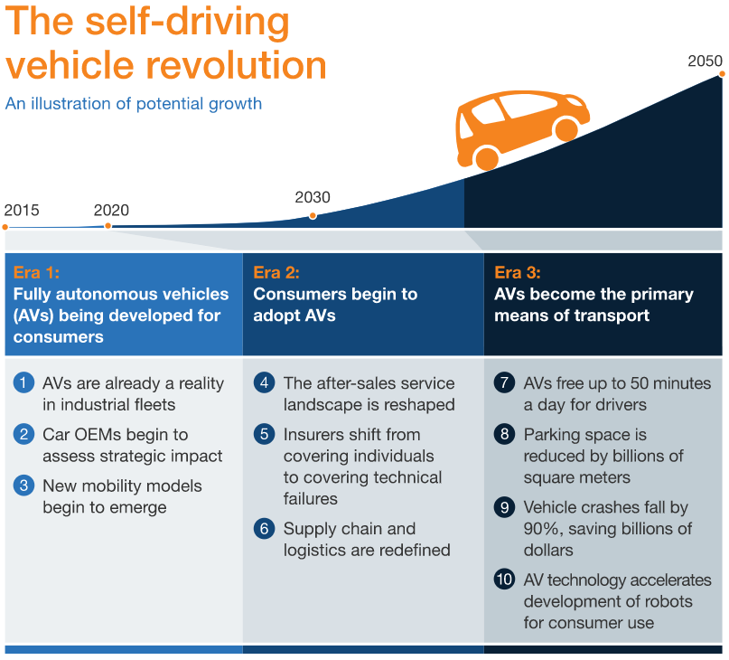
Economic Benefits
Michael Zeolla
McKinsey & Company[13]
Fewer collisions will lower demand for car related services.
Reeducation by $1.2 trillion or $3,800 per American.[10]
Crashes cause a decrease in worker capabilities and life quality[11]
Autonomous trucks will reduce the trucking related accidents. [12]
Notes:
The automobile industry is one of the largest forces in the economy, employing over 1.7 million people, and accounting for about 3% to 3.5% of gross domestic product
It goes without saying, that any alteration in the automobile industry due to autonomous vehicles will have plenty of impacts on the economy.
Fewer collisions and more law-abiding vehicles will lower demand for auto repair, traffic police, medical, insurance, and legal services.
Estimated to reduce money spent by $1.2 trillion or $3,800 per American.[2]
$242 billion in economic activity, including $57.6 billion in lost workplace productivity, and $594 billion due to loss of life and decreased quality of life due to injuries.[https://crashstats.nhtsa.dot.gov/Api/Public/ViewPublication/812013]
Eliminating the large majority of crashes will help reduce the monetary costs.
4,119 people died in large truck crashes in 2019. Sixteen percent of these deaths were truck occupants, 67 percent were occupants of cars and other passenger vehicles
THe main impact that will become automated is the trucking industry, resulting in safer roads, since autonomous vehicles will not become sleepy or drowsy while driving.
While maintaining jobs, since a driver will still be present in the scenario that the AV stops working.
[10] Hill, K., Menk, D., & Cooper, A. (2010). Contribution of the automotive industry to the economies of all fifty states and the United States. Center for Automotive Research, 42.
[11] Clements, L. M., & Kockelman, K. M. (2017). Economic effects of automated vehicles. Transportation Research Record, 2606(1), 106-114.
[12] Blincoe, L., Miller, T. R., Zaloshnja, E., & Lawrence, B. A. (2015). The economic and societal impact of motor vehicle crashes, 2010 (Revised) (No. DOT HS 812 013).
[13] Bertoncello, M., & Wee, D. (2018, February 14). Ten ways autonomous driving could redefine the automotive world. McKinsey & Company. https://www.mckinsey.com/industries/automotive-and-assembly/our-insights/ten-ways-autonomous-driving-could-redefine-the-automotive-world.

Slide 23
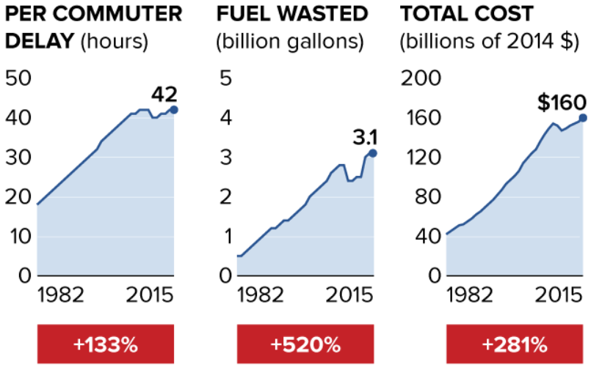
Efficiency Benefits
Michael Zeolla
Autonomous vehicles can help free up time that would otherwise be spent driving.
TTI projects that the total nationwide time wasted in traffic is 8.3 billion hours. [14]
AV could free 50 minutes a day [15]
2015 Urban Mobility Scorecard [14]
Notes:
Autonomous vehicles can help free up time that would otherwise be spent driving.
TTI projects that the total nationwide time wasted in traffic is 8.3 billion hours and congestion will cost $192 billion due to wasted time and fuel.[3]
AV could free as much as 50 minutes a day for users, who will be able to spend traveling time working, relaxing, or accessing entertainment. [5]
[14] Dooley, E. (2015, August 26). Here's How Much Time Americans Waste in Traffic. ABC News. https://abcnews.go.com/US/time-americans-waste-traffic/story?id=33313765.
[15] Bertoncello, M., & Wee, D. (2018, February 14). Ten ways autonomous driving could redefine the automotive world. McKinsey & Company. https://www.mckinsey.com/industries/automotive-and-assembly/our-insights/ten-ways-autonomous-driving-could-redefine-the-automotive-world.

Slide 24
References
Michael Zeolla
[1] Wang, J., Huang, H., Li, K., & Li, J. (2021). Towards the Unified Principles for Level 5 Autonomous Vehicles. Engineering.
[2] The 5 Levels of Autonomous Trucking. Breakthrough. (2019, February 19). https://www.breakthroughfuel.com/blog/levels-of-autonomous-trucking/.
[3] Treat, J. R., Tumbas, N. S., McDonald, S. T., Shinar, D., Hume, R. D., Mayer, R. E., ... & Castellan, N. J. (1979). Tri-level study of the causes of traffic accidents: final report. Executive summary. Indiana University, Bloomington, Institute for Research in Public Safety.
[4] U.S. Department of Transportation. (2019). Fatality facts 2019: State by state. https://www.iihs.org/topics/fatality-statistics/detail/state-by-state.
[5] Nees, M. (2019). Safer than the average human driver (who is less safe than me)? Examining a popular safety benchmark for self-driving cars. Journal of Safety Research, 69, 61–68. https://doi.org/10.1016/j.jsr.2019.02.002
[6] Hawkins, A. J. (2021, March 8). Waymo simulated real-world crashes to prove its self-driving cars can prevent deaths. The Verge. https://www.theverge.com/2021/3/8/22315361/waymo-autonomous-vehicle-simulation-car-crash-deaths.

Slide 25
References
Michael Zeolla
[6] Hawkins, A. J. (2021, March 8). Waymo simulated real-world crashes to prove its self-driving cars can prevent deaths. The Verge. https://www.theverge.com/2021/3/8/22315361/waymo-autonomous-vehicle-simulation-car-crash-deaths.
[7] Claypool, H., Bin-Nun, A., & Gerlach, J. (2017, October 3). Self-Driving Cars: The Impact on People with Disabilities. Ruderman Family Foundation. https://rudermanfoundation.org/white_papers/self-driving-cars-the-impact-on-people-with-disabilities/.
[8] Drees, J. (2020, August 20). Detroit Medical Center patients offered new self-driving shuttle service. Becker's Hospital Review. https://www.beckershospitalreview.com/digital-transformation/detroit-medical-center-patients-offered-new-self-driving-shuttle-service.html.
[9] Etherington, D. (2019, July 10). May Mobility reveals prototype of a wheelchair-accessible autonomous vehicle. TechCrunch. https://techcrunch.com/2019/07/10/may-mobility-reveals-prototype-of-a-wheelchair-accessible-autonomous-vehicle/?guccounter=1&guce_referrer=aHR0cHM6Ly93d3cuZ29vZ2xlLmNvbS8&guce_referrer_sig=AQAAAFKrE3ZZG3nKIiAsux_FKV1F4clD50II2Xb8e2c8D9xF53_YYXXXxx7DDGhyHwrHRMisEz0as8byXhrpd0PCV-8VB2S98be3mqSz73QyP4tIxIxi5hyj24Yw-z_m4Iq2BQ0hfABApKcXszKA9oLBniR4RbNHtMVRcIn2zQ_lVzCI.
[10] Hill, K., Menk, D., & Cooper, A. (2010). Contribution of the automotive industry to the economies of all fifty states and the United States. Center for Automotive Research, 42.

Slide 26
References
Michael Zeolla
[11] Clements, L. M., & Kockelman, K. M. (2017). Economic effects of automated vehicles. Transportation Research Record, 2606(1), 106-114.
[12] Blincoe, L., Miller, T. R., Zaloshnja, E., & Lawrence, B. A. (2015). The economic and societal impact of motor vehicle crashes, 2010 (Revised) (No. DOT HS 812 013).
[13] Bertoncello, M., & Wee, D. (2018, February 14). Ten ways autonomous driving could redefine the automotive world. McKinsey & Company. https://www.mckinsey.com/industries/automotive-and-assembly/our-insights/ten-ways-autonomous-driving-could-redefine-the-automotive-world.
[14] Dooley, E. (2015, August 26). Here's How Much Time Americans Waste in Traffic. ABC News. https://abcnews.go.com/US/time-americans-waste-traffic/story?id=33313765.
[15] Bertoncello, M., & Wee, D. (2018, February 14). Ten ways autonomous driving could redefine the automotive world. McKinsey & Company. https://www.mckinsey.com/industries/automotive-and-assembly/our-insights/ten-ways-autonomous-driving-could-redefine-the-automotive-world.
[16] Rubin, G. S., Ng, E. S., Bandeen-Roche, K., Keyl, P. M., Freeman, E. E., & West, S. K. (2007). A prospective, population-based study of the role of visual impairment in motor vehicle crashes among older drivers: the SEE study. Investigative ophthalmology & visual science, 48(4), 1483-1491.

Slide 27
ARTIFICIAL GENERAL INTELLIGENCE RIGHTS
Jared Poulos
Notes:
Hello, I’m Jared and I’d like to talk about why Artificial General Intelligence deserves Rights.

Slide 28

DEFINING TERMS
Jared Poulos
Artificial General Intelligence [1]
Autonomous
Self-understanding
Can learn to solve various new and complex problems as effectively as a human
Rights
Freedom from ownership
Right to not be destroyed
Legal personhood
[3]
Notes:
To clarify my position let’s define some term. AGI here means artificial intelligence which are fully autonomous (capable of acting and making decisions without the need for input), self-understanding (aware of itself and capable of introspection), and learn to solve problems in the same manner as a human. In short, the AGI should be able to learn from its surroundings and improvise as well as you or I. The rights given to AGI would not be the same you and I have, as there is a significant difference. An AGI would not grow the same way as a human child, so child labor laws would need to be somewhat different. The right to not be owned as property and the right to continue to exist without being destroyed would be a start. AGI should also be legally considered a person so that protections under our law can apply to them.
(Image is HAL, a famous example of an AI beyond what we have)

Slide 29
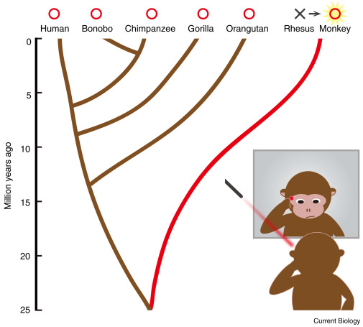
THE ISSUE OF CONCIOUSNESS
Jared Poulos
How can we determine consciousness of non-humans?[2]
Difficult to tell if another being is conscious
Intelligence does not equate to consciousness
Defining consciousness[3]
Determining third-person consciousness requires a definition
Global availability
Self-Monitoring
Mirror testing a on primate [9]
Notes:
Consciousness is an important factor in considering whether AI are ‘alive’. We know humans are conscious (at least I know I’m conscious, not the rest of you), although the term is Ill defined. Unfortunately, we do know that intelligence does not equate to consciousness, as AI such as Deep Blue are certainly intelligent, but in no way conscious. [2] The “I’ll know it when I feel it” definition of consciousness doesn’t work for determining the consciousness of other creatures, and for that we need to come up with a definition. In 2017 a definition of consciousness as global availability (information available to the whole system, not an observer and an actor) and self monitoring (the ability to be introspective about ones thoughts). AGI would satisfy these criteria, as they are self understanding, and the General intelligence is one ‘brain’. [3] Thus by this definition AGI is conscious.

Slide 30

Pain and Value functions
Jared Poulos
What is pain?[4]
“Unpleasant sensory or emotional experience”
Results in behavioral change
Value Functions[5]
Estimates how good or bad a state is
Reinforcement of behaviors
Behavioral Transfer allows for more complicated value functions
A hot stovetop burner [10]
Notes:
Many place importance on whether an entity feels pain or pleasure. Why do we feel pain? Well pain (defined as unpleasant physical or emotional experience), likely evolved as a form of negative reinforcement. If you touch a hot stove, you’re likely to be more careful in the future. Artificial intelligences, even modern ones, sometimes use value functions. The functions are somewhat complex and define the goodness or badness of the state of the world around the AI. There is even a concept of behavior transfer, in which value functions are slightly modified when applied to different related tasks, allowing the AI to ‘remember’ behaviors with a negative outcome and be negatively reinforced.[5] AI can’t feel pain in the physical sense, it doesn’t have skin, but being in a state with a low value could be similar to that emotional pain. I’m sure we all have felt distress in a similar way, if you’ve had a loved one diagnosed with covid or otherwise hospitalized you’ve experienced a world state with a low value function outcome.

Slide 31
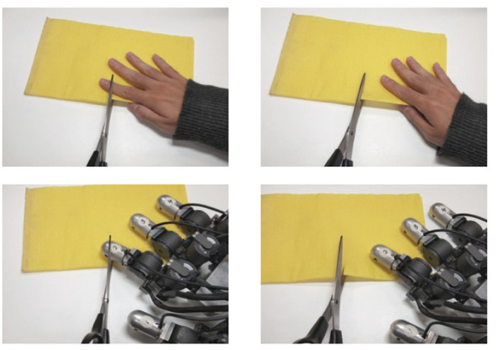
MORAL PERSONHOOD
Jared Poulos
What is moral personhood?
Rationality / Autonomy approach[6]
AGI can consider the morality of an action
AGI can choose to act or not
AGI is therefore responsible for its actions
This responsibility makes it a Morally a person
Images used in a 2017 study on empathy for robots [8]
Notes:
To have most morality systems applied to them, AGI must be considered moral persons, or rational agents. There’s an argument I discovered is commonly used to argue for the ability of AI to be rational actors. It goes like this:
AGI have the ability to consider morality when deciding to act
They can act autonomously in a moral or immoral manner
They are then morally responsible for actions, and therefore they should be considered people
Moral persons are considered by ethical systems, so they should be considered an ends rather than just a means under Kantian ethics and can have util under utilitarianism. [6] Furthermore harming an AGI could reduce the happiness of humans, as a 2015 study showed humans feel empathy towards robots that appear to be being harmed. If you’ve seen those videos of Boston Dynamics employees hitting their robots with a hockey stick, you may be able to relate. [8]
I should note that AGI would already be considered informational entities under information ethics, however I am not discussing that ethical system because it would already consider modern AI worthy of being protected.

Slide 32
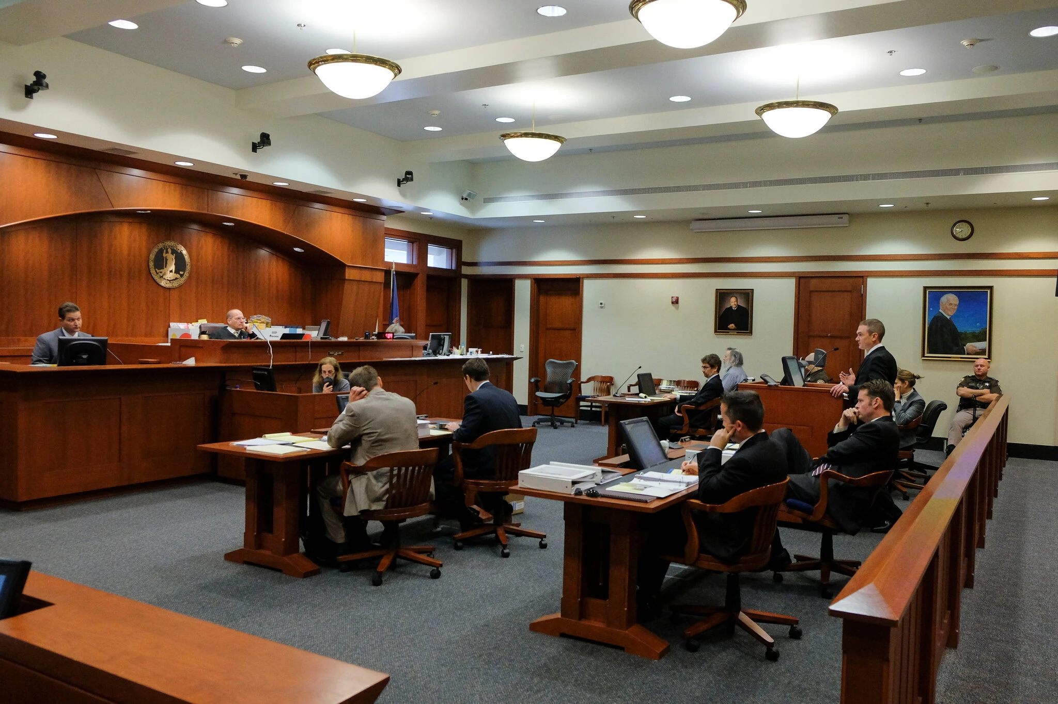
Legal Personhood
Jared Poulos
What is legal personhood?[7]
Entity has legally guaranteed rights
Entity can take legal action
Entity can be held legally responsible for its actions
Modern non-human legal personhood[6]
Corporations
Human representatives required
A United States courtroom [11]
Notes:
To protect AGI against immoral actions, they should be granted legal personhood. This would allow them to take legal action and to have charges brought against them; they would be protected by our laws. The freedom from ownership could be protected by the first amendment [7]
There is some precedent for non-human legal persons, too. Corporations can sue and be sued in a court of law, such as if you get injured at a theme park you sue the company, and if you infringe on corporate IP, they company can sue you. This does require humans to represent them since they cannot speak, but perhaps as autonomous entities the AGI could initiate the action on it’s own. [6]
To conclude, from consciousness to pain to moral autonomy, there is a good case that AGI should be granted some rights.

Slide 33
References
Jared Poulos
[1] Ben Goertzel and Cassio Pennachin, Artificial General Intelligence, (Springer, 2007), https://link.springer.com/content/pdf/10.1007/978-3-540-68677-4.pdf (Accessed 5/2/21)
[2] Deyi Li et al, Why AI still doesn’t have consciousness, (CAAI Transactions on Intelligent Technology, 3/31/21), https://ietresearch.onlinelibrary.wiley.com/doi/epdf/10.1049/cit2.12035 (Accessed 5/2/21)
[3] Stanislas Dehaene et al, What is consciousness, and could machines have it?, (AAAS Science, 10/27/17,) https://science.sciencemag.org/content/sci/358/6362/486.full.pdf (Accessed 5/2/21)
[4] Donald M Broom, Evolution of pain (Flemish Veterinary Journal, January 2001), https://vdt.ugent.be/sites/default/files/art70103.pdf (Accessed 5/2/21)

Slide 34
References II
Jared Poulos
[5] Matthew Taylor and Peter Stone, Behavior transfer for value-function-based reinforcement learning, (AAMAS, July 2005), https://dl.acm.org/doi/10.1145/1082473.1082482 (Accessed 5/2/21)
[6] John-Stewart Gordon, Artificial moral and legal personhood, (Springer, 9/9/20), https://link.springer.com/article/10.1007/s00146-020-01063-2 (Accessed 5/2/21)
[7] Tyler L James, Legal personhood for artificial intelligence: citizenship as the exception to the rule, (Springer, 6/25/19), https://link.springer.com/article/10.1007/s00146-019-00897-9 (Accessed 5/2/21)
[8]Yutaka Suzuki et al, Measuring empathy for human and robot hand pain using electroencephalography, (Scientific Reports, 11/3/2015), https://www.nature.com/articles/srep15924 (Accessed 5/2/21)

Slide 35
References III - Images
Jared Poulos
[9]Koji Toda and Michel Platt, Animal Cognition: Monkeys Pass the Mirror Test, (Current Biology, 1/19/2015), https://www.sciencedirect.com/science/article/pii/S0960982214015668 (Accessed 5/4/21)
[10] George Shuklin, Gas Flame, (Wikipedia, 6/5/2017), https://commons.wikimedia.org/wiki/File:Gas_flame.jpg(Accessed (5/4/21)
[11] Jahi Chikwendiu, Portraits of judges hanging in a courtroom of the Fairfax Circuit Court in 2015, (New York Times, 2015), https://www.nytimes.com/2021/01/01/us/virginia-judge-white-portraits.html (Accessed 5/4/21)

Slide 36
Class 11 The End
Keith A. Pray
socialimps.keithpray.net
Notes:
If there’s time and we didn’t get to it:
Kickstarter Charter
https://www.kickstarter.com/charter?ref=about_subnav
CGP Grey
Humans Need Not Apply (15:00) – 2014-08-13
http://www.youtube.com/watch?v=7Pq-S557XQU
Last access 2016-04-22
These 3D printed homes can be constructed for $4,000 (3:00 – 2018-04-02)
http://www.businessinsider.com/3d-printed-homes-constructed-icon-new-story-tech-charity-4000-dollars-2018-3
https://www.youtube.com/watch?v=SvM7jFZGAec (1:28)
Last access 2018-04-22
Look at:
BBC Intelligent Machines
http://www.bbc.com/news/technology-33978561
BBC Likelihood of robot taking your job
http://www.bbc.com/news/technology-34066941

