Slide 1
Class 9 Errors Failures Risks
Keith A. Pray
socialimps.keithpray.net
Notes:
What is the point of this assignment? (Did SW Teams from the reading pick good test strategies? Will you be able to support your choices if something goes wrong?)
What errors? – Have student record list on board
Who looked for directions on how to test currency?

Slide 2
what works well Online With Zoom
Sign in with First and Last Name
Stay muted unless you are going to speak
To speak use the raise your hand feature
To answer yes/no questions use the “yes” ”no” buttons
Turn your camera on
Wait until the end of student presentations to ask questions
Write them down so you don’t forget

Slide 3
Papers
Use at least 5 high quality, primary sources
Review fallacies in Appendix B and Class 2 Slides
Counter Point and Rebuttal should relate to each other and conclusion
http://socialimps.keithpray.net/assignments/paper-guidelines/
Notes:
0s not included.
Save for next time:
Make decisive conclusions
may, could, etc. = trivial
Absolute statements are difficult to prove
Avoid: all, always, any, every, everyone, never, none… unless you can show it
Be sure to put quotes around entire quote
Hyperbole is the best thing ever!
but not in these papers
Print 2 sided and save a tree
Use template, saves time (and -1 point)
Use and cite supporting data from high quality sources
Argument should directly support conclusion
Response should directly address counter point
Arguments should have at least 3 statements
Avoid Strawman Fallacy
Quantify
Terms like: less, more, a lot, huge, great, big, tiny, growing, etc.

Slide 4
Grades To Date
34 Max Possible

Slide 5
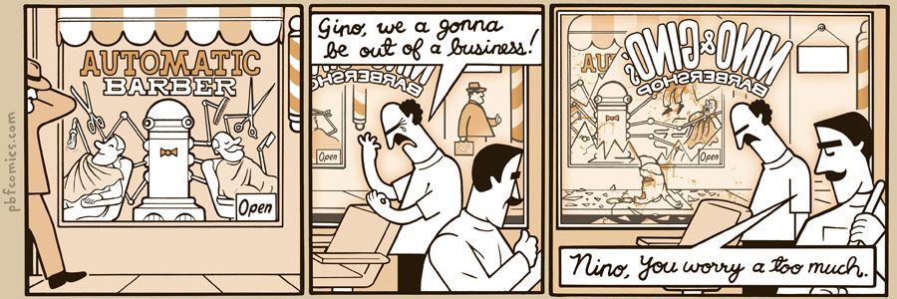
http://pbfcomics.com/197 (2014-09-26)
Notes:
10 – Errors, Failures, Risks

Slide 6
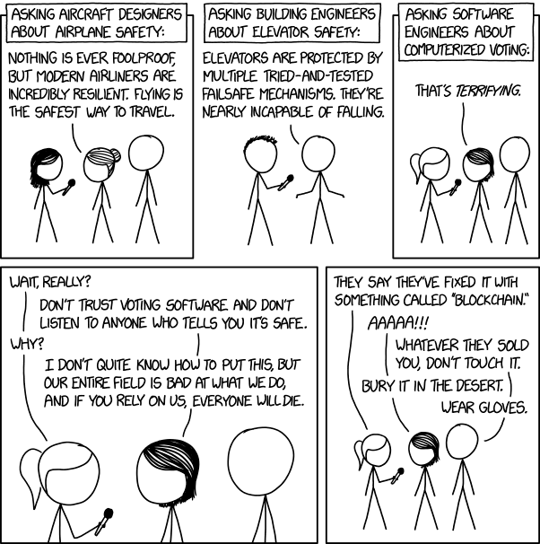
Overview
Review
Assignment
Students Present
https://xkcd.com/2030/ (2018-09-21)
Notes:
Good alternative if guest speaker not coming or late
Why Electronic Voting is a BAD Idea - Computerphile
https://www.youtube.com/watch?v=w3_0x6oaDmI
Might be better in Security
We can also discuss articles listed on Security Discussions under documents of course web site.
TODO: add quiz as backup if class discussion or guest speaker fail

Slide 7
My Reading Notes
pp. 366 Any false arrests since 1989?
pp. 368 Argument assumes DB cannot exist without existing inaccuracies.
pp. 373 This is not to keep the PATRIOT system from responding to false alarms.
pp. 375 Always encapsulate units! Not clear if SW involved.
pp. 376 Any SW diffs between Mars Missions?
pp. 378 Why did the Tokyo Stock Exchange refuse?
pp. 380 Republicans and Florida?
pp. 381. Do the second thoughts on DRE machines make the interview at end Chapter’s end less relevant?
pp. 389 No simulation examples since 2002?
pp. 390 Did The Limits to Growth predictions motivate people to change?
pp. 392 What happened to Verification?
pp. 394 “satisfies the specification” = verification. “needs of the user” = validation.
pp. 395 SW quality since 2009?
pp. 396 Gender bias nice addition!
pp. 406 21, source from 2004, is it implemented yet? 23 like game release question in next chapter.
Questions I liked: 10, 12, 16, 17, 18, 20, 21
Notes:
MSNBC on Denver's Automated Baggage System 2010-08-23 (2:27)
https://www.youtube.com/watch?v=xx8f4x6C_KY
Accessed 2019-04-09
No Discussion Board

Slide 8
Overview
Review
Assignment
Students Present
Notes:
We can also discuss articles listed on Security Discussions under documents of course web site.
ADD QUIZ AS BACKUP IF CLASS DISCUSSION OR GUEST SPEAKER FAIL

Slide 9
Assignment
Prepare for Debate
You are a software engineer in the company
from Chapter 9 In-class Exercises # 24.
Should the company produce the game?
Use the SWE Code Of Ethics as the basis for your argument.
Use high quality sources for supporting data
Optional 1 paper on topic, lowest paper grade will be dropped

Slide 10
Medical robots Need More time
Tyler Looney

Slide 11

Overview
Tyler Looney
Medical robots are service robots created to improve patient care [1].
There are many risks associated with medical robots [2].
Human error adds additional risk to operating medical robots [2].
https://createdigital.org.au/algorithm-medical-robots/
[1][2]
Notes:
The WPI Robotics Engineering Curriculum defines a robot as something that senses its surroundings and reacts to these “stimuli”. There can be some argument whether human input counts as an environmental stimulus but for medical robots, we will conclude yes because of the definition of medical robots.
The Association for Advancing Automation defines medical robots as “professional service robots used in and out of hospital settings to improve the overall level of patient care” There are also other categories of medical robots from mobile medical robots that deliver medication, to chatbots for diagnoses, or even therapeutic robots for children with disabilities. Based on these definitions, it is clear that human interaction is a major component for medical robots.
Regardless of which category these medical robots fall into, there are always some risks associated with the use of these technologies. Some robots, like the ones I will be focusing on in this presentation pose greater risks to human health than others, but you’ll still find that some of the smaller robots (that you may not even consider to be a robot can cause severe damage as well).

Slide 12

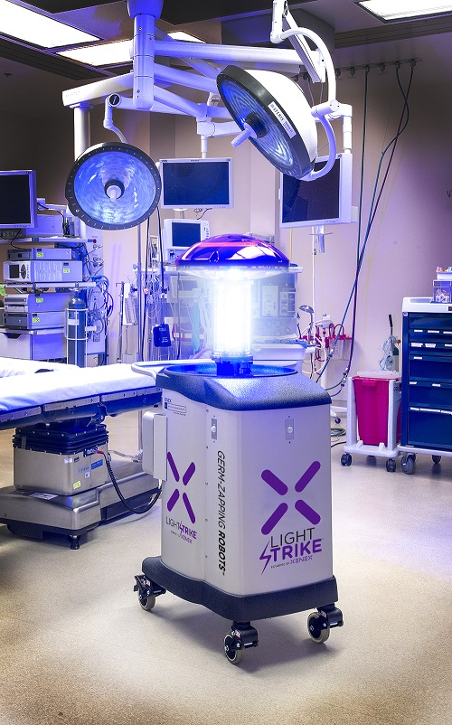
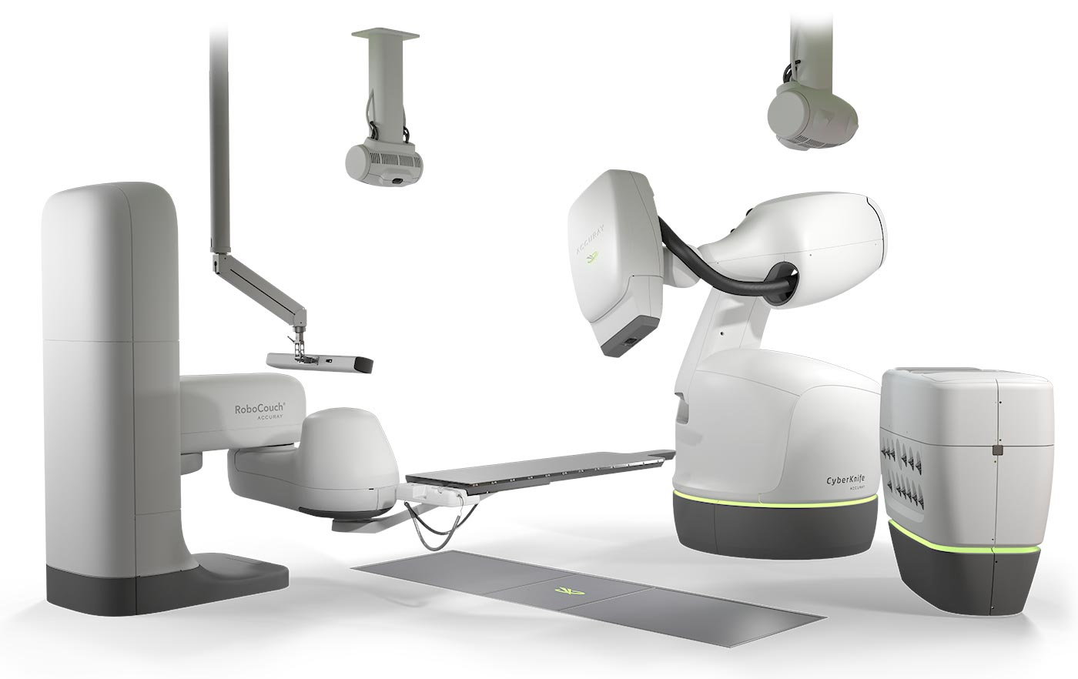
Examples of Medical Robots
Tyler Looney
da Vinci® Surgical Robot
Xenex Germ-Zapping Robot
CyberKnife
https://cyberknife.com/cyberknife-technology/
https://www.biospectrumasia.com/news/27/16026/xenex-lightstrike-germ-zapping-robots-deactivate-sars-cov-2-.html
https://www.amitahealth.org/services/surgical-services/surgical-technology/robotic-surgery/da-vinci
[3]
Notes:
Here are a few examples of robots that are used in many hospitals today.
The da Vinci robot is said to give surgeons more precise control during operations and is used for minimally invasive surgeries which allow patients to heal faster
The Xenex germ-Zapping Robot is used to clean rooms using powerful UV rays which helps to prevent Hospital Acquired Infections (HAIs).
Lastly the CyberKnife. This robot isn’t a knife as the name implies but rather it is a robot that delivers radiation therapy to tumors in patients without needing to reorient the patient.

Slide 13
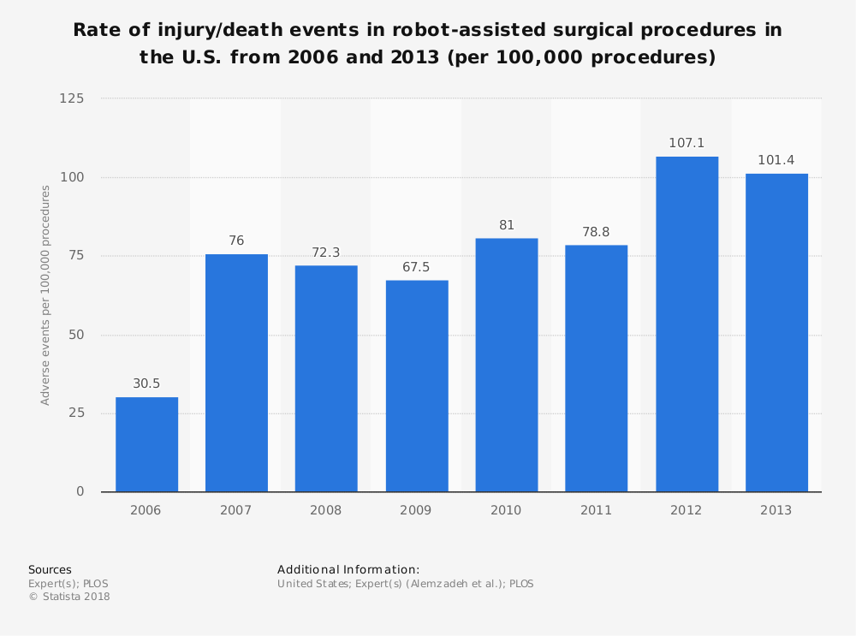
Existing Concerns
Tyler Looney
An FDA survey for the da Vinci® robot said that users didn’t undergo the same training [4]
The number of accidents related to robot-assisted surgeries was increasing years after FDA approval. [5]
People are hesitant to have robot-assisted surgeries. [6]
[4][5][6]
Notes:
The training programs and the approach to monitoring surgeons vary among institutions. Some programs are comprehensive, team-focused, and involve close monitoring by proctors. In the same FDA survey, some respondents said they didn’t know of certain system recalls the manufacturers had made. One of the OB/GYNs said they only had a day of training for the system in a “pig lab” and stated that more time was needed with the system before working a case.
This FDA report also included a list of device problems that professionals experienced while using the system:
Arm drifted during procedure
Crack in the arm caused instrument to fail
Excessive collision of arms
The most recent available data from the Statista database shows that there has even been an increase in accidents related to robot-assisted surgical procedures per 100,000 procedures between 2006 and 2013 (keeping in mind robots such as the da Vinci robot became FDA approved in 2000).

Slide 14
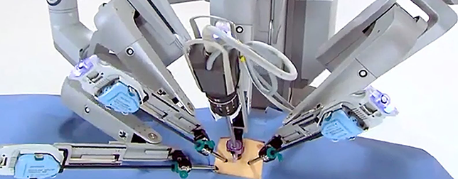
Benefits of these surgeries
Tyler Looney
Robots don’t experience fatigue and actions can be scaled to a microscopic area [2]
Robot-assisted surgery generally leads to faster recovery times for patients [4]
They can reach positions on people that are traditionally harder to reach [3]
https://www.wearable-technologies.com/2018/07/borns-ai-powered-minimally-invasive-surgery-has-huge-prospects-in-healthcare/
[2][3][4]
Notes:
Although medical robots provide benefits in the medical industry such as (listed on slide), they are still an emerging market for technology that has much room for error. Not just in mechanical and software aspects such as broken arms and drifting that have been shown to impact operations but also in human error. Many of the FDA surveyees stated that they needed more practice than what was provided during training.
People’s lives are at stake and even though these robots are designed to increase the number of lives saved, they can have the inverse effect if they aren’t tested, evaluated, maintained and rehearsed on enough times which is why medical robots need more time, but they are heading in the right direction.

Slide 15
References
Tyler Looney
[1] Service Robots: Medical. (Association for Advancing Automation). Automate. Retrieved April 20, 2021, from https://www.automate.org/blogs/service-robots-medical
[2] Buettner, R., Renner, A., & Boos, A. (2020). A Systematic Literature Review of Research in the Surgical Field of Medical Robotics. 2020 IEEE 44th Annual Computers, Software, and Applications Conference (COMPSAC), 517–522. Retrieved April 21, 2021 from https://doi.org/10.1109/COMPSAC48688.2020.0-200
[3] 5 Medical Robots Making a Difference in Healthcare at CWRU. (n.d.). Retrieved April 21, 2021, from https://online-engineering.case.edu/blog/medical-robots-making-a-difference
[4] Small Sample Survey – Final Report Topic: da Vinci Surgical System(FDA 2013). Retrieved April 22, 2021, from https://www.fda.gov/media/87485/download
[5] Robot-assisted procedures injury/death event rate U.S. 2013. Statista. Retrieved April 22, 2021, from https://www.statista.com/statistics/818810/robot-assisted-procedures-injury-death-event-rate-in-the-us/
[6] Robot assisted and traditional surgery preference adults U.S. 2018. (n.d.). Statista. Retrieved April 22, 2021, from https://www.statista.com/statistics/829596/robot-assisted-and-traditional-surgery-preference-us/

Slide 16
ADOLESCENCE AND VIDEO GAMES
Maxine Shi
Notes:
Today I am going to talk about adolescence and video games.
Video Games are a popular leisure activity that is also fueled by capitalism.
The global gaming market reached a value of US$ 167.9 Billion in 2020.

Slide 17
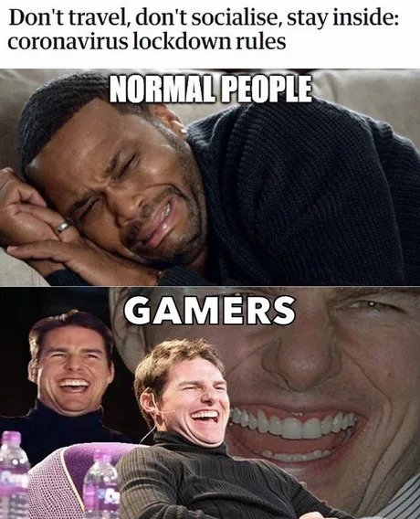
POTENTIAL BENEFITS
Maxine Shi
Community
Passion
Creativity
Development
Physical
Psychological
Entertainment
Variety
Evolving
© 2021 Keith A. Pray
Notes:
Firstly, I am going to cover the potential benefits of video games.
The large player base of games like PubG which boasted a whopping 1037 million player count means that the community created contains a wide diversity of players. Fanbases of such games
According to a American Psychological Association article, Playing video games also helps children develop problem-solving skills.The more adolescents reported playing strategic video games, such as role-playing games, the more they improved in problem solving and school grades the following year.Children's creativity was also enhanced by playing any kind of video game, but not when the children used other forms of technology, such as a computer or cell phone, other research revealed. Additionally there are different video games such as those provided on the wii and the switch that promotes physical activity and serves as a valid form of cardio. Furthermore, the entertainment potential of video games are endless. Books and other forms of media are often adapted into video games. For example, the harry potter series is seeing a new release soon. Video games are also constantly evolving, take the half life series which first released in 1998 now has a title in VR called half-life alyx.

Slide 18

POTENTIAL DANGERS
Maxine Shi
Addiction
Consumerism
Time
Social
Developmental harm
Physical
Psychological
Social
https://game-posts.tumblr.com/
Notes:
Whenever video games are in question, the risks and potential dangers of video games are also never neglected.
The most common concern regarding addiction is Addiction. There are many forms of this, I will only touch on the time, money, and social aspects of this. Addiction to gaming is described in the American Psychiatric Association's Diagnostic and Statistical Manual of Mental Disorders (DSM-5), which is used by mental health professionals to diagnose mental disorders. The often hated loot box system is debatably a form of gambling. Which also ties these games to cause similar addictions. Additionally, systems are often put into games that promote engagement within the game and punish players for disengagement, for example not logging on consecutive days or forcing players to play for a certain time in order to complete a season pass.
There are also concerns in regards to video games hindering one’s growth during adolescence. Over 67 percent of gamers reported they missed sleep due to playing. And sleep is a necessity for both cognitive development and physical growth.
Research also shows that, most video games prolongs hours players spend sitting down whether due to immersion or reward, which puts people at a higher risk of chronic illnesses like heart disease and obesity.
(NPR.org)

Slide 19

APPLICATIONS OF VIDEO GAMES
Maxine Shi
Healthcare
Mental Health
Physical Health
DENTIST
Educational
STEM
Children
Engagement
https://www.amazon.com/Nintendo-Labo-Toy-03-Switch-Japanese/dp/B07GZPHMB1
Notes:
There are practical applications of video games and technology used in video games. APA confirms that Video games and video game technology have long been used to improve patient safety and patient care through their use as tools to teach doctors. Commercial games have been explored as a means to improve surgical skills, and tailor-made games for medical students have been used to teach clinical skills. The relative 60 percent higher dopamine level video games can make you feel also means that they can help patients relax before an appointment. The application of video games also extends to educational purposes. Educational video games are important for individualized learning.Children can learn programming, coding, and CAD design using video game play. Penn today also highlighted the ease that online teaching can be with aid from educational games.

Slide 20

ETHICS
Maxine Shi
Addiction
Encouragement
Actions
Loot Boxes
Gambling
Actions
Dark Patterns
UX Practices
Actions
© 2021 Keith A. Pray
Notes:
It’s particularly important in this case to help distinguish between passionate engagement with a game and pathologic gaming. There needs to be regulation regarding certain mechanics the game industry (and overall the tech industry) often uses. Like the punishing disengagement behavior even triple A titles exhibits.
It is my opinion that avoiding loot boxes in all games that aren’t rated Adults Only or Mature within the ESRB rating system (or 18+ with PEGI) is the most ethical option, given the issues described above. And when loot boxes are used, they should really be completely random (e.g. players can get them at a certain rate that is not manipulated, and this rate should be transparent). Gambling advertising should also be banned in games that children can play. It seems that child gambling has quadrupled in the past 2 years according to the Gambling Commission in Great Britain, in a study conducted on 11-16 year olds. Although it’s hard to have a clear understanding of the impact of such ads on child gambling (correlation does not mean causation), it would be a good ethical practice to protect children from adult content.
Lastly, is regarding the concern that tech and videogames “manipulate” us into doing something that we didn’t want to do. In the book Predictably Irrational the author goes into greater detail on how cognitive biases impact our everyday lives, inducing systematic errors in our reasoning and our financial decision making. This point ties in to both the addiction and loot box aspect of game design. Lastly, it is critical for the gaming industry to openly and seriously reflect on ethics.

Slide 21
REFERENCES
Maxine Shi
[1] K;, Przybylski AK;Weinstein N;Murayama. “Internet Gaming Disorder: Investigating the Clinical Relevance of a New Phenomenon.” The American Journal of Psychiatry, U.S. National Library of Medicine, pubmed.ncbi.nlm.nih.gov/27809571/.
[2] Kuss, Daria J, et al. “DSM-5 Diagnosis of Internet Gaming Disorder: Some Ways Forward in Overcoming Issues and Concerns in the Gaming Studies Field.” Journal of Behavioral Addictions, Akadémiai Kiadó, 1 June 2017, www.ncbi.nlm.nih.gov/pmc/articles/PMC5520128/.
[3] Parekh, Ranna, M.D., M.P.H. Internet Gaming, www.psychiatry.org/patients-families/internet-gaming.
[4] Gray, Colin M., et al. “The Dark (Patterns) Side of UX Design.” Proceedings of the 2018 CHI Conference on Human Factors in Computing Systems, 2018, doi:10.1145/3173574.3174108.
[5] Zendle, David, et al. “Adolescents and Loot Boxes: Links with Problem Gambling and Motivations for Purchase.” 2019, doi:10.31234/osf.io/wdc2u.

Slide 22
Internet Access should be free
Dylan Grady

Slide 23
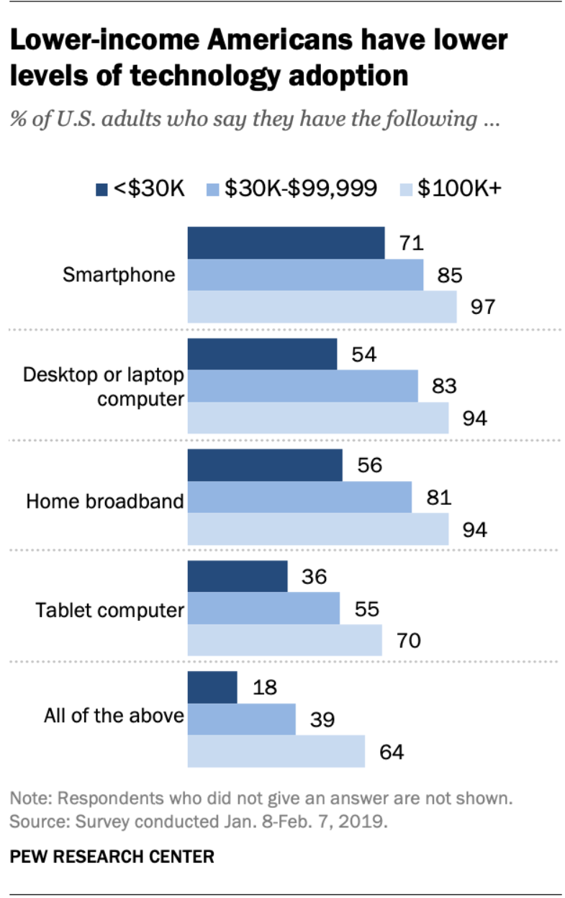
Many people can’t access the internet
Dylan Grady
19 Million Americans lack Broadband Internet Access
Mostly poor people and rural communities
[1]
Notes:
Many people do not have Internet access in the United States. According to the FCC’s Eighth Broadband Access Report, 19 million Americans lack access to broadband Internet, six percent of the population. Most of these people (14.5 million) live in rural areas. This is one fourth of America’s rural population. The percentage is even higher for the residents of Native American reservations (one third of these people lack Internet access)
Poor people are less likely to have Internet access than those who are wealthier. According to Pew Research Center, just over half of US adults making under 30,000 dollars every year have home broadband. Over 90 percent of people making more than 100,000 dollars every year have access to home broadband. The wealth divide also applies to other online technologies like smartphones and desktop computers.

Slide 24

Visual Representation
Dylan Grady
Map of Alaska
Shows number of fixed residential broadband providers by region
Link: https://broadbandmap.fcc.gov/#/
[5]
Notes:
Here is a visual representation of the divides that exist in Internet access from the FCC. It shows the number of fixed residential broadband providers by region for the state of Alaska. The darker an area is, the more providers that area has, while lighter areas have less and in some cases none. Similar data exists for other states, but Alaska’s map best represents the divides between urban and rural areas when it comes to Internet access. The dark blue area in the center of the map is the city of Anchorage, Alaska’s largest city. This part of the state unsurprisingly has the most broadband Internet providers. The light green areas north and west of Anchorage are rural communities which have far fewer providers. These areas also have large concentrations of indigenous people.
If you would like to look more closely at the data for Alaska as well as every other state and territory, I recommend checking out the link on screen.

Slide 25
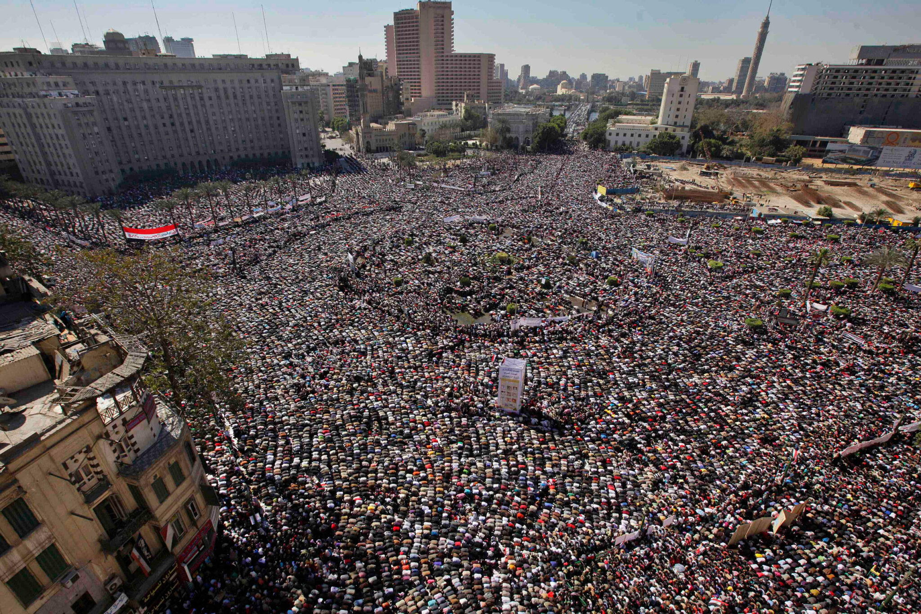
Why does this matter?
Dylan Grady
Political Engagement
The “Homework Gap”
Finding a Job
[6]
Notes:
The Internet is a very important part of today’s society, and the fact that many people can not access it puts them at a huge disadvantage in certain areas. One of those areas is in political engagement. A study conducted by Dr. Merten Reglitz at the University of Birmingham concluded that Internet access was important for people to protect and practice other human rights. This is because political engagement is increasingly taking place online, so not having Internet access can undermine someone’s right to free expression, freedom of assembly, etc. According to Dr. Reglitz, "Without such access, many people lack a meaningful way to influence and hold accountable supranational rule-makers and institutions.” In his study, Dr. Reglitz cites the Arab Spring protest movement as a successful example of people using the Internet to practice their right to free speech and hold their government’s accountable.
Another area where lack of Internet access can disadvantage people is in education. The primary example of this is the so-called Homework Gap, which describes the barriers students who lack access to high-speed Internet face when trying to do their schoolwork at home. This can be a very serious problem for these students since, according to the FCC, more than 70 percent of teachers assign homework that requires broadband Internet access, while around 65 percent of students use the Internet to perform important school-related activities such as research, submitting assignments and reaching out to their teachers. This data suggests that having access to high-speed Internet is very important for students to be successful, and that students from the over five million households that don’t have high-speed Internet access will be left behind the students who do have access.
Internet access can also make it easier for people to find work. A study conducted by Professor Eleanor Choi of Hanyang University found that unemployed people who used the Internet to find a job were 13.6 percent more likely to find a job than unemployed people who didn’t use the Internet. This result is not too surprising with the existence of LinkedIn and other websites which make finding work so convenient, but its another example of how those with Internet access have an advantage over those without it.

Slide 26
References
Dylan Grady
[1] Anderson, Monica, and Madhumitha Kumar. “Digital Divide Persists Even as Lower-Income Americans Make Gains in Tech Adoption.” Pewresearch.org, Pew Research Center, 7 May 2019, www.pewresearch.org/fact-tank/2019/05/07/digital-divide-persists-even-as-lower-income-americans-make-gains-in-tech-adoption/. (Accessed April 20th, 2021)
[2] University of Birmingham. "Free Internet access should be a basic human right: Study." ScienceDaily. ScienceDaily, 11 November 2019. <www.sciencedaily.com/releases/2019/11/191111084929.htm>. (Accessed April 20th, 2021)
[3] McLaughlin, Clare. “The Homework Gap: The 'Cruelest Part of the Digital Divide'.” Nea.org, National Education Association, 20 Apr. 2016, www.nea.org/advocating-for-change/new-from-nea/homework-gap-cruelest-part-digital-divide. (Accessed April 20th, 2021)
[4] “Eighth Broadband Progress Report.” Fcc.org, Federal Communications Commission, 21 Aug. 2012, www.fcc.gov/reports-research/reports/broadband-progress-reports/eighth-broadband-progress-report#:~:text=Notwithstanding%20this%20progress%2C%20the%20Report,lack%20access%20to%20this%20service. (Accessed April 20th, 2021)
[5] “Fixed Broadband Deployment.” Broadbandmap.fcc.gov, Federal Communications Commission, broadbandmap.fcc.gov/#/.
[6] Simon, Clea. “Ten Years Later: Was the Arab Spring a Failure?” Harvard Gazette, Harvard Gazette, 4 Feb. 2021, news.harvard.edu/gazette/story/2021/02/ten-years-later-was-the-arab-spring-a-failure/.
[7] Choi, Eleanor Jawon, “Does the Internet Help the Unemployed Find Jobs?” (March 21, 2021).

Slide 27
Class 9 The End
Keith A. Pray
socialimps.keithpray.net
Notes:
This is the end. Any slides beyond this point are for answering questions that may arise but not needed in the main talk. Some slides may also be unfinished and are not needed but kept just in case.

Slide 28
Reliability Of Statistics
Are other factors controlled?
Is enough time covered?
Is all data reported?
Use Intuition
Are results reasonable?
Notes:
Power line dangers. Electromagnetic fields? PCBs in transformers?

Slide 29
Some Measures
Mean Time To Failure (MTTF)
Mean Time Between Failures (MTBF)
Mean Time To Repair (MTTR)
Notes:
Is it repairable?
What does it mean to repair? Running again? Data fixed? Caught up?
Restoring the GBC Web site.

Slide 30
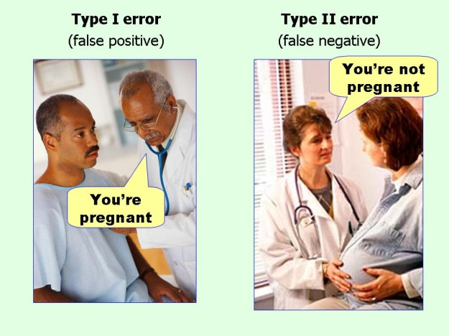
marginalrevolution.com/marginalrevolution/2014/05/type-i-and-type-ii-errors-simplified.html (2016-04-11)

Slide 31
Survey Results (1/3) -11 Responses
Notes:
Common items for next time:
I am in FL 140 about an hour before and after each class
Estimated breakdown of course time per week:
4 hours class time
4 hours reading (2 chapters ~90 pages @ 2 minutes per page)
8 hours practicing mastery of material (papers, group project, class activity prep)
If you are spending much more than this let me know and we can figure out a more efficient way to spend your time

Slide 32
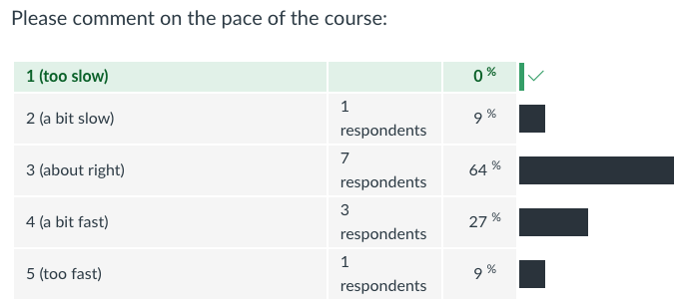
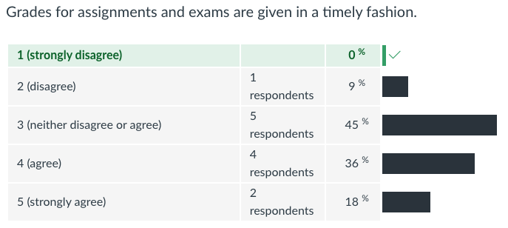
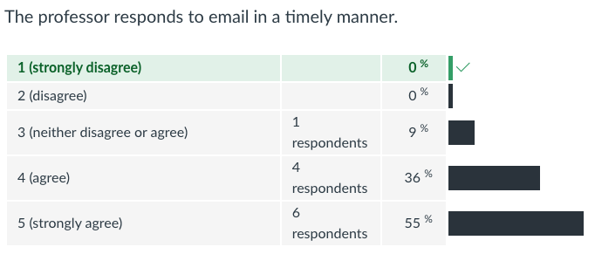
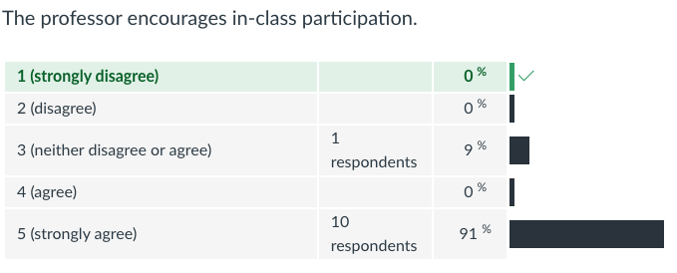
Survey Results (2/3) -11 Responses

Slide 33
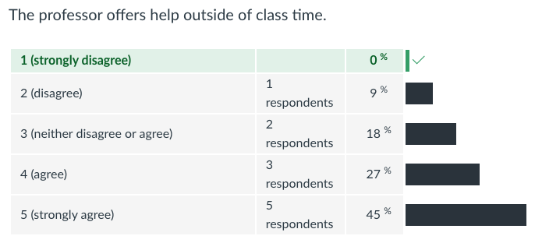
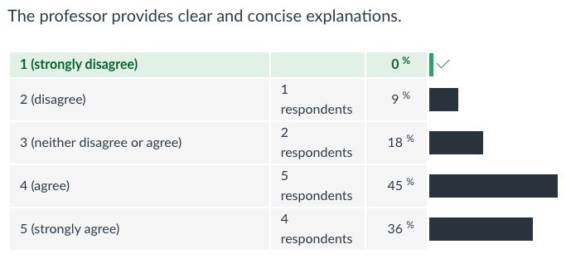
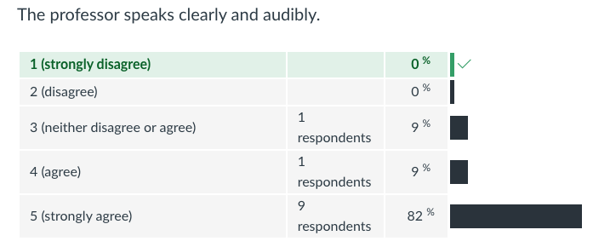
Survey Results (3/3) -11 Responses

