Slide 1
Class 7
Privacy and Government
Keith A. Pray
socialimps.keithpray.net
Notes:
After this class we will be half done with the course… very sad I know.
Somebody’s Watching Me (1984) – Rockwell (3:36)
https://www.youtube.com/watch?v=7YvAYIJSSZY
Be the envy of all your classmates if you know the band and/or year:
Rockwell (1984) Michael Jackson sings chorus and Jermaine Jackson on backing vocals.

Slide 2
what works well Online With Zoom
Sign in with First and Last Name
Stay muted unless you are going to speak
To speak use the raise your hand feature
To answer yes/no questions use the “yes” ”no” buttons
Turn your camera on
Wait until the end of student presentations to ask questions
  Write them down so you don’t forget

Slide 3
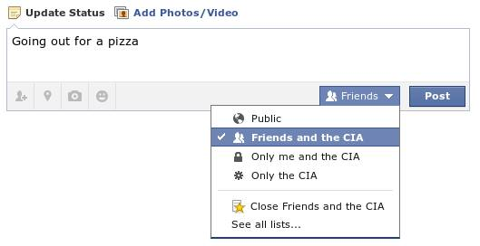
Overview
Review
Assignment
Students Present
Notes:
Review before debate in case anyone unsure of something in reading.
TODO: Image source?

Slide 4
My Reading Notes
pp. 276 Any examples from the last 25 years? Arrests, altering and deleting records are violations of privacy?
pp. 277 Why not try to verify and correct records?
pp. 278 Figure does not show # cameras increasing.
pp. 279 300 times = frames, locations, …? More police drones since 2013?
pp. 296 Shouldn’t credit card issuers take “reasonable steps” to verify identity all the time?
pp. 297 Any syndromic system successes in the last 15 years?
pp. 301 Confusing false positive and negative explanations. Not correct use of “Orwellian”
pp. 305 E-ZPass now mandatory on Mass Pike…
pp. 310 # 17 Interesting but not computing related
End of Chapter questions: 1, 18
pp. 319 “Since I have done nothing wrong, why should the government be investigating me?”
Notes:
Let’s see who said the government should make a law requiring ID for Internet access. Let’s debate!

Slide 5
Debate Ground Rules
Before Debate
  Add “(YES)” or “(NO)” to the end of your name in Zoom to show your side
  10 minutes to converse with your team
  Share argument points, counter points, and responses
  Share experiences in different countries, web sites, access points
  Decide who will: Go first, Respond to which points from opposing side
During Debate
  1 turn per person until everyone on your team has spoken
  Try to keep remarks to 30 seconds
  Switch sides at any time if you change your mind
Notes:
“Should law require you to use an official ID for Internet access” Debate
If in class:
Stand up when speaking
30 second limit (elect a timekeeper)
Previous:
National ID or Not Debate

Slide 6
Group Quiz
List two problems with using biometrics for identification.
List two advantages of using biometrics for identification.
Describe two tools people can use to protect their privacy on the Web.
For each of the 4 categories of Daniel Solove’s privacy taxonomy give an example not listed in the book.
Notes:
Only if need to fill time, Orwellian video better use of time if we’ve not seen it yet.
Information Collection
Information Processing
Information Dissemination
Invasion

Slide 7
Overview
Review
Assignment
Students Present

Slide 8
Assignment – Group Project
Catch up on reading
Analyze Movie for all topics covered to date
Add analysis of computing technology portrayed
See group project slide deck for more
-----
Mid Term Survey on Canvas → Quizzes
Notes:
Movie group project:
List of computing technologies portrayed in movie on website
Categorize computing technologies as existing, future, emerging, impossible or plausible with rationale
Analyze movie for all topics covered to date

Slide 9
Overview
Review
Assignment
Students Present
Notes:
What "Orwellian" really means - Noah Tavlin (5:31)
http://ed.ted.com/lessons/what-orwellian-really-means-noah-tavlin

Slide 10
Cambridge Analytica and Facebook
Alexander Kwan
Notes:
-The impact of the Cambridge Analytica and Facebook scandal
-What this shows our society needs

Slide 11
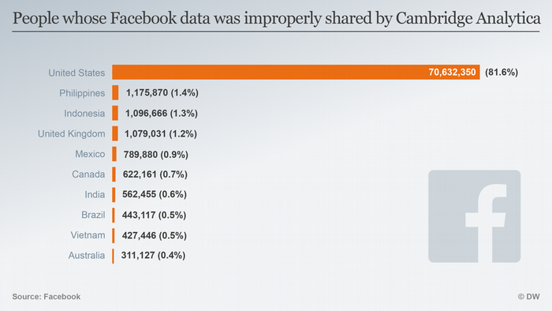
Facebook mishandles data of users
Alexander Kwan
87 million Facebook users got their data obtained by Cambridge Analytica
Cambridge Analytica provides tools that can identify the personalities of people
Beneficial: Used in right business scenario or contravention of people’s human rights
Detrimental: Used to change outcome of democratic process
Notes:
In early 2018 Facebook admitted to mishandling data from over 87 million Facebook users through an external app in 2015. This data had been improperly obtained by the political data-analytics firm Cambridge Analytica. Cambridge Analytica is a company that works with data from food security research to counter-narcotics to political campaigns. This company offers tools that could identify the personalities of the people they have data on. These tools can be really helpful in many business situations and even in situations involving the contravention of people’s human rights. It starts getting dangerous when the use of these tools are used to play with the psychology of an entire nation in terms of a democratic process. Unfortunately, Cambridge Analytica did use their tools to play with the psychology of an entire nation during the 2016 presidential election.
Picture from: https://www.dw.com/en/washington-sues-facebook-over-cambridge-analytica-scandal/a-46811290

Slide 12
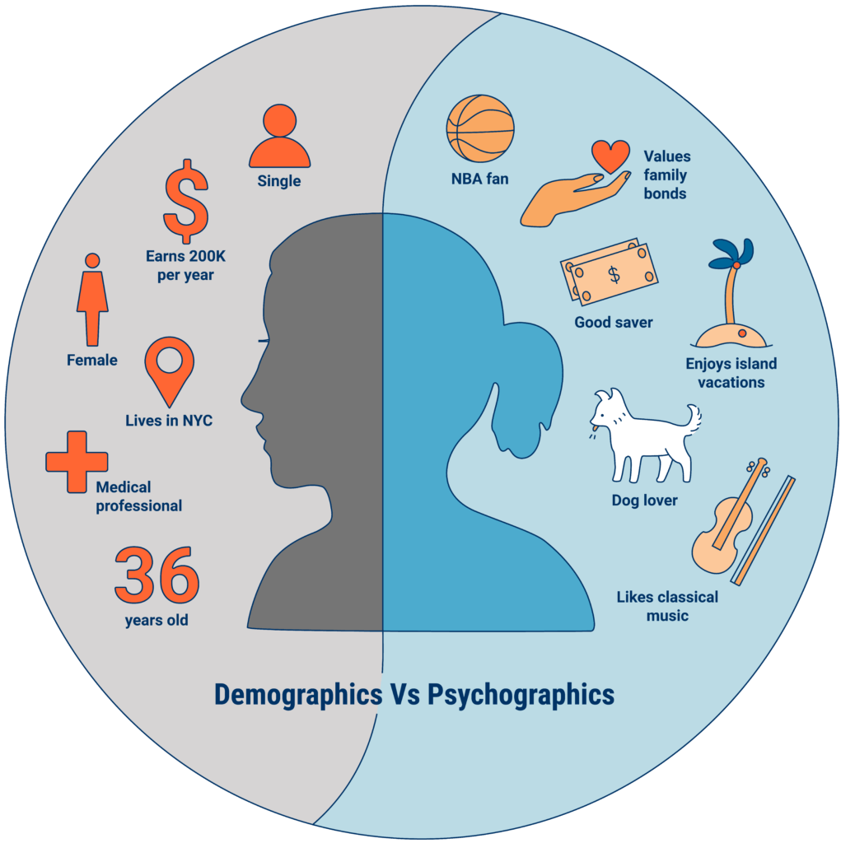
Psychographic profiles
Alexander Kwan
CA discovers a new way to understand people's personalities
Michal Kosinski finds way to reverse engineer a personality profile from Facebook activity
Demographics are informational
Psychographics are behavioral
Notes:
There are usually 2 ways of getting to know someone's personality, you can either get to know them really well - over an extended amount of time-, or get them to take a personality test and ask them to share it with you. Cambridge Analytica found a third way. They paid for access to 270,000 personality tests completed by Facebook users. They also bought Facebook data from the personality test-takers friends - with an average of 200 friends per person, this added up to 50 million people. But not all 50 million people took a personality test. Cambridge Analytica hired Michal Kosinski to figure out a way to reverse engineer a personality profile from Facebook activity such as likes. Kosinski’s model is able to predict someone's personality profile with the same accuracy as a spouse, on the basis of 300 likes. Cambridge Analytica obtained the personal data of tens of millions of facebook users without their consent, and used that data to develop “psychographic profiles” of them. Psychographics are a qualitative methodology used to describe traits of humans on psychological attributes. Cambridge Analytica wasn’t satisfied with knowing just the cold hard facts about people like their gender, where they live, or how old they are. They developed these psychographic profiles of people to actually understand people’s personalities, values, opinions, and attitudes. Demographics are purely informational, while psychographics are a means to segment by personality - so they’re behavioural.
Picture from: https://www.cbinsights.com/research/what-is-psychographics/

Slide 13
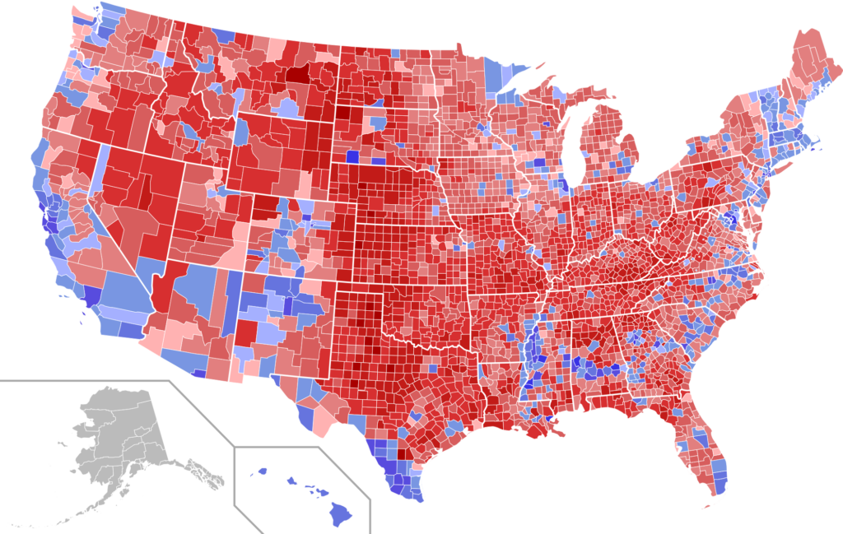
2016 presidential election
Alexander Kwan
CA founded in 2013 with the focus on U.S. elections
Personality drives behavior and behavior influences how you vote
Target persuadable in specific precincts to flip the state
Content bombardments with ads, blogs, websites, and articles
Notes:
Cambridge Analytica was founded around 2013 initially with a focus on the U.S. elections, since they received $15 million in donations from Republicans Robert Mercer and Steven Bannon. CA worked with Ted Cruz to test and finalize the methodology before working with Donald Trump. The entire campaign understood that when it comes to politics in the U.S., people are so polarized that they can’t understand or work with each other. Their goal was to increase the gap in the polarization through the use of the psychographic profiles that they developed. They used this to their advantage knowing that personality drives behavior and behavior influences how you vote. The bulk of the campaign’s budget went into targeting the persuadables: the swings states. Each state was broken down into a precinct and the goal was to target enough persuadables in the right precincts so that the state would turn red instead of blue. The psychographic profiles were utilized to personalize content to trigger these individuals through the use of bombardments with ads, blogs, websites, and articles. These bombardments continued until the target saw the world the way Cambridge Analytica wanted them to, thus voting for their candidate.
Picture from: https://globalsecurityreview.com/cambridge-analytica-darker-side-big-data/

Slide 14
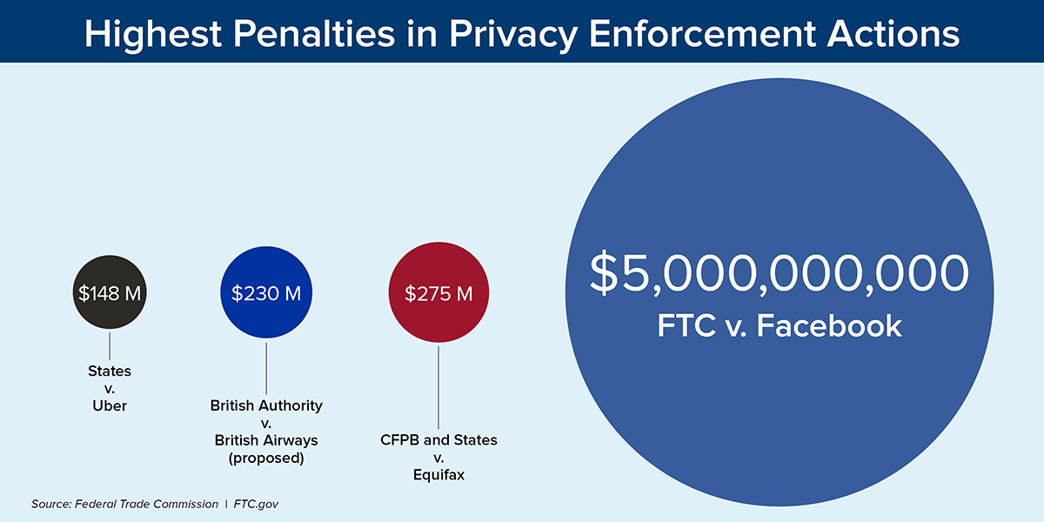
Data privacy legislation is needed
Alexander Kwan
Facebook failed to keeps user's personal information secure
Facebook charged with $5 billion penalty
Legislation is required to hold big tech companies accountable for the decisions they make its users’ privacy
Notes:
The ICO found that Facebook breached data protection laws by failing to keep users personal information secure, allowing CA to harvest data of millions of people without consent worldwide. Although this scandal ultimately led to a record breaking $5 billion penalty imposed on Facebook by the Federal Trade Commision in July 2019, I think that this action needs to be criticized more for failing to adequately address the privacy and other harms emanating from Facebook's release of 87 million users data without user authorization. This scandal has shown how rich the collection of data is. It also shows that the large tech companies that are storing this data can socially manipulate people. The amount of data that can be stored today, with the advanced technology that works around data, it’s necessary for more legislation to protect people from manipulation in any form.
Picture from: https://www.ftc.gov/news-events/press-releases/2019/07/ftc-imposes-5-billion-penalty-sweeping-new-privacy-restrictions

Slide 15
References
Alexander Kwan
[1]Michael R. Wade, “Psychographics: the behavioural analysis helping Cambridge Analytics”, August 28, 2018, https://www.imd.org/research-knowledge/articles/psychographics-the-behavioural-analysis-that-helped-cambridge-analytica-know-voters-minds/ (4/10)
[2]Alexandra Ma, “Facebook understood how dangerous the Trump-linked data firm Cambridge Analytica could be much earlier than it previously said. Here's everything that's happened up until now.”, August 23, 2019, https://www.businessinsider.com/cambridge-analytica-a-guide-to-the-trump-linked-data-firm-that-harvested-50-million-facebook-profiles-2018-3 (4/10
[3]Scott Detrow, “What Did Cambridge Analytica Do During The 2016 Election?”, March 20, 2018, https://www.npr.org/2018/03/20/595338116/what-did-cambridge-analytica-do-during-the-2016-election (4/10)
[4] The Great Hack(2019) – Netflix
[5] Vian Bakir, “Psychological Operations in Digital Political Campaigns: Assessing Cambridge Analytica's Psychographic Profiling and Targeting”, July 27, 2020, https://www.frontiersin.org/articles/10.3389/fcomm.2020.00067/full (4/16)

Slide 16
Opting out
Arthur Robinson IV
Notes:
Hello everyone!
My presentation is about how tech companies collect data on us by default, often without our knowledge, understanding, or consent. Data collection and tracking settings are set to on by default, requiring users to put effort into figuring out how to opt out, and this is not ethical.

Slide 17
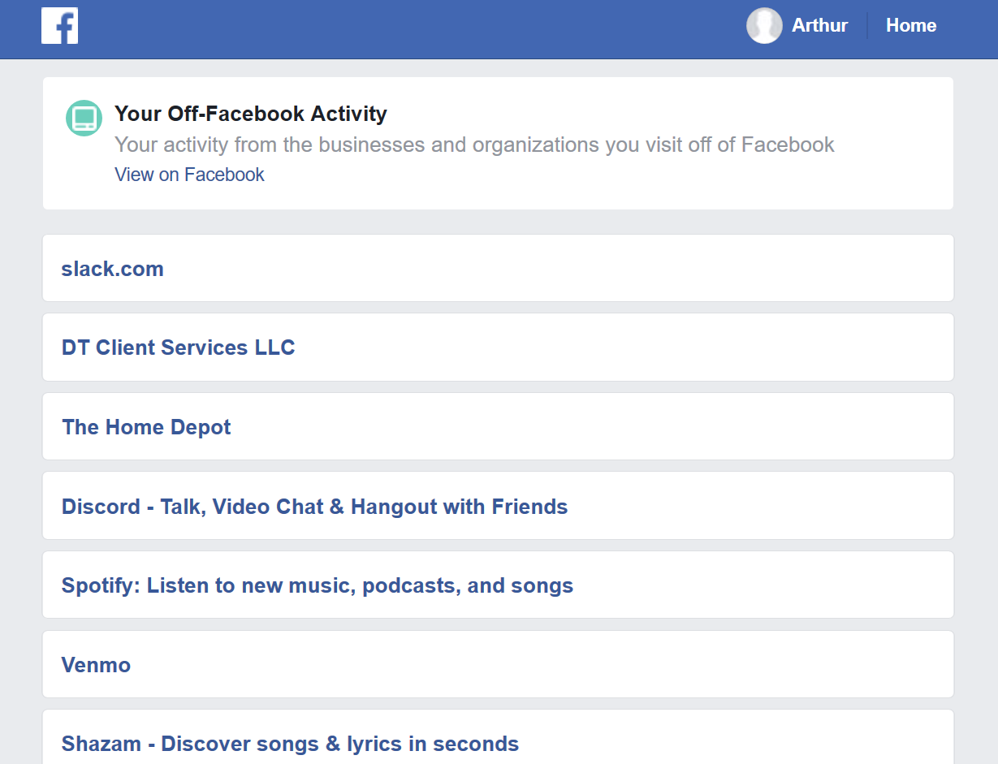
The PROBLEM
Arthur Robinson IV
Google:
  Web/app activity
  Ad personalization
  Account required even for free apps
Facebook
  Off-Facebook activity
  In-app history permanently on
  Collects info on non-users
Is this ethical? No!
Notes:
I’m going to focus on Facebook and Google because they’re some of the most high-profile offenders.
When you create a new Google account, all your search history, app activity, and YouTube browsing history is saved by default. This includes recordings of voice searches and Google Assistant commands on a phone or a Google Home. Ad personalization is also on by default, which means this data will be used to show you targeted advertisements.
Also, Google requires you to make an account to download even free apps from the Google Play store. This is an artificial restriction placed in Android by Google to collect more data about users.
Facebook also has some shady data collection techniques. By default, they collect data on their users from a myriad of sources outside Facebook. Unlike Google, they don’t provide the option to turn off your history for in-Facebook data. Everything you’ve ever done on Facebook is stored permanently, unless you trust them to delete it when you delete your account. This includes everything from search queries to the number of seconds you spent on every video you’ve watched. Additionally, they detail in a blog post explaining how they collect data on users who aren’t even on Facebook! This data includes IP addresses, browser information, and cookies. People cannot opt out of this data collection unless they create a Facebook account [1].
As an example of how much Facebook knows about us, this is a list of sources that have given them information about me. I rarely use Facebook – I’ve logged in a total of 16 times since making my account. An especially creepy entry is the Home Depot. I’ve never downloaded the Home Depot app and I don’t have an account with them. Also, I’ve never bought anything from them online. This means that Facebook either received data about me from browsing their site logged out, or from an in-person visit to a store.

Slide 18
Act Utilitarianism: People are unhappy
Arthur Robinson IV
Lack of control:
Risks outweigh benefits:
Concern over data use:
Lack of understanding about data use:
81%
81%
79%
59%
Auxier, Brooke, et al. “Americans and Privacy: Concerned, Confused and Feeling Lack of Control Over Their Personal Information” (Pew Research Center, 2019) [2]
Notes:
Let’s evaluate the ethics of this data collection with Act Utilitarianism. Here are the results of a 2019 survey on how people feel about their data being collected. Most people feel that they lack control over their data and that the risks of companies collecting data on them outweigh the benefits. The majority of people are concerned about and lack understanding of, how their data is being used [2]. In other words, the happiness of the users is being decreased. The happiness of advertisers and tech company executives is being increased. However, the number of users outweighs the size of these parties. We have a net decrease in happiness; therefore, the current paradigm of data collection is unethical by Act Utilitarianism.

Slide 19
Kantianism: users are a means to an end
Arthur Robinson IV
Do people read the Privacy Policy?
  Privacy Policy should have taken 29-32 minutes to read
  Users who didn’t skip spent average of 73 seconds reading
Why not?
  Information overload
  Nothing to hide
  Difficult to understand
26%
74%
Obar, Jonathan A. & Oeldorf-Hirsch, Anne, “The biggest lie on the Internet: ignoring the privacy policies and terms of service policies of social networking services” (Information, Communication & Society, 2018) [3]
Notes:
Now, let’s consider a Kantian perspective. Kant says that we should treat people as ends in themselves, not just as a means to an end. This means informing users of relevant information on data collection that may influence how they use a service. In legal terms, the privacy policy accomplishes this. However, in a 2018 study using a mock social media site, 74% of people didn’t even read the privacy policy [3]. This and the previous study show us that most people are not informed. The information is usually presented in a lengthy, complicated, and dense document. Most tech companies have an unfulfilled moral obligation to present this information in a way that their users can easily understand and internalize. Therefore, by Kantianism, most of this data collection is not ethical. However, some companies have started placing short overviews at the top of these types of documents. This is a step in the right direction, and hopefully, we’ll see it happening more.

Slide 20

Data collection enables useful tech
Arthur Robinson IV
Google Maps
  Realtime traffic
Google Assistant
  Neural networks for speech recognition
  Noise removal
Opting in
  0.2% of voice recordings human-transcribed
Notes:
Companies shouldn’t just stop collecting user data. Besides the fact that this would be damaging to the economy, many useful technologies rely on user data collection. For example, Google Maps can provide real-time traffic reports by aggregating GPS data from everyone who’s currently using the app. Also, Google Home’s neural network has become spectacularly good at voice recognition. This is because Google has humans transcribe thousands of hours of user voice queries, then uses them as training data [5]. However, Google themselves admit that only 0.2% of user voice recordings actually get transcribed. So even if only a tiny sliver of their users consented to this, they would have plenty of training data. In a survey on the Privacy Attitudes of Smart Speaker Users, respondents considered 74% of their voice recordings to be acceptable for use to improve performance and develop new features [6]. From this, we can conclude that even if Google took a more ethical approach to data collection, they would still have plenty of training data.

Slide 21
Questions?

Slide 22
References
Arthur Robinson IV
[1] Facebook, “Hard Questions: What Data Does Facebook Collect When I’m Not Using Facebook, and Why?”, (Facebook, 2018), https://about.fb.com/news/2018/04/data-off-facebook/ (Accessed April 14, 2021)
[2] Auxier, Brooke, et al. “Americans and Privacy: Concerned, Confused and Feeling Lack of Control Over Their Personal Information” (Pew Research Center, 2019), https://www.pewresearch.org/internet/2019/11/15/americans-and-privacy-concerned-confused-and-feeling-lack-of-control-over-their-personal-information/ (Accessed April 14, 2021)
[3] Obar, Jonathan A. & Oeldorf-Hirsch, Anne, “The biggest lie on the Internet: ignoring the privacy policies and terms of service policies of social networking services” (Information, Communication & Society, 2018), https://www.tandfonline.com/doi/full/10.1080/1369118X.2018.1486870 (Accessed April 15, 2021)
[4] Monsees, David, “More information about our processes to safeguard speech data”, (Google, 2019), https://www.blog.google/products/assistant/more-information-about-our-processes-safeguard-speech-data/ (Accessed April 15, 2021)
[5] Sainath T.N. et al. (2017) Raw Multichannel Processing Using Deep Neural Networks. In: Watanabe S., Delcroix M., Metze F., Hershey J. (eds) New Era for Robust Speech Recognition. Springer, Cham. https://doi.org/10.1007/978-3-319-64680-0_5 (Accessed April 15, 2021)
[6] Malkin, Nathan, et al. “Privacy Attitudes of Smart Speaker Users”, (Proceedings on Privacy Enhancing Technologies, 2019), https://par.nsf.gov/servlets/purl/10109137 (Accessed April 15, 2021)

Slide 23
Regulating access to genetic data
Daire Daly
Notes:
Today I will be discussing the importance of why access to genetic data needs to be regulated, specifically in that there needs to be an increase of laws applicable to genetic data

Slide 24
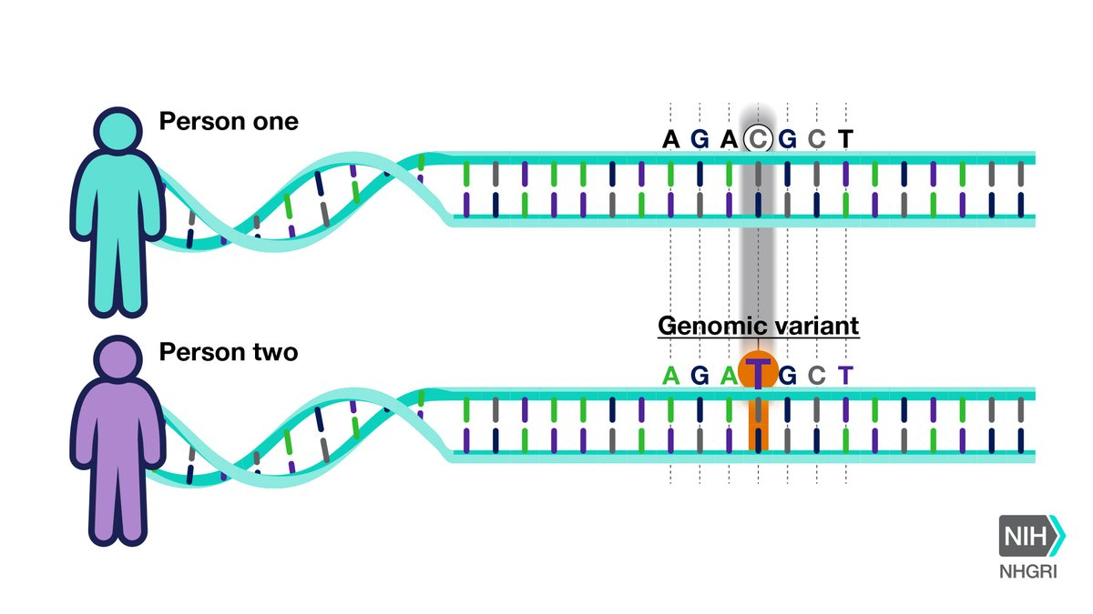
What is Genomics? Why do I Care?
Daire Daly
Genomics
  The recipe for you
The Human Genome Project
  1990 to 2003
Examples of Use
  Medicine
  Ancestry
  Criminal Investigation
https://www.genome.gov/Health/Genomics-and-Medicine/Polygenic-risk-scores
Notes:
In order to understand why greater regulation is needed to ensure the privacy of DNA it is important to understand what genomics is. Genomics is quantifying and characterizing an organisms genome (DNA) and studying this to understand the interactions the individual genes have with each other and the overall impact this has on you.
The most famous example of genome sequencing was the human genome project, this was the first case in which an entire human genome was sequenced. This started in 1990 and ended in 2003, 13 years, now companies like Illumia are sequencing human genomes in less than an hour…
This technology is used in medicine and healthcare for diagnoses for diseases and research for treatment and cures, building ancestral trees through sites like ancestry.com, as well as use in criminal investigation like finger printing.

Slide 25
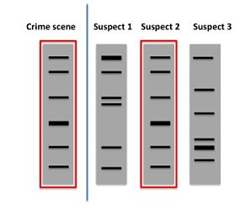
Morally ambiguous information
Daire Daly
Unique Identifier
  Not only you…
  Cannot separate from the person
National DNA Index System
  FBI DNA database
The Golden State Killer
  Ancestry data used to locate a murder
https://bitesizebio.com/19816/how-are-crimes-solved-by-pcr/
Notes:
Having the ability to access someone's genome give you access to everything about you. Your genome is a unique identifier, much like a social security number it is unique to you and only you. Because of this it is impossible to separate oneself from their genome, even if you remove the name of the person, if you are able to gather another piece of your genetic information your genome can be tracked back to you.
So what if you don’t care about someone having access to your genetic information? When you someone sees your genome that are also able to make connections to your family, so you aren’t giving up just your own information you are also giving up pieces of your family members
NDIS – fbi data base of genetic information on past criminals
Specific case of the use of genetic information – golden state killer. In this situation there was a serial murder who they were unable to catch, but had a sample of his DNA. They ran it across data that was received from a private ancestry company, due to this they were able to narrow down the suspect list significantly and eventually catch the golden state killer. Obviously in this situation this is a positive outcome that we can all agree benefited society, but what protections might be offered in a more grey case.

Slide 26
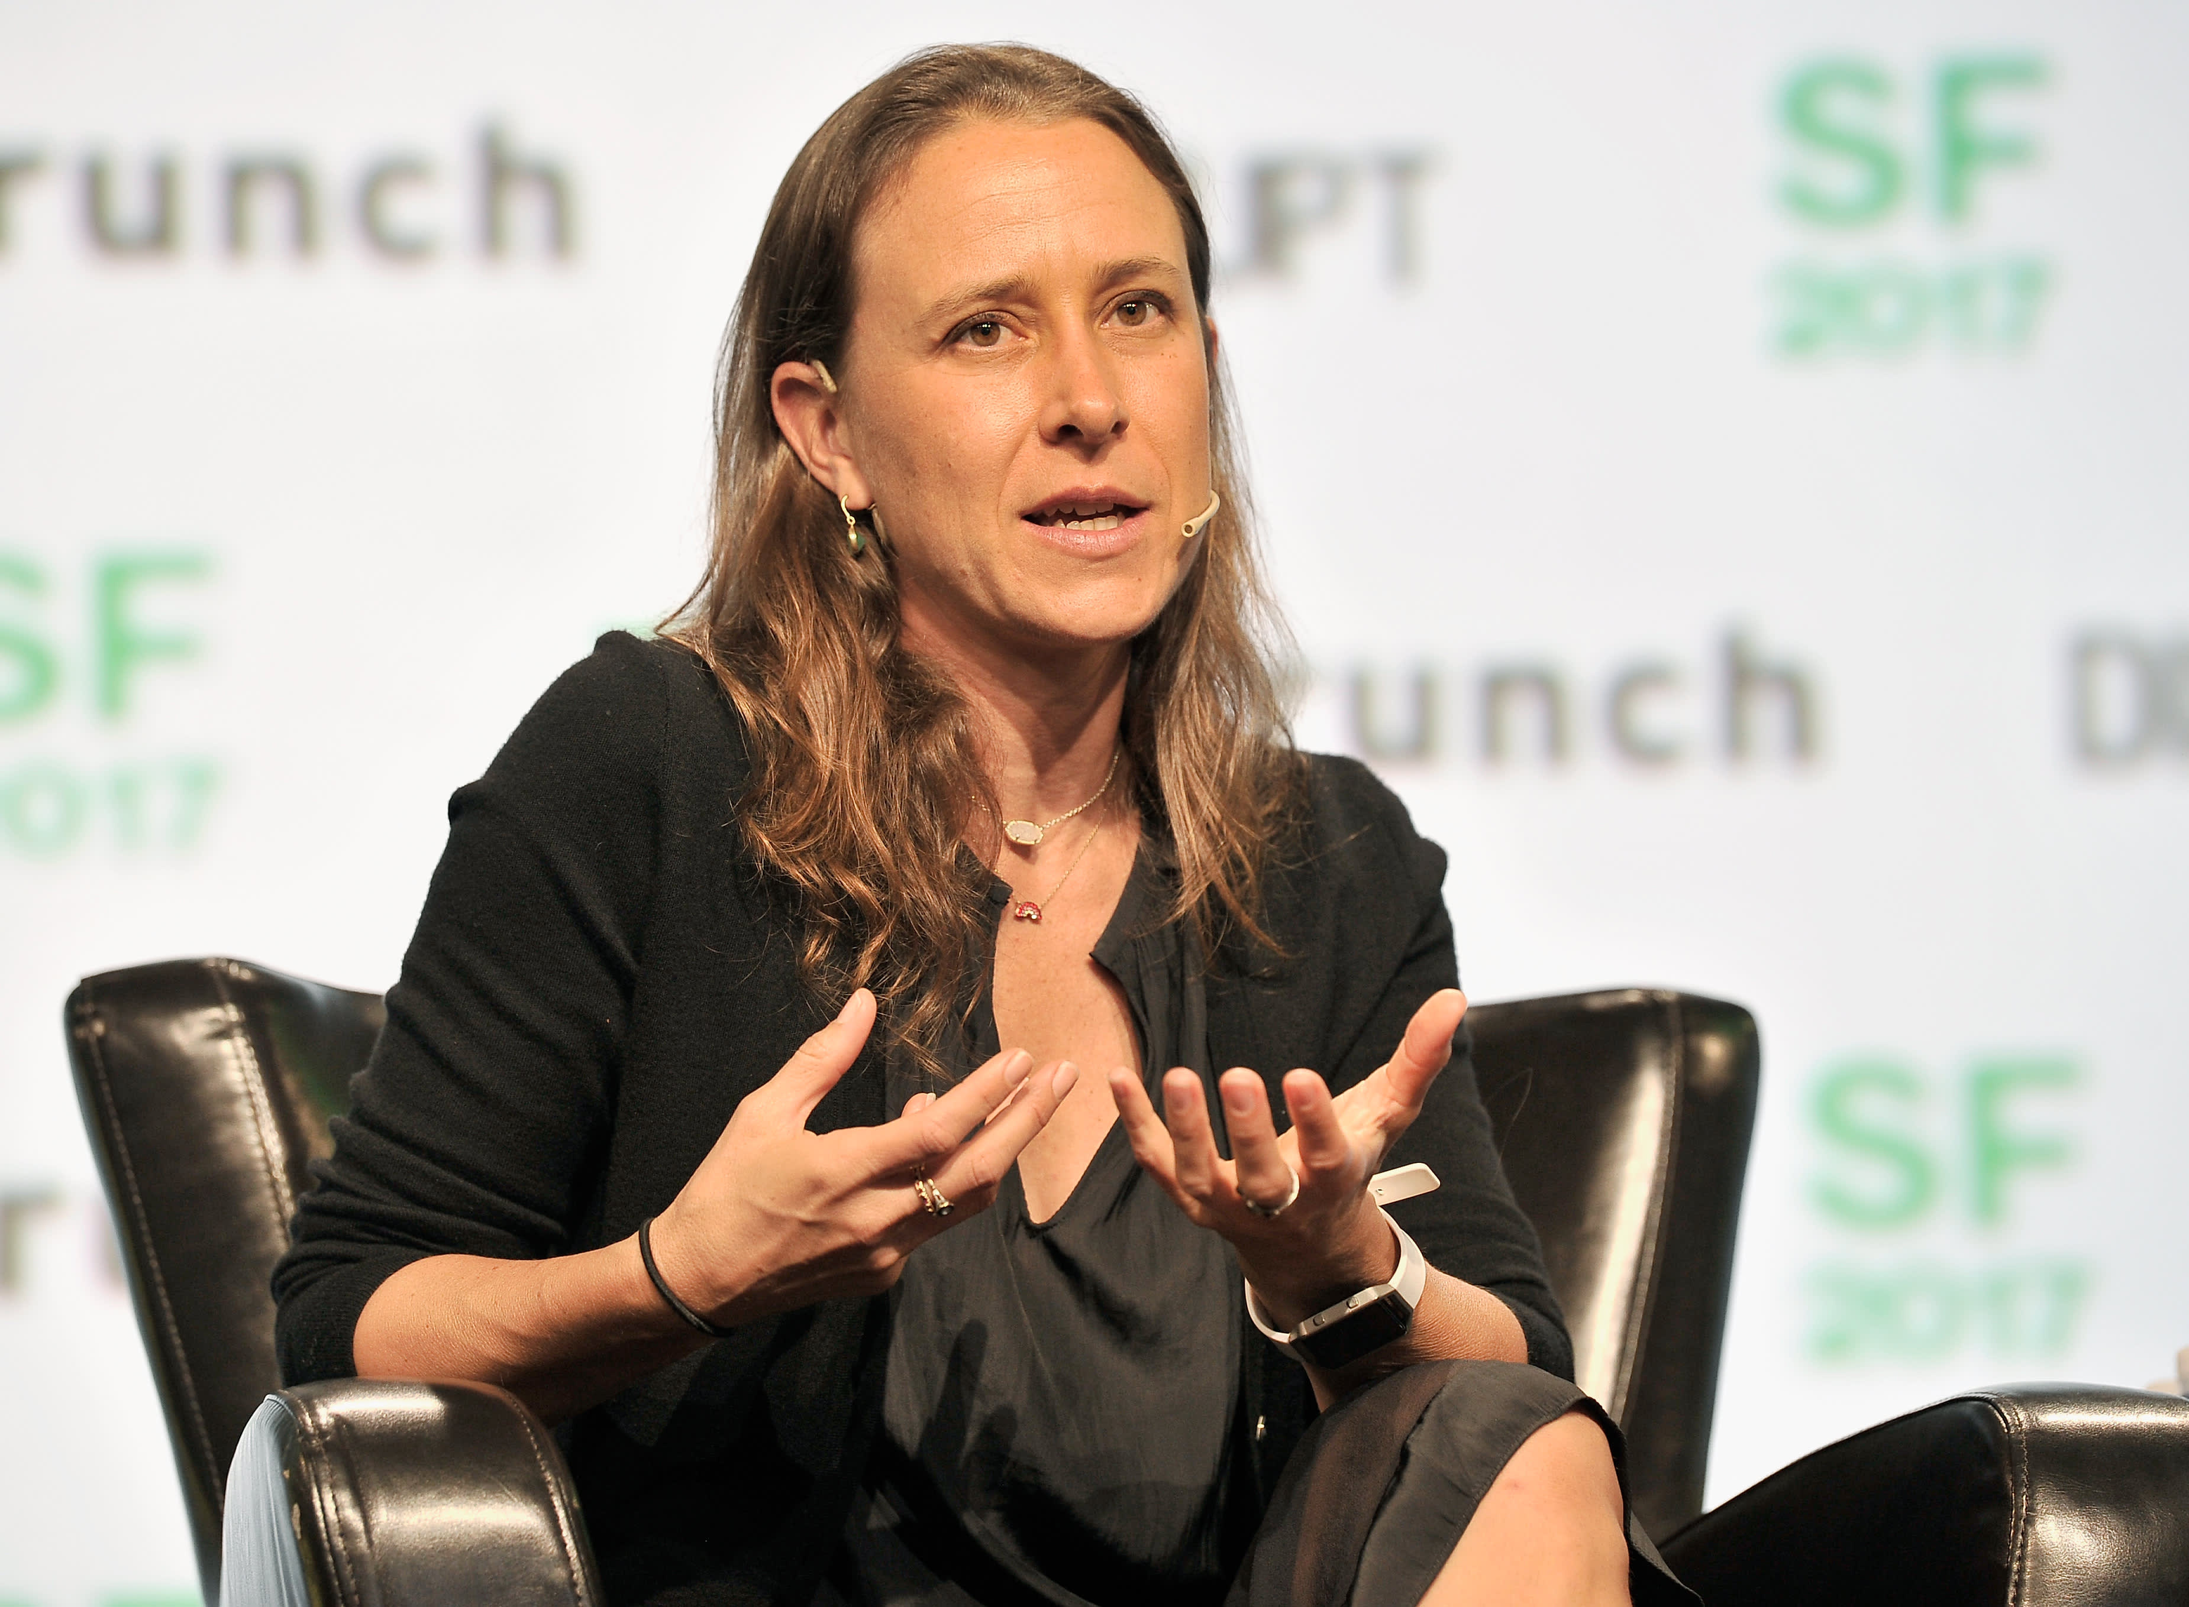
How is the government regulating this?
Daire Daly
THEY AREN’T!
  Individualized privacy agreement
  Third Party Vendors
Healthcare
  HIPPA
  GINA
Maryland v King
  Warrant laws
“I think the tech world needs to own this better communicate privacy standards to build trust” – Anne Wojciki, 23andMe CEO
https://www.cnbc.com/2020/01/23/23andme-lays-off-100-people-ceo-anne-wojcicki-explains-why.html
Notes:
So how is the government regulating when your genetic information can be accessed, sold, viewed, etc…
They really aren’t. There are little to no laws governing what consumer companies such as 23 and me can do with your genetic data. The only form of “regulation” is seen in the individual companies privacy agreement, so if you ever do one of these tests make sure to fully read their privacy agreement. If you read 23 and mes they state that they can sell your genetic data to a third party vendor, noting they will only sell to disease treatment companies, but this is still important to note. In the case of security breach your genetic information could be shared with anyone, as article states “You can cancel a credit card. You can’t change your DNA”
Thankfully in healthcare you are protected by HIPPA laws and GINA (genetic information nondiscrimination act) which protect the sharing of your genetic data from healthcare providers, and prevent discrimination in the hiring process/workplace and some insurance situations. (This mentioned in book)
Specific court case Maryland v King. This relates back to the golden state killer as it outlines warrant laws for demanding genetic data. Parallel to entering a house, unless it is within reasonable suspicion that there is criminal activity you cannot demand someone provide their genetic information.

Slide 27
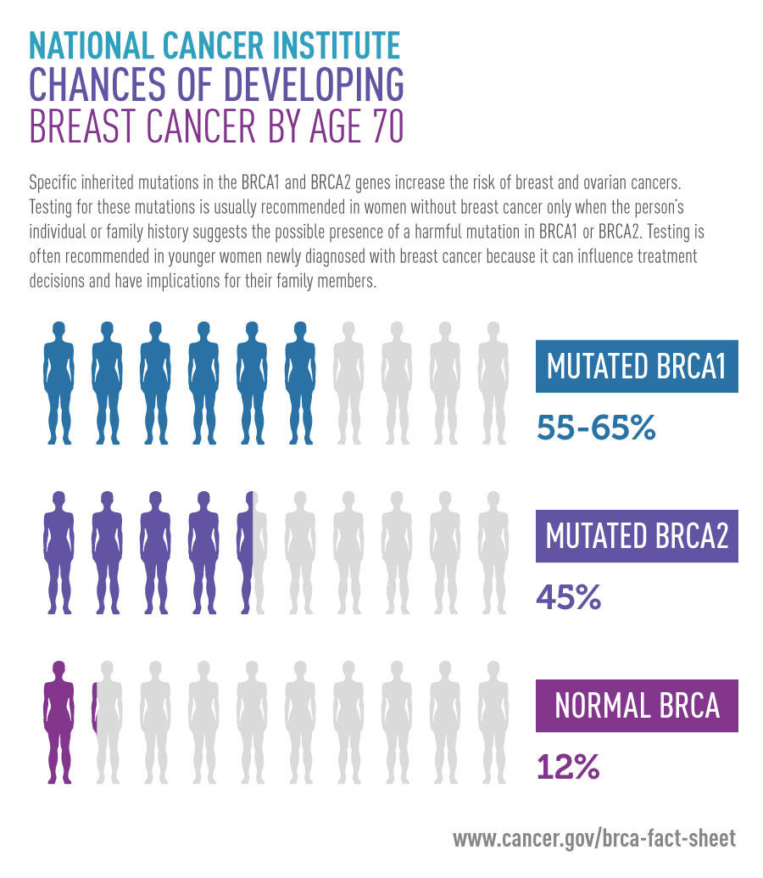
What needs to change?
Daire Daly
Regulations
  Private Companies
  Healthcare
  Government itself
Future Changes
  Fetal Genomes
  Predictive Analysis
  Genetic Database
https://www.cancer.gov/news-events/cancer-currents-blog/2016/brca-testing-breast-cancer
Notes:
What needs to be changed and improved upon?
Regulations added across the board. Specific laws made that consumer companies must follow, the updating and amending of laws within healthcare, greater detailed outline of what the government can access about your genetic information and how this information can be used. Since this is such a new technology there is no precedent for how this should work, but regardless of the details regulations needs to be put into effect as the future implications could be extraordinary.
What could the future hold? Sequencing of fetal genomes → already minorly used for screening of fatal diseases and disorders, but where does the line get drawn for too much data on a being that cannot consent -> designer babies. Predictive analysis is already a technology present, telling you what predisposition you may have to health problems. This is not considered within GINA, and can cause problems with insurance and overall anxiety if not properly understood and regulated. Government genetic database? A requirement for all adults to get their genome sequenced to be stored by the government, the replace of SSN? Has the potential to significantly progress research, but I would say this is an extreme breach of privacy. All loops back to the precedent needs to be set and regulations need to be added.

Slide 28
References
Daire Daly
[1] 23andMe. (2020, October 30). Dna genetic testing & analysis. Retrieved April 15, 2021, from https://www.23andme.com/about/privacy/
[2] Lynch, J., & Hussain, S. (n.d.). Genetic information privacy. Retrieved April 15, 2021, from https://www.eff.org/issues/genetic-information-privacy
[3] Privacy in genomics. (2020, February 24). Retrieved April 15, 2021, from https://www.genome.gov/about-genomics/policy-issues/Privacy
[4] Webster, P. C. (2010). Regulation of genetic tests unnecessary, government says. Canadian Medical Association Journal, 182(16), 1715-1716. doi:10.1503/cmaj.109-3686
[5] Wright Clayton, E., Evans, B. J., Hazel, J., & Rothstein, M. A. (2019). The law of genetic Privacy: Applications, implications, and limitations. SSRN Electronic Journal. doi:10.2139/ssrn.3384321

Slide 29
Class 7
The End
Keith A. Pray
socialimps.keithpray.net
Notes:
This is the end. Any slides beyond this point are for answering questions that may arise but not needed in the main talk. Some slides may also be unfinished and are not needed but kept just in case.

