Slide 1
Class 6
Information Privacy
Keith A. Pray
socialimps.keithpray.net
Notes:
Here’s the title slide. Excited already, aren’t you?
How did the self search paper go? Offer small group discussion instead of class wide.
Who: found a lot, very little, surprised, not surprised, creepy, share conclusions

Slide 2
what works well Online With Zoom
Sign in with First and Last Name
Stay muted unless you are going to speak
To speak use the raise your hand feature
To answer yes/no questions use the “yes” ”no” buttons
Turn your camera on
Wait until the end of student presentations to ask questions
  Write them down so you don’t forget

Slide 3
Papers
http://socialimps.keithpray.net/assignments/paper-guidelines/
State conclusion clearly
Quantify
  Not terms like: less, more, a lot, huge, great, big, tiny, drastic, etc.
Avoid absolutes
  Terms like: all, none, always, never
  Difficult to prove, easy to show false
Beware of fallacies
Counter Point and Rebuttal should directly relate
Notes:
Save for next time:
Define terms
Read paper aloud to proof
Read directions, many time lines missing
Be sure to put quotes around entire quote
State a strong, clear conclusion
First statement preferred
Provide Counter Point and Response
Print 2 sided and save a tree
Hyperbole is the best thing ever!
but not in these papers
No strawman fallacy in counter point
Text book is not a primary source
Use template, saves time (and -1 point)
Cite as suggested [1]

Slide 4
Logistics
Address email to entire course staff for quickest response
Use paper and presentation templates
Keep topics inside the course scope: Computing + Society
Review Presentation and Paper Guidelines on course site
Notes:
Not needed this time:
Address email to entire course staff for quickest response time
Do not change the format, footers, etc. in the template slides.
Paper writing process: Sources → Notes → Conclusion → Argument → Counter Point → Response
Turn extra credit paper in on myWPI/Canvas and hard copy in class like regular papers
Presentations are due 24 hours before class
Use Presentation Guidelines on course web site

Slide 5
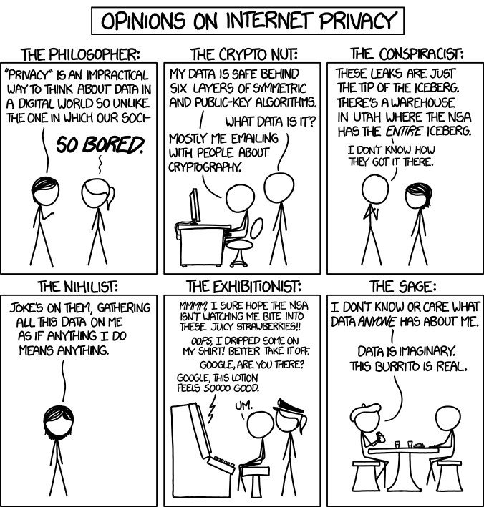
Overview
Review
Assignment
Students Present
http://xkcd.com/1269/
Notes:
1 – Accessed 2014-04-14
Everyone pick the category they identify most with.
Share reasons why.

Slide 6
My Reading Notes
pp. 229 means to end?
pp. 230 who videotapes anymore?
pp. 231 “businesswoman” nice change. Moral capitol – source published in 1984, “taking away” “1984”
pp. 234 Hilton consent to pic being in book?
pp. 237 Many daycares monitor, any studies yet?
pp. 238 “…privacy…in their own homes…” != nanny to expect privacy “…when… insides Sullivans’ home.
pp. 244 Human chip implant sources getting old, 2002, 2004, 2007, 2010
pp. 250 2012 source same year Target outed pregnant teen to parents
pp. 255 Why did Apple not enforce policy of asking permission in the API?
pp. 245 “…by 2015” did it happen?
pp. 246 Web Browsers put cookies on on your hard drive, not Web Servers.
pp. 250 why is bills – responsibility assumption flawed?
pp. 268 Why WPI not in list?
Notes:
Jimmy Kimmel Live – What is your password? (2:49)
https://www.youtube.com/watch?v=opRMrEfAIiI
Find out what your DNA says about you and your family.
https://www.23andme.com/
https://motherboard.vice.com/en_us/article/xwkaz3/23andme-sold-access-to-your-dna-library-to-big-pharma-but-you-can-opt-out?utm_source=vicefbus
Notes updated: 2018-04-03

Slide 7
Assignment
Prepare for class debate:
Should law require you to use an official ID for Internet access?
  Once you’ve done the research and have decided “Yes” or “No” assign yourself to the appropriate group on Canvas:
    Canvas → People → Internet ID: Use the groups to share your research
    https://canvas.wpi.edu/courses/23995/groups#tab-6898
  Come prepared with notes, facts, dates, high quality sources
  Optional One Page Paper on the topic, lowest paper grade will be dropped
Notes:
Previous Debates:
Is a National ID System a good thing?

Slide 8
Overview
Review
Assignment
Students Present

Slide 9
Addictive target ads
Madyson Kelly

Slide 10
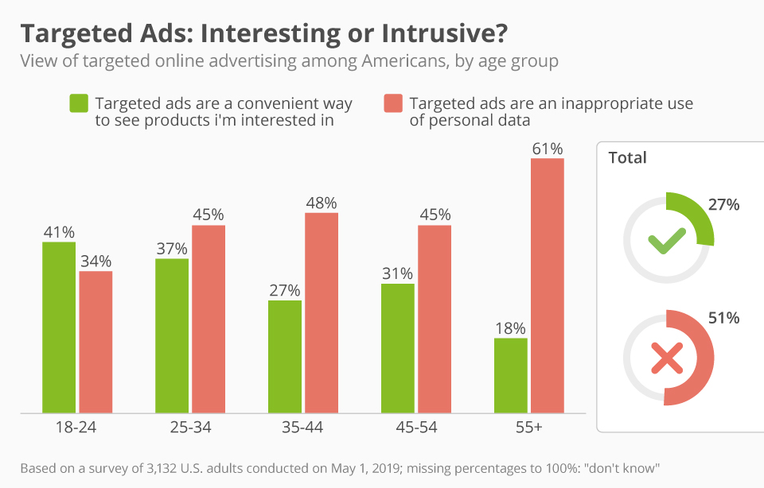
Targeted Ads are making a negative impact
Madyson Kelly
Targeted ads can include personal information
Easier to see and buy products than ever before
Privacy and money concerns
[7]
Notes:
I’m sure everyone has searched for something that they wanted to buy whether it was a new pair of shoes or a new game. Then, later that day you're on your computer and you see ads of the same thing that you just searched for earlier that day.
The same applies to social media apps. In the past ten years, we have seen more and more ads show up in between posts, before videos, and some social media platforms have even created its own features just for shopping.
Ad platforms and social media companies are using everything in their power to make clicking on and buying products as easy as possible so us as the consumers are more likely to just that.
Some of these ads also contain personal information, such as your location or personal hobbies. [9]
These personalized ads make people question how these websites know this information and whether their privacy is being invaded. [4]
Companies displaying these ads, such as Google or Facebook, and the retailers themselves are making billions of dollars from this new form of advertisement, but at what cost to the consumers? [6]
My conclusion is that these targeted ads are making a negative impact in the consumer world.

Slide 11
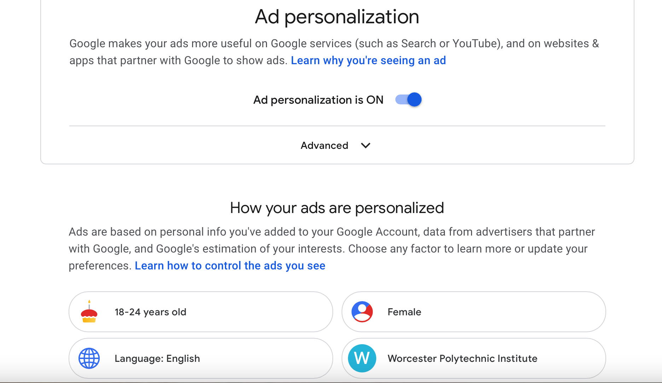
Google Ads are Collecting your data
Madyson Kelly
Basic Info, Search History, Location, Visited Websites
Higher engagement = More money
Ads for services & websites, not just goods
[8]
Notes:
Google Ads is a platform where advertisers can bid to have their ads displayed to consumers. Google uses data and algorithms to target ads to consumers who will most likely engage with them. [8]
Google does most of its tracking through a user’s account. [9]
This includes the personal information you gave Google when you signed up, the location of your phone that you allow Google to track, your search history on Google and YouTube, and much more. [9]
Most people don’t even remember the information they give to Google, or many other sites, when they sign up for an account with them. [4]
On the right, there is a picture of my personal ad settings on Google. I’m sure many of you know this, but you can see what kind of data Google has collected about you.
As you can see, the top four points about me are accurate, although this is very basic information about me.
However, as I was looking further down the list there was still accurate information about me that was more specific, such as some of my hobbies and things that I have searched for.
Google takes this information to target specific audiences in search results, during YouTube videos, and on websites that partner with Google.
This could be based on a keyword a user types when searching for something or websites that you spend the most time on. [2]
The whole process of ad targeting is to benefit the platforms showing the advertisements and the retailers who are trying to sell their products.
At the end of the day, if more consumers are clicking on ads and buying products, more retailers will pay to advertise on certain platforms and the retailers are making larger profits by selling more goods. [6]
When people think about ads they mostly think about it showing off a physical good, but another aspect of ads that isn’t the first thing people think of is ads that advertise services or websites.
One example of an ad that I’ve personally seen more and more before YouTube videos is Discord. Discord ads have been increasingly more popular recently.
This is a type of advertisement that encourages users to spend even more time on their phones and personal devices.
Although they are not buying a physical good. Discord is still making money when more consumers are using their product and users now have another way to spend more time on the internet.

Slide 12
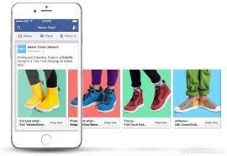
Dynamic ads are showing consumers more and more products
Madyson Kelly
Use machine learning to scale ads
Two Targets:
  Reach broad audiences
  Retarget consumers
Reason Retailers use Dynamic Ads:
  More personalized
  Optimize and promote all products
  Retarget customers
  Reach new customers
[5]
Notes:
As a retailer, Facebook’s dynamic ads use machine learning to scale ads when they have a broad range or large volume of products to sell. [3]
When a shopper expresses interest in one item from a retailer’s product, Facebook will dynamically generate an ad for that person and deliver it to them. [3]
They will chose the best products from that retailer that the consumer will most likely click on and will want to buy. [3]
Dynamic ads have two targets: one is for broad audiences to reach consumers who have not yet purchased from a certain business or do not show interest in the products at first. The second is to retarget consumers who have expressed interest and the ads are pushing them to complete the final action of purchasing the product. [3]
Facebook gave reasons to use their targeted ads. They are:
“They’re more personalized. They deliver relative content based on consumer’s behaviors and interests.” [3]
“They’re always optimizing and promoting all products of a business without having to configure each individual ad.” [3]
“They retarget consumers to remind them of items they didn’t buy.” [3]
“They reach new consumers who have expressed interest in a certain product even if they haven’t visited the website the product is being sold on.” [3]
These ads allow much more flexibility when advertising a type of product because it can show multiple products of a similar type.
The more a consumers sees the same products the more interested they become and the more likely they are to buy them.

Slide 13
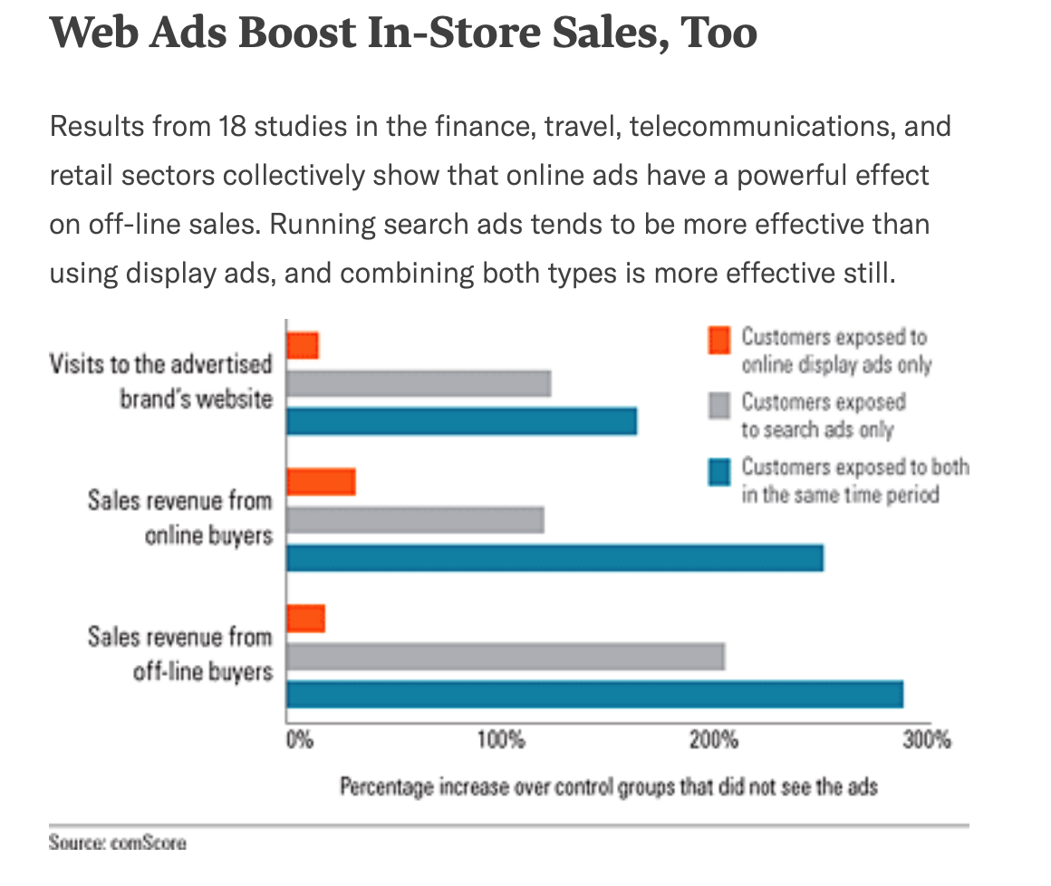
Increase shopping – Online & offline
Madyson Kelly
Retail e-commerce is up during the pandemic
Ads for products you didn’t know existed
Off-lines sales are rising too
[1]
Notes:
So what do all these personalized, targeted ads mean for the consumer?
Well, in the U.S., retail e-commerce was up 31.8% in the second quarter of 2020 compared to the same time in 2019. It hit $211.5 billion. [6]
This was partial due to targeted ads and a new feature called Facebook Shops where businesses list products for sale like a virtual storefront or a catalog. [6]
Facebook’s ad revenue was $16.6 billion in the second half of 2020 which was up 28% from last year. [6]
This is concerning seeing that many people were out of work and tight on money due to the pandemic, but they still chose to buy goods with money that may or may not have had to go to more important things such as rent and other bills. [6]
Many different businesses from luxury brands to mom-and-pop businesses believe Facebook ads are indispensable in helping sell products online. [6]
Businesses that don’t have a physical location benefit greatly from online advertisements because they can’t use their own home as advertisement like a store front.
People find the products of the small business and might decided that they want to buy it even though they didn’t know it existed before the ad.
For example, there are so many unique clothing brands that sell clothes based on a certain location or certain styles and it would be impossible for people to know about all of them if it weren’t for advertising on the internet.
It’s easy to know if you do or don’t want a product that is well known and is sold at large retail stores, but online ads expose consumers to so many more unique products.
Internet advertising was found to increase sales for companies in-store locations more than online. [1]
Over a three-month period in 2014, U.S. sales increased by 40% online and 50% off-line among people who were exposed to an online search and display-ad holiday campaign. [1]
People respond more to search ads because they had to show some interest first in order to see the ad. [1]
For some, as sales increase for goods/products advertised online, this could mean that one’s necessities may be getting compromised.

Slide 14
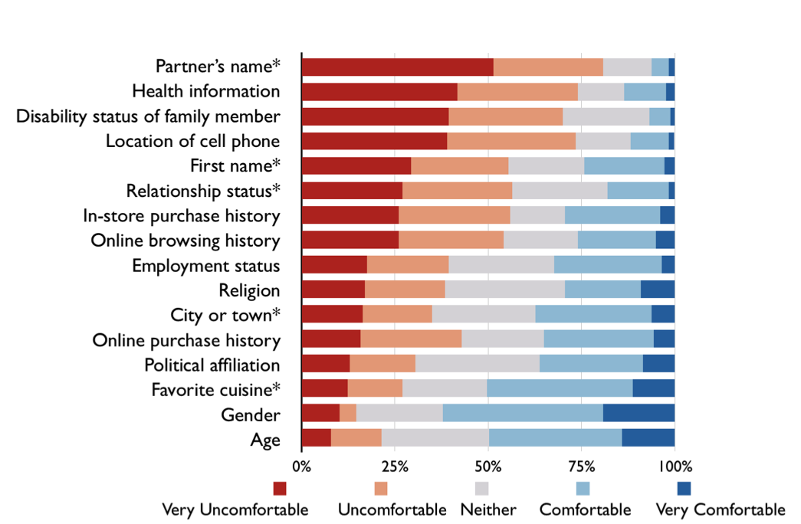
Users have negative opinions on targeted ads
Madyson Kelly
Privacy Paradox
Concerned, Surprised, Uncomfortable
Still shared personal information
Those marked with a * were used in the personalized ads
[4]
Notes:
A study of 305 participants found that many users had negative reactions to personalized robotexts and online banner advertisements. [4]
Some participants received generic ads while others received personalized ads. [4]
The personalized ads included information, such as a user’s location or spouse’s name. [4]
The participants that received personalized ads said they felt concerned, surprised, and uncomfortable when they read the ads. [4]
However, as another part of the study, the participants were asked to answer questions varying in potential invasiveness. [4]
On average the participants answered 37.1 out of 43 of these questions (86.3%). [4]
19.2% participants said that they did not feel at risk giving these answers and 12.9% didn’t even remember giving the answers in the first place. [4]
Although participants willingly gave information to create these personalized ads, they still felt uncomfortable when they saw the ads. This is an example of a privacy paradox. [4]

Slide 15
References
Madyson Kelly
[1] Abraham, Magid. “The Off-Line Impact of Online Ads.” Harvard Business Review, 1 Aug. 2014, hbr.org/2008/04/the-off-line-impact-of-online-ads#.
[2] Brady, Robert. “How Google Collects Data to Personalize Ads.” Practical Ecommerce, Practical Ecommerce, 2 Sept. 2019, www.practicalecommerce.com/how-google-collects-data-to-personalize-ads.
[3] “Business Help Center.” Facebook Business Help Center, 10 Apr. 2021, www.facebook.com/business/help/397103717129942?id=1913105122334058.
[4] Hanson, Julia, et al. “Taking Data Out of Context to Hyper-Personalize Ads: Crowdworkers’ Privacy Perceptions and Decisions to Disclose Private Information.” ACM Digital Library, Association for Computing Machinery, Apr. 2020, dl-acm-org.ezpxy-web-p-u01.wpi.edu/doi/pdf/10.1145/3313831.3376415.
[5] Ekine, Renata. “How to Get Started with Facebook's Dynamic Ads.” Newsfeed.org, newsfeed.org/how-to-get-started-with-facebooks-dynamic-ads/.

Slide 16
References
Madyson Kelly
[6] Joseph, Seb. “As Online Shopping Intensifies, e-Commerce Marketers Are Becoming Increasingly Reliant on Facebook's Ads.” Digiday, 25 Aug. 2020, digiday.com/media/as-online-shopping-intensifies-e-commerce-marketers-are-becoming-increasingly-reliant-on-facebooks-ads/.
[7] Richter, Felix. “Infographic: Targeted Ads: Interesting or Intrusive?” Statista Infographics, 23 May 2019, www.statista.com/chart/18146/view-of-targeted-online-advertising-among-americans/.
[8] “Targeting Your Ads.” Google Ads Help, Google, support.google.com/google-ads/answer/1704368?hl=en.
[9] “Why You're Seeing an Ad.” Google Account Help, Google, support.google.com/accounts/answer/1634057?p=adssettings_gapnac&hl=en&visit_id=637535767846244793-1135113488&rd=1. [5] Ekine, Renata. “How to Get Started with Facebook's Dynamic Ads.” Newsfeed.org, newsfeed.org/how-to-get-started-with-facebooks-dynamic-ads/.

Slide 17
Large-scale Published data needs
Differential Privacy
Javier Salido

Slide 18

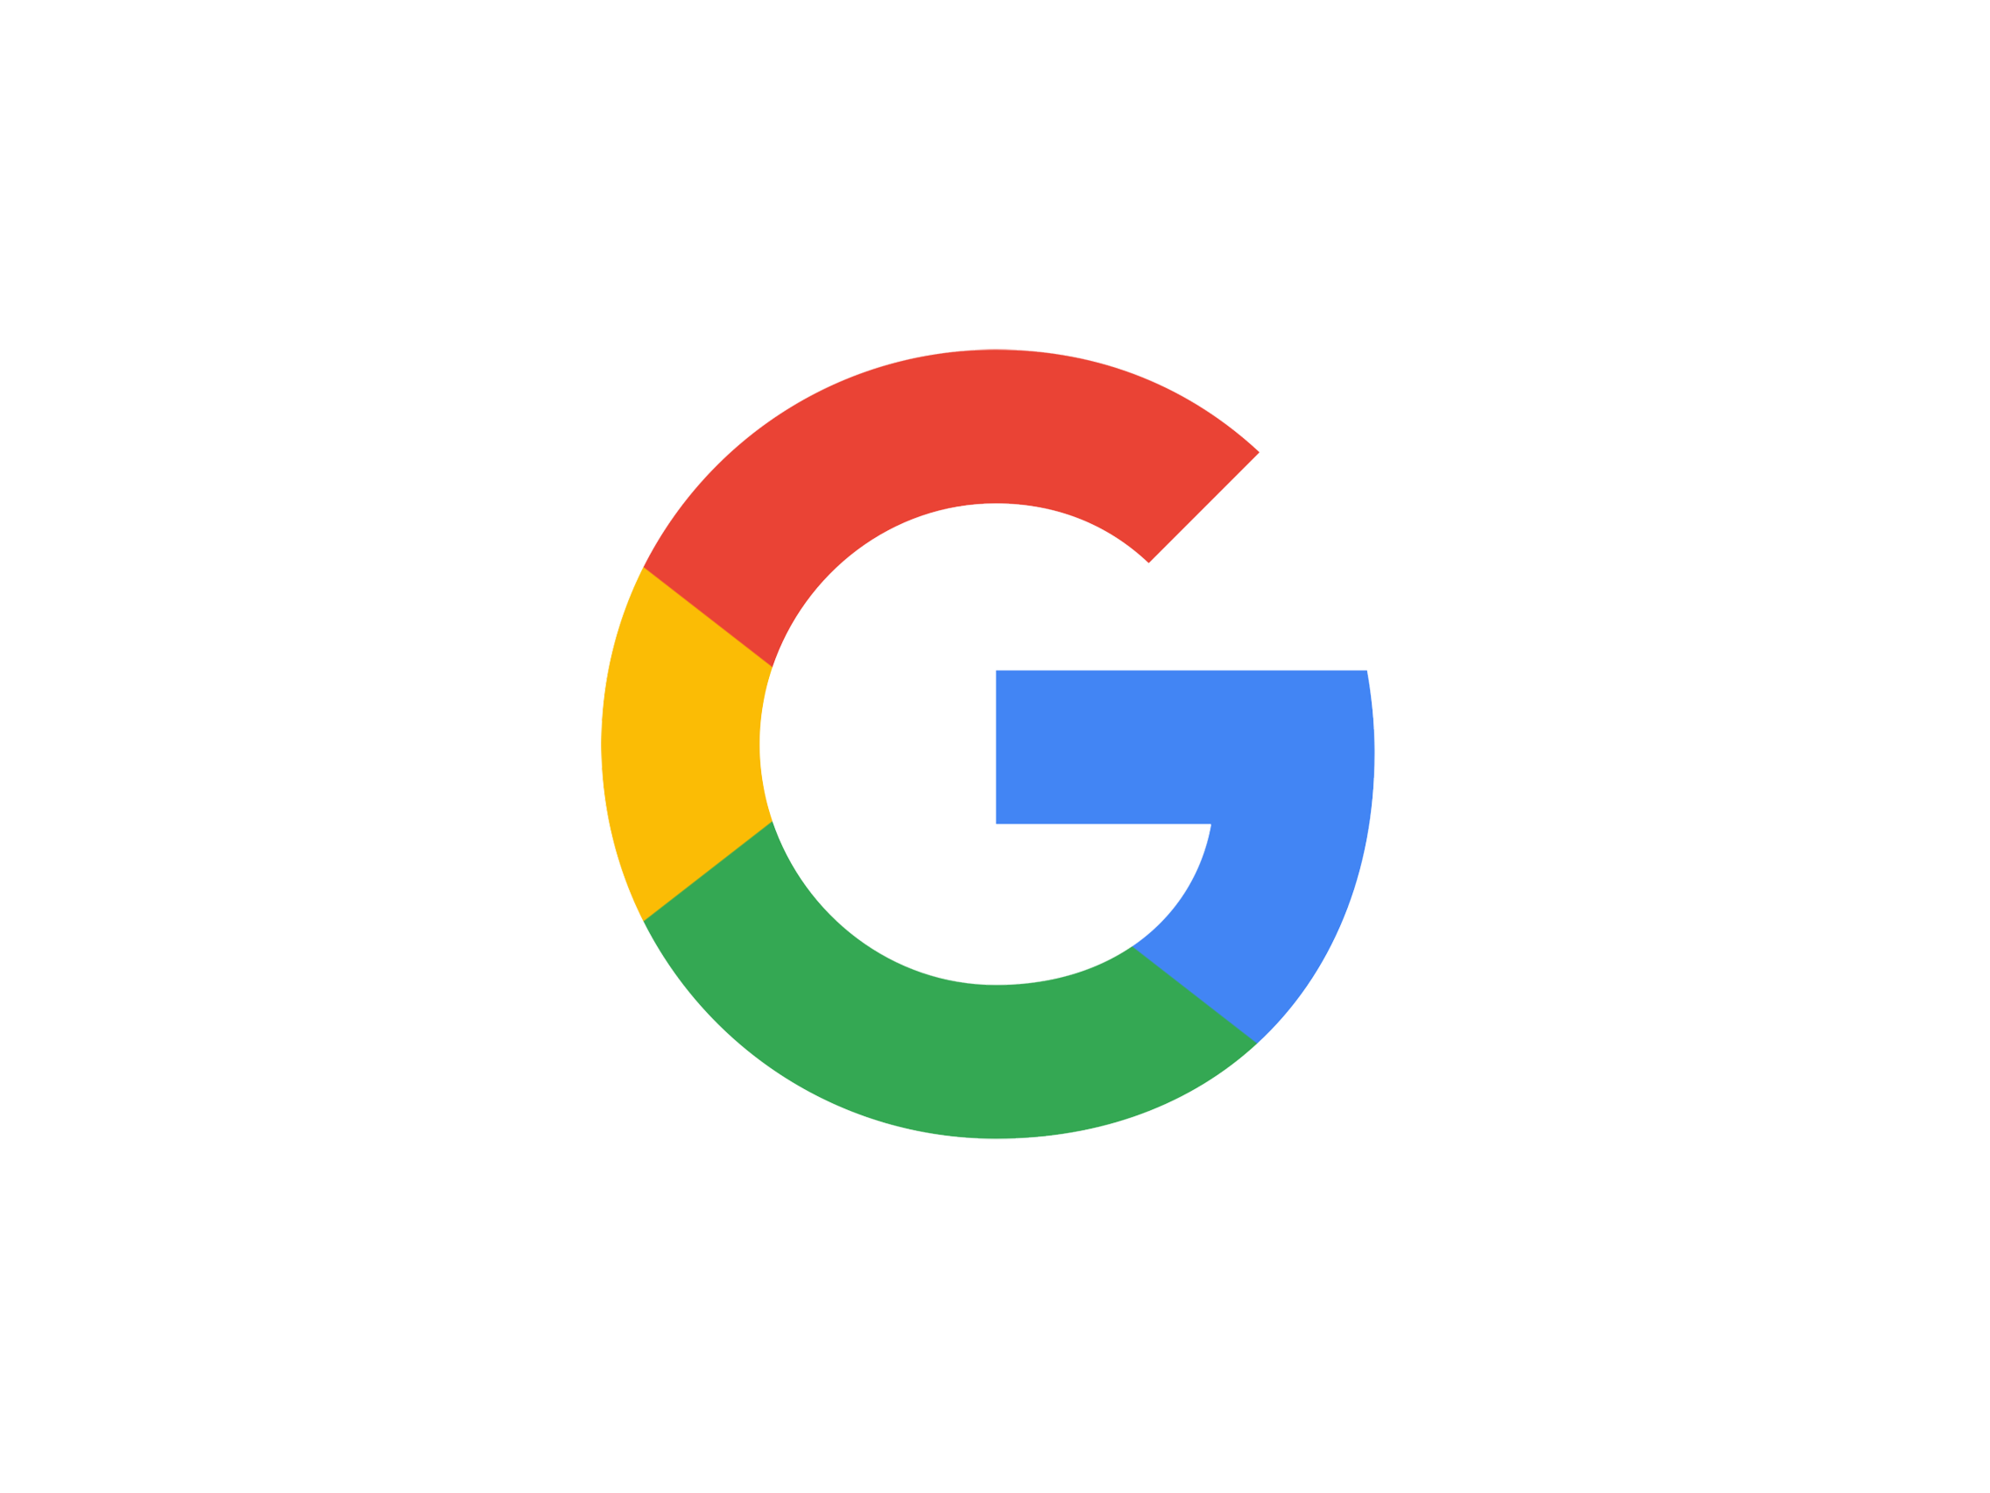

Formal, not ad-hoc
Javier Salido
Currently no other “formal” definitions of privacy
Mathematical definition
Quantifies the level of privacy leakage
Understand future risks
Notes:
Other approaches are done ad-hoc, and fail to appropriately acknowledge and address the risks, much less quantify them
Differential Privacy can be mathematically described and therefore understood to a measurable degree
As more data is published, traditional methods of making information private fail to stand up to scrutiny

Slide 19
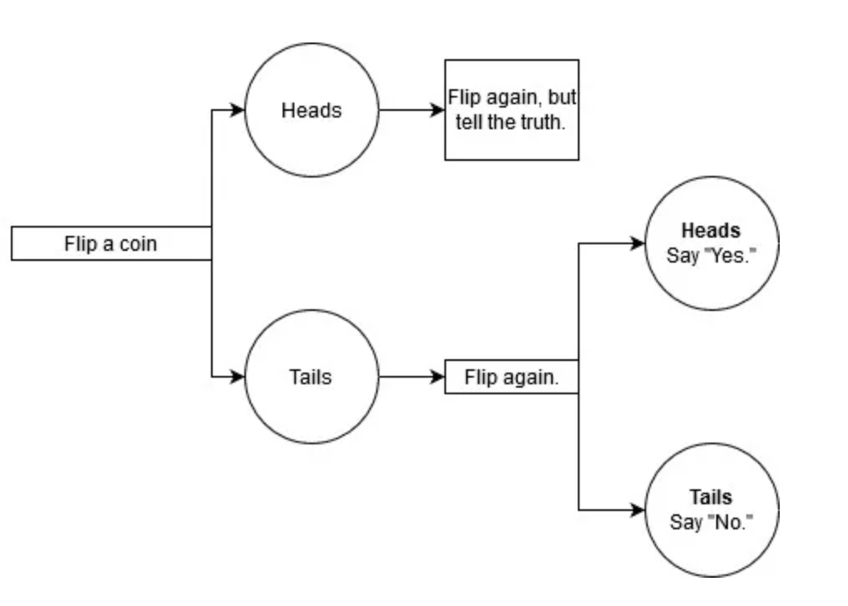
How does it work?
Javier Salido
Adds noise
Depends on the type of analysis
In Short:
“No new information can be discovered about a specific individual that is not already true for all individuals in the group.”
DP - Proportion Estimation
Notes:
DP adds noise in order to obscure the true information while preserving the trend that is being analyzed
The exact implementation depends on the type of analysis being performed
Toy example – what if the SAHMSA wants information on the proportion of people who have used Oxycodone for recreational purposes

Slide 20
Why is this necessary?
Javier Salido
Reconstruction attacks
“Fundamental Law of Information Recovery”
Famous Examples
IMDB & Netflix Datasets: Movie critic de-anonymization
Massachusetts Health and Voter Datasets: Private health information de-anonymization
<Graphic as big as will fit>
Address | Annual Income | Fav. Color
Undersea Pineapple | $70,402 | Beige
4 Privet Drive | $0.34 | Red
221B Baker St. | $61,132 | Pink
Half-Blood Hill | $10,210 | Blue
Waystone Inn | $16,372 | Black
Notes:
Why can’t we remove identifiers or mix it up? Why is DP necessary?
Reconstruction attack involves your data and any other publicly or easily accessible database
Described by some as the fundamental law of information recovery – the more new information can be found within the data, the less private it is

Slide 21
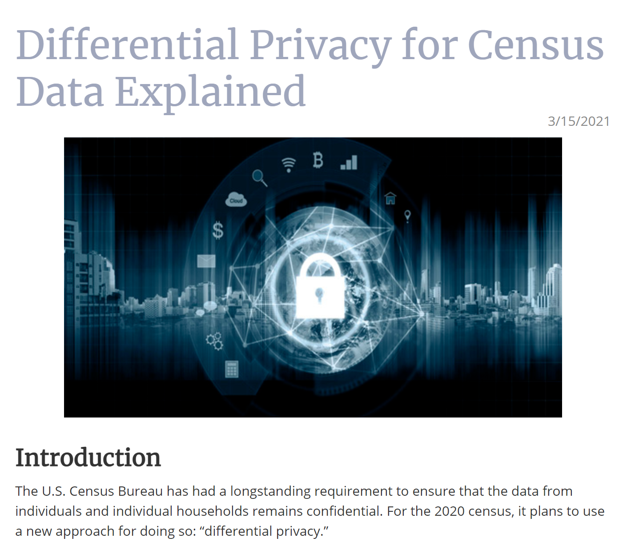
Why Should I Care?
Javier Salido
There is some debate:
  Adding noise destroys other information
Laws lag behind technology
WE NEED DATA
Notes:
Knowledge about the subject empowers those who would defend it
Groups who want to extract more information from the data than what it was intended for will argue against the introduction of noise see:
Republican gerrymandering in Alabama and civil rights groups
Laws need to have public support and legislation will lag behind so much of the responsibility falls on the engineers and even consumer groups to push for more privacy
We need information to improve society, see timeline and Germany/France post WWII

Slide 22
References
Javier Salido
[1] Abowd, John M.. Washington Statistical Society Julius Shiskin Memorial Award Seminar: How Will Statistical Agencies Operate When All Data Are Private?, (2016). https://www2.census.gov/cac/sac/meetings/2016-09/2016-abowd_2.pdf, April 2nd, 2021.
[2] Auxier, Brooke. Rainie, Lee. Anderson, Monica. Perrin, Andrew. Kumar, Madhu. Turner, Erica. (Pew Research Center, 2019). https://www.pewresearch.org/internet/2019/11/15/americans-and-privacy-concerned-confused-and-feeling-lack-of-control-over-their-personal-information/, April 2nd, 2021.
[3] Braun, Andrew. (Uqnic Network Pte Ltd., March 20, 2020) https://www.maketecheasier.com/differential-privacy-keeping-data-useful-confidential/, April 10th, 2021.
[4] Czajka, John. Schneider, Craig. Sukasih, Amang. Collins, Kevin. Minimizing Disclosure Risk in HHS Open Data Initiatives (Mathematica Policy Research, 2014). https://aspe.hhs.gov/report/minimizing-disclosure-risk-hhs-open-data-initiatives/re-identification-individuals-data-released-public#:~:text=The%20most%20famous%20re-identification%2C%20which%20predated%20the%20HIPAA,employees%20discharged%20from%20hospitals%20%28Cavoukian%20and%20Castro%202014%29, April 2nd, 2021
[5] Dwork, Cynthia. Roth, Aaron. The Algorithmic Foundations of Differential Privacy, (Foundations and Trends® in Theoretical Computer Science Vol. 9, Nos. 3–4 , 2014), https://www.cis.upenn.edu/~aaroth/Papers/privacybook.pdf, April 2nd, 2021.
[6] Riccardi, Nicholas. Schneider, Mike. Alabama sues to stop redistricting delay, privacy initiative. (Associated Press, March 10, 2021). https://apnews.com/article/alabama-redistricting-lawsuits-census-2020-courts-9627c66d67629942d2f961bf781f4309, April 2nd, 2021.
[7] Sweeney, Latanya. Simple demographics often identify people uniquely. https://dataprivacylab.org/projects/identifiability/index.html, April 2nd, 2021.
[8] National Conference of State Legislatures. Differential Privacy for Census Data Explained. (NCLS, 2021). https://www.ncsl.org/research/redistricting/differential-privacy-for-census-data-explained.aspx, April 2nd, 2021
[9] Salido, Javier. Differential Privacy for Everyone. (Microsoft Corp., 2012). Link found here: https://www.microsoft.com/security/blog/2012/11/05/the-promise-of-differential-privacy/ , April 5th, 2021.

Slide 23
Deep Fakes Threaten Privacy
Nour Elmaliki

Slide 24
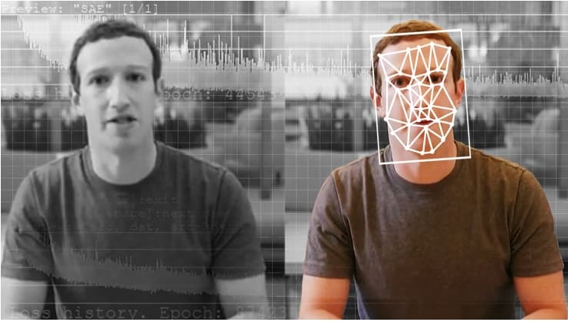
DEEP fake = “DEEP Learning” + “Fake”
Nour Elmaliki
Generative Adversarial Network designed to create images/videos of people[4]
Elyse Samuels | Washington Post
Notes:
Generative Adversarial Network is two competing Neural Nets. One attempts to create an image and the other one tries to detect if a given image was generated by that network. They compete against each other and improve until the image is desirable.
These networks can create images/videos of a given person or generate completely new people

Slide 25
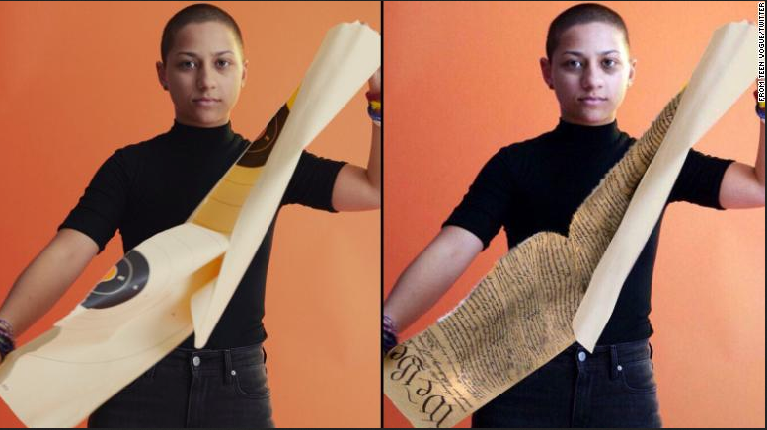
Why are deepfakes SCARy?
Nour Elmaliki
Disinformation
  Governments and other interests use Deep Fakes to create false narratives
Personal Damages
  90% depict non-consensual porn[1]
  Phishing
Widespread availability
  Anyone can create Deep Fakes
  Social Media = training data
Iapp.org
Notes:
Privacy = the ability to withhold private information from the public. Deep Fakes have the capability of creating “private information” and making it public knowledge regardless if it is true. A study by Amnesty International investigated the effects of similar abuse on twitter and showed that women who experience this kind attack are discouraged from ever participating online again. Deep Fakes create many opportunities for Phishing and blackmail. Someone could steal the likeness of your boss to convince you to do something seemingly innocent at your workplace. Or they could generate a video of you in a compromised position and threaten to release it to the public. The number of applications of Deep Fakes is only matched by its growing availability. The computing technology is easily available now, anyone can create a Deep Fake and most people have enough personal data online to have a deep fake made of them.

Slide 26
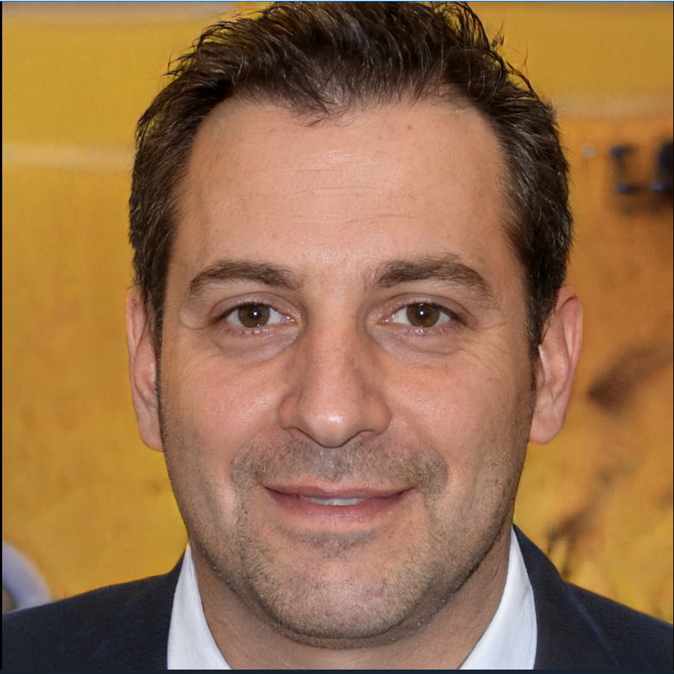
Limitations of current protections
Nour Elmaliki
Legislation[2]:
  Defamation, False Light, and Emotional Distress laws
  Vs Freedom of Speech
Detection[3]:
  Use Machine Learning to detect Machine Learning
  Will always be an Arms race between detectors and creators[3]
Generated from: https://thispersondoesnotexist.com/
Notes:
United States specifically has little digital privacy protections. Previous cases have (more or less) successfully argued the above protections in cases of deep fakes. False light = Defamation but not entirely false just misleading. More specific protections have been proposed but it’s a careful balance between privacy and freedom of speech. Even if Deep Fakes can fool people, machine learning can be employed to detect doctored images.

Slide 27
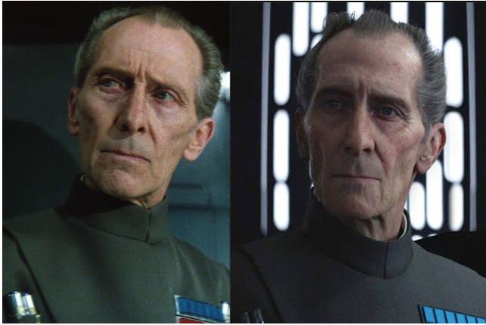
Alternate Uses of Deep Fakes
Nour Elmaliki
Brighter AI replaces faces to prevent facial recognition [5]
Grand Moff Tarkin was a combination of live acting and CGI
MyHeritage app animates pictures of family members to “Experience family history like never before” [6]
See Honorable Mentions at the end
Pinterest.com
Notes:
Not all Deep Fakes are nefarious. Brighter AI is trying to use Deep Fakes to protect privacy by replacing images of people with Deep Faked imaginary people. This would prevent someone from using pictures of you online to steal your identity or create a deep fake of you. Similar technology has already been employed in Hollywood and discussion about the ownership of someone’s likeness is an entire new presentation. Myheritage App animates family photos so you can see your great grandparents looking around and breathing and stuff. The app just shows how easy it is to create a DeepFake just from your phone. Deep fakes have been useful for comedy and entertainment (see the youtube videos at the end).

Slide 28
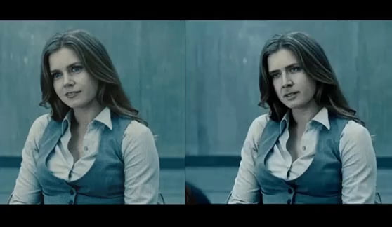
Ethical Questions
Nour Elmaliki
Is it okay to make a Deep Fake of someone with or without their consent?
  How does the intent/contents of the fake change the ethical calculus?
What if the Deep Fake is clearly labelled?
  Honesty
Superman: Man of Steel
Notes:
I would argue that creating and publishing a deep fake without labelling it as such is immoral, regardless of the consent of the people portrayed in the media. Misleading people online is still dishonesty and most* ethical frameworks have lying firmly in the “bad person stuff” camp. Not having the consent of the people in the video is even worse as you are at best stealing their likeness and at worst you are ruining their reputation. If the Deep Fake is clearly labelled, then it’s a completely different story. There are many comedy videos online of deep fakes from popular tv and movies. In this situation I would argue that these are okay, famous actors already have little to no expectation of privacy and the content can’t really harm their reputation since everyone knows it’s a fake.

Slide 29
References
Nour Elmaliki
[1] Sophie Compton, More and More Women Are Facing the Scary Reality of Deepfakes(Vogue, 2021), https://www.vogue.com/article/scary-reality-of-deepfakes-online-abuse
[2] Nicholas Schmidt, Privacy law and resolving 'deepfakes' online(IAPP, 2019), https://iapp.org/news/a/privacy-law-and-resolving-deepfakes-online/
[3] John Villasenor, Artificial intelligence, deepfakes, and the uncertain future of truth(Brookings, 2019), https://www.brookings.edu/blog/techtank/2019/02/14/artificial-intelligence-deepfakes-and-the-uncertain-future-of-truth/
[4] Graco Shao, What ‘deepfakes’ are and how they may be dangerous(CNBC, 2019), https://www.cnbc.com/2019/10/14/what-is-deepfake-and-how-it-might-be-dangerous.html
[5] John Koetsier, This AI Deepfakes Reality In The Name Of Privacy(Forbes, 2020), https://www.forbes.com/sites/johnkoetsier/2020/10/07/synthetic-faces-this-ai-falsifies-reality-in-the-name-of-privacy/?sh=3a57252035a1
[6] https://www.myheritage.com/deep-nostalgia/…

Slide 30
Honorable mentions
Nour Elmaliki
Better Call Trump - https://www.youtube.com/watch?v=Ho9h0ouemWQ
Bill Hader Becomes Al Pacino - https://www.youtube.com/watch?v=kjI-JaRWG7s

Slide 31
Class 6
The End
Keith A. Pray
socialimps.keithpray.net
Notes:
This is the end. Any slides beyond this point are for answering questions that may arise but not needed in the main talk. Some slides may also be unfinished and are not needed but kept just in case.
If there’s time and we didn’t already look at:
Find out what your DNA says about you and your family.
https://www.23andme.com/
Jimmy Kimmel Live – What is your password? (2:49)
https://www.youtube.com/watch?v=opRMrEfAIiI

