Slide 1
Class 5 Intellectual Property
Keith A. Pray
socialimps.keithpray.net
Notes:
Papers expected to be finished tonight. TA Office hours this weekend to be announced. Send email for ad hoc meeting if can’t make those times.
Here’s the title slide. Excited already, aren’t you?
Weird Al Yankovic “Don’t Download This Song” (3:53) 2006-08-21 released exclusively as digital download
https://www.youtube.com/watch?v=zGM8PT1eAvY
Some Analysis Points:
- Slippery Slope Fallacy - CDs were most common way to obtain music - Winner take all society
- Virtue ethics, guilt, shame

Slide 2
what works well Online With Zoom
Sign in with First and Last Name
Stay muted unless you are going to speak
To speak use the raise your hand feature
To answer yes/no questions use the “yes” ”no” buttons
Turn your camera on
Wait until the end of student presentations to ask questions
Write them down so you don’t forget

Slide 3
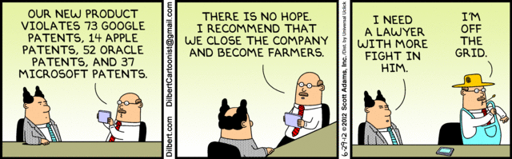
Overview
Review
Assignment
Students Present
Notes:
News: 2021-04-05: SUPREME COURT OF THE UNITED STATES Syllabus GOOGLE LLC v. ORACLE AMERICA, INC. https://www.supremecourt.gov/opinions/20pdf/18-956_d18f.pdf
Accessed 2021-04-09
Comments, observations, questions on IP Chapter?
TODO: Add graph from AON report: 2019 Intangible Assets Financial Statement Impact Comparison Report

Slide 4
My Reading Notes
pp. 165 “...ownership of ideas...” not quite right
pp. 168 public domain year 1997/1999 from source published in 1996?
pp. 170 SaaS, Google Search example? “…before he gave them the plot.”? “…cannot erase the memories...” Paycheck (2003)
pp. 180 4.4 #2 preferred?
pp. 186/196 revenue != profit
pp. 190 blocking 100% seems impossible
pp. 194 Any legitimate BitTorrent use examples since 2005?
pp. 197 “licensing agreement … hardware”? Confidential source code very outdated.
pp. 198 4.7.3 references?
pp. 205 Perhaps friends should not ask you to break the law?
Any successful businesses operate as a support service?
pp. 207 Is Perl still most popular? Quality study from 2003, change?
pp. 209 who uses tape?
pp. 210 “human-readable, lawyer-readable…”
pp. 223 Interview has nothing to do with computing

Slide 5
Group Quiz For each On the left answer a–d on Right
Trademark
Copyright
Patent
Trade Secret
What does it protect?
What qualifications have to be met?
How long does protection last?
Give a specific example currently protected?
Notes:
Trademark
Used to denote a product or service.
Apply in specific areas of commerce. Only applies in specified area of business
Indefinite term as long as in use and protected against becoming a common noun or verb.
You do not have to register a trademark unless you want to bring litigation before a federal court (there are other benefits too, but what are they?)
Copyright
Expression, not ideas: Fuzzy. E.g. derivative works, characters, merchandising, plots.
Mickey Mouse, Tarzan.
US Default : Original Author, Exception: work for hire, Transferred: yes
Rights: Publication, Performance / exhibition, Adaptation to other media, Excerpting, Attribution, Derivative works
US Term: Lifetime of author plus 70 years., 95 years for companies.
Governed by US law and international treaties (e.g. WIPO).
Fair Use: News reporting, reviews, etc., Scholarly / educational use, Private, non-commercial use, Lending libraries and archives
Fair Use restrictions: Admission charge, Re-transmission
In general, you can: Read, view, play, etc., Copy for personal use., Time-shift, Space-shift
In general, you cannot: Copy for others., Transfer to someone else but keep a copy., Show / perform it publicly.
What about video rentals?
Rationale: Encourage creativity. Encourage dissemination. Balance between private and public good. It’s a social contract.
Patent
A mechanism, process, or composition of matter.
Must be: Novel. Useful. Non-obvious. Described clearly. Must do what it says.
Usual term 20 years.
Utility and plant patents: 20 years.
Design patents last 14 years. (ornamental design of functional item)
Provisional patent gives 1 year, before full patent
Trade Secret
You must take steps.
Enforceable by: Contracts, Laws against industrial espionage.

Slide 6
Group Quiz For each On the left answer a–d on Right
Trademark
Copyright
Patent
Trade Secret
What does it protect?
Qualifications required?
How long does protection last?
Specific example currently protected?
Notes:
Trademark
Used to denote a product or service.
Apply in specific areas of commerce. Only applies in specified area of business
Indefinite term as long as in use and protected against becoming a common noun or verb.
You do not have to register a trademark unless you want to bring litigation before a federal court (there are other benefits too, but what are they?)

Slide 7
Group Quiz For each On the left answer a–d on Right
Trademark
Copyright
Patent
Trade Secret
What does it protect?
Mark denoting product or service
Qualifications required?
Unique in specific area of commerce
How long does protection last?
While in use and protected against common noun or verb usage. Need to register to sue.
Specific example currently protected?
Notes:
Trademark
Used to denote a product or service.
Apply in specific areas of commerce. Only applies in specified area of business
Indefinite term as long as in use and protected against becoming a common noun or verb.
You do not have to register a trademark unless you want to bring litigation before a federal court (there are other benefits too, but what are they?)

Slide 8
Group Quiz For each On the left answer a–d on Right
Trademark
Copyright
Patent
Trade Secret
What does it protect?
Qualifications required?
How long does protection last?
Specific example currently protected?
Notes:
Copyright
Expression, not ideas: Fuzzy. E.g. derivative works, characters, merchandising, plots.
Mickey Mouse, Tarzan.
US Default : Original Author, Exception: work for hire, Transferred: yes
Rights: Publication, Performance / exhibition, Adaptation to other media, Excerpting, Attribution, Derivative works
US Term: Lifetime of author plus 70 years., 95 years for companies.
Governed by US law and international treaties (e.g. WIPO).
Fair Use: News reporting, reviews, etc., Scholarly / educational use, Private, non-commercial use, Lending libraries and archives
Fair Use restrictions: Admission charge, Re-transmission
In general, you can: Read, view, play, etc., Copy for personal use., Time-shift, Space-shift
In general, you cannot: Copy for others., Transfer to someone else but keep a copy., Show / perform it publicly.
What about video rentals?
Rationale: Encourage creativity. Encourage dissemination. Balance between private and public good. It’s a social contract.

Slide 9
Group Quiz For each On the left answer a–d on Right
Trademark
Copyright
Patent
Trade Secret
What does it protect?
Expression, not ideas. Derivative work, publication, performance
Qualifications required?
Original
How long does protection last?
Author lifetime + 70 years, 95 years for companies
Specific example currently protected?
Notes:
Copyright
Expression, not ideas: Fuzzy. E.g. derivative works, characters, merchandising, plots.
Mickey Mouse, Tarzan.
US Default : Original Author, Exception: work for hire, Transferred: yes
Rights: Publication, Performance / exhibition, Adaptation to other media, Excerpting, Attribution, Derivative works
US Term: Lifetime of author plus 70 years., 95 years for companies.
Governed by US law and international treaties (e.g. WIPO).
Fair Use: News reporting, reviews, etc., Scholarly / educational use, Private, non-commercial use, Lending libraries and archives
Fair Use restrictions: Admission charge, Re-transmission
In general, you can: Read, view, play, etc., Copy for personal use., Time-shift, Space-shift
In general, you cannot: Copy for others., Transfer to someone else but keep a copy., Show / perform it publicly.
What about video rentals?
Rationale: Encourage creativity. Encourage dissemination. Balance between private and public good. It’s a social contract.

Slide 10
Group Quiz For each On the left answer a–d on Right
Trademark
Copyright
Patent
Trade Secret
What does it protect?
Qualifications required?
How long does protection last?
Specific example currently protected?
Notes:
Patent
A mechanism, process, or composition of matter.
Must be: Novel. Useful. Non-obvious. Described clearly. Must do what it says.
Usual term 20 years.
Utility and plant patents: 20 years.
Design patents last 14 years. (ornamental design of functional item)
Provisional patent gives 1 year, before full patent

Slide 11
Group Quiz For each On the left answer a–d on Right
Trademark
Copyright
Patent
Trade Secret
What does it protect?
Mechanism, process, composition of matter
Qualifications required?
Novel, useful, non-obvious, described clearly, must function
How long does protection last?
Utility and plant: 20 years
Design: 14 years
Provisional adds 1 year
Specific example currently protected?
Notes:
Patent
A mechanism, process, or composition of matter.
Must be: Novel. Useful. Non-obvious. Described clearly. Must do what it says.
Usual term 20 years.
Utility and plant patents: 20 years.
Design patents last 14 years. (ornamental design of functional item)
Provisional patent gives 1 year, before full patent

Slide 12
Group Quiz For each On the left answer a–d on Right
Trademark
Copyright
Patent
Trade Secret
What does it protect?
Qualifications required?
How long does protection last?
Specific example currently protected?
Notes:
Trade Secret
Anything with business value
You must take steps to keep it secret: Non Disclosure Agreement, protected storage, compartmentalization, etc.
As long as the secret is kept
Enforceable by: Contracts, Laws against industrial espionage.

Slide 13
Group Quiz For each On the left answer a–d on Right
Trademark
Copyright
Patent
Trade Secret
What does it protect?
Anything
Qualifications required?
Must take steps to keep secret, e.g. Non-Disclosure Agreements, contracts
How long does protection last?
As long as kept secret
Specific example currently protected?
Notes:
Trade Secret
Anything with business value
You must take steps to keep it secret: Non Disclosure Agreement, protected storage, compartmentalization, etc.
As long as the secret is kept
Enforceable by: Contracts, Laws against industrial espionage.

Slide 14
Overview
Review
Assignment
Students Present
Notes:
But first take a look at:
CGP Grey
Copyright: Forever Less One Day (6:27)
https://www.youtube.com/watch?v=tk862BbjWx4
Tom Scott
http://tomscott.com
Welcome To Life (2:44)
https://www.youtube.com/watch?v=IFe9wiDfb0E&feature=youtu.be

Slide 15
Assignment - Self Search 1/3
Profile 2
Is You
1 Page
Paper
Filter
Inspiration
Search Methods
…
…
…
…
Filter
Profile 1
Could Be You

Slide 16
Assignment - Self Search 2/3 Discussion Board
Post search techniques
Do not repeat entries.
Use techniques listed to produce a profile that could be you.
Not responsible for techniques posted less than 24 hours before due
Filter first profile so that the information is for you.
Provide as paper appendix
Summary is fine. No details needed unless you for making a point.
Consider:
Exactly how did the data get there?
How can this data be used?
Is this a secondary use?
Did you authorized use of the data? If not and you want to, request its use be discontinued and share the experience.
Be creative, anyone can type a name into Google
Do not pay for search services

Slide 17
Assignment - Self Search 3/3 1 Page Paper
Refer to search results to support your conclusion
Subscribe to the Discussion Board
Example questions conclusion could answer:
What impression would the profile make on a potential employer?
What would your elder family members (or equivalent) think?
Are you comfortable with what you found or did not find?
Do you believe protecting your privacy is important or needed?
5 High quality sources still required

Slide 18
Overview
Review
Assignment
Students Present

Slide 19
The Success of failures
Elise Nerden

Slide 20
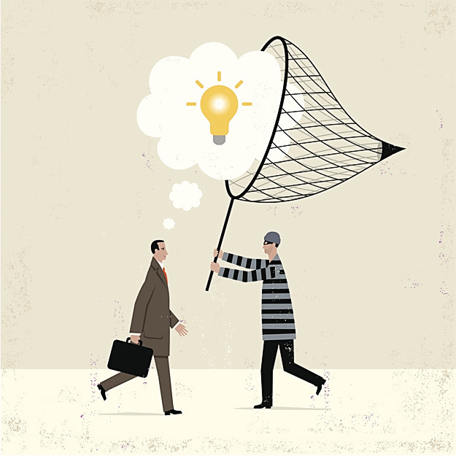
“Stealing” is necessary for innovation
Elise Nerden
May not be ethically correct, but furthers innovation
Building off of other’s ideas
Creator’s interest vs. the public’s interest
[6]
Notes:
Throughout the age of technology, new developments are made by learning from failures. Many of these failures are from other competitors/other companies.
Especially at WPI, we are all told that we need to fail in order to succeed. In the technology industry, it is often learning from others that helps other products/companies succeed, which can be considered “stealing” intellectual property.
The technology industry’s purpose is to keep innovating for the benefit of the public, so stealing intellectual property actually benefits the public and the tech industry itself.
This brings up the question of what is more important, the creator’s interest (which is usually money) or the industry and public’s interest?
I argue that the public/industry’s interest is more important.
Throughout technology history, companies have taken ideas from other companies’ failed products and made a better version of them, or have even stolen the ideas before they were implemented.
Having someone/a team of people from a different background and perspective work on the product can speed up the innovation process.

Slide 21
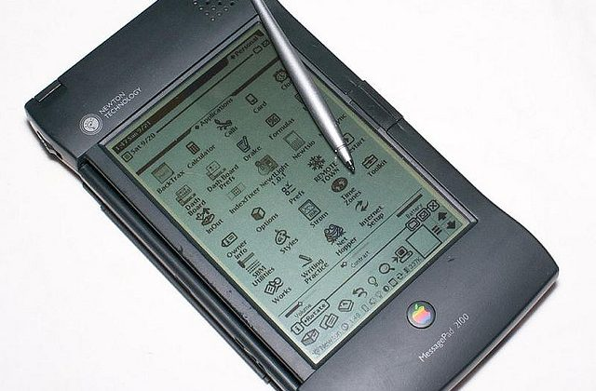

Apple newton vs. palm pilot
Elise Nerden
Apple Newton (1993) was one of the first personal digital assistants
Slow software and not appealing to users
Palm Pilot (1995)
Easier to use and better software
[7]
Palm Pilot 100 (1995) (left)
Palm Treo 650 (2001) (right)
[8]
[1] [2] [3] [4]
Notes:
Before the invention of smartphones, there were personal digital assistants. One of the first personal digital assistants was the Apple Newton.
It was a handheld device that you could write on the screen with a stylus, and the Newton would convert it to text.
The Newton failed for many reasons including inaccurate software, slow software, too big, and too expensive.
The Newton was created when Steve Jobs was “exiled” from Apple and John Sculley was the CEO.
Sculley expected to sell 1 million units in the first year, but only sold 50,000 in the first 3 months.
Steve Jobs stopped the Newton project when he returned to Apple in 1997.
The Palm Pilot was created by Palm Computing. At first they wanted to just make handwriting recognition software that other devices used, but they realized that they could make a
more successful personal digital assistant than the Newton and be a competitor by going off of their idea/product.
The Palm Pilot was smaller, cheaper, and had better software.
The first Palm Pilot sold 1 million units in the first year.
Apple learned from their mistake and started working towards iPhone and iPad when Steve Jobs came back and killed the Newton.
Some may say that Apple did just fine improving upon their own mistakes to create the iPhone, but they learned from the Palm Pilot as well.
The Palm Pilot “boosted” the personal digital assistant market/industry, which Apple was able to build upon. In the image you can see how much the Palm Pilot evolved (many different versions)

Slide 22
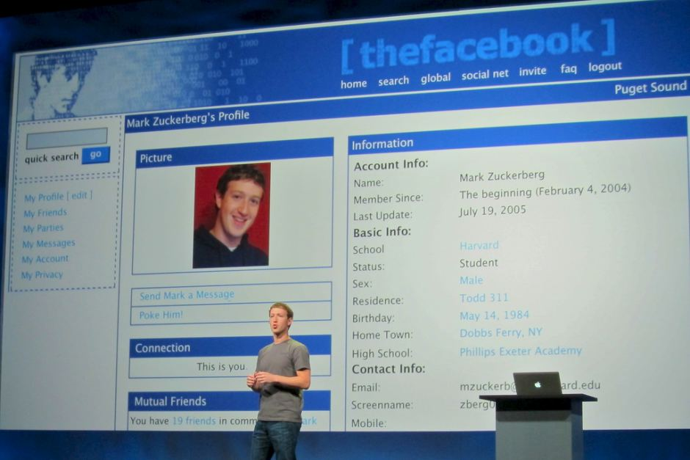
Facebook
Elise Nerden
Zuckerberg stole the original idea
Facebook a better version of the idea
“May the best man win” mentality
Who can create the best version
[9]
[5]
Notes:
Another way to think about gaining success from failures (different type of failure)
Facebook is one of the most infamous examples of success from a stolen idea/failure. Mark Zuckerberg may not have succeeded from witnessing the failure of a produced product, but
he succeeded from the failure of intellectual property protection.
Students at Harvard, Tyler and Cameron Winklevoss and Divya Narendra, asked Zuckerberg to code a web site named HarvardConnections.com for them. Which was supposed to be
A social website for Harvard students and alumni, but eventually spread it to other schools.
Zuckerberg worked on the website, but soon started (a week into the project) working on his own (then called “the Facebook”) and delaying the other.
Zuckerberg’s main goal was to release and finish his project before HarvardConnections. While Zuckerberg did lie to the HarvardConnections group about his progress on the web site in order
to come out with facebook on his own in the end, it was a major technological innovation.
Zuckerberg’s plan worked, because when ConnectU (formerly HarvardConnections) came out after the Facebook (both in 2004), it was not as popular and failed.
If Zuckerberg had not taken the idea and modified it to his version, which he intended to keep growing beyond just schools, social media may not be as advanced and what it is today.
The creation of Facebook led to a whole new industry of social websites, which advanced the tech industry and has led to many other successful social media developments.
The failure of securing the original idea led to a more experienced programmer (Mark) to create a monumental success.
If the original website had been created, it may not have had the same impact as Facebook has.
This idea of “may the best man win” or in this case, the best creator/developer, ensure that the
best technology is created to further innovate the industry and provide these developments to the public – in the end it benefitted the public.
Some may say that if Zuckerberg put the same amount of effort into the HarvardConnections web page instead, it could be as successful as Facebook is today.
But we do not know for sure, and Zuckerberg may have not been able to evolve that website into the success that Facebook is.
Was Mark Zuckerberg the best person to lead this idea/technology? (not talking about his personality)
OVERALL CONCLUSION:
Innovation requires creators to figure out who can make the best version of a product. “Stealing” others ideas and improving them is necessary to keep developing new technologies for
the benefit of the public.

Slide 23
References
Elise Nerden
[1] Tom Huddleston Jr., Remember these failed Apple products? They were some of the tech giant’s biggest flops, (CNBC LLC., Sept 1, 2018) https://www.cnbc.com/2018/08/31/from-the-newton-to-lisa-failed-apple-products.html (Accessed April 2, 2021)
[2] Lisa Eadicicco, Matt Peckham, John Patrick Pullen and Alex Fitzpatrick, The 20 Most Successful Technology Failures of All Time, (TIME USA, LLC., April 3, 2017) https://time.com/4704250/most-successful-technology-tech-failures-gadgets-flops-bombs-fails/ (Accessed April 2, 2021)
[3] Lamin Ben-Hamdane, Apple Newton – how the launch of an innovative product can go wrong, (Linkedin, Jan 14, 2015) https://www.linkedin.com/pulse/apple-newton-how-launch-innovative-product-can-go-lamin-ben-hamdane (Accessed April 3, 2021)
[4] Ina Fried, Palm products through the years (photos), (CNET, April 28, 2010) https://www.cnet.com/pictures/palm-products-through-the-years-photos/7/ (Accessed April 7, 2021)
[5] Nicholas Carlson, At last — the full story of how Facebook was founded, (Insider Inc., Mar 5, 2010) https://www.businessinsider.com/how-facebook-was-founded-2010-3 (Accessed April 4, 2021)

Slide 24
References
Elise Nerden
[6] Behr, Alyson, and Derek Slater. “Stealing Intellectual Property.” CSO, IDG Communications, Inc., 28 Feb. 2019, www.csoonline.com/article/2138380/intellectual-property-protection-10-tips-to-keep-ip-safe.html.
[7] Davies, Chris. “The Apple Newton.” SlashGear, SlashGear, 13 Jan. 2012, www.slashgear.com/apple-newton-15-years-too-early-says-ex-ceo-high-hopes-for-apple-television-13209176/.
[8] Kairer, Ryan. “PalmPilot 100 next to Palm Treo 650.” Palm Infocenter, GlassWave LLC., 27 Mar. 2006, www.palminfocenter.com/news/8493/pilot-1000-retrospective.
[9] Kennedy, Niall. “Facebook History.” ABC, ABC, 24 May 2014, www.abc.net.au/news/2014-05-25/facebook-founder-mark-zuckerberg-and-his-original-profile/5476220?nw=0.

Slide 25
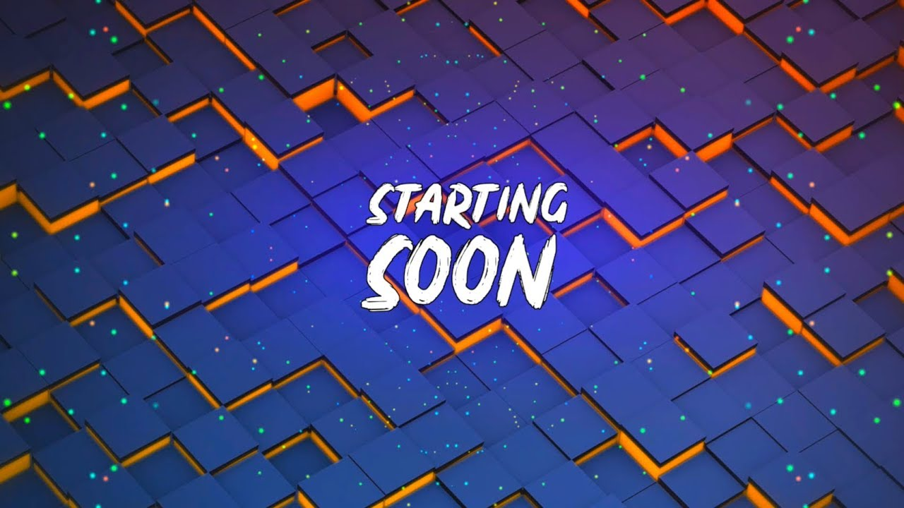
<Talk Title>
Lorenzo Lopez
<Your Name>
Notes:
This slide should be familiar, this happens at the beginning of every stream. Thought it would be a great intro to the topic at hand.

Slide 26
Twitch Takedown
By: Lorenzo Lopez
Notes:
Give a quick introduction about myself and interest in the topic of Twitch Takedowns

Slide 27
Quick Poll
Lorenzo Lopez
Please use the raise hand or yes reaction button
Notes:
How many people in the audience have tuned into a twitch stream?
Was there music present in the background?
If there was not music present, think about how often the streamer interacted with chat / the game and what awkwardness could have been brought on by this?

Slide 28
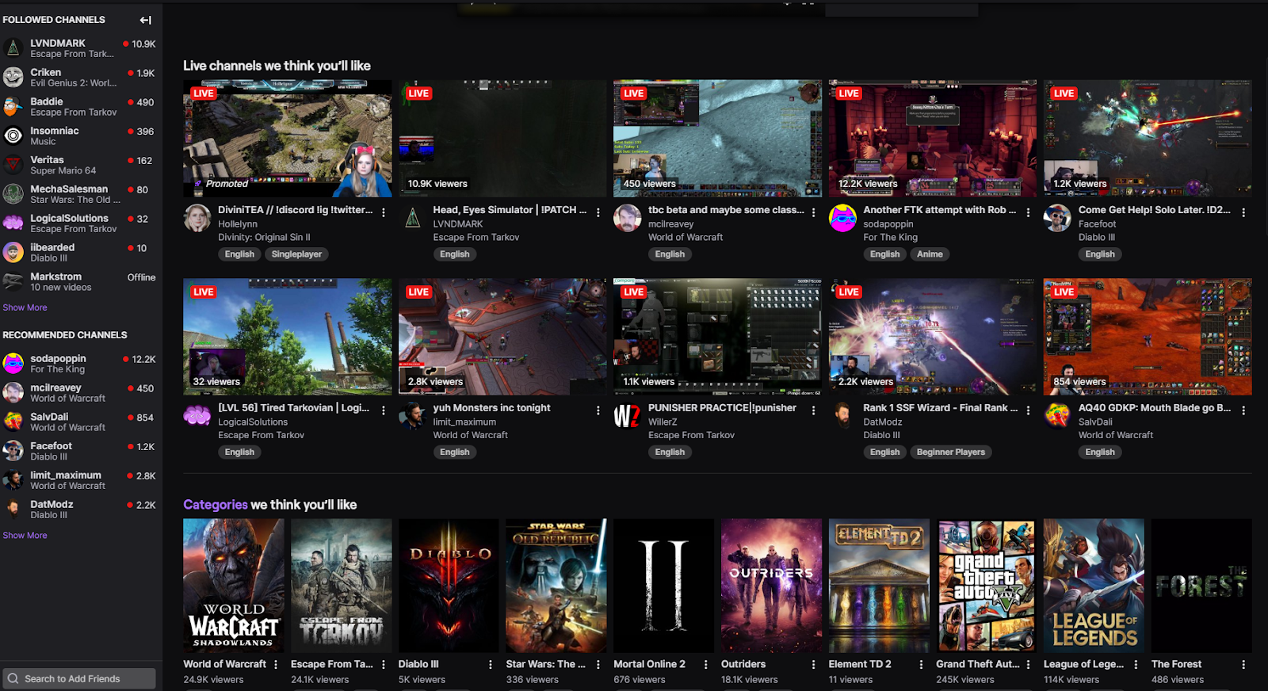
Twitch Takedown
Lorenzo Lopez
By: Lorenzo Lopez
Notes:
This is my twitch screendeck. Almost if not all streamers I tune into have music in the background, if I were to select anyone of these I would hear something other than the game sound and the streamer.

Slide 29
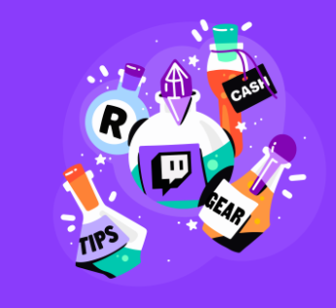
How this Stream started…
Lorenzo Lopez
The impact of COVID-19
Mass Lockdowns
“Free Entertainment”
Unemployment
Twitch DMCA Bonanza
Music Rights
Copyright Strikes
Legal Fees
Notes:
The streaming industry positively benefited from COVID-19 as the mass lockdowns kept individuals within their homes. During IQP I would often work late, past the 9-5 hours. I would turn to twitch to escape the madness and stress of working 100% remote.
It's a form of free entertainment because you choose how you spend your time and most importantly your money. Streamers produce content and viewers choose to support them by subscribing, buying bits and donating.
Streamers that I watched during the initial few months of COVID-19 understood the monetary effects it was on people. They didn't push sub goals, donation goals but rather asked their viewers to make sure they took care of themselves before making the decision.

Slide 30
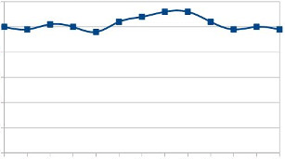
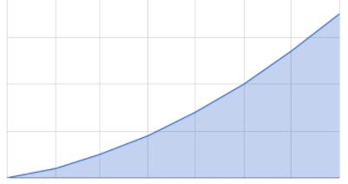
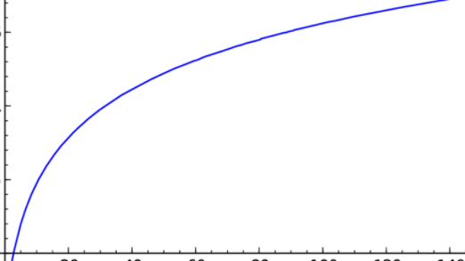
Brief History
Lorenzo Lopez
Twitch DMCA Claims Generalized
Before COVID-19:
Negligible DMCA claims [1]
During COVID-19
Tens of Thousands
Source: IGN [2]
Average number
COVID-19
Proposed amounts
Notes:
Twitch began receiving mass DMCA claims on content that was as old as 2017 to the present day (over the summer and now). We will get into Copyright strikes and legal fees at a later point.
This is a generalized history of the totality of DMCA claims Twitch received prior to COVID-19. Previous years saw roughly 50 or so claims, that seems like a drop in the bucket compared to the size of Twitch. I am hesitant to trust those numbers because of the scale of the platform. There must be violators that are slipping through the cracks, but it might be because they are smaller streamers on the platform, they don't get noticed therefore continue to use pirated music.
This was below the radar until COVID-19 hit. Third party companies were hired by record labels to hunt violators that were using copyrighted music. Twitch suddenly received tens of thousands of claims within a short amount of time that continued to snowball. This carpet coverage hit streamers regardless if they themselves had produced the music, or the games soundtrack was caught in a claim.
I included this proposed graph because currently Twitch has not reported actual numbers. Streamers have evolved as they have requested permission directly from record label companies or developing their own playlists with non-copy righted music.

Slide 31
Long time coming vs. Caught off guard
Lorenzo Lopez
1. Business Entity
Primary goal: $
Keep revenue in constant influx
Potential Lawsuits
Forcefully delete your content
Investors
Good ROI vs Poor
2. Licensed Property
Record Labels
Incalculable claims
Potential Lawsuits
Streamer
Unwarranted but valid claims
Aged like fine wine
Notes:
Twitch is in fact a business and a businesses priority is to make money. Instead of paying for the numerous fines, twitch recommended streamers to delete their copyrighted clips. Investors of twitch were paying close attention to this ongoing fiasco. This has a large impact of what twitch policy equates to and we will get into that on the next slide.
Not only was twitch faced with lawsuits but streamers themselves were facing the brunt of the lawsuits. Court cases in any specialty are expensive, the odds of a streamer fighting this battle and coming out victorious is miniscule. Some of these claims are very outdated but regardless, they are valid claims.

Slide 32
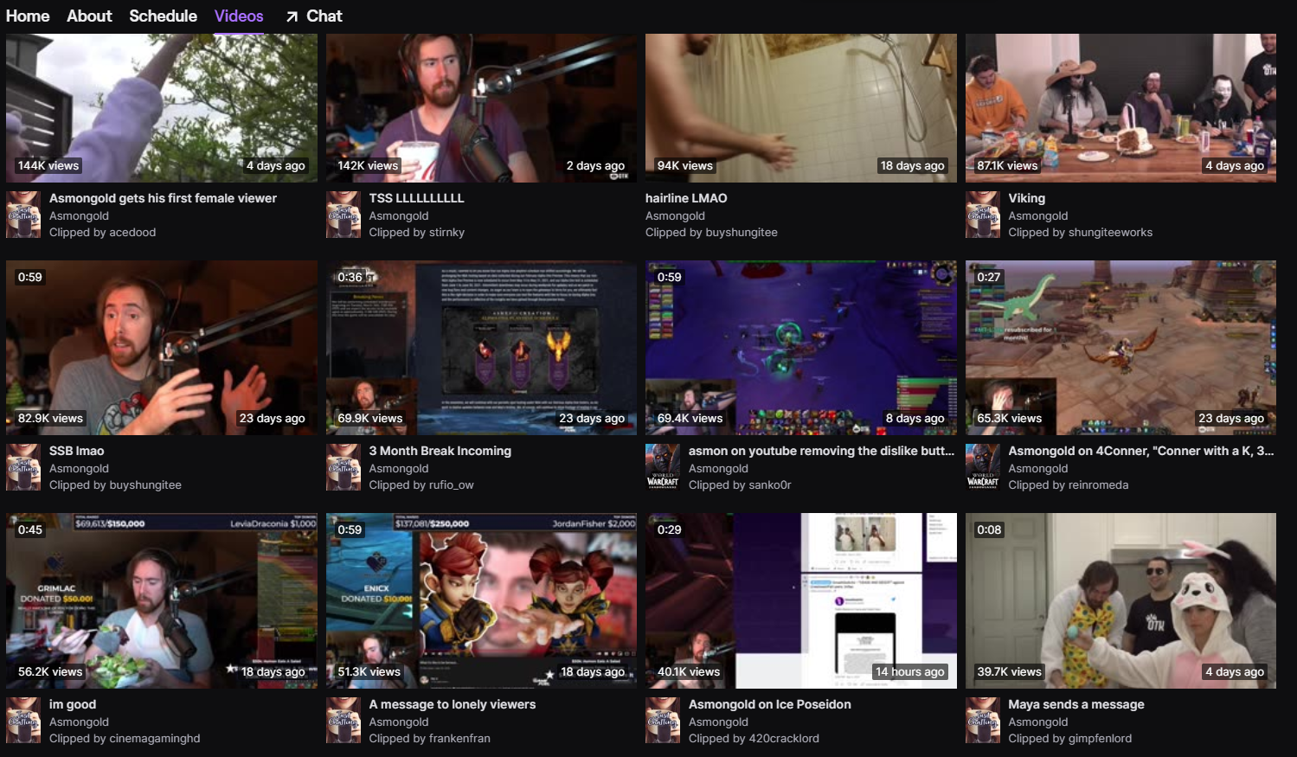

Long time coming vs. Caught off guard cont.
Lorenzo Lopez
3. COVID-19 (50/50 win)
Disclaimer: Monetary outlook
High site traffic
More viewers
Twitch Flaws
Outdated tools
Notes:
I said previously that COVID-19 was beneficial for streamers. With droves of users on the platform during different times of the day, the possibility of getting discovered became that much more achievable. Larger streamers, such as Asmongold had taken a break during late March and just recently returned and his viewers came back stronger than ever. But twitch had some outdated tools, the clip feature mentioned earlier caused the most prolific problems of the DMCA struggle.

Slide 33
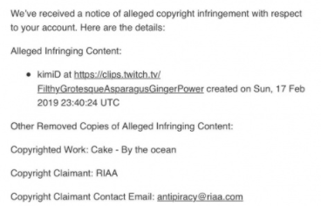
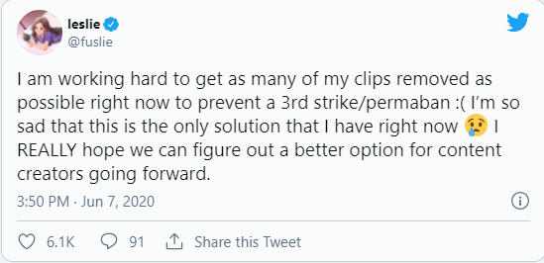
Aged wine…Aged Clips
Lorenzo Lopez
[3]
[5]
“ I don’t know what it is with their system, but they’re recording and they’re looking at infractions from past clips from years ago that are already deleted. Its up to like 250k per infraction past the three-strikes. ” – xQcOW [4]
Notes:
Streamers were not able to delete their clips en mass, they needed to manual delete each clip by itself. If you have thousands of clips, some of the larger streamers do then what are they to do? Twitch left them holding the bag and the bag had many holes in it. Luckily twitch rectified this but it was not after streamers turned to their followers to vent their outrage.
This copyright claim was filed circa June 6, 2020 and the clip was published on Feb 17, 2019. A full year later and then some did the streamer get claimed. Deleting clips is the last thing a streamer wants to do, they are removing a part of the community, their livelihood, memories. xQcOW clearly describes his outrage on the subject.

Slide 34
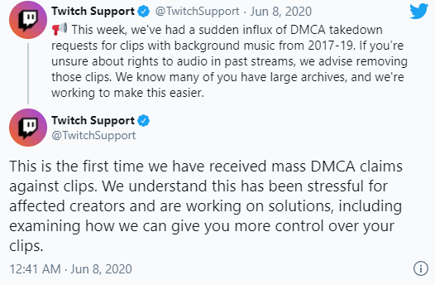
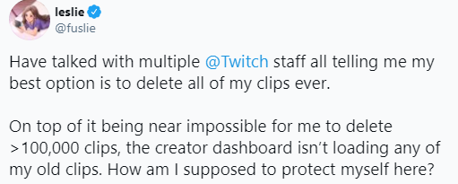
Why should viewers be worried?
Lorenzo Lopez
Twitch has issued several strikes and, in some cases, bans to channels of streamers, including partnered content creators. – Dot Esports [5]
Notes:
Two statements from twitch and another from the streamer in the previous slide. Receiving copyright strikes from twitch is career ending, each strike comes with a ban that increases time away from your community and your revenue.

Slide 35
What is twitch soundtrack?
Lorenzo Lopez
[6]
Streamers pay royalties
(per artist)
Costly
Contracts with Record Labels
Extensive Music Library
Renewing Faith
No scary DMCA Strikes
No Bans
Notes:
Twitch has been developing a product to assist streamers in their fight against DMCA claims. Twitch Soundtrack has a highly curated selection of music chosen by streamers and music artists on the platform. It is a good start for addressing the problem but there are some different avenues twitch can take. For the better interest of their clients, streamers, they could negotiate contracts with record label companies for licensing rights. Streamers would be asked to pay royalties for the artist they are listening to onstream. The same software that allows companies to DMCA music can be used to calculate the number of times a song was played. The streamer would then have to pay for that sum at the end of the month. This renews faith between the twitch - streamer partnership and encourages new streamers to join the platform. This can be extremely costly in the end though, its unseen if twitch would even consider this option as they are a business after all.

Slide 36
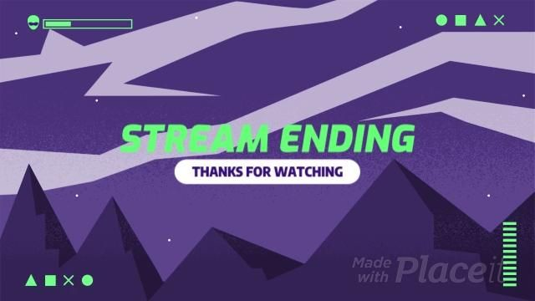
<Talk Title>
Lorenzo Lopez
<Your Name>
Notes:
Are there any questions?

Slide 37
References
Lorenzo Lopez
[1] ---. “Music-Related Copyright Claims and Twitch.” Twitch Blog, blog.twitch.tv/en/2020/11/11/music-related-copyright-claims-and-twitch/. Accessed 8 Apr. 2021.
[2] Kim, Matt. “Twitch Admits It Handled DMCA Takedowns Poorly, Says Better Tools Are on the Way - IGN.” Www.ign.com, 11 Nov. 2020, www.ign.com/articles/twitch-dmca-takedown-apology.
[3] Amos, Andrew. “XQc Slams Record Labels for Going ‘Full Crazy’ over Twitch DMCA Takedowns.” Dexerto, 5 Nov. 2020, www.dexerto.com/entertainment/xqc-slams-record-labels-for-going-full-crazy-over-twitch-dmca-takedowns-1447176/.
[4] Stephen, Bijan. “Twitch Streamers Are Getting Blindsided by Years-Old Copyright Notices.” The Verge, 8 June 2020, www.theverge.com/21284287/twitch-dmca-copyright-takedowns-clips-controversy-broken-system.
[5] Galloway, Ryan. “Asmongold Shares Plan to Fight DMCA on Twitch.” Dot Esports, 11 Nov. 2020, dotesports.com/streaming/news/asmongold-shares-plan-to-fight-dmca-on-twitch.
[6] Twitch. “Customer Support.” Help.twitch.tv, help.twitch.tv/s/article/soundtrack?language=en_US. Accessed 8 Apr. 2021.
Supplemental: Geigner, Timothy. “Twitch Continues to Trip over Itself in Response to DMCA Apocalypse.” Techdirt., 16 Nov. 2020, www.techdirt.com/articles/20201112/13574745696/twitch-continues-to-trip-over-itself-response-to-dmca-apocalypse.shtml.

Slide 38
Copyright and Content Creators
Kersten Prince
Notes:
(Note: Speaker notes are paraphrased)
I would like to start this off with stating the question of “Does the current system of copyright still works for present day content creators?” As I will be explaining, the answer to this is no.
Is this because of Youtube or Twitch or Tiktok or any social media site’s copyright algorithms being broken? Also no.
Might sound surprising to some, but let me explain
(end slide)

Slide 39
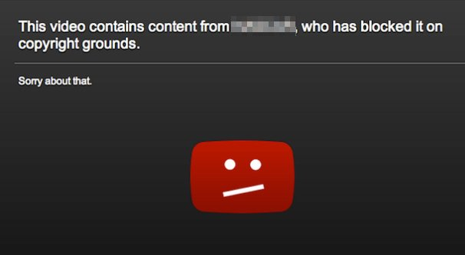
“This video has been taken down for copyright infringement”
Kersten Prince
“Since January 2014, Content ID claims have outnumbered copyright takedowns by more than 50 to 1.” - Google Support, about Youtube
“Amazon-owned live streaming platform Twitch has been hit with ‘thousands’ of DMCA infringement notifications over copyrighted music used in videos.” - Music Business Worldwide, about Twitch
“Over 104.5 million videos were removed from the platform in the first six months of 2020. TikTok also received 1,800 legal requests and 10,625 copyright takedown notices.” - Digital Music News, about Tiktok
Notes:
Who here has searched for a video, found exactly what you were looking for, only for it to pop up with a “This video has been taken down for violating someone’s copyright”
Happens with many social media websites
Youtube has its Content ID system, will get more into youtube later
Twitch has had times where thousands of videos, both for many creators or for a single creator, will be taken down at a time
TikTok, an app that has had a burst of popularity over the past two years, also deals with frequent copyright takedowns (see quote)
Every app, every program, has to set up algorithms or a copyright agreement to work to make sure that companies will not sue them for all the money they make off of the content that is violated.
Content creators, who need to provide content that they viewers enjoy and are interested in, often have to deal with copyright law to avoid their content getting taken down, but without spending exorbitant amounts of money on lawyers, edge cases and issues frequently appear.
(end slide)

Slide 40
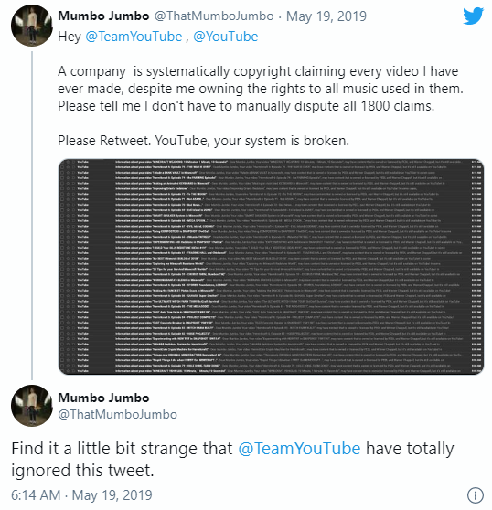
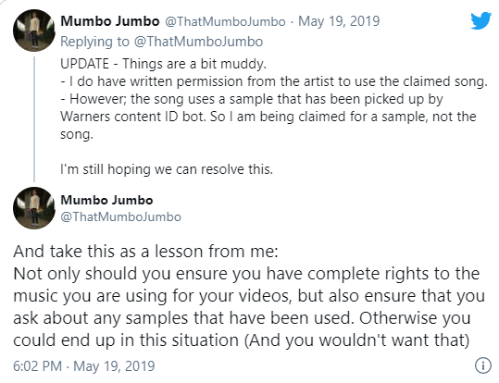
Commentary from Major Independent Creators
Kersten Prince
Notes:
One example: Content creator Ollie
More popularly known as “Mumbo Jumbo”, Ollie at the time stood at 3 million followers, and presently stands at 7.3 million followers
In May of 2019, without warning for the entirety of one morning, hundreds of his videos were taken down systematically for a song that he had asked explicit permission to use
Later discussion and debating eventually revealed that, while he did get permission from the song’s artist, the artist without Ollie’s knowledge has sampled parts from Warners
He had done everything right, he gotten a signed contract with the songwriter, which to his knowledge gave him full permission to the song, and yet he still had to deal with the fallout of copyright law.
(end slide)

Slide 41
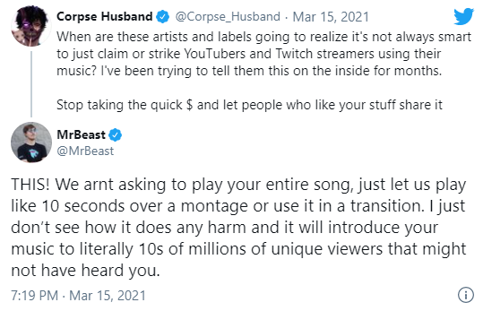
Commentary from Major Independent Creators
Kersten Prince
“Various songs have blown up following the rise of Tik Tok that people would have never heard before. Clearly, the current relationship between music labels and content creators needs improvement.” - Essentially Spots
“This system allows copyright holders, including the major studios, but also smaller companies and individuals, to wildly abuse Youtube’s policies and to restrict the free speech rights of other content creators, to confiscate their earnings, and to damage their livelihood.” - Cartoon Brew
Notes:
Another popular content creator who has spoken on the matter is one known as Corpse Husband.
Corpse, who himself is a songwriter alongside being a content creator, standing at 7.4 million on Youtube, talked in March on the publicity that allowing songs to be used in videos allows for.
Many other content creators, including Mr Beast, who is known for having pushed his fanbase that currently consists of 59.1 million to join the Team Trees challenge, added supportive responses on this
News sites in the past and in response alike have commented on these issues as well.
The rise of popularity of songs via the related Tik Tok trends, for example, has been well documented over the past few years, with songs such as LilNasX’s “Old Town Road” being boosted into leaderboards by its popularity through relevant videos.
It is also worth noting that there is a problem with these algorithms through how easy they are to abuse. 5 magazine wrote in 2019 on how “Last year a musician who uploaded a 10 hour video of white noise – similar to the static on TV – was attacked by 5 notices of infringement. They didn’t want the video taken down – just the revenue from it.”
But, is it unfair to say that the copyright system, which was put in place to ensure that creators get the deserved revenue from their hours of hard work, is only problematic in today’s time?
(end slide)

Slide 42
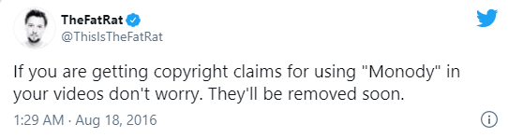
From the Songwriter’s Perspective
Kersten Prince
Notes:
What is the songwriter’s perspective on this?
I included the captioned post as a transition from the last topic, as it does show one part of the songwriter’s perspective relevant to the false copyright claims.
In this case, this songwriter has stated that his songs are free to use and within public domain, and as such many content creators use these songs in videos.
Despite this, copyright claims from people seeking to steal revenue off of the content creators continue to pop up, the captioned post being a response to one case of this.
(end slide)

Slide 43
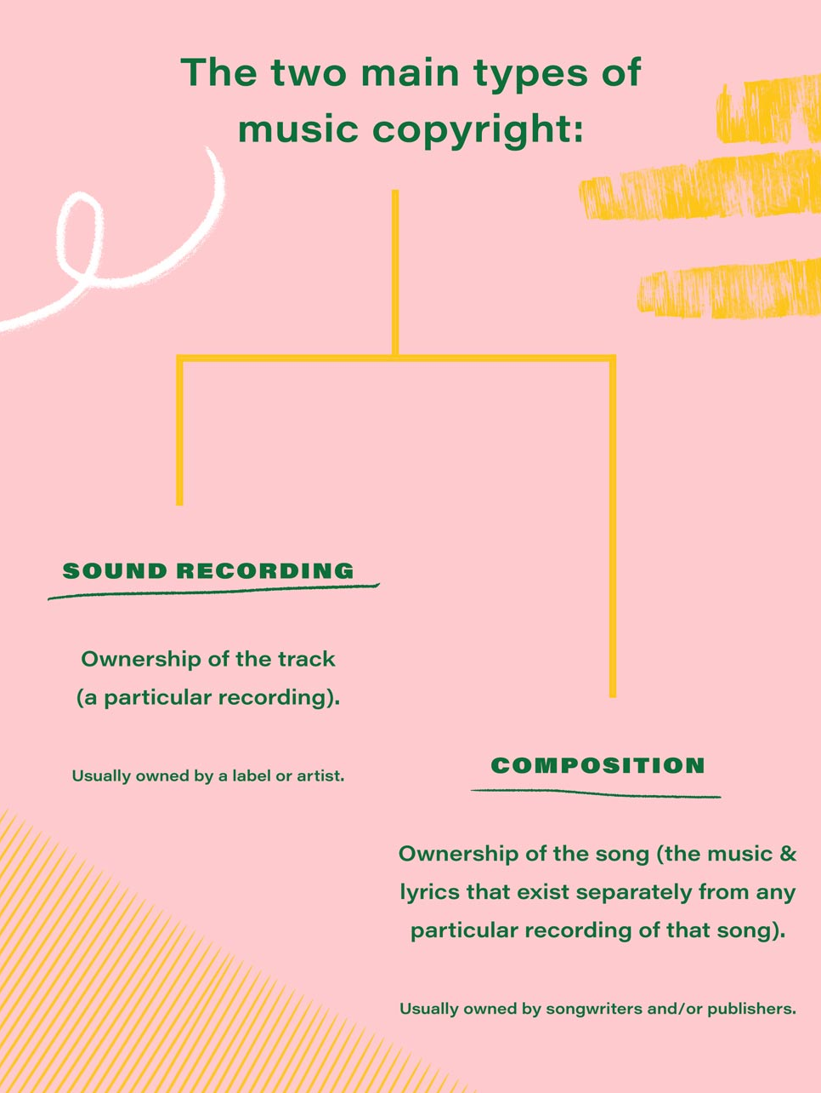
The Complication of Getting Copyright Permission
Kersten Prince
“These (image) license violations have the potential to result in up to €532.5 billion in damages daily.” - Copytrack
“Though copyright affixes to a work upon its creation, in the U.S., you can’t use the courts to enforce those rights until you register it. That will cost you $35 per registration and will take a good chunk of your time.” - Plagiarism Today, 2010
Picture from DIY Musician
Notes:
However, the fact that many people improperly use content under copyright is not something to be brushed aside.
In 2019, Copytrack, an image copywriting service, estimated that up to $532.5 billion occur in damages daily from improper use of images under copyright alone.
Those who create content can spend anywhere from hours to months creating content. Put that in terms of minimum wage, and that can be anywhere from deserving to get a return of a couple 20s to a couple thousand dollars.
Very rarely do artists get this compensation, however, and copyright is in place to try to help them get this deserved compensation.
However, despite existing to ensure that the creators get compensated for their work, there is still a money buffer to get in.
In 2010, over ten years ago, Plagiarism Today reported copyright costing around $35 per registration. That’s one song, one image, one video, and one type of copyright at that.
And that is without taking inflation into account. I found conflicting resources ranging the price of copyright from $50 to $100s.
This makes it very easy for major corporations to be protected, but very hard for small creators to even get started.
(end slide)

Slide 44
Turning a Blind Eye
Kersten Prince
Notes:
And then there is the daily problem of turning a blind eye to these faults.
(end slide)

Slide 45
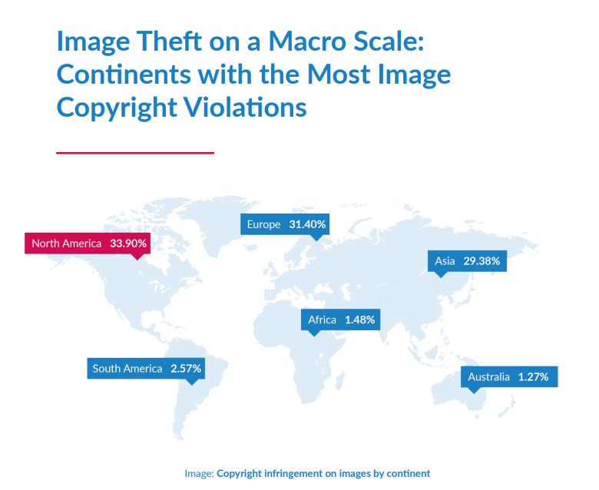
Have you ever done one of these?
Kersten Prince
Website for downloading music, movies, shows, etc for free
Used a gif about from a movie or show to react to something
Sent a screencap of a movie or show.
“Two studies from IMGembed and Copytrack show that of the 3 billion images shared on the internet daily, around 85 percent are used without a valid license.” (Copytrack)
Notes:
Have you ever done one of the listed activities?
Often times, copyright infringement occurs simply due to people not knowing where the line exists. And I could have spent this entire time talking on the number of edge cases that exist to these laws.
Giphy is a common example of one edge case, however. It is “commonly understood” that gifs are under fair use, but a court case has never occurred on this subject. It would be entirely within someone’s right to claim copyright on this as well.
The aforementioned Copytrack estimates that through the internet, of the 3 billion images shared daily, 85% of these images are shared without a valid license. That’s around 2.5 billion images every single day.
So, Does the current system of copyright still works for present day content creators? No.
How do we fix it? Well, that is complicated to say the least, and there is a lot of differing opinions on it. And I am not one for personally discussing politics in class.
(end slide)

Slide 46
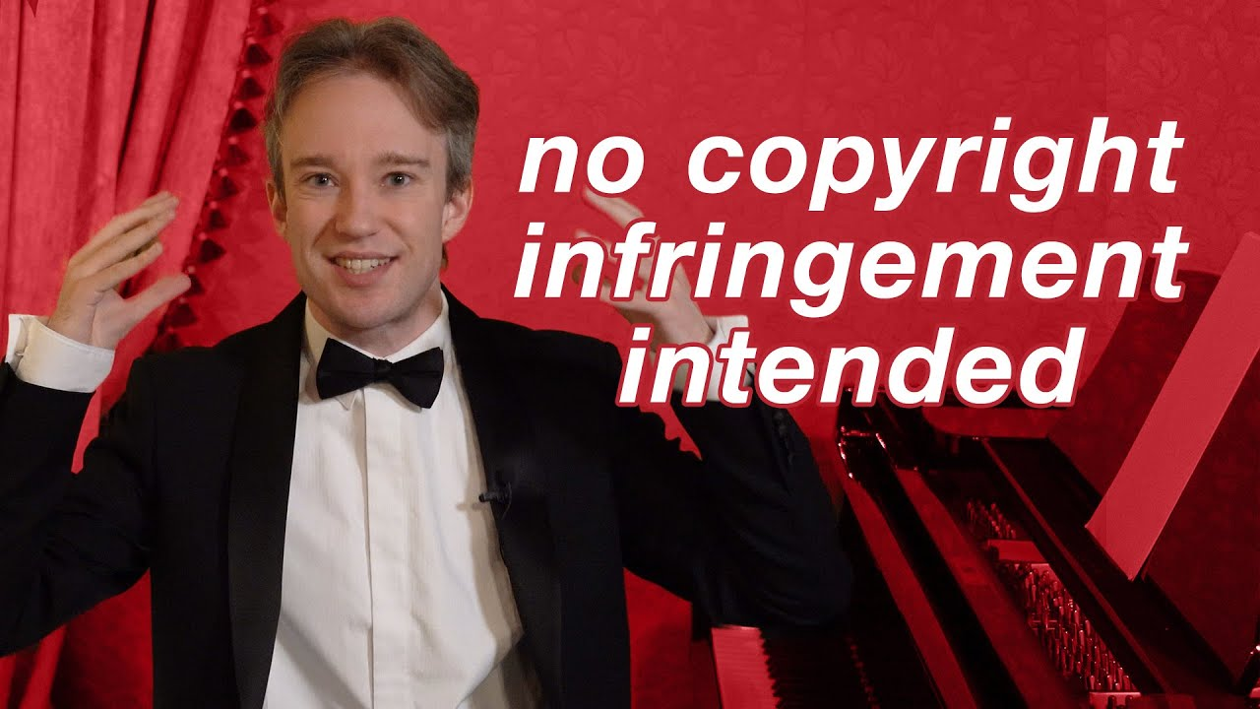
Recommended Resources For Further Learning
Kersten Prince
YouTube's Copyright System Isn't Broken. The World's Is.
https://www.youtube.com/watch?v=1Jwo5qc78QU&t=1849s
42 minute video detailing in depth how Youtube and present day law copyright works in layman’s terms
References
Notes:
If you are interested on this subject and seeing some opinions on how to solve this, I highly recommend doing some personal research.
Tom Scott made a 42 minute video that you can get from this class slide after class that breaks down all of the current problems and some possible solutions.
A few of the articles in the references, can help you learn more about copyright and help you form your own opinion on the matter.

Slide 47
REFERENCES
Kersten Prince
[1] Google, The difference between copyright takedowns and Content ID claims (Google) https://support.google.com/youtube/answer/7002106?hl=en (4/7/2021)
[2] Stassen, Murray, Twitch Music Copyright Headache Gets Worse As ‘thousands’ Of Videos Get Deleted Over Infringement Notices (Music Business Worldwide, October 21, 2020) https://www.musicbusinessworldwide.com/twitch-copyright-headache-gets-worse-as-thousands-of-videos-get-deleted-over-infringement-notices/ (4/7/2021)
[3] King, Ashley, TikTok Received 10,625 Copyright Takedown Notices In the First Six Months of 2020 (Digital Music News, September 22, 2020) https://www.digitalmusicnews.com/2020/09/22/tiktok-transparency-report-2020/ (4/8/2021)
[4] Gabriel, Brian, Internet Creators Are Pressuring Youtube To Respect Fair Use Laws, (Cartoon Brew, February 23, 2016) https://www.cartoonbrew.com/law/internet-creators-pressuring-youtube-respect-fair-use-laws-137274.html (4/7/2021)
[5] Matthew, Terry, YouTuber Receives 400 Copyright Claims Before Lunch, (5 Magazine, May 19, 2019) https://5mag.net/news/mumbo-jumbo-youtube-copyright-warner-chappell/#:~:text=Worse%2C%20Mumbo%20Jumbo%20%E2%80%93%20who%20has,isn't%20your%20money.%E2%80%9D (4/8/2021)

Slide 48
REFERENCES
Kersten Prince
[6] Parthsarthy, Shwetang, Corpse Husband Urges Artists to Refrain From Claiming Content Using Their Music (Essentially Sports, March 16, 2021) https://www.essentiallysports.com/corpse-husband-urges-artists-to-refrain-from-claiming-content-using-their-music-news-esports/ (4/6/2021)
[7] Bailey, Jonathan, 5 Ways Copyright is Screwing Smaller Creators, (Plagiarism Today, October 20, 2010) https://www.plagiarismtoday.com/2010/10/20/5-ways-copyright-is-screwing-smaller-creators/ (4/7/2021)
[8] Rob Ciampa, Theresa Moore, John Carucci, Stan Muller, Adam Wescott, 10 Things to Know About Copyright and YouTube, (Dummies) https://www.dummies.com/business/marketing/social-media-marketing/10-things-to-know-about-copyright-and-youtube/ (4/6/2021)
[9] Franklin Graves and Michael Lee, The Law of YouTubers: The Next Generation of Creators and the Legal Issues They Face, (The American Bar Association, May/June 2017) https://www.americanbar.org/groups/intellectual_property_law/publications/landslide/2016-17/may-june/law-youtubers-next-generation-creators-legal-issues-they-face/ (4/6/2021)
[10] Copytrack GmbH, Copytrack Global Infringement Report 2019, (Copytrack GmbH, 2019) https://www.copytrack.com/wp-content/uploads/2019/04/190328_Global_Infringement_Report_2019_EN_Online.pdf (4/8/2021)

Slide 49
Ethical Dilemmas in piracy
Alex Bolduc

Slide 50
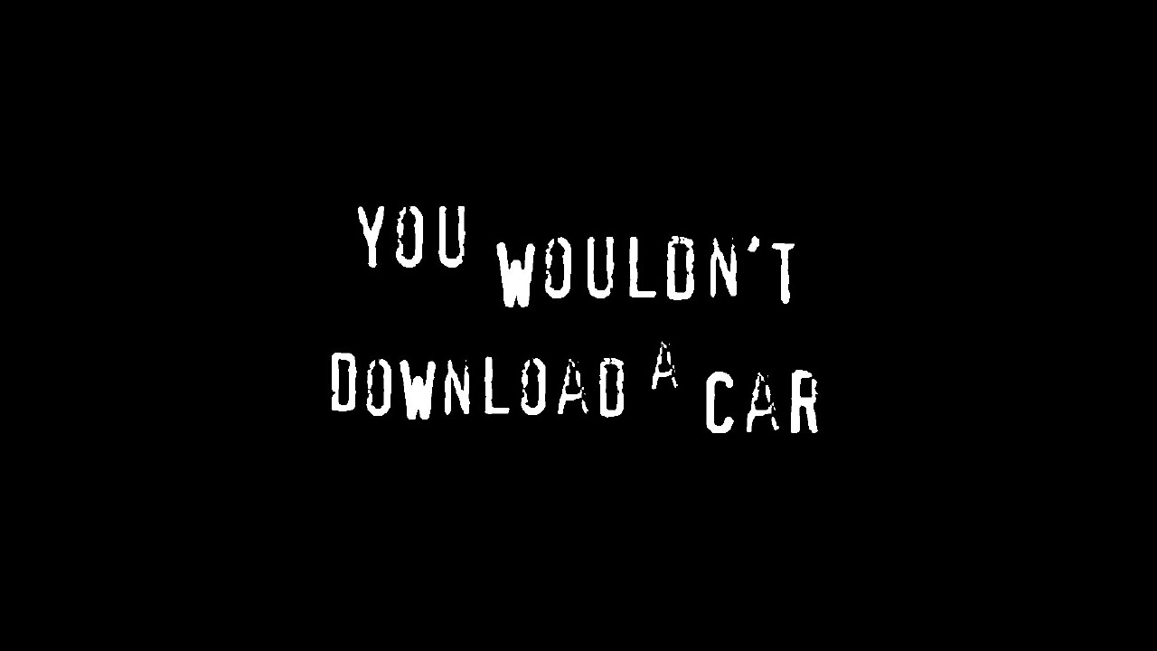
Disclaimer – Piracy is Illegal
Alex Bolduc
In the US piracy is illegal
Please acquire all copyrighted goods legally.
I take no responsibility for any actions that come from this presentation
Figure 1: Screenshot from an anti-piracy commercial
Notes:
Piracy is Illegal
This presentation is neither an encouragement or endorsement of piracy

Slide 51
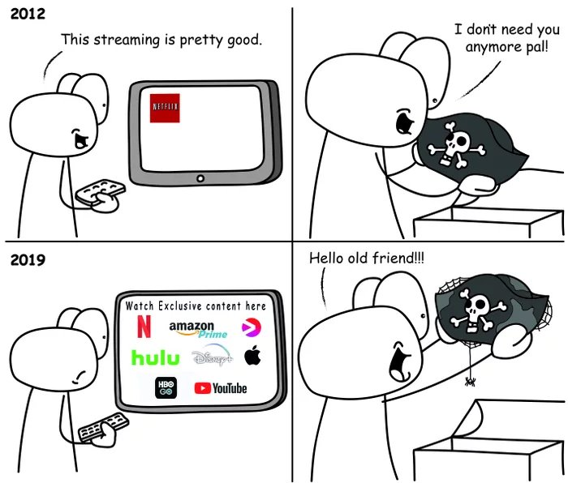
A Dip and rise in piracy
Alex Bolduc
Piracy had been steadily decreasing in recent years [1]
Streaming services splitting up by network
Piracy becoming an attractive alternative [2]
Figure 2: Meme which captures the current uptick in piracy
Notes:
With the consolidation of lots of different media onto a single platform like Netflix for a reasonable price took the incentive away for many people to go out and manually pirate their shows as it was much more convenient to load up Netflix or Hulu and just have the show be there.
Now, however many TV networks are letting the licensing deals they had with Netflix expire and are launching their own streaming services to host their content.
This decreases the convenience behind streaming services
Increases cost as now you need to pay for 3 or 4 streaming services to watch all your shows on demand where you used to only need the one.
Big example was the office leaving Netflix for NBC’s Peacock Service
This is driving some people back to piracy as its cheaper (free) and now there are tools that can automatically download your favorite shows when they release in greater quality than you could get on some streaming services.

Slide 52
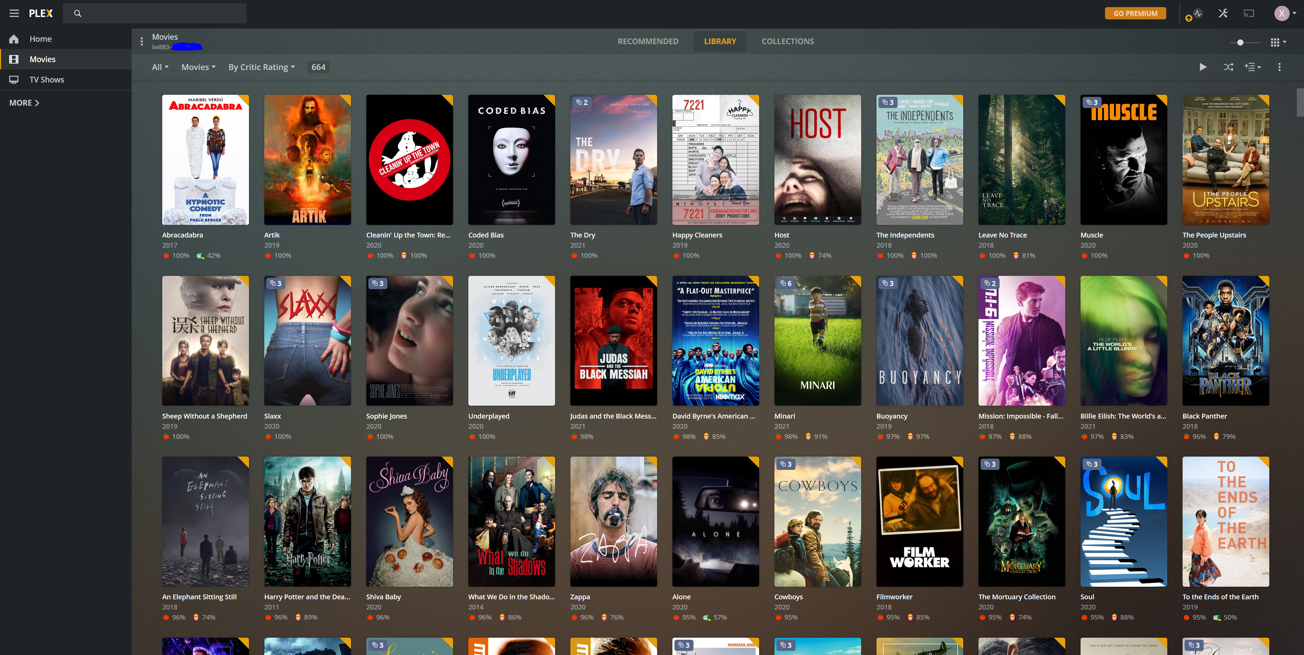
Downloading content you own
Alex Bolduc
You buy a DVD for a movie you love
You then illegally download that movie
You run software on that server that allows you to access it anywhere [4]
Is this ethical?
Figure 3: Screenshot of Plex, software that makes your media library available anywhere
Notes:
Services like plex are becoming increasingly popular as it allows people to organize their media like a streaming service with the same ease of use and convenience
Ethics:
If you paid for the physical copy of the movie then you have a physical copy that allows you unlimited plays (as long as you have a dvd player)
Downloading the content creates no harm for the production company as they have been paid through the purchase of the physical media.
Act-Utilitarian analysis would dictate this as morally right as the company receives its payment for goods through the purchase of physical media and you as a consumer also benefit through having easy access to the content you paid for anywhere.
Fair use copy protections

Slide 53
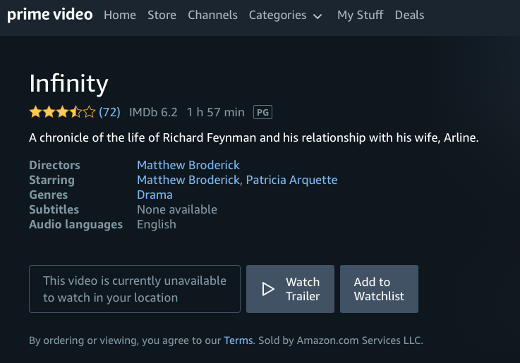
Downloading restricted content
Alex Bolduc
Downloading content blocked by streaming services. [5]
Downloading content blocked by governments. [6]
Figure 4: Screenshot of Prime Video restricting a movie based on location
Notes:
If you pay for a certain service like Disney+ or Netflix and they come out with a show that wont release in your country for another 6 months is it ethical to download the show early considering you have already paid for the service, it will eventually release on?
The Mandalorian released on Disney+ for US and UK viewers first and delayed the release in many other countries.
If you pay for the service throughout the duration of the time it took you to watch the show or movie then the company gets paid and you get the entertainment you wanted, just a little earlier.
Governments blocking certain movies from their populations presents many issues when it comes to censorship of ideas and free speech.
Often used to silence views that oppose the government or make it look bad even if the depictions are accurate.
More ethically ambiguous given that there is no way to actually legally purchase this content and support its creator, but on the other hand escaping the strong grip of an overreaching government makes me lean towards it being morally acceptable.

Slide 54
References
Alex Bolduc
[1] “The Rise of Netflix Competitors Has Pushed Consumers Back Toward Piracy.” VICE. Accessed April 8, 2021. https://www.vice.com/en/article/d3q45v/bittorrent-usage-increases-netflix-streaming-sites.
[2] Feldman, Brian. “Piracy Is Back.” Intelligencer. Intelligencer, June 26, 2019. https://nymag.com/intelligencer/2019/06/piracy-is-back.html.
[3] Stephen, Bijan. “Plex Makes Piracy Just Another Streaming Service.” The Verge. The Verge, July 23, 2019. https://www.theverge.com/2019/7/23/20697751/piracy-plex-netflix-hulu-streaming-wars.
[4] Cohen, Randy. “E-Book Dodge.” The New York Times. The New York Times, April 2, 2010. https://www.nytimes.com/2010/04/04/magazine/04FOB-ethicist-t.html.
[5] Fields, Courtni. “Disney+ Content Might Not Match Up Country to Country.” CBR, February 18, 2020. https://www.cbr.com/disney-plus-content-varies-internationally/.
[6] Siegel, Tatiana. “Disney's 'Christopher Robin' Won't Get China Release Amid Pooh Crackdown (Exclusive).” The Hollywood Reporter, August 3, 2018. https://www.hollywoodreporter.com/heat-vision/christopher-robin-refused-china-release-winnie-pooh-crackdown-1131907.

Slide 55
Class 5 The End
Keith A. Pray
socialimps.keithpray.net
Notes:
This is the end. Any slides beyond this point are for answering questions that may arise but not needed in the main talk. Some slides may also be unfinished and are not needed but kept just in case.

