Slide 1
Class 4 Freedom Of Speech
Keith A. Pray
socialimps.keithpray.net

Slide 2
what works well Online With Zoom
Sign in with First and Last Name
Stay muted unless you are going to speak
To speak use the raise your hand feature
To answer yes/no questions use the “yes” ”no” buttons
Turn your camera on
Wait until the end of student presentations to ask questions
Write them down so you don’t forget

Slide 3
Overview
Review
Assignment
Students Present
Notes:
Show syllabus updates if any

Slide 4
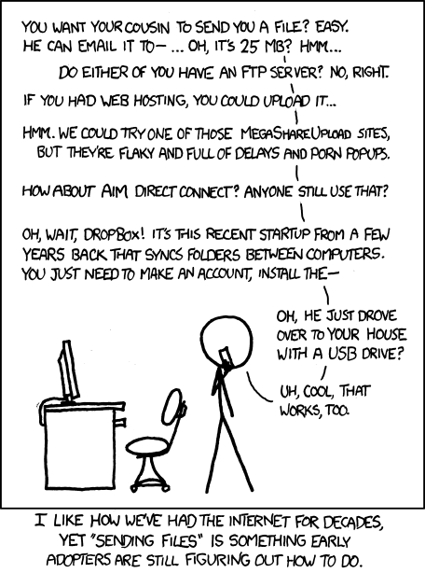
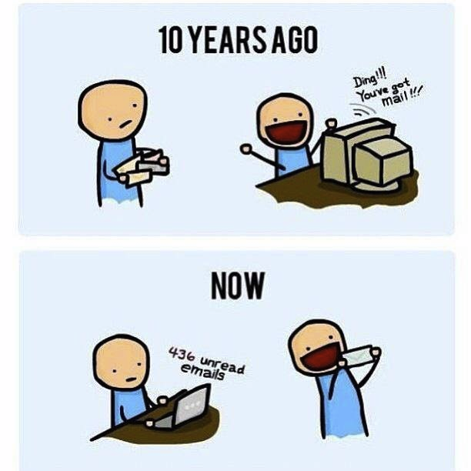
http://poofytoo.com/
25
http://xkcd.com/949/

Slide 5
My Reading Notes
pp. 110 First e-games 1972 at Stanford [1]
pp. 111 What powers the cell phones and towers? “everyday tasks” not apparent from image.
pp. 113 Ann did not force people to complain.
pp. 117 9% # transactions or $$? Wikipedia critics source from 2005, is quality still in question?
pp. 118 MOOC source from 2012, now?
pp. 123 “may have” = weak conclusion. Who funded studies?
pp. 124 Easier consolidation of newspapers. Advertisers switching away from newspaper source from 2014.
pp. 136 Stating people searching did not consent to material being blocked makes more sense.
pp. 138 sexting examples all from 2009?
http://en.wikipedia.org/wiki/Wikipedia:Citing_Wikipedia
Notes:
[1] Owen Good (19 October 2012). "Today is the 40th Anniversary of the World's First Known Video Gaming Tournament". Kotaku. Retrieved 1 August 2013
Need to check against 8th edition of text book:
pp. 145 More accurate to say addicted to single app - good
pp. 149 20 same as 39
pp. 150 36 same as 42
End of Chapter questions I liked: 2, 25

Slide 6
Group Quiz
Name two methods some governments use to control access to information.
A large company has a policy prohibiting employees from blogging about company products.
Name two possible reasons for the policy.
Does it violate the First Amendment? Why?
Is it reasonable? Why?
What does “URL” stand for and what is it?
Notes:
Censorship (religious, governmental, private). Adult authentication. Firewalls. Government owned media outlets.
First Amendment prohibits Congress from making laws limiting free speech, not private companies.
Uniform Resource Locator

Slide 7
Overview
Review
Assignment
Students Present
Notes:
But before that:
CPG Grey - This Video Will Make You Angry [Thought Germs] (7:25)
https://www.youtube.com/watch?v=rE3j_RHkqJc
If not shown yet:
What "Orwellian" really means - Noah Tavlin (5:31)
http://ed.ted.com/lessons/what-orwellian-really-means-noah-tavlin
Cedric Gervais - Hashtag (Original Mix) (3:58)
https://www.youtube.com/watch?v=6OmBKd7X7EE
Dave Audé vs Luciana - You Only Talk In #HASHTAG (3:36)
http://www.youtube.com/watch?v=53wIN87lJn0

Slide 8
Assignment
Reading
Individual Presentations
Extra Credit – One page paper
Is WPI’s IT Acceptable Use Policy morally acceptable?
Work on your group project
See full group project description on course website
Send Web Site URL before next class
Notes:
- Or review group project and individual presentation guidelines right now.
Possible One page paper:
Global intellectual property laws, friends or foes?

Slide 9
Overview
Review
Assignment
Students Present

Slide 10
Out of the rabbit hole
Tian Yu Fan

Slide 11
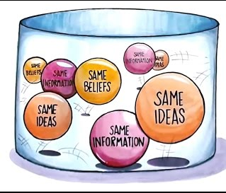
Should YouTube regulate content?
Tian Yu Fan
Claim: Yes!
Echo chambers
Conspiracy theories
Dangerous children content
MinuteVideos. Echo Chamber. YouTube, 28 Dec. 2016, www.youtube.com/
watch?v=Zk1o2BpC79g&ab_channel=MinuteVideos. Accessed 4 Apr. 202
Notes:
In this presentation, we will explore whether YouTube should regulate the content consumption of its audience. I believe that it should because it has become a breeding ground for echo chambers, conspiracy theories, and inappropriate children content.

Slide 12
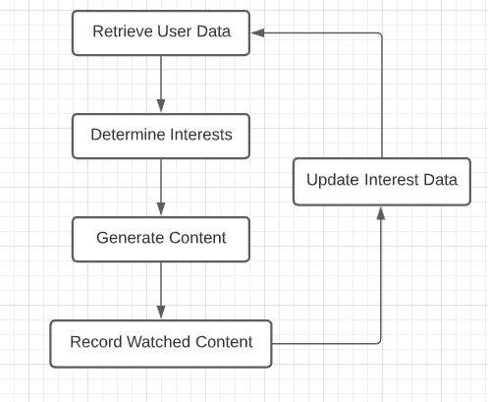
Creates Echo chambers
Tian Yu Fan
Recommendation engine
Relies on demonstrated interest
Creates echo chambers
Leads to political radicalization
Promotes ignorance
Notes:
Slide 2: Echo Chambers
Most content that we consume on YouTube is suggested by the recommendation engine. It affects the content on the home page, the trending page, and even whenever we search for a specific result. This algorithm suggests content based on demonstrated viewer interest to maintain traffic on the website. This is usually determined through watch history and previous searches. For example, if I absolutely adored cats, I will naturally search for lots and lots of cat videos. YouTube will eventually recognize this pattern and conclude that I love cats based on my online activities. As a result, the engine will recommend more cat videos. However, in this process, there will be no dog videos and I will never know how awesome dogs are. Now, imagine if this concept is applied to political content. A republican or democrat would constantly be delivered content that supports and strengthens the beliefs of their political party. They are unlikely to ever be exposed to equally valid views from opposing perspectives. This creates an echo chamber effect and facilitates radicalization. A 2020 study tracked 3 hundred thousand videos across 349 channels and 72 million comments. It concluded that alt-lite content could be a gateway to alt-right content because those who frequent alt-lite content were twice as likely to engage in alt-right content within a year. Viewers who are radicalized become more ignorant of reality. They also become less accepting and progressive. In order to prevent this, YouTube must burst the audience out of their content bubble and promote diverse content.

Slide 13
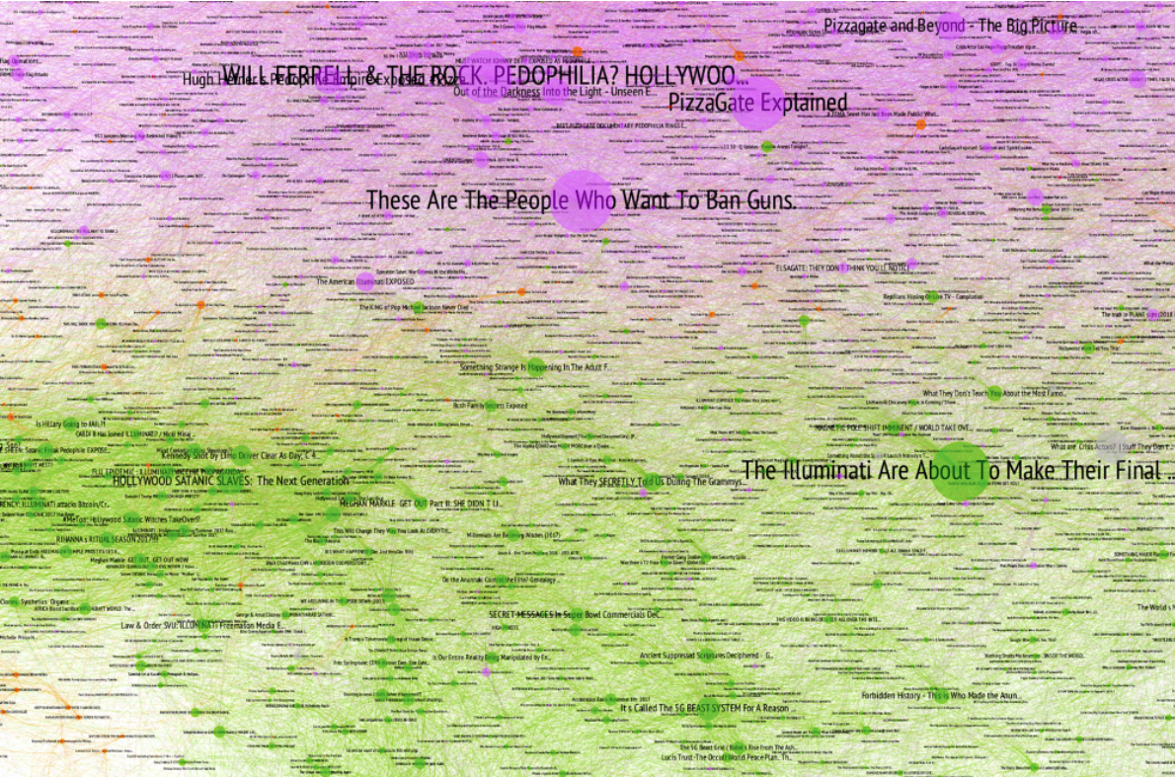
Promotes Conspiracy theories
Tian Yu Fan
Content metrics of algorithm
Retention rate
Click-through rate
Inherent flaw against absurdism
Increases promotion
Generates rabbit hole effect
Converts viewer into believer
Albright, Jonathan. "Popular Conspiracy Videos on YouTube." Jonathan Albright, 25 Feb. 2018, d1gi.medium.com/
untrue-tube-monetizing-misery-and-disinformation-388c4786cc3d. Accessed 4 Apr. 2021.
Notes:
Slide 3: Conspiracy Theories
The recommendation engine relies on a few metrics to boost the relevancy of a video. Examples of these metrics include retention rate and click-through rate. Retention rate is the percentage of audience that watches the entire video. Click-through rate is the number of clicks on your video divided by the number of times it was recommended on someone’s feed. Both of these metrics make the inherent design of the algorithm favor conspiracy theories. This is because conspiracy theories are naturally thrilling and intriguing due to their absurdism. They captivate the audience to keep on watching which increases retention rate. Also, the thumbnail and title of these videos are often outlandish like for example “Mark Zuckerberg is a lizard”. This effectively tricks the audience into watching the video and increases click-through rate. As a result, both of these metrics boost the relevancy of conspiracy theories. In 2018, a study showed that from 250 seeds, a network of 9000 conspiracy videos can be generated. Some of the most popular videos were about The Illuminati and Hollywood Satanic Slaves. This network shows that watching one conspiracy video could lead to a rabbit hole effect. Overconsumption of this content could convert a normal viewer into a firm believer. As a result, YouTube should promote diverse content to avoid this.

Slide 14
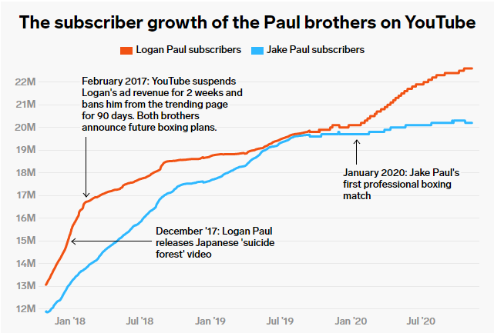
Promotes dangerous content for children
Tian Yu Fan
Promote outrageous content
Popularize controversial creators
Jake Paul
Children are impressionable
Adopt bad role models & morals
Hall, Madison. "Paul Brothers Subscriber Growth." Insider, 15 Dec. 2020, www.insider.com/jake-paul-logan-data-graphs-will-never-be-canceled-2020-12. Accessed 4 Apr. 2021.
Notes:
Slide 4: Children Content
Another important concern is the consumption of content amongst children and teenagers. We already established from the previous slide that outrageous content do very well on YouTube because of the algorithm. A similar phenomenon occurs with many influencers who have young audiences. A popular example is the creator Jake Paul with currently 20 million subscribers who are mostly between the ages of 8 and 18. Jake Paul often uploads content that is provocative and instills bad morals into children. He burned expensive furniture inside a pool, smashed his friend’s lamborghini with a hammer, promotes gambling websites, sexualizes his friends, and constantly flaunts his wealth. From the graph, we can clearly see that the algorithm does not punish creators for bad behavior because Jake Paul’s subscriber count skyrockets despite all the converversies. According to a 1989 study, young children and young adults are more more susceptible to attitude change than adults, making them more impressionable. This makes sense because children still have to learn the difference between right and wrong. So, children who see how popular and wealthy Jake Paul is equate bad behavior and success. They make him a role model and follow his bad behavior which instills bad morals in them. Although no formal research has been done with this, some hypothesize that YouTube encourages children to drop out of school to pursue a career on social media. In order to prevent these deviant behavior, YouTube should redesign its algorithm to consider viewer age.

Slide 15
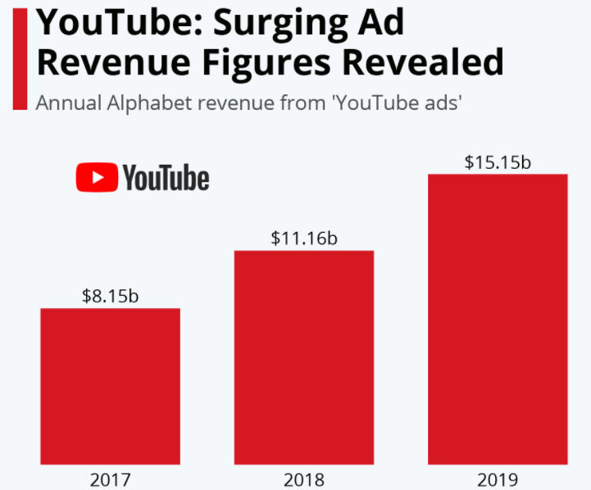
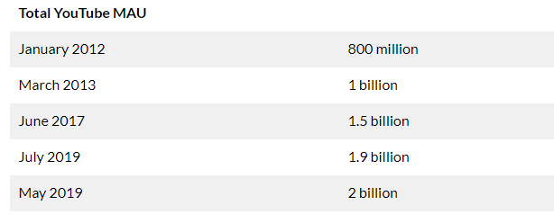
Moral responsibility
Tian Yu Fan
Counter: right to make profit
Rebuttal: act utilitarianism
Hall, Madison. "Paul Brothers Subscriber Growth." Insider, 15 Dec. 2020, www.insider.com/jake-paul-logan-data-graphs-will-never-be-canceled-2020-12,Accessed 4 Apr. 2021.
Iqbal, Mansoor. "Total YouTube MAU." Business of Apps, 8 Mar. 2021, www.businessofapps.com/data/youtube-statistics/. Accessed 4 Apr. 2021. Infographic.
Notes:
Slide 5: Counter-Argument
From our previous slides, we can conclude that the YouTube algorithm is flawed and needs revision. Some argue that it is not YouTube’s responsibility to do so. A private company like YouTube has the right to prioritize its profits according to the law. If they keep on shoving content which their audience does not agree with, they might lose their viewer base. However, lawfulness does not guarantee ethics. We can use act utilitarianism to analyze the situation. A poorly-designed algorithm will negatively affect everyone in YouTube’s massive viewer base of billions. This clearly outweighs the comparatively small happiness derived from the extra profits of already-wealthy YouTube executives. For reference, these executives make around two-hundred thousand a year on average.
Conclusion
The YouTube algorithm creates echo chambers, promotes conspiracy theories, and polarizes its young audience. As a result, to fulfill its moral duty, it should be responsible for exposing its audience to diverse content.

Slide 16
References
Tian Yu Fan
[1] Cooper, Paige. "How Does the YouTube Algorithm Work? A Guide to Getting More Views." Hootsuite, 18 Aug. 2020, blog.hootsuite.com/ how-the-youtube-algorithm-works/. Accessed 4 Apr. 2021.
[2] Ribeiro, Manoel. "Auditing Radicalization Pathways on YouTube." Arvix, 22 Aug. 2019, arxiv.org/abs/1908.08313. Accessed 4 Apr. 2021.
[3] YouTube. "Metrics." Google Developers, 4 July 2019, developers.google.com/ youtube/analytics/metrics. Accessed 4 Apr. 2021. [4] <reference 4>
[4] Albright, Jonathan. "Untrue-Tube: Monetizing Misery and Disinformation." D1gi, 25 Feb. 2018, d1gi.medium.com/untrue-tube-monetizing-misery-and-disinformation-388c4786cc3d. Accessed 4 Apr. 2021.
[5] Hall, Madison. "How Jake and Logan Paul Thrive on Controversy and Avoid Cancelation." Insider, 15 Dec. 2020, www.insider.com/ jake-paul-logan-data-graphs-will-never-be-canceled-2020-12. Accessed 4 Apr. 2021.

Slide 17
References
Tian Yu Fan
[6] Krosnick, Jon. "Aging and Susceptibility to Attitude Change." PPRG, 1989, pprg.stanford.edu/wp-content/uploads/ 1989-Aging-and-Att-Change-Krosnick-and-Alwin.pdf. Accessed 4 Apr. 2021.
[7] Melendres, Matisse. "Youtubers Influence of Young People." Scholar Commons, 14 Sept. 2019, scholarcommons.scu.edu/engl_176/42/. Accessed 4 Apr. 2021.
[8] Klein, Frankfurt. "YouTube is Not a Public Forum and Its Policies are Not Advertising." Lexology, 30 Mar. 2020, www.lexology.com/library/ detail.aspx?g=e982d202-390d-4ab5-b1ac-d8d6bd27794f. Accessed 4 Apr. 2021.
[9] Iqbal, Mansoor. "YouTube Revenue and Usage Statistics (2020)." Business of Apps, 8 Mar. 2021, www.businessofapps.com/data/youtube-statistics/. Accessed 4 Apr. 2021.

Slide 18
Should you regulate your social media use?
Nupur Shukla

Slide 19
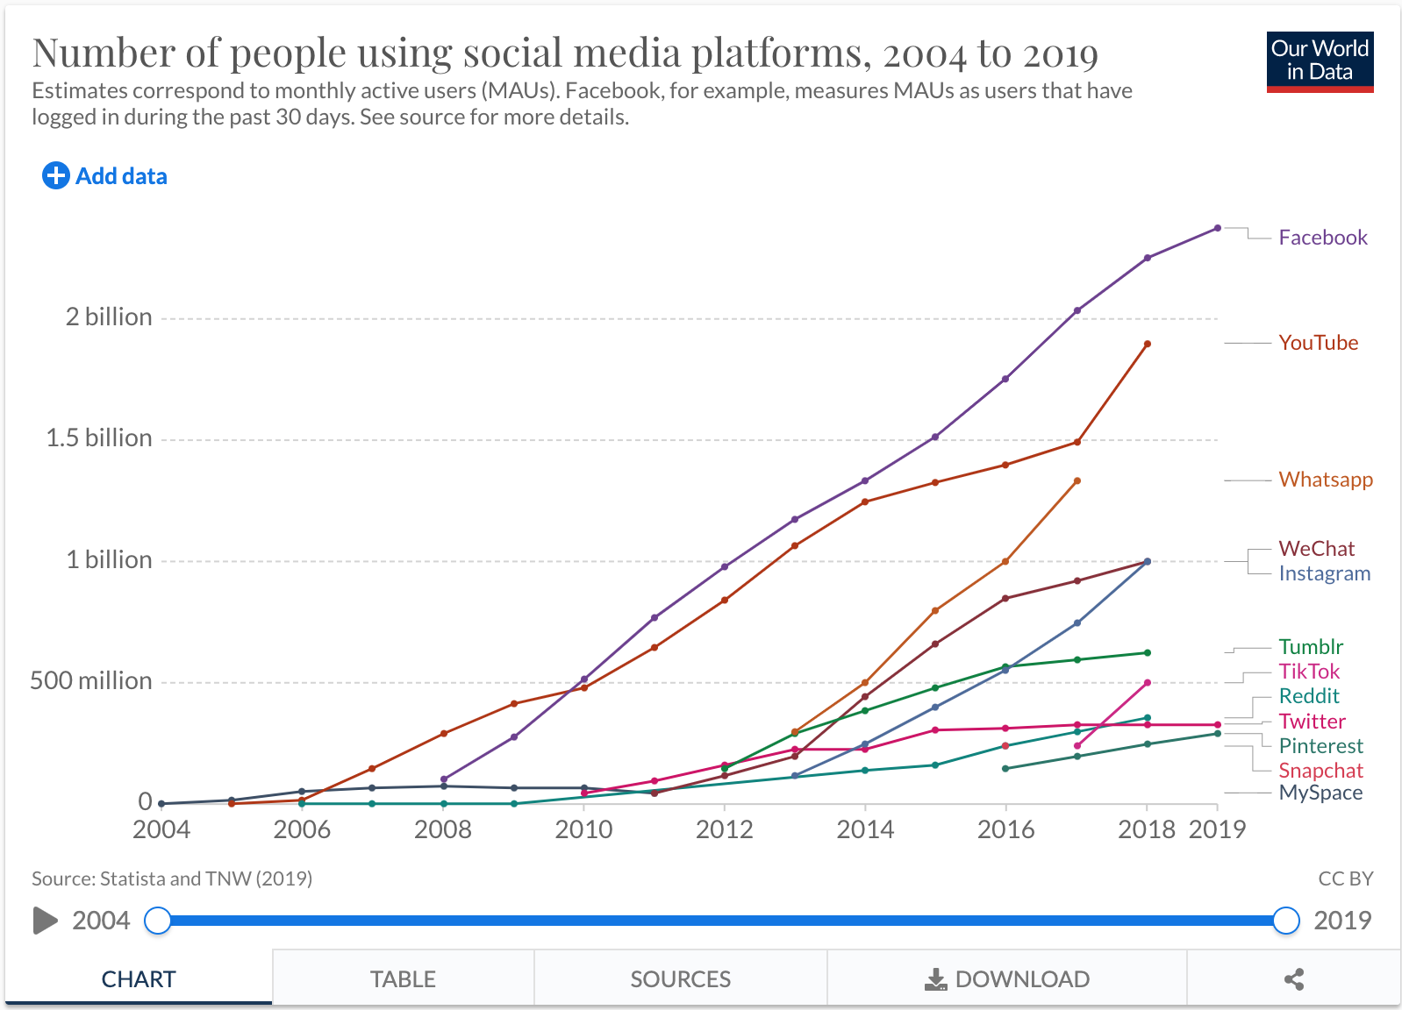
How much we use social media
Nupur Shukla
3.96 billion social media users
Average of 3 hours per day is spent on social networks
98% of teens have smartphones
99% of social media users use smartphones to access their networks
Figure 1. shows the rise of social media users [6]
[1]
Notes:
Present the facts listed
Second bullet more (how time adds up throughout the day and we don’t notice)
Figure:
- Shows the timeline from 2004 to 2019 of people who use social media platforms
Notice how Facebook has skyrocketed in 2008 which is 4 years after its first launch, and it’s been an upward trend since
Instagram started its climb near 2012

Slide 20
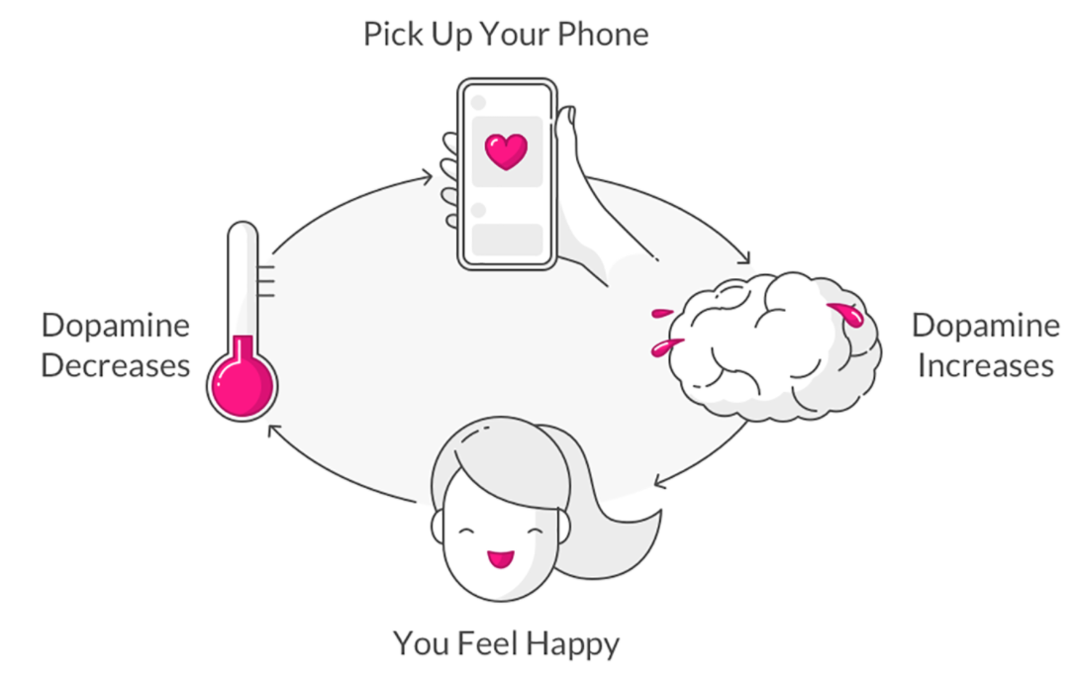
Why do we use social media so much?
Nupur Shukla
Behavioral addiction
Psychological effects
“I feel a tremendous amount of guilt. The short-term, dopamine-driven feedback loops that we have created are destroying how society works” [3]
Former Vice President of Facebook
Figure 2. shows the psychological reasoning for extended amounts of social media usage [7]
[3]
Notes:
Behavioral addiction - someone is addicted to a set of actions instead of a physical substance
Social Media algorithms
Social dilemma folks will know
Thousands of engineers behind developing this platform
Some of these engineers are only focused on designing features which are supposed to become addictive
UI is huge, choosing specific colors to draw your eyes to the app
The others work on the algorithm which has 2 jobs
To keep you sucked in if you are on the app
Or to get you to stop what you are doing and get you to pick up that phone
Psychological effects:
Dopamine cycle
Reward is that dopamine high
Action which let’s us get the reward is checking our phones constantly
- Former Vice President of Facebook, Chamath Palihapitiya

Slide 21
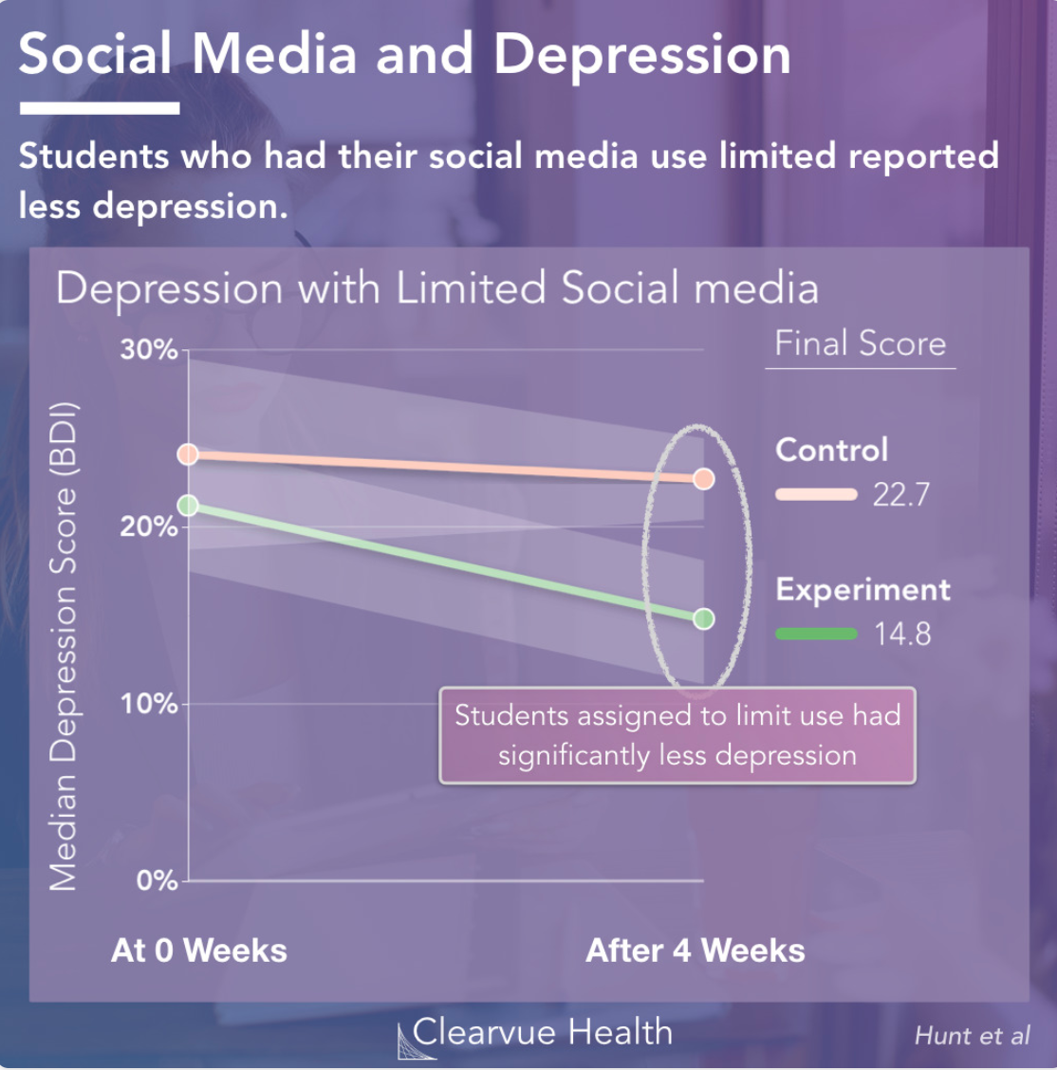
Effects of social media
Nupur Shukla
Mental health issues
Body image issues/Disordered eating
Causes distractions
Poorer sleep quality
Constant need for validation
And many more…
Figure 3. shows that cutting down social media usage lowers feelings of depression [8]
[2], [4]
Notes:
Mental Health Issues:
Teens reported rise in anxiety, depression, loneliness, and stress after increasing their use in social media
Body Image Issues/Disordered Eating
We see the highlights of everyone's life and start comparing their edited versions to our reality
Causes self deprecation
Causes distractions
The constant notification alerts light up our phone
And we can’t help but check because we have developed “the fear of missing out”
The phone lighting up catches our eye
Poorer sleep quality
A lot of research has surfaced very recently about sleep and social media
The blue light we are exposed tricks our brain to feeling more alert
When you are supposed to be winding down, your brain is forced to do the opposite so you get less and worse sleep
Constant need for validations
Sometimes we get caught up in the number is likes, comments, or even the content of the comments
We start becoming dependent on others to validate our self worth
Figure:
- Psychology experiment done by Clearvue Health which lasted for 4 weeks
A set of randomly selected students split into 2 groups
Both groups displayed similar depression levels before the experiment
Control group was free to use social media as they pleased
Experimental group was asked to limit their social media use to 10 mins a day per platform
After the 4 weeks, both groups measure their levels of depression and the experimental group reported less depression levels
Move into next slide

Slide 22
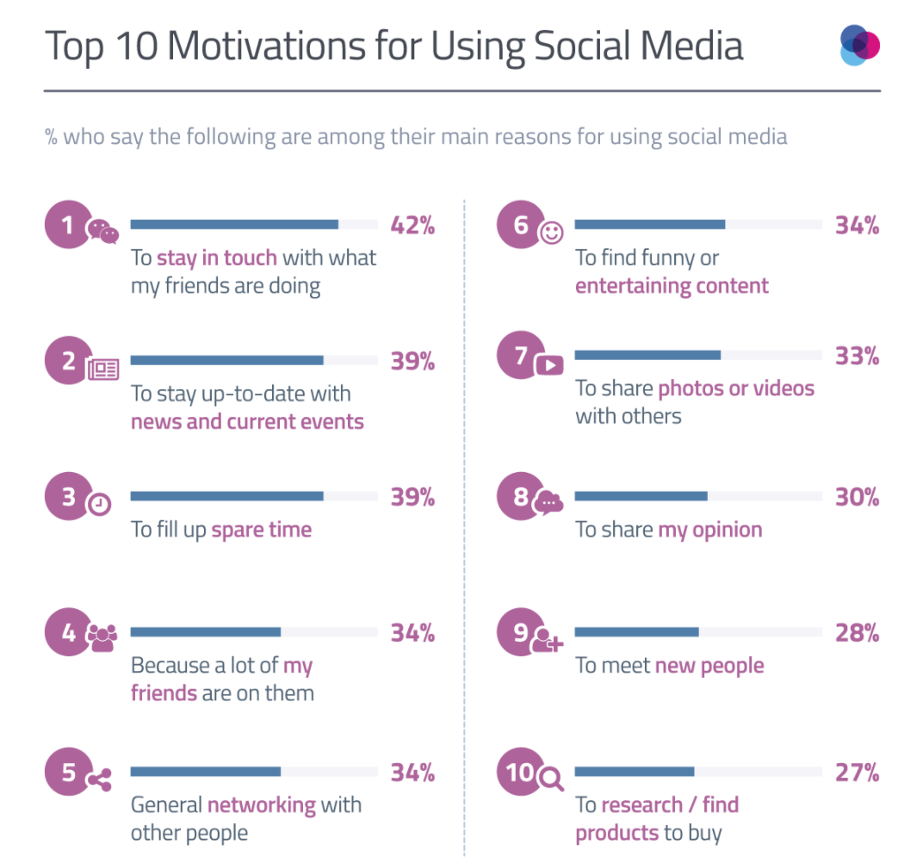
How to regulate social media use
Nupur Shukla
Delete apps
Set time limits on usage
Turn off notifications
Consider who you follow
When you do use social media…
Be active! (retrain the algorithm)
Figure 4. shows that the tops reason for using social media are passive [8]
[2], [5]
Notes:
Deleting apps is the quickest method if you stick to it
Don’t have to delete forever, just helps to take a break
Also helps to identify which social medias you use vs. which ones are to fill spare time
Setting time limits only helps if you follow the time limits
Start of slowly and decrease amount of time spent on social media over time
Consider who you follow
Your feed should be only be your feed
Following people or creators you are close to or passionate about will force you to interact if you are using social media
Makes you be active on these platforms (creates a better connection than when you are mindlessly scrolling and just absorbing content)
Retrain algorithm
Be active so the algorithm shows you what you want to see
Also reinforces the fact that being active on these platforms makes a better connection than mindlessly scrolling
Figure:
16 to 24 year-olds use social media to “fill spare time”
25 to 34 year-olds use social media to “stay in touch”
34 to 44 year-olds use social media to ”stay up-to-date with current news”

Slide 23
References
Nupur Shukla
[1] Social Network Usage and Growth Statistics: How Many People Use Social Media in 2021?, Brian Dean, https://backlinko.com/social-media-users (March 29th, 2021)
[2] Online Social Networking and Mental Health, Igor Pantic, https://www.ncbi.nlm.nih.gov/pmc/articles/PMC4183915/ (March 28, 2021)
[3] The Dark Side of AI: Social Media and the Optimization of Addiction, Dr. Francesco Gadaleta, https://datascienceathome.com/the-dark-side-of-ai-social-media-and-the-optimization-of-addiction/ (April 1, 2021)
[4] Sleep and Social Media, Rob Newson, , https://www.sleepfoundation.org/how-sleep-works/sleep-and-social-media (March 29, 2021)
[5] Social Media Addiction, Jenna Hilliard, https://www.addictioncenter.com/drugs/social-media-addiction/ (March 31, 2021)

Slide 24
References
Nupur Shukla
[6] The Rise of Social Media, Esteban Ortiz-Ospina, https://ourworldindata.org/rise-of-social-media (March 31, 2021)
[7] Here’s Why You Can’t Stop Looking at Your Phone, Team Lemonade, https://www.lemonade.com/blog/psychology-behind-phone-addiction/ (April 2, 2021)
[8] Social Media Use and Depression, Clearvue Health, https://www.clearvuehealth.com/b/social-media-depression/ (March 31, 2021)
[9] Top 10 Reasons for Using Social Media, Olivia Valentine, https://blog.globalwebindex.com/chart-of-the-day/social-media/ (April 2, 2021)

Slide 25
Political polarization
Andrew Whitney

Slide 26
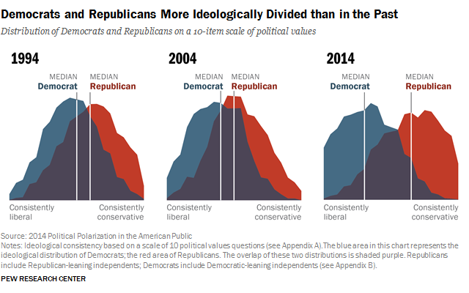
US CITIZENS
Andrew Whitney
Average American Voter
10 Questions various topics
Drifting Apart
[1]
Notes:
The gap in political views in the 90’s and early 2000’s did not have much of a shift. However, from 2004-2014 there was a large shift and in stance of the average democrat and republican.
The graphic on the right is from pew research center and was based off a survey with 10 political questions with varying topics. These topics help determine the political views of the individual taking the survey.
This large shift from 2004 to 2014 is cause for concern because it indicates polarization in the political climate. One explanation for this shift the climate is politics in social media.

Slide 27
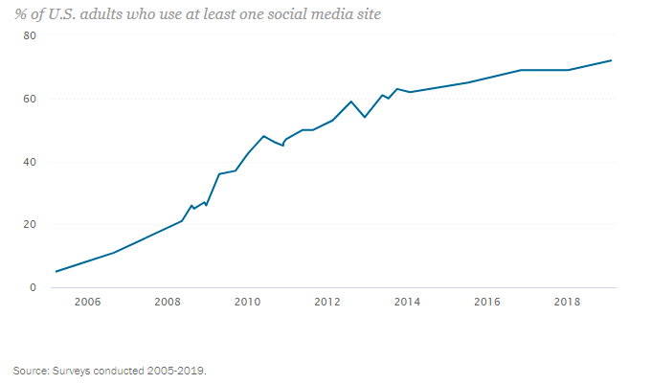
SOCIAL MEDIA GROWTH
Andrew Whitney
Social Media rapidly growing
Trend between use and political divide
[2]
Notes:
Social media has exploded in growth over the last 2 decades. This chart on the right shows only social media use in adults, who would be individuals eligible to vote compared to assessing children’s use as well.
This includes anyone from 18 to 85 and over. In 2006, only about 10% of adults are using social media, so it would not be very impactful in politics, and there would not be a large scale shift in the climate.
However, from 2006 to 2014 there is massive growth.
In 2014 number is around 60%.
This would be enough people have a large impact on the political stances of the nation.
This spike in social media lines up with this large divide in political views from the previous graphic.

Slide 28
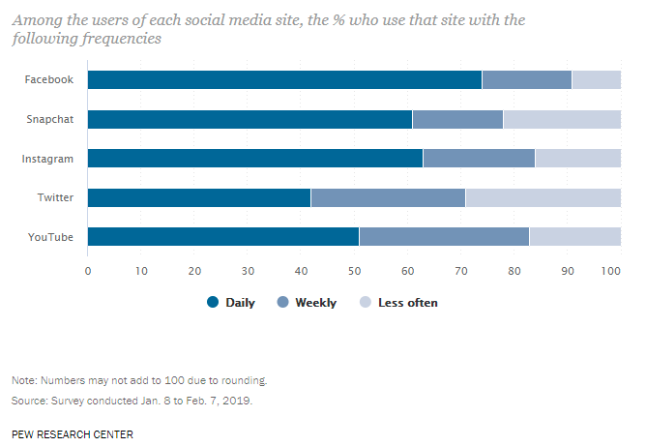
SOCIAL MEDIA USE
Andrew Whitney
Part of Daily Life
Get Information
Facebook & Twitter
[2]
Notes:
Social Media use continued to skyrocket into 2019. It is now an integral part of most Americans lives.
It is now a part of daily routine in America. 70% of all surveyed fb users consider their use daily. And twitter, a platform known for politics, is used daily by 40% of its users.
With using something so often, it becomes a source of information, where those posting on platform know their message can be seen by many people in a sort amount of time.
Politicians have begun utilizing this to get their name out their and campaign.

Slide 29
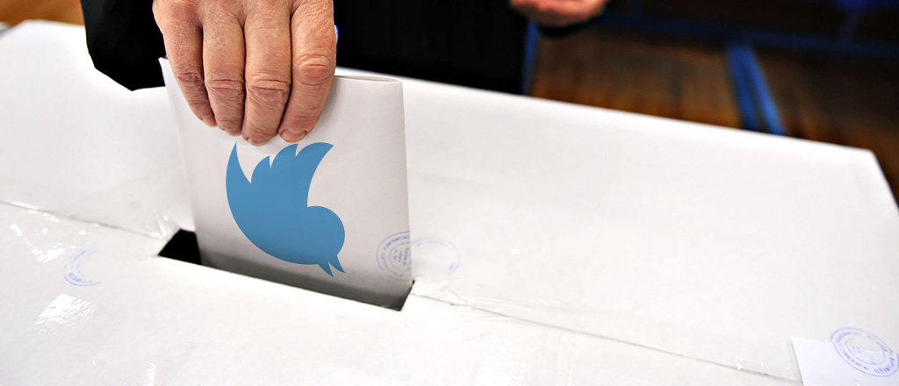
POLTICS IN SOCIAL MEDIA
Andrew Whitney
Politicians using social media
More Accessible
Validates Information
Lead to misinformation
[6]
Notes:
Politicians have begun using social media.
It makes campaigning easier for new candidates, who can make 1-3% of their annual campaign revenue in one month of social media.
This is a more accessible way for the politicians to interact with the general public, which is a good for the health of the nation. Direction communication also for unfiltered thoughts and opinions by major news networks which is good in preventing news bias. It is also largely available to the public. This however has a dangerous side effect. It validates the platform and information spread on it. Now instead of information coming from news networks with editors who try to make sure the information is accurate and true, or from politicians who are sharing their own thoughts, it can come from unverified sources who are held to no standard and have editorial processes. This greatly increaseds the chance for misinformation. There is also a change to see a lack of differing views by misused algorithms which were not designed with politics in mind.

Slide 30
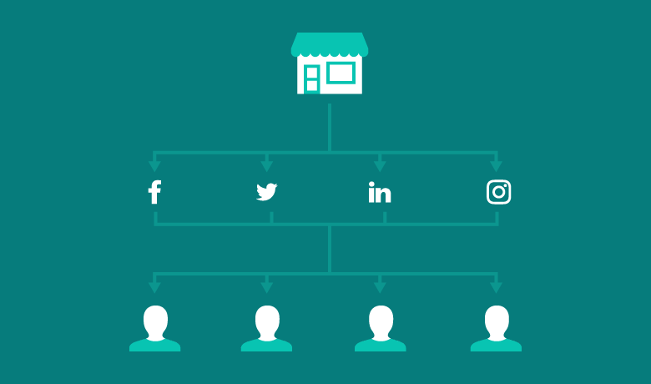
ECHO CHAMBER
Andrew Whitney
Filter based on views [3]
Interaction-based algorithms [4]
[4]
Notes:
Social media designed to filter content to tailor your feed to what you enjoy. This is also applied to politics and political views. It creates a political view echo chamber, since people will show preference over the views they align with.
This echo chamber can lead to more radicalized views, since each side is not seeing the other side's opinion nearly as often. This will cause the other sides views to look more radical and unreasonable since they are not exposed to it as often and have not read the reasoning behind it. This causes the polarization in politics.
Interaction-based algorithms trap users from seeing differing points of view as the interact more and more with one party, which can cause a sense of overload.

Slide 31
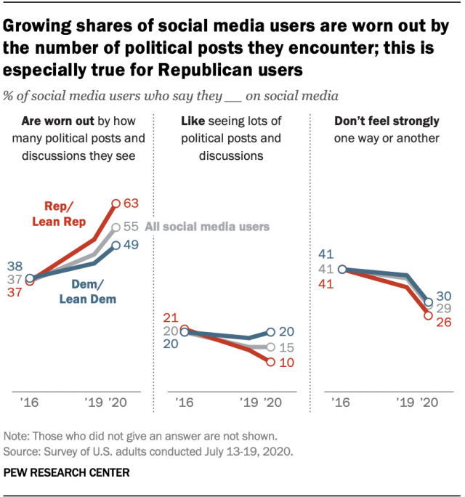
POLTICS OVERLOAD
Andrew Whitney
Politics taken over
Unable to avoid
Users frustrated
[5]
Notes:
Politics has taken over social media. Pew Research center assessed in 2020 who felt overwhelmed or worn out by the number of political posts seen on social media.
It has become unavoidable on the platform, from candidates or from other sources, as well as from their peers.
This has led to a lot of frustration from users of these platforms.
55% of all social media users are worn out by this overload. That does not mean however that the other 45 like seeing them. Only 15% of users actively like seeing politics in social media, which is a small group of users. This is a large issue which needs to be addressed since over have of the users do not enjoy the content they are viewing.

Slide 32
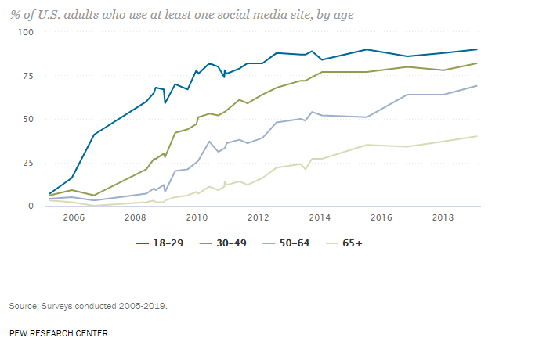
NEXT GENERATION
Andrew Whitney
Next Generation is most heavily impacted
Shape future of political climate
[2]
Notes:
Next Generation of Voters most heavily use social media. This means they will be most heavily impacted since they will be seeing a lot of the posts.
As time continues and this young generation becomes older, the ones younger than them will have the same or higher social media use and assuming they keep up with their use, in general more voters will be using social media.
This will further the polarization in the country's political scene.
The fallout of this is politics will be shaped through their radicalized political views and will impact elections to come.
Action needs to be taken quick to prevent further polarization and lose dialog between the parties further.

Slide 33
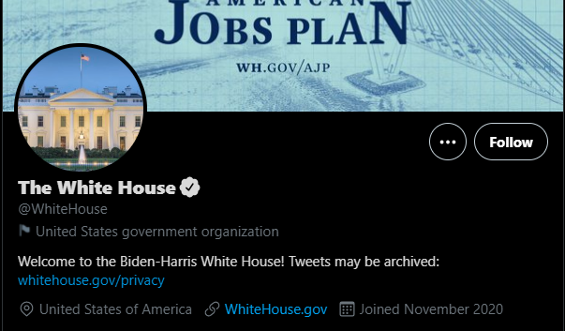
FALLOUT
Andrew Whitney
Parler
Twitter Govt. Labels [7]
[8]
Notes:
The result of this has been an attempt to clear up misinformation and remove politics from algorithms.
Parler was created by the right wing to remove bias in what was considered misinformation but could create further polarization as the two parties move to two separate platforms.
Twitter introduced Labels for govt. affiliated accounts, as a way for people viewing tweets to know if the information is coming right from the government or not.

Slide 34
References
<Your Name>
[1] Political Polarization in the American Public, (Pew Research Center, 2014) https://www.pewresearch.org/politics/2014/06/12/political-polarization-in-the-american-public/ (4/1/21)
[2] Social Media Fact Sheet, (Pew Research Center, 2020) https://www.pewresearch.org/internet/fact-sheet/social-media/ (4/1/21)
[3] Meghan Lopez, Social Media helps bring people together… , (Denver7, 2021) https://www.thedenverchannel.com/news/360/social-media-helps-bring-people-together-but-in-this-political-climate-its-tearing-us-apart (4/2/21)
[4] Brent Barnhart, Everything you need to know about social media algorithms, (Sprout, 2021) https://sproutsocial.com/insights/social-media-algorithms/ (4/2/21)
[5] 55% of U.S. Social Media Users say they are ‘worn out’… (Pew Research Center, 2020) https://www.pewresearch.org/fact-tank/2020/08/19/55-of-u-s-social-media-users-say-they-are-worn-out-by-political-posts-and-discussions/ (4/2/21)
[6] How Social Media Is Shaping Political Campaigns, (UPenn, 2020) https://knowledge.wharton.upenn.edu/article/how-social-media-is-shaping-political-campaigns/ (4/3/21)
[7] (Twitter, 2021) https://help.twitter.com/en/rules-and-policies/state-affiliated (4/3/21)
[8] (Twitter, 2021) https://twitter.com/WhiteHouse?ref_src=twsrc%5Egoogle%7Ctwcamp%5Eserp%7Ctwgr%5Eauthor (4/3/21)

Slide 35
Political facts: where to draw the line
Ben Staw

Slide 36

We live in a very polarized time
Ben Staw
Everything political is being watched closely
Everyone is looking for a slip up
Perception of the truth can be manipulated
https://attorneyatlawmagazine.com/a-lesson-from-politics-its-all-in-the-optics
Notes:
We live in a very polarized time.
Talk about how there’s a goal in politics to have the best optics, even it means hammering a small fact hard or downplaying a larger one.
Talk about how everyone is playing the game and how in the process, the absolute truth is being lost and the perception is being manipulated

Slide 37


Different social media handle the truth differently
Ben Staw
Facebook
Twitter
Parler
This Photo by Unknown Author is licensed under CC BY
This Photo by Unknown Author is licensed under CC BY-SA
https://www.facebook.com/journalismproject/programs/third-party-fact-checking
Notes:
Talk about how social media has a lot of influence over how facts are managed
Talk about how facebook, twitter, and parler, have different fact management styles and what they could mean

Slide 38
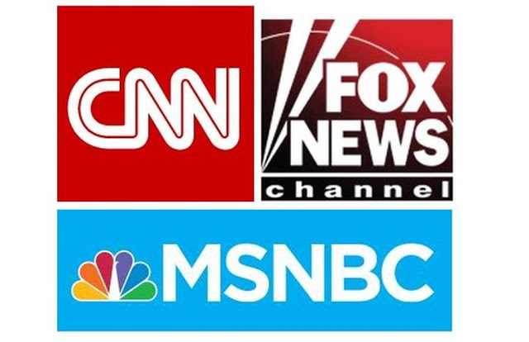
News outlets have varying definitions of truth
Ben Staw
CNN
Washington Post
Fox News
Wall Street Journal
New York Times
MSNBC
This Photo by Unknown Author is licensed under CC BY-NC-ND
https://www.journalism.org/2020/01/24/u-s-media-polarization-and-the-2020-election-a-nation-divided/
Notes:
Talk about the polarized nature of news media and how they shape consumers’ views on subjects

Slide 39
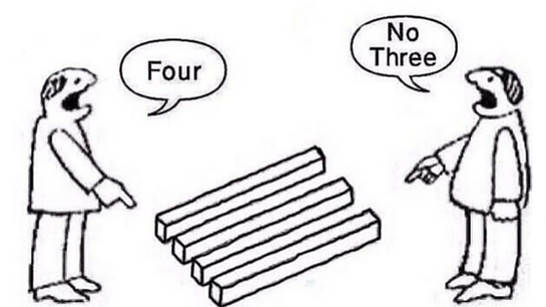
If the truth can’t be agreed on, it can’t be trusted
Ben Staw
If someone saw something on the news, should they believe it?
If they heard news from a friend, should they believe that?
Increasingly, it is getting harder for people to agree on what they think is real.
This Photo by Unknown Author is licensed under CC BY-SA-NC
https://www.pewresearch.org/politics/2019/07/22/the-state-of-personal-trust/
Notes:
Tie everything together and show that finding the truth is more difficult when people don’t agree on what it is.
Discuss the examples about how people feel about news they’ve heard through different means
End covid example to show the present danger of misinformation and how it can make lives even worse.

Slide 40
References
Ben Staw
[1] Deborah Johnson, A Lesson in Politics: It’s All In The Optics,(Attorney at Law, 2017) https://attorneyatlawmagazine.com/a-lesson-from-politics-its-all-in-the-optics, Accessed on 4/5/2021
[2]Facebook, Facebook’s Third-Party Fact Checking Program,(Facebook, 2021) https://www.facebook.com/journalismproject/programs/third-party-fact-checking, Accessed on 4/5/2021
[3] Mike Isaac and Kellen Browning, Fact-Checked on Facebook and Twitter, Conservatives Switch Their Apps,(New York Times, 2020) https://www.nytimes.com/2020/11/11/technology/parler-rumble-newsmax.html,Accessed on 4/5/2021
[4] Mark Jurkowitz et. al., U.S. Polarization And the 2020 Election: a Nation Divided,(Pew Research Center, 2020) https://www.journalism.org/2020/01/24/u-s-media-polarization-and-the-2020-election-a-nation-divided/,Accessed on 4/5/2021
[5]Lee Rainie et. al., Trust and Distrust in America, (Pew Research Center, 2019) https://www.pewresearch.org/politics/2019/07/22/the-state-of-personal-trust/,Accessed on 4/5/2021

Slide 41
Class 4 The End
Keith A. Pray
socialimps.keithpray.net
Notes:
Use remaining time to form groups, approve group topics, etc.
This is the end. Any slides beyond this point are for answering questions that may arise but not needed in the main talk. Some slides may also be unfinished and are not needed but kept just in case.

