Slide 1
Class 11 Work
Keith A. Pray
socialimps.keithpray.net
Notes:
Styx - Mr. Roboto (1983) (5:34) https://www.youtube.com/watch?v=uc6f_2nPSX8
Ask about Automation paper:
What did people choose to automate
Share 1 main reason

Slide 2
what works well Online With Zoom
Sign in with First and Last Name
Stay muted unless you are going to speak
To speak use the raise your hand feature
To answer yes/no questions use the “yes” ”no” buttons
Turn your camera on
Wait until the end of student presentations to ask questions
Write them down so you don’t forget

Slide 3
Papers
Use and cite supporting data from high quality sources: peer reviewed, editorial process…
Blogs are usually not good sources for academic work
medium.com may appear like newspaper articles have no peer review or editorial process
StackOverflow.com likewise
http://socialimps.keithpray.net/assignments/paper-guidelines/
Notes:
0s not included.
Save for next time:
Quantify
Do not use terms like: less, more, a lot, huge, great, big, tiny, growing, etc.
Make decisive conclusions
may, could, etc. = trivial
Absolute statements are difficult to prove
Avoid: all, always, any, every, everyone, never, none… unless you can show it
Be sure to put quotes around entire quote
Hyperbole is the best thing ever!
but not in these papers
Print 2 sided and save a tree
Use template, saves time (and -1 point)
Read assignment
Argument should directly support conclusion
Response should directly address counter point

Slide 4
Grades To Date
46 Max Possible

Slide 5
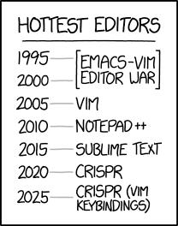
Overview
Review
Assignment
Students Present
https://www.xkcd.com/1823/
Notes:
Full circle.
CRISPR: Clustered Regularly Interspaced Short Palindromic Repeats
Allows permanent modification of genes within organisms.
Published 2017-04-12 according to https://www.explainxkcd.com/wiki/index.php/List_of_all_comics_(1501-2000)
Kickstarter Charter
https://www.kickstarter.com/charter?ref=about_subnav

Slide 6
Overview
Review
Assignment
Students Present
C lustered R egularly I nterspaced S hort P alindromic R epeats
Permanent gene modification
https://www.xkcd.com/1823/
Notes:
Full circle.
CRISPR: Clustered Regularly Interspaced Short Palindromic Repeats
Allows permanent modification of genes within organisms.
Published 2017-04-12 according to https://www.explainxkcd.com/wiki/index.php/List_of_all_comics_(1501-2000)
Kickstarter Charter
https://www.kickstarter.com/charter?ref=about_subnav

Slide 7
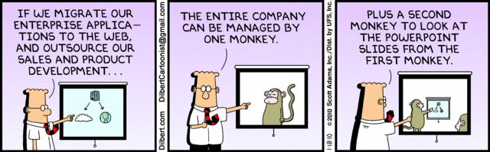
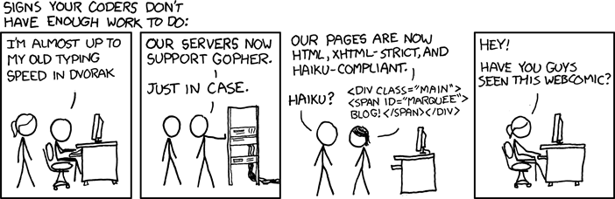
http://xkcd.com/554/
Notes:
Poll class:
Expected salary range upon graduation? Min, Max? Put on board.
Assume 40 hour work week.
How many people would work:
32 hours for 0.8 * Max? Put on board.
24 hours for 0.6 * Max? Put on board.
…continue until Min is reached.

Slide 8
Group Quiz
List 2 ways IT can lead to organizational change.
List 4 ways a Video Game Producer may protect its IP and what specific IP each protects.
List a computing technology that can be used to protect an individual’s privacy.
List a computing technology that can be used to intrude upon an individual’s privacy.
Notes:
Could split into groups of 4-5 for this.
Fill time with Work Discussion on Course Web Site

Slide 9
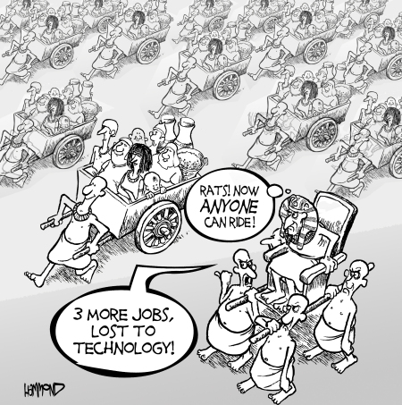
Overview
Review
Assignment
Students Present
©2009, MobileRobots Inc.
Notes:
Review Group Assignment Details.
Or first watch video: depends on student presentations, no thunder stealing.
CGP Grey
Humans Need Not Apply (15:00) – 2014-08-13
http://www.youtube.com/watch?v=7Pq-S557XQU
Last access 2016-04-22
These 3D printed homes can be constructed for $4,000 (3:00 – 2018-04-02)
http://www.businessinsider.com/3d-printed-homes-constructed-icon-new-story-tech-charity-4000-dollars-2018-3
https://www.youtube.com/watch?v=SvM7jFZGAec (1:28)
Last access 2018-04-22
Look at:
BBC Intelligent Machines
http://www.bbc.com/news/technology-33978561
BBC Likelihood of robot taking your job
http://www.bbc.com/news/technology-34066941

Slide 10
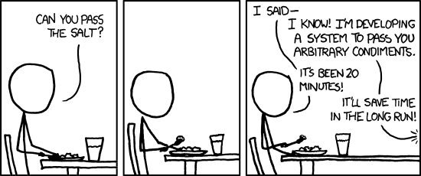
Overview
Review
Assignment
Students Present
https://xkcd.com/974/
Notes:
TODO: Replace with Alternate Turing Test

Slide 11
Net Neutrality And You
Brett Foster

Slide 12
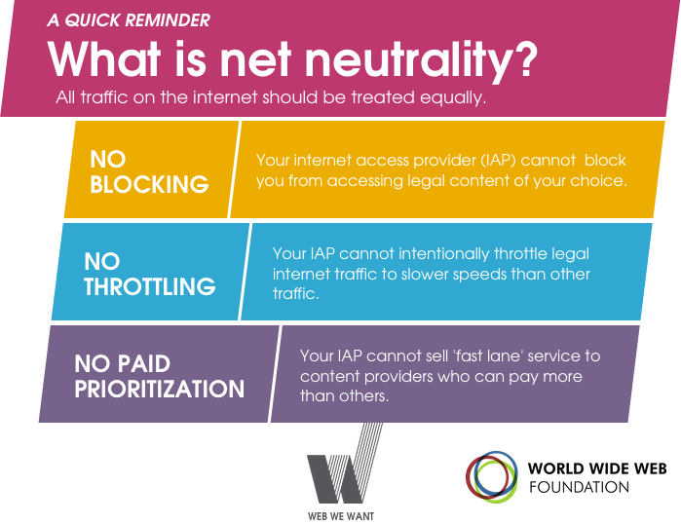
A Brief Overview
Brett Foster
What is Net Neutrality?
No blocking, throttling, or paid prioritization
Communications Act of 1934 [1]
Title I vs Title II
Telecommunications Act of 1996 [2]
ISPs classified as Title I
Open Internet Order of 2010 [3]
Transparency, no blocking, no discrimination
Title II Order in 2015 [6]
ISPs reclassified as Title II
Title II Repeal in 2017 [5]
Image source: https://webwewant.org/wp-content/uploads/2017/07/Graphic-WhatIsNetNeutrality.png
Notes:
What is Net Neutrality – Mentioned briefly in the textbook as not allowing ISPs to use tiered services, a.k.a. paid prioritization, but it also includes bans on blocking and throttling certain data as well
Blocking – Preventing users from accessing legal content
Throttling – Slowing down a user’s connection to some or all content
Paid prioritization – Creating “fast lanes” for users who pay more
1934 Act – Established the FCC, and Titles I and II
Title I – General provisions, only has light regulations
Title II – Common carriers, has more regulations
Common carrier – A person/company that transports people/goods for any other person/company. Provides service to general public without discrimination. Includes things like public utilities and TSPs
1996 Act – FCC had to decide where the internet fell with regards to 1934 Act, since obviously the internet didn’t exist in 1934. Telecommunications became Title II, and ISPs became Title I
2010 Open Internet Order – Set of regulations from the FCC
Transparency – ISPs must disclose their practices
No Discrimination – ISPs can’t discriminate in transmitting lawful content
2015 Title II Order – Reclassified ISPs as Title II
2017 Repeal – Repealed the 2015 order to make ISPs be Title I again

Slide 13

Pros of Net Neutrality
Brett Foster
Treat internet as a public utility
ISPs don’t get to choose what you do with your bandwidth [1, 2, 3, 4]
Small startups and large companies are treated equally [6]
Encourages competition, free market
Large online services (e.g. Netflix) won’t need to pay more for necessary speeds [6]
Increased costs would be passed on to consumers [6]
Image Source: https://occupy.com/article/next-stage-net-neutrality-conflict-begins
Notes:
Public Utilities – Utilities are generally classified under Title II. Analogous to electricity, where you pay for a certain amount of electricity (bandwidth), and you can use it for whatever you want
Treated equally – Imagine cable, which is Title I, and how you can buy different packages including different channels. There are no small channel startups because they can’t pay enough to be put in these packages. A similar thing could legally happen without Net Neutrality
Large companies don’t need to pay more – Services like Netflix require fast connections in order to stream video. If they are required to pay more for these speeds, the cost would be passed on to consumers. Using previous analogy, they can’t make large companies pay more for the electricity they use just because they use a lot of it

Slide 14
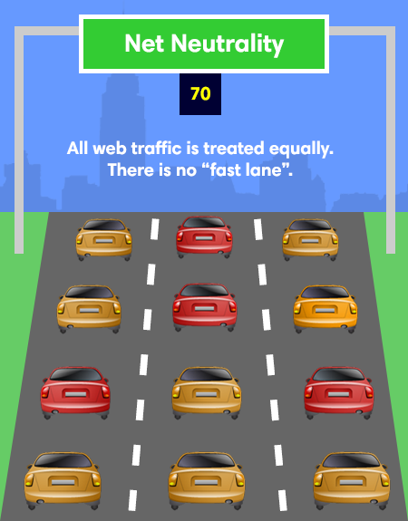
Pros OF Net Neutrality, Continued
Brett Foster
Important technologies can’t be throttled
Ex: California firefighters in 2018 [7]
ISPs can’t block competitors, privacy services (e.g. VPNs), etc.
Ex: Comcast throttled BitTorrent in 2007 [8]
Ex: Verizon blocking free alternatives to their smartphone tethering in 2012 [8]
AT&T, Sprint, and Verizon blocked Google Wallet, which competed with their own mobile-payment service, from 2011-2013 [8]
Image Source: https://www.websitetooltester.com/en/net-neutrality-complete-guide/
Notes:
California firefighters – During 2018 forest fires in California (largest fire in California history), the Santa Clara County fire dept. used a high-tech truck “Incident Support Unit”, which needs a robust internet signal to work correctly, but Verizon throttled them to 1/200th speed, resulting in loss of property and even loss of life, and the throttled speeds continued for some time after the firefighters alerted Verizon to the issue. This throttling would be illegal under Net Neutrality (Title II version)
Comcast blocked all VPNs except their own @Home Pro ($95/month) (early 2000s)
Comcast throttling BitTorrent – In 2007, Comcast blocked and slowed peer-to-peer technologies such as BitTorrent without disclosing this to customers. They did this because these services continuously upload data, limiting others’ bandwidth
Verizon blocking tethering – In 2012, Verizon removed 11 free tethering apps (use phones as Wi-Fi hotspots) from the app store, which could be used to circumvent Verizon’s $20 tethering fee
Google Wallet – From 2011-2013, AT&T, Sprint, and Verizon blocked Google Wallet, since it competed with a similar service called Isis (renamed to Softcard), which all three companies had a stake in developing
+ 10 more just from [8] alone
One common argument against Net Neutrality is that the internet worked just fine before it, and that consumer outrage would stop companies from abusing it, but clearly it didn’t

Slide 15
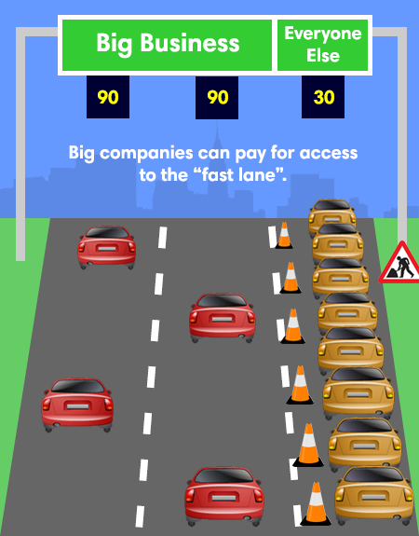
Cons of Net Neutrality
Brett Foster
Not enough infrastructure to guarantee top speeds for all
Results in slower speeds for everyone
Some devices and services require high-speed bandwidth
Medical devices
Self-driving cars
Reduced investment in better infrastructure
Upgrades to better infrastructure would benefit competitors just as much
Ex: 2011-2015, telecommunications investment dropped 20-30% due to reclassification [9]
Image Source: https://www.websitetooltester.com/en/net-neutrality-complete-guide/
Notes:
Not enough infrastructure – ISPs built infrastructure under the assumption that not everyone uses full bandwidth 24/7 – e.g. given 10 people with 100 Mbps, they share much less than 1 Gbps together because they will almost never use all of it at the same time. ISPs can’t guarantee top speeds for everyone because that would require more expensive infrastructure, a cost which would be passed on to customers. Similarly, services like Netflix, aren’t effective without high speeds, vs things like emails which would be affected very little by throttling. NN results in slower max speeds for everyone, which would be bad for things like medical devices which could be life or death if they are throttled
Reduced investment – Some ISPS have their own video streaming services, without NN they will try to improve their infrastructure to give them an edge over competitors, but with NN any upgrades benefit competitors just as much which reduces incentive. For example, after the Open Internet Order in 2010 and leading up to reclassification as Title II in 2015, investments dropped 20-30% based on a study by economist George S. Ford, which was the only time it dropped not during a recession

Slide 16
References
Brett Foster
[1] Communications Act of 1934, https://transition.fcc.gov/Reports/1934new.pdf
[2] Telecommunications Act of 1996, Federal Communications Commission, https://transition.fcc.gov/Reports/tcom1996.pdf
[3] Preserving the Open Internet, Federal Communications Commision, https://docs.fcc.gov/public/attachments/FCC-10-201A1.pdf
[4] Protecting and Promoting the Open Internet, Federal Communications Commission, https://docs.fcc.gov/public/attachments/FCC-15-24A1_Rcd.pdf
[5] Restoring Internet Freedom, Federal Communications Commission, https://transition.fcc.gov/Daily_Releases/Daily_Business/2017/db1122/DOC-347927A1.pdf
[6] Kang, Cecilia, “The effect of net neutrality rules on consumers”, (Washington Post, April 24, 2014), https://www.washingtonpost.com/business/technology/the-effect-of-net-neutrality-rules-on-consumers/2014/04/24/59c90556-cbda-11e3-95f7-7ecdde72d2ea_story.html
[7] Kruzel, John, “Could net neutrality have shielded California firefighters from throttling”, (PolitiFact, September 7, 2018), https://www.politifact.com/factchecks/2018/sep/07/fight-future/could-net-neutrality-have-shielded-california-fire/
[8] Karr, Timothy, “Net Neutrality Violations: A Brief History”, (Free Press, January 24, 2018), https://www.freepress.net/our-response/expert-analysis/explainers/net-neutrality-violations-brief-history
[9] Ford, George, “Net Neutrality, Reclassification and Investment: A Counterfactual Analysis”, (Perspectives, Phoenix Center for Advanced Legal & Economic Public Policy Studies, April 25, 2017), https://ssrn.com/abstract=2982436

Slide 17
Perception of Art
Marcus Chalmers

Slide 18
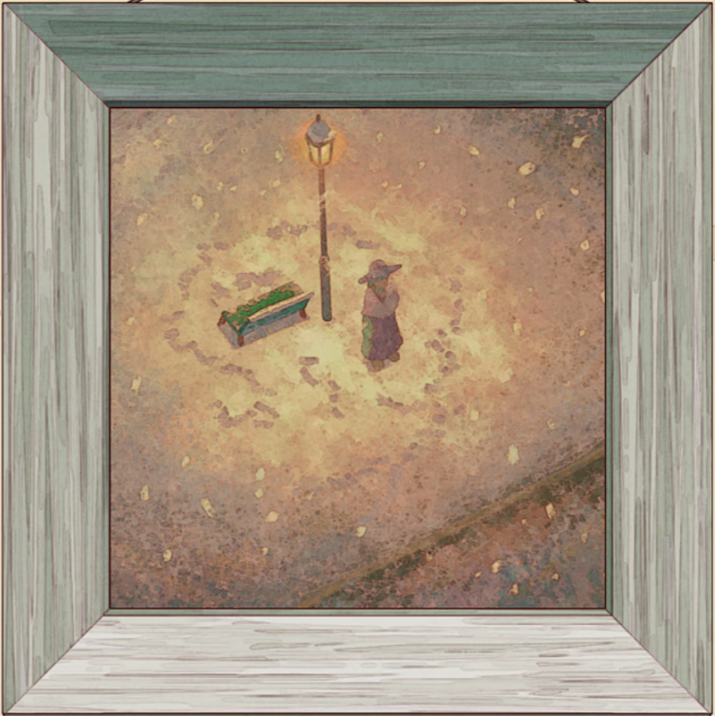
Why do we create art?
Marcus Chalmers
Art is Expression [18]
The human experience
Emotional and intellectual stimulus
Art Benefits the Mind [10][16]
Positive attitudes
Evolutionarily drawn towards beauty
[15]
Notes:
"The arts matter because they help us understand why we matter.“[18]
This quote comes from a large collection of quotes from the National Endowment for the Arts. The questions ‘why do we create art’ or ‘what does art mean’ are very personal and non-quantifiable. If I had to define art, I would classify it as any form of expression. When humans draw, sing, write, dance, or do anything with the intent of expressing themselves, I would classify that action or product as art. Of course this is only half the equation, The more art is produced the more viewers benefit. Even if someone creates some art only for himself the media is still being perceived. This is an important point that the National Endowment for the Arts mentioned, Art illustrates the human experience and makes us feel something and allows us to connect with one another. Art is meant to move people emotionally and intellectually. It created a record of our civilization and it shows us a view other than our own. Life without perspective is boring. Art allows for the perceiver to gain a viewpoint outside their own.
While you may not realize it art and beauty have actual physical effects on our emotional state and our health.
A study found that patients and faculty reported positively when questioned about the art in their hospitals
Patients tended to preferer natural / nature scenes with greens and blues rather than more abstract art
Ulrich has conducted many experiments that have shown patient stress relief with the implementation of nature as well as art
It’s hypothesized that humans are evolutionarily drawn to look at images of nature and feel calm
But its not just paintings of nature, humans are predisposed to pay attention to smiling and sympathetic faces and we get a positive feeling
Which reduces stress
So if art is a form of expression what do changes in art mean for society? Well I ‘d argue changes in how humans produce and consume art are a good thing
Specifically the most recent major change in art, the information era. >

Slide 19
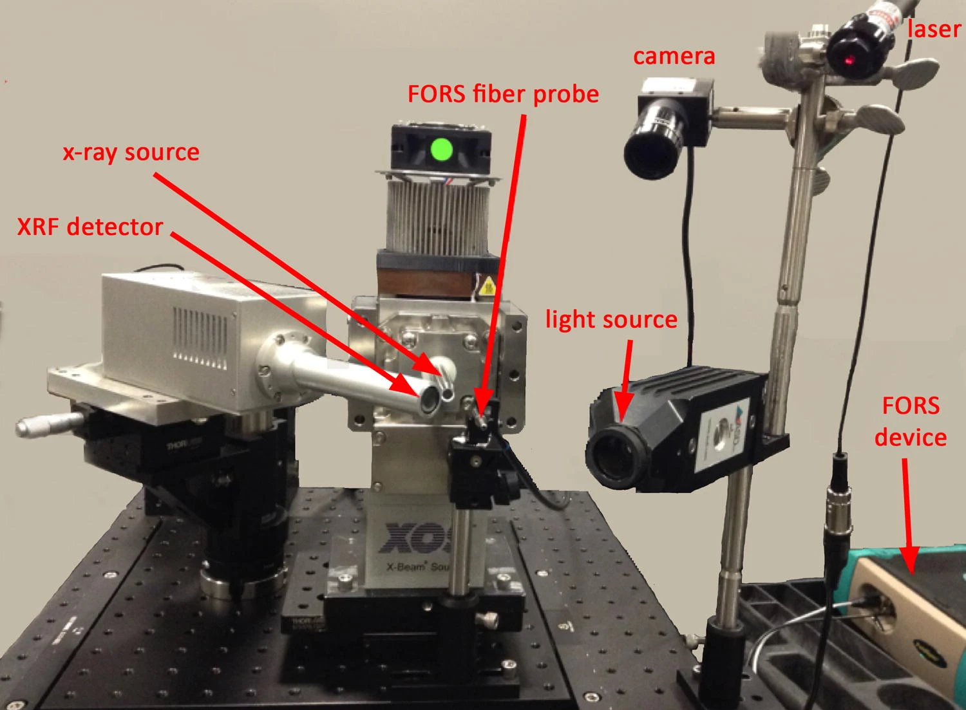
Digitized art history
Marcus Chalmers
Turning Point in Art History[5]
Large Scale Digitization
Analog to Digital [9]
Machine learning [19]
New Technology in Restoration [6] [7][8][14]
XRF & FORS
Macrophotography
A photograph of the XRF and FORS point measurement collection head.
Fig. 1. [8]
Notes:
The information era has brought a major turning point in art history and history in general
Many have likened the introduction of the internet to the creation of the printing press and I would agree, especially with regards to reproduction of art
The first major change of the information era relates to the digitization of art.
With the introduction of the internet it seems like every museum and art gallery has been able to digitize their media and display it for a much larger audience than ever before. But this process is not as straight forward as it may first seem. There are many differences between a photograph and a painting. Images do not have a natural perfect equivalent in digital form, like literature does. The texture and size and detail of paintings need to be carefully recorded. The conversion from analog to digital will tend to cause some loss of information. Even something that should be as simple as digitizing photographs can be challenging do you do it in full light or ranking light? do you get the textures? However, museums have found ways to best capture paintings which we will look at later.
Another interesting development related to the conversion of paintings is that Computer/automated image analysis is now possible. you can trace the inspiration and history of paintings in only minuets rather than years of tracking down obscure physical works machine learning has been able to identify and detect artistic influences since 2014 (big data)
The information age brought with it new ways to preserve these works and restore them to their original glory.
Digital media is a great way of representing art, allowing for many different angles and dynamic viewpoints
But how do you capture these paintings in the best way if not just with a camera
Well special imaging technology is used to analyze these paintings and then macrophotography is used to preserve them as images.
X-rays and infrared imaging technology.
These cameras XRF and FORS allow for more to be seen from these paintings than just the naked eye.
The X-rays are just like how you’d imagine they are but instead of looking into your body they are able to look into paintings showing different layers of paint with
A surprising level of detail. these first radiographic campaigns made it possible to discover several forgeries
Infrared imaging allows for different wavelengths of light to be picked up allowing for a better analysis of color and material.
These cameras can help identify the materials and color in many different mediums from canvas to stained glass
(the photograph shown here was taken from the point of view of a piece of art)
When the painting is ready to be properly recorded macrophotography is used to ensure that as little detail as possible is lost. We will see examples of this
Macrophotography in the next slide >

Slide 20

digital art preservation
Marcus Chalmers
Elisabeth Borluut [12]
Notes:
This is two images of the
Painting: Elisabeth Borluut, panel by Van Eyck
Part of the Ghent Altarpiece 15th century Belgium 1432
This piece is just one of many that has been restored and digitized using this new technology for the viewing pleasure of everyone. The painting on the right was the original state of this piece and the version on the left is the restored version, where if you know anything about painting restoration, they repainted the panel and digitized it again.
There are two major problems with the original that were solved using Infrared and X-rays, the faded colors which should be apparent, but also there was the problem of overpainting which we will discuss later.
First infrared was used>

Slide 21
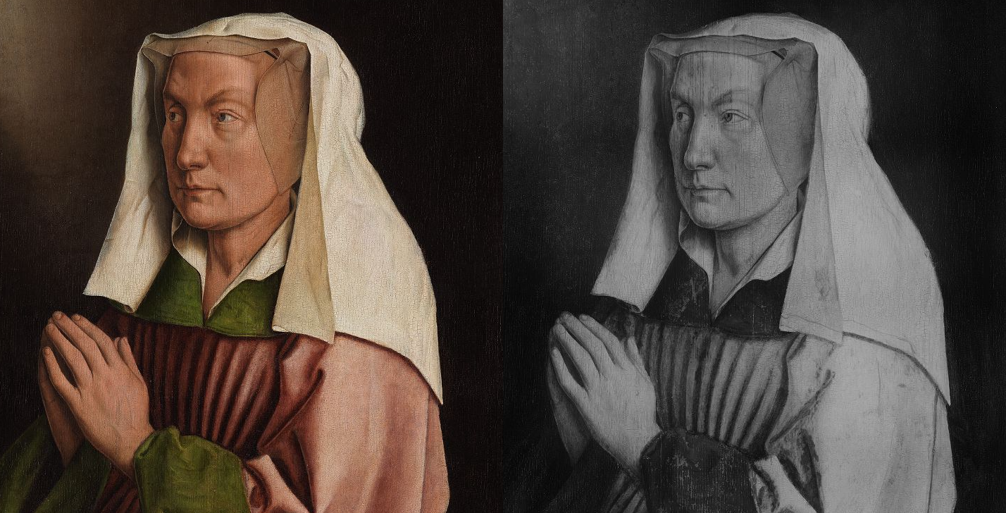
Infrared Macrophotography
Marcus Chalmers
Elisabeth Borluut [12]
Notes:
On the right how is the infrared version of the original painting. Infrared macrophotography captures near red waves just outside the visible spectrum. This is an important distinction because this painting isn’t grayscale. It is in black and white, but they aren’t correspondent to the darkness of the original image. As you can see the darkest part of the image is actually her cuffs and the area just around her neck, if you look at the colored version these are not the darkest areas. The reason for this is that the infrared spectrum for this photo is actually with regards to color, the closer the blue end of the spectrum the color is the darker it will be and the closer to the red end the lighter it will be. This is helpful for finding the exact colors used and how to best restore the image back to its unfaded version.
The other problem to be fixed is shown next>

Slide 22

Macrophotography
Marcus Chalmers
Elisabeth Borluut [12]
Notes:
If you notice in the top left, we are only looking at a small section of this painting. You should also notice that this smalls section isn’t pixelated, this is thanks to the Macrophotography. Macrophotography is the science of taking pictures of really small things and so if you take a large amount of small pictures of a big thing and then stick them together you will get an image that can be zoomed in quite far. This helps to mitigate the data loss because you would have to go in really really far for the pixels to show that you're not actually looking at a canvas. The macro is detailed if you look closely at this range you can see the cracks in the panel. Now I could zoom in closer than this but I want to show the next flaw in the old version. If you look closely at the cloth right next to the pillar you can see that they don’t fold the same way, they don’t match up. This is because of an overpainting. At some point between the 15th century and today this painting was redone just like it is now, however they weren’t able to paint it exactly like how it was and so little variations have appeared. This is where X-ray would help us to find the original way this cloth fell. This next slide is hard to see so look closely at the area on the right that was painted over and see how the X-ray shows the original cloth pattern shown on the left. >

Slide 23
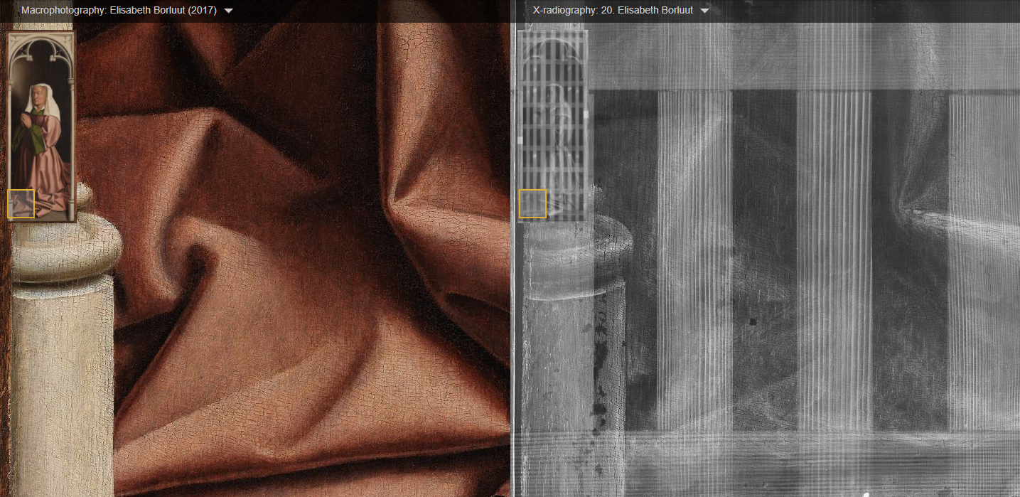
X-Radiography
Marcus Chalmers
Elisabeth Borluut [12]
Notes:
The X-Ray is hard to see because of the canvas grid but if you look closely you can see how the fabric folds the correct way.
Because at some point this fabric fold was painted over. Artists were then able to see how the original paint lied due to the X-ray and
Paint the folds in the original manner.
All this work is now available to view for free on the internet. But not only has the introduction of the digital age brought a tremendous way to showcase
Old art, it has also offered current artists a plethora of new mediums with which to express themselves.

Slide 24
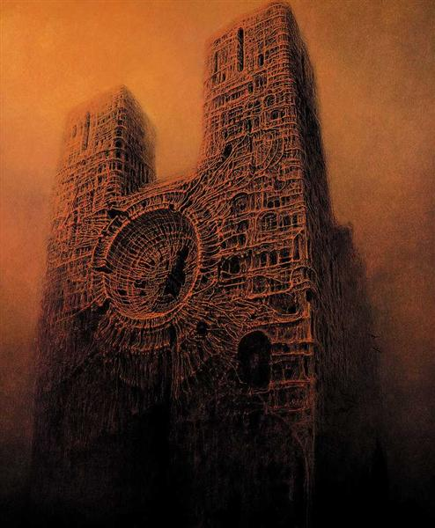
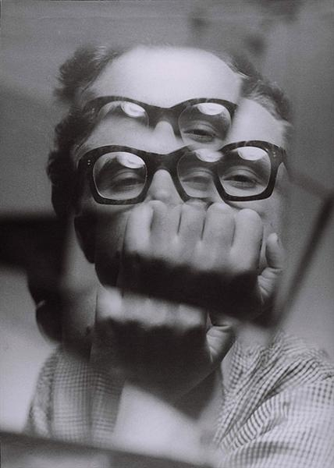
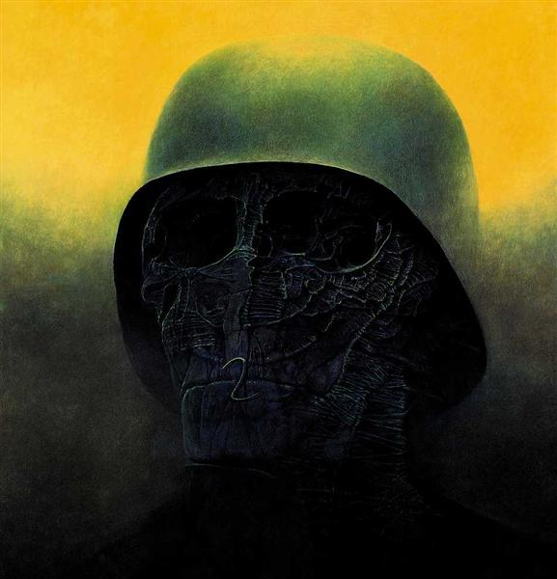
zdzisław Beksiński
Marcus Chalmers
Beksinski, Z. (n.d.). Untitled [Painting].
Beksinski, Z. (1957). Untitled [Self-Portrait].
Beksinski, Z. (1985). Untitled [Painting].
Notes:
This is Vu-chi-swave Ben-shin-ski
A polish artist born in Sanok, Poland in 1929. [artnet]
Sanok had one of the largest Jewish populations in Poland and being born right before the WWII era Beksinski witnessed many horrors firsthand that would shape the
Majority of his works. Beksinski often noted that in his works he strived to portray the feeling of nightmares. Most of his work were surrealist paintings, often much more disturbing than the images I’ve chosen to show here. Every piece from Beksinski was untitled and the interpretation of the pieces should be left to the observer. In the two paintings displayed there is obvious imagery of the Sistine Chapel and of a Soldier, but many other works are less straight forward. While the piece in the middle was made in 59’ towards the middle of his career Beksinski started to move into more photography where he would often distort the images, leaving large black rectangles or obscuring the subject in some way. The reason I wanted to talk about Beksinski is because of his willingness to embrace digital art when it was just forming. Beksinski had no significant impact on the development of digital art. however, I feel that his experience can be translated to many artists. Through his career, his work in photography and painting often depected distorted images of well-known objects, like bodies or buildings. Something we might today associate with Photoshop. Well in the early 90s and 2000s Beksinski did embrace the new digital medium. >

Slide 25
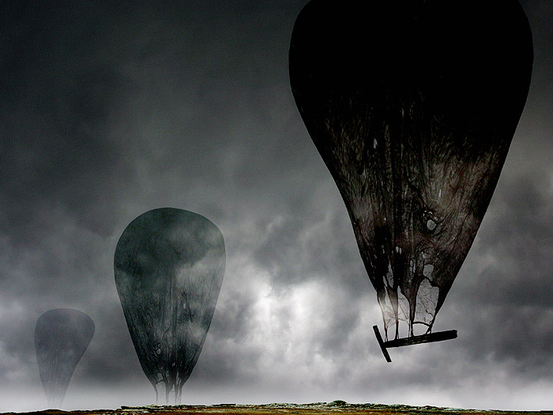
zdzisław Beksiński
Marcus Chalmers
Beksinski, Z. (1996). Untitled [Digital].
Notes:
Beksinski created much more artwork through photoshop, as you can see one example here. Beksinski fully embraced the medium with its abilities to distort and manipulate images. He is quoted in saying:
“There is certain refreshment of mind in this work, the view from a totally different perspective than at painting. Playing with these programs, I can create artificial reality at any angle and figuratively ‘photographed’ it, which would be the final result of creation.” [24]
Simple but it shows the importance of new mediums for artists. Art is created through expression, and when given the opportunity to show emption in different ways whole new creative venues open up. The only problem was that Beksinski only lived to 2005 and a because he was involved in the digital imaging scene so early, many of his digital works do not age well today. That limitation was only on the software and I wish he could have lived longer to see what else computer imaging had in store. >

Slide 26

New artistic mediums
Marcus Chalmers
Digital Painting
3D Modeling
Digital Animation
Podcasts
Pixel Art
Vector Images
[2]
Notes:
Photoshop has gotten much better since the early 2000s. Especially since the 1990’s
This is a short and not at all exhaustive list of the different mediums that came around because of computers and the internet
Digital Painting – Using Photoshop, Illustrator, Procreate, Paint tool sai, clip studio paint pro, Krita or any of the hundreds of software available and a drawing tablet you can create as many drawings or paintings as you desire without the need for paint and paper.
3D Modeling – The introduction of 3D modeling is an new medium like Sculpting for the informational age, programs like Maya are really helpful
Digital Animation – this goes hand in hand with 3D modeling but there's also 2D animation that has almost entirely switched over to digital, The amount of paper that animation takes digital is a real timesaver if used right.
Podcasts – you might not think of them as art, but they are a form of creative expression that only came around because of the ability to post wherever you wanted onto the internet, Like a radio talk show but without the need for a network.
Pixel Art – This was originally because of a limitation but it has become a truly beautiful medium. The restrictive nature allows for true creativity to show.
Vector Images – this one is kind of weird but the ability to create an image that can scale infinitely is a new development within computers Logo’s can be created and sized to fit on any sized object. It’s like a print with no set size.

Slide 27
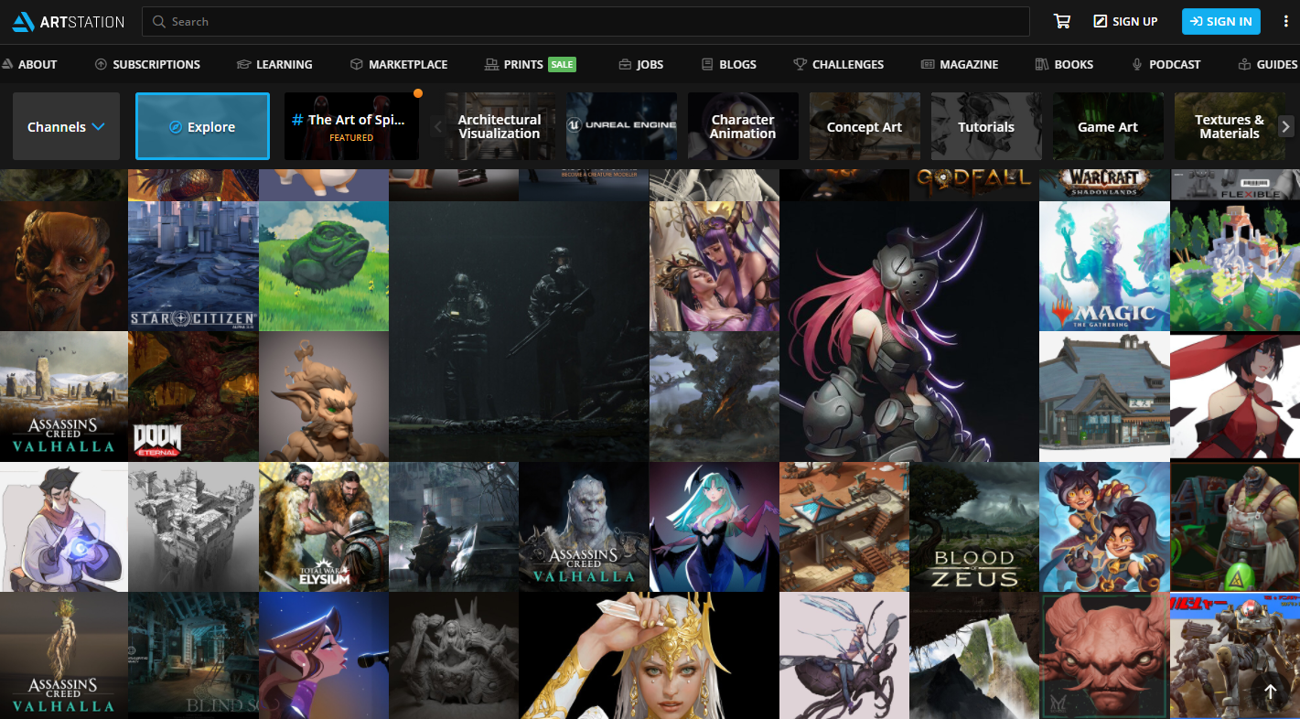
How we view art
Marcus Chalmers
Official Websites
Twitter
ArtStation
Deviant Art
Pixiv
Tumblr
Homepage of ArtStation
[4]
Notes:
The internet has made the world of art much more available to many more people. This is the main point with regards to perception. This is just a small list of places where art
is presented on the internet but if you think about it, when was the last time you saw art outside of the internet, maybe you have some handing in your house, or you’ve seen an advertisement recently, but I guarantee you the amount of art available not for free is incredible. Each of these websites alone offers a gallery larger than any building could ever hold. >

Slide 28
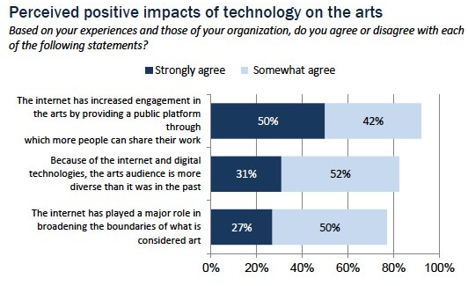
Technology on artistic presentation
Marcus Chalmers
Positive Impact of Technology
92% increased engagement[21]
83% more diverse audience[21]
77% broadened art[21]
81% promotes the arts [20]
52% gain inspiration[17]
Recognition & Exposure [23][21]
Pew Research Center’s Internet & American Life Project. Conducted between May 30-July 20, 2012. N for respondents who answered this question=1,207
Notes:
So what does this mean to people? All of this information and perspectives are available at a larger rate than ever before how has this changed art?
Well
92% of people surveyed agreed that the internet has increased engagement in the arts by providing public platforms through which people can share their work
83% of people agreed that the internet and digital technologies have made the arts audience more diverse than it was in the past
The nature of the internet allows for people to view art continently and for free which is a luxury that wasn’t afforded before
77% of people agree that the internet has played a major role in broadening the boundaries of what is considered art
With so much being displayed and so many different new ways to display artistic expressions, what is art has grown.
81% of organizations agreed that the internet and digital tech was very important in promoting the arts
The internet connects everyone and so of course it connects people to the arts, even preforming arts.
52% of artists say they get inspiration from online
This statistic was taken from 2004, and while its outdated it shows that even when it was just starting there was already so much potential.
The exposure allowed by all of this art is incredible too, there are so many people, on soundcloud for example that were able to come from nowhere and get a start
lizzo chance lil naz x
non-profit organizations can share so much educational content and art as well as artists who just post art for fun. >

Slide 29
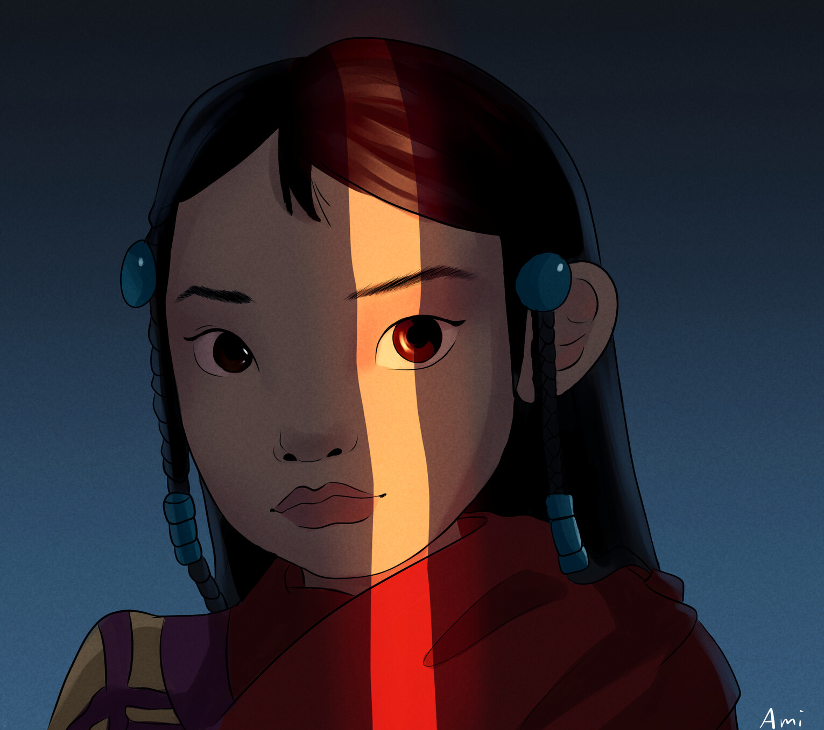
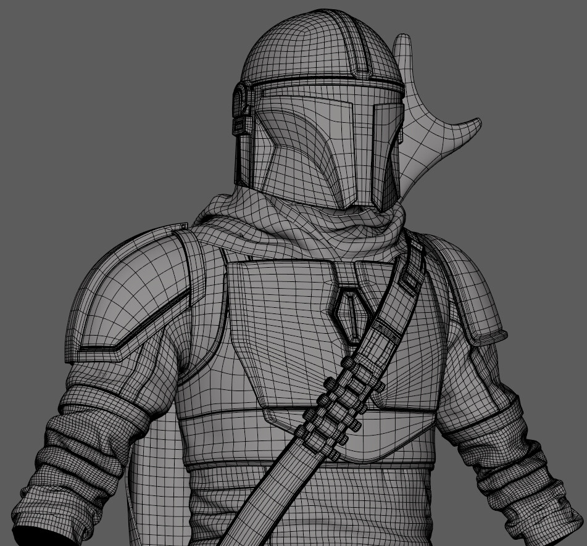
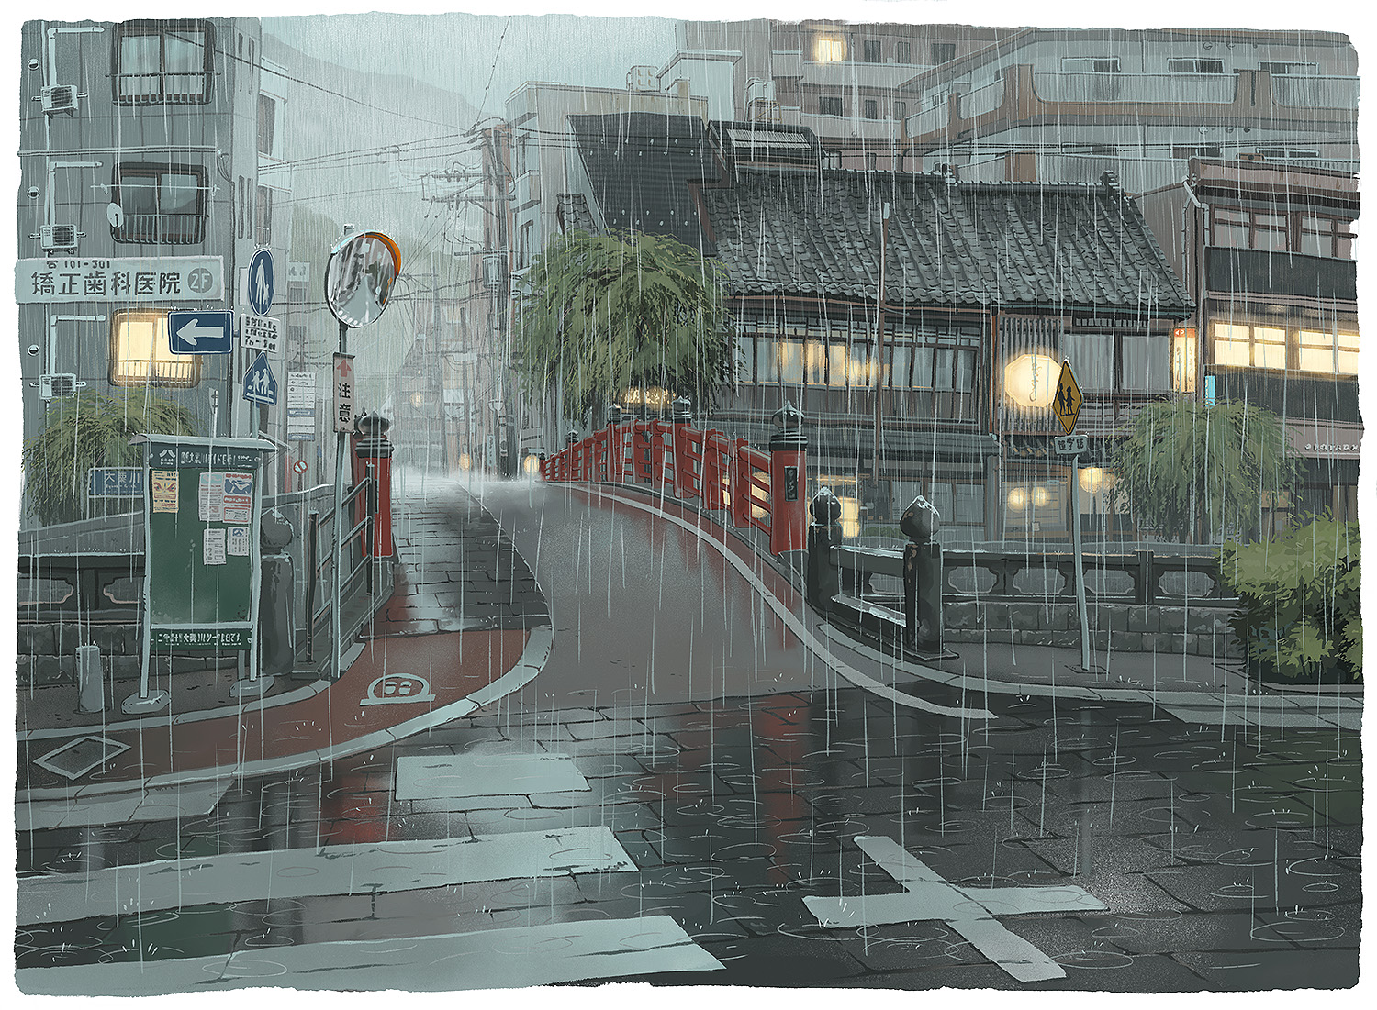

The effect on our society
Marcus Chalmers
Preservation of Art History
New Form of Expression
New Level of Accessibility
(left to right)[25][1][11][22]
Notes:
This change in how art is recorded, created, and perceived is a welcome one and I’m glad that I’m able to live in a time that has such incredible access.
Access to so many old works through the process of restoration that share a viewpoint so far removed from my own.
Access to new mediums, not just for my own want to create, but also to see how others use those same tools.
Access to view an impossible amount of art. These pictures to the right aren’t even particularly special, they were just on the surface of the never-ending wave of new art that’s available
Thank you.

Slide 30
References 1/3
Marcus Chalmers
[1] Acvodad, A. (2020). Curiosity [Digital Painting]. https://www.artstation.com/artwork/68ZmJN
[2] Adobe Photoshop, Jurek, J., & Porodina, E. (2017). Adobe Photoshop Splash Screen.
[3] Artnet. (n.d.). Zdzisław Beksiński. Artnet. Retrieved December 1, 2020, from http://www.artnet.com/artists/zdzislaw-beksinski/
[4] ArtStation—Explore. (2020). [Screenshot]. https://www.artstation.com/?sort_by=community
[5] Bentkowska-Kafel, A., Cashen, T., & Gardiner, H. (2005). Digital art history : A subject in transition. computers and the history of art series, volume 1. ProQuest Ebook Central https://ebookcentral-proquest-com.ezpxy-web-p-u01.wpi.edu
[6] Cardinali, M. (2019). Digital Tools and Technical Views: The Intersection of Digital Art History and Technical Art History in a Digital Archive on the Painting Technique of Caravaggio and His Followers. Visual Resources, 35(1-2), 52–73. https://doi.org/10.1080/01973762.2019.1555351
[7] Cotte, P. (2017). The ID21 X-ray and infrared microscopy beamline at the ESRF: status and recent applications to artistic materials. Journal of Analytical Atomic Spectrometry, 32(3), 477–493. https://doi.org/10.1039/c6ja00356g
[8] Delaney, C. (2018). Integrated X-ray fluorescence and diffuse visible-to-near-infrared reflectance scanner for standoff elemental and molecular spectroscopic imaging of paints and works on paper. Heritage Science, 6(1), 1–12. https://doi.org/10.1186/s40494-018-0197-y
[9] Drucker, J. (2013). Is There a “Digital” Art History? Visual Resources, 29(1-2), 5–13. https://doi.org/10.1080/01973762.2013.761106
[10] Eisen, S. L., Ulrich, R. S., Shepley, M. M., Varni, J. W., & Sherman, S. (2008). The stress-reducing effects of art in pediatric health care: art preferences of healthy children and hospitalized children. Journal of Child Health Care, 12(3), 173–190. https://doi.org/10.1177/1367493508092507

Slide 31
References 2/3
Marcus Chalmers
[11] Evrard, S. (2020). The Mandalorian [3D Model]. https://www.artstation.com/artwork/bK5O9n
[12] Getty Foundation. (n.d.). Closer to Van Eyck: Rediscovering the Ghent Altarpiece. Retrieved December 1, 2020, from http://closertovaneyck.kikirpa.be/
[13] Gilpin, L., & Ulrich, R. (2003). Healing Arts: Nutrition for the Soul. Putting Patients First; Designing and Practicing Patient-Centered Care, 117–146.
[14] Harnischmacher, C. (2016). The Complete Guide to Macro and Close-Up Photography. In The Complete Guide to Macro and Close-Up Photography (1st ed.). Rocky Nook.
[15] Kaburagi, H. (2020). Snow of London (No. 11). In Great Pretender. Fuji TV.
[16] Lankston, L., Cusack, P., Fremantle, C., & Isles, C. (2010). Visual art in hospitals: case studies and review of the evidence. Journal of the Royal Society of Medicine, 103(12), 490–499. https://doi.org/10.1258/jrsm.2010.100256
[17] Madden, M. (2004). Artists, Musicians and the Internet [Pew Research Center: Internet, Science & Tech]. https://www.pewresearch.org/internet/2004/12/05/artists-musicians-and-the-internet/
[18] NEA Staff. (2015). Why The Arts Matter. National Endowment for the Arts. https://www.arts.gov/stories/blog/2015/why-arts-matter
[19] Nuria Rodríguez-Ortega (2019) Digital Art History: The Questions that Need to Be Asked, Visual Resources, 35:1-2, 6-20, DOI: 10.1080/01973762.2019.1553832
[20] Purcell, K., Rainie, L., & Thomson, K. (2013). Arts Organizations and Digital Technologies [Pew Research Center: Internet, Science & Tech]. https://www.pewresearch.org/internet/2013/01/04/arts-organizations-and-digital-technologies/

Slide 32
References 3/3
Marcus Chalmers
[21] Purcell, K., Rainie, L., & Thomson, K. (2013). Section 6: Overall Impact of Technology on the Arts [Pew Research Center: Internet, Science & Tech]. https://www.pewresearch.org/internet/2013/01/04/section-6-overall-impact-of-technology-on-the-arts/
[22] Soemy, Y. (2020). Phos [Digital Painting]. https://www.artstation.com/artwork/VgbGlg
[23] SoundCloud. (2020). Celebrating the TWELVE Grammy nominees that were First on SoundCloud. https://blog.soundcloud.com/2020/01/23/celebrating-the-twelve-grammy-nominees-that-were-first-on-soundcloud/
[24] Szomko-Osękowska, D. (n.d.). Graphics. Muzeum Historyczne w Sanoku. Retrieved December 1, 2020, from http://muzeum.sanok.pl/en/zbiory/zdzislaw-beksinski/grafika
[25] Urbanowicz, M. (2020). City Scenes pt.2 [Digital Painting]. https://twitter.com/gommatt/status/1308234768350236675

Slide 33
As AlphaGoes Will Humans Go?
Baian Ou(Byron)

Slide 34
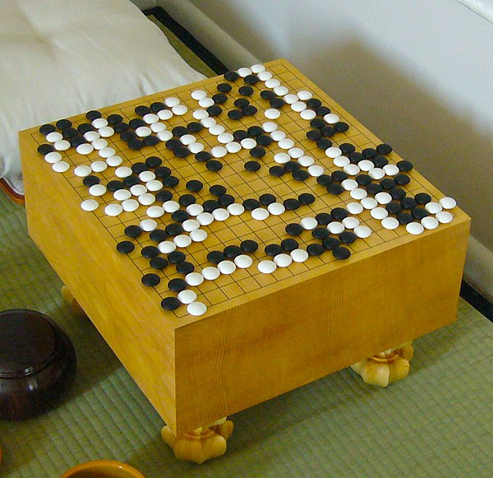
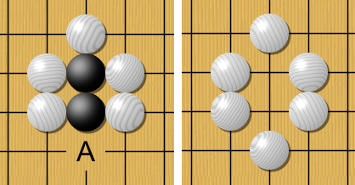
What is GO?
Baian Ou
2-player chess/board game
Standard: 19 x 19
Basic Rule: Capture (on the right)
Handicap
Area scoring / Territory scoring
[1]
Notes:
Briefly introduce Go:
chess game
stanardboard 19*19
basic play rules on the right
Handicap: give specific player larger advantage by let him places a few pieces on certain position(from 1 to 9)
Scoring method: different depends on the area, central idea is to take advantages by circling or capturing larger territory on the board
Why? Rules are simple, actual play is complicated
the average 150-move game contains more possible board configurations — 10^170 [6] from Nature, Google AI algorithm masters
ancient game of Go(notice atoms of universe are estimated as 10^78 to 10^82 atoms [7]from UniverseToday)

Slide 35

What is AlphaGo?
Baian Ou
Background
Evolutional computer program for Go
Arguably the strongest Go player in history[2]
Before AlphaGo
A hefty handicap was needed for computers to win at Go.[3]
Professional players think they are close to the ceiling of Go[4]
<Citation>
Notes:
Background:
From deepmind website:
AlphaGo is the first computer program to defeat a professional human Go player, the first to defeat a Go world champion, and is arguably the strongest Go player in history.[2]
Before AlphaGo:
Other software: Zen(4/5 stone handicap), Crazy Stone (4 stone handicap)[3]
Reason being complexity of GO: different layers of strategy require
From a Chinese magazine about GO, one question “If there is a God of Go, what is difference in the level in between?”
Most of the professional say they need 2 or 3 stone handicap in order to compete at the same level [4]

Slide 36


Where does AlphaGo?
Baian Ou
In October 2015, AlphaGo 5-0 Mr Fan Hui
March 2016, 4-1 Mr Lee Sedol
May 2017, 3-0 Ke Jie
After it, AlphaGo Zero and AlphaZero
[2]
Notes:
Fan Hui:three-time European Champion
Lee Sedol: the winner of 18 world titles, who is widely considered the greatest player of the past decade.
8 International champs, 4 years for world’s best player according to Go Rating(he is also very young, born in 1997)
Retired
More advanced versions of AlphaGo, 100:0 and 60:40
GO Zero starting from completely random plays, learn from itself
Zero get rid of the rules

Slide 37
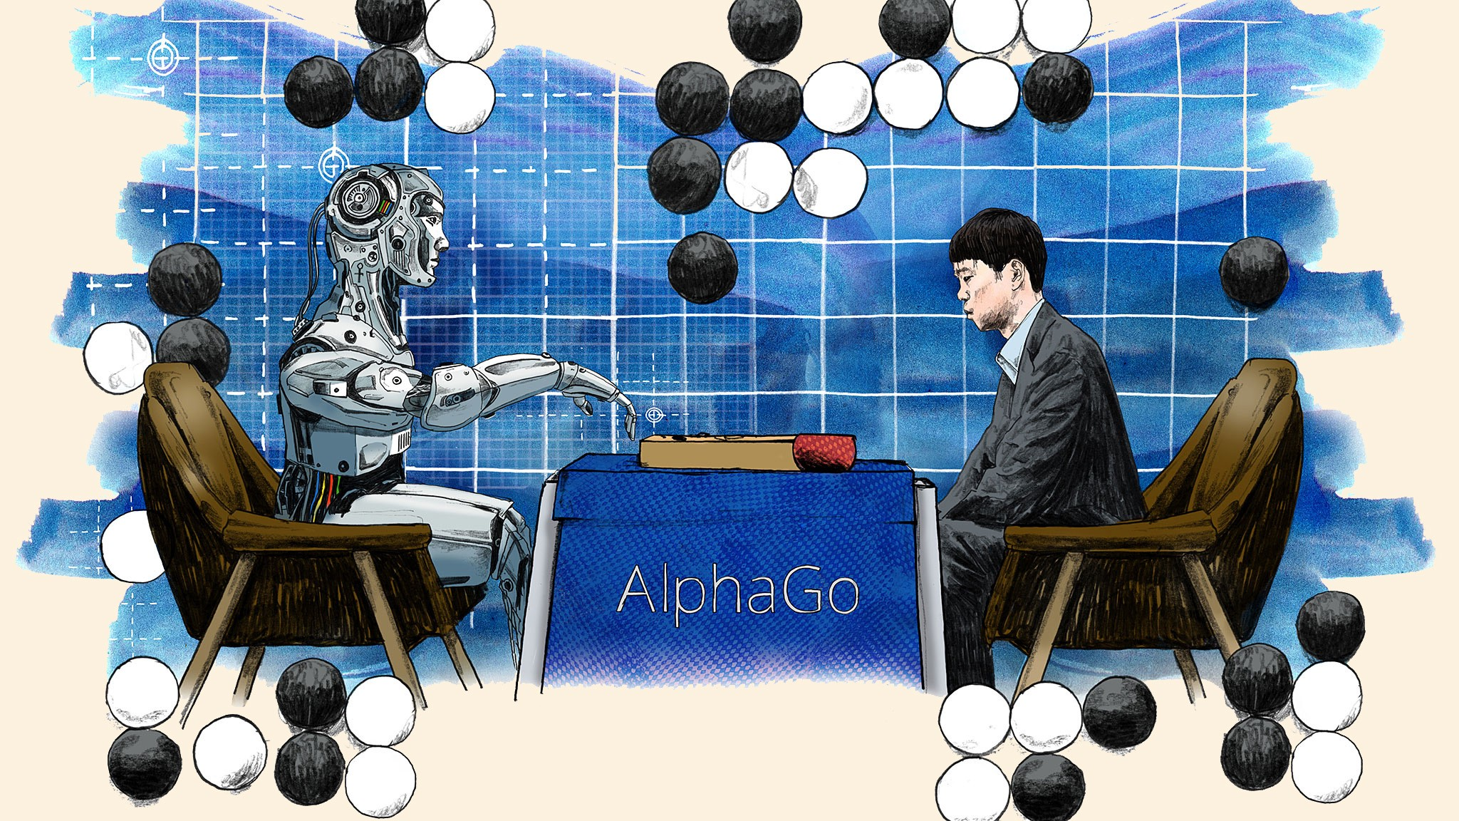
Conclusion:
Baian Ou
AlphaGo is benefiting human(Go)
Pros(arguments)
Shows limits of human, and the essential of Go[5]
Promote the game itself[2]
Cons(counter arguments)
It ruins the game Go for human
Spending too much time and effort to win a game
Notes:
Pros:
Famous move call “move 37”, in vs Lee Sedol game 2 [5]
Thought was error, but end up being human have made that mistakes for thousands of years
AlphaGo had calculated that there was a one-in-ten-thousand chance that a human would make that move
Popularity
The Language situation in China 2017, Alpha Go was one of the top 10 words in 2016[8]
Lee Sedol game was watched by over 200 million people worldwide. This landmark achievement was a decade ahead of its time[2]
Cons reponse:
Ke Jie made a 22 wins against human player after vs Alphagohttps://sports.qq.com/a/20170719/052498.htm [9]
Mastering the game of Go with Deep Neural Networks & Tree Search(106k Accesses 3647 Citations) [10]
Mastering the game of Go without Human Knowledge (149k Accesses 1597 Citations) [11]

Slide 38
REFERENCES 1/2
Baian Ou
[1]No author, Welcome to the American Go Association, (American Go Association, n.d.), https://www.usgo.org/(accessed on 11/28/2020)
[2]No author, AlphaGo, (Deepmind, n.d.), https://deepmind.com/research/case-studies/alphago-the-story-so-far(accessed on 11/28/2020)
[3]David Ormerod, zen computer Go program beats Takemiya Masaki with just 4 stones!,( Go Game Guru, ,02/01/2016), https://web.archive.org/web/20160201162313/https://gogameguru.com/zen-computer-go-program-beats-takemiya-masaki-4-stones/(accessed on 11/28/2020)
[4]Xu Mei, 这一年，AI重写围棋江湖 This year, AI changes the Go world, (Southern People Weekly, 6/20/2018), https://weiqi.qq.com/news/9435.html(accessed on 11/28/2020)
[5]Cade Metz, In Two Moves, AlphaGo and Lee Sedol Redefined the Future，(Wired, 03/16/2016), https://www.wired.com/2016/03/two-moves-alphago-lee-sedol-redefined-future/(accessed on 11/28/2020)
[6]Elizabeth Gibney, Google AI algorithm masters ancient game of Go, (Nature, 01/27/2016), https://www.nature.com/news/google-ai-algorithm-masters-ancient-game-of-go-1.19234(accessed on 11/29/2020)
Notes:
Author, Title, (Publisher, Date), URL (Access Date)

Slide 39
REFERENCES 2/2
Baian Ou
[7] John Carl Villanueva, How Many Atoms Are There in the Universe?, (Universe Today, 07/30/2009), https://www.universetoday.com/36302/atoms-in-the-universe/#:~:text=%E2%80%9Cthe%20known%20Universe%E2%80%9D)%20is,roughly%2093%20billion%20light%20years.&text=At%20this%20level%2C%20it%20is,hundred%20thousand%20quadrillion%20vigintillion%20atoms.(accessed on 11/28/2020)
[8]Yuming, Wei, The Language Situation in China, (De Gruyter Mouton, 2019)https://linguistlist.org/issues/30/30-4746/(accessed on 11/28/2020)
[9] No author, 围甲-柯洁战阿法狗后22连胜被终结 排历史第三(Ke Jie’s 22 win strikes was terminated, ranking third of the history), (Tencent Sport, 07/19/2017), https://sports.qq.com/a/20170719/052498.htm(accessed on 11/28/2020)
[10] ,Silver, D., Huang, A., Maddison, C. et al. , Mastering the game of Go with deep neural networks and tree search, (Nature, 01/27/2020), https://www.nature.com/articles/nature16961 (Nature 529, 484–489)
[11]Silver, D., Schrittwieser, J., Simonyan, K. et al. , Mastering the game of Go without human knowledge, (Nature, 10/19/2017), https://www.nature.com/articles/nature24270#citeas (Nature 550, 354–359)
Notes:
Author, Title, (Publisher, Date), URL (Access Date)

Slide 40
AI, Please take my job
Rose McGovern

Slide 41
Overview
Rose McGovern
Common worries of AI taking over jobs
Benefits of increasing productivity
Other Considerations
Notes:
To give a quick overview of my presentation I will begin by reviewing some of the common worries that people have about AI taking over their jobs, increasing productivity and the benefits of that which includes improving employee satisfaction, and then some other considerations to make related to my argument.

Slide 42
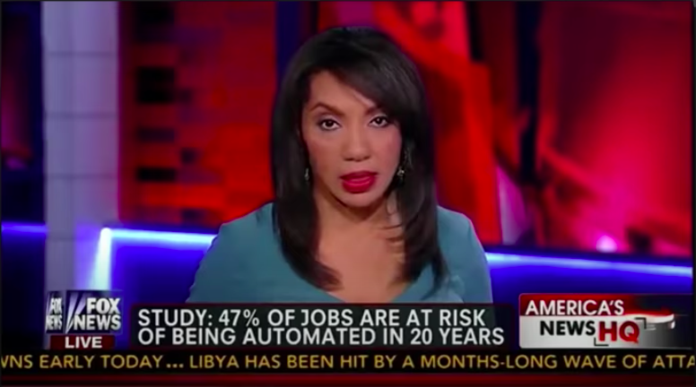
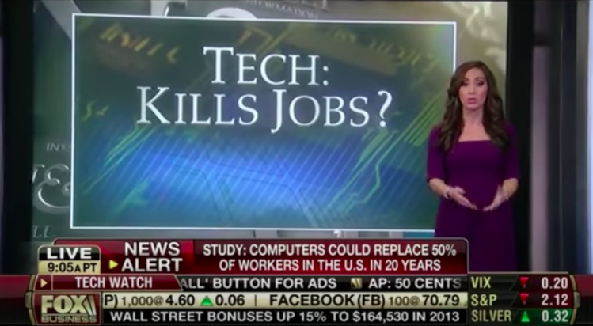
Automation Anxiety
Rose McGovern
2013 Oxford University study reported that 47% of US jobs could be replaced by computers in the next decade_{[1]}
AI will cost 1.8 million jobs by 2023, but will create an additional 2.3 million_{[4]}
The share of jobs requiring AI has increased by 450% since 2013, per Adobe_{[4]}
_{[2]}
_{[2]}
[1,2,4]
Notes:
Automation anxiety has always been a thing, It's hard to visualize the jobs that will be created with a new world to come
False projects of how many jobs will be taken over by automation are only assessing the capabilities of new technologies, not the overall effect on employment. A 2013 Oxford University study reported that 47% of US jobs could be replaced by computers in the next decade. The study notes that it is not estimating how many jobs will actually be automated, because that depends on additional external additional factors.
In situations like this, people and media outlets get easily caught up on the negative statistics and fail to highlight the more positive ones.
Gartner, a global research and advisory company, predicts that AI will cost 1.8 million jobs by 2023, but will create an additional 2.3 million_{[4]}
The share of jobs requiring AI has increased by 450% since 2013, per Adobe, however this has not led to a drop in employment

Slide 43

Economic cycle
New
Technologies
Rose McGovern
Lost Jobs
Tech Suppliers
New Jobs
New industries and jobs to make automated technology
More productive companies that can expand and lower their prices
New jobs created with these opportunities
New Industries
Higher Productivity
Expand
Lower Prices
New
Jobs
We Buy More
We Buy Other Things
New Jobs
[2]
Notes:
We won’t be killing the economy.
The effect of labor-saving inventions creates a cycle of jobs, as opposed to the common misconception that new automated technologies only eliminate jobs.
First, the actual making of these new technologies opens doors for tech suppliers to increase the amount of products that they are making, and sometimes these processes create the need for new industries which both create more jobs.
Next, automated technologies/processes make companies more productive. When companies can do more with less, they can expand which creates more jobs if say a company is making more products or adding new locations for example. Additionally, more productive processes mean that they can lower prices to be more competitive.
With lower prices consumers can buy more of their product (which leads back to expanding) or they can use the money saved to put towards other things, which once again leads to new jobs.

Slide 44

productivity
Rose McGovern
Labor productivity growth in the U.S. averaged only 1.3 percent per year from 2005 to 2016
Less than half of the 2.8 percent annual growth rate sustained from 1995 to 2004_{[3]}
More productivity could lead to shorter workdays
Before labor unions pushed for the 8-hour standard work week, many workers spent 12-14 hours per day at work
[3]
Notes:
To focus back on increasing productivity…
Measured productivity growth has declined by half over the past decade, and real income has stagnated since the late 1990s for a majority of Americans. labor productivity growth in the U.S. averaged only 1.3 percent per year from 2005 to 2016, less than half of the 2.8 percent annual growth rate sustained from 1995 to 2004. there is a need for increased productivity in order to create more employee satisfaction and to improve the quality of life for workers.
More productivity can lead to shorter workdays. And this can be projected to happen with out lower salaries for many industries, if you look at how to standard 8-hour work week came to be. Before labor unions pushed for this 8-hour standard, most people worked typically 12-14 hours, or more, per day.
Adam Grant, organizational psychologist and New York Times bestselling author of Originals: How Non-Conformists Move the World, says that “the more complex and creative jobs are, the less it makes sense to pay attention to hours at all.” And I think with new technologies it gives us an opportunity to reevaluate our workplace standards.

Slide 45
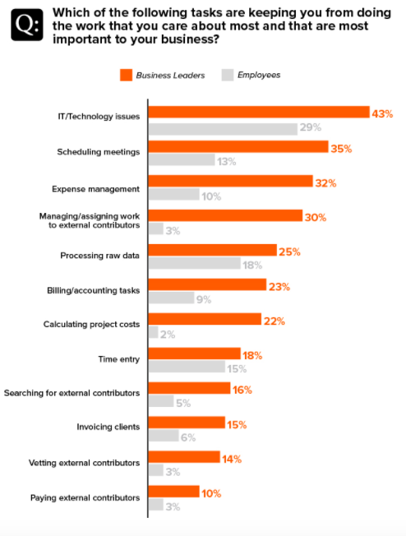
Satisfied Employees
Rose McGovern
Employee empowerment is correlated with profitability and engagement
Unengaged employees are more likely to quit and have lower levels of productivity
Happy workers are 13% more productive_{[5]}
[5,6]
[6]
Notes:
So If businesses are more productive it opens more doors,
Ai can allow us more time to do things that matter, creating a more balanced and healthier lifestyle, with work, some of which is repetitive and dehumanizing, not dominating our lives.
With automated processes where AI takes over tasks that are repetitive and don’t take a ton of skill, we can avoid employees having to do unfulfilling, busy tasks.
As you can see in the chart on the right that shows which tasks are keeping employees from doing the work that they care most about and find most important to the mission of their business, many of these tasks are the simple, repetitive ones that could be done by a computer.
A 2005 Pepperdine University study pinpointed 40 highly empowered companies and tracked their financial performance against the S&P 500], and found empowerment is strongly correlated with profitability. Empowerment also boosts engagement. On top of that, Unengaged employees are more likely to quit and have lower levels of productivity. If AI is able to complete the jobs that take employees away from doing their meaningful work, it creaetes room for employees to spend all of their time doing engaging work.
On another note, Research done by Oxford University’s Business School found that Happy workers are 13% more productive which once again relates back to the cycle of benefits from increasing productivity.

Slide 46
Other Considerations
Rose McGovern
Humans are uncomfortable with the idea of free time
Just because we have more free time doesn’t mean we will use it
Automated tasks will force us to reconsider not just how much we work, but also how we find meaning in it
Notes:
with this there are still some other considerations to make.
We are not used to having free time and having large amounts of it can make us uncomfortable and feeling like we are unroductive. So if we were to create more free time it would be an adjustment to figure out how to make that time valuable and stimulating. Yes, this would allow people to focus on more creative things, such as projects and hobbies or family, but people would have to take that initiative by themselves. But this does create more opportunity for greater community engagement, where people have more time to give back or form relationships with others.,
Automated tasks will force us to reconsider not just how much we work, but also how we find meaning in it. People who work jobs that do not require a lot of skills and do involve very repetitive tasks, such as cashiers or receptionists, if eliminated will be a challenge for those people to find work that is meaningful or accessible to them, and I think we could see this a lot with people from varying educational levels. But again, this is something that has happened before in history, for example if you look at milk men with the creation of refrigerators, and really its just part of the cycle of an advancing society.

Slide 47
Conclusion
Rose McGovern
Increasing the involvement of AI in the workplace makes the workplace more human.
Notes:
In conclusion, we are human first and a lot of times we forget that and we don’t prioritize our health and satisfaction. Increasing the involvement of AI in the workplace makes the workplace more human by ultimately improving employee satisfaction.

Slide 48
References
Rose McGovern
[1] Carl Frey & Michael Osborne, The Future Of Employment: How Susceptible Are Jobs To Computerisation?, (Oxford University, September 2013), https://www.oxfordmartin.ox.ac.uk/downloads/academic/The_Future_of_Employment.pdf (November 30, 2020)
[2] Joss Fong, The Big Debate About the Future of Work, Explained,(Vox, November 2017), https://www.youtube.com/watch?v=TUmyygCMMGA&t=1s (November 30, 2020)
[3] Erik Brynjolfsson, Daniel Rock, & Chad Syverson, Artificial Intelligence and the Modern Productivity Paradox: A Clash of Expectations and Statistics, (NBER, 2017), https://siepr.stanford.edu/system/files/Artificial%20Intelligence%20and%20the%20Modern%20Productivity%20Paradox-%20A%20Clash%20of%20Expectations%20and%20Statistics.pdf (November 30, 2020)
[4] The Connected CIO Talks AI, (Dell Technologies, January 2019), https://www.delltechnologies.com/resources/en-gb/asset/white-papers/solutions/2271-DELL-Connected-CIO-Talks-AI-23Jan2019.pdf?dgc=SM&lid=spr2481815766&linkId=70647865 (November 30, 2020)
[5] Clement Bellet, Jan-Emmanuel De Neve, & George Ward, Does Employee Happiness have an Impact on Productivity?, (Said Business School WP, October 2019), http://dx.doi.org/10.2139/ssrn.3470734 (November 30, 2020)
[6] WorkMarket 2020 In(Sight) Report: What AI & Automation Really Mean For Work, (WorkMarket, 2020), https://www.workmarket.com/press/workmarket-2020-insight-report-what-artificial-intelligence-automation-mean-for-work (November 30, a2020)

Slide 49
Class 11 The End
Keith A. Pray
socialimps.keithpray.net
Notes:
If there’s time and we didn’t get to it:
Kickstarter Charter
https://www.kickstarter.com/charter?ref=about_subnav
CGP Grey
Humans Need Not Apply (15:00) – 2014-08-13
http://www.youtube.com/watch?v=7Pq-S557XQU
Last access 2016-04-22
These 3D printed homes can be constructed for $4,000 (3:00 – 2018-04-02)
http://www.businessinsider.com/3d-printed-homes-constructed-icon-new-story-tech-charity-4000-dollars-2018-3
https://www.youtube.com/watch?v=SvM7jFZGAec (1:28)
Last access 2018-04-22
Look at:
BBC Intelligent Machines
http://www.bbc.com/news/technology-33978561
BBC Likelihood of robot taking your job
http://www.bbc.com/news/technology-34066941
This is the end. Any slides beyond this point are for answering questions that may arise but not needed in the main talk. Some slides may also be unfinished and are not needed but kept just in case.

