Slide 1
Class 9 Errors Failures Risks
Keith A. Pray
socialimps.keithpray.net
Notes:
Here’s the title slide. Excited already, aren’t you?
What is the point of this assignment? (Did SW Teams from the reading pick good test strategies? Will you be able to support your choices if something goes wrong?)
What errors? – Have student record list on board
Who looked for directions on how to test currency?

Slide 2
what works well Online With Zoom
Sign in with First and Last Name
Stay muted unless you are going to speak
To speak use the raise your hand feature
To answer yes/no questions use the “yes” ”no” buttons
Turn your camera on
Wait until the end of student presentations to ask questions
Write them down so you don’t forget

Slide 3
Survey Results (1/3) -11 Responses
Notes:
Common items for next time:
I am in FL 140 about an hour before and after each class
Estimated breakdown of course time per week:
4 hours class time
4 hours reading (2 chapters ~90 pages @ 2 minutes per page)
8 hours practicing mastery of material (papers, group project, class activity prep)
If you are spending much more than this let me know and we can figure out a more efficient way to spend your time

Slide 4
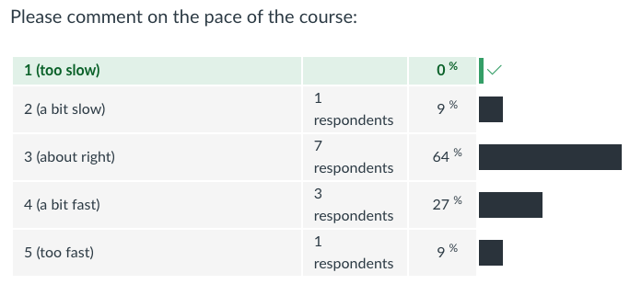
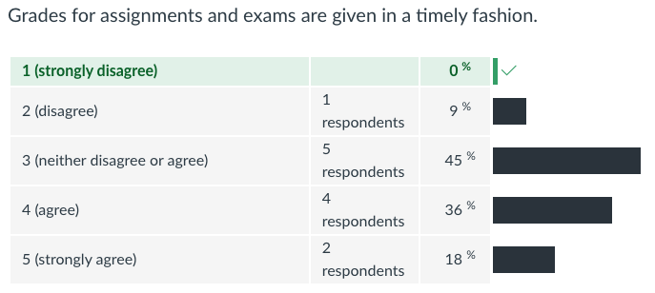
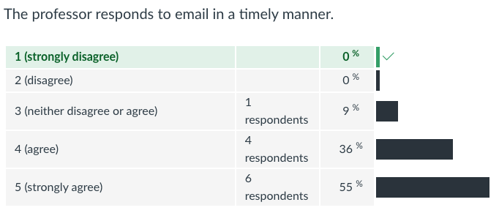
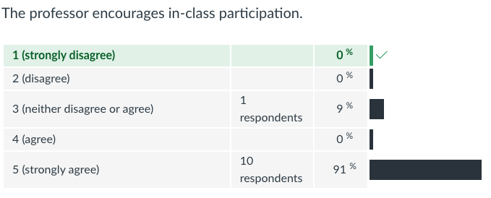
Survey Results (2/3) -11 Responses

Slide 5
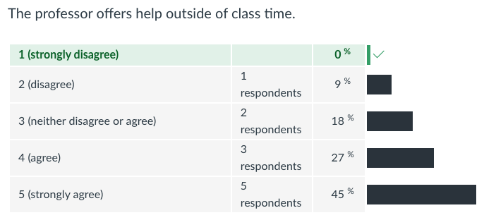
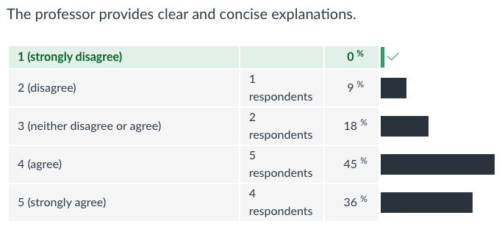
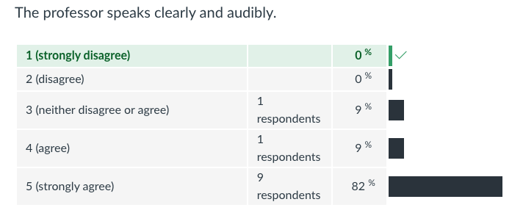
Survey Results (3/3) -11 Responses

Slide 6
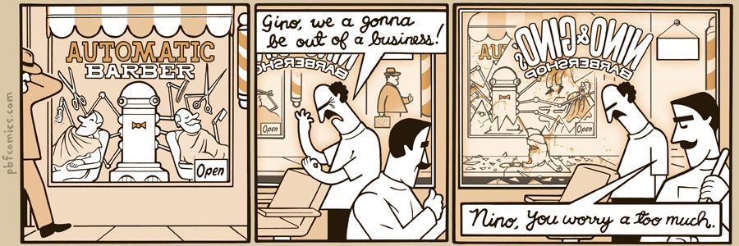
http://pbfcomics.com/197 (2014-09-26)
Notes:
10 – Errors, Failures, Risks

Slide 7
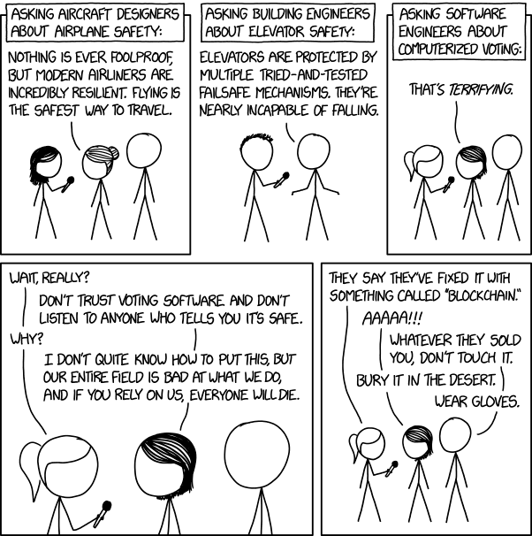
Overview
Review
Assignment
Students Present
https://xkcd.com/2030/ (2018-09-21)
Notes:
Good alternative if guest speaker not coming or late
Why Electronic Voting is a BAD Idea - Computerphile
https://www.youtube.com/watch?v=w3_0x6oaDmI
We can also discuss articles listed on Security Discussions under documents of course web site.
TODO: add quiz as backup if class discussion or guest speaker fail

Slide 8
My Reading Notes
pp. 366 Any false arrests since 1989?
pp. 368 Argument assumes DB cannot exist without existing inaccuracies.
pp. 373 This is not to keep the PATRIOT system from responding to false alarms.
pp. 375 Always encapsulate units! Not clear if SW involved.
pp. 376 Any SW diffs between Mars Missions?
pp. 378 Why did the Tokyo Stock Exchange refuse?
pp. 380 Republicans and Florida?
pp. 381. Do the second thoughts on DRE machines make the interview at end Chapter’s end less relevant?
pp. 389 No simulation examples since 2002?
pp. 390 Did The Limits to Growth predictions motivate people to change?
pp. 392 What happened to Verification?
pp. 394 “satisfies the specification” = verification. “needs of the user” = validation.
pp. 395 SW quality since 2009?
pp. 396 Gender bias nice addition!
pp. 406 21, source from 2004, is it implemented yet? 23 like game release question in next chapter.
Questions I liked: 10, 12, 16, 17, 18, 20, 21
Notes:
MSNBC on Denver's Automated Baggage System 2010-08-23 (2:27)
https://www.youtube.com/watch?v=xx8f4x6C_KY
Accessed 2019-04-09

Slide 9
Overview
Review
Assignment
Students Present
Notes:
We can also discuss articles listed on Security Discussions under documents of course web site.
ADD QUIZ AS BACKUP IF CLASS DISCUSSION OR GUEST SPEAKER FAIL

Slide 10
Assignment
Prepare for Debate
From Chapter 9 In-class Exercises # 24.
Should the company produce the game?
Use the SWE Code Of Ethics as the basis for your argument.
Use other sources for supporting data
Optional 1 paper on topic, lowest paper grade will be dropped

Slide 11
I’m Suing My AI Doctor
Connor Mclaughlin
Notes:
Hey everyone, I’m going to be discussing the current state of AI in healthcare, and how its recent growth may lead to interesting scenarios of ambiguous liability.

Slide 12
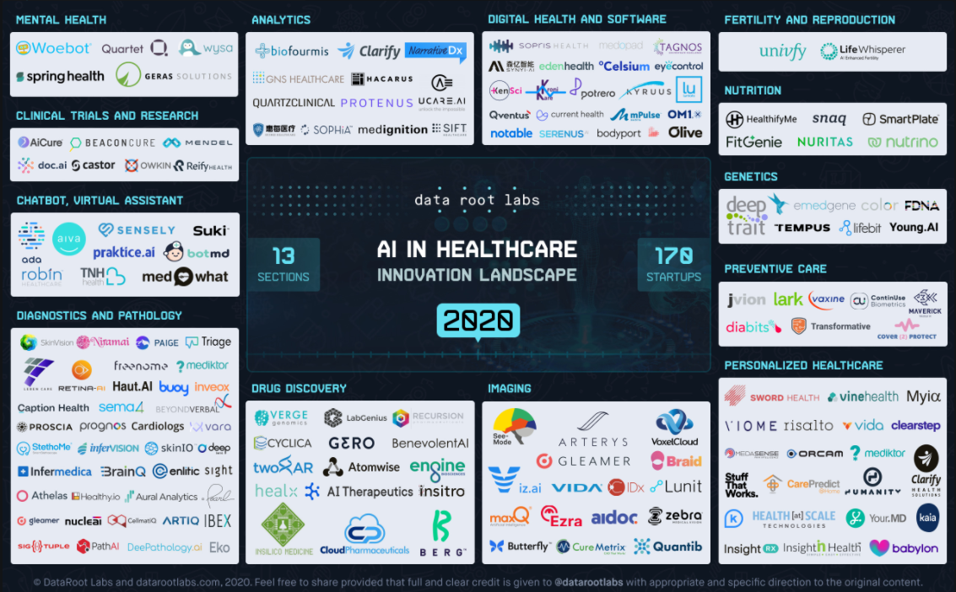
Overview of Machine Learning in Healthcare
Connor Mclaughin
A fast-growing industry
Startups raised $4B in 2019, projected to reach over $6.5B by 2021 [1] [2]
New Surge in Research
Number of papers covering AI in medicine/healthcare rose from 600 to 12500 in past 10 years [3]
Wide Variety of Applications
Image from DataRoot Labs
Notes:
So first, an overview of machine learning in healthcare.
It’s a very fast growing industry, with AI startups in the US raising over 4 billion in 2019, and all sources indicate continued growth. For reference, the industry raised less than 800 million dollars in 2016, so that’s over four times what we had then.
It’s also a very new field, most research has occurred very recently, and just 10 years ago nobody was really discussing this at all. And part of these being such a new field, is that a lot of the issues with respect to regulation and ethics have yet to be ironed out.
Additionally, as you can see from the image on the right, there’s a wide variety of applications that new companies are applying AI to in this industry. We are seeing developments in everything from robot-assisted surgery, to new drug discovery, and even virtual chatbots for general care.
Other data if people ask about past: AI healthcare startups raised 796M in 2016 [2]. Earlier projections from 2018 suspected mid 2020s investments of over 35B.

Slide 13
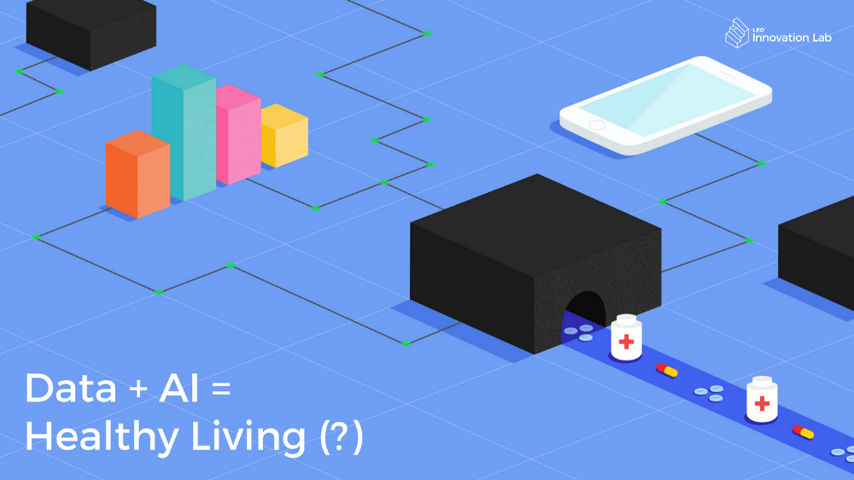
Efficacy of New Methods
Connor Mclaughin
Powerful “black-box” models
Moving away from need for medical expertise, but limited accountability
Dosage Estimation
ML methods for blood thinner dosage up to 20% more accurate than traditional methods [4]
Cancer Diagnosis (Melanoma)
2019 NVIDIA model > field experts [5]
In-home application: SkinVision
Image from MC AI
Notes:
So how effective are these methods?
First, it’s critical that we see the use of AI for what it really is, a black box -- something that we dump data into, that gives us an answer without explaining its process. This is powerful as it allows us to process large amounts of data much faster without the need for medical expertise, but again we don’t have the comfort of someone with a medical degree backing up their decisions.
So just as a few examples of emerging technologies in the field, some models for predicting accurate doses for blood thinners have come up which outperform traditional methods used by doctors. Assessing these dosages are very important, as blood thinners are a high-risk drug.
Another popular domain of AI in healthcare is for cancer diagnosis through imaging technology. Just last year NVIDIA researchers came up with a model that was able to outperform a panel of expert dermatologists. There’s a phone application currently available in Europe that uses a similar method, which people can use to take pictures of their skin and it will flag whether or not they should visit a doctor.

Slide 14
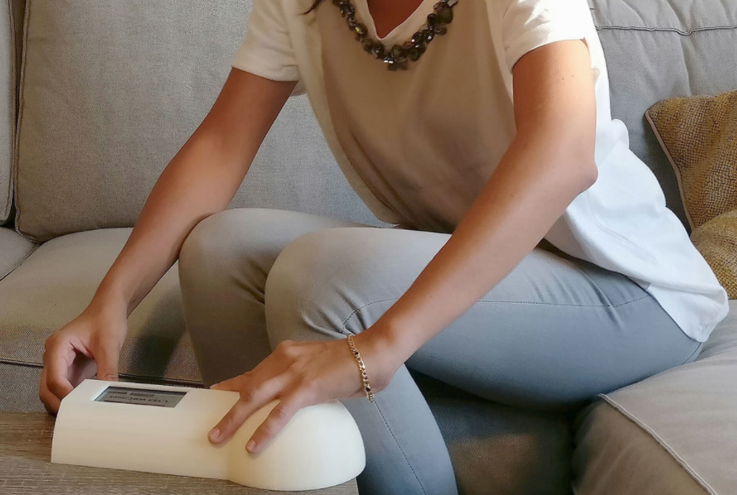
Realistic Usage of Black Box Models
Connor Mclaughin
Another tool in the medical toolbox
Introduces work for physicians → slow adoption into hospitals [6]
Dosage
Inherent risk & controlled substances
A second opinion at most
Diagnostic Tools
At-home testing has been popularized due to convenience and privacy
Most (~80%) of FDA-approved devices are for this purpose [7]
Image from Leuko
Notes:
So we can see from the research domain, that these models can be very accurate in providing critical information for patients. So how are they actually used?
So the first thing to note is that these methods are just seen as another tool in the already large toolbox for doctors. Introducing AI technologies as a second opinion could help doctors, but that would require new training and vetting that really slows this process down.
For instance with models helping with drug dosage amounts, it’s unlikely that we’ll reach a stage soon where AI-alone will be prescribing drug amounts, due to the inherent risk and issue of controlled substances. At most, they would be used as a second opinion for the doctor.
Where there is some potential is with AI for diagnostic tools, as there’s been a lot of success there in the past. For example, for pregnancy tests, people used to have to consult a doctor, but now portable tests have become very popular. Most FDA-approved medical devices are diagnostic tools, but none yet are available for the consumer home. (On the right we have an image of an at-home white blood cell monitor for cancer patients, currently pending FDA approval).

Slide 15
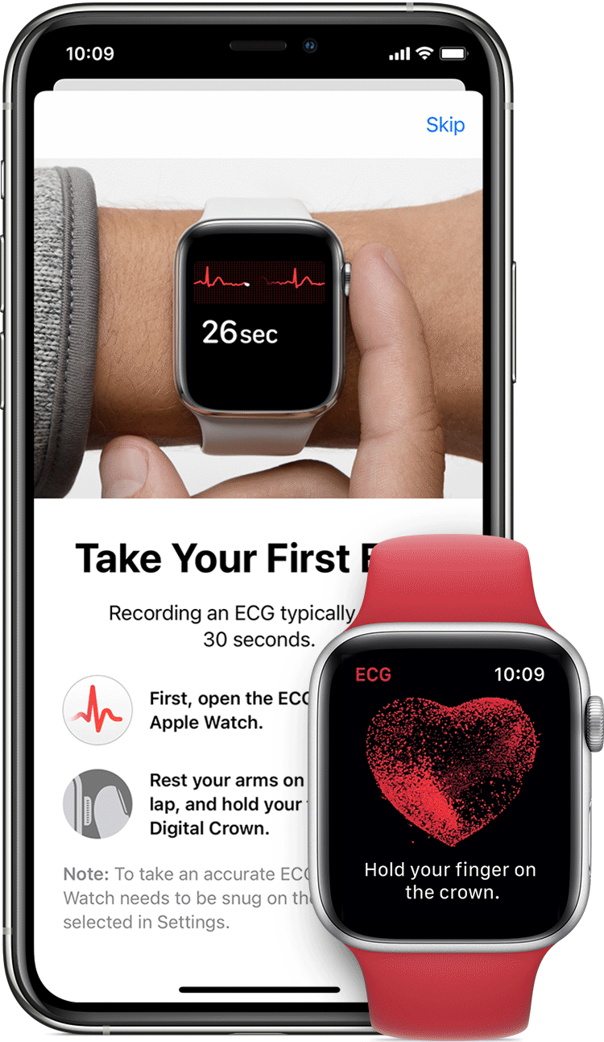
Current State of Regulation
Connor Mclaughin
AI Software Considered as a Medical Device
Currently only 29 FDA-approved AI medical devices [7]
22 within the last two years
Many more “lower-risk” devices have been granted FDA-clearance → e.g. more research-facing tools
Framework for processing is a work in progress [8]
1) Algorithms must be “locked”; no continuous learning → however recent changes proposed
2) Requires use of big data
Usage without approval would leave hospitals vulnerable to malpractice claims
Example: IBM Watson Cancer Treatment Failures[9]
Image from Apple
Notes:
Currently, all medical AI software is considered by the FDA as a medical device, and they have a few additional requirements on top of those already expected of medical devices. There’s only 29 FDA-approved AI medical devices to date, but most of these have come from the last two years. There could actually be more, as the FDA doesn’t have a way to search for AI devices, so outside researchers have built their own database for this.
The whole process of FDA approval for these is currently under development as well. Last year the FDA published a proposal for their approval framework, that laid out two key points: 1) the algorithms submitted must be frozen, and shouldn’t be continuously learning based on new user data (in part to stay as deterministic/controlled as possible). 2) Companies must use big data → difficult for startups, also introduces overhead in light of novel threats such as COVID.
These regulations are crucial for widespread use, as operating without FDA approval leaves companies vulnerable to malpractice claims. For example, the IBM Watson Cancer Treatment AI was widely used by hospitals for a period of time alongside doctors, but it was found that because of how the AI had been trained, it sometimes made decisions which would have done considerable harm to the patient. This would have been found by FDA vetting methods.

Slide 16
Liability and Malpractice of Algorithms
Connor Mclaughin
There are currently no precedents for how to handle liability considering AI in medicine
What should happen in cases of malpractice and disagreement with AI diagnosis?
E.g. radiologist dismisses patient scan flagged by algorithm
How would a precedent of having to agree with an AI affect healthcare? Will we trust AI models purely based on numbers?
Notes:
So what happens when one of these medical devices is tied to a lawsuit? We don’t know yet. As most of the technology is so new, and is often used as a consulting opinion to an expert, there haven’t been any cases to date. So what I think is the most likely case for the initial lawsuit is a malpractice suit where there was some disagreement between the care provider and the algorithm, where the care provider had the final say and was wrong. I think without proper precautions, this could potentially lead to a situation where they are not only liable for malpractice, but for disagreeing with the AI, which may lead to professionals practicing more defensively and sticking to what the algorithm says, even when they can’t understand it’s black-box decision.

Slide 17
REFERENCES
Connor Mclaughlin
[1] Insights Team, AI and Healthcare A Giant Opportunity, (Forbes 2019), https://www.forbes.com/sites/insights-intelai/2019/02/11/ai-and-healthcare-a-giant-opportunity/?sh=6fe000fc4c68, (November 16, 2020)
[2] Nora Zhou, The Rise of Healthcare Artificial Intelligence, (Axial 2017), https://www.axial.net/forum/ai-and-ml-are-boosting-the-healthcare-startup-scene/, (November 16, 2020)
[3] Tran, B., Vu, G., Ha, G., Vuong, Q., Ho, M., Vuong, T., . . . Ho, R. (2019). Global Evolution of Research in Artificial Intelligence in Health and Medicine: A Bibliometric Study. Journal of Clinical Medicine, 8(3), 360. doi:10.3390/jcm8030360
[4] Ashkan Sharabiani, Adam Bress, Elnaz Douzali, Houshang Darabi, "Revisiting Warfarin Dosing Using Machine Learning Techniques", Computational and Mathematical Methods in Medicine, vol. 2015, Article ID 560108, 9 pages, 2015. https://doi.org/10.1155/2015/560108
[5] Qishen Ha, Bo Liu, Fuxu Liu,Identifying Melanoma Images using EfficientNet Ensemble: Winning Solution to the SIIM-ISIC Melanoma Classification Challenge, October 2020, https://arxiv.org/abs/2010.05351
[6] Kononenko, I. (2001). Machine learning for medical diagnosis: History, state of the art and perspective. Artificial Intelligence in Medicine, 23(1), 89-109. doi:10.1016/s0933-3657(01)00077-x
[7] Benjamens, S., Dhunnoo, P. & Meskó, B. The state of artificial intelligence-based FDA-approved medical devices and algorithms: an online database. npj Digit. Med. 3, 118 (2020). https://doi.org/10.1038/s41746-020-00324-0
[8] Bradley Thompson, New Developments in FDA Regulation of AI, (MDDI, 2020) , https://www.mddionline.com/regulatory-quality/new-developments-fda-regulation-ai, (November 16 2020)
[9] Topol, E.J. High-performance medicine: the convergence of human and artificial intelligence. Nat Med 25, 44–56 (2019). https://doi.org/10.1038/s41591-018-0300-7

Slide 18
Smart Cities
Kaitlyn Fichtner

Slide 19
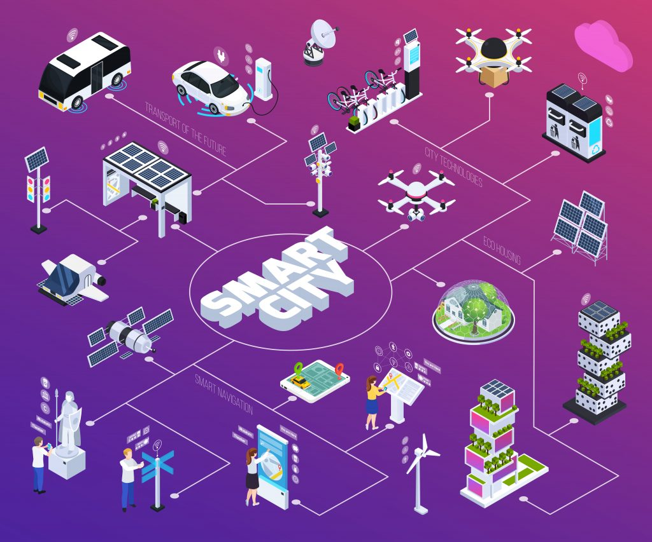
What are smart cities?
Kaitlyn Fichtner
Use IoT sensors and technology to collect data [10]
Improve quality of life [10]
Reduce environmental impact [14]
Maintain public safety [14]
<Graphic as big as will fit>
Smart City Graphic [5]
Notes:
Smart cities are cities that use internet of things technology and sensors spread out across the city to collect data that is used to efficiently manage assets, resources, and public services [10].
Smart street lights, traffic management, waste management, weather and air quality monitoring, and natural disaster warning systems are just some of the ways smart cities can improve quality of life, reduce environmental impact, and maintain public safety for citizens [14].

Slide 20
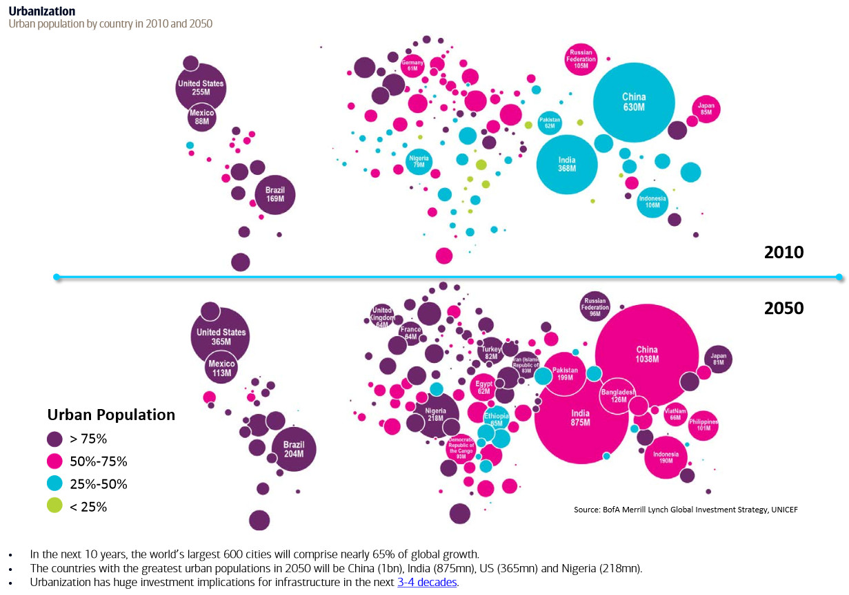
Why are Smart cities important?
Kaitlyn Fichtner
By 2050, 68% of the population will live in urban areas [1]
Congestion causes $300 billion in damages per year [7]
Cities account for 70% of global carbon emissions [4]
Smart cities can improve energy efficiency by 30% within 20 years [3]
Global Urban Population Percentages in 2010 (top) vs 2050 (bottom) [15]
Notes:
Smart cities are important because more and more people are moving to urban areas. Currently 55% of the world’s population is living in urban areas, however, the UN projects that by the year 2050, this number will reach 68% [1]. The map here on the right shows countries with over 50% urban populations in pink, and countries with over 75% in purple [15]. This influx of people will increase challenges in cities such as traffic congestion, crime, pollution, as well as increased strain on public transit and energy grids [2]. As of 2019, congestion caused 300 billion dollars in damages in the U.S. per year [7]. This number will only increase as cities become more densely populated. Climate change is also a major global concern. Cities contribute to about 70% of the world’s carbon emissions and smart city implementations can improve energy efficiency by 30% within 20 years [7, 3].

Slide 21
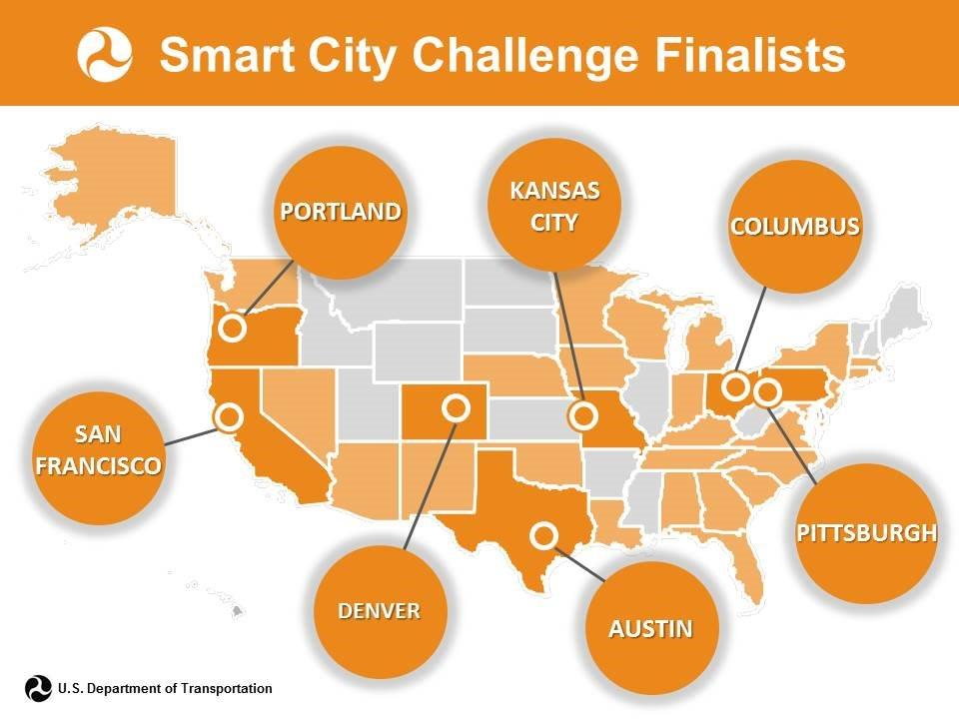
Smart cities are inevitable
Kaitlyn Fichtner
66% of U.S. cities investing in smart city technology [9]
CONCLUSION: Federal action needs to be taken
Finalists from Smart City Challenge sponsored by U.S. Department of Transportation [11]
Notes:
Smart cities are already here and more are coming whether we like it or not. As of 2017, 66% of U.S. cities were investing in smart city technology [9]. Cities such as Columbus, Dallas, Philadelphia, Pittsburgh, San Fransisco, and many other U.S. cities are already implementing smart city technology despite the fact that no federal legislation has been passed on the matter [2]. Because smart cities are inevitable and there are significant risks involved, I came to the conclusion that federal action needs to be taken to ensure that smart cities are implemented in a way the protects the rights and data of U.S. citizens.

Slide 22
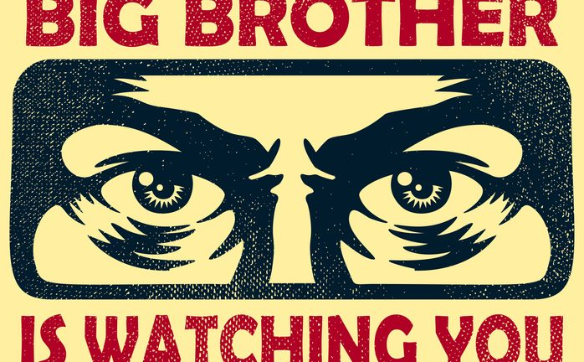
The dark side of smart cities
Kaitlyn Fichtner
Privacy [5, 8]
Security [8]
Bias [5]
Big brother is watching you [6]
Notes:
The reason smart cities need to be well regulated and implemented with a systematic and collaborative approach is that there are many ethical concerns surrounding the topic. One major concern is privacy. Many human rights organizations see mass surveillance as a threat to freedom and civil liberties, especially in the hands of a corrupt government [5]. It is very difficult to give notice and get consent for data collection when citizens are interacting with a large number of data collection devices on a daily basis [8]. It is also especially challenging to keep the data collected secure as the smart city technologies are composed of many interacting systems run by different corporations and the local government [8]. With so many moving parts any weakness in the system could be detrimental. Stolen data could be used for financial gain, to create civil distress, or to advance political goals [14]. Bias is also likely to be introduced, particularly to policing applications of smart city technology. Predictive modeling using data from an already biased law enforcement system will introduce human bias to policing algorithms [5].

Slide 23
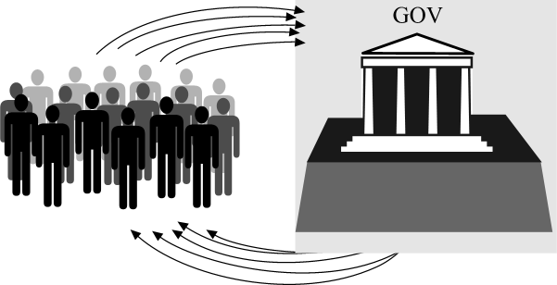
Addressing Concerns
Kaitlyn Fichtner
Transparency [5]
Inclusion [5]
Anonymity [8]
Proactive security [8]
Auditing of datasets [5]
Government and the people [12]
Notes:
Precautionary measures need to be taken to address these concerns. Cities should be transparent with residents about where and when data is being collected [5]. Citizens should be included in the decision-making process as the smart cities are developed and maintained [5]. Data should also be kept anonymous meaning it should not be connected to individual profiles in any way that could be traced back to an individual [8]. All technologies collecting, using or storing data should be well tested and as secure as possible [8]. Furthermore, datasets should be audited to ensure they are free from bias [5] and the use of predictive modeling should be avoided in situations where there is no unbiased data available.

Slide 24
Implementing law
Kaitlyn Fichtner
The Smart Cities and Communities Act of 2019 [2]
The Internet of Things Cybersecurity Improvement Act of 2019 [2]
The DIGIT Act [2]
90% of businesses favor federal legislation [13]
Notes:
On the state level many states have already passed laws regarding internet privacy and data protection. One example of this is Colorado’s House bill 18-1128 which mandates companies to destroy or dispose of data when it is no longer in use. While State legislation is beneficial, to ensure the proper steps are taken to minimize risks in the development of ALL smart cities in the U.S. , it is important for actions to be taken on a federal level. There are several bills that have been written regarding smart cities, however, none of them have passed yet due to disagreements on where funding would come from [2]. I will go through a few of these bills and how they would hopefully improve smart city programs. The Smart Cities and Communities Act of 2019 would invest $220 million per year in smart cities over a 5 year period. This bill is intended to increase cross-city coordination, consolidate smart city elements the federal government has already been working on, and implement interagency oversight and collaboration [2]. The Internet of Things Cybersecurity Improvement Act of 2019 contains a list of requirements for secure connected devices, federal agencies, contractors and vendors [2]. There is also the DIGIT act which regulates consumer protection, privacy, and security [2]. Ultimately, law has already been written addressing many of the concerns regarding smart cities, but it is necessary for these laws to be passed soon for them to have any impact. Many businesses support the idea of having federal legislation on smart cities. In fact, TechRepublic reported that 90% of businesses favor federal legislation including 62% of public safety technology firms and 50% of communication firms [13]. So while smart cities may pose a risk to our privacy and data security, it is important to understand that there are many benefits to these technologies and the technology is already being implemented across the United States. There may be no stopping smart cities but federal legislation can be a step in the right direction for providing standards and regulations to protect our rights as this technology becomes further integrated into U.S. cities.

Slide 25
References
Kaitlyn Fichtner
[1] 68% of the world population projected to live in urban areas by 2050, says UN | UN DESA Department of Economic and Social Affairs. (2018, May 18). Retrieved November 19, 2020, from https://www.un.org/development/desa/en/news/population/2018-revision-of-world-urbanization-prospects.html
[2] Anderson-Hall, K., Bordenkircher, B., Hall, A., & Penn, B. (2020, January 31). Race to the Future of American Cities. Retrieved November 19, 2020, from https://las.depaul.edu/centers-and-institutes/chaddick-institute-for-metropolitan-development/Documents/ChaddickUrbanTechnologySeries_RaceToTheFuture_20200129.pdf
[3] Cisco Unveils "Intelligent Urbanisation" Global Blueprint. (2009, February 12). Retrieved November 19, 2020, from https://newsroom.cisco.com/press-release-content?type=webcontent&articleId=4767464#:~:text=Cities%20which%20are%20run%20on,improve%20city%20services%20and%20management.&text=Additionally%2C%20cities%20that%20run%20on,30%25%20within%2020%20years.%22
[4] Cities – United Nations Sustainable Development. (n.d.). Retrieved November 19, 2020, from https://www.un.org/sustainabledevelopment/cities/#:~:text=The world's cities occupy just,per cent of carbon emissions.&text=By 2050 70 per cent,to live in urban settlements
[5] Ethical issues of smart city tech and how to solve them. (2020, February 27). Retrieved November 19, 2020, from https://intetics.com/blog/ethical-issues-of-smart-city-tech-and-how-to-solve-them
[6] How Much Is Smart Home Privacy Worth? (2019). Retrieved from https://www.iotworldtoday.com/2019/10/28/how-much-is-smart-home-privacy-worth/
[7] Inrix. (2020, March 08). Scorecard. Retrieved November 19, 2020, from https://inrix.com/scorecard/

Slide 26
References
Kaitlyn Fichtner
[8] Kitchin, R. (2016). The ethics of smart cities and urban science. Philosophical Transactions. Series A, Mathematical, Physical, and Engineering Sciences, 374(2083). doi:10.1098/rsta.2016.0115
[9] Maddox, T. (2017, November 06). 66% of US cities are investing in smart city technology. Retrieved November 19, 2020, from https://www.techrepublic.com/article/66-of-us-cities-are-investing-in-smart-city-technology/
[10] Maddox, T. (2018, July 16). Smart cities: A cheat sheet. Retrieved November 19, 2020, from https://www.techrepublic.com/article/smart-cities-the-smart-persons-guide/
[11] Smart City Challenge- Urban Transportation Reimagined. (2018, April 13). Retrieved from https://www.imsinfo.com/industry-insights/1194/
[12] Public to public - blueprint for e-democracy: Home. (n.d.). Retrieved November 19, 2020, from http://publictopublic.org/
[13] Rayome, A. D. (2017, June 28). Legislation is needed for smart cities, say 90% of US companies. Retrieved November 19, 2020, from https://www.techrepublic.com/article/legislation-is-needed-for-smart-cities-say-90-of-us-companies/
[14] Smart City Challenges: What Stands in the Way of Smart Cities?: HERE Mobility. (n.d.). Retrieved November 19, 2020, from https://mobility.here.com/learn/smart-city-initiatives/smart-city-challenges-what-stands-way-smart-cities
[15] Urban population by country in 2010 & 2050. (n.d.). Retrieved November 19, 2020, from https://vividmaps.com/urban-population-by-country-in-2010-2050/

Slide 27
ML Curated Echo Chambers
Jacob van Steyn
Notes:
Hi everyone,
My name is Jacob van Steyn and I’ll be presenting on how Machine learning creates personalized echo chambers on the internet.

Slide 28
Evolution of Mass Media
Jacob van Steyn
(1440) Printing press
(1455) Printed Books
(1690) Newspapers
(1741) Magazines
(1888) Movies
(1895) Radio
(1927) Television
(1969) Internet
Image courtesy of History.com [1]
Notes:
First, we’ll be looking at a short timeline.
The media landscape has changed drastically since it’s inception in the 1600’s with the creation of the printing press. With the invention of the printing press, easy replication allowed common people to have access to books and eventually newspapers.
From newspapers came magazines, and then in the 1800’s Radio broadcasting was invented and quickly took over as the main media source.
In the 1900’s as technology adoption was increasing, mass media shifted to the Television where it stayed for many years, until the creation of the internet in 1969 which slowly took over.

Slide 29
Where Are we Now?
Jacob van Steyn
Widespread access to news & information
Social Media
Online News & Journalism
Forums
Live Streaming
Instant communication
Image courtesy of Getty Images [2]
Notes:
But where does that leave us today? We have unparalleled access to news and information at our fingertips, and a culture that’s heavily invested in social media and online content.
Additional sources of media exist in forums, video hosting websites, and instant communication platforms.
What’s the common factor in these sources? Nearly every source of media today is tailored to the individual user that is consuming it. When we compare these sources to historically popular media outlets, we can see that previously – media was not individually tailored, and instead focused on having a broad appeal to large numbers of people. What this means is that media presented a wider spectrum of opinions and showed both sides of an argument more often than it does today.

Slide 30
“Suggested for you” & Homepage results
Jacob van Steyn
Notes:
Have you ever clicked on a cat video on youtube at 4am, and all of a sudden your home page is filled with videos of cats? This is machine learning in action. It suggests content specifically ’for you’ and generates a personalized homepage (or feed) of information for you to consume.

Slide 31
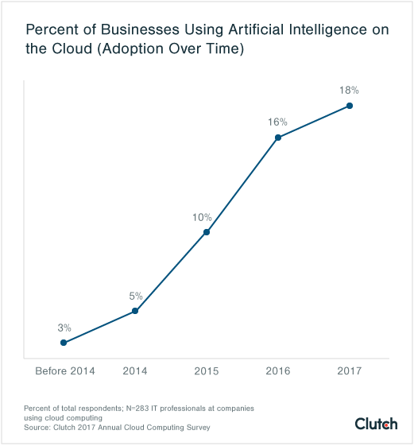
Machine Learning
Jacob van Steyn
Algorithmic prediction
Tailored to end user
Statistical model based on:
Large data models
Historical data
Similar user data
Matches users with content the model “thinks” they want to see
Image courtesy of Clutch.co [3]
Notes:
I assume most people in this class are familiar with machine learning, but here’s a quick overview for those that aren’t.
By definition, machine learning allows computers to learn how to perform a task without being explicitly programmed. In our case, the task is identifying which news story or youtube video to suggest to a user. The algorithm uses vast amounts of historical data and other inputs to make a prediction on what you’ll want to see. These inputs can be based on links you’ve visited in the past, what people who are similar to you click on, and much more. Companies spend millions of dollars developing this software to be as accurate as possible with the goal of keeping users engaged.
This technology has seen rapid adoption into nearly every facet of the internet and is the technology behind curated content. It matches users with content the model thinks they want to see, generating your homepage or feed, suggested people to follow, links to similar news articles and more.

Slide 32
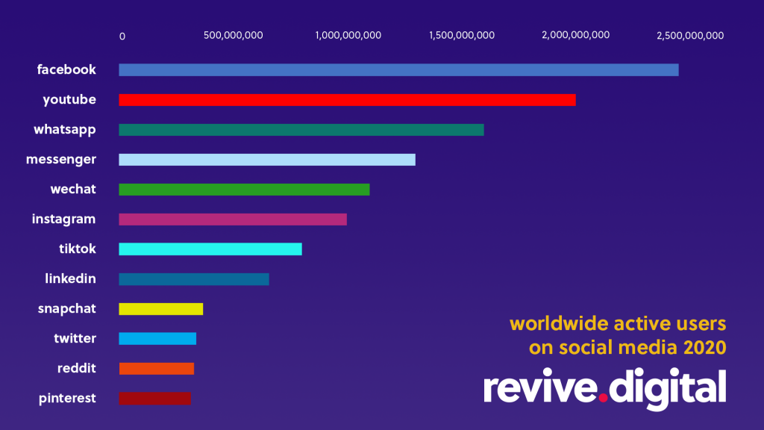
Biggest Impact
Jacob van Steyn
Social Media:
Facebook
Youtube
Instagram
Weibo
Twitter
Reddit
Curated ‘Feeds’ of content
‘Compulsive Media’
Capture attention
Image Courtesy of Revive.digital [4]
Notes:
What platforms are the biggest users of machine learning? If we take a look at the top social media platforms in 2020, every single one uses machine learning in some form to suggest content.
These businesses make more money the more time a user spends on their platform. Therefore they are incentivized to capture your attention through a term called ‘compulsive media’. This simply means that they use curated feeds of content to get users to compulsively click on the next article or video on their site. Looking at the chart on the right gives a good scale to the impact these platforms have on people. Combining the user numbers of social media sites alone gets to over 3 billion daily active users that are affected by the design choices of these websites.

Slide 33
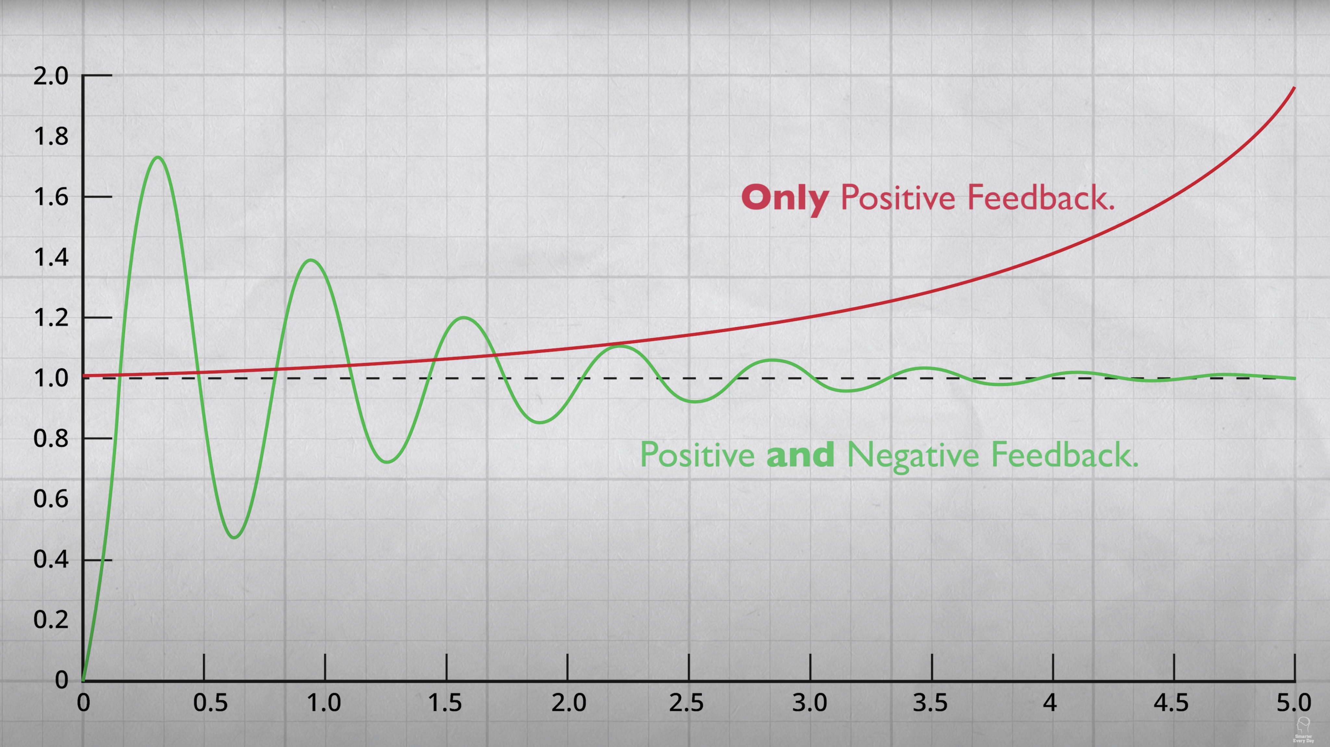
Echo Chambers
Jacob van Steyn
Positive Feedback loop
Reinforces Existing Opinions
Extreme ideology becomes normalized
Forums / Internet Communities
Surrounded with similar opinions
ML Creates personal echo chamber
Image courtesy of Smarter Every Day [5]
Notes:
The problem with curated content is that it narrows down the range of opinions that are presented to people. Generally, content is suggested based on predicted interests or opinions that users already have. By showing users content a model thinks they will agree with or like, people are only being given positive feedback that reinforces their pre-existing opinions. This creates a positive feedback loop, and creates a rapid divergence from centered viewpoints. Thus extreme ideology becomes normalized and polarization becomes more prevalent. While machine learning can create a personal echo chamber – parts of the internet are already designed to be echo chambers. Forums and specific internet communities are a prime example of this, as in their simplest form they are a collection of like-minded individuals. What the introduction of machine learning has done is turn entire platforms into individual forums designed around you.

Slide 34
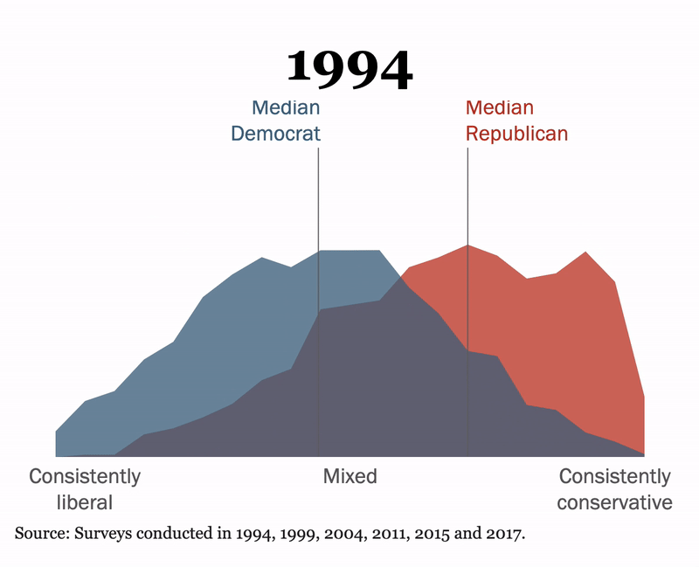
Polarization
Jacob van Steyn
Image courtesy of Pew Research [6]
Notes:
If we go back to the concept that these echo chambers cause polarization – how can we prove this is happening? One example can be found by looking at the political spectrum within the US. Our political system is bipartisan and thus demonstrates this phenomenon extremely well. As you can see, we face the largest polarization gap in recent history as of 2017, a divide that’s unlikely to decrease any time soon. From looking at this change over time, we can see that the gap really starts to widen from 2004 to 2011.

Slide 35
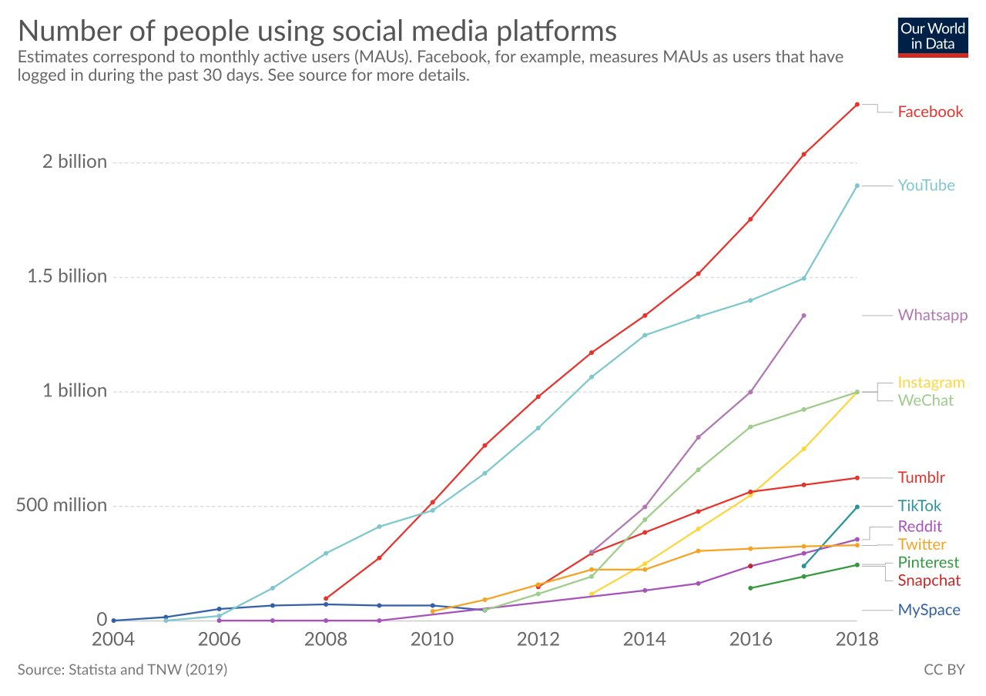
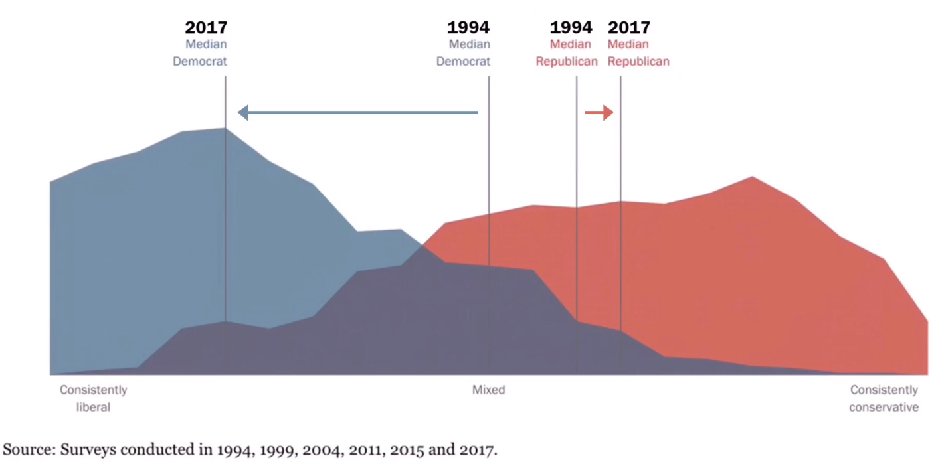
Polarization
Jacob van Steyn
Image courtesy of Our World In Data [7]
Image courtesy of Pew Research [6]
Notes:
There are a number of factors that could be contributing to this divide, but from looking at social media adoption over time, we can see a dramatic increase around the same time that the political polarization gap started to become larger. Correlation does not equal causation, but there’s evidence here that the adoption of technology as a whole has changed our society and this is one potential way it’s done so.

Slide 36
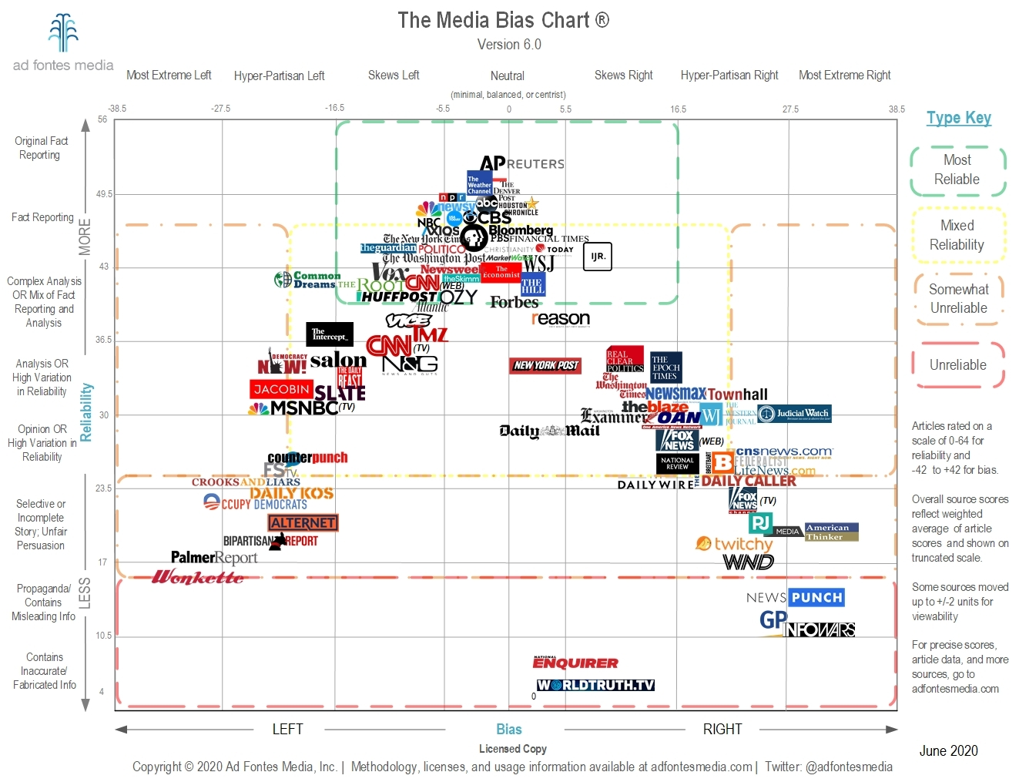
Solutions
Jacob van Steyn
Anonymous Browsing
Non-curated content
Unbiased Media Sites
Associated Press
Reuters
NPR
Consume media you disagree with
Improve Algorithmic Curation
Image courtesy of Ad Fontes Media, Inc [8]
Notes:
1 / 2. Use tracker blocking software and don’t create an account on media websites. This will make it more difficult for algorithms to tailor content to you.
3. Visit unbiased media sources. Top options include: AP, Reuters, NPR, and more
4. Increase your consumption of media from the ‘other side’ of an argument
5. Allow users to select level of bias towards content the algorithm thinks they’ll like
These are just some suggestions for possible solutions, ultimately this is a problem more people need to engage with to push the large tech companies to make a change.
Thank you, any questions?

Slide 37
References
Jacob van Steyn
[1] Roos, Dave. “Johannes Gutenberg’s First Printing Press.” 7 Ways the Printing Press Changed the World, History.com, 28 Aug. 2019, https://www.history.com/.image/t_share/MTY2NTE2OTU2MzQ0NjI0MzUx/961d16d5-5443-409c-ac14-23c67cb6592f.jpg.
[2] Charlet, Denis. “Logos of Mobile Apps Facebook and Google Displayed on a Tablet.” Getty Images, 1 Oct. 2019, http://media.gettyimages.com/photos/picture-taken-on-october-1-2019-in-lille-shows-the-logos-of-mobile-picture-id1172921208.
[3] Panko, Riley. “Percent of Businesses Using Artificial Intelligence on the Cloud (Adoption Over Time).” How Businesses Use Cloud Computing: 2017 Survey, Clutch.co, 21 June 2017, http://static2.clutch.co/s3fs-public/ai-timeline-final_0.png.
[4] “Worldwide Active Users on Social Media 2020.” Most Popular Social Media Networks (Updated for 2020) – Digital Marketing’s Most Powerful Tool, Revive.digital, 2020, http://revive.digital/wp-content/uploads/2020/06/social-media-graph-Worldwide-2020-1024x576.png.
[5] Sandlin, Destin. “Positive Feedback Loop in Systems Modeling.” What I Learned from President Obama - Smarter Every Day 151, SmarterEveryDay, 31 Jan. 2016, https://www.youtube.com/watch?v=GpWQHFzrEqc.
[6] “Political Polarization, 1994-2017.” The Shift in the American Public’s Political Values, Pew Research, 2017, http://www.pewresearch.org/politics/interactives/political-polarization-1994-2017/.
[7] Ortiz-Ospina, Esteban. “Number of People Using Social Media Platforms.” The Rise of Social Media, Our World In Data, 18 Sept. 2019, https://www.ourworldindata.org/rise-of-social-media.
[8] “The Media Bias Chart v. 6.0 (2020).” Media Bias Chart , Ad Fontes Media, 2020, https://www.adfontesmedia.com/wp-content/uploads/2020/06/Media-Bias-Chart-6.0_Low_Res_Licensed.jpg.

Slide 38
Class 9 The End
Keith A. Pray
socialimps.keithpray.net
Notes:
This is the end. Any slides beyond this point are for answering questions that may arise but not needed in the main talk. Some slides may also be unfinished and are not needed but kept just in case.

Slide 39
Reliability Of Statistics
Are other factors controlled?
Is enough time covered?
Is all data reported?
Use Intuition
Are results reasonable?
Notes:
Power line dangers. Electromagnetic fields? PCBs in transformers?

Slide 40
Cost-Benefit Analysis
How much does it cost?
What do I get for this cost?
Notes:
Like a social contract.

Slide 41
Risk-Benefit Analysis
What could go wrong?
How likely is it?
How costly are the consequences?

Slide 42
Limitations to Risk-Benefit Analysis
Hard to quantify probabilities
Hard to quantify costs
Who bears the costs?
Are the potential benefits worth it?
Notes:
What is the value of a human life?
What is the value of a species?
E.g. future generations, poor people.
Omelas

Slide 43
Some Measures
Mean Time To Failure (MTTF)
Mean Time Between Failures (MTBF)
Mean Time To Repair (MTTR)
Notes:
Is it repairable?
What does it mean to repair? Running again? Data fixed? Caught up?
Restoring the GBC Web site.

Slide 44
Relying Too Much
Limits of modeling reality
Limits of precision
Limits of algorithms
Limits of interpretation
Notes:
Battle of the X-Planes
Trusting the statistics. Are differences significant?
Colin Chapman’s Lotus 7 chassis.

Slide 45
Producing Good Software
Good specifications
Good usability
Good design
Robustness
Good implementation
Testing
Notes:
Specs: Know what you are going to do. Often difficult. What does the customer want? What does the customer need?
Usability: Logical and intuitive, Consistent, Helpful, Complete, Accessible, Disability. Complete—not have to write things down.
Design: Logical, Modular, Consistent, Well-specified, Flexible, Extensible, Adaptable, New features, new platforms.
Robustness: Tolerant of data errors, Tolerant of human errors, Tolerant of network errors, Enough detail / not too much. Stack trace vs. “?” “A script error has occurred. Do you want to debug?”
Implementation: Adequate hardware (E.g. memory, storage, speed), Adequate software (Languages, OS, libraries), Internal and external documentation
Testing: Should be at all phases of the development cycle. Plan ahead for it. Consistent, repeatable, documented. Regression testing.

Slide 46
Plan For The Long Term
Version control
Future development
New platforms
Patches
Security
Training
Customer support

Slide 47
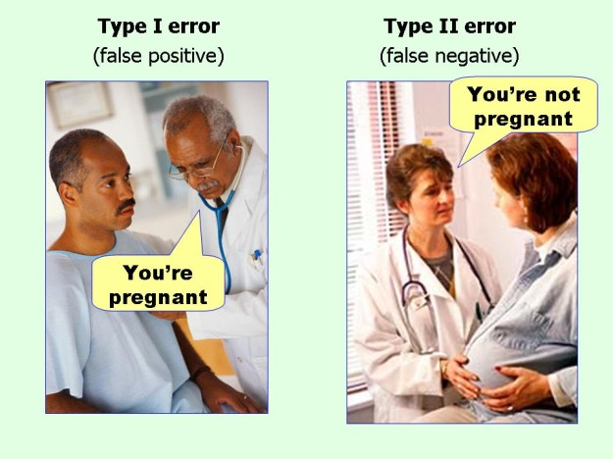
marginalrevolution.com/marginalrevolution/2014/05/type-i-and-type-ii-errors-simplified.html (2016-04-11)

