Slide 1
Class 7
Privacy and Government
Keith A. Pray
socialimps.keithpray.net
Notes:
After this class we will be half done with the course… very sad I know.
Somebody’s Watching Me (1984) – Rockwell (3:36)
https://www.youtube.com/watch?v=7YvAYIJSSZY
Be the envy of all your classmates if you know the band and/or year:
Rockwell (1984) Michael Jackson sings chorus and Jermaine Jackson on backing vocals.

Slide 2
what works well Online With Zoom
Sign in with First and Last Name
Stay muted unless you are going to speak
To speak use the raise your hand feature
To answer yes/no questions use the “yes” ”no” buttons
Turn your camera on
Wait until the end of student presentations to ask questions
  Write them down so you don’t forget

Slide 3
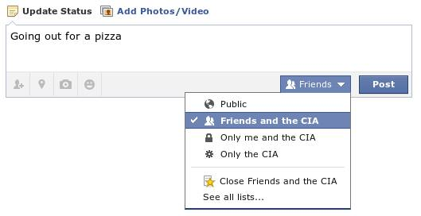
Overview
Review
Assignment
Students Present
Notes:
Review before debate in case anyone unsure of something in reading.
TODO: Image source?

Slide 4
My Reading Notes
pp. 276 Any examples from the last 25 years? Arrests, altering and deleting records are violations of privacy?
pp. 277 Why not try to verify and correct records?
pp. 278 Figure does not show # cameras increasing.
pp. 279 300 times = frames, locations, …? More police drones since 2013?
pp. 296 Shouldn’t credit card issuers take “reasonable steps” to verify identity all the time?
pp. 297 Any syndromic system successes in the last 15 years?
pp. 301 Confusing false positive and negative explanations. Not correct use of “Orwellian”
pp. 305 E-ZPass now mandatory on Mass Pike…
pp. 310 # 17 Interesting but not computing related
End of Chapter questions: 1, 18
pp. 319 “Since I have done nothing wrong, why should the government be investigating me?”
Notes:
Let’s see who said the government should make a law requiring ID for Internet access. Let’s debate!

Slide 5
Debate Ground Rules
Before Debate
  Add “(YES)” or “(NO)” to the end of your name in Zoom to show your side
  10 minutes to converse with your team
  Share argument points, counter points, and responses
  Share experiences in different countries, web sites, access points
  Decide who will: Go first, Respond to which points from opposing side
During Debate
  1 turn per person until everyone on your team has spoken
  Try to keep remarks to 30 seconds
  Switch sides at any time if you change your mind
Notes:
Government should make law requiring ID for Internet Access Debate
If in class:
Stand up when speaking
30 second limit (elect a timekeeper)
Previous:
National ID or Not Debate

Slide 6
Group Quiz
List two problems with using biometrics for identification.
List two advantages of using biometrics for identification.
Describe two tools people can use to protect their privacy on the Web.
For each of the 4 categories of Daniel Solove’s privacy taxonomy give an example not listed in the book.
Notes:
Only if need to fill time, Orwellian video better use of time if we’ve not seen it yet.
Information Collection
Information Processing
Information Dissemination
Invasion

Slide 7
Overview
Review
Assignment
Students Present

Slide 8
Assignment – Group Project
Catch up on reading
Analyze Movie for all topics covered to date
Add list of computing technology portrayed
See group project slide deck for more
-----
Mid Term Survey on Canvas → Quizzes
Notes:
Movie group project:
List of computing technologies portrayed in movie on website
Categorize computing technologies as existing, future, emerging, impossible or plausible with rationale
Analyze movie for all topics covered to date

Slide 9
Overview
Review
Assignment
Students Present
Notes:
What "Orwellian" really means - Noah Tavlin (5:31)
http://ed.ted.com/lessons/what-orwellian-really-means-noah-tavlin

Slide 10
When should companies Give Access to your data
Maranda Allen

Slide 11
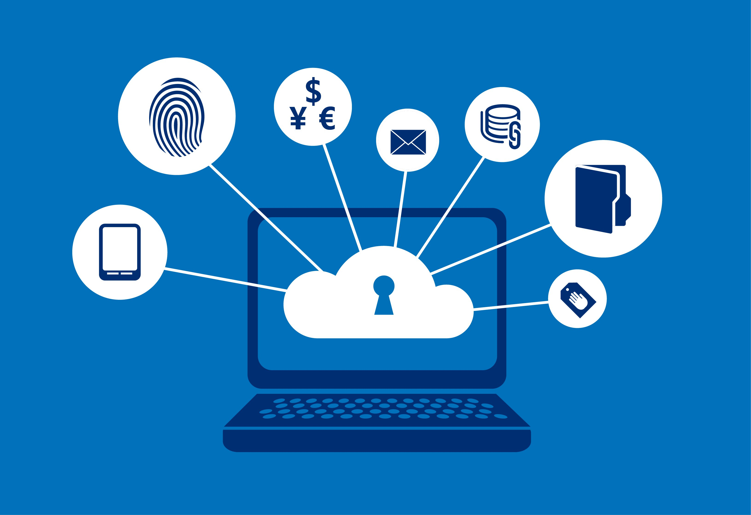
Guidelines for Consumer Privacy
Maranda Allen
Privacy Policies
  Dealing with private or personal information
  Outline type, usage, reasons and access to collected information
Clarity and read time
  Lexile score
  Average college reading level: 1300
  Many policies scored above 1300
Image from https://www.microsoft.com/security/blog/2014/05/22/protecting-data-and-privacy-in-the-cloud-part-1/
Notes:
Privacy policies are common across any kind of organization dealing with your private or personal information, for example, companies like Apple, Google, and Microsoft that make our electronic devices.
These policies outline what kind of information the company collects, how it is collected, how it can be or will be used, who can access it, and what choices you have regarding what information is given and used by them.
These policies provide companies with justification for collecting and using your information, fueling the market on data, so its important to read through them, yet most people never do.
This has to do with not just the time it takes to read through them, but also how easy they are to understand.
An article published by the New York Times compared more than 150 privacy policies to find out how long and easy to understand they were. It worked off a Lexile scale, which categorizes literature under a number score for how easy it is for a certain level reader to understand. The average college reading score is around a 1300, and this source found that most of the privacy policies it looked at scored above this, meaning for most people, even if they take the time to read a privacy policy, they’re unlikely to leave with a strong understanding

Slide 12
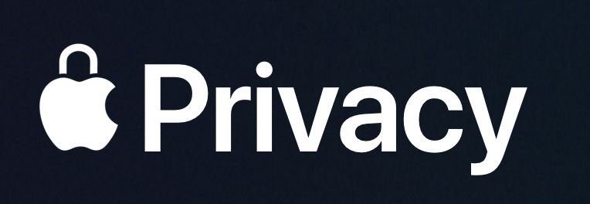
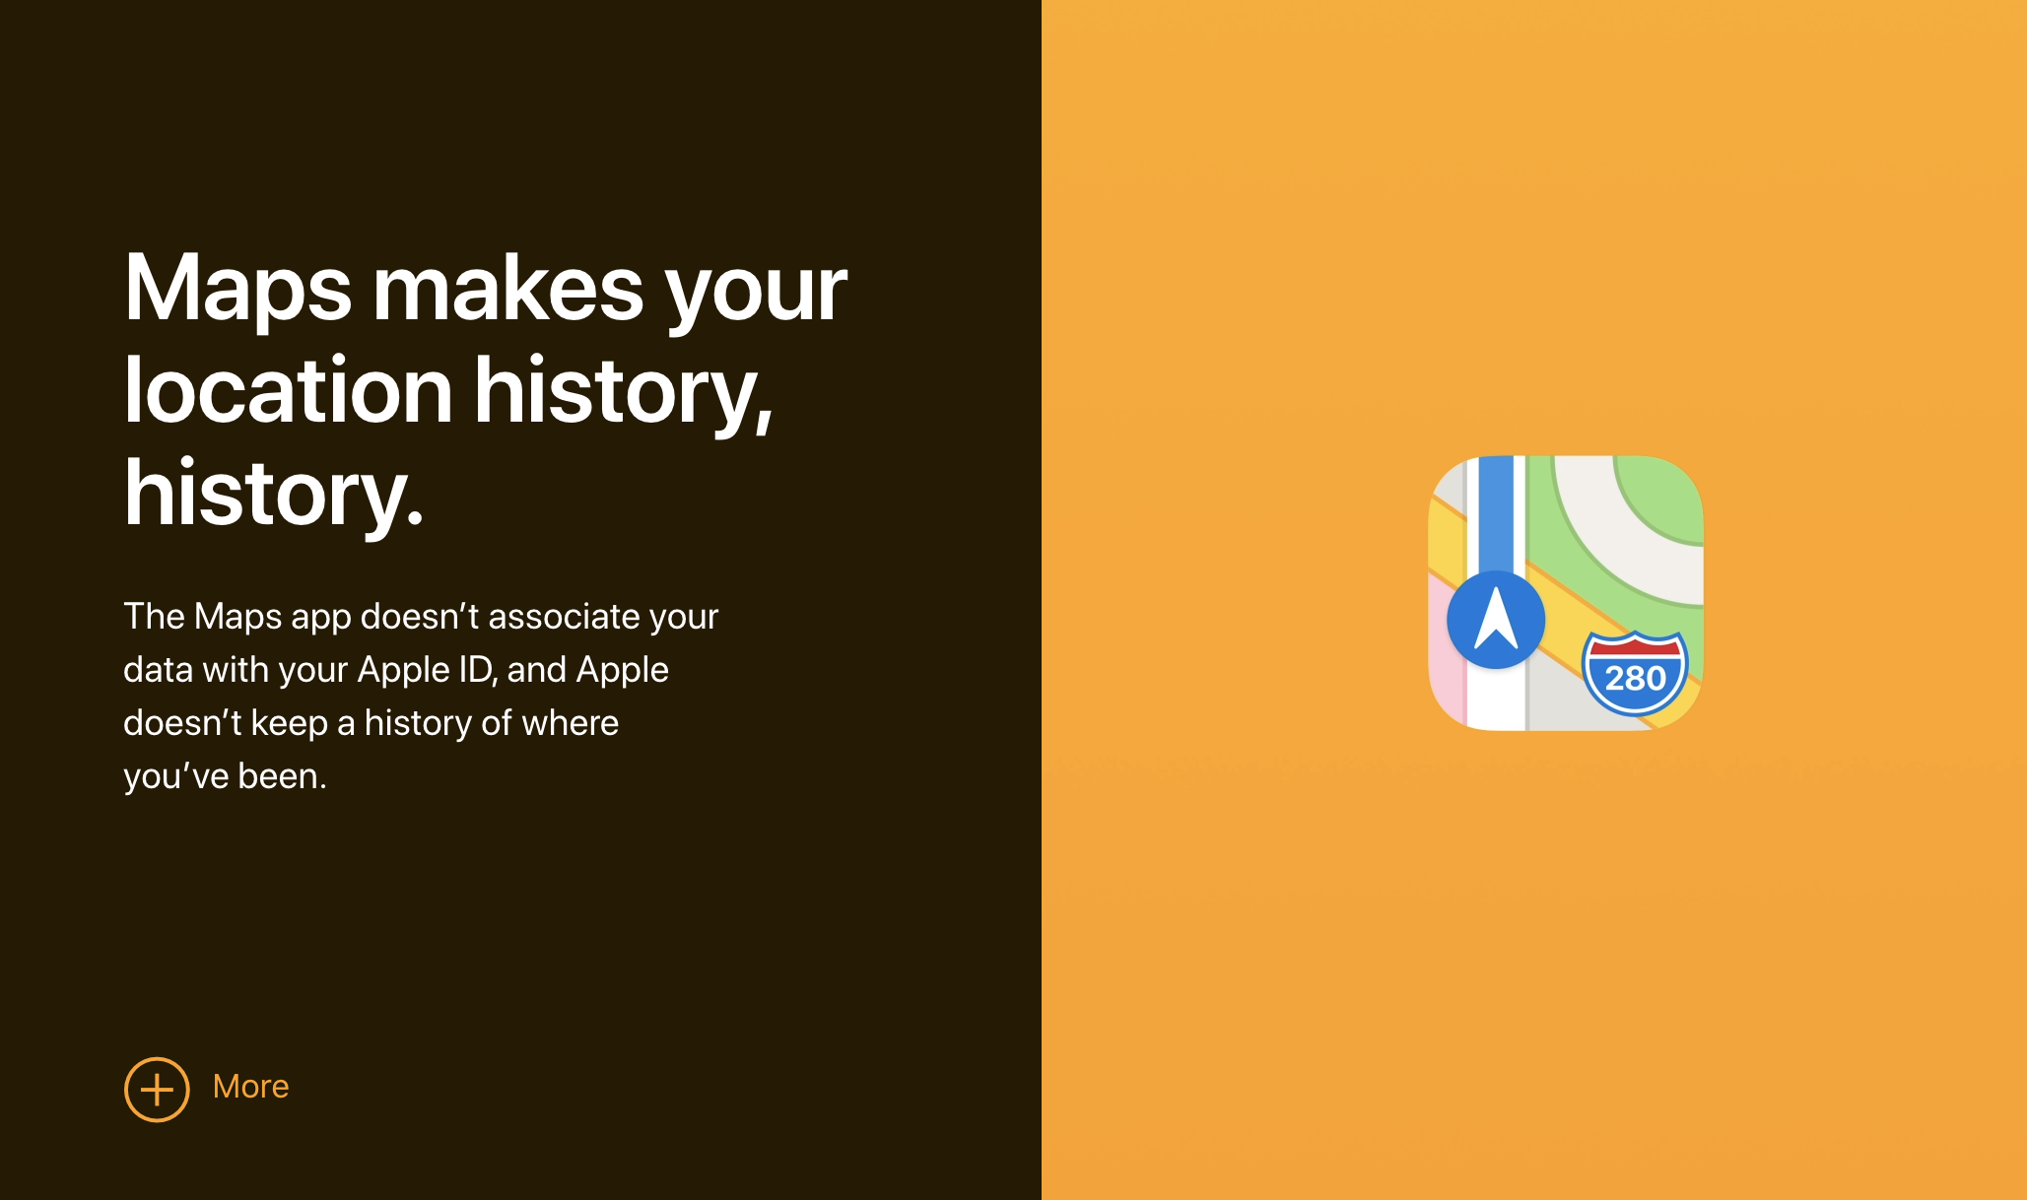
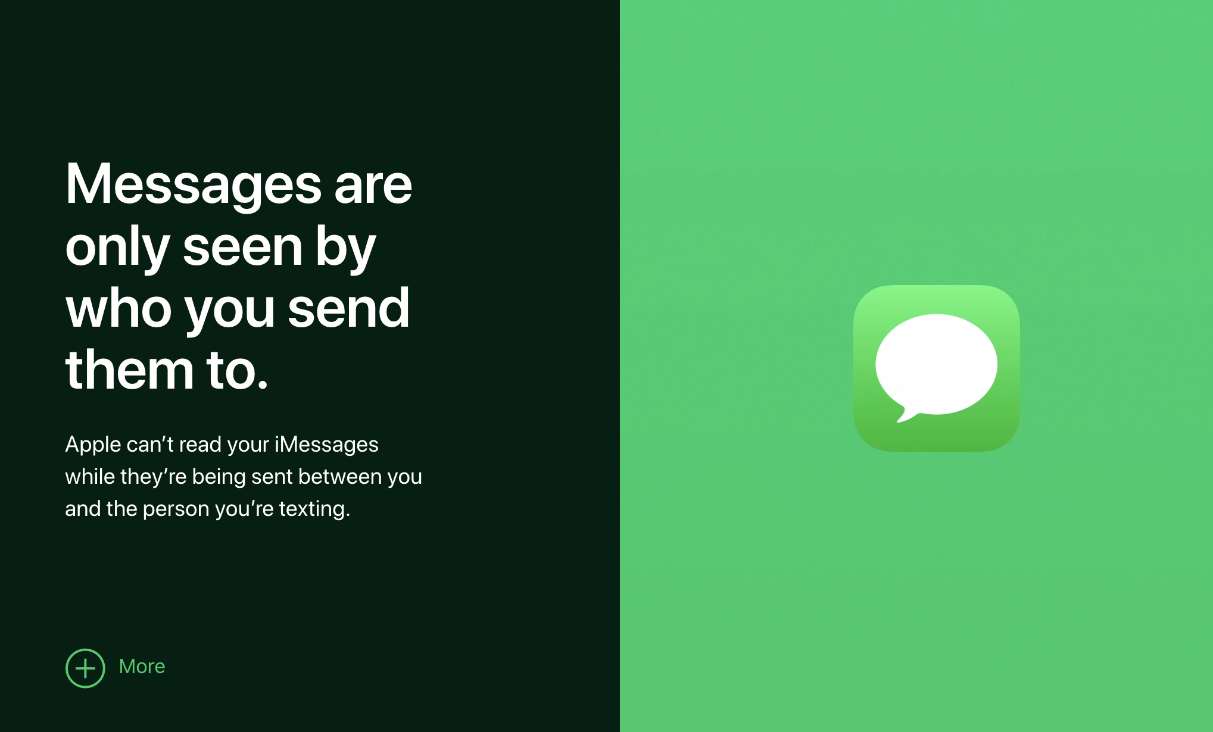
Apple’s Privacy Policy
Maranda Allen
Lexile score: 1400
Defines personal information
Clarifies ability to choose
Type of information
Use of information
Where information comes from
Law, legal processes and litigation
Encryption
All images from https://www.apple.com/privacy/
Notes:
Next I looked specifically at Apple’s privacy policy. From the previous source, this policy got a score of 1400 on the Lexile scale.
The first thing I noticed about Apple’s policy was that they defined what personal information is. I found this immediately interesting as it seems like a deliberate effort to make the policy more understandable for everyone.
It continues to make it clear in the first paragraph that you may be asked to share personal details with the company and how that information might be shared within Apple or its affiliates, but that there is always a choice when it comes to what is shared, though it might hinder the services they can provide you.
Apple’s policy continues, covering all the topics mentioned previously, including the specific types of information, such as names addresses and emails, why each type of information is collected and how its used, as well as other places information about you might be collected from.
They are also careful to say that when necessary ”by law, legal process, litigation, and/or requests from […] authorities,” Apple may disclose so of your personal information.
Finally, Apple also has a privacy page, with interactive displays relating to specific apps such as messages, maps and photos, explaining that the information contained in those apps is encrypted and actions performed in those apps are local to your device, so they never have record of any of that information.

Slide 13
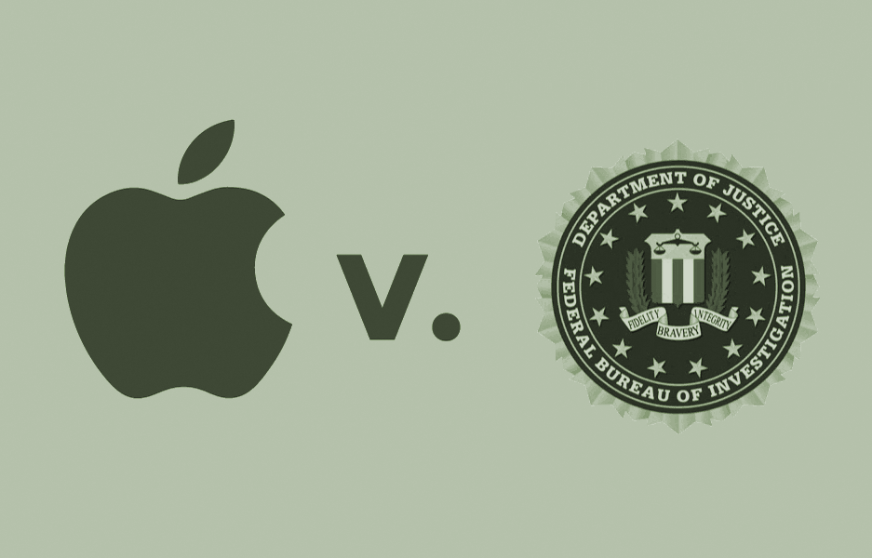
Apple v. FBI
Maranda Allen
December 2015 attack in San Bernardino
Authorities recovered a shooter’s phone
Could not access information on the phone
  4-digit passcode and auto-erase
Image from https://www.eff.org/deeplinks/2018/04/fbi-could-have-gotten-san-bernardino-shooters-iphone-leadership-didnt-say
Notes:
So, now understanding what a privacy policy is, and how Apple specifically presents theirs, lets talk about the Apple v. FBI case.
This case came up in response to the mass shooting and attempted bombing that happened in San Bernardino in December of 2015, which killed 14 people and injured 22 others.
The two perpetrators, a husband and wife, were killed in a shootout with the police following the attack and one of their work phones were recovered from their car afterwards.
The security on the phone, specifically the lock screen and Apple’s auto-erase feature made it so that the FBI was unable to access the information on the phone. After failed attempts to break into the phone, the FBI went to Apple in 2016 hoping they could help.

Slide 14
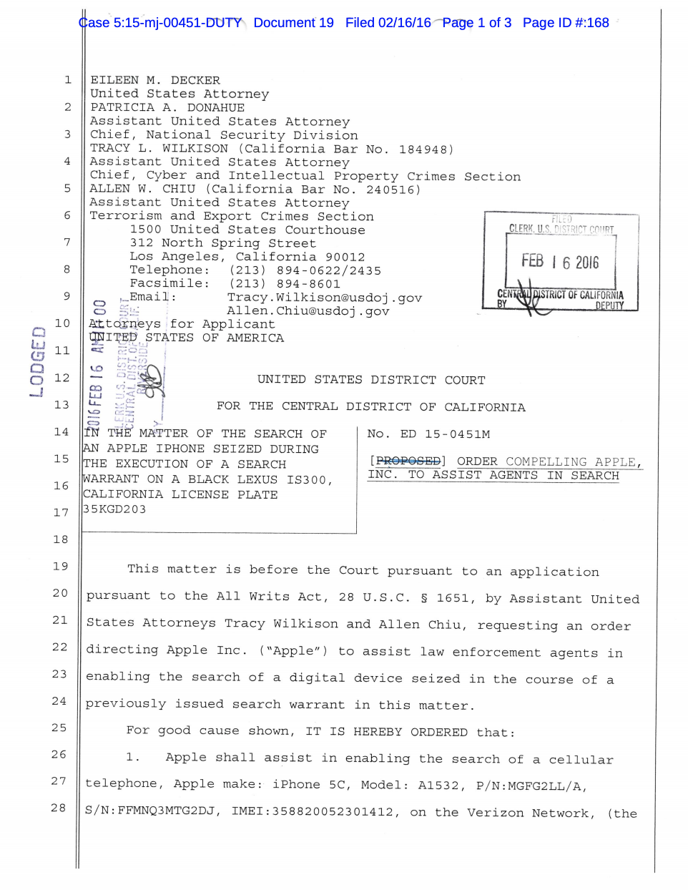
FBI Request
Maranda Allen
Unique iOS to disable or bypass security protections
Ability to try passwords electronically
Apple opposed the court order
Unsealed legal proceedings and informed the press
First page of order of assistance from https://epic.org/amicus/crypto/apple/In-re-Apple-AWA-Order.pdf
Notes:
The FBI applied for a court order to enlist Apple to build a unique iOS that would be able to bypass or disable the security protections on the phone’s lock screen.
They also wanted this custom iOS to provide them with the capability to try passwords electronically, such as via Bluetooth or Wi-Fi, as opposed to manually inputting password attempts.
This would give the FBI the ability to perform a brute force attack on the phone’s security, connecting it to a computer that would generate possible passcodes and continue to try them until it found one that worked and allowed them to access the information.
Immediately, Apple submitted their intent to oppose the order, so the FBI moved to unseal the records of legal proceedings that were happening and notify the press, hoping that the pressure of the public eye would force Apple to comply.

Slide 15
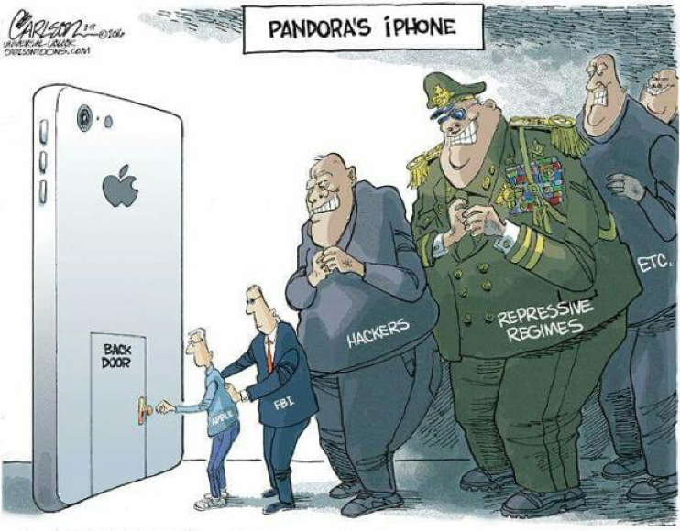
Apple’s Response
Maranda Allen
Apple responded with a letter to customers
Unlawful and unconstitutional
Conscripting Apple for a backdoor into iPhones is not upheld by the All Writs Act
Leads to a dangerous precedent
Image from https://www.jumble.io/blog/2016/02/26/apple-vs-fbi-battle-encryption-privacy-security/
Notes:
However, the CEO of Apple responded with a letter aimed directly at their customers., explaining the situation then their response.
Apple’s opposition to the court claimed that asking Apple to create such a custom iOS for the government was unlawful and unconstitutional, and did not actually fall under the All Writs Act, as the FBI stated in their application, saying specifically that ”the All Writs Act does not provide basis to conscript Apple to create software enabling the government to hack into iPhones”
For reference, the All Writs Act is a federal statute put in place by George Washington in 1789, authorizing federal courts to “issue all writs necessary or appropriate in aid of their respective jurisdictions and agreeable to the usages and principles of the law.”
Despite the act being so old, the courts were able to call on it in this case due to its broad language, allowing it to cover things that did not even exist at the time it was written.
However, Apple claimed that creating this iOS would have a number of consequences. For one, a government ordered back door would intentionally weaken the security of all their products, and would set a dangerous precedent for similar cases in the future.
Such a system would never be destroyed, as nothing on the internet ever is, so it could be guaranteed that this back-door would be quickly used for more cases.
So, Apple won their opposition and did not create the backdoor. However, they did provide the FBI with all the information about the device they could, and worked with them to suggest ways to proceed. The FBI ended up gaining access to the phone on their own, though it unfortunately did not contain any relevant information about the attacks.

Slide 16
Conclusions
Maranda Allen
Implications reach beyond the case itself
  Future, similar cases
  Integrity of a company’s product
  Company-consumer trust
Privacy vs. public safety
  How does people’s safety change with the implications of a backdoor to personal information?
At what point are our rights to privacy overridden? Who gets to decide?
Notes:
Going into learning about this topic, my initial thoughts were that, knowing Apple had denied the request, I felt that my own information, being a dedicated Apple user myself, is well contained. However, know a little about the background of the case, I had an initial opinion of, well, this was a phone belonging to a terrorist, to me, that nullifies some of their right to privacy. The owner of the phone had also been killed, so while I was grateful for Apple’s apparent commitment to its customers, I wasn’t sure why they couldn’t just make this one exception.
Upon learning more about the case and what they were really being asked to do, I began understand the problems and implications of the case much better, and realizing how much farther those consequences could reach. For one, it’s effect on the security of all its other customer would be compromised. The possibility of a backdoor into our information existing poses a dangerous possibility for loss of safety due to loss of privacy and security. So for me, I found myself in agreement with Apple’s course of action, but also wondering about privacy versus public safety, and the places in which the two do and don’t overlap.
For example, I wondered, if the threat were an active terrorist threat and a phone belonging to someone who was an active danger, what would that have changed about the case and the response of the two sides.
So, I’m leaving you with that thought experiment, as well as a couple questions about at what point should our right to privacy be overridden, and who gets to decide that?

Slide 17
References
Maranda Allen
Litman-navarro, Kevin. “We Read 150 Privacy Policies. They Were an Incomprehensible Disaster.” The New York Times, The New York Times, 12 June 2019, www.nytimes.com/interactive/2019/06/12/opinion/facebook-google-privacy-policies.html. (Accessed November 10 2020)
“Privacy.” Apple, www.apple.com/privacy/. (Accessed November 9 2020)
“Privacy Policy” Apple, 31 Dec. 2019, www.apple.com/legal/privacy/en-ww/. (Accessed November 9 2020)
“EPIC - Apple v. FBI.” Electronic Privacy Information Center, epic.org/amicus/crypto/apple/. (Accessed November 9 2020)
Cook, Tim. “Customer Letter.” Apple, 16 Feb. 2016, www.apple.com/customer-letter/. (Accessed November 10 2020)
Lewis, Danny. “What the All Writs Act of 1789 Has to Do With the IPhone.” Smithsonian.com, Smithsonian Institution, 24 Feb. 2016, www.smithsonianmag.com/smart-news/what-all-writs-act-1789-has-do-iphone-180958188/. (Accessed November 10 2020)
“What Should I Know About Privacy Policies.” Education Foundation, Consumer Federation of California, consumercal.org/about-cfc/cfc-education-foundation/what-should-i-know-about-privacy-policies-2/. (Accessed November 9 2020)

Slide 18
big data in Insurance
Erich Schwarzrock
Notes:
For my presentation I will discuss the ethical and unethical uses of “big data” in the insurance industry

Slide 19
Insurance and Data
Erich Schwarzrock
Typical Data/Demographics
  Name
  Age
  Gender
  Ect.
There is a growing interest in “Big Data”
  $2.4 Billion invested in 2018[1]
  $3.6 Billion projected investment by 2021[1]
Notes:
The Insurance industry is all about determining the risks of each policy holder. This allows insurance companies to estimate how much money each customer will cost them on average And charge each customer accordingly. In order to be profitable the insurance companies have to make accurate estimations of risk, so that they don’t charge too little, and thus lose money, or charge too much and allow other companies undercut them. In order to estimate these risks insurance companies rely on statistical models and data. Some types of traditional data the companies use to determine prices are, Age, Gender, address, and marital status. However with the advent of more complex prediction models, and easy access to large amounts data a new field of data analytics and modeling, known as big data, is being developed. The insurance field has started to look into and fund research for the use of big data in regards to insurance.[1] With insurance companies investing 2.4 billion dollars into the research of big data in 2018, and an expected growth to 3.6 billion dollars for 2021.[1]

Slide 20
“Big Data” Defined
Erich Schwarzrock
Big data refers to diverse data that is too complex for traditional data manipulation[1]
Big Data has led to 40-70% cost savings and 30% better access to insurance[2]
Notes:
However what exactly is big data?
In this presentation I will be referring to big data as large amounts of complex and diverse data that requires higher level prediction models to be usable[1]. Big data is usually used to infer more concrete data about someone[1]. An example of big data out side the insurance industry is when target used sales history to predict which customers were pregnant and then mailed them specialized adds[9]. This inference of a more definite attribute, being pregnant, from abstract data, like previous purchases, is what differentiates big data from normal data modeling.
Insurance companies can use big data to gather a more in-depth view of their clients and make more accurate risk assessments of them, and thus allow them to offer better rates. Currently, according to yfs magazine, the big data used in the insurance industry has lead to 40 to 70% cost savings and 30% better access to insurance[2].

Slide 21
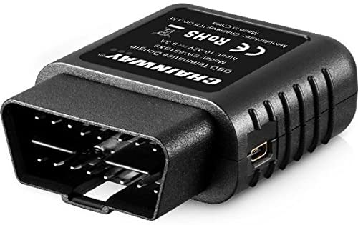
Telematics
Erich Schwarzrock
Personalized Auto Insurance rates
Gathers data about an individual’s driving habits[3]
  How fast one drives
  How hard one breaks
  Where one drives
  How much one drives
  Ect.
Image Source [4]
Notes:
One example of an ethical use big data within the insurance industry is telematics. Telematics is used in the auto insurance industry to more accurately determine risk based on an individuals driving habit. Insurance companies want to charge “good” drivers less money then “bad” drivers, because that would incentivize more good drivers to sign up and thus the insurance company will have to play out fewer claims. But how do you gather if someone is a good or bad driver, traditionally insurance companies would use factors like age, and gender to determine this, however these factors are not that reliable. So telematic collects data like, How fast you drive, How hard and often you break, where you drive, and how much you drive[3]. It then runs that data through a model to determine if you are a good or bad driver and insurance companies can charge you accordingly. This is used throughout the auto insurance field and I believe it is an ethical use of big data because usually this is an optional program that customers can opt into. Also the customers are well aware of the data collection because the customer needs to personally plug the data collection device into the car, and At any point of the process the customer can simply opt out of the program.

Slide 22
Genetic Data
Erich Schwarzrock
Possibly used to determine risk[5]
  Its more accurate in predicting health conditions and mortality
Many Countries have already outlawed it[5]&[6]
  USA
  France
  Denmark
Notes:
Another form of big data insurance companies are looking into is genetic data. Health and life insurance companies will be able to use this data to test for genetic diseases and easily determine what they will be expected to pay and adjust their rates accordingly[5]. Traditionally insurance companies would use family history to help find the likelihood of specific genetic diseases, but if the insurance companies had access to genetic data they will be able to know for certain if their customers have those genetic diseases [5]. Insurance companies say that this data would be helpful for preventative care[5]. This would allow insurance companies to see if customers are susceptible to specific diseases, and then recommend treatments or precautions to help prevent or mitigate these diseases, before they become a huge problem[5]. This is mutually beneficial because the customers get preventative care, and thus live a healthier life, while the insurance companies will save money because the preventative care is much cheaper than diagnostic care[5]. However insurance companies also want to use this genetic data to help determine rates[5]. Many people view this use of genetic data as too much of an invitation of privacy, so much so that many European countries, like Austria, Belgium, Denmark, and France have already outlawed the use of genetic testing for rate determinization[5]. Here in America the affordable care act also known as Obamacare goes a step further and prevents the use of any medical records for determining eligibility and rates for health insurance, however other forms of insurance, like life insurance, can still use genetc data to determine their rates[6]. Overall I believe the use of genetic data to determine rates is immoral, and an invasion of privacy, however if the customer wants to use their genetic data for preventative care that would be acceptable.

Slide 23
Additional big data for health insurance
Erich Schwarzrock
Health insurance companies are not allowed to use health records [7]
Other companies are using big data to predict risk, like LexisNexis and Optum[8]
Other data for predicting risk[8]
  education level
  TV habits
  marital status
  net worth
  criminal records
Notes:
Since the affordable care act prevents the use of heath records in determining health insurance rates insurance companies don’t have much to base risk on. Currently they only use age, address, and tobacco use to predict risk, however there are companies that are researching the use of more abstract data to infer risk[7]&[8]. For instance the company LexisNexis collects millions of American’s data, from criminal records, to education, to property records, and uses that data to build a model to predict the expected medical costs of the individuals, which can be used by Insurance companies to determine rates[8]. Another company Optum is also working to try and use big data to predict health risks[8]. They filed for a patent in 2016 for a technology that allows them to collect data shared on Facebook and twitter, and then use that data to try and predict individual’s medical information[8].
However not illegal I believe this type of big data is still highly immoral. For one thing these companies are collecting peoples data behind their backs, and if the insurance companies were to use these models the customers will most likely be unaware of this. If it was to be used for preventative care, that would be more acceptable, but at that point just find a way to legally use health records, with the customers permission of course.
Overall I find big data to be morally acceptable, if the customer knows it is going on and agrees to the data being collected.

Slide 24
References
Erich Schwarzrock
[1] The Center for Insurance Policy and Reasurch, 3/27/2020, Big Data, NAIC. https://content.naic.org/cipr_topics/topic_big_data.htm
[2] Alex Gayduk, 7/24/2020 How Big Data Impacts The Insurance Industry And Beyond, YFS Magazine. https://yfsmagazine.com/2019/07/24/how-big-data-impacts-the-insurance-industry-and-beyond/
[3] Allstate, Aug 2020, ﻿How Telematics May Help You Save Money On Car Insurance, https://www.allstate.com/tr/car-insurance/telematics-device.aspx#:~:text=Telematics%20(or%20a%20telematics%20system,insurance%20policy%20for%20safe%20driving
[4] Amazon, Vehicle OBD II Dongle Telematics Device, https://www.amazon.com/telematics-tracking-management-smartphone-platform/dp/b00ufk5ppa
[5] Béatrice Godard, 1/13/2004, Genetic information and testing in insurance and employment: technical, social and ethical issues, European Journal of Human Genetics. https://www.nature.com/articles/5201117
Notes:
Here are all the link I used, if some one were to present this they could read up on the topic at these sites.
[1](big data statisticks for insurance)
https://content.naic.org/cipr_topics/topic_big_data.htm
[2]
our book
[3](US can’t use genetic results)
https://medlineplus.gov/genetics/understanding/dtcgenetictesting/dtcinsurancerisk/#:~:text=This%20means%20that%20health%20insurance,you%20to%20pay%20higher%20premiums.&text=GINA%20does%20not%20apply%20to,care%20insurance%2C%20or%20life%20insurance.
[4](article on ethics of big data in insurance, genetic testing)
https://www.nature.com/articles/5201117
[5](usage based insurance)
https://en.wikipedia.org/wiki/Usage-based_insurance
[6](telematrix)
https://en.wikipedia.org/wiki/Telematics#:~:text=Telematics%20is%20an%20interdisciplinary%20field,%2C%20Internet%2C%20etc.).
[7](deep learning for auto insurance fraoud)
https://www.sciencedirect.com/science/article/abs/pii/S0167923617302130
[8](Insurance convention and big data for getting around medical history)
https://www.scientificamerican.com/article/health-insurers-are-vacuuming-up-details-about-you-and-it-could-raise-your-rates/
[9](marketing for big data company)
https://www.optum.com/content/dam/optum3/optum/en/resources/brochures/optum-advisory-services-payer-brochure-next-generation-underwriting.pdf
[10](health insurance rate factors)
https://www.healthcare.gov/how-plans-set-your-premiums/#:~:text=Five%20factors%20can%20affect%20a,can't%20affect%20your%20premium.
[11](allstate telematics)
https://www.allstate.com/tr/car-insurance/telematics-device.aspx#:~:text=Telematics%20(or%20a%20telematics%20system,insurance%20policy%20for%20safe%20driving.
[12](big data stat)
https://www.reportbuyer.com/product/5482376/big-data-in-the-insurance-industry-2018-2030-opportunities-challenges-strategies-and-forecasts.html?utm_source=datafloq&utm_medium=ref&utm_campaign=datafloq
[13](big data cost saving stat)
https://yfsmagazine.com/2019/07/24/how-big-data-impacts-the-insurance-industry-and-beyond/

Slide 25
References
Erich Schwarzrock
[6] Genetics Home Reference, Can the results of direct-to-consumer genetic testing affect my ability to get insurance? Medline Plus. https://medlineplus.gov/genetics/understanding/dtcgenetictesting/dtcinsurancerisk/#:~:text=This%20means%20that%20health%20insurance,you%20to%20pay%20higher%20premiums.&text=GINA%20does%20not%20apply%20to,care%20insurance%2C%20or%20life%20insurance
[7] HeathCare.gov, How insurance companies set health premiums, https://www.healthcare.gov/how-plans-set-your-premiums/
[8] Marshall Allen, 7/18/2018, Health Insurers Are Vacuuming Up Details about You—and It Could Raise Your Rates, https://www.scientificamerican.com/article/health-insurers-are-vacuuming-up-details-about-you-and-it-could-raise-your-rates/
[9] Charles Duhigg, 2/16/2012, How Companies Learn Your Secrets, New York Times https://www.nytimes.com/2012/02/19/magazine/shopping-habits.html

Slide 26
THE Us SHOULD REGULATE BIG TECH COMPANIES
Nicholas Jurovich

Slide 27
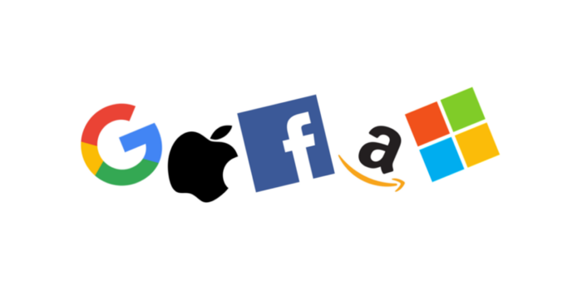
Big tech and their stance on regulation
Nicholas Jurovich
What is Big Tech?
  Facebook, Google, Microsoft, Amazon, and Apple [1][2]
  Others included in conversations (Reddit, Twitter, etc) [3]
They are for regulation
  Mark Zuckerberg called for global regulators to set clearer rules regarding the Internet [4]
  Microsoft executive Satya Nadella said legislative solutions needed for problems such as encryption [2]
Image from Medium
Notes:
First, what is Big Tech?
The term Big Tech typically refers to Facebook, Google, Microsoft, Amazon, and Apple, but other companies have also been in the conversation regarding regulation, some specific examples are Reddit and Twitter.
What do Big Tech companies think about regulation?
They are for regulation. Multiple company leaders have spoken out in favor of regulation.
In 2019, Mark Zuckerberg called on global regulators to set clearer rules regarding how to govern the Internet. Specifically, he mentioned the regulation of harmful content and the implementation of laws regarding privacy and data portability.
Microsoft’s Satya Nadella also called for legislative solutions. He said we should not leave it to CEOs to make important decisions on subjects such as encryption.

Slide 28
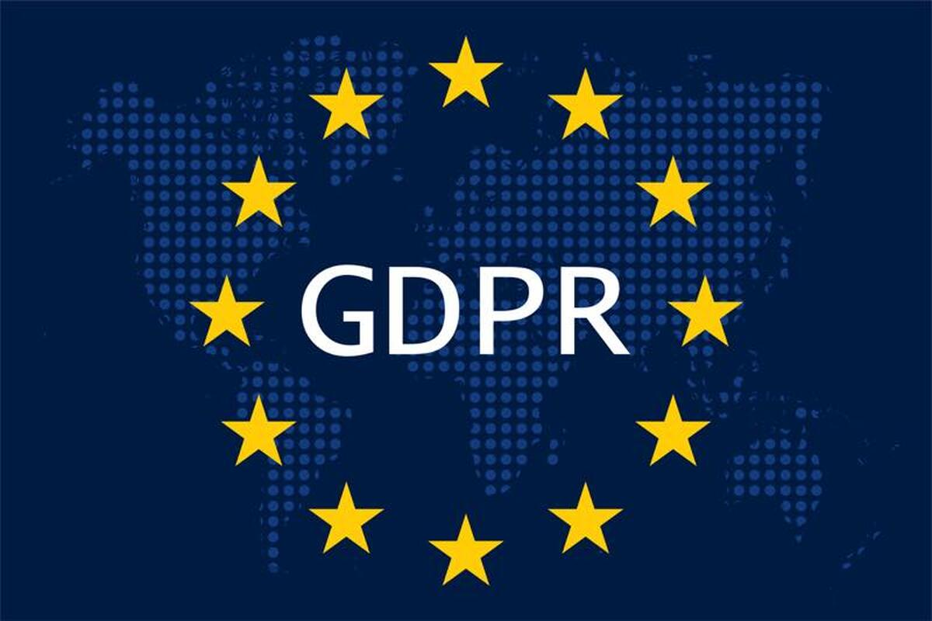
Privacy concerns
Nicholas Jurovich
Previous controversies
  Facebook, Cambridge Analytica [5]
  Google, Google+ [6]
Apple Chief Executive Tim Cook called for United States to follow EU’s lead, create privacy laws [7]
  GDPR, General Data Protection Regulation [8]
Image from TechRepublic
Notes:
One of the main reasons behind the call for more regulation is the issue of privacy.
Two examples of previous controversies that involved privacy issues were the Facebook and Cambridge Analytica situation and the Google+ situation.
Facebook found in 2015 that a professor from the University of Cambridge had shared user data with Cambridge Analytica, who went on to work with Donald Trump in his 2016 campaign. While Cambridge Analytica claimed they destroyed the records, Facebook found in 2018 that they did not.
Google revealed in 2018 that a software glitch allowed outside developers to access hundreds of thousands of people’s data from Google+, which eventually led to the shutdown of Google+.
These events led Apple’s Tim Cook to call for the US to follow the EU’s lead by implementing privacy laws.
In 2018, the EU implemented the GDPR, or General Data Protection Regulation, which says that companies may only collect information that they need. Additionally, people can demand to see any information a company has on them and can order it to be deleted or corrected, with some exceptions. The US has no equivalent law.

Slide 29
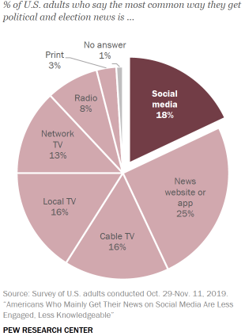
Misinformation
Nicholas Jurovich
Approximately 18% of the United States population gets their political news from social media [9]
Significant now due to 2020 election
  Twitter and Facebook label posts as possibly misleading [10]
  Mark Zuckerberg and Jack Dorsey testified, Hunter Biden story [12] [13]
Zuckerberg had called for more regulation around policing misinformation [11]
Image from the Pew Research Center
Notes:
Another reason for more regulation is the rise of misinformation. Approximately 18% or 1 in 5 people in the US get their political news from social media. This means that it is essential that the news that they find there is accurate.
This became even more significant before and during the recent 2020 election. As many of you have probably seen, Twitter and Facebook have been labeling posts as possibly misleading.
Additionally, a recent story regarding Hunter Biden was removed by both Facebook and Twitter for possibly including misinformation. This led to a Senate hearing with Mark Zuckerberg and Jack Dorsey, where they answered a combined 81 questions regarding censorship. Republicans especially believed that the social media companies were censoring conservatives, while Democrats focused more on the spread of misinformation.
In 2019, Zuckerberg called for more regulation on how to police misinformation, which would eliminate situations like the one regarding the election.

Slide 30
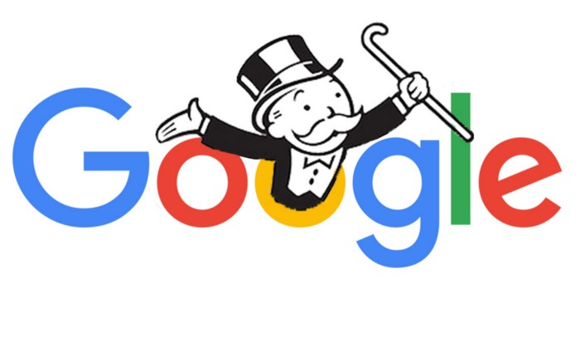
Tech monopolies
Nicholas Jurovich
House lawmakers have said that Big Tech companies are monopolies [14]
  Related them to the old oil barons
Anti-competitive actions
  Facebook bought WhatsApp and Instagram [14]
  Google pays Apple $12 billion a year to put Google as the default search engine [15]
Google antitrust suit
  Department of Justice want to break up Google [15]
Image from Medium
Notes:
One final reason for more regulation is that Big Tech companies have essentially become monopolies. In fact House lawmakers stated this year that Big Tech companies are monopolies similar to those of 20th century oil barons. They recommended that these companies be broken up.
Without regulation, these companies have performed anti-competitive actions to dominate the market, such as buying up other companies, like Facebook did to WhatsApp and Instagram, or signing deals, such as Google paying Apple 12 billion dollars a year to be the default search engine. These actions have allowed them to set prices and control the market.
The Department of Justice recently filed an antitrust suit against Google, which aims to break up the company.

Slide 31
problems we face
Nicholas Jurovich
“Net-states” [16]
  Expansive (ex: Google has Search, Maps, Translate, Waze, FitBit, etc) [16]
  Operate in multiple countries
  Only two fines from GDPR for Big Tech (Facebook and Google) [17]
    Armies of lawyers vs Agency in Ireland
Small companies can have powerful amounts of data [3]
  Use A.I.
Notes:
We still are facing a lot of problems when it comes to regulating Big Tech.
Companies have become net states that don’t only control one market. For instance, Google is made up of many different aspects, such as Search, Maps, Translate, Waze, Fitbit and more. Additionally, these companies don’t only operate in one country so regulation and legislation will have to be implemented in other countries as well.
The regulation will also have to be better enforced. Only two fines have been given to Big Tech companies due to the GDPR, one against Facebook and one against Google.This is due to underfunding and an overwhelming number of cases. Additionally, Big Tech companies can afford to hire armies of lawyers to defend them.
Even if we break up the large companies into small companies, small companies can still use things such as AI to gather large amounts of data, which can be as threatening as the big companies.
It is not enough to break up the big companies. We need to create regulations and legislation and we need to enforce it.

Slide 32
References
Nicholas Jurovich
[1] Steve Denning, “Why Big Tech Should Regulate Itself”, (Forbes, Aug. 2, 2020), https://www.forbes.com/sites/stevedenning/2020/08/02/why-big-tech-should-regulate-itself/?sh=2422e6fd2677 (Nov. 11, 2020)
[2] Sebastian Herrera, “Tech Giants’ New Appeal to Governments: Please Regulate Us”, (Wall Street Journal, Jan. 27, 2020), https://www.wsj.com/articles/tech-giants-new-appeal-to-governments-please-regulate-us-11580126502 (Nov. 11, 2020)
[3] Alice Tugend, “Fervor Grows for Regulating Big Tech”, (New York Times, Nov. 11, 2019), https://www.nytimes.com/2019/11/11/business/dealbook/regulating-big-tech-companies.html, (Nov. 11, 2020)
[4] Jeff Horwitz, “Facebook Chief Mark Zuckerberg Wants More Internet Regulation”, (Wall Street Journal, Mar. 30, 2019), https://www.wsj.com/articles/facebook-chief-mark-zuckerberg-wants-more-internet-regulation-11553999323?mod=article_inline (Nov. 11, 2020)
[5] Deepa Seetharaman, “Facebook Suspends Data Firm That Helped Trump Campaign”, (Wall Street Journal, Mar. 17, 2018), https://www.wsj.com/articles/facebook-suspends-cambridge-analytica-for-failing-to-delete-user-data-1521260051?mod=searchresults&page=3&pos=14&mod=article_inline (Nov. 11, 2020)
[6] Douglas MacMillan and Robert McMillan, “Google Exposed User Data, Feared Repercussions of Disclosing to Public”, (Wall Street Journal, Oct. 8, 2018), https://www.wsj.com/articles/google-exposed-user-data-feared-repercussions-of-disclosing-to-public-1539017194?mod=article_inline (Nov. 11, 2020)
[7] Sam Schechner and Emre Peker, “Apple CEO Condemns ‘Data-Industrial Complex’”, (Wall Street Journal, Oct. 24, 2018), https://www.wsj.com/articles/apple-ceo-tim-cook-calls-for-comprehensive-u-s-privacy-law-1540375675?mod=article_inline (Nov. 11, 2020)
[8] Sam Schechner, “GDPR Takes Effect on Friday – Here’s What to Expect”, (Wall Street Journal, May 24, 2018), https://www.wsj.com/articles/5-questions-about-what-to-expect-when-gdpr-takes-effect-1527154200?mod=article_inline (Nov. 11, 2020)

Slide 33
References
Nicholas Jurovich
[9] Amy Mitchell, Mark Jurkowitz, J. Baxter Oliphant, Elisa Shearer, “Americans Who Mainly Get Their News on Social Media Are Less Engaged, Less Knowledgeable”, (Pew Research Center, Jul. 30, 2020), https://www.journalism.org/2020/07/30/americans-who-mainly-get-their-news-on-social-media-are-less-engaged-less-knowledgeable/ (Nov. 11, 2020)
[10] Cat Zakrzewski, “The Technology 202: Parler surges in popularity as Big Tech cracks down on election disinformation”, (The Washington Post, Nov. 11, 2020), https://www.washingtonpost.com/politics/2020/11/11/technology-202-parler-surges-popularity-big-tech-cracks-down-election-disinformation/ (Nov. 11, 2020)
[11] Jeff Horwitz and Deepa Seetharaman, “Facebook’s Zuckerberg Backs Privacy Legislation”, (Wall Street Journal, Jun. 26, 2019), https://www.wsj.com/articles/facebooks-zuckerberg-backs-privacy-legislation-11561589798?mod=article_inline (Nov. 11, 2020)
[12] Abram Brown, “Mark Zuckerberg and Jack Dorsey Are Gonna Have A Rotten Day As They Testify Before The Senate”, (Forbes, Oct. 27, 2020), https://www.forbes.com/sites/abrambrown/2020/10/27/mark-zuckerberg-and-jack-dorsey-are-gonna-have-a-rotten-day-as-they-testify-before-the-senate/?sh=260fea745fdd (Nov. 11, 2020)
[13] David McCabe, Kate Conger, Cecilia Kang, Mike Isaac, Daisuke Wakabayashi, Kellen Browning, “At Hearing, Republicans Accuse Zuckerberg and Dorsey of Censorship”, (New York Times, Oct. 28, 2020), https://www.nytimes.com/live/2020/10/28/technology/tech-hearing (Nov. 11, 2020)
[14] Cecilia Kang and David McCabe, “House Lawmakers Condemn Big Tech’s ‘Monopoly Power’ and Urge Their Breakups”, (New York Times, Oct. 6, 2020), https://www.nytimes.com/2020/10/06/technology/congress-big-tech-monopoly-power.html (Nov. 11, 2020)
[15] Sarah Miller, “A US antitrust suit might break up Google. Good – it’s the Standard Oil of our day”, (The Guardian, Oct. 21, 2020), https://www.theguardian.com/commentisfree/2020/oct/21/google-antitrust-monopoly-power-us-politics (Nov. 11, 2020)
[16] Alexis Wichowski, “The U.S. can’t regulate Big Tech companies when they act like nations”, (The Washington Post, Oct. 29, 2020), https://www.washingtonpost.com/outlook/2020/10/29/antitrust-big-tech-net-states/ (Nov. 11, 2020)
[17] Katie Collins, “As the GDPR turns 2, Big tech should watch out for big sanctions”, (CNET, May, 24, 2020), https://www.cnet.com/news/as-the-gdpr-turns-2-big-tech-should-watch-out-for-big-sanctions/ (Nov. 11, 2020)

Slide 34
Should Government Have Citizen Private Data?
Bryan Lima
Notes:
Introduction

Slide 35
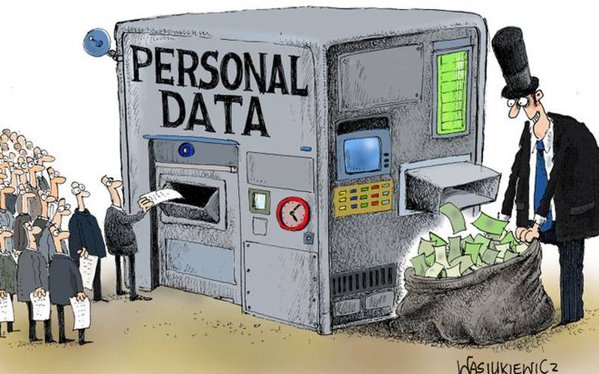
PROS for the Government
Bryan Lima
Combat terrorism [3]
Monitor phone traffic and people’s movements [2]
Ensure each state is represented
Taxes [2]
Image retrieved from: https://www.gisreportsonline.com/the-value-of-data,politics,2877.html
Notes:
First ask: “Why does the government want our private data?”
Ever since 9/11, when the PATRIOT ACT was introduced, citizen private data has been crucial to national security.
People’s phone and internet usage are tracked which allows location tracking and eavesdropping
The Census collects private citizen data in order to ensure that each state is equally represented around the country
The IRS uses data to ensure that everyone pays that national income tax and that all taxes are collected

Slide 36
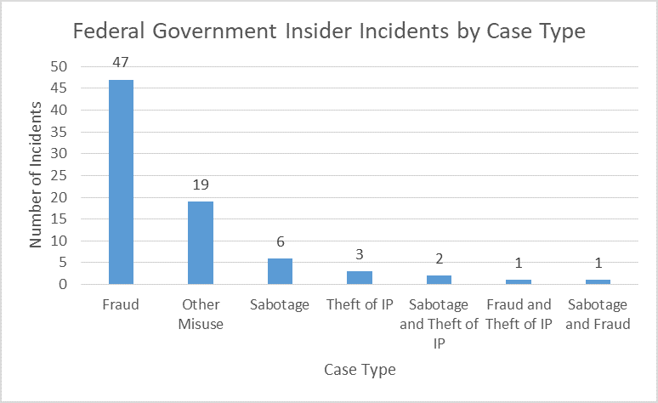
Cons For The Government
Bryan Lima
Threat of insider abuse [5]
Expensive [4]
No evidence of less crime due to increased surveillance [2]
Distrust from citizens [2]
Image retrieved from: https://insights.sei.cmu.edu/insider-threat/2018/11/insider-threats-in-the-federal-government-part-3-of-9-insider-threats-across-industry-sectors.html
Notes:
On the other hand, there have been plenty of struggles for the government when it comes to managing so much data.
There is always a risk of insider abuse
Examples of insider abuse are fraud, sabotage, IP address theft, etc.
The costs and resources associated with managing this data is costly.
Costs: Equipment, investments, labor, hours, technology, etc.
There is no strong evidence supporting that increased government surveillance causes crime to decrease
Just an assumption that criminals and terrorists would be deterred
The collection of this data causes a distrust from citizens since people feel as they have no idea what is happening with their data
84% of adults feel a lack of control over their data collected by the government

Slide 37
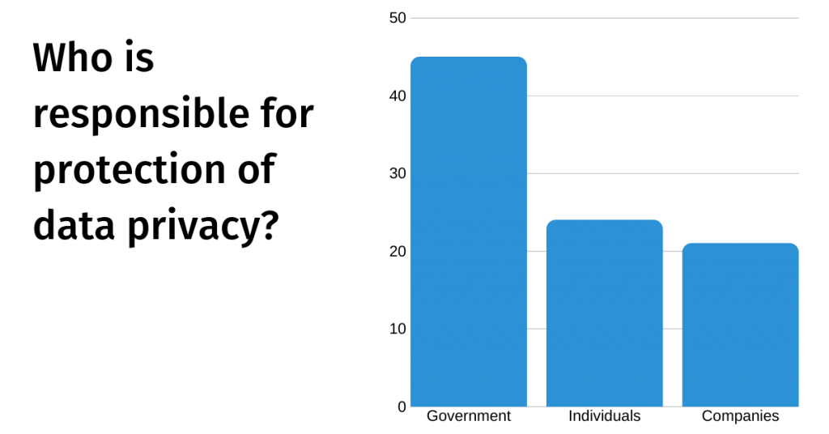
Pro For Citizens
Bryan Lima
Safety [1]
Accurate evidence [4]
No physical harm [4]
Convenience through AI surveillance
Image retrieved from: https://dataprivacymanager.net/100-data-privacy-and-data-security-statistics-for-2020/
Notes:
”How is this collection by the government beneficial for citizens?”
The Cisco Consumer Privacy Survey 2019 revealed that 45% of respondents felt that the government was responsible for protecting data [1]
Surveillance allows for more accurate evidence and recount of events
In the case of the death of Trayvon Martin, there were several different accounts of the story and surveillance could have caught the incident
Surveillance does not cause any physical harm to citizens
As AI advances, AI surveillance can automate tasks and make life more convenient

Slide 38
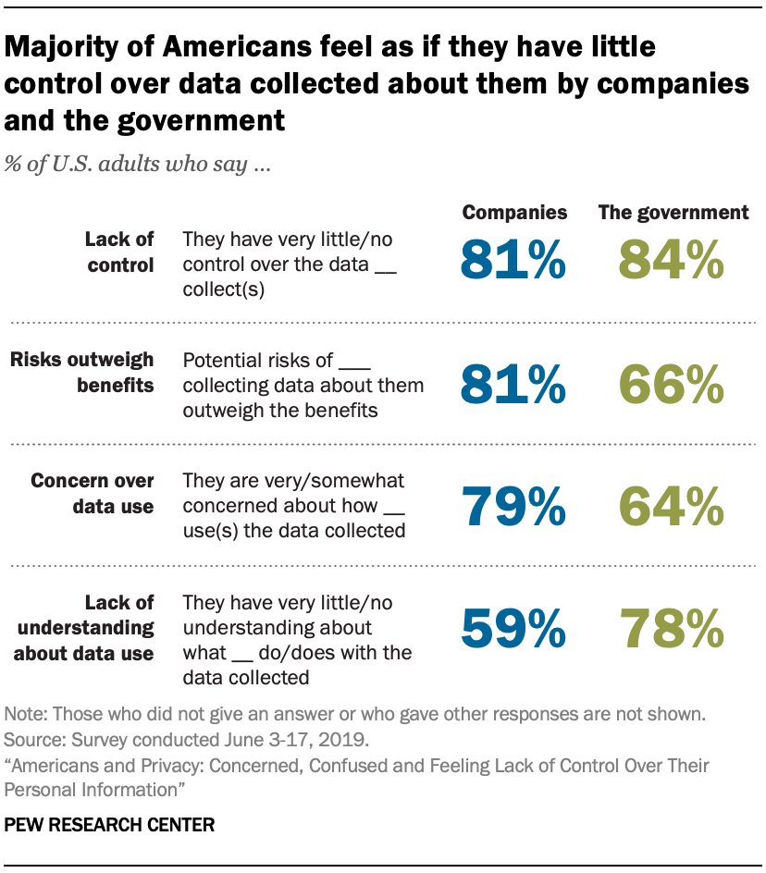
Cons for Citizens
Bryan Lima
Psychological impact [3]
Hackers [3]
Risk the unfair advantage of data being misused [3]
Innocent people become accused [4]
No supervision by higher authority [4]
Image retrieved from: https://www.pewresearch.org/internet/2019/11/15/americans-and-privacy-concerned-confused-and-feeling-lack-of-control-over-their-personal-information/
Notes:
However, not all citizens are on board with government surveillance.
The sense of being controlled by the government can have a psychological impact
Sometimes surveillance clashes with an individual’s rights and liberties
Hackers are becoming more common in today’s world and they are after data to sell
The government may misuse information collected and have an unfair advantage over a citizen
In the case of a criminal investigation, job hiring, etc.
The more data that is collected, the easier it can become to convict someone who is innocent
The PARTIOT Act has given a lot of power to these defense groups

Slide 39
Conclusion
Bryan Lima
Should Government Have Citizen Private Data?
  In my opinion, yes, but to a certain extent.
    Protects national security
    Holds all citizens accountable
I’d now like to open it up to any questions and discussion
Notes:
In conclusion, should the government have citizen private data?
Yes
Protects national security
Holds people accountable in the terms of taxes and other responsibilities
Questions? Discussion?

Slide 40
References
Bryan Lima
[1] Data Privacy Manager, 100 Data Privacy and Data Security statistics for 2020, (Data Privacy Manager, August 20, 2020), https://dataprivacymanager.net/100-data-privacy-and-data-security-statistics-for-2020/ (November 10, 2020)
[2] Brooke Auxier, Lee Rainie, Monica Anderson, Andrew Perrin, Madhu Kumar and Erica Turner, Americans and Privacy: Concerned, Confused and Feeling Lack of Control Over Their Personal Information, (Pew Research Center, November 15, 2019), https://www.pewresearch.org/internet/2019/11/15/americans-and-privacy-concerned-confused-and-feeling-lack-of-control-over-their-personal-information/ (November 10, 2020)
[3] Netivist, Mass governnment surveillance pros and cons: Is NSA internet spying and data mining justified?, (Netivist), https://netivist.org/debate/government-surveillance-pros-and-cons-nsa-spying (November 10, 2020)
[4] ConnectUS, 16 Pros and Cons Government Surveillance of Citizens, (ConnectUS, July 6, 2019), https://connectusfund.org/16-pros-and-cons-government-surveillance-of-citizens (November 10, 2020)
[5] Sarah Miller, Insider Threats in the Federal Government (Part 3 of 9: Insider Threats Across Industry Sectors), (Carnegie Mellon University, November 5, 2018), https://insights.sei.cmu.edu/insider-threat/2018/11/insider-threats-in-the-federal-government-part-3-of-9-insider-threats-across-industry-sectors.html (November 10, 2020)
[6] Prince Michael of Liechtenstein, The value of data, (Geopolitical Intelligence Services, May 13, 2019), https://www.gisreportsonline.com/the-value-of-data,politics,2877.html (November 10, 2020)
Notes:
References

Slide 41
Class 7
The End
Keith A. Pray
socialimps.keithpray.net
Notes:
This is the end. Any slides beyond this point are for answering questions that may arise but not needed in the main talk. Some slides may also be unfinished and are not needed but kept just in case.

