Slide 1
Class 6
Information Privacy
Keith A. Pray
socialimps.keithpray.net
Notes:
Here’s the title slide. Excited already, aren’t you?
How did the self search paper go? Offer small group discussion instead of class wide.
Who: found a lot, very little, surprised, not surprised, creepy, share conclusions

Slide 2
what works well Online With Zoom
Sign in with First and Last Name
Stay muted unless you are going to speak
To speak use the raise your hand feature
To answer yes/no questions use the “yes” ”no” buttons
Turn your camera on
Wait until the end of student presentations to ask questions
  Write them down so you don’t forget

Slide 3
Logistics
Any course logistic questions?
Notes:
Not needed this time:
Address email to entire course staff for quickest response time
Send presentations via email as attachment.
Do not change the format, footers, etc. in the template slides.
Paper writing process: Sources → Notes → Conclusion → Argument → Counter Point → Response
Turn extra credit paper in on myWPI/Canvas and hard copy in class like regular papers
Presentations are due 24 hours before class
Use Presentation Guidelines on course web site

Slide 4
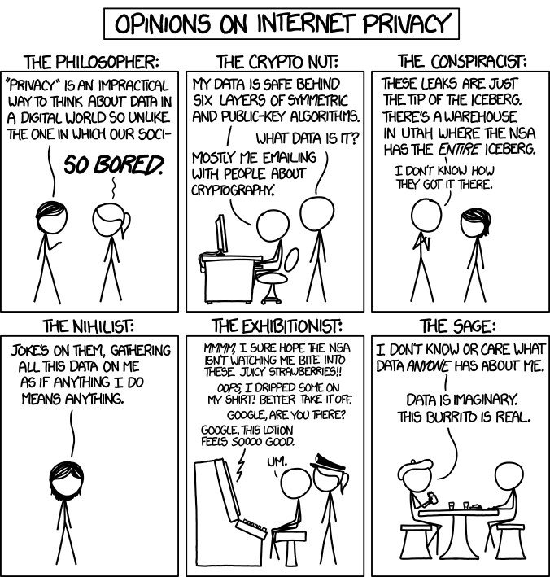
Overview
Review
Assignment
Students Present
http://xkcd.com/1269/
Notes:
1 – Accessed 2014-04-14
Everyone pick the category they identify most with.
Share reasons why.

Slide 5
My Reading Notes
pp. 229 means to end?
pp. 230 who videotapes anymore?
pp. 231 “businesswoman” nice change. Moral capitol – source published in 1984, “taking away” “1984”
pp. 234 Hilton consent to pic being in book?
pp. 237 Many daycares monitor, any studies yet?
pp. 238 “…privacy…in their own homes…” != nanny to expect privacy “…when… insides Sullivans’ home.
pp. 244 Human chip implant sources getting old, 2002, 2004, 2007, 2010
pp. 250 2012 source same year Target outed pregnant teen to parents
pp. 255 Why did Apple not enforce policy of asking permission in the API?
pp. 245 “…by 2015” did it happen?
pp. 246 Web Browsers put cookies on on your hard drive, not Web Servers.
pp. 250 why is bills – responsibility assumption flawed?
pp. 268 Why WPI not in list?
Notes:
Jimmy Kimmel Live – What is your password? (2:49)
https://www.youtube.com/watch?v=opRMrEfAIiI
Find out what your DNA says about you and your family.
https://www.23andme.com/
https://motherboard.vice.com/en_us/article/xwkaz3/23andme-sold-access-to-your-dna-library-to-big-pharma-but-you-can-opt-out?utm_source=vicefbus
Notes updated: 2018-04-03

Slide 6
Assignment
Prepare for class debate:
Should law require you to identify yourself for Internet access?
In other words you would not be anonymous online.
  Once you’ve done the research and have decided “Yes” or “No” assign yourself to the appropriate group on Canvas:
    Canvas → People → Internet ID: https://canvas.wpi.edu/courses/22060/groups#tab-6111
    Use the groups to share your research
  Come prepared with notes, facts, dates, high quality sources
  Optional One Page Paper on the topic, lowest paper grade will be dropped
Notes:
Previous Debates:
Is a National ID System a good thing?

Slide 7
Overview
Review
Assignment
Students Present

Slide 8
Do Personalized Advertisements Aid internet users?
Jenna Galli

Slide 9
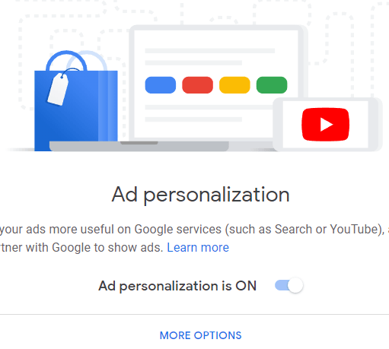
Personalized Advertisements
Jenna Galli
Target Consumers
  Increase relevancy
Use Data
  Profiles
Different ways
  Browsing websites, email, text messages
<Graphic as big as will fit>
How to Stop Personalized Ads and Search Results in Google and Facebook
Notes:
Personalized advertising also known as interest based advertising
Uses tools that improve advertising relevance for users
It Specifically targets consumers by providing ads of their interest
The tools knows what is relevant towards consumers because of the collection of data.
Over time with more internet use, consumers start to build a profile which includes their shopping habits, Interests, and approximate age
After doing the self search assignment over the weekend there was a lot more information about me online than I had thought, even getting the voting recordswas suprising, because my relatives were linked to it
Very big in politics and elections
There are different ways to receive personalized ads such as when browsing a website or checking your email
Google has an option to turn this on and off as well as guidelines they follow w/ personalized ads
Their terms of service mentions no advertising based on someone's mental behavior or sexual interests.
And this is done to protect consumers partially
But just because google turns it off doesn’t mean websites through google wont still be tracking your data
On the next slide I’m going to discuss how companies gather data.

Slide 10

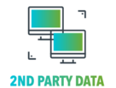
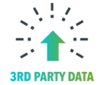
Where The Data Is Coming From
Jenna Galli
1st Party Data
Data collected directly from customers
2nd Party Data
Someone else's 1st party data
3rd Party Data
Data from outside sources that are not the original collectors
1st Party Data, 2nd Party Data, 3rd Party DM. What Does It All Mean
Notes:
Data can come from three different sources
1st,2nd,3rd party data
1st party data is collected directly from customers
This is subscription data
Behavior data on your website
Or data from your CRM(Customer relationship management)
can be a database of users
Overall Can be used to predict future patterns and gain audience insights
2nd party data is someone else’s 1st party data
Activity on websites
Mobile app usage
Customer surveys
Useful to increase the scale of your data
Reach new audiences
You can Get it by buying from another company
3nd party data is from outside sources that are not the original collectors of that data
Can use it to
Enhance 1st party data
Expand your audience
Most importantly discover new audiences
This data is bought

Slide 11
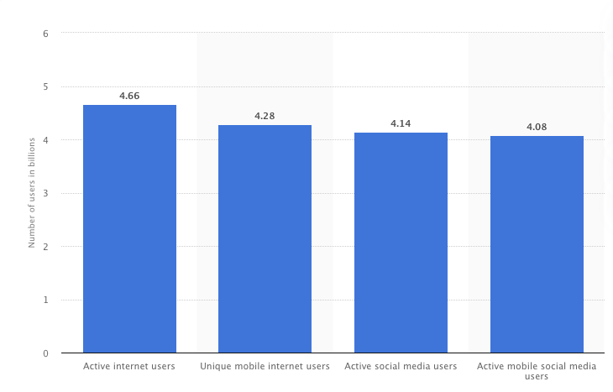
Who Are Internet Users
Jenna Galli
Consumers
  Global digital population
  Browse Internet
  Receive Ads
Global digital population as of July 2020
Notes:
Now that we understand what personalized ads are and where the data comes from, we have to define internet users to answer my original question
First we have consumers
These are people that use the internet for purposes besides selling products
As of July 2020, our global digital population of active internet users was 4.66 billion people.
These are all people browsing the internet and receiving personalized ads
This is obvoisly a huge amount of data which is valuabe to companies bulding profiles

Slide 12
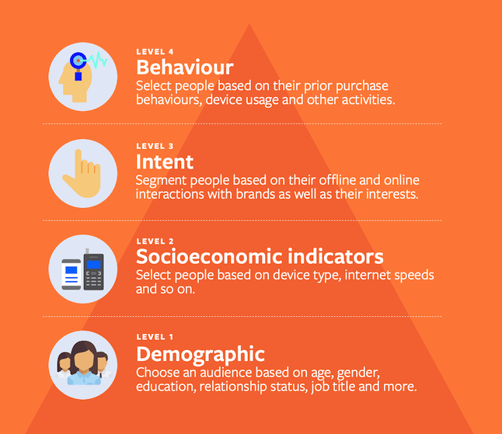
Who Are Internet Users cont’d.
Jenna Galli
Suppliers
  Sell a product or service
  Have different techniques
  Must have a good relationship with consumers
How to Stop Personalized Ads and Search Results in Google and Facebook
Notes:
Next we have Suppliers
These are internet users who's goal is to sell a product or service
Suppliers have different techniques on connecting with consumers depending on their data
Overall they use demographic, and socioeconomic indicators to perform personalized advertising
It is important for suppleirs to have a good relationship with customers to achieve loyalty and receive profits

Slide 13
Pros and cons
Jenna Galli
Consumers
- Quick focus
Suppliers
- More focused advertising
Consumers
- Loss of Privacy
Suppliers
- If done incorrectly, lowered consumer interest
Examining Me Determinants of Consumer Avoidance of Personalized Advertising
Notes:
There are pros and cons for both internet users regarding personalized advertising
For consumers there is a quick focus time when interacting with ads because chances are it’s something you’re interested in and would like to engage with
However, there is a loss of privacy with data mining and building profiles of consumers
A pro for suppliers is more focused advertising. Once they identify their audience, they can cater ads towards them without having to please all internet users.
However, if advertising is done incorrectly, like you identified the wrong audience, it will actually lower consumer interest in your product

Slide 14
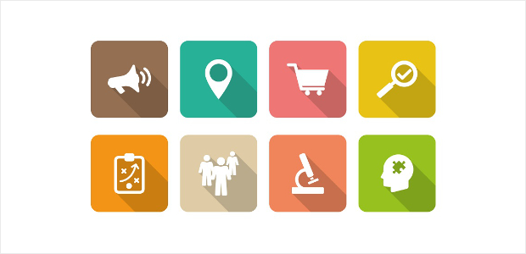
Real World Application
Jenna Galli
Creating McBurger
  High quality fast food with a subscription
Find an Audience
  Similar companies
Conclusion
  Is it right?
<Graphic as big as will fit>
How to Find Demographic and Interest Reports in Google Analytics
Notes:
For a real world application of this, lets pretend we’re creating a new fast food joint called McBurger
What’s different about this brand is that they serve high quality fast food but you need to be a yearly subscriber like Costco
The first thing for success McBurger will do is try to find an audience by putting out advertisements. They’ll buy 3rd party data which shows the most frequent fast food eaters in the region they want to open the first store. After weeks of advertising, they open the store and it was a huge success.
Many of the people who came had already been identified through the personalized advertising campaign and they enjoyed their food.
Is this ethically correct for all parties involved?
Would you give the same answer if the grand opening wasn’t as successful?

Slide 15
Conclusion
Jenna Galli
  Do Personalized Advertisements Aid internet users?
  Yes:
    Reoccurrence of targeted advertisements
    Shift in purpose
    More pros than cons
Notes:
To remind you this is the originally question I asked
Now that we’ve defined personalized advertisements and internet users, I concluded that
Targeted ads have been around since propaganda usage
The difference is that in todays world there has been a shift from individuals being targeted through ads to generalized advertisements targeted to a specific audience.
While some may find the data collection creepy, it seems to help others so I’m concluding there are more pros than cons to personalized ads.
I’d love to hear your thoughts on this topic or any questions you may have.

Slide 16
References
Jenna Galli
[1] "STAY AWAY FROM ME: Examining Me Determinants of Consumer Avoidance of Personalized Advertising.” , Baek, Tae Hyun, and Manko Morimoto. Journal of Advertising 41.1 (2012): 59-76. Web.
[2] “Personalization: Opportunities, Pitfalls and How To Get it Right.”, Facebook for Business. https://www.facebook.com/business/news/personalization-opportunities-pitfall-and-how-to-get-it-right Web. November 7th 2020
[3] “1st Party Data, 2nd Party Data, 3rd Party DM. What Does It All Mean.” , Lotame. https://www.lotame.com/1st-party-2nd-party-3rd-party-data-what-does-it-all-mean/ Web. November 7th 2020
[4] “Personalized advertising" , Google. https://support.google.com/adspolicy/answer/143465?hl=en Web. November 7th 2020
[5] "How to Find Demographic and Interest Reports in Google Analytics.” , MonsterInsights. https://www.mon-sterinsights.com/how-to-find-demographic-and-interest-reports-in-google-analytics/ Web. November 7th 2020
[6] . "Global digital population as of July 2020.” , Statistahttps://www.statista.com/statistics/617136/digital-population-worldwide/#:~:text=How%20many%20people%20use%20the,in%2Oterms%20of%20internet%20users. , Web. November 7th 2020
[7] “How to Stop Personalized Ads and Search Results in Google and Facebook.” Green, Ollie, https://helpdeskgeek.com/how-to/how-to-stop-personalized-ads-and-search-results-in-google-and-facebook/ Web. November 7th 2020

Slide 17
Does Internet Privacy Exist?
Patrick Spillane

Slide 18
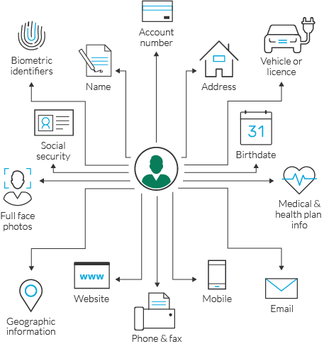
Privacy of what information?
Patrick Spillane
Two types of information:
  Personally identifiable information (PII)
  Non-personally identifiable information (Non-PII)
PII examples [1]
  Name
  Personal identification numbers (SSN)
  Address information
Non-PII examples [2]
  Language preference
  Time zone
  Browser type
Image from: https://www.imperva.com/learn/wp-content/uploads/sites/13/2019/03/Personally-Identifiable-Information-PII.png
Notes:
Read first bullet
Explain pii - information that can be used to distinguish or trace an individual’s identity
Go over examples written as well as in picture – Name, SSN, address, account numbers, birthdays, email, medical and health info
Explain non pii - data can not be used to distinguish or trace an individual’s identity
Examples – Language preference, time zone, browser type, device type, screen size
Usually collected by businesses to track and understand the digital behavior of their consumers

Slide 19
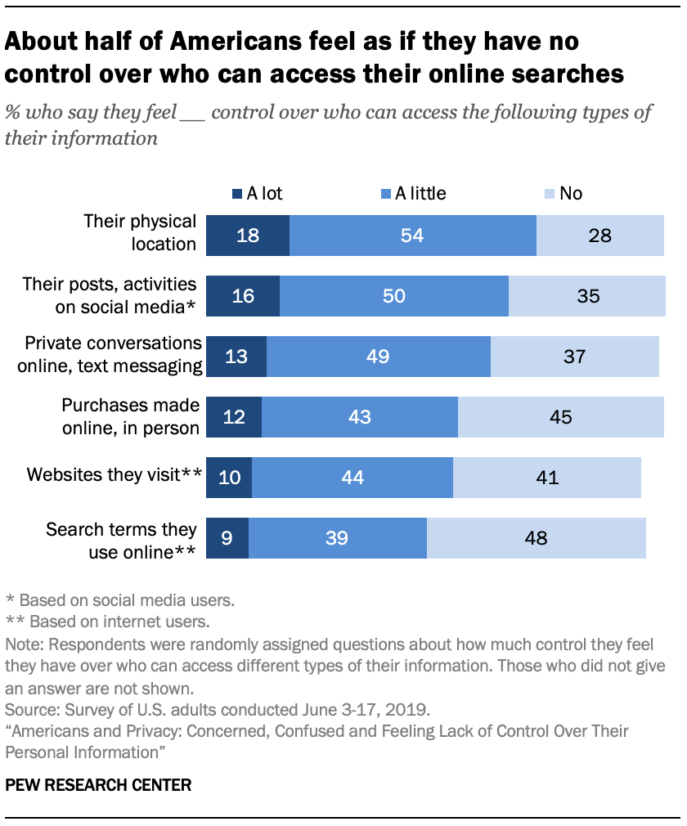
How do people feel about privacy?
Patrick Spillane
Majority of people feel that they have little to no control over their privacy [3]
If you take no steps to increase your privacy, it is true that you probably have little control over who gets your data
Image from: https://www.pewresearch.org/internet/wp-content/uploads/sites/9/2019/11/PI_2019.11.14_privacy_0-04.png
Notes:
First bullet
Based on this information from the Pew Research Center, people feel that they have the least control over who has access to
The search terms online, the websites they visit, and purchases they make.
Meanwhile, more people feel they have control over who has access to their physical location
It is true that without taking steps to increase your privacy, you may have little control over who has access to your data.

Slide 20
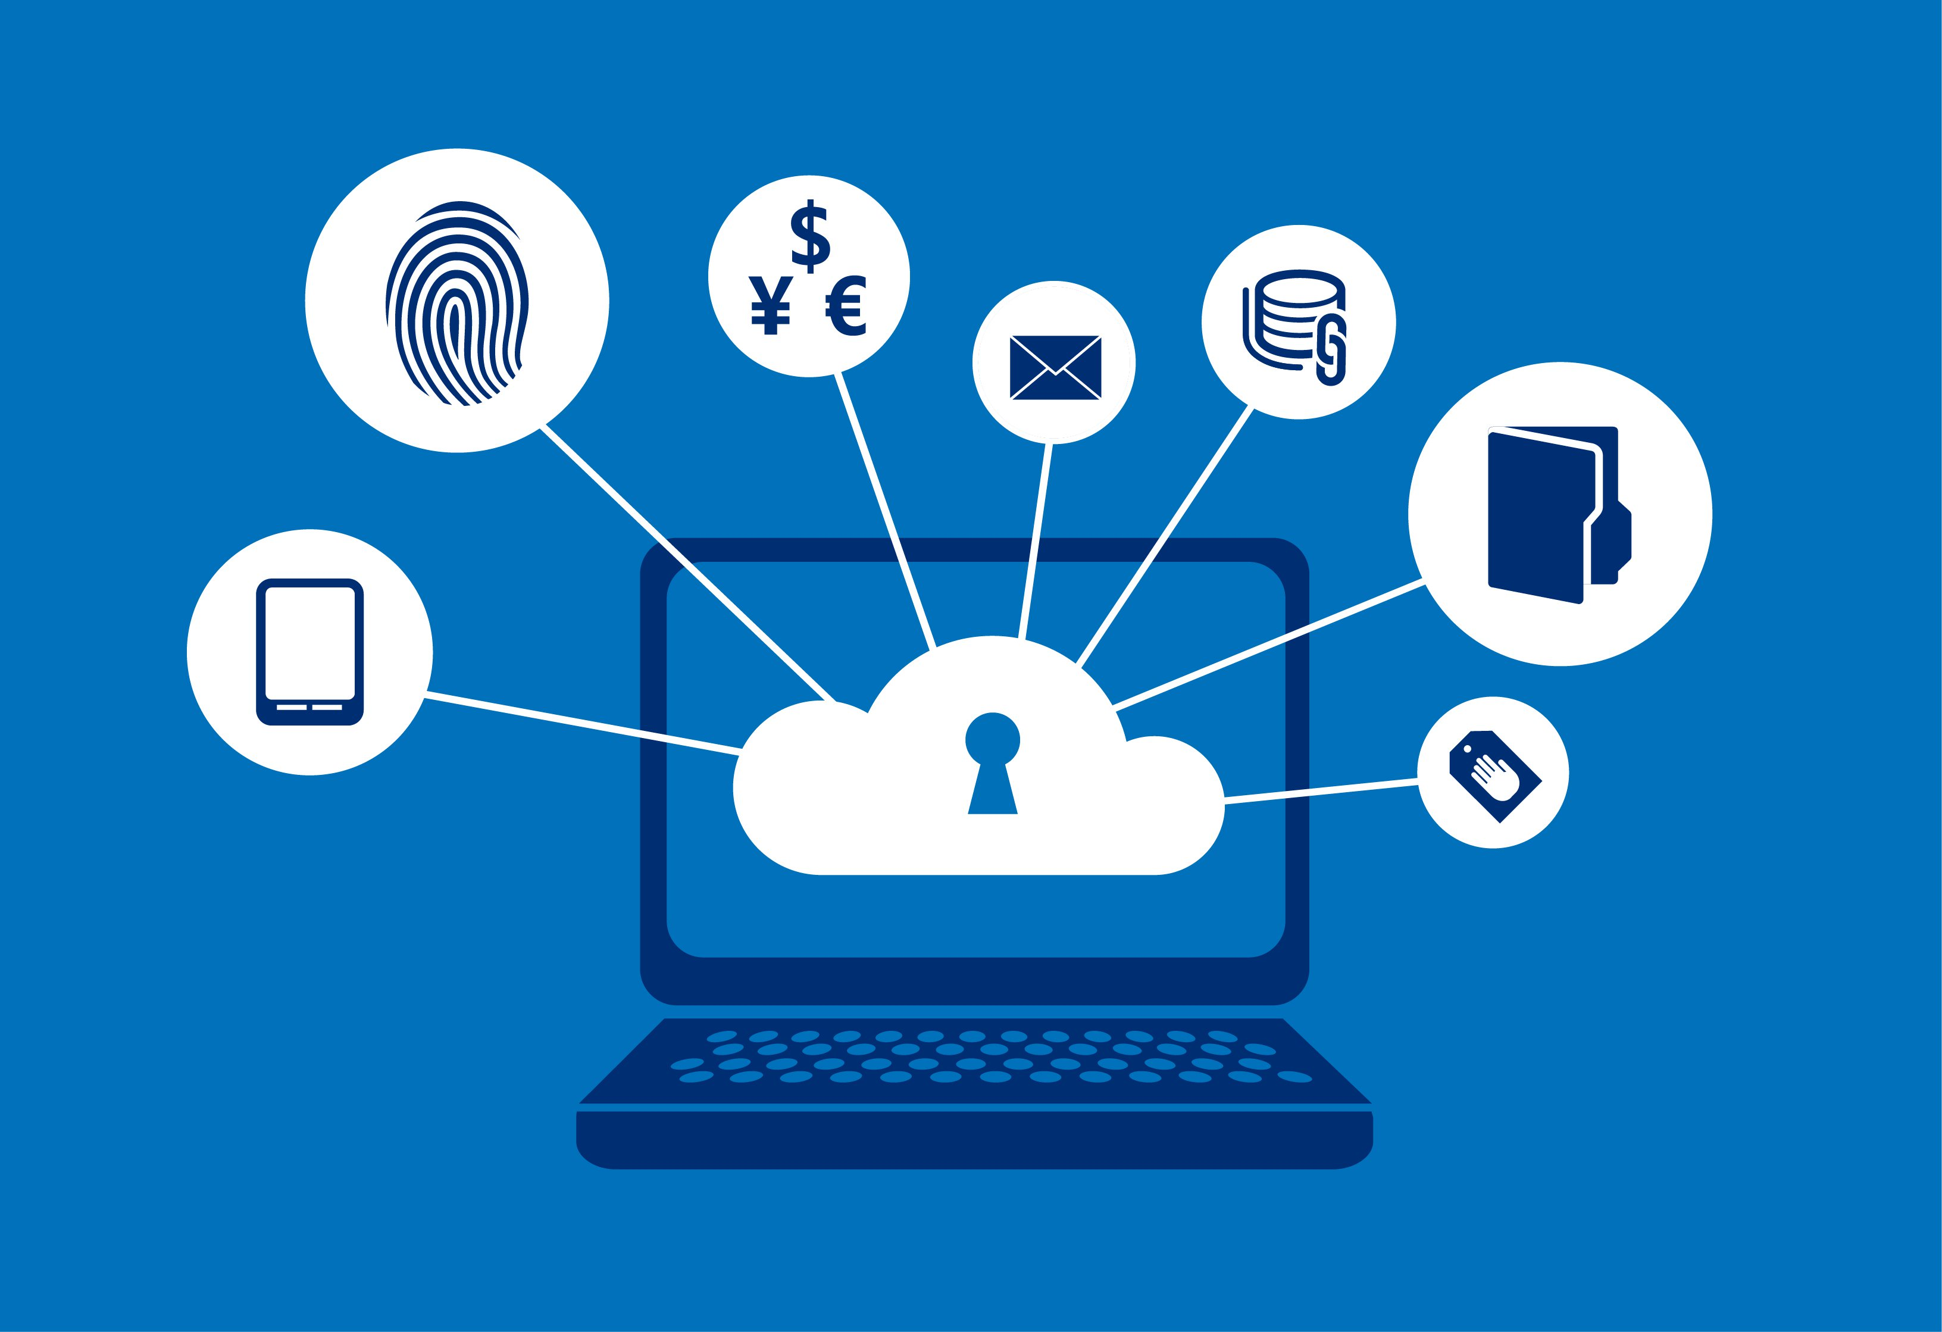
Why should you care?
Patrick Spillane
No one should want everything about them to be public information
Its possible to find out more than just what you reveal
Conditions may change
Your data has value
[4]
Image from: https://cloudblogs.microsoft.com/microsoftsecure/wp-content/uploads/sites/13/2014/05/protecting-data-and-privacy-in-the-cloud.jpg
Notes:
You don’t want things like your name and address being in the wrong hands
Possible to make inferences about you from your data
You may not care about your data now, but that may change in the future (Career? Family?)
Data has value, if someone asked you 100 questions about you just so they could sell it to make profit, you wouldn’t answer those questions

Slide 21
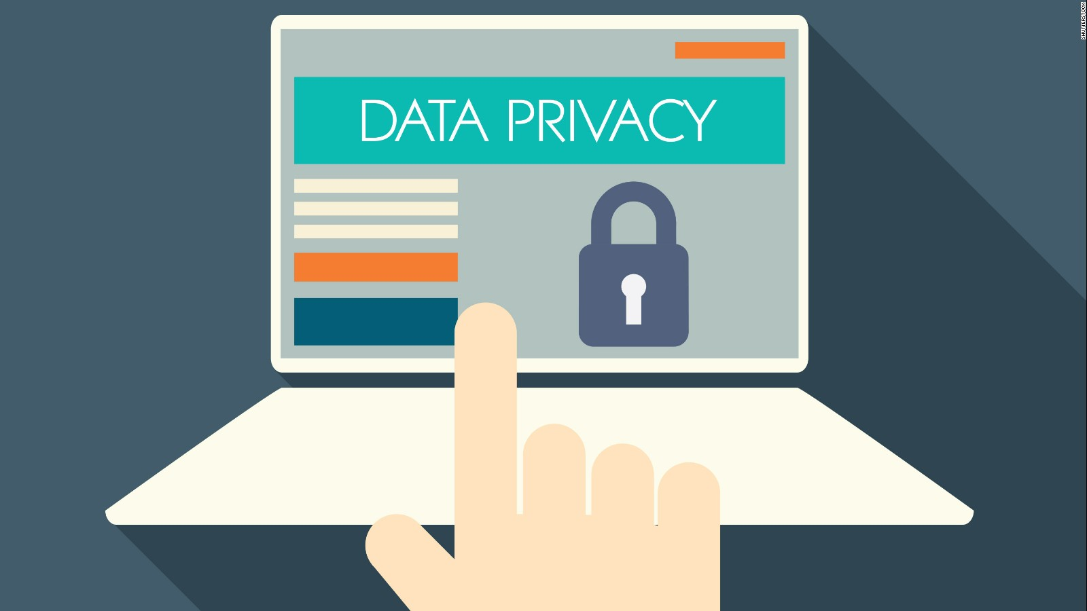
Obvious ways to increase Privacy
Patrick Spillane
Limit what you share online
Use strong passwords
Use the available incognito/private modes
Be careful of phishing attempts
Use an antivirus
[5]
Image from: https://cdn.cnn.com/cnnnext/dam/assets/170329120959-internet-privacy-illustration-full-169.jpg
Notes:
Limit what you share online, such as on social media
strong passwords to prevent easy access to your information, mix of capitalization, numbers, and special characters make passwords much more secure
Incognito and private modes help increase privacy of your device itself, does not prevent isps, network administrators, or websites from seeing what you do
Phishing – fraudulent link pretending to be a well known company in order to trick you into revealing information like passwords or credit card numbers
Use an antivirus or malware detection software to prevent malicious software designed to harm or exploit
Good start but not exhaustive

Slide 22
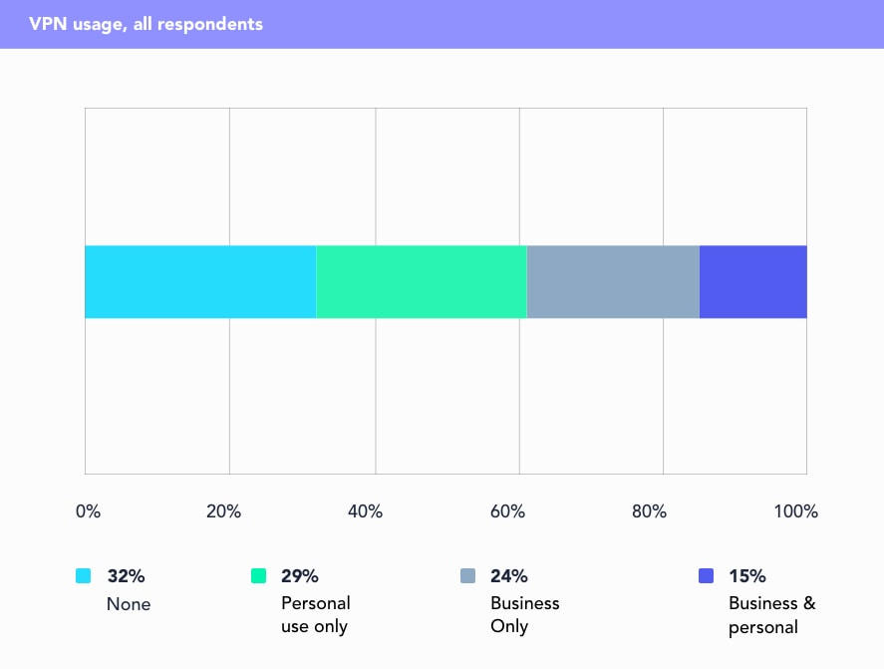
More ways to increase privacy
Patrick Spillane
Use a more secure search engine
Use 2FA when possible
Use a VPN
  What is a VPN?
    A private network that encrypts and transmits data while it travels on the internet
    Hides IP address and encrypts internet connection [6]
Image from: https://www.security.org/wp-content/uploads/2020/06/vpn-2.jpg
Notes:
Google stores every search you make on their servers, even if you delete your history on your own device
Search engines example – duckduckgo does not store anything and does not collect information
2FA – 2 factor authentication provides another layer of protection that is very difficult to get around
VPN – connect to private server, provides you with the ip of the server, hiding your ip, encrypts your connection to prevent even isps from observing
Does internet privacy exist? Yes, but only to the extent that you seek it out

Slide 23
References
Patrick Spillane
[1] Guide to Identifying Personally Identifiable Information (PII), University of Pittsburgh, 9 Nov. 2020, www.technology.pitt.edu/help-desk/how-to-documents/guide-identifying-personally-identifiable-information-pii.
[2] Non (Personally Identifiable Information) PII Data, Latentview, 2020, www.latentview.com/non-pii-data/.
[3] Auxier, Brooke, et al. Americans and Privacy: Concerned, Confused and Feeling Lack of Control Over Their Personal Information, Pew Research Center, 15 Nov. 2019, pewresearch.org/internet/2019/11/15/americans-and-privacy-concerned-confused-and-feeling-lack-of-control-over-their-personal-information/.
[4] Hennig, Casey. Why Should We Care About Online Privacy?, UC Berkeley, 20 Jan. 2020, security.berkeley.edu/news/why-should-we-care-about-online-privacy.
[5] Rafter, Dan. How to protect your privacy online, Norton LifeLock Inc., 19 Mar. 2019, us.norton.com/internetsecurity-privacy-protecting-your-privacy-online.html.
[6] Bari, Christina. The Ultimate Guide to Virtual Private Networks (VPN), Avast Software, 4 Nov. 2020, www.avg.com/en/signal/what-is-a-vpn-and-why-should-you-use-one#topic-3.
[7] Gabe Turner and Security.org Team. VPN Consumer Usage, Adoption & Shopping Study: 2020, Security.org, www.security.org/resources/vpn-consumer-report-annual/.

Slide 24
Democracy Under Attack
Jarius Thomas

Slide 25


Drawing inspiration from these two movies:
<Your Name>
The Great Hack
Netflix documentary
2019
The Social Dilemma
Netflix documentary
2020
<Citation>
Notes:
Great Hack:
A movie about the digital manipulation of the 2016 election
Talks about the subversion campaigns Cambridge Analytica did in the UK, Trinidad & Tobago, and most recently the US
Social Dilemma
A movie about the detrimental effects of social media algorithms
Highlights the prevalence of mass misinformation
Also my group project movie, so I won’t say too much about it

Slide 26
Some intersections with topics in this class:
The role of networked communications, and how they have already impacted the democratic process in several countries
Cambridge Analytica’s violation of Facebook users’ data privacy
  The large-scale Web Scraping done by Cambridge Analytica [2] relates to Bill’s presentation

Slide 27
The role of networked communications in the 2016 election
Advertisements and heavily targeted messaging contributed to “the increasing scourge of ‘viral’ hoaxes and other kinds of misinformation that could propagate through [social media and other] networks” [1]
Over 25% of voting-age adults visited a fake news website supporting either Clinton or Trump in the final weeks of the 2016 campaign [5]
  Observed in a sample of more than 2,500 Americans' web traffic data between October and November of 2016
Notes:
[1] is a direct quote from Alexis Madrigal, who reported on this in 2017

Slide 28
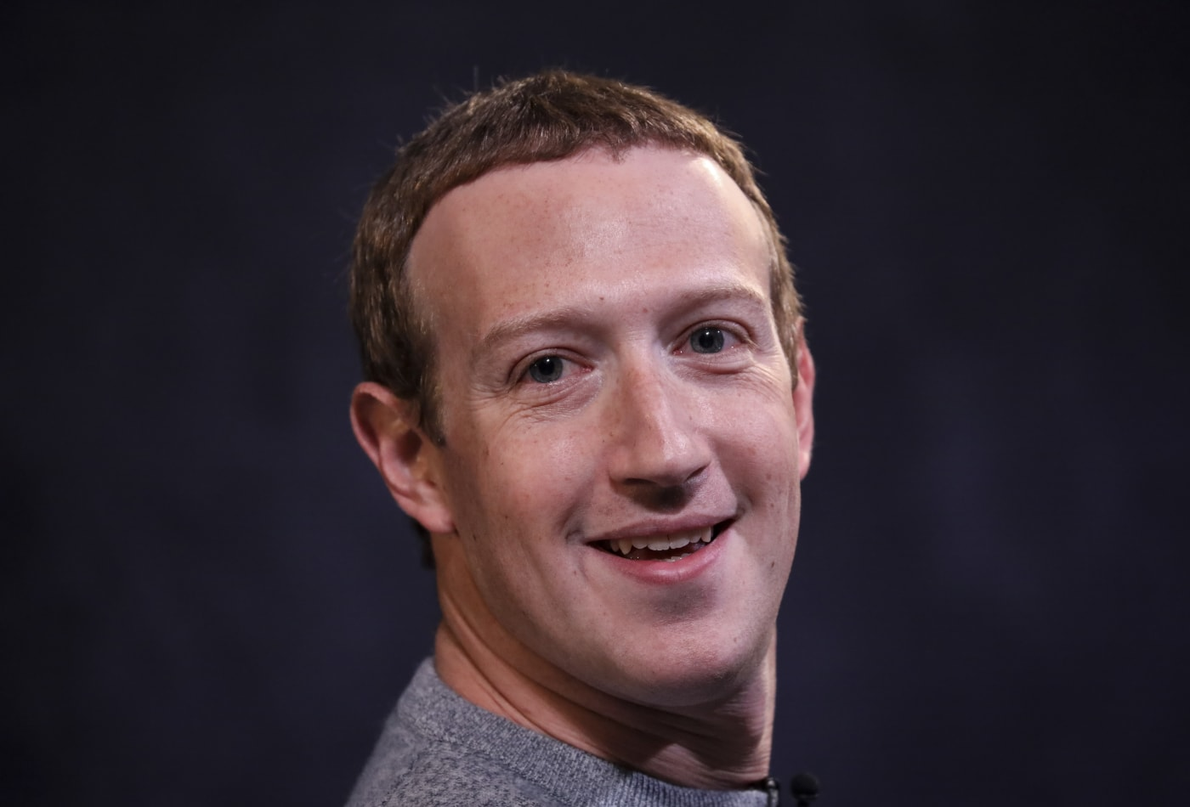
The role of Facebook in the 2016 election
"Facebook and Twitter were the reason we won this thing," he says. "Twitter for Mr. Trump. And Facebook for fundraising” [4]
  Brad Parscale, Trump’s digital director
"They have an advantage … a platform that has users that are conditioned to click and engage and give you feedback… Their platform’s built to inform you about what people like and dislike.” [4]
  Gary Coby, director of advertising at the Republican National Committee
  Worked on Trump's campaign

Slide 29
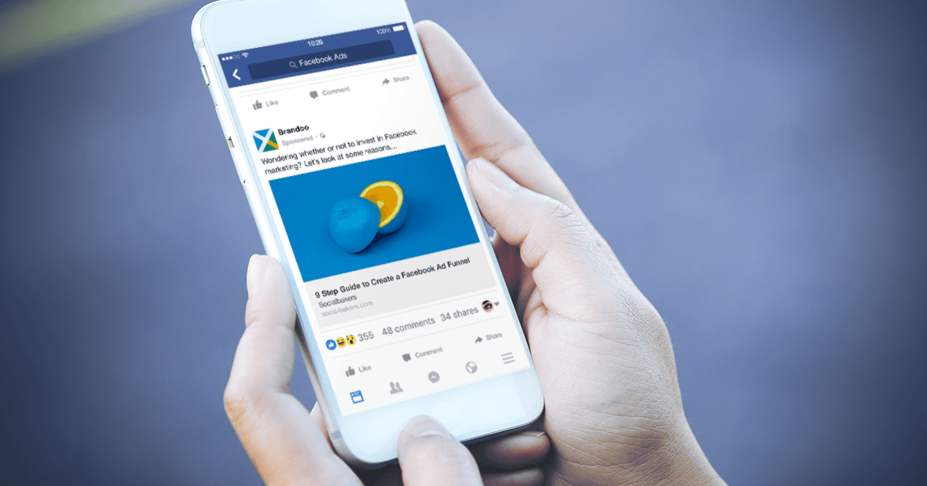
Counter Point:
Washington Post determined we “don’t know how much any ad or news story [affected] someone’s vote” [2]
Organically shared content “reached a lot more people than Trump’s ads or the Russians’ ads did” during the 2016 campaign. [2]
Notes:
[2] from the Washington post

Slide 30

Digital voter suppression
Mainly referring to the 2010 - Trinidad and Tobago Election [6] [8]
Cambridge Analytica was involved in a campaign encouraging young Afro-Caribbean voters not to vote [6]
The involvement of Big Tech in running election-influencing digital campaigns predates the 2016 US Election
2014 - “Harvard Law scholar Jonathan Zittrain wrote an essay … in which he called attention to the possibility of Facebook selectively depressing voter turnout...” [1]

Slide 31
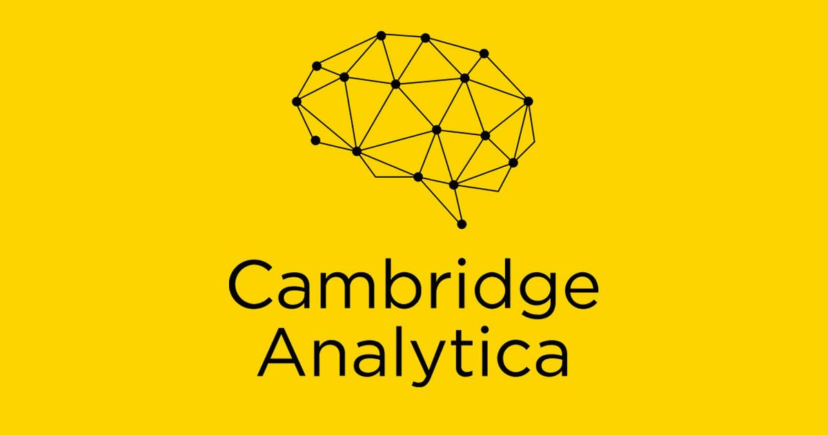
Violations of privacy
CA proposed “it could offer insight into the psychology of individual US voters” [2]
  50 million Facebook users had their accounted scraped to construct these profiles
Cambridge hired a British researcher who created a tool that gathered data from people’s Facebook accounts [2]
  Scraped information from users with no connection to the British researcher
  “Cambridge Analytica had to exploit a vulnerability (which is a criminal act) to gain unauthorized access to user data” [10]
Notes:
- Scraped information from users : consent-free search

Slide 32
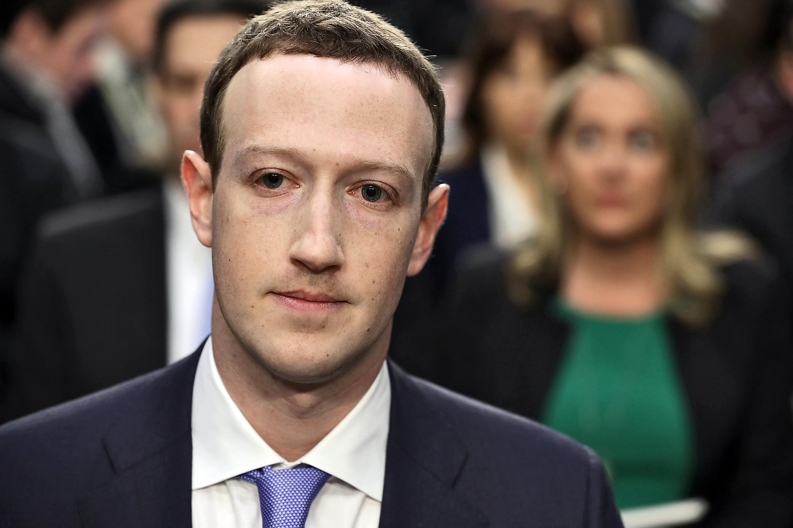
Counter Point:
Facebook’s rules in 2014 were more relaxed than they are now
Since the fallout of Cambridge Analytica and SCL, Zuckerberg has directly addressed his role in the breach of privacy:
“It's clear… we didn't do enough to prevent these tools from being used for harm as well.
That goes for fake news, foreign interference in elections…, hate speech, [and] data privacy. We didn't take a broad enough view of our responsibility, and that was a big mistake.
It was my mistake, and I'm sorry. I started Facebook … I'm responsible for what happens here.”
-Mark Zuckerberg [5]
Notes:
[2] from the Washington post

Slide 33
QuestionS
I will take any questions from the class
Notes:
Questions for the class:
1. Have you ever seen a post online that felt a little too targeted?
Maybe they trying to change your opinion on some topic, or sell you some movement you don’t have any interest in?
2. Cambridge Analytica got into loads of trouble in 2018 after an employee exposed what the business was involved in.
For people who are familiar with what happened, did you feel any particular way about how people’s data were gathered?
3. Most of this presentation cites sources about prevalence of targeted ads and content in the 2016 election cycle.
The technologies that fueled those campaigns is still out there, but the sources haven’t caught up yet.
That being said, does anyone see any contuations in the impact of these technologies?
Are they still relevant in 2020, or have things changed since 4 years ago?

Slide 34
References
<Your Name>
The Atlantic, on Facebook - https://www.theatlantic.com/technology/archive/2017/10/what-facebook-did/542502/
Washington Post on Facebook’s impact in 2016 election - https://www.washingtonpost.com/news/politics/wp/2018/03/22/all-the-ways-trumps-campaign-was-aided-by-facebook-ranked-by-importance/
NPR, Facebook Acknowledges its role in advertising - https://www.npr.org/2017/09/08/549284183/facebook-acknowledges-russian-ads-in-2016-election-will-investigations-follow
"Facebook and Twitter were the reason we won this thing … Twitter for Mr. Trump. And Facebook for fundraising.“ - Donald Trump's digital director Brad Parscale - https://www.wired.com/2016/11/facebook-won-trump-election-not-just-fake-news/
From NPR, quoting Zuck – “It's clear… we didn't do enough to prevent these tools from being used for harm as well. That goes for fake news, foreign interference in elections…, hate speech, [and] data privacy. We didn't take a broad enough view of our responsibility, and that was a big mistake. It was my mistake, and I'm sorry. I started Facebook … I'm responsible for what happens here.“
https://www.npr.org/2018/04/11/601323233/6-facts-we-know-about-fake-news-in-the-2016-election
Trinidad and Tobago Election - https://advox.globalvoices.org/2019/08/06/netflixs-the-great-hack-highlights-cambridge-analyticas-role-in-trinidad-tobago-elections/
Russian Account bought $100K in Facebook ads in 2016 - https://time.com/4930532/facebook-russian-accounts-2016-election/
The Great Hack
The Social Dilemma
https://hackernoon.com/web-scraping-and-the-fight-for-the-open-internet-ly1o2t8i

Slide 35
Class 6
The End
Keith A. Pray
socialimps.keithpray.net
Notes:
This is the end. Any slides beyond this point are for answering questions that may arise but not needed in the main talk. Some slides may also be unfinished and are not needed but kept just in case.
If there’s time and we didn’t already look at:
Find out what your DNA says about you and your family.
https://www.23andme.com/
Jimmy Kimmel Live – What is your password? (2:49)
https://www.youtube.com/watch?v=opRMrEfAIiI

