Slide 1
Class 5
Intellectual Property
Keith A. Pray
socialimps.keithpray.net
Notes:
Here’s the title slide. Excited already, aren’t you?
Weird Al Yankovic “Don’t Download This Song” (3:53)
https://www.youtube.com/watch?v=zGM8PT1eAvY

Slide 2
what works well Online With Zoom
Sign in with First and Last Name
Stay muted unless you are going to speak
To speak use the raise your hand feature
To answer yes/no questions use the “yes” ”no” buttons
Turn your camera on
Wait until the end of student presentations to ask questions
  Write them down so you don’t forget

Slide 3
Papers
http://socialimps.keithpray.net/assignments/paper-guidelines/
Quantify
  Not terms like: less, more, a lot, huge, great, big, tiny, etc.
Avoid absolutes
  Terms like: all, none, always, never
  Difficult to prove, easy to show false
Conclusion should be specific enough to be argued
Notes:
Save for next time:
Define terms
Read paper aloud to proof
Read directions, many time lines missing
Be sure to put quotes around entire quote
State a strong, clear conclusion
First statement preferred
Provide Counter Point and Response
Print 2 sided and save a tree
Hyperbole is the best thing ever!
but not in these papers
No strawman fallacy in counter point
Text book is not a primary source
Use template, saves time (and -1 point)
Cite as suggested [1]

Slide 4
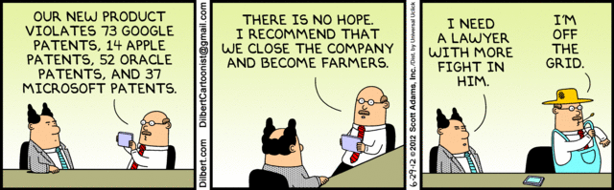
Overview
Review
Assignment
Students Present
Notes:
Comments, observations, questions on IP Chapter?

Slide 5
My Reading Notes
pp. 165 “...ownership of ideas...” not quite right
pp. 168 public domain year 1997/1999 from source published in 1996?
pp. 170 SaaS, Google Search example? “…before he gave them the plot.”? “…cannot erase the memories...” Paycheck (2003)
pp. 180 4.4 #2 preferred?
pp. 186/196 revenue != profit
pp. 190 blocking 100% seems impossible
pp. 194 Any legitimate BitTorrent use examples since 2005?
pp. 197 “licensing agreement … hardware”? Confidential source code very outdated.
pp. 198 4.7.3 references?
pp. 205 Perhaps friends should not ask you to break the law?
Any successful businesses operate as a support service?
pp. 207 Is Perl still most popular? Quality study from 2003, change?
pp. 209 who uses tape?
pp. 210 “human-readable, lawyer-readable…”
pp. 223 Interview has nothing to do with computing

Slide 6
Group Quiz
For each On the left answer a–d on Right
Trademark
Copyright
Patent
Trade Secret
What does it protect?
What qualifications have to be met?
How long does protection last?
Give a specific example currently protected?
Notes:
Trademark
Used to denote a product or service.
Apply in specific areas of commerce. Only applies in specified area of business
Indefinite term as long as in use and protected against becoming a common noun or verb.
You do not have to register a trademark unless you want to bring litigation before a federal court (there are other benefits too, but what are they?)
Copyright
Expression, not ideas: Fuzzy. E.g. derivative works, characters, merchandising, plots.
Mickey Mouse, Tarzan.
US Default : Original Author, Exception: work for hire, Transferred: yes
Rights: Publication, Performance / exhibition, Adaptation to other media, Excerpting, Attribution, Derivative works
US Term: Lifetime of author plus 70 years., 95 years for companies.
Governed by US law and international treaties (e.g. WIPO).
Fair Use: News reporting, reviews, etc., Scholarly / educational use, Private, non-commercial use, Lending libraries and archives
Fair Use restrictions: Admission charge, Re-transmission
In general, you can: Read, view, play, etc., Copy for personal use., Time-shift, Space-shift
In general, you cannot: Copy for others., Transfer to someone else but keep a copy., Show / perform it publicly.
What about video rentals?
Rationale: Encourage creativity. Encourage dissemination. Balance between private and public good. It’s a social contract.
Patent
A mechanism, process, or composition of matter.
Must be: Novel. Useful. Non-obvious. Described clearly. Must do what it says.
Usual term 20 years.
Utility and plant patents: 20 years.
Design patents last 14 years. (ornamental design of functional item)
Provisional patent gives 1 year, before full patent
Trade Secret
You must take steps.
Enforceable by: Contracts, Laws against industrial espionage.

Slide 7
Group Quiz
For each On the left answer a–d on Right
Trademark
Copyright
Patent
Trade Secret
What does it protect?
Qualifications required?
How long does protection last?
Specific example currently protected?
Notes:
Trademark
Used to denote a product or service.
Apply in specific areas of commerce. Only applies in specified area of business
Indefinite term as long as in use and protected against becoming a common noun or verb.
You do not have to register a trademark unless you want to bring litigation before a federal court (there are other benefits too, but what are they?)

Slide 8
Group Quiz
For each On the left answer a–d on Right
Trademark
Copyright
Patent
Trade Secret
What does it protect?
  Mark denoting product or service
Qualifications required?
  Unique in specific area of commerce
How long does protection last?
  While in use and protected against common noun or verb usage. Need to register to sue.
Specific example currently protected?
Notes:
Trademark
Used to denote a product or service.
Apply in specific areas of commerce. Only applies in specified area of business
Indefinite term as long as in use and protected against becoming a common noun or verb.
You do not have to register a trademark unless you want to bring litigation before a federal court (there are other benefits too, but what are they?)

Slide 9
Group Quiz
For each On the left answer a–d on Right
Trademark
Copyright
Patent
Trade Secret
What does it protect?
Qualifications required?
How long does protection last?
Specific example currently protected?
Notes:
Copyright
Expression, not ideas: Fuzzy. E.g. derivative works, characters, merchandising, plots.
Mickey Mouse, Tarzan.
US Default : Original Author, Exception: work for hire, Transferred: yes
Rights: Publication, Performance / exhibition, Adaptation to other media, Excerpting, Attribution, Derivative works
US Term: Lifetime of author plus 70 years., 95 years for companies.
Governed by US law and international treaties (e.g. WIPO).
Fair Use: News reporting, reviews, etc., Scholarly / educational use, Private, non-commercial use, Lending libraries and archives
Fair Use restrictions: Admission charge, Re-transmission
In general, you can: Read, view, play, etc., Copy for personal use., Time-shift, Space-shift
In general, you cannot: Copy for others., Transfer to someone else but keep a copy., Show / perform it publicly.
What about video rentals?
Rationale: Encourage creativity. Encourage dissemination. Balance between private and public good. It’s a social contract.

Slide 10
Group Quiz
For each On the left answer a–d on Right
Trademark
Copyright
Patent
Trade Secret
What does it protect?
  Expression, not ideas. Derivative work, publication, performance
Qualifications required?
  Original
How long does protection last?
  Author lifetime + 70 years, 95 years for companies
Specific example currently protected?
Notes:
Copyright
Expression, not ideas: Fuzzy. E.g. derivative works, characters, merchandising, plots.
Mickey Mouse, Tarzan.
US Default : Original Author, Exception: work for hire, Transferred: yes
Rights: Publication, Performance / exhibition, Adaptation to other media, Excerpting, Attribution, Derivative works
US Term: Lifetime of author plus 70 years., 95 years for companies.
Governed by US law and international treaties (e.g. WIPO).
Fair Use: News reporting, reviews, etc., Scholarly / educational use, Private, non-commercial use, Lending libraries and archives
Fair Use restrictions: Admission charge, Re-transmission
In general, you can: Read, view, play, etc., Copy for personal use., Time-shift, Space-shift
In general, you cannot: Copy for others., Transfer to someone else but keep a copy., Show / perform it publicly.
What about video rentals?
Rationale: Encourage creativity. Encourage dissemination. Balance between private and public good. It’s a social contract.

Slide 11
Group Quiz
For each On the left answer a–d on Right
Trademark
Copyright
Patent
Trade Secret
What does it protect?
Qualifications required?
How long does protection last?
Specific example currently protected?
Notes:
Patent
A mechanism, process, or composition of matter.
Must be: Novel. Useful. Non-obvious. Described clearly. Must do what it says.
Usual term 20 years.
Utility and plant patents: 20 years.
Design patents last 14 years. (ornamental design of functional item)
Provisional patent gives 1 year, before full patent

Slide 12
Group Quiz
For each On the left answer a–d on Right
Trademark
Copyright
Patent
Trade Secret
What does it protect?
  Mechanism, process, composition of matter
Qualifications required?
  Novel, useful, non-obvious, described clearly, must function
How long does protection last?
  Utility and plant: 20 years
  Design: 14 years
  Provisional adds 1 year
Specific example currently protected?
Notes:
Patent
A mechanism, process, or composition of matter.
Must be: Novel. Useful. Non-obvious. Described clearly. Must do what it says.
Usual term 20 years.
Utility and plant patents: 20 years.
Design patents last 14 years. (ornamental design of functional item)
Provisional patent gives 1 year, before full patent

Slide 13
Group Quiz
For each On the left answer a–d on Right
Trademark
Copyright
Patent
Trade Secret
What does it protect?
Qualifications required?
How long does protection last?
Specific example currently protected?
Notes:
Trade Secret
Anything with business value
You must take steps to keep it secret: Non Disclosure Agreement, protected storage, compartmentalization, etc.
As long as the secret is kept
Enforceable by: Contracts, Laws against industrial espionage.

Slide 14
Group Quiz
For each On the left answer a–d on Right
Trademark
Copyright
Patent
Trade Secret
What does it protect?
  Anything
Qualifications required?
  Must take steps to keep secret, e.g. Non-Disclosure Agreements, contracts
How long does protection last?
  As long as kept secret
Specific example currently protected?
Notes:
Trade Secret
Anything with business value
You must take steps to keep it secret: Non Disclosure Agreement, protected storage, compartmentalization, etc.
As long as the secret is kept
Enforceable by: Contracts, Laws against industrial espionage.

Slide 15
Overview
Review
Assignment
Students Present
Notes:
But first take a look at:
CGP Grey
Copyright: Forever Less One Day (6:27)
https://www.youtube.com/watch?v=tk862BbjWx4
Tom Scott
http://tomscott.com
Welcome To Life (2:44)
https://www.youtube.com/watch?v=IFe9wiDfb0E&feature=youtu.be

Slide 16
Assignment - Self Search 1/3
Profile 2
Is You
1 Page
Paper
Filter
Inspiration
Search Methods
…
…
…
…
Filter
Profile 1
Could Be You

Slide 17
Assignment - Self Search 2/3
Discussion Board
Post search techniques
  Do not repeat entries.
Use techniques listed to produce a profile that could be you.
  Not responsible for techniques posted less than 24 hours before due
Filter first profile so that the information is for you.
Provide as paper appendix
  Summary is fine. No details needed unless you for making a point.
Consider:
  Exactly how did the data get there?
  How can this data be used?
  Is this a secondary use?
  Did you authorized use of the data? If not and you want to, request its use be discontinued and share the experience.
Be creative, anyone can type a name into Google
Do not pay for search services

Slide 18
Assignment - Self Search 3/3
1 Page Paper
Refer to search results to support your conclusion
Subscribe to the Discussion Board
Example questions conclusion could answer:
  What impression would the profile make on a potential employer?
  What would your elder family members (or equivalent) think?
  Are you comfortable with what you found or did not find?
  Do you believe protecting your privacy is important or needed?
5 High quality sources still required

Slide 19
Overview
Review
Assignment
Students Present

Slide 20
To scrape or not to scrape?
Hoang (Bill) Phan Pham
Notes:
Introduction:
I am Bill and I am computer science major
During last summer I was making a project that required me to extract data from a website so I could use it later on. And I stumbled upon the questions whether it is ok for me to web scrape that website. Today I will tell you everything about web scraping.

Slide 21
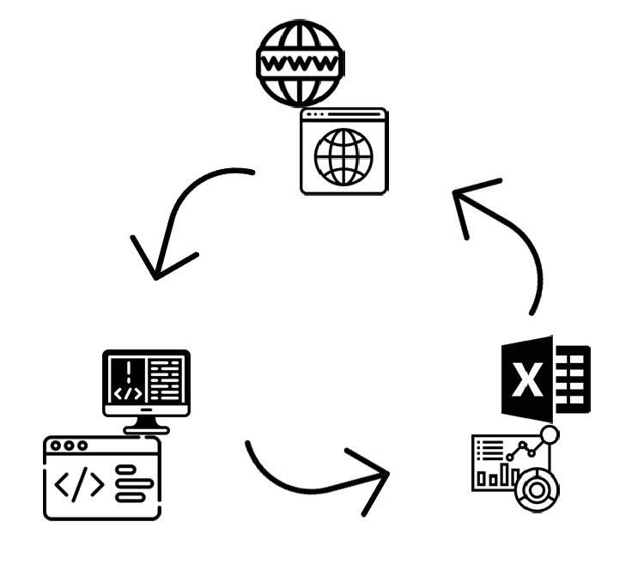
What is web scraping?
Hoang (Bill) Phan Pham
It is a technique to extract data form World Wide Web using a Hypertext Transfer Protocol and storing it to a local file in your computer or database table format [1].
Icons provided by https://www.flaticon.com/
Notes:
Web scraping is a powerful tool that allows to extract data from an online webpage and store it on a local machine in different forms.
Any data that is presented on a webpage can be scraped: starting from a header of the page to the video files that are shown.
The data can be then stored as a spreadsheet or with the same file type or anything you want really (Examples)

Slide 22


Why is it a powerful tool?
Hoang (Bill) Phan Pham
Web Scraping
Makes it easy to extract data
Extracts data faster
Better presents data
[2]
Icons provided by https://www.flaticon.com/
Notes:
Web scraping is a great tool that powers up your efficiency:
Instead of looking for each value on a page it can look for each type of value
It is automatic which increases the speed of extraction
Representation of data will be come easier to comprehend

Slide 23
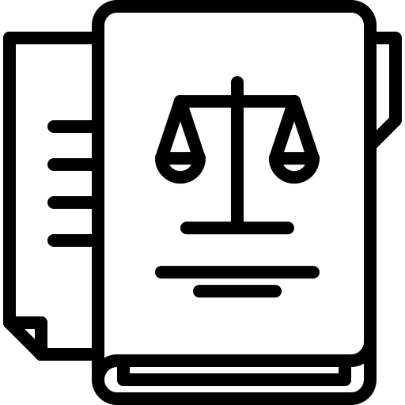
Is it legal to web scrape?
Hoang (Bill) Phan Pham
How web scrape is used:
Search Engines
Budgeting Apps
Journalism
Computer Fraud and Abuse Act:
Hacking is “Intentional access a computer without authorization or exceeds authorized access”
[1]
https://www.flaticon.com/
Notes:
Web scraping is publicly used:
Search engines are using scraping to understand if something you are looking for is present in a webpage
Budgeting apps scrape data from your bank and then presents it in a more comprehensive form for you to budget
Journalists use scraping to make online investigations and making reports to later easier to understand
Law and Web Scraping:
Web scraping as a tool is not hacking, since the webpage is in public domain everyone has authorization
However web scraping can touch other parts of the law depending on how a person is doing it.

Slide 24




How to know whether it is ok?
Hoang (Bill) Phan Pham
Things to consider before scraping:
Web-site content
”Terms of Use”
Sign-In credentials
Technical check:
robots.txt
[3]
Icons provided by https://www.flaticon.com/
Notes:
Even if it is not considered illegal, there are still things to consider before web scraping:
Content that is copyrighted or belongs to an intellectual property can not be commercially used
The term of use on a web page may prevent the ability to web scrape such page
Any web page that requires a sign in credentials is not supposed to be scraped under CFAA
In addition, the web page might have a robots.txt that may disallow certain parts of a web page to be accessed therefore scraped.
From removed Questions slide:
All in all web scraping is a powerful tool to extract data but one should now how and when it is ok to do it.
Are there any questions?

Slide 25
References
Hoang (Bill) Phan Pham
[1] Macapinlac, Tess, “The Legality of Web Scraping: A Proposal,” (Federal communications law journal 71.3, 2019) URL (11/2020)
[2] Guillaume Odier “11 reasons why you should use web scraping” (Captain Data, November 19, 2018) URL (11/2020)
[3] Mondaq Business Briefing, “Web Scraping – Legal Considerations,” (Gale OneFile: Business, September 30, 2020) URL (11/2020)

Slide 26
Shift to digital in the music industry
Samantha Gould

Slide 27
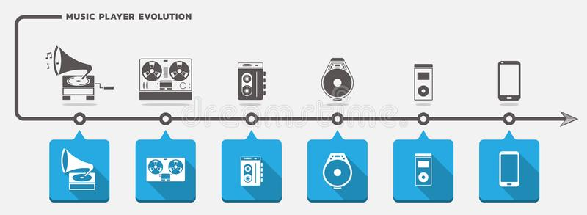
Technology to consider
Samantha Gould
Vinyl Records: 1948
Cassettes: 1963
CDs: 1982
MP3 format: 1993
  iTunes: 2001
Spotify: 2008 [8]
Music Player Evolution Vector, Kerdazz
Notes:
Vinyl, cassette: analog
CDs: remember 1982, that’s important on the next slide
Spotify: mentioned because it is the primary music subscription service

Slide 28
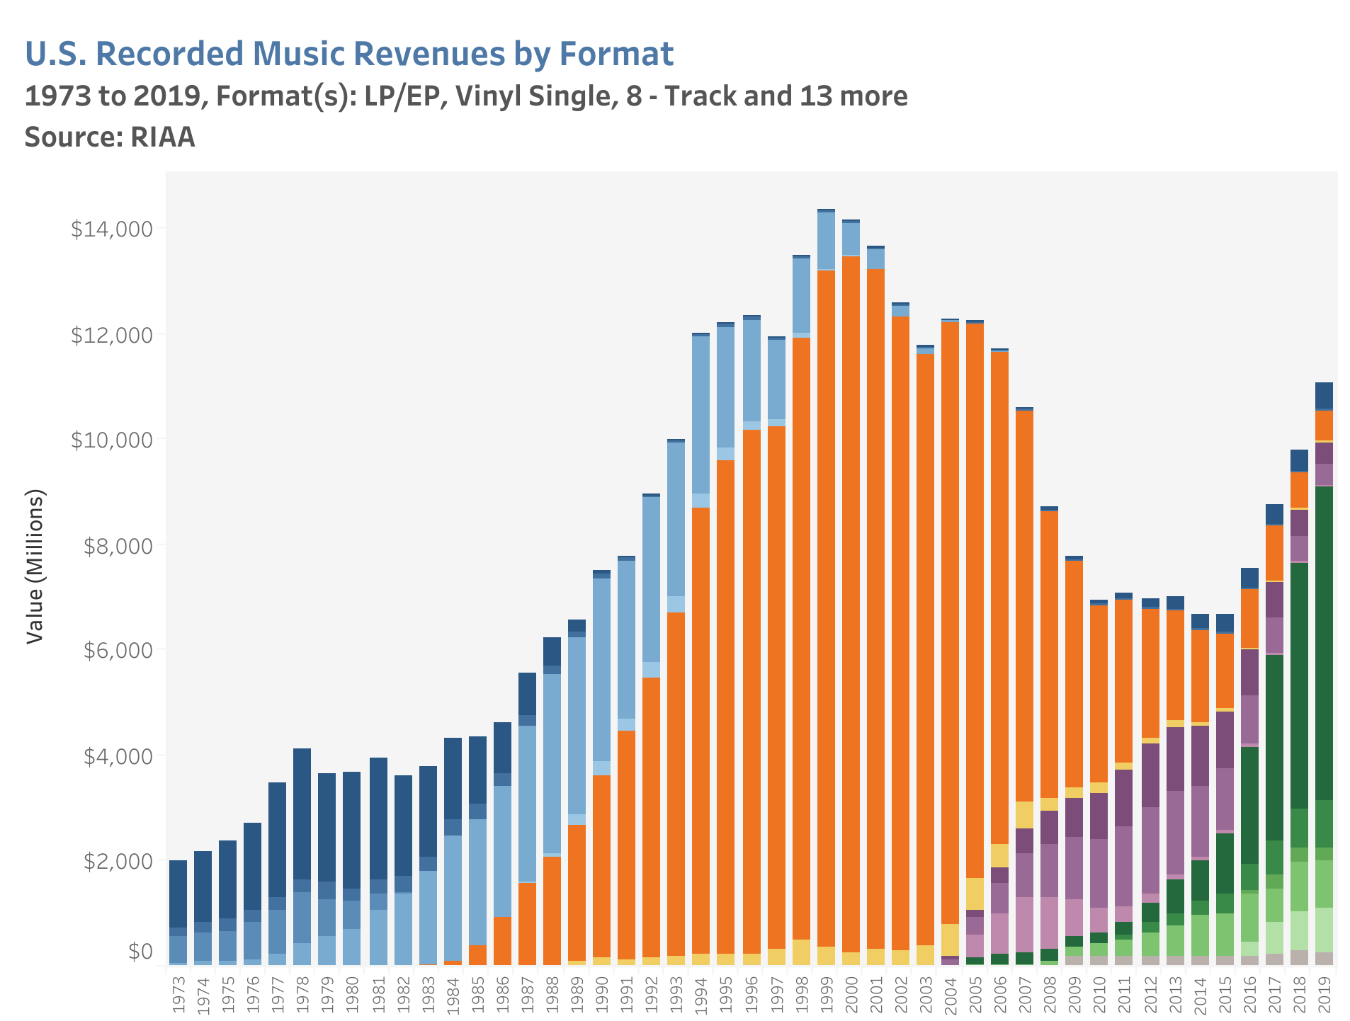
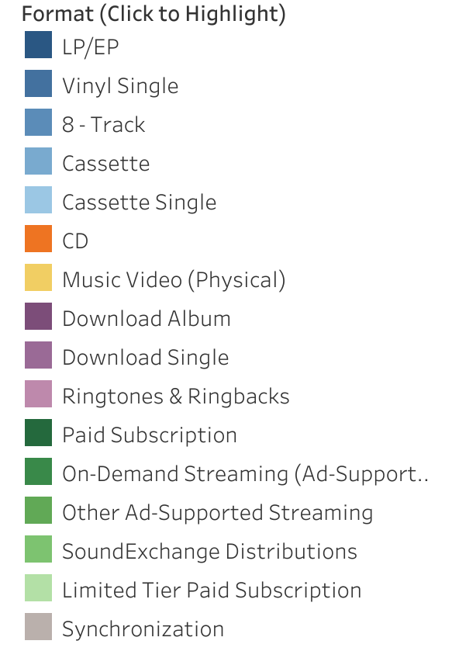
Music revenue over time
Samantha Gould
U.S Sales Database, RIAA
Notes:
This specific graphic is paired down to the most significant forms of music formats
CDs started in 1982, they’re orange
digital had a large positive effect on the music industry
Downward trend of sales attributed to pirating from MP3s (after 1993, 2001 (iTunes))
digital had a large negative effect on the music industry
Streaming starts before Spotify, but look at the market share
positive effect again
Notice that vinyl makes a comeback starting around 2008, in 2019 it was ~0.5 billion dollar market, that’s neat

Slide 29
Positives to music Streaming
Samantha Gould
Streaming promotes smaller artists [10]
Diversifies music taste
  Good for smaller artists
Increases music consumption
  No financial penalty for experimentation
Cheaper than purchasing music [1]
Personal Recommendations
  Spotify Daily Mixes
  YouTube recommendations [2]
Notes:
Streaming has a promotional effect on artists, people will stream their music and be encouraged to find more of their music and/or buy it
Diverse taste -> more room for the little guy
Consumer pro -> cheaper than buying every song/album
Personalization -> algorithms curate music tailored to our tasted (vs radio)

Slide 30
Neutrals to music Streaming
Samantha Gould
Shift from albums to songs
  Easy to purchase/stream specific songs
Playlist model
  Spotify Daily Mixes
  Individual songs from artists gain popularity through popular playlists
  Different listening experience
  Playlist curation similar to CD/album collecting [2]
Streaming charts have a large effect on music purchases [5]
  Comparable to radio
Notes:
Shift from albums to songs -> neutral because there are positives and negatives
Playlist model -> not a good or bad thing, just a very different thing
instead of albums, focus is on playlists
spotify at different times makes a listener put an album into a playlist to download it
playlist curation is comparable to CD/album curation
show off playlist collection instead of CD collection
Spotify/iTunes charts are now factored into radio charts, but also it acts as the new Top 40 or w/e

Slide 31
Negatives to music Streaming
Samantha Gould
Artists/Songwriters aren’t highly compensated
  Ex: Wake Me Up by Avicii on Pandora
    168 million streams
    Aloe Blacc, performer & songwriter received < $4,000 [6]
  Taylor Swift & Spotify disagreement
Ease of pirating
Loss of revenue due to reposting content
  Ex: lyric videos not posted by the publisher [10]
Notes:
Biggest complaint of streaming services: not well-comepensated
Example: Wake Me Up by Aviciii featuring Aloe Blacc
singer, writer on the track
Pandora: 168 million streams was worth less than $4,000
Example: does everyone remember how Taylor Swift pulled all of her music off of Spotify
she felt artists weren’t paid enough
Ease of pirating
as discussed in the textbook, digital is easy to pirate
Loss of revenue
this is very similar to pirating, but how many of us have watched not official youtube lyric videos for songs? Those are streams not going to the publisher/copyright holder so they lose money

Slide 32
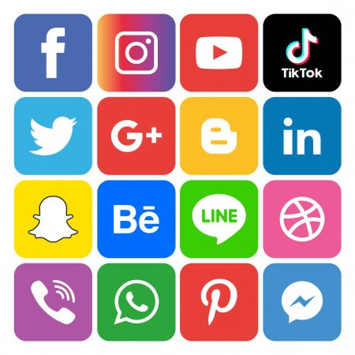
Social Media and music
Samantha Gould
Social Media can cause songs to go viral which leads to streams/purchases
  YouTube Music
TikTok has a large effect on popular music
  Mother Mother has received millions of streams from TikTok [7]
Social Media Icons Set Logo Vector, Amir Hassan
Notes:
Social Media has a large effect on music
YouTube Music -> what’s trending can make things have a larger audience
trending music videos get promoted, get more viewers, get trending higher, etc
TikTok especially
if you’re not aware, people make videos which can contain “audios” or 60s or less audio files that they can talk over/lipsync to
audios can trend and make videos more popular
songs that are popular “audios” on tiktok can get very popular
Dreams by Fleetwood Mac hit the charts recently because a TikTok went viral
My favorite example is Mother Mother, an indie band I like. Their songs became popular in videos with certain communities on the app, such as the LGBTQ+ community and as a result of the videos, their music from the early 2000s has received millions of streams

Slide 33
References
Samantha Gould
[1] Datta, Hannes, et al. “Changing Their Tune: How Consumers’ Adoption of Online Streaming Affects Music Consumption and Discovery.” Marketing Science (Providence, R.I.), vol. 37, no. 1, 2018, pp. 5–21., doi:10.1287/mksc.2017.1051.
[2] Hagen, Anja Nylund. “The Playlist Experience: Personal Playlists in Music Streaming Services.” Popular Music and Society, vol. 38, no. 5, 2015, pp. 625–645., doi:10.1080/03007766.2015.1021174.
[3] Hassan, Amir. “Social Media Icons Set Logo Vector.” Dreamstime, 19 Apr. 2019, www.dreamstime.com/tiktoc-image145329378.
[4] Kerdazz. “Music Player Evolution Vector.” Dreamstime, 12 Dec. 2017, www.dreamstime.com/vector-set-music-players-icons-time-scale-music-player-evolution-vector-set-image105744066.
[5] Lee, Minhyung, et al. “Can Digital Consumption Boost Physical Consumption? The Effect of Online Music Streaming on Record Sales.” Decision Support Systems, vol. 135, 2020, p. 113337., doi:10.1016/j.dss.2020.113337.
[6] Lewis, Frances. “Slipping through the Cracks: How Digital Music Streaming Cuts Corners on Artists' Royalty Revenues Globally.” Brooklyn Journal of International Law, vol. 43, no. 1, 2017, p. 297.
[7] Hissong, Samantha. “TikTok Is Giving a Niche Indie Band's 2008 Music Millions of New Streams.” Rolling Stone, Rolling Stone, 22 Oct. 2020, www.rollingstone.com/pro/news/mother-mother-viral-tiktok-charts-1079256/.
[8] Huismann, Mary, University of Minnesota. Audio Timeline, Yale University Library, 2006, web.library.yale.edu/cataloging/music/audiotimeline.
[9] Recording Industry Association of America. “U.S. Sales Database.” RIAA, 2020, www.riaa.com/u-s-sales-database/.
[10] Scott Hiller, R. “Sales Displacement and Streaming Music: Evidence from YouTube.” Information Economics and Policy, vol. 34, 2016, pp. 16–26., doi:10.1016/j.infoecopol.2015.12.002.

Slide 34
Can Artificial intelligence be an inventor?
Eri Kim
Notes:
Introduction
Hi everyone, I’m Eri and I will be answering this question, “Can AI be an Inventor?” in this presentation.

Slide 35
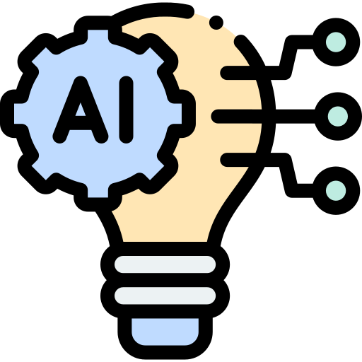
Artificial intelligence issues
Eri Kim
Patent Act
  Refers to persons as inventors
  Similarly, courts hold only natural persons as inventors
Does the patent extend to the technologies invented by AI?
Icon made by www.flaticon.com
Notes:
As you may have read in the textbook, a patent is a way the government provides an inventor with an exclusive right to intellectual property.
It promotes the progress of science and useful arts, by granting the inventors the exclusive right to their inventions.
Inventorship is an important concept in patent law. Inventors are those who contribute to the ingenuity that is necessary to create an invention. It has been considered that the terms "inventors" refer to human beings.
The Patent Act repeatedly refers to persons as inventors, and courts also have taken a similar approach, holding that only a natural person can be an inventor.
And recently, a question has raised about whether intellectual property protection extends to technologies invented by AI.

Slide 36

WHO is considered an inventor?
Eri Kim
DABUS (Device for the Autonomous Bootstrapping of Unified Sentience) =? Inventor
  DABUS had "identified the novelty of its own idea before a natural person did" [4].
  DABUS = Inventor
  Dr. Stephen Thaler = Owner
Decisions regarding DABUS
  United States Patent and Trademark Office (USPTO)
  European Patent Office (EPO)
  UK Intellectual Property Office (UKIPO)
Icon made by www.flaticon.com
Notes:
So, who is considered an inventor?
There was a recent case that is directly related to my topic. DABUS, which is an AI system developed by Dr. Thaler, came up with the innovations with the data that was given to it. It contributed to creating lights or food containers that Thaler has no expertise in that instead of listing a human author on the applications, the inventor was listed as DABUS AI in the patent application.
There have been several decisions on DABUS as an inventor and I will be reviewing each case to look into whether the AI can be an inventor or not.

Slide 37

WHO is considered an inventor?
Eri Kim
United States Patent and Trademark Office (USPTO)
  Patent inventors must be HUMAN
    “Accordingly, because the above-identified application names a machine, ‘[DABUS] (Invention generated by artificial intelligence),’ as the inventor, and because current statues, case law, and USPTO regulations and rules limit inventorship to natural persons, the above-identified application does not comply…” [2].
Image by https://www.commerce.gov/images/us-patent-and-trademark-office-uspto-logo
Notes:
USPTO ruled that the patent inventors must be human.
( more explanation )
Read the quote
USPTO regulations and rules limit the inventorship to natural persons that the application was rejected.

Slide 38




WHO is considered an inventor?
Eri Kim
“U.S. patent law does not permit a machine to be named as the inventor in a patent application” [2].
35 U.S.C. 115 similarly refers to individuals and uses pronouns specific to natural persons – “himself” or “herself”– …” [2].
Icons made by www.flaticon.com
Notes:
As mentioned before, the U.S. patent law does not permit the machine to be named as the inventor since it does not fall into the category of individuals where the pronouns of himself or herself can be used.

Slide 39

WHO is considered an inventor?
Eri Kim
European Patent Office (EPO)
  The name of the machine does not meet the requirements of Rule 19(1) EPC, which requires a family name, given names, and a full address of the inventor [3].
  Legislation would be required to create a legal personality for AI systems or machines because ”legislative history shows the the legislators of the EPC were in agreement that the term ‘inventor’ refers to a natural person only” [3].
  Internationally applicable standard
    “No national law has been determined which would [recognize] a thing, in particular an Al system or a machine, as an inventor” [3].
Image by https://www.epo.org/
Notes:
EPO has also stated that the name of the machine does not meet the requirements of having a family name, given name, and full address of the inventor.
( more explanation )
Read the quote
EPO said that it would be required to create a legal personality for AI systems or machines since the term inventor refers to a natural person only
In addition, it mentioned how this matter I internationally applicable standard since no national law recognized the AI as an inventor.

Slide 40
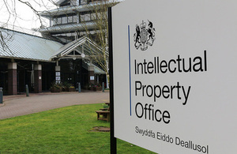
WHO is considered an inventor?
Eri Kim
UK Intellectual Property Office (UKIPO)
  Accepted that DABUS created the invention but noted that the application must be withdrawn because it is not a person that it cannot be considered an inventor [3].
  Noted that AI inventions are likely to be more prevalent that it is correct to debate this issue [3].
Image by https://www.gov.uk/government/news/intellectual-property-and-the-transition-period
Notes:
In UKIPO, it accepted that the DABUS created the invention, which differed from what USPTO ruled, but noted that the application must be withdrawn because it is not a person that it cannot be considered an inventor.
However, it mentioned how AI inventions are likely to be more prevalent that it is worth debating this issue.

Slide 41

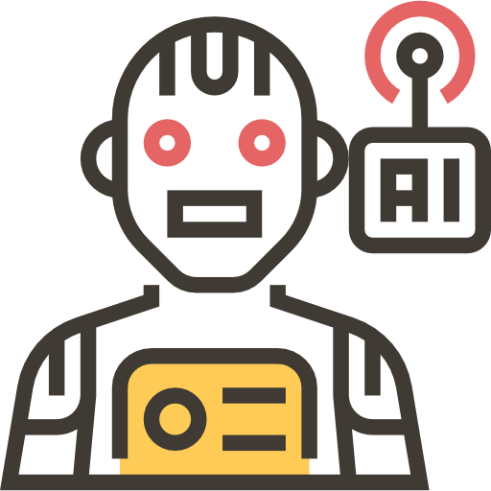
What do you think?
Eri Kim
Should AI own the patent?
  Nobody is arguing that the AI should own the patent. It’s common for the owner to be the company that employs the inventor.
    DABUS: Inventor
    Thaler: Owner
  Having a patent that covers a machine does not mean that the machine can be listed as an inventor in another patent application [3].
    “a patent for a camera allows the camera hold a copyright” [3].
  If AIs were inventors, they’d also have to be able to enter into contracts. They’d have to be able to authorize licenses and file lawsuits as well. They can do none of those things [5].
Icons made by www.flaticon.com
Notes:
What do you think? Should AI own the patent?
In previous cases that we covered, nobody is arguing that the AI should own the patent as DABUS was considered an inventor not an owner.
Also, DABUS being patented does not mean that it can be an inventor in other patent application. It is like allowing the camera to hold a copyright by granting the patent for a camera.
And if AI were inventors, they would have to enter into contracts and authorize licenses and file lawsuits, which currently they are incapable of.
But if humans cannot be listed as inventors because they were not directly involved, and the AI cannot be listed as an inventor either due to its not human being, then the invention may not be patentable at all.
This could be problematic that it could prevent companies from investing money in AI technologies. Although there may not be much social good to be gained by giving patent rights to the AI, it is worth considering whether the intellectual property law to acknowledge its contribution at least.

Slide 42
References
Eri Kim
[1] “The Ultimate Idea.” Imagination Engines, Inc., Home of the Creativity Machine, imagination-engines.com/iei_dabus.php.
[2] United States Patent and Trademark Office, 16524350_22apr2020, https://www.uspto.gov/sites/default/files/documents/16524350_22apr2020.pdf
[3] Tapscott, Rebecca. “USPTO Shoots Down DABUS' Bid For Inventorship.” IPWatchdog.com | Patents & Patent Law, 5 May 2020, www.ipwatchdog.com/2020/05/04/uspto-shoots-dabus-bid-inventorship/id=121284/.
[4] Ireland, Imogen, and Jason Lohr. “'DABUS': the AI Topic That Patent Lawyers Should Be Monitoring.” Managing Intellectual Property, Managing Intellectual Property, 15 Sept. 2020, www.managingip.com/article/b1n8q624s4vyv4/dabus-the-ai-topic-that-patent-lawyers-should-be-monitoring.
[5] Chen, Angela. “Can an AI Be an Inventor? Not Yet.” MIT Technology Review, MIT Technology Review, 2 Apr. 2020, www.technologyreview.com/2020/01/08/102298/ai-inventor-patent-dabus-intellectual-property-uk-european-patent-office-law/.

Slide 43
Class 5
The End
Keith A. Pray
socialimps.keithpray.net
Notes:
This is the end. Any slides beyond this point are for answering questions that may arise but not needed in the main talk. Some slides may also be unfinished and are not needed but kept just in case.

