Slide 1
Class 4
Freedom Of Speech
Keith A. Pray
socialimps.keithpray.net
Notes:
Here’s the title slide. Excited again, aren’t you? You should be.

Slide 2
what works well Online With Zoom
Sign in with First and Last Name
Stay muted unless you are going to speak
To speak use the raise your hand feature
To answer yes/no questions use the “yes” ”no” buttons
Turn your camera on
Wait until the end of student presentations to ask questions
  Write them down so you don’t forget

Slide 3
Overview
Review
Assignment
Students Present
Notes:
Show syllabus updates if any

Slide 4
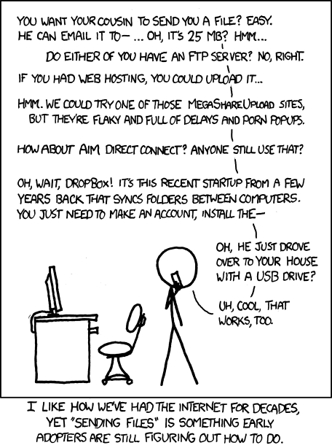
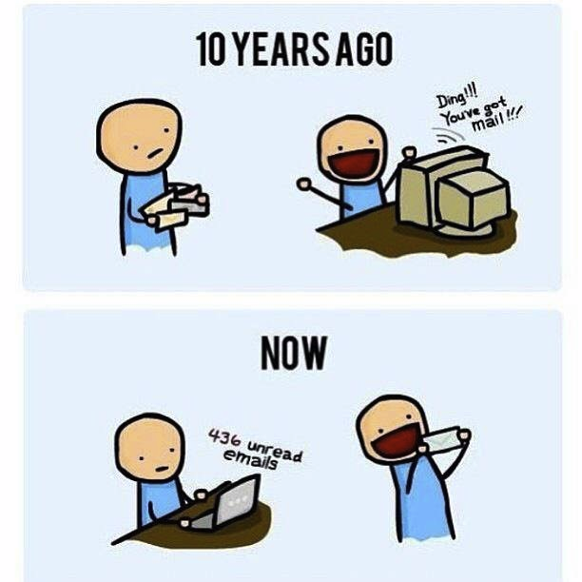
http://poofytoo.com/
25
http://xkcd.com/949/

Slide 5
My Reading Notes
pp. 110 What powers the cell phones and towers? “everyday tasks” not apparent from image.
pp. 114 Ann did not force people to complain.
pp. 117 7% # transactions or $$? Wikipedia critics source [19] from 2005, how has quality turned out? Nice to see darknet added.
pp. 118 [27] PC bangs youth source from 2003, all grown up now.
pp. 130 Is 20% realistic? What will search engines and facial recognition be capable of? Rule Utilitarian ignores the private setting.
pp. 131 Do any filters use image processing?
pp. 133 Stating people searching did not consent to material being blocked makes more sense.
pp. 134 Web access for no cost?
pp. 145 More accurate to say addicted to single app - good
pp. 149 20 same as 39
pp. 150 36 same as 42
End of Chapter questions I liked: 2, 25 http://en.wikipedia.org/wiki/Wikipedia:Citing_Wikipedia

Slide 6
Group Quiz
Name two methods some governments use to control access to information.
A large company has a policy prohibiting employees from blogging about company products.
  Name two possible reasons for the policy.
  Does it violate the First Amendment? Why?
  Is it reasonable? Why?
What does “URL” stand for and what is it?
Notes:
Censorship (religious, governmental, private). Adult authentication. Firewalls. Government owned media outlets.
First Amendment prohibits Congress from making laws limiting free speech, not private companies.
Uniform Resource Locator

Slide 7
Overview
Review
Assignment
Students Present
Notes:
But before that:
CPG Grey - This Video Will Make You Angry [Thought Germs] (7:25)
https://www.youtube.com/watch?v=rE3j_RHkqJc
If not shown yet:
What "Orwellian" really means - Noah Tavlin (5:31)
http://ed.ted.com/lessons/what-orwellian-really-means-noah-tavlin
Cedric Gervais - Hashtag (Original Mix) (3:58)
https://www.youtube.com/watch?v=6OmBKd7X7EE
Dave Audé vs Luciana - You Only Talk In #HASHTAG (3:36)
http://www.youtube.com/watch?v=53wIN87lJn0

Slide 8
Assignment
Reading
Individual Presentations
Extra Credit – One page paper
  Is WPI’s IT Acceptable Use Policy morally acceptable?
Work on your group project
  See full group project description on course website
  Send Web Site URL before next class
Notes:
- Or review group project and individual presentation guidelines right now.
Possible One page paper:
Global intellectual property laws, friends or foes?

Slide 9
Overview
Review
Assignment
Students Present

Slide 10
Starlink: Reaching for the stars
Ben Peters

Slide 11
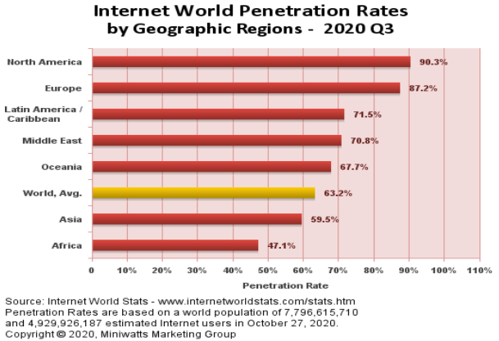
A world without internet
Ben Peters
36.8% of people do not have access to the internet [1]
  >2.75 Billion people not on the internet
  Largely in Africa and Asia
  Less Access to information and less representation
Only 90.3% within North America [1]
  Largely caused by lack of infrastructure and the expense of satellite
Internet World Stats
Notes:
While the world is more connected than ever a surprising number of people still don’t have access to the internet. In Q3 of 2020 more than 2.75 billion people still didn’t have access to the internet. The lack of access is caused by two main problems, the first is a lack of infrastructure in many rural areas as well as in developing countries. This infrastructure is expensive to build and maintain as well as taking significant resources in terms of manpower. The other main reason that these people don’t have access is because of the expense associated with a connection. Between installation costs and monthly subscription costs it simply isn’t feasible for many of these people.

Slide 12

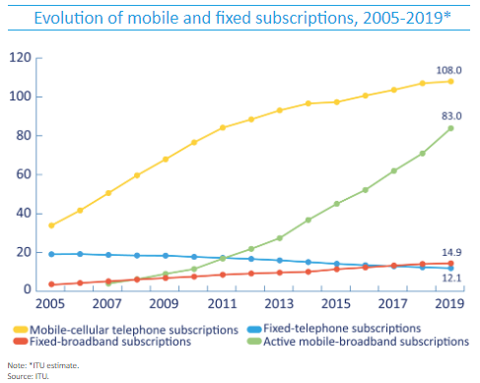
A desire to be connected
Ben Peters
Mobile internet is easiest
  Mobile-broadband subscriptions grew by 18.4% in 2019 [2]
  Even in developing countries the subscriptions are more than 75 per 100 people [2]
Wired Internet is more important than phone
  Developing Countries are prioritizing getting fixed-broadband over fixed-telephone [2]
  Least Developed Countries have twice as many fixed-broadband connections as fixed-telephone [2]
Subscriptions per 100 Inhabitants
International Telecommunication Union
Notes:
Despite not having access to the internet many of the people who are in developing countries still have a desire to be connected. Cellular data is one of the easiest and cheapest ways to get connected because it is wireless, so it requires less infrastructure and monthly subscriptions are generally cheaper. Because Starlink is also a wireless technology the only infrastructure needed is the antenna. In developing countries and least developed Countries there are up to twice as many wired internet connections compared to wired phone connections showing that they still want to be if it is affordable.

Slide 13
Internet without censorship
Ben Peters
No need to rely on existing infrastructure
  Only thing needed to establish a connection is an antenna
  Antenna does not need to be accurately aimed as it will self-orient [3]
  Runs on standard wall power so it can be run off batteries [3]
Governments can’t stop it
  With traditional networks companies needed permission to run cable and provide a connection
  Trying to jam the signal would be difficult or impossible everywhere and all the time [3]
  There is virtually no way to way to stop the satellites from transmitting
John Koetsier
Notes:
One of the great advantages of Starlink is that it requires nothing on the ground besides the antenna. This means that if you can get the terminal, a subscription, and power you will be able to connect to an open and free internet despite what the local government wants. The antenna is also extremely simple to setup only requiring to be roughly aimed at the sky and powered on. Governments could try and jam the signal, but it would be nearly impossible for them to jam the signal everywhere all the time giving an opportunity for oppressed people to gain access to the uncensored information.

Slide 14
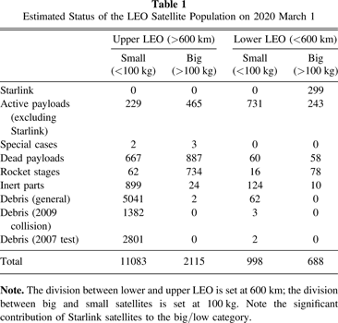
Crowding an already busy sky
Ben Peters
Satellites will obscure the sky
  During dusk and dawn satellites will be particularly noticeable[5]
  Astronomers are concerned about satellites obscuring their view [5]
Collision avoidance
  With more satellites in orbit more coordination is needed [4]
  Each maneuver shortens the lifespan of the satellites [4]
Jonathan C. McDowell
Notes:
As the number of satellites grows so does their impact. One of the largest impacts of satellites is the glair they produce. This glair can disrupt observations being made by sensitive equipment. Additionally, even if the satellites are completely dark their passing in front of this equipment can cause the data to be invalid. Another problem that more satellites has is that they need to avoid hitting each other. This process already takes lots of coordination between the owners of the satellite but when you introduce 40,000 more satellites you increase the number of issues. Even if the collision avoidance can be automated each time a satellite has to change it’s orbit it has to use a limited amount of propellent shortening its lifespan.

Slide 15

Can the visual impact be reduced
Ben Peters
Astronomers concern
  Worried that Starlink will make it harder to observe meteors near earth [5]
DARKSAT
  Coated a Starlink satellite coated to be less reflective [5]
  Significantly reduces the brightness
Other Solutions
  Sun visors are being investigated as an alternative solution [5]
Dr. Marco Langbroek
Notes:
SpaceX recognizes the concern from astronomers and is actively working on reducing the impact their satellites will have. They launched a satellite that was coated with dark paint to reduce the glair. This was nicknamed DARKSAT and it did work. It reduced the brightness by around 55% and made the satellite invisible to the naked eye but it was still bright enough to be picked up by sensitive equipment. Currently, SpaceX is looking into other solutions such as a sunshade that would completely alleviate the glair from the satellite.

Slide 16
References
Ben Peters
[1] World Internet Usage and Population Statistics 2020 Year-Q3 Estimates(Internet World Stats, 20 October 2020), https://www.internetworldstats.com/stats.htm (1 November 2020)
[2] Doreen Bogdan-Martin, Measuring digital development (International Telecommunication Union, 2019) https://www.itu.int/en/ITU-D/Statistics/Documents/facts/FactsFigures2019.pdf (1 November 2020)
[3] John Koetsier, Elon Musk’s 42,000 Starlink Satellites Could Just Save The World (Forbes, 9 January 2020), https://www.forbes.com/sites/johnkoetsier/2020/01/09/elon-musks-42000-starlink-satellites-could-just-save-the-world (1 November 2020)
[4] Jonathan C. McDowell, The Low Earth Orbit Satellite Population and Impacts of the SpaceX Starlink Constellation, (The Astrophysical Journal Letters, 6 April 2020), https://iopscience.iop.org/article/10.3847/2041-8213/ab8016 (1 November 2020)
[5] Loren Grush, The true impact of SpaceX’s Starlink constellation on astronomy is coming into focus ( The Verge, 24 March 2020), https://www.theverge.com/2020/3/24/21190273/spacex-starlink-satellite-internet-constellation-astronomy-coating (1 November 2020)

Slide 17
DEEP FAKES
Pheobe Yeung

Slide 18
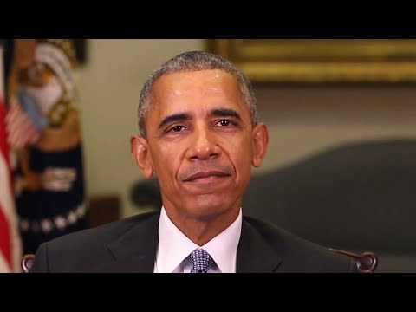
WHAT IS A DEEP FAKE?
Pheobe Yeung
“Manipulated videos or other digital reprsentations produced by AI” (Shao, 2019)
BuzzFeedVideo, 2018
Notes:
<speaker notes>

Slide 19
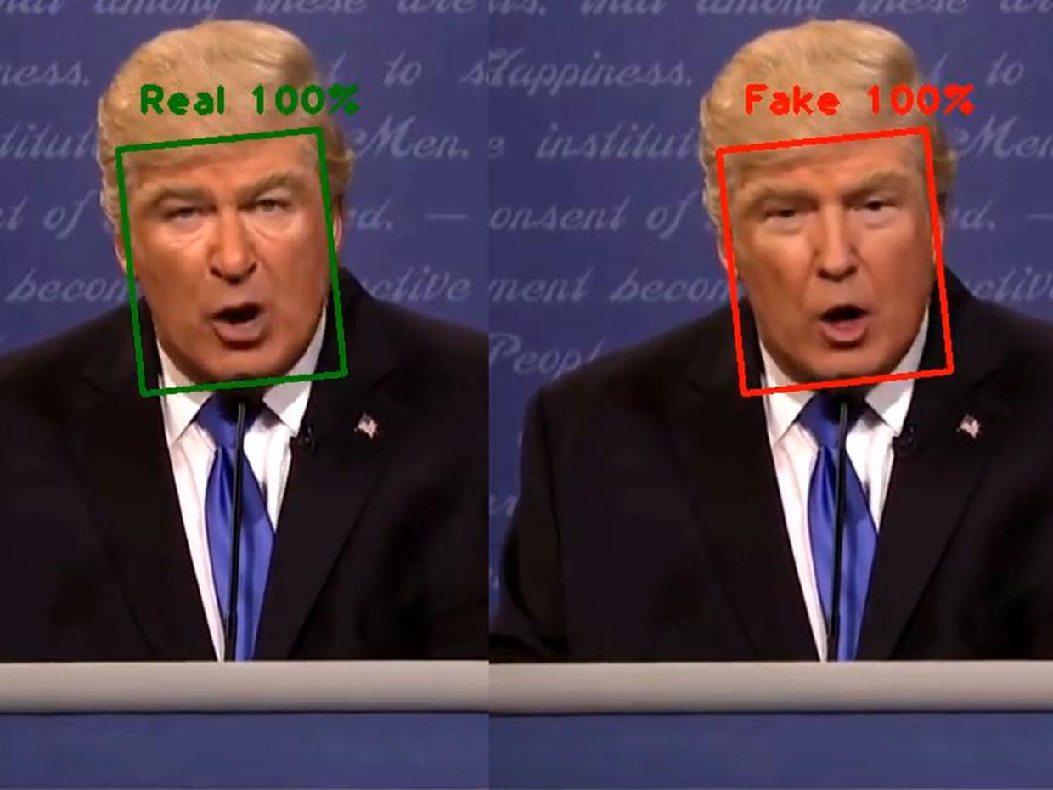
TECHNOLOGY
Pheobe Yeung
Ian Goodfellow developed the deepfake technology in 2014
Created with machine learning through deep network of auto encoders
Implemented by social media
IEEE, 2019
Notes:
<speaker notes>

Slide 20
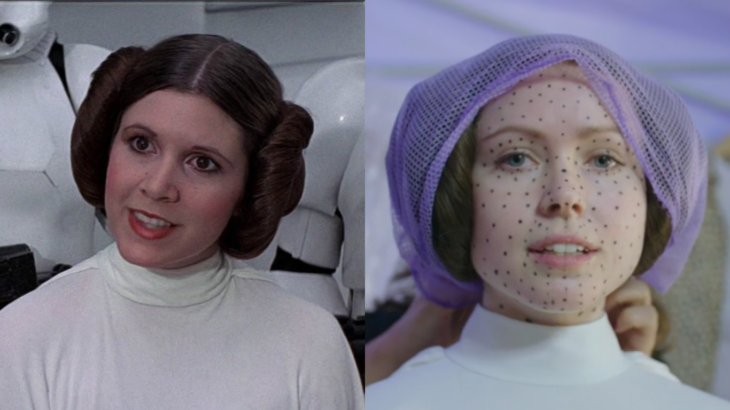
PROS
Pheobe Yeung
Recreate videos of those who have passed away
AI software advancement
Opens doors for graphic design within entertainment industry
Paige, 2017
Notes:
<speaker notes>

Slide 21
CONS
Pheobe Yeung
Non-consensual deep fake pornography
Growth of fake news sources
Financial scams
Difficult to regulate and control
Notes:
<speaker notes>

Slide 22
GOVERNMENT ACTIONS
Pheobe Yeung
DARPA is trying to get ahead of deep fake videos
National Defense Authorization Act:
  report on foreign weaponization
  requires notification of disinformation targeting elections
  competition to encourage research
Notes:
<speaker notes>

Slide 23
ARE DEEP FAKES GOOD OR BAD?
Pheobe Yeung
Used in medical field
Recreate historical events
Challenges society
Notes:
<speaker notes>

Slide 24
REFERENCES
Pheobe Yeung
[1] BuzzFeedVideo. 2018, April 17. You Won’t Believe What Obama Says In This Video! [Youtube]. https://www.youtube.com/watch?v=cQ54GDm1eL0&feature=emb_title&ab_channel=BuzzFeedVideo
[2] Brown, D. (2019, December 09). A more realistic Bitmoji? Snapchat is rolling out a tool called Cameo that uses deepfake technology. Retrieved from https://www.usatoday.com/story/tech/2019/12/08/snapchat-cameo-deepfake-tool-social-media-app/4376790002/
[3] Chandler, S. (2020, March 09). Why Deepfakes Are A Net Positive For Humanity. Retrieved from https://www.forbes.com/sites/simonchandler/2020/03/09/why-deepfakes-are-a-net-positive-for-humanity/?sh=49f525082f84
[4] Hale, W. (2019, December 24). First Federal Legislation on Deepfakes Signed Into Law. Retrieved from https://www.jdsupra.com/legalnews/first-federal-legislation-on-deepfakes-42346/
[5] Hsu, J. (2019, February 28). Can AI Detect Deepfakes To Help Ensure Integrity of U.S. 2020 Elections? Retrieved from https://spectrum.ieee.org/tech-talk/artificial-intelligence/machine-learning/will-deepfakes-detection-be-ready-for-2020
[6] Inside the Pentagon's race against deepfake videos. (n.d.). Retrieved from https://www.cnn.com/interactive/2019/01/business/pentagons-race-against-deepfakes/
[7] Rachel Paige Updated Mar 30, & Paige, R. (n.d.). Here's what the actress playing Princess Leia in "Rogue One" looked like *before* she became Princess Leia. Retrieved from https://hellogiggles.com/reviews-coverage/movies/princess-leia-rogue-one-behind-the-scenes/
[8] Walter, J. (2020, August 13). Deepfakes: The Dark Origins of Fake Videos and Their Potential to Wreak Havoc Online. Retrieved from https://www.discovermagazine.com/technology/deepfakes-the-dark-origins-of-fake-videos-and-their-potential-to-wreak-havoc
[9] Zhang, T., Deng, L., Zhang, L., & Dang, X. (2020). Deep Learning in Face Synthesis: A Survey on Deepfakes. 2020 IEEE 3rd International Conference on Computer and Communication Engineering Technology (CCET). doi:10.1109/ccet50901.2020.9213159

Slide 25
Are VIDEO Games Bad For Youth?
Kush Shah

Slide 26
IS THERE A RELATIONSHIP WITH PLAYING VIDEO GAMES AND POOR MENTAL HEALTH IN DEVELOPING BRAINS?
Kush Shah
Notes:
<speaker notes>

Slide 27
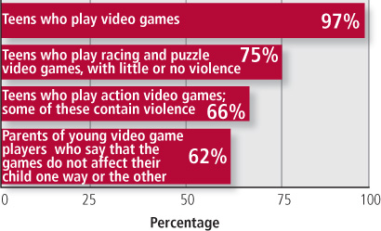
The argument for video games
Kush Shah
Researchers found that the main draw to violent video games was the competitive nature not the violence itself ¹
Games are used as an escape from boredom²
A survey conducting of 4 thousand students from CT³
Personal experience
Source: PEW Internet & American Life Project, September 2008.
Notes:
Although adults tend to view video games as isolating and antisocial, other studies found that most young respondents described the games as fun, exciting, something to counter boredom, and something to do with friends. For many youths, violent content is not the main draw. Boys in particular are motivated to play video games in order to compete and win. Seen in this context, use of violent video games may be similar to the type of rough-housing play that boys engage in as part of normal development. Video games offer one more outlet for the competition for status or to establish a pecking order. ACCORDING TO A PAPER FROM HARVARD MEDICAL SCHOOL TITLED VIOLENT VIDEO GAMES AND YOUNG PEOPLE FROM 2010
Although all reasons for playing video games were related to positive affect while playing, the strongest associations emerged for gamers who played because of the social relations, to stimulate their imagination, and for curiosity. It is interesting that, for gamers who played video games because of the storyline and for relaxation, there was a relation only to positive but not to negative affect while playing. ACCORDING TO A PAPER IN MEDICAL JOURNAL, FROUNTIERS IN PSYCOLOGY, ARCHIVED IN THE US NATIONAL LIBRARY OF MEDICINE AND NATIONAL INSTITUTES OF HEALTH TITLED, THE ASSOCIATION BETWEEN VIDEO GAMING AND PSYCHOLOGICAL FUNCTIONING FROM 2019
research challenges the popular belief that video game playing leads to exclusively negative outcomes for youth ACCORDING TO A 2011 ARTICLE FROM GREATER GOOD MAGAZINE TITLED ARE VIDEO GAMES TRULY BAD FOR KIDS HEALTH?
Over half reported playing for more than an hour a week. Roughly 5% reported they felt:
they have been unsuccessful at cutting back
have an irresistible urge to play
tension that is only relieved by playing
The three things that the researchers classified as problematic behaviors
I have used gaming as an escape when school gets stressful or to combat boredom. I personally play a few different types of games from fast pace 5v5 shooters to more relaxing card games or city building games. I also enjoy to occasional virtual reality game.

Slide 28

The argument against video games
Kush Shah
Common phrases associated with gaming culture
Self-esteem²
Performance in school²
Gender inequality / misogyny⁴
Addiction
Source: https://www.medicalnewstoday.com/articles/318345%23Video-games-and-brain-changes.
Notes:
“Video games are corrupting today’s youth!”
“Video games fry your brain!”
Toxic behavior leads to depreciated mental health
Lower self-esteem, lower life satisfaction, and, to a lesser extent, poorer perceived social support and lower self-efficacy went along with potentially problematic video game use. There was an association between fewer offline friends and acquaintances but more online connections with potentially problematic video gaming. Finally, poorer performance in school (i.e., higher grades) was related to the potentially problematic use of video games. These results suggest that potentially problematic video gaming goes along with poor psychological functioning and vice versa. ACCORDING TO A PAPER IN MEDICAL JOURNAL, FROUNTIERS IN PSYCOLOGY, ARCHIVED IN THE US NATIONAL LIBRARY OF MEDICINE AND NATIONAL INSTITUTES OF HEALTH TITLED, THE ASSOCIATION BETWEEN VIDEO GAMING AND PSYCHOLOGICAL FUNCTIONING FROM 2019
This is most prevalent as there are very few if any all-female pro esports teams after the failure of Siren an all-female League of Legends team. Unfortunately, the toxic gaming behavior extends to being sexist at all levels of play not just the professionals.
Games especially mobile games tend to focus on hooking players in order to serve them ads. Games like Candy Crush are infamous for this reason. There is a lot of thought put into the cognitive effects of game design and how to most effectively ‘hook’ the player. Free to play business models usually come with the pay to win caveat. Conditioning players to spend a few dollars to advance in the world they are so engaged in.

Slide 29
References
Kush Shah
[1] Claire McCarthy, Protecting children from the dangers of “virtual violence” ( Harvard Health Publishing, August 2nd 2016), https://www.health.harvard.edu/newsletter_article/violent-video-games-and-young-people (October 29th)
[2] Juliana M. von der Heiden, Beate Braun, Kai W. Müller, Boris Egloff, The association Between Video Gaming and Psychological Functioning, (Frontiers Media SA, July 26 2019) https://www.ncbi.nlm.nih.gov/pmc/articles/PMC6676913/(October 29th)
[3]Neha John-Henderson , Are Video Games Truly Bad for Kids Health?, (Greater Good Magazine, April 5th, 2011, https://greatergood.berkeley.edu/article/item/are_video_games_truly_bad_for_kids_health (October 29th)
[4] Daniel Fu, A Look at Gaming Culture and Gaming Related Problems: From a Gamer’s Perspective. http://smhp.psych.ucla.edu/pdfdocs/gaming.pdf (November 1st)
[5]Qi Ni, Yonghai Yu, Research on educational mobile games and the effect it has on the cognitive development of preschool children, (IEEE, 2015), https://ieeexplore.ieee.org/document/7054236 (November 2nd)

Slide 30
Class 4
The End
Keith A. Pray
Instructor
socialimps.keithpray.net
Notes:
Use remaining time to form groups, approve group topics, etc.
This is the end. Any slides beyond this point are for answering questions that may arise but not needed in the main talk. Some slides may also be unfinished and are not needed but kept just in case.

