Slide 1
Class 11 Work
Keith A. Pray
Instructor
socialimps.keithpray.net
Notes:
Styx - Mr. Roboto (1983) (5:34) https://www.youtube.com/watch?v=uc6f_2nPSX8
Here’s the title slide. Excited already, aren’t you?
Ask about Automation paper:
What did people choose to automate
Share 1 main reason

Slide 2
what works well Online With Zoom
Sign in with First and Last Name
Stay muted unless you are going to speak
To speak use the raise your hand feature
To answer yes/no questions use the “yes” ”no” buttons
Chat is fine for questions
Turn your camera on
Wait until the end of student presentations to ask questions
Write them down so you don’t forget
Others?

Slide 3
Papers
Read assignment
Use and cite supporting data from high quality sources
Argument should directly support conclusion
Response should directly address counter point
http://socialimps.keithpray.net/assignments/paper-guidelines/
Notes:
0s not included.
Save for next time:
Quantify
Do not use terms like: less, more, a lot, huge, great, big, tiny, growing, etc.
Make decisive conclusions
may, could, etc. = trivial
Absolute statements are difficult to prove
Avoid: all, always, any, every, everyone, never, none… unless you can show it
Be sure to put quotes around entire quote
Hyperbole is the best thing ever!
but not in these papers
Print 2 sided and save a tree
Use template, saves time (and -1 point)

Slide 4
Grades To Date
46 Max Possible

Slide 5
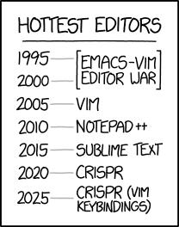
Overview
Review
Assignment
Students Present
https://www.xkcd.com/1823/
Notes:
Full circle.
CRISPR: Clustered Regularly Interspaced Short Palindromic Repeats
Allows permanent modification of genes within organisms.
Published 2017-04-12 according to https://www.explainxkcd.com/wiki/index.php/List_of_all_comics_(1501-2000)
Kickstarter Charter
https://www.kickstarter.com/charter?ref=about_subnav

Slide 6
Overview
Review
Assignment
Students Present
C lustered R egularly I nterspaced S hort P alindromic R epeats
Permanent gene modification
https://www.xkcd.com/1823/
Notes:
Full circle.
CRISPR: Clustered Regularly Interspaced Short Palindromic Repeats
Allows permanent modification of genes within organisms.
Published 2017-04-12 according to https://www.explainxkcd.com/wiki/index.php/List_of_all_comics_(1501-2000)
Kickstarter Charter
https://www.kickstarter.com/charter?ref=about_subnav

Slide 7
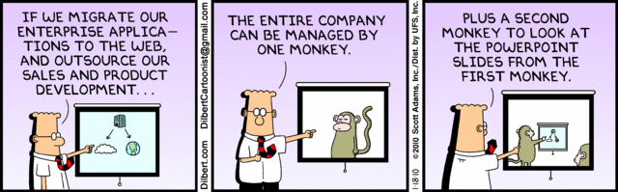
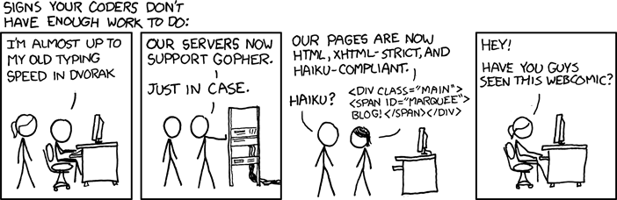
http://xkcd.com/554/
Notes:
Poll class:
Expected salary range upon graduation? Min, Max? Put on board.
Assume 40 hour work week.
How many people would work:
32 hours for 0.8 * Max? Put on board.
24 hours for 0.6 * Max? Put on board.
…continue until Min is reached.

Slide 8
Group Quiz
List 2 ways IT can lead to organizational change.
List 4 ways a Video Game Producer may protect its IP and what specific IP each protects.
List a computing technology that can be used to protect an individual’s privacy.
List a computing technology that can be used to intrude upon an individual’s privacy.
Notes:
Could split into groups of 4-5 for this.
Fill time with Work Discussion on Course Web Site

Slide 9
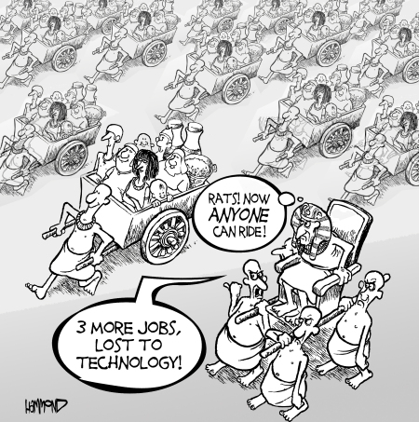
Overview
Review
Assignment
Students Present
©2009, MobileRobots Inc.
Notes:
Review Group Assignment Details.
Or first watch video: depends on student presentations, no thunder stealing.
CGP Grey
Humans Need Not Apply (15:00) – 2014-08-13
http://www.youtube.com/watch?v=7Pq-S557XQU
Last access 2016-04-22
These 3D printed homes can be constructed for $4,000 (3:00 – 2018-04-02)
http://www.businessinsider.com/3d-printed-homes-constructed-icon-new-story-tech-charity-4000-dollars-2018-3
https://www.youtube.com/watch?v=SvM7jFZGAec (1:28)
Last access 2018-04-22
Look at:
BBC Intelligent Machines
http://www.bbc.com/news/technology-33978561
BBC Likelihood of robot taking your job
http://www.bbc.com/news/technology-34066941

Slide 10
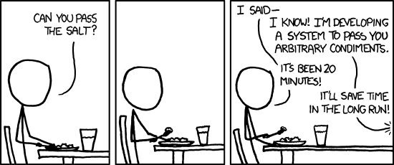
Overview
Review
Assignment
Students Present
https://xkcd.com/974/
Notes:
TODO: Replace with Alternate Turing Test

Slide 11
AI in Education
Ian Scott

Slide 12
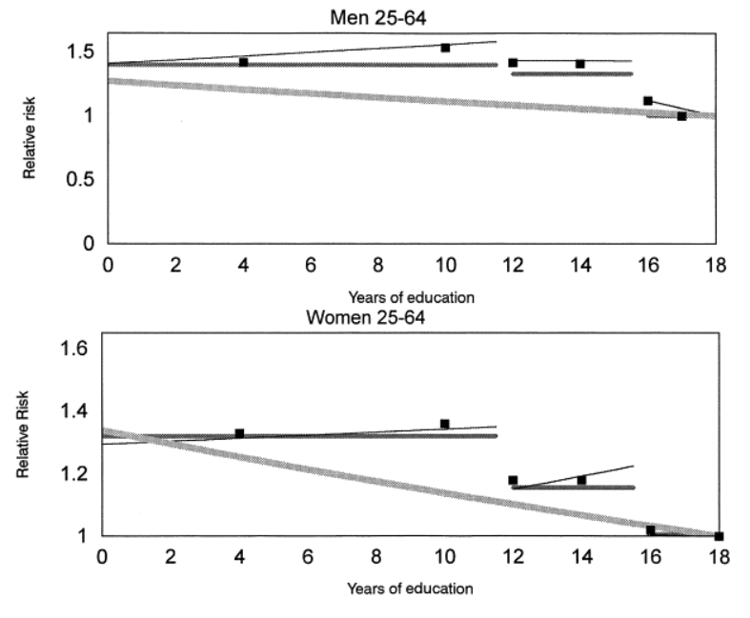
Background: education is one of the most crucial indicators of future health and wealth
Ian Scott
Education has been statistically linked to
mortality rate⁵
future income⁶
income distribution in a country⁶
<Graphic as big as will fit>
Risk of Mortality vs Years of Education⁵
Notes:
<speaker notes>

Slide 13
Argument: AI can and should be used to enhance current educational platforms
Ian Scott
Notes:
<speaker notes>

Slide 14
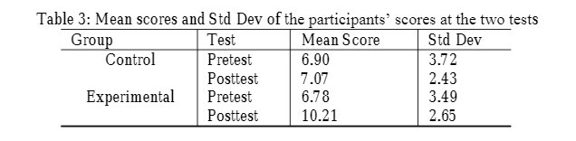
Current Examples - Quizlet
Ian Scott
A digital flashcards/ online learning tool that incorporates AI into its educational process
Shown to have significant effect on students ability to learn language
Score improvements due to quizlet²
Notes:
<speaker notes>

Slide 15
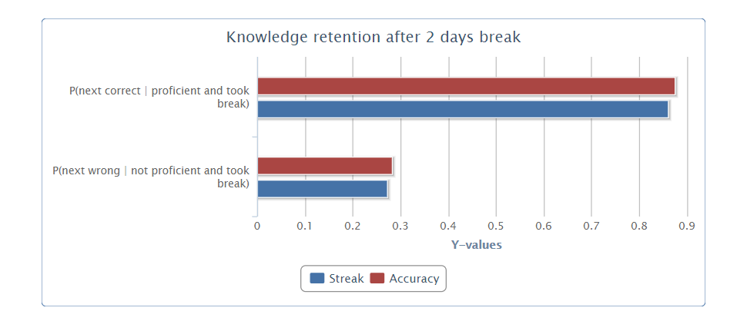
Current Examples - Khan Academy
Ian Scott
An online learning platform that has released thousands of free educational videos and tests on knowledge
Machine Learning outperformed other methods of predicting learning outcomes
Knowledge retention vs prediction method⁴
Notes:
<speaker notes>

Slide 16
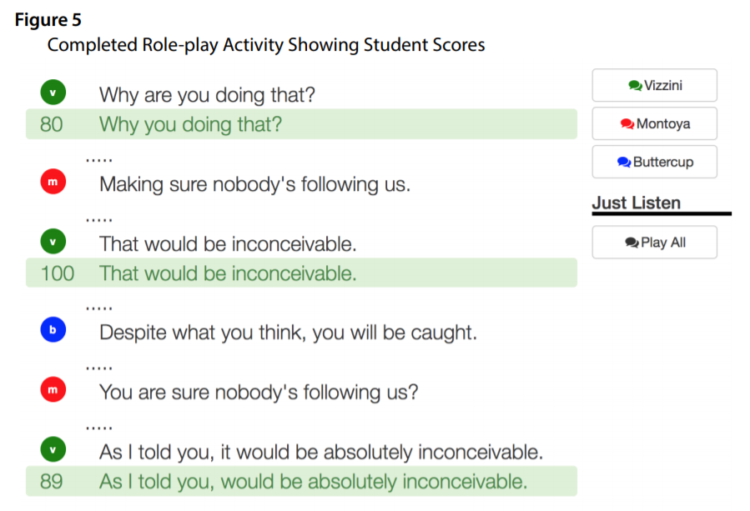
Research into different AIED applications is very promising
Ian Scott
Study with a small group of students found an 13% increase in language test scores after 30 min training with vocal recognition learning software.²
Dozens of companies pedaling AIED software⁷
Sample speech recognition in learning usage²
Notes:
<speaker notes>

Slide 17
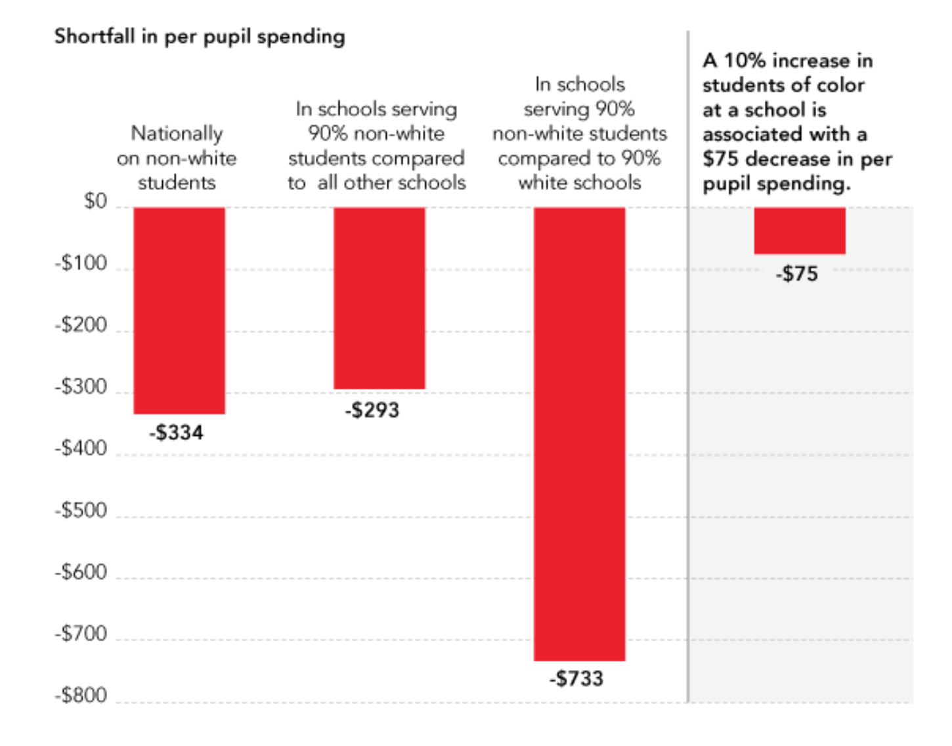
Why is this significant?
Ian Scott
AIED solutions offer far more affordable, scalable, high quality education to those who are failed by existing economic systems, helping to address educational, racial, economic, and health inequalities.¹
Current US spending discrepancies based on race⁸
Notes:
<speaker notes>

Slide 18
REFERENCES
Ian Scott
[1] Rose Luckin and Co., Intelligence Unleashed: An argument for AI in education (The Open University, 2016), http://oro.open.ac.uk/50104/1/Luckin%20et%20al.%20-%202016%20-%20Intelligence%20Unleashed.%20An%20argument%20for%20AI%20in%20Educ.pdf (10/5/2020)
[2] Abdulaziz Sanosi, The Effect of Quizlet on Vocabulary Acquisition (Asian Journal of Education and E-Learning, August 2018), https://www.researchgate.net/publication/327108959_The_Effect_of_Quizlet_on_Vocabulary_Acquisition (10/5/2020)
[3] Gary Ross and Co., Speaking with Your Computer: A New Way to Practice and Analyze Conversation (Japan Association for Language Teaching, 2019), https://d1wqtxts1xzle7.cloudfront.net/61970107/AI-and-Machine-Learning-in-Language-Education20200202-61217-w1qkn4.pdf?1580695941=&response-content-disposition=inline%3B+filename%3DAI_and_Machine_Learning_in_Language_Educ.pdf&Expires=1601921724&Signature=VQo6dRwFdlNkfdApNj5eBsF8LDZ1a2Q5KbNgubEjv-HjjFn8tQo1SIpSlV-sl95FWblDfB2WJIbbSfSwcWbIQ6rqKx9KyNUVu0gJHs~In-ZlPxH-ZBpAyPoV2kcjlkNp8R~N-urTHu3TQ5or0KEkoh1dqJi38DR8jhI1Z4kX592kxirGuGXWZ7VDfX2-QruLQZHsM0wTPXRXNcqBVF2yCQefzUtx7P3CB2ZMvuIJtHmOMcl7g8Sg6N0a0-BM6Ag1HPCzIitAsbkgRzU5JGs7g0x2jC2~WygqRqMw0BCeV14DQzYvZCOljgDdyD4dKuwg4WawmpA7AVRCRUxF2mT10A__&Key-Pair-Id=APKAJLOHF5GGSLRBV4ZA (10/5/2020)
[4] David Hu, How Khan Academy is Using Machine Learning to Assess Student Learning (davidhu.com, November 2011) http://david-hu.com/2011/11/02/how-khan-academy-is-using-machine-learning-to-assess-student-mastery.html (10/5/2020)
[5] Eric Backlund and Co., A comparison of the relationships of education and income with mortality: the national longitudanal mortality study (Social Science and Medicine, November 1999), https://www.sciencedirect.com/science/article/pii/S0277953699002099 (10/5/2020)
[6] Jose De Gregorio and Jong-Wha Lee, Education and Income Inequality: New Evidence From Cross-Country Data (Review of Income and Wealth, September 2002), https://onlinelibrary.wiley.com/doi/epdf/10.1111/1475-4991.00060?saml_referrer (10/5/2020)
[7] Alyssa Schroer, AI in Education: 12 companies using AI in education to enhance the classroom (Builtin.com, December 2018), https://builtin.com/artificial-intelligence/ai-in-education (10/3/2020) (This is just further reading into different companies with AIED products)
[8] Race in the Race (The Common Core), https://comcore.wordpress.com/minorities/race-in-the-race/ (10/5/2020)

Slide 19
WeChat Economy
Tianyang Gao
Notes:
Most people might have already heard WeChat because of trump. He is trying to ban it in US. What is WeChat? Many of you who might not know about it. It is an app like Facebook. Owned by Tencent Technology. (a company which involve in many industries like riot(league of legend), tesla, QQ, etc. By the 2nd quarter 2020, WeChat had 1206 millions of users all over the world. Fun fact, Many professors in New York University use WeChat. As the WeChat gets more diverse functions, it starts to involve to a WeChat economy?

Slide 20
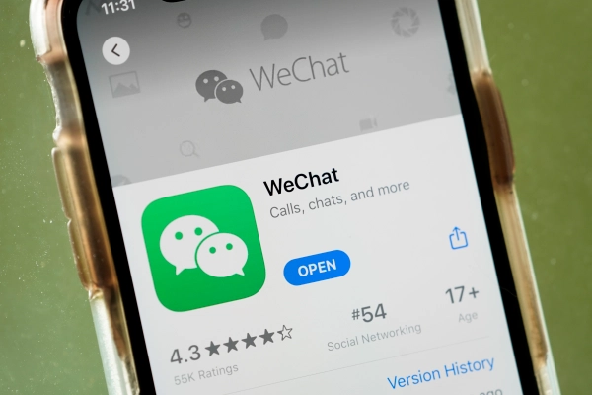
Tianyang Gao
WeChat Economy’s thriving is a double-edged sword
It helped the growth of China’s economy dramatically
But…
It caused the increase of illegal activities
[1]
Notes:
Wechat pay is part of wechat which was released by 2011, they started to build the economy by 2011. They were not just intending to create a chat app but also a lifestyle platform. As More an more people start to use wechat. In 2013, wechat business started to pop up.
However, it also caused the rise of online illegal activities.

Slide 21
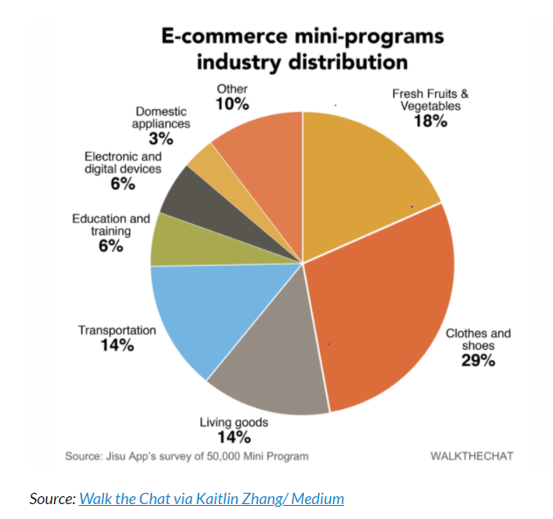
WeChat Business
Tianyang Gao
Increased 30.6 % of China GDP in 2016
72 million businesses registered to WeChat Pay in 2017
WeChat drove $50 billion into the Chinese Economy in 2017
1 billion(around 0.15 billion dollars) transaction in 2018
[2][9][11][12]
Notes:
So, the good side of the Wechat economy is wechat business. As we said, it started at 2013. It mainly formed by two parts.
600 millions of yuan was managed in Wechat bank.
It is also a lifestyle platform which has many mini programs such like Xicheng, douban, tianmao, etc.
Two type of businesses:
mini-program WeChat mini-programs are “sub-applications” within the WeChat system.
Official websites or bands
Public transportation
Living goods
Clothes
Educations
Loans
WeChat individual accounts
Countless
Tax-free
0.1% transaction fee (fifty thousand max per day) cheaper than bank 1%

Slide 22
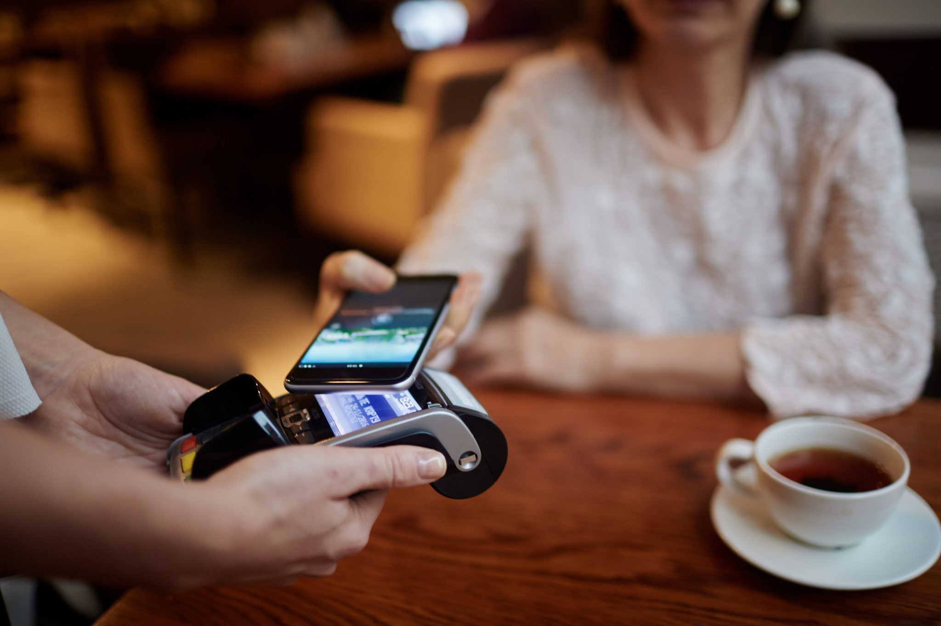
Illegal Industries
Tianyang Gao
400 billion USD fake products every year which is 86% of the global counterfeit industry
A 260 % increase of prostitution year on year(2014-2018)
50.8% growth rate on online scams every year from 2017 to 2019
[11][12][14]
Notes:
Three main issues: fake products, prostitutions, and online scams.
Among the 50.8%, 31.52% of online scams involved identify theft. And 17.67% was Internet fraud.
That’s because there was No protection for WeChat transactions and increasing hackers.

Slide 23

Personal experience
Tianyang Gao
[6]
Notes:
Someone hacked my WeChat account last year and texted my mom to transfer $5000 tuition for the global program. The hacker knew everything about me. My mom was fooled and she transferred the money the hacker’s account without even calling me. When she realized it, she called the police.
The police can not trace the money back at all. The money was withdrawn with 15 minutes at 3 different atm all over the China(Shanghai, Guangdong, and Fujian)

Slide 24
Solutions
Tianyang Gao
Law
New China’s e-commerce law, which took effect on January 1st 2019
Ban accounts
20 million accounts were banned in 2019
Police Force
Over 7000 prostitutes were arrested in 2018 in Dongguan, Guangdong Province
[9][10][13][14]
Notes:
Accounts
1.Each account has to link to a phone number which require an identity.
2.Any detected stolen identity, the account will be banned immediately.
3.Require face identification.
Law
1.China through heavier fines and places more responsibility on digital platform to remove sellers of fake goods, Fake-advertising,etc
2. Can be fined up to RMB 2 million(300 thousand)
Police force
1.Cybersecuirty department was developed
Many people might say that with the restrictions, the down side is much better. So, the wechat economcy is 100% good. However, it can not prevent those bad things 100%
They are still happening. Chinese government thinks it brings more benefits instead of flaws.
As a result, WeChat economy is indeed a double-edged sword. It totally depends how people handle it.
Any questions?

Slide 25
References
Tianyang Gao
[1]“Don't Lose Sight of the Proposed WeChat Ban.” Marketplace, www.marketplace.org/shows/marketplace-tech/dont-lose-sight-of-the-proposed-wechat-ban.
[2]https://chinahelp4u.com/wp-content/uploads/2020/04/Activate-WeChat-Pay.png
[3]Thomala, Published by Lai Lin, and Aug 20. “WeChat: Active Users Worldwide.” Statista, 20 Aug. 2020, www.statista.com/statistics/255778/number-of-active-wechat-messenger-accounts/.
[4]Graham, Jefferson. “What Is WeChat and Why Does President Trump Want to Ban It?” USA Today, Gannett Satellite Information Network, 7 Aug. 2020, www.usatoday.com/story/tech/2020/08/07/what-is-wechat-why-trump-wants-ban-tencent/3319217001/.
[5]“How WeChat Drives China's Economy with It's Business Features in 2018.” Digital Crew, 18 June 2018, www.digitalcrew.com.au/blogs-and-insights/how-wechat-turned-china-into-a-super-economy/.
[6]Charlesliu. “Beijing Metro Round-Up: WeChat Pay (Finally) Officially Accepted, and Free Phone Recharges.” The Beijinger, The Beijinger, 9 Aug. 2018, www.thebeijinger.com/blog/2018/08/08/beijing-metro-round-wechat-pay-officially-accepted-free-phone-recharges.…

Slide 26
References
Tianyang Gao
[8]“WeChat Revenue and Usage Statistics (2020).” Business of Apps, 30 July 2020, www.businessofapps.com/data/wechat-statistics/.
[9]创事记 . “微信之战：从微商裂变到独角兽的流量之争.” _手机新浪网, 25 Aug. 2019, tech.sina.cn/csj/2019-08-25/doc-ihytcitn1703000.d.html?vt=4&cid=38712.
[10]Team, CIW. “WeChat Total Daily Payment Transactions Exceeded 1 Billion in 2018.” China Internet Watch, 21 Mar. 2019, www.chinainternetwatch.com/28775/wechat-pay-2018/.
[11]“Chinese Scammers Use WeChat More Than Any Other App to Conduct Online Fraud, Report Shows.” Caixin Global - Latest Business and Financial News on China, U.S. Trade War and Negotiations, Breaking News, Headlines and Developments, www.caixinglobal.com/2019-11-20/chinese-scammers-use-wechat-more-than-any-other-app-to-conduct-online-fraud-report-shows-101485342.html.
[12]Allison. “Behind the Counterfeit Goods Industry in Modern China: Daxue Consulting.” Daxue Consulting – Market Research China, 23 June 2020, daxueconsulting.com/counterfeit-products-in-china/.
[13]Times, Global. “Sex Workers Pose as Models, Actresses and Advertise on WeChat.” Global Times, www.globaltimes.cn/content/921051.

Slide 27
Half Life of Computing Technology and its impact on the future
Philip Rago

Slide 28
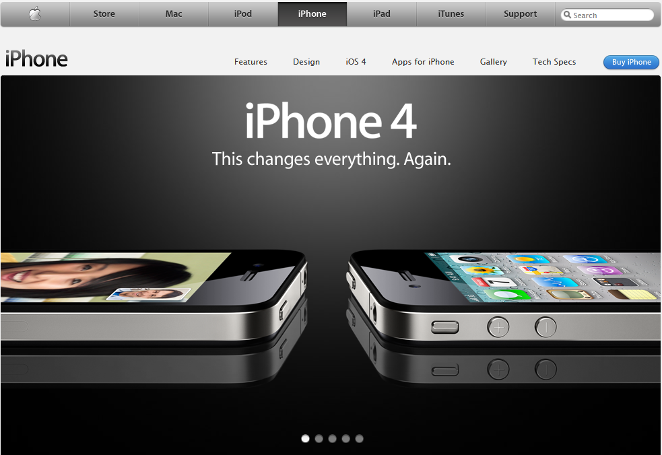
Remember this?
Philip Rago
16 or 32 GB Storage
1Ghz Processor
$199 - 299
I Phone 11
6 Core Processor
$699 - 1449
[1, 8]
Notes:
Believe it or not the Iphone 4 was unveiled mid 2010 and released fall of 2011.
Hearing the price today almost sounds made up.
All 6 cores in the I phone 11 have at least double the processing power as the Iphone 4
Most of you are probably familiar with Moore's Law which explains that the transistors per microprocessor will roughly double every 2 years
The law has held true since 1965, we are currently at around 54 Billion transistors

Slide 29
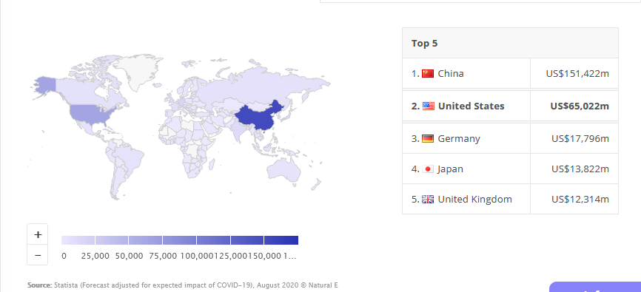
Consumer Electronics Trends
Philip Rago
$375,000 m total in revenue (2020)
[3, 7]
Notes:
As you can see here, China and the US have a huge lead on other nations
China has pop of 1.433 Billion
US has pop of 330 Million
Less than ¼ but our revenue is 40% that of China

Slide 30
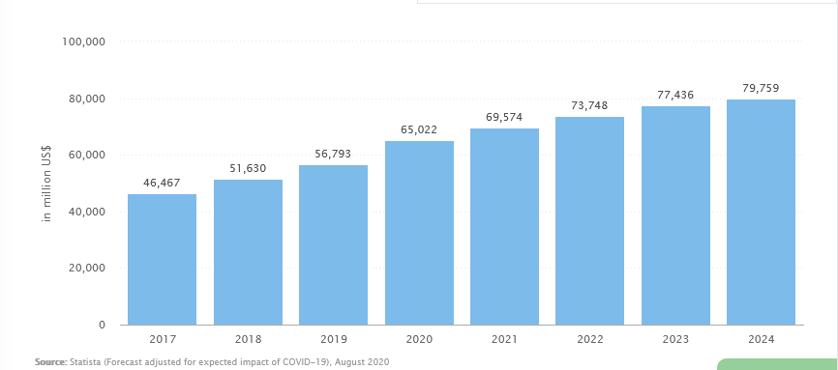
Consumer Electronics Trends
Philip Rago
16.6% growth worldwide, 15% in US
US Consumer Electronics Revenue (millions)
[3]
Notes:
As you can see revenue on consumer electronics is only increasing.
At an impressive rate of 16.6% worldwide and almost more surprisingly a solid 15% in the US.
This is of note because the US is established in electronics and rates like that are generally seen in developing countries.

Slide 31
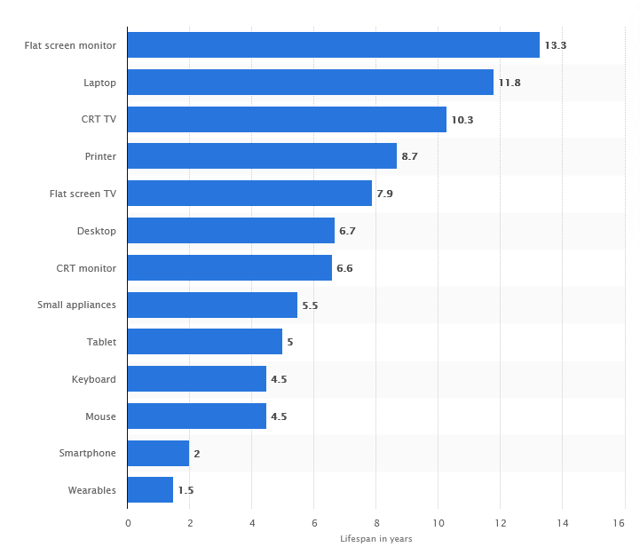
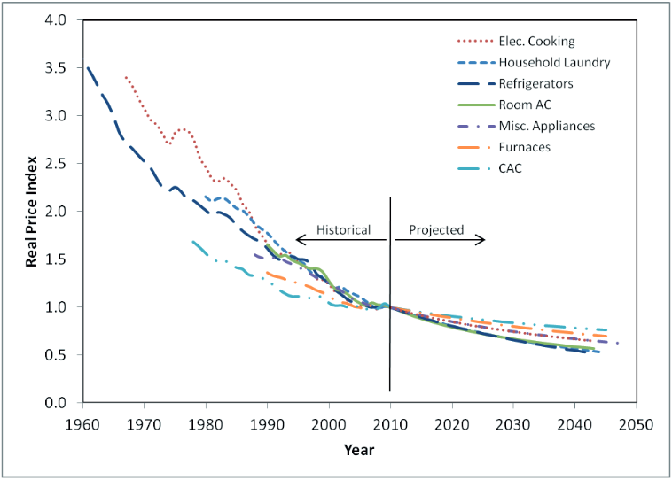
Philip Rago
Lifespan of Tech (2015)
Real Price of Electronics
[5,4]
Notes:
You might think that it makes sense that electronics revenue is going up, but in fact prices for electronics are going down.
Smartphones are a special case, due to the extremely prevalent place phones have taken in our lives people are willing to pay more and more for phones that have premium features. That’s why Apple and Samsung keep pushing the bubble and releasing phones that cost upwards of 2k
If the real value of electronics is going down and the revenue on electronics is going up that leads us to believe that there must simply be growth in consumption.

Slide 32
49.2 Million tons of e-Waste (2016)
Philip Rago
7 million tons from the US…
That’s 42 Pounds of E-Waste per capita in the US…
There is no national regulation on E Waste…
15 States still lack regulation
[2, 6]
Notes:
Basel Convention on hazardous waste, 186 signatories, US is the only developed nation not to ratify it, 15 US states still have no E Waste disposal system
Less than 20% of the waste from the US is Recycled
While over 35% from the EU is
Materials in Waste are worth over 60 B
On top of this all, Most E Waste is exported out of the US to less developed countries and only represents 2% of waste in Landfills here.

Slide 33
References
Philip Rago
[1] Apple. (n.d.). Retrieved October 05, 2020, from https://www.apple.com/
[2] Balde, Cornelis P., Wang, Feng, Kuehr, Ruediger and Huisman, Jaco, The Global E-waste Monitor 2014: Quantities, flows and resources, (Tokyo & Bonn: United Nations University, 2015).
[3] Consumer Electronics - United States: Statista Market Forecast. (2020, August). Retrieved October 05, 2020, from https://www.statista.com/outlook/251/109/consumer-electronics/united-states
[4] Department, P., & 30, M. (2016, May 30). Consumer electronics/tech device lifespan 2015. Retrieved October 05, 2020, from https://www.statista.com/statistics/688455/consumer-electronics- tech-device-average-lifespan/
[5] Desroches, L. (2013, Summer). Trends in the cost of efficiency for appliances and consumer electronics [Scholarly project]. In ECEEEE. Retrieved October 05, 2020, from ECEEE.com
[6] Larmer, B. (2018, July 05). E-Waste Offers an Economic Opportunity as Well as Toxicity. Retrieved October 05, 2020, from https://www.nytimes.com/2018/07/05/magazine/e-waste-offers-an- economic-opportunity-as-well-as-toxicity.html
[7] Population Comparison: China, EU, USA, and Japan. (2019). Retrieved October 05, 2020, from https://www.worldometers.info/population/china-eu-usa-japan-comparison/
[8] Wikipedia. (2020, September 21). Moore's law. Retrieved October 05, 2020, from https://en.wikipedia.org/wiki/Moore's_law

Slide 34
Class 11 The End
Keith A. Pray
Instructor
socialimps.keithpray.net
Notes:
If there’s time and we didn’t get to it:
Kickstarter Charter
https://www.kickstarter.com/charter?ref=about_subnav
CGP Grey
Humans Need Not Apply (15:00) – 2014-08-13
http://www.youtube.com/watch?v=7Pq-S557XQU
Last access 2016-04-22
These 3D printed homes can be constructed for $4,000 (3:00 – 2018-04-02)
http://www.businessinsider.com/3d-printed-homes-constructed-icon-new-story-tech-charity-4000-dollars-2018-3
https://www.youtube.com/watch?v=SvM7jFZGAec (1:28)
Last access 2018-04-22
Look at:
BBC Intelligent Machines
http://www.bbc.com/news/technology-33978561
BBC Likelihood of robot taking your job
http://www.bbc.com/news/technology-34066941
This is the end. Any slides beyond this point are for answering questions that may arise but not needed in the main talk. Some slides may also be unfinished and are not needed but kept just in case.

