Slide 1
Class 10
Professional Ethics
Keith A. Pray
Instructor
socialimps.keithpray.net
Notes:
Here’s the title slide. Excited already, aren’t you? You may not be depending on how you enjoyed the last class.

Slide 2
what works well Online With Zoom
Sign in with First and Last Name
Stay muted unless you are going to speak
To speak use the raise your hand feature
To answer yes/no questions use the “yes” ”no” buttons
Chat is fine for questions
Turn your camera on
Wait until the end of student presentations to ask questions
  Write them down so you don’t forget
Others?

Slide 3
Overview
Review
Debate
Assignment
Students Present
Notes:
ADD QUIZ AS BACKUP IF CLASS DISCUSSION NOT LONG ENOUGH

Slide 4
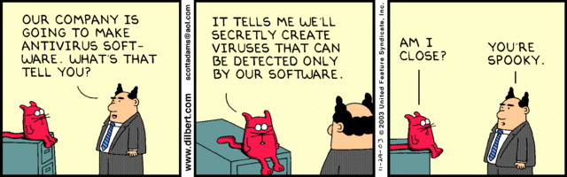
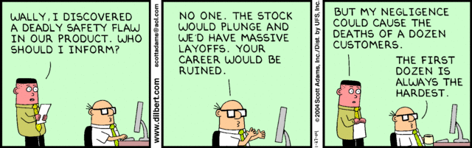
Notes:
Ask how many people in ACM or IEEE

Slide 5
Debate Ground Rules
Before Debate
  Add “(YES)” or “(NO)” to the end of your name in Zoom to show your side
  10 minutes to converse with your team
  Share argument points, counter points, and responses
  Share experiences in different countries, web sites, access points
  Decide who will: Go first, Respond to which points from opposing side
During Debate
  1 turn per person until everyone on your team has spoken
  Try to keep remarks to 30 seconds
  Switch sides at any time if you change your mind
Notes:
Release Game or Not Debate
Chapter 9 In-class Exercises # 24.
Should the company produce the game?
Use the SWE Code Of Ethics as the basis for your argument.

Slide 6
My Reading Notes
pp. 409 Can one perform services for one’s self?
pp. 412 1993-1999 Does this seem like a long time?
pp. 413 “errors of omission or commission”?
UPDATE
pp. 422 3. Would people agree – social contract?
pp. 438 So the baby can be left outside and no one is responsible?
Notes:
An error of commission is one where the person responds where they should not. This is compared to an error of omission, where the person fails to respond when they should.

Slide 7
Assignment
1 Page Paper
  What should computerized automation be applied to next?
Finish all reading
Group Project
  Add analysis to website addressing all topics covered to date
  Group Presentation Draft
    Submit as Power Point on Canvas
    Post Power Point file on group website
Notes:
1 Page Paper Ideas:
For Good - How will you use your computing related education to do good in the world?
Dark Net - Is the Dark Net good or bad?
Does computerized automation help the economy or society?
What should computerized automated be applied to next?
If productivity has increased so much, why are we working so hard? Should we?
What job skills will survive computerized automation?

Slide 8
Overview
Review
Debate
Assignment
Students Present
Notes:
Show WPI and/or corporate code of ethics.

Slide 9
Causes and implications OF Bias in NLP
to identify and categorize entities
Olajumoke Jackson
Notes:
Hi, I’m Olajumoke Jackson and this is my presentation going over the causes and implications of bias in natural language processing or NLP.

Slide 10
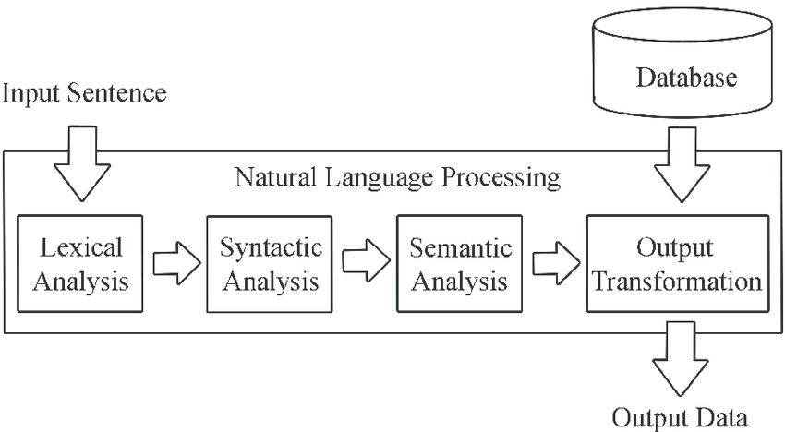
What is NLP (Natural Language Processing)?
Olajumoke Jackson
Definition: The conversion of human language into data that is easy for a computer to manipulate. [1]
Six Tasks of NLP:
  Part-Of-Speech Tagging (POS)
  Chunking
  Named Entity Recognition (NER)
  Semantic Role Labeling
  Language Models
  Semantically Related Words
<[1]>
Notes:
So what is Natural language processing? Natural language processing works on converting language into computable data that can be easily extracted for information. The diagram on the slide shows the process in which phases are evaluated by what words they use, what structure phrases are constructed, and their meaning in the overall text. All three steps produce easy to compute data (words/numbers) that can be compiled to produce analysis or it can be used to a corpus for machine learning. Additional tasks include:
Part-Of-Speech Tagging, the act of breaking down the grammatical construction of a sentence.
Chunking, creating phrases from an unstructured body of text
Named Entity Recognition (NER), locating and classifying entities in unstructured text
Language Models, using probability to predict the sequence or the occurrence of words.
Semantically Related Words, grouping words that are conceptually related to one another.

Slide 11
WHAT IS BIAS AND WHAT DOES IT LOOK LIKE?
Olajumoke Jackson
Statistical bias: Differences between the estimator’s expected value and true value due to failure within the sample or methodology.
Societal bias: Differences between the expectations espoused in a society and the reality of the people who inhabit it.
What happens when our statistical conclusions does not match the lived experiences of people in our society?
What if our datasets are representative of the dominant narratives in our society?
<[1]>
Notes:
But this presentation is not about the development of NLP but the significance it has on our society. In order understand that we need to understand what bias is and the big question everybody is thinking about.
There are two ways to approach bias in natural language processing: statistically and socially. Statistically, a computer program can produce bias if the expected value deviates from the estimated value. This can be accounted towards sample bias or methodology error, the latter being far easier to fix. Socially, bias or discrimination is the reality that you live a life that does not align with the rules/or values of that society. This can be account towards laws and how their enforced, or how power is distributed in a society.
This brings us to the big question everyone was asking: What happens when our statistical conclusions does not match the lived experiences of people in our society, and how do we fix it? However, in the last couple of years, the question has shifted to “what if our datasets are representative of the dominant narratives in our society”? That is a lot harder to fix and brings up interesting questions.

Slide 12
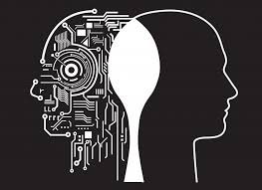
WHY Should I Care about this?
Olajumoke Jackson
Citigroup is responsible for America losing 16 trillion dollars which was caused by discrimination towards African Americans. [2]
Perceived discrimination from healthcare provider is responsible for higher unmet needs and poorer health among marginalized groups. [3]
<Graphic as big as will fit>
<[2], [3]>
Notes:
Before I talk about how this bias appears, I want to show you why you should care. Why there is a big hoopla around this issue? As our society becomes more reliant on data to optimize and influence our lives, we need to start thinking the potential risks a society that does not care about discrimination in their data are open to.
Financially, you run the risk of excluding groups of people from contributing to the economy. Recently, Citigroup was found responsible for America losing 16 trillion dollars which was caused by discrimination towards African Americans. Healthwise, perceived discrimination from healthcare provider is responsible for higher unmet needs and poorer health among marginalized groups.
Imagine all of these incidents happening at state-level, national-level issues. We don’t have to because we’re slowly seeing a world were world leaders are making massive decisions on a single number. If we don’t ask these questions now, when the risk is fairly low, we will have to deal with the consequences when the stakes are high.

Slide 13
Case 1: FAILURE OF Supervised DATASETS
Olajumoke Jackson
MISTAKES MADE:
Laziness
&
Lack of Forethought
CONLL-2003 is an open source dataset used to help machine learning datasets learn to identify and categorize entities in text.
PROBLEM: that dataset was built to more male names than female names, around 5x more [4].
RESULT: It becomes harder to find women in search engines, address books, etc. than it is for men.
<[4]>
Notes:
The first case is a failure of supervised datasets. Recently, it was discovered that CONLL-2003, one of the most widely used datasets to identify and categorize entities , has a bias favoring male names over female names. Many have speculated that effects of this bias is responsible for women losing opportunities because their names were harder to show up on search engines and the such.
Why did this happen? According to the team who made the dataset, they blame laziness and a lack of foresight. First, they blame laziness because they partially blame companies for using such an old dataset made in 2003 in their machine learning programs in present day. Using old data puts people at risk for having gaps in their conclusions. Additionally, they never foresaw the extensive use on their dataset. They grind and cram to produce the dataset for a conference and didn’t think about the implications until they received word of bias.

Slide 14
Case 2: FAILURE IN SOCEITAL NORMS
Olajumoke Jackson
MISTAKES MADE:
Power Imbalances
&
Financial Incentive
Verus is a monitoring system that downloads, analyzes, and transcribes phone calls among prison inmates.
PROBLEM: It is recently expanded to being used to track calls mentioning COVID-19, believed to be used to expand control over prisoners.
RESULT: Dorm-wide lockdowns or forced solitary confinement [5]. Accused of charging high rates for phones and listening to attorney-client phone calls[6].
<[5], [6]>
Notes:
The second case is a failure in societal norms. Verus is a monitoring system that downloads and transcribes phone calls of prison inmates. It was originally used to reduce suicides but has expanded to deal with drug deals and other illegal activity in prison. Right now, it being used to track calls mentioning COVID-19 to track the spread of the disease. However, many believe this is just a tool to control the prisoners even more. There have been many reports of prisoners with coronavirus being thrown in solitary confinement, dorms being locked down, and still not receiving adequate care.
The mistakes made here were power imbalances and financial incentive. Technology is not value-free because as long as we live within a society what values get enforced is what will translate into our technology. This technology was not made with the perception that prisoners have rights but that prisoners must be controlled, corralled by any means necessary. Additionally, we cannot ignore the fact that the private prison industry is a multi-billion industry and producing technology for that industry is very lucrative.
Note: the question is not whether making money is wrong. It is simply the claim that technology having a financial motive will bend moral tendencies to whatever creates a larger profit. When happens at a societal scale, we have people choosing profit over a society that protects and values the life of all.

Slide 15
What Can WE DO
Olajumoke Jackson
Laziness
Lack of Forethought
Failure to understand power dynamics
Financial Incentive
Consistently maintain and update datasets
Dual Use
Create a one-to-one relation with our data or algorithms
Developing an open-source community
Notes:
So, what can we do to make nlp( and machine learning as a whole) a more ethical field? First, we need to encourage companies and organizations to update their datasets. This can be time-consuming and cost of bit of money to produce samples to extract data from but if we are to ever have a ethical basis this is where we need to start.
Next, we need to encourage data and computer scientists to have dual use their code. Dual use is having an intention of what something will be used for vs. the consequences of its’ existence. We need to abandon this cycle of create, crash, and not think of the larger scale of our applications.
Next, we need to our algorithms to simulate the complexity of our society. Too often, complexity and additional work is traded off for simplicity and easier analysis. We don’t exactly have the technology for this but I have seen cases for using participatory datasets from the public and simulations.
Finally, I think it is very important to develop an open-source community for not just NLP but for data–collection in general. Right now, we are in a middle of race between massive companies on who better utilize this technology and it’s often costly usage. If the technology had an open-source community where people can freely discuss its’ usage and application outside the need of profit, I believe we could gather diverse opinions about its’ ethical usage.

Slide 16
References
Olajumoke Jackson
[1] Collobert, R., & Weston, J. (2008). A unified architecture for natural language processing. Proceedings of the 25th international conference on Machine learning - ICML '08. https://doi.org/10.1145/1390156.1390177[2] <reference 2>
[2] Akala, A. (2020, September 23). Cost of racism: U.S. economy lost $16 trillion because of discrimination, bank says. NPR.org. https://www.npr.org/sections/live-updates-protests-for-racial-justice/2020/09/23/916022472/cost-of-racism-u-s-economy-lost-16-trillion-because-of-discrimination-bank-says
[3] Benjamins, M. R., & Middleton, M. (2019). Perceived discrimination in medical settings and perceived quality of care: A population-based study in Chicago. PLOS ONE, 14(4), e0215976. https://doi.org/10.1371/journal.pone.0215976[4] <reference 4>
[4] Field, H. (2020, August 20). An A.I. Training tool has been passing its bias to algorithms for almost two decades. Medium. https://onezero.medium.com/the-troubling-legacy-of-a-biased-data-set-…

Slide 17
References
Olajumoke Jackson
[5] Lacy, A., Speri, A., Smith, J., & Biddle, S. (2020, April 21). Prisons attempt to track coronavirus-related keywords in inmate phone calls. The Intercept. https://theintercept.com/2020/04/21/prisons-inmates-coronavirus-monitoring-surveillance-verus/
[6] Francescani, C. (2019, October 24). US prisons and jails using AI to mass-monitor millions of inmate calls. ABC News. https://abcnews.go.com/Technology/us-prisons-jails-ai-mass-monitor-millions-inmate/story?id=66370244

Slide 18
Robotic Surgery
Christopher Lobo

Slide 19
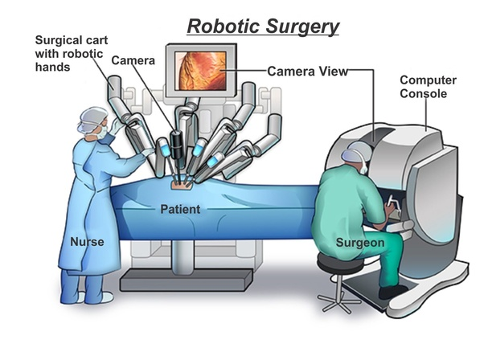
What does Robotic Surgery Look Like?
Christopher Lobo
Minimally invasive
Surgeon sees through camera
Surgeon uses controls
No robot autonomy [1]
Image Source: https://www.stanfordchildrens.org/en/topic/default?id=robotic-assisted-cardiac-surgery-135-11
Notes:
Describe that robotic surgery is most commonly used for minimally invasive surgery.
small incisions and more precise movements (no need to cut a person open)
Surgeon sees through camera as show in diagram
Surgeon has controls to move arms that each have different tools/camera
Fully autonomous robot surgery has not been introduced in the U.S. yet, there is always a trained surgeon at the helm.

Slide 20
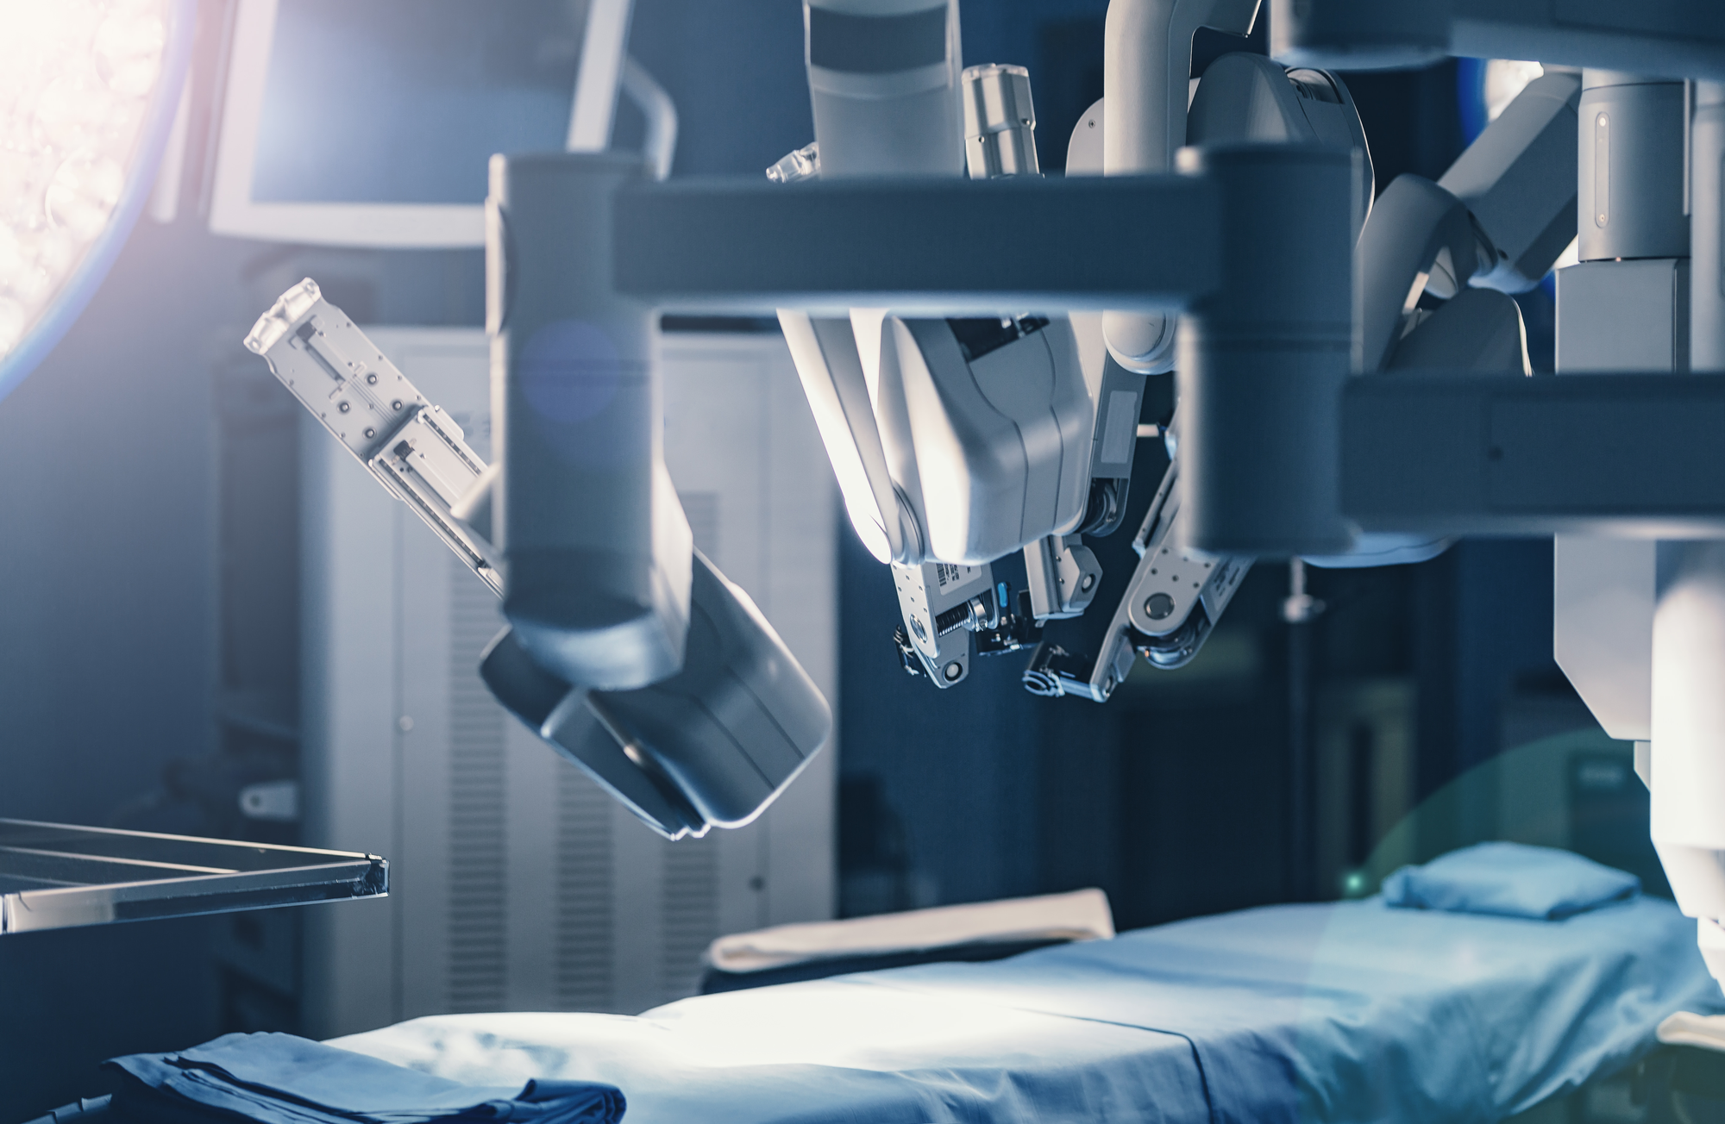
IS it Better?
Christopher Lobo
Open Surgery
Laparoscopic Surgery
Old vs. New
  Complications
  Surgeon Fatigue
  Cost
  Malfunctions
Image Source: https://thesurgicalclinics.com/robotic-surgery/ (10/1/2020)
Notes:
Mention that we are comparing it to open surgery and laparoscopic surgery
Highlight the difference to be covered (on slide)

Slide 21
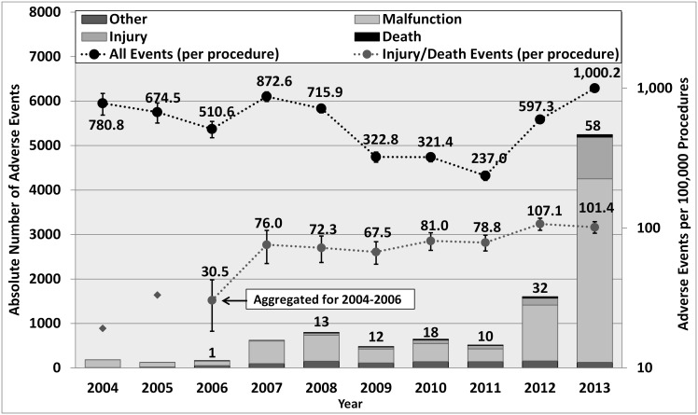
Complications
Christopher Lobo
Fewer injuries/deaths during surgeries [2]
Less bleeding [3]
Fewer instances of dysphagia
Image Source: [2]
Notes:
Fewer injuries: 106.3 vs. 232.9 per 100,000 procedures

Slide 22
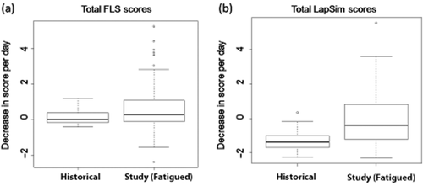
Surgeon Fatigue
Christopher Lobo
Long surgeries cause deterioration in skills [4]
Robot allows frequent surgeon rotations
Image Source: [4]
Notes:
Surgeon fatigue causes grip strength to become weaker
surgeons make less precise moves/incisions
Robotic surgery is less taxing on surgeon

Slide 23
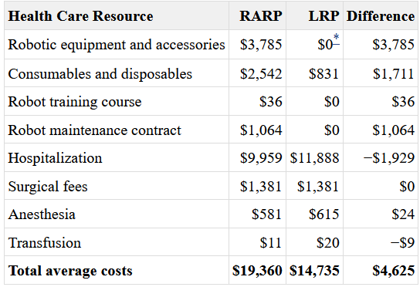
Cost
Christopher Lobo
Initial Cost:
  Surgery Robot
  Robot Training
  Maintenance Contract
Per-Use Cost:
  Disposable
  Anesthesia
  Transfusion
Long-term lower cost [6]
Image Source: [5]
Notes:
The initial cost of purchasing a robot is obviously higher than not purchasing a robot.
The cost of performing individual surgeries is lower
surgery robot goes up 5 to 7 years without additional costs
in addition, hospitals avoid cost of complications (lower rate of complications as previously mentioned)

Slide 24
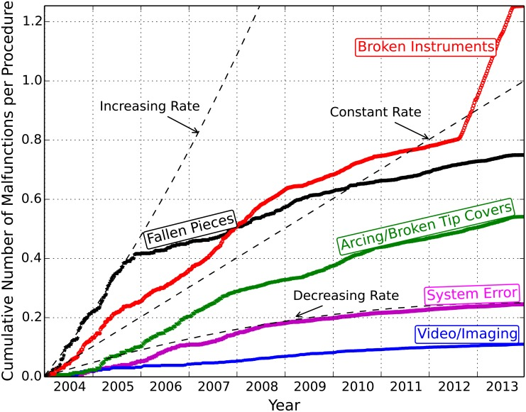
Malfunctions
Christopher Lobo
Video/Imaging
Arcing
System Error
Fallen Pieces
Broken Instruments
Image Source: [3]
Notes:
System errors and video/imaging problems contributed to 787 (7.4%) of the adverse events
both of these problems are shown to have declining rates as showing improvement of the worst malfunctions
Arcing is when electricity flows through air and causes burning.
Fallen pieces increased up until 2005 and has been decreasing

Slide 25
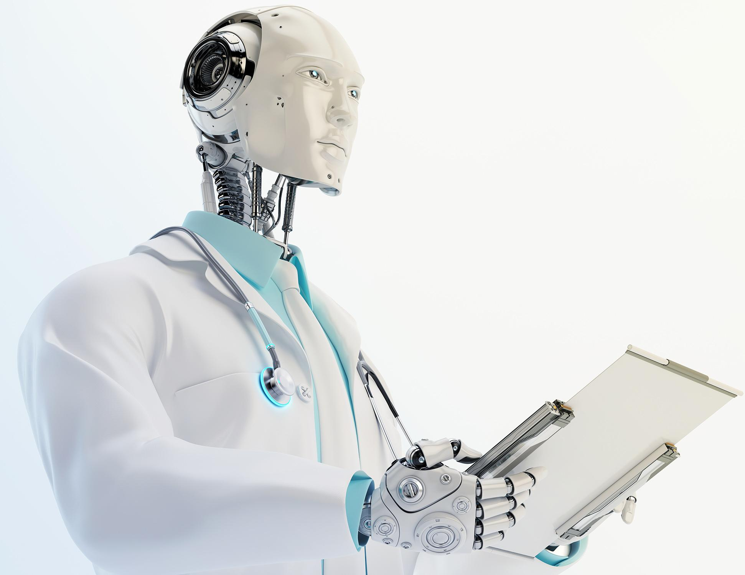
The Future: Autonomy
Christopher Lobo
Surgeons approve [7]
Humans need human doctors [8]
Image Source: https://www.thetimes.co.uk/article/is-there-a-robot-doctor-in-the-house-g578cpqb2 (10/1/2020)
Notes:
It is found that 73% of surgeons agreed with using robotic surgery
68% of patients need to see their operating surgeon before/during the surgery
Autonomous robotic surgery has similar ethical dilemmas to autonomous vehicles (who is to blame for issues?)

Slide 26
References
<Your Name>
[1] Mayo Clinic Staff (2020, February 04). Robotic surgery. Retrieved October 01, 2020, from https://www.mayoclinic.org/tests-procedures/robotic-surgery/about/pac-20394974
[2] Alemzadeh, H., Raman, J., Leveson, N., Kalbarczyk, Z., & Iyer, R. K. (2016). Adverse Events in Robotic Surgery: A Retrospective Study of 14 Years of FDA Data. Retrieved October 01, 2020, from https://doi.org/10.1371/journal.pone.0151470
[3] Transoral Robotic Surgery: A Review of Clinical and Cost-Effectiveness [Internet]. Ottawa (ON): Canadian Agency for Drugs and Technologies in Health; 2015 Jan 12. SUMMARY OF EVIDENCE. Retrieved October 01, 2020, from https://www.ncbi.nlm.nih.gov/books/NBK269433/
[4] Daruwalla, J., Marlow, N., Field, J., Altree, M., Babidge, W., Hewett, P. and Maddern, G.J. (2014), Fatigue and laparoscopic surgical skills. Retrieved on October 01, 2020, from https://onlinelibrary-wiley-com.ezpxy-web-p-u01.wpi.edu/doi/full/10.1111/ans.12069
[5] Ho C, Tsakonas E, Tran K, et al. Robot-Assisted Surgery Compared with Open Surgery and Laparoscopic Surgery: Clinical Effectiveness and Economic Analyses [Internet]. Ottawa (ON): Canadian Agency for Drugs and Technologies in Health; 2011 Sep. (CADTH Technology Report, No. 137.) 5, ECONOMIC ANALYSIS. Accessed October 01, 2020, from: https://www.ncbi.nlm.nih.gov/books/NBK168933/
[6] Hagen, M.E., Pugin, F., Chassot, G. et al. Reducing Cost of Surgery by Avoiding Complications: the Model of Robotic Roux-en-Y Gastric Bypass. OBES SURG 22, 52–61 (2012). Accessed October 01, 2020, from https://doi.org/10.1007/s11695-011-0422-1
[7] Saad Aldousari, Ali Buabbas, Said Yaiesh, Rawan Alyousef, Abdullah Al-Enezi, Fawzi Abul, Perceptions of robot-assisted surgery: Results of a survey of surgeons in Kuwait, Arab Journal of Urology, Volume 16, Supplement 1, 2018, Accessed October 01, 2020 from http://www.sciencedirect.com/science/article/pii/S2090598X18301736
[8] Markar, S.R., Kolic, I., Karthikesalingam, A.P. et al. International survey study of attitudes towards robotic surgery. J Robotic Surg 6, 231–235 (2012). Accessed October 01, 2020, from https://doi.org/10.1007/s11701-011-0301-8

Slide 27
Class 10
The End
Keith A. Pray
Instructor
socialimps.keithpray.net
Notes:
This is the end. Any slides beyond this point are for answering questions that may arise but not needed in the main talk. Some slides may also be unfinished and are not needed but kept just in case.

