Slide 1
Class 8
Crime
Keith A. Pray
Instructor
socialimps.keithpray.net
Notes:
Here’s the title slide. Is anyone not excited?
Take 5 minutes to fill out survey on Canvas → Quizzes → SGA’s Midterm Course Feedback Questionnaire

Slide 2
what works well Online With Zoom
Sign in with First and Last Name
Stay muted unless you are going to speak
To speak use the raise your hand feature
To answer yes/no questions use the “yes” ”no” buttons
Chat is fine for questions
Turn your camera on
Wait until the end of student presentations to ask questions
  Write them down so you don’t forget
Others?

Slide 3
Papers
Quantify
  Do not use terms like: less, more, a lot, huge, great, big, tiny, growing, etc.
Use and cite supporting data from high quality sources
Argument should directly support conclusion
Response should directly address counter point
http://socialimps.keithpray.net/assignments/paper-guidelines/
Notes:
0s not included.
Save for next time:
Make decisive conclusions
may, could, etc. = trivial
Absolute statements are difficult to prove
Avoid: all, always, any, every, everyone, never, none… unless you can show it
Be sure to put quotes around entire quote
Hyperbole is the best thing ever!
but not in these papers
Print 2 sided and save a tree
Use template, saves time (and -1 point)

Slide 4
Grades
To Date
32 Max Possible

Slide 5
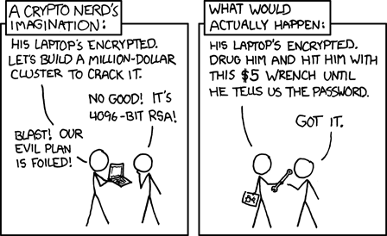
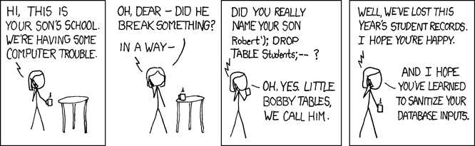
Overview
Review
Assignment
Students Present
https://xkcd.com/538/ (2010-11-14)
https://xkcd.com/327/ (2007-10-10)
Notes:
Are there any questions on the assigned reading?
Use the backup slides to explain any of the attack methods from the text.
XKCD Links last accessed 2020-09-25

Slide 6
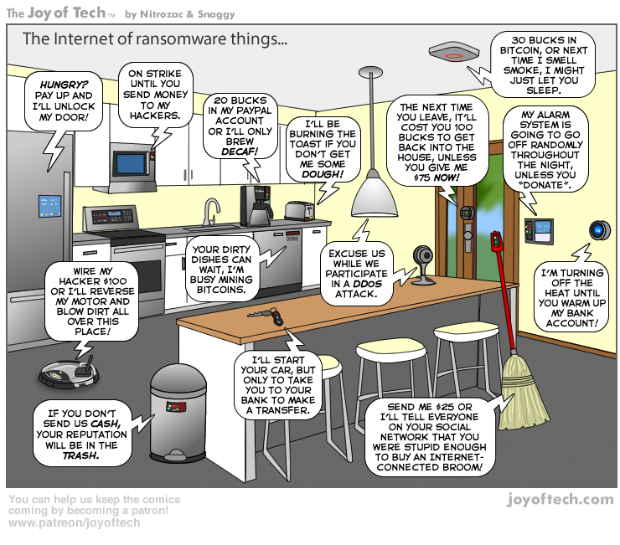
https://cointelegraph.com/storage/uploads/view/5e8f6e0d3a029807dfe181dc3d160cf0.png
Notes:
Find publish date
Note which really exist
Extra credit

Slide 7
My Reading Notes
pp. 323 Might be interesting to compare password guidance over the years.
pp. 325 plenty not sent with HTTP
pp. 328 Getting on TV much more difficult than releasing software
pp. 330 Virus could be new
pp. 332 Goals include infect 3 machine per LAN and as many computers as possible? Never make last minute changes before release. Were they related to the defects?
pp. 333 Testing w/out DEBUG often neglected
pp. 335 Do people use the Internet as an experimental laboratory these days? Shutdown right after booting, “benign” doesn’t seem like the right word.
pp. 337 “send reports back to a host computer”?
pp. 338 Firewalls often not running on same machine as malware, routers?
pp. 339 Have 2003 fears of cyber terrorist attacks been realized?
pp. 347 How is online voting a moral issue?
End of Chapter questions: 14. 25. 29.
Notes:
- If time ask class about online voting in light of COVID-19 challenges.

Slide 8
Group Quiz
A denial of service attack shuts down a bunch of retailer, stock brokerage, large corporate entertainment and information web sites. Possible guilty parties:
  Terrorist who aimed to cause billions of damage to U.S. economy.
  Protest organization opposing commercialization of the web and corporate manipulation of consumers.
  Script kiddie (a minor) just having fun with tools he found on the web.
  Show off hacker in search of bragging rights.
State what penalties are appropriate for each.
Explain your answer to 1. using a single Ethical Theory for all.
Name the laws/acts under which these parties could be prosecuted.
Notes:
Works well as small group exercise.
Note: short answer format expected.
Note: 2. only one argument needed, should include logic for all parties
Note: 3. same law(s) should be applicable to all parties

Slide 9
Assignment
Code Testing 1 Page Paper 1/2
Test the given code
Find as many defects possible
There are major and minor defects to find
Once testing is done write paper with conclusion: testing strategy was adequate
Things that might be useful in your argument:
  Rationale for testing strategy used (use data and sources)
  Explanations of defects found (use data and sources)
  How to fix them (use data and sources)
  Consequences of leaving defects in production code (use data and sources)
Use a weakness in testing strategy as counter point (use data and sources)
Working example: http://socialimps.keithpray.net/assignments/Test_Sales_Fun
Notes:
If guest presenter coming next class remind students to prepare questions for him.
Remember to work on groups projects.
Each group should have material on their sites for the topics we’ve covered so far.
OLD Prompt:
Design tests for the code on the following slide.
Contains at least one major defect and several minor ones.
Write a paper (1 page not counting any source code) including :
Did you choose a good test strategy? (This is your conclusion.)
The inputs and expected outputs
What defects you found
How you would fix the defects (you may include fixed source)
Why would that fix the problems?
What could happen if the defects are not found before the code is put into production?

Slide 10
Assignment
Code Testing 2/2
import java.text.NumberFormat;
public class SalesFun {
public static double calculateSalesTotal ( double amount, double discountRate, double taxRate ) {
double discount = amount * discountRate;
double total = amount - discount;
double tax = total * taxRate;
double taxedTotal = tax + total;
NumberFormat numberFormat = NumberFormat.getCurrencyInstance();
System.out.println ( "Subtotal : " + numberFormat.format ( amount ) );
System.out.println ( "Discount : " + numberFormat.format ( discount ) );
System.out.println ( "Total : " + numberFormat.format ( total ) );
System.out.println ( "Tax : " + numberFormat.format ( tax ) );
System.out.println ( "Tax+Total: " + numberFormat.format ( taxedTotal ) );
return taxedTotal;
}
}
} Lines of interest
Notes:
Bold lines are real focus.
Example input:
amount = 100.05;
discountRate = 0.10;
taxRate = 0.05;
OR
0.70, 0.0, 0.05
95.67, 0.20, 0.7

Slide 11
Overview
Survey
Review
Assignment
Students Present

Slide 12
Global cybercrime
Kate Varteresian
Notes:
Hello, my name is Kate and today I am going to talk to you about the scope of global cyber crime, as well as what is being done to combat it.
(next slide)

Slide 13
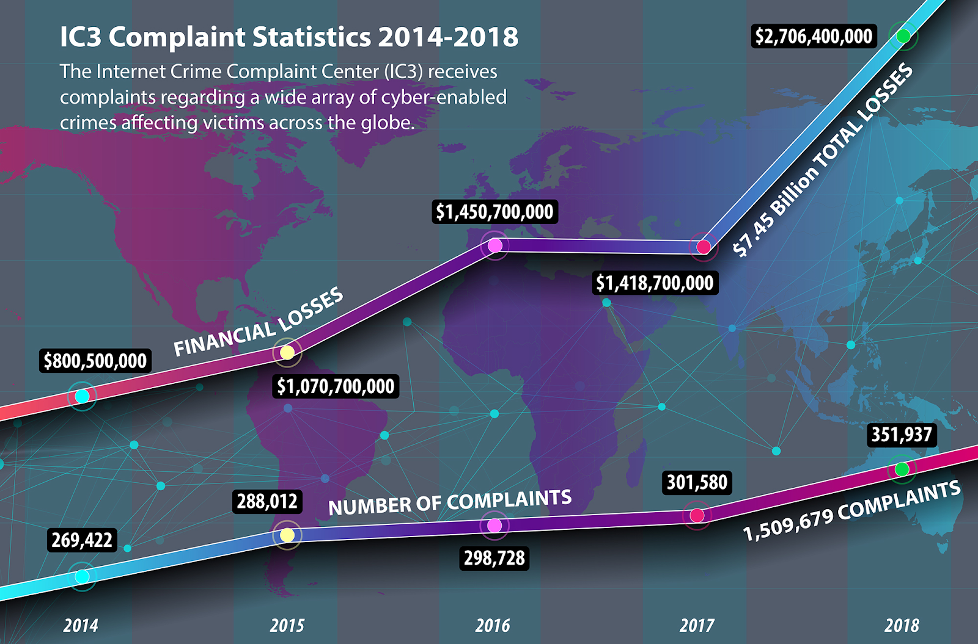
Why do we care?
Kate Varteresian
Increasingly sophisticated technology is making cyber crime easier and easier [2]
Cyber criminals are hard to track, identify, and prosecute [6]
Cyber Crime is not victimless, [2]
  Individuals can loose
    Money
    Credibility
    Data
    Security
    And even their freedom
Graphic from [1]
Notes:
Lets first take a moment and discuss the extent and nature of cyber crime today.
As a country, and as a world, we are currently facing the relatively new problem of cyber crime.
The types of crimes are not new. Criminals have been stealing credit cards off tourists, and starting scams for a while, and although it was hard to fight, it wasn’t impossible. If someone physically stole your credit card while you were walking around, and you were able to find the person who did it, it would be possible to prosecute them.
But, that is no longer the case. If someone from another country steals your credit card information from a website, or sets up a phising scam, it’s a very different problem.
Often cyber criminals use chains of computers to launch their attacks, so tracing is almost impossible. And if you were to find them, but they don’t live in your country, how to do you prosecute them? Is it America’s job? Is it the job of their native law enforcement? What if what they did was illegal in America, but its not where they live? What happens then?
Further, as people in this class know, but the general public has yet to really understand, cyber crime is not victimless. It can be just as dangerous and costly as conventional crime
Governments worldwide have been noticing and addressing this problem, so let's see whats already in place (next slide)

Slide 14
What are we doing about it?
Kate Varteresian
Several International and Domestic efforts have been made to combat cybercrime
International
Interpol [4]
  An inter-governmental organization serving 194 countries [4]
Convention on Cybercrime [5]
  An international treaty signed by 65 countries [7]
Domestic
79% of countries have fully enacted Legislation[3]
5% of countries have drafted Legislation [3]
In the US: The FBI has enacted the Internet Crime Complaint Center (IC3)[1]
Notes:
So, what are we doing about it? There are several international and domestic efforts to fight cyber crime.
domestic = within one country. International=several countries are working together to arrive at the same solution and policy to combat cyber crime.
Domestically, almost 80% of countries have some sort of fully enacted legislation against cyber crime, and another 5% of countries are still drafting legislation. Specifically in the US, we have a subset of the FBI called the IC3, which is tasked with logging and responding to incidents of cyber crime in the US.
Internationally, have Interpol, their full name is “international police” and they have several functions, but one of them is cyber crime. They boasted on their website that they can have a task force briefed and deployed within 12-48 hours of an incident or national disaster.
There also was a Convention on CyberCrime in 2001, held in Budapest. At this event many countries in the EU as well as America, Japan, and Cnanda helped draft a treaty which outlined ways in which to fight cyber crime, but also how to help each other fight cybercrime.
In 2018, 65 countries had singed it, but a lesser fraction had fully implemented it. Its actually very interesting to read and still seems relevant, despite its age.(next slide)

Slide 15

Is it working?
Kate Varteresian
Crime rates are still on the rise, despite these efforts being in place [1]
Several domestic policies are proving to be controversial yet insufficient
  Ex: HADOPI law in France [9]
Convention on Cybercrime: Short Comings [2]
  Domestic law of the individual countries complicate things
  Scarce use of tools provided
  Not universally implemented
    Some countries that signed it didn’t fully enact it
Graphic from [5]
Notes:
So is it working? Global crime rates are still rising every year, as well as crime rates within America. Each year brings more technology, more access, more opportunities, but usually not more legislation.
Also, as time progresses, we are seeing that some legislation doesn’t age well, and needs further amendments to fix the problems embedded within. An example is the HADOPI law in France. The situation that is often mentioned when discussing this law was one where a woman’s IP address was used by a criminal to commit a crime, and when it was traced back to her, the law mandated that she go to prison for it. The law was written by someone who didn’t understand modern computing systems and modern cyber crime, and an innocent woman suffered for it
In addition, the convention of cyber crime is proving to be harder to enforce. There are several articles that leave things up to the “domestic laws of any given country” which create discrepancies when enacted.
Further, although it spells out several tools, and pathways for countries to get help, very few of them are used, despite the continuously climbing crime statistics.
And finally, even among the countries that signed the treaty are not forced to adopt it entirely, they can pick the aspects they want to enforce, and leave the ones they don’t, which leads to a lesser overall impact on cyber crime. (next slide)

Slide 16
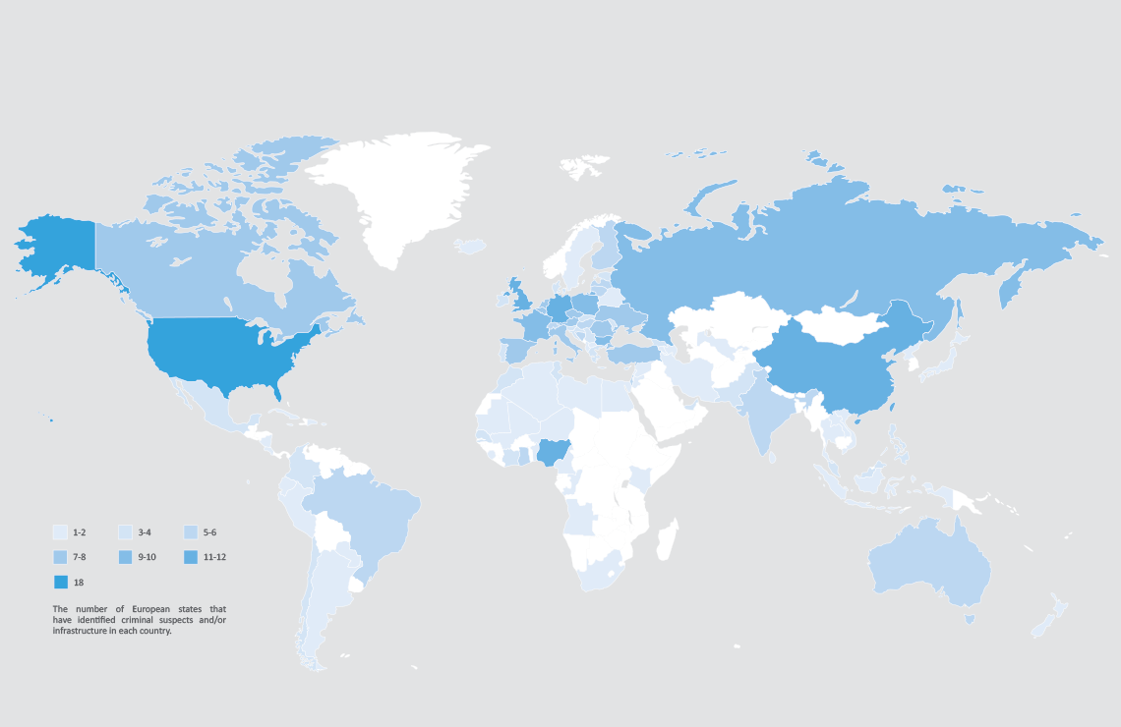
What needs to happen?
Kate Varteresian
“But as pertinent as it may be, and as widely as it may be accepted, a convention alone will not suffice to address the issue efficiently. There must be an actual political and governance will to use the tools it implements”[2]
“Those who would give up essential Liberty, to purchase a little temporary Safety, deserve neither Liberty nor Safety.” [10]
Graphic from [8]
Notes:
What needs to happen? As we just saw, our current plan of hobbling together legislation and hoping that other countries follow suit is not working.
There needs to be a collective coordinated effort to combat, outthink, and stop cyber criminals.
Politians need to understand or at least b e brief by someone who understand cyber crime, and it needs to become a top priority among all countries.
The second one is a quote by Benjamin Franklin. He says that any society willing to give up freedom or security for safety doesn’t deserve either.
There are many solutions to cyber crime. Several of them could entail ridding individuals of their freedoms and liberties, and although it would work, it is not the ideal solution.
The solution to cybercrime is some happy medium where criminals can be held accountable, yet ordinary citizens still have protected rights.
[Questions?]

Slide 17
References
Kate Varteresian
[1] FBI. (2019, April 22). 2018 IC3 Report Released. Retrieved September 23, 2020, from https://www.fbi.gov/news/stories/ic3-releases-2018-internet-crime-report-042219
[2] Lovet, Guillaume. (2009). FIGHTING CYBERCRIME:TECHNICAL, JURIDICAL AND ETHICAL CHALLENGES.
[3] UNCTAD. (2020, April 2). Cybercrime Legislation Worldwide. Retrieved September 23, 2020, from https://unctad.org/en/Pages/DTL/STI_and_ICTs/ICT4D-Legislation/eCom-Cybercrime-Laws.aspx
[4] INTERPOL. (2020). Cybercrime threat response. Retrieved September 23, 2020, from https://www.interpol.int/en/Crimes/Cybercrime/Cybercrime-threat-response
[5] Convention on Cybercrime = Convention sur la cybercriminalité. (2002). Strasbourg: Council of Europe. doi:https://www.europarl.europa.eu/meetdocs/2014_2019/documents/libe/dv/7_conv_budapest_/7_conv_budapest_en.pdf
[6] Eurojust and Europol. (2019, June). Common Challenges in Combating Cybercrime (Europol and Eurojust Public Information). Retrieved September 23, 2020, from http://www.eurojust.europa.eu/doclibrary/Eurojust-framework/Casework/Joint%20report%20of%20Eurojust%20and%20Europol%20on%20Common%20challenges%20in%20combating%20cybercrime%20%28June%202019%29/2019-06_Joint-Eurojust-Europol-report_Common-challenges-in-combating-cybercrime_EN.PDF
[7] Full list. (2018). Retrieved September 23, 2020, from https://www.coe.int/en/web/conventions/full-list/-/conventions/treaty/185/signatures?p_auth=pUbzbuPY
[8] UN Statistics Division. (2013). THE GEOGRAPHIC DISTRIBUTION OF CYBERCRIME. Retrieved September 23, 2020, from https://www.europol.europa.eu/iocta/2016/distribution.html
[9]EDRi. (2013, October 23). After 3 Years: French Authority Hadopi Keeps Proving Its Uselessness. Retrieved September 23, 2020, from https://edri.org/our-work/after-3-years-french-authority-hadopi-keeps-proving-its-uselessness/
[10] Founders Online: Pennsylvania Assembly: Reply to the Governor, 11 November 1755. (n.d.). Retrieved September 23, 2020, from https://founders.archives.gov/documents/Franklin/01-06-02-0107

Slide 18
Stealing Your Data
Ke Zhao

Slide 19
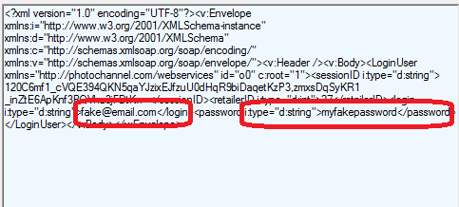
Achieved method
Ke Zhao
HTTP
  Fiddler
    Costco
    Account and password
  Wireshark
    Weibo
    Exact message
[1]
Notes:
Age of big data.
HTTP is not safe.
Use fiddler can capture your input data, such as account and password.
Use Wireshark can capture what people send.

Slide 20
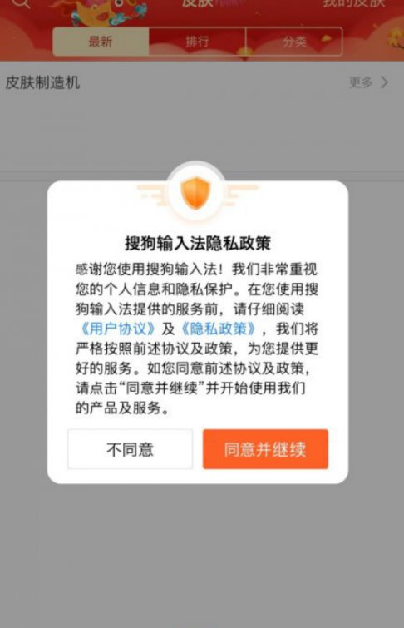
Situation in CHina
Ke Zhao
Sogou
  ‘upon your consent and confirmation’
  ‘collect relevant personal information provided by you, such as name, gender, age, date of birth, ID number, bank card number, Email address, telephone number, mailing address, occupation and education level, etc.’
Ifly Baidu
Baidu
[2]
Notes:
Sogou’s personal information policy is leaking personal information.
If hacker hacked the server, huge amount of personal information will be leaked.
Ifly and baidu have the same logic.
Foreshadowing the personal experience slide.

Slide 21
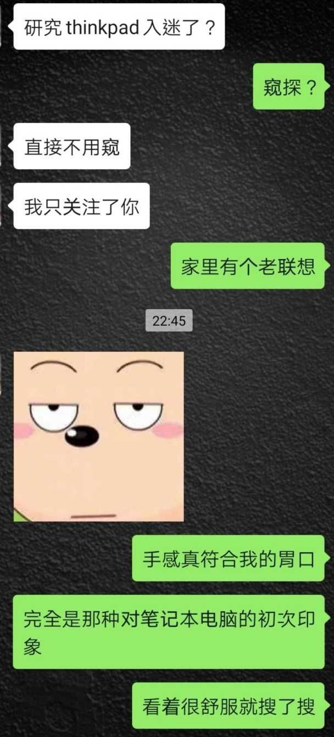
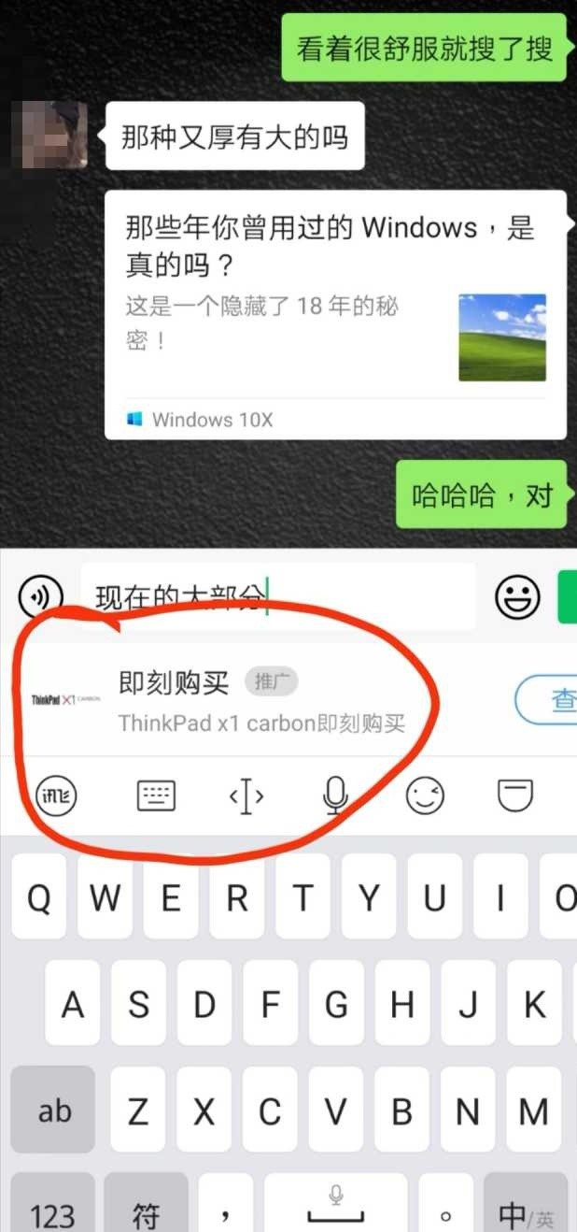
PERSONAL EXPERIENCE
Ke Zhao
Notes:
My personal experience on ifly input method.
The using app is called wechat.
Ifly immediately capture what I want.

Slide 22
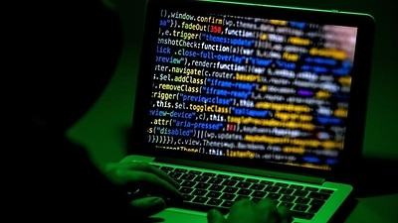
reduce the risk
Ke Zhao
App with build-in input method.
Don’t login account in public wireless network
Change password
[3]
Notes:
Three method on reduce the risk of leaking personal information.
First is build-in input method. This app include bank app.
Second, public wireless network is the most dangerous zone. Hacker can capture any people in that public wireless network.
Third, change password often. This can help increase the security.

Slide 23
References
Ke Zhao
[1] McAfee Lab. (2015, Jan 14). Apps Sending Plain HTTP Put Personal Data at Risk. Retrieved September 24, 2020, from https://www.mcafee.com/blogs/other-blogs/mcafee-labs/apps-sending-plain-http-put-personal-data-risk/
[2] Sogou. (2017, Sep 1) Retrieved September 24, 2020, from https://corp.sogou.com/private.html
[3] SBS News. (2020, September 13). Personal details of more than 35,000 Australians included in leaked Chinese database. Retrieved September 24, 2020, from https://www.sbs.com.au/news/personal-details-of-more-than-35-000-australians-included-in-leaked-chinese-database
Notes:
Reference.
Thank the audience and answer the questions.

Slide 24
Neural Network Security
Zachary Jester

Slide 25

What is a neural net?
Zachary Jester
System of connected “nodes”, each a function that processes data. [1]
Nodes pass data through the network.
System is “trained” by processing a number of test cases with known outcomes.
Trained network can then notice patterns and characteristics in the input data.
<Graphic as big as will fit>
Image: Powerpoint Stock Images
Notes:
Neural networks are used for complex data processing and decision-making.
They can be adapted to almost any situation with clear input and desired output data, assuming enough data already exists to train it.
Require a very powerful processor to train the model, then a somewhat less-powerful processor to run it.

Slide 26
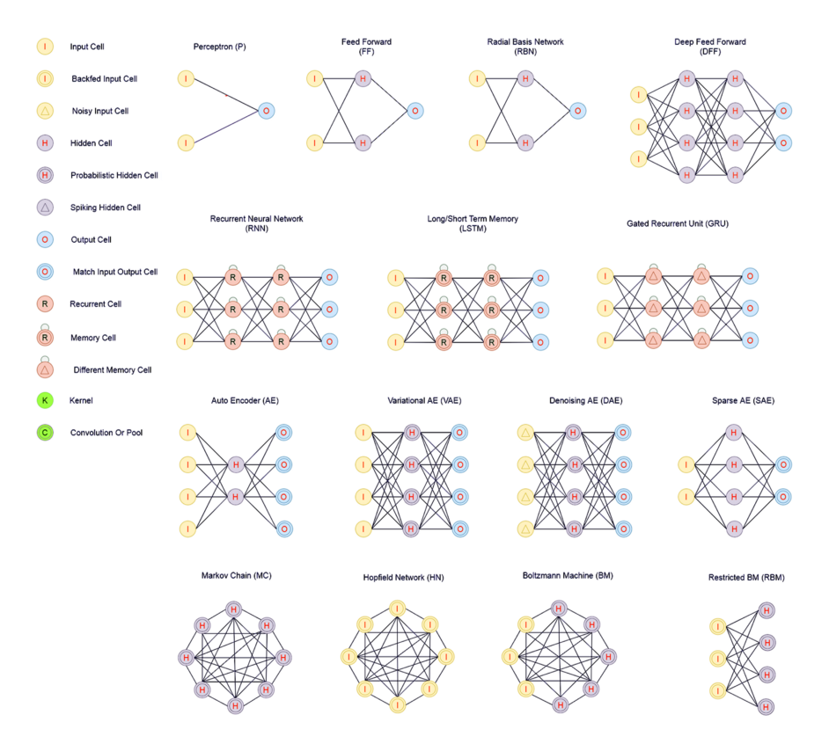
Training Examples
Zachary Jester
Deep Mind’s AlphaGo network trained using archives of human games and by playing itself repeatedly. [2]
Google Lens trained using photographs where the writing or text in each image was known. [3]
Image: medium.com [4]
Notes:
One of the most effective methods of training a network is to have it compete against itself.
This allows for incredibly rapid iteration with minimal human involvement
However, training by using datasets with known outcomes is the most common method.

Slide 27
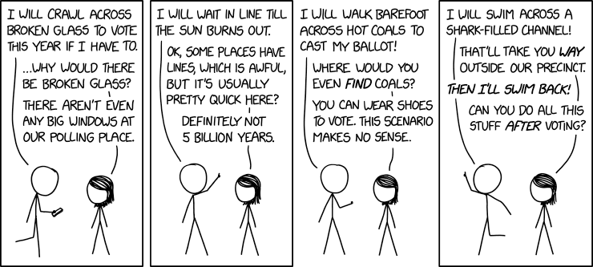
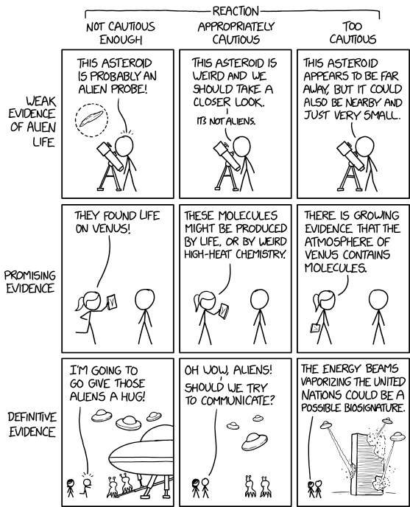
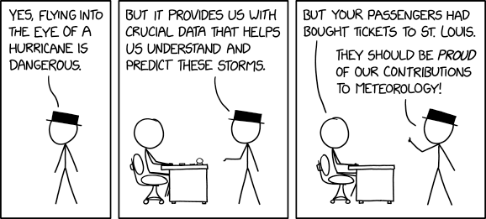
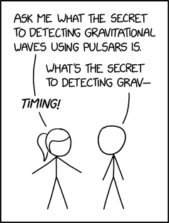
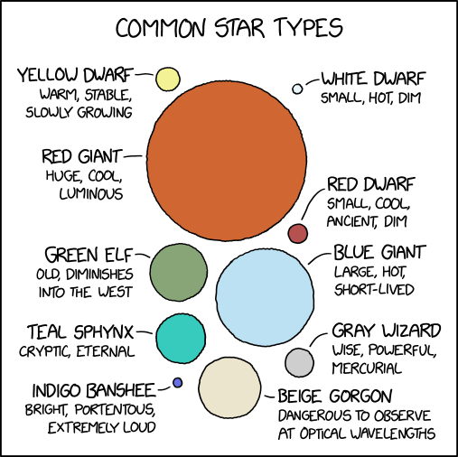
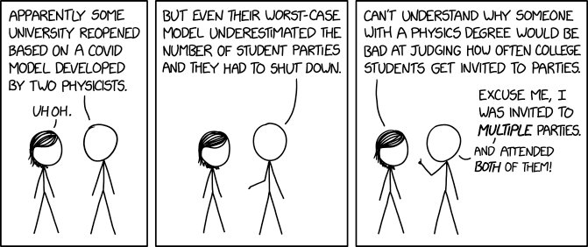
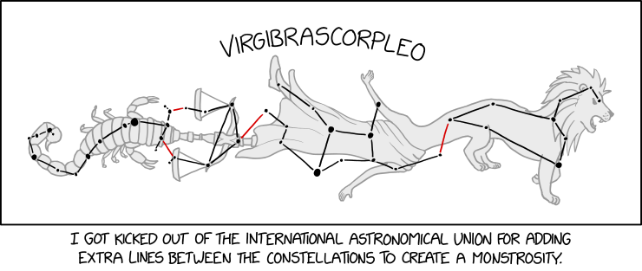
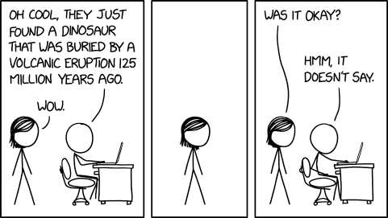
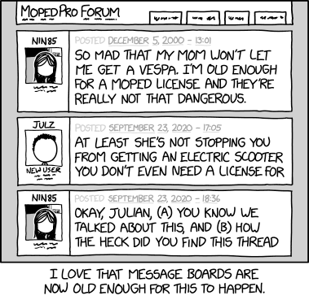
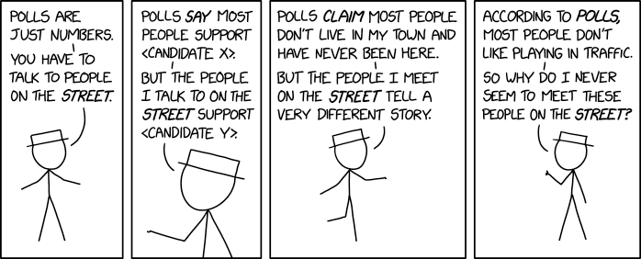
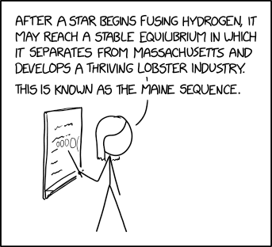
Zachary Jester
xkcd.com [5]
Notes:
If a network was trained by watching the class slides in CS 3043 and monitored class reactions to those slides, it would notice that class members react positively to presentations with XKCD strips.
Presentations with more XKCD strips seem to have a more favorable reaction.
Therefore, by including a slide composed completely out of XKCD strips, I am guaranteed an A on this presentation, right?

Slide 28

Biased Operation
Zachary Jester
Networks trained on biased data (intentionally or otherwise)
Amazon hiring algorithm gave preference to male applicants when reviewing their applications [6]
Provides unfair or inefficient results
Image: PowerPoint Stock Images
Notes:
Biased networks create unfair results in many cases. These networks often have a detrimental effect on humans, as it can lead to workplace discrimination.
When the networks do not directly effect humans, they can instead be inefficient as they may make unwise decisions on company operations.

Slide 29
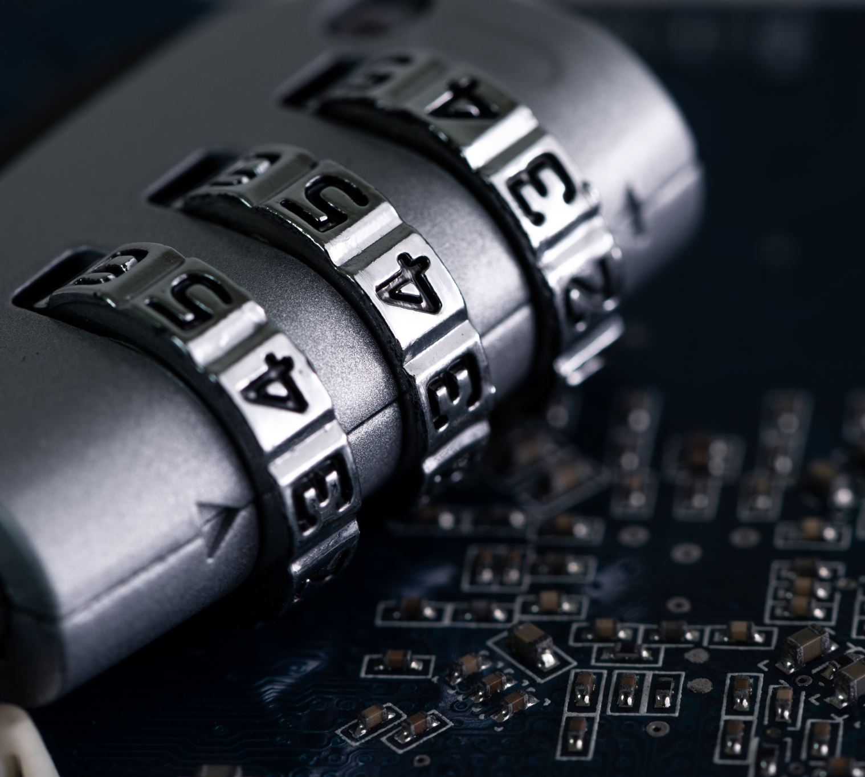
Insecure Operation
Zachary Jester
Not operating as expected due to interference in model.
Pavel Pleskov cheated at a Kaggle competition by bypassing algorithm when outcome was known. [7]
Produces illegitimate or damaging results
Image: PowerPoint Stock Images
Notes:
Insecure networks have backdoors or other vulnerabilities that allow external influence. The results of these networks can be harmful to users, and since the security is in question even seemingly normal results should not be trusted due to the security flaws.

Slide 30
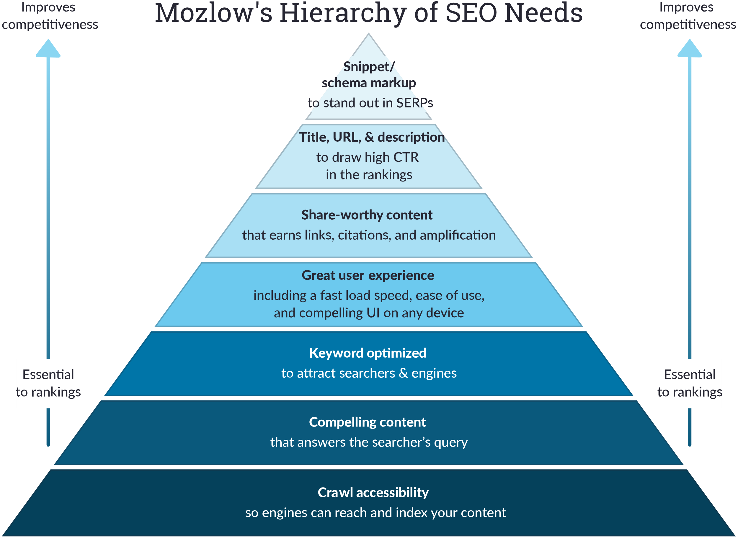
Manipulated operation
Zachary Jester
System exploited in order to provide unexpected output
Search Engine Optimization (SEO) can be used to rank webpages higher in search results than they would otherwise place. [8]
Provides misleading or unfair results
Image: moz.com [7]
Notes:
Manipulated networks are commonly found in search engines and social media. Using specific keywords in a website can cause it to be displayed higher than normal in a search engine, increasing exposure for the page at the expense of the other websites which are pushed down the list. Unlike the other 2 types of malicious operation, this is rarely combatted by developers, as it does not affect the creators of the network.

Slide 31
Securing AI Networks
Zachary Jester
Do
Examine training data to remove biases
Ensure model is not influenced by external information
Identify and fix exploits
Plan ongoing support and moderation for network
Don’t
Use a small or homogeneous data set for training
Leave “back doors” or vulnerabilities in network
Expect algorithm to be foolproof
Plan to stop development after model releases
Notes:
Network developers need to combat these issues by ensuring their systems are unbiased, secure, and well-maintained. These areas of focus will ensure that the algorithm processes data as intended for all users.

Slide 32
Zachary Jester
Which of the 3 types of neural network vulnerability did the XKCD example exploit? Why?
Notes:
Ask the questions on screen, then if there is time:
Do you think the observation made in the example was accurate?
Do you think the conclusion made from the observation was accurate?
Ask for student questions

Slide 33
References
Zachary Jester
[1] MIT. Explained: Neural Networks. (news.mit.edu, 2017) https://news.mit.edu/2017/explained-neural-networks-deep-learning-0414 (Accessed 09/24/2020)
[2] DeepMind. AlphaGo. (deepmind.com, 2017) https://deepmind.com/research/case-studies/alphago-the-story-so-far (Accessed 09/24/2020)
[3] Chennapragada, Aparna. The era of the camera: Google Lens, one year in. (blog.google.com, 2018) https://blog.google/perspectives/aparna-chennapragada/google-lens-one-year/ (Accessed 09/24/2020)
[4] Towards AI. Main Types of Neural Networks and its Applications. (medium.com, 2020) https://medium.com/towards-artificial-intelligence/main-types-of-neural-networks-and-its-applications-tutorial-734480d7ec8e (Accessed 09/24/2020)
[5] Munroe, Randall. XKCD, comics 2353-2363. (xkcd.com, 2020) https://xkcd.com/2353/ (Accessed 09/24/2020)
[6] Terence S. Real-life Examples of Discriminating Artificial Intelligence. (towardsdatascience.com, 2020) https://towardsdatascience.com/real-life-examples-of-discriminating-artificial-intelligence-cae395a90070#:~:text=Arguably%20the%20most%20notable%20example,defendant%20would%20become%20a%20recidivist. (Accessed 09/24/2020)
[7] Greenfield, Yuval. Kaggle 1st place winner cheated, $10,000 prize declared irrecoverable. (towardsdatascience.com, 2020) https://towardsdatascience.com/kaggle-1st-place-winner-cheated-10-000-prize-declared-irrecoverable-bb7e1b639365 (Accessed 09/24/2020)
[8] Moz Inc. Beginners Guide to SEO. (moz.com, 2019) https://moz.com/beginners-guide-to-seo (Accessed 09/24/2020)
Notes:
Not sure what the best way to cite 10 different pages from a website is other than 10 lines of citations, which would not fit.

Slide 34
Class 8
The End
Keith A. Pray
Instructor
socialimps.keithpray.net
Notes:
This is the end. Any slides beyond this point are for answering questions that may arise but not needed in the main talk. Some slides may also be unfinished and are not needed but kept just in case.

Slide 35
Buffer Overrun
Run time stack
Local Variables
Return Address
Parameters
Variable Attack
buffer
Target Variable
Stack Attack
buffer
Return Address
code
Return Address
Notes:
Retired slide. Most students have this in depth from new class now.
When a function call is made, local variables, return address, parameters stored on run time stack. Local variables occupy lower memory addresses.
Variable attack – change variable value. Program expects user to input character and allocates a buffer for them. Attacker supplies too many characters and ends up over writing a variable.
Run example of this if there’s interest – next slide
Stack Attack – goal is to change value of return address so execution control goes to code which the attacker has provided in the input buffer.
Prevention – add checks against array bounds being exceeded. modify operating system to not execute instructions stored on run time stack.

Slide 36
Run Example Code
Notes:
Retired demonstration. Most students have this in depth from new class now.
> imps
> assembly
> 123456789qwerty1

Slide 37
Buffer Overrun Code
#include <stdio.h>
#include <string.h>
int main ( void ) {
char buff [ 15 ]; int ace = 0;
printf ( "\n Enter best class ever : \n" );
gets ( buff );
if ( strcmp ( buff, "imps" ) ) {
printf ( "\n %s is wrong! You should FAIL! \n ace=%i\n", buff, ace ); }
else { printf ( "Correct! \n") ; ace = 1; }
if ( ace ) { printf ( "You get an A! \n" ); }
return 0; }
} The Naughty Line
Notes:
Retired slide. Most students have this in depth from new class now.

Slide 38
TCP Three-way Handshake
SYN
SYN-ACK
ACK
Notes:
Retired slide. Most students have this in depth from new class now.
SYNchronize
SYNchronize ACKnowledgement (socket reserved awaiting ACK)
ACKnowledgement
TCP socket connection established

Slide 39
SYN Flood Attack
SYN
SYN-ACK
Notes:
Retired slide. Most students have this in depth from new class now.
Attacker spoofs the IP address so the SYN-ACK is sent to a different machine that cannot respond to the SYN-ACK.
This leaves the connection half open on the server machine decreasing the resources (sockets, memory, threads/processes) available to respond to legitimate clients.
The attacker send many such spoofed SYN messages.

Slide 40
Ping Attack
Target
Attacker
ping
ping
Notes:
Retired slide. Most students have this in depth from new class now.
Attacker finds routers that support broadcasting messages to all computers on their local area networks.
The attacker sends a spoofed ping message, which the routers echo to the spoofed address.

Slide 41
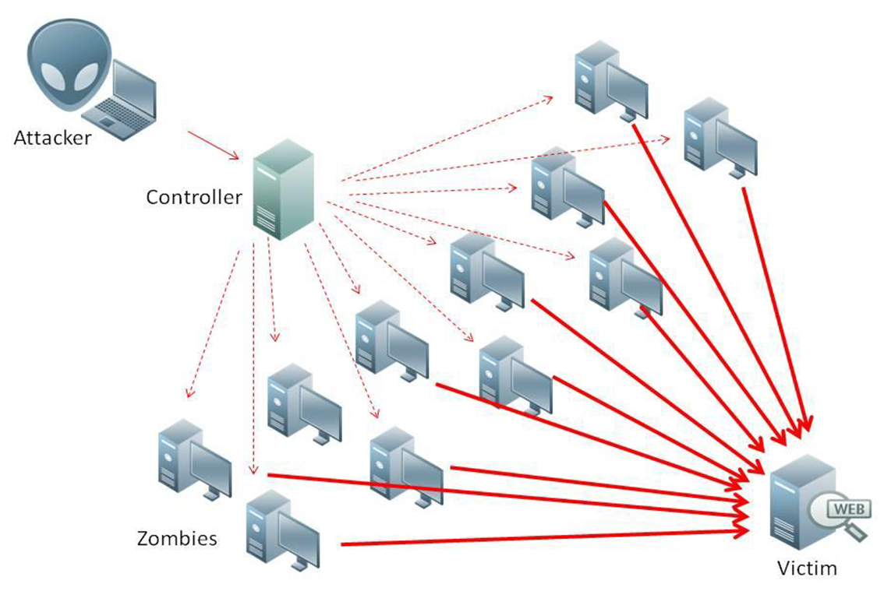
What is Denial of Service (DoS)
Attempts to make target unavailable by flooding with traffic
If victim has to filter attack, it’s too late
Internet Providers have no incentive to help
  Businesses get affected, but would not pay provider enough to make worthwhile
  This is why Cloudflare, e.g., exists
Many ways to perform this attack
Notes:
Contributed by Brett Ammeson.
https://www.cloudflare.com/ddos/reflection-attack-1.png
https://i.imgur.com/lxYv8cF.png

Slide 42
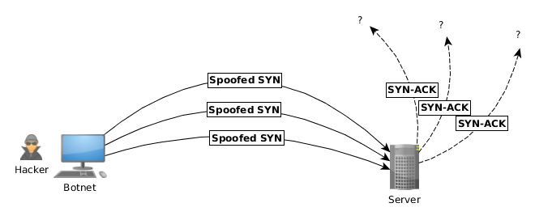
Distributed DoS Vectors
TCP SYN attack
  SYN packets are small, low difficulty for attacker
  Leaves half-open connections on server
  SYN cookies mitigate this
DNS amplification attack
  DNS requests are small
  Can request all records on server
  Crippled by proper configuration
Ingress/egress filtering will reduce effect
Notes:
Contributed by Brett Ammeson.
TCP SYN: https://www.cert.org/historical/advisories/CA-1996-21.cfm
DNS amplification: https://www.cert.org/historical/incident_notes/IN-2000-04.cfm
Ingress/egress: www.giac.org/paper/gsec/705/egress-filtering-keeping-internet-safe-systems/101588

Slide 43
Crime How
Technical and Non-Technical
  Break into computer.
  Prevent access to computer.
What things make computer related crime easy?
Notes:
Exploit security holes, Break encryption, Spoofing
Social Engineering: Guess passwords, Find out passwords and procedures
Poor passwords, Insecure protocols, Program limitations (buffer overruns), Eavesdropping (Email, Interactive), Insecure files

Slide 44
Crime Bane
Trojan Horse
Virus
Worm
Bot Network
Buffer Overrun
(Distributed) Denial Of Service Attack
How do they work?
How harmful are they?

Slide 45
Crime Why
Why?
Notes:
Money: stolen credit cards, change records, stolen property.
Political, military, economic.
Challenge, Revenge, Mean
Why do at all? Have motivation, think about it, think it will help, think it’s acceptable.
Feel forced. Don’t agree. Don’t care.

Slide 46
Crime Time
What is different now compared to:
  10 years ago?
  20 years ago?
  30 years ago?
  40 years ago?
Notes:
More computers. Unsophisticated owners. More complex software. Greater connectivity. Easy access to cracking tools. Incentives. File-sharing
In ’60s and ’70s, access was mostly localized.
Modems. Wardialing.
Some Arpanet and Usenet.

Slide 47
Crime Doers
Hacker or Cracker
  Pre-1980 - Golden Age ☺ ?
  Eighties
  Nineties
  Naughts
Criminal Hacking == Cracking?
Notes:
Script kiddies
Phreakers
Security analysts
Packet monkey

Slide 48
Crime Gain
Justifications for Computing Crimes?
What can be done after access is gained?
  What resources are available?
  How valuable are they?
Notes:
Machines are unused. No harm done. Education. Exposes security holes. Exposes abuses.
Use computer and/or resources. Take data. Destroy data. Alter data. Lock out others. Attack other computers.
Equipment, Processor Time, Disk space, Printer time / paper, Bandwidth

Slide 49
Crime Pay
Computer Fraud and Abuse Act (1986)
  Bans :
    unauthorized access or use of computers, copying, modifying, or destroying data, disclosing of passwords.
    disrupting government and utilities.
  Covers government, financial, medical, and interstate systems.
USA Patriot Act (2001)
  Raised penalties.
  Permits freer surveillance and monitoring to detect illegal activity.
Electronic Communications Privacy Act
  Illegal to intercept telephone, email, other data transmissions, access stored email messages without authorization
Assign Cybercrime Treaty (2006), Wire Fraud Act, National Stolen Property Act, Identity Theft and Assumption Deterrence Act
Notes:
Are either of these laws still in effect? Have they been changed?
For additional legislation ask for presenting volunteers to brief recent incidents/cases.
Also ask for volunteers to find out laws from their home country/state.

Slide 50
Crime Stop
Technical
  Protect Data
  Protect Machine
  Protect Access
Non-technical?
  Social?
  Legal?
Notes:
Encryption, Authentication, Biometrics, Anti-virus, File integrity checking (E.g. Tripwire), Virtual private networks, Point-to-point networking (Twisted-pair Ethernet vs. Coax vs. wireless)
Security through obscurity, physical access required, not on network, behind locked doors.
Remove desire, remove incentives
Legalize, increase penalties, increase chance of getting caught.

