Slide 1
Class 14 Last Day
Keith A. Pray
Instructor
socialimps.keithpray.net
Notes:
This is the loneliest title slide you’ll ever see…

Slide 2
Automation Papers
A Term 2018
3 - Construction
3 - Medical
2 - Everything
2 - Food Prep
2 - Retail
2 - Transportation
1 - Agriculture
1 - Crowdturfing Detection
1 - Cyber Security
1 - Firefighting
1 - Human Presence
1 - Problem Solving
1 - Small Scale Manufacturing
D Term 2019
5 - Food Prep
3 - Education
1 - Medical
1 - Manufacturing
1 - Manual Labor
1 - Transportation
1 - Waste Management
1 - Taxes
1 - Tree Logging
1 - Stock Market Trading
1 - Programming
1 - Language Translation
1 - Nothing
A Term 2019
4 - Dangerous Jobs
2 - Cooking
2 - Driving
2 - Retail
1 – Warehouse Work
1 – Air Traffic Control
1 – Online Moderation
1 – Customer Service
1 - IT
D Term 2020
6 - Medical
5 - Transportation
3 - Cooking
2 - Construction
2 - Video Games
1 - Agriculture
1 - Firefighting
1 - Driving
1 - Retail
1 -Hiring
1 - Laundry
1 - Art
1 - Calendars
1 – Legal Defense

Slide 3
Papers
Great improvement!
Notes:
Save for next time:
Clearly state conclusion
First statement preferred
Absolute statements are difficult to prove
Avoid: all, always, any, every, everyone, never, none… unless you can show it
Be sure to put quotes around entire quote
Hyperbole is the best thing ever!
but not in these papers
Print 2 sided and save a tree
Use template, saves time (and -1 point)
Include Counter Point and Response
Include Author, Title, Publish Date, Publisher for references
Read paper aloud to proof

Slide 4
Grades To Date
70 Max Possible

Slide 5
Overview
Course Evaluations
Students Present
Students’ Choice

Slide 6
Classroom Computing
Benjamin Babalola

Slide 7
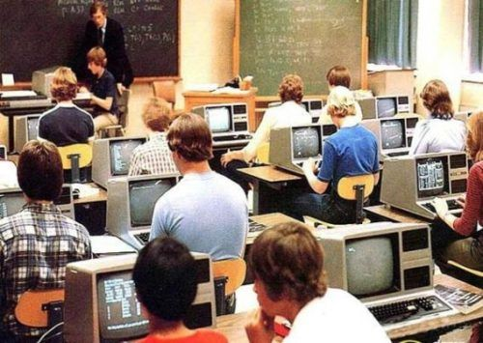
Brief Learning Computing History
Benjamin Babalola
In 1980s schools started adopting computers to aid in the education process, however their use spiked in late 1980s to early 2000s
Internet greatly influenced the spike
<Graphic as big as will fit>
[1] [2] [5]
Notes:
Start off the lecture pretty general, give a brief overview of the history of computers in education. Talk about how Pascal was created in 1970, and how in the 70s a small subset of schools had mainframes and microprocessors, but people didn’t really use it for teaching others. In ‘75 some apple 1 pcs were donated to schools, however some schools decided to stay with the mainframes and microprocessors and refused the pcs. 1980s were where it really took off.
The first entirely online course is offered at NYIT in 1986, and the amount of people who used computers with regards to learning had a small spike in late 80s early 90s
[2]

Slide 8
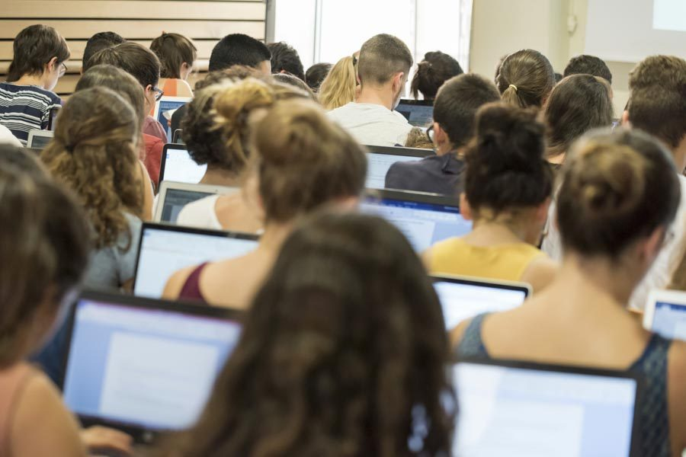
Is computing technology in classes a problem?
Benjamin Babalola
The addition of computers when it comes to learning was overall positive, even though there are some problems
[3] [10]
Notes:
Explain your conclusion.
Start to describe what it means – I believe that computers have had an overall positive additions to the learning scene, whether that be for those learning, or for those delivering the knowledge, maybe if you want you can also start to give some reasoning into why – things like zoom calls, convenience of classes online, some things taught are specifically for computers or online, so it would be hard to teach without being on a computer, or practicing on a computer
If at all possible, try to connect any aforementioned reasoning to the history on computing, maybe something like “before there wasn’t any computers, so people weren’t able to take classes that taught them things about them. Nowadays, that would be impossible!” or something along those lines I’m not completely sure
Also, you could touch on the counterpoints, things like: there are many cases where giving students computers can cause problems (i.e. in my highschool AP computer science class someone hacked into the school grades database and changed their grades, which is a true story actually I sat behind the student who did that… all during class btw)
Just try to say whatever flows well for this slide, this one I can tell will be a little sticky to get out, also there isn’t really any citations, other than for the image you’ll use, which will probably be some weird stock photo of a online class, or of students learning with computers in a class

Slide 9
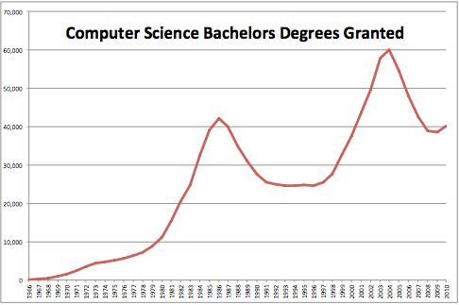
Those Learning about computers
Benjamin Babalola
[11]

Slide 10

Sometimes you can’t learn without a PC
Benjamin Babalola
For some subjects, learning on a computer is the best way.
It can be ineffective if you try to learn programming, per say, just by writing on paper.
Also, it can help make things easier in classes, like how some people prefer notetaking on a computer
[3] [6]
Notes:
These next couple supporting argument slides should be pretty short when it comes to the talking front. Basically, you want to generally discuss your reasoning, say something like “I remember my first computer science class at WPI, where my test were on paper, I could never do them well, but funnily enough, my labs and my homework’s were all straight A’s, I don’t think it was because I wasn’t prepared, I feel like coding is for a computer, not a sheet of paper” Honestly a line similar to that should get the main point across.
Another thing, try to find a study of how many majors or classes (in wpi or in general) are things that would be better suited for a computer, from things like Art, to Computer Science, to Civil Engineering, etc
Again, I’m not sure exactly what image fits in for here, again maybe just some students learning something on a computer, or some art students animating something in a lab session.

Slide 11
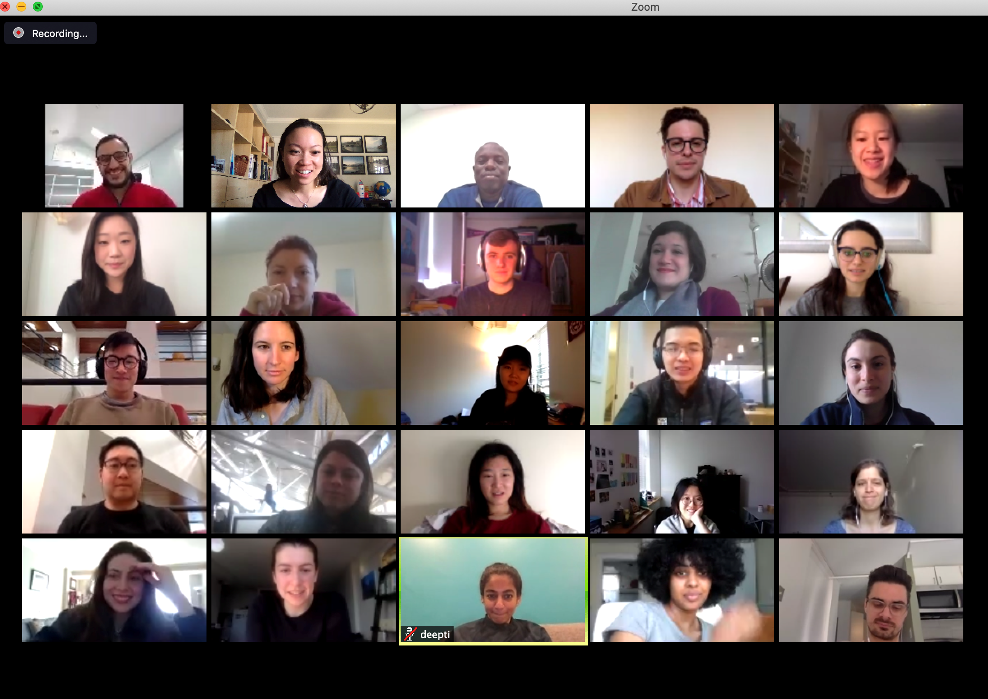
Zoom classes saved us in 2020
Benjamin Babalola
The great thing about being able to learn on a computer is how flexible the location is.
There are even programs online that are made to tutor classes to your specific needs and speed of learning
<Graphic as big as will fit>
[4] [7]
Notes:
I don’t think I’m keeping this title; I just couldn’t think of anything better for this atm that wasn’t too long.
Mention how flexible a computer can be, mention online classes, and how it allows people of all demographics and locations to take classes in situations where they basically would be unable to learn or find the time at the right setting. Some people are night people (as I am writing this at 2:13 a.m.) and some are morning, but the good thing about pre-recorded or asynchronous classes is that they don’t require you to have a set apart time of your day to do something, and it’s just what fits into your schedule.
Try to find a source that states how good it is that classes are able to be moved online or something along the lines of “Without a computer, many schools would’ve had to end this school year early—and some did!” I’m not sure what im looking for in a source lol this is just a brainstorm

Slide 12
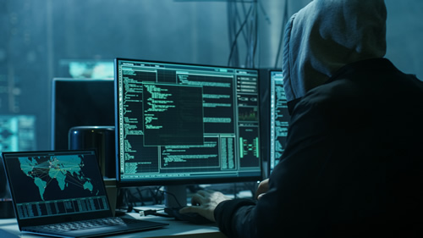
The Issue – Some students can’t be trusted
Benjamin Babalola
The sad truth is there are some students who would use computers to do a lot of things that aren’t classroom appropriate
[8]
Notes:
The counter-argument. Make sure to state this so it’s clear
Also- this title isn’t permanent either, I’m just writing this real fast so I can get my thoughts in my head down while they’re there
An easy thing to do for this slide is to go into depth on the story of the student in my AP CS A class in high school who hacked into the teacher’s database to change his grades. That’s obviously really wrong and a clear flaw to the whole idea of students being able to have computers as learning equipment in class, as he was in a class that needed the computers to learn, however this student abused his privilege of a computer and ended up getting himself in some serious trouble.
After you go deep into that story, talk about all the other things that could go wrong, like how it’s ridiculously easy for students to cheat, and how the internet can be used for a whole lot of wrong things, all of which aren’t things that should be done in a classroom
Also, I’m not sure what image I could put on here, maybe an image of a child hacker to go along with my story? Idk. Also, don’t forget to find a source that goes along with the idea of this not being good

Slide 13
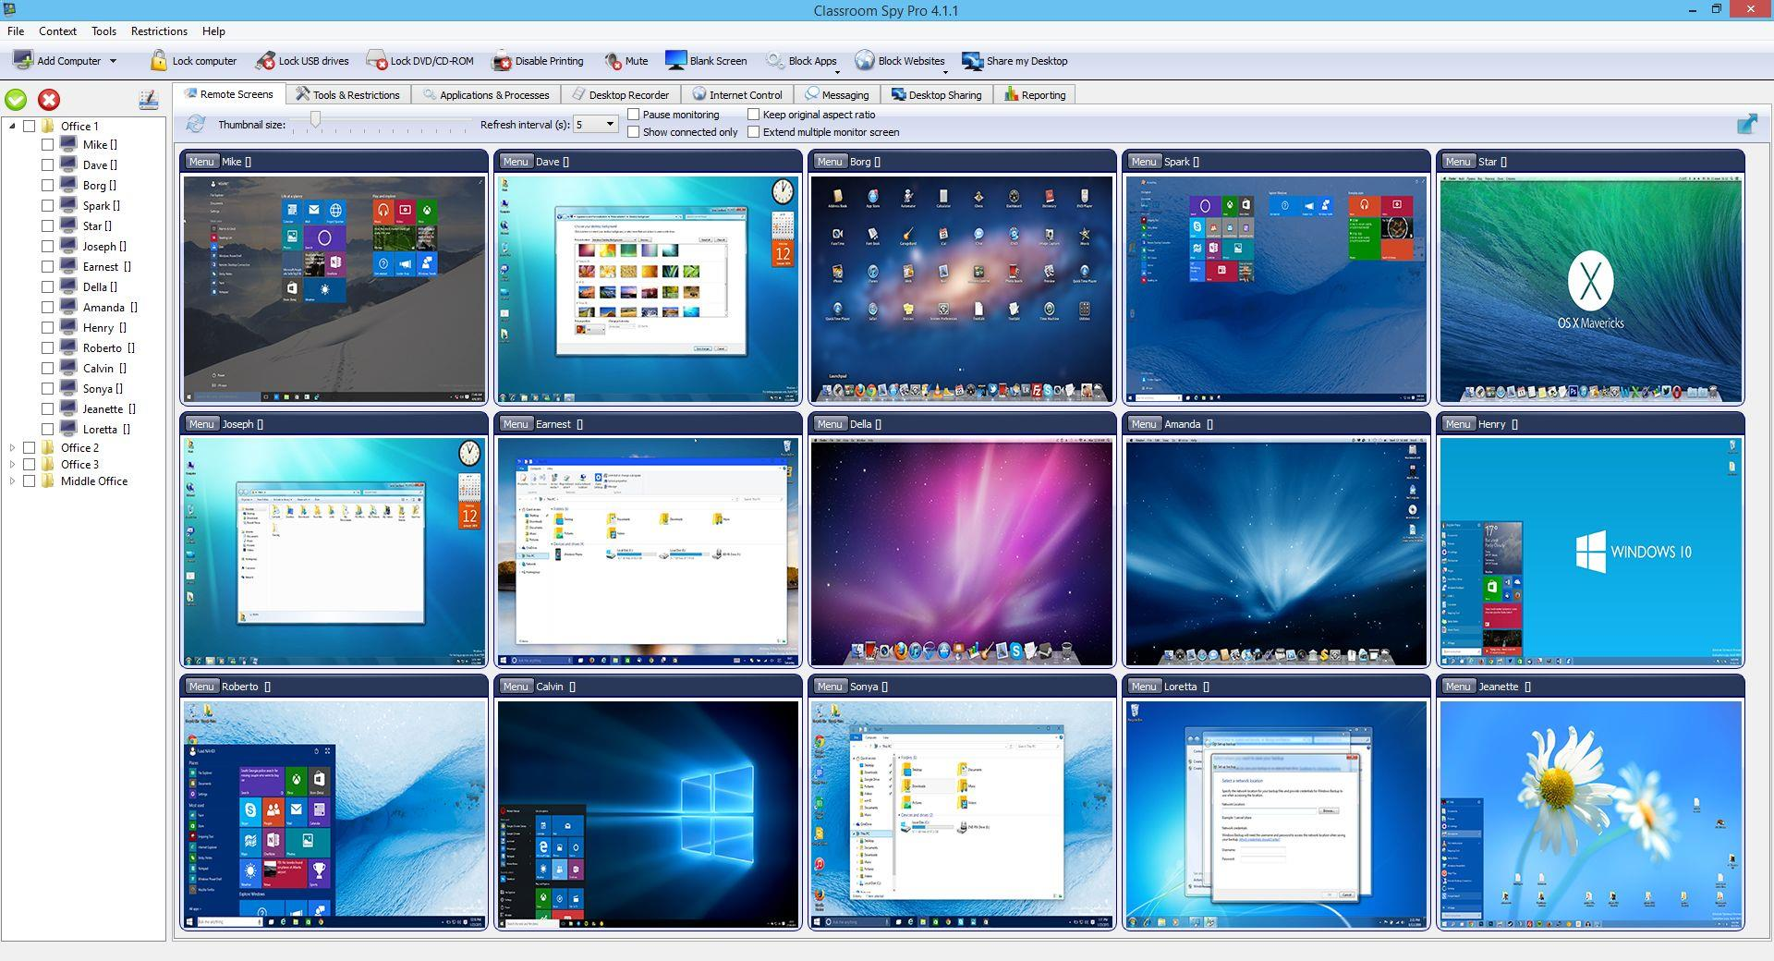
How to Circumvent the issue
Benjamin Babalola
There have been software in place for teachers to monitor their student’s screens
Constant checkups can be very helpful
[9]
Notes:
The Counter Counter point – countering the counter!
Also, title is not permanent, and image is currently blank, need to fill that in
During this slide, pretty much just read off of the slide and go into more detail on whatever you can. Talk about how recently after the whole situation with the kid hacker in our school, our school adopted the monitor checker program for that class.
Also a good idea would be to re-mention some of the original arguments you made, as that could reinforce the fact that it is a good idea that students have access to computers to learn especially while in class, and how if handled correctly, there can be next to no issues
Finally, thank everyone for listening and ask for questions.

Slide 14
References
Benjamin Babalola
[1] “History, the History of Computers, and the History of Computers in Education.” History of Computers in Education, California State University, Long Beach, 2008, web.csulb.edu/~murdock/histofcs.html.
[2] “History of Computers in Education.” History of Computers in Education, Old Dominion University, 2017, www.cs.odu.edu/~tkennedy/cs300/development/Public/M06-HistoryOfComputersinEducation/index.html.
[3] Himmelsbach, Vawn. “Six Major Pros &amp; Cons of Technology in the Classroom.” Top Hat, Tophatmonicle Corp, 2 Jan. 2020, tophat.com/blog/6-pros-cons-technology-classroom/.
[4] Beard, Alex. “Can Computers Ever Replace the Classroom?” The Guardian, Guardian News and Media, 19 Mar. 2020, www.theguardian.com/technology/2020/mar/19/can-computers-ever-replace-the-classroom.
[5] Darth-Azrael. “Darth-Azrael.” Megalextoria, Tumblr, 17 Feb. 2014, darth-azrael.tumblr.com/post/76902984732/they-were-still-using-trs-80s-to-teach-basic.
Notes:
Just references, currently I don’t have all the one’s I’ll use, also I don’t have images and their sources will go here too. Probably will use MLA format

Slide 15
References
Benjamin Babalola
[6] Dino, Ali. “9 Benefits of Computer Programming as a Career.” 5 Best Things, 5BestThings.Com, 8 Dec. 2019, 5bestthings.com/9-benefits-of-computer-programming-as-a-career/.
[7] Klein, Berkman. “Early Reflections on Transitioning to Online Teaching.” Medium, Medium, 10 Apr. 2020, medium.com/berkman-klein-center/early-reflections-on-transitioning-to-online-teaching-768189470dbb.
[8] Scione, Laura A. “These Student Hackers Won Big for Spotting Network Vulnerabilities-Could Yours Do the Same?” ECampus News, ESchoolMedia and ECampus News, 24 Sept. 2019, www.ecampusnews.com/2019/10/01/student-hackers-competition/.
[9] Classroom Spy. Clasroomspy.com, 2020. Print.
[10] Boring, Anne. “Should Professors Ban Students' Use of Computers in Class ?” Learning Lab, SciencesPo Learning Lab, 2016, www.sciencespo.fr/learning-lab/en/should-professors-ban-students-use-of-computers-in-class/.
[11] Soper, Taylor. “Analysis: The Exploding Demand for Computer Science Education, and Why America Needs to Keep Up.” GeekWire, GeekWire, LLC, 21 Feb. 2015, www.geekwire.com/2014/analysis-examining-computer-science-education-explosion/.
Notes:
Just references, currently I don’t have all the one’s I’ll use, also I don’t have images and their sources will go here too. Probably will use MLA format

Slide 16
Computing Racial Bias
Benny Klaiman
Notes:
Intro

Slide 17
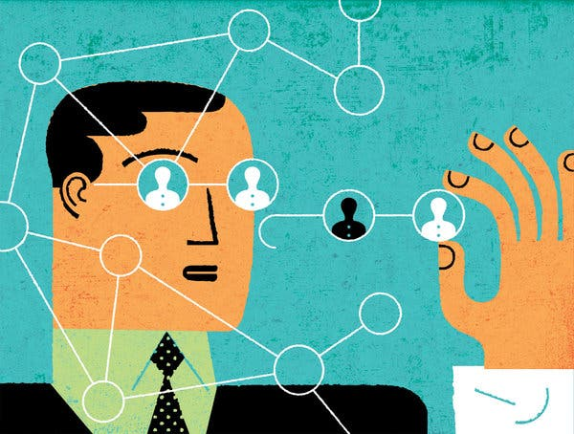
Computers and Bias
Benny Klaiman
Past data is valuable in algorithm-related decisions
In a perfect world, algorithmic bias would not exist
However, this is not a perfect world
[2]
Notes:
- seems easy to pass hard decisions onto machines
- problem is, all programs need data to operate
- past data is useful in this regard
- algorithmic bias would not exist in a perfect world

Slide 18
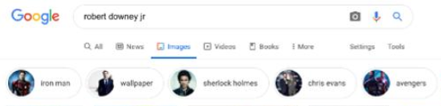
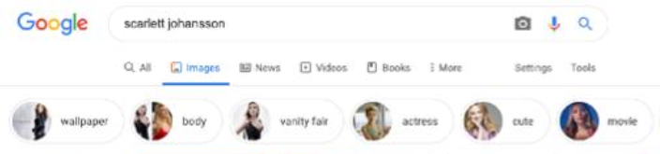
Types of Algorithmic Bias
Benny Klaiman
Interaction Bias
bias evident in interactions with others
lack of representation is a common cause
Latent Bias
use of outdated data
Selection Bias
more information on one subgroup and not others
Pictured: Google Images results, February 2020
- Sample RDJ tags: “iron man”, “sherlock holmes”, “avengers”
- Sample SJ tags: “body”, “vanity fair”, “cute”
[4]
Notes:
- interaction bias: mistakes resulting from not enough info
- latent bias: prejudice bias, outdated data
- selection bias: more information on one subgroup than others
- talk about RDJ and SJ Google Images example

Slide 19
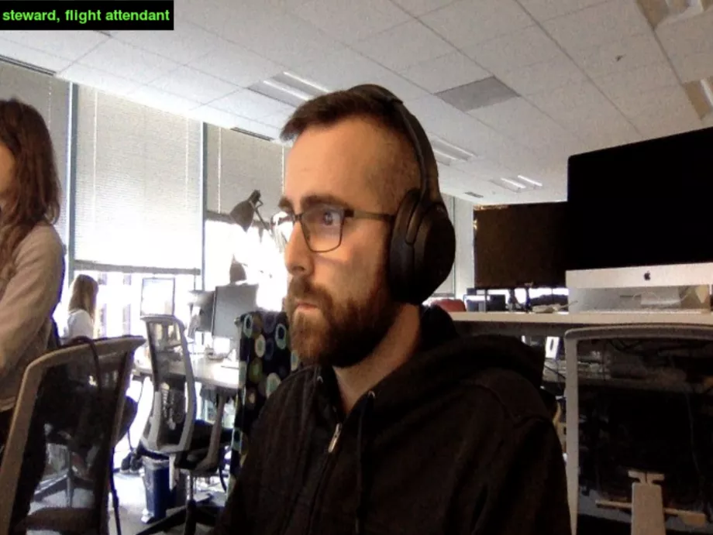
ImageNet Roulette
Benny Klaiman
Website that attempted to classify a user-uploaded photo
Had tendency to assign racist/sexist/etc. tags to photos
Project intended to expose inappropriate image classification
[5]
Notes:
explain how IR worked
Seemingly randomly assigned tags (hence ‘Roulette’)
Project designed to show inappropriate/offensive classification

Slide 20
When Lives Are On the Line
Benny Klaiman
Major health care algorithm affected by racial bias
Name of company responsible left anonymous
used on > 2 million people
Relied on faulty metric for determining need for care
Previous patients’ health care spending
2019 study: 50,000 patients
6,079 self-identified as black, 43,539 white
[1]
Notes:
Healthcare
2019 study: 50,000 patients, >6000B, >43000W
Algorithm name and dev anon.
Ex. Used by 200M people in US
Flaw: healthcare spending records

Slide 21
When Lives Are On the Line
Benny Klaiman
Result: black patients generally received lower risk scores
Black health care costs on par with white health care costs
Eligible black patients less likely to get picked for high-risk care
Why?
Correlation between race and income
POC generally have lower incomes
Lower incomes -> lower-quality care -> less trust in doctors
[1]
Notes:
Black patients received lower risk scores
Roughly equal costs across both B/W
Black patients statistically less likely to get picked for care
Talk about correlation between race and income, consequences

Slide 22
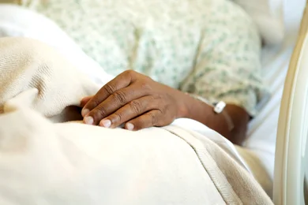
Current Efforts to Improve
Benny Klaiman
ImageNet’s response to Roulette
Removed derogative words
Discouraged using words that give images meaning (e.g. “flight steward”) in AI
Tool developed to show more images of diverse gender, race, and age
Proper regulation is essential
We need to shape how AI is used, or it will shape us.
[3] [5]
Notes:
Good things are happening
ImageNet/WordNet changes
Google image tag experiment, 5/2020
Regulation is still needed, unregulated AI still in use enforcing old biases
End with cool ending line

Slide 23
References
Benny Klaiman
[1] Starre Vartan, “Racial Bias Found in a Major Health Care Risk Algorithm” (Scientific American, 10/24/2019), https://www.scientificamerican.com/article/racial-bias-found-in-a-major-health-care-risk-algorithm/ (Accessed 5/6/2020)
[2] Sendhil Mullainathan, “Biased Algorithms Are Easier to Fix Than Biased People” (The New York Times, 12/6/2019), https://www.nytimes.com/2019/12/06/business/algorithm-bias-fix.html (Accessed 5/8/2020)
[3] Will Knight, “AI is Biased. Here’s How Scientists Are Trying to Fix It” (Wired, 12/19/2019), https://www.wired.com/story/ai-biased-how-scientists-trying-fix/ (Accessed 5/9/2020)
[4] Annie Brown, “Biased Algorithms Learn From Biased Data: 3 Kinds of Biases Found In AI Datasets” (Forbes, 2/7/2020), https://www.forbes.com/sites/cognitiveworld/2020/02/07/biased-algorithms/#6c59861d76fc (Accessed 5/10/2020)
[5] Kate Crawford and Trevor Paglen, “Excavating AI: The Politics of Images in Machine Learning Training Sets” (The AI Now Institute, NYU, 9/19/2019), https://www.excavating.ai/ (Accessed 5/9/2020)
Notes:
question time

Slide 24
Biases in Machine Learning
Jason Asidi

Slide 25

What is Fairness?
Jason Asidi
Fairness in machine learning means dealing with classification in data. [1]
Anti-classification - No protected attributes are used
Classification parity - Results are the same across attribute groups
Calibration - Outcomes are independent of attributes
<Citation>
Notes:
<speaker notes>

Slide 26
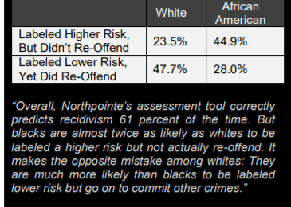
What’s the Problem?
Jason Asidi
Algorithms learn based on what they are “fed”
When based on incomplete or inherently biased data, the algorithm outputs inherently biased data. [2]
Google jobs
African-American photos
Prison risk assessment systems
<Graphic as big as will fit>
<Citation>
Notes:
<speaker notes>

Slide 27

So What Can We Do?
Jason Asidi
We don’t know exactly what’s going on inside an Algorithm’s “head”, only what we have input and what it output.
Judge people similarly at risk of bias similarly [1]
Inclusivity and Stakeholder Awareness [2]
Address statistical bias in the data early on in the process [3]
<Citation>
Notes:
<speaker notes>

Slide 28
Conclusion
Jason Asidi
Algorithms can have biases both inherent in their design and from the data sets they’ve been fed.
Biases in these data negatively impact minority groups and others whom the algorithm is used for outside of its trained data set.
Must be aware of biases and shift to compensate for them in interpretation of data.
<Citation>
Notes:
<speaker notes>

Slide 29
REFERENCES
<Your Name>
[1] Corbett-Davies, Sam, and Sharad Goel. “The Measure and Mismeasure of Fairness: A Critical Review of Fair Machine Learning∗.” CoRR, vol. 1808, no. 23, ser. 2, 14 Aug. 2018. 2.
[2]Weiss, J. (2020, March). Hawaii International Conference on System Sciences | . Hawaii International Conference on System Sciences | . Hawaii.
[3] Bald, Laura. Identifying and Mitigating Bias in Machine Learning Applications. Eugene: University of Oregon Applied Information Management Program, 2019.

Slide 30
Police Cellphone Surveillance
Ben Robinson
Notes:
→ Introduce myself → Explain briefly what I will be talking about in the presentation

Slide 31

What is Police Cellphone Surveillance?
Ben Robinson
Police acquire cell phone location data from cell phone manufacturers
This data is used to narrow down suspects based on the location data of the cell phone.
Is typically used when no other leads can be found
Can lead to the arrest of someone who was not involved in the crime.
[1]
Notes:
→ Begin by explaining the specific circumstances I will be covering with my presentation → Get into the basics about how the the data is collected, why this method is used, and how it can affect people.

Slide 32

Where does the data come from?
Ben Robinson
Police get their location data from cell phone manufacturers such as Apple or Google.
Police can use search warrants to force these companies to give up your personal data.
Anytime location data is turned on, your phone is sending data to a server.
Google has said they’ve received up to 180 requests a week.
[2] [6]
Notes:
→ Explain how people in the class most likely have their location services on now, and relate that to how they cant be affected → Note how these requests have increased significantly in the past few years.
→ Go into detail about how police can force companies to give up your private information

Slide 33
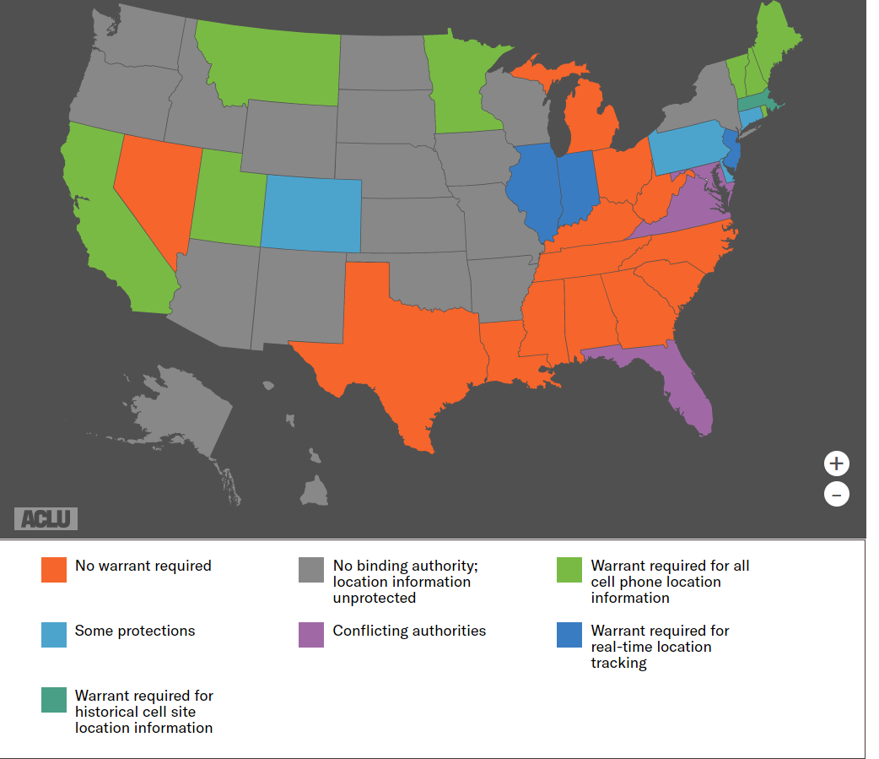
What does the law say?
Ben Robinson
Until 2018, the vast majority of states did not protect cell phone location data.
The supreme court ruled that police must have a warrant to acquire this information
Should police have access to this information even with a warrant?
[2]
[1][4]
Notes:
→ Begin with explaining how there used to be no protections, but it is getting better → Lead into the supreme court case
→ Finish with talking about how it is still unacceptable for this data to accessible through warrents

Slide 34
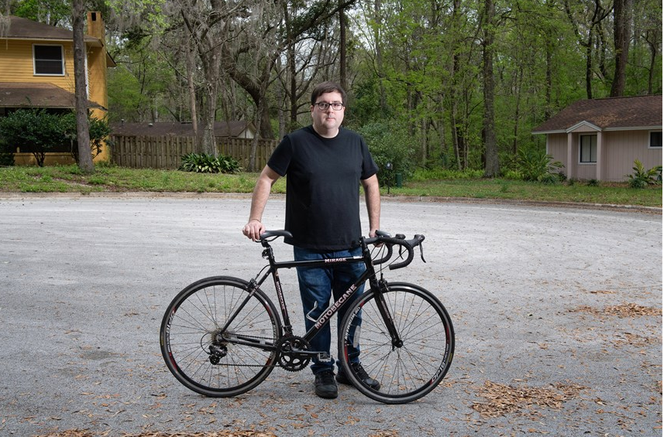
Real life example #1
Ben Robinson
Zachary McCoy received an email in January of 2020 notifying him that his location data was requested by police.
Authorities gave him no warning they were accessing his personal information.
Was able to null the warrant thanks to the warning from Google.
[3]
Notes:
→ Begin by talking about the backstory (Was accused of robbing his elderly neighbor). → Talk about how police had no leads, and went after location data.
→ Explain how lucky he was to have had received the email from google.

Slide 35
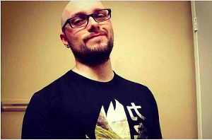
Real life example #2
Ben Robinson
In December of 2018, Jorge Molina was arrested in Avondale, Arizona for murder based on his cell phone location data.
He sat in jail for a week before detectives found he was innocent.
Molina lost his job, and couldn’t find another one due to background checks.
He is currently suing the City of Avondale.
[5]
Notes:
→ Begin by explaining how Jorge wasn’t as lucky. → Go into how the wrong place wrong time really is a factor in these situations
→ Explain how his life was torn apart because of this and conclude that this is unacceptable

Slide 36
Conclusion
Ben Robinson
Police cell phone surveillance can lead to innocent people being arrested and their lives ruined
To avoid this from happening to you:
Make sure your cell phone data is off when it isn’t needed
Familiarize yourself with State laws to understand how protected you are
[1] [5]
Notes:
→ Conclude by giving advice to the audience.

Slide 37
REFERENCES
Ben Robinson
[1]Hurley, Lawrence. “Supreme Court Restricts Police on Cell Phone Location Data.” Reuters, Thomson Reuters, 22 June 2018, www.reuters.com/article/us-usa-court-mobilephone/supreme-court-rules-warrants-required-for-cellphone-location-data-idUSKBN1JI1WT.
[2] Valentino-devries, Jennifer. “Tracking Phones, Google Is a Dragnet for the Police.” The New York Times, The New York Times, 13 Apr. 2019, www.nytimes.com/interactive/2019/04/13/us/google-location-tracking-police.html.
[3]Schuppe, Jon. “Google Tracked His Bike Ride Past a Burglarized Home. That Made Him a Suspect.” NBCNews.com, NBCUniversal News Group, 7 Mar. 2020, www.nbcnews.com/news/us-news/google-tracked-his-bike-ride-past-burglarized-home-made-him-n1151761.
[4] “Cell Phone Location Tracking Laws By State.” American Civil Liberties Union, 22 June 2018, www.aclu.org/issues/privacy-technology/location-tracking/cell-phone-location-tracking-laws-state.
[5]O'Connor, Meg. “Avondale Man Sues After Google Data Leads to Wrongful Arrest for Murder.” Phoenix New Times, 4, 17 Jan. 2020, www.phoenixnewtimes.com/news/google-geofence-location-data-avondale-wrongful-arrest-molina-gaeta-11426374.
[6]Valentino-devries, Jennifer. “Tracking Phones, Google Is a Dragnet for the Police.” The New York Times, The New York Times, 13 Apr. 2019, www.nytimes.com/interactive/2019/04/13/us/google-location-tracking-police.html.

Slide 38
Cyberespionage
Vrandol Perez

Slide 39
Conclusion
Vrandol Perez
Cyberespionage is one of the least known cybersecurity problems, and therefore could be one of the most potent
Biggest Cybersecurity Threats
Stuxnet
Duqu
<Graphic as big as will fit>
<Citation>
Notes:
<speaker notes>

Slide 40
What is cyberespionage?
Vrandol Perez
Cyber attack intended to steal intellectual property and data
Mainly used towards the government or other organizations
Used by foreign countries and organizations to gather intelligence information about opposing forces
<Graphic as big as will fit>
<Citation>
Notes:
<speaker notes>

Slide 41
Stuxnet
Vrandol Perez
Infection
Search
Update
Compromise
Control
Destroy
<Graphic as big as will fit>
<Citation>
Notes:
<speaker notes>

Slide 42
Duqu
Vrandol Perez
Malware that collects information rather than infects data
Arrives as a Word file
File drops installers
Installer then drops Duqu components
<Graphic as big as will fit>
<Citation>
Notes:
<speaker notes>

Slide 43
References
[1] https://www.carbonblack.com/resources/definitions/what-is-cyber-espionage/
[2] https://www-sciencedirect-com.ezpxy-web-p-u01.wpi.edu/science/article/pii/S1874548211000618
[3] https://www-sciencedirect-com.ezpxy-web-p-u01.wpi.edu/topics/computer-science/stuxnet
[4] https://www-sciencedirect-com.ezpxy-web-p-u01.wpi.edu/topics/computer-science/industrial-control-system [5] https://www-sciencedirect-com.ezpxy-web-p-u01.wpi.edu/topics/engineering/malware

Slide 44
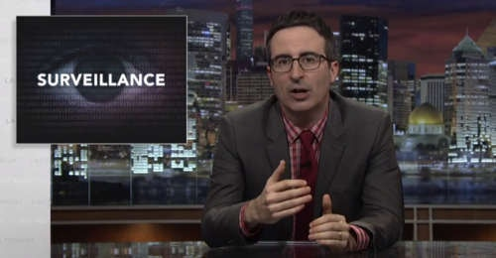

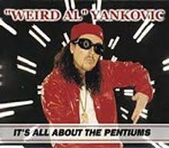


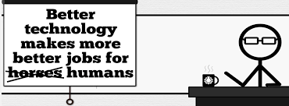


Student Choice – Interesting Videos
Last Week tonight with John Oliver Snowden (33:14)
It’s All About The Pentiums
Weird Al (3:34)
White and Nerdy Weird Al (2:50)
The Game Of Trust - Nicky Case
Why Electronic Voting is a BAD Idea
Computerphile (Tom Scott) (8:20)
Welcome To Life – Tom Scott (2:44)
What "Orwellian" really means - Noah Tavlin (5:31)
Humans Need Not Apply
CGP Grey (15:00)
Notes:
All Last Accessed 2018-10-04
CGP Grey
Humans Need Not Apply (15:00) – 2014-08-13
http://www.youtube.com/watch?v=7Pq-S557XQU
Last access 2016-04-22
Why Electronic Voting is a BAD Idea – Computerphile (Tom Scott) (8:20)
https://www.youtube.com/watch?v=w3_0x6oaDmI
Last Week tonight with John Oliver – Patriot Act, Edward Snowden (33:14)
http://www.upworthy.com/john-oliver-flew-10-hours-to-russia-to-interview-edward-snowden-and-get-him-on-record?c=ufb1
Weird Al – It’s All About The Pentiums (3:34) and look at lyrics
https://www.youtube.com/watch?v=qpMvS1Q1sos
Tie into Ray Kurzweil Singularity
Epic Rap Battles of History: Steve Jobs vs. Bill Gates (If class ok with obscene lyrics) (2:47)
https://www.youtube.com/watch?v=njos57IJf-0
Also Work links on web site http://socialimps.keithpray.net/documents/
-----
Tom Scott
http://tomscott.com
Welcome To Life (2:44)
https://www.youtube.com/watch?v=IFe9wiDfb0E&feature=youtu.be
Passphrases (2:08 need to give context for video)
https://firstlook.org/theintercept/2015/03/26/passphrases-can-memorize-attackers-cant-guess/
If not shown during first class
What "Orwellian" really means - Noah Tavlin (5:31)
http://ed.ted.com/lessons/what-orwellian-really-means-noah-tavlin
Weird Al – White and Nerdy (2:50) and look at lyrics
https://www.youtube.com/watch?v=N9qYF9DZPdw

Slide 45
Student Choice – Interesting Videos (Full)
Last Week tonight with John Oliver Snowden (33:14)
It’s All About The Pentiums
Weird Al (3:34)
White and Nerdy Weird Al (2:50)
The Game Of Trust - Nicky Case
Why Electronic Voting is a BAD Idea
Computerphile (Tom Scott) (8:20)
Welcome To Life – Tom Scott (2:44)
What "Orwellian" really means - Noah Tavlin (5:31)
Humans Need Not Apply
CGP Grey (15:00)
Notes:
All Last Accessed 2018-10-04
CGP Grey
Humans Need Not Apply (15:00) – 2014-08-13
http://www.youtube.com/watch?v=7Pq-S557XQU
Last access 2016-04-22
Why Electronic Voting is a BAD Idea – Computerphile (Tom Scott) (8:20)
https://www.youtube.com/watch?v=w3_0x6oaDmI
Last Week tonight with John Oliver – Patriot Act, Edward Snowden (33:14)
http://www.upworthy.com/john-oliver-flew-10-hours-to-russia-to-interview-edward-snowden-and-get-him-on-record?c=ufb1
Weird Al – It’s All About The Pentiums (3:34) and look at lyrics
https://www.youtube.com/watch?v=qpMvS1Q1sos
Tie into Ray Kurzweil Singularity
Epic Rap Battles of History: Steve Jobs vs. Bill Gates (If class ok with obscene lyrics) (2:47)
https://www.youtube.com/watch?v=njos57IJf-0
Also Work links on web site http://socialimps.keithpray.net/documents/
-----
Tom Scott
http://tomscott.com
Welcome To Life (2:44)
https://www.youtube.com/watch?v=IFe9wiDfb0E&feature=youtu.be
Passphrases (2:08 need to give context for video)
https://firstlook.org/theintercept/2015/03/26/passphrases-can-memorize-attackers-cant-guess/
If not shown during first class
What "Orwellian" really means - Noah Tavlin (5:31)
http://ed.ted.com/lessons/what-orwellian-really-means-noah-tavlin
Weird Al – White and Nerdy (2:50) and look at lyrics
https://www.youtube.com/watch?v=N9qYF9DZPdw

Slide 46
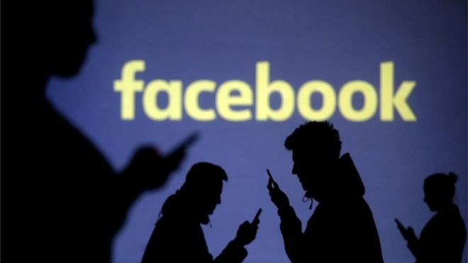
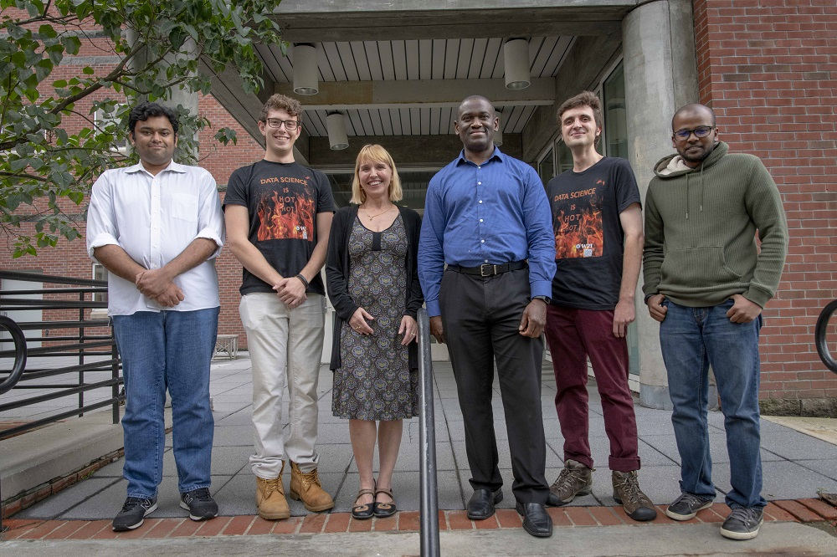

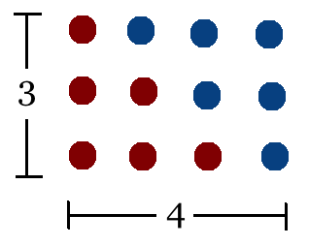
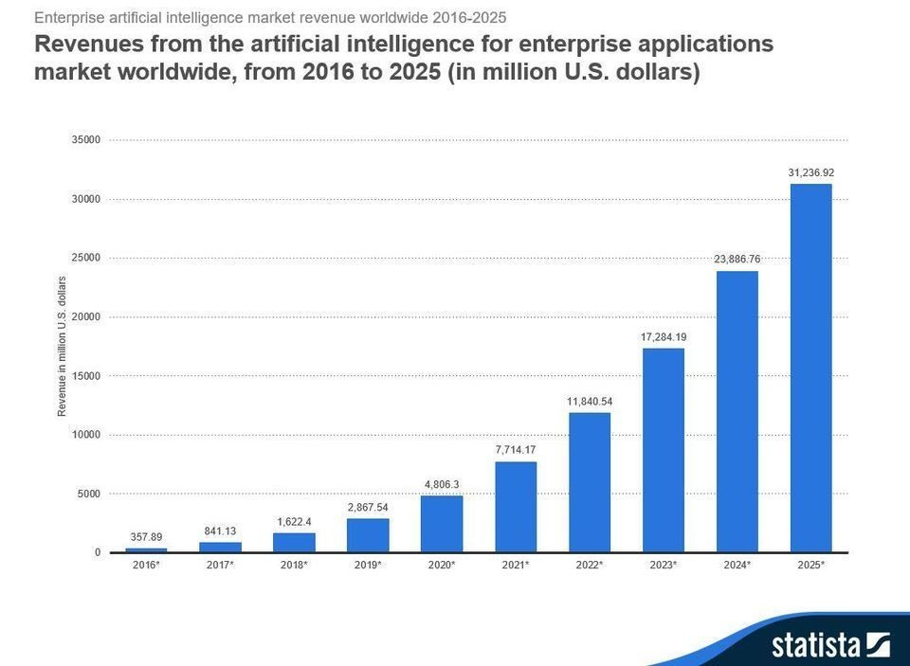
Student Choice – Interesting Articles 1/2
Facebook security breach: Up to 50m accounts attacked - Dave Lee, North America technology reporter, 2018-09-29
WPI Secures $2.8 Million to Develop a Smartphone App to Help Assess the Health of Soldiers, 2018-09-24
Quantified Toilets, 2014, Quantified Toilets LLC
What Did Ada Lovelace's Program Actually Do? - Sinclair Target, 2018-08-18 (First Programming Bug 1843?)
We know ethics should inform AI. But which ethics? - Mauro Guillen, World Economic Forum, 2018-07-26
Notes:
All Last Accessed 2018-10-04
TOOD: Add to first day slides.
Emacs – psychoanalyze-pinhead
doctor (implementation of ELIZA)
yow (quotes from Zippy the Pinhead zippythepinhead.com)

Slide 47
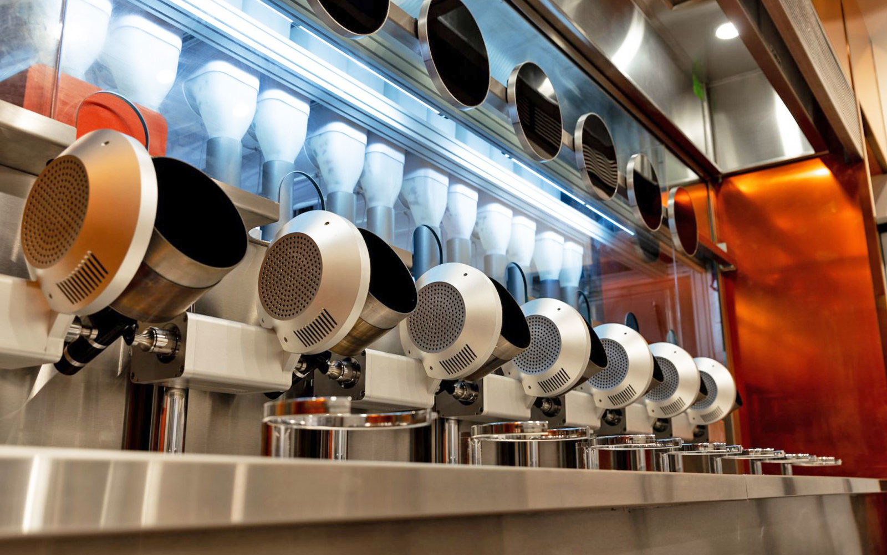
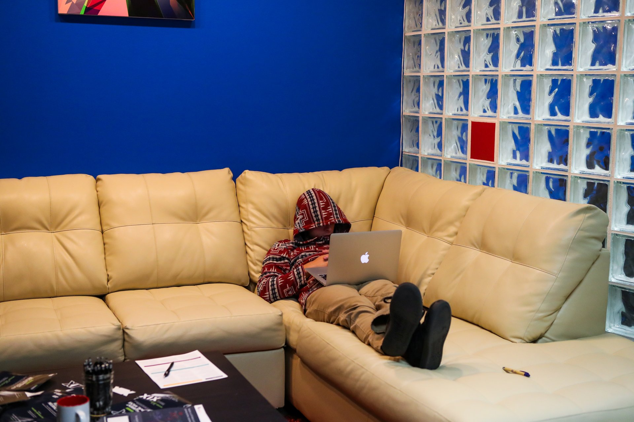
Student Choice – Interesting Articles 2/2
MIT-born Spyce raises $21M to open new robotic restaurants - Lucia Maffei, BostInno, 2018-09-07
The Coders Programming Themselves Out of a Job - Brian Merchant, The Atlantic, 2018-10-02
Notes:
All Last Accessed 2018-10-04
Spyce image: https://www.engadget.com/2018/05/04/boston-robotic-kitchen-spyce/ , 2018-05-04
Coders Programming Themselves Out of a Job image: Gabrielle Lurie, Reuters (date unknown)

Slide 48
Class 14 The End
Keith A. Pray
Instructor
socialimps.keithpray.net
Notes:
This is the end. Any slides beyond this point are for answering questions that may arise but not needed in the main talk. Some slides may also be unfinished and are not needed but kept just in case.

Slide 49
Evaluations
Use only BLUE or BLACK ballpoint pen
Use an X to mark (Do NOT fill in box)
Course Evaluation
Write MY NAME and COURSE TITLE in box at top of form
Keith A. Pray
CS 3043 Social Implications Of Information Processing
Return to Academic Advising Office in Daniels Hall
Include “Evaluation Sheet” cover letter
Notes:
No TA/SA this time
TA/SA Evaluation
Name:
Return to CS Department: Fuller 233

