Slide 1
Class 9 Errors Failures Risks
Keith A. Pray
Instructor
socialimps.keithpray.net
Notes:
Here’s the title slide. Excited already, aren’t you?
What is the point of this assignment? (Did SW Teams from the reading pick good test strategies? Will you be able to support your choices if something goes wrong?)
What errors? – Have student record list on board
Who looked for existing test strategies?
Who looked for directions on how to test currency?

Slide 2
Survey Results (1/5 Participation)
Participation too low to review
Papers will now be due 1 week after being assigned
Class discussion or activity based on papers will still occur the class after it is assigned
Code Test Paper will be accepted up until Saturday, 2020-04-25 at noon Eastern Time
Notes:
I’m going to switch back to in class paper mid-term surveys, response rate just too low. (but not with remote teaching…)
Common items for next time:
I am in FL 140 about an hour before and after each class
Estimated breakdown of course time per week:
4 hours class time
4 hours reading (2 chapters ~90 pages @ 2 minutes per page)
8 hours practicing mastery of material (papers, group project, class activity prep)
If you are spending much more than this let me know and we can figure out a more efficient way to spend your time

Slide 3
Grades To Date
33 Max Possible

Slide 4
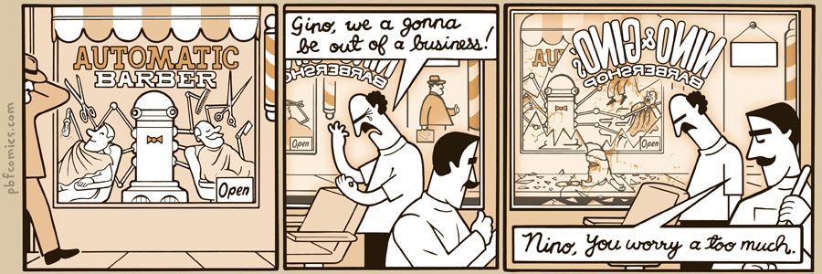
http://pbfcomics.com/197 (2014-09-26)
Notes:
10 – Errors, Failures, Risks

Slide 5
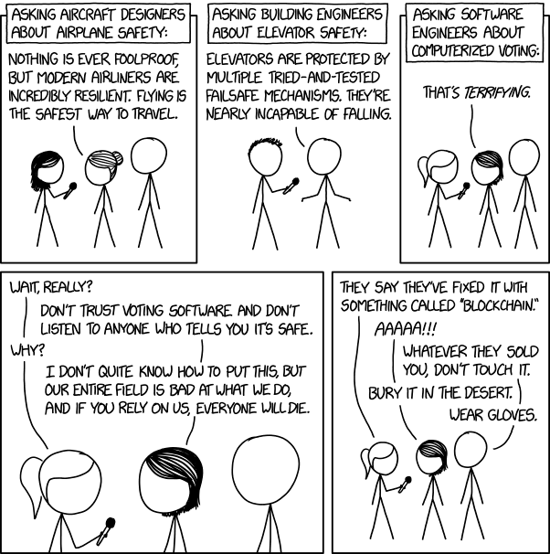
Overview
Guest Speaker
Review
Assignment
Students Present
https://xkcd.com/2030/ (2018-09-21)
Notes:
Good alternative if guest speaker not coming or late
Why Electronic Voting is a BAD Idea - Computerphile
https://www.youtube.com/watch?v=w3_0x6oaDmI
We can also discuss articles listed on Security Discussions under documents of course web site.
TODO: add quiz as backup if class discussion or guest speaker fail

Slide 6
My Reading Notes
pp. 366 Any false arrests since 1989?
pp. 368 Argument assumes DB cannot exist without existing inaccuracies.
pp. 373 This is not to keep the PATRIOT system from responding to false alarms.
pp. 375 Always encapsulate units! Not clear if SW involved.
pp. 376 Any SW diffs between Mars Missions?
pp. 378 Why did the Tokyo Stock Exchange refuse?
pp. 380 Republicans and Florida?
pp. 381. Do the second thoughts on DRE machines make the interview at end Chapter’s end less relevant?
pp. 389 No simulation examples since 2002?
pp. 390 Did The Limits to Growth predictions motivate people to change?
pp. 392 What happened to Verification?
pp. 394 “satisfies the specification” = verification. “needs of the user” = validation.
pp. 395 SW quality since 2009?
pp. 396 Gender bias nice addition!
pp. 406 21, source from 2004, is it implemented yet? 23 like game release question in next chapter.
Questions I liked: 10, 12, 16, 17, 18, 20, 21
Notes:
MSNBC on Denver's Automated Baggage System 2010-08-23 (2:27)
https://www.youtube.com/watch?v=xx8f4x6C_KY
Accessed 2019-04-09

Slide 7
Overview
Guest Speaker
Review
Assignment
Students Present
Notes:
We can also discuss articles listed on Security Discussions under documents of course web site.
ADD QUIZ AS BACKUP IF CLASS DISCUSSION OR GUEST SPEAKER FAIL

Slide 8
Assignment
Prepare for Debate
From Chapter 9 In-class Exercises # 24.
Should the company produce the game?
Use the SWE Code Of Ethics as the basis for your argument.
Use other sources for supporting data
Optional 1 paper on topic, lowest paper grade will be dropped

Slide 9
Self Driving Car Legislation
Michael Rossetti

Slide 10
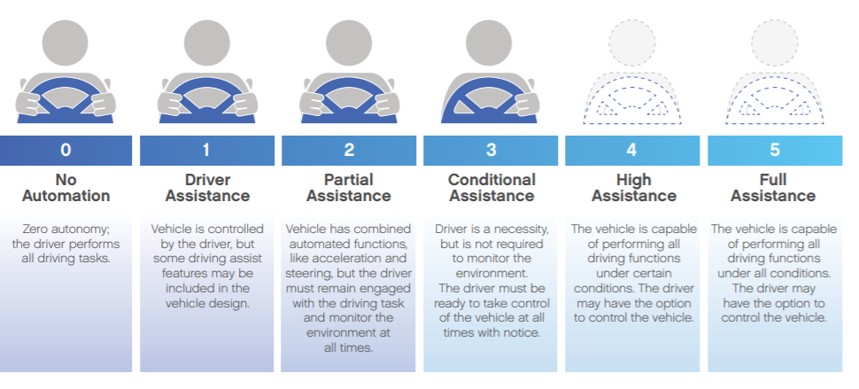
What Classifies as Autonomous Driving?
Michael Rossetti
[3]
Notes:
I am sure that everybody has heard of self-driving cars, but when looking at the legal aspects of these machines, it is important that we define what A.I vehicle is. The National Highway Traffic Safety Administration defines automated vehicles as vehicles with systems that automate or control certain features. This could be automatic braking, automatic parking, adaptive cruise control, or driving, but only if given control by the driver. Many cars on the road today that have A.I. have these systems. Autonomous vehicles are capable of operating without a human in almost all conditions. Currently, there are not any fully autonomous cars that are legally driving on roads, although there is testing.

Slide 11
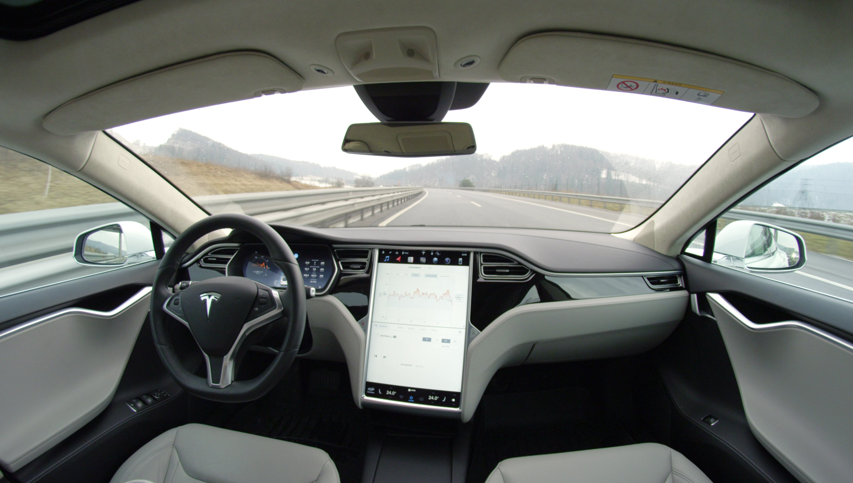
Why A.I. Vehicles Are Good
Michael Rossetti
Improves accident avoidance
30,000 deaths from collisions
2.2 million collisions with injury
Improve traffic conditions
Improve carbon emissions
Eliminate human elements
[6]
Notes:
If the United States is going to legislate self-driving cars, there has to be a need for them on the roads. In recent years, more and more companies are researching self-driving vehicles and systems. The ultimate goal is to make roads safer, more efficient, and more environmentally friendly. There are over 30,000 deaths in automobile collisions each year and 2.2 million crashed result in some type of injury. A.I. vehicles can add systems that improve the ability of a car to avoid collisions or remove human failings in driving, such as intoxication, fatigue, inexperience, and other issues.

Slide 12
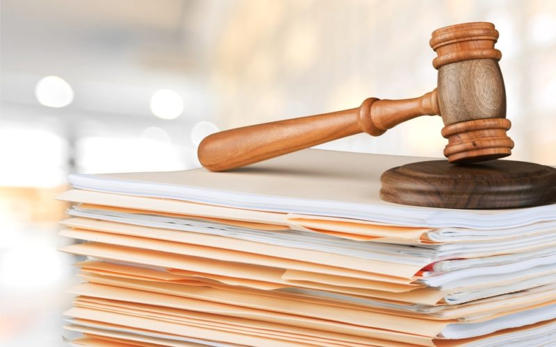
Current Legislation
Michael Rossetti
NHTSA Automated Driving Systems Guidelines
SELF-DRIVE Act
State Laws
Upcoming Legislation
[3],[4],[5]
Notes:
The National Highway Traffic Safety Administration created a set of guidelines for what technology should have to be on the roads. The federal government and states have enacted laws that regulate testing and operation of vehicles on public roads. Upcoming legislation hopes to address issues with fully autonomous vehicles. Another important aspect of upcoming legislation is the need of manufactures to implement security features in cars. If a vehicle is hacked and not controlled by its primary code, the company or driver cannot be possibly liable for any accidents caused.

Slide 13
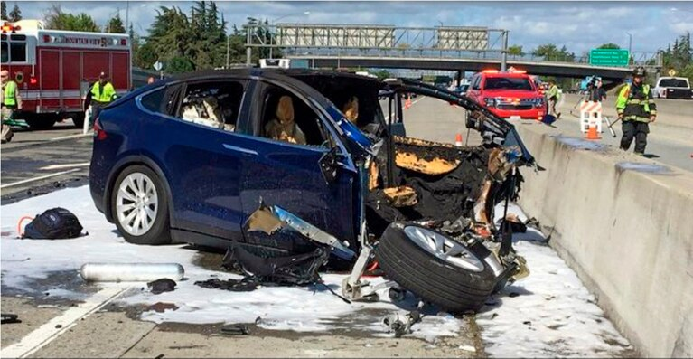
Accident Liability
Michael Rossetti
Operator of the Vehicle
Uber Crash
Tesla Crash
Car Manufacturer
Company of Vehicle
Volvo
Company of Software
[1],[2],[7]
Notes:
An important part of legislation is determining who is at fault for an accident caused by a self-driving car. Currently, there are no completely autonomous cars on the road. This leads many cases to find the vehicle operators responsible. Given that the vehicles have features that allow for automated driving assistance, they are not completely autonomous and require that a person have hands on the wheel and be able to operate the car if necessary. The National Transportation Safety Board found the driver of an automated Uber at fault when the vehicle hit and killed a pedestrian. Another incident that was deemed operator error was a Tesla single vehicle accident. The car had a tendency to veer and the operator did not have his hands on the wheel and was unable to take actions to prevent the accident.
Car manufactures could be held liable for vehicles in crashes if fully autonomous as they were the last to install parts into the vehicle. Some states have laws that limit liability though.
Some companies have taken it upon themselves to take blame in an autonomous accident. Volvo has decided that if any of their cars in autonomous mode were to get into an accident, the company is accepting full responsibility.
The last way liability could be given is through software development. This route has two different aspects. If the software is defective, the company designing it is responsible for the effects of their product. There is also an ethical dilemma. When programming vehicles to “make decisions” there will always be unknowns that could happen, or situations like the trolley problem, where the vehicles decision would result in an accident regardless.

Slide 14
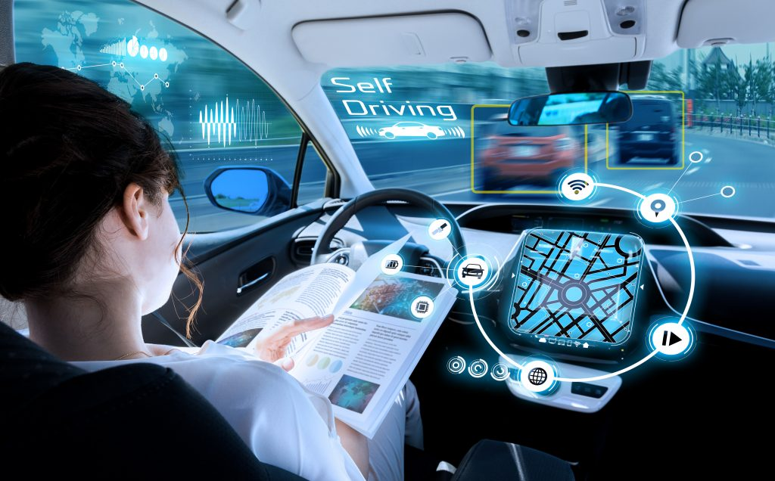
Conclusions
Michael Rossetti
Current legislation is not enough to handle the future of autonomous vehicles
Car companies or nobody should be liable in accidents.
Notes:
The current legislation of self-driving cars is not enough to handle advancements and autonomous cars on the road today or in the future. Most laws regulate tests or involve vehicles that have a human who could take control at a moments notice. As laws are created, liability will always be an important issue. From what I have researched, I feel that car companies should be liable for their vehicles accidents if there is no human operator. By monitoring the creation process and creating the car, companies can try to ensure that the vehicle is as safe as possible and even utilize insurance in case of accidents. If companies do not take fault, I feel that nobody would be liable. An artificial intelligence is capable of doing what it is told and cannot be punished in court. Even if one wanted to blame the software for an accident, the intention is to create the safest possible scenario and sometimes it is not possible to have 100% safety.

Slide 15
References
Michael Rossetti
[1] Davies, Alex & Marshall, Aarian, “Feds Pin Uber Crash on Human Operator, Call for Better Rules,” (WIRED, 2019, November 19), Retrieved April 22, 2020 from https://www.wired.com/story/feds-blame-uber-crash-on-human-driver-call-for-better-rules/
[2] Laris, Michael, “Tesla running on ‘Autopilot’ repeatedly veered toward the spot where Apple engineer later crashed and died, federal investigators say,” (The Washington Post, 2020, February 11), Retrieved April 22, 2020 from https://www.washingtonpost.com/transportation/2020/02/11/telsa-running-autopilot-repeatedly-veered-toward-spot-where-apple-engineer-later-crashed-died-federal-investigators-say/
[3] Jones Day, White Paper: “Legal Issues related to the Development of Automated, Autonomous, and Connected Cars,” (Jones Day, 2017, November),
[4] NCSL, “Autonomous Vehicles | Self-Driving Vehicles Enacted Legislation,” (NCSL, 2020), Retrieved April 22, 2020 from https://www.ncsl.org/research/transportation/autonomous-vehicles-self-driving-vehicles-enacted-legislation.aspx
[5] Rodrigo, Chris Mills, “House lawmakers close to draft bill on self-driving cars,” (The Hill, 2020, February 11), Retrieved April 22, 2020 from https://thehill.com/policy/technology/482628-house-lawmakers-close-to-draft-bill-on-self-driving-cars
[6] Sudzus, David B., “Autonomous Vehicles – Liability and Policy Issues,” (Drake Management Review, 2015, April), Volume 4, Issue ½
[7] Volvo, “US urged to establish nationwide Federal guidelines for autonomous driving,” (Volvo, 2015, October 7), Retrieved April 22, 2020 from https://www.media.volvocars.com/global/en-gb/media/pressreleases/167975/us-urged-to-establish-nationwide-federal-guidelines-for-autonomous-driving

Slide 16
Automated Patient Diagnosis and Treatment Selection
Kalani Picho
Notes:
Main question to address: “Could AI take the place of doctors in patient diagnosis and treatment selection?”

Slide 17
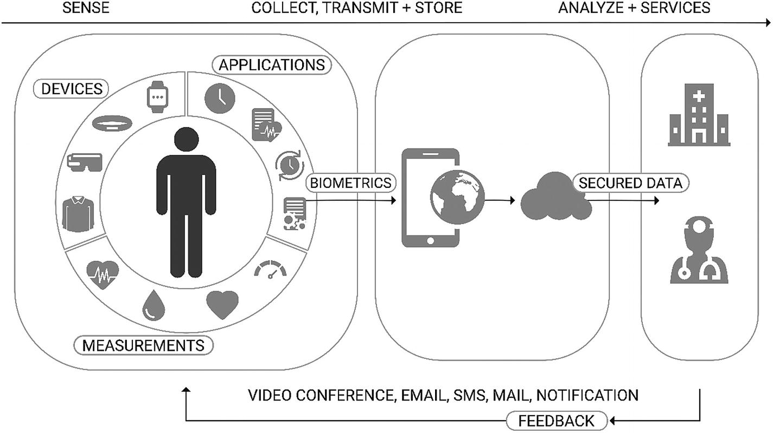
AI in patient diagnosis & healthcare
Kalani Picho
Condition Diagnosis
Personalized Treatment Plans
Support of Clinical Processes
Follow-Up Care
Prediction of Outbreaks
Image: [1]
[1][2]
Notes:
For the purposes of this presentation, consider AI as the simulation of intelligent behavior and decision-making by computer systems. [1]
AI has a variety of applications in healthcare, particularly in patient diagnosis and doctor support.
Diagnosis of patient conditions and differentiation between conditions with similar symptoms [2]
Creating treatment plans based on personal health data of patients [1]
Support of clinic operation and day-to-day processes [1]
Ensuring adequate follow-up care for patients after doctor’s apportionments [1]
Even used in prediction of disease outbreaks and other health crises [1]

Slide 18
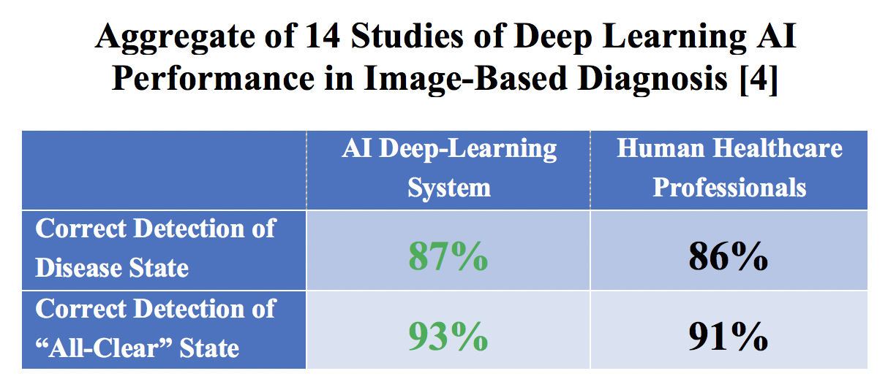
Medical AI development & Performance
Kalani Picho
IDx-DR: 1st FDA-Approved AI Medical Diagnostic
AI Performance: Matches & Outperforms Human Doctors
Image Analysis & Diagnosis
[3][4]
Notes:
While slow to adopt, AI has seen an increase in development and performance recently.
In April 2018, the FDA approved the first autonomous diagnostic system, known as IDx-DR. This system takes images of patient’s eyes and identifies cases of an eye condition known as diabetic retinopathy with an accuracy of 87.4%. The FDA has since released further guidelines about the evaluation and adoption of AI diagnosis technology. [3]
In terms of performance, automated diagnosis systems have been shown to match the performance of professionals, in some cases outperforming them. AI is especially effective with diagnoses that involve image scanning and processing. The chart on the right compares the performance of AI deep-learning system vs. human professionals evaluated in 14 studies involving image-based diagnoses. The results show that the AI detected both disease states and “all-clear” states with a frequency that matches the professionals, even doing slightly better. [4]

Slide 19
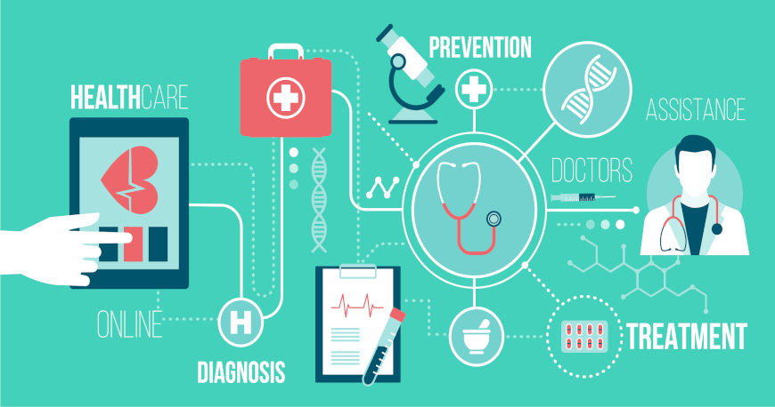
Benefits of ai in healthcare
Kalani Picho
Improved Accuracy
Increased Efficiency
Lower Cost
Objective Information
Image: https://medium.com/datadriveninvestor/humans-and-ai-hand-in-hand-for-better-healthcare-1cb61f489f12
[3][5][6]
Notes:
The use of AI by doctors and healthcare professionals can provide a number of benefits.
- As discussed in the previous slide, AI diagnosis can match and in some cases outperform doctor diagnosis. Also, the additional analysis and data provided by AI can assist with doctor diagnoses. [5]
- AI enables the faster providing of healthcare diagnoses and services, as it automizes certain time-consuming processes such as visual analysis of scan data. This allows doctors to focus more on providing for patients [6][3]
- AI can also low the cost of healthcare services by reducing the number of personnel, and in some cases removing the need for multiple in-person follow-up visits.
- In addition, studies have shown that patients are more willing to provide information to an AI than a human, especially when the information is negative, such as not taking prescribed medicine [5]. This results in more objective information gathering and gives doctors more accurate/complete information with which to diagnose patients. [5]

Slide 20
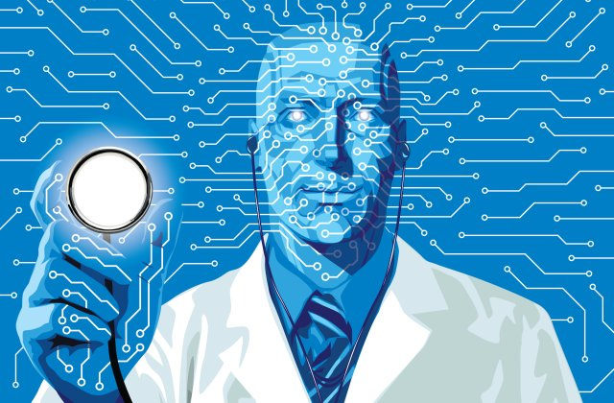
AI Roadblocks: Patient trust
Kalani Picho
Patients Trust Doctors vs. AI
Demand for Personalized Care
Risk of Bias
Response: Future Shift to Trust AI vs. Doctors
Image: https://www.myzeo.com/health/how-artificial-intelligence-can-improve-the-health-industry/
[1][3][6][7]
Notes:
Despite these shown benefits of AI in patient diagnosis, the widespread adoption of AI in healthcare faces a huge hurtle of gaining patient trust. One of the most prevalent reasons patients cited for not choosing AI-based healthcare is that they don’t believe AI will take into account the uniqueness of their personal healthcare. [7]
Insight provided by a 700-person survey: provided with two healthcare providers, one with superior accuracy and performance. Presented in two situations: one with two human doctors, and one with a human and superior AI. All respondents chose the better human doctor in the first scenario, but the majority chose the human doctor when faced with the AI. In other words, respondents would accept inferior healthcare in order to have a human doctor instead of an IA provider. [7]
In addition, like other machine-learning systems, healthcare AI runs the risk of being biased based on the datasets that it is exposed to. This could result in algorithms that benefit certain patient subgroups and further decrease trust. [1] [6]
However, a notable counter-point to this argument is that, with the development of highly accurate AI diagnosis systems, this gap in trust could shift to favor AI. As we’ve seen, AI is on par with and in some cases even superior at diagnosis than human doctors. Once the initial hurtle of gaining trust in AI is overcome, and AI is more widely adopted, we may see a shift in patient perception to trust AI over doctors. After all, doctors are not infallible, and it can sometimes be months or years before the errors that a doctor make become clear to the patient, while data management by AI can maintain more centralized records to keep track of the effectiveness of treatments. [3]

Slide 21
conclusion
Kalani Picho
AI shown to be a beneficial tool in improving patient diagnosis
Performance on-par with and exceeding human doctors
Barriers with patient trust: opportunity for future development and widespread adoption
[1][3][4][7]
Notes:
Based on performance and various positive applications in assisting doctors, AI has been shown to be a beneficial tool in automating and improving patient diagnosis. [1]
Performance of current AI deep-learning systems is on-par with human doctors, even outpacing performance in some applications. [4]
However, patients are still wary to trust an AI doctor, based on worries of not having unique care and the risk of machine learning bias [7]
AI currently best serves as an assistant to human doctors, but performance data is promising for potential replacement of many core responsibilities of healthcare professionals. [3]

Slide 22
References
Kalani Picho
Panesar, Arjun, “Machine Learning and AI for Healthcare : Big Data for Improved Health Outcomes,” (Apress, Feb. 2019).
Kaul, Monish et al., “Siamese bayesian networks for AI based differential diagnosis,” (HP3C, Mar. 2019), pp 45-59.
Lo, Chris, “Is AI paving the way to doctorless diagnosis?” (Verdict Medical Devices, Dec. 2019), https://www.medicaldevice-network.com/features/ai-diagnosis/ (22 April 2020).
Davis, Nicola, “AI equal with human experts in medical diagnosis, study finds,” (Guardian News & Media, Sep. 2019), https://www.theguardian.com/technology/2019/sep/24/ai-equal-with-human-experts-in-medical-diagnosis-study-finds (22 April 2020).
La Rosa, Emily and Danks, David “Impacts on Trust of Healthcare AI,” (AIES, Feb. 2018), pp 210-215.
Park, Sun Young et al., “Identifying Challenges and Opportunities in Human-AI Collaboration in Healthcare,” (CSCW, Nov. 2019), pp 506-510.
Longoni, Chiara and Morewedge, Carey K., “AI Can Outperform Doctors. So Why Don’t Patients Trust It?,” (Harvard Business School, Oct. 2019), https://hbr.org/2019/10/ai-can-outperform-doctors-so-why-dont-patients-trust-it (22 April 2020).

Slide 23
Submarine communication cables
Ann Jicha
Notes:
Today I am going to talk about submarine communications cables.

Slide 24
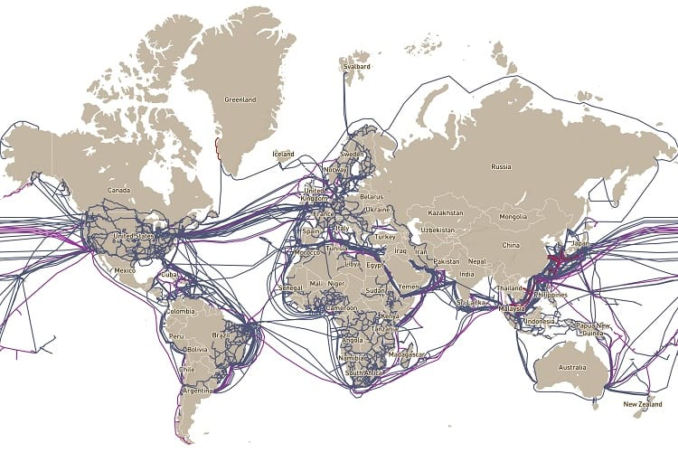
Submarine cables are the backbone of the internet
Ann Jicha
Historically used infrastructure
Faster and cheaper than satellites
Constantly improving
More physical protection
Higher speeds when transferring more data
Map of Submarine Communications Cables [10]
[1][9]
Notes:
When most people think about the internet, they don’t think of a physical infrastructure. Despite this, we rely on one to use the internet every day. Ninety five percent of all intercontinental communication travels through a network of submarine communications cables [1]. These cables use fiber optics to transfer data and, as you can see from the image, span all over the globe.
Submarine cables were in use for communication before the internet. Submarine cables in some form have been around since the 1820s and were used for technologies like the telegraph. 1979 was the first trial of a fiber-optic cable, which meant that the timing was right for it to be used as an effective tool to expand the internet. [1]
It is a common misconception that satellites are the way most data is transferred. Although they are used, cables are used more. Fiber optic cables are faster and cheaper. The specifics of how much faster and cheaper vary by cable. Satellites are a solution for providing internet to areas not reached by cables.
Cables themselves are constantly evolving [9]. As the internet gets more widespread, manufacturers are working to make cables able to transfer more data, faster. Switches like coaxial cables and improving repeaters (the mechanisms that ensure the signal is not lost over the distance) have enabled progress. Scientists work to ensure cables remain a fast, cheap method we can depend on for the internet.

Slide 25
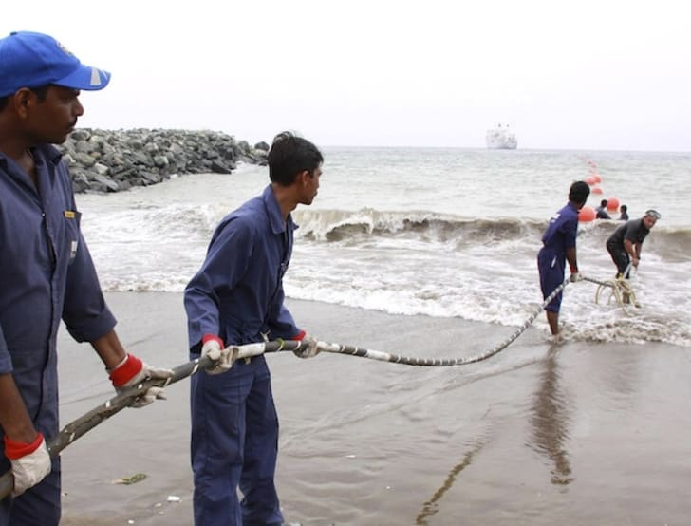
Cables are vulnerable
Ann Jicha
Natural disasters
Earthquakes
Storms
Human activity
Anchors
Trawling
Deliberate cutting
Cybersecurity concerns
Cable Being Laid [11]
[1][3][5][6]
Notes:
With all of this dependence, it’s important to think about how this network might be harmed. When experts talk about damages to submarine cables, it’s in terms of faults - a damage to a cable which is severe enough to affect transmission. Cables as they are currently manufactured have a lifetime of approximately 25 years, but there are a myriad of factors to cut that lifetime short. As you can see from this photo, the current size of cables is roughly that of a garden hose, and it is much more vulnerable than you might think [6].
The first category we will discuss is natural causes. Less than 10% of all faults are from natural causes [1]. Damages can be caused by earthquakes. In 2006 Taiwan Earthquake [1] cut 9 cables and it took 11 repair ships 49 days to restore service. Violent storms can also cause sediment disruptions that damage the cables. It’s especially important to remember that climate change can affect this by increasing ocean levels and worsening storms [1]. In some cases even curious sea life can cause damage, though not necessarily faults. Sharks and other curious sea life have been recorded biting the cable, causing Google to coat their cables in Kevlar [3].
The biggest source of faults is human activity. Approximately 65-75% of faults are from fishing and shipping activities [1]. Ironically, these activities are increasing as the global economy fueled by the internet expands. When laying the cables engineers try their best to avoid areas with a lot of traffic, but this is still an issue. The two most common activities causing faults are ship anchors and bottom trawling (a type of fishing involving dragging nets along the ocean floor). Cable companies try their best to keep fishermen aware of where the cables are, and in some areas this has led to the formation of collaboration committees aiming for mutual safety [1]. It’s not only harmful to the cable company when a cable has a fault, it is also dangerous to the ship. Nevertheless, this system is not perfect.
Experts are also concerned about the potential for deliberate cable cutting [5], though reported cases of faults from this are less concrete. This would be extremely dangerous if someone did it due to the amount of power in the fiber optic cables. It is still possible, and there are groups which have allegedly cut them, accidentally or on purpose. In 2013, the Egyptian government offered deliberate cutting as a possible explanation when 3 men were arrested in conjunction with a cable fault that slowed internet speeds in Egypt by 60%. Experts continue to be concerned by the possibility that malicious actors can easily access vulnerable cables.

Slide 26
Faults are costly and protections poorly addressed
Ann Jicha
History has shown devastating effects to faults
Extended interruptions in access
There is not enough redundancy
There are concerning gaps in legislative protections
Jurisdiction is complicated
Penalties are limited
[1][6][7][8]
Notes:
According to the UN, submarine cables are a critical communications infrastructure vital to the global economy and national security of all states [6.] It’s intuitive that the internet is important, and the damage caused by losing it can be difficult to quantify. These cables carry an excess of 10 trillion dollars a day in transactions [6]. The International Cable Protection Committee (ICPC) legal advisor estimates that interruptions of underwater fiber optics communications systems have a financial impact exceeding $1.5 million per hour [8] that they remain cut. Global manufacturing also relies on this network and would be cut short by a severe outage.
Historical faults, like the one in Taiwan, have left entire countries without vital internet. Trading in the Korean won was almost totally halted due to the communications disruption, and 98% of communications with nearby countries such as Japan, Singapore and Malaysia were disrupted, as were basic services such as email. When a cable breaks, it can have devastating effects on services in many countries. [7]
The cables lack redundancy in many places. There are clusters of cables which, if severed all at once, could cut the internet with no chance of rerouting [6]. Other areas offer only limited rerouting that would significantly slow internet speeds. If cables break, satellites cannot replace them completely due to the sheer volume of traffic in cables compared to in satellites [1].
International law on cyberattacks and on cables is fragmented, and so ways of dealing with people who cause faults are limited. The central criticism of the current legal approach is that because cables are private infrastructure, governments in general have been less active about enacting protections [7]. International cable protections are generally addressed by the United Nations Convention on the laws of the sea. Although that convention urges states to enact penalties for cable cutting, many states have not. The most common penalty for cutting is a fine. Other key missing areas [7], include how to address deliberate cutting and treatment of cables as targets during wartime. Some scholars are pushing for an international treaty to address these gaps and ensure that governments treat these cables like critical infrastructure nationally and internationally. [6]

Slide 27
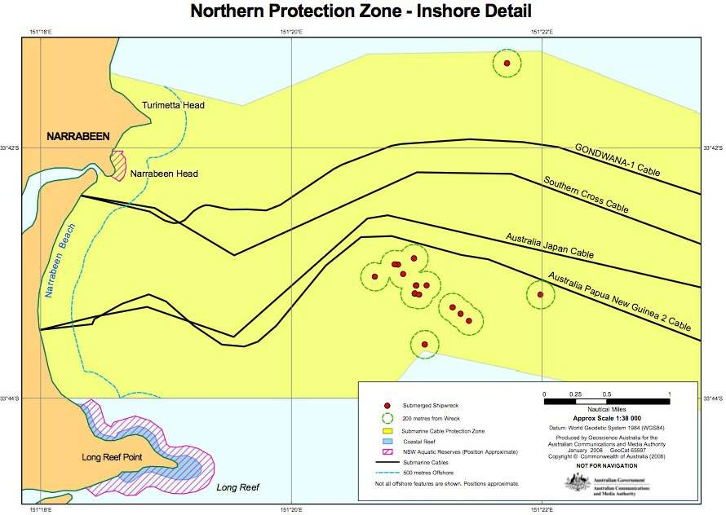
There are more steps to take
Ann Jicha
Cable Protection Zones (CPZs)
Collaboration with fishermen
Extended international legal protections
Well-articulated penalties
Clear jurisdictions
One of the Australian Protection Zones [7]
[7][6][9]
Notes:
More than half of the global population is now online, and demand for cables will only go up [2]. There are several strategies suggested and even implemented around the world to protect the reliability of the internet.
Experts laud countries that have taken steps to treat cables as critical infrastructure, most notably Australia and New Zealand. These countries designated areas around the cables as Cable Protection zones. In these areas, trawling, anchoring, and most other kinds of fishing are banned in order to protect the cables. Vessels who do not follow the rules of these zones are heavily fined. The International Cable Protection Committee advocates for the more widespread use of this approach. [7]
As discussed in the textbook, redundancy is important. Companies should take steps to ensure more redundancy [9] in their cable networks and ensure breakages do not interrupt service. They can also adopt more ways to communicate with fishermen about where the cables are and to avoid anchoring near them.
Experts argue international legal protections should be expanded in order to address the gaps. This could come in the form of an international treaty addressing specific protections. [6]

Slide 28
More countries should establish cable protection zones
Ann Jicha
This will limit the most common cause of cable faults
It will help maintain what should be considered critical infrastructure
[7]
Notes:
Internet reliability can be affected in unexpected ways, and it’s important to prepare for all of them. The Cable Protection Zone approach protects cables from the most common cause of faults, and also forces nations to treat these cables like the critical infrastructure that we know they are. Redundancy and international law should also be addressed, but CPZs are an effective first step. [7]
There should be more extensive laws in place for protecting these cables. But everyday people should also be aware of how much they rely on the ocean, and approach climate change, fishing, and their telecoms awareness to include this massive web of powerful fiber optics.

Slide 29
References
Ann Jicha
[1] Carter, B. et. al, Submarine cables and the oceans: connecting the world, (UNEP World Conservation Monitoring Center, 2009), https://www.unep-wcmc.org/system/dataset_file_fields/files/000/000/118/original/ICPC_UNEP_Cables.pdf?1398680911 (Accessed 23 April 2020)
[2] Satariano, A., How The Internet Travels Across Oceans, (New York Times, 10 March 2019) https://www.nytimes.com/interactive/2019/03/10/technology/internet-cables-oceans.html(Accessed 23 April 2020)
[3] Oremus, Will, The Global Internet Being Attacked by Sharks, Google Confirms (Slate, 15 August 2014), https://slate.com/technology/2014/08/shark-attacks-threaten-google-s-undersea-internet-cables-video.html (Accessed 23 April 2020)
[4] Osthoff, David et. al, Impact on submarine cables due to ship anchor-soil interaction, (Geotechnik, 8 May 2017), https://onlinelibrary-wiley-com.ezpxy-web-p-u01.wpi.edu/doi/full/10.1002/gete.201600027 (Accessed 23 April 2020)
[5] Chang, Alexandra, Undersea Cables are actually more vulnerable than you think, (Wired, 3 April 2013), https://www.wired.co.uk/article/vulnerable-undersea-cables (Accessed 23 April 2020)
[6] Davenport, Tara, Submarine Cables, Cybersecurity, and International Law: An Intersectional Analysis, (Catholic University Journal of Law and Technology, December 2015), https://scholarship.law.edu/cgi/viewcontent.cgi?article=1001&context=jlt (Accessed 23 April 2020)
[7] Sunak, Rishi, Undersea Cables: Indispensable, insecure, (Policy Exchange, 2017), https://policyexchange.org.uk/wp-content/uploads/2017/11/Undersea-Cables.pdf, (Accessed 23 April 2020)
[8] UnclosDebate, Underseas Cables are vital to global economy, (Unclosdebate, n.d.), https://www.unclosdebate.org/argument/861/underseas-cables-are-vital-global-economy (Accessed 23 April 2020), further reading
[9] Coffey, Valerie, Sea Change: The Challenges Facing Submarine Optical Communications, (Optics and Photonics, March 2014), https://www.osa-opn.org/home/articles/volume_25/march_2014/features/sea_change_the_challenges_facing_submarine_optical/#.VGv4NLfF-5M (Accessed 23 April 2020)
[10] Muckherjee, Dipanjana, Submarine Communications Cables: All It Takes to Keep the Internet Up and Running, (STSW, 23 June 2019), https://www.ststworld.com/submarine-communications-cables/ (Accessed 23 April 2020) image source
[11] Brown, David, 10 Facts about the Internet’s Undersea Cables, (Mental Floss, 12 November 2015), https://www.mentalfloss.com/article/60150/10-facts-about-internets-undersea-cables (Accessed 23 April 2020) image source

Slide 30
Class 9 The End
Keith A. Pray
Instructor
socialimps.keithpray.net
Notes:
This is the end. Any slides beyond this point are for answering questions that may arise but not needed in the main talk. Some slides may also be unfinished and are not needed but kept just in case.

Slide 31
Reliability Of Statistics
Are other factors controlled?
Is enough time covered?
Is all data reported?
Use Intuition
Are results reasonable?
Notes:
Power line dangers. Electromagnetic fields? PCBs in transformers?

Slide 32
Cost-Benefit Analysis
How much does it cost?
What do I get for this cost?
Notes:
Like a social contract.

Slide 33
Risk-Benefit Analysis
What could go wrong?
How likely is it?
How costly are the consequences?

Slide 34
Limitations to Risk-Benefit Analysis
Hard to quantify probabilities
Hard to quantify costs
Who bears the costs?
Are the potential benefits worth it?
Notes:
What is the value of a human life?
What is the value of a species?
E.g. future generations, poor people.
Omelas

Slide 35
Some Measures
Mean Time To Failure (MTTF)
Mean Time Between Failures (MTBF)
Mean Time To Repair (MTTR)
Notes:
Is it repairable?
What does it mean to repair? Running again? Data fixed? Caught up?
Restoring the GBC Web site.

Slide 36
Relying Too Much
Limits of modeling reality
Limits of precision
Limits of algorithms
Limits of interpretation
Notes:
Battle of the X-Planes
Trusting the statistics. Are differences significant?
Colin Chapman’s Lotus 7 chassis.

Slide 37
Producing Good Software
Good specifications
Good usability
Good design
Robustness
Good implementation
Testing
Notes:
Specs: Know what you are going to do. Often difficult. What does the customer want? What does the customer need?
Usability: Logical and intuitive, Consistent, Helpful, Complete, Accessible, Disability. Complete—not have to write things down.
Design: Logical, Modular, Consistent, Well-specified, Flexible, Extensible, Adaptable, New features, new platforms.
Robustness: Tolerant of data errors, Tolerant of human errors, Tolerant of network errors, Enough detail / not too much. Stack trace vs. “?” “A script error has occurred. Do you want to debug?”
Implementation: Adequate hardware (E.g. memory, storage, speed), Adequate software (Languages, OS, libraries), Internal and external documentation
Testing: Should be at all phases of the development cycle. Plan ahead for it. Consistent, repeatable, documented. Regression testing.

Slide 38
Plan For The Long Term
Version control
Future development
New platforms
Patches
Security
Training
Customer support

Slide 39
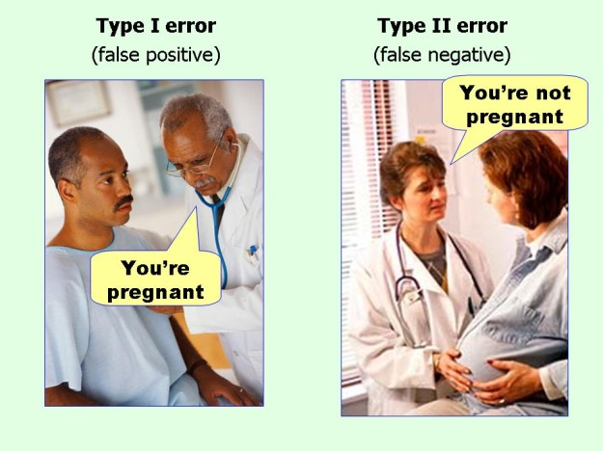
marginalrevolution.com/marginalrevolution/2014/05/type-i-and-type-ii-errors-simplified.html (2016-04-11)

Slide 40
Survey Results (1/2 Participation)
Notes:
I’m going to switch back to in class paper mid-term surveys, response rate just too low.
Common items for next time:
I am in FL 140 about an hour before and after each class
Estimated breakdown of course time per week:
4 hours class time
4 hours reading (2 chapters ~90 pages @ 2 minutes per page)
8 hours practicing mastery of material (papers, group project, class activity prep)
If you are spending much more than this let me know and we can figure out a more efficient way to spend your time

Slide 41
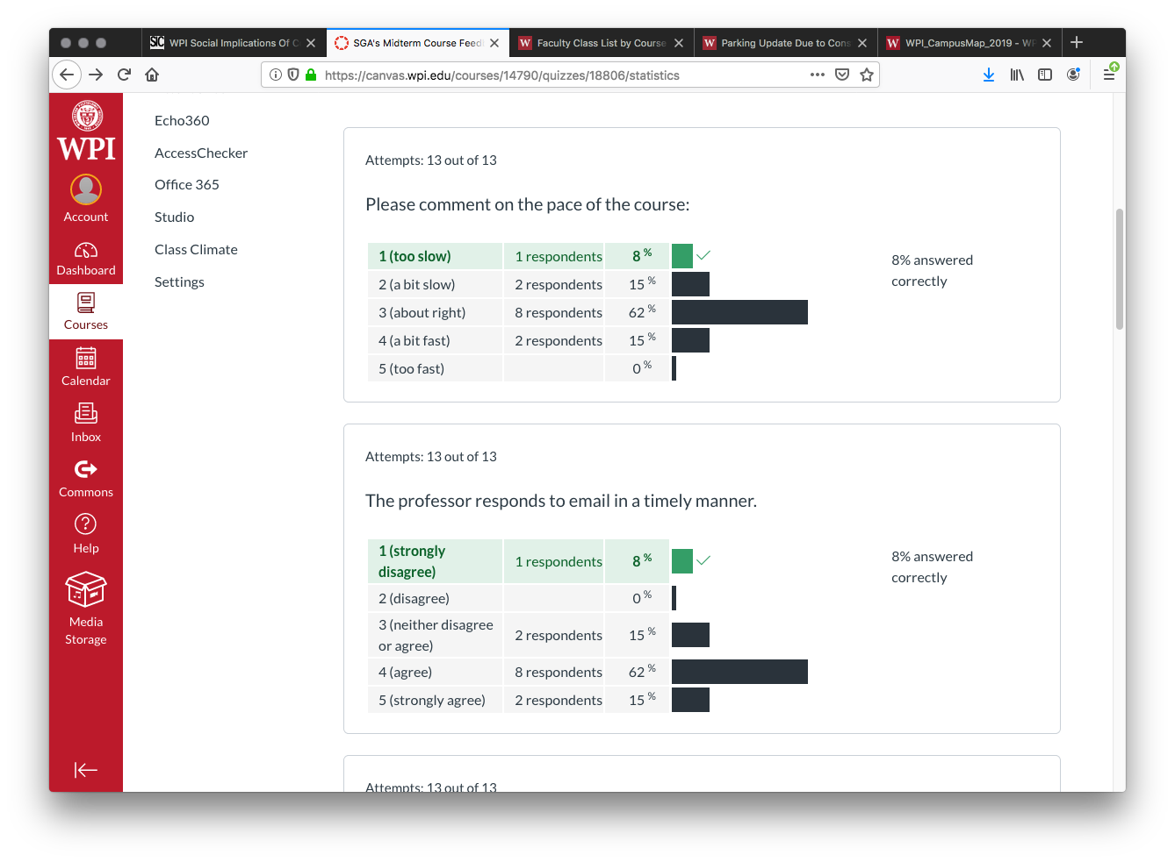
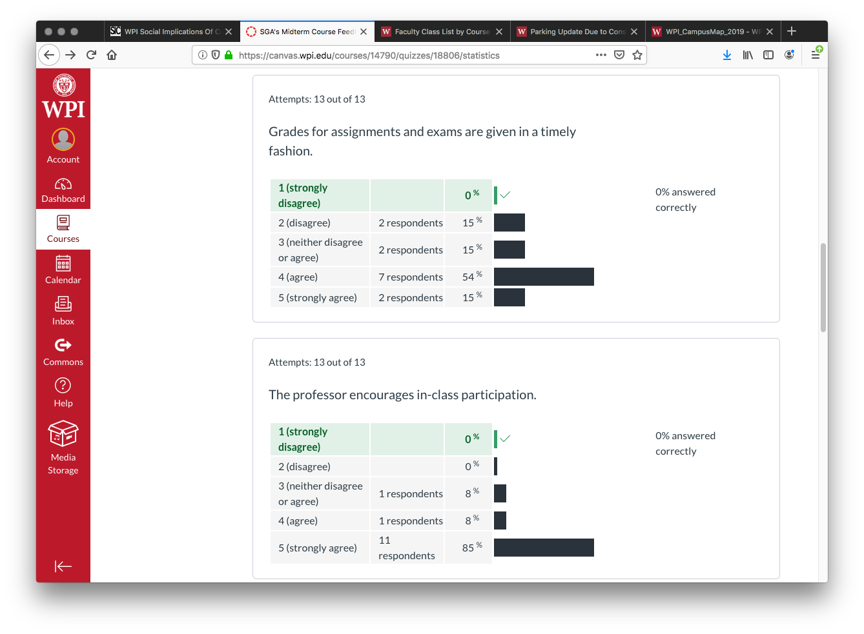

Slide 42
