Slide 1
Class 4 Freedom Of Speech
Keith A. Pray
Instructor
socialimps.keithpray.net
Notes:
Here’s the title slide. Excited again, aren’t you? You should be.

Slide 2
Let’s keep track of what works well Online and Remote
Sign in with First and Last Name
Stay muted unless you are going to speak
To speak use the raise your hand feature
To answer yes/no questions use the “yes” ”no” buttons
Chat is fine for questions
Turn your camera on if possible
Others?

Slide 3
Overview
Review
Assignment
Students Present
Notes:
Show syllabus updates if any

Slide 4
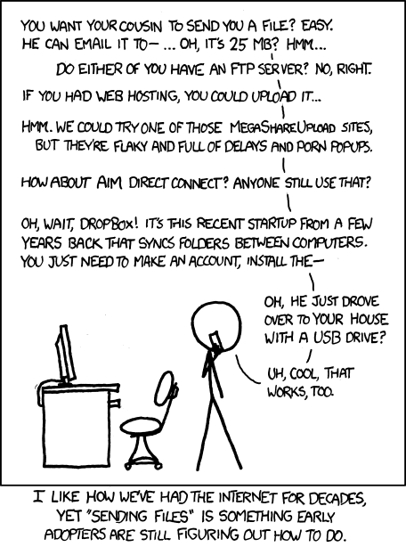
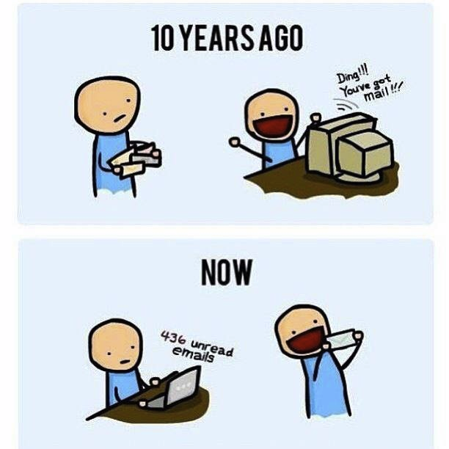
http://poofytoo.com/
25
http://xkcd.com/949/

Slide 5
My Reading Notes
pp. 110 What powers the cell phones and towers? “everyday tasks” not apparent from image.
pp. 114 Ann did not force people to complain.
pp. 117 7% # transactions or $$? Wikipedia critics source [19] from 2005, how has quality turned out? Nice to see darknet added.
pp. 118 [27] PC bangs youth source from 2003, all grown up now.
pp. 130 Is 20% realistic? What will search engines and facial recognition be capable of? Rule Utilitarian ignores the private setting.
pp. 131 Do any filters use image processing?
pp. 133 Stating people searching did not consent to material being blocked makes more sense.
pp. 134 Web access for no cost?
pp. 145 More accurate to say addicted to single app - good
pp. 149 20 same as 39
pp. 150 36 same as 42
End of Chapter questions I liked: 2, 25 http://en.wikipedia.org/wiki/Wikipedia:Citing_Wikipedia

Slide 6
Group Quiz
Name two methods some governments use to control access to information.
A large company has a policy prohibiting employees from blogging about company products.
Name two possible reasons for the policy.
Does it violate the First Amendment? Why?
Is it reasonable? Why?
What does “URL” stand for and what is it?
Notes:
Censorship (religious, governmental, private). Adult authentication. Firewalls. Government owned media outlets.
First Amendment prohibits Congress from making laws limiting free speech, not private companies.
Uniform Resource Locator

Slide 7
Overview
Review
Assignment
Students Present
Notes:
But before that:
CPG Grey - This Video Will Make You Angry [Thought Germs] (7:25)
https://www.youtube.com/watch?v=rE3j_RHkqJc
If not shown yet:
What "Orwellian" really means - Noah Tavlin (5:31)
http://ed.ted.com/lessons/what-orwellian-really-means-noah-tavlin
Cedric Gervais - Hashtag (Original Mix) (3:58)
https://www.youtube.com/watch?v=6OmBKd7X7EE
Dave Audé vs Luciana - You Only Talk In #HASHTAG (3:36)
http://www.youtube.com/watch?v=53wIN87lJn0

Slide 8
Assignment
Reading
Individual Presentations
Extra Credit – One page paper
Is WPI’s IT Acceptable Use Policy morally acceptable?
Work on your group project
Groups will be announce by midnight tomorrow
See full group project description on course website
Send Web Site URL before next class
Notes:
- Or review group project and individual presentation guidelines right now. - Respond with top 3 choices by noon tomorrow
Possible One page paper:
Global intellectual property laws, friends or foes?
Group Happiness 1 = everyone got first pick, 2 = everyone got second pick, etc.
Average Group Happiness 1.21

Slide 9
Overview
Review
Assignment
Students Present

Slide 10
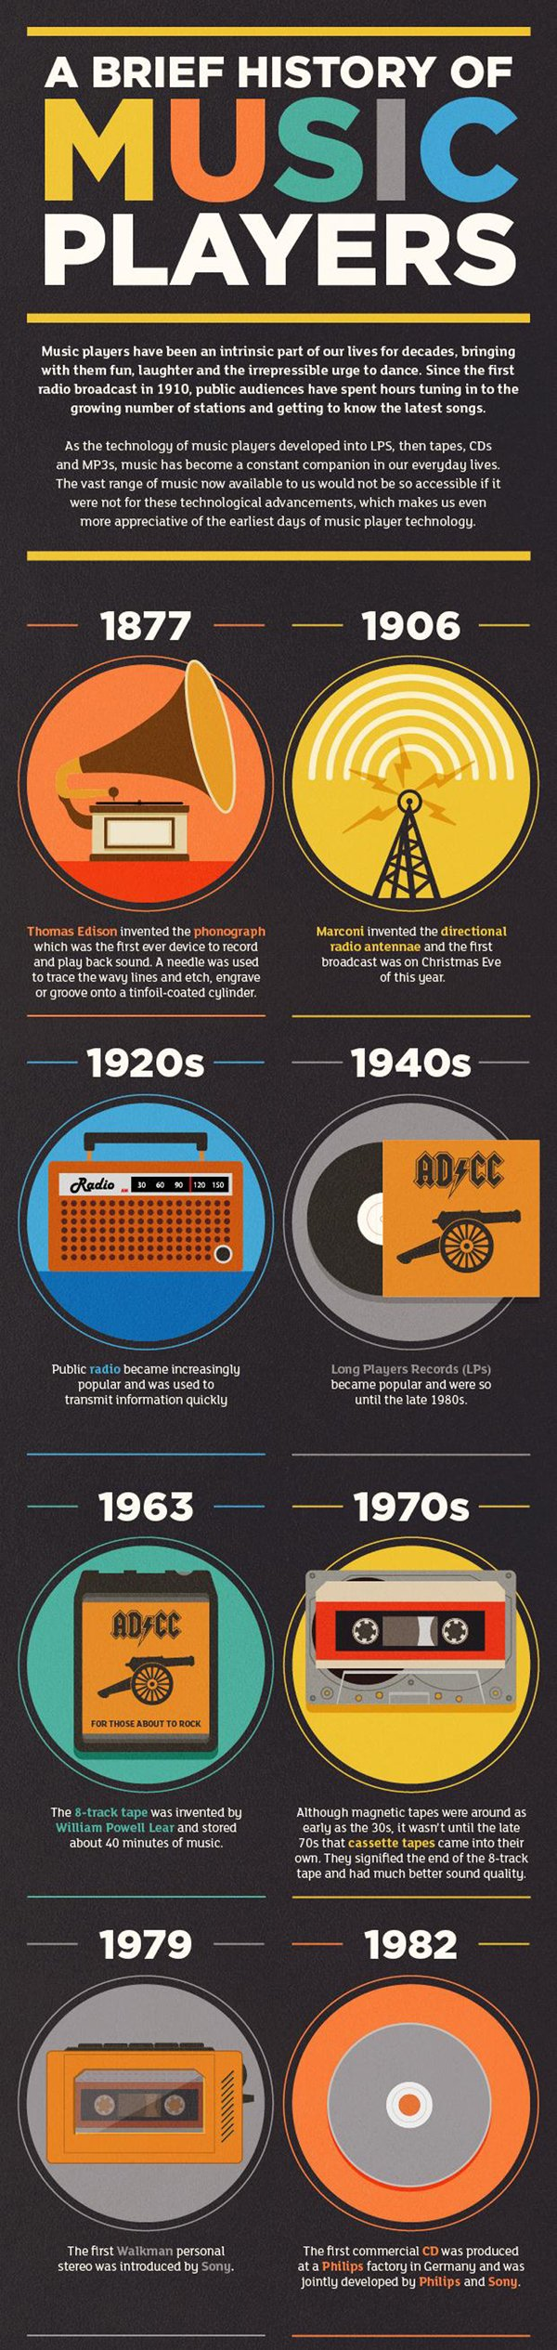
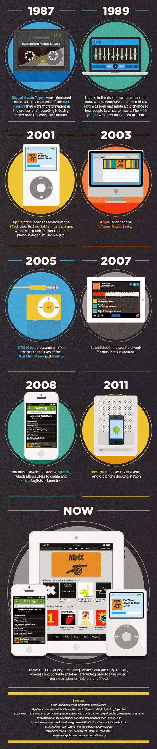
The Rise of Music Streaming
Pooja Patel
History of Music Players: [1]
Notes:
I will be discussing the rise of music streaming services and how it has impacted society.
The question guiding my presentation is, “How has the widespread adoption of smartphones and other smart devices led way to the rise of streaming services?”.
I briefly wanted to show how streaming became the phenomenon it is today by displaying the methods to which music has been accessed over time.
Before listening devices, in-person was the only way to hear music.
But the developments of the phonograph, radio, and handheld music players increased the connectivity of music to people.
For streaming services to be available today there were was a fast progression in the development of computing technology.
Mostly taking place during the 80’s and 90’s
For example in 1987 Digital Audio Tapes were introduced but only 2 years later in 1989 MP3 was introduced as a result of the rise in computers and the internet.
Not long after, portable handheld devices (the iPod, smart phones, tablets) had the functionality to connect to networks and communicate to other devices

Slide 11
The Rise of Music Streaming
Pooja Patel
History of Music Players: [1]
Notes:
With each advancement there was an improved way for connection and communication that has led to where we are now.
Today streaming is the latest development to how music is accessed.
And streaming has been developed through peer-to-peer networks with encoding, decoding, routing, data transfer, and media playing

Slide 12
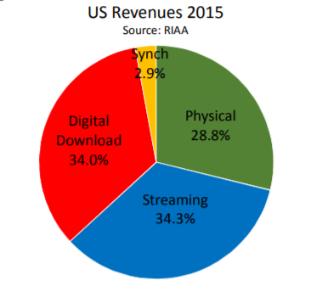
Current State of Streaming Services
Pooja Patel
Streaming: the continuous transmission of audio or video files from a server to a client.
Streaming is what happens when consumers watch TV or listen to music on Internet-connected devices. [2]
Popular music streaming services: Spotify, Apple Music, and Pandora Radio [3]
2015 U.S. Music Industry Revenue by Sector: [4]
Notes:
I'm going to begin with discussing the current state of streaming services.
Streaming is the continuous transmission of audio or video files from a server to a client
It’s what happens when a consumer is watching tv or listening to music on an internet connected device.
The top three most popular music streaming services based on the number of active users are Sportify, Apple Music, and Pandora.
Looking at Figure 1, in 2015 the United States music industry revenue for streaming services constituted only 34.3% of music industry revenue followed by digital download and then physical.
If we look further back the revenue generated by streaming only gets smaller, and the revenue generated by digital download and physical hold the majority

Slide 13
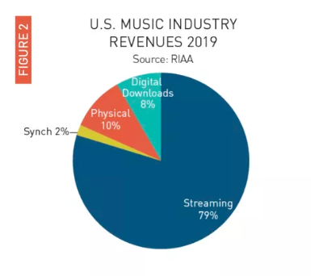
Current State of Streaming Services
Pooja Patel
Music listening moved from tangible products and downloads to online services
Streaming includes:
Paid subscriptions
Ad-supported on-demand
Digital and customized radio services
Streaming market in the United States is not representative of the global market [5]
2019 U.S. Music Industry Revenue by Sector: [6]
Notes:
Looking at Figure 2, in 2019 streaming services generated 79% of the total revenue in the U.S. music industry.
Clearly, we can see the market for streaming services has grown in those years
And so we see consumer behavior has changed away from tangible products and downloads to online services.
The revenue generated from streaming includes paid subscriptions, ad-supported on-demand, and digital customized radio services.
Even though streaming has produced the most revenue in the United States market it is not at the same degree in the global market.
Based on 2018 data, streaming only accounted for 47% of the global music industry revenue, followed by 25% for physical and the remaining for other distribution methods

Slide 14
Streaming Services and Free Speech
Pooja Patel
Free speech is accepted into most streaming services
Spotify updated their policy around hate content (2018) [7]
Does not permit “content whose principal purpose is to incite hatred or violence against people because of their race, religion, disability, gender identity, or sexual orientation. ”
Hateful conduct by artists “may affect the ways [Spotify] work with or support that artist or creator.”
Notes:
Though most music streaming services have integrated free speech into their terms and conditions some have policies in place that appear to be censorship
Not too long ago, the popular streaming service Sportify announced a policy change surround hate content
Essentially, content that incites hatred or violence against people because of their race, religion, disability, gender identity, or sexual orientation may be subject to removal
Additionally, if an artist is seen to be involved in hateful conduct Spotify takes the liberty to adjust how that artist is promoted on the platform.

Slide 15
Adoption of Streaming Services
Pooja Patel
Discovery of new music
Easier for users to share
Faster access to new releases
Instant gratification
Cut back on the amount of money spent on music
Users can choose from free plans or paid plans with benefits
Limitless access
This leads to increase in the total consumption of music
Conclusions: [8]
Notes:
Drawing some conclusions from the data, some of the factors leading to the adoption of streaming include:
Users can discover new music easily
Also users can share what they are listening to and create playlists
Moreover, streaming services have been integrated with social media platforms
The time it takes for a user to hear new releases is instant
Users can either use streaming apps for free or with a paid plan that provides additional benefits
And streaming services are like libraries with a large selection of music paired with limitless access

Slide 16
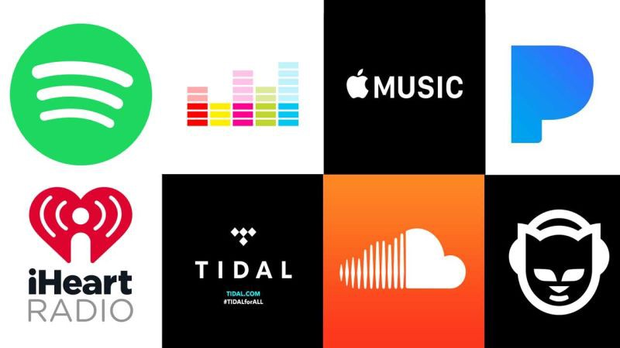
Implications of Streaming
Pooja Patel
Physical copies of music will continue to decline
Music piracy will continue to decline
Users are drawn to streaming for convenience, access, and instant listening
Streaming services will continue to tailor content to its users
Implications: [9]
Streaming Services: [10]
Notes:
As a result of the adoption to streaming services, consumer behavior has changed.
Some implications of the rise of streaming services are:
Revenue generated from physical copies will continue to decline
Music piracy will also continue to decline because music has been made so accessible
Users are drawn to streaming services over other distribution methods because it offers convenience, easy access, and instant listening.
Streaming services are taking data from users to provide more individual listening experiences by continuing to tailor content to its users
And because of the increasing reliance and developments in computing technology streaming will continue to be the format that is used most

Slide 17
References
Pooja Patel
[1] Infographic: A brief history of music players (Virgin, n.d.), https://www.virgin.com/music/infographic-brief-history-music-players (Accessed: 4/6/2020)
[2] What is streaming? | How video streaming works (Cloudflare, n.d.), https://www.cloudflare.com/learning/performance/what-is-streaming/ (Accessed: 4/6/2020)
[3] Amy Watson, Most popular music streaming services in the U.S. 2018-2019, by audience (Statista, March 11, 2020), https://www.statista.com/statistics/798125/most-popular-us-music-streaming-services-ranked-by-audience/ (Accessed: 4/6/2020)
[4] Joshua Friedlander, News and Notes on 2015 RIAA Shipment and Revenue Statistics (RIAA, 2016), https://www.riaa.com/wp-content/uploads/2016/03/RIAA-2015-Year-End-shipments-memo.pdf (Accessed: 4/6/2020)
[5] Global Music Report 2019- State of the Industry (IFPI, 2019), https://www.ifpi.org/news/IFPI-GLOBAL-MUSIC-REPORT-2019&lang=en (Accessed: 4/6/2020)
[6] Dani Deahl, Music revenue saw big growth last year, thanks to a jump in paid streaming subscribers (The Verge, February 26, 2020), https://www.theverge.com/2020/2/26/21154504/riaa-report-paid-subscriptions-93-percent-streaming-revenue-growth-2019 (Accessed: 4/6/2020)
[7] Spotify Announces New Hate Contnent and Hateful Conduct Public Policy (Spotify, May 10, 2018), https://newsroom.spotify.com/2018-05-10/spotify-announces-new-hate-content-and-hateful-conduct-public-policy/ (Accessed: 4/6/2020)
[8] Mehmet Delikan, Changing Consumption Behavior of Net Generation and the Adoption of Streaming Music Services (Jonkoping International Business School, June 2010), http://www.diva-portal.org/smash/get/diva2:324142/FULLTEXT01.pdf (Accessed: 4/6/2020)
[9] How Music Streaming Works and The Popular Music Streaming Trends of Today (Soundcharts, June 13, 2019), https://soundcharts.com/blog/how-music-streaming-works-trends (Accessed: 4/6/2020)
[10] Christina Warren, Streaming Music Services, From Most Screwed to Least Screwed (Gizmodo, 2017), https://gizmodo.com/streaming-music-services-from-most-screwed-to-least-sc-1793612699 (Accessed: 4/6/2020)
Notes:
Here are my references.

Slide 18
Automating misinformation dissemination
Xiaoyue Lyu
Notes:
In late 2016, Oxford Dictionaries selected “post-truth” as the word of the year, defining it as “relating to or denoting circumstances in which objective facts are less influential in shaping public opinion than appeals to emotion and personal belief.” As people become more and more used to get their daily news from the internet rather than traditional newspaper or evening news, social media as a key source of news content has created a new ecosystem for the spreading of misinformation. Such phenomena and the reasons behind it lead me to the topic that I am going to present today. Automating misinformation dissemination. The question I am attempting to answer is why the spread of falsity is outpacing the truth on online platforms such as Google, Twitter, etc.

Slide 19
“Falsehood flies, and truth comes limping after it.”
-- Jonathan Swift 1710
Notes:
Intuitively, we may blame bots and social media algorithms for spreading unverified information. But is it the whole story? Misinformation itself is not a new concept, it has been around our society for long. Early in 1710, there has already been a famous saying from the essayist Jonathan Swift that said "falsehood flies, and truth comes limping after it," indicating false information is always spreading with a greater velocity than the truth.

Slide 20
Why is misinformation spreading?
Xiaoyue Lyu
· Negativity bias
· Novelty hypothesis
Notes:
Specifically, false information often contains more novelty and frequently triggers negative emotions, these two features of information always grab our attention and make us want to share with others, without considering about the creditability of the information at all.

Slide 21
NEGATIVITY BIAS
Xiaoyue Lyu
· Negativity is essentially an attention magnet
· Both Activeness and attentiveness increase when reading negative news stories_{[1]}
· People love reading negative news_{[2]}
[1] Soroka et al. (2019). Cross-national evidence of a negativity bias in psychophysiological reactions to news.
[2] BBC News(2014). Russia: 'Good news day' decimates website's readership.
Notes:
First, let's take a look at the first feature, negativity bias. According to Wikipedia, negativity bias is a notion that even when of equal intensity, things of a more negative nature have a greater effect on one's psychological state and processes than neutral or positive things.
The relationship between the spreading of the misinformation and negativity bias has been addressed by findings published in September 2019, where the authors suggested that all around the world, the average human is more physiologically activated by negative than by positive news stories.
By capturing a combination of activation (increasing heart rate) and attentiveness (decreasing heart rate), the study examined negativity biases in terms of psychophysiology, which leads to a result that participants exhibited higher variability in heart rate during negative news stories than they did during positive news stories, which reflects higher attentiveness and arousal during reading negative stories[1].
People may argue, it is not we human beings like negative news, no one likes anger, sadness, and anxiety, but there are just too many bad things taking place every day that they have almost used up every inch of social media timeline. But, is it? To argue this here is an actual example that showed us what would happen if a news site chooses to report good news to its readers for the entire day. [4]. Therefore, we human beings love reading negative stories by nature, even if the news itself contains unverified information.
Therefore, we human beings love reading negative stories by nature, even if the news itself contains unverified information.

Slide 22
Novelty hypothesis
Xiaoyue Lyu
Novel and emotional content earn more popularity
Findings indicate misinformation is more novel than the truth across all novelty metrics_{[3]}
[3] Vosoughi et al. (2018). The spread of true and false news online.
Notes:
In addition to negativity bias, there is another feature of misinformation that people like. That is the novelty. People on social media are not always for news, but also socializing, seeking excitement, and expressing themselves. Therefore, which piece of news will get the most reposts and likes does not necessarily have to depend on the content and truthfulness, but which one is more catchy and therefore can spark more conversations online. That being said, fake news stories, since the events they describe never really happened, are always novel.
According to the authors of a report focused on studying the dissemination of both true and false news, they found that falsehood diffused significantly farther, faster, deeper, and more broadly than the truth in all categories of information, and the degree of novelty and the emotional reactions of recipients may be responsible for the differences observed.
The authors tested the novelty level of both falsity and the truth by randomly choosing 5000 twitter users who have propagated false or true rumors and analyzing how novel the information in the true and false rumors was. It turns out that false rumors are significantly more novel than the truth across all novelty metrics.
Their study further highlighted that the effect of emotional elements in terms of news-sharing on social media. They indicated that reading true news mostly triggers positive emotions such as joyfulness, expectation, and trust, while reading fake news produces feelings of anxiety, repulsion, and shock. The researchers suggested that these emotions are crucial when deciding to share something on social media.[3]

Slide 23
conclusion
Xiaoyue Lyu
Humans’ inclination for negativity and novelty allows misinformation dissemination

Slide 24
References
Xiaoyue Lyu
[1] Soroka, S., Fournier, P., & Nir, L. (2019). Cross-national evidence of a negativity bias in psychophysiological reactions to news. Proceedings of the National Academy of Sciences, 116(38), 18888–18892. doi: 10.1073/pnas.1908369116
[2] BBC News(2014, December 4). Russia: 'Good news day' decimates website's readership. Retrieved April 4, 2020, from https://www.bbc.com/news/blogs-news-from-elsewhere-30318261
[3] Vosoughi, S., Roy, D., & Aral, S. (2018). The spread of true and false news online. Science, 359(6380), 1146–1151. doi: 10.1126/science.aap9559

Slide 25
Internet free Speech
Benjamin M’Sadoques

Slide 26
People should care more about internet free speech
Benjamin M’Sadoques
What is free speech?
The internet allows many forms of expression
People value freedom of speech
[1][2][5][7]
Notes:
What is free speech?
“The first amendment of the constitution explicitly guarantees freedom of speech, expression, press, etc. it is the right to express oneself how they see fit, sorta. It is no longer a negative right and regulating speech requires government protection to keep society working smoothly. [1] Many types of speech are not as protected such as obscenity, fighting words, defamation, etc. [6]”
“The internet allows many forms of expression
Such as text, pictures, videos, and audio. People communicate globally across many countries, each with their own speech restrictions. [1] To simplify regulations, I will focus on the United States legal system since it’s likely somewhat familiar.”
“People value freedom of speech
To understand and discover truth, to fulfil oneself, [2] to allow people to participate in developing culture and democracy [5]. On the internet, anyone can try and prevent you from exercising your free speech. The internet makes both protecting and regulating freedom of speech challenging. I will not propose a solution. Rather, I aim to inform you on internet free speech and convince you to care, and give you some tools to start.” NEXT

Slide 27
Free Speech is not an absolute right
Benjamin M’Sadoques
We can exercise our own judgement
Many people are concerned but not enough
The law serves as a good starting point
The Brandenburg Test
[2][3][5][10]
Notes:
We can exercise our own judgement
“Many people want to restrict freedom of speech, they may claim to support it but often try to ‘shout down or shut out’ what they dislike or disagree with. They may deem racism, hate speech, or even religion to be unsuitable for everyone rather than let people decide what they enjoy [2]. according to “self-governance theory”, People should be able to exercise their own judgement to speak freely to contribute to society [5].
Many people are concerned but not enough.
“According to a study done by CIGI, Only 64% of the world internet users are concerned about internet censorship… (elaborate)
“Some expressions have been restricted because they keep people from participating on the internet; one spottable example is ‘fighting words’. It can be difficult to judge if some speech may carry over into the real world.”
“The BrandenBurg Test
Allows the government to restrict free speech that may invoke illegal action and could be potentially dangerous. If the speech is “directed to inciting or producing imminent lawless action,” AND The speech is “likely to incite or produce such action.” [3] The context and specifics of the speech matters. For example, if someone posts on facebook, “Let’s trash the school!” They did not specify a call to action, or any details, whereas if someone from Boston Massachusetts posts “Let’s trash Harvard Square tomorrow at noon,” is more likely to incite illegal action.” NEXT

Slide 28
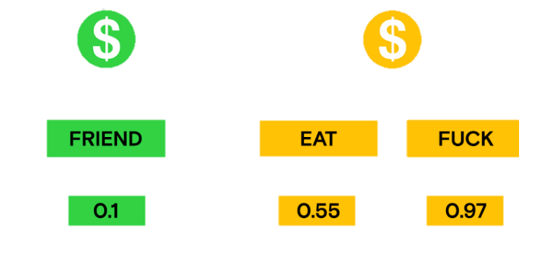
The Government isn’t the only regulator
Benjamin M’Sadoques
Platforms regulate more than people realize
They hold lots of power to regulate content
YouTube
?
YouTube’s Hidden Confidence
Threshold [9]
[2][3][7][9]
Notes:
Platforms regulate more than people realize
“Platforms hold a lot of power on how they regulate content.
Their process can determine what content they promote and what voices they silence. Youtube, for instance, scans content using bots to determine monetization, ratings, and who will likely see the video. Demonetized videos can be submitted for human review, this review trains the AI system to help improve its judgement. Demonetized videos are often suppressed from recommended and receive far fewer views than monetized videos. But content creators are given little information on exactly what words or content is not advertiser-friendly. For example, LGBT cretors may be demonetized for using ‘gay’ or ‘lesbien’ in their videos so they have to unreasonably censor themselves, unable to use their own terminology in perfectly reasonable context and videos. Yet, Youtube promotes gay pride by creating videos in support. [7] (Figure) A study done by Sealow and continued by Youtube Analysed tested over 15-thousand words. Youtube’s bots have a hidden confidence threshold between 0 and 1. Many of the results make sense, but they found over 300 outliers that should be perfectly acceptable such as brand names. [7]. Regulating content in methods not-explicitly stated keeps people from being able to govern themselves.” NEXT

Slide 29
We need alternate platforms
Benjamin M’Sadoques
Press Freedom Index
Media freedom rating
180 countries
[8]
Notes:
“The Press Freedom Index
“Is a score given yearly to countries that measures the level of media freedom in 180 countries and territories. A lower score is better. In 2019, Only 8% of countries have a good situation, and 15% have a satisfactory situation. The top countries were Norway, Finland, Sweden, and the Netherlands. The bottom countries were Vietnam, China, Eritrea, North Korea, and Turkmenistan. The United States ranks 48 and falls into a problematic situation.[8]” NEXT

Slide 30

We can make alternate platforms
Benjamin M’Sadoques
Using other platforms can help people bypass regulation
Minecraft “Uncensored Library” Server
Mexico’s Branch of the Uncensored Library Minecraft Server
(taken by me)
[4]
Notes:
“The Uncensored Library Minecraft Server or Map,
created by reporters without borders and built by blockworks, opened its doors on March 12, 2020 on World Day Against Cyber Censorship. It gives reporters a platform to bypass internet censorship and publish articles inside minecraft books. Anyone can access the server or download the map to learn about the true political situations in Egypt, Russia, Saudi Arabia, Mexico, and Vietnam. These countries score poorly on the world press freedom index.The server also has information on the press freedom of every country in the world [4]. The picture shows Mexico’s branch that has graves of reporters and journalists who were murdered for doing their job showing a harsh reality to fighting free speech.”

Slide 31
References
<Your Name>
[1] Nunziato, D. (2009). Virtual freedom net neutrality and free speech in the Internet age . Stanford, Calif: Stanford Law Books.
[2] Bernal, P. (2018). The Internet, Warts and All: Free Speech, Privacy and Truth. Cambridge University Press. https://doi.org/10.1017/9781108381161
[3] Brandenburg test. (n.d.). LII / Legal Information Institute. Retrieved April 6, 2020, from https://www.law.cornell.edu/wex/brandenburg_test[4] <reference 4>
[4] The Uncensored Library – Reporters without borders. (n.d.). Retrieved April 6, 2020, from https://www.uncensoredlibrary.com/
[5] Citron, D. (2014). Hate Crimes in Cyberspace. Harvard University Press. Retrieved April 7, 2020, from www.jstor.org/stable/j.ctt7zsws7
[6] Ruane, K. A. (n.d.). Freedom of Speech and Press: Exceptions to the First Amendment. Fighting Words., 38.
[7] Nerd City. (n.d.). Youtube’s Biggest Lie. Retrieved April 7, 2020, from https://www.youtube.com/watch?v=ll8zGaWhofU
[8] 2019 World Press Freedom Index – A cycle of fear. (2019, April 15). RSF. https://rsf.org/en/2019-world-press-freedom-index-cycle-fear
[9] Sealow, Demonetization report. (n.d.). Google Docs. Retrieved April 7, 2020, from https://docs.google.com/document/d/18B-X77K72PUCNIV3tGonzeNKNkegFLWuLxQ_evhF3AY/edit?usp=embed_facebook
[10] CIGI. (November 24, 2014). Share of global internet users who are concerned about the government censoring the internet as of November 2014, by country [Graph]. In Statista. Retrieved April 07, 2020, from https://www-statista-com.ezpxy-web-p-u01.wpi.edu/statistics/373479/global-opinion-government-censoring-internet/

Slide 32
Class 4 The End
Keith A. Pray
Instructor
socialimps.keithpray.net
Notes:
Use remaining time to form groups, approve group topics, etc.
This is the end. Any slides beyond this point are for answering questions that may arise but not needed in the main talk. Some slides may also be unfinished and are not needed but kept just in case.

