Slide 1
Class 14 Last Days
Keith A. Pray
Instructor
socialimps.keithpray.net
Notes:
This is the loneliest title slide you’ll ever see…

Slide 2
Automation Papers
A Term 2018
3 - Construction
3 - Medical
2 - Everything
2 - Food Prep
2 - Retail
2 - Transportation
1 - Agriculture
1 - Crowdturfing Detection
1 - Cyber Security
1 - Firefighting
1 - Human Presence
1 - Problem Solving
1 - Small Scale Manufacturing
D Term 2019
5 - Food Prep
3 - Education
1 - Medical
1 - Manufacturing
1 - Manual Labor
1 - Transportation
1 - Waste Management
1 - Taxes
1 - Tree Logging
1 - Stock Market Trading
1 - Programming
1 - Language Translation
1 - Nothing
A Term 2019
4 - Dangerous Jobs
2 - Cooking
2 - Driving
2 - Retail
1 – Warehouse Work
1 – Air Traffic Control
1 – Online Moderation
1 – Customer Service
1 - IT
Notes:
Save for next time:
Clearly state conclusion
First statement preferred
Quantify
Do not use terms like: less, more, many, a lot, huge, great, big, tiny, etc.
Absolute statements are difficult to prove
Avoid: all, always, any, every, everyone, never, none… unless you can show it
Be sure to put quotes around entire quote
Hyperbole is the best thing ever!
but not in these papers
Print 2 sided and save a tree
Use template, saves time (and -1 point)
Include Counter Point and Response
Read aloud to proof.

Slide 3
Papers
Great improvement!
Notes:
Save for next time:
Clearly state conclusion
First statement preferred
Absolute statements are difficult to prove
Avoid: all, always, any, every, everyone, never, none… unless you can show it
Be sure to put quotes around entire quote
Hyperbole is the best thing ever!
but not in these papers
Print 2 sided and save a tree
Use template, saves time (and -1 point)
Include Counter Point and Response
Include Author, Title, Publish Date, Publisher for references
Read paper aloud to proof

Slide 4
Grades To Date
70 Max Possible

Slide 5
Overview
Course Evaluations – Done!
Students Present
Students’ Choice

Slide 6
Should we stop online piracy
Mir Sultan

Slide 7
Conclusion
Mir Sultan
There should be a large effort put towards ending online piracy, but due to the complicated matter of the issue, it will probably still continue to be a problem.
<Graphic as big as will fit>
https://www.statista.com/chart/3416/tv-producers-lose-billions-to-piracy/
Notes:
Piracy cannot be stopped due to how diverse media piracy has become. With nearly infinite domains on the internet, websites hosting pirated media can jump from host to host as they are being copyright claimed from domain. An interesting game where the “pirates” are one step ahead. Not because they’re necessarily smarter, but because there are so many more directions for them to traverse. [1]
The suit calls for $2,000,000 in damages for copyright infringement and another $150,000 for each “Nintendo copyrighted work.” All in, it is estimated that the claimed damages surpass $100 million. [1]

Slide 8
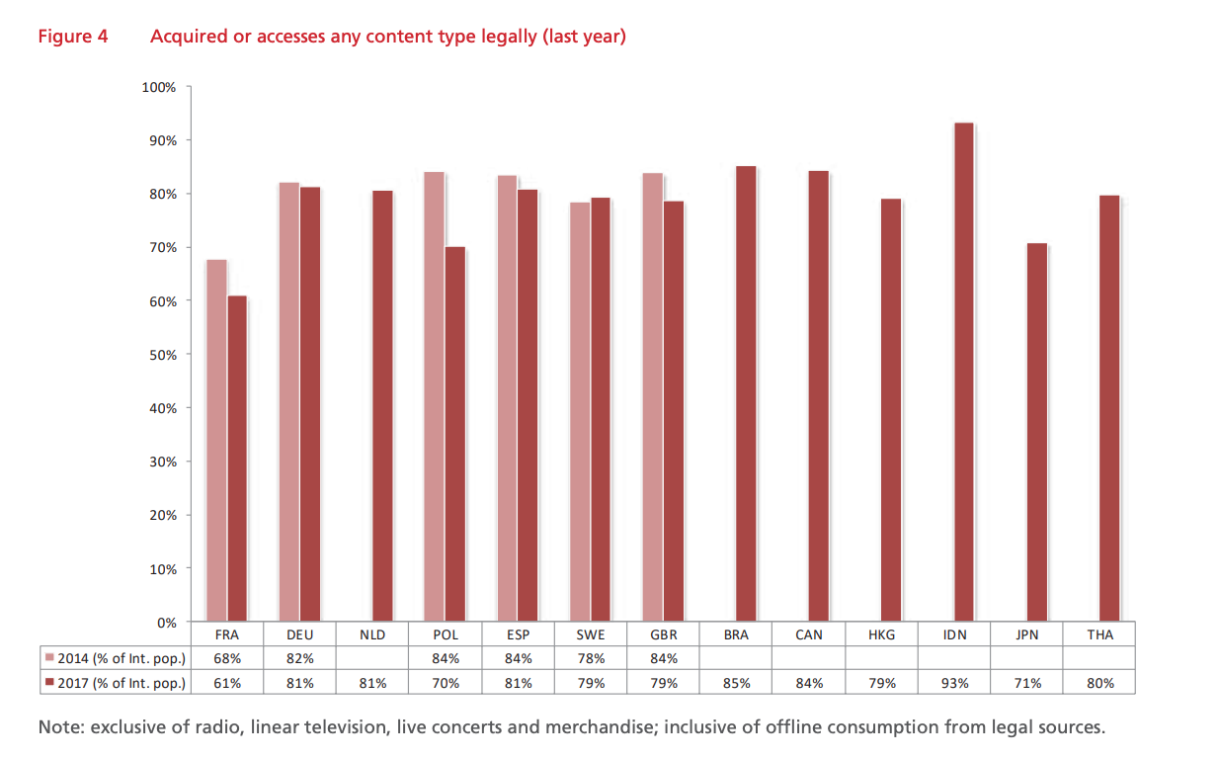
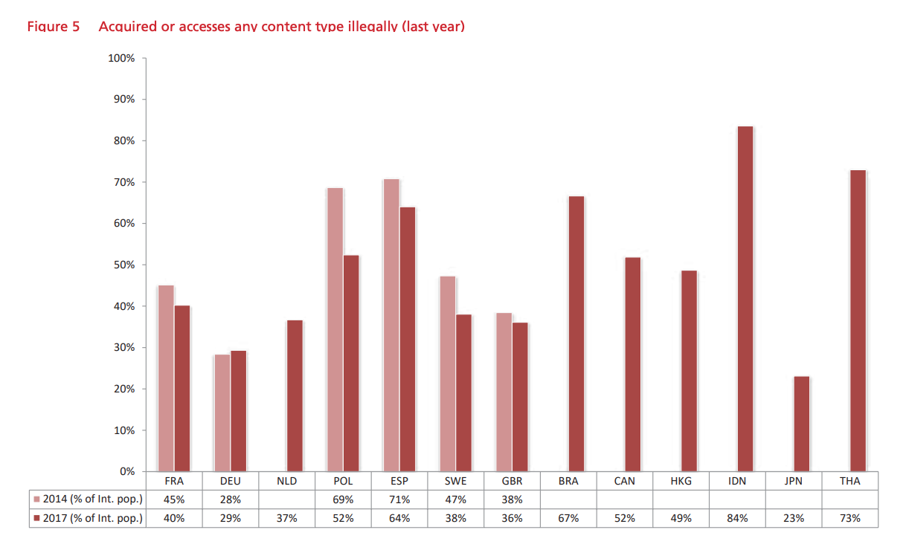
Mir Sultan
[3]
Notes:
More data, this time represented through graphs. This implies that the issue of piracy is gradually becoming confined to a smaller group, although its total volume is not decreasing: fewer people consume more on aggregate via illegal channels. [3] However, data may be showing underwhelming results because there was not much demand for any particular type of media which would cause piracy to rise

Slide 9
Deterrents to online Piracy
Mir Sultan
Netflix [4]
Knowing the law [4]
Computer Security [4]
Laws [2,4]
https://play.google.com/store/apps/details?id=com.netflix.mediaclient&hl=en
Notes:
These are all deterrents. What Netflix provides is an alternate route. A compromise of sorts where all/most of desired media is in one source, like a pirated film website but it’s at a reasonable price with high quality content. [4]
Nobody would willing break the law, and if this activity is constantly associated with being illegal, less people will gravitate towards it [4].
Cut off sources to pirated content as it usually contains viruses and bar entry to such parts of the internet [4]. Privacy should not be compromised for convenience here
The simple answer is, we don't know. And neither do movie industry executives. Speaking to a federal court in California, the MPAA explained how actual damages (that is, the exact number in financial damages done to the organisation) cannot be defined: To permit consideration of actual damages under these circumstances would be perverse — and particularly unfair — given that Plaintiffs elected statutory damages precisely because their actual damages are not capable of meaningful measurement. [5]

Slide 10
Laws against Piracy
Mir Sultan
Stop Online Piracy Act (SOPA) [2]
Article 13 [6]
Notes:
But “dedicated to the theft of US property” was defined in a troublingly ambiguous and overbroad way [2]. -> Unequal say of what copyright laws are being violated, kinda like YouTube’s copyright system right now.
Similar issues currently exist with Article 13, now renamed as Article 17. Piracy would be deterred and same legal setbacks in blocking pirated media stashes would be overcome. But copyright definition would extend into other legitimate websites like YouTube where intent is obviously different. [6]

Slide 11
Pros and Cons of Piracy
Mir Sultan
PROS
Some see it as free promotion [1]
Distributes access to media in a larger fashion for less [1]
Cheaper prices for high quality products [5]
CONS
Huge financial losses in media industry [1]
Pirated products are often not of the same quality [3]
Often embedded with malware and viruses [4]
Notes:
In an interview with Forbes in 2012, CD Projekt Red (makers of 2015 smash hit The Witcher 3: Wild Hunt) CEO Marcin Iwinski made it clear that he sees piracy as a marketing vehicle. “If [pirates] like the game and they start investing the time, some of them will go and buy it,” he said [1]
Adobe touched on this when it launched the Creative Cloud subscription model. Adobe executive David Wadhwani explained that the reason people pirated their software wasn't out of malicious intent, but what we all knew already: they wanted to use high-quality software, but couldn't afford it [5] I do not think people who pirate our software do it because they are bad people, or because they like to steal things. I just think that they decided that they can not afford it. And now, with the switch to subscriptions and with the ability to offer software at a cheaper price, we see that the situation is beginning to change and we're excited. [5]

Slide 12
References
Mir Sultan
[1] Fruhlinger, J., Online Piracy Is Still Very, Very Real. Why Can’t Companies Stop It?, 09/26/18, https://observer.com/2018/09/online-piracy-video-game-roms/ (10/6/2019)
[2] Samuelson, P., Can Online Piracy Be Stopped By Laws, (Communications of the ACM, July 2012), Vol. 55 No. 7, Pages 25-27. (10/6/2019)
[3] Poort, J., Quintais, J., Ende, M. A. V. D., Yagafarova, A., & Hageraats, M. (2018). Global Online Piracy Study. SSRN Electronic Journal. doi: 10.2139/ssrn.3224323 (10/6/2019)
[4] Kent, A., 6 Ways to Stop Digital Piracy. 05/18/2019, https://www.viaccess-orca.com/blog/six-ways-to-stop-digital-piracy. (10/6/2019)
[5] Ravenscraft, E., How Piracy Benefits Companies, Even If They Dont Admit It. (2015, April 8). https://www.lifehacker.com.au/2014/10/how-piracy-benefits-companies-even-if-they-dont-admit-it (10/6/2019)
[6] Andy, Will Piracy-Focused Torrent & Streaming Sites Be Affected by Article 13/17?, (03/30/2019) https://torrentfreak.com/will-piracy-focused-torrent-streaming-sites-be-affected-by-article-13-17-190330/ (10/6/2019)

Slide 13
Video Games Are Good For Children
Luke Bodwell

Slide 14
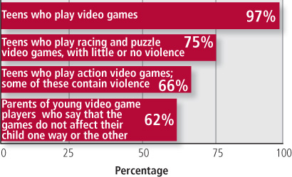
How Many Kids Play Video Games?
Luke Bodwell
90% of all children in the U.S. and 97% of children ages 12-17 play videogames[1]
Children under 8 spend, on average each day, 69 minutes on handheld/ console games, 57 minutes on PC games, and 45 minutes on mobile games
85% of video games contain violence [1]
With this many violent games available and given the vast majority of children play video games, it’s important to study their effects
http://www.personal.psu.edu/afr3/blogs/siowfa13/M1010a-1.jpg
Notes:
90% of all children in the U.S. play video games in some capacity and if you narrow the focus down to children between the ages of 12 and 17, that number raises to 97%. Though typically the focus is put on teenagers, even children under 8 play video games a significant amount, spending on average, 69 mintues playing handheld or console games, 57 minutes playing PC games, and 45 minutes playing mobile games each day.
Breakdown of image.
Now, 85% of all video games on the market contain violence in some form. With this many violent games available and taking into account that 97% of children play video games, it’s very important to study the effects these games have on the children who play them.
90% figure—Lenhart et.al, 2008
97% figure—NDP Group, 2011

Slide 15
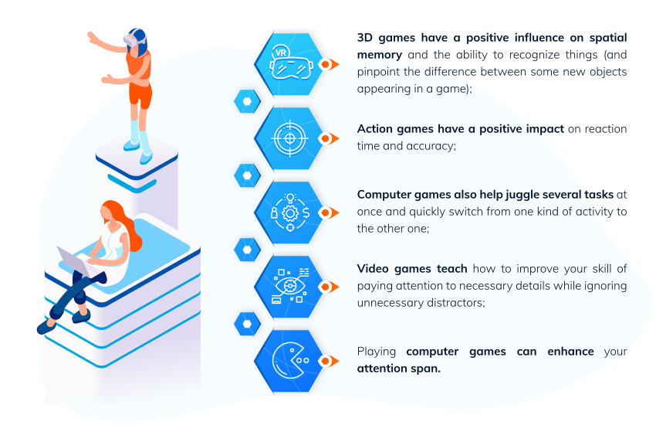
Cognitive Benefits of Gaming
Luke Bodwell
Video games can aid in students’ learning [2]
In a 2007 study, students who played a video game meant to teach material performed better on a test than the control group
Video games, particularly shooters, improve spatial skills [3]
Spatial skills are a strong predicter of achievement in STEM-related fields [7]
The part of the brain that controls attention allocation was less active in gamers than non-gamers during a pattern recognition test
“Video games are controlled training regimens delivered in highly motivating behavioral contexts”
https://gogetessays.com/storage/posts/October2018/Y2izk8pCle4uRjIxyRRd.png
Notes:
Video games can have many cognitive benefits for children as seen in this image—one of those being their ability to learn new material.
In a 2007 study, students were split into two groups and were taught about fire safety in two different ways. The control group used a traditional website marked up with solely HTML to help teach students the material while the experimental group used a video game that presented the same material in a more interesting and engaging way. After the two groups had learned the material they took a test and the control group had an average score of 70.05 while the experimental group had an average score of 76.18.
Video games, particularly first person shooters, can also improve spatial skills. In an experiment in which gamers that play first person shooters regularly and non-gamers engaged in a difficult pattern detection test, it was found through functional magnetic resonance imaging that the part of the brain that controls attention allocation was generally not as active in regular gamers as it was in non-gamers. This suggests that gamers, particularly those who play action or FPS games are able to more efficiently partition their attention span and to ignore irrelevant information. In a word, “Video games are controlled training regimens delivered in highly motivating behavioral contexts.”

Slide 16

Video Games are Social In Nature
Luke Bodwell
Playing video games is a highly social activity [4]
Some argue video games make children antisocial, though kids that turn to video games often already have difficulties fitting in
Video games let these children be social with people all over the world
Video games help build teamwork skills
Often times gamers need to coordinate with one another to accomplish a task effectively
https://o.aolcdn.com/images/dims?quality=85&image_uri=http%3A%2F%2Fo.aolcdn.com%2Fhss%2Fstorage%2Fmidas%2F545ce8f5ded91c753cadec85964b5b62%2F204670978%2Fcurse-video-calls.jpg&client=amp-blogside-v2&signature=4797cb43daa431639d891a11919eb1399da11248
Notes:
Some people will argue that video games are not good for children as extended play will cause them to withdraw from society and personal relationships and become antis
Often times kids that turn to video games already have difficulties fitting in in school due to things like bullying and video games can act as an escape to help take their mind off of those sorts of things
Video games offer an avenue for these children to engage in discussion with people all over the world that share similar interests with them using programs like Discord or in-game chat features.
Video games also help to build important skills like effective communication, cooperation, and working with a team to accomplish a common goal in the most efficient way possible.

Slide 17
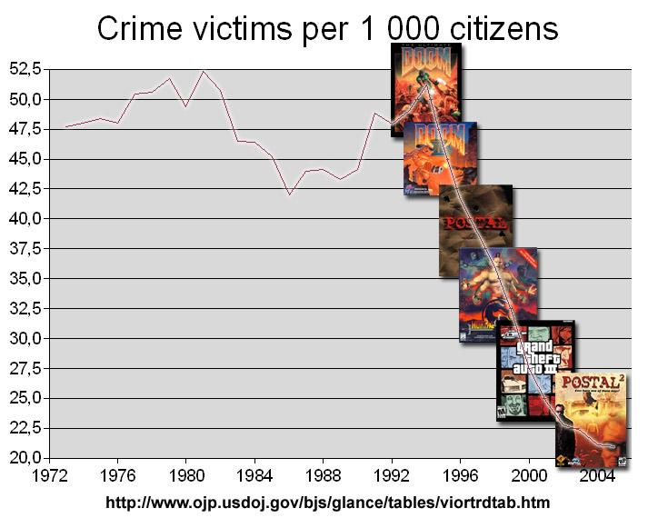
Video Games Don’t Cause Violence
Luke Bodwell
Gaming is a common scapegoat for violent crimes like mass shootings, though there’s no conclusive evidence
There is no correlation between playing violent video games and behavior [5]
An increase in realism does not increase aggression
Ragdoll vs cartoon physics and realistic vs non-realistic soldier behavior had no effect on participants
https://blogs-images.forbes.com/erikkain/files/2012/12/videogameviolencechart.jpg
Notes:
Gaming is a common scapegoat for violent crimes like shootings, though there’s no conclusive evidence to support this. At best, there are mixed results regarding a correlation between violent video games and aggressive behavior. In fact, as more video games have come out, the crime rate has actually fallen over time, reaching about 21% in 2004 as seen in the image.
A University of York study found there was no correlation between playing violent video games with graphic realism and violent or aggressive behavior
Several experiments were conducted in which players were split into two groups and played two slightly different versions of a given game. In one experiment, the game had realistic, or “ragdoll” physics in which bodies behaved like they would in real life in one version of the game and the other version of the game that had a more animated style but still looked convincingly real. In another experiment, one version of the game included soldiers with realistic behavior that would engage in battle and fight and die realistically. The other version featured soldiers that showed unrealistic and obviously stylized and almost cartoonish behavior. After the two groups played their versions of the games, they took word fragment completion tests and the group that played the more realistic and violent versions of the games did not choose more violent word associations as the researchers expected they would.

Slide 18
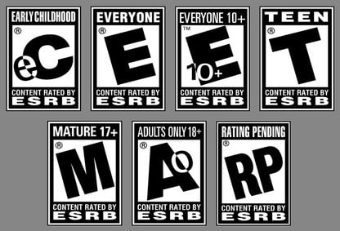
Game Developers Are Not Liable
Luke Bodwell
It’s not fair to blame game developers for violent behavior
It’s the responsibility of parents to limit their children from playing inappropriate games
The ESRB rating system supplies guidelines that are not followed as well as they should be
Parental involvement [6]
Parents may be reluctant to use the ESRB system due to “mixed messages connecting violent video games and behavior”
Parents must also set well-defined and fair rules regarding their children’s gameplay in addition to maintaining their own behavior
https://img.digitaltrends.com/image/esrbratings-416x666.jpg
Notes:
Game developers are ultimately not responsible for the actions of the people who play their games and are not to blame for any violent behavior they engage in. Parents play a critical role in ensuring children play their games responsibly and in moderation. The ESRB rating system is in place for parents to decide whether their children should be playing a given game, but many parents don’t make use of it as much as they should.
In a 2017 study, Iowa State University professor Russel Laczniak hypothesized that parents may not fully understand and be reluctant to use the ESRB system due to “mixed messages connecting violent video games and behavior.”
The ESRB rating system is a good baseline, though Laczniak states, "It's important that parents set specific rules for their children regarding video game play. However, parents need to consider their own behavior. Our previous research shows that parents who are warm and restrictive are more successful in limiting play for violent games. If parents are highly emotional and anxious, children will tend to play more, regardless of their use of mediation and ESRB knowledge."

Slide 19
References
Luke Bodwell
[1] Resolution on Violent Video Games (APA, 2015). Retrieved from https://www.apa.org/about/policy/violent-video-games. Accessed 10/07/2019.
[2] Tsung-Yen Chuang et al, Effect of Computer-Based Video Games on Children: An Experimental Study (IEEE, 2007) Retrived from https://ieeexplore.ieee.org/abstract/document/4148840. Accessed 10/07/2019
[3] Isabela Granic et al, The Benefits of Playing Video Games (APA, 2013). Retrived from https://ecirtam.net/autoblogs/autoblogs/wwwpsyetgeekcom_b5b05cdb291029679998f4bbf13bf6d0c1b27186/media/affa8d7f.amp-a0034857.pdf. Accessed 10/07/2019.
[4] Viviane Kovess-Masfety et al, Is time spent playing video games associated with mental health, cognitive and social skills in young children? (Springer Berlin Heidelber, 2016). Retrieved from https://link.springer.com/article/10.1007/s00127-016-1179-6?no-access=true. Accessed 10/07/2019.
[5] University of York, No evidence to support link between violent video games and behavior (ScienceDaily, 2018). Retrieved from https://www.sciencedaily.com/releases/2018/01/180116131317.htm. Accessed 10/07/2019.
[6] Iowa State University, Video game ratings work, if you use them (2017, ScienceDaily). Retrieved from https://www.sciencedaily.com/releases/2017/01/170125145805.htm. Accessed 10/07/2019.
[7] Sheryl Sorby et al, Does spatial skills instruction improve STEM outcomes? The answer is ‘yes’ (2017 ScienceDirect). Retrieved from https://www.sciencedirect.com/science/article/pii/S1041608018301456. Accessed 10/07/2019.

Slide 20
Computing good for democratic Elections?
Joseph Turcotte
Notes:
Introduce myself
I’ll be discussing the impacts of computing technology on democratic elections
Have computing technologies helped or hurt the election process?

Slide 21
A Utilitarian Approach
Joseph Turcotte
FOR
Against
Notes:
Utilitarian approach towards the issue
Using a scale to weigh the benefits against the costs (whichever side has a heavier weight wins)
Can’t easily measure using $, so I’ll assign arbitrary weights based on how significant of an impact each benefit/cost makes

Slide 22
Increasing voter turnout
Joseph Turcotte
Online voting could reach those who are not voting in person
2016 survey, 1,000 Americans: 60% likely to vote online, mostly 18-25 [1]
Arizona: online voting for overseas military since 2014 [2]
2
Source: Adapted from https://www.census.gov/content/dam/Census/newsroom/press-kits/2017/voting-and-registration/figure01.png
Notes:
The notion of online voting has existed for two decades (Arizona Democratic Party ran its presidential primary using the website votation.com)
Could help increase voter turnout; only 61.4% of eligible voters cast a vote in the 2016 election (almost 40% skipped out!)
For younger voters, having an online option may encourage more of them to cast a vote instead of going to their precinct in person
Could also benefit military personnel who are overseas but should still have the right to cast a vote and have it count on time (mail takes weeks)
I give this a weight of 2 in favor because getting people to the polls is a problem the U.S. has faced for a long time, and maybe it’s time to incorporate technology

Slide 23
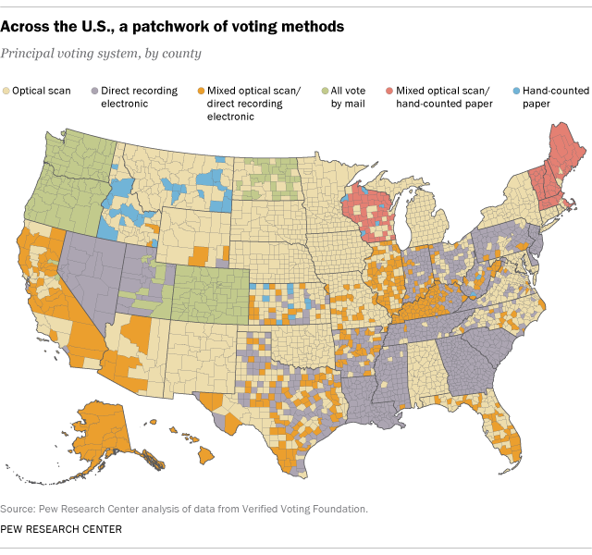
Increasing VOTE Accuracy
Joseph Turcotte
Optical scanners can detect and help voters fix ballot mistakes
Pew Research Center, 2016: 47% of U.S. districts are optical-scanner only [3]
2008 Senate election in Minnesota: Net accuracy (optical scanning) = 99.99% [4]
2
2
Source: https://www.pewresearch.org/fact-tank/2016/11/08/on-election-day-most-voters-use-electronic-or-optical-scan-ballots/ft_16-11-07_votingtechnology/
Notes:
Another factor in favor of computing technology is that it can help increase the accuracy of votes cast
Optical scanners work by taking a paper ballot and scanning it for errors (if none detected, tally the result)
Almost half of U.S. voting districts only use optical scanners for voting
Beneficial because of accuracy; 99.99% success rate in Minnesota
I also assign this a weight of 2 because computing technology has the power to ensure the votes we cast are accurate; otherwise, there’s no point in casting a vote

Slide 24
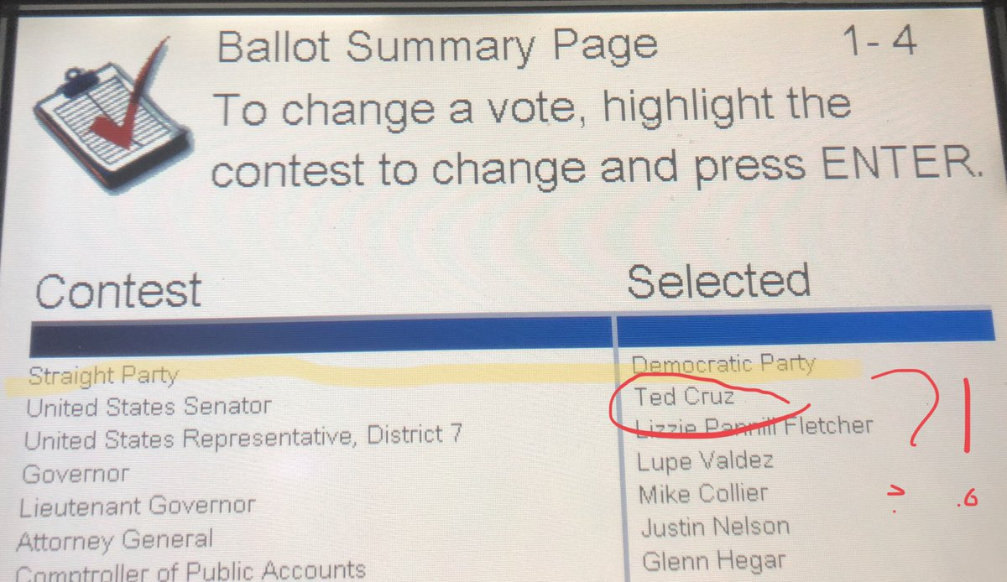
Errors in voting technology
Joseph Turcotte
Software bugs in e-voting machines can distort election results
2018: “Vote-flipping” in Texas voting machines due to UI design choice [5]
2
2
Source: https://www.vice.com/en_us/article/negayg/texas-voting-machines-have-been-a-known-problem-for-a-decade
2
Notes:
On the flipside, there are some computing technologies that have been shown to make mistakes
On the voting software used in Texas precincts, there is an option called “straight party” which means you cast all your votes for candidates from one party
Sometimes if voters click on the interface while the ballot is loading, there’s a bug where some of the votes will get flipped and counted for the other candidate (Ted Cruz is not a member of the Democratic Party)
A group of computer scientists from Rutgers sued New Jersey and showed that the voting machine used is vulnerable to a variety of software-based attacks; the case was settled by NJ providing allegedly tamper-evident seals on the machines
I give this a weight of 2 because an election is not fair if the results are distorted from the voters’ intentions

Slide 25
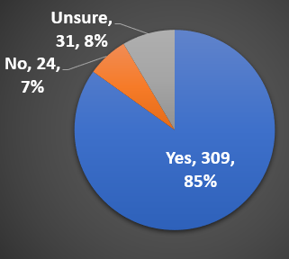
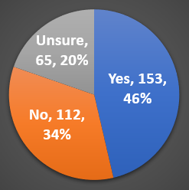
Undermining vote legitimacy
Joseph Turcotte
Democrats
Republicans
Interference with election diminishes faith in the process
Ipsos, 1,005 Americans: 60% believe Russia meddled in 2016 election [6]
2018: J. Alex Halderman breached and infected voting software [7]
3
364 total
331 total
2
2
2
Source: Adapted from https://www.ipsos.com/en-us/news-polls/attitudes-toward-Russian-investigation
Notes:
A larger concern is related to the legitimacy of the votes cast during an election
One of the biggest controversies of the 2016 election (and is still being discussed now) is whether Russian hackers meddled in the 2016 election to get Trump into office
Internet Research Agency based in Saint Petersburg created thousands of social media profiles that supported radical political groups
GRU (Russian military intelligence service) publicly released stolen files from Democratic correspondents on Wikileaks to damage Clinton’s campaign
A poll conducted by Ipsos of 1,005 Americans found that 60% agreed with the idea that Russia meddled/interfered (nearly half of Republican)
Independents not shown but 53% said yes, 17% said no, and 30% were unsure
Researchers have shown how easy it is to hack elections; J. Alex Halderman gave a presentation at MIT in 2018 where he infected a machine’s memory card to change the outcome of an election (originally 3 votes Washington; after hacking, 2 votes for Benedict Arnold and 1 vote for Washington)
As someone who is interested in cybersecurity, I must assign the greatest weight to this issue; how can an election be democratic if we can’t trust the results? (loss of confidence in the election process)

Slide 26
Conclusion
Joseph Turcotte
FOR
4
5
Against
Questions?
Notes:
In conclusion, computing technology has had a negative impact on the election process
I don’t think DRE machines should be used for elections; they are error-prone and vulnerable to attacks, and they can also confuse voters
Paper is better, and optical scanners can do the tallying without requiring voters to learn how to use the machine
With optical scanners, there is a paper trail (DRE only has electronic record)
The Russian hacking issue is more complex; it requires an understanding of why a foreign entity would advocate for or against a certain candidate, and what we can do here to minimize that entity’s interference in the election
We also need to figure out a way to get more people voting; that 40% could have made the difference in 2016

Slide 27
References
Joseph Turcotte
[1] Jeremiah Small, “Would You Vote Online? [Infographic]”, URL: https://www.soliantconsulting.com/blog/would-you-vote-online/ (Accessed: October 5, 2019)
[2] Erin Vogel Fox, “Arizona’s online voting system makes it easy for military personnel to cast their vote”, URL: https://azcapitoltimes.com/news/2016/05/19/arizonas-online-voting-system-makes-it-easy-for-military-personnel-to-cast-their-vote/ (Accessed: October 5, 2019)
[3] Drew DeSilver, “On Election Day, most voters use electronic or optical-scan ballots”, URL: https://www.pewresearch.org/fact-tank/2016/11/08/on-election-day-most-voters-use-electronic-or-optical-scan-ballots/ (Accessed: October 5, 2019)
[4] Andrew Appel, “Optical-scan voting extremely accurate in Minnesota”, URL: https://freedom-to-tinker.com/2009/01/21/optical-scan-voting-extremely-accurate-minnesota/ (Accessed: October 5, 2019)
[5] Adi Robertson, “Texas voting machines are switching votes – but it’s bad design, not hacking”, URL: https://www.theverge.com/2018/10/30/18037872/texas-voting-machine-hart-eslate-voting-ballot-switch-problems (Accessed: October 6, 2019)
[6] Chris Jackson and Mallory Newall, “Attitudes Toward the Russian Investigation”, URL: https://www.ipsos.com/en-us/news-polls/attitudes-toward-Russian-investigation (Accessed: October 6, 2019)
[7] Jen Schwartz, “The Vulnerabilities of Our Voting Machines”, URL: https://www.scientificamerican.com/article/the-vulnerabilities-of-our-voting-machines/ (Accessed: October 6, 2019)

Slide 28
DEEPFAKE & WHY YOU COULD PROBABLY CARE A LITTLE MORE ABOUT FACE-SWAPPING TECHNOLOGY
Chioma Onyenokwe

Slide 29



Don’t Ever Envisage Prerecorded Faces As Keen Expressions
Chioma Onyenokwe
What is deepfake? [2]
First coined in 2017
Free face-swapping video software
Distressingly easy (and fun) to use →
How does it work? [6]
Machine-learning
Images realistically superimposed onto videos
There seems to be an extensive collection of wholesome Nicolas Cage deepfakes on such sites as gfycat.com
Notes:
<speaker notes>

Slide 30
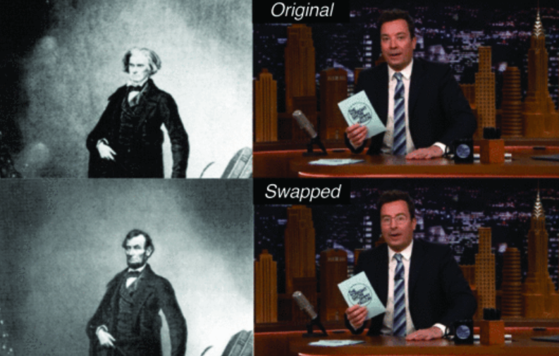
HOW DID WE GET HERE?
Chioma Onyenokwe
Advances in prior face-swapping technology
1865: First recorded attempt [6]
1976: Westworld becomes first major motion picture to use 3D CGI [5]
Improved accessibility
Low cost ($2.5mil vs. $500) [5]
Low skill
Readily available
“Face swapping is not new. Examples such as the swap of U.S. President Lincoln’s head with politician John Calhoun’s body were produced in mid-19th century (left). Modern tools like FakeApp have made it easy for anyone to produce "deepfakes", such as the one swapping the heads of late-night TV hosts Jimmy Fallon and John Oliver (right).” [6]

Slide 31
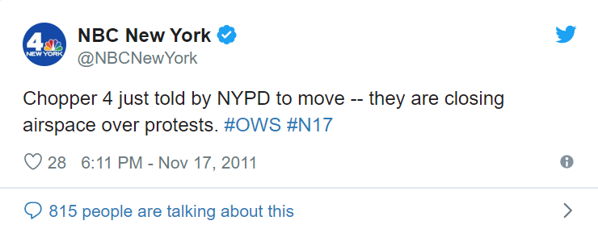
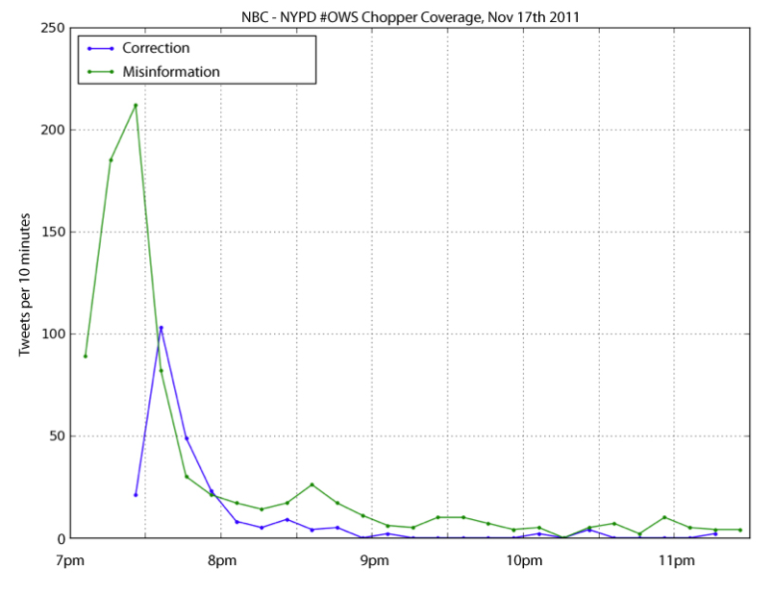
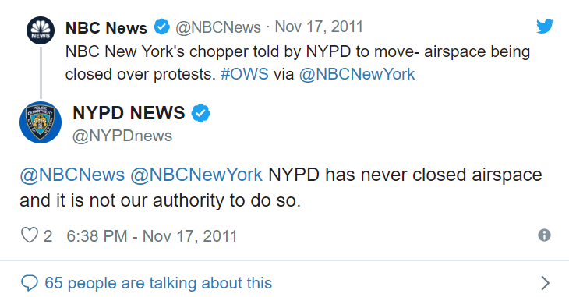
SOCIETAL IMPLICATIONS
Chioma Onyenokwe
(M/D)isinformation
Travels fast
Not easily corrected
Public distrust
“The liar’s dividend” [3]
After an Occupy Wall Street protest in NYC in November 2011, the series of tweets depicted above (left) took place. A study by SocialFlow later found that the misinformation traveled faster than its correction (right). [4]
Notes:
As deepfake tech becomes more and more ubiquitous, it poses the risk of not only fomenting the spread of harmful misinformation, but also of reducing the credibility of real videos.

Slide 32


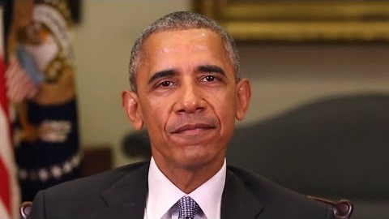

CURRENT MANIFESTATIONS
Chioma Onyenokwe
Key Manifestations | Why People Currently Care: “High-profile” Victims | Why People Should Also Care: “Low-profile” Victims
Revenge porn | Celebrity Women: Gal Gadot’s “Sex tape” [2] | (Sex-working) Women: Several sites dedicated to sharing this info [2]
Political (m/d)isinformation | Politicians: “Obama” on Trump [2] | Pretty much anyone with an online presence: Is anyone truly safe? [2]

Slide 33
WHAT CAN BE DONE?
Chioma Onyenokwe
“Deepfake detection using recurrent neural networks” [5]
DARPA- and AFRL- sponsored research
Constantly evolving
Draft laws that
Protect those most vulnerable to such crimes (i.e. sex workers) [7]
Hold any such video makers accountable for their actions
Notes:
sponsored by the Defense Advanced Research Projects Agency (DARPA) and the Air Force Research Laboratory (AFRL) under agreement number FA8750-16-2-0173

Slide 34
References
Chioma Onyenokwe
All Google images were labeled explicitly for reuse unless otherwise indicated.
Jesselyn Cook, "Here's What It's Like To See Yourself In A Deepfake Porn Video", https://www.huffpost.com/entry/deepfake-porn-heres-what-its-like-to-see-yourself_n_5d0d0faee4b0a3941861fced (Accessed: September 17, 2019).
Jeselyn Cook, “Deepfake Videos And The Threat Of Not Knowing What’s Real”, https://www.huffpost.com/entry/deepfake-videos-and-the-threat-of-not-knowing-whats-real_n_5cf97068e4b0b08cf7eb2278?guccounter=1 (Accessed: September 17,2019).
Rachel Ehrenberg, “Social Media Sway: Worries over Political Misinformation on Twitter Attract Scientists' Attention” (Science News, vol. 182, no. 8, 2012), pp. 22–25.
Maureen Furniss, "Animation and Digital Media" (Bloomington, IN, USA: Indiana University Press, 2014), pp. 173-96.
D. Güera and E. J. Delp, "Deepfake Video Detection Using Recurrent Neural Networks," (2018 15th IEEE International Conference on Advanced Video and Signal Based Surveillance (AVSS), Auckland, New Zealand, 2018), pp. 1-6.
Emily Van Der Meulen, "When Sex Is Work: Organizing for Labour Rights and Protections." (Labour / Le Travail 69 (2012)), pp. 147-67.

Slide 35
chatbots: future of customer interaction
Nugzar Chkhaidze

Slide 36
chatbots make better assistants
Nugzar Chkhaidze
“Bots are where customers are” [1]
Can handle high query volume [1]
Elimination of human element = Resources and Time Saved
Fast automated response and problem solving
Notes:
We all know what chatbots are and I’d like to talk about why they are better.
Chatbots save companies a lot of money and resources involved in employing human assistants and save customers time.
They are faster in finding solutions and directing customers in the right direction.
Companies with large customer volume cannot afford enough humans to serve their customers. So, large and highly profiting companies have bots at their forefront.
Because of this, automated chatbots are replacing human assistants

Slide 37
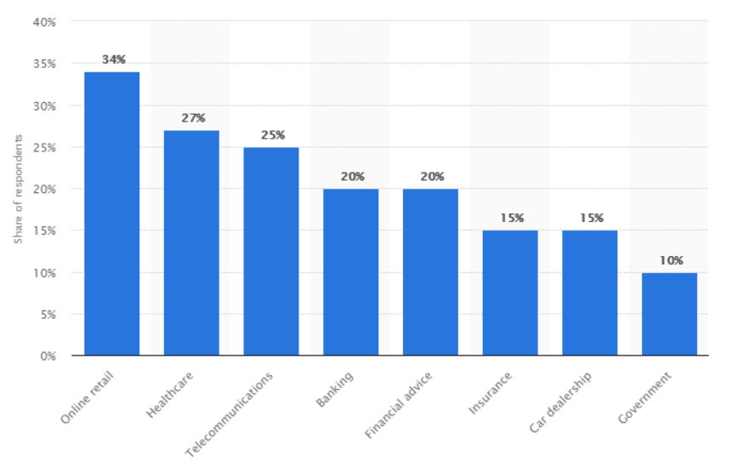
Interest across industries
Nugzar Chkhaidze
https://chatbotsmagazine.com/chatbot-report-2018-global-trends-and-analysis-4d8bbe4d924b
Notes:
E commerce and online retail industries have the most chatbot use as they deal with customers most directly. Closely following this are healthcare and telecommunication.

Slide 38
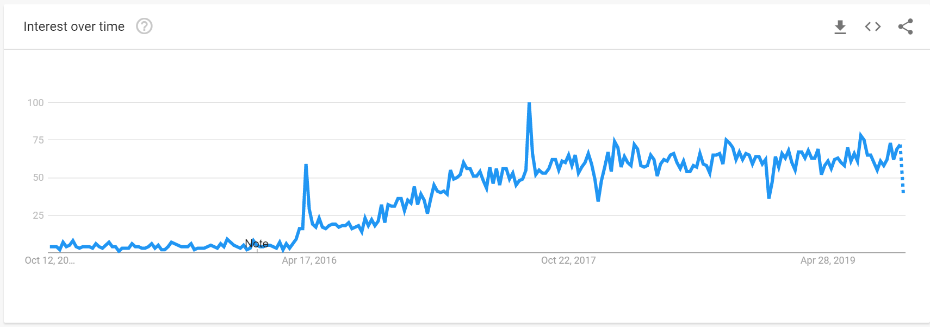
Chatbot 5-year industry interest
Nugzar Chkhaidze
https://chatbotsmagazine.com/chatbot-report-2019-global-trends-and-analysis-a487afec05b
Notes:
Graph shows interest in chatbots from google trends.
This is proportional to the spread of chatbots. For example.<>
More companies are interested in using automated service technology.

Slide 39
Chatbot timeline
Nugzar Chkhaidze
Bots Launched in Social Platforms
Companies Adopt and Develop Bots
Daily Tasks Become Bot-Assisted
2015-2016
2018-2019
Post 2024
https://www.entrepreneur.com/article/325830
Notes:
<speaker notes>

Slide 40
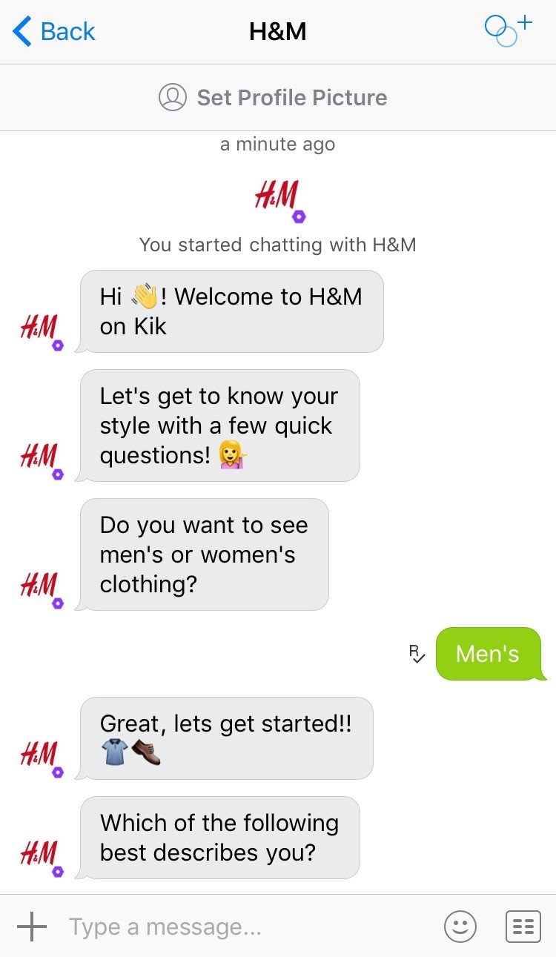
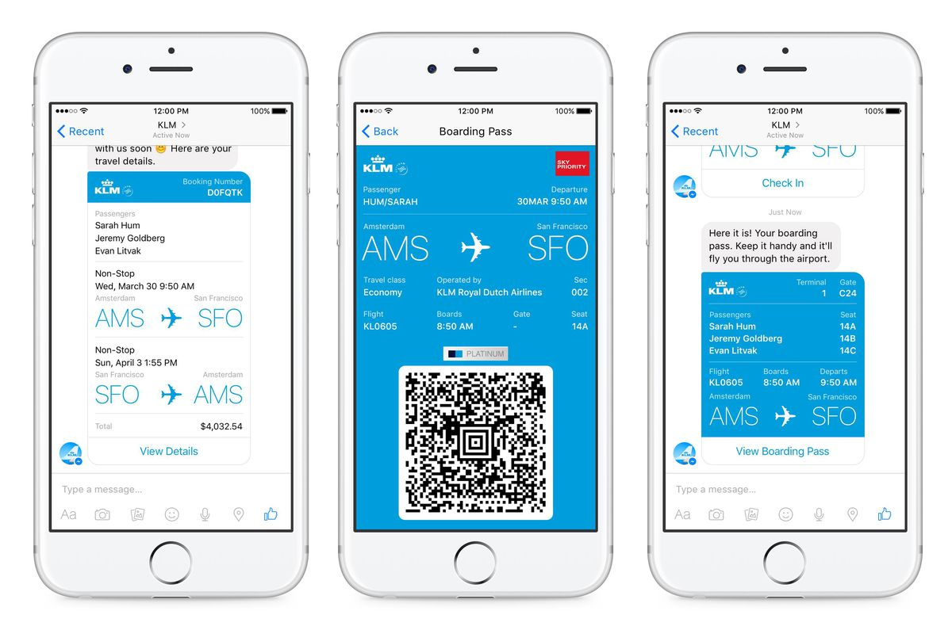
Real life chats with bots
Nugzar Chkhaidze
KLM Messenger chatbot
H&M Shopping
https://bot-hub.com/reviews/official-chatbot-review

Slide 41
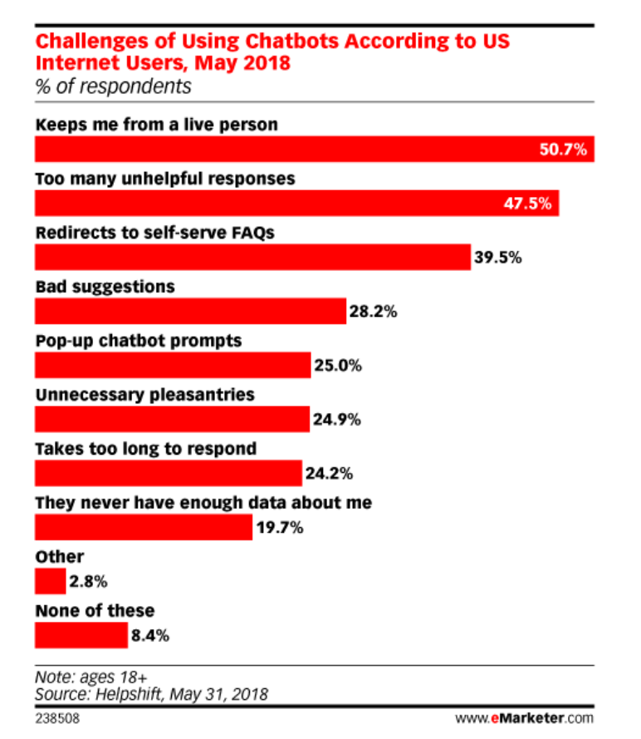
limitations
Nugzar Chkhaidze
Efficiency depends on natural language processing capabilities [5]
Unable to deal with multiple questions[6]
Customers prefer dealing directly with human [3]
[3], [5], [6]
Notes:
Chatbots are still developing and have several points of improvement
Many customers get frustrated by having to use chatbots and still prefer human interaction as they believe it is fasrter
Since NLP is still in development, we find the first 2 problems in the graph.

Slide 42
References
Nugzar Chkhaidze
[1] Five Reasons Why Chatbots are the Future of Customer Service, Aakrit Vaish, https://www.entrepreneur.com/article/325830 (Access date 7th October)
[2] Chatbot Report 2018: Global Trends and Analysis, Alex Galert, https://chatbotsmagazine.com/chatbot-report-2018-global-trends-and-analysis-4d8bbe4d924b (Access date 7th October)
[3] Chatbot Report 2019: Global Trends and Analysis, Alex Galert, https://chatbotsmagazine.com/chatbot-report-2019-global-trends-and-analysis-a487afec05b(Access date 7th October)
[4] H&M: official chatbot review, bot-hub.com, https://bot-hub.com/reviews/official-chatbot-review (Access date 7th October)
[5] Why chatbots fail, AImultiple https://blog.aimultiple.com/why-chatbots-fail/ (Access date 7th October)
[6] Meet 11 of the Most Interesting Chatbots in Banking, Jim Marous, https://thefinancialbrand.com/71251/chatbots-banking-trends-ai-cx/ (Access date 7th October)

Slide 43
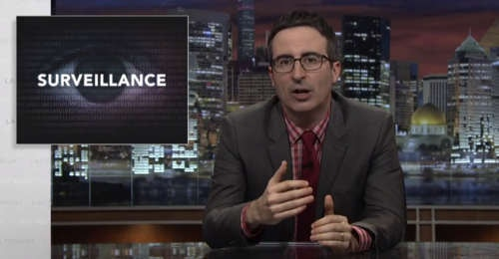

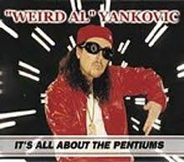




Student Choice – Interesting Videos
Last Week tonight with John Oliver Snowden (33:14)
It’s All About The Pentiums
Weird Al (3:34)
White and Nerdy Weird Al (2:50)
The Game Of Trust - Nicky Case
Why Electronic Voting is a BAD Idea
Computerphile (Tom Scott) (8:20)
Welcome To Life – Tom Scott (2:44)
What "Orwellian" really means - Noah Tavlin (5:31)
Notes:
All Last Accessed 2018-10-04
CGP Grey
Humans Need Not Apply (15:00) – 2014-08-13
http://www.youtube.com/watch?v=7Pq-S557XQU
Last access 2016-04-22
Why Electronic Voting is a BAD Idea – Computerphile (Tom Scott) (8:20)
https://www.youtube.com/watch?v=w3_0x6oaDmI
Last Week tonight with John Oliver – Patriot Act, Edward Snowden (33:14)
http://www.upworthy.com/john-oliver-flew-10-hours-to-russia-to-interview-edward-snowden-and-get-him-on-record?c=ufb1
Weird Al – It’s All About The Pentiums (3:34) and look at lyrics
https://www.youtube.com/watch?v=qpMvS1Q1sos
Tie into Ray Kurzweil Singularity
Epic Rap Battles of History: Steve Jobs vs. Bill Gates (If class ok with obscene lyrics) (2:47)
https://www.youtube.com/watch?v=njos57IJf-0
Also Work links on web site http://socialimps.keithpray.net/documents/
-----
Tom Scott
http://tomscott.com
Welcome To Life (2:44)
https://www.youtube.com/watch?v=IFe9wiDfb0E&feature=youtu.be
Passphrases (2:08 need to give context for video)
https://firstlook.org/theintercept/2015/03/26/passphrases-can-memorize-attackers-cant-guess/
If not shown during first class
What "Orwellian" really means - Noah Tavlin (5:31)
http://ed.ted.com/lessons/what-orwellian-really-means-noah-tavlin
Weird Al – White and Nerdy (2:50) and look at lyrics
https://www.youtube.com/watch?v=N9qYF9DZPdw

Slide 44
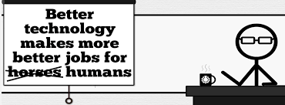
Student Choice – Interesting Videos (Full)
Last Week tonight with John Oliver Snowden (33:14)
It’s All About The Pentiums
Weird Al (3:34)
White and Nerdy Weird Al (2:50)
The Game Of Trust - Nicky Case
Why Electronic Voting is a BAD Idea
Computerphile (Tom Scott) (8:20)
Welcome To Life – Tom Scott (2:44)
What "Orwellian" really means - Noah Tavlin (5:31)
Humans Need Not Apply
CGP Grey (15:00)
Notes:
All Last Accessed 2018-10-04
CGP Grey
Humans Need Not Apply (15:00) – 2014-08-13
http://www.youtube.com/watch?v=7Pq-S557XQU
Last access 2016-04-22
Why Electronic Voting is a BAD Idea – Computerphile (Tom Scott) (8:20)
https://www.youtube.com/watch?v=w3_0x6oaDmI
Last Week tonight with John Oliver – Patriot Act, Edward Snowden (33:14)
http://www.upworthy.com/john-oliver-flew-10-hours-to-russia-to-interview-edward-snowden-and-get-him-on-record?c=ufb1
Weird Al – It’s All About The Pentiums (3:34) and look at lyrics
https://www.youtube.com/watch?v=qpMvS1Q1sos
Tie into Ray Kurzweil Singularity
Epic Rap Battles of History: Steve Jobs vs. Bill Gates (If class ok with obscene lyrics) (2:47)
https://www.youtube.com/watch?v=njos57IJf-0
Also Work links on web site http://socialimps.keithpray.net/documents/
-----
Tom Scott
http://tomscott.com
Welcome To Life (2:44)
https://www.youtube.com/watch?v=IFe9wiDfb0E&feature=youtu.be
Passphrases (2:08 need to give context for video)
https://firstlook.org/theintercept/2015/03/26/passphrases-can-memorize-attackers-cant-guess/
If not shown during first class
What "Orwellian" really means - Noah Tavlin (5:31)
http://ed.ted.com/lessons/what-orwellian-really-means-noah-tavlin
Weird Al – White and Nerdy (2:50) and look at lyrics
https://www.youtube.com/watch?v=N9qYF9DZPdw

Slide 45
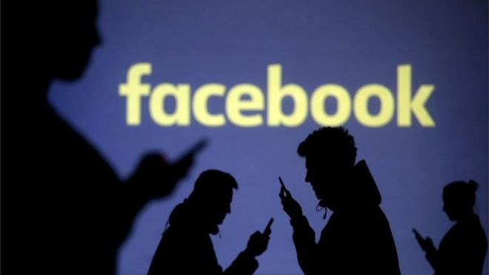
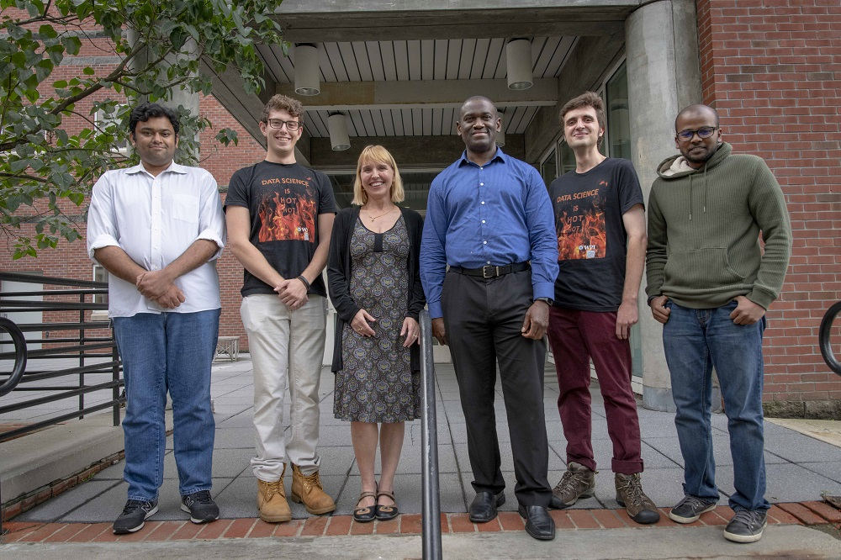

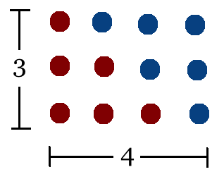
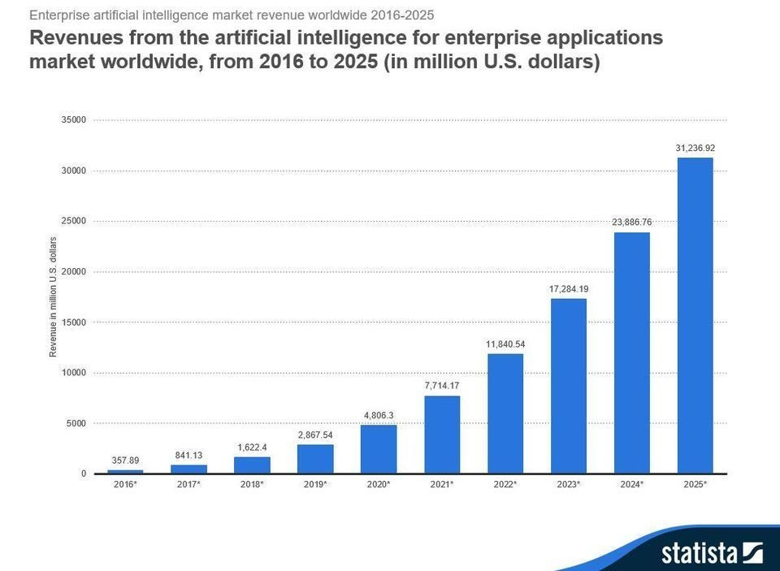
Student Choice – Interesting Articles 1/2
Facebook security breach: Up to 50m accounts attacked - Dave Lee, North America technology reporter, 2018-09-29
WPI Secures $2.8 Million to Develop a Smartphone App to Help Assess the Health of Soldiers, 2018-09-24
Quantified Toilets, 2014, Quantified Toilets LLC
What Did Ada Lovelace's Program Actually Do? - Sinclair Target, 2018-08-18 (First Programming Bug 1843?)
We know ethics should inform AI. But which ethics? - Mauro Guillen, World Economic Forum, 2018-07-26
Notes:
All Last Accessed 2018-10-04
TOOD: Add to first day slides.
Emacs – psychoanalyze-pinhead
doctor (implementation of ELIZA)
yow (quotes from Zippy the Pinhead zippythepinhead.com)

Slide 46
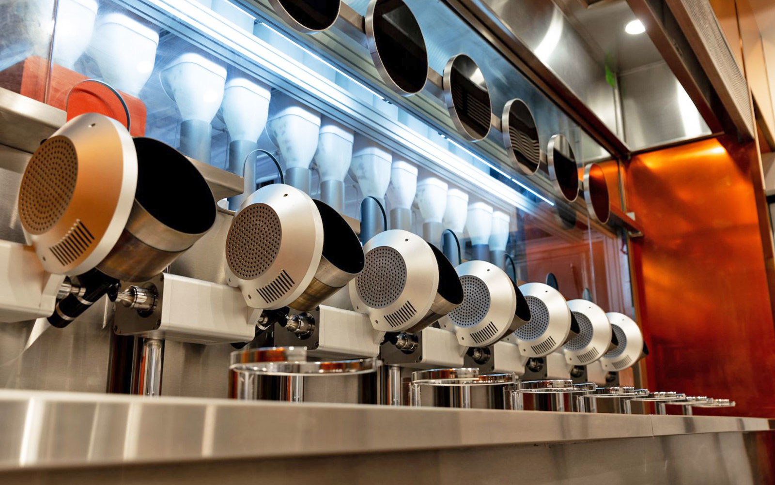

Student Choice – Interesting Articles 2/2
MIT-born Spyce raises $21M to open new robotic restaurants - Lucia Maffei, BostInno, 2018-09-07
The Coders Programming Themselves Out of a Job - Brian Merchant, The Atlantic, 2018-10-02
Notes:
All Last Accessed 2018-10-04
Spyce image: https://www.engadget.com/2018/05/04/boston-robotic-kitchen-spyce/ , 2018-05-04
Coders Programming Themselves Out of a Job image: Gabrielle Lurie, Reuters (date unknown)

Slide 47
Class 14 The End
Keith A. Pray
Instructor
socialimps.keithpray.net
Notes:
This is the end. Any slides beyond this point are for answering questions that may arise but not needed in the main talk. Some slides may also be unfinished and are not needed but kept just in case.

Slide 48
Evaluations
Use only BLUE or BLACK ballpoint pen
Use an X to mark (Do NOT fill in box)
Course Evaluation
Write MY NAME and COURSE TITLE in box at top of form
Keith A. Pray
CS 3043 Social Implications Of Information Processing
Return to Academic Advising Office in Daniels Hall
Include “Evaluation Sheet” cover letter
Notes:
No TA/SA this time
TA/SA Evaluation
Name:
Return to CS Department: Fuller 233

