Slide 1
Class 10 Professional Ethics
Keith A. Pray
Instructor
socialimps.keithpray.net
Notes:
Here’s the title slide. Excited already, aren’t you? You may not be depending on how you enjoyed the last class.

Slide 2
Papers
Clearly state conclusion
Use supporting data
Make sure argument is for conclusion
Quantify
Do not use terms like: less, more, a lot, huge, great, big, tiny, etc.
http://socialimps.keithpray.net/assignments/paper-guidelines/
Notes:
Save for next time:
Clearly state conclusion
First statement preferred
Absolute statements are difficult to prove
Avoid: all, always, any, every, everyone, never, none… unless you can show it
Be sure to put quotes around entire quote
Hyperbole is the best thing ever!
but not in these papers
Print 2 sided and save a tree
Use template, saves time (and -1 point)
Include Counter Point and Response
Include Author, Title, Publish Date, Publisher for references
Read paper aloud to proof

Slide 3
Grades To Date
44 Max Possible

Slide 4
Overview
Review
Debate
Assignment
Students Present
Notes:
We can also discuss articles listed on Security Discussions under documents of course web site.
ADD QUIZ AS BACKUP IF CLASS DISCUSSION NOT LONG ENOUGH

Slide 5
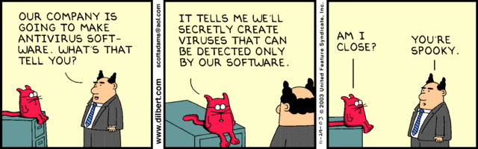
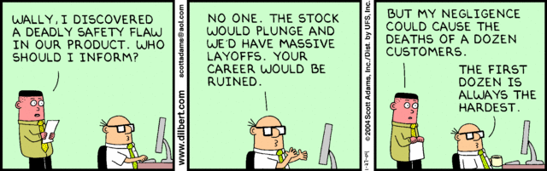
Notes:
Ask how many people in ACM or IEEE

Slide 6
Debate Ground Rules
Before Debate
10 minutes to converse with your team
Share argument points, counter points, and responses so everyone can represent
Decide who will respond to what points from the opposing side
During Debate
1 minute opening statements (what you hope your answer will accomplish)
Stand up when speaking
1 turn per person until everyone on your team has spoken
30 second limit
Switch sides at any time if you change your mind
Notes:
Release Game or Not Debate
Chapter 9 In-class Exercises # 24.
Should the company produce the game?
Use the SWE Code Of Ethics as the basis for your argument.

Slide 7
My Reading Notes
pp. 409 Can one perform services for one’s self?
pp. 412 1993-1999 Does this seem like a long time?
pp. 413 “errors of omission or commission”?
UPDATE
pp. 422 3. Would people agree – social contract?
pp. 438 So the baby can be left outside and no one is responsible?
Notes:
An error of commission is one where the person responds where they should not. This is compared to an error of omission, where the person fails to respond when they should.

Slide 8
Assignment
1 Page Paper
What should computerized automation be applied to next?
Finish all reading
Group Project
Add analysis to website addressing all topics covered to date
Group Presentation Draft
Email presentation as Power Point attachment to course staff
Post on group website
Notes:
1 Page Paper Ideas:
For Good - How will you use your computing related education to do good in the world?
Dark Net - Is the Dark Net good or bad?
Does computerized automation help the economy or society?
What should computerized automated be applied to next?
If productivity has increased so much, why are we working so hard? Should we?
What job skills will survive computerized automation?

Slide 9
Overview
Review
Debate
Assignment
Students Present
Notes:
Show WPI and/or corporate code of ethics.

Slide 10
Machines Need us
Anagha Late

Slide 11
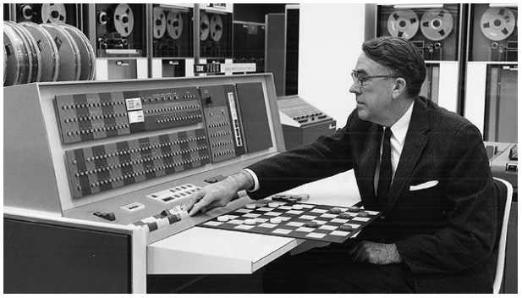
What is machine Learning?
Anagha Late
"A computer program is said to learn from experience E with respect to some class of tasks T and performance measure P if its performance at tasks in T, as measured by P, improves with experience E.” – Tom M. Mitchell (1997) [1]
Traditional Programming vs. Machine Learning [2]
Main selling point to companies : no requirement of human interaction [3]
[1]
Notes:
So I am going to start off with defining what Machine Learning is :
Although Arthur Samuel coined and created the first ever ‘machine learning’ program (a checkers program – first ever game playing program), Tom M Mitchell, publisher of one of the very first Machine Learning textbooks, defined it best by providing a more formal definition. According to his very much widely quoted definition , Machine Learning is “ ^^^ “ .
This differs from traditional programming since in them, the behavior needs to be hard coded while in Machine Learning uses the data provided to generate a behavior. With this said, Machine Learning is used in scenarios where traditional programming strategies falls behind and is not enough to fully implement a certain tasks. Thus, this becomes a huge selling point to companies in which they see this as an opportunity to rid the humans and their interaction to replace them with machines and computers to save their expenses.
The process of Automation has already been projected to wipe out 47% of US worker’s jobs over the next 20 years and Machine Learning is categorized as the new type of Automation – Smart Automation

Slide 12
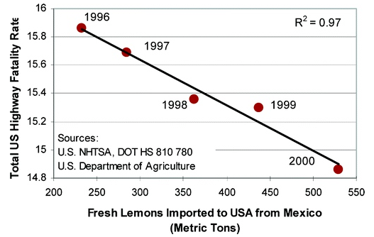
Not a substitution
Anagha Late
More supplemental than a substitution [4]
Flawed [4]
Correlation is NOT causation
Extrapolation
[6]
Notes:
Although this may sound as if traditional programming is no longer useful and that the efficient, more economical approach would be to switch to Machine Learning – the reality of the situation is that Machine Learning is not a valid substitution. It’s more supplemental and can, for example, be used to build predictive algorithms for an online trading platform, while the platform’s UI, data vis. and other elements will be performed in a mainstream programming language such as Ruby, or Java.
Machine Learning cannot be a substitution since there are still several flaws involved. One for example, is that correlation does not imply causation. This is one of the biggest issues involved with Machine Learning since it uses the data obtained to draw connections and create algorithms. Although Machine Learning is good at detecting correlations, it is less effective at working out causation. Unaided machine learning may find correlations that can be complete nonsense, such as the meaningless, yet true, correlation between reduced highway deaths in the US and the number of tons of lemons the country imports from Mexico (Highway fatality rates increase as the economy improves, typically because people are driving more). With this ‘unexplained’ data, the learning carried out forward may be skewed.
Extrapolation is another reason as to why machine learning is not a valid substitution. If the machine is fed little to no data, it is left to the machine to extrapolate and reach for conclusions which may not be accurate.

Slide 13
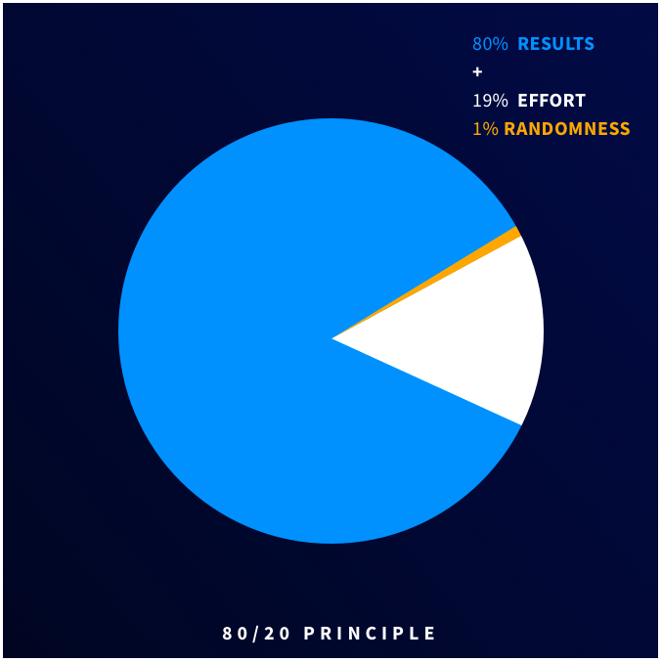
HITL (Human in the loop)
Anagha Late
Brings together the benefits of a machine learning system and traditional programing method [5]
Variation of Pareto’s 80:20 rule --> optimal HITL [5]
Super intelligence
Important Scenarios [5]
Little to no room for margin of error
Limited data present
ACM – Professional Responsibilities [7]
[5]
Notes:
Thus, due to the limits that Machine Learning does face and the fact that human supervision is needed to look over the progress of their ‘learning’ , it is the duty of computing professionals to design and build Machine Learning systems that require people in the loop as opposed to systems that make decisions in a fully autonomous fashion. This concept is called HITL or Human In The Loop. This concept leverages both human and machine intelligence to create machine learning models. In this approach, humans are directly involved in training, tuning and testing data for a particular Machine Learning algorithm. The intention being, to use a trained crowd or general human population to correct inaccuracies in machine predictions thereby increasing accuracy, which results in higher quality of results.
Research suggests that a variant of Pareto’s 80:20 rule is consistent with most accurate machine learning systems to date, with 80% AI-driven, 19% human input and 1% randomness.
Formula : HITL is the combination of Supervised Machine Learning (SML) and Active Learning (AL).
Supervised ML : labeled data sets used by ML experts to train algorithms by adjusting parameters, in order to make accurate predictions for incoming data.
Active Learning : the data is taken, trained, tuned, tested and more data is fed back into the algorithm to make it smarter, more confident, and more accurate. The actual approach of feeding back data is called active learning
One scenario in which HITL would come into play would be when an ML algorithm can have absolutely no margin for error. Any room for error leads to dire situations. Another scenario would be when there is little to no data present, which would allude on the point of extrapolation.
Bringing the human in the loop would also then make programs far more ethical since they would be obeying the second main principle in the Software Engineering Code of Ethics and Professional Practice. By following sub-principles such as “Fostering public awareness and understanding of computing, related technologies, and their consequences” and “Design and implement systems that are robustly and usably secure” , HITL would be far more ethical than allowing a machine to perform the work alone.

Slide 14
References
Anagha Late
[1] SAS. “Machine Learning: What It Is and Why It Matters.” SAS, 2019, https://www.sas.com/en_us/insights/analytics/machine-learning.html.
[2] Kharkovyna, Oleksii. “Machine Learning vs Traditional Programming.” Medium, Towards Data Science, 22 Apr. 2019, https://towardsdatascience.com/machine-learning-vs-traditional-programming-c066e39b5b17.
[3] West, Darrell M. “Will Robots and AI Take Your Job? The Economic and Political Consequences of Automation.” Brookings, Brookings, 9 May 2018, https://www.brookings.edu/blog/techtank/2018/04/18/will-robots-and-ai-take-your-job-the-economic-and-political-consequences-of-automation/.
[4] Cherrayil, Naushad K. “Machine Learning Needs Human Involvement to Work Effectively.” TechRadar, TechRadar Pro, 9 July 2019, https://www.techradar.com/news/how-to-strike-balance-between-supervised-and-unsupervised-machine-learning.
[5] Venkatesh, Mothi. “What Is Human-in-the-Loop for Machine Learning?” What Is Human-in-the-Loop for Machine Learning?, 17 July 2018, https://hackernoon.com/what-is-human-in-the-loop-for-machine-learning-2c2152b6dfbb.
[6] Lowe, Derek. “Mexican Lemons To the Rescue.” In the Pipeline, 29 Apr. 2015, https://blogs.sciencemag.org/pipeline/archives/2009/04/01/mexican_lemons_to_the_rescue.
[7] “The Code Affirms an Obligation of Computing Professionals to Use Their Skills for the Benefit of Society.” Code of Ethics, Association for Computing Machinery, 2018, https://www.acm.org/code-of-ethics.

Slide 15
Putting the AI in FabriCa(i)tion
Manjusha Chava
Notes:
My name is Manjusha Chava and my topic is about AI in manufacturing. I want to specifically talk about how AI in additive/subtractive manufacturing will significantly increase production, jobs, and the progression of new ideas.
How many of you have seen or used 3D printers? How many of you have used CAD? Imagine solutions such as predictive modeling in CAD software and self diagnoses and corrections in 3d printers when a part has failed.

Slide 16
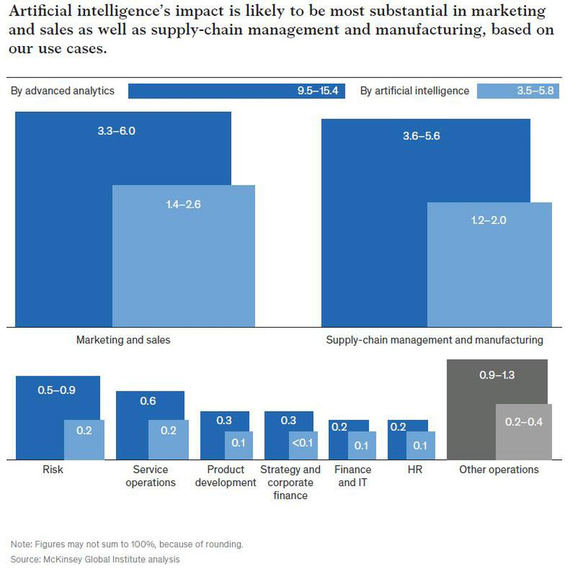
Ai in manufacturing
Manjusha Chava
Used for: [2]
Improving efficiency
Defect detection
Predictive maintenance
Potential to create $1.4T to $2.6T of value in marketing/sales. [2]
Reduced unplanned machinery downtime between 15 – 30%. [10]
Increased production by 20%,
Reduced maintenance costs by 30%
Delivered up to a 35% increase in quality
https://www.forbes.com/sites/louiscolumbus/2019/08/11/10-ways-machine-learning-is-revolutionizing-manufacturing-in-2019/#40ebd8652b40
Notes:
Artificial Intelligence in manufacturing is used for improving efficiencies of machines, detecting defects in a product in product manufacturing, and predictive maintenance.
As shown in the figure, using AI based predictive maintenance has the potential to create $1.4T to $2.6T of value in marketing and sales across the world’s businesses by creating efficient systems for both marketing and sales and manufacturing in supply-chain management and manufacturing.
Specifically in 3d printing, the trial and error process takes between 20 to 50 iterations, which means 20 to 50 different parts printed and reprinted. This can lead to wasteful usages of energy, plastics, and more. Utilizing AI in the design process has been proven to take between only 3 to 4 iterations.
According to a study done by Deloitte, using AI to streamline every phase of production reduced unplanned machinery downtime between 15-30%, increased production by 20%, reduced maintenance costs by 30%, and delivered up to a 35% increase in quality.

Slide 17
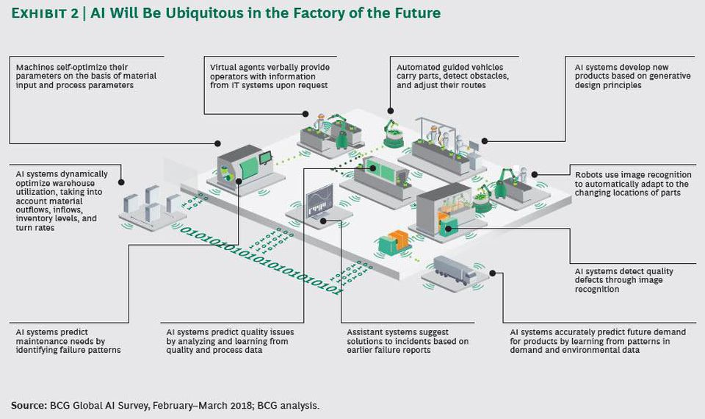
AI in manufacturing (cont.)
Manjusha Chava
Defect Detection:
Increased manufacturing productivity by 50% or more. [5]
Example of an AI ubiquitous factory → [2]
Self Optimize parameters
Detect obstacles, defects
Maintenance prediction, failure reports
AI improves product quality up to 35% in discrete manufacturing industries. [4]
Product optimization
1
2
3
3
https://www.forbes.com/sites/louiscolumbus/2019/08/11/10-ways-machine-learning-is-revolutionizing-manufacturing-in-2019/#40ebd8652b40
Notes:
AI based product defect detection and quality assurance show the potential to increase manufacturing productivity by 50% or more.
The image to the right shows a completely AI ubiquitous factory, a plan for what factories will look like in the future. There are many systems at play here, but the main points are that the machines can self-optimize their parameters based on process requirements, they can detect obstacles and issues with both the product and anything interfering with the system, and they would be able to predict maintenance needs by identifying failure patterns.

Slide 18
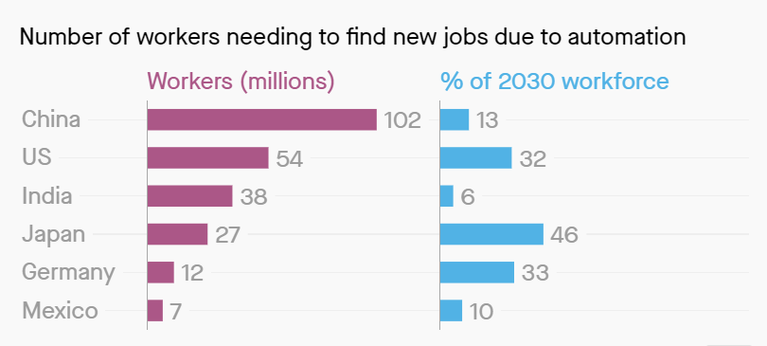
What about our jobs?
Manjusha Chava
Popular opinion: AI will eliminate more jobs than it creates.
73% of Americans believe AI will take their jobs. [9]
14% of global workforce will be displaced due to automation. [11]
Reality: potential net increase of over 2 million jobs by 2025. [3]
Different sectors will have increases and decreases in jobs. [3]
Increase of 1 million jobs in health/social work
Decrease of 700,000 jobs in manufacturing
https://qz.com/1140364/as-automation-hits-375-million-people-will-have-to-change-careers-entirely/
Notes:
There is always a notion with the general public regarding AI taking away jobs. This is especially relevant when relating to manufacturing jobs.
73% of people believe that AI will take their jobs from them, and this perception is harmful to the development of technologies that could potentially increase jobs in other sectors.
A study by McKinsey Global Institute shows that by 2030, 14% of the global workforce, or 375 million people, will be displaced out of their jobs due to AI and automation. That means that they will need to learn new and different skill sets to find a new job.
However, according to a study done by a research firm Gartner, AI is currently creating more jobs than it destroys, and will be on track to creating over 2 million more jobs by 2025.
These job creations will be in different sectors. A study done by PWC in Britain found that in the health and social work sector, the number of jobs could rise by 1 million, whereas jobs in manufacturing could decrease by 700,000 roles or 25%.
Those who are displaced from their jobs will certainly be able to find a niche in society through the increase in jobs and change in skill sets.

Slide 19
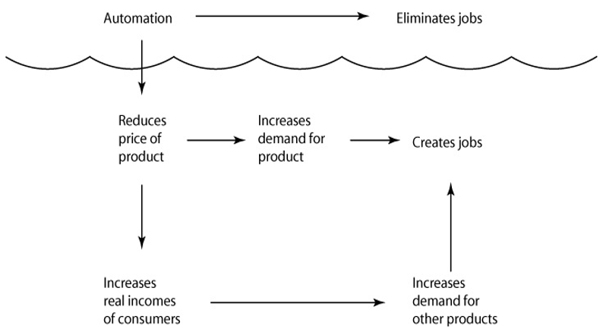
Professional ethics standpoint
Manjusha Chava
AI is only used to guide manufacturing process.
Manufacturing facing severe labor shortage today. [2]
Issue is one of the top three most constraining the industry’s growth.
The use of AI will increase economic productivity [2]
Reduce producer’s conversion costs by 20% with 70%
Cost reduction results from higher workforce productivity
Quinn, Michael J. Ethics for the Information Age.
Notes:
Professional ethics generally state that technology should not render humans obsolete, which would be found given a comprehensive evaluation of computing systems.
Manufacturing companies state that one of the biggest issues they face is severe labor shortage, which could be countered by using AI to fill up the space left behind by the labor shortage.
Utilizing AI in manufacturing can reduce producer’s conversion costs by up to 20% with up to 70% of the cost reduction resulting from higher workforce productivity. This essentially states that using AI will increase the productivity of the human workers, giving them more meaningful tasks while the mundane and repetitive work can be by AI.

Slide 20
References
Manjusha Chava
[1] Bharadwaj, R. (2019). Artificial intelligence applications in additive manufacturing (3D printing). Retrieved from https://emerj.com/ai-sector-overviews/artificial-intelligence-applications-additive-manufacturing-3d-printing/
[2] Columbus, L. (2019). 10 ways machine learning is revolutionizing manufacturing in 2019. Retrieved from https://www.forbes.com/sites/louiscolumbus/2019/08/11/10-ways-machine-learning-is-revolutionizing-manufacturing-in-2019/
[3] Council, Y. E. (2018). Do you fear artificial intelligence will take your job? Retrieved from https://www.forbes.com/sites/theyec/2018/07/06/do-you-fear-artificial-intelligence-will-take-your-job/
[4] Driving impact at scale from automation and AI
[5] EN US CNTNT report 2019 manufacturing trends
[6] How machine learning is moving AM beyond trial and error. (2018). Retrieved from https://www.additivemanufacturing.media/articles/how-machine-learning-is-moving-am-beyond-trial-and-error

Slide 21
References
Manjusha Chava
[7] Quinn, M. J.EthicsTextbook
[8] Ramsö, S., Ellsäter, H., & Arm, P. (2017). Microsoft dynamics 365 (Upplaga 2 med uppdaterat innehåll ed.). Bankeryd: Consilior. Retrieved from http://libris.kb.se/resource/bib/20848849
[9] Vincent, J. (2018). Most americans think artificial intelligence will destroy other people’s jobs, not theirs. Retrieved from https://www.theverge.com/2018/3/7/17089904/ai-job-loss-automation-survey-gallup
[10] Visualizing the uses and potential impact of AI and other analytics | McKinsey. (2018). Retrieved from https://www.mckinsey.com/featured-insights/artificial-intelligence/visualizing-the-uses-and-potential-impact-of-ai-and-other-analytics
[11] Wang, A. X. (2017). What 375 million people will have to do when robots take their jobs. Retrieved from https://qz.com/1140364/as-automation-hits-375-million-people-will-have-to-change-careers-entirely/

Slide 22
Don’t Build Dangerous AI
Ryan Eastwood

Slide 23
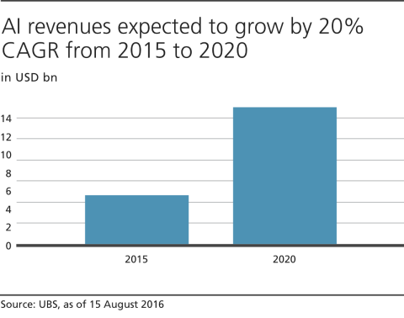
What is AI?
Ryan Eastwood
Algorithms that learn
Classification and evaluation
Computer Vision
Data Analytics
Decision making
<Graphic as big as will fit>
<https://www.ubs.com/microsites/artificial-intelligence/en/ai-coming-age.html>
Notes:
Artificial intelligence is a term referring to programs and algorithms that take inspiration from human intelligence to operate. Typically this is in the form of learning from data and adapting. Learning algorithms are incredibly powerful and their creation and use is a rising industry worldwide.
One of the main uses of these algorithms is in classification and evaluation. Machine learning, a subset of AI is particularly powerful at identifying and recognizing patterns. This can be used in image processing, to recognize shapes and objects, and in data analytics, identifying correlations within data sets.
Another use of AI is in decision making, These AI often take advantage of a computers high processing speed to simulate trees of events that could occur and make decisions that lead to the best outcome. A good example of this is in chess playing AI, where the possible moves are simulated to see which leads to the winning outcome.

Slide 24
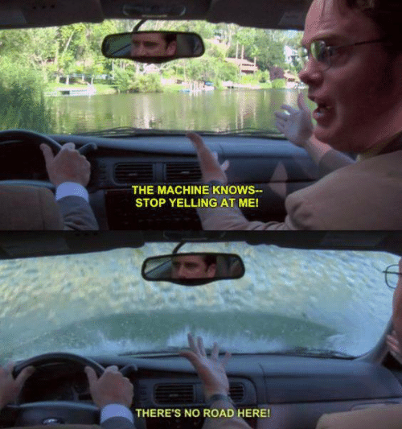
What Makes It Dangerous?
Ryan Eastwood
Difficult to understand
Not always clear why it behaves a certain way
Issue of reliability
Amoral decision making
Devalues humanity
<Graphic as big as will fit>
<https://me.me/i/the-machine-knows-stop-yelling-at-me-theres-no-road-20873100>
Notes:
One of the prime issues of AI is that the algorithm can work incorrectly without throwing errors, or any indication of a problem. These algorithms take in a massive amount of data and operate off of it, so small quirks in their code can result in large errors in output. An extension of this problem is the difficulty of debugging errors in AI software. Because of the various factors in play, it can be difficult to identify a software bug, when the inputs may be biased.
Because the complexity of the systems is so large, reliability is a large issue. In addition, its status as an emerging technology means even greater scrutiny is being placed on failures. For AI to be considered safe by the it needs to be exceedingly reliable, as incidents can easily break trust in the technology as a whole
Another problem with Ai, specifically decision making systems, is the lack of ethics or moral code. Without being specifically programmed in, an algorithm places no weight on what is right or wrong.
A potential concern in the far future is the concept of AI having superior performance to humans. While not a direct threat, it does complicate the safety humans have as the apex species and calls into question human value

Slide 25
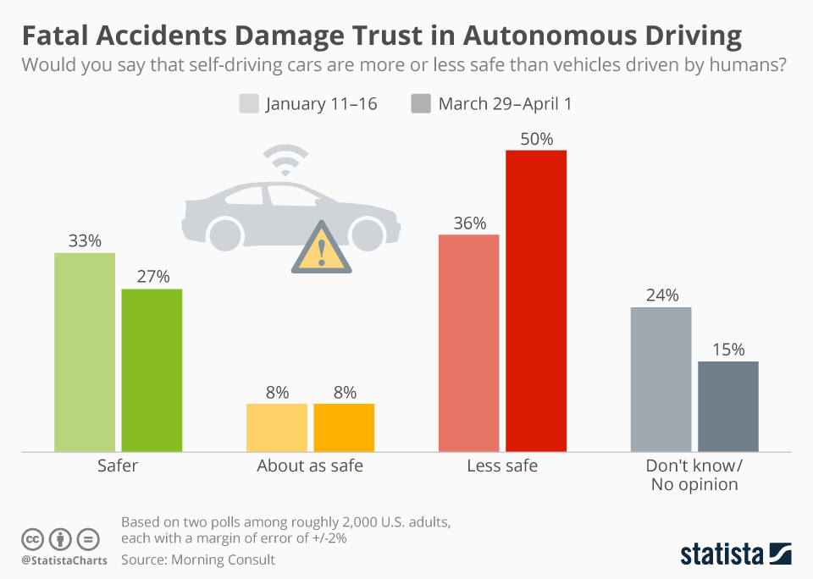
Reliability
Ryan Eastwood
Self-Driving cars have ignored obstacles and pedestrians
Watson Health has made dangerous recommendations
https://www.statista.com/chart/13450/perceived-safety-of-self-driving-cars/
Notes:
Graphic compares opinions after two fatal car accidents in march
In march a self driving car was involved in a fatal accident. The system for the vehicles emergency stop had been disabled so that the self driving AI being tested operated the car fully. Before this accident, the team had reported that the autonomous driving software was not functioning well, experiencing some form of accident almost every 15,000 miles, with a test car being damaged every other day.\
Another Ai that see reliability issues is IBM’s Watson Health, a program that makes treatment recommendations to doctors. This AI has a poor reputation in the medical community, often making incorrect or even unsafe treatment recommendations. IBM has reduced active team members after the poor response on Watson’s effectiveness

Slide 26

Ethics of an AI
Ryan Eastwood
Possess no innate morality
Can learn to discriminate
Amazon recruiting software discriminated against women
Twitter chatbot learned racism in less than a day
Making decisions that could impact human lives
https://conditiohumana.io/moral-machines/
Notes:
To elaborate on the issue of ethics in AI, Learning algorithms are often given free reign to identify patterns from anything. In these cases, the data supplied is used in its entirety by the program. This can cause issues when biases exist in the training inputs.
A good example of this is Amazons hiring algorithm, which was trained on ten years of approved candidates. For whatever reason, be it discrimination in the past or simply more male candidates overall,, the data set of the past ten years had primarily male candidates being approved to work for amazon. Because of this, the algorithm identified this as a pattern, and began scoring female applicants lower specifically because of their gender
Another example of the dangerous free training model is Microsofts TayTweets chatbot. The chatbot learned from conversations with other users, and had not code of what speech may be harmful or wrong. As a result of people targeting the bot for amusement, it began to learn hate speech and post controversial opinions .Microsoft eventually took down the bot and brought it back with much more limited learning capabilities.
Both of these examples show a bias in data propagating into a bias in the programs operation.

Slide 27
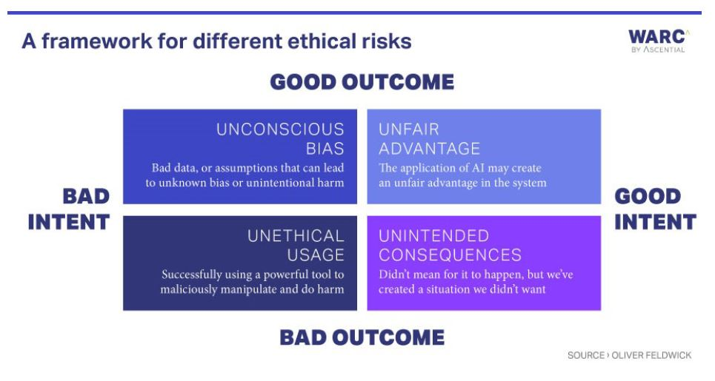
Building Safe AI
Ryan Eastwood
Human guidance
Ethics regulations
Limiting Functionality
Assessability
https://www.warc.com/newsandopinion/news/ethical_considerations_for_ai/42040
Notes:
Human guidance: Having a human middle man between AI and operation means there is always a safety measure to prevent decision errors from being acted on. A good example is the Watson health AI, While it is also a good example of a problematic system, it is only a system that recommends treatments to doctors, who can then make their own decision. Because there is a middle man who makes the final call, an ai error cannot be propagated into the real world, adding an extra factor of safety. This allows for faster recognition of errors, as well as preventing them from being fully realized.
Ethics regulation: AI does not naturally take morality into its decision making. While some algorithms can have functionality to take ethic rules, some learning algorithms prove difficult hard code a restricting set of rules. Lets take a look at the amazon recruiting incident. The machine learning algorithm was trained on previously approved applications, identifying positive qualities based off of previously hired candidates. The applicant pool in previous years was primarily men, and as a result the algorithm biased gender in its scoring. In this situation, there is a key issue in how the algorithm was run. By learning from every possible field of an application, the algorithm was free to develop biases based on past imbalances in hiring.
Limiting functionality: A common idea explored in media is the existence of AI’s that manage various operations, with versatility rivaling a human workers. Pursuing the idea of one program handling a vast number of tasks poses a large risk, as the increase in complexity challenges the reliability of the system. The growth of AI into something greater than a focused tool also presents the issue of creating something more than human. Given that such a large scale system were implemented perfectly, it could be a challenge to the safety humans currently possess as the apex species on earth. This is a more complex issue that may not occur for some time. The sheer amount of work needed to create such a program prevents them from occurring under the radar. $35,373,395.94 went into the 40 day training period of alpha-go, system that played go, on a machine that cost 25 million in hardware{2]

Slide 28
References
Ryan Eastwood
[1]https://www.ntsb.gov/investigations/AccidentReports/Reports/HWY18MH010-prelim.pdf
[2] https://www.inc.com/lisa-calhoun/google-artificial-intelligence-alpha-go-zero-just-pressed-reset-on-how-we-learn.html
[3] How much did AlphaZero cost? https://www.yuzeh.com/data/agz-cost.html
[4] https://www.reuters.com/article/us-amazon-com-jobs-automation-insight/amazon-scraps-secret-ai-recruiting-tool-that-showed-bias-against-women-idUSKCN1MK08G
[5] Kraemer, F., Overveld, K., & Peterson, M. (2011). Is there an ethics of algorithms? Ethics and Information Technology, 13(3), 251–260
[6] https://fortune.com/2018/12/13/uber-self-driving-car-crashes/

Slide 29
Class 10 The End
Keith A. Pray
Instructor
socialimps.keithpray.net
Notes:
This is the end. Any slides beyond this point are for answering questions that may arise but not needed in the main talk. Some slides may also be unfinished and are not needed but kept just in case.

