Slide 1
Class 8 Crime
Keith A. Pray
Instructor
socialimps.keithpray.net
Notes:
Here’s the title slide. Is anyone not excited?

Slide 2
Papers
Make decisive conclusions
may, could, etc. = trivial
Quantify
Do not use terms like: less, more, a lot, huge, great, big, tiny, growing, etc.
Absolute statements are difficult to prove
Avoid: all, always, any, every, everyone, never, none… unless you can show it
Read paper aloud to proof
http://socialimps.keithpray.net/assignments/paper-guidelines/
Notes:
0s not included.
Save for next time:
Absolute statements are difficult to prove
Avoid: all, always, any, every, everyone, never, none… unless you can show it
Be sure to put quotes around entire quote
Hyperbole is the best thing ever!
but not in these papers
Print 2 sided and save a tree
Use template, saves time (and -1 point)

Slide 3
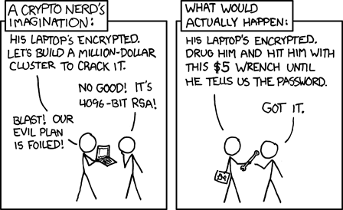
Overview
Review
Assignment
Students Present
http://xkcd.com/538/ (2010-11-14)
Notes:
Are there any questions on the assigned reading?
Use the slides ahead to explain any of the attack methods from the text.
If there are no questions you can skip those slides.

Slide 4
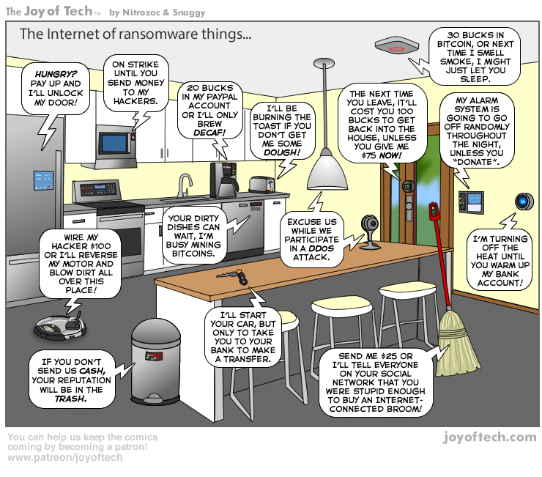
https://cointelegraph.com/storage/uploads/view/5e8f6e0d3a029807dfe181dc3d160cf0.png
Notes:
Find publish date
Note which really exist
Extra credit

Slide 5
My Reading Notes
pp. 323 Might be interesting to compare password guidance over the years.
pp. 325 plenty not sent with HTTP
pp. 328 Getting on TV much more difficult than releasing software
pp. 330 Virus could be new
pp. 332 Goals include infect 3 machine per LAN and as many computers as possible? Never make last minute changes before release. Were they related to the defects?
pp. 333 Testing w/out DEBUG often neglected
pp. 335 Do people use the Internet as an experimental laboratory these days? Shutdown right after booting, “benign” doesn’t seem like the right word.
pp. 337 “send reports back to a host computer”?
pp. 338 Firewalls often not running on same machine as malware, routers?
pp. 339 Have 2003 fears of cyber terrorist attacks been realized?
pp. 347 How is online voting a moral issue?
End of Chapter questions: 14. 25. 29.

Slide 6
Group Quiz
A denial of service attack shuts down a bunch of retailer, stock brokerage, large corporate entertainment and information web sites. Possible guilty parties:
Terrorist who aimed to cause billions of damage to U.S. economy.
Protest organization opposing commercialization of the web and corporate manipulation of consumers.
Script kiddie (a minor) just having fun with tools he found on the web.
Show off hacker in search of bragging rights.
State what penalties are appropriate for each.
Explain your answer to 1. using a single Ethical Theory for all.
Name the laws/acts under which these parties could be prosecuted.
Notes:
Works well as small group exercise.
Note: short answer format expected.
Note: 2. only one argument needed, should include logic for all parties
Note: 3. same law(s) should be applicable to all parties

Slide 7
Assignment Code Testing 1 Page Paper 1/2
Given code you did not write yourself, you need to test and potentially break it
Find as many bugs possible
There are major and minor bugs to find
Once testing is done write paper arguing your testing was adequate
Things that might be useful in your argument:
Explanations of defects
How to fix them
Consequences of leaving defects in production code
Use weaknesses (or strengths) in your testing methods as a counter argument
Working example: http://socialimps.keithpray.net/assignments/Test_Sales_Fun
Notes:
If guest presenter coming next class remind students to prepare questions for him.
Remember to work on groups projects.
Each group should have material on their sites for the topics we’ve covered so far.
OLD Prompt:
Design tests for the code on the following slide.
Contains at least one major defect and several minor ones.
Write a paper (1 page not counting any source code) including :
Did you choose a good test strategy? (This is your conclusion.)
The inputs and expected outputs
What defects you found
How you would fix the defects (you may include fixed source)
Why would that fix the problems?
What could happen if the defects are not found before the code is put into production?

Slide 8
Assignment Code Testing 2/2
import java.text.NumberFormat;
public class SalesFun {
public static double calculateSalesTotal ( double amount, double discountRate, double taxRate ) {
double discount = amount * discountRate;
double total = amount - discount;
double tax = total * taxRate;
double taxedTotal = tax + total;
NumberFormat numberFormat = NumberFormat.getCurrencyInstance();
System.out.println ( "Subtotal : " + numberFormat.format ( amount ) );
System.out.println ( "Discount : " + numberFormat.format ( discount ) );
System.out.println ( "Total : " + numberFormat.format ( total ) );
System.out.println ( "Tax : " + numberFormat.format ( tax ) );
System.out.println ( "Tax+Total: " + numberFormat.format ( taxedTotal ) );
return taxedTotal;
}
}
} Lines of interest
Notes:
Bold lines are real focus.
Example input:
amount = 100.05;
discountRate = 0.10;
taxRate = 0.05;
OR
0.70, 0.0, 0.05
95.67, 0.20, 0.7

Slide 9
Overview
Survey
Review
Assignment
Students Present

Slide 10
Be in a botnet
Raymond Schade
Notes:
Hello, I’m Raymond Schade
How many of you have heard of or contributed to a community computing project such as SETI@home or Folding@home?

Slide 11
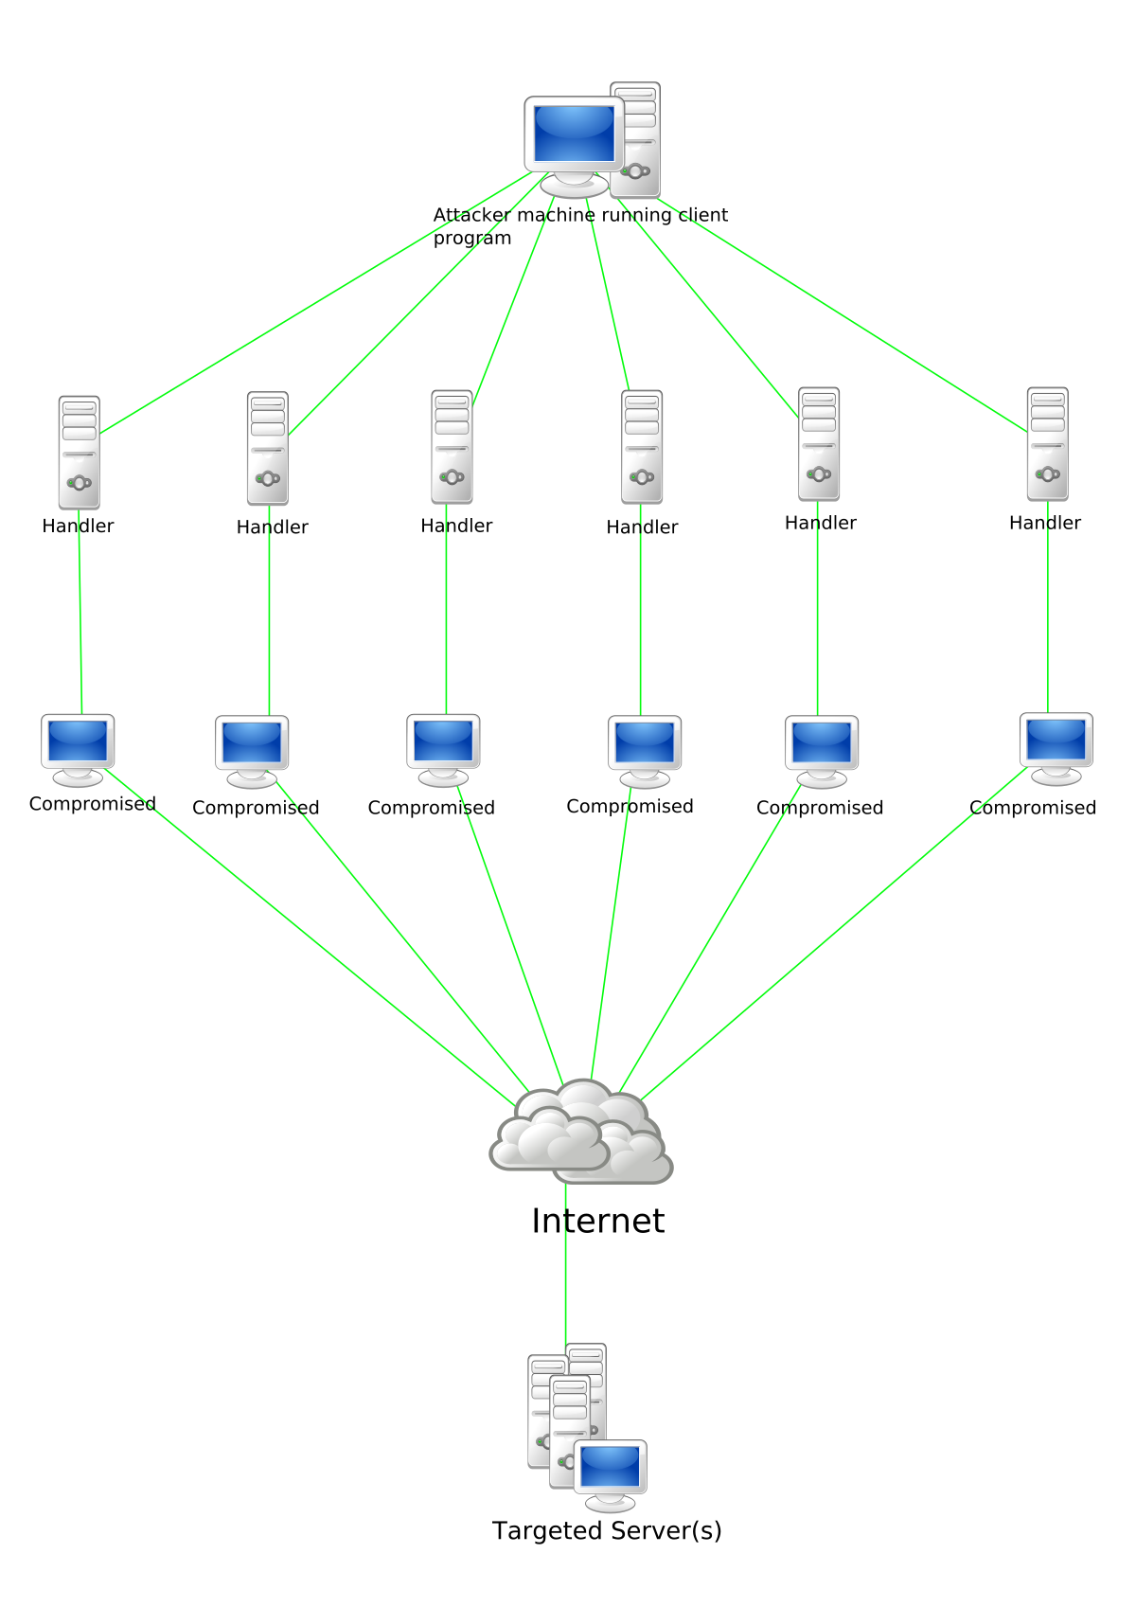
The power of botnets
Raymond Schade
Many computers act together
Can be used for good or evil
Can be extremely powerful
All BOINC projects combined = 6th largest supercomputer[1][2]
Titanic used this approach to render the final movie[3]
https://commons.wikimedia.org/wiki/File:Stachledraht_DDos_Attack.svg
Notes:
Botnets are where many computers work together in order to complete a task. This can be accomplished by coordination through a command and control server or through peer to peer networking. Historically, these large tasks would be completed by mainframes or by clusters of computers called supercomputers. However, networking has gotten ubiquitous enough to allow coordination between thousands of computers across the world. These computers can be taken by force using malware and malicious webpage code or they can be donated by willing people. Surprisingly, many people choose to donate their computation time for no reward.
One such donation based framework is called BOINC. People can subscribe to projects and donate varying amounts of their computer’s resources to them. All of these projects combined have enough processing power as to be equivalent to the 6th largest supercomputer in the world. However, BOINC has a few drawbacks. It’s running on untrusted hardware so integrity checks require the same job be run multiple times. Also, people can drop out of the network any time they want, so many jobs can be terminated part of the way through and require the system to re-allocate them to different computers.
The movie Titanic was rendered using similar technology. They used many computers from their office to render the final movie because it would be cost prohibitive to use a super computer. Their grid of computers was much more dependable and had faster communication compared to BOINC and similar projects but it used the same principal of distributing work across many computers and putting it together at the end in order to speed up their final rendering time.
This powerful idea can be used for positive effects as I just described. However, they can also be used for malicious reasons. These evil botnets have more publicity and tend to overshadow the good uses of such ideas and technology.

Slide 12
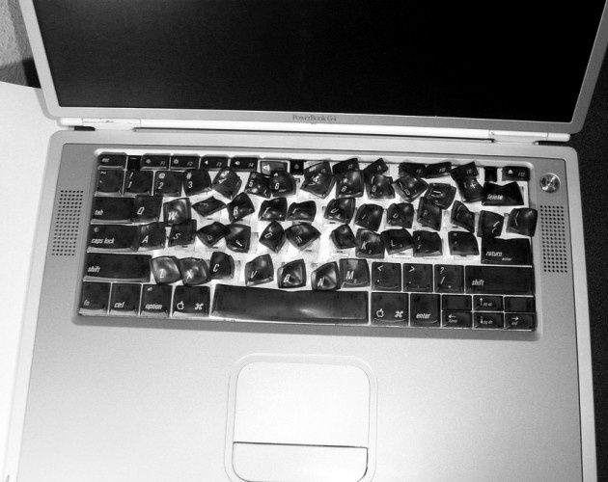
Botnets are associated with harm
Raymond Schade
People rent botnets on the darkweb [4]
Social media blasts [4]
Distribute malware [4]
Cryptojacking
The Pirate Bay used this for revenue [5]
Coinhive was inserted into YouTube ads [5]
Chrome extension did this silently on 100,000+ users [5]
https://in.pcmag.com/consumer-electronics/28298/a-gallery-of-melted-technology
Notes:
If you were to see a botnet story on the news, it would probably be about some form of illegal behavior. People rent botnets on the darkweb in order to spam social media, distribute malware and spam people’s emails.
A new threat is crypto jacking, where a website or other program will mine a cryptocurrency for another person in the background. This has been used on The Pirate Bay’s website for a supplemental revenue stream. There have been two other notable incidents. Coinhive, a mining application, was inserted into ad code for a particular YouTube ad, so while the ad was displayed on the site a user’s PC would be mining cryptocurrency for the attacker. A chrome extension also had malicious code that mined crypto, and it affected over 100,000 users. Many of these crypto botnets do not throttle or set a low priority on their processes, so they use all available resources while active which is much more taxing on the system than community botnets. This attack is dangerous because it can hurt the lifespan and battery life of many people’s computers for a single person’s gain. However, if these sites and applications clearly disclosed this use case and provided some kind of benefit like reduced banner or video ads it might not be as harmful. Many banner ads and video ads take up a lot of resources anyways, so it would be significantly less invasive if something were generating money in the background and using the same amount of resources. However, many browsers have taken a hard line stance against this and have integrated code that blocks known mining applications automatically.
On the right you can see a potential downfall of altruistic botnet participation. This person was running SETI@Home on their computer, which tries to find alien life by examining signals from outer space. Their keyboard melted because they fell asleep with it taking up all the laptop’s resources.

Slide 13
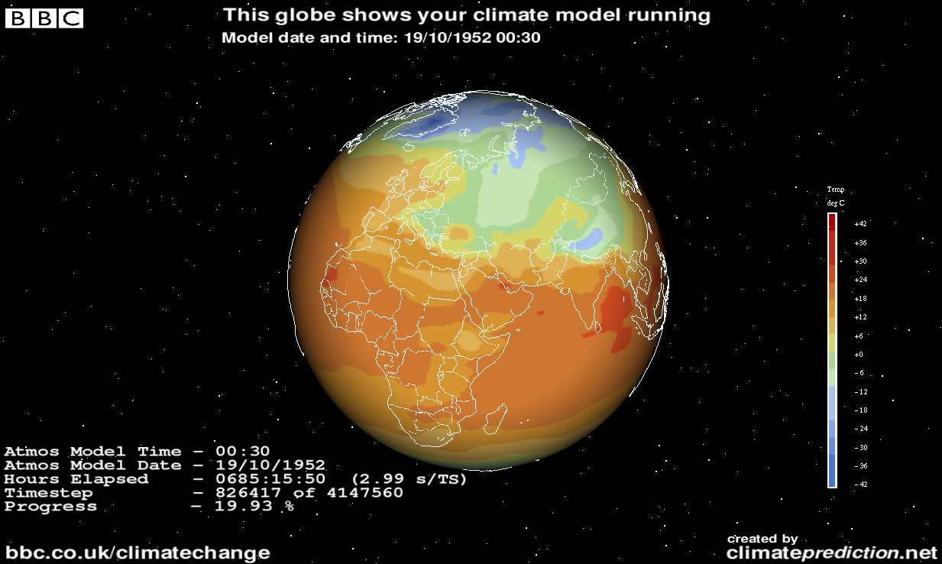
Community Projects, good botnets
Raymond Schade
BOINC [6]
Framework
Community Driven
Handles Untrusted Hardware
ClimatePrediction.net [7]
Predicts climate years into the future
Many small variations
Folding@home [8]
Protein folding problems
Solves the previously unsolvable
https://en.wikipedia.org/wiki/Climateprediction.net#/media/File:CPDN-Client.png
Notes:
BOINC is a framework used for many of these projects. Many people contribute their own computing power to BOINC for nothing in return except for listings on a scoreboard. As you run more jobs in these projects, you accumulate credits and these points are publicly accessible on their website. It’s a clever idea to gamify the system and provide some sort of incentive for people to continue to use it. It’s a good motivator for some users, people have actually been caught cheating the system and exploiting vulnerabilities to get more credits than they deserve. It’s community driven and was developed by the university UC Berkely, it automatically handles things such as validating outputs with untrusted hardware and network issues on worker PCs. It provides a base for many projects like ClimatePrediction.net and SETI@home. BOINC is open source so anyone can use it for their own project and contribute fixes and new features back. Recently android support has been added so phones can even participate in the projects.
ClimatePrediction.net predicts global climate many years into the future with many variations in order to better understand the effects of climate change and what humanity can do in order to mitigate them. This would cost a lot more money using a traditional cluster or grid. A supercomputer on this scale costs many thousands of dollars and requires maintenance and the facility to hold it. BOINC is essentially free besides the upfront setup cost to the researcher and a central hosting server. The cluster can also scale upwards as more people take an interest in the project. The picture to the side is an example of one such climate model created by ClimatePrediction.net
Folding@home is another such project and has made large advances in cancer and genetics research. Protein folding problems are particularly difficult because they have many variations and can take a long time to simulate small models. Their system gives computers small pieces of the proteins to simulate for short periods of time and the central server puts the pieces back together at the end.
These types of problems would be unsolvable if people didn’t donate their computing power to the system.

Slide 14
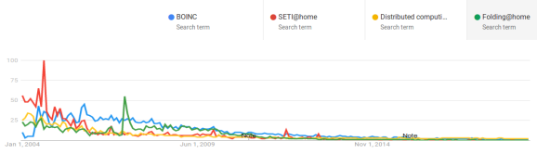
They need your help
Raymond Schade
Decline in popularity [9]
No advertising
No budget for it
Researchers aren’t focused on community outreach [9]
However, easier than ever to join [9]
Android app
Faster PCs
Google Search Analytics
Notes:
Even though these projects can cause good in the world they have been seeing a decline. To the right you can see a graph of Google’s analytics about several search terms associated with positive botnets and they have all been on the decline since the early 2000s. Some of the reasons include a lack of advertising and a small budget for outreach. Many institutions don’t even fund outreach for these projects. News stories haven’t been run on the technology in a while because it isn’t a new story. Many people don’t know about these projects even though they are very easy to install and require virtually no maintenance to keep running on your computer or phone. It also feels good to know you are contributing in a small way to important projects that further cancer research or climate change research.
This is unfortunate because our PCs have been getting stronger and stronger as this has been happening. People could donate a small fraction of their computer or android device’s processing power at idle and this combined effort would speed up the entire system dramatically compared to back in 2004 when most of these projects hit their peak. Computational problems have only been getting more rigorous as time goes on and this is a very cost effective way of conducting research. I believe that research towards these projects will be severely hindered in the future if more people don’t contribute some of their processing power and they keep declining as they have been. This is unfortunate because everyone here could contribute to these projects at some level with almost no cost to them.
As a follow up to my previous question, how many people after hearing this presentation will consider contributing to one or more of these projects?

Slide 15
References
Raymond Schade
[1] Top500.org, Top 500 Supercomputer list, https://www.top500.org/list/2019/06/?page=1 (Accessed 9/15/19)
[2] BOINC stats, BOINC Overall Statistics, https://www.boincstats.com/stats/-1/project/detail/ (Accessed 9/15/19)
[3] Daryll Strauss, Linux Helps Bring Titanic to Life, https://www.linuxjournal.com/article/2494 (Accessed 9/15/19)
[4] Jacob Roach, What is a Botnet?, https://www.cloudwards.net/what-is-a-botnet/ (Accessed 9/15/19)
[5] Shayan Eskandari, Andreas Leoutsarakos, Troy Mursch, Jeremy Clark, A First Look at Browser-Based Cryptojacking, https://ieeexplore.ieee.org/abstract/document/8406561 (Accessed 9/15/19)

Slide 16
References
Raymond Schade
[6] David P. Anderson, BOINC: A System for Public-Resource Computing and Storage, https://dl.acm.org/citation.cfm?id=1033223 (Accessed 9/15/19)
[7]Malik Shahzad K. Awan, Stephen A. Jarvis, Understanding Resource Provisioning for ClimatePrediction.net, https://ieeexplore.ieee.org/abstract/document/5578267 (Accessed 9/15/19)
[8] Stefan M. Larson, Cristopher D. Snow, Michael Shirts, Vijay S. Pande, Folding@Home and Genome@Home, https://arxiv.org/abs/0901.0866 (Accessed 9/15/19)
[9] Johnnie Chamberlin, The Strongest Supercomputer on Earth Still Needs Your Laptop to Cure Cancer, https://www.inverse.com/article/6592-supercomputer-boinc-update (Accessed 9/15/19)

Slide 17
Online or Brick and mortar crime
Dian Chen

Slide 18
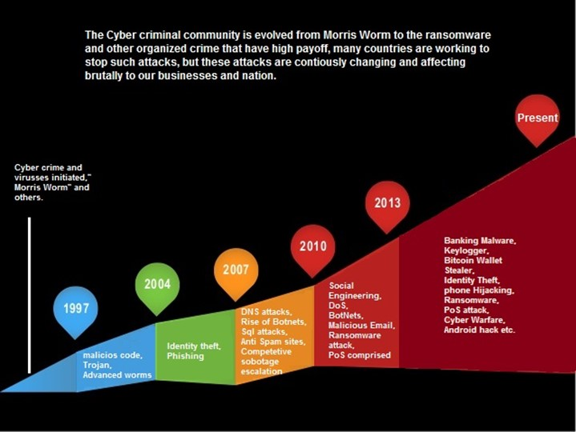
Most common crime in the country
Dian Chen
Online fraud is now the most common crime in the country
Almost one in ten people falling victim
Yet only 15 percent of cyber fraud victims ever report the crimes to law enforcement, the FBI says.
According to Juniper Research, the global cost of cyber will reach $2 trillion by 2019.
Marks a threefold increase from a $500 billion estimate in 2015[1]
<Graphic as big as will fit>
https://richardvanhooijdonk.com/blog/en/how-cybercrime-is-overtaking-physical-crime/
Notes:
I’m going to talk about the law enforcement has to get serious about cybercrime, and introduce some new technology which could be used by criminal in the future.
In today’s environment, we treat cybercrime differently than traditional crimes. Police departments don’t have adequate training or resources to deal with a robbery where the criminal could be anywhere and the evidence is lost in echoes of ones and zeros. If you call the police to tell them your refrigerator has a virus and is controlled by others, they would likely tell you to take it back to the store and wonder why you called 911. But if someone broke into your home and stole your refrigerator, there would be an investigation.
Hundreds of thousands of Americas are victims of cybercrime every year. Yet only 15 percent of victims ever report the crimes to law enforcement, from FBI’s report. Many victims — those who have lost hundreds or thousands of dollars — feel they have nowhere to turn.
Cyber criminals realize that most crimes will get little engagement from law enforcement — if they are reported at all — unless the event reaches large global companies or governments. As a result, cybercrime remains a lucrative enterprise. According to Juniper Research, the global cost of cybercrime will reach $2 trillion by 2019. That marks a three times increase from a $500 billion estimate in 2015
https://resources.infosecinstitute.com/evolution-in-the-world-of-cyber-crime/#gref

Slide 19
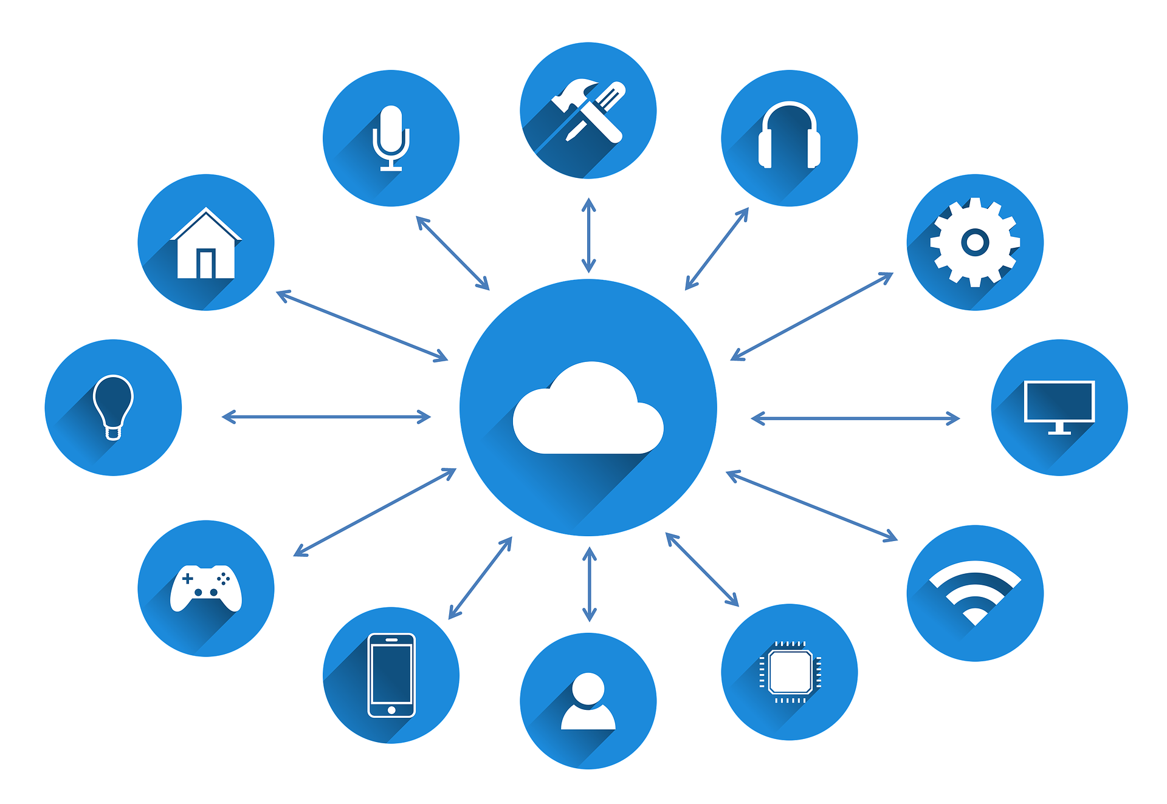
Make our awareness keep up with our technological changes
Dian Chen
Internet of Things(IoT)
By 2020, it is estimated that there will be up to 21 billion connected devices to the internet[2].
46% of all attack types that these devices experience are remote access attempts
39% are used for detecting behavioral patterns[3]
<Graphic as big as will fit>
https://irishtechnews.ie/ai-and-iot-will-the-marriage-work/
Notes:
We have to make our awareness and justice keep up with our technological changes. I want to introduce some rapidly developing technology could be used by criminals. The Internet of Things (known as IoT) is a system of interrelated computing devices, mechanical and digital machines, objects, animals or people that are provided with unique identifiers (UIDs) and the ability to transfer data over a network without requiring human-to-human or human-to-computer interaction
IoT devices are becoming a part of the mainstream electronics culture and people are adopting smart devices into their homes faster than ever. By 2020, it is estimated that there will be up to 21 billion connected devices to the internet. IoT devices will be a huge part of how we interact with basic everyday objects. In just one year alone, we went from having 5 million IoT devices connected to the internet to billions. Imaging if a criminal takes control of your house just by attacking your refrigerator, how many pieces of data and financial information will lost?

Slide 20
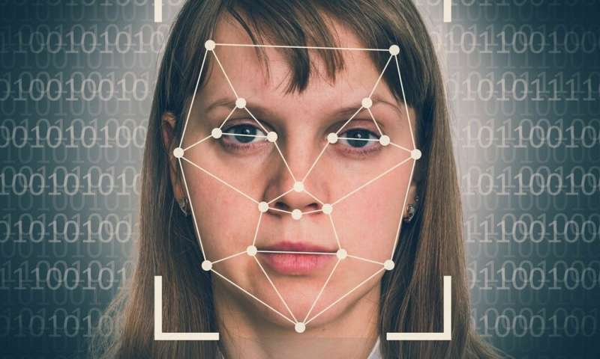
Can’t stop technology
Dian Chen
Deepfake: a technique for human image synthesis based on artificial intelligence
Criminals are using deepfakes to impersonate CEOs
Right now there just aren’t reliable tools to easily and automatically identify deepfake media[4]
<Graphic as big as will fit>
https://phys.org/news/2019-02-deepfake-videos-societyhere.html
Notes:
Deepfake (a portmanteau of "deep learning" and "fake"^{[1]}) is a technique for human image synthesis based on artificial intelligence. I think many people may be familiar with this, which is widely used on facebook. Let’s take a look about what criminal can do with it while we are using it for entertainments.
Audio deepfakes have been used as part of social engineering scams, fooling people into thinking they are receiving instructions from a trusted individual.^{[35]} The attacks were first reported in the BBC. Symantec, a major cybersecurity company, says it has seen three successful audio attacks on private companies. In each, a company’s “CEO” called a senior financial officer to request an urgent money transfer. Scammers were mimicking the CEOs’ voices with an AI program that had been trained on hours of their speech. Millions of dollars were stolen from each company, whose names were not revealed.
And unfortunately, right now there just aren’t reliable tools to easily and automatically identify deepfake media on the web. By the time a deepfake video or audio recording has been debunked, the damage could already be done.

Slide 21
References
<Your Name>
[1] Micheal K. Daly, Law enforcement has to get serious about cyber crime, https://venturebeat.com/2018/05/26/law-enforcement-has-to-get-serious-about-cyber-crime/ (May 26,2018)
[2] Richard van Hooijdonk, How cybercrime is overtaking physical crime, https://richardvanhooijdonk.com/blog/en/how-cybercrime-is-overtaking-physical-crime/ (November 27,2015)
[3] Einaras von Gravrock, Here are the biggest cybercrime trends, https://www.weforum.org/agenda/2019/03/here-are-the-biggest-cybercrime-trends-of-2019/ (March 4, 2019)
[4] Michael Grothaus, Criminal are using deepfakes to impersonate CEOs, https://www.fastcompany.com/90379001/criminals-are-using-deepfakes-to-impersonate-ceos(July 19, 2019)

Slide 22
Class 8 The End
Keith A. Pray
Instructor
socialimps.keithpray.net
Notes:
This is the end. Any slides beyond this point are for answering questions that may arise but not needed in the main talk. Some slides may also be unfinished and are not needed but kept just in case.

Slide 23
Buffer Overrun
Run time stack
Local Variables
Return Address
Parameters
Variable Attack
buffer
Target Variable
Stack Attack
buffer
Return Address
code
Return Address
Notes:
Retire slide. Most students have this in depth from new class now.
When a function call is made, local variables, return address, parameters stored on run time stack. Local variables occupy lower memory addresses.
Variable attack – change variable value. Program expects user to input character and allocates a buffer for them. Attacker supplies too many characters and ends up over writing a variable.
Stack Attack – goal is to change value of return address so execution control goes to code which the attacker has provided in the input buffer.
Prevention – add checks against array bounds being exceeded, or modify operating system to not execute instructions stored on run time stack.

Slide 24
Run Example Code
Notes:
Retire demonstration. Most students have this in depth from new class now.
> imps
> assembly
> 123456789qwerty1

Slide 25
Buffer Overrun Code
#include <stdio.h>
#include <string.h>
int main ( void ) {
char buff [ 15 ]; int ace = 0;
printf ( "\n Enter best class ever : \n" );
gets ( buff );
if ( strcmp ( buff, "imps" ) ) {
printf ( "\n %s is wrong! You should FAIL! \n ace=%i\n", buff, ace ); }
else { printf ( "Correct! \n") ; ace = 1; }
if ( ace ) { printf ( "You get an A! \n" ); }
return 0; }
} The Naughty Line
Notes:
Retire slide. Most students have this in depth from new class now.

Slide 26
TCP Three-way Handshake
SYN
SYN-ACK
ACK
Notes:
Retire slide. Most students have this in depth from new class now.
SYNchronize
SYNchronize ACKnowledgement (socket reserved awaiting ACK)
ACKnowledgement
TCP socket connection established

Slide 27
SYN Flood Attack
SYN
SYN-ACK
Notes:
Retire slide. Most students have this in depth from new class now.
Attacker spoofs the IP address so the SYN-ACK is sent to a different machine that cannot respond to the SYN-ACK.
This leaves the connection half open on the server machine decreasing the resources (sockets, memory, threads/processes) available to respond to legitimate clients.
The attacker send many such spoofed SYN messages.

Slide 28
Ping Attack
Target
Attacker
ping
ping
Notes:
Retire slide. Most students have this in depth from new class now.
Attacker finds routers that support broadcasting messages to all computers on their local area networks.
The attacker sends a spoofed ping message, which the routers echo to the spoofed address.

Slide 29
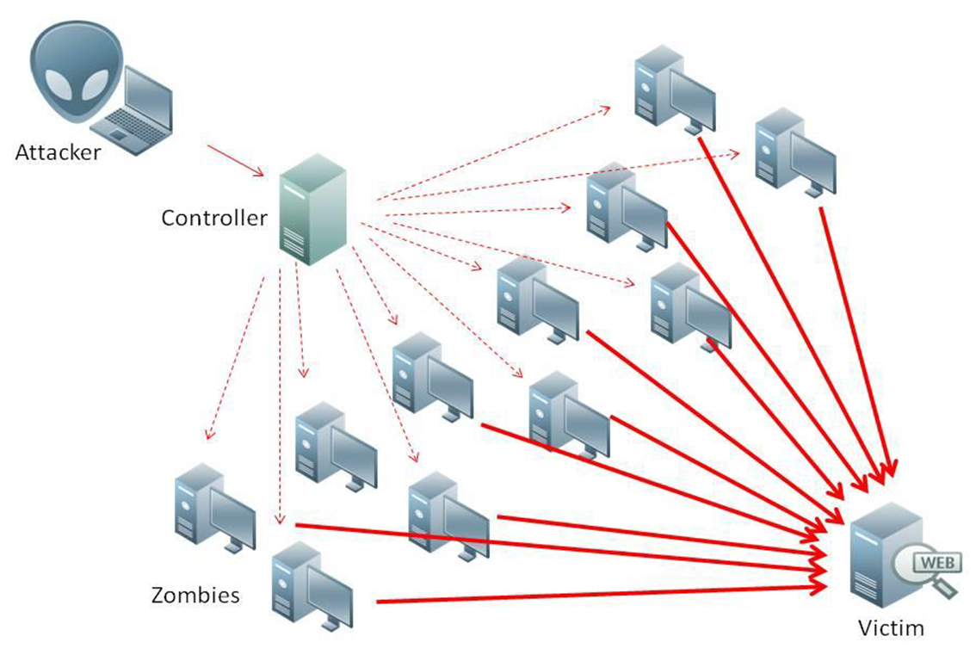
What is Denial of Service (DoS)
Attempts to make target unavailable by flooding with traffic
If victim has to filter attack, it’s too late
Internet Providers have no incentive to help
Businesses get affected, but would not pay provider enough to make worthwhile
This is why Cloudflare, e.g., exists
Many ways to perform this attack
Notes:
Contributed by Brett Ammeson.
https://www.cloudflare.com/ddos/reflection-attack-1.png
https://i.imgur.com/lxYv8cF.png

Slide 30
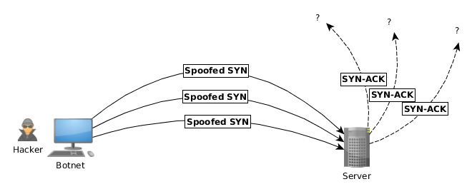
Distributed DoS Vectors
TCP SYN attack
SYN packets are small, low difficulty for attacker
Leaves half-open connections on server
SYN cookies mitigate this
DNS amplification attack
DNS requests are small
Can request all records on server
Crippled by proper configuration
Ingress/egress filtering will reduce effect
Notes:
Contributed by Brett Ammeson.
TCP SYN: https://www.cert.org/historical/advisories/CA-1996-21.cfm
DNS amplification: https://www.cert.org/historical/incident_notes/IN-2000-04.cfm
Ingress/egress: www.giac.org/paper/gsec/705/egress-filtering-keeping-internet-safe-systems/101588

Slide 31
Crime How
Technical and Non-Technical
Break into computer.
Prevent access to computer.
What things make computer related crime easy?
Notes:
Exploit security holes, Break encryption, Spoofing
Social Engineering: Guess passwords, Find out passwords and procedures
Poor passwords, Insecure protocols, Program limitations (buffer overruns), Eavesdropping (Email, Interactive), Insecure files

Slide 32
Crime Bane
Trojan Horse
Virus
Worm
Bot Network
Buffer Overrun
(Distributed) Denial Of Service Attack
How do they work?
How harmful are they?

Slide 33
Crime Why
Why?
Notes:
Money: stolen credit cards, change records, stolen property.
Political, military, economic.
Challenge, Revenge, Mean
Why do at all? Have motivation, think about it, think it will help, think it’s acceptable.
Feel forced. Don’t agree. Don’t care.

Slide 34
Crime Time
What is different now compared to:
10 years ago?
20 years ago?
30 years ago?
40 years ago?
Notes:
More computers. Unsophisticated owners. More complex software. Greater connectivity. Easy access to cracking tools. Incentives. File-sharing
In ’60s and ’70s, access was mostly localized.
Modems. Wardialing.
Some Arpanet and Usenet.

Slide 35
Crime Doers
Hacker or Cracker
Pre-1980 - Golden Age ☺ ?
Eighties
Nineties
Naughts
Criminal Hacking == Cracking?
Notes:
Script kiddies
Phreakers
Security analysts
Packet monkey

Slide 36
Crime Gain
Justifications for Computing Crimes?
What can be done after access is gained?
What resources are available?
How valuable are they?
Notes:
Machines are unused. No harm done. Education. Exposes security holes. Exposes abuses.
Use computer and/or resources. Take data. Destroy data. Alter data. Lock out others. Attack other computers.
Equipment, Processor Time, Disk space, Printer time / paper, Bandwidth

Slide 37
Crime Pay
Computer Fraud and Abuse Act (1986)
Bans :
unauthorized access or use of computers, copying, modifying, or destroying data, disclosing of passwords.
disrupting government and utilities.
Covers government, financial, medical, and interstate systems.
USA Patriot Act (2001)
Raised penalties.
Permits freer surveillance and monitoring to detect illegal activity.
Electronic Communications Privacy Act
Illegal to intercept telephone, email, other data transmissions, access stored email messages without authorization
Assign Cybercrime Treaty (2006), Wire Fraud Act, National Stolen Property Act, Identity Theft and Assumption Deterrence Act
Notes:
Are either of these laws still in effect? Have they been changed?
For additional legislation ask for presenting volunteers to brief recent incidents/cases.
Also ask for volunteers to find out laws from their home country/state.

Slide 38
Crime Stop
Technical
Protect Data
Protect Machine
Protect Access
Non-technical?
Social?
Legal?
Notes:
Encryption, Authentication, Biometrics, Anti-virus, File integrity checking (E.g. Tripwire), Virtual private networks, Point-to-point networking (Twisted-pair Ethernet vs. Coax vs. wireless)
Security through obscurity, physical access required, not on network, behind locked doors.
Remove desire, remove incentives
Legalize, increase penalties, increase chance of getting caught.

