Slide 1
Class 4
Freedom Of Speech
Keith A. Pray
Instructor
socialimps.keithpray.net
Notes:
Here’s the title slide. Excited again, aren’t you? You should be.

Slide 2
Overview
Review
Assignment
Students Present
Notes:
Show syllabus updates if any

Slide 3
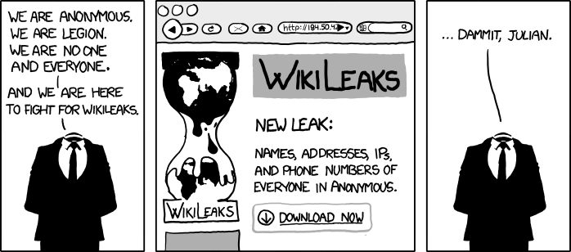
http://www.xkcd.com/834/

Slide 4
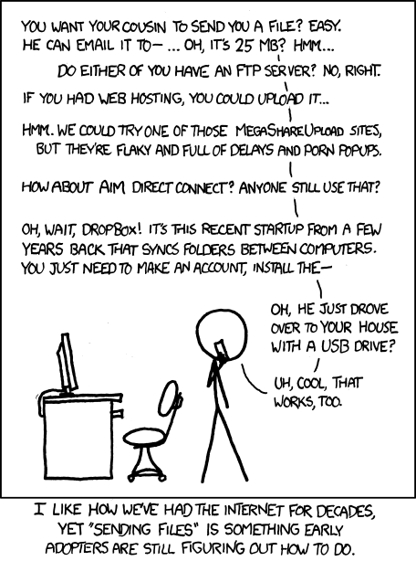
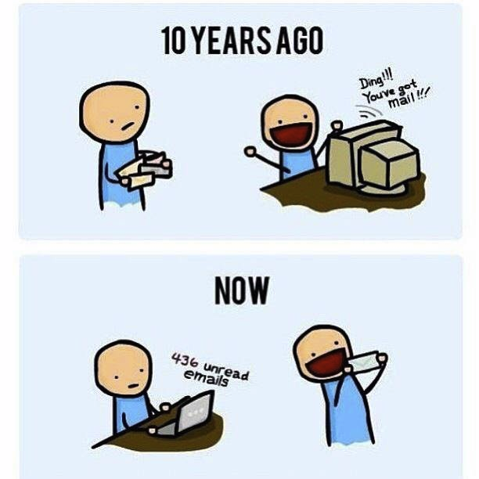
http://poofytoo.com/
25
http://xkcd.com/949/

Slide 5
My Reading Notes
pp. 110 What powers the cell phones and towers? “everyday tasks” not apparent from image.
pp. 114 Ann did not force people to complain.
pp. 117 7% # transactions or $$? Wikipedia critics source [19] from 2005, how has quality turned out? Nice to see darknet added.
pp. 118 [27] PC bangs youth source from 2003, all grown up now.
pp. 130 Is 20% realistic? What will search engines and facial recognition be capable of? Rule Utilitarian ignores the private setting.
pp. 131 Do any filters use image processing?
pp. 133 Stating people searching did not consent to material being blocked makes more sense.
pp. 134 Web access for no cost?
pp. 145 More accurate to say addicted to single app - good
pp. 149 20 same as 39
pp. 150 36 same as 42
End of Chapter questions I liked: 2, 25 http://en.wikipedia.org/wiki/Wikipedia:Citing_Wikipedia

Slide 6
Group Quiz
Name two methods some governments use to control access to information.
A large company has a policy prohibiting employees from blogging about company products.
  Name two possible reasons for the policy.
  Does it violate the First Amendment? Why?
  Is it reasonable? Why?
What does “URL” stand for and what is it?
Notes:
Censorship (religious, governmental, private). Adult authentication. Global dissemination.
Freedom of Speech not an absolute right.

Slide 7
Overview
Review
Assignment
Students Present
Notes:
But before that:
CPG Grey - This Video Will Make You Angry [Thought Germs] (7:25)
https://www.youtube.com/watch?v=rE3j_RHkqJc
If not shown yet:
What "Orwellian" really means - Noah Tavlin (5:31)
http://ed.ted.com/lessons/what-orwellian-really-means-noah-tavlin
Cedric Gervais - Hashtag (Original Mix) (3:58)
https://www.youtube.com/watch?v=6OmBKd7X7EE
Dave Audé vs Luciana - You Only Talk In #HASHTAG (3:36)
http://www.youtube.com/watch?v=53wIN87lJn0

Slide 8
Assignment
Reading
Individual Presentations
Extra Credit – One page paper
  Is WPI’s IT Acceptable Use Policy morally acceptable?
Work on your group project
  Groups will be announce by midnight tomorrow
  See full group project description on course website
  Send Web Site URL before next class
Notes:
- Or review group project and individual presentation guidelines right now.
- Respond with top 3 choices by noon tomorrow
Possible One page paper:
Global intellectual property laws, friends or foes?
Group Happiness 1 = everyone got first pick, 2 = everyone got second pick, etc.
Average Group Happiness 1.21

Slide 9
Overview
Review
Assignment
Students Present

Slide 10
What about Myspace?
Anthony Galgano
Notes:
I am Anthony Galgano a Sophomore Robotics Engineering Major.

Slide 11
Popularity
Anthony Galgano
Friendship
  People join due to presence of friends
  There is no restriction on the number of friends a user can have [1]
More than a social network [2]
  Listen to music and watch videos
  Customize home page to include favorite music, shows, books, etc. [4]
  Designed for people of all ages
Built with ColdFusion
  Simple programming language [2]
  Good for being quick to market
<Citation>
Notes:
In order for social media to be popular, people must use it.
Myspace allowed for users to have unlimited amounts of friends. This was very appealing as people could reach out to many other people with their ideas and posts.
Myspace tried to be a platform where people could live their lives. People were drawn to the idea of being able to listen to music, posts anything they wanted, and watch videos.
It was built with ColdFusion which was a very simple programming language at the time. Engineers referred to it as the micky mouse language at the time. It had a syntax that was easy to pickup.

Slide 12
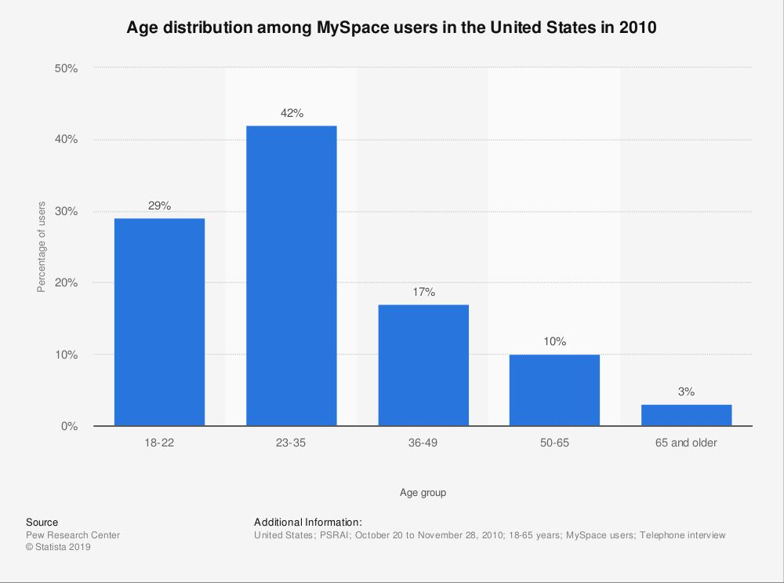
Anthony Galgano
Statusta Research Department, https://www.statista.com/statistics/192699/age-distribution-of-users-on-myspace-in-the-united-states/
Notes:
MySpace is being used for people of all ages. The popularity curve shows that the majority of people that use MySpace are 23-35 years old.
This statistic can be backed up also by the idea of emotional intellect.
Emotional intelligence (EI) is an individual’s ability to understand and regulate his or her emotional responses both internally and in others” [4].
People use MySpace for getting into relationships, and the age of can be argued to be the ages in life where most people are going to get married or start a family. This is why people could be looking for relationships.

Slide 13
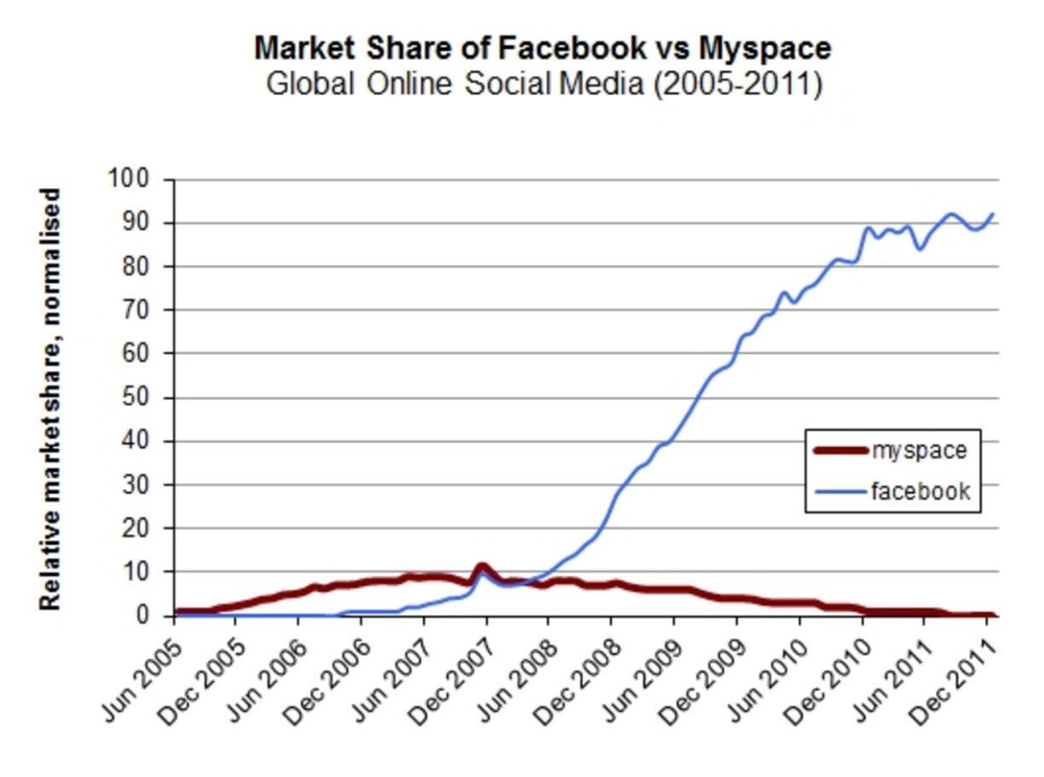
Facebook Passing myspace
Anthony Galgano
On June 20, 2008, Facebook passed MySpace in total number of users [3]
  Facebook was designed to shift with the market [3]
  Facebook was built with other developers in mind
MySpace used a tradition business plan
  Used smart MBAs
  Forecasted and Planned, but did not deviate or change with market [3]
Jon Erlichman, https://twitter.com/JonErlichman/status/1009407220143087618
Notes:
Myspace tried to create every application themselves, while Facebook opened up to allow other developers access to making their programs.
Facebook had 600 million active users in 2019 [3].
Facebook’s founders kept pushing the technology to do anything users wanted [3].
Facebooks platform was cleaner with fewer advertisement initially and less bugs. [2].

Slide 14
Failure
Anthony Galgano
Friendship Strength
  Users would be friends with many people they did not know
  Abandoned MySpace after users had few strong friendships left [1]
New products were buggy
  Not enough testing, measuring, and iterating [2]
  Went with quantity over quality
Poor Development
  Switched to .NET in 2005
  Developers wanted an“ open-source-code software” instead so the became unhappy[2]
  Poor spam filters
<Citation>
Notes:
Friendship strength is defined as how close someone is to someone they are friends with on social media. It is reported that the maximum number of people one can have a strong friendship with is 150. [1].
MySpace did not want to test and used the idea that if they were first to market and kept pushing out content and programs they would continue to grow indefinitely. This was not the case.
MySpace started to become buggy and users responded negatively to this

Slide 15
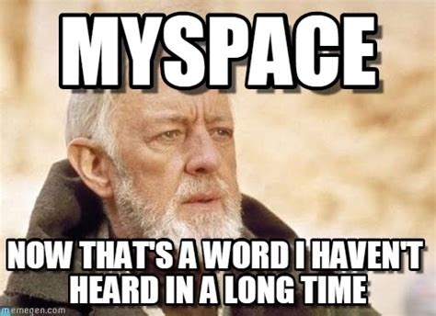
Importance Socially
Anthony Galgano
Worries about children safety
  In 2008, MySpace added 60 new features to protect against online predators [5]
  Created a panel called Internet Safety Technical Task Force [5]
Public Perception
  All social medias are reflective of how they are reported in media
MySpace shows that social media is volatile and can change at any minute
https://www.memesmonkey.com/topic/myspace#&gid=1&pid=1
Notes:
Connects to what the book talks about with children safety and predators online.
Officials needed to step in and force MySpace to have more ways to protect children from viewing pornography or adult content [5].
The media had a case against myspace that said they were involved in children seeing inappropriate content in 2006. The Connecticut attorney general Richard Blumenthal launched an investigation and came to the conclusion that MySpace was a dangerous place. Forced them to put safety measures in place [2].

Slide 16
References
Anthony Galgano
[1] Simrat Chhabra, Ajit Brundavanam, Saswata Shannigrahi, An Alternative Explanation for the Rise and Fall of MySpace, https://arxiv.org/pdf/1403.5617.pdf (Access Date 9/1/2019)
[2] Felix, Gillette, The Rise and Inglorious Fall of Myspace, http://web.a.ebscohost.com.ezproxy.wpi.edu/ehost/detail/detail?vid=0&sid=220dfcc4-c3d6-478b-a013-8e92aae70512%40sdc-v-sessmgr02&bdata=JnNpdGU9ZWhvc3QtbGl2ZQ%3d%3d#AN=61890850&db=bsh, (Access Date 9/2/2019)
[3] Adam Hartung, How Facebook Beat MySpace, https://www.forbes.com/sites/adamhartung/2011/01/14/why-facebook-beat-myspace/#15b4ca80147e, (Access Date 9/2/2019)
[4] Qingwen Dong, Mark Urista, Dunane Gundrum, The Impact of Emotional Intelligence, Self-Esteem,and Self-Image on Romantic Communication over MySpace, https://www-liebertpub-com.ezproxy.wpi.edu/doi/pdf/10.1089/cpb.2007.0154 , (Access Date 9/2/2019)
[5]Heather Havenstein, MySpace States Sign Kids Online Safety Pact, https://search-proquest-com.ezproxy.wpi.edu/docview/216091673?accountid=29120&rfr_id=info%3Axri%2Fsid%3Aprimo, (Access Date 9/2/2019)

Slide 17
Fandoms and Discussion behavior in social media
Parker Coady

Slide 18
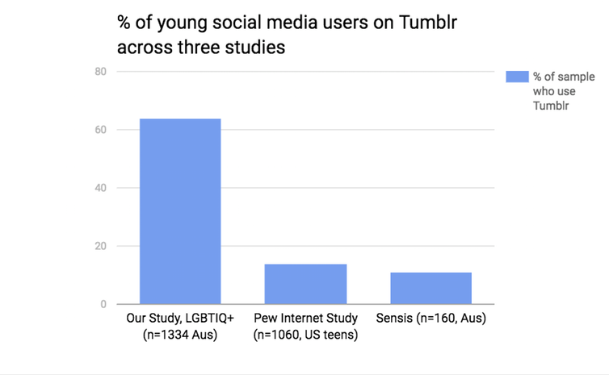
Tumblr’s DESIGN lets people express themselves without fear of judgement
Parker Coady
Tumblr allows users to obscure their identities with psuedonyms
  Typical social hierarchy by real-life identity/follower count removed
Identity is still present in the form of blog layout/avatars
Fandom culture reflects this
Out of multiple studied groups of young social media users, one conducted of only LGBT+ individuals showed a much higher use of Tumblr
Beth Daley, “There’s Something Queer About Tumblr”, http://theconversation.com/theres-something-queer-about-tumblr-73520, 9/1/19
Notes:
Tumblr’s users weren’t afraid to be weird. It is difficult to gain recognition on Tumblr- follower and following counts are kept private, unlike most forms of social media, so it’s impossible to find out how “popular” a user is unless by way of screenshot or hearsay. Posts that appear on a user’s dashboard (Tumblr’s form of feed) were often circulated thousands of times to the point where their origins were often obscured or removed. This is another feature of Tumblr’s design- users can edit or entirely delete the sources to posts when “reblogging” them- reposting them to their followers’ feed. And yet, it wasn’t a completely anonymous platform- users can still directly message each other, and create biography pages with information about themselves, and customize both the appearance and content of their blog with access to a full HTML editor. So what this created was an environment where socially outcast people could express their sexualities, identities, and fandoms without fear of judgement or decreasing social clout [1]. Tumblr has a bit of a reputation for being a dominated by LGBT+ youth to discuss their favorite TV shows, and this is accurate. Tumblr fandoms have an extremely high population of socially marginalized kids, so Tumblr fandoms would often talk about LGBT characters and share personal thoughts about media that other platforms with a stronger sense of identity or social hierarchy would discourage sharing. That’s not to say it’s perfect, though: its relative anonymity and the culture of unabashedly praising media allows anonymous bullies to harass and target individual users over minor, fandom-related things. A famous case is the bullying of a Steven Universe fanartist to attempted suicide because of disagreements about her art within the Tumblr fandom [4].

Slide 19
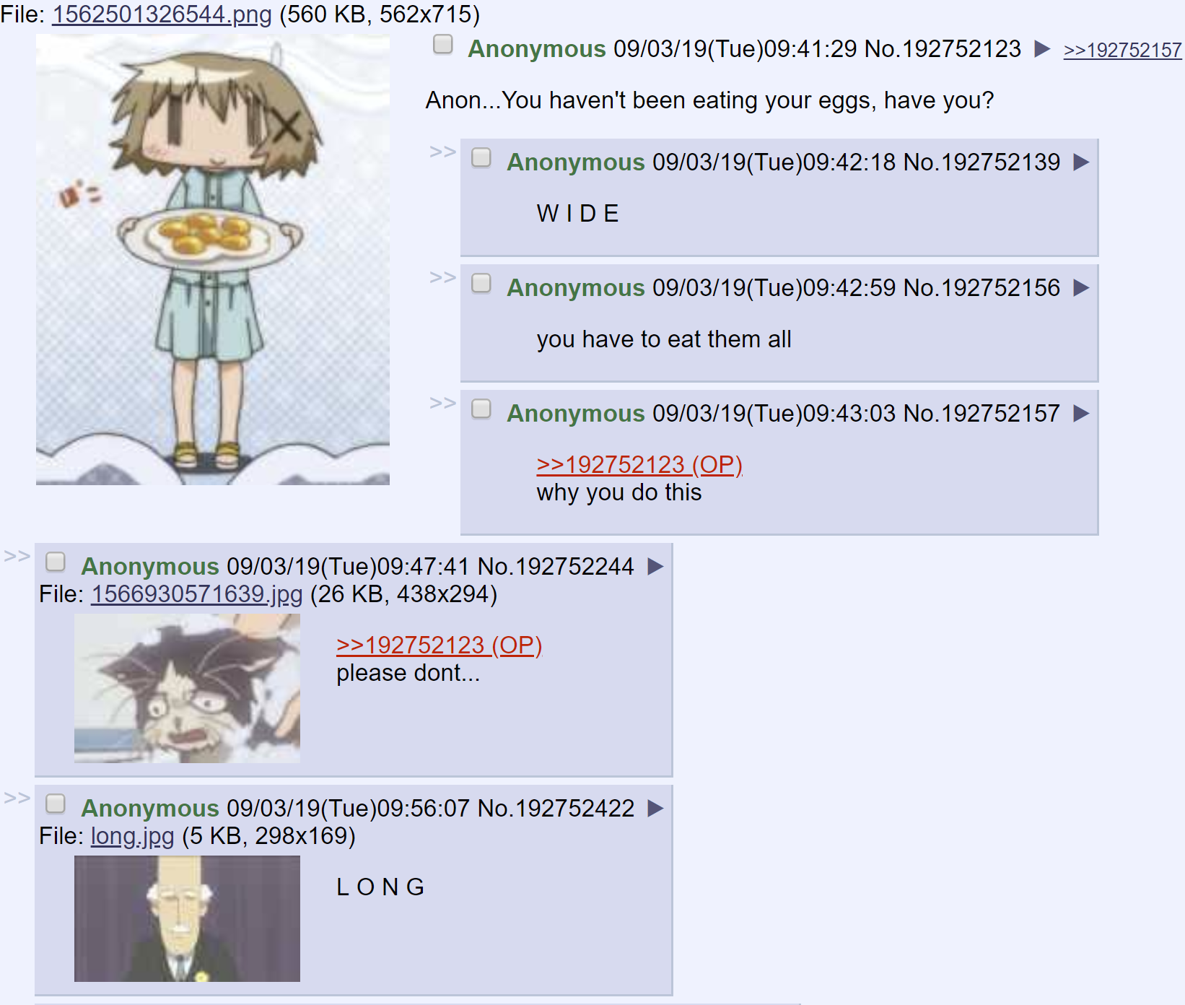
4chan’s complete anonymity makes users rely on in-jokes and inflammatory speech
Parker Coady
4chan has total anonymity and extremely lax moderation
Discussions and conversations are hard to have
Extreme viewpoints are rewarded by the site’s design
A typical thread on 4chan’s /a/board is filled with nonsensical in-jokes,
http://boards.4channel.org/a/thread/192752123,9/3/19
Notes:
4chan takes Tumblr’s anonymity to the extreme. It’s divided into several boards, each with dedicated topics. You don’t need to pick a username to post on 4chan, nor do you need to create a user profile- your identity is kept anonymous, and you can’t message anyone directly. Every thread is also deleted from the site’s servers after a certain amount of time, lending to a sense of “impermanence” about discussions [2]. This makes conversations hard to have, because you never know what posts are from which person, and the entire discussion will be deleted after a time. Since conversations are nigh impossible, most ‘discussion’ ends up looking like the above thread, where every single post relies on a short in-joke to entertain other users as the poster’s way of communicating with others. It can also take the form of posts which I will not show with extremely inflammatory contents, as to make their opinions heard and memorable among the nonsense. This is how extremist beliefs are able to propagate on the site. Since rational discussions are almost impossible, and users do not face accountability for their words since posts are temporary, their identities are anonymous, and there is little moderation, radicals are encouraged by the design of the site itself to yell as loudly and as often as possible [3].

Slide 20
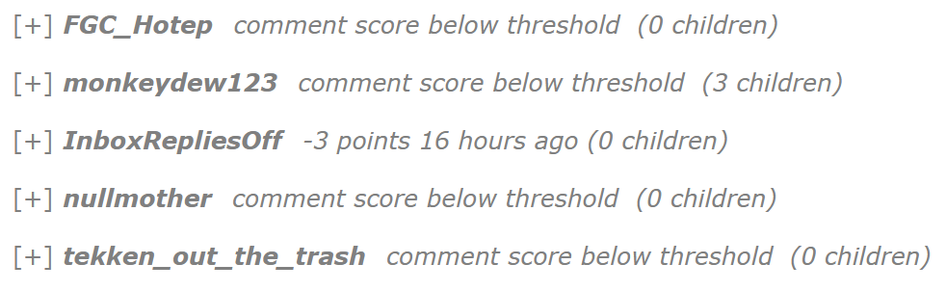
Reddit’s self-moderation encourages like-mindedness
Parker Coady
Reddit is divided into secular communities of subreddits
All content on a subreddit is self-moderated and self-policed by its own users
Content with a low score is hidden
Reddit posts are hidden when the community downvotes them enough times,
https://old.reddit.com/r/Kappa/comments/cysebg/bruh_momento/, 9/3/19
Notes:
I think an appropriate avenue to discuss how Reddit’s fandoms work is by discussing how Reddit’s more controversial parts work. Reddit is divided into an innumerable amount of “subreddits,” each with their own self-contained moderation team. Reddit relies completely on its users to “upvote” or “downvote” posts to adjust a post’s “score”, which, in turn, adjusts the post’s visibility on its subreddit. This means that a subreddit’s users have complete control of what content is visible to the rest of the community- they can make other users see content, or hide content they want silenced [5]. Recently, Reddit has received criticism for its communities of Anti-semites, racists, misogynists, conspiracy theorists, and other hateful groups which possess their own subreddits moderated and curated by their own kind [6]. It’s easy to see how leaving the content in each community at the hands of its users can create single-minded groups of people that fail to police their own hate speech, and this process can be extended to fandoms. Because the site encourages the like-minded community to vote on posts to either promote or silence them, those with dissenting opinions usually find themselves unable to find a platform for discussion. Indeed, the voting system can act as a quality filter, denying the inflammatory posters and harassers that would be welcome on Tumblr and 4chan the ability to speak, but it also discourages deviation from the community mindset.

Slide 21
References
Parker Coady
[1] Allison McKraken, Tumblr Youth Subcultures and Media Engagement (Cinema Journal, Fall 2017), 151-161
[2] Catlin Dewey, Absolutely everything you need to know to understand 4chan, the Internet’s own bogeyman https://www.washingtonpost.com/news/the-intersect/wp/2014/09/25/absolutely-everything-you-need-to-know-to-understand-4chan-the-internets-own-bogeyman/?noredirect=on, 9/1/19
[3] Dillon Ludeman, /pol/emics: Ambiguity, scales, and digital discourse on 4chan (Elsevier, 2/1/18), 92-97
[4] Clinton Nguyen, An Attempted Suicide Forced a Tumblr Community to Open Its Eyes About Bullying, https://www.vice.com/en_us/article/3da838/an-attempted-suicide-forced-a-tumblr-community-to-open-its-eyes-about-bullying, 9/2/19
[5] Hussam Habib, et. al., To Act or React? (Cornell, 6/27/2018), 1-17
[6] Mike Rothschild, “How one subreddit is fighting hate on its own platform”, https://www.dailydot.com/layer8/against-hate-subreddits-reddit/, 9/1/19

Slide 22
Class 4
The End
Keith A. Pray
Instructor
socialimps.keithpray.net
Notes:
Use remaining time to form groups, approve group topics, etc.
This is the end. Any slides beyond this point are for answering questions that may arise but not needed in the main talk. Some slides may also be unfinished and are not needed but kept just in case.

