Slide 1
Class 10 Professional Ethics
Keith A. Pray
Instructor
socialimps.keithpray.net
Notes:
Here’s the title slide. Excited already, aren’t you? You may not be depending on how you enjoyed the last class.

Slide 2
Papers
Clearly state conclusion
Include Author, Title, Publish Date, Publisher for references
Use supporting data
Quantify
Do not use terms like: less, more, a lot, huge, great, big, tiny, etc.
Read paper aloud to proof
http://socialimps.keithpray.net/assignments/paper-guidelines/
Notes:
Save for next time:
Clearly state conclusion
First statement preferred
Absolute statements are difficult to prove
Avoid: all, always, any, every, everyone, never, none… unless you can show it
Be sure to put quotes around entire quote
Hyperbole is the best thing ever!
but not in these papers
Print 2 sided and save a tree
Use template, saves time (and -1 point)
Include Counter Point and Response

Slide 3
Overview
Review
Debate
Assignment
Students Present
Notes:
We can also discuss articles listed on Security Discussions under documents of course web site.
ADD QUIZ AS BACKUP IF CLASS DISCUSSION NOT LONG ENOUGH

Slide 4
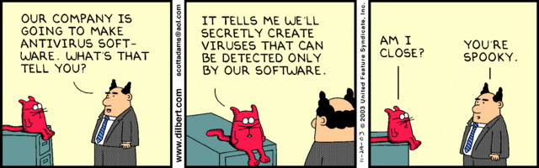
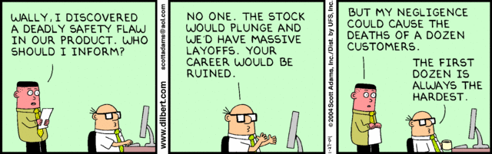
Notes:
Ask how many people in ACM or IEEE

Slide 5
Debate Ground Rules
Before Debate
10 minutes to converse with your team
Share argument points, counter points, and responses so everyone can represent
Decide who will respond to what points from the opposing side
During Debate
Stand up when speaking
1 turn per person until everyone on your team has spoken
30 second limit
Switch sides at any time if you change your mind
Notes:
Release Game or Not Debate
Chapter 9 In-class Exercises # 24.
Should the company produce the game?
Use the SWE Code Of Ethics as the basis for your argument.

Slide 6
My Reading Notes
pp. 409 Can one perform services for one’s self?
pp. 412 1993-1999 Does this seem like a long time?
pp. 413 “errors of omission or commission”?
UPDATE
pp. 422 3. Would people agree – social contract?
pp. 438 So the baby can be left outside and no one is responsible?
Notes:
An error of commission is one where the person responds where they should not. This is compared to an error of omission, where the person fails to respond when they should.

Slide 7
Assignment
1 Page Paper
What should computerized automation be applied to next?
Finish all reading
Group Project
Add analysis to website addressing all topics covered to date
Group Presentation Draft
Email presentation as attachment to course staff
Post on group website
Notes:
1 Page Paper Ideas:
For Good - How will you use your computing related education to do good in the world?
Dark Net - Is the Dark Net good or bad?
Does computerized automation help the economy or society?
What should computerized automated be applied to next?
If productivity has increased so much, why are we working so hard? Should we?
What job skills will survive computerized automation?

Slide 8
Overview
Review
Debate
Assignment
Students Present
Notes:
Show WPI and/or corporate code of ethics.

Slide 9
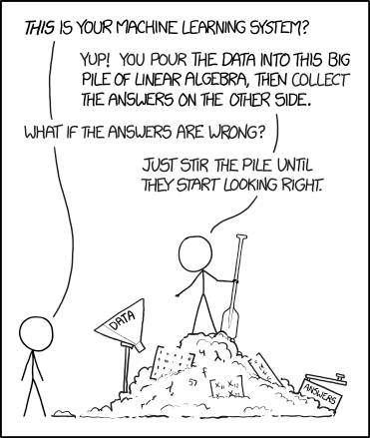
Machine Learning: If you Use it, you should understand it
Saahil Claypool
Machine Learning is not magic
Correlations are not causal
Extrapolate with caution
Domain knowledge is still needed
[1]
Notes:
I’m going to be talking about machine learning, and how that, if you are going to rely on it to make decisions, you should understand how it works. Despite its seemingly mystical nature, Machine learning is not magic. This XKCD comic describes how machine learning is sometimes (wrongly) viewed. The first part, “You pour the data into this big pile of linear algebra”, is fair, but the dangers I will talk about arise when you take that answer without thinking further about the problem. And, if you do not understand how it works, there are real dangers to blindly relying on it. Thankfully, many of these issues are fixable with some domain knowledge.

Slide 10
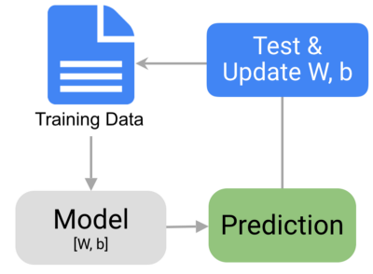
What is Machine learning?
Saahil Claypool
“Machine Learning: Field of study that gives computers the ability to learn without being explicitly programmed” – Arthur Samuel 1959
Main Categories:
Supervised
Unsupervised
[2]
Notes:
So, what is machine learning? According to the man who coined the term machine learning, Arthur Samuel, machine learning is: “”.
So, how does this differ from normal programming? Well, in normal programming, you the programmer are responsible for creating the rules. Let’s say you are identifying a dog breed from an image, you would write “If the ear is pointy, its not a golden retriever”.
In machine learning, you would give the program some data and metaphorically say “These are all golden retrievers, figure out what why”.
This learning is done in an iterative manner. The machine learning program takes in some data, makes some prediction, evaluates its progress, and updates its guesses. This is supposedly a model for real human learning (but, not quite – see AI class temporal learning, reward structures etc)
You might notice that this is old – machine learning isn’t new – at least in computer terms. But, it is very computationally heavy. Recent computer advances have lead to its rise.
I’ll briefly cover the two main categories for machine learning – supervised and unsupervised

Slide 11
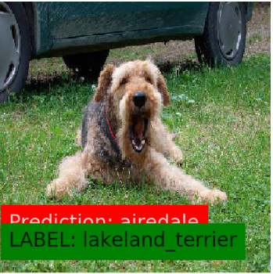
What is Machine learning?
Saahil Claypool
“Machine Learning: Field of study that gives computers the ability to learn without being explicitly programmed” – Arthur Samuel 1959
Main Categories:
Supervised
Unsupervised
[2][16]
Notes:
So, what is machine learning? According to the man who coined the term machine learning, Arthur Samuel, machine learning is: “”.
So, how does this differ from normal programming? Well, in normal programming, you the programmer are responsible for creating the rules. Let’s say you are identifying a dog breed from an image, you would write “If the ear is pointy, its not a golden retriever”.
In machine learning, you would give the program some data and metaphorically say “These are all golden retrievers, figure out what why”. <Switch Slide>
This learning is done in an iterative manner. The machine learning program takes in some data, makes some prediction, evaluates its progress, and updates its guesses. This is supposedly a model for real human learning (but, not quite – see AI class temporal learning, reward structures etc)
You might notice that this is old – machine learning isn’t new – at least in computer terms. But, it is very computationally heavy. Recent computer advances have lead to its rise.
I’ll briefly cover the two main categories for machine learning – supervised and unsupervised

Slide 12
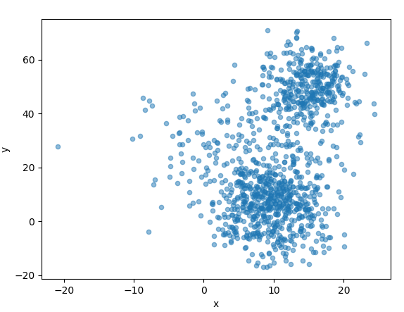
Unsupervised machine Learning
Saahil Claypool
Categorizing unlabled data
Group data with no ground truth
Use Case:
Group people based on their interests on social media
Example: K Means
Given a set of data points
Guess the “True Centers” that generated these points
[3][4][17]
Notes:
Unsupervised machine learning is the idea that the algorithm will categorize the data given no extra information (no labels). For example, some social media company, such as facebook, might want to introduce users to other, similar, users. There is no true grouping available, but an unsupervised machine learning could make some decent fitting groups given some measure of “closeness”
An example of this algorithm is the K-Means algorithm. Given some points, it attempts to find the K centers that best approximate those points. This is the algorithm that generated the images on the right. There are around 5 clusters that generate the points, and the machine learning algorithm is able to split these points up into groups with no extra information.

Slide 13
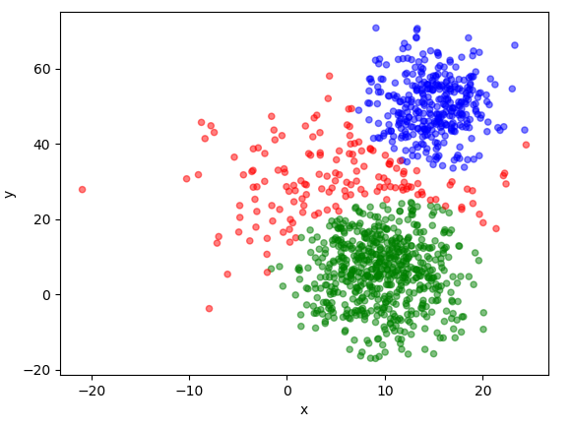
Unsupervised machine Learning
Saahil Claypool
Categorizing unlabled data
Group data with no ground truth
Use Case:
Group people based on their interests on social media
Example: K Means
Given a set of data points
Guess the “True Centers” that generated these points
[3][4][17]
Notes:
Unsupervised machine learning is the idea that the algorithm will categorize the data given no extra information (no labels). For example, some social media company, such as facebook, might want to introduce users to other, similar, users. There is no true grouping available, but an unsupervised machine learning could make some decent fitting groups given some measure of “closeness”
An example of this algorithm is the K-Means algorithm. Given some points, it attempts to find the K centers that best approximate those points. This is the algorithm that generated the images on the right. There are around 5 clusters that generate the points, and the machine learning algorithm is able to split these points up into groups with no extra information.

Slide 14
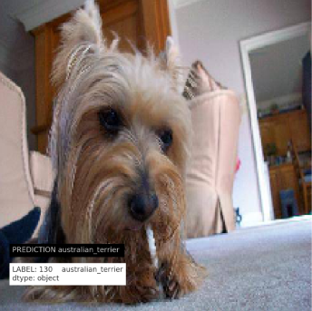
Supervised Machine Learning
Saahil Claypool
Categorizing labeled data
Trying to predict new data given ground truth
Use Case:
Identify a dog breed from an image
Example: Neural Network
Input: Vector, labels
Processing: Matrix of Weights
Output: Vector
Learning: Adjust weights based on “gradient descent”
[5][16]
Notes:
In contrast, supervised machine learning is used when you have a bunch of labled data. That is, you know the “true” answer for each data point in your dataset.
For example, in my AI class, my team created an application that could identify a dog breed from a picture. Our input data was a bunch (tens of thousands) of images of dogs, AS WELL AS THEIR TRUE BREED. The label, the true breed, is the important classification here.
This image is from my AI class. We classified it using something called a neural network. Given this image, we turned it into a vector, and multiplied it by a bunch of weights. This gave us some output the prediction. Over time, these weights were adjusted until our model became pretty good at classifying dogs!

Slide 15
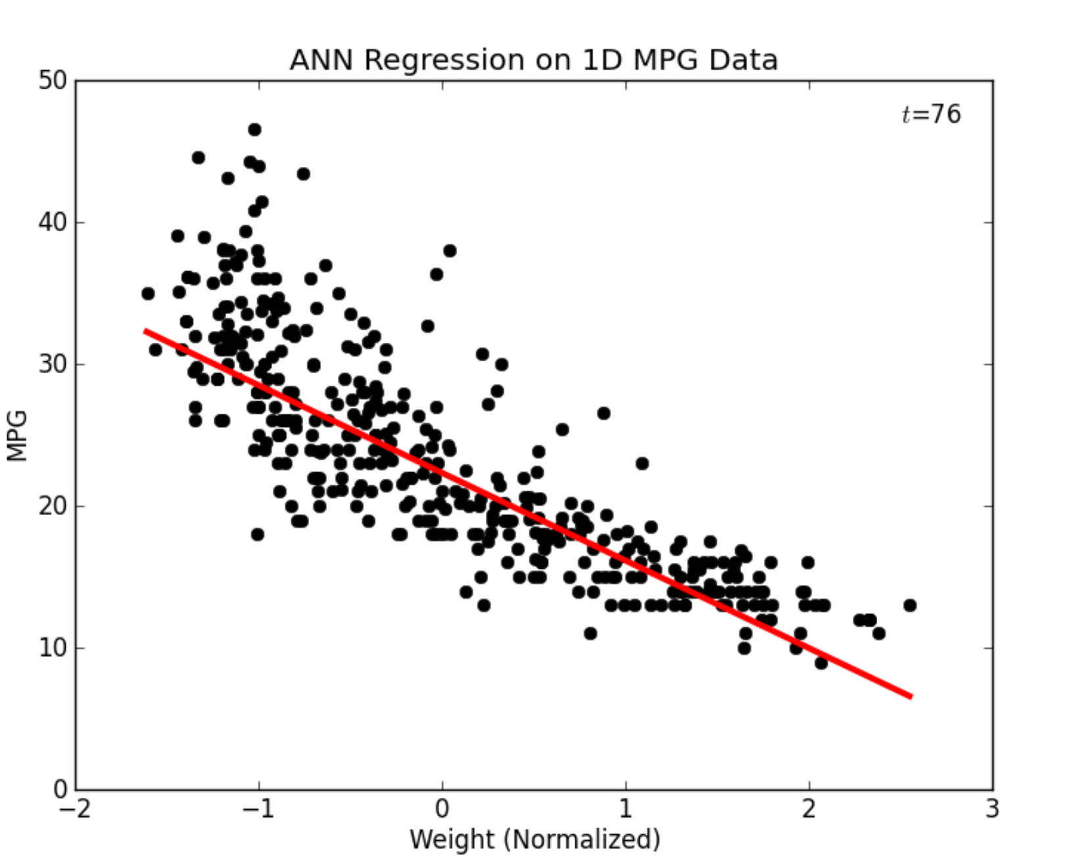
Back TO Basics: Linear Regression
Saahil Claypool
Linear regression is a single layered neural network
Same dangers apply:
Correlation does not imply causation
Extrapolation is dangerous
[5]
Notes:
So, both of these techniques seem complicated, but not all machine learning techniques are. Take Linear regression for example. While this may not always be thought of as a machine learning technique, it is roughly similar to a single layer neural network.
For those of you that haven’t used linear regressions too much, they’re pretty simple. They are a linear model (a line) that best fits the data. Think “best fit line” from high school algebra days. For example, this model approximates the miles per gallon of a car given the weight of the car. As the car becomes heavier, the MPG goes down. That makes intuitive sense. But, if you use this model carelessly, you can have poor, and even dangerous results (form a social perspective).
The two possible user errors I will discuss are correlations, and extrapolation

Slide 16
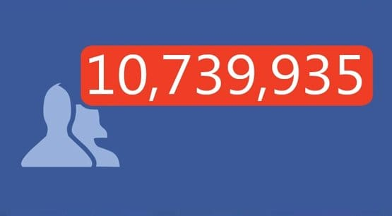
Correlation is not Causation
Saahil Claypool
Machine Learning Provides Prediction
Example:
Facebook users are likely to stay if they make 7 friends in 10 days
- Should we suggest friends so everyone has 7 friends in 10 days?
[6][7]
Notes:
Correlation does not imply causation. If you have taken any statistics course, you probably have heard this statement. But what does it mean? Correlation does not imply causation means that: just because two things are related, doesn’t mean that the change in ONE variable is the cause for the change in the other. So, why is this a big deal? Well, if you are the one using machine learning, and you interpret the prediction from your algorithm as the CAUSE, you are going to have a problem. Say, for example, you are working for some social media platform such as facebook, and you find that “Users are likely to stay if they make 7 friends in 10 days (this is a real stat from a facebooker). Then, you might conclude that the most important thing is to get new users more friends. So, you push your team to bombard your new users with new friend suggestions to get them to stay longer.
This might sounds reasonable, but there is a flaw here. The correlation only states “Those that happen to have 7 friends in 10 days, happen to stay longer”. That doesn’t mean that, by artificially adding more friends to the lonely users, you will get them to stay longer. In fact, for all we know, that could just bother them and force even more new users out quicker. Thus, your blind appliance of fancy algorithms could hurt your company’s performance. (Note: In this case you might be right, but the fact that a regressions shows a relationship is in no way conclusive that there is a causal relationship.
So, what use are these predictors if they can’t help identify causation?

Slide 17
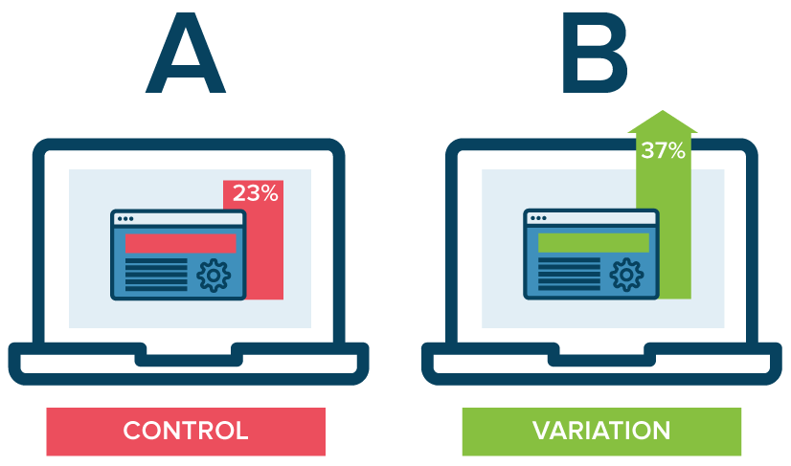
A/B Testing: Testing For Causation
Saahil Claypool
Linear regression gives you a prediction
This helps narrow possibilities
Hypothesis testing is needed to conclude causation
[6][13]
Notes:
Well, correlation is useful. Correlation indicates there is a relationship, which means it’s a good area to explore further. Once you know there is a relationship, you can use A/B testing to see if is causal. Note: We would be testing to see if the feature suggesting friends to new users would cause them to stay longer. For example, in our Facebook scenario, we could take a correlation as a good guess at what might be a causation, and we could make 5% of new users get extra friend notifications. This could help identify is more friends causes people to stay on the fb longer.
Note: there could be some implication with testing people without their consent, even in minor ways like this. But, the idea stands – test your correlations with A/B testing.

Slide 18
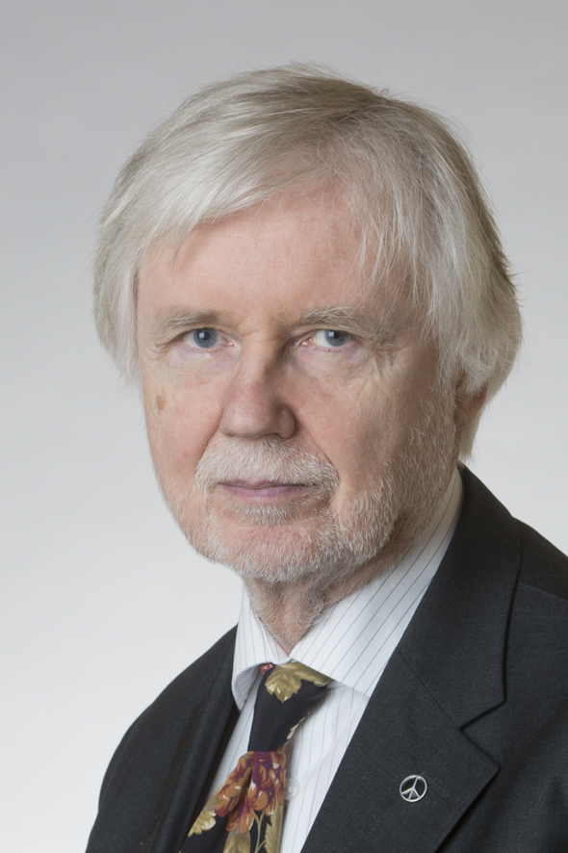

Is Machine Learning Biased?
Saahil Claypool
“Facial Recognition Is Accurate, if You’re a White Guy” – New York Times
Gender misidentification rates:
White Male: 1%
Black Female: 35%
What about outside of the U.S?
What about in Humans?
[14]
Notes:
The second fear or danger about machine learning is that “its biased”. For example, this new York times article is titled “Facial Recognition is Accurate if you’re a white guy”. So, clearly, this headline is indicating there is some bias toward white men. So, some facial recognition algorithm would be better able to identify this white man than this black woman.
This might seem minor, but if say this is being used for security purposes in a train station, the low accuracy on minorities could cause more false positives, and in turn cause them to be harassed, so this might matter!
But, how did this get here? Why is a computer algorithm biased? And, what about countries where the majority of people are not white?

Slide 19
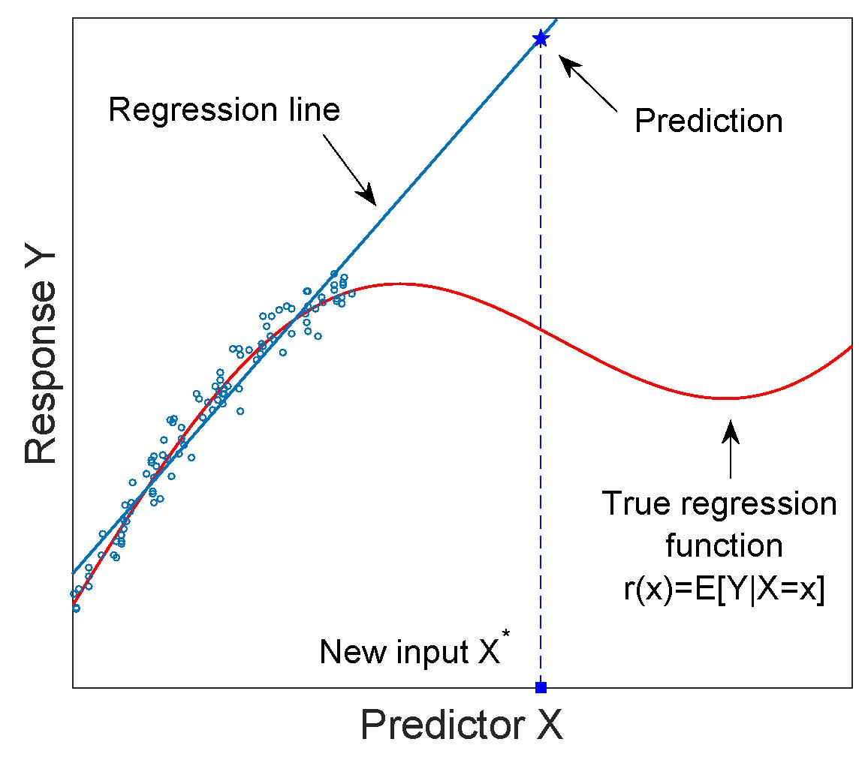
Bias is caused by Extrapolation
Saahil Claypool
Machine Learning performs best when it has more data
Machine learning performs poorly in under represented categories
In China, facial recognition performs better on Chinese
The other-race effect:
Misidentification of other races increases by 50%
[10][14][15]
Notes:
I am going to propose that the main source of bias in machine learning comes from extrapolation, or low data densities for minorities. This example here on the right tries to visualize that – Given bunch of data points, we can fit a very good model over that data, but
As we step outside of that data-dense region, our model is going to get increasingly worse.
This can help explain the bias we see in machine learning – if we feed a data set to a machine learning algorithm that contains mostly white, male faces, it will be very good at identifying white male faces. But, it will almost surely be worse at identifying other categories of people.
In fact, this was confirmed in a study of Chinese facial recognition algorithms where they performed very well on Chinese faces, but not so well on white faces. And, also cited in that paper, was the fact that this effect is present in humans. It is called the “other-race” effect and has been studied by psychologists.
White babies that see a majority of faces similar to their own race get better at discerning features on those faces than with other races. So, this phenomenon isn’t just computer related, but rather general information density related.
Thus, even if the creators of the some machine learning model are perfectly sincere in their belief in equality, the dataset they use can create a bias depending on how much data it has on different races. So, what are your options?
You can pay for more data to oversample minorities, or you can report the accuracy of your model in finer detail. Instead of reporting 95% accuracy, you can report the accuracy for some set of categories, and explain where your model breaks down. This will take domain knowledge of your model. Thus, you should know what you are doing before you us machine learning
Although humans have additional social prejudices that impact our ability to recognize other-race faces [Levin 1996; 2000; Slone et al. 2000], perceptual factors seem to be the primary cause of the other-race effect in
humans [Bryatt and Rhodes 1998; O’Toole et al. 1994; Walker and Tanaka 2003]
AUTHOR=Zhou Guifei, Liu Jiangang, Ding Xiao Pan, Fu Genyue, Lee Kang
TITLE=Development of Effective Connectivity during Own- and Other-Race Face Processing: A Granger Causality Analysis

Slide 20
References
Saahil Claypool
[1] https://xkcd.com/1838/: 9/22/2018
[2] IBM What Is Machine Learning JeanFrancoisPuget . IBM, May 18 2016 : 9/22/2018
[3] machine learning explained: kmeans: October 24, 2017 By Antoine Guillot, r-bloggers.com 9/22/2018
[4] Cluster analysis and its application to healthcare claims data: a study of end-stage renal disease patients who initiated hemodialysis, by Minlei Liao 2016: 9/22/2018
[5] Artificial Neural Networks Part 1 Brian Dolhansky 2013: 9/22/2018
[6] Machine Learning For Decision Making, Medium, Emily Glassberg Sands, 2017: 9/22/2018
[7] Facebook Friend Requests, Kenny Knovak, Autolikes.com, 2017: 9/22/2018
[8] MultiVariable Regression, Boston University: 9/23/2018
[10] P. Jonathan Phillips: An Other-Race Effect for Face Recognition Algorithms, 2010
[11] What is wrong with extrapolation, statsexchange.com, 2016 : 9/23/2018
[12] The 7 Steps for Machine Learning, Yufeng G, Medium, 2017: 9/23/2018
[13] AB Testing, Optimizely.com 9/24/2018
[14] Facial Recognition is Accurate, If You’re a White Guy, Steve Lohr, 2018, NYT, : 9/24/2018
[15] Recognition of own-race and other-race caricatures: Implications for models of face recognition: 9/25/2018
[16] My Machine Learning Dog Project: Saahil Claypool, 2018
[17] Github Project: https://github.com/SaahilClaypool/CS534_AI/tree/master/3_Assignment

Slide 21

It’s All fun and games...
Can video games cause violent behavior?
Notes:
Just a quick show of hands, how many of you play or have played video games. (Tie into statistic on next page)

Slide 22
the Issue
97% of American teens play video games [3]
Games have become more violent [13]
President Trump addressed topic in wake of school shooting [4]
[13]
Notes:
Over the past two decades, this issue has been brought up constantly. There’s been a lot of debate about this as early as the 80s, but its become more prevalent today because more and more games today have violent aspects. As you can see in the chart, over time games have received higher ratings (suitable for higher age groups as a result of mature themes, usually intense violence, blood, gore, and strong language). One of the more recent times this topic was brought up was after the Parkland school shooting earlier this year, President Trump hosted a meeting to address this issue even inviting video game industry reps to participate.

Slide 23
Case for violence
Praneeth Appikatla
Violence vs. Aggression [5]
Violent games cause higher levels of aggression [6][11]
Psychologists link aggression to video games and other media [7]
Call of Duty: MW2
LittleBigPlanet 2
[11]
Notes:
To expand on this, we’re going to look at what has already been done. So first, I want to clarify the difference between violence and aggression which are often used interchangeably. Aggression is generally defined as anger and is more characterized by emotions while violence is usually considered a physical expression usually with an intent to injure someone or destroy property. One of the studies I looked at connects higher levels of aggression to more violent video games. For the violent game they chose a first-person shooter game Call of Duty: Modern Warfare 2 and for the neutral game it was LittleBigPlanet 2. Video games are also often grouped in with other forms of violent media when looking at their effect (Tie into graph on next slide).

Slide 24
Violence in Other Media
[12]
Notes:
Positive correlation between aggressive behavior and media violence and even a negative correlation with helpful behavior
I could not find a clear difference between aggression induced from video games and other media. Overall, the fact that other forms of media can induce the same behavior shows that video games are not the sole cause of aggression.

Slide 25
Other cases
Praneeth Appikatla
Competition brings about aggression [6]
Desensitization to violence [7][8]
Violent crime trend decreased [1][10]
C = Competitive, LC = Less Competitive, NC = Noncompetitive
V = Violent, NV = Nonviolent
[6]
Notes:
While a lot of the case for violence connects the level of violence to aggression, another study looked at the effect of competition on aggressive behavior on the basis that most violent games that were studied were also competitive. As you can see from the graph, the study connects short-term aggression more so to a game’s competitiveness rather than its level of violence. Another study also showed the correlation between players playing violent games and their desensitization to real-life violence (this is also seen in other types of violent media) however did not conclude anything about causing violent behavior. Lastly, this study shown on the graph shows no correlation between video game sales and violent crimes. In fact, the multiple studies done by this group found that violent crime actually decreased in response to violent video games.

Slide 26
Violent crime and Game sales (1998-2015)
[10]
Notes:
This graph shows the correlation between the violent crime rate and video game sales in the past in about the past 20 years. As you can see that while sales grow the crime rate actually decreases.

Slide 27
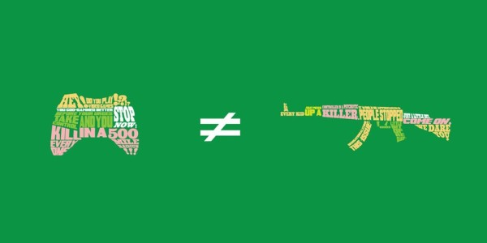
Conclusion
Praneeth Appikatla
Some evidence for aggression [6]
Nothing is decisive
Case for desensitization [8]
[9]
Notes:
One of the conclusions you can get from this is that there is some evidence that violence in games can cause an increase in aggression; however, it has also been shown that competition can have the same effect. There are a lot of conflicting views, but overall there is no decisive evidence that can link video games to real violent behavior. Just to add on to this, you can however make the case that violence in games can desensitize people as it can change the way society perceives violence but does not directly cause violence. This topic has been on debate for nearly 40 years, and it may not be over for a while. Desensitization may be a factor in this debate lasting so long as there is not much priority to explore new theories on why violence has increased beyond just video games and other media.

Slide 28
References
Praneeth Appikatla
[1] Markey, Patrick M. et al. “Violent Video Games and Real-World Violence: Rhetoric Versus Data.” Psychology of Popular Media Culture 4.4 277–295.
[2] https://www.nytimes.com/2013/02/12/science/studying-the-effects-of-playing-violent-video-games.html (Accessed 23 Sep. 2018)
[3] Greitemeyer, Tobias, and Mügge, Dirk O. “Video Games Do Affect Social Outcomes: A Meta-Analytic Review of the Effects of Violent and Prosocial Video Game Play.” Personality and Social Psychology Bulletin 40.5 578–589.
[4] https://www.cnn.com/2018/03/07/politics/donald-trump-video-games/index.html (Accessed 23 Sep. 2018)
[5] https://www.goodtherapy.org/learn-about-therapy/issues/aggression-violence (Accessed 23 Sep. 2018)
[6] Adachi, Paul JC, and Teena Willoughby. "The effect of video game competition and violence on aggressive behavior: Which characteristic has the greatest influence?." Psychology of violence 1.4 (2011): 259
[7] DeLisi, Matt, et al. "Violent video games, delinquency, and youth violence: New evidence." Youth Violence and Juvenile Justice 11.2 (2013): 132-142.

Slide 29
References
Praneeth Appikatla
[8] Carnagey, Nicholas L., Craig A. Anderson, and Brad J. Bushman. "The effect of video game violence on physiological desensitization to real-life violence." Journal of experimental social psychology 43.3 (2007): 489-496.
[9] http://pixelkin.org/2015/10/12/a-psychologist-reacts-to-a-recent-apa-report-on-video-game-violence-studies/ (Accessed 24 Sep. 2018)
[10] Entertainment Software Association, "Essential Facts about Games and Violence," www.theesa.com (accessed June 12, 2018)
[11] Hollingdale, Jack, and Tobias Greitemeyer. “The Effect of Online Violent Video Games on Levels of Aggression.” Ed. Cheryl McCormick. PLoS ONE 9.11 (2014): e111790. PMC. Web. 24 Sept. 2018.
[12] Bushman, Brad J., and L. Rowell Huesmann. "Short-term and long-term effects of violent media on aggression in children and adults." Archives of Pediatrics & Adolescent Medicine160.4 (2006): 348-352.
[13] https://www.businessinsider.com/chart-shows-esrb-video-game-ratings-over-the-last-10-years-2015-9 (Accessed 24 Sep. 2018)

Slide 30
Simulations! - Are we in one?
Thomas Curtis
<Citation>
Notes:
Hello, my name is Thomas Curtis. Today I’m going to be presenting the simulation theory, and explaining its moral implications.

Slide 31
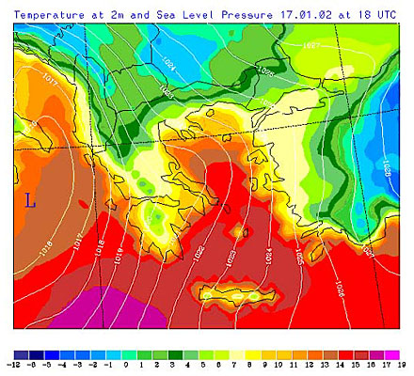
What is a simulation?
Thomas Curtis
A simulation is an imitative representation of the functioning of one system or process by means of the functioning of another
E.G. Real life weather being imitated by a computer for meteorological predictions.
Notes:
Simulations are imitations of other systems. Typically they are run with computers. The level of accuracy of a simulation is proportionate to how much computing power is available, and cannot exceed 100% accuracy. Simulations can be run in various speeds as well depending on how much processing ability you have available.

Slide 32
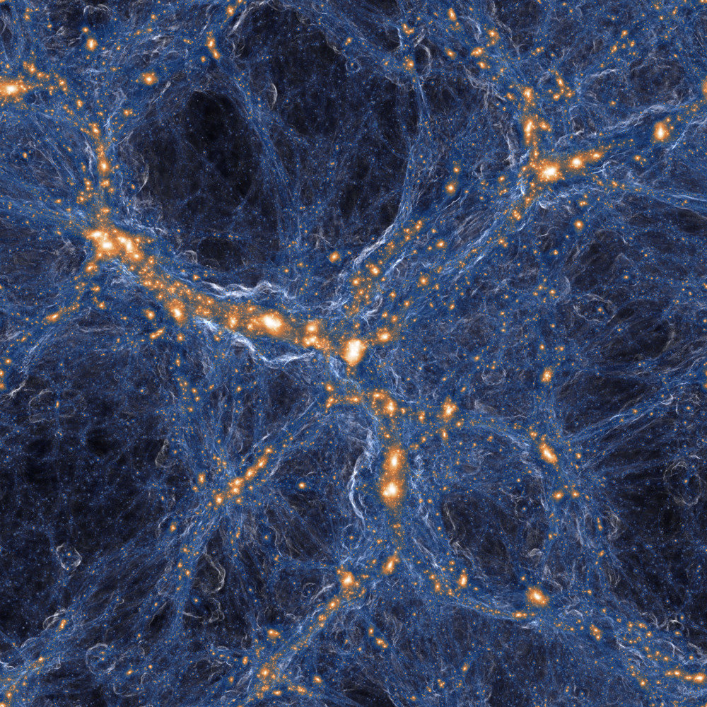
A Simulation of the Universe
Thomas Curtis
MIT’s IllustrisTNG models 1,000,000,000^3 cubic light years of space in order to predict cosmic structures Not accurate for smaller structures
Currently the cutting edge for simulation technology
Notes:
The IllustrisTNG simulation, by MIT, models space. It models a massive region of space, and shows the changing shapes of cosmic structures, it has an impressive resolution for particles, but it doesn’t follow enough of the rules of physics and chemistry to allow for life to form. In this sense, the simulation is abstracting the universe to create specific types of useful information while ignoring the certain levels

Slide 33
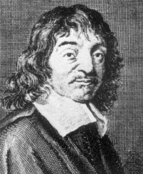
An Introduction to Not Existing
Thomas Curtis
Rene Descartes
Solipsism
People’s experiences can be broken down into inputs
Notes:
Descartes was a philosopher who surmised that the human experience of life could be not one of a material world, but rather a world that merely appears material. This idea is a form of solipsism, an ideology that claims objective knowledge to be impossible. With that in mind, the premise is this. All of our experiences in the world can be broken down into simple inputs, the 5 senses. While we can assume that these sense are the result of a large contiguous universe that stays the same whether or not we look at it, solipsism makes the claim that we can never know for sure that anything is objectively true, since all of our existence is purely subjective.

Slide 34
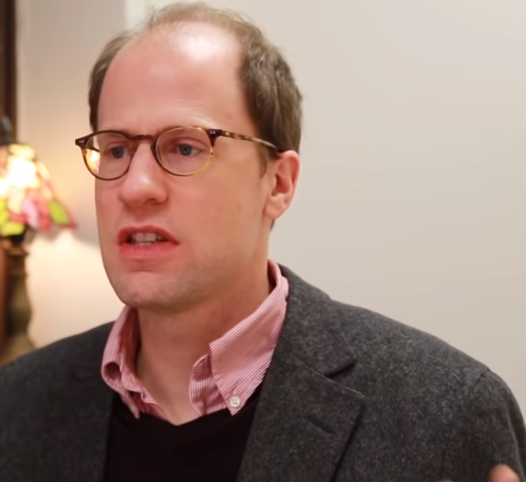
Future possibilities
Thomas Curtis
Humanity goes extinct before becoming capable of creating a realistic simulation of the world
Humanity becomes capable but has no interest
We will create a simulated world, which will then be capable of creating its own simulated world.
Notes:
So let’s take a look at the future possibilities. Nick Bostrom, a professor at Oxford University, has 3 hypotheses for the future of humanity and the future of simulation. A) Humans die out before becoming capable of making simulations. This one is kind of sad, but also increases the chance dramatically that we are in a real universe.
B) Humanity becomes capable of making a simulation of reality, but they choose not to. If humans reason that it’s unethical to create a universe full of people that don’t know they aren’t real, then we end up being either the tail of a recursion, or not in a simulation. C) Humans create simulations indistinguishable from our own. Said simulations create their own simulations and we end up part of a massive recursive chain that has no meaning in life or death and we all feel empty forever.

Slide 35

Should we pursue A, B, or C?
Thomas Curtis
We have a responsibility for simulated life.
Over 107 Billion people have lived on Earth, where did they go?
Is suffering ethical, or just accurate.
Notes:
We have a responsibility for simulated life. If we choose to follow C, then we must treat the creation of that life with how we would like to be treated by our creator.
What happens when the simulated occupants die? Should we store them, reuse them, or create an afterlife for them.
Creating consciousness capable of suffering and putting them in circumstances where they suffer makes the creators responsible. At the same time, suffering is necessary for an authentic human experience.

Slide 36

Conclusion
Thomas Curtis
We should not undertake a simulation of our own reality.
If we do, then we are likely in a simulation.
Nothing we do would matter.
Notes:
We shouldn’t pursue a simulation of reality. Creating a simulation that would eventually come up with it’s own simulation and so on, and so on would only provide a meaningless answer to the question of creation. We could probably come up with ways to prove whether or not we were in a simulation, test and prove it unequivocally. But then what? We theory-craft ways to hack the system and end up becoming gods? We live life without any fear of death since we know that a storage system exists that gives everyone eternal happiness?
This rabbit hole leads to unfulfillment and emptiness. Possibly worse. It’s better to just leave the rabbit hole alone and find our own meanings. After all...

Slide 37
Thomas Curtis
Notes:
We still have so much universe to understand.

Slide 38
REFERENCES
Thomas Curtis
[1] https://www.merriam-webster.com/dictionary/simulation
[2] http://www.emy.gr/emy/en/meteorology/meteorologia_xartis_kairou
[3] http://news.mit.edu/2018/modeling-universe-Vogelsberger-IllustrisTNG-0131
[4] https://plato.stanford.edu/entries/descartes-works/
[5] https://www.youtube.com/watch?v=nnl6nY8YKHs
[6] https://www.bbc.com/news/magazine-16870579
[7] https://www.dailymail.co.uk/sciencetech/article-4941808/Researchers-claim-NOT-living-simulation.html

Slide 39
Class 10 The End
Keith A. Pray
Instructor
socialimps.keithpray.net
Notes:
This is the end. Any slides beyond this point are for answering questions that may arise but not needed in the main talk. Some slides may also be unfinished and are not needed but kept just in case.

