Slide 1
Class 8 Crime
Keith A. Pray
Instructor
socialimps.keithpray.net
Notes:
Here’s the title slide. Is anyone not excited?

Slide 2
Papers
Make decisive conclusions
may, could, etc. = trivial
Quantify
Do not use terms like: less, more, a lot, huge, great, big, tiny, growing, etc.
Read paper aloud to proof
“Internet” – proper noun, there is only one [1] but debatable [2]
http://socialimps.keithpray.net/assignments/paper-guidelines/
Notes:
Change in Paper 1 from last time due to not including 0s in average now.
[1] Marina Lukyanchuk, publish date unknown
https://www.grammarly.com/blog/capitalization-rules/ (Accessed 2018-09-16)
[2] Katherine Connor Martin, 2016-04-05
https://blog.oxforddictionaries.com/2016/04/05/should-you-capitalize-internet/ (accessed 2018-09-16)
Save for next time:
Absolute statements are difficult to prove
Avoid: all, always, any, every, everyone, never, none… unless you can show it
Be sure to put quotes around entire quote
Hyperbole is the best thing ever!
but not in these papers
Print 2 sided and save a tree
Use template, saves time (and -1 point)

Slide 3

Survey Results (2/3 Participation)
Notes:
See Canvas for histograms of other questions.
TODO: Put hour breakdown on web site
Common items for next time:
I am in FL 140 about an hour before and after each class
Estimated breakdown of course time per week:
4 hours class time
4 hours reading (2 chapters ~90 pages @ 2 minutes per page)
8 hours practicing mastery of material (papers, group project, class activity prep)
If you are spending much more than this let me know and we can figure out a more efficient way to spend your time

Slide 4
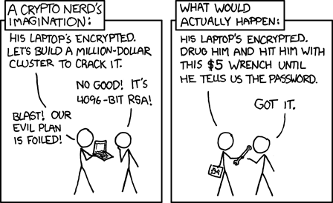
Overview
Review
Assignment
Students Present
http://xkcd.com/538/ (2010-11-14)
Notes:
Are there any questions on the assigned reading?
Use the slides ahead to explain any of the attack methods from the text.
If there are no questions you can skip those slides.

Slide 5
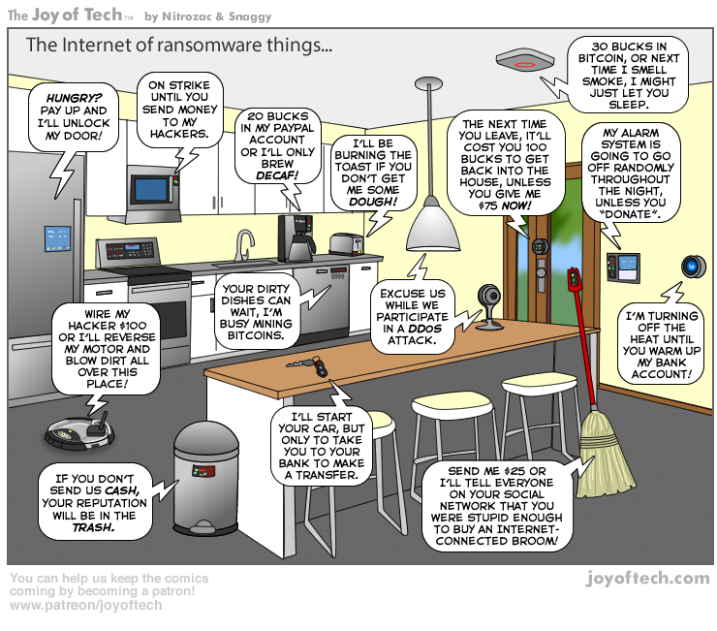
https://cointelegraph.com/storage/uploads/view/5e8f6e0d3a029807dfe181dc3d160cf0.png

Slide 6
My Reading Notes
pp. 323 Might be interesting to compare password guidance over the years.
pp. 325 plenty not sent with HTTP
pp. 328 Getting on TV much more difficult than releasing software
pp. 330 Virus could be new
pp. 332 Goals include infect 3 machine per LAN and as many computers as possible? Never make last minute changes before release. Were they related to the defects?
pp. 333 Testing w/out DEBUG often neglected
pp. 335 Do people use the Internet as an experimental laboratory these days? Shutdown right after booting, “benign” doesn’t seem like the right word.
pp. 337 “send reports back to a host computer”?
pp. 338 Firewalls often not running on same machine as malware, routers?
pp. 339 Have 2003 fears of cyber terrorist attacks been realized?
pp. 347 How is online voting a moral issue?
End of Chapter questions: 14. 25. 29.

Slide 7
Group Quiz
A denial of service attack shuts down a bunch of retailer, stock brokerage, large corporate entertainment and information web sites. Possible guilty parties:
Terrorist who aimed to cause billions of damage to U.S. economy.
Protest organization opposing commercialization of the web and corporate manipulation of consumers.
Script kiddie (a minor) just having fun with tools he found on the web.
Show off hacker in search of bragging rights.
State what penalties are appropriate for each.
Explain your answer to 1. using a single Ethical Theory for all.
Name the laws/acts under which these parties could be prosecuted.
Notes:
Works well as small group exercise.
Note: short answer format expected.
Note: 2. only one argument needed, should include logic for all parties
Note: 3. same law(s) should be applicable to all parties

Slide 8
Assignment Code Testing 1 Page Paper 1/2
Given code you did not write yourself, you need to test and potentially break it
Find as many bugs possible
There are major and minor bugs to find
Once testing is done write paper arguing your testing was adequate
Things that might be useful in your argument:
Explanations of defects
How to fix them
Consequences of leaving defects in production code
Use weaknesses in your testing methods as a counter argument
Working example: http://socialimps.keithpray.net/assignments/Test_Sales_Fun
Notes:
The online working example source code is best not viewed with IE though looking at the source for the page will reveal the implementation. (trying native Java app)
If guest presenter coming next class remind students to prepare questions for him.
Remember to work on groups projects.
Each group should have material on their sites for the topics we’ve covered so far.
OLD Prompt:
Design tests for the code on the following slide.
Contains at least one major defect and several minor ones.
Write a paper (1 page not counting any source code) including :
Did you choose a good test strategy? (This is your conclusion.)
The inputs and expected outputs
What defects you found
How you would fix the defects (you may include fixed source)
Why would that fix the problems?
What could happen if the defects are not found before the code is put into production?

Slide 9
Assignment Code Testing 2/2
import java.text.NumberFormat;
public class SalesFun {
public static double calculateSalesTotal ( double amount, double discountRate, double taxRate ) {
double discount = amount * discountRate;
double total = amount - discount;
double tax = total * taxRate;
double taxedTotal = tax + total;
NumberFormat numberFormat = NumberFormat.getCurrencyInstance();
System.out.println ( "Subtotal : " + numberFormat.format ( amount ) );
System.out.println ( "Discount : " + numberFormat.format ( discount ) );
System.out.println ( "Total : " + numberFormat.format ( total ) );
System.out.println ( "Tax : " + numberFormat.format ( tax ) );
System.out.println ( "Tax+Total: " + numberFormat.format ( taxedTotal ) );
return taxedTotal;
}
}
} Lines of interest
Notes:
Bold lines are real focus.
Example input:
amount = 100.05;
discountRate = 0.10;
taxRate = 0.05;
OR
0.70, 0.0, 0.05
95.67, 0.20, 0.7

Slide 10
Overview
Survey
Review
Assignment
Students Present

Slide 11
Eric Arthur
How to Catch Cyber Criminals?
Reducing the growing threat of cyber crime

Slide 12
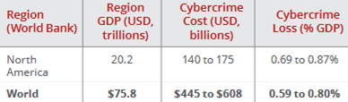
Cyber Crime becoming a global threat
Eric Arthur
Cyber crime is “criminal activities carried out by means of computer or internet”[1]
Fastest growing cybercrime is ransomware[2]
Data breach average cost: $3.8 M [3]
[1][2][3]
Notes:
Cyber crime is bullet point one. Such a broad definition leads to many different estimates for cost. The study I used, the graphic on the slide, assumes that the costs related to cyber crime are not just the direct amount of money stolen but also the money lost by a program being shut down or customers not using the company after a data breach.
The fastest growing cybercrime is ransomware in only the first quarter of 2016 $209 million was spent on ransomware but in all of 2015 it was only $24 million [2]. Ransomware targets individual computers as opposed to business so no one is safe. Companies are facing more data breaches than ever, with the average cost of a data breach being 3.8 million dollars according to Microsoft
Image on right shows that the cost of cyber crime is approaching 1% of the global gdp, this trend has been growing over the years and will continue to grow if no action is taken by governments.
Source 2 is from CSIS(Center for Strategic and international Studies) in association with McAffee security.

Slide 13
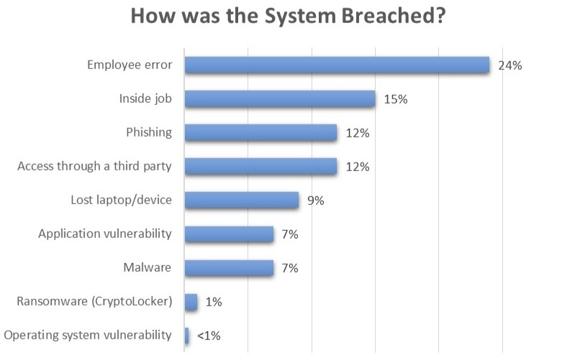
Lack of information enables criminals
Eric Arthur
81% of data breach victims had no way to detect they were[4]
Laws don’t change fast enough with technology[5]
Companies fail to update software [5]
[4][5][10]
Notes:
81% of data breach victims didn’t have any way to know they were compromised and therefore relied on third party companies to tell them. The average time required for a third party company to detect an intrusion is around 140 days according to Microsoft[3]. This causes another issue that very few companies actually report to the government that they have been a victim of cyber crime and therefore it’s very hard to put together records and cases.
Laws don’t change fast enough, case study where a New York officer couldn’t wire tap an alleged child pornographic distributor because the N.Y. penal code didn’t consider child pornography a communications threat [5]. Therefore officers have to use sketchy ways that aren’t guaranteed to get their information into the court room.
Most data breaches occur because a company doesn’t update their software, a Microsoft SQL virus in 2001 caused $1.2B in damage to companies that hadn’t updated their software. On top of that over 63% of network intrusions are due to compromised user credentials[3]. These are employees that open a suspicious email and then the cyber criminal can use this information to enter the system. This is showed in the graphic on the right side, where the most intrustions were caused by employees as opposed to technological intrusion.

Slide 14
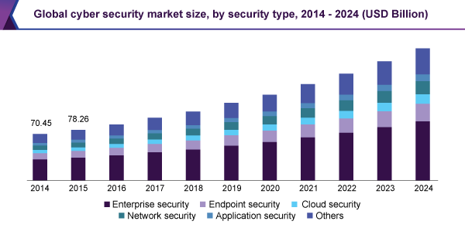
Initiatives to catch cyber criminals
Eric Arthur
Invest into self-detection systems, reduce time for detection to 14.5 days[13]
Train more “cyber investigators” [6]
[6][11][13]
Notes:
According to Trustwave global security report if companies invest into their own ways to detect data breaches they can be detected within 2 weeks, as opposed to last slide where it was 140 days for external company to detect intrusion. More and more companies are doing this as shown in the graph, the term enterprise security means the cyber security of an entire business.
As cyber criminals are becoming more and more advanced normal police officers or even FBI agents cannot detect them. Therefore the training of cyber investigators through the FBI, the Internet Crime Complaint Center, and the National White Collar Crime Center allow for specialized cyber teams to be put together that can catch a cyber criminal.

Slide 15
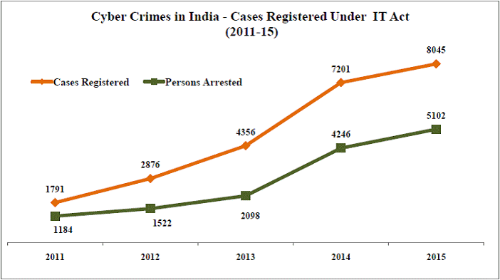
Cyber crime cases require too much effort
Eric Arthur
A single case takes thousands of hours to conclude[6]
Proving an owner’s connection to a device is very difficult[7]
Hard to identify common practices as cases differ[7]
[6][7][9]
Notes:
Individual cases take thousands of hours and require special cyber crime teams to be assembled to catch a single or a few criminals. Because of this a lot of cyber crimes go unpunished, see graphic where growth of cyber crime in India has left around 3000 cases unresolved. These teams require investigators that understand the complexity of cyber crimes. On top of that attempting to prove a criminals connection to the crime is very hard as they use many layers of protection to guarantee that their identity cannot be associated with the attack. Many criminals use bot networks or computers they have already compromised making it very hard to find the actual criminal and not an innocent computer that was taken over.
The cases also are very different so its very hard for legal employees and investigators to look at similar cases to try and form a plan to catch the criminal. Depending on the scope of the crime some have never been prosecuted and therefore it is very hard to catch these people.

Slide 16
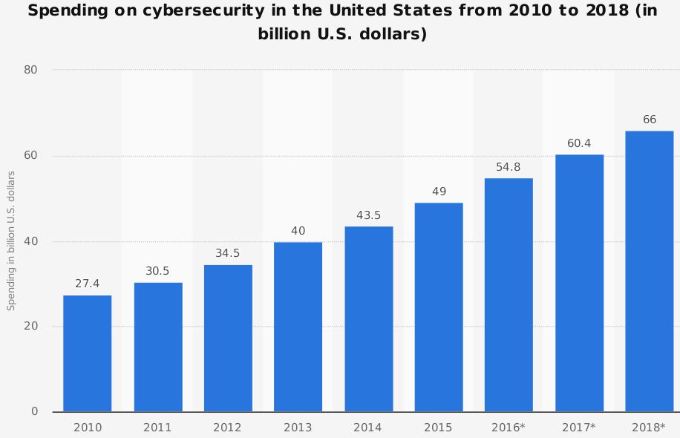
Conclusions
Eric Arthur
Increased effort and spending will catch more cyber criminals
Artificial Intelligence could help reduce cyber crime [8]
[8][12]
Notes:
Overall more money needs to be spent at all levels, for businesses this mostly means spending money on cyber security detection to know that they have been a victim, governments need to spend more money on training investigators and assembling these teams. And most importantly there needs to be cooperation between all parties, companies need to report they have compromised so the government can start to track this information, third party cyber security companies should share records of intrusion to identify repeat offenders, and most importantly governments need to band together to solve this global issue.
In the future artificial intelligence could help solve this issue but at the same time criminals could use AI to hide their tracks even better. On the right shows the trend of increased spending that needs to be donr.

Slide 17
References
Eric Arthur
[1] Goyal, Nitika, and Deepam Goyal. "Cyber Crime in the Society: Security Issues, Preventions and Challenges." Research Journal of Engineering and Technology 8.2 (2017): 73-80. ProQuest. Web. 16 Sep. 2018.
[2] Lewis, J. (2018, February). Economic Impact of Cybercrime— No Slowing Down. Retrieved September 16, 2018, from https://www.mcafee.com/enterprise/en-us/assets/reports/restricted/rp-economic-impact-cybercrime.pdf
[3] Microsoft. (n.d.). Enterprise Mobility Security. Retrieved September 16, 2018, from https://www.microsoft.com/en-us/cloud-platform/advanced-threat-analytics
[4] ISACA. (2015, January). 2015 Global Cybersecurity Status Report. Retrieved September 16, 2018, from http://www.isaca.org/cyber/Documents/2015-Global-Cybersecurity-Status-Report-Data-Sheet_mkt_Eng_0115.pdf
[5] Reyes, A., Brittson, R., O'Shea, K., & Steele, J. (2011). Cyber crime investigations : bridging the gaps between security professionals, law enforcement, and prosecutors. Retrieved from https://ebookcentral-proquest-com.ezproxy.wpi.edu
[6] Symantec. (n.d.). How Do Cybercriminals Get Caught? Retrieved September 16, 2018, from https://us.norton.com/internetsecurity-emerging-threats-how-do-cybercriminals-get-caught.html
[7] Shavers, B. (2013). Cybercrime investigation case studies an excerpt from Placing the suspect behind the keyboard . Oxford: Syngress.
[8] Maher, D. (2017). Can artificial intelligence help in the war on cybercrime? Computer Fraud & Security, 2017(8), 7-9. Retrieved September 16, 2018, from https://www-sciencedirect-com.
[9] Dubbudu, R. (2016, September 2). Most number of Cyber Crimes reported in Maharashtra & Uttar Pradesh. Retrieved September 16, 2018, from https://factly.in/cyber-crimes-in-india-which-state-tops-the-chart/
[10] ACC. (2015, December 9). One-Third of In-house Counsel Have Experienced a Corporate Data Breach, ACC Foundation: The State of Cybersecurity Report Finds. Retrieved September 16, 2018, from https://www.acc.com/aboutacc/newsroom/pressreleases/accfoundationstateofcybersecurityreportrelease.cfm
[11] Grand View Research. (2018, February). Cyber Security Market Size, Share & Trends Report Cyber Security Market Size, Share & Trends Analysis Report. Retrieved September 16, 2018, from https://www.grandviewresearch.com/industry-analysis/cyber-security-market
[12] Statista. (2018). Cybersecurity Spending in the U.S. 2010-2018. Retrieved September 16, 2018, from https://grafy.grafiti.io/facts/3375
[13] Trustwave. (2015, June 9). 2015 Trustwave Global Security Report. Retrieved September 18, 2018, from https://www.trustwave.com/Resources/Library/Documents/2015-Trustwave-Global-Security-Report/

Slide 18
A look at the Economics of the virtual black market
Luke Ludington
Notes:
Crime is work trillions of dollars

Slide 19

Piracy
Luke Ludington
Between $58 and $250 Billion lost to piracy
The Pirate Bay made $4 Million a year when it operated
[1][2][7][8][12][13]
Notes:
The main illegal activity online is piracy
There is a lot of conflicting information on the size and impact

Slide 20
Drugs
Luke Ludington
Silk Road $189 million (According to the Economist)
Total drug market $320 billion to $652 billion (According to GFI)
*According to global drug survey
[3][9][15]
Notes:
Drugs are easier to buy in person than online
Cities with lots of cameras make it difficult
Hard to find websites easy to find people IRL
No real recourse for fake drugs or no delivery whatsoever
Hard to tell which sites are scams bestheroinonline.com
15% of darknet dedicated to drugs

Slide 21

Arms
Luke Ludington
Not a very large market
Less than 3% of illegal online trading (traffic)
Makes buying guns illegally “like buying a bar of chocolate” ~Lyburd
Market as a whole 250,000 guns a year
[1][11]
Notes:
Lyburd was convicted of plotting mass murder and had a large bag of
The illegal arms trade is dwarfted by the legal arms trade

Slide 22
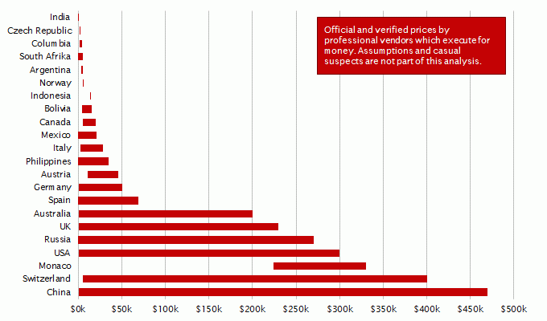
Contract Killing
Luke Ludington
Hard to tell true scope
Murder can be really cheap
[1]
Notes:
Not a lot of information on this
No evidence that any of it takes place on regular internet
Unable to find any real information about the scope of IRL contract killings as well
Hard to tell why people were murdered

Slide 23
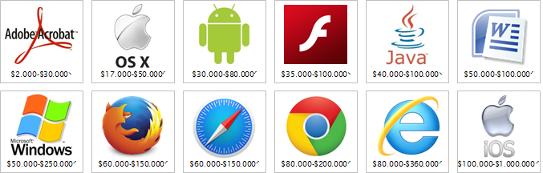
Viruses
Luke Ludington
A single Zero Day exploit can be worth up to a million dollars
Apple will pay 1.5 million for a remote jailbreak
A large above ground market as well
Not very many, around 4,000 in 2013 and decreasing to around 2,000 today
Value of exploits on different platforms
[1][6][14]
Notes:
The majority are bought buy the developers
The supply is dwindling (we’re getting better at security)

Slide 24
Identity theft
Luke Ludington
The market is huge 179 Million American Identities
Individual identities are cheap
Varies wildly with completeness
[4][5][10]
Notes:
Identities are of more value to assume than to steal from
Supply and demand plays a large part in high prices
15 million people have their ID used each year costing 3.5k on average

Slide 25

Conclusion
Luke Ludington
We really don’t know how big the digital black market is
The internet is not as big a part of the illegal economy as it is the legal economy
[1][5][12]
Notes:
There is a lot of conflicting information on the size and impact
Digital Economy is worth 1.2 trillion dollars

Slide 26
References
Luke Ludington
[1] Marc Ruef, Jan 14th 2016, A LOOK AT THE VIRTUAL BLACK MARKET https://www.scip.ch/en/?labs.20160114
[2] Stewart Clarke, Oct 30th 2017 https://variety.com/2017/tv/news/piracy-cost-streaming-players-over-50-billion-1202602184/
[3] Admin, Aug 3rd 2017, How Big is the Dark Net’s Drug Market? https://intervention911.com/big-dark-nets-drug-market/
[4] Crime Museum, Identity Theft https://www.crimemuseum.org/crime-library/silent-crimes/identity-theft/
[5] Michael Kan, Nov 15th 2017, Here's How Much Your Identity Goes for on the Dark Web https://www.pcmag.com/news/357382/heres-how-much-your-identity-goes-for-on-the-dark-web
[6] Ryan Gallagher, Jan 16th 2013, Cyberwar’s Gray Market http://www.slate.com/articles/technology/future_tense/2013/01/zero_day_exploits_should_the_hacker_gray_market_be_regulated.html
[7] George Bevir, Oct 30th 2017, How Much Do Music and Movie Piracy Really Hurt the U.S. Economy? https://www.ibc.org/delivery/cost-of-online-piracy-to-hit-52bn/2509.article

Slide 27
References Cont.
Luke Ludington
[8] Kal Raustiala, Jan 12 2012, How Much Do Music and Movie Piracy Really Hurt the U.S. Economy? http://freakonomics.com/2012/01/12/how-much-do-music-and-movie-piracy-really-hurt-the-u-s-economy/
[9] Avinash Thanror, Apr 21 2017, Report: Global Drug Trafficking Market Worth Half a Trillion Dollars https://www.talkingdrugs.org/report-global-illegal-drug-trade-valued-at-around-half-a-trillion-dollars
[10] Matt Tatham, Mar 15th 2018, Identity Theft Statistics https://www.experian.com/blogs/ask-experian/identity-theft-statistics/
[11] Thom Patterson, Aug 11th 2016, Inside the illegal online weapons trade https://www.cnn.com/2016/08/10/us/declassified-illegal-online-weapons-trade/index.html
[12] Shelly Hagan, Mar 15th 2018, Digital Economy Has Been Growing at Triple the Pace of U.S. GDP https://www.bloomberg.com/news/articles/2018-03-15/digital-economy-has-been-growing-at-triple-the-pace-of-u-s-gdp
[13] Erick SchonFeld, 2007,
The Pirate Bay Makes $4 Million a Year on Illegal P2P File-Sharing, Says Prosecutor https://techcrunch.com/2008/01/31/the-pirate-bay-makes-4-million-a-year-on-illegal-p2p-file-sharing-says-prosecutor/
[14] Patrick Howell O’Neill, Apr 26 2017, Zero day exploits are rarer and more expensive than ever, researchers say https://www.cyberscoop.com/zero-day-vulns-are-rarer-and-more-expensive-than-ever/
[15] Jelter Meers, May 9th2018 https://www.occrp.org/en/27-ccwatch/cc-watch-briefs/8055-new-report-shows-more-people-buying-illegal-drugs-online

Slide 28
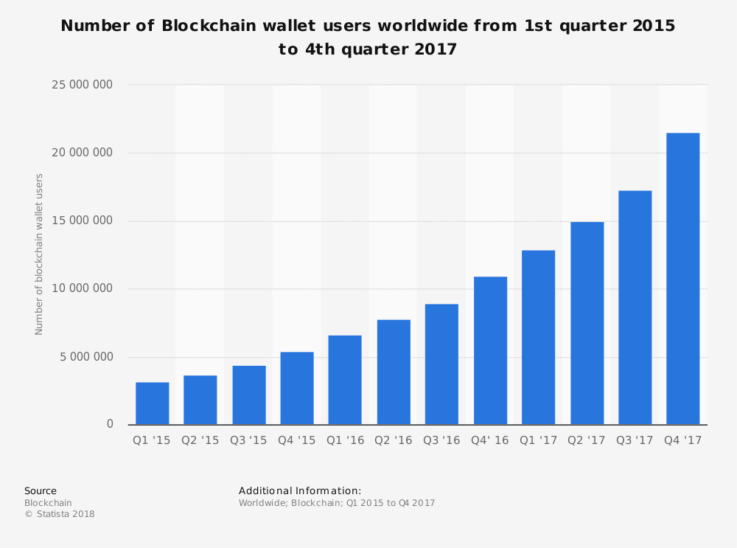
How secure is blockchain?
Yuan Wang
Who will use the blockchain?
People who trust others.
The Banking Industry
The Real Estate Industry
The Healthcare Industry
The Legal Industry
The Startup Industry
Politics
The Video Industry
The Education Industry
[1][2]
Notes:
The whole point of using a blockchain is to let people—in particular, people who don’t trust one another—share valuable data in a secure, tamperproof way. That’s because blockchains store data using sophisticated math and innovative software rules that are extremely difficult for attackers to manipulate. But the security of even the best-designed blockchain systems can fail in places where the fancy math and software rules come into contact with humans, who are skilled cheaters, in the real world, where things can get messy.

Slide 29
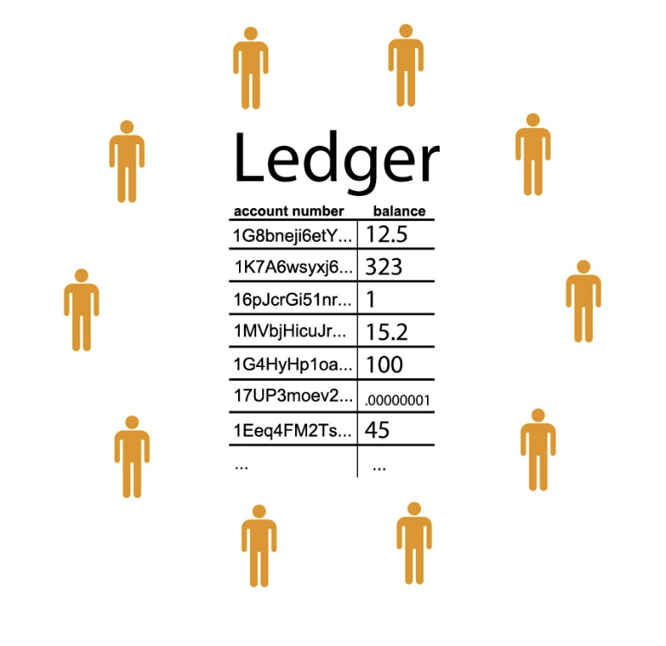
What makes blockchain secure? - BITCOIN
Yuan Wang
<Graphic>
What makes this system theoretically tamperproof?
A cryptographic fingerprint unique to each block (Hash)
A “consensus protocol” : the process by which the nodes in the network agree on a shared history
[3][4]
Notes:
In Bitcoin’s blockchain, the shared data is the history of every Bitcoin transaction ever made: an accounting ledger. The ledger is stored in multiple copies on a network of computers, called “nodes.” Each time someone submits a transaction to the ledger, the nodes check to make sure the transaction is valid—that whoever spent a bitcoin had a bitcoin to spend. A subset of them compete to package valid transactions into “blocks” and add them to a chain of previous ones. The owners of these nodes are called miners. Miners who successfully add new blocks to the chain earn bitcoins as a reward.
What makes this system theoretically tamperproof is two things: a cryptographic fingerprint unique to each block, and a “consensus protocol,” the process by which the nodes in the network agree on a shared history.
The fingerprint, called a hash, takes a lot of computing time and energy to generate initially. It thus serves as proof that the miner who added the block to the blockchain did the computational work to earn a bitcoin reward (for this reason, Bitcoin is said to use a “proof-of-work” protocol). It also serves as a kind of seal, since altering the block would require generating a new hash. Verifying whether or not the hash matches its block, however, is easy, and once the nodes have done so they update their respective copies of the blockchain with the new block. This is the consensus protocol.
The final security element is that the hashes also serve as the links in the blockchain: each block includes the previous block’s unique hash. So if you want to change an entry in the ledger retroactively, you have to calculate a new hash not only for the block it’s in but also for every subsequent block. And you have to do this faster than the other nodes can add new blocks to the chain. So unless you have computers that are more powerful than the rest of the nodes combined (and even then, success isn’t guaranteed), any blocks you add will conflict with existing ones, and the other nodes will automatically reject your alterations. This is what makes the blockchain tamperproof, or “immutable.”

Slide 30
Yuan Wang
1,100,000,000
[4]
Notes:
1.1 Billion worth of cryptocurrency was stolen in the first half of 2018

Slide 31
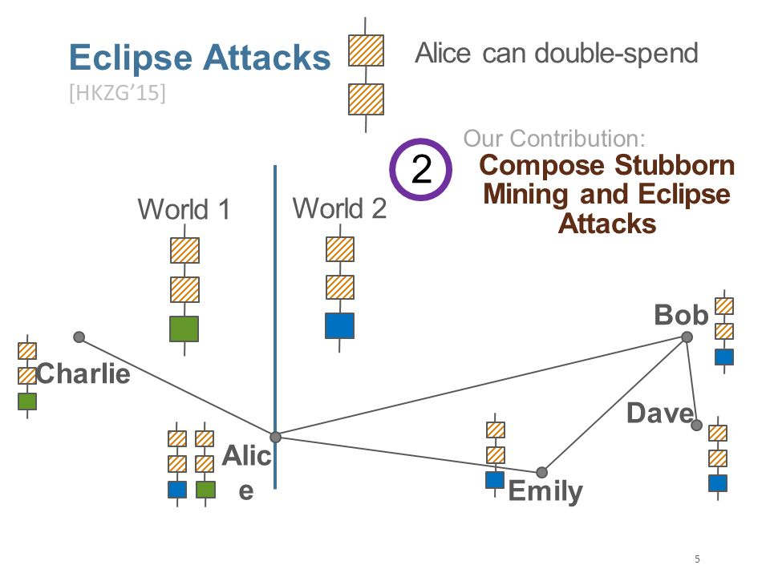
CHEAT in bitcoin
Yuan Wang
Selfish-Mine Strategy
“Eclipse attack”
“Does not exist in a vacuum”
<Graphic>
[4][5]
Notes:
So much for the theory. Implementing it in practice is harder. The mere fact that a system works like Bitcoin—as many cryptocurrencies do—doesn’t mean it’s just as secure. Even when developers use tried-and-true cryptographic tools, it is easy to accidentally put them together in ways that are not secure, says Neha Narula, director of MIT’s Digital Currency Initiative. Bitcoin has been around the longest, so it’s the most thoroughly battle-tested
People have also found creative ways to cheat. Emin Gün Sirer and his colleagues at Cornell University have shown that there is a way to subvert a blockchain even if you have less than half the mining power of the other miners. The details are somewhat technical, but essentially a “selfish miner” can gain an unfair advantage by fooling other nodes into wasting time on already-solved crypto-puzzles.
Another possibility is an “eclipse attack.” Nodes on the blockchain must remain in constant communication in order to compare data. An attacker who manages to take control of one node’s communications and fool it into accepting false data that appears to come from the rest of the network can trick it into wasting resources or confirming fake transactions.
The cryptocurrency hacks driving recent headlines are usually failures at places where blockchain systems connect with the real world—for example, in software clients and third-party applications.
Hackers can, for instance, break into “hot wallets,” internet-connected applications for storing the private cryptographic keys that anyone who owns cryptocurrency requires in order to spend it. Wallets owned by online cryptocurrency exchanges have become prime targets. Many exchanges claim they keep most of their users’ money in “cold” hardware wallets—storage devices disconnected from the internet. But as the January heist of more than $500 million worth of cryptocurrency from the Japan-based exchange Coincheck showed, that’s not always the case.

Slide 32
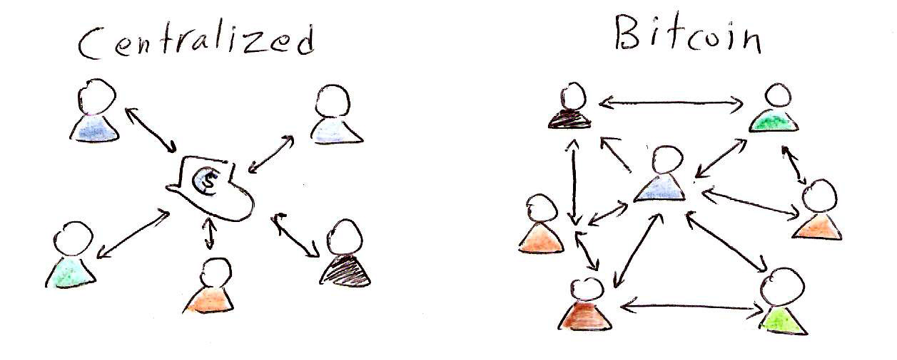
Conclusion
Yuan Wang
Be aware of “centralization question”
Theoretically secure, not secure in practice.
More methods will appears for protecting blockchain.
[4][6]
Notes:
One supposed security guarantee of a blockchain system is “decentralization.” If copies of the blockchain are kept on a large and widely distributed network of nodes, there’s no one weak point to attack, and it’s hard for anyone to build up enough computing power to subvert the network. But recent work by Sirer and colleagues shows that neither Bitcoin nor Ethereum is as decentralized as you might think. They found that the top four bitcoin-mining operations had more than 53 percent of the system’s average mining capacity per week. By the same measure, three Ethereum miners accounted for 61 percent.
Some say alternative consensus protocols, perhaps ones that don’t rely on mining, could be more secure. But this hypothesis hasn’t been tested at a large scale, and new protocols would likely have their own security problems.
Others see potential in blockchains that require permission to join, unlike in Bitcoin’s case, where anyone who downloads the software can join the network. Such systems are anathema to the anti-hierarchical ethos of cryptocurrencies, but the approach appeals to financial and other institutions looking to exploit the advantages of a shared cryptographic database.
Permissioned systems, however, raise their own questions. Who has the authority to grant permission? How will the system ensure that the validators are who they say they are? A permissioned system may make its owners feel more secure, but it really just gives them more control, which means they can make changes whether or not other network participants agree—something true believers would see as violating the very idea of blockchain.
So in the end, “secure” ends up being very hard to define in the context of blockchains. Secure from whom? Secure for what? “It depends on your perspective,” says Narula.

Slide 33
References
Yuan Wang
[1] Number of Blockchain wallet users worldwide from 1st quarter 2015 to 2nd quarter 2018, retrieved from https://www.statista.com/statistics/647374/worldwide-blockchain-wallet-users/
[2] 9 Industries That Will Soon Be Disrupted By Blockchain, retrieved from https://www.inc.com/john-white/9-industries-that-will-soon-be-disrupted-by-blockchain.html
[3] How do Bitcoin transactions work?, retrieved from https://bitcoinhub.co.za/faq/how-bitcoin-transactions-work/
[4] How secure is blockchain really?, retrieved from https://www.technologyreview.com/s/610836/how-secure-is-blockchain-really/
[5] Stubborn Mining: Generalizing Selfish Mining and Combining with an Eclipse Attack, retrieved from https://slideplayer.com/slide/10501792/
[6] Centralization vs. Decentralization, retrieved from https://blog.cryptorobo.com/en/blog/2017/07/13/decentralization/

Slide 34
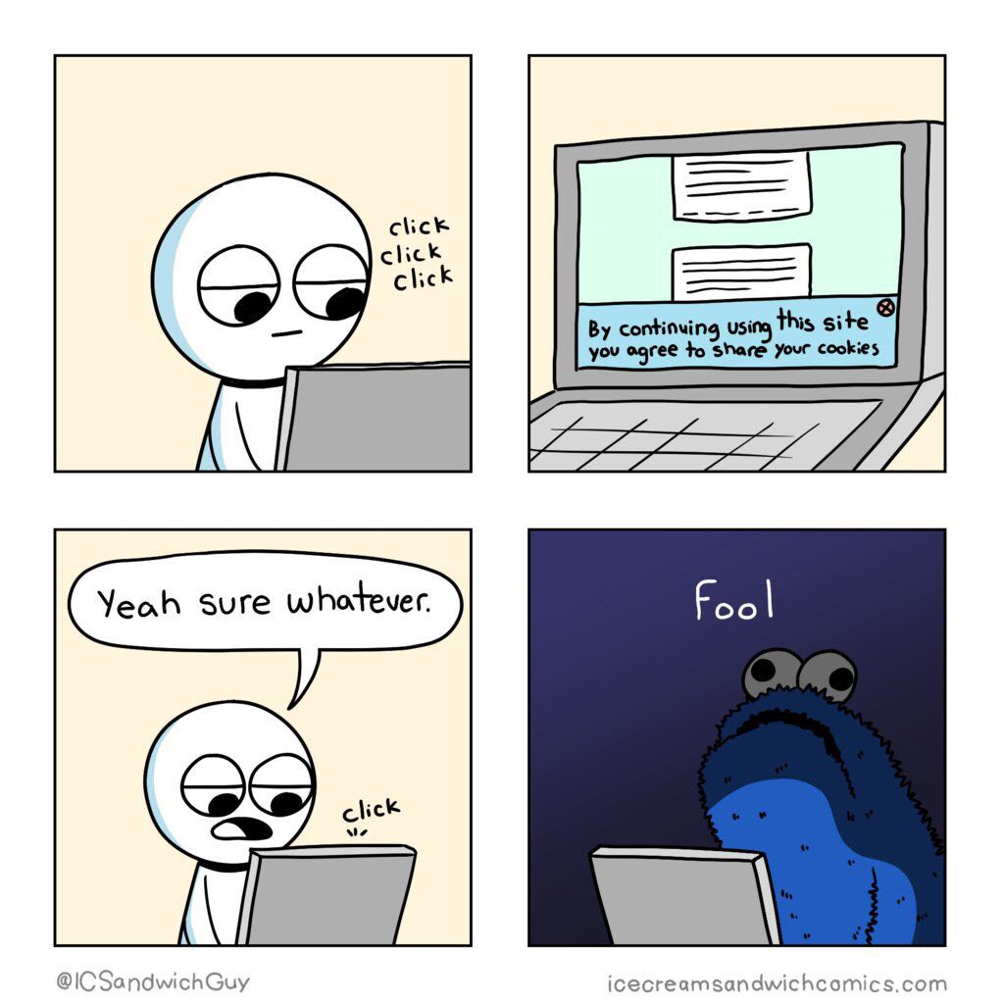
Protect your browser
Treksh Marwaha
Threats
Identify theft
History tracking
Advertiser profiles
Invasive data mining
Methods to collect browser data
Super Cookies
Fingerprints
HTTP Referer
[1] [2] [3] [4] [5]
Notes:
Everyday we loose some of our privacy, phone apps, location services or websites and browsers.
Today I will talk about the threats to your privacy on your browser and how to defend against them.
A significant portion of your time on the internet is spend in a browser and, as such, it is prime real estate to get your information.
Every website your visit, link you click or like button you press gets recorded, either on a cookie, in your extensions, or sent as a fingerprint to the website you are on.
All this data can be used to steal your identity, read your browsing history, build up advertising profiles on you to show you targeted adverts and much more.
So I will show you how your data Is collected and how to stop it.

Slide 35
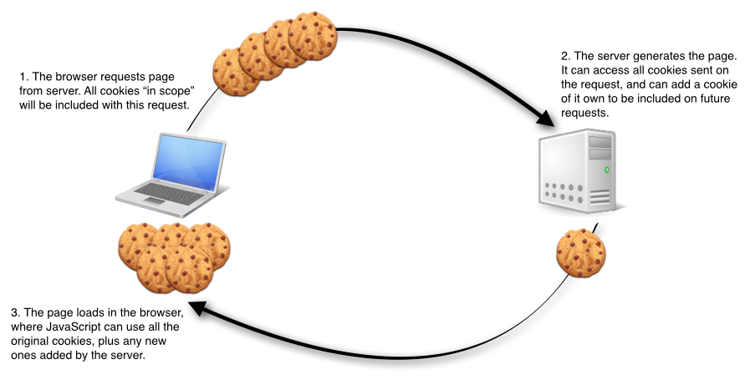
cookies
Treksh Marwaha
Normal Cookies
Ignored by most users which allows it to slowly collect information.
Super Cookies
Copies itself to prevent deletion
Flash cookies
Silverlight storage
browsing history
Stores more information than a regular cookie
[3]
Notes:
Although normal cookies can be easily blocked using todays browsers most users never bother to block them, so they sit in your computer slowly collecting and storing your information.
Some users aren't even aware of what cookies are, and even if people know of them, it is often though of as too inconvenient to go into the browsers settings to block cookies as such they are left there unaddressed.
But now that a significant enough portion of users block their cookies or have extensions do it for them, new ways to prevent cookies from being deleted and store more information are increasing in use. They are called super cookies, simply put to escape deletion by the browser they save their data in other places, be it adobe flash, Silverlight application storage, even your browsing history. This allows them to copy themselves back to the browser even after it deleted them.

Slide 36
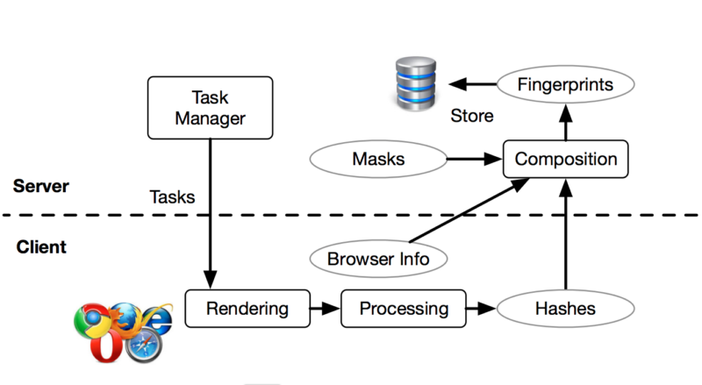
Browser Fingerprints
Treksh Marwaha
A more hidden approach to track you
Uses JS to request information from your browser, the type of information can be
Your OS, Browser, Plug ins, Time zone etc
The plug ins, OS, browser versions and other information create a unique pattern that represents your browser fingerprint.
Can be used for
Identity theft
Compiling long term records of browsing history
Credit card fraud
[2]
Notes:
Browser fingerprints are a more hidden approach to track you on your browser. They use JavaScript to query browser for information, a wide range of information is collected and it coleases into your fingerprint
Explain how versions an types make it unique.
Where cookies don’t work the unique fingerprint left by your browser will be used by websites.
Fortunate although fingerprinting is not very well known it is rather easy to hide from it by sending out fake randomized fingerprints to any website that looks.

Slide 37
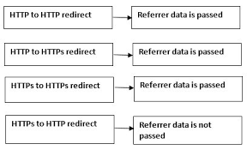
HTTP referer
Treksh Marwaha
Most hyperlinks allow the website they lead to, to track where it originated form.
Usually used to gather data for promotional or statically proposes
The web servers maintain logs of all traffic.
[1]
Notes:
Where fingerprints and cookies fail the http referrer swoops in, every hyperlink you click tells the website you visit where you clicked the link.
Although this is mostly used for seeing which promotions are the most effective they can also be used to track user behavior and patterns.
Unfortunately how the websites use of this data is entirely up to them. But there are indeed ways to block referer links and convert them to normal links upon clicking.

Slide 38

Protect yourself
Treksh Marwaha
Cookies
Incognito mode
‘Better privacy’ add on a Super-Cookie safeguard
‘Clear console’ add on a easy way to clear your cookies, cache and history
Browser Fingerprints
‘Canvas Defender’ add on, creates fake fingerprints and feeds them to websites
Disable JavaScript
VPN
HTTP Referer
‘HTTPS Everywhere’ add on
‘Referer Control’ add on
[3][4][5]
Notes:
Describe each measure generally
Questions

Slide 39
References
Treksh Marwaha
[1] Daniel W. Margo and Margo Seltzer. The Case for Browser Provenance. Daniel Margo 2009-02-11
[2] N. Kaur, S. Azam, K. Kannoorpatti, K. C. Yeo and B. Shanmugam, "Browser Fingerprinting as user tracking technology," 2017 11th International Conference on Intelligent Systems and Control (ISCO), Coimbatore, 2017, pp. 103-111.
[3] Gaurav Aggarwal, Elie Bursztein, Collin Jackson, Dan Boneh. An Analysis of Private Browsing Modes in Modern Browsers. http://crypto.stanford.edu/~dabo/papers/privatebrowsing.pdf 17/9/18
[4] Iskander Sanchez-Rola and Igor Santos. Extension Breakdown: Security Analysis of Browsers Extension Resources Control Policies. ISBN 978-1-931971-40–9.
[5] Paul Syverson, Michael Reed, and David Gold-schlag. Private web browsing. Journal of Computer Security (JCS), 5(3):237–248, 1997

Slide 40
Class 8 The End
Keith A. Pray
Instructor
socialimps.keithpray.net
Notes:
This is the end. Any slides beyond this point are for answering questions that may arise but not needed in the main talk. Some slides may also be unfinished and are not needed but kept just in case.

Slide 41
Buffer Overrun
Run time stack
Local Variables
Return Address
Parameters
Variable Attack
buffer
Target Variable
Stack Attack
buffer
Return Address
code
Return Address
Notes:
Retire slide. Most students have this in depth from new class now.
When a function call is made, local variables, return address, parameters stored on run time stack. Local variables occupy lower memory addresses.
Variable attack – change variable value. Program expects user to input character and allocates a buffer for them. Attacker supplies too many characters and ends up over writing a variable.
Stack Attack – goal is to change value of return address so execution control goes to code which the attacker has provided in the input buffer.
Prevention – add checks against array bounds being exceeded, or modify operating system to not execute instructions stored on run time stack.

Slide 42
Run Example Code
Notes:
Retire demonstration. Most students have this in depth from new class now.
> imps
> assembly
> 123456789qwerty1

Slide 43
Buffer Overrun Code
#include <stdio.h>
#include <string.h>
int main ( void ) {
char buff [ 15 ]; int ace = 0;
printf ( "\n Enter best class ever : \n" );
gets ( buff );
if ( strcmp ( buff, "imps" ) ) {
printf ( "\n %s is wrong! You should FAIL! \n ace=%i\n", buff, ace ); }
else { printf ( "Correct! \n") ; ace = 1; }
if ( ace ) { printf ( "You get an A! \n" ); }
return 0; }
} The Naughty Line
Notes:
Retire slide. Most students have this in depth from new class now.

Slide 44
TCP Three-way Handshake
SYN
SYN-ACK
ACK
Notes:
Retire slide. Most students have this in depth from new class now.
SYNchronize
SYNchronize ACKnowledgement (socket reserved awaiting ACK)
ACKnowledgement
TCP socket connection established

Slide 45
SYN Flood Attack
SYN
SYN-ACK
Notes:
Retire slide. Most students have this in depth from new class now.
Attacker spoofs the IP address so the SYN-ACK is sent to a different machine that cannot respond to the SYN-ACK.
This leaves the connection half open on the server machine decreasing the resources (sockets, memory, threads/processes) available to respond to legitimate clients.
The attacker send many such spoofed SYN messages.

Slide 46
Ping Attack
Target
Attacker
ping
ping
Notes:
Retire slide. Most students have this in depth from new class now.
Attacker finds routers that support broadcasting messages to all computers on their local area networks.
The attacker sends a spoofed ping message, which the routers echo to the spoofed address.

Slide 47
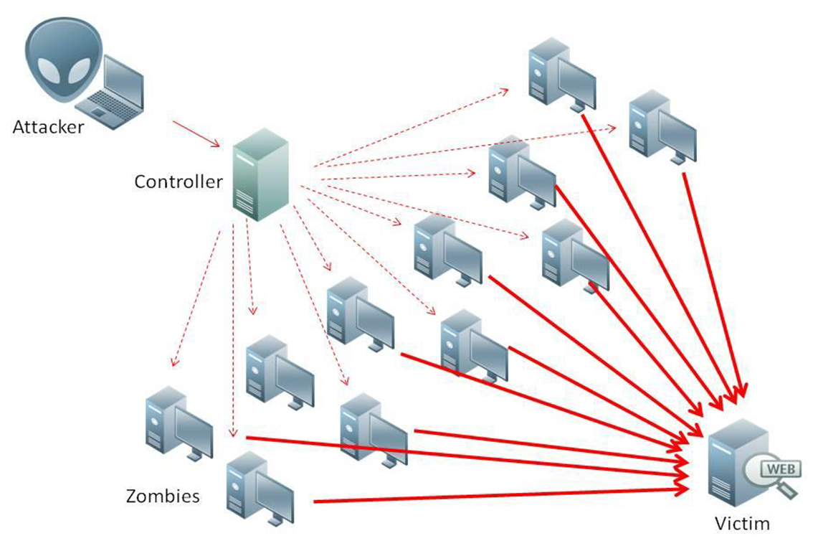
What is Denial of Service (DoS)
Attempts to make target unavailable by flooding with traffic
If victim has to filter attack, it’s too late
Internet Providers have no incentive to help
Businesses get affected, but would not pay provider enough to make worthwhile
This is why Cloudflare, e.g., exists
Many ways to perform this attack
Notes:
Contributed by Brett Ammeson.
https://www.cloudflare.com/ddos/reflection-attack-1.png
https://i.imgur.com/lxYv8cF.png

Slide 48
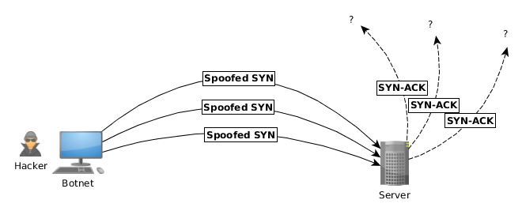
Distributed DoS Vectors
TCP SYN attack
SYN packets are small, low difficulty for attacker
Leaves half-open connections on server
SYN cookies mitigate this
DNS amplification attack
DNS requests are small
Can request all records on server
Crippled by proper configuration
Ingress/egress filtering will reduce effect
Notes:
Contributed by Brett Ammeson.
TCP SYN: https://www.cert.org/historical/advisories/CA-1996-21.cfm
DNS amplification: https://www.cert.org/historical/incident_notes/IN-2000-04.cfm
Ingress/egress: www.giac.org/paper/gsec/705/egress-filtering-keeping-internet-safe-systems/101588

Slide 49
Crime How
Technical and Non-Technical
Break into computer.
Prevent access to computer.
What things make computer related crime easy?
Notes:
Exploit security holes, Break encryption, Spoofing
Social Engineering: Guess passwords, Find out passwords and procedures
Poor passwords, Insecure protocols, Program limitations (buffer overruns), Eavesdropping (Email, Interactive), Insecure files

Slide 50
Crime Bane
Trojan Horse
Virus
Worm
Bot Network
Buffer Overrun
(Distributed) Denial Of Service Attack
How do they work?
How harmful are they?

Slide 51
Crime Why
Why?
Notes:
Money: stolen credit cards, change records, stolen property.
Political, military, economic.
Challenge, Revenge, Mean
Why do at all? Have motivation, think about it, think it will help, think it’s acceptable.
Feel forced. Don’t agree. Don’t care.

Slide 52
Crime Time
What is different now compared to:
10 years ago?
20 years ago?
30 years ago?
40 years ago?
Notes:
More computers. Unsophisticated owners. More complex software. Greater connectivity. Easy access to cracking tools. Incentives. File-sharing
In ’60s and ’70s, access was mostly localized.
Modems. Wardialing.
Some Arpanet and Usenet.

Slide 53
Crime Doers
Hacker or Cracker
Pre-1980 - Golden Age ☺ ?
Eighties
Nineties
Naughts
Criminal Hacking == Cracking?
Notes:
Script kiddies
Phreakers
Security analysts
Packet monkey

Slide 54
Crime Gain
Justifications for Computing Crimes?
What can be done after access is gained?
What resources are available?
How valuable are they?
Notes:
Machines are unused. No harm done. Education. Exposes security holes. Exposes abuses.
Use computer and/or resources. Take data. Destroy data. Alter data. Lock out others. Attack other computers.
Equipment, Processor Time, Disk space, Printer time / paper, Bandwidth

Slide 55
Crime Pay
Computer Fraud and Abuse Act (1986)
Bans :
unauthorized access or use of computers, copying, modifying, or destroying data, disclosing of passwords.
disrupting government and utilities.
Covers government, financial, medical, and interstate systems.
USA Patriot Act (2001)
Raised penalties.
Permits freer surveillance and monitoring to detect illegal activity.
Electronic Communications Privacy Act
Illegal to intercept telephone, email, other data transmissions, access stored email messages without authorization
Assign Cybercrime Treaty (2006), Wire Fraud Act, National Stolen Property Act, Identity Theft and Assumption Deterrence Act
Notes:
Are either of these laws still in effect? Have they been changed?
For additional legislation ask for presenting volunteers to brief recent incidents/cases.
Also ask for volunteers to find out laws from their home country/state.

Slide 56
Crime Stop
Technical
Protect Data
Protect Machine
Protect Access
Non-technical?
Social?
Legal?
Notes:
Encryption, Authentication, Biometrics, Anti-virus, File integrity checking (E.g. Tripwire), Virtual private networks, Point-to-point networking (Twisted-pair Ethernet vs. Coax vs. wireless)
Security through obscurity, physical access required, not on network, behind locked doors.
Remove desire, remove incentives
Legalize, increase penalties, increase chance of getting caught.

