Slide 1
Class 5
Intellectual Property
Keith A. Pray
Instructor
socialimps.keithpray.net
Notes:
Here’s the title slide. Excited already, aren’t you?
Weird Al Yankovic “Don’t Download This Song” (3:53)
https://www.youtube.com/watch?v=zGM8PT1eAvY

Slide 2
Overview
Review
Assignment
Students Present
Guest Speaker –

Slide 3
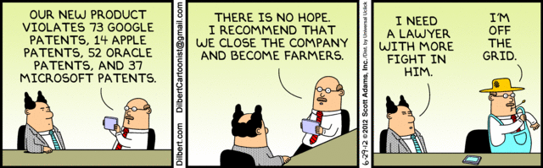
Notes:
Comments, observations, questions on IP Chapter?

Slide 4
My Reading Notes
pp. 165 “...ownership of ideas...” not quite right
pp. 168 public domain year 1997/1999 from source published in 1996?
pp. 170 SaaS, Google Search example? “…before he gave them the plot.”? “…cannot erase the memories...” Paycheck (2003)
pp. 180 4.4 #2 preferred?
pp. 186/196 revenue != profit
pp. 190 blocking 100% seems impossible
pp. 194 Any legitimate BitTorrent use examples since 2005?
pp. 197 “licensing agreement … hardware”? Confidential source code very outdated.
pp. 198 4.7.3 references?
pp. 205 Perhaps friends should not ask you to break the law?
Any successful industries operate as a support service?
pp. 207 Is Perl still most popular? Quality study from 2003, change?
pp. 209 who uses tape?
pp. 210 “human-readable, lawyer-readable…”
pp. 223 Interview has nothing to do with computing

Slide 5
Group Quiz
For each On the left answer a–d on Right
Trademark
Copyright
Patent
Trade Secret
What does it protect?
What qualifications have to be met?
How long does protection last?
Give a specific example currently protected?
Notes:
Trademark
Used to denote a product or service.
Apply in specific areas of commerce. Only applies in specified area of business
Indefinite term as long as in use and protected against becoming a common noun or verb.
You do not have to register a trademark unless you want to bring litigation before a federal court (there are other benefits too, but what are they?)
Copyright
Expression, not ideas: Fuzzy. E.g. derivative works, characters, merchandising, plots.
Mickey Mouse, Tarzan.
US Default : Original Author, Exception: work for hire, Transferred: yes
Rights: Publication, Performance / exhibition, Adaptation to other media, Excerpting, Attribution, Derivative works
US Term: Lifetime of author plus 70 years., 95 years for companies.
Governed by US law and international treaties (e.g. WIPO).
Fair Use: News reporting, reviews, etc., Scholarly / educational use, Private, non-commercial use, Lending libraries and archives
Fair Use restrictions: Admission charge, Re-transmission
In general, you can: Read, view, play, etc., Copy for personal use., Time-shift, Space-shift
In general, you cannot: Copy for others., Transfer to someone else but keep a copy., Show / perform it publicly.
What about video rentals?
Rationale: Encourage creativity. Encourage dissemination. Balance between private and public good. It’s a social contract.
Patent
A mechanism, process, or composition of matter.
Must be: Novel. Useful. Non-obvious. Described clearly. Must do what it says.
Usual term 20 years.
Utility and plant patents: 20 years.
Design patents last 14 years. (ornamental design of functional item)
Provisional patent gives 1 year, before full patent
Trade Secret
You must take steps.
Enforceable by: Contracts, Laws against industrial espionage.

Slide 6
Group Quiz
For each On the left answer a–d on Right
Trademark
Copyright
Patent
Trade Secret
What does it protect?
Qualifications required?
How long does protection last?
Specific example currently protected?
Notes:
Trademark
Used to denote a product or service.
Apply in specific areas of commerce. Only applies in specified area of business
Indefinite term as long as in use and protected against becoming a common noun or verb.
You do not have to register a trademark unless you want to bring litigation before a federal court (there are other benefits too, but what are they?)

Slide 7
Group Quiz
For each On the left answer a–d on Right
Trademark
Copyright
Patent
Trade Secret
What does it protect?
  Mark denoting product of service
Qualifications required?
  Unique in specific area of commerce
How long does protection last?
  While in use and protected against common noun or verb usage. Need to register to sue.
Specific example currently protected?
Notes:
Trademark
Used to denote a product or service.
Apply in specific areas of commerce. Only applies in specified area of business
Indefinite term as long as in use and protected against becoming a common noun or verb.
You do not have to register a trademark unless you want to bring litigation before a federal court (there are other benefits too, but what are they?)

Slide 8
Group Quiz
For each On the left answer a–d on Right
Trademark
Copyright
Patent
Trade Secret
What does it protect?
Qualifications required?
How long does protection last?
Specific example currently protected?
Notes:
Copyright
Expression, not ideas: Fuzzy. E.g. derivative works, characters, merchandising, plots.
Mickey Mouse, Tarzan.
US Default : Original Author, Exception: work for hire, Transferred: yes
Rights: Publication, Performance / exhibition, Adaptation to other media, Excerpting, Attribution, Derivative works
US Term: Lifetime of author plus 70 years., 95 years for companies.
Governed by US law and international treaties (e.g. WIPO).
Fair Use: News reporting, reviews, etc., Scholarly / educational use, Private, non-commercial use, Lending libraries and archives
Fair Use restrictions: Admission charge, Re-transmission
In general, you can: Read, view, play, etc., Copy for personal use., Time-shift, Space-shift
In general, you cannot: Copy for others., Transfer to someone else but keep a copy., Show / perform it publicly.
What about video rentals?
Rationale: Encourage creativity. Encourage dissemination. Balance between private and public good. It’s a social contract.

Slide 9
Group Quiz
For each On the left answer a–d on Right
Trademark
Copyright
Patent
Trade Secret
What does it protect?
  Expression, not ideas. Derivative work, publication, performance
Qualifications required?
  Original
How long does protection last?
  Author lifetime + 70 years, 95 years for companies
Specific example currently protected?
Notes:
Copyright
Expression, not ideas: Fuzzy. E.g. derivative works, characters, merchandising, plots.
Mickey Mouse, Tarzan.
US Default : Original Author, Exception: work for hire, Transferred: yes
Rights: Publication, Performance / exhibition, Adaptation to other media, Excerpting, Attribution, Derivative works
US Term: Lifetime of author plus 70 years., 95 years for companies.
Governed by US law and international treaties (e.g. WIPO).
Fair Use: News reporting, reviews, etc., Scholarly / educational use, Private, non-commercial use, Lending libraries and archives
Fair Use restrictions: Admission charge, Re-transmission
In general, you can: Read, view, play, etc., Copy for personal use., Time-shift, Space-shift
In general, you cannot: Copy for others., Transfer to someone else but keep a copy., Show / perform it publicly.
What about video rentals?
Rationale: Encourage creativity. Encourage dissemination. Balance between private and public good. It’s a social contract.

Slide 10
Group Quiz
For each On the left answer a–d on Right
Trademark
Copyright
Patent
Trade Secret
What does it protect?
Qualifications required?
How long does protection last?
Specific example currently protected?
Notes:
Patent
A mechanism, process, or composition of matter.
Must be: Novel. Useful. Non-obvious. Described clearly. Must do what it says.
Usual term 20 years.
Utility and plant patents: 20 years.
Design patents last 14 years. (ornamental design of functional item)
Provisional patent gives 1 year, before full patent

Slide 11
Group Quiz
For each On the left answer a–d on Right
Trademark
Copyright
Patent
Trade Secret
What does it protect?
  Mechanism, process, composition of matter
Qualifications required?
  Novel, useful, non-obvious, described clearly, must funciton
How long does protection last?
  Utility and plant: 20 years
  Design: 14 years
  Provisional adds 1 year
Specific example currently protected?
Notes:
Patent
A mechanism, process, or composition of matter.
Must be: Novel. Useful. Non-obvious. Described clearly. Must do what it says.
Usual term 20 years.
Utility and plant patents: 20 years.
Design patents last 14 years. (ornamental design of functional item)
Provisional patent gives 1 year, before full patent

Slide 12
Group Quiz
For each On the left answer a–d on Right
Trademark
Copyright
Patent
Trade Secret
What does it protect?
Qualifications required?
How long does protection last?
Specific example currently protected?
Notes:
Trade Secret
You must take steps.
Enforceable by: Contracts, Laws against industrial espionage.

Slide 13
Group Quiz
For each On the left answer a–d on Right
Trademark
Copyright
Patent
Trade Secret
What does it protect?
  Anything
Qualifications required?
  Must take steps to keep secret, e.g. Non-Disclosure Agreements, contracts
How long does protection last?
  As long as kept secret
Specific example currently protected?
Notes:
Trade Secret
You must take steps.
Enforceable by: Contracts, Laws against industrial espionage.

Slide 14
Overview
Review
Assignment
Students Present
Guest Speaker
Notes:
But first take a look at:
CGP Grey
Copyright: Forever Less One Day (6:27)
https://www.youtube.com/watch?v=tk862BbjWx4
Tom Scott
http://tomscott.com
Welcome To Life (2:44)
https://www.youtube.com/watch?v=IFe9wiDfb0E&feature=youtu.be

Slide 15
Assignment - Self Search 1/3
Profile 2
Is You
1 Page
Paper
Filter
Inspiration
Search Methods
…
…
…
…
Filter
Profile 1
Could Be You

Slide 16
Assignment - Self Search 2/3
Discussion Board
Post search techniques
  Do not repeat entries.
Use techniques listed to produce a profile that could be you.
  Not responsible for techniques posted less than 24 hours before class
Filter first profile so that the information is for you.
Provide as appendix
  Provide a brief description if you’d rather not list the details
For search result consider:
  Exactly how did the data get there?
  How can this data be used?
  Is this a secondary use?
  Did you authorized use of the data? If not and you want to, request its use be discontinued and share the experience.
Be creative, anyone can type a name into Google
Do not pay for search services

Slide 17
Assignment - Self Search 3/3
1 Page Paper
Refer to search results to support your conclusion
Subscribe to the Discussion Board
Conclusion idea examples (not comprehensive):
  What impression would the profile make on a potential employer?
  What would your elder family members (or equivalent) think?
  Are you comfortable with what you found or did not find?
  Do you believe protecting your privacy is important or needed?
5 High quality sources still required

Slide 18
Overview
Review
Assignment
Students Present
Guest Speaker

Slide 19
Should You patent Software?
Why Patenting Software is No Longer an Effective option for software protection
Christopher Whimpenny
Notes:
Patenting Software is not a viable option anymore for anyone other than large corporations. The costs of setting up and maintaining them greatly outweigh the small protection that they currently give to the individual. As such it is much better to receive a trade secret or copyright your code over filing a patent

Slide 20
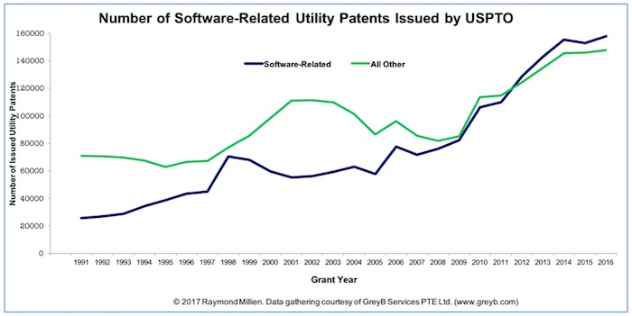
Patents for software are on the rise
Christopher Whimpenny
Software patents have become very common in the past few years
Surpassed number of non-software utility patents in 2011
Alice Corp vs. CLS Bank
  Causes the dip in 2014
Recent cases in 2016 have reinstated some patents voided by Alice vs. CLS Bank
[3], [4], [5], [6]
Notes:
Recently in 2012 the number of software patents rose above those not software related so the industry is really booming and people are trying to protect their intellectual property
Alice Corp vs. CLS Bank background
In recent years patents have been getting harder to receive and patents that were previously granted may be invalid, however recently the courts are reinstating some of these
Study done in 2017

Slide 21
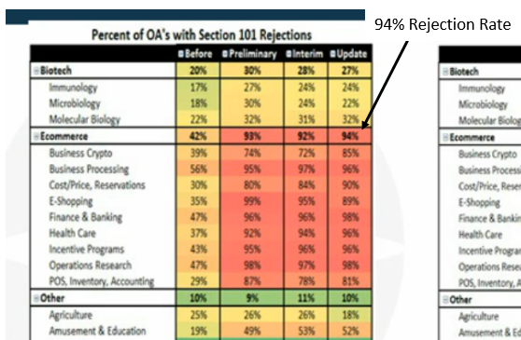
Effect of Alice vs. CLS Bank
Software must have an industry application
An algorithm or concept of software usage is not enough
Software patents are becoming harder to get
Line for what can and cannot be patented is very fuzzy
[3], [4], [5], [6]
Notes:
Now software must either be part of the hardware or have an industrial application not just that software is being used a certain way
Concepts, ideas, algorithms i,.e. the logic of your code cannot be patented
As such it is much harder to receive a patent and the fees that go into it are not refundable
At this point it is partially a gamble of your money whether you will receive your patent or not

Slide 22
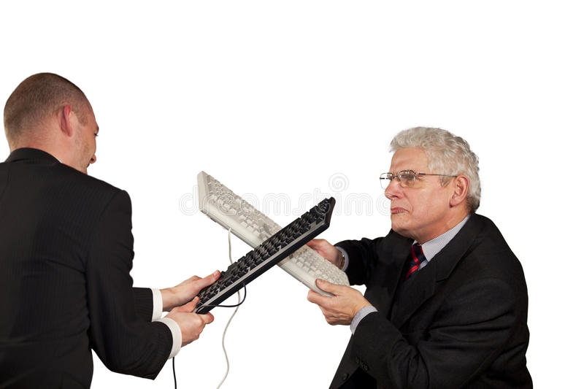
Costs vs. gains of software patents
Christopher Whimpenny
For:
Allows individuals to be competitive in the market
  In reality this breaks down
Allows for innovators to be protected
Against:
Patents being used as legal weapons (waste of money)
  One investor said large opponents would tie you into court battles for 10 years which would at lowest cost $1.5 Million
Slows innovations
For individuals, patents are not worth the time and money spent (Can cost up to $10,000 and take 4 years to file)
[1], [2], [6], [8]
Notes:
The ideas for why software patents are good break down in the real world
Patents are often used to keep companies in legal battles during which your patent may be infringed upon
It costs lots of money and time to file by which time the shelf life of the product may be over and protecting against infringements will cost even more time and money

Slide 23
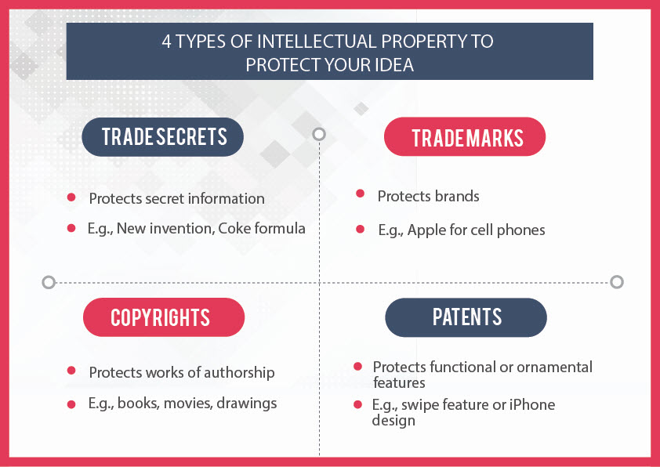
Patents are not the best option
Christopher Whimpenny
Essentially stops others from stealing your code
Doesn’t protect program logic or algorithms
Copyrighting software may be just as effective
Trade Secrets and Copyrights are much better routes
  Less Expensive
  More Protection
[1], [7]
Notes:
Since it doesn’t protect against the logic of your code it basically ensures someone doesn’t copy and paste it
This can be achieved via copyrighting for much easier
Trade Secrets can protect against the logic i.e. the google search algorithm so it gives more protection but don’t have any procedural formalities

Slide 24
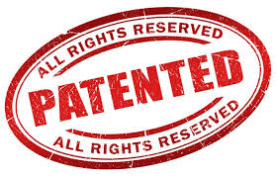
Conclusion
Christopher Whimpenny
Currently main use of software patents is for companies to use them in legal battles
For software patents to become a viable option they would need to be overhauled
  Separate type of patent
  Better definitions of the requirements and protections granted
  Less expensive in legal battles and filing
Notes:
State conclusion again
Patenting Software is not a viable option anymore for anyone other than large corporations. The costs of setting up and maintaining them greatly outweigh the small protection that they currently give to the individual. As such it is much better to receive a trade secret or copyright your code over filing a patent

Slide 25
References
Christopher Whimpenny
[1] Ashley Ellis. (2013, May 17). Steal This Idea: The Arguments For and Against Software Patents. Retrieved September 6, 2018, from Ashley Ellis General Employment Enterprises Website: http://www.ashleyellis.com/2013/05/steal-this-idea-the-arguments-for-and-against-software-patents/
[2] Kline, D. (2017, April 24). Should Software Patents Be Outlawed? Retrieved September 6, 2018, from The Michelson Institute for Intellectual Property Website: http://michelsonip.com/software-patents-outlawed/
[3] Legal Zoom. (n.d.). What can be patented? Retrieved September 6, 2018, from Legal Zoom Web Site: https://www.legalzoom.com/knowledge/patent/topic/what-is-patentable9
[4] Millien, R. (2017, May 21). Alice Who? Over Half the U.S. Utility Patents Issued Annually are Software Related! Retrieved September 6, 2018, from IP Watchdog Website: https://www.ipwatchdog.com/2017/05/21/alice-over-half-u-s-utility-patents-issued-annually-software/id=83367/
[5] Morningside IP. (2017, May 11). The Alice Decision and Its Fallout in the U.S. Retrieved September 6, 2018, from Morningside IP Website: https://www.morningsideip.com/the-alice-decision-and-its-fallout-in-the-u-s/
[6] PatentFile.org. (2018). The Slow Death of Software Patents. Retrieved September 6, 2018, from patentfile.org: https://patentfile.org/the-slow-death-of-software-patents/
[7] Yang, J. (n.d.). Four types of intellectual property you can use to protect your idea and how to use them. Retrieved September 6, 2018, from ocpatentlawyer.com: https://ocpatentlawyer.com/four-types-intellectual-property-protect-idea/
[8] Mann, R. J. (2005, November 4). Do Patents Facilitate Financing in the Software Industry. Texas Law Review, 961-1030. Retrieved September 7, 2018, from https://heinonline.org/HOL/LandingPage?handle=hein.journals/tlr83&div=29&id=&page=

Slide 26
Class 5
The End
Keith A. Pray
Instructor
socialimps.keithpray.net
Notes:
This is the end. Any slides beyond this point are for answering questions that may arise but not needed in the main talk. Some slides may also be unfinished and are not needed but kept just in case.

