Slide 1
Class 4
Freedom Of Speech
Keith A. Pray
Instructor
socialimps.keithpray.net
Notes:
Here’s the title slide. Excited again, aren’t you? You should be.

Slide 2
Papers
http://socialimps.keithpray.net/assignments/paper-guidelines/
Hyperbole is the best thing ever!
  but not in these papers
Quantify
  Do not use terms like: less, more, a lot, huge, great, big, tiny, etc.
Read paper aloud to proof
Use template, saves time (and -1 point)
Notes:
Save for next time:
Missing Counter Point and Response
Be sure to put quotes around entire quote
Clearly state conclusion
First statement preferred
Print 2 sided and save a tree

Slide 3
Overview
Review
Assignment
Students Present
Notes:
Show syllabus updates if any

Slide 4
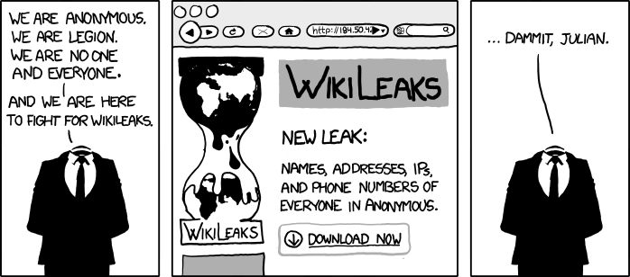
http://www.xkcd.com/834/

Slide 5
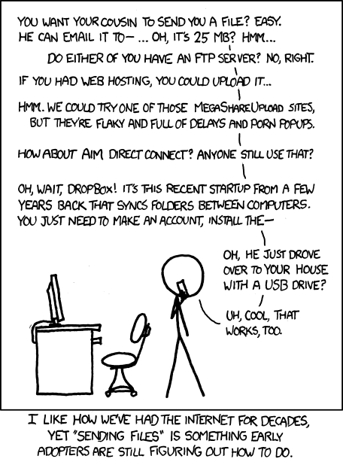
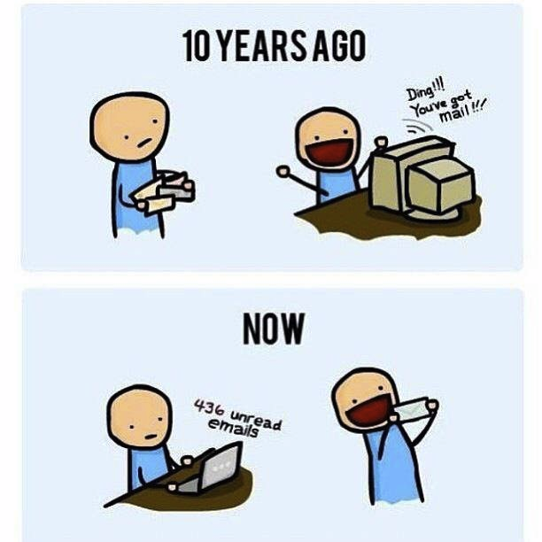
http://poofytoo.com/
25
http://xkcd.com/949/

Slide 6
My Reading Notes
pp. 110 What powers the cell phones and towers? “everyday tasks” not apparent from image.
pp. 114 Ann did not force people to complain.
pp. 117 7% # transactions or $$? Wikipedia critics source [19] from 2005, how has quality turned out? Nice to see darknet added.
pp. 118 [27] PC bangs youth source from 2003, all grown up now.
pp. 130 Is 20% realistic? What will search engines and facial recognition be capable of? Rule Utilitarian ignores the private setting.
pp. 131 Do any filters use image processing?
pp. 133 Stating people searching did not consent to material being blocked makes more sense.
pp. 134 Web access for no cost?
pp. 145 More accurate to say addicted to single app - good
pp. 149 20 same as 39
pp. 150 36 same as 42
End of Chapter questions I liked: 2, 25 http://en.wikipedia.org/wiki/Wikipedia:Citing_Wikipedia

Slide 7
Group Quiz
Name two methods some governments use to control access to information.
A large company has a policy prohibiting employees from blogging about company products.
  Name two possible reasons for the policy.
  Does it violate the First Amendment? Why?
  Is it reasonable? Why?
What does “URL” stand for and what is it?
Notes:
Censorship (religious, governmental, private). Adult authentication. Global dissemination.
Freedom of Speech not an absolute right.

Slide 8
Overview
Review
Assignment
Students Present
Notes:
But before that:
CPG Grey - This Video Will Make You Angry [Thought Germs] (7:25)
https://www.youtube.com/watch?v=rE3j_RHkqJc
If not shown yet:
What "Orwellian" really means - Noah Tavlin (5:31)
http://ed.ted.com/lessons/what-orwellian-really-means-noah-tavlin
Cedric Gervais - Hashtag (Original Mix) (3:58)
https://www.youtube.com/watch?v=6OmBKd7X7EE
Dave Audé vs Luciana - You Only Talk In #HASHTAG (3:36)
http://www.youtube.com/watch?v=53wIN87lJn0

Slide 9
Assignment
Reading
Individual Presentations
Extra Credit – One page paper
  Is WPI’s IT Acceptable Use Policy morally acceptable?
Work on your group project.
  Average Group Happiness 1.21
  See full group project description on course website.
  Send Web Site URL before next class
Notes:
Or review group project and individual presentation guidelines right now.
Possible One page paper:
Global intellectual property laws, friends or foes?
Group Happiness 1 = everyone got first pick, 2 = everyone got second pick, etc.

Slide 10
Overview
Review
Assignment
Students Present

Slide 11
Social MEDIA
GOT YOU DOWN?
Is it true that the use of social media leads to an increase in depression?
Joseph Yuen
Notes:
Name
Joseph Yuen
Topic formulation
Before we begin, who has heard of the correlation between social media and depression?
While we may have heard of this phenomenon before, what does science actually say? Is it true that the use of social media leads to an increase in depression?
Like many topics, it depends on a person’s personality and how one uses social media. So to answer the question, it could… but in either case, social media has a tendency to strongly correlate with depression which should lead people to examine themselves.
Transition
To start this off correctly, let’s define some terms, so we’re all on the same page.

Slide 12
Terminology
Joseph Yuen
Social Media
  A group of Internet-based applications that allow the creation and exchange of User Generated Content [2]
    Ex: Twitter, Facebook, Instagram
Depression
  A psychoneurotic disorder characterized by lingering sadness, inactivity, and difficulty in thinking and concentration [3]
  Often begins in young adulthood [1]
[1] [2] [3] [4]
Notes:
What is social media?
See Slide
Social media platforms still defer in one way or another, so they can’t be simply lumped together[4]
What is depression?
See slide
Dejection, hopelessness, excessive sleeping, suicide [3]
This makes its relation to social media so much more prevalent with 90% of young adults using social media [1]
Projected to become the leading cause of disability in high-income countries by 2030 [1]
Transition
We’re going to look at the two different sides on the issue and come to a conclusion

Slide 13
Joseph Yuen
SOCIAL MEDIA -> DEPRESSION
Unrealistic impressions of reality [4]
  Everyone is happy
Constant self-evaluation [5] [6]
  Life is unfair
SOCIAL MEDIA -> HAPPINESS
Social media can strengthen relationships [7]
Increases communication [5]
[4] [5] [6] [7] [8]
Notes:
Point 1
People tend to post about the good things in life which leads to an unrealistic impression of reality.
This may lead one to think that everyone is happy.
Point 2
In combination with the first point, by constantly evaluating oneself, one can easily think that life is unfair -> depression.
Point 3
When social networks and the Internet in general are used to strengthen and maintain social ties, particularly within family members and close friends, the resulting social support has beneficial effects on mental health.
Point 4
Social media can one present oneself in a better light due to having more time to respond, as opposed to face to face interaction.
These studies had small samples and mainly focused on Facebook.

Slide 14
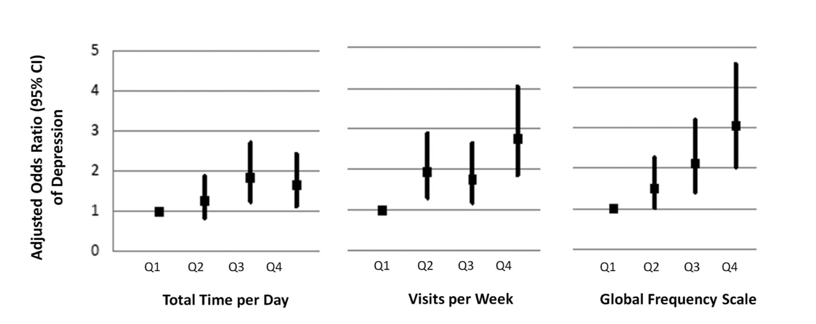
SOCIAL MEDIA VS DEPRESSION
Joseph Yuen
Correlation between social media use and depression [1]
[1]
Notes:
Study of 1787 American young adults
Participants in the highest quartile of total time per day on social media had significantly greater odds of having depression.
Show graphic.

Slide 15
CAUSATION IS NOT CLEAR
Joseph Yuen
Social media causes depression [4]
Depressed individuals use social media [4]
Depends on the person [8]
[4] [8]
Notes:
Causation is not clear
Which one is it? This is one of the main reasons why the psychiatric community is not certain.
People interpret posts in differing ways. There’s not just one way.

Slide 16
Conclusion
Joseph Yuen
Exact direction of causation remains in question
  Personality plays a factor
Social media and depression have a relationship
  Strong positive correlation between the time spent on social media and depression among young adults
  Social media’s false representation of reality
  Effects of constant self evaluation
Action
  Examine whether participation is positive or negative
  Use to identify individuals at risk of depression
Notes:
Conclusion
While the exact direction of causation remains in question, social media and depression have a relationship because of social media’s false representation of reality, the strong positive correlation between the time spent on social media and depression among young adults, and the effects of constant self evaluation.
Action
Participants should be aware of their usage and examine whether their participation is positive or negative
Social media platforms may be a useful tool to identify individuals at risk of depression and to provide intervention.

Slide 17
References
Joseph Yuen
[1] Lin, L., Sidani, J., Shensa, A., Radovic, A., Miller, E., Colditz, J., Hoffman, B., et al. (n.d.). ASSOCIATION BETWEEN SOCIAL MEDIA USE AND DEPRESSION AMONG U.S. YOUNG ADULTS. Depression and Anxiety, 33(4), 323–331. doi:10.1002/da.22466
[2] Kaplan AM, Haenlein M. Users of the world, unite! The chal- lenges and opportunities of social media. Bus Horiz 2010;53:59– 68.
[3] Depression. (2014). In K. L. Lerner & B. W. Lerner (Eds.), The Gale Encyclopedia of Science (5th ed.). Farmington Hills, MI: Gale. Retrieved from http://link.galegroup.com/apps/doc/CV2644030660/SCIC?u=mlin_c_worpoly&sid=SCIC&xid=65d1e408
[4] Pantic, I. (2014). Online Social Networking and Mental Health. Cyberpsychology, Behavior and Social Networking, 17(10), 652–657. http://doi.org/10.1089/cyber.2014.0070
[5] Hui-Tzu Grace Chou and Nicholas Edge.Cyberpsychology, Behavior, and Social Networking.Feb 2012.ahead of printhttp://doi.org/10.1089/cyber.2011.0324
[6] Brenda K. Wiederhold.Cyberpsychology, Behavior, and Social Networking.Jan 2016.ahead of print http://doi.org/10.1089/cyber.2015.29020.bkw
[7] Bessière K, Pressman S, Kiesler S, Kraut R, Effects of Internet Use on Health and Depression: A Longitudinal Study, J Med Internet Res 2010;12(1):e6
[8] Susan Krauss Whitbourne, Is Facebook Making You Depressed, https://www.psychologytoday.com/us/blog/fulfillment-any-age/201710/is-facebook-making-you-depressed [9/3/18]

Slide 18
Types of Distribution
Sam Baumgarten
Self-Hosted
Cloud
Content Platform (open)
Content Platform (curated)
User
ISP
Your Server
User
ISP
Cloud Provider
Your App
User
ISP
Platform
Your Content
User
ISP
Platform
Your Content
Filter
[1]
Notes:
Start by introducing various distribution mechanisms I’ll be referencing through rest of presentation. Briefly discuss difference between curated and non-curated content platforms for purposes of this presentation. YouTube would be an example of a content platform. Comcast an example of an ISP. AWS example of Cloud (multiple types of distribution can be in use at the same time i.e. a video on your website can both be self-hosted and cloud hosted). I’m referring to types of distribution in terms of legal liability for content.
Self-Hosted: Content where the only middle man is ISPs
Cloud: Content where the middle men are ISPs and your host
Content Platform (open): Content where there is an application middle man who controls your platform
Content Platform (curated): Content where there is an application middleman who controls your platform and content

Slide 19
47 U.S. Code § 230 - Safe harbor
Sam Baumgarten
The term “information content provider” means any person or entity that is responsible, in whole or in part, for the creation or development of information provided through the Internet or any other interactive computer service.
[2]
Notes:
Intro to 47 U.S. CODE § 230: why it’s important to ISPs, what it does, who it protects (listed on screen).
The “Safe Harbor” provision essentially says that content platforms cannot be held responsible as content providers. The definition says what a content provider is. The 4 types of distribution platforms above make use of the safe harbor provision differently.
Example: CNN. Content provider and curator is not protected by Safe Harbor Provision
Example: YouTube. Content platform but not provider. Protected by safe harbor provision
Example: Comcast. Platform but not provider.
Right now most platforms and ISPs are protected by safe harbor; however, that is now up for question.

Slide 20
Is Censorship Okay?
Sam Baumgarten
Notes:
Pose question is censorship okay? When a content platform censors content, what type of censorship is it (based on definitions from book). In what cases does self-censorship vs. direct-censorship apply.
Look at a case like YouTube. Right now they are protected by Safe Harbor; however, censoring could lead to their role being questioned.

Slide 21
ISPs
Sam Baumgarten
Anti-Piracy
COPA
Wiki-Leaks
Net Neutrality
Joe Doe lawsuits have seen a major rise and have a major impact on ISPs.
[4], [5], [6]
Notes:
Breaks down types of censorship directly applicable to ISPs:
Anti-Piracy – what type of censorship is it when an ISP prevents piracy? Is it protected by safe harbor? Comment on 2012 anti-piracy bill and political hurdles/challenges that led to it being shelved. How do ISPs interact w/ piracy? Discuss rise of Joe Doe lawsuits as shown in graphic.
COPA – what type of censorship does COPA permit. How does COPA relate to ISPs?
WikiLeaks -- Bank Julius Baer & Co v. WikiLeaks. Discuss legal challenge regarding WikiLeaks injunction. How does this relate to direct-censorship and the 1A.
Net Neutrality – How could these protections change ISPs start censoring content (either outright or with speed changes).
Figure: Joe Doe Lawsuits. Cause of major rise.
Anti-Piracy is protected by Safe Harbor. Direct-censorship by governmental policy. Joe Doe lawsuits are when content producer file a lawsuit and request information from ISP w/ a warrent w/o knowing who the person is. Massive increase.
COPA had injunction passed in 2009. Direct-censorship by governmental policy. Definition in book.
WikiLeaks. Direct-censorship. Struck down by injunction.
Net Neutrality: direct-censorship by ISP policy. Conversations about how this could affect safe harbor protection.

Slide 22
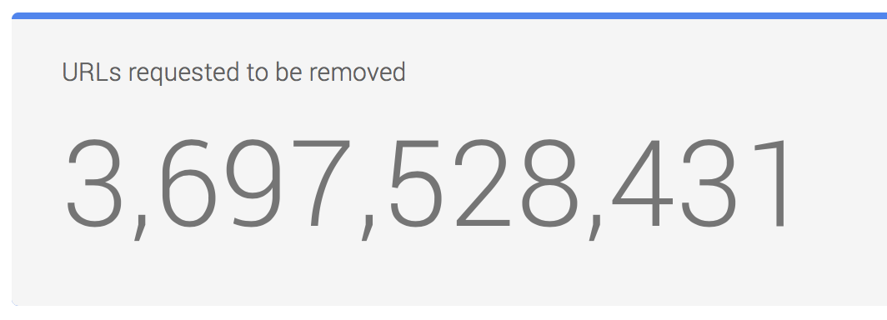
Online Platforms
Sam Baumgarten
DMCA
Hate Speech
Curation
Companies such as Google act on many DMCA notices
[7], [8], [9]
Notes:
Breaks down types of censorship directly applicable to video platforms (such as YouTube or Facebook):
DMCA – What type of censorship is the DMCA related to? How does this relate to safe harbor?
Hate Speech – Discuss recent Alex Jones hate-speech case.
Curation -- Are content platforms acting as content providers if they censor based on rules not laid out in USC § 230?
DMCA. Direct-censorship. Protected by safe-harbor
Hate-Speech. How does this relate to safe-harbor? Is it protected (right now yes).
Curation. Builds on last points

Slide 23
Conclusion
Sam Baumgarten
Notes:
Lots of protection for content platforms.
As platforms get into curation, we will see how safe harbor adapts. Safe-harbor protection is what allows content platforms to exist and w/o it it would be near impossible to use user generated content.

Slide 24
References
<Your Name>
[1] https://motherboard.vice.com/en_us/article/59jgka/a-brief-history-of-youtube-censorship (9/2/2018)
[2] https://www.law.cornell.edu/uscode/text/47/230 (9/2/2018)
[3] https://www.nytimes.com/2012/01/21/technology/senate-postpones-piracy-vote.html (9/2/2018)
[4] https://www.eff.org/cases/bank-julius-baer-co-v-wikileaks (9/2/2018)
[5] https://opennet.net/research/regions/namerica (9/2/2018)
[6] https://torrentfreak.com/people-sued-for-piracy-in-united-states-drops-84-since-2010-160114/ (9/3/2018)
[7] https://www.nytimes.com/2018/08/06/technology/infowars-alex-jones-apple-facebook-spotify.html (9/2/2018)
[8] https://support.google.com/youtube/answer/6005900 (9/2/2018)
[9] https://transparencyreport.google.com/copyright/overview (9/3/2018)

Slide 25
Class 4
The End
Keith A. Pray
Instructor
socialimps.keithpray.net
Notes:
Use remaining time to form groups, approve group topics, etc.
This is the end. Any slides beyond this point are for answering questions that may arise but not needed in the main talk. Some slides may also be unfinished and are not needed but kept just in case.

