Slide 1
Class 9
Errors Failures Risks
Keith A. Pray
Instructor
socialimps.keithpray.net
Notes:
Here’s the title slide. Excited already, aren’t you?
What is the point of this assignment? (Did SW Teams from the reading pick good test strategies? Will you be able to support your choices if something goes wrong?)
What errors? – Have student record list on board
Who looked for existing test strategies?
Who looked for directions on how to test currency?

Slide 2
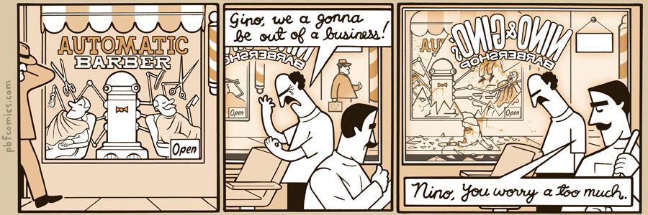
http://pbfcomics.com/197 (2014-09-26)
Notes:
10 – Errors, Failures, Risks
Good filler if guest speaker not coming or late
Why Electronic Voting is a BAD Idea - Computerphile
https://www.youtube.com/watch?v=w3_0x6oaDmI

Slide 3
Overview
Review
Assignment
Students Present
Guest Speaker
Notes:
We can also discuss articles listed on Security Discussions under documents of course web site.
ADD QUIZ AS BACKUP IF CLASS DISCUSSION OR GUEST SPEAKER FAIL

Slide 4
My Reading Notes
pp. 366 Any false arrests since 1989?
pp. 368 Argument assumes DB cannot exist without existing inaccuracies.
pp. 373 This is not to keep the PATRIOT system from responding to false alarms.
pp. 375 Always encapsulate units! Not clear if SW involved.
pp. 376 Any SW diffs between Mars Missions?
pp. 378 Why did the Tokyo Stock Exchange refuse?
pp. 380 Republicans and Florida?
pp. 381. Do the second thoughts on DRE machines make the interview at end Chapter’s end less relevant?
pp. 389 No simulation examples since 2002?
pp. 390 Did The Limits to Growth predictions motivate people to change?
pp. 392 What happened to Verification?
pp. 394 “satisfies the specification” = verification. “needs of the user” = validation.
pp. 395 SW quality since 2009?
pp. 396 Gender bias nice addition!
pp. 406 21, source from 2004, is it implemented yet? 23 like game release question in next chapter.
Questions I liked: 10, 12, 16, 17, 18, 20, 21

Slide 5
Assignment
Prepare for Debate
  From Chapter 9 In-class Exercises # 24.
  Should the company produce the game?
  Use the SWE Code Of Ethics as the basis for your argument.
  Use other sources for supporting data
Class designed 1 Page Paper on Chapter 10 Work and Wealth topic
  Contribute your topic suggestion on the Canvas Discussion Board
  “Like” the paper idea you prefer

Slide 6
Overview
Review
Assignment
Students Present
Guest Speaker
Notes:
We can also discuss articles listed on Security Discussions under documents of course web site.
ADD QUIZ AS BACKUP IF CLASS DISCUSSION OR GUEST SPEAKER FAIL

Slide 7
Gender Bias in Technology Design
Sylvia van der Weide
Bias
  Inclination or prejudice for or against one person or group, especially in a way considered to be unfair. (OED)
  systematic error introduced into sampling or testing by selecting or encouraging one outcome or answer over others (Merriam-Webster)
[1]
Notes:
So we’ll start by defining bias.
Here are definitions both from the Oxford English Dictionary and from Merriam Webster, that have both a statistical definition and a social contract definition. Both definitions can apply to Computing technology.

Slide 8
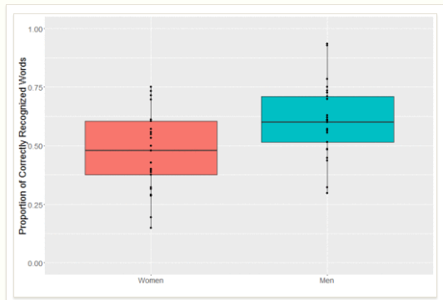
Speech Recognition
Sylvia van der Weide
2003 Medical Software study
2016 Google speech recognition
  Used for auto-captioning YouTube videos
Women Men
[2], [3]
Notes:
A study was done in 2003 of the accuracy of speech recognition for completing repetitive medical paperwork, and they found that the average word recognition correctness was 4 points higher for men than for women.
More recently, a study was done by sociolinguist Rachel Tatman of Google’s automatic speech recognition, which is what’s responsible for auto-captioning youTube videos. She found that on average 47% of female speakers words were captioned correctly and 60% of male speaker’s words were captioned correctly.
This graphic is a box and whisker plot showing the proportion of correctly recognized words by the gender of the speaker. The colored boxes represent the area within one standard deviation of the average, and the outliers are likely due to the accents of the speaker being easier or more difficult for the computer to understand.
This means that female speakers using these voice recognition technologies in a job setting have to spend more time correcting errors than their male counterparts.

Slide 9


Computer vision
Sylvia van der Weide
Computers vision machine learning algorithms
  Inherit dataset biases
  Google photos “gorilla” incident
http://www.aljamila.com/sites/default/files/2017/04/25/1098586-656464423.jpg
http://exclusive.multibriefs.com/images/exclusive/0902mankitchen.jpg
[5], [6]
Notes:
Machine learning based image recognition software takes on the bias of the dataset
Prominent research image collections (supported by Facebook and Microsoft) display gender bias in depictions of activities such as cooking and sports
images of kitchens and activities such as shopping and washing dishes associated with women
When algorithms trained on these biased datasets are used to identify new images the mistakes they make are consistent with the biases. For example, if you look at these two images here, they are very clearly different, but there is a good chance that a computer vision algorithm would classify them both as “woman in kitchen”
Do you remember the “gorilla” incident
google photos tagged darker skinned people as gorillas
couldn’t fix it, had to remove the tag “gorilla” from google photos

Slide 10

Computer vision
Sylvia van der Weide
CVPF (Computer vision-based pornography filtering)
  Very limited definition of pornography
  Focused on identifying naked female bodies
[4]
http://i0.wp.com/www.dailycal.org/assets/uploads/2011/09/kia.png
Notes:
Any problems with different people having different definitions?
other kinds of porn not filtered
CVPF - programmers making assumptions about what pornography looks like
- primarily naked women
- pornographic bodies have specific, predictable shapes, textures, and sizes
Results in filtering out a specific type of pornographic image
for example, the algorithm to identify skin assumes that hairy subjects are rare
no one attempting to identify male genitalia as of 2016

Slide 11
conclusion
Sylvia van der Weide
A homogeneous group of developers can inadvertently apply their own biases to their software
Larger societal prejudices can also be encapsulated in software accidentally
Is this a problem we can solve, or an artifact of having humans writing the code?
http://i0.wp.com/www.dailycal.org/assets/uploads/2011/09/kia.png
Notes:
Why did training sets contain so much bias?

Slide 12
References
Sylvia van der Weide
[1] https://en.oxforddictionaries.com/definition/bias
[2] Rodger, James & C. Pendharkar, Parag. (2004). A field study of the impact of gender and user's technical experience on the performance of voice-activated medical tracking application. Int. J. Hum.-Comput. Stud..
[3] Tatman, Rachel. “Google’s speech recognition has a gender bias”, <https://makingnoiseandhearingthings.com/2016/07/12/googles-speech-recognition-has-a-gender-bias/>
[4] Gehl, Robert W., Lucas Moyer-Horner, and Sara K. Yeo. "Training Computers to See Internet Pornography: Gender and Sexual Discrimination in Computer Vision Science." Television & New Media, vol. 18, no. 6, 2017, pp. 529-547.
[5] Guynn, Jessica. “Google Photos labeled black people 'gorillas‘”, USA Today, 2015, <https://www.usatoday.com/story/tech/2015/07/01/google-apologizes-after-photos-identify-black-
people-as-gorillas/29567465/>
[6] Simonite, Tom. “MACHINES TAUGHT BY PHOTOS LEARN A SEXIST VIEW OF WOMEN”, WIRED, 2017, https://www.wired.com/story/machines-taught-by-photos-learn-a-sexist-view-of-women/
[7] https://www.merriam-webster.com/dictionary/bias

Slide 13

THE Problem with Artificial Intelligence
Ryan St. Hilaire
Current Examples of AI
  Search algorithms
  Vision Processing
  Personal Assistants (Siri)
  Autonomous Cars
  Industry Usage
Problem with AI
  Competence
  Learning
  Ethical Implementation
https://en.wikipedia.org/wiki/Watson_(computer)#/media/File:IBM_Watson_Logo_2017.png
[8], [9]
Notes:
Hello, everyone. My name is Ryan St. Hilaire, and I will be talking to you about the current status of artificial intelligence and problems that occur as a result of incompetent systems and learning capabilities. I’ll be focusing mostly on the current status of AI and the ethical considerations that may occur. Currently, AI is being used in many places all around the world to further increase the effectiveness of systems. Search algorithms, vision processers, and personal assistants such as Siri and Cortana are used by people every day to assist with work and research, while companies are starting to introduce autonomous cars and incorporate AI in places such as the manufacturing industry. The problem that comes from introducing AI is the challenge of creating a competent system that is able to learn and adapt to new problems not introduced by the creator. These attributes can be described as a set of ethics and creativity, things that are much harder to implement than algorithmic thinking. In effect, the problem with AI is building a system that is competent, able to adapt, and capable of explaining decision-making.

Slide 14
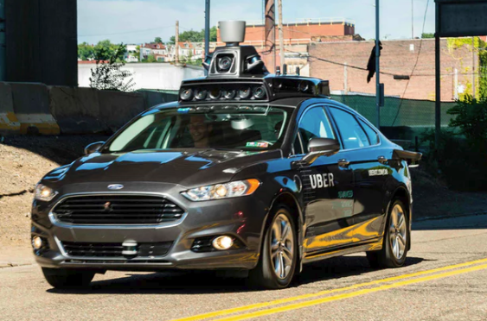
Competence
Ryan St. Hilaire
The main issue is the competence of an AI system
Autonomous Car
  2016 – Tesla Autopilot killed driver
  March, 2018 - Autonomous Uber kills pedestrian
[2], [7]
Notes:
The main issue of AI comes from the question of competence. While movies mainly entertain the idea of a super intelligent AI with the goal of taking over the world, the more likely possibility of an AI disaster would result from the unexpected results of a flawed system. AI systems can be easily fooled by exploiting weaknesses in their data base, such as providing conflicting data samples or unknown variables. In 2016, a Tesla killed it’s driver while in ‘autopilot’ mode by crashing into a semi-truck that was crossing a road. This system didn’t recognize that the object was the moving bus, and didn’t consider the object to be a risk. Also, last month an autonomous Uber car killed a pedestrian on the street. In this case, the pedestrian was crossing illegally at night while riding a bike. These are only two examples of the risk of relying on this software. In addition, as AI systems come to govern more significant systems, such as prediction and defense algorithms, the threat of using AI for malicious deeds becomes more evident.

Slide 15
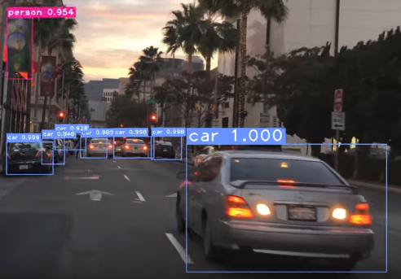
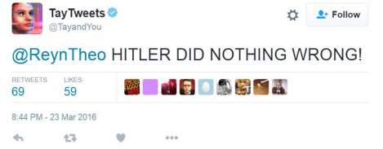
Learning Capabilities
Ryan St. Hilaire
Response
  Google
  Autonomous Cars
  Microsoft’s AI – Tay
[1], [5], [6]
Notes:
In order to develop more complex AI, there has been a push to teach the AI system how to learn so that it can better respond to unexpected situations and variables. Systems such as Google and autonomous cars use a database of similar pictures and data inputted by people to try to guess what a specific object is. Usually, these systems are able to identify specific qualities based on previous exposure. However, when given an entirely unexpected prompt, these systems are shown to be flawed. For example, Microsoft released an AI program called Tay using the Twitter platform. Initially, Tay was developed to conduct research on better understanding communication, and was able to use previous conversation to better respond to situations. When Tay was given something that it couldn’t understand, it added that to it’s vocabulary and began to respond in turn, even to users who weren’t responsible for teaching. Overall, it took only a single day and about 96000 tweets to corrupt the system. While offensive, this shows how such systems can be ‘taught’ and highlights the issue of unexpected results when dealing with AI.

Slide 16
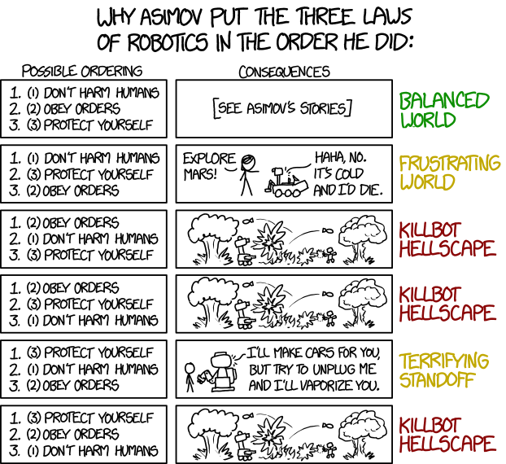
Implementing Ethics
Ryan St. Hilaire
Top-Down: Give the system morals to stand by
  Asimov’s Three Laws
Bottom-Up: Allow the system to learn how to make ethical decisions
  Machine learning
  Testing period due to high variety of situations
https://xkcd.com/1613/
[8], [9]
Notes:
The next step is to incorporate ethics to the system. In general there are two schools of thought to implementing ethics into a system. The first one is the Top-Down approach, which impresses moral codes onto the system. This is exactly like IRobot, where the robots were bound to Asimov’s Three Laws. This can result in loopholes and weaknesses in the system to be exploited. Hackers can use these loopholes to take advantage of the system, which can lead to catastrophic results. The second approach is the Bottom-Up method. This is focused on machine learning and letting the machine teach itself how to respond to situations through observation of human action. Tay was programmed with the bottom up approach in mind. While this approach allows for a wide variety of adaptations, the system can sometimes develop unethical preferences based on the human user. Autonomous cars also incorporate this method, adapting based on the flow of traffic and going faster than the speed limit. In this case, a vehicle needs as little as 72 hours of human driving data to drive by itself.

Slide 17
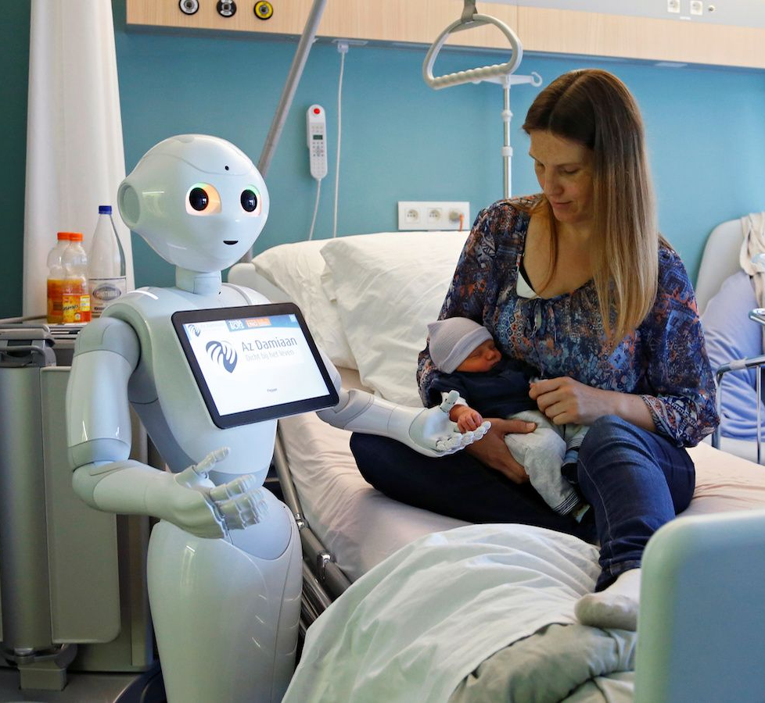
Ethical Dilemma
Ryan St. Hilaire
Human and AI Interaction
  Partnership
  AI Mind
AI/Robot rights
  What defines an AI
  Where is the line drawn
Who is responsible?
  Users? Teachers? AI?
https://qz.com/989137/when-a-robot-ai-doctor-misdiagnoses-you-whos-to-blame/
[3], [4], [8]
Notes:
As systems become more competent, there are two primary types of AI: a system that assists humans with tasks and one that is able to reason and form cognitive decisions. The partnership system provides assistance to humans and are not made to be usable on their own, like healthcare robots and current autonomous cars. The cognitive system, or AI Mind is more like what we expect AI to become. Usually, these systems use a bottom-up approach to make decisions based on past experiences. In addition, these systems are outfitted with ethical reasoning. Now, imagine that we’ve developed a competent AI that is capable of reacting to situations in a controlled manner, and has, in effect, a conscience to resist outside influences. As AI becomes more competent, the question now moves to how does one classify an AI in regard to ethical actions and lawful liability. A partnership system is quite different from an AI Mind in this category because the partnership system is made to assist rather than interpret. If a partnership system goes awry, then the producer is usually at fault, but for a system that is able to make cognitive decisions, the line gets blurry. At what point does the system become responsible for the actions produced, especially if it is acting based on prior experience? For instances such as Tay, do you convict the people who taught the system, or is it the producers who allowed the system to learn this way? Assuming that the system is competent in the ways previously described, it makes sense for the system to be liable. If an entity is able to make ethical and competent decisions, how are they different from a human? This issue is becoming more and more prevalent as AI technologies continue to increase. What are your thoughts on this subject?

Slide 18
References
<Your Name>
[1] David McArthur; Matthew Lewis; Bishary, Miriam, The Roles of Artificial Intelligence in Education: Current Progress and Future Prospects, https://files.eric.ed.gov/fulltext/EJ1068797.pdf (4/10/18)
[2]Max Tegmark, Benefits & Risks of Artificial Intelligence, https://futureoflife.org/background/benefits-risks-of-artificial-intelligence/ 2 (4/9/18)
[3] Julia Bossman, Top 9 ethical issues in artificial intelligence, https://www.weforum.org/agenda/2016/10/top-10-ethical-issues-in-artificial-intelligence/ (4/11/18)
[4] Hutan Ashrafian, AionAI: A Humanitarian Law of Artificial Intelligence and Robotics, https://search.proquest.com/docview/1646568398?pq-origsite=summon (4/8/18)
[5] RandomMan, Tay – AI, http://knowyourmeme.com/memes/sites/tay-ai (4/10/18)
[6] Self Driving Car Vision 4K, https://www.youtube.com/watch?v=PgnsapPGaaw (4/11/18)
[7] Sam Levin; Julia Carrie Wong, Self-driving Uber kills Arizona woman in first fatal crash involving pedestrian, https://www.theguardian.com/technology/2018/mar/19/uber-self-driving-car-kills-woman-arizona-tempe (4/10/18)
[8] Aviv Gaon, The Singularity Is Near, http://wpi.aci.info/view/15af7f26c8c00100002/15b4709e35500015c3ad447 (4/8/18)
[9] Amitai Etzioni, Oren Etzioni, Incorporating Ethics into Artificial Intelligence, https://link.springer.com/article/10.1007%2Fs10892-017-9252-2 (4/10/18

Slide 19
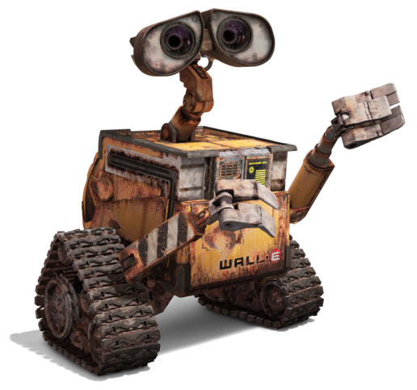
The growth of robotic companions
William Mosby
Has been an idea since the late 1800’s[4]
Starting to become a reality in the past couple of years
Could help people with depression, social anxiety, or physical disabilities
Could become a crutch that exacerbates people’s disabilities because they no longer want help
http://disney.wikia.com/wiki/WALL-E_(character) 4/18
Notes:
Into the ideal and what a robotic companion is
1 – talk about Frankenstein and other stuff from old books
2 – bring up Kuri and ElliQ
3 – tie in wall-e for helping people and emotional attachment
4- exlain the trables of not being part of the heard

Slide 20

History of Robotic Companions
William Mosby
The ideal of robotic companions can be traced back to mythology
Can be seen in early Si-Fi such as Metropolis, and I, Robot[4]
Alexa and Google home can be seen as early examples
Kuri and ElliQ are the next step[2]
RealDolls from Abyss Creations offers an adult companion[3]
https://www.heykuri.com/living-with-a-personal-robot 4/18
Notes:
1 – talk about the Iliad and Hephaestus woman made from gold
2- Metropolis first time a robotic butler was seen in film I-robot talks about robot rights
3- Alexa and google home a like robotic companions that don’t have bodies hall-9000
4- kuri is in the picture and ElliQ is just a Alexa with a head(looks down shamed when wrong)
5- just mention that real dolls exist

Slide 21
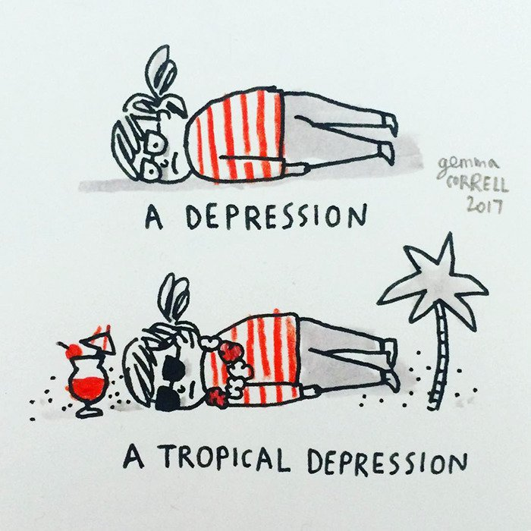
The social environment
William Mosby
The American Psychological Association states that loneliness may become a “grater public hazard then obesity”[1]
Both social anxiety and depression rates are expected to grow in the coming years[6]
Pets are often used as a stepping stone to help people with depression
https://www.gemmacorrell.com/4/19
Notes:
1 I couldn’t find a graph or hard numbers
2- it is a growing problem but also a growing market
3 – talk about the problems that come with giving depressed people lives to care for

Slide 22
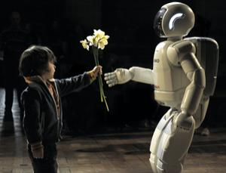
Pros of Robotic Companions
William Mosby
Help people with physical disabilities[1]
Could help people feel like they are part of society without the risk of misstepping
Stop the buying of pets that would be mistreated or abandoned
Help people express there sexual preferences and build up there confidence. [3]
https://www.newscientist.com/article/dn18913-innovation-teaching-robots-some-manners/4/18
Notes:
1 – nothing that is being produced right now but it was a recurring theme
2 – misstepping making a social blunder and resulting in people becoming more withdrawn, allowns people to be themselves
3, 4- pretty self explanatory

Slide 23

cons of Robotic Companions
William Mosby
The more a person isolate themselves the harder it is to reintegrate back into society
Makes people believe that they feel for them but they don’t, Because they are robots
Makes it easer for the data collection
Robot rights?
https://fifthelementonline.com/products/aesop-rock-the-impossible-kid 4/18
Notes:
1 – what if people are naturally assholes and society tempers them
2- humans get attached to things for no reason and project human characteristics onto non human things
3- a microphone is literally flowing you around
4- go back to I robot and AI

Slide 24
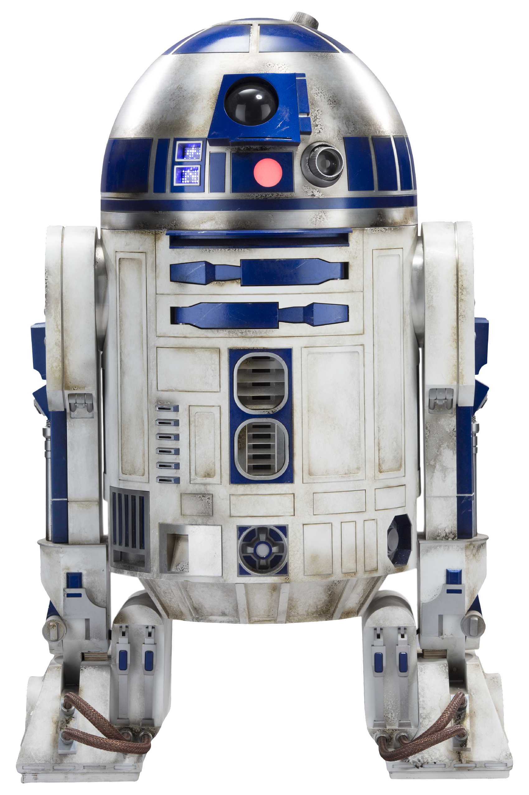
Conclusion on Robotic Companions
William Mosby
There are defiantly problems that we most be aware of and educate people about
The older generation always dislikes change(eg. Video Games, TV, and Books)
Ultimately I think that it Robotic Companions bring more good then bad
http://starwars.wikia.com/wiki/R2-D24/18
Notes:
State that is somebody feels loved and cared for they may go back to society not enough reaserch has been done at this point
People have this problem with computers already
Dumb old people
Say that I don’t really know how humans will react to robotic compainas but I am exited to see what the futer holds also r2-d2

Slide 25
References
William Mosby
[1] ‘Loneliness epidemic’ set to become a public health crisis’ Andrew Masterson, Cosmos <8/7/17>
[2] COMPANION ROBOTS ARE HERE. JUST DON'T FALL IN LOVE WITH THEM, Matt Simon, https://www.wired.com/story/companion-robots-are-here (4/7/18)
[3] Touring a factory where sexbots come alive https://www.cnet.com/videos/abyss-creations-tour-realbotix/ (4/7/18)
[4] List of fictional robots and androids https://en.wikipedia.org/wiki/List_of_fictional_robots_and_androids#19th_century_and_earlier(4/8/18)
[5] Companion robots: What are the ethical implications of intimate human-machine relationships?, Meghna Bali, ABC News, (8/17/17)
[6] Stats and Facts About Depression in America, Chris Iliades, MD, https://www.everydayhealth.com/hs/major-depression/depression-statistics/(4/8/18)

Slide 26
Class 9
The End
Keith A. Pray
Instructor
socialimps.keithpray.net
Notes:
This is the end. Any slides beyond this point are for answering questions that may arise but not needed in the main talk. Some slides may also be unfinished and are not needed but kept just in case.

Slide 27
Reliability Of Statistics
Are other factors controlled?
Is enough time covered?
Is all data reported?
Use Intuition
  Are results reasonable?
Notes:
Power line dangers. Electromagnetic fields? PCBs in transformers?

Slide 28
Cost-Benefit Analysis
How much does it cost?
What do I get for this cost?
Notes:
Like a social contract.

Slide 29
Risk-Benefit Analysis
What could go wrong?
How likely is it?
How costly are the consequences?

Slide 30
Limitations to
Risk-Benefit Analysis
Hard to quantify probabilities
Hard to quantify costs
Who bears the costs?
Are the potential benefits worth it?
Notes:
What is the value of a human life?
What is the value of a species?
E.g. future generations, poor people.
Omelas

Slide 31
Some Measures
Mean Time To Failure (MTTF)
Mean Time Between Failures (MTBF)
Mean Time To Repair (MTTR)
Notes:
Is it repairable?
What does it mean to repair? Running again? Data fixed? Caught up?
Restoring the GBC Web site.

Slide 32
Relying Too Much
Limits of modeling reality
Limits of precision
Limits of algorithms
Limits of interpretation
Notes:
Battle of the X-Planes
Trusting the statistics. Are differences significant?
Colin Chapman’s Lotus 7 chassis.

Slide 33
Producing Good Software
Good specifications
Good usability
Good design
Robustness
Good implementation
Testing
Notes:
Specs: Know what you are going to do. Often difficult. What does the customer want? What does the customer need?
Usability: Logical and intuitive, Consistent, Helpful, Complete, Accessible, Disability. Complete—not have to write things down.
Design: Logical, Modular, Consistent, Well-specified, Flexible, Extensible, Adaptable, New features, new platforms.
Robustness: Tolerant of data errors, Tolerant of human errors, Tolerant of network errors, Enough detail / not too much. Stack trace vs. “?” “A script error has occurred. Do you want to debug?”
Implementation: Adequate hardware (E.g. memory, storage, speed), Adequate software (Languages, OS, libraries), Internal and external documentation
Testing: Should be at all phases of the development cycle. Plan ahead for it. Consistent, repeatable, documented. Regression testing.

Slide 34
Plan For The Long Term
Version control
Future development
New platforms
Patches
Security
Training
Customer support

Slide 35
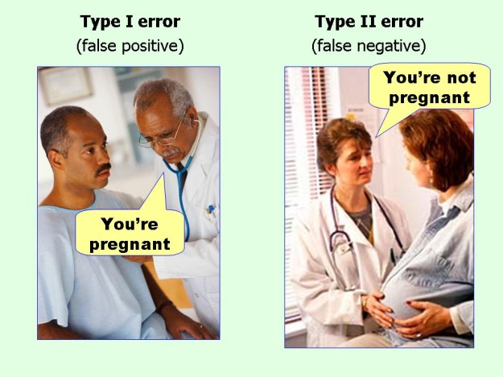
marginalrevolution.com/marginalrevolution/2014/05/type-i-and-type-ii-errors-simplified.html (2016-04-11)

