Slide 1
Class 8 Crime
Keith A. Pray
Instructor
socialimps.keithpray.net
Notes:
Here’s the title slide. Is anyone not excited?

Slide 2
Papers
Clearly state conclusion
First statement preferred
Quantify
Do not use terms like: less, more, a lot, huge, great, big, tiny, etc.
Include Counter Point and Response
Read paper aloud to proof
http://socialimps.keithpray.net/assignments/paper-guidelines/
Notes:
Save for next time:
Absolute statements are difficult to prove
Avoid: all, always, any, every, everyone, never, none… unless you can show it
Be sure to put quotes around entire quote
Hyperbole is the best thing ever!
but not in these papers
Print 2 sided and save a tree
Use template, saves time (and -1 point)

Slide 3
Survey Results
About 1/3 the class took survey
I am in FL 140 about an hour before and after each class
Estimated breakdown of course time per week:
4 hours class time
4 hours reading (2 chapters ~90 pages @ 2 minutes per page)
8 hours practicing mastery of material (papers, group project, class activity prep)
If you are spending much more than this let me know and we can figure out a more efficient way to spend your time
The next 2 papers have yes/no prompts
There is a discussion board for alternate paper ideas, please share your ideas

Slide 4
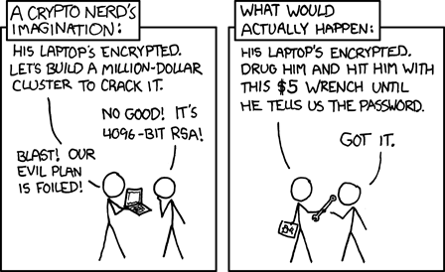
Overview
Review
Assignment
Students Present
http://xkcd.com/538/ (2010-11-14)
Notes:
Are there any questions on the assigned reading?
Use the slides ahead to explain any of the attack methods from the text.
If there are no questions you can skip those slides.

Slide 5
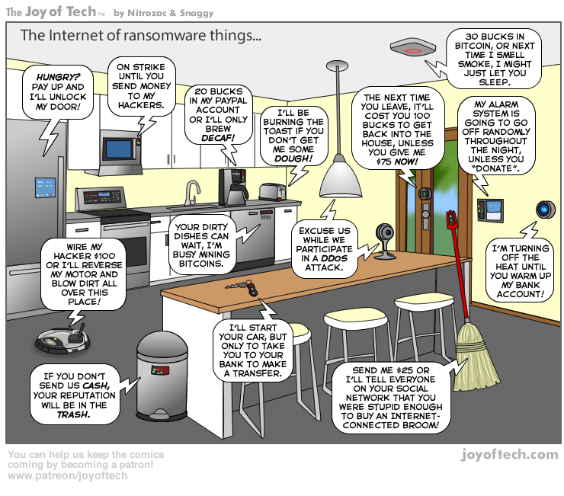
https://cointelegraph.com/storage/uploads/view/5e8f6e0d3a029807dfe181dc3d160cf0.png

Slide 6
My Reading Notes
pp. 323 Might be interesting to compare password guidance over the years.
pp. 325 plenty not sent with HTTP
pp. 328 Getting on TV much more difficult than releasing software
pp. 330 Virus could be new
pp. 332 Goals include infect 3 machine per LAN and as many computers as possible? Never make last minute changes before release. Were they related to the defects?
pp. 333 Testing w/out DEBUG often neglected
pp. 335 Do people use the Internet as an experimental laboratory these days? Shutdown right after booting, “benign” doesn’t seem like the right word.
pp. 337 “send reports back to a host computer”?
pp. 338 Firewalls often not running on same machine as malware, routers?
pp. 339 Have 2003 fears of cyber terrorist attacks been realized?
pp. 347 How is online voting a moral issue?
End of Chapter questions: 14. 25. 29.
Notes:
If there is time:
Why Electronic Voting is a BAD Idea - Computerphile
https://www.youtube.com/watch?v=w3_0x6oaDmI

Slide 7
Group Quiz
A denial of service attack shuts down a bunch of retailer, stock brokerage, large corporate entertainment and information web sites. Possible guilty parties:
Terrorist who aimed to cause billions of damage to U.S. economy.
Protest organization opposing commercialization of the web and corporate manipulation of consumers.
Script kiddie (a minor) just having fun with tools he found on the web.
Show off hacker in search of bragging rights.
State what penalties are appropriate for each.
Explain your answer to 1. using a single Ethical Theory for all.
Name the laws/acts under which these parties could be prosecuted.
Notes:
Works well as small group exercise.
Note: short answer format expected.
Note: 2. only one argument needed, should include logic for all parties
Note: 3. same law(s) should be applicable to all parties

Slide 8
Assignment Code Testing 1 Page Paper 1/2
Given code you did not write yourself, you need to test and potentially break it
Find as many bugs possible
There are major and minor bugs to find
Once testing is done write paper arguing your testing was adequate
Things that might be useful in your argument:
Explanations of defects
How to fix them
Consequences of leaving defects in production code
Use weaknesses in your testing methods as a counter argument
Working example: http://socialimps.keithpray.net/assignments/index.jsp?content=Code_Test.jsp
Notes:
The online working example source code is best not viewed with IE though looking at the source for the page will reveal the implementation. (trying native Java app)
If guest presenter coming next class remind students to prepare questions for him.
Remember to work on groups projects.
Each group should have material on their sites for the topics we’ve covered so far.
OLD Prompt:
Design tests for the code on the following slide.
Contains at least one major defect and several minor ones.
Write a paper (1 page not counting any source code) including :
Did you choose a good test strategy? (This is your conclusion.)
The inputs and expected outputs
What defects you found
How you would fix the defects (you may include fixed source)
Why would that fix the problems?
What could happen if the defects are not found before the code is put into production?

Slide 9
Assignment Code Testing 2/2
import java.text.NumberFormat;
public class SalesFun {
public static double calculateSalesTotal ( double amount, double discountRate, double taxRate ) {
double discount = amount * discountRate;
double total = amount - discount;
double tax = total * taxRate;
double taxedTotal = tax + total;
NumberFormat numberFormat = NumberFormat.getCurrencyInstance();
System.out.println ( "Subtotal : " + numberFormat.format ( amount ) );
System.out.println ( "Discount : " + numberFormat.format ( discount ) );
System.out.println ( "Total : " + numberFormat.format ( total ) );
System.out.println ( "Tax : " + numberFormat.format ( tax ) );
System.out.println ( "Tax+Total: " + numberFormat.format ( taxedTotal ) );
return taxedTotal;
}
}
} Lines of interest
Notes:
Bold lines are real focus.
Example input:
amount = 100.05;
discountRate = 0.10;
taxRate = 0.05;
OR
0.70, 0.0, 0.05
95.67, 0.20, 0.7

Slide 10
Overview
Survey
Review
Assignment
Students Present

Slide 11
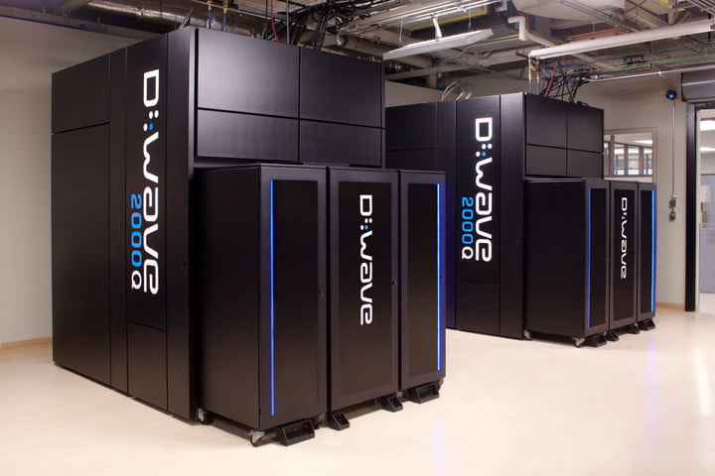
QUANTUM CYBER THREAT
Apiwat Ditthapron
How Quantum Computing can threaten current Cryptography System?
What is Quantum Computing?
Quantum superposition[1]
Quantum Entanglement[1]
Qubit represents memory
300 qubits ~ number of possible states of atoms in the universe
D-wave: quantum annealing machine ($15 million)
Image: dwavesys.com
Notes:
In this presentation, I will point out how Quantum can threaten Cryptography System?
But, let me tell you basic of quantum computing concept. Quantum machine uses quantum-mechanical phenomena, such as superposition and entanglement in computation.
In Classical machine, bit is a sequence of zero or one
Superposition makes Quantum sequence can be basis states on zero or one or can be any point on the surface of a 3D sphere between basis states.<>
Each qubit is linked to each other, so that they can influence other qubits, which called Entanglement
- Not only can each qubit be in such a superposition state, but the system as a whole can be in
a superposition of every combination of different states of all the qubits, which makes quantum computing powerful.
-Number of qubits does not represent the speed like CPU frequency, but represents memory.
300 qubits quantum would have the same number of possible states of atoms in the universe.
Speed of Quantum is determined by control and measurement of ion
At first, Quantum Computing is used only to approximate global optimum of functions to solve mathematic annealing problem.

Slide 12
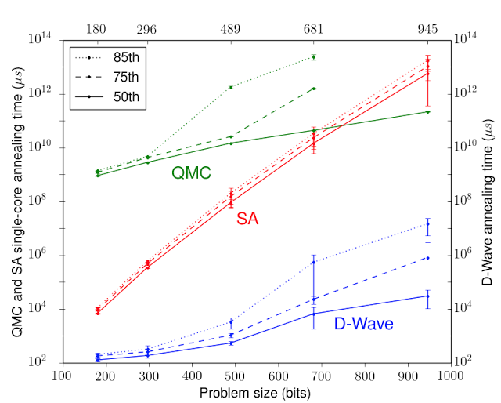
QUANTUM MACHINE
Apiwat Ditthapron
D-wave Machine
1,152 qubits quantum
Only for annealing problem
Image: [5]
Notes:
D-wave Machine was built as commercial quantum computing to solve annealing problem.
Benchmark diagram on the left was done by NASA and google in 2015, The Green line is Quantum Monte Carlo (QMC) simulator and Red line is Simulated Annealing , both are implemented on classical machine
Blue line is D-wave machine, which is 10^8 times faster than two optimized implementation on classical computer

Slide 13
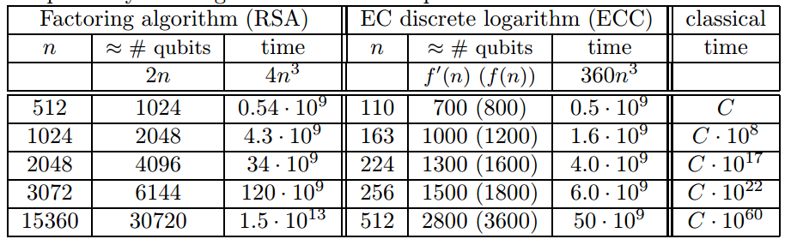
VULNERABLE CRYPTOGRAPHY SYSTEM
Apiwat Ditthapron
In 2017, “Prime factorization using quantum annealing and computational algebraic geometry” paper was published.[7]
RSA[5]
Ex. Public key :1934557 (1373x 1409)
Ex. Private key: 1373 and 1409
Image: [5]
Notes:
In 2017, “Prime factorization using quantum annealing and computational algebraic geometry” paper was published.
Which means, now, Prime number can be factored by commercial quantum machine.
RSA is one of cryptographic algorithms that uses prime numbers as private key to decrypted the message, and use multiply of those two prime number as public key to encrypt the message.
The tables on the right show that what quantum resource require to factor RSA public key, and The time growth of Quantum is linear, while exponentially on Classical machine

Slide 14
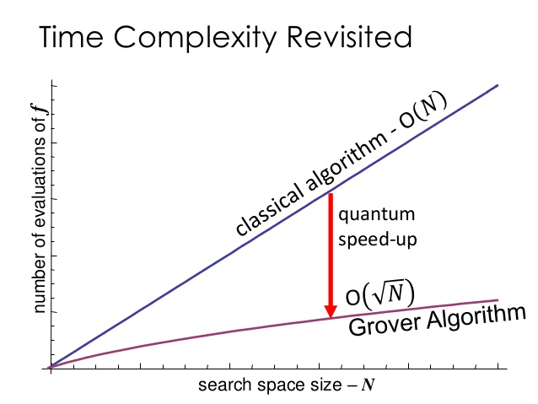
VULNERABLE CRYPTOGRAPHY SYSTEM
Apiwat Ditthapron
Grover Algorithm[2]
Searching unsorted data in O(sqrt(n))
Brute-force on symmetric cryptographic key
128- bit in 2^64 iterations
256-bit in 2^128 iterations
AES
Symmetric-key cryptographic system
Image : [2]
Notes:
Grover's algorithm can speed up searching of domain n in square root N
It can brute-force a 128-bit symmetric cryptographic key in roughly 2^64 iterations, or a 256-bit key in roughly 2^128 iterations.
AES is symmetric-key algorithm which uses the same key for encryption and decryption
With current quantum machine, only 128-bit key is vulnerable.

Slide 15
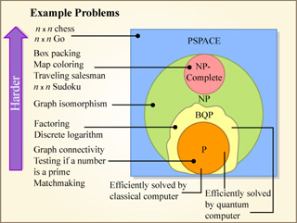
VULNERABLE CRYPTOGRAPHY SYSTEM
Apiwat Ditthapron
Quantum computer is able to solve Factoring Discrete logarithm[3]
Factoring Discrete logarithm is used in some cryptography systems[4]
Digital Signature Algorithm
Diffie–Hellman key exchange
elliptic curves over finite fields
Image:[3]
Notes:
Quantum computer can solve Factoring Discrete logarithm problem, which is one of NP problem much faster than classical computer.
Many algorithms in public-key cryptography assumes that discrete logarithm problem over carefully chosen groups has no solution, which is not true in quantum computing.
There are three famous public-key cryptography that are affected.

Slide 16
QUANTUM CYBER THREAT
Apiwat Ditthapron
Vulnerable Cryptography System[6]
RSA
Elliptic Curve Digital Signature Algorithm (ECDSA)
Elliptic Curve Diffie-Hellman (ECDH)
Diffie-Hellman (DH)
AES-128
Safe
AES-256
hashing algorithms with large key size (SHA-384)
“we recommend not making a significant expenditure to do so at this point but instead to prepare for the upcoming quantum-resistant algorithm transition.”
Information Assurance Directorate(IAD) , NSA[6]
Notes:
IAD, NSA warns companies to prepare for quantum-resistant algorithm transition. And gave a list of Vulnerable Cryptography System.
From the research only AES-256 and SHA 384 are safe from quantum attack.

Slide 17
CONCLUSION
Apiwat Ditthapron
Quantum Computing has a potential to threat Cryptography System in the future.
Most of Quantum machines were built for specific tasks.
Notes:
Conclusion
Quantum Computing has a potential to threat Cryptography System in the future.
As of now, there is no report of quantum attacks. The reasons may be powerful Quantum machines are only built for specific tasks, solving Mathematics problem, Deep learning, and powerful quantum machine will cost at least 15 million dollars,
However, we should aware of using Vulnerable Cryptography System that can be targeted in the future.

Slide 18
REFERENCES
Apiwat Ditthapron
[1] Andrew Daley. (2012, December). Quantum Computing. Retrieved April 08, 2018, from http://qoqms.phys.strath.ac.uk/research_qc.html
[2] Daniel J. Bernstein (2010-03-03). "Grover vs. McEliece" .
[3] Scott Aaronson. 6.845 Quantum Complexity Theory. Fall 2010. Massachusetts Institute of Technology: MIT OpenCourseWare, https://ocw.mit.edu. License: Creative Commons BY-NC-SA.
[4] Shor, Peter (1997). "Polynomial-Time Algorithms for Prime Factorization and Discrete Logarithms on a Quantum Computer". SIAM Journal on Computing. 26 (5): 1484–1509. arXiv:quant-ph/9508027
[5] Denchev, V. S., Boixo, S., Isakov, S. V., Ding, N., Babbush, R., Smelyanskiy, V., ... & Neven, H. (2016). What is the computational value of finite-range tunneling?. Physical Review X, 6(3), 031015.
[6] Information Assurance Directorate at NSA. (2015, August 19). Commercial National Security Algorithm Suite. Retrieved April 08, 2018, from https://www.iad.gov/iad/programs/iad-initiatives/cnsa-suite.cfm
[7] P., J., & C. (2004, January 22). Shor's discrete logarithm quantum algorithm for elliptic curves. Retrieved April 08, 2018, from https://arxiv.org/abs/quant-ph/0301141
[8] Dridi, R., & Alghassi, H. (2017). Prime factorization using quantum annealing and computational algebraic geometry. Scientific Reports, 7, 43048.

Slide 19
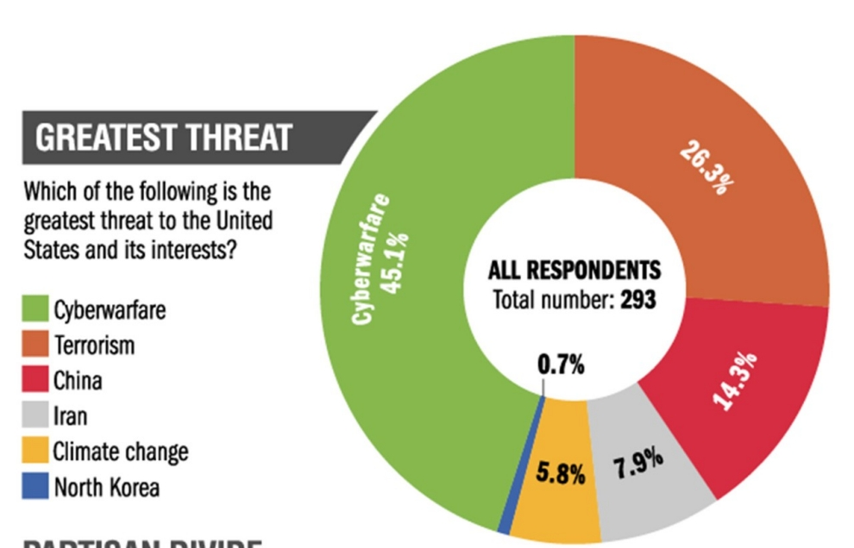
Cyber Warfare: a current threat witH consequences
Mario Zyla
Russians have recently been charged with interfering in the US 2016 election [1]
Phishing email [2]
Defense leaders place cyber warfare at the top of current US threats
[4]
Notes:
I am going to talk about Cyber Warfare. My main point is the fact that cyber warfare is a huge threat and much like any other type of war it has potential implications.
You may have heard talks about cyber attacks, countries fighting the systems of each other in search of information or just to cause disorder.
Our book mentions a few of these cases, and they are all almost 10 years old, but we could see the kind of disruption they could cause.
Unfortunately, cyber warfare keeps posing a greater risk to our days, as countries are doing a lot to be safe.
A very recent case is that of the 2016 Russian tempering with the US elections. Just last months, a number of Russians were found guilty on this matter.
It was as simple as Hillary Clinton’s Chairmain of the Presidential Campaign clicking on a Russian phishing email.
This is how they were able to retrieve around 60,000 emails.
Because of similar events in the past, according to defense, military and national security leaders believe cyber warfare to be the greatest threat facing the United States – outstripping even terrorism. This was back in 2012, but again, keeping in mind what has happened, I can only see that number growing.

Slide 20
Cyber attacks can cause damage
Mario Zyla
Atlanta experienced a ransomware attack, March 22
In a letter hackers demanded $51,000 [3]
Responsible?
The WannaCry ransomware attack was a May 2017 worldwide cyber attack
around 200,000 computers were infected across 150 countries
Hospitals affected: computers, MRI scanners, blood-storage refrigerators
North Korea found responsible [5]
Notes:
Is this something we have to worry about, not as computer scientists, but as citizens.
In a more recent event, the City of Atlanta experienced a ransomware cyberattack that affected multiple applications and client devices.
They haven’t released too much info yet, as they are still trying to figure out what happened, but the City of Atlanta received a letter where hackers demanded $51,000 in order to restore functionality.
But Atlanta’s government officials were not allowed to use computers for around 4 days. They went back to papers and pens.
This event also brought up some really good questions, that I will mention in the end.
If 4 days of paper forms is not too much of an inconvenience, I have more:
The WannaCry ransomware attack in May 2017 was a worldwide attack.
It affected around 200,000 devices, especially in Europe.
Some car manufacturers stopped production because their systems were compromised.
National Health Service hospitals in England and Scotland, and up to 70,000 devices – including computers, MRI scanners, blood-storage refrigerators
On December 18, 2017, the United States Government formally announced that it publicly considers North Korea to be the main culprit behind the WannaCry attack

Slide 21
Mario Zyla
Countries putting a lot of effort
Most of the attacks towards each other
[6]
Notes:
These are the top 5 countries where most of the cyber attacks originate.
Towards each other, most importantly.
United States is second, responsible for around 17% of all the cyber attacks initiated.

Slide 22
Why are they going to keep investing?
Mario Zyla
Anticipate or manipulate future or current events, to sway public perception
Elections
Intelligence Gathering
June 2015, Office of Personnel Management (OPM) announced that it had been the target of a data breach, targeting the records of four million people. (China??) [7]
Destructive attacks
Stuxnet: sabotage Iran's nuclear program [8]
Notes:
Why is this happening? What do those top 5 players I mentioned gain from cyber warfare?
By reading a lot of articles on this, these are the 3 main reasons I thought were the most common.
Although countries have tried to get it further than that, the main impacts have been on public perceptions or manipulating future events.
Intelligence gathering
OPM among the largest breaches of government data in the history of the United States
President Trump publicly acknowledged that China was behind this, but I couldn’t find any official investigation
And the most worrying of all these are probably attacks that are destructive in nature.
US is actually believed to be behind the Stuxnet attack.

Slide 23
What’s in the future?
Mario Zyla
Artificial Intelligence
Centralized Databases
More destructive (better methods)
Hard Choice for Cities Under Cyberattack: Whether to Pay Ransom [9]
NATO added cyberspace as the fifth domain, after land, sea, air and space. Implications on countries trying to join NATO, with no superpowers in cyber security?
Other implications?
Notes:
Opening it up to some focused discussion

Slide 24
References (accessed April 9, 2018)
Mario Zyla
[1] Russia-Trump inquiry: Russians charged over US 2016 election tampering, http://www.bbc.com/news/world-us-canada-43092085
[2] Top Democrat's emails hacked by Russia after aide made typo, investigation finds, https://www.theguardian.com/us-news/2016/dec/14/dnc-hillary-clinton-emails-hacked-russia-aide-typo-investigation-finds
[3] Six days after a ransomware cyberattack, Atlanta officials are filling out forms by hand, https://www.cnn.com/2018/03/27/us/atlanta-ransomware-computers/index.html
[4] Cyberwarfare greater threat to US than terrorism, say security experts, http://america.aljazeera.com/articles/2014/1/7/defense-leaders-saycyberwarfaregreatestthreattous.html
[5] WannaCry ransomware attack, https://en.wikipedia.org/wiki/WannaCry_ransomware_attack
[6] Top 5 Countries Where Cyber Attacks Originate, https://securitytoday.com/Articles/2017/03/03/Top-5-Countries-Where-Cyber-Attacks-Originate.aspx?Page=2
[7] U.S. Suspects Hackers in China Breached About 4 Million People’s Records, Officials Say, https://www.wsj.com/articles/u-s-suspects-hackers-in-china-behind-government-data-breach-sources-say-1433451888
[8] List of Cyberattacks, https://en.wikipedia.org/wiki/List_of_cyberattacks
[9] Hard Choice for Cities Under Cyberattack: Whether to Pay Ransom, https://www.nytimes.com/2018/03/29/us/atlanta-cyberattack-ransom.html?rref=collection%2Ftimestopic%2FCyberwarfare

Slide 25

Backlash of a Data Breach on Businesses
Myles Spencer
Direct financial costs
Loss of consumer confidence [9]
Loss of investor confidence
[2]
Notes:
Start out with a remark about looking at Data Breaches from a business point of view instead of an individual standpoint
Answering the question, “what is the worst type of backlash of a data breach?”
The different types of backlash for businesses
Direct financial costs
Loss of consumer confidence
Loss of investor confidence
The combination of these can really hurt a business, including putting them out of business
Mossack Fonseca, a law firm, had documents leaked and end up closing up because of “irreparable damage to its reputation”

Slide 26

Direct Financial Costs
Myles Spencer
Legal fees
Technology and security upgrades
Restitution to consumers [8]
Additional labor cost
[4]
Notes:
There are many direct cost associated with data breaches
Legal fees
Technology and security upgrades
Restitution to consumers
Additional labor cost
Estimated to cost Equifax 439 million dollars in 2017
May end up being upwards of 600 million dollars when it’s all said and done

Slide 27
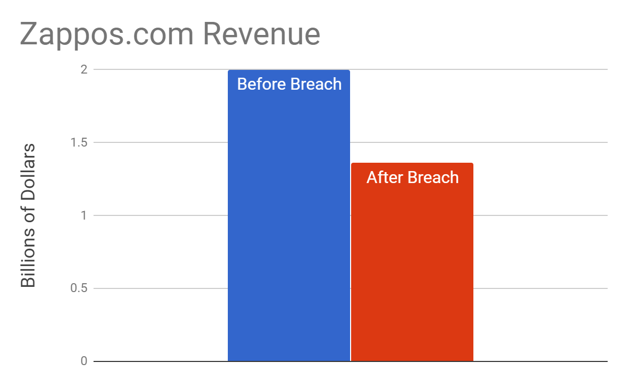
Loss of Consumer Confidence
Myles Spencer
People often become scared of doing business with the company [7]
Decreases revenue right when businesses need it to cover the direct costs
[5]
Notes:
After a data breach people are often scared to do business with the company
One study found that consumer spending decreased 32% for the seven months after the announcement of a data breach
For a company like Zappos that could be up to 600 million dollars of lost revenue

Slide 28

Loss of Investor Confidence
Myles Spencer
A company’s stock drops 5% on average [1]
For Target that is about $2 billion
Can affect current and future business deals [6]
[3]
Notes:
This is often closely tied to consumer confidence
A company’s stock drops 5% on average falling the announcement of a data breach
For a company of Target’s size that is just shy of 2 billion dollars
Breaches can also affect current and future business deals
Yahoo announced two data breaches while they were negotiating an acquisition by Verizon, and it cost them 350 million dollars

Slide 29
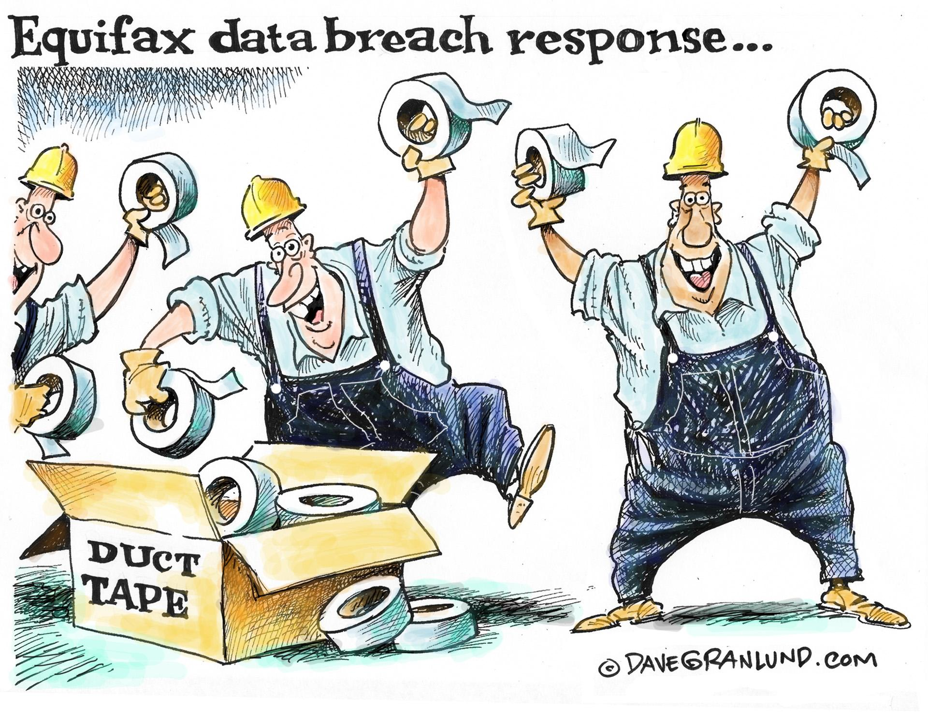
Loss of Consumer Confidence Hurts The Most
Myles Spencer
Direct financial costs and loss of investor confidence have larger immediate impacts
Loss of consumer confidence is a bigger long term problem
60% of businesses go out of business [11]
Backlash can be minimized with a plan [11]
[15]
Notes:
Direct financial costs and loss of investor confidence have larger immediate impacts
The loss of consumer confidence is what hurts the business the most in the long term
60% of businesses that have a data breach go out of business within 6 months
It’s been found that the biggest differentiator of businesses that recover well and those that don’t is whether they have a good response plan in place and execute on it
It builds consumer confidence (or at least decrease the loss of confidence)
Letting customers know that it happened in a timely manner
Equifax waited over a month
Mentioning how they are preventing future data breaches
And telling people what they should do to protect themselves if their data was compromised

Slide 30
REFERENCES
Myles Spencer
[1] “THE IMPACT OF DATA BREACHES ON REPUTATION & SHARE VALUE”, Ponemon Institute, 4/8/2018, https://www.centrify.com/media/4772757/ponemon_data_breach_impact_study_uk.pdf
[2] http://images.huffingtonpost.com/2015-12-02-1449080701-5081325-Mossackl.png (4/9/2018)
[3] https://bsmac.org/2016/10/11/verizon-yahoo-a-third-force-arises/ (4/9/2018)
[4] https://www.eff.org/files/equifax-4.png (4/9/2018)
[5] https://tettra.co/wp-content/logos/zappos.png (4/9/2018)
[6] “Verizon completes its $4.48 billion acquisition of Yahoo; Marissa Mayer leaves with $23 million”, Arjun Kharpal, 4/9/2018, https://www.cnbc.com/2017/06/13/verizon-completes-yahoo-acquisition-marissa-mayer-resigns.html.

Slide 31
REFERENCES
Myles Spencer
[7] “The Effect of a Data Breach Announcement on Customer Behavior: Evidence from a Multichannel Retailer”, Janakiraman, Ramkumar, Lim, Joon Ho, Rishika, Rishika, 4/9/2018.
[8] “Equifax breach could be most costly in corporate history”, John McCrank, Jim Finkle, 4/9/2018, https://www.reuters.com/article/us-equifax-cyber/equifax-breach-could-be-most-costly-in-corporate-history-idUSKCN1GE257.
[9] “Mossack Fonseca to close doors at end of month”, Richard L. Cassin, 4/9/2018, http://www.fcpablog.com/blog/2018/3/16/mossack-fonseca-to-close-doors-at-end-of-month.html.
[11] “60 Percent of Companies Fail in 6 Months Because of This (It's Not What You Think)”, Thomas Koulopoulos, 4/9/2018, https://www.inc.com/thomas-koulopoulos/the-biggest-risk-to-your-business-cant-be-eliminated-heres-how-you-can-survive-i.html.
[12] https://ycharts.com/companies/TGT/market_cap (4/9/2018)
[13] “What Is Happening At Zappos?”, Dan Pontefract , 4/9/2018, https://www.forbes.com/sites/danpontefract/2015/05/11/what-is-happening-at-zappos/#553854934ed8.
[14] “What Is Happening At Zappos?”, Dan Pontefract , 4/9/2018, https://www.forbes.com/sites/danpontefract/2015/05/11/what-is-happening-at-zappos/#553854934ed8.
[15] http://www.boonvilledailynews.com/storyimage/MO/20170915/OPINION/170919091/AR/0/AR-170919091.jpg (4/10/2018)

Slide 32
Class 8 The End
Keith A. Pray
Instructor
socialimps.keithpray.net
Notes:
This is the end. Any slides beyond this point are for answering questions that may arise but not needed in the main talk. Some slides may also be unfinished and are not needed but kept just in case.

Slide 33
Buffer Overrun
Run time stack
Local Variables
Return Address
Parameters
Variable Attack
buffer
Target Variable
Stack Attack
buffer
Return Address
code
Return Address
Notes:
Retire slide. Most students have this in depth from new class now.
When a function call is made, local variables, return address, parameters stored on run time stack. Local variables occupy lower memory addresses.
Variable attack – change variable value. Program expects user to input character and allocates a buffer for them. Attacker supplies too many characters and ends up over writing a variable.
Stack Attack – goal is to change value of return address so execution control goes to code which the attacker has provided in the input buffer.
Prevention – add checks against array bounds being exceeded, or modify operating system to not execute instructions stored on run time stack.

Slide 34
Run Example Code
Notes:
Retire demonstration. Most students have this in depth from new class now.
> imps
> assembly
> 123456789qwerty1

Slide 35
Buffer Overrun Code
#include <stdio.h>
#include <string.h>
int main ( void ) {
char buff [ 15 ]; int ace = 0;
printf ( "\n Enter best class ever : \n" );
gets ( buff );
if ( strcmp ( buff, "imps" ) ) {
printf ( "\n %s is wrong! You should FAIL! \n ace=%i\n", buff, ace ); }
else { printf ( "Correct! \n") ; ace = 1; }
if ( ace ) { printf ( "You get an A! \n" ); }
return 0; }
} The Naughty Line
Notes:
Retire slide. Most students have this in depth from new class now.

Slide 36
TCP Three-way Handshake
SYN
SYN-ACK
ACK
Notes:
Retire slide. Most students have this in depth from new class now.
SYNchronize
SYNchronize ACKnowledgement (socket reserved awaiting ACK)
ACKnowledgement
TCP socket connection established

Slide 37
SYN Flood Attack
SYN
SYN-ACK
Notes:
Retire slide. Most students have this in depth from new class now.
Attacker spoofs the IP address so the SYN-ACK is sent to a different machine that cannot respond to the SYN-ACK.
This leaves the connection half open on the server machine decreasing the resources (sockets, memory, threads/processes) available to respond to legitimate clients.
The attacker send many such spoofed SYN messages.

Slide 38
Ping Attack
Target
Attacker
ping
ping
Notes:
Retire slide. Most students have this in depth from new class now.
Attacker finds routers that support broadcasting messages to all computers on their local area networks.
The attacker sends a spoofed ping message, which the routers echo to the spoofed address.

Slide 39
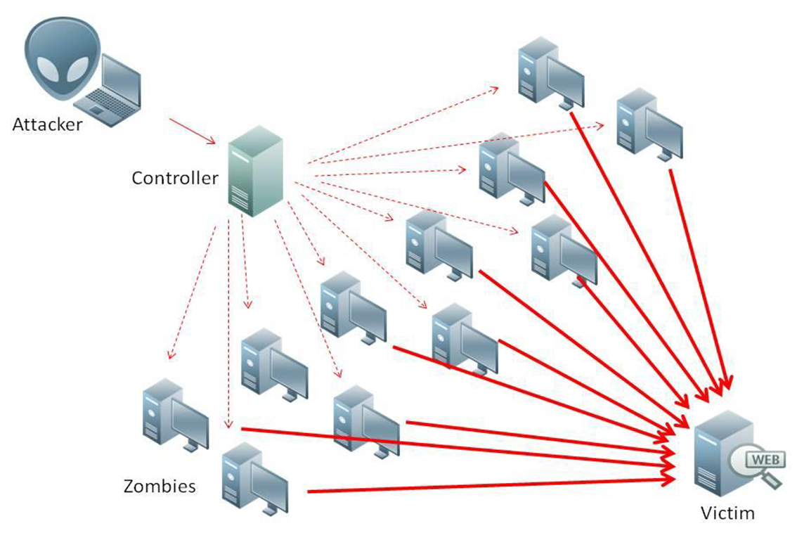
What is Denial of Service (DoS)
Attempts to make target unavailable by flooding with traffic
If victim has to filter attack, it’s too late
Internet Providers have no incentive to help
Businesses get affected, but would not pay provider enough to make worthwhile
This is why Cloudflare, e.g., exists
Many ways to perform this attack
Notes:
Contributed by Brett Ammeson.
https://www.cloudflare.com/ddos/reflection-attack-1.png
https://i.imgur.com/lxYv8cF.png

Slide 40
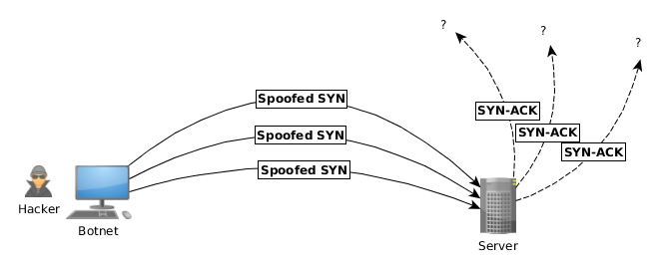
Distributed DoS Vectors
TCP SYN attack
SYN packets are small, low difficulty for attacker
Leaves half-open connections on server
SYN cookies mitigate this
DNS amplification attack
DNS requests are small
Can request all records on server
Crippled by proper configuration
Ingress/egress filtering will reduce effect
Notes:
Contributed by Brett Ammeson.
TCP SYN: https://www.cert.org/historical/advisories/CA-1996-21.cfm
DNS amplification: https://www.cert.org/historical/incident_notes/IN-2000-04.cfm
Ingress/egress: www.giac.org/paper/gsec/705/egress-filtering-keeping-internet-safe-systems/101588

Slide 41
Crime How
Technical and Non-Technical
Break into computer.
Prevent access to computer.
What things make computer related crime easy?
Notes:
Exploit security holes, Break encryption, Spoofing
Social Engineering: Guess passwords, Find out passwords and procedures
Poor passwords, Insecure protocols, Program limitations (buffer overruns), Eavesdropping (Email, Interactive), Insecure files

Slide 42
Crime Bane
Trojan Horse
Virus
Worm
Bot Network
Buffer Overrun
(Distributed) Denial Of Service Attack
How do they work?
How harmful are they?

Slide 43
Crime Why
Why?
Notes:
Money: stolen credit cards, change records, stolen property.
Political, military, economic.
Challenge, Revenge, Mean
Why do at all? Have motivation, think about it, think it will help, think it’s acceptable.
Feel forced. Don’t agree. Don’t care.

Slide 44
Crime Time
What is different now compared to:
10 years ago?
20 years ago?
30 years ago?
40 years ago?
Notes:
More computers. Unsophisticated owners. More complex software. Greater connectivity. Easy access to cracking tools. Incentives. File-sharing
In ’60s and ’70s, access was mostly localized.
Modems. Wardialing.
Some Arpanet and Usenet.

Slide 45
Crime Doers
Hacker or Cracker
Pre-1980 - Golden Age ☺ ?
Eighties
Nineties
Naughts
Criminal Hacking == Cracking?
Notes:
Script kiddies
Phreakers
Security analysts
Packet monkey

Slide 46
Crime Gain
Justifications for Computing Crimes?
What can be done after access is gained?
What resources are available?
How valuable are they?
Notes:
Machines are unused. No harm done. Education. Exposes security holes. Exposes abuses.
Use computer and/or resources. Take data. Destroy data. Alter data. Lock out others. Attack other computers.
Equipment, Processor Time, Disk space, Printer time / paper, Bandwidth

Slide 47
Crime Pay
Computer Fraud and Abuse Act (1986)
Bans :
unauthorized access or use of computers, copying, modifying, or destroying data, disclosing of passwords.
disrupting government and utilities.
Covers government, financial, medical, and interstate systems.
USA Patriot Act (2001)
Raised penalties.
Permits freer surveillance and monitoring to detect illegal activity.
Electronic Communications Privacy Act
Illegal to intercept telephone, email, other data transmissions, access stored email messages without authorization
Assign Cybercrime Treaty (2006), Wire Fraud Act, National Stolen Property Act, Identity Theft and Assumption Deterrence Act
Notes:
Are either of these laws still in effect? Have they been changed?
For additional legislation ask for presenting volunteers to brief recent incidents/cases.
Also ask for volunteers to find out laws from their home country/state.

Slide 48
Crime Stop
Technical
Protect Data
Protect Machine
Protect Access
Non-technical?
Social?
Legal?
Notes:
Encryption, Authentication, Biometrics, Anti-virus, File integrity checking (E.g. Tripwire), Virtual private networks, Point-to-point networking (Twisted-pair Ethernet vs. Coax vs. wireless)
Security through obscurity, physical access required, not on network, behind locked doors.
Remove desire, remove incentives
Legalize, increase penalties, increase chance of getting caught.

