Slide 1
Class 6
Information Privacy
Keith A. Pray
Instructor
socialimps.keithpray.net
Notes:
Here’s the title slide. Excited already, aren’t you?
How did the self search paper go?
Who: found a lot, very little, surprised, not surprised, creepy, share conclusions

Slide 2
Logistics
SA is unable to continue to support the course
Groups presentation volunteers for first day via email
Notes:
Not needed this time:
Address email to entire course staff for quickest response time
Send presentations via email as attachment.
Do not change the format, footers, etc. in the template slides.
Paper writing process: Sources → Notes → Conclusion → Argument → Counter Point → Response
Turn extra credit paper in on myWPI/Canvas and hard copy in class like regular papers
Presentations are due 24 hours before class
Use Presentation Guidelines on course web site

Slide 3
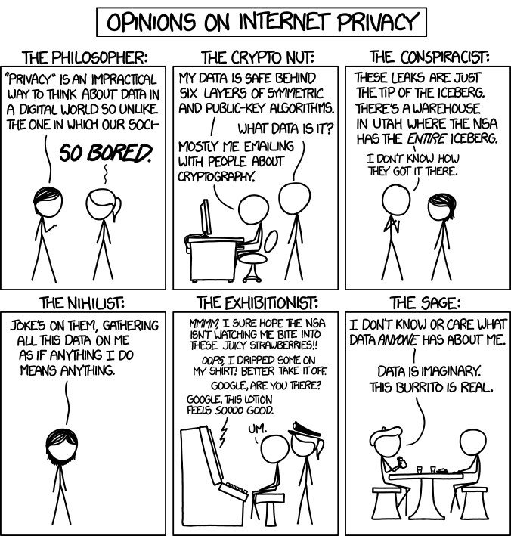
Overview
Review
Assignment
Students Present
http://xkcd.com/1269/
Notes:
1 – Accessed 2014-04-14
Personal Information Privacy

Slide 4
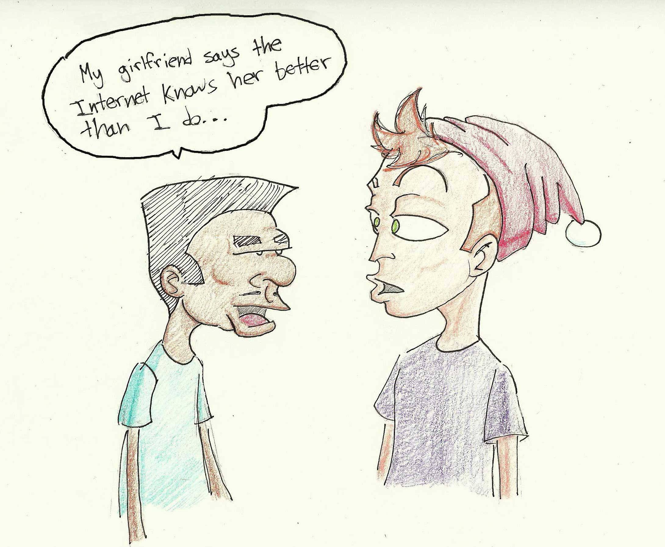
http://dailytrojan.com/2010/04/25/online-information-sharin>
ts-benefits
Notes:
Not generating much discussion, consider removing.
Seems class prefers it removed.

Slide 5
My Reading Notes
pp. 229 means to end?
pp. 230 who videotapes anymore?
pp. 231 “businesswoman” nice change. Moral capitol – source published in 1984, “taking away” “1984”
pp. 234 Hilton consent to pic being in book?
pp. 237 Most daycares monitor, any studies yet?
pp. 238 “…privacy…in their own homes…” != nanny to expect privacy “…when… insides Sullivans’ home.
pp. 244 Human chip implant sources getting old, 2002, 2004, 2007, 2010
pp. 250 2012 source same year Target outed pregnant teen to parents
pp. 255 Why did Apple not enforce policy of asking permission in the API?
pp. 245 “…by 2015” did it happen?
pp. 246 Web Browsers put cookies on on your hard drive, not Web Servers.
pp. 250 why is bills – responsibility assumption flawed?
pp. 268 Why WPI not in list?
Notes:
Find out what your DNA says about you and your family.
https://www.23andme.com/
Jimmy Kimmel Live – What is your password? (2:49)
https://www.youtube.com/watch?v=opRMrEfAIiI
Notes updated: 2018-04-03

Slide 6
Assignment
Prepare for class debate: Is a National ID System a good thing?
  Come prepared with notes, facts, dates, high quality sources
  You can build upon your self search work
  Optional One Page Paper on the topic, lowest paper grade will be dropped
Mid Term Survey on Canvas
Notes:
Consider removing this paper going forward. Perhaps just a prompt to prepare for debate will do.
Class decided in favor of debate prep only. We will see how many takers on optional paper.

Slide 7
Overview
Review
Assignment
Students Present

Slide 8
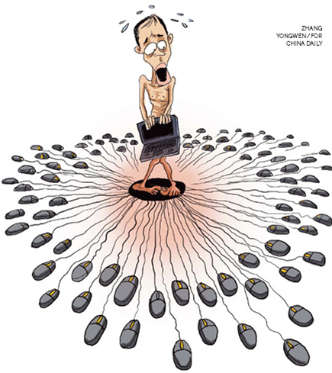
Human Flesh Search in China
Ming Xu
Definition: netizens identify and release information on a targeted person [1].
Doxing
<Graphic>
[1]
Notes:
- Overview of today’s speech: My topic today is human flesh search in china. For today’s presentation, first, I will define this term. Then I will show you some famous cases of human flesh search to help you understand why this phenomenon showed up in China and how this search engine works. At last, we will have a discussion on how it impacts our society.
Give a definition of human flesh search engine:A human flesh search is a phenomenon of distributed research, where many netizens use a Web forum or other resource to identify and release as much information on a targeted individual or group as possible. This term is originated from China, and it’s similar to the concept of doxing in the US, which is to search for and publish private information about a particular individual on the Internet.

Slide 9
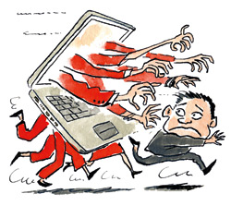
Searching methods and target
Ming Xu
Methods for individual searchers:
  Scouring social media sites, forums, existing search engines, …
  Contacting the people who know the target
Target: who may not receive an adequate punishment through the legal system [2].
<Graphic>
[2]
Notes:
Human flesh search is not organized in any official way. It’s more like many netizens spontaneously collaborate with each other. If anyone finds out any information about the target person, he/she will post the findings and update other searchers online. And then searchers will use the updated information for further search, and update their findings again, and repeat the process. Generally, there are two ways of conducting human flesh search by individual searchers: First, scouring social media sites, forums and any existing search engines in order to find out as much information about the target as possible. But searchers don’t stop there, they will also contact people who live near the target, work with the target or go to school with the target.
For now, in China, Human flesh searches are increasingly used in situations where the netizens feel that the target may not, for some reasons, receive an adequate punishment through the legal system. So, the intent here is not only to expose the person who has violated cultural norms or committed crimes, but also to encourage adequate punishment.

Slide 10
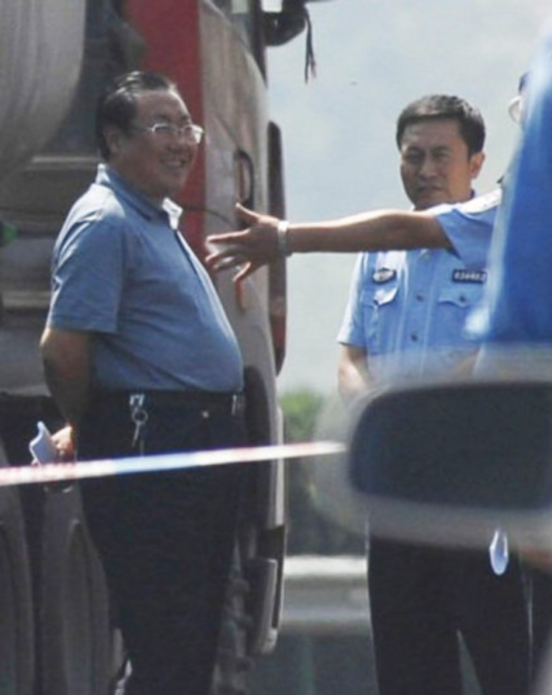

Case 1
Ming Xu
Smiling on the scene of an accident that killed 36 people
Human flesh searched
Being arrested for corruption [3]
<Graphic>
Yeah!
[3]
Notes:
Case1: A very famous case of human flesh searches in China is about a government officer, Yang. He was unfortunately caught in a photograph smiling on the scene of an accident that killed 36 people. This smile got him human flesh searched. Netizens quickly collected many photos of Yang from the past news. And people found that he had an extensive collection of luxury watches — that belied his salary. As you can see on the comics, he is wearing many luxury watches. This resulted in public outrage. Finally, he was arrested. In this case, we have to say that human flesh searches helped to detect corruption and thus encouraging punishment. Actually, during these years, Chinese government noticed that human flesh search did help to reduce such corruption, because under the pressure of potential human flesh search, government officers are becoming more self-discipline. but in other cases, human flesh search may ruin an innocent person’s life.

Slide 11
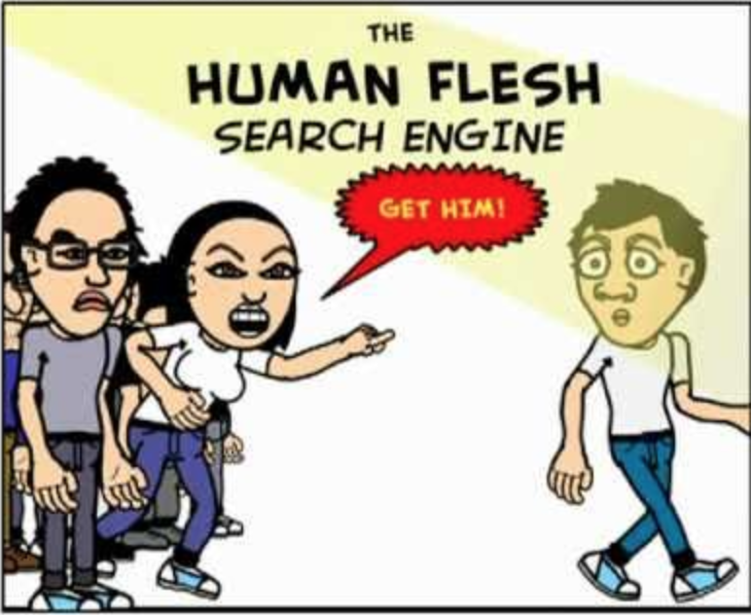
Case 2
Ming Xu
The video of “A Man is Touching a Girl on the Light Rail” was spread online
Human flesh searched
It’s a misunderstanding, but the man’s family was still assaulted [4]
<Graphic>
Notes:
Case2: Let’s take a look at an example of false human flesh search. In 2014, a video entitled “A man is touching a girl on the light rail” was widely spread on the Internet, and the man denied the harassment. One day later, many netizens posted his personal information such as the pictures of his wife, his telephone numbers, home addresses and so on. Under the blame and pressure, this man had to resign from his company. Even though the girl clarified that the video was a misunderstanding, the man’s family was still assaulted during the following days. Some strangers called the man’s family saying some insulting words, and finally, this man had to ask the police for protection.

Slide 12
Impact
Ming Xu
Good:
Push for an idea of justice
12 government officials were arrested for corruption in 2012
The public becomes empowered
Bad:
Public humiliation
Exposure of secrets
Losing jobs
Having social media, email and bank accounts hacked
Being blacklisted from future employment
Being socially excommunicated [5]
vs
Notes:
It seems that the digital world in China is ubiquitous. It’s everywhere. When you want to find out what’s going on in China, you don’t turn on the TV news, you turn into the social media networks and forums in China. It is through these mediums that news and information is shared across this country. Although these social media networks are highly censored by the government, human flesh search engines are often able to quickly distribute controversial content before the censors know what hit them. And as you can see in the previous case, human flesh searches might persecute innocent people. So, how do we ensure that every target must be guilty? Should we allow human flesh searches within the law? If yes, how to balance privacy and free search?
- On the one hand, human flesh searches have proven to be successful methods for the public to push for an idea of justice. According to a report in China, 12 government officials were arrested for corruption after being flesh searched — which is big in China where the public has virtually no say in politics. In a way, the public of China has become empowered against corrupt or dishonest officials.
- On the other hand, however, the spoils of human flesh searches often result in some type of retribution being taken out on the target, including public humiliation, the exposing of secrets...

Slide 13
Who is liable for HUMAN FLESH SEARCH?
Ming Xu
Internet users?
Internet intermediaries?
…
Don’t leave victims of the human flesh search vulnerable or helpless !!
Notes:
As it is in the second case, if the target is proved to be innocent, who should be liable for the human flesh search? A victim of the human flesh search generally has two options:
- Pursue legal remedy against those Internet users who are directly responsible for online persecution.
- Hold the Internet intermediaries liable
But anyway, we should not leave victims of the human flesh search vulnerable or helpless. Now in China, there is not a specific law for human flesh search, but according to the current law, posting other people’s personal information online is illegal. Obviously, that’s not enough. To draw a conclusion, it’s true that human flesh search encourages adequate punishment, but we should also think about its boundary. And not only the netizens, but also the Internet intermediaries should take responsibility of protecting individual’s privacy.

Slide 14
References
Ming Xu
[1] “Human flesh search engine,” Wikipedia, 18-Mar-2018. [Online]. Available: https://en.wikipedia.org/wiki/Human_flesh_search_engine. [Accessed: 29-Mar-2018].
[2] W. Shepard, “What is a Human Flesh Search?,” Vagabond Journey, 25-Nov-2012. [Online]. Available: https://www.vagabondjourney.com/what-is-a-human-flesh-search/. [Accessed: 29-Mar-2018].[3] <reference 3>
[3] J. Levine, “What Is a 'Human Flesh Search,' and How Is It Changing China?,” The Atlantic, 05-Oct-2012. [Online]. Available: https://www.theatlantic.com/international/archive/2012/10/what-is-a-human-flesh-search-and-how-is-it-changing-china/263258/. [Accessed: 30-Mar-2018].
[4] C. Hatton, “Chinas internet vigilantes and the human flesh search engine,” BBC News, 28-Jan-2014. [Online]. Available: http://www.bbc.com/news/magazine-25913472. [Accessed: 30-Mar-2018].
[5] W. Shen, “Online Privacy and Online Speech: The Problem of the Human Flesh Search Engine.,” pp. 12–268, 2016.…

Slide 15
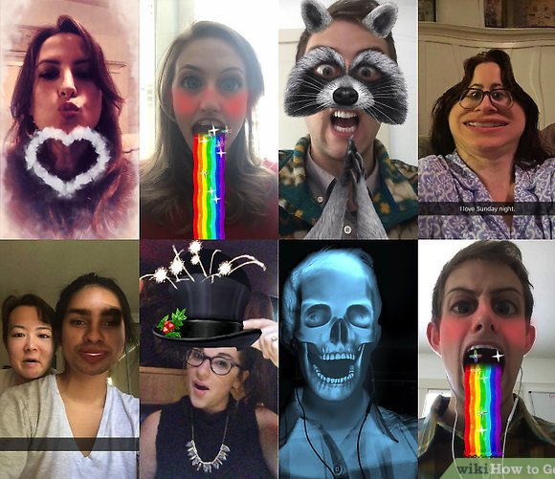
FACIAL RECOGNITION: it’s already everywhere
Synella Gonzales
[1]
Notes:
Hi, I’m Synella and today I am going to talk about the pros and cons of facial recognition, and its potential security uses/exploits.

Slide 16
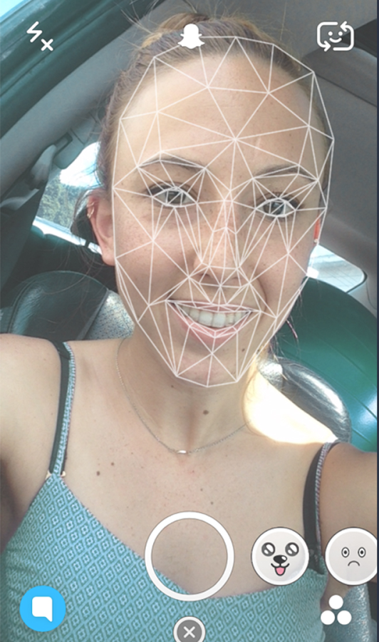
Snapchat lenses: fun and playful
Synella Gonzales
Snapchat Demographics:
150 million daily users
  45% aged between 18-24
  70% female
  30% millennials use Snapchat regularly
[7]
Notes:
How many people here use snapchat? Snapchat lenses are a fun and playful way to turn yourself into virtually anything.
I’m sure you all see the way snapchat does this - you tap on the screen, and a grid appears on your face.
This is your “face map”, and it’s what snapchat uses to map its own filters to your face.

Slide 17
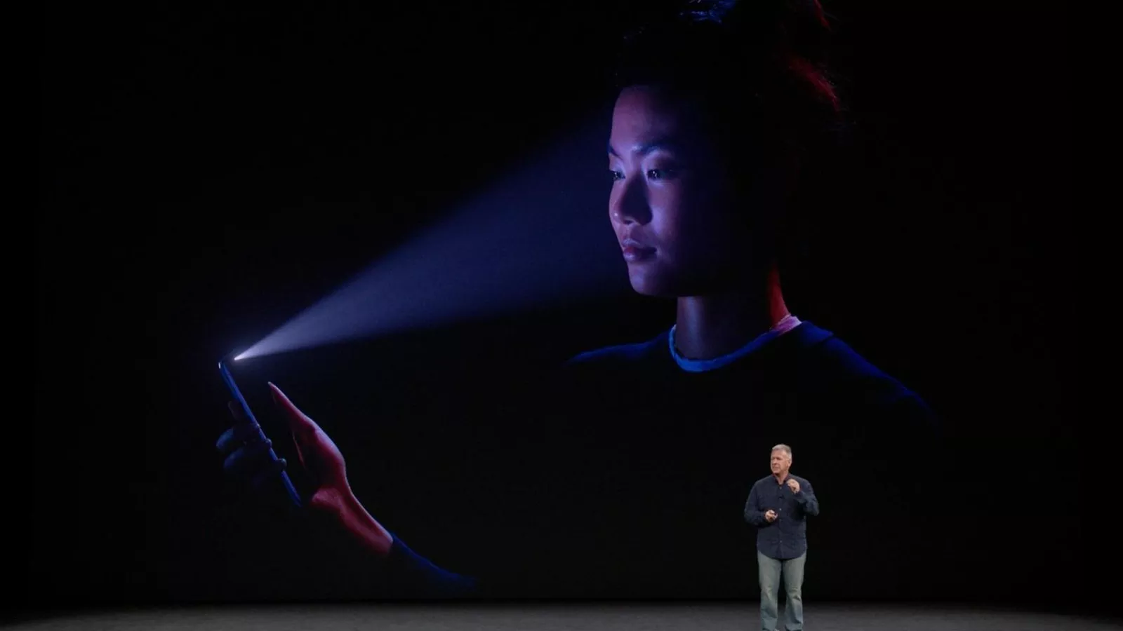
Face id: futuristic and innovative
Synella Gonzales
Face ID is enabled by the TrueDepth camera
Projects and analyzes more than 30,000 invisible dots to create a precise depth map of your face
Your facial map is encrypted and protected by the Secure Enclave.
Authentication happens instantly on the device, not in the cloud.
Face ID uses the A11 Bionic chip for the machine learning to recognize changes in your appearance
[2], [6]
Notes:
According to Apple, FaceID essentially analyzes your face and creates its own version of snapchat’s facemap - its far more accurate, and even analyzes features of your face under the surface, like bone structure. It even utilizes some sort of machine learning so as you live your life, your phone learns that you’ve grown a beard or decided to wear glasses instead of contacts.
As of January 23, 2018 apple hasn’t revealed how many iPhone Xs have been sold, but it is estimated that they sold 29 million units in the 4th quarter.

Slide 18
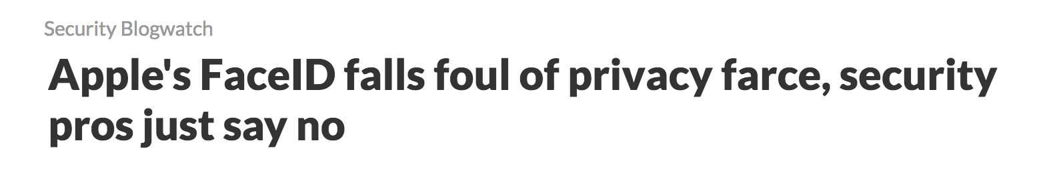
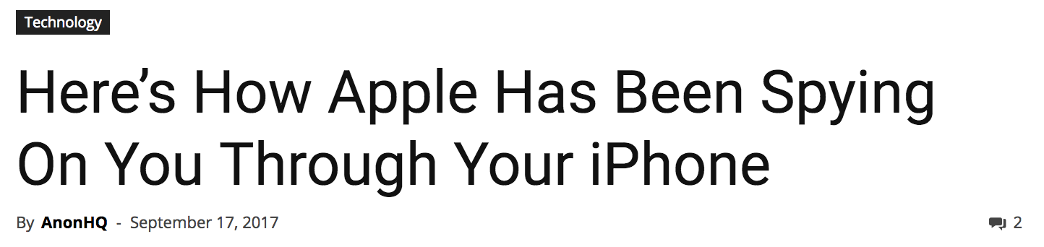
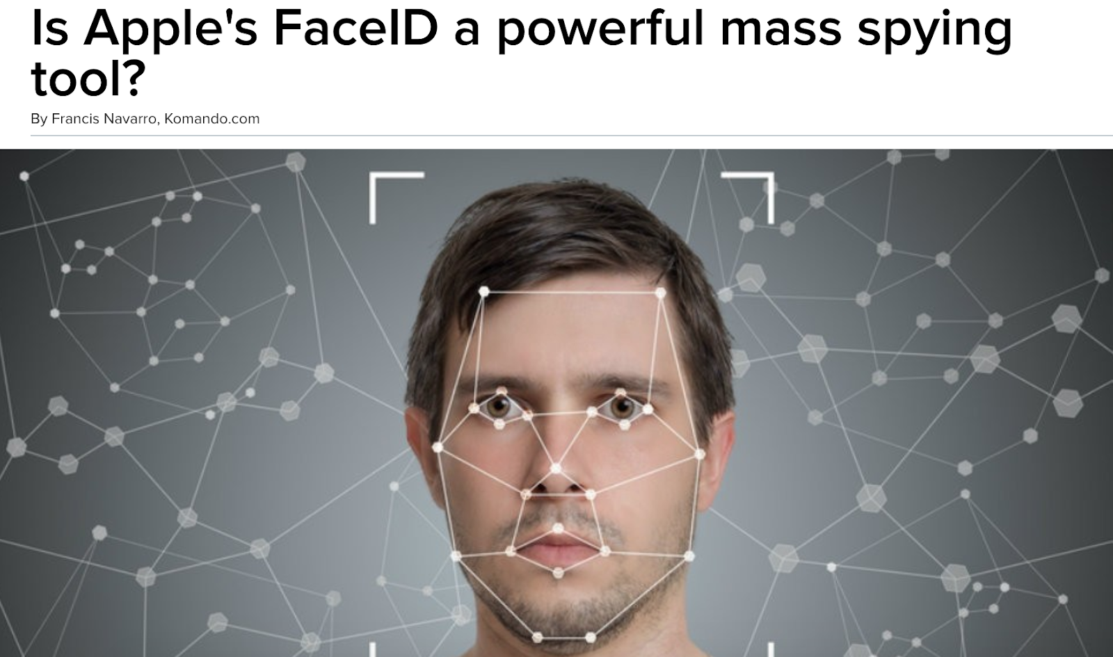
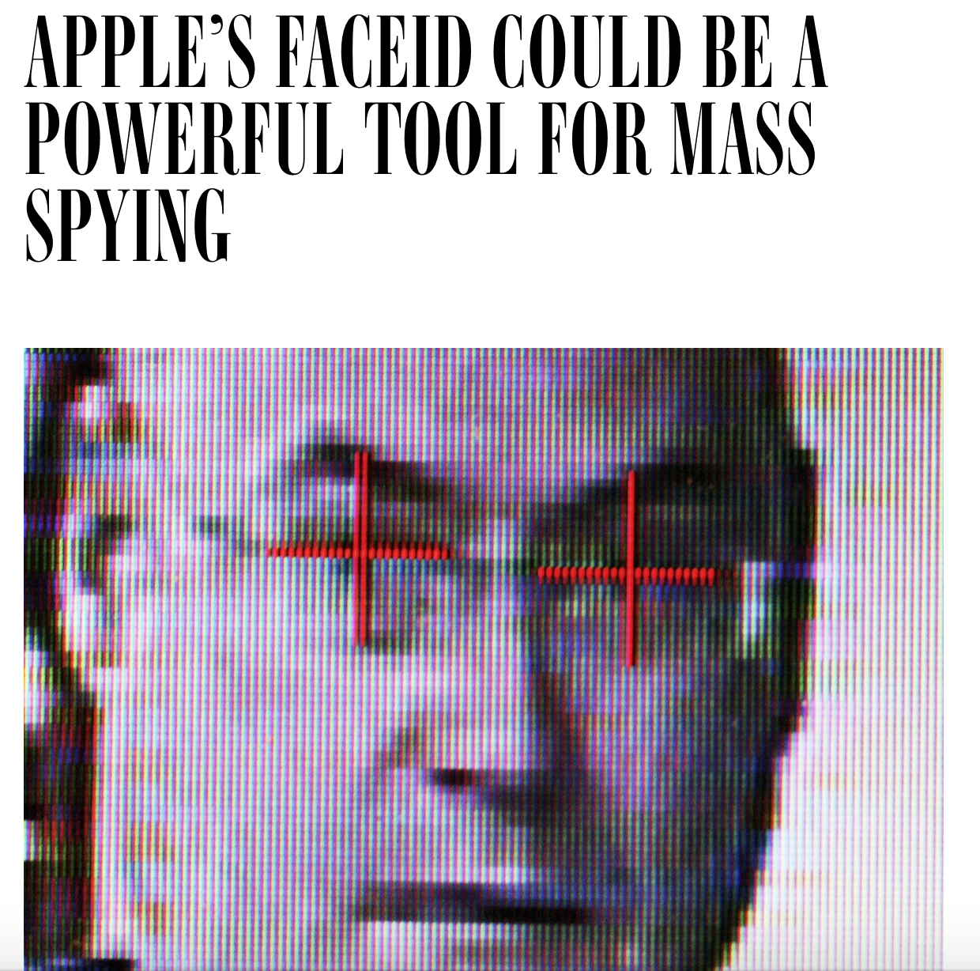
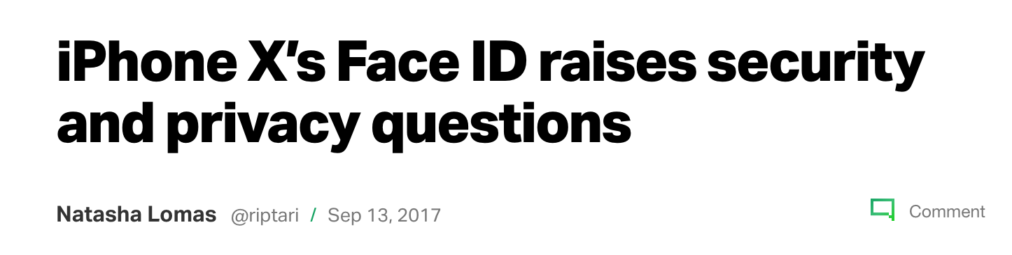
“Your friends might not recognize you, but iPhone X will.”
Synella Gonzales
[2]
Notes:
Headline talking points: people concerned about apple selling/giving the faceID data to government, twins or familiar people, well-made masks can fool faceID, people are fearing the “big brother is always watching” – how does it know you’re looking at the camera? Is it always on?
While facial recognition software is cool and fun, like snapchat, or convenient and futuristic, like iPhone X, we should also keep in mind other uses of this kind of software. The government can use your “facemaps”, and cross reference security cam footage to track individuals.
A lot of people are skeptical of this feature, but what they don’t know is that the government is already working towards utilizing this software for themselves.

Slide 19
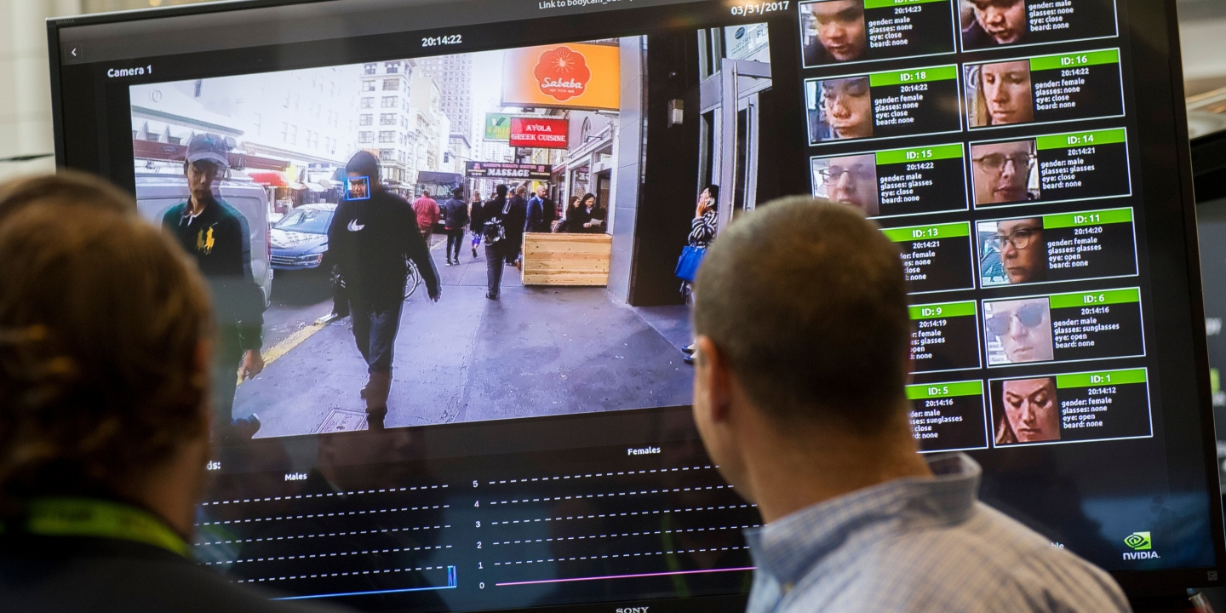
Law enforcement already integrating facial recognition software
Synella Gonzales
[3]
Notes:
In this picture, you can see a screen displaying a facial recognition system for law enforcement during the NVIDIA GPU Technology Conference. The government is actively scoping out and taking bids for companies to produce these softwares for them, for use at airports or border security.

Slide 20
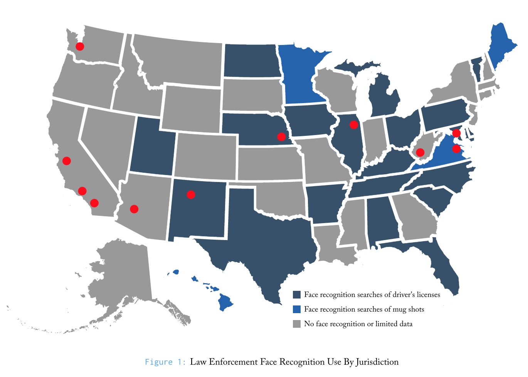
Law enforcement already integrating facial recognition software
Synella Gonzales
16 states let the FBI use face recognition technology.
One in two American adults can be found in one of these face recognition databases
At least one in four police departments have the capacity to run face recognition searches.
[4]
Notes:
This technology is already being used today, on a smaller scale. At the state level, 16 states have approved the use of this software to aid the FBI in investigations. Your driver’s license could be put in a line up, with an algorithm being the person behind the mirror.
But if facial recognition software helps investigators find the person or people that committed the crime, how can this software be bad?
Red dots indicate large cities, interactive map from the source displayed more information that would be redundant for this presentation

Slide 21
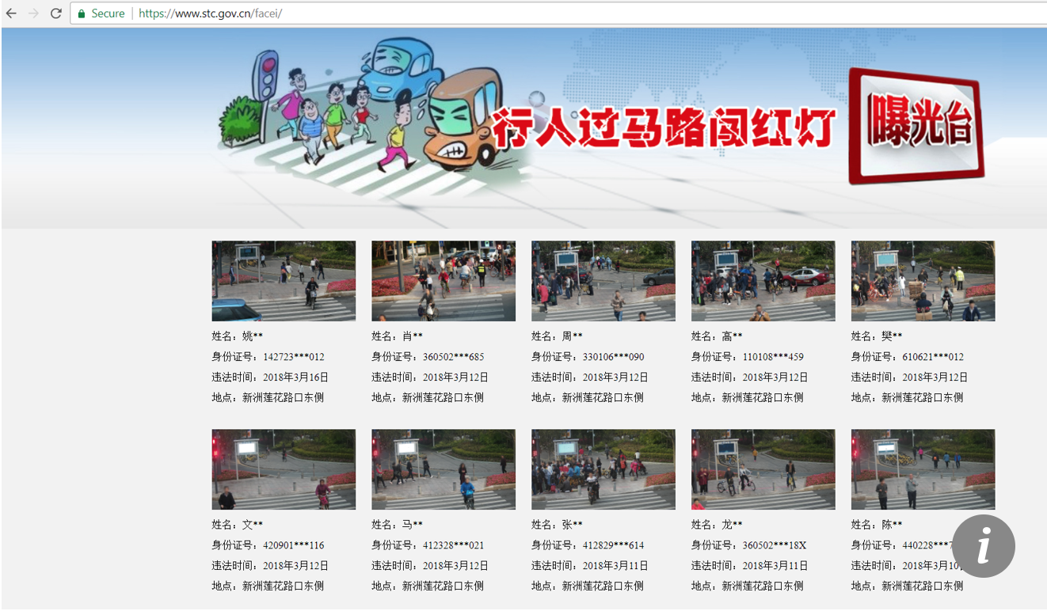
“Facial recognition technology can now text jaywalkers a fine”
Synella Gonzales
[5]
Notes:
Well, in China, this software is now being used to fine jaywalkers. The Chinese government is actually using CCTV systems to publicly humiliate jaywalkers and can even send them a text with a fine.

Slide 22
“Facial recognition technology can now text jaywalkers a fine”
Synella Gonzales
[5]
Notes:
Well, in China, this software is now being used to fine jaywalkers. The Chinese government is actually using CCTV systems to publicly humiliate jaywalkers and can even send them a text with a fine.

Slide 23
FACIAL RECOGNITION: PROS AND CONS
Synella Gonzales
PROS
  Convenient
  Fun applications
  Helps investigators
CONS:
  Security flaws
  Potential for exploitation
  Fear of government abuse
[6], [8]
Notes:
So, while facial recognition is new and exciting technology, the concept is inherently flawed until there are rules and regulations in place to limit the extent in which it can be used.
In conclusion, I believe that because of how widespread this software is, we should be expecting to see widespread government use of it within our lifetimes.
What do you think?

Slide 24
References
Synella Gonzales
[1] Leone, Gabriella, Is Facial Recognition Already Part of Your Everyday Life? Yes!, https://www.kairos.com/blog/is-facial-recognition-already-part-of-your-everyday-life-yes (Accessed March 31, 2018)
[2] Apple, Apple Special Event, https://www.apple.com/apple-events/september-2017/ (Accessed March 31, 2018)
[3] NVIDIA GPU Technology Conference, Government and Federal Agency Conference Sessions, https://www.nvidia.com/en-us/gtc/topics/government-and-national-labs/ (Accessed March 31, 2018)
[4] Beyoda, Alvaro et. al., The Perpetual Line-Up: Unregulated Police Face Recognition in America, https://www.perpetuallineup.org/ (Accessed March 31, 2018)
[5] Tao, Li, Jaywalkers under surveillance in Shenzhen soon to be punished via text messages, http://www.scmp.com/tech/china-tech/article/2138960/jaywalkers-under-surveillance-shenzhen-soon-be-punished-text (Accessed March 31, 2018)
[5] Gates, Kelly A., Our Biometric Future: Facial Recognition Technology and the Culture of Surveillance (NYU Press, 2011)
[6] Reisinger, Don, Apple iPhone X Sales, http://fortune.com/2018/01/23/apple-iphone-x-sales-2/ (Accessed March 31, 2018)
[7] Aslam, Salman, Snapchat Statistics, https://www.omnicoreagency.com/snapchat-statistics/ (Accessed March 31, 2018)
[8] Martin, Grant, Lufthansa Installs Facial Recognition Stations in Los Angeles to Speed Up Airplane Boarding, https://www.forbes.com/sites/grantmartin/2018/03/25/lufthansa-installs-facial-recognition-stations-in-los-angeles-to-speed-up-airplane-boarding/#4a90fc0236c2 (Accessed April3, 2018)
Video: https://www.youtube.com/watch?v=pNf4-d6fDoY

Slide 25
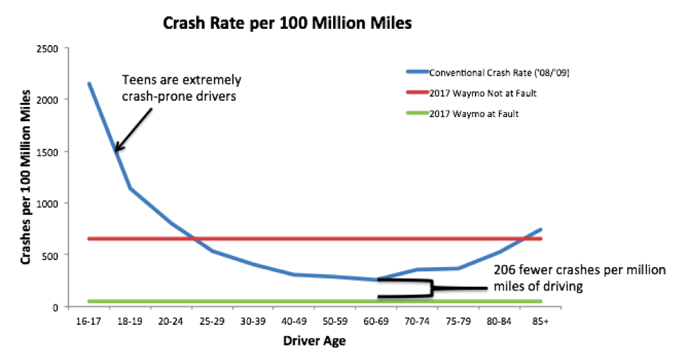
Self Driving Cars: the issue at hand
Nathan Drewniak
Self driving (Autonomous) Vehicles will grow in popularity
  2025: 2.1 million AV
  2030: 20.8 million AV [8]
May pose a great threat to our privacy without proper precautions
PwC; www.rmi.org
Notes:
56% of americans woudnt trust an AV (http://www.pewinternet.org/2017/10/04/automation-in-everyday-life/pi_2017-10-04_automation_0-02/)
Main conclusion: Self driving cars pose a great threat to our privacy, without the correct precautions put into place
Waymo is google’s self driving car project (https://www.rmi.org/news/safe-self-driving-cars/)

Slide 26
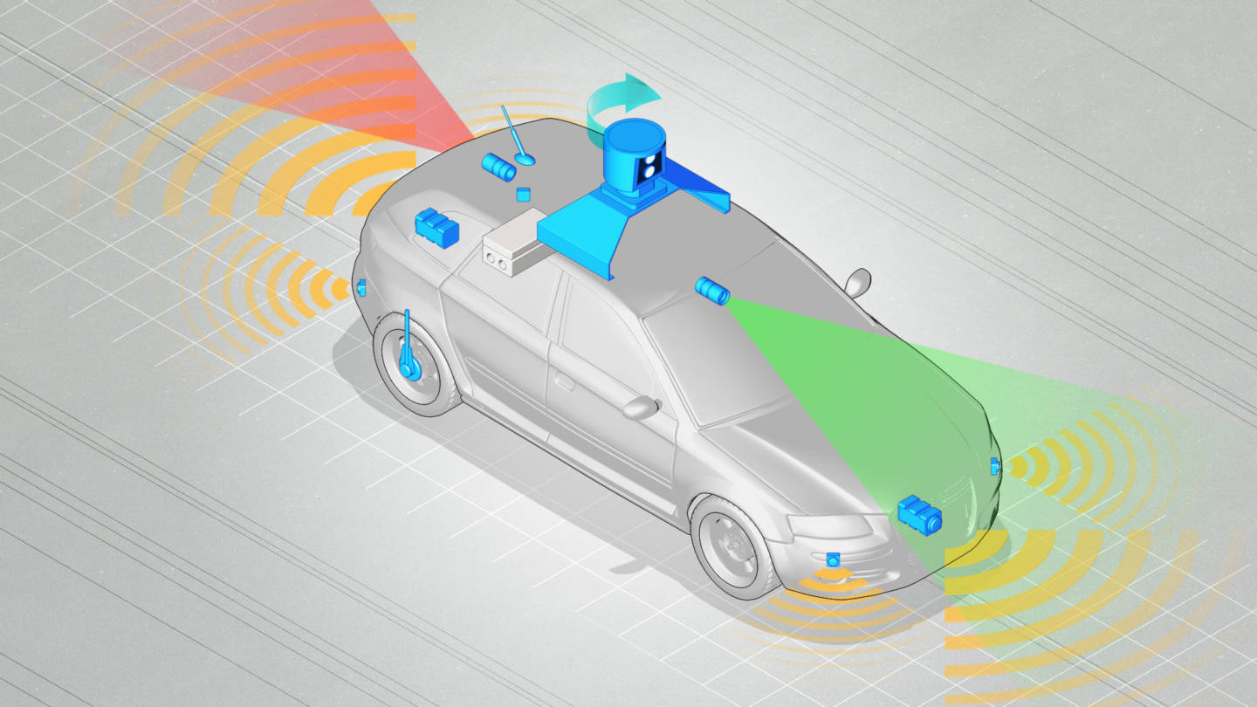
Data is important to av
Nathan Drewniak
Keeps track of every object on the road
  Radars
  Cameras
  LiDAR
  Ultrasonic
  Wheel speed
Needs to connect to cellular/ wireless networks
Notes:
Radar: “sensing the environment”
LiDAR: light-based radar, invisible laser pulses to create 3d profile
Ultrasonic: sound waves, distance from object
Talk about driving to work, doing errands, then coming home (reminding you of errands)
Uses data from many sensors
HD cameras and GPS to know where to go, update traffic and find routes
Picture: https://www.kqed.org/science/1035195/how-safe-is-safe-enough-for-a-self-driving-car

Slide 27

Security vulnerability leads to privacy breach
Nathan Drewniak
Many different manufacturer parts of AV
  Sensors
  GPS
  Cameras
  Bluetooth
Autonomy privacy
Information privacy
Surveillance privacy
Notes:
Camera vs radio vs gps vs Onstar dash-cam in the mirror vs Bluetooth
How do we know when it is under attack?
How do we keep it secure?
AutoPilot story
Three privacy concerns:
Autonomy: desire to avoid being manipulated/dominated
worry that autonomy will be taken away from humans
Information: when widely used, provides wealth of information
advertising
sensitive information, compromising that info
Surveillance: bring up the study, how participants overwhelmingly believed that AV has the capability to
gather rich information about environment and detect humans
and perform off-line analyses on that information
Deleting dash-cam footage? Good or bad? Tampering of evidence
Would retention of AV information be necessary for legal compliance?
Picture: http://www.itsecurityguru.org/2016/03/02/biggest-security-threats-may-hit-us-2016/

Slide 28
Action can be taken ahead of time
Nathan Drewniak
Trust in AV may be similar to IoT devices
We can implement three types regulations
  Industry
  Federal
  State/Local
AV can be designed to minimize personal info collection
Notes:
Collect our information through internet, and perform deep analysis of it
Make data anonymous
Industry self-regulation
many different types of parts going into the car
radio, gps,

Slide 29
California has a law in place
Nathan Drewniak
Requires that all AV preserve detailed records 30 seconds before an accident
Also demands that “manufacturer of the autonomous technology installed on a vehicle shall provide a written disclosure...that describes what information is collected by the autonomous technology equipped on the vehicle”[4]
This a good start
Is this enough?
Notes:
Questions

Slide 30
References
Nathan Drewniak
[1] https://www.technologyreview.com/s/608618/hackers-are-the-real-obstacle-for-self-driving-vehicles/ (3/28/2018)
[2]https://www.theatlantic.com/technology/archive/2016/03/self-driving-cars-and-the-looming-privacy-apocalypse/474600/ ((3/28/2018)
[3] http://joshktan.com/papers/soups2017.pdf (3/26/2018)
[4]https://www.tandfonline.com/doi/abs/10.1080/13600834.2017.1269871#aHR0cHM6Ly93d3cudGFuZGZvbmxpbmUuY29tL2RvaS9wZGYvMTAuMTA4MC8xMzYwMDgzNC4yMDE3LjEyNjk4NzE/bmVlZEFjY2Vzcz10cnVlQEBAMA(3/28/2018)
[5] https://www.rmi.org/news/safe-self-driving-cars/(3/28/2018)
[6] https://www.kqed.org/science/1035195/how-safe-is-safe-enough-for-a-self-driving-car (3/29/2018)
[7] http://www.itsecurityguru.org/2016/03/02/biggest-security-threats-may-hit-us-2016/(3/29/2018)
[8] https://www.statista.com/statistics/750149/us-autonomous-vehicles-in-operation-forecast/
[9] https://www.quora.com/What-sensors-do-driverless-cars-have

Slide 31
Class 6
The End
Keith A. Pray
Instructor
socialimps.keithpray.net
Notes:
This is the end. Any slides beyond this point are for answering questions that may arise but not needed in the main talk. Some slides may also be unfinished and are not needed but kept just in case.
If there’s time and we didn’t already look at:
Find out what your DNA says about you and your family.
https://www.23andme.com/
Jimmy Kimmel Live – What is your password? (2:49)
https://www.youtube.com/watch?v=opRMrEfAIiI

