Slide 1
Class 4 Freedom Of Speech
Keith A. Pray
Instructor
socialimps.keithpray.net
Notes:
Here’s the title slide. Excited again, aren’t you? You should be.

Slide 2
Papers
http://socialimps.keithpray.net/assignments/paper-guidelines/
Hyperbole is the best thing ever!
but not in these papers
Quantify
Do not use terms like: less, more, a lot, huge, great, big, tiny, etc.
Clearly state conclusion
First statement preferred
Read paper aloud to proof
Use template, saves time (and -1 point)
Print 2 sided and save a tree
Notes:
Save for next time:
Missing Counter Point and Response
Be sure to put quotes around entire quote

Slide 3
Overview
Guest Speaker
Review
Assignment
Students Present
Notes:
Show syllabus updates if any

Slide 4
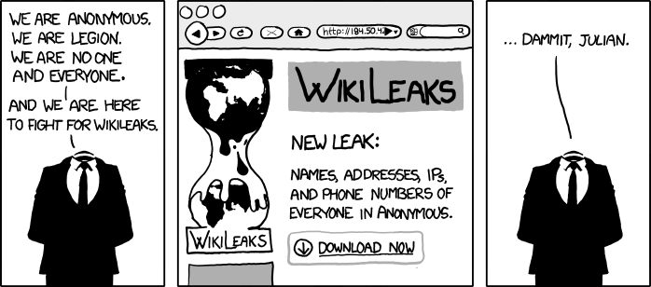
http://www.xkcd.com/834/

Slide 5
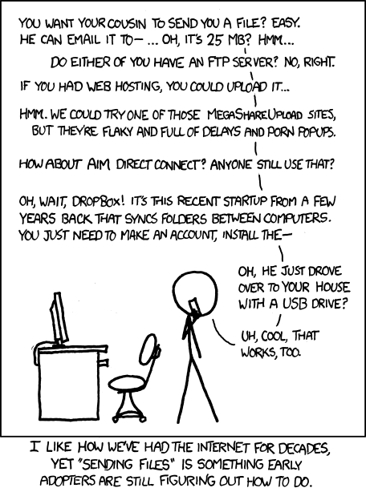
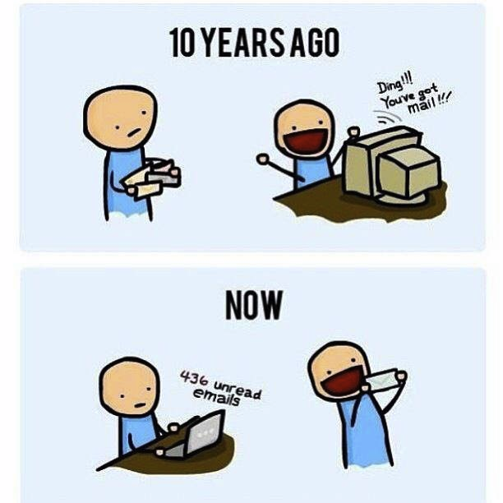
http://poofytoo.com/
25
http://xkcd.com/949/

Slide 6
My Reading Notes
pp. 110 What powers the cell phones and towers? “everyday tasks” not apparent from image.
pp. 114 Ann did not force people to complain.
pp. 117 7% # transactions or $$? Wikipedia critics source [19] from 2005, how has quality turned out? Nice to see darknet added.
pp. 118 [27] PC bangs youth source from 2003, all grown up now.
pp. 130 Is 20% realistic? What will search engines and facial recognition be capable of? Rule Utilitarian ignores the private setting.
pp. 131 Do any filters use image processing?
pp. 133 Stating people searching did not consent to material being blocked makes more sense.
pp. 134 Web access for no cost?
pp. 145 More accurate to say addicted to single app?
pp. 149 20 same as 39
pp. 150 36 same as 42
End of Chapter questions I liked: 2, 25 http://en.wikipedia.org/wiki/Wikipedia:Citing_Wikipedia

Slide 7
Group Quiz
Name two methods some governments use to control access to information.
A large company has a policy prohibiting employees from blogging about company products.
Name two possible reasons for the policy.
Does it violate the First Amendment? Why?
Is it reasonable? Why?
What does “URL” stand for and what is it?
Notes:
Censorship (religious, governmental, private). Adult authentication. Global dissemination.
Freedom of Speech not an absolute right.

Slide 8
Overview
Review
Assignment
Students Present
Notes:
But before that:
CPG Grey - This Video Will Make You Angry [Thought Germs] (7:25)
https://www.youtube.com/watch?v=rE3j_RHkqJc
Cedric Gervais - Hashtag (Original Mix) (3:58)
https://www.youtube.com/watch?v=6OmBKd7X7EE
Dave Audé vs Luciana - You Only Talk In #HASHTAG (3:36)
http://www.youtube.com/watch?v=53wIN87lJn0

Slide 9
Assignment
Reading
Individual Presentations
Extra Credit – One page paper
Is WPI’s IT Acceptable Use Policy morally acceptable?
Work on your group project.
Average Group Happiness 1.43
See full group project description on course website.
Send Web Site URL before next class
Notes:
Or review group project and individual presentation guidelines right now.
Possible One page paper:
Global intellectual property laws, friends or foes?
Group Happiness 1 = everyone got first pick, 2 = everyone got second pick, etc.

Slide 10
Overview
Review
Assignment
Students Present

Slide 11
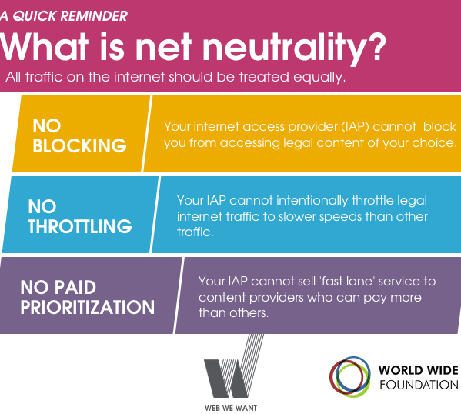
net neutrality
Alazar Genene
Webster Dictionary- Internet Service Providers should allow access to all regardless of the source and without favoring particular products or websites
Notes:
<Net neutrality in theory should protect from the internet service providers from blocking, throttling or prioritizing internet traffic to or from any website>

Slide 12
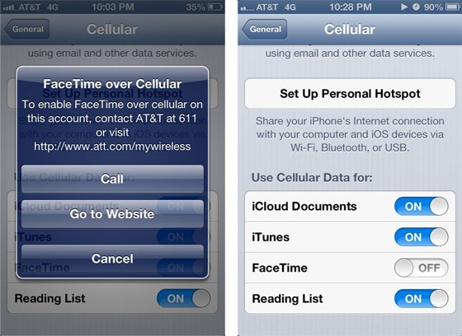
Net neutrality history
Alazar Genene
1996 Telecommunication Act
2005-The supreme court ruled the Internet as an information service
2012-AT&T were blocking Face Time unless users subscribed to mobile share plan
Notes:
1996 Telecommunication Act- Allowed anyone to join the communications business, in an attempt to increase competition in the internet. In 2007 Comcast was the first company accused of bottlenecking Bit Torrent file transfers. In 2010 The FCC passed the Open Internet Order, which attempted to make ISP transparent on how they handle network congestion. This was an attempt to outlaw discriminatory blocking of websites. Later that year Verizon sued the FCC, because of the 2005 supreme court ruling, which was that the FCC didn’t have jurisdiction over the internet. In 2014 The federal court again sided with Verizon stating that the internet was not a telecommunications entity, and could not be treated as such, with the caveat that it could be added as a telecommunications service. 2014 March the CEO of Netflix Reed Hastings called out ISPs for charging big companies connection fees.

Slide 13

Net neutrality history(continued)
Alazar Genene
2014- Websites like Word press and Reddit participated in internet slowdown day
Notes:
The sites didn’t actually stimulate throttling of their services, but displayed the proverbial swirling icon of death.

Slide 14
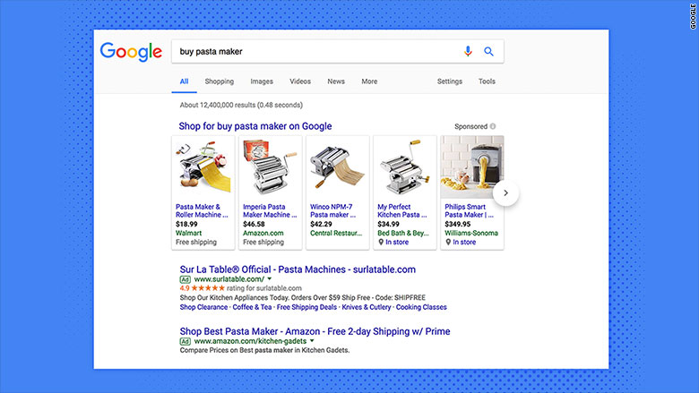
Google breaks European anti-Trust laws
Alazar Genene
Tech giant Google were promoting sales on the Google store and sending their competitors to the 3rd and sometimes the fourth search page
Notes:
This broke European antitrust laws, because Google were using their dominance in the search engine market to prioritize their own shopping services.

Slide 15
Counter Argument
Alazar Genene
Net neutrality stifles innovation
Big Tech giants are under the mercy of ISPs
Possible privacy issues
Notes:
The government is generally corrupt and isn’t as good at regulations, because of lobbying by big corporations such as ISPs. On the issue of privacy the government might need to install their software to monitor traffic and “ensure” that no one breaks net neutrality.

Slide 16
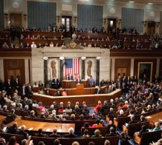
Act II repealed in the US
Alazar Genene
In December 2017 a vote was held to repeal the net neutrality bill and it passed with a vote of 3-2
Notes:
The rules that were repealed were the rules that protected against Blockage, throttling and paid prioritization

Slide 17
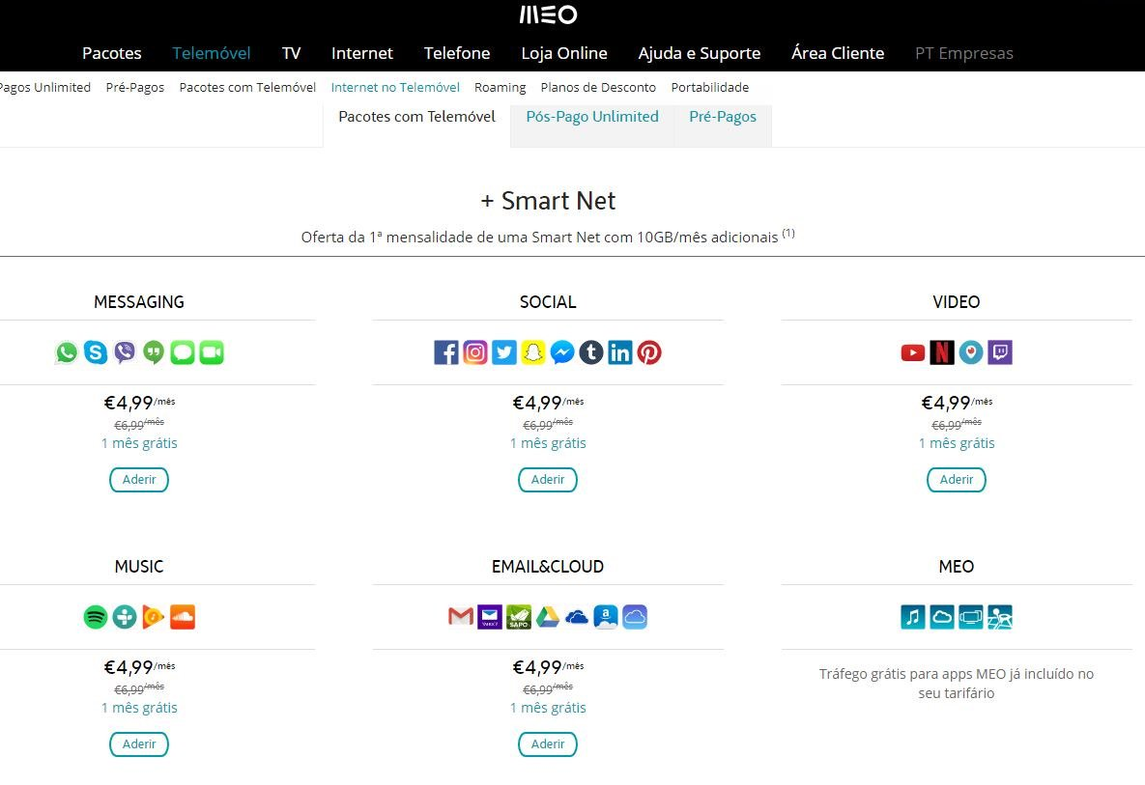
How does this affect you?
Notes:
This is Portugal, without net neutrality laws the ISPs are splitting up the web into packages. There is currently no legislation that would stop this from happening. This is why net neutrality is very important to support.

Slide 18
References
<Alazar Genene>
[1] <https://www.merriam-webster.com/dictionary/net%20neutrality date retrieved: 26/03/2018>
[2] <https://www.sutori.com/story/the-history-of-net-neutrality-in-the-u-s date retrieved: 26/03/2018>
[3] <https://www.dogonews.com/2017/12/16/the-us-federal-communication-corporation-repeals-net-neutrality date retrieved: 26/03/2018>
[4] <http://money.cnn.com/2017/06/27/technology/business/google-eu-antitrust-fine/index.html date retrieved: 26/03/2018>
[5] <https://www.nytimes.com/2017/12/14/technology/net-neutrality-repeal-vote.html 26/03/2018>
[6] <https://www.forbes.com/sites/joshsteimle/2014/05/14/am-i-the-only-techie-against-net-neutrality/#50745f7670d5 date retrieved: 26/03/2018>

Slide 19
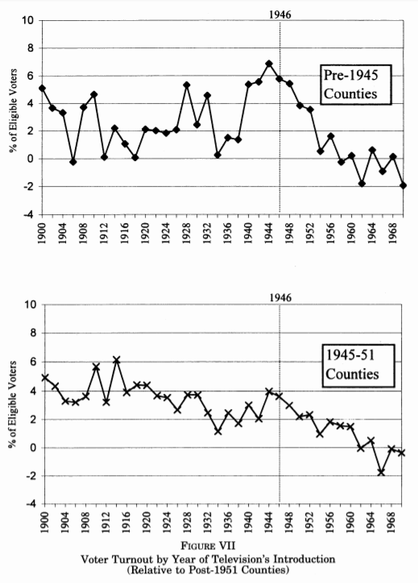
Technology Is Decreasing Voter Turnout
Samuel Goldman
Television Increased Information [3]
Reaches a wider audience
Caused a drop in information regarding local elections
Substitution from local news sources
Opinion Polls Dissemination [5]
Shifts voter expectations
Generates bandwagon effect
Shown in 1980 Presidential election
Notes:
Has the rise of television led to lower voter turnout
Evidence suggests it has, in some cases
Television has decreased the price of information
Broadened the audience
However, it has replaced locals news sources
Decline of local news sources has led to a decline in turnout, mostly in local elections
The charts show turnout rates relative to counties that received TV after 1951
Left: counties with TV pre 1945
Right: counties with TV 1945-51
Shows a larger decline in the second group
Opinion polls have the potential to shape elections
They gauge the electorate prior to the official poll
Has the dissemination of polls changed expectations?
Yes: generates a bandwagon effect
Analysis of 1980 Presidential election:
Generated a small bandwagon effect for Reagan
May depend on context:
Size of lead
How long before election?
Moral questions:
Should news agencies still publish polls?
How should the data be handled
Also brings up the question of exit polls

Slide 20
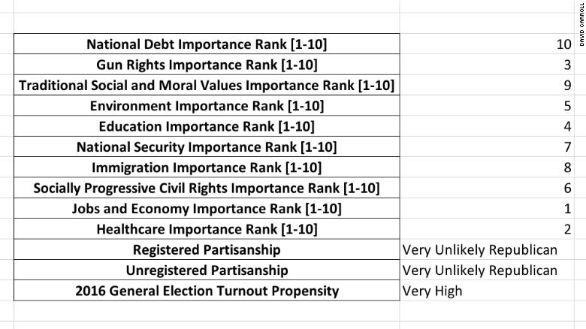
Use of SOCIAL Media data
Samuel Goldman
~270,000 users took a quiz on Facebook [4]
Researcher at Cambridge University
Believed it to be for academic purposes
This exposed ~50 million users
Used by Cambridge Analytica
CA worked on the Trump campaign [1]
Creating a profile
Based on ‘likes’ [2]
https://www.cnn.com/2018/03/17/politics/professor-lawsuit-cambridge-analytica/index.html
Notes:
The prior to examples are, for most part, unintentional influences
What about intentional use of information processing and data?
Created profiles based on ‘likes’
Demographic information and voter registration as well
To the right is a sample profile
Professor requested under a British data law
Ranks 10 issues high to low
Provides likely party affiliation
From what I could find, not much is known about how it developed this profile
2016 Election:
Cambridge Analytica is working for Trump
270,000 Facebook users agreed to take quiz about personal opinions
Believed to be for academic purposes
Professor gave data, including on 50 million friends, to CA
Extent of effect on election is not fully understood
CA CEO has spoken of micro-targeting with advertisements
How does this affect privacy?
Should the Professor have even had access to data about friends?
How responsible is Facebook?

Slide 21
Responsibility Is Crucial
Samuel Goldman
New media technology will shape elections
Developers and media companies need to consider this
Facebook realized this after the 2016 election [7]
Government Regulation
United Kingdom: ban on election day polls since 2000 [6]
Data privacy: FTC is investigating Facebook for privacy breaches [8]
Notes:
Conclusion: information processing and technology DOES affect elections
As the first two examples showed, tech changes elections
Not always intentional, but innovators need to be aware
Facebook is starting to realize this
Announced changes to policies regarding fake news
Government regulation will help eliminate preventable influence
In 2000, the British parliament, among other things, banned releasing exit polls on the day of an election
Prevent last minute discouragement from voting
Currently, the Federal Trade Commission is looking into Facebook
Ideally, a strong response from the government regarding privacy will ensure compliance in the future
Finally, companies have the ability to finely control what we see and don’t see
Consumers need to be aware of how information reaches us and why

Slide 22
References
<Your Name>
[1] Brannelly, Kate. “Trump Campaign Pays Millions to Overseas Big Data Firm.” NBCNews.com, NBCUniversal News Group, 4 Nov. 2016, www.nbcnews.com/storyline/2016-election-day/trump-campaign-pays-millions-overseas-big-data-firm-n677321. Accessed 26 Mar. 2018.
[2] Collins, Keith, and Gabriel J. X. “How Researchers Learned to Use Facebook 'Likes' to Sway Your Thinking.” The New York Times, The New York Times, 20 Mar. 2018, www.nytimes.com/2018/03/20/technology/facebook-cambridge-behavior-model.html. Accessed 26 Mar. 2018.
[3] Gentzkow, Matthew Aaron. “Television and Voter Turnout.” SSRN Electronic Journal, 2005, doi:10.2139/ssrn.607402.
[4] Granville, Kevin. “How Cambridge Analytica Harvested Facebook Data, Triggering a New Outcry.” The New York Times, The New York Times, 19 Mar. 2018, www.nytimes.com/2018/03/19/technology/facebook-cambridge-analytica-explained.html. Accessed 26 Mar. 2018.
[5] Skalaban, Andrew. “Do the Polls Affect Elections? Some 1980 Evidence.” Political Behavior, vol. 10, no. 2, 1988, pp. 136–150., doi:10.1007/bf00991410.
[6] “What Are the Legal Restrictions on Publishing Exit Polls during Elections?” InBrief.co.uk, www.inbrief.co.uk/media-law/publication-of-exit-polls-law/. Accessed 26 Mar. 2018.
[7] Zuckerberg, Mark. 19 Nov. 2016. https://www.facebook.com/zuck/posts/10103269806149061. Accessed 26 Mar. 2018
[8] Fiegerman, Seth. 26 Mar. 2018. http://money.cnn.com/2018/03/26/technology/facebook-ftc-investigation/index.html. Accessed 26 Mar. 2018.

Slide 23
Who Writes your news feed?
Forrest Cinelli
Applying selectorate theory to understand media incentives
Notes:
Today I’m going to show you how to use Selectorate theory to think more critically about the media you consume

Slide 24

Information
Forrest Cinelli
Information is Important [2]
Determines:
What you buy
What you eat
Where you live
Your job
How you vote
Etc.
Sources of Information:
Your senses
Talking
Media
Image: [9]
Notes:
Information is important [citation needed]. It determines everything about your life, what you buy, what you eat, what you do, how you vote, and on and on. So where does the information you use come from?
You can get information using your own literal senses, perceiving the world around you. You can also get information by talking to people that might know something that you do not.
But, in our technological world, most of your information comes from media. Not just ‘the Media’, like CNN or Fox News, but also books, web articles, videos, blogs, search engine [sic], and so on. Since information is so important, let’s think about where this media comes from.

Slide 25
Sources of Information
Forrest Cinelli
Your senses
Talking
Media
Image: [9]

Slide 26
Media
Forrest Cinelli
‘the Media’, but also:
Books
Newspapers
Articles
Videos
Blogs
Search Engine(s)
Notes:
Hidden intentionally

Slide 27
Who creates media
Forrest Cinelli
Who controls the content you see?
Is it always the author?
What are their incentives?
Morality?
Prestige?
Profit?
Notes:
Who created the media you see? Why did they make it, and why did they make it the way they did? What are their incentives, are they trying to convince you of their moral position? Are they trying to gather fame for themselves? Are they just trying to turn a profit?
These questions can be difficult to answer. We could spend the rest of this class debating about the incentives behind media. For the next ten minutes, I’m going to introduce a framework that tries to answer this question (by answering a much more general question):

Slide 28
Selectorate Theory
Forrest Cinelli
Theory of political leadership
Leaders who try to stay in power are more likely to stay in power
The selectorate chooses the leader(s)
Leaders reward the selectorate (and not others)
Private rewards vs public rewards
Private more concentrated, public more effective
Notes:
selectorate theory. This is a theory of political leadership. It’s based on one fundamental assumption: that leaders who try to stay in power are more likely to stay in power. It makes sense, right? It seems natural that over time leadesr who are less concerned with keeping power would lose it more often, and only the ones trying to keep their power would remain. Selectorate theory is mainly concerned with the selectorate, the group that has the power to choose the leader. A consequence of that assumption and that definition are that the leaders try to give rewards to the selectorate, and not others.
So, identifying the group can tell you a lot about how an organization will function.
A distinction that will be important is private rewards vs. public rewards. Private rewards go to certain people, imagine directly giving certain people stacks of cash under the table. Public goods, on the other hand, are equal for everyone. Infrastructure is a public good.
Let’s look at some examples to help make this abstract idea a little more concrete.

Slide 29
Example Selectorate: Resource Rich Dictatorship
Forrest Cinelli
Small coalition chooses leaders
Leader has money from exports
Solution: leader gives direct kickbacks to coalition members
Public rewards not worth it: small benefit to coalition members
Notes:
The small coalition is composed of a few key people e.g. businessmen, regional leaders, generals. Since the country is resource rich, the leader has money from exports. The natural move for the leader is to use most of their resource wealth to maintain power by directly giving it to their small coalition. Notice how ‘the people’ are totally left out of this equation. Public goods are not worth it for the leader, since they wouldn’t benefit the coalition members very much.

Slide 30
Example Selectorate: Democracy
Forrest Cinelli
Large coalition (~50% of voters) chooses leaders
Leaders draw money from taxation
Solution: leaders invest in public rewards
Direct kickbacks not worth it: too many coalition members
Notes:
In a democracy, on the other hand, the selectorate is huge. Ideally over 50% of the entire country is needed to choose the leaders. In most democracies, leaders get most of their money from taxation. Their natural move is to then invest in public rewards, which both make their people happy and make them more productive, increasing tax income even more. Private rewards wouldn’t be worth it since there are just too many coalition members to spread them among.
Now that we’ve understood the basics, let’s look at the example most interesting to us in this class:

Slide 31
Example Selectorate: Corporation
Forrest Cinelli
Board chooses a CEO
Private goods: direct board compensation
Public goods: share price, dividends
CEO’s actions depend on
size of board
number of shares held by board members
Notes:
Corporations. In a corporation, the selectorate is the group who chooses the C-suite, usually owners or the board of directors. Private rewards take the form of direct compensation to board membes, while public rewards take the form of share price and dividents which help all owners. So the CEO’s actions depend on the size of the board, and how many shares the board members hold.

Slide 32
Consequences
Forrest Cinelli
(Tech) leaders’ priority is political survival
Their coalition is company board, large shareholders
Focus on maximizing profit for a few, not
Wellbeing (profit, prestige) of company
Value of products
Morality of business practices
Notes:
Selectorate theory tells us the following about leadership in companies, especially tech companies:
Politilcal survival is their priority
The group that chooses the leader is not the customer or necessarily even owners
All companies, including tech companies, will therefore focus on maximing profit for their board, over the effectiveness of the company, the value of its products, or even the morality of their actions.

Slide 33
What to do?
Forrest Cinelli
Influential companies should have large selectorates
Don’t consume blindly:
Be critical, be suspicious
How did the author design the content?
Why did the website host the content?
How did the website choose what content to show you?
Brainstorm:
Nobody has a solution, yet
Notes:
So, this is a pretty bleak picture. How can we stop large tech companies with so much power like Microsoft or google from abusing their power, like human leaders have done since the beginning of civilization? Selectorate theory does have a few broad answers for us. We should try to have more people be required for tech leaders to accomplish a goal, which could be achieved through competition or government oversight or maybe something else. Personally, you can think critically about the media you consume, be suspicious of the author’s motives. But really, we don’t have a good answer yet. I can’t tell you how to prevent the abuse of power, in the tech world or outside of it: nobody has figured that out yet. But maybe one of you will be smart enough to finally solve this ancient problem.

Slide 34
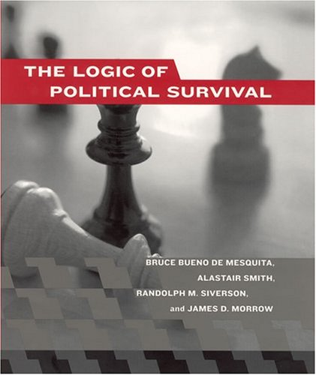
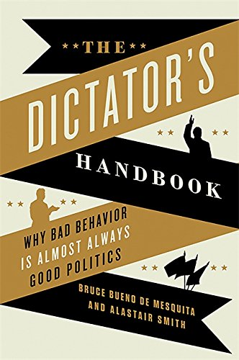
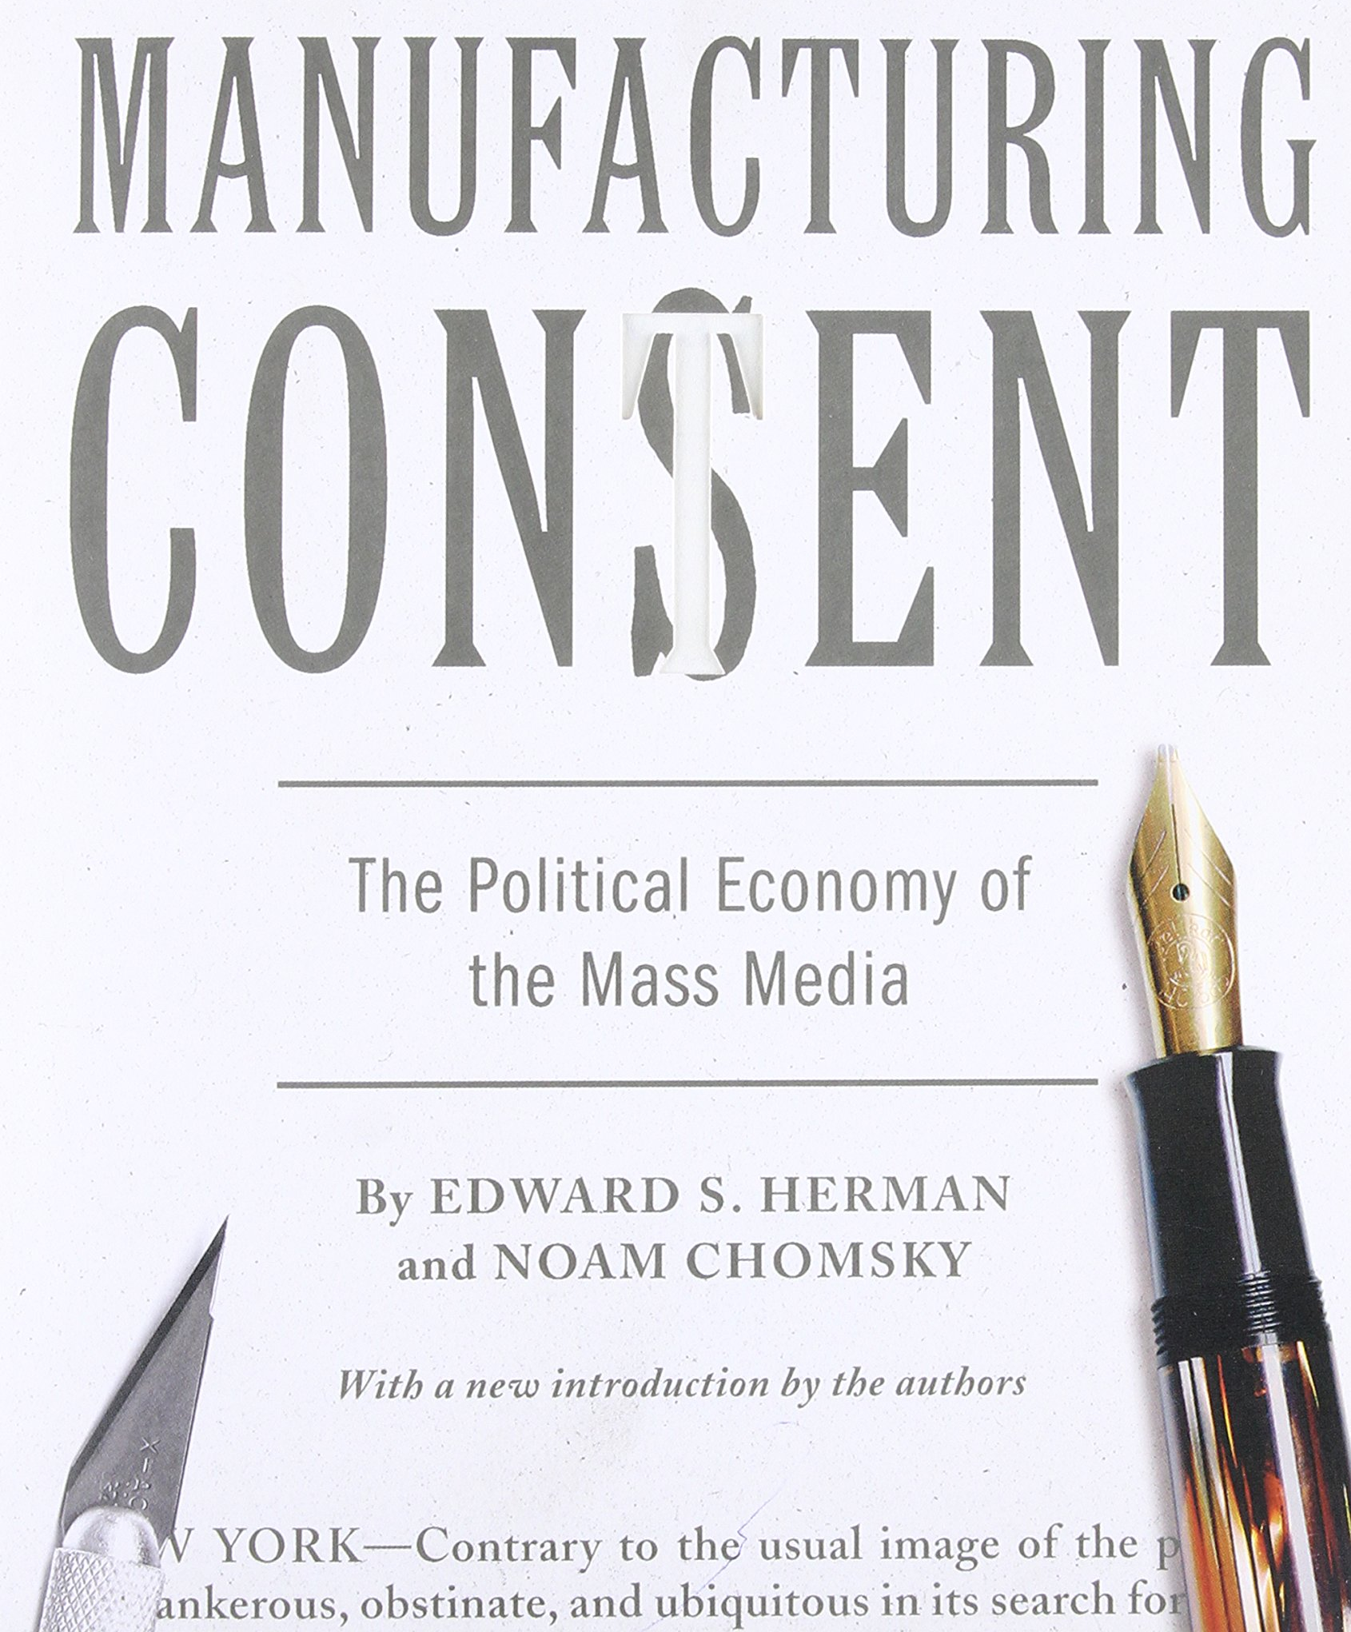

Further Reading
Forrest Cinelli
Selectorate theory
Media ecology
Critical theory
CGP Grey on selectorate theory [3]
Manufacturing Consent: the 5 Media Filters [4]
Clockwise: [5][6][7][8]
Notes:
I have references, I promise. But I think I’ll end it here so you can see how/where to learn more about this kind of suspicion of authority. On the left are some good search terms and a few youtube videos that try to introduce key concepts, and on the right are particularly acclaimed books about these topics. Questions?
Note for me, said if anyone asks:
Critical theory is a critique of previous sociological theories and of our perception of reality. It seeks to “liberate human beings from the circumstances that enslave them” – Max Horkheimer.
Critical theory is related to but not the same as Critical Theory (capitalized), which is a revised form of Marxism also called the ‘Frankfurt School.’
Media Ecology is the study of how media, both its form and its content, shape the reality that we perceive.

Slide 35
References
Forrest Cinelli
[1] De Mesquita, Bruce Bueno, and Alastair Smith. ”The dictator's handbook: why bad behavior is almost always good politics”. Public Affairs, 2011.
[2] Postman, Neil. "What is Media Ecology?". Media Ecology Association, 2009. Retrieved March 26, 2018.
[3] CGP Grey. “The rules for rulers”. YouTube, 2016. Retrieved from https://youtu.be/rStL7niR7gs on March 26, 2018.
[4] Pirak, Pierangelo. “Noam Chomsky - The 5 Filters of the Mass Media Machine”. YouTube, 2017. Retrieved from https://youtu.be/34LGPIXvU5M on March 26, 2018.
[5] Cover of “The Logic of Political Survival by B. Mesquita and A. Smith”. Amazon.com. Retrieved from https://www.amazon.com/Logic-Political-Survival-MIT-Press/dp/0262524406 on March 26, 2018.
[6] Cover of “The dictator’s handbook: why bad behavior is almost always good politics by B. Mesquita and A. Smith”. Amazon.com. Retrieved from https://www.amazon.com/Dictators-Handbook-Behavior-Almost-Politics/dp/1610391845/ on March 26, 2018.
[7] Cover of “Propaganda: the formation of men’s attitudes by J. Ellul”. Amazon.com. Retrieved from https://www.amazon.com/Propaganda-Formation-Attitudes-Jacques-Ellul/dp/0394718747/ on March 26, 2018
[8] Cover of “Manufacturing Consent by N. Chomsky and E. Herman”. Amazon.com. Retrieved from https://www.amazon.com/Manufacturing-Consent-Political-Economy-Media/dp/0375714499/ on March 26, 2018
[9] Levy, Terry. “How violence in media affects children’s behavior” . evergreenpsychotherapycenter.com, 2017. Retrieved from https://www.evergreenpsychotherapycenter.com/violence-media-affects-childrens-behavior/ on March 27, 2018

Slide 36
Class 4 The End
Keith A. Pray
Instructor
socialimps.keithpray.net
Notes:
Use remaining time to form groups, approve group topics, etc.
This is the end. Any slides beyond this point are for answering questions that may arise but not needed in the main talk. Some slides may also be unfinished and are not needed but kept just in case.

