Slide 1
Class 10
Professional Ethics
Keith A. Pray
Instructor
socialimps.keithpray.net
Notes:
Here’s the title slide. Excited already, aren’t you? You may not be depending on how you enjoyed the last class.
Paper:

Slide 2
Debate Ground Rules
Before Debate
  10-15 minutes to converse with your team
  Share argument points, counter points, and responses so everyone can represent
  Decide who will respond to what points from the opposing side
During Debate
  Stand up when speaking
  Only those who have not spoken may respond until everyone has had a turn
  Switch sides at any time when you change your mind
Chapter 9 In-class Exercises # 24.
Should the company produce the game?
Use the SWE Code Of Ethics as the basis for your argument.
Notes:
Release Game or Not Debate

Slide 3
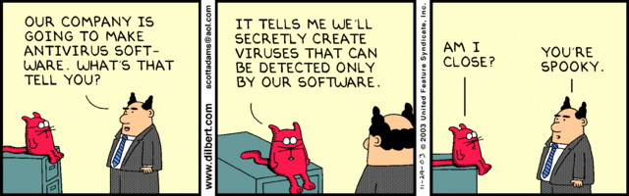
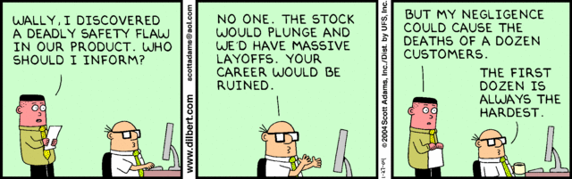
Notes:
Ask how many people in ACM or IEEE

Slide 4
Overview
Review
Assignment
Students Present
Notes:
We can also discuss articles listed on Security Discussions under documents of course web site.
ADD QUIZ AS BACKUP IF CLASS DISCUSSION NOT LONG ENOUGH

Slide 5
My Reading Notes
pp. 409 Can one perform services for one’s self?
pp. 412 1993-1999 Does this seem like a long time?
pp. 413 “errors of omission or commission”?
UPDATE
pp. 422 3. Would people agree – social contract?
pp. 438 So the baby can be left outside and no one is responsible?
Notes:
An error of commission is one where the person responds where they should not. This is compared to an error of omission, where the person fails to respond when they should.

Slide 6
Assignment
Finish all reading
Add analysis to group project website addressing all topics covered to date.
Group Presentation Draft
  Email presentation as attachment to course staff
  Post on group website
Notes:
No extra paper this time, group projects not far along enough
1 Page Paper – For Good
How will you use your computing related education to do good in the world?
1 Page Paper – Dark Net
Is the Dark Net good or bad?
Extra Credit? Extra Paper?

Slide 7
Overview
Review
Assignment
Students Present
Notes:
Show WPI and/or corporate code of ethics.

Slide 8
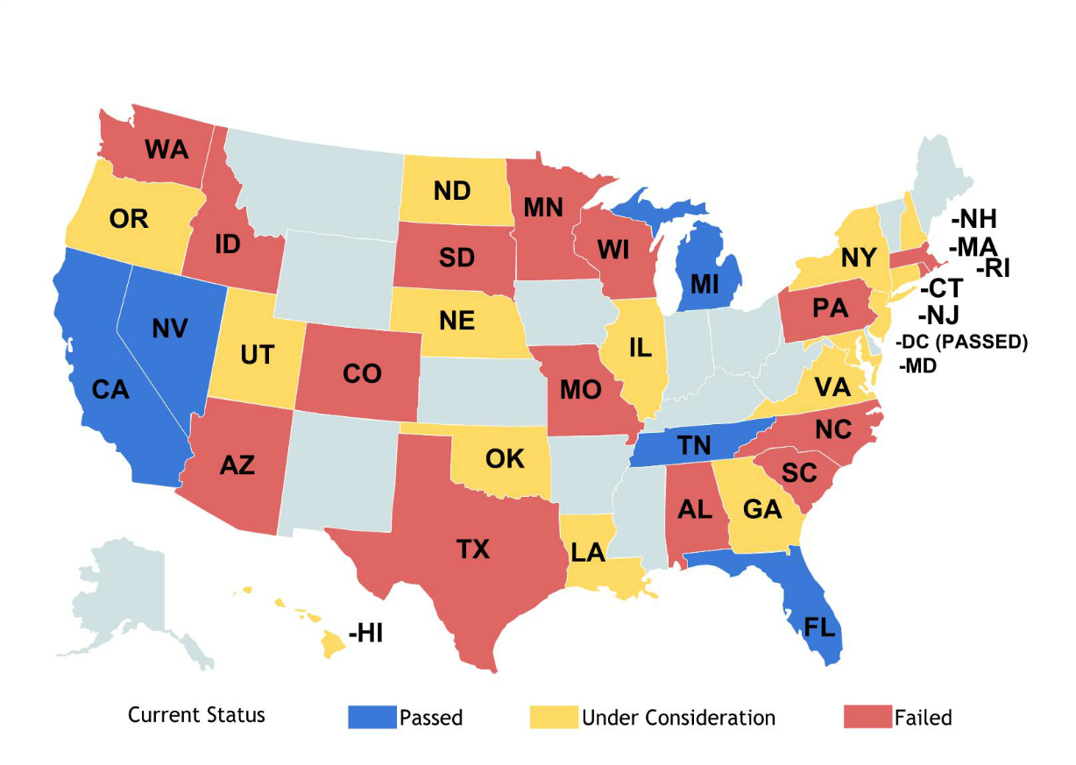
SELF-DRIVING CAR DEVELOPERS SHOULD NOT BE IN CHARGE OF MAKING LIFE & DEATH DECISIONS
Alonso Martinez
No, self-driving car developers should not be the ones that set the standards for how their cars act in life & death decisions
  Self-driving cars are still a new technology, but are scheduled to be released by 11 companies in 2020
  Very little regulation over self-driving cars
    32 states have laws pertaining to AVs
[1]
Notes:
Hello everyone, my name is Alonso and I am here to talk to you guys about professional ethics behind self driving cars. My question is “Should Self-Driving car developers be in charge of making life & death decisions”. I believe that they should not be setting standards for how their cars act in life and death decision. As we all know, self driving cars are still a new technology, but over the next couple of years, several companies are going to be releasing their self driving cars. Specifically, Volvo and Mercedes Benz are expected to start selling their own self driving cars in 2020.
In addition, there has been very little debate both at the national and international scale. There are very little regulations that extend beyond “you can’t drive self driving cars in this state/city”. Self driving cars have not been addressed heavily because they are still very new.

Slide 9
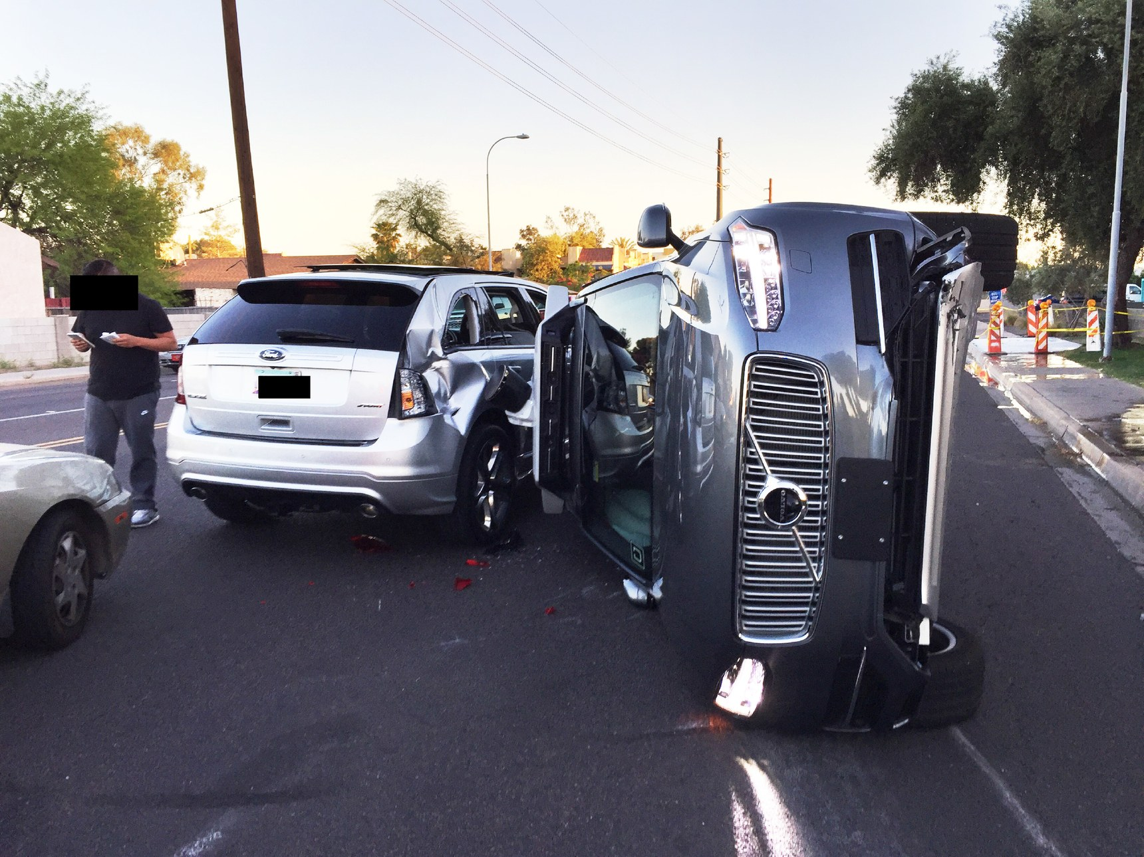
RELIABILITY & SAFETY OF SELF-DRIVING CARS
Alonso Martinez
Host of sensors to obtain data
  LIDAR, Ultrasonic, Radar, Cameras
But sensors can and will fail
  Tesla Model S Fatality
  272 failures, 13 near misses
Therefore, the cars need to be programmed to make critical decisions when necessary
[2][3][4][5]
Notes:
So as was stated last week in the earlier presentation about self-driving cars, these cars come with a significant amount of hardware. Some of these cars come with LIDAR, Ultrasonic Sensors, Radar, High Quality cameras. The purpose of these sensors are to obtain data and through sensor fusion, make the best possible moves given a scenario.
But one thing we need to realize is that sensors fail. Sensors wear out over time, they have small glitches, are affected by ambient conditions – they aren’t fool proof. And we have seen some situations such as the Tesla Model S Fatality in which the sensors were not equipped to deal with certain scenarios. And human error is still present on the road, so these cars are still being crashed into which may also put them into difficult situations that they need to react to.
Because of this, self driving cars still need to be programmed to make critical decisions when necessary.

Slide 10
SOFTWARE ENGINEERING CODE OF ETHICS
Alonso Martinez
Principle 1: Public
  1.02 - “Moderate the interests of the software engineer, the employer, the client and the users with the public good.”
  1.03 –”Approve software only if they have a well-founded belief that it is safe, meets specifications, passes appropriate tests, and does not diminish quality of life…The ultimate effect of the work should be to the public good”
How to measure Public Good?
Should be measured by how many lives can be saved
35,000 deaths in the U.S from car accidents, 1.3 million worldwide.
[6]
Notes:
Back to the software engineering code of ethics, Principle 1 has to do with the public. Section 1.02 says that … <insert recap of the principle>. Furthermore, section 1.03 states that <insert recap of the principle>
The main point here is that software engineers should work to promote the interests of the public good.

Slide 11
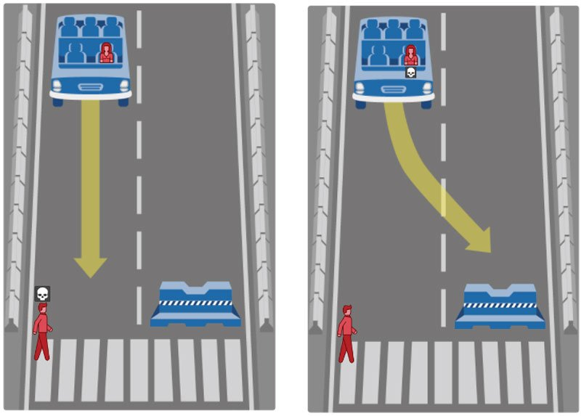
HOW SHOULD THE CAR BE PROGRAMMED TO REACT?
Alonso Martinez
“Save the life in the car” – Von Hugo, Mercedes-Benz
“Hit the smaller thing” – Sebastian Thrun, Google X Founder, 2014
"Avoid hitting unprotected bystanders and moving objects“ – Chris Urmson, Google Autonomous Vehicle Manager, 2016
Divide between how developers should balance protecting their users and protecting the general public
[7][8][9]
Notes:
Here, we have a scenario that many ethical experts debate about. It’s a version of the trolley scenario. In this case, assume that the car is self driven and it is in a situation where it is driving and a human walks into the way. The car has two scenarios, hit the person and save the driver, or crash the car into the guard and kill the passenger.
<Ask question to class if they would swerve into the guard or hit the person>
In our minds, many of us here would attempt to save the person. We would attempt to swerve out of the way and try not to kill the person that is in front of us. Since we are humans, we don't have the proper reflexes and motor control to make a perfect decision in these situations. We are mostly just capable of making an impulse reaction and hoping for the best.
But cars understand more about the situation than we do. Cars would be able to gauge that distance, determine if there is a chance of braking before we hit the person, determine if swerving out of the way would help. The self driving cars can do a lot of stuff in milliseconds that we can't do as humans. If there are no alternatives, who will the car choose to protect.
<go over quote 1 from Mercedes benz>
<go over quote 2 from Sebastian thrun>
<go over quote 3 from Chris Urmson>
We see here that the developers of these cars are choosing what their cars do in certain situations. In the first case, Mercedes is programming their cars to do everything to save the user. They are weighing the interests of the user, their clients, over the general public. In the second case and third cases, we see that there is a shift towards protecting innocent bystanders from accidents. Despite this, we see there is a clear divide between developers on who to protect; their user’s, or the public. Because of this, I think it is unethical for them to be making these decisions, as software engineers are stuck in the middle between protecting their users and protecting innocent bystanders. From a business perspective, they are obligated to protect their customers as users don’t want to drive a car knowing that it will decide to kill them if it needs to, which brings the matter into murky waters.
One of the biggest counter arguments to this scenario is that a self driving car would never get into this scenario. That may be true if every car on the road is autonomous, but that is not the case. Human error from other nearby drivers, car failures, and acts of god could force self driving cars into situations where they may need to make these decisions.

Slide 12
Conclusion
Alonso Martinez
Developers of self-driving cars should not be setting the standards for how their cars react when faced with difficult situations
  Self-driving cars are still a new technology and are not perfect and still get into accidents
  Public interest revolves around saving lives and keeping people safe
  Unethical for companies to be making these decisions as there is clear bias as to who they would want to protect.
These decisions should be made by a collaboration of government officials, the general public, and car developers after further debate on the role of autonomous vehicles in society
Overall, self-driving cars are still a benefit to society
Notes:
To conclude, self driving cars are still in their infancy as a technology. It is still a new technology that came from nowhere, all of a sudden Tesla was selling self driving cars without any regulation.
The developers of these cars should not be settings the standards for how their cars react when faced with critical situations because of conflicts of interest.
I believe that these decisions should be made by a collaboration of government officials, the general public, and car developers after further debate on the role of autonomous vehicles in society.
Lastly, I believe that self-driving cars are still a huge benefit to society. I think that the future of the automotive industry is in self-driving cars and that self driving cars have the potential to revolutionize many aspects of how we live. This argument solely pertains to the life & death decisions that self-driving cars may find themselves in as they become more prominent. Thank you.

Slide 13
REFERENCES
Alonso Martinez
[1] Weinberger, D. (2016, July 01). Should your self-driving car kill you to save a school bus full of kids? Retrieved April 20, 2017, from http://www.digitaltrends.com/cars/self-driving-car-moral-decisions (Image)
[2] Stewart, J. (2017, March 27). Uber Redeploys Its Self-Driving Cars After a Wreck in Arizona. Retrieved April 20, 2017, from https://www.wired.com/2017/03/uber-redeploys-self-driving-cars-wreck-arizona (Image)
[3] Bergen, M., & Newcomer, E. (2017, March 25). Uber to Suspend Autonomous Tests After Arizona Accident. Retrieved April 20, 2017, from https://www.bloomberg.com/news/articles/2017-03-25/uber-autonomous-vehicle-gets-in-accident-in-tempe-arizona
[4] Russell, A. S. (2016, July 01). Inside the Self-Driving Tesla Fatal Accident. Retrieved April 20, 2017, from https://www.nytimes.com/interactive/2016/07/01/business/inside-tesla-accident.html
[5] Lutin, Jerome M, PHD,P.E., A.I.C.P., Alain L. Kornhauser P.H.D., and Eva Lerner-Lam. "The Revolutionary Development of Self-Driving Vehicles and Implications for the Transportation Engineering Profession." Institute of Transportation Engineers.ITE Journal 83.7 (2013): 28-32. ProQuest. Web. 20 Apr. 2017.
[6] Quinn, M. J. (2017). Ethics for the information age. Boston: Pearson. (pg.414-415)
[7] Sebastian Thrun Weighs in on the Self-Driving Revolution. (2016, October 20). Bloomberg.Retrieved April 20, 2017, from https://www.bloomberg.com/news/videos/2016-10-20/sebastian-thrun-weighs-in-on-the-self-driving-revolution
[8] Lubin, G. (2016, December 29). Self-driving cars are already deciding who to kill. Business Insider. Retrieved April 20, 2017, from http://www.businessinsider.com/self-driving-cars-already-deciding-who-to-kill-2016-12
[9] Morris, D. Z. (2016, October 20). Mercedes' Self-Driving Cars Would Save Passengers, Not Bystanders. Fortune. Retrieved April 20, 2017, from http://fortune.com/2016/10/15/mercedes-self-driving-car-ethics/

Slide 14
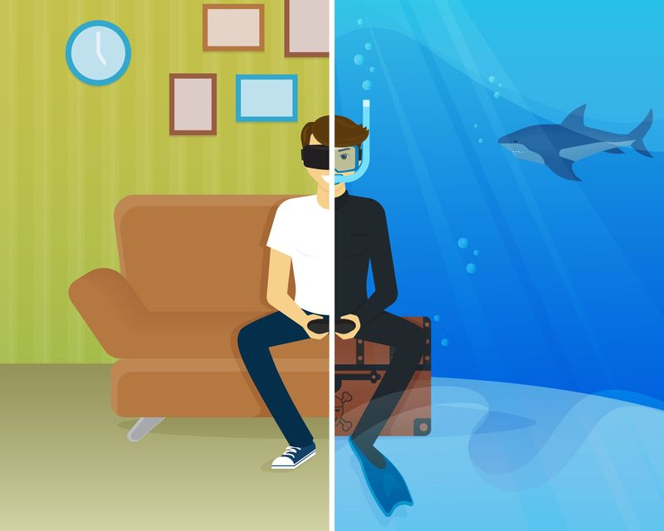
Virtual reality and reality
Ryan Wiesenberg
What is the effect of Virtual Reality on Reality?
How “virtual” is Virtual Reality?
Figure 1: Virtual Reality Visualization [11]
Notes:
Hello everyone, I’m Ryan and I will be talking to you today about Virtual Reality.
To be clear, I’m not talking about the common term virtual reality meaning an immersive virtual experience, I’m talking about virtual environments as a whole and their effects on Reality.
And secondly, how “virtual” is virtual reality? Are the mental effects of it strong enough to change our perspective of our world?

Slide 15
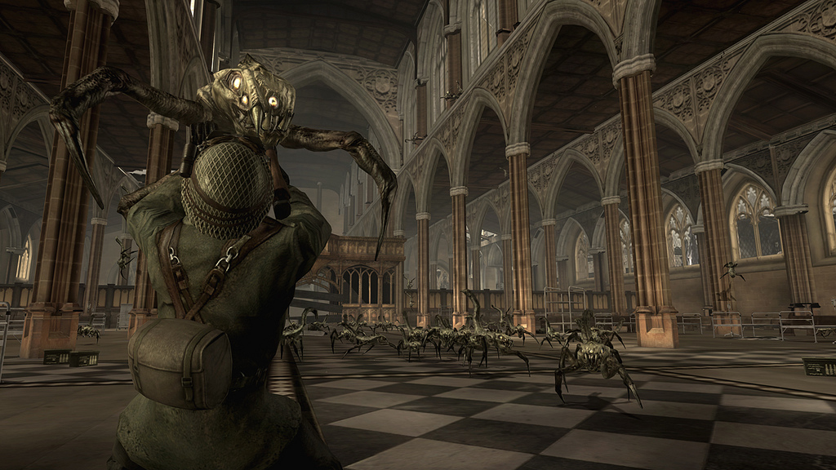
Resistance: Fall of man
Ryan Wiesenberg
Manchester Cathedral
  Took pictures without permission and used them to recreate the building
  “Promoted Violence”
Developers ~ “Not Reality”
Figure 2: In-Game Resistance: Fall of Man [7]
[1][2][7]
Notes:
One of the supporting material citations was a video about the importance of ethics in computing and its main example was the game Resistance: Fall of Man.
The game itself was about an alternate reality involving aliens invading earth in the 1950s and the player must complete a series of tasks to drive them out, much of which includes destroying them at any cost, shooting, explosions, etc.
At one point the player ventures to Manchester Cathedral and finds in infested as well.
To recreate this scene the developer, Insomniac Games, took pictures of the interior without consent and then promoted violence by having the player kill all the aliens inside.
The churched opened up a legal battle with them but lost because the Developers argued that it wasn’t actually reality and that their video representation wouldn’t have any “real” impact on the users.
I was unconvinced about this statement that the two were independent so I decided to do a little research.

Slide 16

Desensitization
Ryan Wiesenberg
Video Game Violence – 2006
257 College participants played either violent or non-violent game
Showed commercial violence
Findings:
  Violence in game “got used to” reality violence
  Game itself did not effect them immediately
Figure 3: Duke Nukem 3D [10]
[9]
Notes:
One of the more popular topics about video games in the media is the question of desensitization brought about by video games and whether or not that impacts decisions in day to day life.
A study done in 2006 had participants play either a violent, such as Duke Nukem or Carmageddon, or non-violent video game, like Tetris, and then measure their reactions to violence that was shown commercially. Stabbings, car thefts, violence in jails, arrests, etc. The study found that there was no significance in heart rate before the participants played or even immediately after the video game.
However, the participants that played a violent game showed a significantly lower heart rate while viewing the footage that the non-violent participants.
This study showed that video games do actually have an effect on reality, at least mentally.

Slide 17
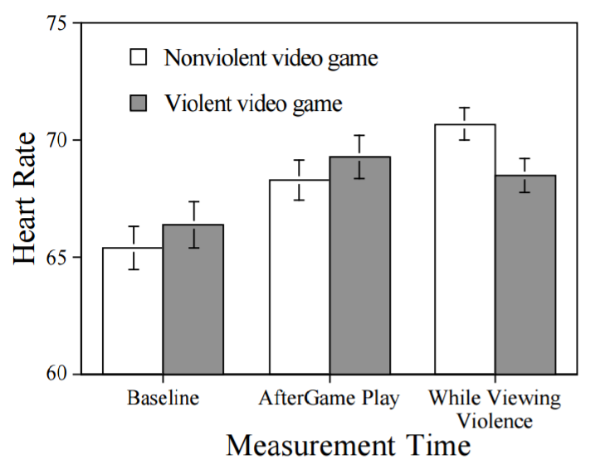
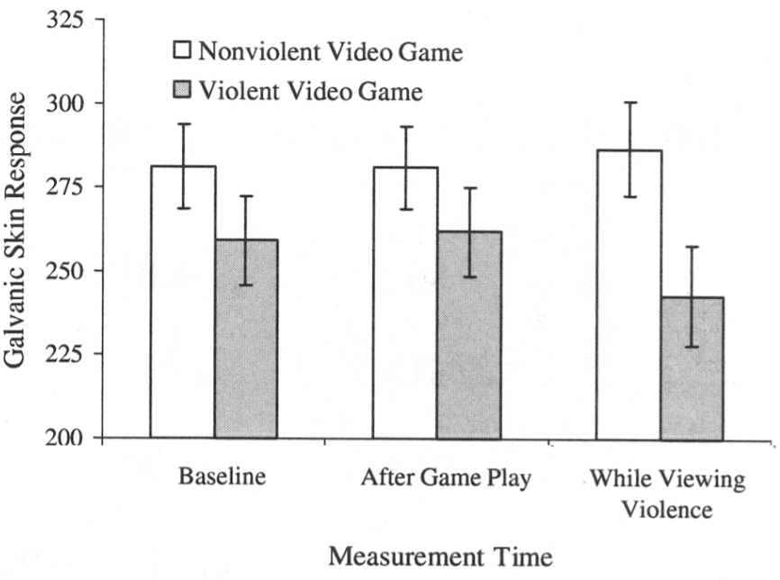
Desensitization
Ryan Wiesenberg
Figures 4 and 5: Desensitization Study Results [9]
[9]
Notes:
Use this Slide to Supplement Previous

Slide 18

Phobia Therapy
Ryan Wiesenberg
Spiders – 1996
  “Fear Level” dropped more than half
Flying – 2015
The Virtual Reality Medical Center
  Closed/Open Spaces, Driving, Heights, Needles, Public Speaking
Figure 6: A Cute Jumping Spider [8]
[3][4][5][6]
Notes:
However, I don’t want to express only the “bad” parts of Virtual Reality exposure.
Many medical institutions are experimenting with Virtual Reality therapy which is the process of exposing people to some of their worst fears through a virtual device and hoping to minimize their adverse reaction.
One of the first studies was done in 1996 where a participant was exposed to interaction with a spider with a headset in a virtual kitchen repeatedly over the course of three months.
The study showed a fairly significant drop in the patient’s fear of spiders after the study when compared to other undergraduates.
A similar test was conducted in 2015 with the fear of flying which involved a few educational exercised reviewing the safety of flying and then concluded with a virtual plane ride and then an actual plane ride with similar results to the spider study.
This study showed a drop
Based on the success of such treatments and experiments The Virtual Reality Medical Center was established to provide treatment for a wide range of phobias including spiders, flying, as well as the others listed on the slide.
These studies help to further prove that virtual reality has a larger impact on reality than initially seem apparent.

Slide 19
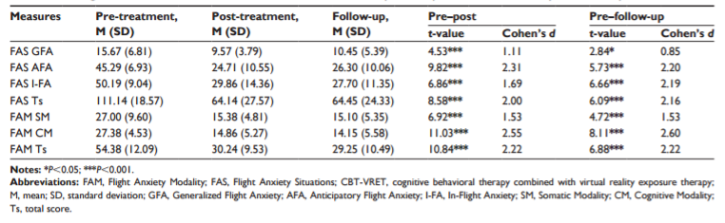
Phobia Therapy
Ryan Wiesenberg
Figure 7: Result of Flight Therapy [5]
[5]
Notes:
However, I don’t want to express only the “bad” parts of Virtual Reality exposure.
Many medical institutions are experimenting with Virtual Reality therapy which is the process of exposing people to some of their worst fears through a virtual device and hoping to minimize their adverse reaction.
One of the first studies was done in 1996 where a participant was exposed to interaction with a spider with a headset in a virtual kitchen repeatedly over the course of three months.
The study showed a fairly significant drop in the patient’s fear of spiders after the study when compared to other undergraduates.
A similar test was conducted in 2015 with the fear of flying which involved a few educational exercised reviewing the safety of flying and then concluded with a virtual plane ride and then an actual plane ride with similar results to the spider study.
This study showed a drop
Based on the success of such treatments and experiments The Virtual Reality Medical Center was established to provide treatment for a wide range of phobias including spiders, flying, as well as the others listed on the slide.
These studies help to further prove that virtual reality has a larger impact on reality than initially seem apparent.

Slide 20
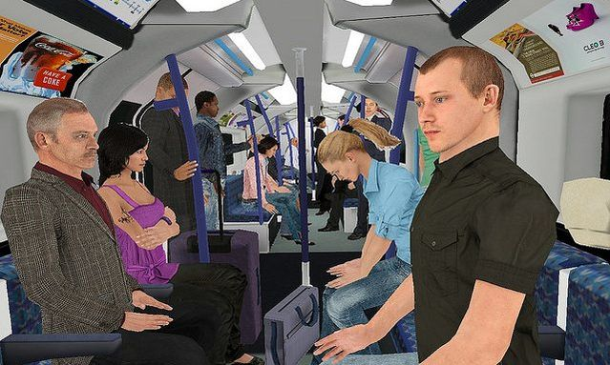
Conclusion
Ryan Wiesenberg
What is the effect of Virtual Reality on Reality?
Allows for the experience of reality without movements
How “virtual” is Virtual Reality?
Not really, mental effects persists even after disconnecting from the virtual world
Figure 8: Closed Spaces VR Therapy [12]
Notes:
In conclusion I would like to answer the two questions that I had posed in the introduction.
What is the effect of Virtual Reality on Reality?
Quite simply, it does what it is supposed to, the user can experience different experiences that he or she may not be able to otherwise, whether it be shooting aliens in a cathedral or touching a spider.
What is the impact of Virtual Reality?
As seen by the desensitization studies, Virtual Reality can be extremely impactful on how we view reality.
The church had a lot of validity to their argument that the game promoted violence and could have legitimately hurt the public’s view of the church had they experienced it through a video game.
And the effects that virtual reality has on day to day life will only increase as their realism does.

Slide 21
References
Ryan Wiesenberg
[1] Rob Haythorne. “Ethics in Computing: Real Ethics and Virtual Reality.” Production Zone, May 28, 2011. 14:19. www.youtube.com
[2] “Cathedral row war over video game.” BBC, June 9, 2007 http://news.bbc.co.uk/2/hi/uk_news/england/manchester/6736809.stm[3] <reference 3>
[3] Carlin, Albert S., Hunter G. Hoffman, and Suzanne Weghorst. "Virtual Reality and Tactile Augmentation in the Treatment of Spider Phobia: A Case Report." Behaviour Research and Therapy, vol. 35, no. 2, 1997, pp. 153-158, doi:10.1016/S0005-7967(96)00085-X.
[4] Choy, Yujuan, Abby J. Fyer, and Josh D. Lipsitz. "Treatment of Specific Phobia in Adults." Clinical Psychology Review, vol. 27, no. 3, 2007, pp. 266-286, doi:10.1016/j.cpr.2006.10.002.
[5] Triscari, MT, et al. "Effectiveness of Cognitive Behavioral Therapy Integrated with Systematic Desensitization, Cognitive Behavioral Therapy Combined with Eye Movement Desensitization and Reprocessing Therapy, and Cognitive Behavioral Therapy Combined with Virtual Reality Exposure Therapy Methods in the Treatment of Flight Anxiety: A Randomized Trial." NEUROPSYCHIATRIC DISEASE AND TREATMENT, vol. 11, 2015, pp. 2591-2598, doi:10.2147/NDT.S93401.
[6] The Virtual Reality Medical Center, http://www.vrphobia.com/
[7] Insomniac Games, http://www.insomniacgames.com/games/resistance-fall-of-man/
[8] cutespiders101. "Fact- Jumping Spiders like to wear water droplets as hats” cutespiders101, Jun 27th, 2014, https://cutespiders101.tumblr.com/post/90108099336/fact-jumping-spiders-like-to-wear-water-droplets
[9] ] Nicholas L. Carnagey, Craig A. Anderson, Brad J. Bushmanm “The effect of video game violence on physiological desensitization to real-life violence" Journal of Experimental Social Psychology, vol. 43, 2007, pp. 489-496
[10] Peele, Britton. “Happy 20th anniversary to ‘Duke Nukem 3D,’ the classic video game made in Garland,” GuideLive. Jan 29, 2016, https://www.guidelive.com/video-games/2016/01/29/happy-20th-anniversary-duke-nukem-3d-classic-video-game-made-garland
[11] Note to Self, “The Realities of Virtual Reality,” WNYC. May 11, 2016 http://www.wnyc.org/story/virtual-reality-turning-forest/
[12] Daniel Freeman. “How Virtual Reality Could Transform Mental Health Treatment“ Psychology Today, May16, 2016, https://www.psychologytoday.com/blog/know-your-mind/201605/how-virtual-reality-could-transform-mental-health-treatment

Slide 22
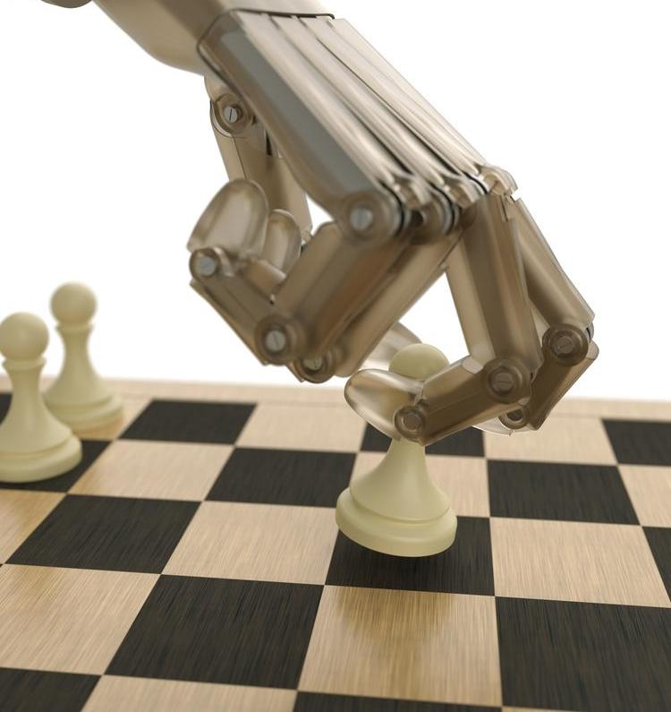
Chess Engine Case Studies
William Van Rensselaer
Chess engines
  Have challenged human intelligence
  Have enabled new forms of cheating
  Help human players improve at and study their play
https://www.chess.com/article/view/the-best-computer-chess-engines
Notes:
Summary of what I’m going to talk about

Slide 23

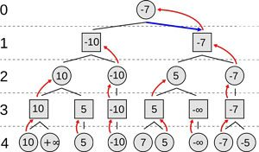

Chess Engine
William Van Rensselaer
Evaluates chess position
Recommends best move [1]
Typically minimax algorithm [2]
Stockfish
Komodo
https://en.wikipedia.org/wiki/Minimax
Notes:
Computer program that attempts to correctly evaluate a position in chess and determine which side is better and by how much
May recommend the best course of action for the player whose turn it is
Quickly mention how they work:
Minimax algorithm
Decision rule based on fine-tuned heuristics
Two players, max (trying to maximize score) and min (trying to minimize score), alternating turns (each branch level)
Heuristics determine score of a position.
Each child node is a playable move from the parent node’s position
At each branch, if min’s turn take minimum child, if max’s turn take maximum value. That’s the move that should be made.
Search depth determine by time or resource constraints
Alpha-beta pruning can be used to boost performance
Opening/end game database
Stockfish (open source) and Komodo (commercial) currently two currently highest-rated (later slide) chess engines.

Slide 24
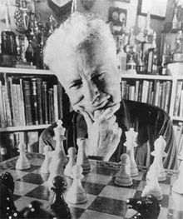


Elo Rating
William Van Rensselaer
Number representing skill level [3]
Magnus Carlsen – Elo 2838
https://en.wikipedia.org/wiki/Elo_rating_system
Notes:
Created by and named after Arpad Elo, Hungarian-born American physics professor and chess player
Adopted by USCF (U.S. Chess Federation) in 1960 and FIDE (World Chess Federation) in 1970
Used to represent skill level of a player or relative skill level between players
E_{A} – Expected score of player A, given the rating of player B (R_{B}) and player A (R_{A}). Logistic curve formula.
R’_{A} – New rating given the actual score of player A (S_{A}), K-factor based on class of the player
Magnus Carlsen – Current World Champion and highest rated player in the world

Slide 25
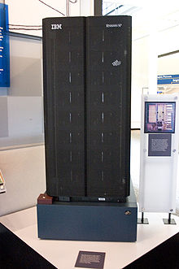
Deep Blue
William Van Rensselaer
Beat Kasparov in 6-game match in 1997 [4]
  2 wins, 3 draws, 1 loss
Aftermath
  New board game (Arimaa)
  New kinds of artificial intelligence systems (Watson)
https://en.wikipedia.org/wiki/Deep_Blue_(chess_computer)
Notes:
Garry Kasparov – World Champion in years 1985-2000. Peak Elo: 2851 (year 1999)
Deep Blue beat Kasparov 3.5-2.5 (2 wins, 3 draws, 1 loss)
First time a computer beat a World Champion.
Chess considered a game that only a human mind could master. Human intelligence brought into question.
Led to creation of Arimaa by Omar Sayed. Similar but meant to be more difficult for computers (requiring real human intelligence)
Today, computers have surpassed humans at Arimaa too
Inspired IBM to further advancements in AI. Created Watson to play jeopardy.

Slide 26

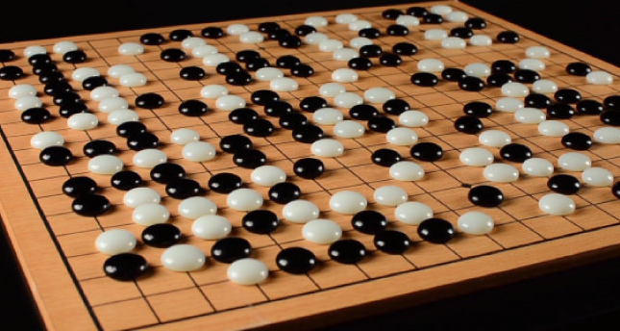
Engines for other Games
William Van Rensselaer
Connect Four [10]
Go [11]
Notes:
Connect Four is a solved game up to board sizes width + height = 15. 1988 by James D. Allen
AlphaGo, developed by DeepMind, beat Lee Sedol 4-1 in March 2016.
More of a neural network/deep learning approach
The advancement of chess engines have encouraged advancement of technologies to play other games.

Slide 27
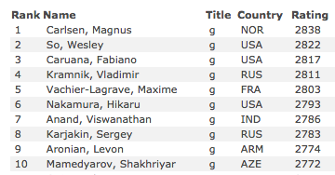

Humans vs. Engines today
William Van Rensselaer
Top 10 Players [5]
Top 10 Engines [6]
348 Elo difference between #1 human and #10 engine
Notes:
Top rated player (Magnus Carlsen) - 2838
Top rated computer (Stockfish 8) - 3391
More than 550 elo (~3 USCF classes) difference
Expert (2000-2199), Class A (1800-1999), Class B (1600-1799), etc
Computers have far surpassed human capabilities in chess

Slide 28
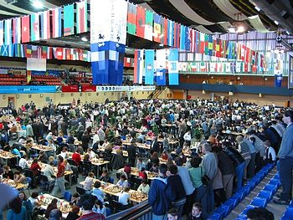
Cheating
William Van Rensselaer
French Team - 2010 World Chess Olympiad [7]
Gaioz Nigalidze – 2015 Dubai Open Chess Tournament [8]
Others, usually involving a smartphone with a chess engine
https://en.wikipedia.org/wiki/Chess_Olympiad
Notes:
Chess engines have allowed new forms of cheating (with far better results)
Three players (Sebastian Feller, Arnaud Hauchard, Cyril Marzolo) of the French team colluded to use a chess engine to decide moves.
Feller won gold medal for his board and 5,000 euros.
They got caught. Feller banned from tournament play for 3 years, Hauchard and Marzolo for 5 years.
Nigalidze (Georgian chess master) used smartphone with a chess engine.
Was caught. Stripped of grandmaster title, banned for 3 years

Slide 29

Intellectual Property
William Van Rensselaer
Rybka Chess Engine accused of plagiarism [9]
Vasik Rajlich used code from Crafty and Fruit
http://www.chessvibes.com/reports/controversy-over-rybkas-disqualification-and-ban-update
Notes:
Rybka won World Computer Chess Championships in 2007, 2008, 2009, 2010
Accused of copying code from the Crafty and Fruit chess engines by ICGA (International Computer Games Association)
ICGA requires engine to be original for competition
Another form of cheating?

Slide 30
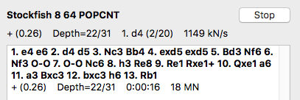
Helping Human Players Improve
William Van Rensselaer
Analyze your games
Validate new ideas
Improve tactical play
Provide new technical challenges
Screenshot (Stockfish 8 on OSX)
Notes:
Engines help you more easily and more accurately analyze your game play
If you are number 1 in the world, how to you improve?
Chess engines provide a way for you to validate creative ideas you come up with
Chess engines are very good at finding tactical variations. Can find deep tactical moves that human players might not catch.
Developing a chess engine is no simple feat. Many complicated algorithms and heuristics are needed for a chess engine to be even remotely good.

Slide 31
Conclusion
William Van Rensselaer
I believe chess engines have benefitted society more than harm it.
Notes:
Augmenting human capability to analyze and improve their play.
Providing new and interesting technical challenges and applying them to other games.
Cheating existed before engines, as did intellectual property issues.

Slide 32
References
William Van Rensselaer
[1] Martin Knudsen (2010). “Creating a chess engine from scratch (Part 1: Basics).” https://www.chess.com/blog/zaifrun/creating-a-chess-engine-from-scratch-part-1 (4/20/2017)
[2] Shannon, C.E. (1950). “XXII. Programming a Computer for Playing Chess.” The London, Edinburgh, and Dublin Philosophical Magazine and Journal of Science.
[3] Elo, Arpad E (2008). “8.4 Logistic Probability as a Rating Basis.” The Rating of Chessplayers, Past&Present. ISHI Press International.
[4] IBM100. Deep Blue. http://www-03.ibm.com/ibm/history/ibm100/us/en/icons/deepblue/ (4/20/2017)
[5] FIDE. Top 100 Players April 2017 – Archive. https://ratings.fide.com/toparc.phtml?cod=445 (4/20/2017)
[6] CCRL Team. CCRL 40/40 Rating List. http://www.computerchess.org.uk/ccrl/4040/index.html (4/20/2017)
[7] FIDE Ethics Commission, Case N. 2/11. http://www.fide.com/images/stories/NEWS_2012/FIDE/FIDE_Ethics_Commission_Judgement_in_the_case_French_Team.pdf
[8] FIDE Ethics Commission, Case N. 7/2015. http://www.fide.com/images/stories/NEWS_2015/FIDE_News/Ethics_case_7_2015_Decision.pdf
[9] ICGA Panel (2011). Rybka Investigation and Summary of Findings for the ICGA. http://www.chessvibes.com/plaatjes/rybkaevidence/RybkaInvestigation.pdf
[10] John Tromp. John’s Connect Four Playground. http://tromp.github.io/c4/c4.html (4/20/2017)
[11] DeepMind Research. AlphaGo. https://deepmind.com/research/alphago/ (4/20/2017)

Slide 33
Class 10
The End
Keith A. Pray
Instructor
socialimps.keithpray.net
Notes:
This is the end. Any slides beyond this point are for answering questions that may arise but not needed in the main talk. Some slides may also be unfinished and are not needed but kept just in case.

