Slide 1
Class 9
Errors Failures Risks
Keith A. Pray
Instructor
socialimps.keithpray.net
Notes:
Here’s the title slide. Excited already, aren’t you?
What is the point of this assignment? (Did SW Teams from the reading pick good test strategies? Will you be able to support your choices if something goes wrong?)
What errors? – Have student record list on board
Who looked for existing test strategies?
Who looked for directions on how to test currency?
Paper Reminders:
National ID average: 6.5
Use #’s and facts instead of “great, a lot, numerous, many, most, much…”
Avoid absolutes unless quoting facts “always, never, must, will…”
Make organization clear, avoid CP R, CP R through out whole paper.

Slide 2
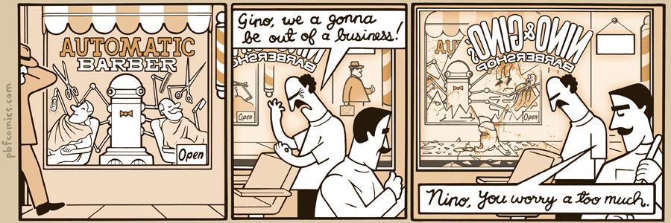
http://pbfcomics.com/197 (2014-09-26)
Notes:
10 – Errors, Failures, Risks
If not used in previous class
Why Electronic Voting is a BAD Idea - Computerphile
https://www.youtube.com/watch?v=w3_0x6oaDmI

Slide 3
Overview
Review
Assignment
Students Present
Guest Speaker
Notes:
We can also discuss articles listed on Security Discussions under documents of course web site.
ADD QUIZ AS BACKUP IF CLASS DISCUSSION OR GUEST SPEAKER FAIL

Slide 4
My Reading Notes
pp. 366 Any false arrests since 1989?
pp. 368 Argument assumes DB cannot exist without existing inaccuracies.
pp. 373 This is not to keep the PATRIOT system from responding to false alarms.
pp. 375 Always encapsulate units!
pp. 378 Why did the Tokyo Stock Exchange refuse?
pp. 380 Republicans and Florida?
pp. 381. Do the second thoughts on DRE machines make the interview at end Chapter’s end less relevant?
pp. 389 No simulation examples since 2002?
pp. 390 Did The Limits to Growth predictions motivate people to change?
pp. 392 What happened to Verification?
pp. 394 “satisfies the specification” = verification. “needs of the user” = validation.
pp. 395 SW quality since 2007?
pp. 396 Gender bias nice addition!
pp. 406 21, source form 2004, is it implemented yet? 23 like game release question in next chapter.
Questions I liked: 10, 12, 16, 17, 18, 20, 21

Slide 5
Assignment – 1 Page Paper
From Chapter 9 In-class Exercises # 24.
Should the company produce the game?
Use the SWE Code Of Ethics as the basis for your argument.
The SWE Code of Ethics should not be the sole source for your premises.

Slide 6
Overview
Review
Assignment
Students Present
Guest Speaker
Notes:
We can also discuss articles listed on Security Discussions under documents of course web site.
ADD QUIZ AS BACKUP IF CLASS DISCUSSION OR GUEST SPEAKER FAIL

Slide 7
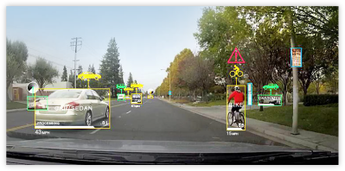
Are self-driving cars reliable?
Mengwen Li
Currently, self-driving cars are not very reliable.
  Technologies required are not fully developed yet.
  Legislation on self-driving cars have not been well-established.
[1]
Notes:
My topic is about “Are self-driving cars reliable”.
My conclusion is that, currently, self-driving cars are not very reliable by itself for two main reasons:
The first reason is that the technologies required by autonomous vehicles are not fully developed yet.
And the second reason is that the legislation on self-driving cars are not well-established across the United States.
I’ll start by talking about the technologies, especially the sensors, used by self-driving cars.

Slide 8
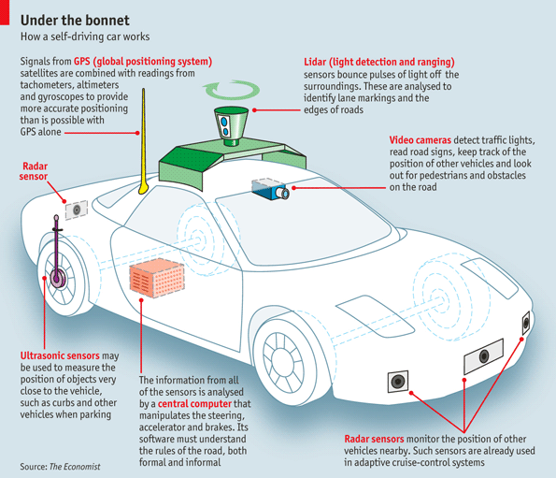
Sensors on Self-driving car
Mengwen Li
Lidar
Cameras
Radar
Ultrasonic sensor
Other sensors such as infrared sensor.
[2]
Notes:
Some important sensors commonly equipped are shown in this figure.
The green one top is a Lidar. Lidar stands for light detection and ranging. It is used to generate 3-D point cloud model of the surroundings.
The blue one below Lidar is a camera. Usually, multiple cameras are used to get the surrounding images of the car. These images can then be used for object detection and lane keeping for example.
The black sensors in the front and back are Radars. Radars can get the distance between the car and other objects.
The purple one on the back wheel is an ultrasonic sensor, which can be used for range sensing at a low speed.
Some other sensors may also be used on the car, for example, an infrared sensor can be used for pedestrian detection.

Slide 9
Each sensor have drawbacks
Mengwen Li
Lidar: Cost $75,000. 80,000 – 100,000 data points / 0.1s. Bad weather.
Camera: Bad weather or extreme light conditions.
Radar: Poor resolution. Atmospheric conditions (moisture, water droplets, dust) also affect performance.
Current Solution: Sensor Fusion
[3][4][5][6][7]
Notes:
Currently, all these sensors have some drawbacks.
For Lidar, it is very expensive. The one used by Google costs $75,000. Also, the point cloud contains too much data to be processed in real-time.
For example, the Lidar used by Ford provides 80,000 – 100,000 data points per 0.1 second.
Lidar also doesn’t perform very well in extreme weather conditions.
Camera also does not work well in bad weather. The images will also have low quality when the environment is too bright or too dark.
For radar, the resolution is low comparing to Lidar and camera. Also, atmospheric conditions, such as dust and water droplets, will also affect radar performance because radar waves are affected.
The current solution for these problems is using sensor fusion technic, which combines data from all sensors to reach a conclusion about current situation of the car.
However, this approach is still not standardized because companies have not even agreed on what sensors a self-driving car should have.
For example, Google and Uber use Lidar, but Nvidia currently relay on multiple cameras[3][4][5][6].
Next, I’m going to talk about driving automation levels and legislations.

Slide 10
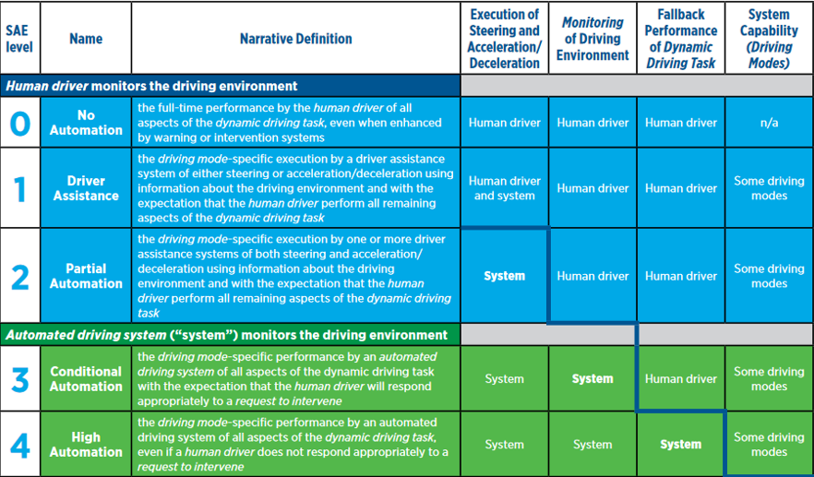
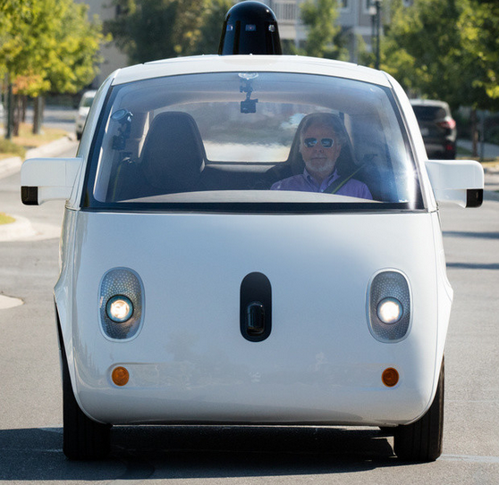
Levels of driving automation
[8][9]
Notes:
According to the definition from Society of Automotive Engineers, there are six levels of automation. The last level is omitted in this picture. The first three levels require drivers to monitor the driving environment constantly.
Currently, the self-driving cars operated by Uber and Tesla all belong to level 2. And the one developed by Google belongs to level 4 since it doesn’t even have a steering wheel.

Slide 11
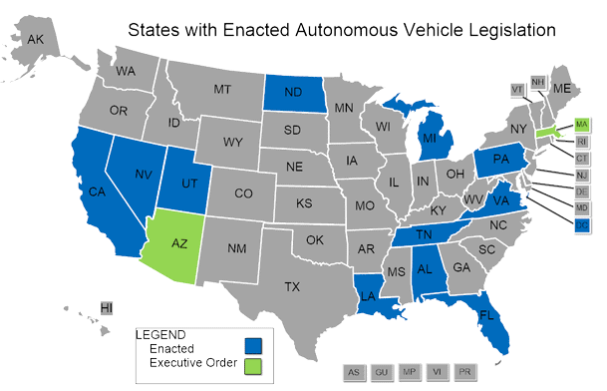
Current Legislation on self-driving cars
Mengwen Li
The majority of states have not reacted to autonomous vehicles.
Legislation issued by different states are different.
Example: Florida and Washington D.C.
[10]
Notes:
This image shows the states with autonomous vehicle legislation.
Since 2012, at least 34 states have considered legislation related to autonomous vehicles, and by 2016, 20 states has introduced legislations.
However, all the gray states have not reacted to autonomous vehicles yet. Also, legislations in different states are different.
States such as Florida, Michigan and California already allows self-driving cars to operate on the road, even without a human driver.
However, states such as Washington D.C. and Virginia allow self-driving cars on public roads only for testing purposes and human drivers must be presented.[10]
Next, I’m going to present two accidents involving self-driving cars.

Slide 12
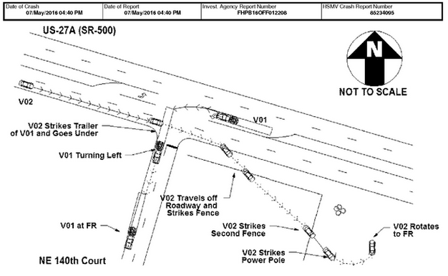
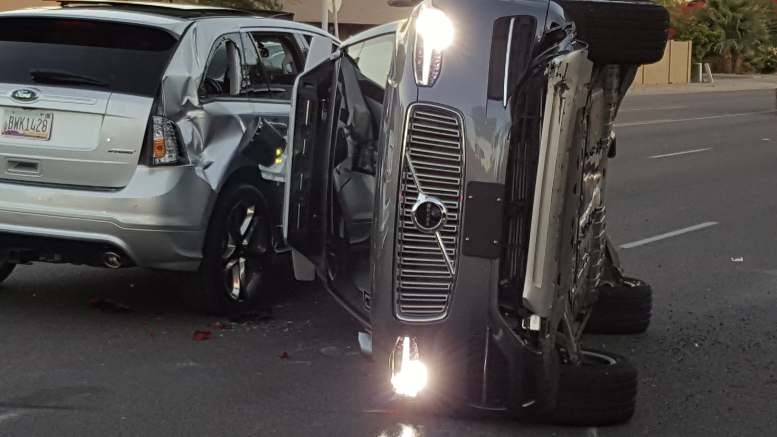
Accidents including self-driving cars
Mengwen Li
Tesla Model S self-driving car accident in 2016.
Uber’s self-driving car crashed in Arizona on March, 2017.
[11][12]
Notes:
The image on the left shows the accident involving Tesla Model S and the right shows self-driving Uber hit by another vehicle.
The Tesla self-driving car accident happened in May, 2016, and this is the first self-driving car accident that causes a person to be killed.
The investigation on Tesla’s accident was started by National Highway Traffic Safety Administration (NHTSA) in June 2016 and lasted 7 months [13].
The purpose of the investigation was to determine whether the accident was caused by the autopilot system on Tesla or by the drive.
According to the investigation, the accident happened because first the Automatic Emergency Braking (AEB) system did not give any warning or automated breaking before the collision happened. Second, the driver also didn’t perform any action to avoid collision.
But, the AEB system was designed only to prevent rear-end crashes and it is not expected to work for crossing path collisions.
Tesla also did their job to inform the system limitation to users. (Require driver to “Always keep your hands on the wheel” and “Be prepared to take over at any time”).
As a result, the NHTSA concluded that the Autopilot system on Tesla was functioning as expected, and it was the drivers fault to not paying attention to road condition.
In the Uber accident, the self-driving Uber was going straight and tries to pass a yellow light, another car turning left hit the Uber on the side and caused it to flip. Fortunately, no one was hurt in the accident.
If it is a human driver, he or she might decide to stop at the yellow light to prevent accidents from happening.

Slide 13
Conclusion
Mengwen Li
Level 2 self-driving cars and are not reliable by itself. Drivers must pay attention all the time to prevent accidents.
The legislations on self-driving cars are also not fully established, which makes them less reliable.
Notes:
My conclusion is that self-driving cars are still not reliable by itself right now because:
First, the self-driving technology is not mature yet. Most commercialized autonomous vehicles belongs to level-2, which require drivers to actively monitoring the environment.
As a result, companies selling self-driving cars need to do their best to inform drivers that they need to pay full attention while driving.
And drivers can not drive carelessly just because the autonomous mode is on.
Second, the legislation on autonomous vehicles are also not fully developed yet.
Not all states have legislations and the rules between states are different. As a result, operating a self-driving car between states is not convenient now.
The process of identifying the respondent if an accident happens is also very long which is around 7 months for the Tesla accident.

Slide 14
References
Mengwen Li
[1]: (n.d.). Self-Driving Vehicles Development Platform | NVIDIA DRIVE PX .... Retrieved April 12, 2017, from http://www.nvidia.com/object/drive-px.html
[2]: (2015, May 12). The Economist explains: How does a self-driving car work? | The .... Retrieved April 12, 2017, from http://www.economist.com/blogs/economist-explains/2013/04/economist-explains-how-self-driving-car-works-driverless
[3]: (2016, July 29). Tesla & Google Disagree About LIDAR -- Which Is Right .... Retrieved April 12, 2017, from https://cleantechnica.com/2016/07/29/tesla-google-disagree-lidar-right/
[4]: Pandey, G., McBride, J. R., & Eustice, R. M. (2011). Ford campus vision and lidar data set. The International Journal of Robotics Research, 30(13), 1543-1552. doi:10.1177/0278364911400640
[5]: (n.d.). factors affecting radar performance - Electronics Technician. Retrieved April 13, 2017, from http://electronicstechnician.tpub.com/14089/css/Factors-Affecting-Radar-Performance-14.htm
[6]: (n.d.). Autopilot | Tesla. Retrieved April 12, 2017, from https://www.tesla.com/autopilot
[7]: (2016, August 17). End-to-End Deep Learning for Self-Driving Cars - Parallel Forall - Nvidia. Retrieved April 12, 2017, from https://devblogs.nvidia.com/parallelforall/deep-learning-self-driving-cars/
[8]: (n.d.). automated driving - SAE International. Retrieved April 12, 2017, from https://www.sae.org/misc/pdfs/automated_driving.pdf
[9]: (n.d.). Waymo. Retrieved April 12, 2017, from https://waymo.com/
[10]: (n.d.). Autonomous Vehicles | Self-Driving Vehicles Enacted Legislation. Retrieved April 12, 2017, from http://www.ncsl.org/research/transportation/autonomous-vehicles-self-driving-vehicles-enacted-legislation.aspx
[11]: (2016, June 30). Self-Driving Tesla Was Involved in Fatal Crash, U.S. Says - The New .... Retrieved April 12, 2017, from https://www.nytimes.com/2016/07/01/business/self-driving-tesla-fatal-crash-investigation.html
[12]: (2017, March 30). Police: The self-driving Uber in the Arizona crash ... - Business Insider. Retrieved April 12, 2017, from http://www.businessinsider.com/uber-self-driving-car-accident-arizona-police-report-2017-3
[13]: (2017, January 19). DOT NHTSA ODI Document. Retrieved April 12, 2017, from https://static.nhtsa.gov/odi/inv/2016/INCLA-PE16007-7876.PDF

Slide 15
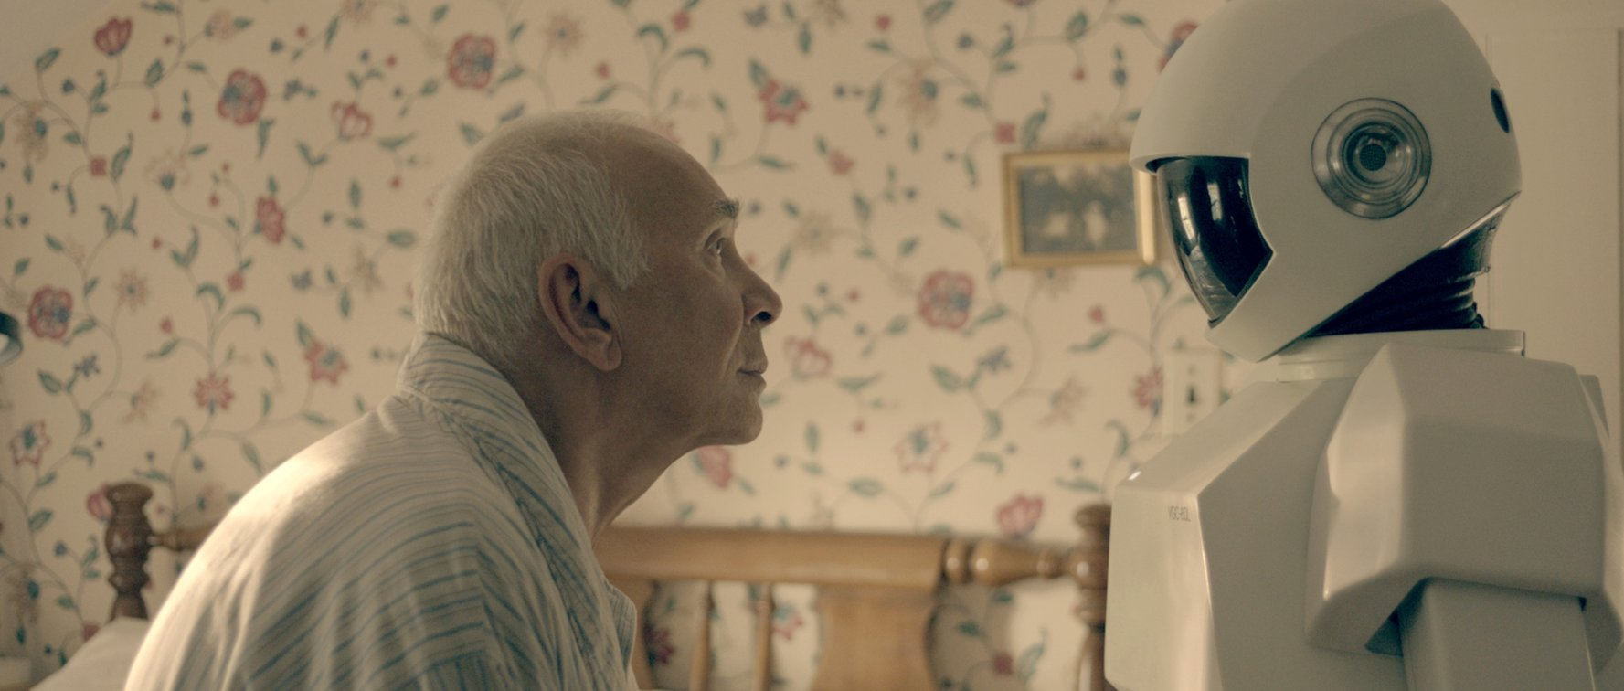
Robotic caregivers
Arianna Kan
Moral Responsibility
  Developers should not be held liable for the blame of a system malfunction
[9]
Notes:
It is my conclusion that developers should not be liable for the blame of a system malfunction. However, there is very little data regarding system or software failures of robotic caregivers because of the youth of this field. Instead we will focus on hypotheticals when answering this question. Firstly though, I would like to introduce the aspect of robotic caregivers.

Slide 16
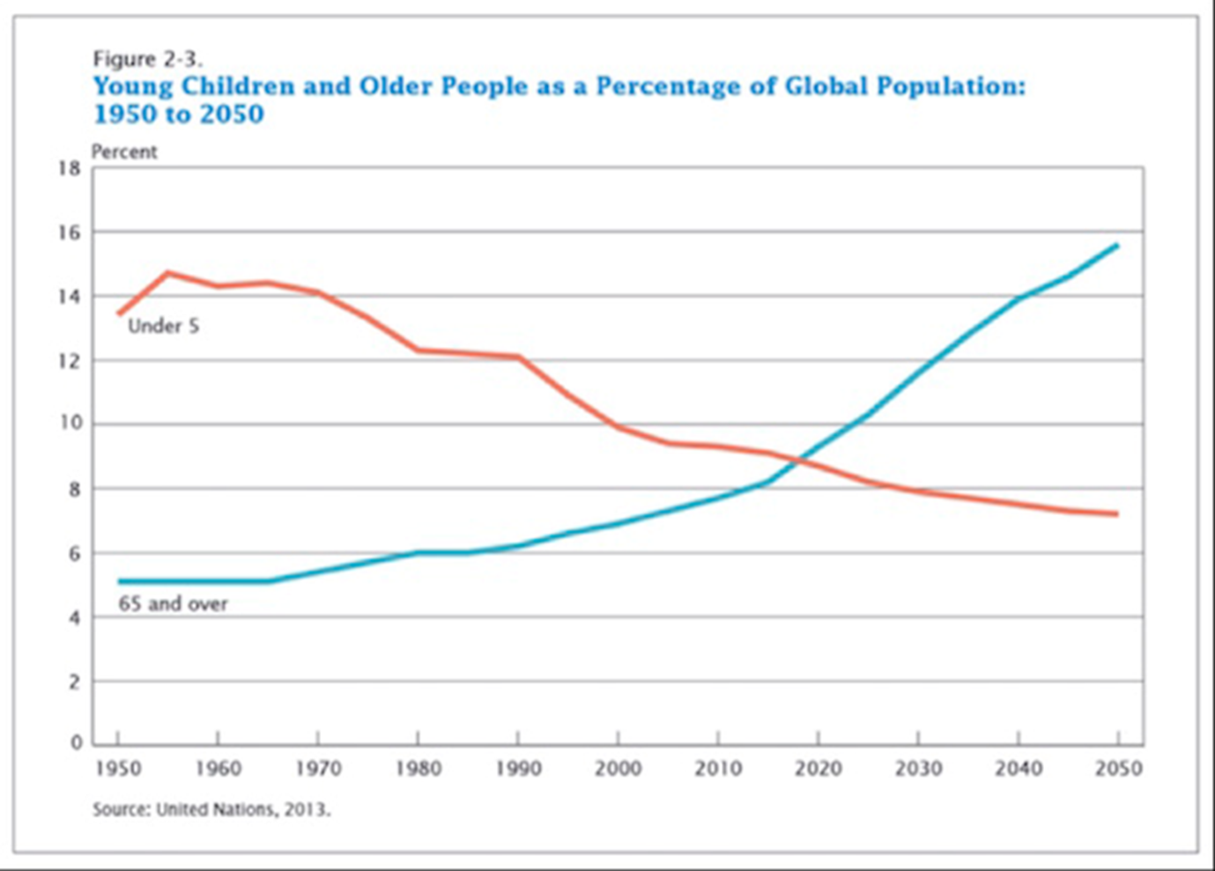
What is the problem?
Arianna Kan
There is an increase in need for caregivers as the population of seniors continues to grow
[2] ZeroHedge – chart demonstrating the increasing disparity between youth and older adults
Notes:
There is an increase in the need of caregivers as the percentage of people over the age of 65 continues to grow while the percentage of people under the age of 5 continues to shrink. This growing disparity is especially notable in Japan, the oldest nation in the world with the fastest aging population. In fact, 20% of Japan’s current population is 65 or older, whereas 13% of the US’s population is 65 or older. However, that number is expected to nearly double by 2050. As countries witness a climbing number of seniors, the amount of caregivers remains stagnant.

Slide 17
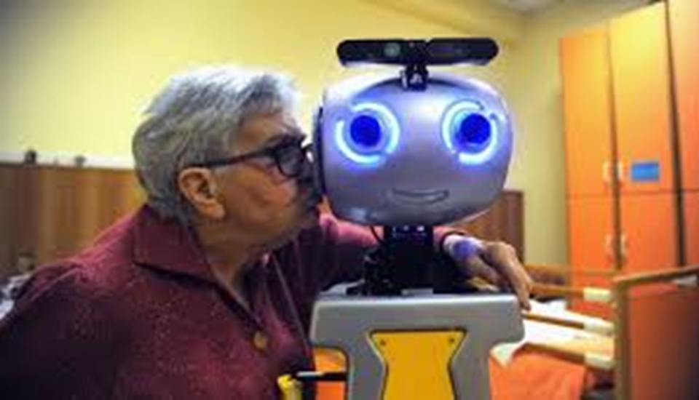
What are robotic caregivers
Arianna Kan
Benefits
Communication tool
Promote independence
Fill care gaps
Provide companionship
Decrease burden on family and friends
San Lorenzo, Italy [2]
Notes:
They come in many different forms, but their main goal is to relieve human caregivers and family members from the stress of taking care of the growing number of elderly in the world.
There are many potential benefits that robotic caregivers could provide, such as serving as a communication tool, promoting independence, filling care gaps, providing companionship, and most of all, decreasing the burden on family and friends. [6]
For many older adults, their greatest fear is ending up in a nursing home, yet many do not like the idea of strangers in their house any better. These robotic caregivers can fill these gaps, providing a solution that allows these patients to retain their independence without burdening their family.
Most robotic caregivers are equipped with sensors and cameras to supervise an elderly person reminding them about daily tasks, some act as telepresence machines to bridge the gap between health-care professionals and the elderly, some act as companions to engage their minds

Slide 18
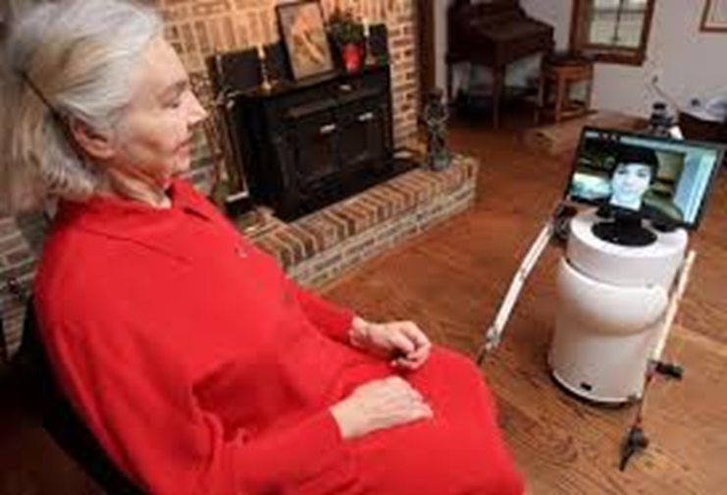
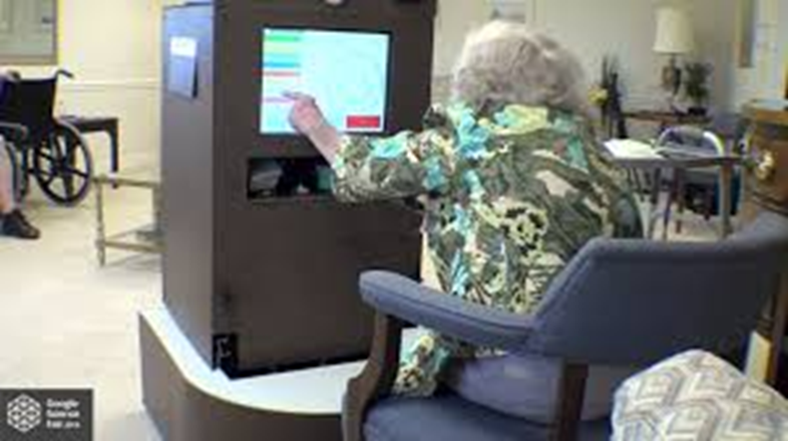
Inspiration for this topic
Arianna Kan
Ben Hylak
  MAYA - $500
    Commercial telepresence: $15,000
  ALAIR - $1250
MAYA telepresence robot [1]
ALAIR health aid robot [1]
Notes:
My inspiration for pursuing this topic came from a guy that currently attends WPI. I don’t know if many of you have heard of Ben Hylak, but I met him once and learned about the many projects he had done, including his most recent and progressive projects: ALAIR (assisted living autonomous internet robot) and MAYA (me and you anywhere). Both of these robots meet the needs of an aging population.
MAYA – where telepresence robots were almost exclusively $15,000, he developed MAYA for only $500 and received numerous awards for his product (even invited to the White House Science Fair to meet Obama)
ALAIR – created for only $1250, it has the ability to take vitals and detect falls, dispense medication, and connect to off-site professionals through videochats.

Slide 19
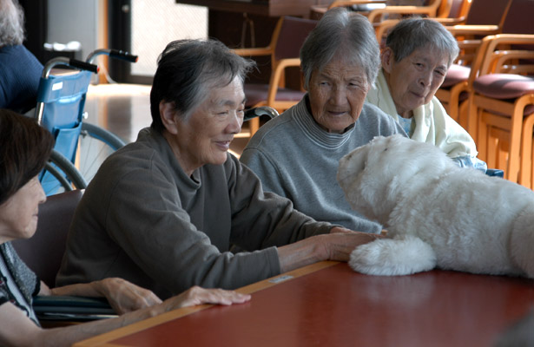
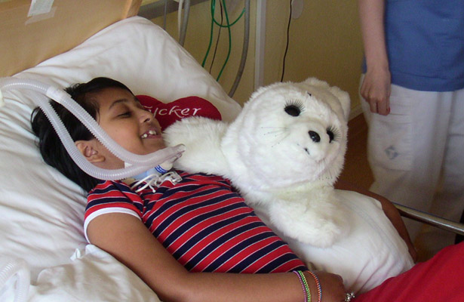
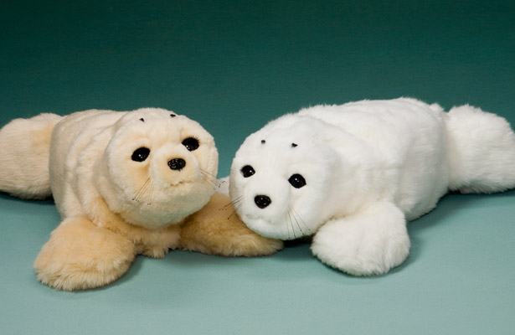
Official products - Robot supported caregiving
Arianna Kan
PARO - $6000 [3]
  Assisted living homes: $3500 a month
  Live-in nurses: $700 - $3000 a week
Notes:
Because robotic caregiving is a young research field, there are not many official products out on the market. However, there are 2 types of caregiving technologies that I would like to address: robotic caregivers and robot-assisted caregiving. These 2 types differ in their role in the caregiving field. PARO is an assistive robot and is meant for companionship. Whereas most other robots within the field aim to aid older adults in the mundane tasks any family member or caregiver must perform. I will expand upon this in the next slide.
It has been well established that social isolation is a serious health risk, particularly for the elderly. Studies have shown that social isolation increases an individual’s risks of dying by 26%, regardless of the cause of death. [4]
PARO is an advanced interactive robot developed by AIST, a leading Japanese industrial automation pioneer. PARO is a socially assistive robot intended as a therapeutic instrument mainly for patients with dementia. It is modeled after a baby harp seal and has been found to reduce patient stress. It can learn to behave in a way that the user prefers and responds to auditory stimuli. It is an 8th generation of a design that has been in use in Japan and throughout Europe since 2003. [3] it costs $6,000 and is classified by the US government as a class 2 medical device.
*images also come from the same website [3]

Slide 20
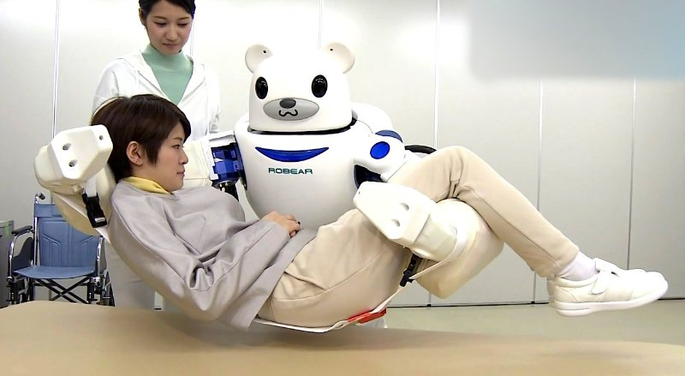
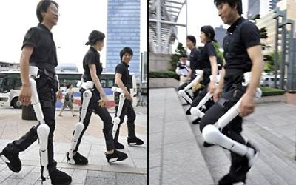
Other products- Robot caregiving
Arianna Kan
RoBear [8]
GiraffPlus [8]
HAL (Hybrid assistive limb) [7]
[8] RoboBear
[7] HAL
Notes:
And then there are the robot caregivers. These are a list of several types of robotic caretakers that focus on the physical health of an older adult.
Robear (designed by sumitomo riko company in Japan) the robot is capable of lifting patients out of bed and into wheel chairs or aid patients who need assistance walking.
GiraffPlus (sweden) a telepresence robot that serves as a vacuum cleaner, standing mirror, a video-chat android that stands in for family time and doctor visits, and a health metrics monitor that can measure and record key variables such as blood pressure and temperature.
Hybrid Assistive Limb (HAL) (Cyberdyne) is currently the most advanced robotic exoskeleton on the market. It could greatly improve the mobility of elderly or disabled people who wear it, expanding the capabilities of the human body.
It is a hybrid system composed of a cybernics voluntary control system that provides complete control of the HAL suit using bioelectric signals and a cybernics robotic autonomous control system.
Cybernics is a very new research field that combines cybernetics, informatics, mechatronics and human body research.
All of these products have passed test demonstrations, however, it will be some time before they reach any form of commercial production.

Slide 21
Summary
Arianna Kan
Growing number of seniors in the world → increased need for caretakers
Growing field of robotic research and projects involving caregivers
Moral responsibility
  Should developers be held liable for the malfunction of a caregiving robot?
No
Notes:
Because robotic healthcare is a relatively young field, there have not been any reports regarding system failures in robotic caregivers. That may be because there are so few robotic caregivers actually in commercial use and many do not yet pose these levels of sophistication. Many products are also too expensive and inaccessible for many people to attain, due to the complexity of the robot and its system. So instead, we will focus on the hypothetical case of who is liable for the blame if an autonomous caregiver robot suddenly malfunctions and causes human harm. My personal opinion is that moral responsibility is tricky. It should be able to differ depending on the situation; however, my conclusion is that the developers of robotic caregivers should not be held liable. Remember that medical machines, including robotic caretakers, are extremely complex and must integrate many different components. And it is well understood that the more components there are in a system, the more likely an error may occur. In fact, according to Murphy’s laws, every non-trivial program has at least one bug. If the robot has passed through a thorough amount of testing and inspection, if the developers see nothing that could possibly be wrong with it (and if they make it clear that they should not be held legally liable for an unseen system error), then they should not be at blame should an accident occur. As seen in the reading, there are two conditions that must hold for a moral agent to be held responsible for a harmful event: the casual condition and the mental condition.
Casual condition: actions or inactions of agent must have caused the harm
Mental condition: the actions or inactions must have been intended or willed by agent.
So say for example, if the roBear malfunctioned and caused harm to its patient, who would be held responsible for this event, or if the GiraffPlus recorded the wrong information about the patient and it caused an overdose in medication? These software malfunctions would be flukes that many times developers would not be able to guess would happen, as seen with AECL and their Therac-25. It is only when they choose to not do anything about it would future malfunctions be considered their fault.

Slide 22
References
Arianna Kan
[1] "Benjamin Hylak." Home. N.p., n.d. Web. 12 Apr. 2017. <http://www.benhylak.com/>.
[2] Durden, Tyler. "6 Charts That Show the Global Demographic Crisis Is Unfolding." ZeroHedge. Mauldin Economics, 06 Jan. 2013. Web. 12 Apr. 2017. <http://www.zerohedge.com/news/2016-05-02/6-charts-show-global-demographic-crisis-unfolding>.
[3] PARO Therapeutic Robot. PARO Robots U.S., Inc., 2014. Web. 12 Apr. 2017. <http://www.parorobots.com/index.asp>.
[4] Dvorsky, George. "Chilling Ad Underscores the Insanity of Caregiving Robots." Gizmodo. Gizmodo.com, 11 Oct. 2016. Web. 12 Apr. 2017. <http://gizmodo.com/chilling-ad-underscores-the-insanity-of-caregiving-robo-1787653450>.
[5] Pfadenhauer, Michaela, and Christoph Dukat. "Robot Caregiver or Robot-Supported Caregiving?"SpringerLink. Springer Netherlands, 30 Jan. 2015. Web. 12 Apr. 2017. https://link.springer.com/article/10.1007/s12369-015-0284-0
[6] Aronson, Louise, MD. "10 Potential Benefits of Robot Caregivers." KevinMD.com. MedPageToday's, 05 Aug. 2014. Web. 12 Apr. 2017. <http://www.kevinmd.com/blog/2014/08/10-potential-benefits-robot-caregivers.html>.
[7] George, Dragos. "How Hybrid Assistive Limb (HAL) Exoskeleton Suit Works." Smashing Robotics. N.p., 12 June 2014. Web. 12 Apr. 2017. <https://www.smashingrobotics.com/how-hybrid-assistive-limb-hal-exoskeleton-suit-works/>.
[8] Calderone, Len. "More Industrial Automation, Robots and Unmanned Vehicles Resources."The New Family Member: A Robotic Caregiver | RoboticsTomorrow. Robotics Tomorrow, 08 Dec. 2015. Web. 12 Apr. 2017. <http://www.roboticstomorrow.com/article/2015/12/the-new-family-member-a-robotic-caregiver/7312/>.
[9] “Robert and Frank: Photo Gallery." IMDb. IMDb.com, n.d. Web. 14 Apr. 2017. <http://www.imdb.com/title/tt1990314/mediaindex?ref_=tt_pv_mi_sm>.

Slide 23
SPEECH RECOGNITION
Yudi Wang
CONCLUSION:
There are benefits in Speech Recognition, but because of accuracy and limitation, it still need to be improved to become a major input methodology.
Notes:
Hello everyone I’m Yudi. My topic today is Speech Recognition, which is a quite popular technology now.
Just think about it.
During your daily online searching, do u prefer typing with keyboard or input with microphone? I believe most of u guys still prefer typing with keyboard right?
My conclusion is there are indeed benefits in Speech Recognition, but because of accuracy and limitation, it still need to be improved to become a major input methodology. I will go through the main technology behind it first and the daily usage of it.
I will also discuss with you guys the future of Speech Recognition.

Slide 24
Speech Recognition engine
Yudi Wang
Language Model or Grammar
  Recognize speech and Wreck a nice beach
Acoustic Model
[2]How Speech Recognition Works
Notes:
Speech recognition works with the following components in the speech engine:
The first part is language model or grammar, which can help distinguish between words sound similar. Language models, just like a dictionary, contains a large vocabulary list and the occurrence probability. Grammars contain different kinds of combination of words.
In speech recognition, the computer tries to match sounds with word sequence. The language model provides context to distinguish between words and phases that sounds similar. For example, the phrases ”recognize speech” and “wreck a nice beach” are pronounced almost the same but have totally different meanings. These ambiguities are easier to resolve when evidence from the language model is incorporated with the acoustic model.
And then audio captured by microphone or telephone will turn into a waveform, a mathematical representation of sound, which provides to the speech engine and let it compare with the other component, Acoustic Model. With the incorporation of Language Model or Grammar, the engine will search its acoustic space, and output the most closely matches result.

Slide 25
daily life usage
Yudi Wang
Everyday Usage [3]
  Telephone voice commands
  Home listening device
Disability Usage [4]
  Learning[6]
  Creativity
[1]Voice-recognition software can help disabled people gain employment.
Notes:
Nowadays, a large number of speech recognition applications benefits our daily lives such as telephone voice commands,
which users can just speak some words to control the operation,
home listening devices like Google Home and Amazon Echo, which Jordan has introduced a lot,
and intelligent personal phone assistant like Siri and Cortana.
These kinds of applications really ease most person’s life. And also, Speech Recognition can benefit disabled person. For people who blind, deaf, or have trouble with hands, they can control computer to take learning courses by voice. If they want to do creative work such as writing books, speech recognition software can provide them with a way to keep their writing production.

Slide 26
Disability statistics
Yudi Wang
56.7 Million
  People in US in 2010 with a disability
27.7 Million
  May need speech recognition
[7]How Common are Specific Disabilities
Notes:
Persons with a disability have a physical or mental impairment that affects one or more major life activities, such as walking, bathing, dressing, eating, preparing meals, going outside the home, or doing housework. A disability can occur at birth or at any point in a person's life.

Slide 27
Errors and failures
Yudi Wang
Accent and Dialect
Speaking Speed
Noise
Notes:
However, because of the diversity of people, vocalizations vary in terms of accent, pronunciation, articulation, volume, and speed. As a result, the accuracy of speech recognition may also vary with these issues.
Because of the language constraints, for example, as you can see in the figures, which represents the vocabulary, sentence processing, and passage comprehension of native vs nonnative speakers in US, Canada, International Sample, UK, Ireland, Italy, and Spain. United States non-native speakers show a very low correct percentage, which may lead to the fact that they have trouble with the pronunciation and understanding of English words, it may cause misrecognition while using speech recognition tools so that lead to misunderstanding of the context.
Speech recognition nearly always involves listening in background noise. The impact of such noise on speech signals and on intelligibility performance increases with the separation of the listener from speaker.Its inability to sort through background noise will also lead to inaccuracy.

Slide 28
Summary and future
Yudi Wang
Summary
  Easy to use and access
  Accuracy and Limitation
Future
  New interaction way
  From Recognition to Understanding
[8] Mother in Alien
Notes:
As a summary, we should say that there are benefits and advantages in Speech Recognition: it’s easy to use, you just need to say something, the speech engine will take care of everything; It’s easy to access, speech recognition software now are frequently used in computer and mobile devices areas. Just as Siri and Cortana I mentioned before, you can have access to them everyday right.
However, because of the difference of pronunciation, various speed of speaking, and the disturbance of background noise, speech recognition may sometimes lead to risks and failures.
In future, as the development of high technology such as Artificial Intelligence, Virtual Reality, voice control should become new major interaction way. For example, although Google Glass, which start with voice control “okay, glass”, is not a prevalent high-tech item now, I believe this kind of items will be popular few years later.
My another consideration is, just like numerous movies have shown us, advanced computer systems use voice control as the major interaction, such as Mother in Alien and Red Queen from Resident Evil. Actually instead of saying they use speech recognition technology, it’s more like a speech understanding. We can talk to computers and mobile devices today, maybe within 5 years, these guys can understand our mind and chat with us just like old friends.

Slide 29
References
<Your Name>
[1] Is voice recognition software a healthier way of working? (2015, August 27). Retrieved April 13, 2017, from http://www.personneltoday.com/hr/freedom-speech-voice-recognition-software-healthier-way-working/
[2] How Speech Recognition Works. (n.d.). Retrieved April 13, 2017, from http://www.lumenvox.com/products/speech_engine/
[3] Speech Recognition for Learning. (n.d.). Retrieved April 13, 2017, from http://www.brainline.org/content/2010/12/speech-recognition-for-learning_pageall.html
[4] Noyes, J., & Frankish, C. (1992). Speech recognition technology for individuals with disabilities. Augmentative and Alternative Communication, 8(4), 297-303. doi:10.1080/07434619212331276333
[5] Speech recognition technology allows voice control of aircraft systems. (n.d.). Retrieved April 13, 2017, from http://newatlas.com/go/7484/
[6] Noyes, J., Haigh, R., & Starr, A. (1989). Automatic speech recognition for disabled people. Applied Ergonomics, 20(4), 293-298. doi:10.1016/0003-6870(89)90193-2
[7] Bureau, U. C. (2016, February 16). Recent U.S. Disability Statistics from the Census Bureau. Retrieved April 14, 2017, from https://www.disabled-world.com/disability/statistics/census-stats.php
[8] O., & K. (2011, April 22). Top Ten Movie Computers. Retrieved April 14, 2017, from http://ohnotheydidnt.livejournal.com/58601274.html

Slide 30
Class 9
The End
Keith A. Pray
Instructor
socialimps.keithpray.net
Notes:
This is the end. Any slides beyond this point are for answering questions that may arise but not needed in the main talk. Some slides may also be unfinished and are not needed but kept just in case.

Slide 31
Reliability Of Statistics
Are other factors controlled?
Is enough time covered?
Is all data reported?
Use Intuition
  Are results reasonable?
Notes:
Power line dangers. Electromagnetic fields? PCBs in transformers?

Slide 32
Cost-Benefit Analysis
How much does it cost?
What do I get for this cost?
Notes:
Like a social contract.

Slide 33
Risk-Benefit Analysis
What could go wrong?
How likely is it?
How costly are the consequences?

Slide 34
Limitations to
Risk-Benefit Analysis
Hard to quantify probabilities
Hard to quantify costs
Who bears the costs?
Are the potential benefits worth it?
Notes:
What is the value of a human life?
What is the value of a species?
E.g. future generations, poor people.
Omelas

Slide 35
Some Measures
Mean Time To Failure (MTTF)
Mean Time Between Failures (MTBF)
Mean Time To Repair (MTTR)
Notes:
Is it repairable?
What does it mean to repair? Running again? Data fixed? Caught up?
Restoring the GBC Web site.

Slide 36
Relying Too Much
Limits of modeling reality
Limits of precision
Limits of algorithms
Limits of interpretation
Notes:
Battle of the X-Planes
Trusting the statistics. Are differences significant?
Colin Chapman’s Lotus 7 chassis.

Slide 37
Producing Good Software
Good specifications
Good usability
Good design
Robustness
Good implementation
Testing
Notes:
Specs: Know what you are going to do. Often difficult. What does the customer want? What does the customer need?
Usability: Logical and intuitive, Consistent, Helpful, Complete, Accessible, Disability. Complete—not have to write things down.
Design: Logical, Modular, Consistent, Well-specified, Flexible, Extensible, Adaptable, New features, new platforms.
Robustness: Tolerant of data errors, Tolerant of human errors, Tolerant of network errors, Enough detail / not too much. Stack trace vs. “?” “A script error has occurred. Do you want to debug?”
Implementation: Adequate hardware (E.g. memory, storage, speed), Adequate software (Languages, OS, libraries), Internal and external documentation
Testing: Should be at all phases of the development cycle. Plan ahead for it. Consistent, repeatable, documented. Regression testing.

Slide 38
Plan For The Long Term
Version control
Future development
New platforms
Patches
Security
Training
Customer support

Slide 39
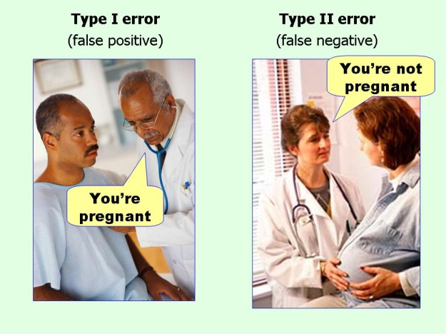
marginalrevolution.com/marginalrevolution/2014/05/type-i-and-type-ii-errors-simplified.html (2016-04-11)

