Slide 1
Class 7
Privacy and Government
Keith A. Pray
Instructor
socialimps.keithpray.net
Notes:
After this class we will be half done with the course… very sad I know.
Play Somebody’s Watching Me (1984) – Rockwell
Be the envy of all your classmates if you know the band and/or year:
Rockwell (1984) Michael Jackson sings chorus and Jermaine Jackson on backing vocals.
Self Search paper – 6.0
Paper averages to date:

Slide 2
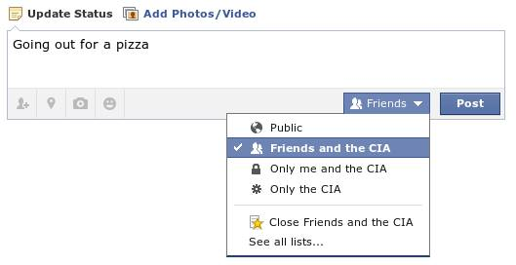
Notes:
Source?

Slide 3
Overview
Survey
Review
Assignment
Students Present

Slide 4

Notes:
Source?
Let’s see who said National ID yes and no. Let’s debate!

Slide 5
Debate Ground Rules
Before Debate
  15 minutes to converse with your team
  Share argument points, counter points, and responses so everyone can represent
  Decide who will respond to what points from the opposing side
During Debate
  Stand up when speaking
  1 turn per person until everyone on your team has spoken
  30 second limit
  Switch sides at any time when you change your mind
Notes:
National ID or Not Debate

Slide 6
My Reading Notes
pp. 274 Arrests, altering and deleting records are violations of privacy?
pp. 275 Why not try to verify and correct records?
pp. 276 Figure does not show # cameras increasing.
pp. 277 300 times = frames, locations, …?
pp. 289 “…don’t want anyone to know…” like seeking medical advice, etc.?
UPDATE
pp. 291 Just because it’s been happening for years doesn’t make it right.
pp. 297 Wouldn’t it be easy to make and show a fake SSN card?
pp. 298 Confusing false positive and negative explanations.
End of Chapter questions: 1, 31, 51

Slide 7
Group Quiz
List two problems with using biometrics for identification.
List two advantages of using biometrics for identification.
Describe two tools people can use to protect their privacy on the Web.
For each of the 4 categories of Daniel Solove’s privacy taxonomy give an example not listed in the book.

Slide 8
Overview
Survey
Review
Assignment
Students Present

Slide 9
Assignment – Group Project
Catch up on reading
Add list of computing technologies portrayed in movie
Categorize computing technologies as existing, future, emerging, impossible, plausible with rationale
Add analysis to group project website addressing all topics covered to date
See group project slide deck for more
Notes:
Movie group project:
Technology group project:
Add list of movies portraying your computing technology
State if the computing technologies was existing, future, or emerging

Slide 10
Overview
Survey
Review
Assignment
Students Present

Slide 11
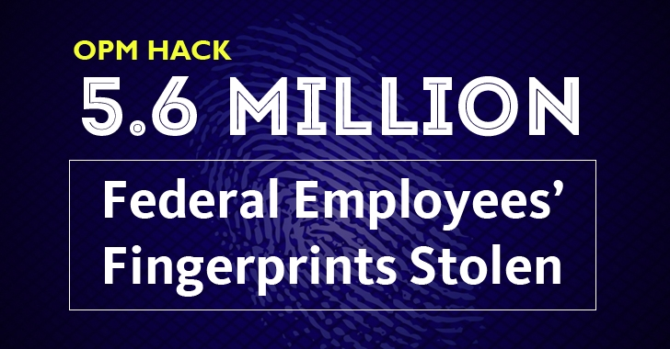
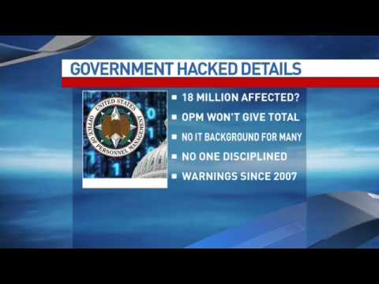
The Attack
Christian Roberts
Timeline
  One full year of access.
  Slow and Steady pinging of information to opmsecurity.org[1]
Information compromised
  Personnel info
  Verification info
  Biometrics
The fun part!
  I’ll get to this, be patient.
[6]
[7]
Notes:
Timeline:
The attackers made their way in between March or April of 2014. Activity was only noticed April 2015. The announcement was made in June (delays were to keep hackers from knowing and protocol).
opmsecurity.org was owned by “Steve Rogers”, a Captain America-inspired pseudonym used by one of the hackers. Site was used to collect data over time.
Information Compromised:
Addresses, names, SSNs, everything to uniquely identify an individual. <- 21 million people
Hackers had gotten legitimate access data, usernames and passwords.
Biometrics made completely useless. agents identifiable by their biometrics.
Fun Part:
This was not the first time this has happened. Shortly before this breach began (March 2014), there was another breach of the OPM. They stole network architecture information.

Slide 12
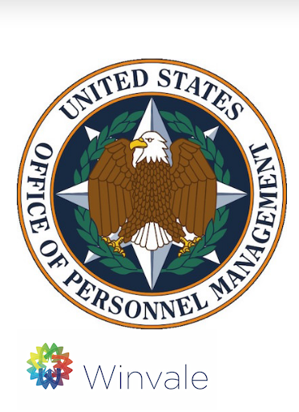
Accountability
Christian Roberts
How we treat private companies
  We provide them trust in exchange for a service.
  Essentially no legal ramifications[3]
  We can discontinue services.
How the government reacted to OPM hacks
  Katherine Archuleta stepped down.[2]
  Self-monitoring Website.[5]
  Security has been increased.[4]
[8]
Notes:
Private companies:
Give them delicate information for a better service. Sometimes they collect data without our permission, Apple and google admitted to collecting location data without permission[3].
Companies don’t often get punished. After all, it is the hackers who committed the crime. Company policies often protect themselves. We speak with our wallets and business, if we are dissatisfied, we leave.
We have a choice when it comes to companies, not when it comes to the government.
Government reaction:
Katherine Archuleta, the Director of the Office of Personnel Management, stepped down. “Of her own volition”. Obama mentioned her not having expertise in cybersecurity[2].
csid.com/opm was made to notify people of the security breach. Tells people how much of their information was taken, provides more services.
New security measures include second one-time passwords for new computers. Can’t access gmail from office computers. More training against phishing attacks.

Slide 13
Accountability discussion
Christian Roberts
Was it enough?
  Changes were made, not just patches.
  Why wasn’t the reaction bigger the first time?
What if someone was hurt?
  Does that make a difference?
  This data exists somewhere.
Notes:
If you can argue that you are doing your best to protect it, is it enough? “If you can’t protect it, don’t request it”. Is it better to not have the information you need? I would personally prefer the country continue to operate.
The first hacks didn’t have this giant increase in security. Why? Was it not big enough? The hack had network architecture blueprints. They should have been FREAKING OUT. Why not react then? Don’t incite panic?
Do you need people to be hurt, more than just “in danger”? Is that worse or the same?
The best reaction the government had was providing information theft protection services moving forward to victims.

Slide 14
References
Christian Roberts
[1] Koerner, Brendan I. "Inside the Cyberattack That Shocked the US Government." Wired. Conde Nast, 23 Oct. 2016. Web. 06 Apr. 2017.
[2] Davis, Julie Hirschfeld. "Katherine Archuleta, Director of Personnel Agency, Resigns." The New York Times. The New York Times, 10 July 2015. Web. 06 Apr. 2017.
[3] Bilton, Nick. "Holding Companies Accountable for Privacy Breaches." The New York Times. The New York Times, 27 Apr. 2011. Web. 06 Apr. 2017.
[4] Naylor, Brian. "One Year After OPM Data Breach, What Has The Government Learned?"NPR. NPR, 06 June 2016. Web. 06 Apr. 2017.
[5] Bennett, Cory. "OPM Launches Self-check Website for Hack Victims." TheHill. The Hill, 04 Feb. 2016. Web. 06 Apr. 2017.
[6] Khandelwal, Swati. "5.6 Million Federal Employees' Fingerprints Stolen in OPM Hack." The Hacker News. N.p., 24 Sept. 2015. Web. 07 Apr. 2017.
[7] ABC7DC. "Government OPM Hack Hearing." YouTube. YouTube, 16 June 2015. Web. 07 Apr. 2017.
[8] csid.com/opm

Slide 15
Cyberwarfare Defense and ethics
Walter Gallati
Overview
  Background
  Coercive Power and Government
  Examples of Cyberwarfare
  Courses of Action
Notes:
Briefing overview
Background – basic definitions to define argument

Slide 16
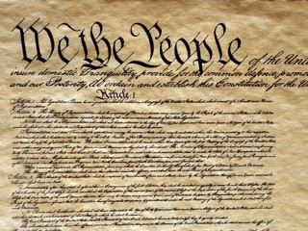
Background
Walter Gallati
Purpose of Government
  Ensure Domestic Tranquility, Provide for Common Defense, and Secure Blessings of Liberty [1]
Power
  Ability to exert will over others’ (Weber) [2]
  “Monopoly of Violence” [3]
http://abcnews.go.com/images/News/gty_us_constitution_jef_111215_mn.jpg
1, 2, 3
Notes:
Purpose of Government-
Basing off of US Constitution, as referencing US Govt.
Focusing on three of the tenets of the constitution as defined in Preamble: Ensure Domestic Tranquility, Provide for Common Defense, Secure Blessings of Liberty
Power-
Using Max Weber’s definition, the ability to exert your will over/in defiance of others’.
Ethics of destructive action references “Monopoly of Violence” (proposed by Weber, modified by Hobbesians) which states that the power to do harm is only assigned to one group in a society (ie. the Government) and any acts outside of it are unethical and lacking authority. Other groups’ use of violence, once accepted, can undermine state monopoly of violence

Slide 17
Coercive power of the individual vs the government
Walter Gallati
Force Multipliers [4]
  Expansion of individual’s capability to project power
  Not limited to government
  Level the playing field
  Not innately physical
Information Age
  Bureaucracy vs Flexibility
4
Notes:
Force Multipliers-
Force multipliers are tools that allow an individual to multiply the amount of power they have. It is often used to describe weaponry; ie, a sword will be more intimidating than fists, a gun more intimidating than a sword.
Governments do not have a monopoly on force multipliers – they can be regulated, but their purpose is still to multiply the power of an individual, regardless of affiliation
Force multipliers are able to “level the playing field” between a singular person and a more populous opposition. For example, in Vietnam, the smaller, more poorly-trained North Vietnamese Army went toe-to-toe with larger, wealthier South Vietnamese and American military forces thanks to their fielding of the Assault Rifle. The Assault Rifle has been regarded as a tipping point for force equalizers, as it gives the individual the capacity to produce a large amount of firepower with minimal effort from the user.
Force multipliers do not have to be physical. A single individual, using code that they wrote, can take down entire commercial and governmental systems (as we will see in the next slide)

Slide 18
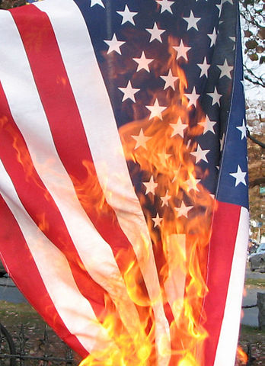
examples
Walter Gallati
Operation Shady RAT (2006-2010) [5]
Shamoon (2012) [6, 7]
Red October (2013) [8]
OPM Breach (2015) [9]
WikiMedia
5, 6, 7, 8, 9
Notes:
Examples:
Operation Shady RAT: Penetration of commercial and government networks over the course of four years, collecting database information from the UN, Olympic Committees, regional organizations, and defense contractors.
Shamoon: A virus targeting hard drives, responsible for damaging or destroying over 30 thousand computers at Saudi oil company Aramco. The virus would completely erase the hard drive, leaving nothing but this picture of a burning American flag.
Red October: Information gathering software that has collected passwords, documents, and emails from governments and companies all over the world, including those in the EU, America, and Russia. It has been found in over 65 countries and infected over 677 computers in the United States alone.
OPM Breach: A massive breach conducted through a contractor’s site, collecting access to files of ~4 million government employees

Slide 19
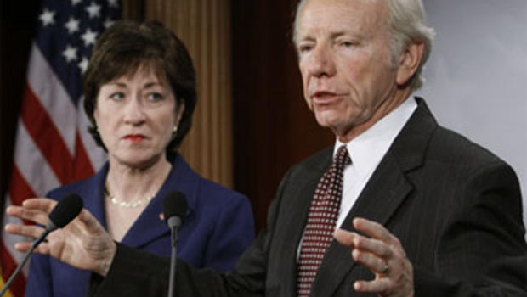
Potential courses of action
Walter Gallati
Kill Switch [10]
Traffic Monitoring
Information Gathering [11]
PenTesting [12]
Citizen Education [13]
Reference 9
10, 11, 12, 13
Notes:
Courses of Action
Kill Switch: Proposed by Sen. Lieberman, the kill switch bill was introduced in 2011 to give the President control over all American internet connections in the event of an emergency cyberattack. Concerns about constitutionality led to the bill dying in office
Traffic Monitoring: Straightforward – the government monitors internet traffic for odd patterns. Controversial, may or may not fringe on individual rights depending on implementation.
Information Gathering: Gathering information on potential hackers or organizations to discover potential attacks before they occur. Constitutionality varies depending on if hacker or hackers are American citizens. Ethics in this presentation is based in Constitutional terms, ergo only ethical if hackers are not citizenry.
PenTesting: Also Penetration Testing, where government targets either public or private computers to see if they can hack it, then report back if they can. Ethical only if done to government computers or with consent of private owners
Citizen Education: Educate citizens on how to best counter cybercrime and cyberwarfare. Promote education in cybersecurity. Currently in place by Department of Homeland Security. Most ethical, least direct

Slide 20
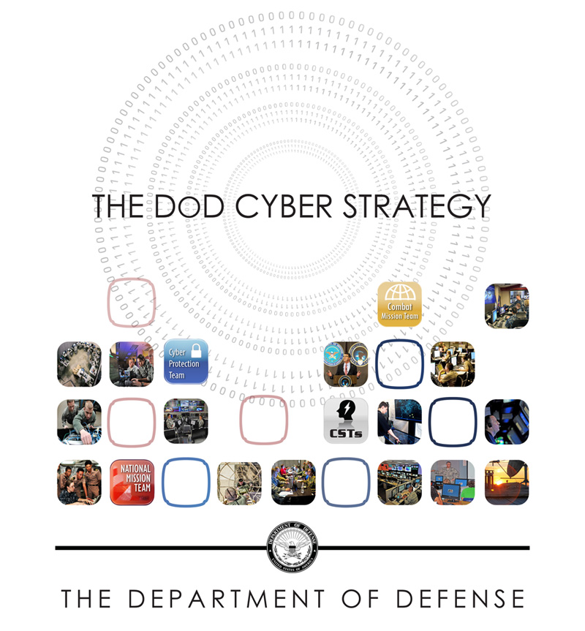
Conclusion
Walter Gallati
Best Course of Action:
DoD Procedure [11]
  Intelligence combined with Education
  PenTesting Public Networks
  Actively predict vulnerabilities and develop countermeasures
Reference 11
11
Notes:
Conclusion:
Best course of action lines up with DoD Cyber Strategy. Gather as much intelligence as possible, educate and train people on how to best deal with and counter cyberattacks. Pentests govt. networks to ensure security. Uses intel and tests to predict vulnerabilities and to establish countermeasures to deter attacks from other nations. Most ethical COA, as provides reasonably strong defense without violating Constitutional rights.

Slide 21
References
Walter Gallati
[1] United States Constitution
[2] Coser. (1977). Max Weber - Class, Status And Power. Retrieved from http://www.cardiff.ac.uk/socsi/undergraduate/introsoc/weber11.html
[3] Munro, A. (2013, March 06). State Monopoly on Violence. Retrieved from https://www.britannica.com/topic/state-monopoly-on-violence
[4] Chivers, C. J. (2011). The Gun. New York: Simon & Schuster Paperbacks.
[5] Alperovitch, D. (2011) Revealed: Operation Shady RAT [White paper]. Retrieved from McAfee: https://www.mcafee.com/us/resources/white-papers/wp-operation-shady-rat.pdf
[6] Symantec Security Response Team. (2016, November 30). Shamoon: Back from the dead and destructive as ever. Retrieved from https://www.symantec.com/connect/blogs/shamoon-back-dead-and-destructive-ever
[7] Elinor Mills August 30, 2012 11:17 AM PDT @elinormills. (2012, August 30). Virus knocks out computers at Qatari gas firm RasGas. Retrieved from https://www.cnet.com/news/virus-knocks-out-computers-at-qatari-gas-firm-rasgas/
[8] Teti, A. (n.d.). Operation 'Red October' and it is Cyber Espionage (Rep.). Retrieved http://gnosis.aisi.gov.it/gnosis/Rivista34.nsf/ServNavigE/34-09.pdf/$File/34-09.pdf?OpenElement
[9] Naylor, B. (2016, June 06). One Year After OPM Data Breach, What Has The Government Learned? Retrieved from http://www.npr.org/sections/alltechconsidered/2016/06/06/480968999/one-year-after-opm-data-breach-what-has-the-government-learned
[10] McCullagh, D. (2011, January 24). Renewed Push to Give Obama an Internet "Kill Switch". Retrieved from http://www.cbsnews.com/news/renewed-push-to-give-obama-an-internet-kill-switch/
[11] The Department of Defense Cyber Strategy (Rep.). (2015, April). Retrieved https://www.defense.gov/Portals/1/features/2015/0415_cyber-strategy/Final_2015_DoD_CYBER_STRATEGY_for_web.pdf
[12] Winterfield, S. P. (n.d.). Use offense to inform defense. Find flaws before the bad guys do. (Rep.). Retrieved https://cyber-defense.sans.org/resources/papers/gsec/cyber-ipb-103147
[13] Protect Myself from Cyber Attacks. (2016, August 8). Retrieved from https://www.dhs.gov/how-do-i/protect-myself-cyber-attacks

Slide 22
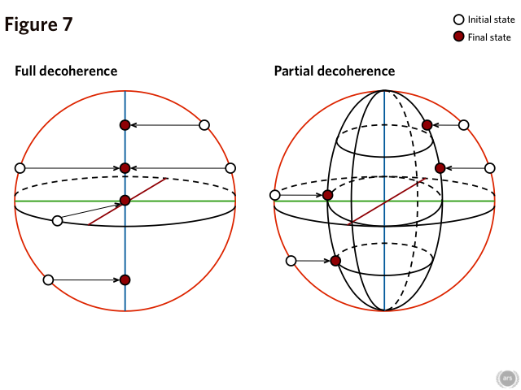
What is quantum computing?
Heric Flores-Huerta
Classical Bits – 0 | 1
Quantum Bits – 0..1
Superposition
Quantum Entanglement
Decoherence
Quantum Processing Power
[8][1]
Notes:
Classical computers use electrical signals to encode information as 1’s and 0’s
Light switch analogy
Quantum Bits can be 0 or 1
State of a qubit can be in a super position of both 0 and 1
Quantum entanglement definition
Occurs when pairs or groups of particles are generated or interact in ways such that the quantum state of each particle cannot be described independently of the others
In a quantum computer, couplers link qubits so they can interact and influence one another
Decoherence is the tendency for qubit to lose their quantum properties due to outside noise
Decoherence is one of the hardest problems to solve
Any and all outside noise causes decoherence
Best case, tens of microseconds of coherence
Using the features of quantum mechanics, superposition and entanglement, a quantum computer can process a vast number of calculations simultaneously
In some situations, a quantum computer’s advantage over a classical computer should grow exponentially with the amount of data to be worked on

Slide 23
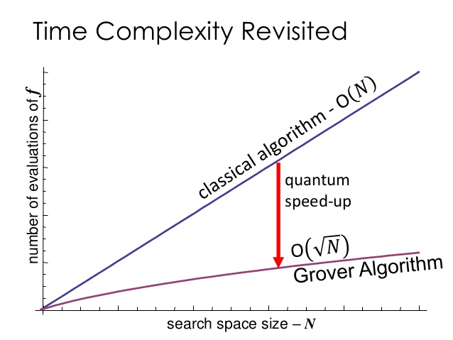
Quantum Technology uses
Heric Flores-Huerta
Quantum algorithms for Factorization and Discrete-log
  RSA, Diffie-Hellman, etc.
Shor’s Algorithm
Quantum Key Distribution
Other uses
[6][4]
Notes:
The study and development of quantum algorithms has been ongoing even without an actual quantum computer to run it on
There already exist quantum algorithms for faster solving of factorization and discrete-log problems
Crypto-protocols such as RSA and DH depend on the hardness of problems like factoring and discrete logarithms
Hardness being the amount of time it would take a classical computer to solve these problems
Shor’s algorithm for discrete logarithms and factoring.
Quantum algorithm for integer factorization
Formulated in 1994
Now we wait for the Quantum computer to run it on
Quantum key distribution uses properties of quantum mechanics to guarantee secure communications
QM property of being able to detect eaves dropping ensures security
Any attempt to measure a quantum system will change the state of the system
Quantum computers promise to help in other areas
More accurate weather
Speed up drug discovery
Help astronomers explore space
Improve machine learning and automation

Slide 24
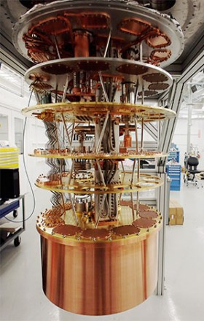
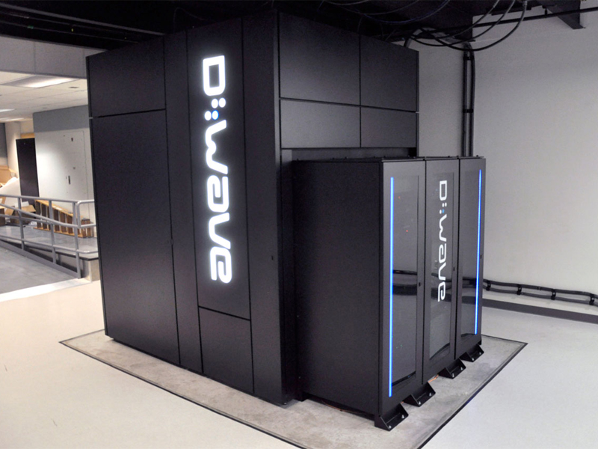
Quantum technology today
Heric Flores-Huerta
D-Wave
Google
Rigetti
[5][1]
Notes:
D-Wave “quantum computer” uses quantum annealing, which is a meta-huristic for finding the global minimum of a given objective function over a given set of candidate solutions by a process using quantum fluctuations
In other words, their quantum machine solves optimization problems
Can be thought of more as a quantum calculator for solving optimization problems
D-Wave was very controversial because
They started marketing a product without proof of quantum entanglement
Hasn’t shown theorized attribute of exponential
Taking cues from D-Wave, Google has set up their own quantum computing lab
The most confident figures I’ve seen are from Google’s quantum computing lab
Promising 50 qubit computer in the year to come
IBM promises to have ~50qubit computer within the next 5 years
IBM likes to make lots of promises
Google made similar promises, only time will tell
Why 50 qubits?
The 50 qubit threshold, known as quantum supremacy
Beyond this, no classical supercomputer would be capable of handling the exponential growth in memory and communications bandwidth needed to simulate a quantum computer (better source needed)
2013: Rigetti Computing came out of Yale research
“The company is building a cloud quantum computing platform for artificial intelligence and computational chemistry”
Manufacture their own Quantum Computing Simulation Chips
Marketing their API for cloud access to this simulated QC
Readthedocs.io intro to quantum computing in python
$64 million in Series A and B funding

Slide 25
Quantum technology Implications
Heric Flores-Huerta
FBI Director James Comey is a critic of the adoption of cryptographic technology in consumer software/electronics
NSA Warns of Quantum Computing
NIST Post Quantum Cryptography Project
Google Testing Quantum Resistant Cryptography
[3][4]
Notes:
FBI Direector James Comey is noted for stating that the adoption of end-to-end encryption technologies is making it hard for agents to do their job
Encryption is making it hard to wiretap on communications
Makes the case of an encryption back-door for law enforcement
Bruce Schneier explains why the overhead involved in such a backdoor is inherently insecure (increase attack surface)
It could be argued that quantum computing, due to the high cost of entry, can be used as a “backdoor”
There is as much potential of our own government abusing these technologies as there is of external entities
NSA said in a statement directed at companies and government departments dealing with sensitive data
We know the NSA hoards vulnerabilities on everything from Cisco routers to RSA
Although these zero-days are not part of their primary methods for intelligence operations
They prefer targeting system administrators
Their resources are incredible and these vulnerabilities are extremely difficult to find
#1: That doesn’t justify their actions, they need to be more transparent as to what their processes are
#2: That even the NSA says we need to move to the post-quantum world is a big statement
NIST (National Institute of Standards and Technology)
Held an open call for proposals into post-quantum cryptographic solutions
NIST has initiated a process to solicit, evaluate, and standardize one or more quantum-resistant public key cryptographic algorithms
Nominations for post-quantum candidate algorithms may now be submitted, up until the final deadline of November 30, 2017
Google is testing post quantum cryptographic algorithms
Need to be careful of new cryptographic algorithms
Pre-quantum crypto is hardened with 20+ years of community review
Where community review means nobody has found out how to break it
Cannot prove it to be secure, only that it is insecure

Slide 26
Conclusion
Heric Flores-Huerta
Government Responsibilities
  Goal is to avoid large scale harm/exploitation of citizens
  Test limits + capabilities of new technologies
  Set standards and write laws
Ex. Internet of Things Devices
Notes:
Government agencies such as the NSA (and NIST) need to help test the limits and capabilities of new and old technologies
It is their responsibility to help prevent the mass exploitation of citizens due to broken or old technologies
Also protect the nation from new technologies that have unchecked capabilities
Ex. Quantum Computing can break classical encryption
Need to help protect nation by
Setting standards and writing laws to the tech industry companies in the right direction
Ex. USA built nukes and now disallows any new nuclear developments
Ex. Drones now have FAA restrictions and must be registered if under 50 ounces in some states
Ex. Prevelance of IoT devices due to the lowering cost of embedded computing has lead to an increase in vulnerable devise
This has lead to DDoS attacks of unseen sizes
Encourage research into keeping old technologies up to date with current and potential future developments
Ex. NIST post-quantum cryptography open call
Things to consider
We won’t have a true, large-scale quantum computer for a while
Even then it will be very expensive
Things like cloud access through APIs could help bring this tech to the masses
What happens when foreign nations and organized criminals find a way to exploit this tech in other ways
What if a pharma company eager to adopt this technology uses it to discover the next 20 life saving drugs and then puts an insane price on them

Slide 27
References
Heric Flores-Huerta
[1] "The CIA And Jeff Bezos Bet On Quantum Computing". MIT Technology Review. N.p., 2017. Web. 1 Apr. 2017.
[2] Simonite, Tom. "NSA Says It “Must Act Now” Against The Quantum Computing Threat". MIT Technology Review. N.p., 2017. Web. 1 Apr. 2017.
[3] "FBI Director Says Agents Need Access To Encrypted Data To Preserve Public Safety". NPR.org. N.p., 2017. Web. 2 Apr. 2017.
[4] "Google's Post-Quantum Cryptography - Schneier On Security". Schneier.com. N.p., 2017. Web. 2 Apr. 2017.
[5] Simonite, Tom. "Inside Google’S Quantum Computing Lab, Questing For The Perfect Computer". MIT Technology Review. N.p., 2017. Web. 3 Apr. 2017.
[6] Dickerson, Kelly. "7 Awesome Ways Quantum Computers Will Change The World". Business Insider Australia. N.p., 2017. Web. 4 Apr. 2017.
[7] "Launching The Quantum Artificial Intelligence Lab". Research Blog. N.p., 2017. Web. 5 Apr. 2017.
[8] Altepeter, Joseph. "A Tale Of Two Qubits: How Quantum Computers Work". Ars Technica. N.p., 2017. Web. 5 Apr. 2017.
…

Slide 28
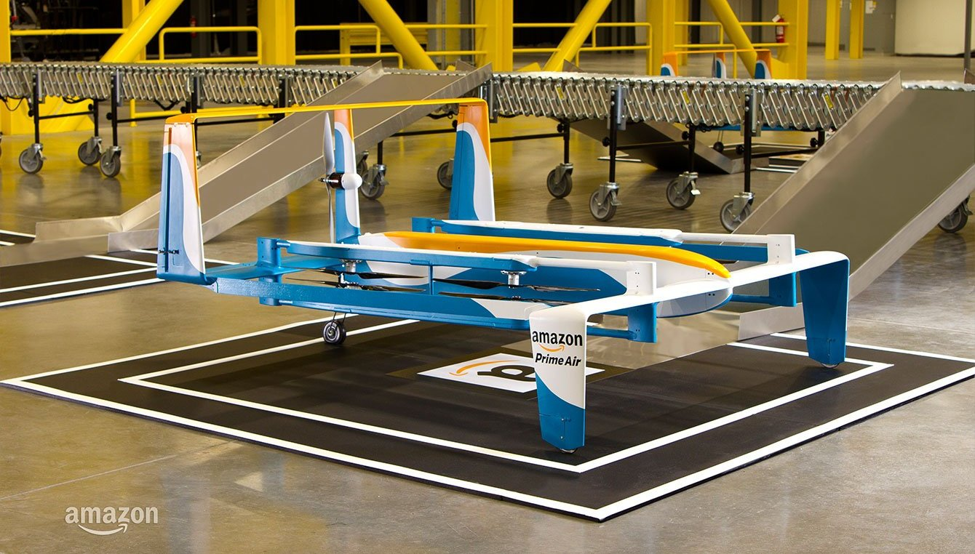
Drone Policy and Regulation
Evan Bosia
No international regulation [1]
  Focused on US policy
Conclusion: Current regulation hamper potential growth picture
https://images-na.ssl-images-amazon.com/images/G/01//112715/image-3._CR0,8,1340,762_.jpg
Notes:
I am going to be talking about current drone regulations. Because there is no global standard for drone legislation, this presentation will be focused on US policy.
Through my research I have come to the conclusion that current drone regulation in the US is harmful to commercial drone companies and should be rolled back.

Slide 29
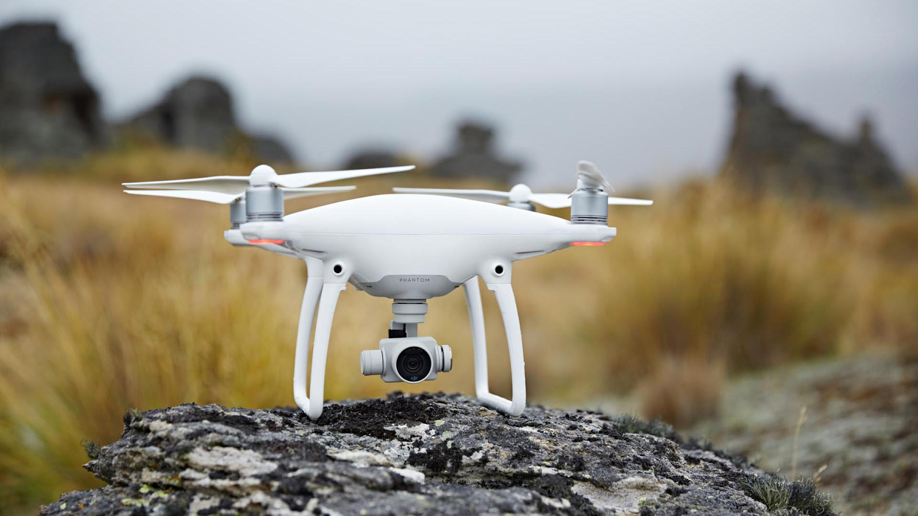
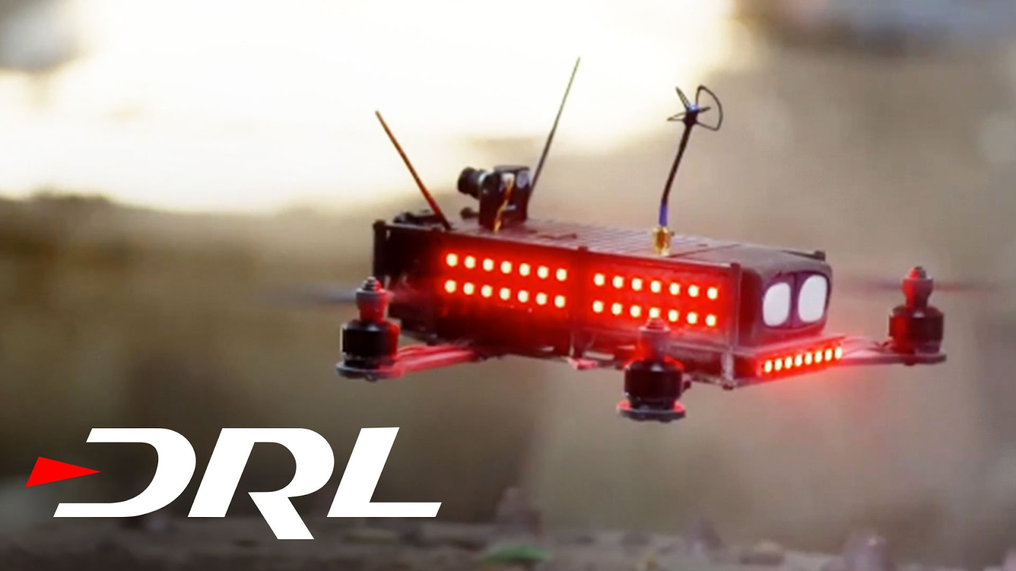
Small UAS
Evan Bosia
Unmanned Aerial System
Under 55 pounds [5]
Definition includes
  Fixed Wing Drones
  VTOL Drones
  Multirotors
Variety of uses
https://i.ytimg.com/vi/bOWkkoczEPQ/maxresdefault.jpg
https://www.cinema5d.com/wp-content/uploads/2016/03/Phantom-4-Action-5.jpg
Notes:
So what is a small UAS?
UAS stands for unmanned aerial system
Small UAS’s are by US definition under 55 pounds
A UAS can be anything from a fixed wing drone (similar to an airplane) to multirotors.
These drones can have many different uses. A few consumer drones are shown to the right, the top is a DJI phantom 4, which is a camera drone. The bottom picture shows a drone used for the drone racing league, a competition featuring pilots flying custom first person view drones through obstacle courses. This has been on ESPN 2, check it out.

Slide 30
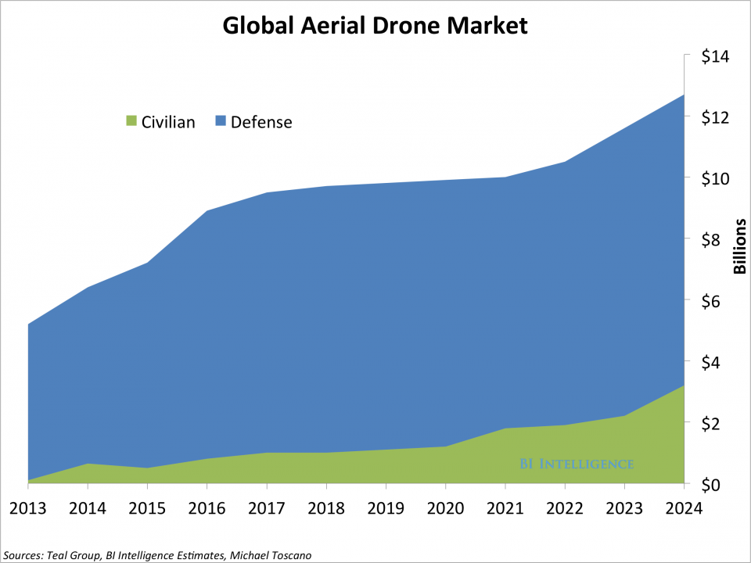
Commercial Drone Applications
Evan Bosia
Growing market [4]
Package Delivery: Amazon [2], Flirtey [6]
Medicine Delivery: Matternet [8]
Emergency Drones [3]
Agriculture [3]
Surveying and Filming
http://static4.businessinsider.com/image/54ad8f0269bedd7078ba7175-960/biidronemarket2014.png
Notes:
Drones used for commercial purposes is a growing market. The graph on the right shows an estimated growth for the global drone market. Obviously defense spending is higher but it is interesting to note that the commercial section is expected to go from almost none in 2013 to more than 3 billion in 2024.
There are many different sectors drone technology is currently being used or in development to be used
- Package delivery
Amazon is the obvious example here with prime air under development. Another transportation company is Flirtey.
Medicine deliver – Matternet is a big company in this space. They are teamed up with Mercedes. The focus of this is to improve the medical supply chain in impoverished areas, such as Africa.
Other uses include emergency drones, agriculture, and surveying and filming. The company I worked at over last summer does drone based surveying and filming out of Worcester. This is the largest commercial industry

Slide 31
Harmful Applications
Evan Bosia
Prison illegal deliveries [6]
Drug smuggling [9]
Illicit Surveillance
Notes:
Drone technology also has some potentially harmful applications
There was a report in 2016 of a drone being used to smuggle in contraband into a prison.
Drones can also be used for drug smuggling. Cartels in Latin American countries use drones to transport drugs. There’s actually an interesting drone battle going on in these South American countries, where anti-drug forces are using drones for surveillance purposes. Which leads to the last point of…
Illicit surveillance, more of a hypothetical but there is no reason a drone couldn’t be used to surveil people

Slide 32

US Regulation
Evan Bosia
FAA Jurisdiction
Visual line-of-sight (VLOS) only [5]
Less than 55 pounds total [5]
  Including payload
Transportation allowed only within the boundaries of a state [5]
https://upload.wikimedia.org/wikipedia/commons/thumb/c/c8/Seal_of_the_United_States_Federal_Aviation_Administration.svg/1200px-Seal_of_the_United_States_Federal_Aviation_Administration.svg.png
Notes:
In terms of US drone regulation, it is governed by the Federal Aviation Administration, or the FAA
The FAA determines the small UAS regulation
Some important rules include
The drone must always be within visual line of sight when flying
Total weight of drone and payload must be less than 55 pounds
Transportation is only allowed within state boundaries – I couldn’t fly my drone from Massachusetts into NH.
There are many more regulations for drones such as max airspeed and altitude but these were the ones I felt were the most important for discussion.

Slide 33
Problems with regulation
Evan Bosia
Hampers useful transportation efforts
Will not stop criminals
Potential issues covered by other laws
  Peeping tom law [8]
  Smuggling is already illegal
Notes:
There are problems with this regulation
- unfairly hampers transportation efforts
visual line of sight makes autonomous delivery impossible and limits range
weight limits package size
interstate travel also limits range
Criminals will not be stopped by regulation
Already doing illicit things
Issues the regulations are attempting to solve are covered by other laws, for example
Peeping tom law – not allowed to electronically film nude people, illegal regardless of done with drone
Drug smuggling is illegal, regardless of done with drone

Slide 34
Summary
Evan Bosia
Drones have many beneficial uses
Current Regulations suppress these uses for no good reason
Regulations should be rolled back
Notes:
What the slide says

Slide 35
References
Evan Bosia
[1] Al Shibli, M. (2015). Towards Global Unification of UAS Standardization: Regulations, Systems, Airworthiness, Aerospace Control, Operation, Crew Licensing and Training. International Journal of Unmanned Systems Engineering.
[2] Amazon. (2017, April 6). Amazon Prime Air. Retrieved from Amazon: https://www.amazon.com/Amazon-PrimeAir/b?node=8037720011
[3] Avampato, C. (2016). Delivery Drones Are a Good Idea. In J. Lasky (Ed.), Opposing Viewpoints. The Impact of the Tech Giants. Farmington Hills, MI: Greenhaven Press. (Reprinted from How Amazon Prime Air's Drone Technology Could Affect Other Businesses, www.fool.com, 2013, December 2) Retrieved from http://libraries.state.ma.us/login?gwurl=http://link.galegroup.com/apps/doc/EJ3010990220/OVIC?u=mlin_c_worpoly&xid=52989d28
[4] Business Insider. (2016, June 10). THE DRONES REPORT: Market forecasts, regulatory barriers, top vendors, and leading commercial applications. Retrieved from http://www.businessinsider.com/uav-or-commercial-drone-market-forecast-2015-2
[5] Federal Aviation Administration. (2016, June 21). SUMMARY OF SMALL UNMANNED AIRCRAFT RULE (PART 107). Retrieved from FAA News: https://www.faa.gov/uas/media/Part_107_Summary.pdf
[6] Flirtey. (2017, April 6). Flirtey. Retrieved from Flirtey.com: http://flirtey.com/
[7] Kelly, H. (2016, June 24). How to catch drones smuggling drugs into prison. CNN. Retrieved from http://money.cnn.com/2016/06/24/technology/dedrone-drone-prisons/
[8] Matternet. (2017, April 6). Retrieved from Matternet: https://mttr.net/
[9] Sanchez, A. (2016). Remote Control: From Surveillance to Smuggling - Drones in the War on Drugs. Remote Control.
[10] The 190Th General Court of the Commonwealth of Massachusetts. (2017). Section 105. Retrieved from https://malegislature.gov/Laws/GeneralLaws/PartIV/TitleI/Chapter272/Section105
[11] Weiner, S. (2017, February 17). Flame-Throwing Drones Are Being Used To Clean Power Lines. Retrieved from Popular Mechanics: http://www.popularmechanics.com/flight/drones/a25282/flame-throwing-drones/

Slide 36
Class 7
The End
Keith A. Pray
Instructor
socialimps.keithpray.net
Notes:
This is the end. Any slides beyond this point are for answering questions that may arise but not needed in the main talk. Some slides may also be unfinished and are not needed but kept just in case.

