Slide 1
Class 5
Intellectual Property
Keith A. Pray
Instructor
socialimps.keithpray.net
Notes:
Here’s the title slide. Excited already, aren’t you?
Paper Notes:
Average: 5.5 (usually 4)
Please use the template
State Conclusion clearly
Quantify
Missing Counter Point and Response
Be sure to put quotes around entire quote
Try reading paper aloud to proof
Weird Al Yankovic “Don’t Download This Song” (3:53)
https://www.youtube.com/watch?v=zGM8PT1eAvY
Reminders:
Do not change the format, footers, etc. in the template slides.
Paper writing process: Sources → Notes → Conclusion → Argument → Counter Point → Response

Slide 2
Overview
Review
Assignment
Students Present
Guest Speaker

Slide 3
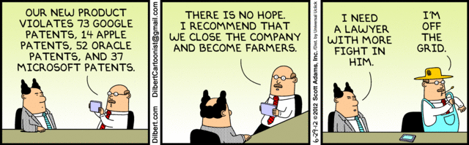
Notes:
Comments, observations, questions on IP Chapter?

Slide 4
My Reading Notes
pp. 165 “...ownership of ideas...” not quite right
pp. 168 public domain year 1997/1999 from source published in 1996?
pp. 170 SaaS, Google Search example? “…before he gave them the plot.”? “…cannot erase the memories...” Paycheck (2003)
pp. 180 4.4 #2 preferred?
pp. 186/196 revenue != profit
pp. 190 blocking 100% seems impossible
pp. 194 Any legitimate BitTorrent use examples since 2005?
pp. 197 “licensing agreement … hardware”?
pp. 198 4.7.3 references?
pp. 205 Perhaps friends should not ask you to break the law?
Any successful industries operate as a support service?
pp. 207 Is Perl still most popular? Quality study from 2003, change?
pp. 209 who uses tape?
pp. 210 “human-readable, lawyer-readable…”
pp. 223 Interview has nothing to do with computing

Slide 5
Group Quiz
For each On the left answer a–d on Right
Trademark
Copyright
Patent
Trade Secret
What kind of IP does it protect?
What qualifications does the IP have to meet to be protected?
How long does the protection last?
Give a specific example of IP currently protected?
Notes:
Trademark
Used to denote a product or service.
Apply in specific areas of commerce. Only applies in specified area of business
Indefinite term as long as in use and protected against becoming a common noun or verb.
You do not have to register a trademark unless you want to bring litigation before a federal court (there are other benefits too, but what are they?)
Copyright
Expression, not ideas: Fuzzy. E.g. derivative works, characters, merchandising, plots.
Mickey Mouse, Tarzan.
US Default : Original Author, Exception: work for hire, Transferred: yes
Rights: Publication, Performance / exhibition, Adaptation to other media, Excerpting, Attribution, Derivative works
US Term: Lifetime of author plus 70 years., 95 years for companies.
Governed by US law and international treaties (e.g. WIPO).
Fair Use: News reporting, reviews, etc., Scholarly / educational use, Private, non-commercial use, Lending libraries and archives
Fair Use restrictions: Admission charge, Re-transmission
In general, you can: Read, view, play, etc., Copy for personal use., Time-shift, Space-shift
In general, you cannot: Copy for others., Transfer to someone else but keep a copy., Show / perform it publicly.
What about video rentals?
Rationale: Encourage creativity. Encourage dissemination. Balance between private and public good. It’s a social contract.
Patent
A mechanism, process, or composition of matter.
Must be: Novel. Useful. Non-obvious. Described clearly. Must do what it says.
Usual term 20 years.
Utility and plant patents: 20 years.
Design patents last 14 years. (ornamental design of functional item)
Provisional patent gives 1 year, before full patent
Trade Secret
You must take steps.
Enforceable by: Contracts, Laws against industrial espionage.

Slide 6
Overview
Review
Assignment
Students Present
Guest Speaker
Notes:
But first take a look at:
CGP Grey
Copyright: Forever Less One Day (6:27)
https://www.youtube.com/watch?v=tk862BbjWx4
Tom Scott
http://tomscott.com
Welcome To Life (2:44)
https://www.youtube.com/watch?v=IFe9wiDfb0E&feature=youtu.be

Slide 7
Assignment - Self Search 1/3
Discussion Board
Post ways one can search for information about a person. Do not repeat entries.
Use each search method listed to produce 2 profiles as an appendix of your paper. Provide a brief description if you’d rather not list the details.
  Profile 1: all information someone might think is you
  Profile 2: all information you know is you.
  You are not responsible for methods posted less than 24 hours before class.
For each search method result consider:
  Exactly how did the data get there?
  How can this data be used?
  Is this a secondary use?
  Did you authorized use of the data? If not and you want to, request its use be discontinued and post the correspondence.
Dig deeper than a basic search engine’s (Google, etc.) results.

Slide 8
Assignment - Self Search 2/3
1 Page Paper
Use your search results to help support your conclusion.
This assignment requires you revisit the Discussion Board frequently as new search methods are posted, subscribe to it.
Conclusion idea examples (not comprehensive):
  What impression would a potential employer have of you given these results, assuming they also had a resume and possibly a cover letter from you?
  What would your elder family members (or equivalent) think?
  Are you comfortable with what you found or did not find?
  Do you believe protecting your privacy is important or needed?
5 High quality sources still required

Slide 9
Assignment - Self Search 3/3
Profile 2
Is You
1 Page
Paper
Filter
Inspiration
Search Methods
…
…
…
…
Filter
Profile 1
Could Be You

Slide 10
Overview
Review
Assignment
Students Present
Guest Speaker

Slide 11
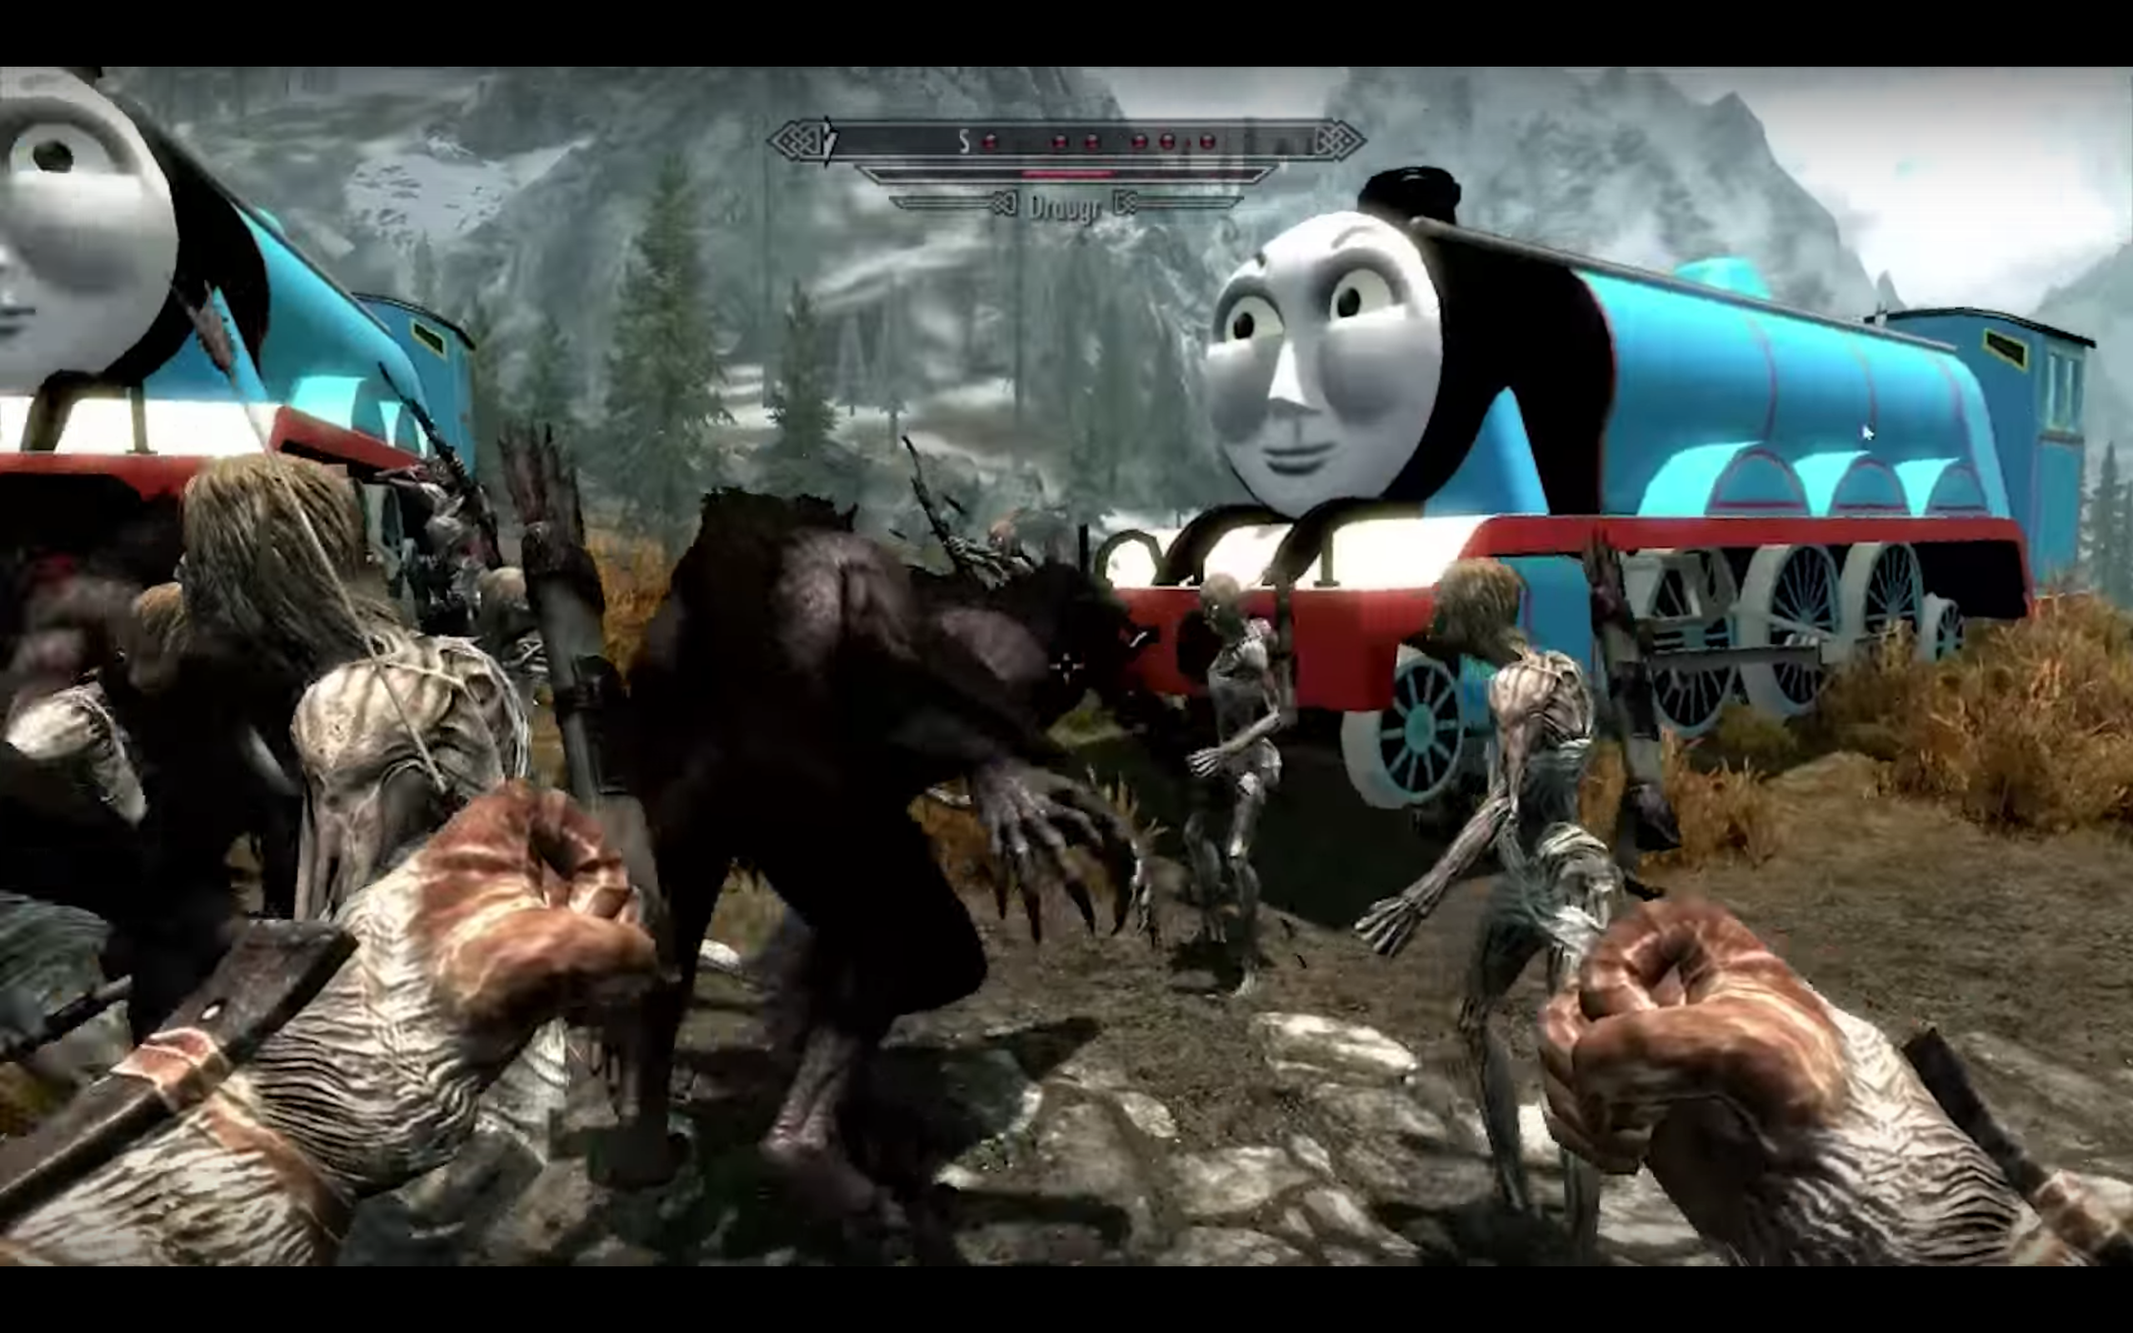
Video Game Mods
Steven Huynh
"alteration where someone, usually a player, takes the code of a video game and changes it”
Graphic from videogamedunkey [1]

Slide 12
Steven Huynh
3. Restrictions
You are not permitted to:
(e) to reverse engineer, derive source code, modify, decompile, disassemble, or create derivative works based on the whole or any part of the Software Product, in whole or in part, except as the applicable law expressly permits. Where applicable law expressly permits any such acts, any lawful modifications, adaptations and improvements and all copyrights therein shall be deemed assigned to and shall belong to, vest in and be the exclusive property of Square Enix and/or its licensors on creation to the maximum extent permitted by law and you hereby waive all or any moral rights in such creations;
From Square Enix [2]
Notes:
Video game modding violates many games' end-user agreements

Slide 13
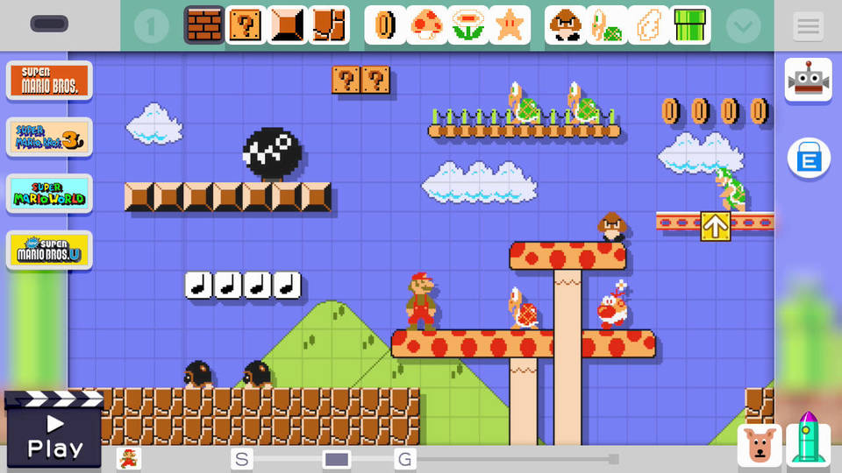
Steven Huynh
Graphic from Nintendo [3]
Notes:
But video games modding is promoted by players and even developers
Tools from Bethesda Game Studios to mod Skyrim
Making user-generated content as gameplay (Super Mario Maker)

Slide 14
Should restrictions from publishers be relaxed to further promote the development of video game mods?
Should this be universalized?
Yes.
Steven Huynh

Slide 15

What do Video Game Mods Do?
Steven Huynh
Mods have [4]:
  Fix bugs
  Add user-made content
  Derive new video games

Slide 16
Ownership Dispute
Steven Huynh
If players use the game to create mods, are they merely playing the game rather than creating intellectual property?
Discussed by Greg Lastowka in his publication, Copyright Law and Video Games: A Brief History of an Interactive Medium [5]
  Video games are like sports events? According to a 1997 circuit court ruling [6]

Slide 17
MODS’ IP Rights
Steven Huynh
Most mods are distributed for free, and society has argued against their monetization
  Steam Workshop backlash in 2015 [7]
  Discourages modders from distributing their mods freely
Although most modders do not make mods for money, are there any incentives that society is not considering?

Slide 18
References
Steven Huynh
[1] videogamedunkey, Ultimate Skyrim, https://www.youtube.com/watch?v=q6yHoSvrTss (Mar. 29, 2017)
[2] Square Enix, END USER SOFTWARE LICENSE AGREEMENT AND LIMITED WARRANTY <NieR:Automata> (the “Software Product”), http://store.steampowered.com//eula/524220_eula_0 (Mar. 29, 2017)
[3] Nintendo, Screenshot of Super Mario Maker, http://media.webcollage.net/rwvfp/wc/cp/19640171/module/nintendous/_cp/products/1437513080473/tab-bdcf273b-bd46-41f2-a694-316636a97957/77f62c25-01c5-41aa-90cb-5c067178aefd.jpg.w960.jpg (Mar. 31, 2017)
[4] Rafi Letzter, Online communities are changing video games to make them better, weirder, and much more wonderful, http://www.businessinsider.com/video-game-modding-2015-7 (Mar. 29, 2017)
[5] Greg Lastowka, Copyright Law and Video Games: A Brief History of an Interactive Medium, http://www.academia.edu/4415769/Copyright_Law_and_Video_Games_A_Brief_History_of_an_Interactive_Medium (Mar. 29, 2017)
[6] Ralph K. Winter Jr., NATIONAL BASKETBALL ASSOC. v. MOTOROLA, INC., 105 F.3d 841 (2nd Cir. 1997), https://www.law.cornell.edu/copyright/cases/105_F3d_841.htm (Mar. 29, 2017)
[7] Emanuel Maiberg, Whoa, Valve Just Monetized Mods, https://motherboard.vice.com/en_us/article/whoa-valve-just-monetized-mods (Mar. 31, 2017)

Slide 19

Should bmi developers receive ip rights?
Matt McCarthy
When technology is developed using BMIs, do the creators of the BMI deserve IP rights towards that product?
All electronic activity is still sourced from the brain
Machines predict what you want to indicate, they do not think
<Graphic>
Notes:
Argument, BMI developers do NOT deserve IP rights to things developed by people using their products
BMI is a tool, not a source of creativity
BMI predict what you intend or have sub consciously decided to do, they do not generate thought
Since they are tools, they do not deserve rights since we do not give IP rights to other tool manufacturers
Mention Vsauce video and how it might seem as though these tools predict thoughts before you know, but it is because it is reading your unconscious decisions which you still own the rights to.

Slide 20
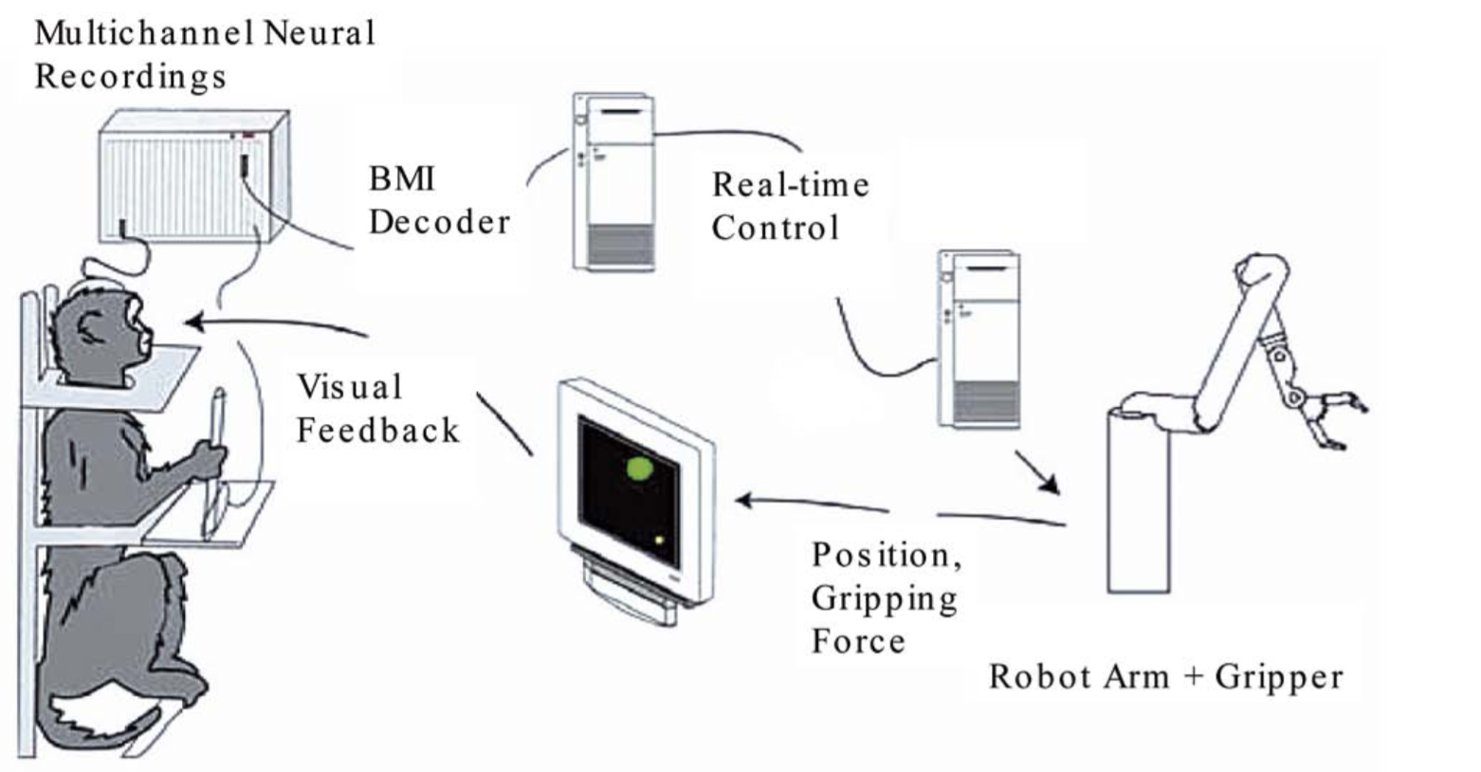
How Brain-Machine interfaces (BMI) work
<Your Name>
Measures activity of neurons [3]
Maps activity in neurons to actions of connected machine [1]
  Statistics and Machine Learning
Feedback sent back to user
1, 3
Notes:
Give brief description of what BMIs are and how they work.
Explain flow of diagram since the image will most likely be difficult to read
Neural activity sensed and decoded using machine learning and statistics
Instructions translated to real time control system which controls arm and visual monitor
Monitor sends visual feedback to the monkey
Explain how the computers use machine learning to map activity patterns to known intended behaviors

Slide 21
Examples in Research
Matt McCarthy
Research done as early as the 1960s and 1970s [3]
Monkeys move a computer cursor without their hands (2002) [4]
Research moved from individual demonstrations to development (2006) [2]
Development now focused on helping physically disabled (2012) [5]
3,4,5
Notes:
Basic research started in the 60s and 70s with EEG scans on patients
In 2002, a monkey was able to move a computer cursor with only neural activity
Article I read indicated that the transition of research went from individual demos like with the monkey to full fledge systems
Such as many BMIs being used to help the physically disabled control systems to help them with every day tasks such as drinking coffee[5]

Slide 22
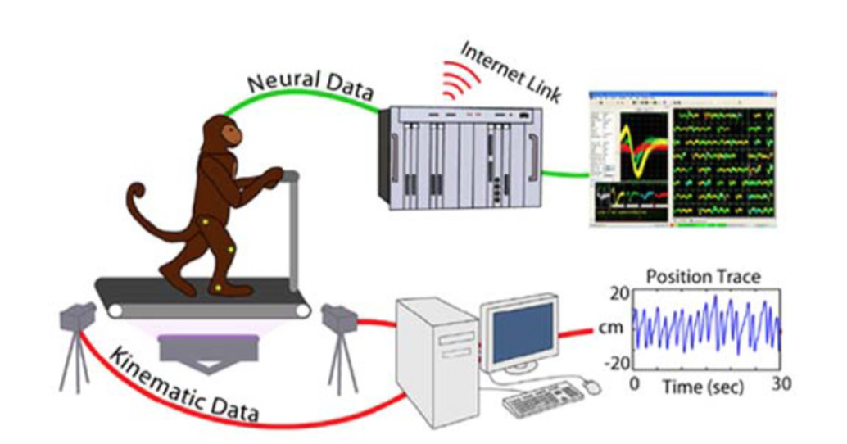
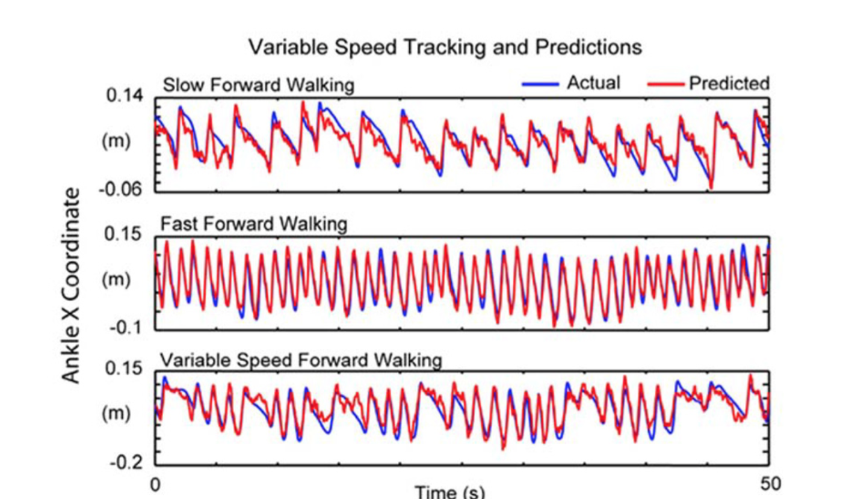
Matt McCarthy
1
Notes:
Explain this image in the study presented in [1]
Neural activity collected and mapped to one tracker
Actual speed and variation recorded from treadmill
We can see that neural activity accurately predicts movement
Red lines are the predicted speeds walking forward based on brain patters
Blue lines are the actual speeds attempted

Slide 23
References
Matt McCarthy
[1] Lebedev, M. (2014). Brain-machine interfaces: An overview. Translational Neuroscience, 5(1), 99-110. doi:10.2478/s13380-014-0212-z
[2] Brunner, P., Bianchi, L., Guger, C., Cincotti, F., & Schalk, G. (2011). Current trends in hardware and software for brain–computer interfaces (BCIs). Journal of Neural Engineering, 8(2), 025001. doi:10.1088/1741-2560/8/2/025001
[3] Lebedev, M. A., & Nicolelis, M. A. L. (2006). Brain–machine interfaces: Past, present and future. Trends in Neurosciences, 29(9), 536-546. doi:10.1016/j.tins.2006.07.004
[4] Serruya, M. D., Hatsopoulos, N. G., Paninski, L., Fellows, M. R., & Donoghue, J. P. (2002). Brain-machine interface: Instant neural control of a movement signal. Nature, 416(6877), 141-142.
[5] Nair, P. (2013). Brain–machine interface. Proceedings of the National Academy of Sciences, 110(46), 18343-18343.

Slide 24
Class 5
The End
Keith A. Pray
Instructor
socialimps.keithpray.net
Notes:
This is the end. Any slides beyond this point are for answering questions that may arise but not needed in the main talk. Some slides may also be unfinished and are not needed but kept just in case.

